Slide 1



FUDAN UNIVERSITY
The Casimir Effect
汇报人：吕圣民
组员：吕圣民 叶斌

Slide 2


01
FUDAN UNIVERSITY
课题回顾
目 录
02
Abel-Plana公式法
CONTENTS
03
格林函数法

Slide 3



FUDAN UNIVERSITY
FUDAN UNIVERSITY
01
课题回顾

Slide 4
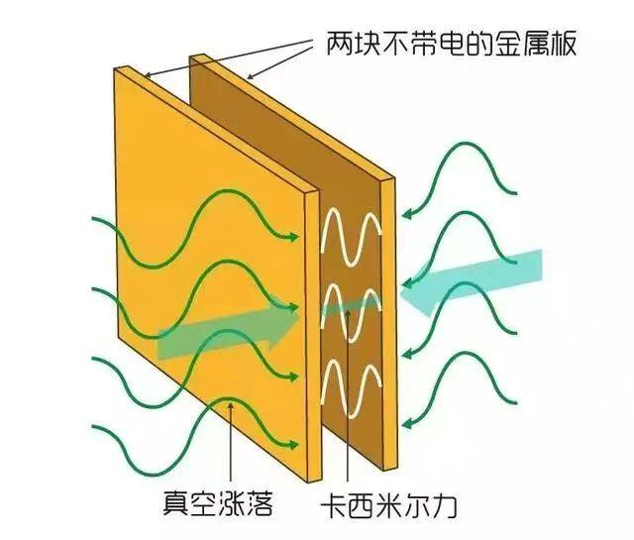


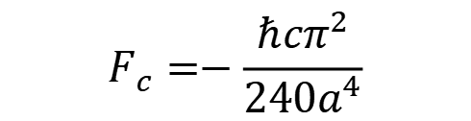
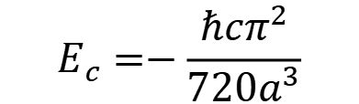
01
卡西米尔效应
FUDAN UNIVERSITY
$$E_{c}=−\frac{ℏcπ^{2}}{720a^{3}}$$
$$F_{c}=−\frac{ℏcπ^{2}}{240a^{4}}$$
$$E\left(a\right)=\sum_{n}{\frac{{ℏω}_{n}}{2}}$$
高频截断函数: $f(k/k_{m})$
正规化：$ζ函数$，hard cutoff，heat kernel

Slide 5
FUDAN UNIVERSITY
FUDAN UNIVERSITY
02
Abel-Plana公式法

Slide 6
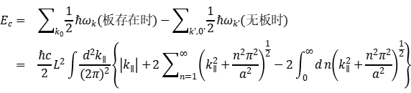
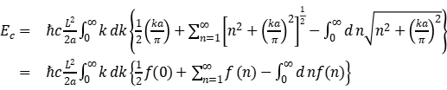
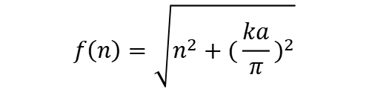
02
模式求和
FUDAN UNIVERSITY
$$f\left(n\right)=\sqrt{n^{2}+{(\frac{ka}{π})}^{2}}$$

Slide 7
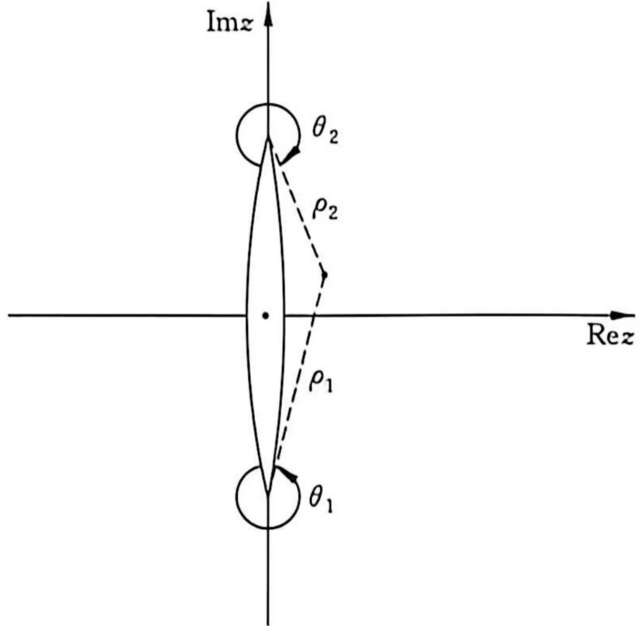
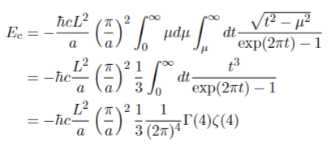
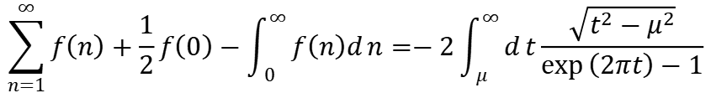
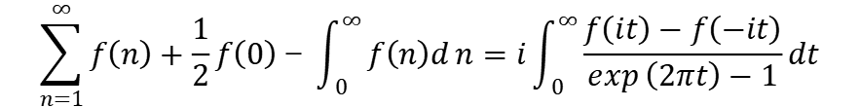


02
Abel-Plana求和公式
FUDAN UNIVERSITY
设函数f(z)当Rez>0为解析
$$\sum_{n=1}^{∞}{f\left(n\right)}+\frac{1}{2}f\left(0\right)－\int_{0}^{∞}{f\left(n\right)d}n=i\int_{0}^{∞}{\frac{f\left(it\right)−f\left(−it\right)}{\exp\left(2πt\right)−1}}dt$$
记变量$\text{n}\text{=}\text{z}\text{,}\text{ka}\text{/}\text{π}\text{=} \text{μ}$
$$f\left(z\right)=\sqrt{\left(z+μi\right)\left(z−μi\right)}=\sqrt{ρ_{1}ρ_{2}exp(iθ_{1}+iθ_{2})}$$
$$\sum_{n=1}^{∞}{f\left(n\right)}+\frac{1}{2}f\left(0\right)−\int_{0}^{∞}{f\left(n\right)d}n=−2\int_{μ}^{∞}{d}t\frac{\sqrt{t^{2}−μ^{2}}}{\exp\left(2πt\right)−1}$$
$$=−\frac{ℏcπ^{2}L^{2}}{720a^{3}}$$

Slide 8
FUDAN UNIVERSITY
FUDAN UNIVERSITY
03
格林函数法

Slide 9





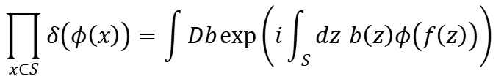





03
格林函数法
FUDAN UNIVERSITY
Dirichlet边界约束 ${φ|}_{S}=0 ，对应TM模式$
$$Z=\int{Dφ\prod_{x∈S}{δ\left(φ\left(x\right)\right)\exp{\{}}}−S\}$$
$$S=\int{dx\left(\frac{1}{2}φ\left(x\right)\left(−∂^{2}\right)φ\left(x\right)\right)}$$
$$\prod_{x∈S}{δ\left(φ\left(x\right)\right)}=\int{Db}\exp\left(i\int_{S}{dz} b\left(z\right)φ\left(f\left(z\right)\right)\right)$$
$$Z=\int{Dφ}Db\exp\left(−\tilde{S}\right)$$
$$\tilde{S}=\frac{1}{2}\int{dx} φ\left(x\right)\left(−∂^{2}\right)φ\left(x\right)−i\int{dx\int_{S}{dz}} φ\left(x\right)H\left(x,z\right)b\left(z\right)$$
$$H\left(x,z\right)=δ\left(x−f\left(z\right)\right)$$
$$K\left(z,z^{′}\right)=\int{dx\int{dy}} H\left(x,z\right)G\left(x,y\right)H\left(y,z^{′}\right)=G\left(f\left(z\right),f\left(z^{′}\right)\right)$$
$$\left(−∂^{2}\right)G\left(x,x^{′}\right)=δ\left(x−x^{′}\right)$$
$$Z=C{\left(\det\left(∂^{2}+m^{2}\right)\right)}^{−1/2}{\left(\det{K}\left(z,z^{′}\right)\right)}^{−1/2}$$
$$E=−\frac{1}{T}lnZ$$
$$E_{c}=−\frac{1}{T}{\ln\left(\det{K}\left(z,z^{′}\right)\right)}^{−1/2}$$
$$\ln\left(\det{K}\right)=Tr\ln{K}$$
$$E_{c}=\frac{1}{2T}Tr\ln{K}=\frac{1}{2π}\int_{0}^{∞}{dω} Tr\ln{K}\left(z,z^{′};ω\right)$$

Slide 10

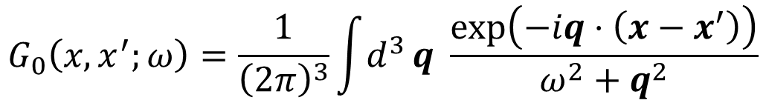

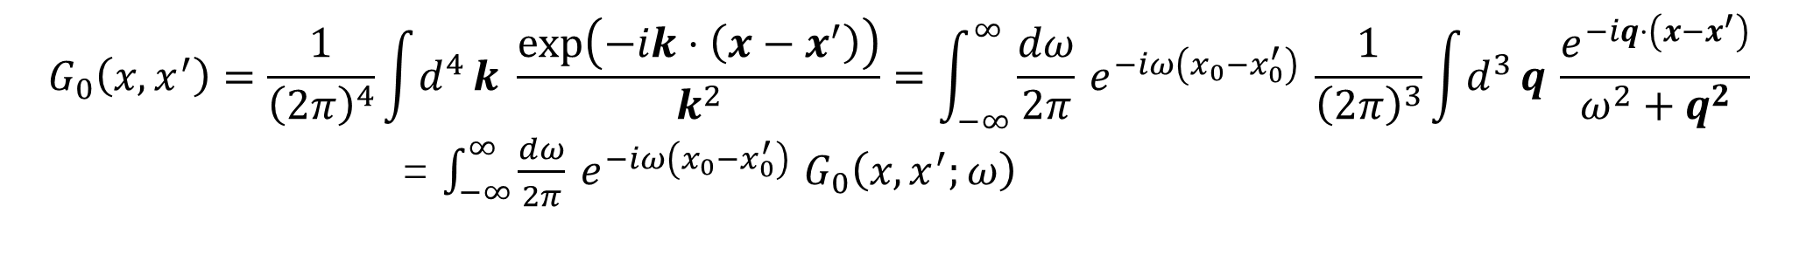
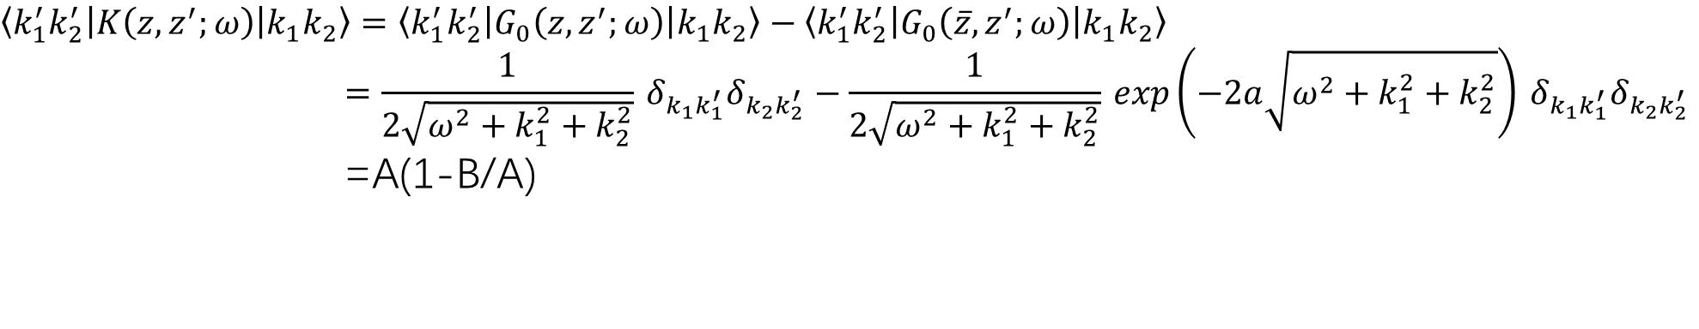
03
格林函数法
FUDAN UNIVERSITY
$$G_{0}\left(x,x^{′}\right)=\frac{1}{{\left(2π\right)}^{4}}\int{d^{4}}k \frac{\exp\left(−ik⋅\left(x−x^{′}\right)\right)}{k^{2}}=\int_{−∞}^{∞}{\frac{dω}{2π}} e^{−iω\left(x_{0}−x_{0}^{′}\right)} \frac{1}{{\left(2π\right)}^{3}}\int{d^{3}}q \frac{e^{−iq⋅\left(x−x^{′}\right)}}{ω^{2}+q^{2}}$$
= $\int_{−∞}^{∞}{\frac{dω}{2π}} e^{−iω\left(x_{0}−x_{0}^{′}\right)}$ $G_{0}\left(x,x^{′};ω\right)$
$$G_{0}\left(x,x^{′};ω\right)=\frac{1}{{\left(2π\right)}^{3}}\int{d^{3}}q \frac{\exp\left(−iq⋅\left(x−x^{′}\right)\right)}{ω^{2}+q^{2}}$$
$$G\left(x,x^{′};ω\right)=G_{0}\left(x,x^{′};ω\right)−G_{0}\left(\overline{x},x^{′};ω\right)$$
$$x=\left(x_{1},x_{2},x_{3}\right), \overline{x}=\left(x_{1},x_{2,}2a−x_{3}\right)$$
$$z=\left(x_{1},x_{2,}0\right), \overline{z}=\left(x_{1},x_{2,}2a\right)$$
函数$空间正交归一基\left|k_{1}k_{2}\right\rangle =\frac{1}{\sqrt{2π}}\exp\left(i\left(k_{1}x_{1}+k_{2}x_{2}\right)\right)$
$$\left\langle k_{1}^{′}k_{2}^{′}\left|K\left(z,z^{′};ω\right)\right|k_{1}k_{2}\right\rangle =\left\langle k_{1}^{′}k_{2}^{′}\left|G_{0}\left(z,z^{′};ω\right)\right|k_{1}k_{2}\right\rangle −\left\langle k_{1}^{′}k_{2}^{′}\left|G_{0}\left(\overline{z},z^{′};ω\right)\right|k_{1}k_{2}\right\rangle$$
$$=\frac{1}{2\sqrt{ω^{2}+k_{1}^{2}+k_{2}^{2}}} δ_{k_{1}k_{1}^{′}}δ_{k_{2}k_{2}^{′}}−\frac{1}{2\sqrt{ω^{2}+k_{1}^{2}+k_{2}^{2}}} exp\left(−2a\sqrt{ω^{2}+k_{1}^{2}+k_{2}^{2}}\right) δ_{k_{1}k_{1}^{′}}δ_{k_{2}k_{2}^{′}}$$
=A(1-B/A)

Slide 11

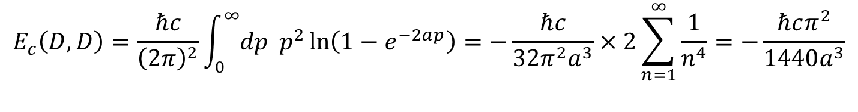
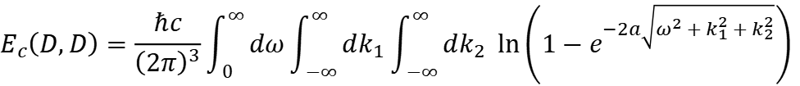
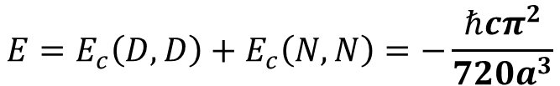


03
格林函数法
FUDAN UNIVERSITY
$$E_{c}\left(D,D\right)=\frac{1}{2π}\int_{0}^{∞}{dω} Tr\ln\left(I−BA^{−1}\right)$$
$$E_{c}\left(D,D\right)=\frac{ℏc}{{\left(2π\right)}^{3}}\int_{0}^{∞}{dω\int_{−∞}^{∞}{dk_{1}}}\int_{−∞}^{∞}{dk_{2}} \ln\left(1−e^{−2a\sqrt{ω^{2}+k_{1}^{2}+k_{2}^{2}}}\right)$$
$$E_{c}\left(D,D\right)=\frac{ℏc}{{\left(2π\right)}^{2}}\int_{0}^{∞}{dp} p^{2}\ln\left(1−e^{−2ap}\right)=−\frac{ℏc}{32π^{2}a^{3}}×2\sum_{n=1}^{∞}{\frac{1}{n^{4}}}=−\frac{ℏcπ^{2}}{1440a^{3}}$$
Neumann边界约束：$∂_{n}{φ|}_{S}=0$，对应TE模式
$$K\left(z,z^{′}\right)=∂_{z_{3}}∂_{z_{3}^{′}}G\left(f\left(z\right),f\left(z^{′}\right)\right)$$
$$G\left(x,x^{′};ω\right)=G_{0}\left(x,x^{′};ω\right)+G_{0}\left(\overline{x},x^{′};ω\right)$$
$E_{c}\left(N,N\right)=\frac{1}{2π}\int_{0}^{∞}{dω} Tr\ln\left(I−C\right)$ $=−\frac{ℏcπ^{2}}{1440a^{3}}$
$$E=E_{c}\left(D,D\right)+E_{c}\left(N,N\right)=−\frac{ℏcπ^{2}}{720a^{3}}$$

Slide 12
FUDAN UNIVERSITY
Thank you!

