Slide 1

Entanglement Entropy in QFT —— From Area Law to Ryu-Takayanagi Formula
Haoxiang Xu, 24300190073

Slide 2




Presentation Outline
1.UV divergence and Area Law
2. Specific Calculation Method
3. Ryu-Takayanagi Formula
Starting from lattice model
Path integral language and replica trick
AdS/CFT correspondence
Fudan University | Physics Department
Page 2

Slide 3

UV Divergence and Area Law
Fudan University | Physics Department
Page 3

Slide 4
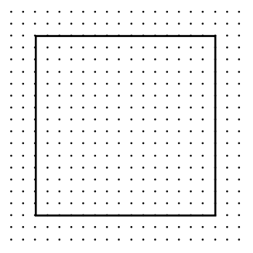

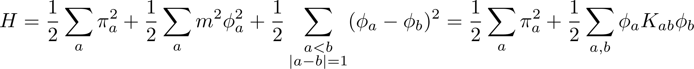
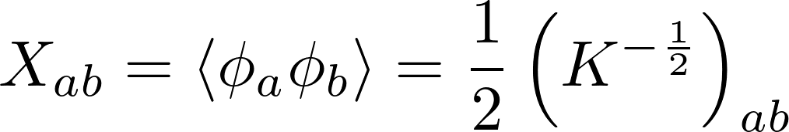
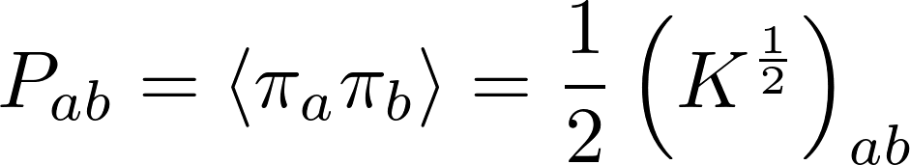


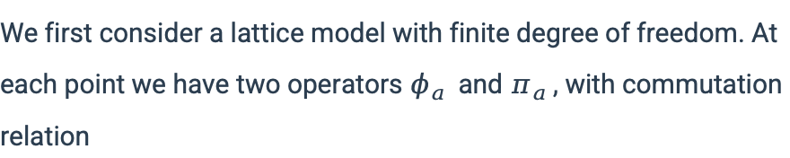

Lattice Model
We first consider a lattice model with finite degree of freedom. At each point we have two operators $φ_{a}$ and $π_{a}$, with commutation relation
$$W$$
Correlators:
Check: If $W$ represents the whole lattice, then $C=\frac{1}{2}Ι$, leading to $S_{w}=0$. Perfect!
There, all the indices belong to rigion $W$.
Entanglement entropy:
Fudan University | Physics Department
Page 4

Slide 5
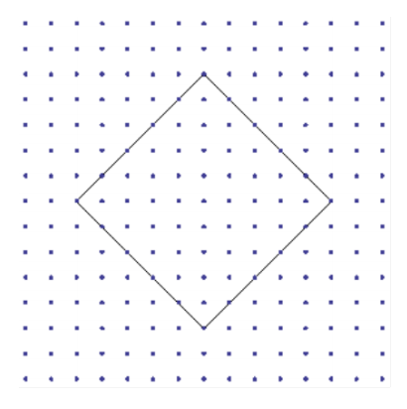
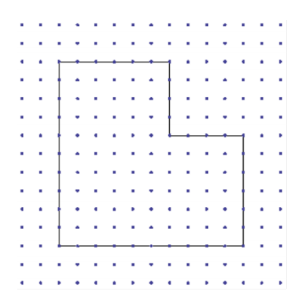
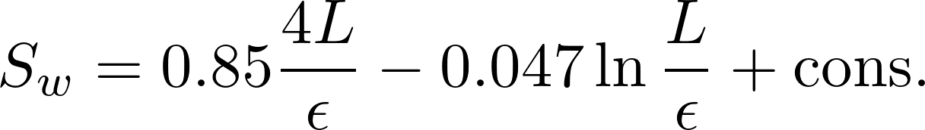
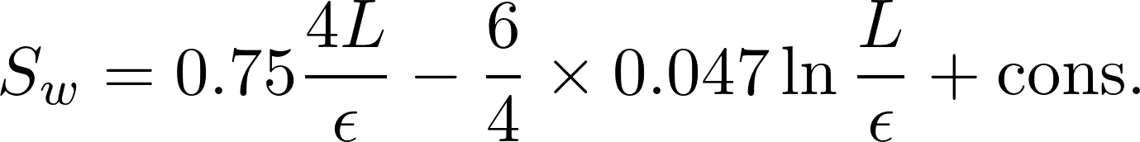

Numerical Computation
Leading order term: $4L/ε$
Compare the first lattice and the third lattice. After rotation, the coefficient of singular term does not change, while the coefficient of leading order term varies.
Singular term: $\ln{(L/ε)}$
Of course we have different cut-off methods, but there may exist some universal constant which is irrelevant to which scheme we choose.
$ε→0$: UV divergence!
Fudan University | Physics Department
Page 5

Slide 6
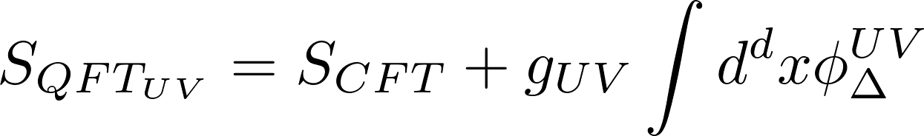
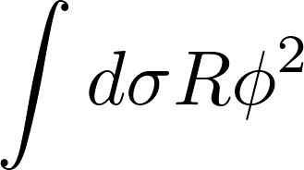
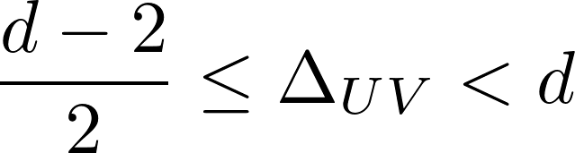
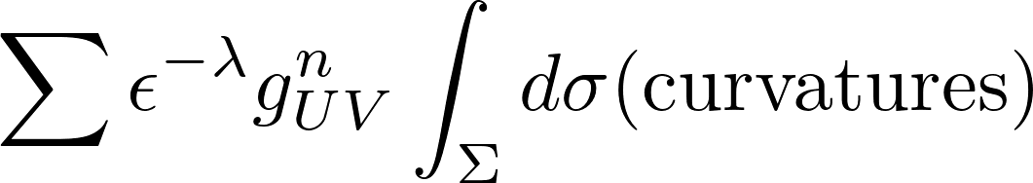
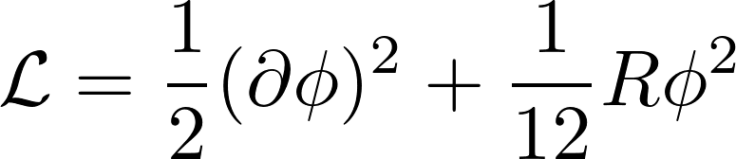
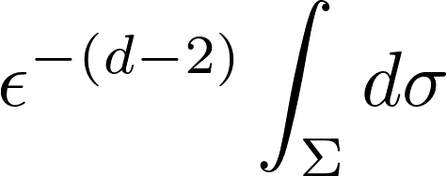
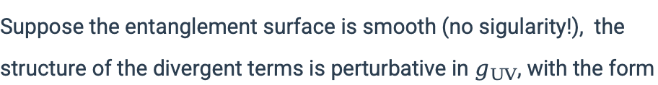
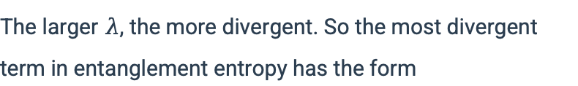
EFT Perspctive
When we calculate the entanglement entropy, the following term will appear:
Taking the UV limit: The theory can be regarded as a perturbed CFT
There $φ_{UV}$ is a relevent operator with scaling dimension
Later we will make some specific calculation.
Suppose the entanglement surface is smooth (no sigularity!), the structure of the divergent terms is perturbative in $g_{UV}$, with the form
As we know, the entanglement entropy must be dimensionless. With dimensional analysis, the cervatures have positive mass dimension, which leads to
Example: Conformal scalar
The larger $λ$, the more divergent. So the most divergent term in entanglement entropy has the form
CFT
Fudan University | Physics Department
Page 6

Slide 7

Question: Whether we should focus on divergent term or universal term?
divergent term
universal term
$S_{w}\sim ∂W$, but can be renormalized
extract the significant constant. (central charge, a-anormaly etc.)
Fudan University | Physics Department
Page 7

Slide 8
Calculation: Path Integral Language and Replica Trick
Fudan University | Physics Department
Page 8

Slide 9
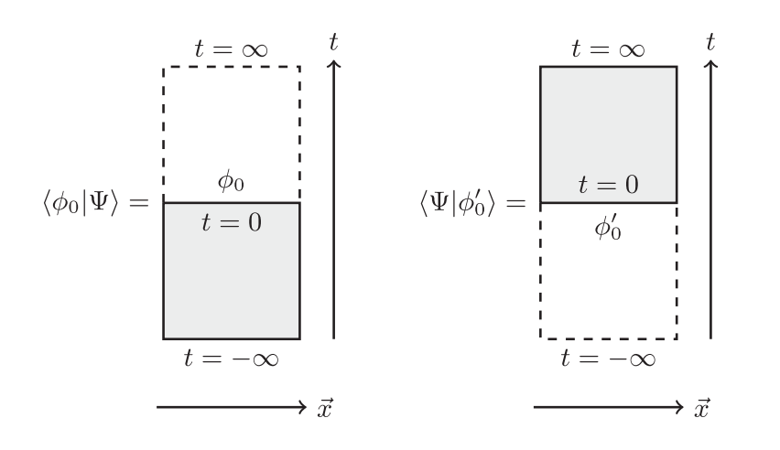
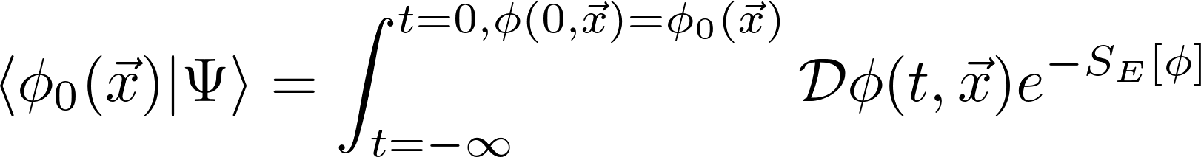
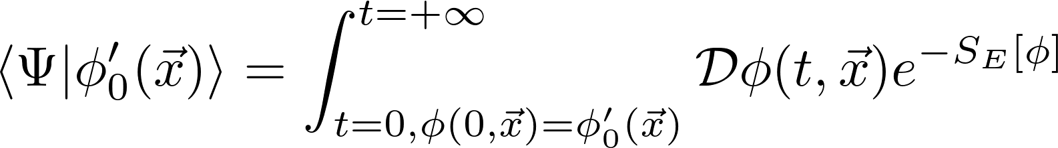
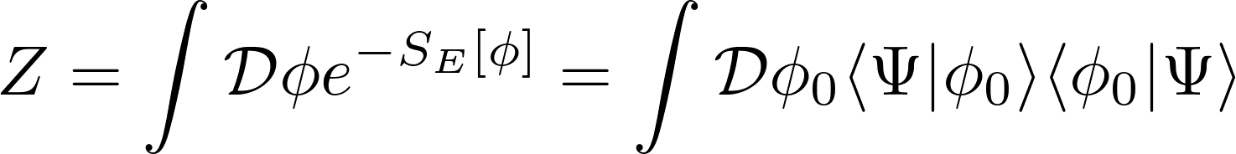
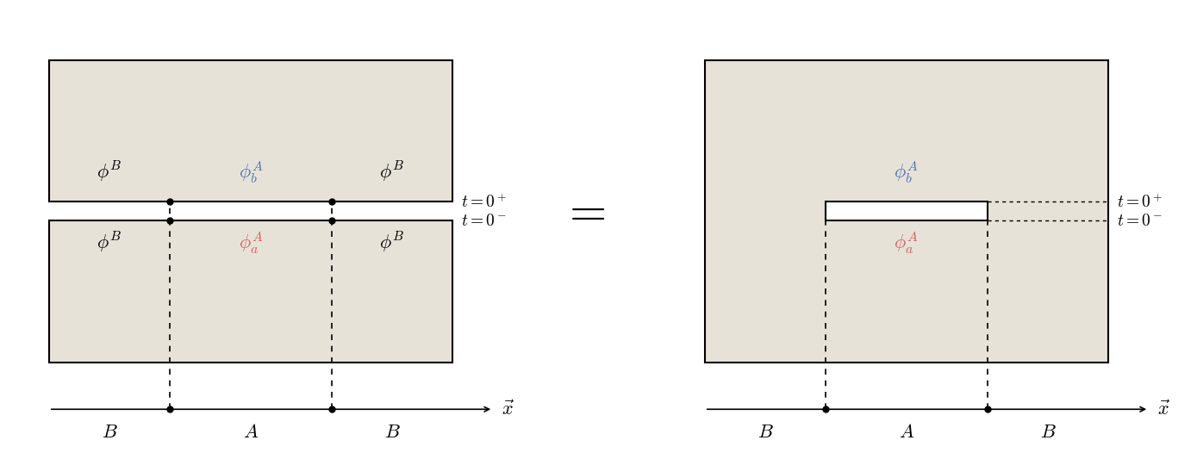
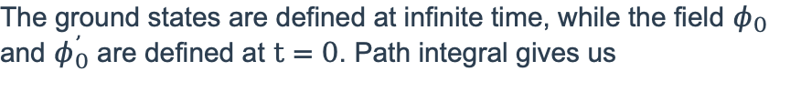
Density Matrix Under Path Integral
The ground states are defined at infinite time, while the field $φ_{0}$ and $φ_{0}^{’}$ are defined at$t=0$. Path integral gives us
The partition function over the entire Euclidean space is
Suppose we have two regions A and B. After tracing rigion B we will get the density matrix in rigion A and calculate the entanglement entropy.
Fudan University | Physics Department
Page 9

Slide 10
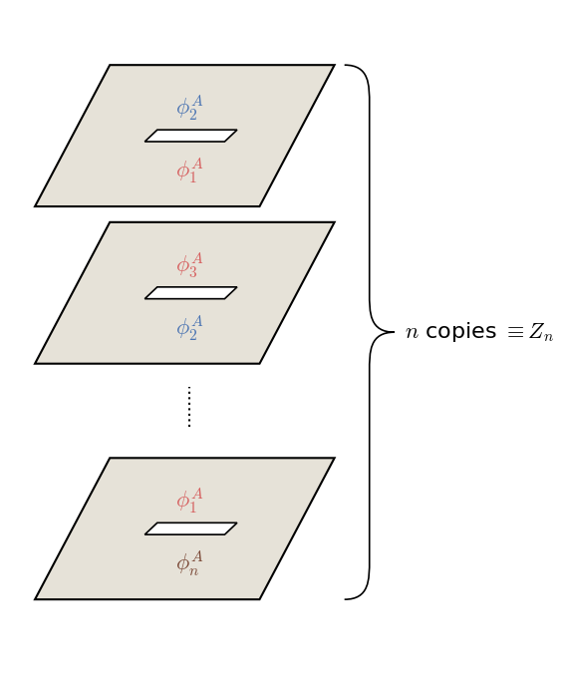
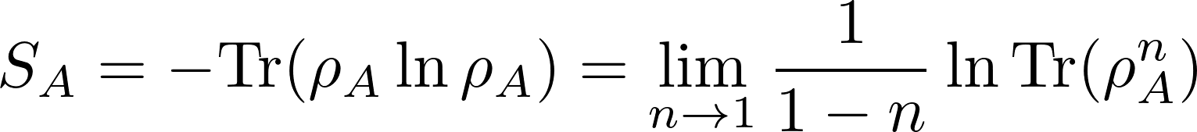
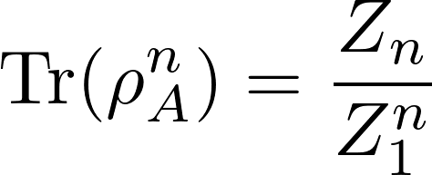
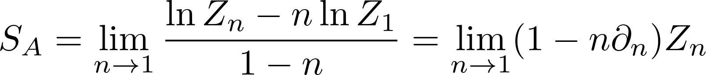
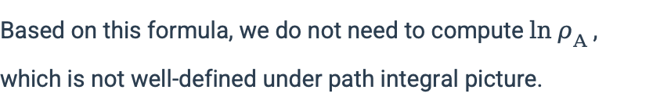
Replica Trick
Based on this formula, we do not need to compute $\ln{ρ_{A}}$, which is not well-defined under path integral picture.
Results
Fudan University | Physics Department
Page 10

Slide 11
Ryu-Takayanagi Formula
Fudan University | Physics Department
Page 8

Slide 12
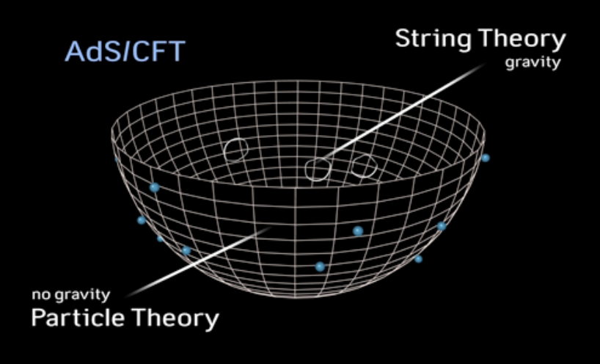
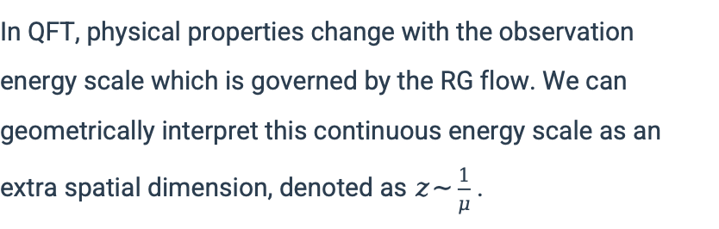
AdS/CFT Correspondence
In QFT, physical properties change with the observation energy scale which is governed by the RG flow. We can geometrically interpret this continuous energy scale as an extra spatial dimension, denoted as $z\sim \frac{1}{μ}$ .
$d$-dimensional CFT $⟺$ $(d+1)$-dimensional quantum gravity
Fudan University | Physics Department
Page 12

Slide 13
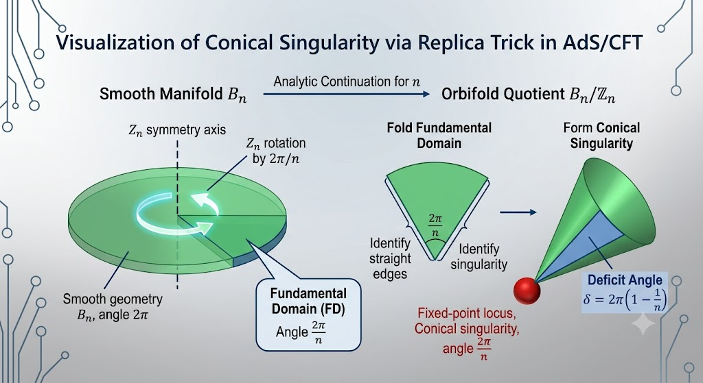

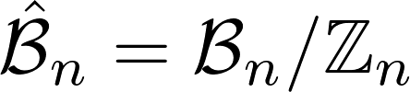
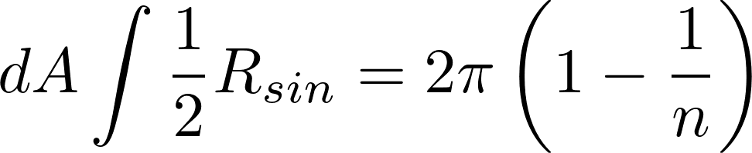
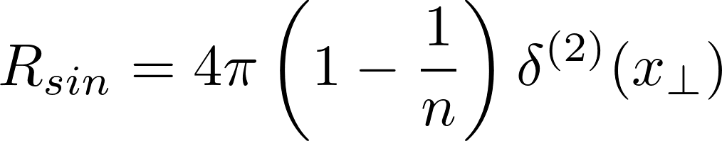
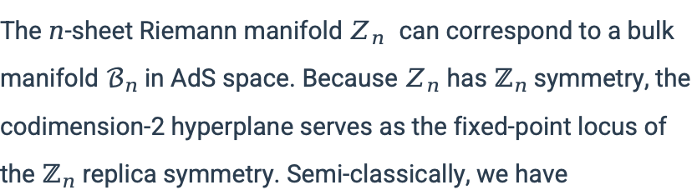
Ryu-Takayanagi Formula
The $n$-sheet Riemann manifold $Z_{n}$can correspond to a bulk manifold $ℬ_{n}$in AdS space. Because $Z_{n}$ has $ℤ_{n}$symmetry, the codimension-2 hyperplane serves as the fixed-point locus of the $ℤ_{n}$ replica symmetry. Semi-classically, we have
How to turn $n$ into a continuous parameter?
Define the quotient space
Conic singularity$⇒$ An extra singular Ricci scalar apprears
Using Gauss-Bonet theorem, we conclude that
Fudan University | Physics Department
Page 13

Slide 14
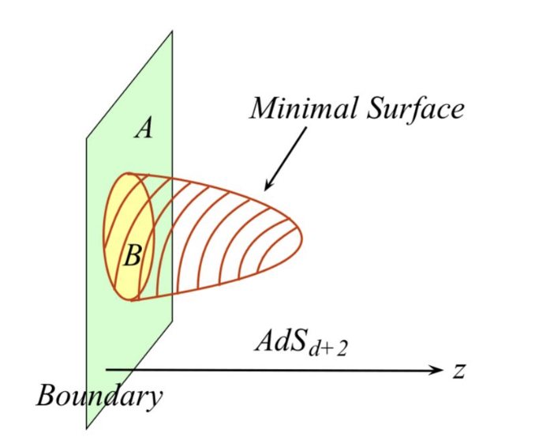

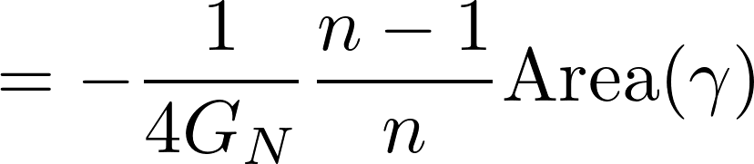
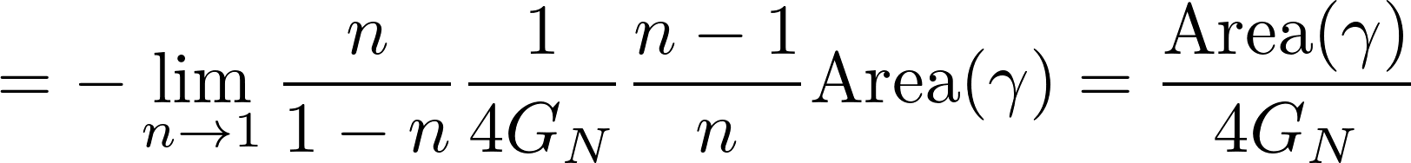
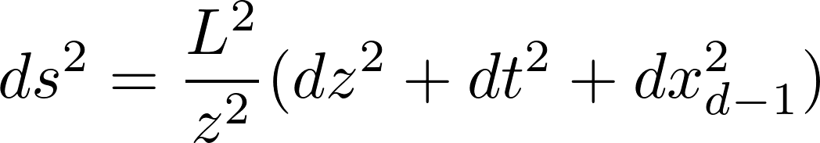
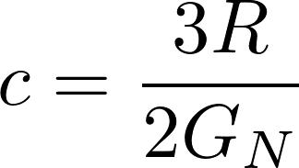


Ryu-Takayanagi Formula
Area law apprears!
${AdS}_{3}$/${CFT}_{2}$ correspondence:
${AdS}_{d+1}$ metric:
Fudan University | Physics Department
Page 14

Slide 15
Conclusion
"The Divergence weaves the fabric of spacetime, while the Universal Constant encodes the soul of the quantum theory."
Susskind-Uglum mechanism: The UV divergence of entanglement entropy (area law) acts as a microscopic "tension" that defines the macroscopic strength of gravity.
The universal term remainsinvariant regardless of the microscopic cutoff. While the divergent area law defines the geometric fabric of spacetime, the universal term uniquely identifies the system's phase and intrinsic quantum properties.
Fudan University | Physics Department
Page 15

Slide 16


Thank you

