Slide 1

Paradigm changing studies of spin entangled hyperons and antihyperons at BESIII
Hai-Bo Li
(On behalf of the BESIII collaboration)
Institute of High Energy Physics
lihb@ihep.ac.cn
第6届LHCb前沿研讨会
22-26 May, 2026, Guangzhou, China
Notes:
各位老师大家下午好，很高兴有机会给大家汇报一下BESIII上利用处在自旋纠缠态的正反超子对寻找CP破坏的研究进展

Slide 2
Introduction
Outline
CONTENTS
Highlights of Hyperon CP Studies @BESIII
Summary

Slide 3
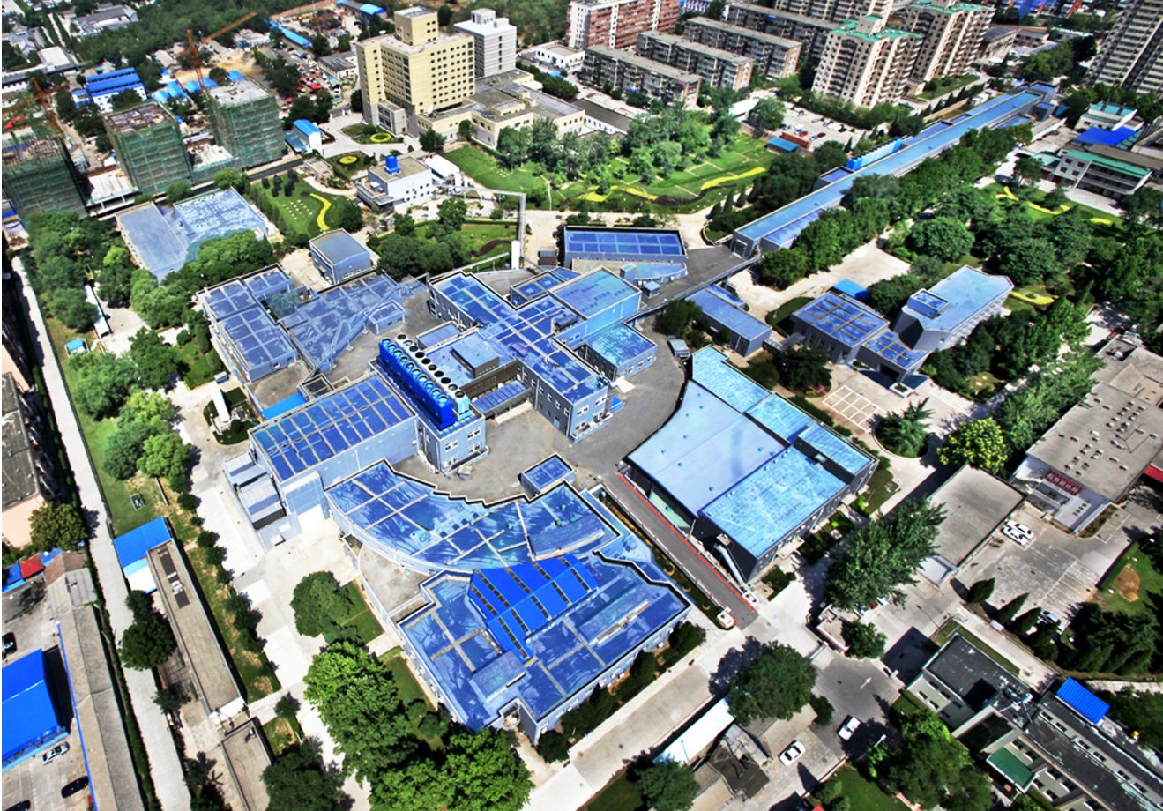

Beijing Electron-Positron Collider II (BEPCII)
Center of mass energy: $1.84\sim 4.95$ GeV
2008- Now (BEPCII):
L_{peak}=1.1x10³³/cm²s
Reached peak luminosity in 2016
Reached highest Ecm=4.95 GeV in Jan. 2021
Linear part
BEPCII
(Circular part)
BESIII detector
Notes:
Circumference : 240 meters, Linac part: 200 meters

Slide 4
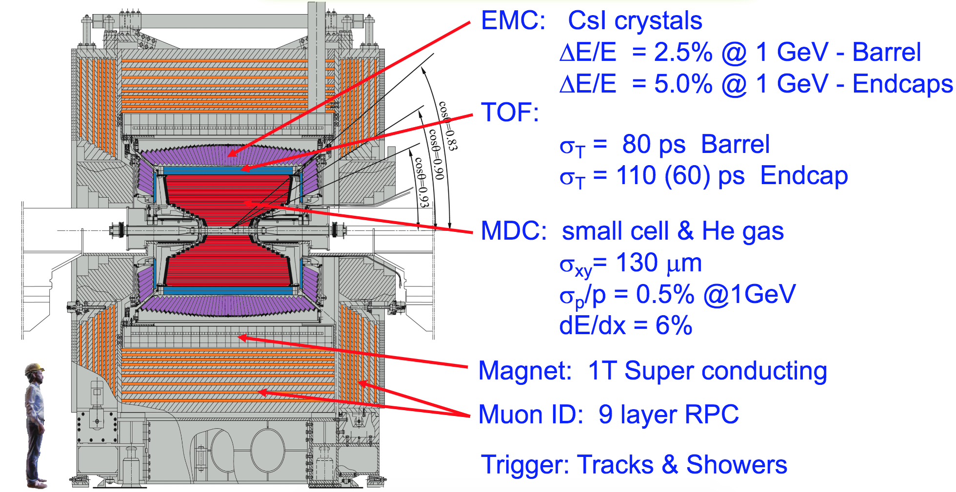
BESIII detector
The detector is designed for neutral and charged particle with excellent resolution, PID, and large coverage.
Total weight 730 ton, ~40,000 readout channels, Data rate: 5kHz, 50Mb/s
Has been in full operation since 2008, all subdetectors are in very good status!

Slide 5

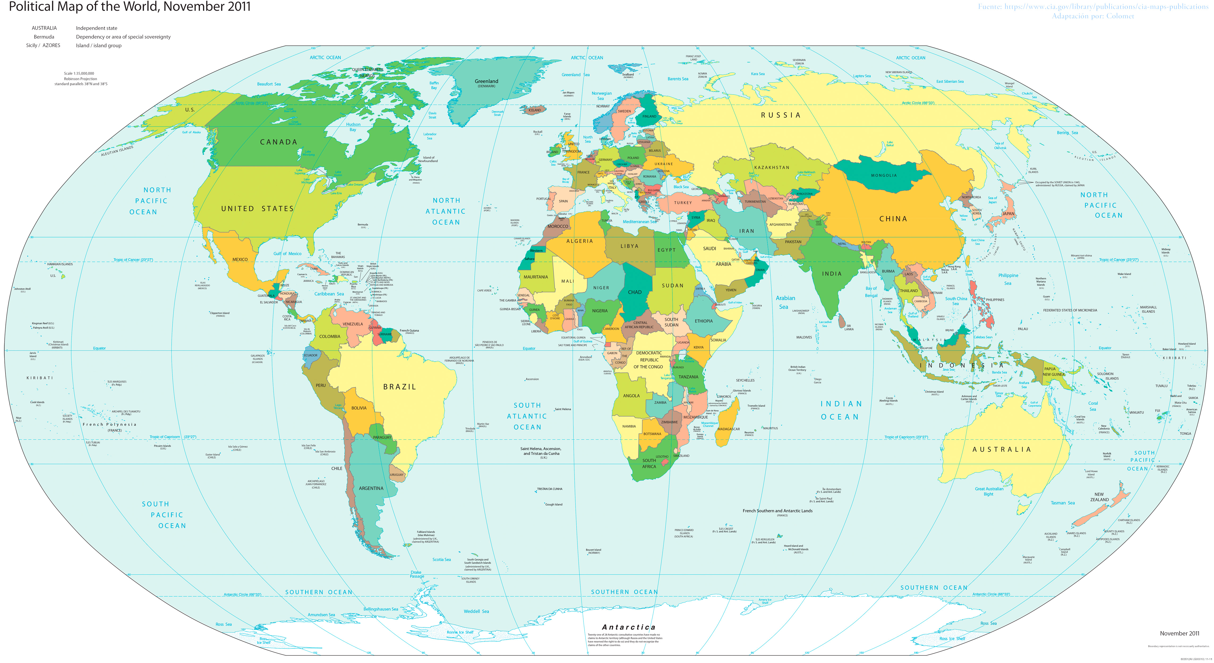

BESIII Collaboration
Europe (19/130)
Germany (6): Bochum University,
GSI Darmstadt, Helmholtz Institute Mainz, Johannes Gutenberg University of Mainz, Universitaet Giessen,University of Münster
Italy (3): Ferrara University, INFN, University of Torino
Netherlands (1):KVI/University of Groningen
Russia (3): Budker Institute of Nuclear Physics, Dubna JINR, Lebedev Physical Institute
Sweden (1):Uppsala University
Turkey (1):Turkish Accelerator Center Particle Factory Group
UK (2): University of Manchester, University of Oxford
Poland (1)National Centre for Nuclear Research
Asia (6/10)
Pakistan (2): COMSATS Institute of Information Technology
University of the Punjab, University of Lahore
Mongolia (1): Institute of Physics and Technology
Korea (1): Chung-Ang University
India (1): Indian Institute of Technology madras
Thailand (1): Suranaree University of Technology
USA(4/8)
Carnegie Mellon University
Indiana University
University of Hawaii
University of Minnesota
China (63/567)
Institute of High Energy Physics (146), other units(221): Beijing Institute of Petro-chemical Technology, Beihang University,
China Center of Advanced Science and Technology, Fudan University,
Guangxi Normal University, Guangxi University,
Hangzhou Normal University, Henan Normal University,
Henan University of Science and Technology,
Huazhong Normal University, Huangshan College, Hunan University,
Hunan Normal University, Henan University of Technology
Institute of modern physics, Jilin University, Lanzhou University, Liaoning Normal University, Liaoning University, Nanjing Normal University, Nanjing University, Nankai University, North China Electric Power University,
Peking University, Qufu normal university, Shanxi University,
Shanxi Normal University, Sichuan University, Shandong Normal University,
Shandong University, Shanghai Jiaotong Univeristy, Soochow University,
South China Normal University, Southeast University, Sun Yat-sen University,
Tsinghua University, University of Chinese Academy of Sciences, University of Jinan, University of Science and Technology of China,
University of Science and Technology Liaoning,
University of South China, Wuhan University, Xinyang Normal University,
Zhejiang University, Zhengzhou University,YunNan University , China University of Geosciences
South America (2/4)
Chile: University of Tarapaca
University of La Serena
~700 members
From 96 institutions in 15 countries

Slide 6

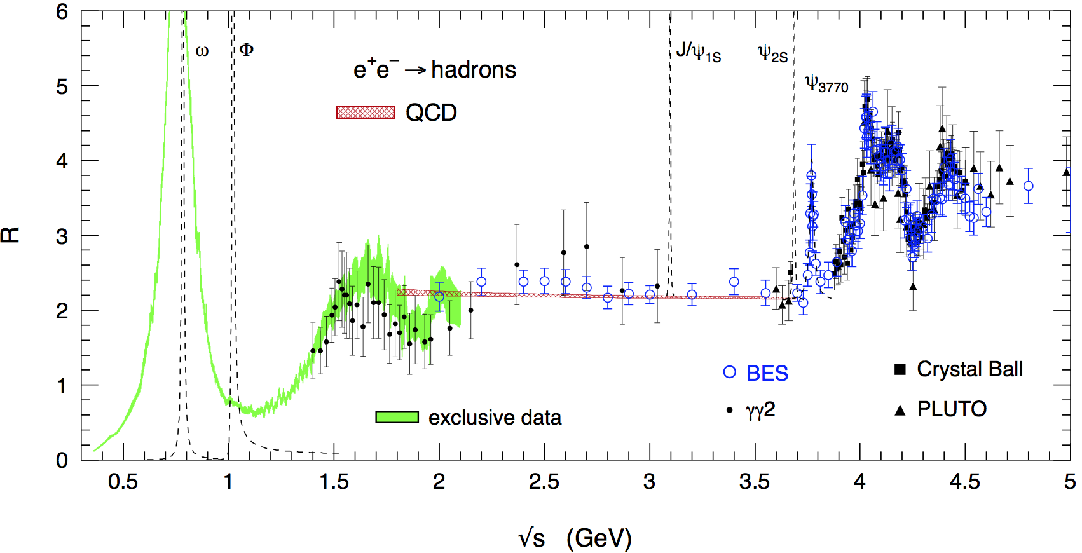
Rich Physics at τ-charm Energy Region
Hadron form factors
R values and QCD
Light hadron spectroscopy
Gluonic and exotic states
Physics with τ lepton
XYZ particles
Charm mesons
Charm baryons

Slide 7
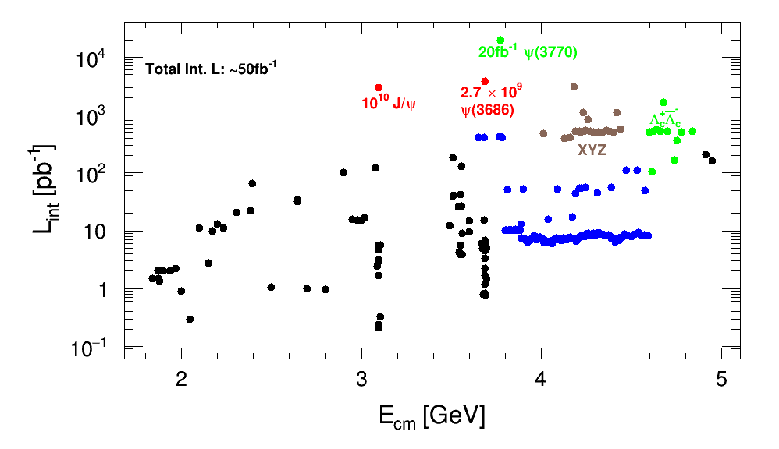
BESIII data sets

Slide 8
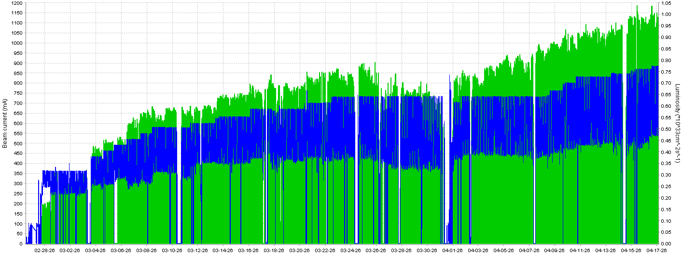
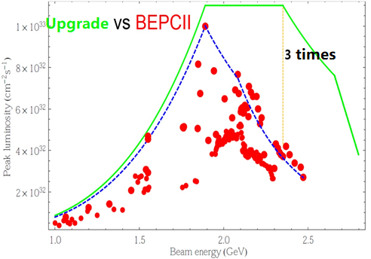
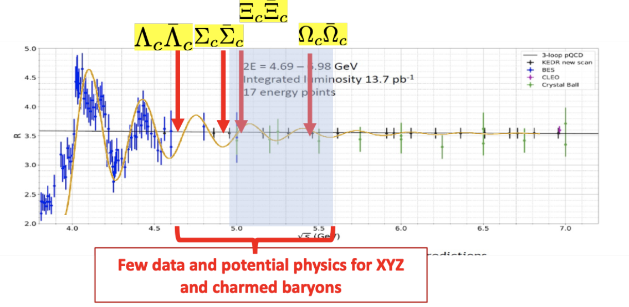
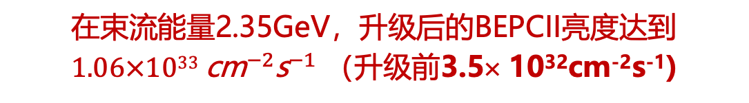
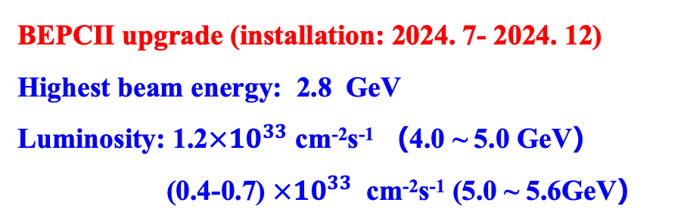
BEPCII：2024年升级亮度达标
在束流能量2.35GeV，升级后的BEPCII亮度达到$1.06×1033 {\text{cm}}^{−2}{\text{s}}^{−1}$ （升级前3.5× 10³²cm⁻²s⁻¹)
BEPCII upgrade (installation: 2024. 7- 2024. 12)
Highest beam energy: 2.8 GeV
Luminosity: 1.2$×{10}^{33}$ cm⁻²s⁻¹ （4.0 ~ 5.0 GeV）
(0.4-0.7) $×{10}^{33}$ cm⁻²s⁻¹ (5.0 ~ 5.6GeV）
◆ beam current ◆ luminosity

Slide 9
BESIII publications
总发文: 821篇， 其中PRL 144篇

Slide 10
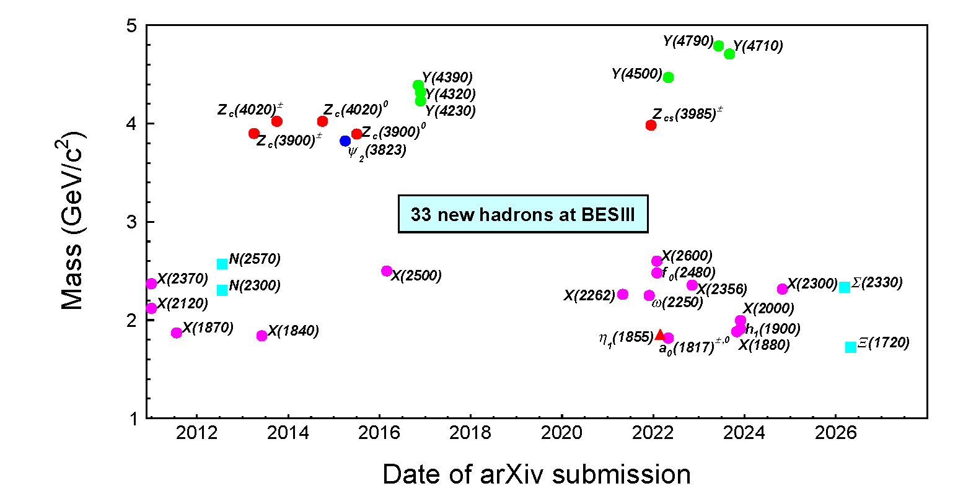
New hadrons discovered at BESIII
https://english.ihep.cas.cn/bes/re/pu/NewParticles/

Slide 11
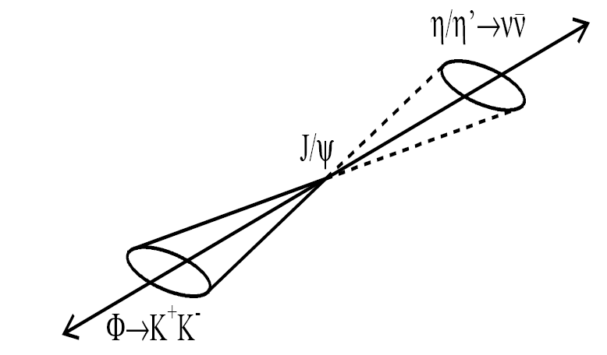
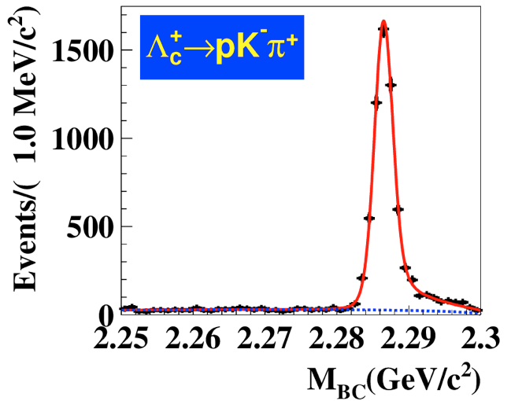
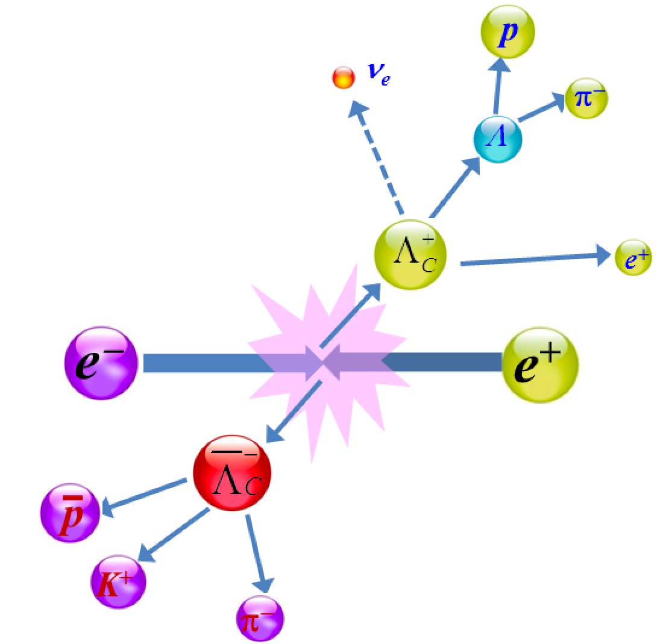
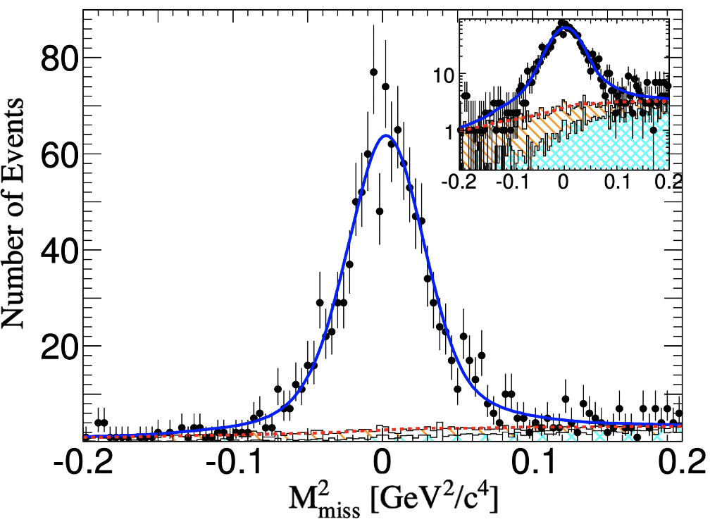
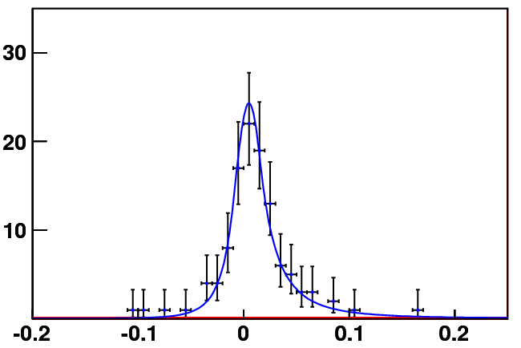
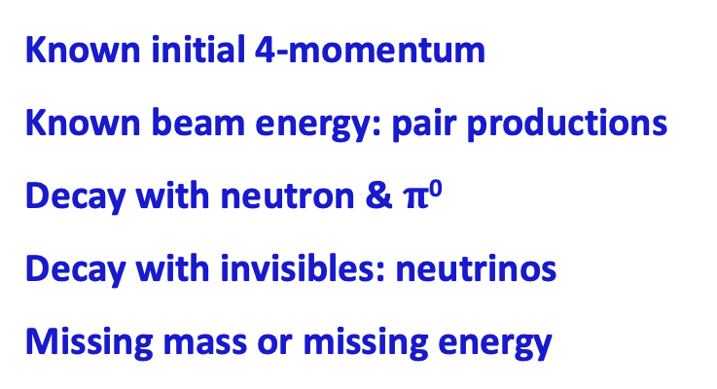

BESIII advantage: unique data near to the thresholds
Known initial 4-momentum
Known beam energy: pair productions
Decay with neutron & $π$⁰
Decay with invisibles: neutrinos
Missing mass or missing energy
Double tag
Excellent resolution
Beam-constraint Λ_{c} mass
e+
e-
Single tag
$$Σ^{+}→pπ^{0}$$
Missing mass
Neutrino reconstruction
Events /0.010 (GeV)
U_{miss} (GeV)

Slide 12
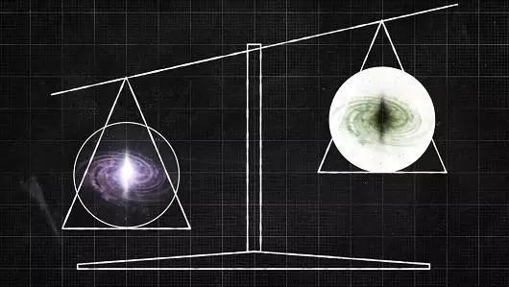
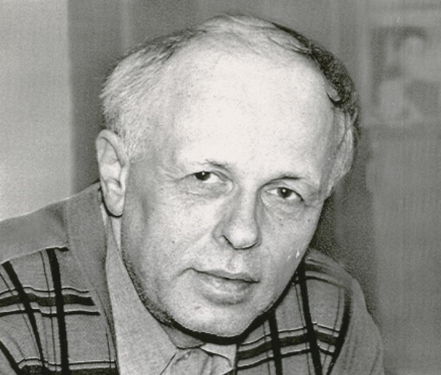
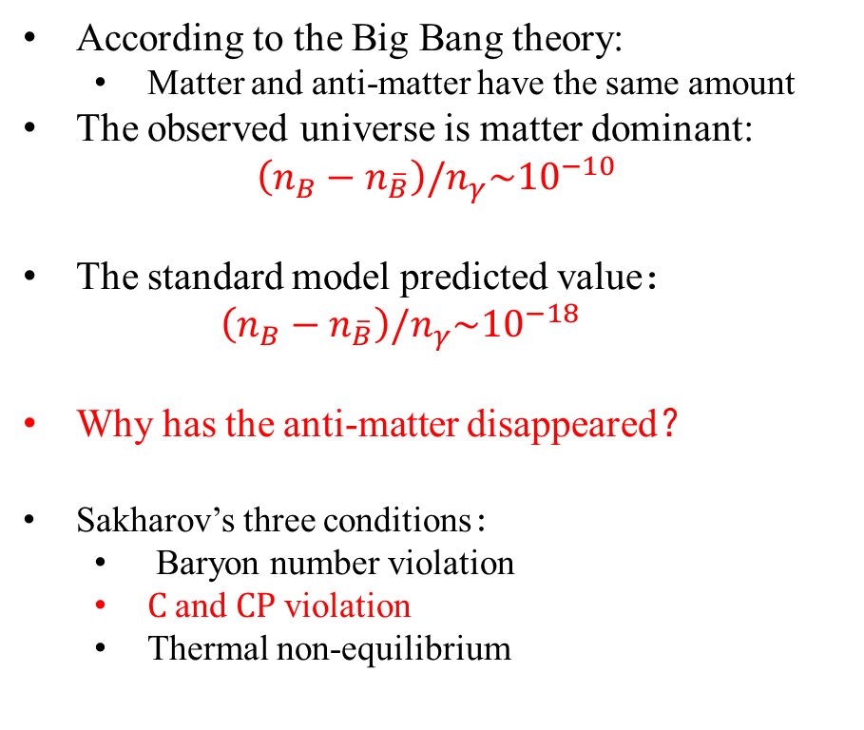
Mystery of matter-antimatter asymmetry
According to the Big Bang theory:
  Matter and anti-matter have the same amount
The observed universe is matter dominant:
$$\left(n_{B}−n_{\overline{B}}\right)/n_{γ}\sim {10}^{−10}$$
The standard model predicted value：
  $$\left(n_{B}−n_{\overline{B}}\right)/n_{γ}\sim {10}^{−18}$$
Why has the anti-matter disappeared？
Sakharov’s three conditions:
  Baryon number violation
  C and CP violation
  Thermal non-equilibrium
Anti-matter
Matter
Pisma Zh. Eksp. Teor. Fiz., 1967, 5: 32-35
Notes:
正反物质不对称是当前物理学界一大未解之谜，根据大爆炸宇宙论，在宇宙诞生之初产生了等量的正物质和反物质，但是目前天文学观测的结果是宇宙是由正物质组成的，几乎不存在反物质。那么为什么反物质在宇宙演化过程中消失了呢？为了回答这一问题，前苏联物理学家萨哈罗夫提出了他的著名的三个必要条件，第一是必须存在重子数破坏的过程，二是必须有破坏C和CP对称性的过程，第三点是必须存在热平衡太破坏的过程。我们报告主要是与第二点相关，寻找超子衰变中的CP破坏。

Slide 13


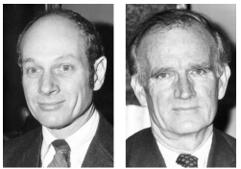



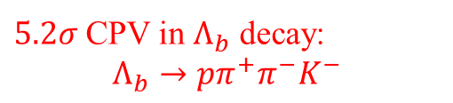


Roadmap of CP violation in flavored hadrons
All of them are consistent with CKM theory in the Standard Model, but too small to explain the matter-dominant world.
Before 21 Mar 2025, there is no observation of CPV in the baryon system.
$5.2σ$ CPV in $Λ_{b}$ decay:
$$Λ_{b}→pπ^{+}π^{−}K^{−}$$
$K$ meson $CPV$
$B$ meson $CPV$
$D$ meson $CPV$
$Λ_{b}$ baryon
Hyperon/charmed baryon?
1964
2001
2019
2025
James Watson
Cronin
Val Logsdon
Fitch
[1] Phys. Rev. 104 (1956) 254-258
[2] Phys. Rev. 105 (1957) 1413-1414
[3] Phys. Rev. Lett., 1964, 13: 138-140
[4] Phys. Rev. Lett., 2001, 87: 091801
[5] Phys. Rev. Lett., 2001, 87: 091802
[6] Phys. Rev. Lett., 122, 211803 (2019)
[7] Nature 643 (2025) 8074, 1223-1228
Notes:
这一页展示的是实验上对CP破坏的研究进程，上个世纪六十年代，人们首次在K介子的衰变中发现了CP破坏效应，然后在本世纪相继在B介子和粲介子的衰变中发现了CP破坏，最近在25年的三月份，LHCb实验首次在重子的衰变中也发现了CP破坏效应，在Lambda_b->ppi+pi-K-过程。这些已发现的CP破坏程度都与标准模型的预期相一致，都不足以解释当前观测到的正反物质不对称。因此一定还存在其他的CP破坏来源。目前在超子和粲重子的衰变中还未发现CP破坏的迹象，是值得深入研究的方向。

Slide 14

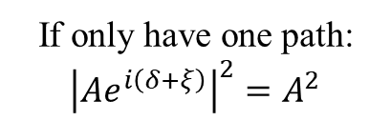









Search for CP violation in hyperon decays
1) a CP-violating phase:
Ordinary phases in QM
CP violating phases
matter antimatter
matter antimatter
δ
δ
ξ
−ξ
same sign
opposite sign
If only have one path: ${\left|Ae^{i\left(δ+ξ\right)}\right|}^{2}=A^{2}$
2) two or more interfering paths to the same final state
The CPV phase vanishes in the probability density.
S-wave
$$Se^{i(δ_{S}+ξ_{S})}$$
$$B$$
$$Y$$
$$π$$
$$Pe^{i(δ_{P}+ξ_{P})}$$
P-wave
Spin-1/2 baryon
Spin-1/2 hyperon
S-wave
$$Se^{i(δ_{S}−ξ_{S})}$$
$$\overline{B}$$
$$\overline{Y}$$
Suitable for CPV searches!
$$π$$
$$Pe^{i(δ_{P}−ξ_{P})}$$
P-wave
Notes:
要想在实验上观测到CP破坏效应，必须满足两个条件，一个是衰变振幅中必须存在CP破坏的相角，在CP变换下会出一个负号。第二个是对于一个反应过程，必须存在两个或者两个以上的分波振幅，否则的话即使存在CP破坏相角，振幅一模方就被消掉了，实验上就没有办法去测量它。而超子的非轻子弱衰变存在S波和P波两个分波振幅，并且S波P波在同一个量级，因此非常适合研究CP破坏。

Slide 15

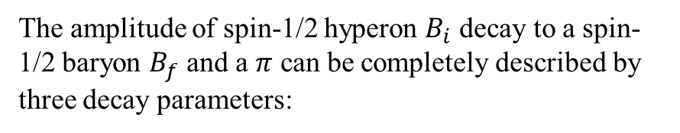
Non-leptonic hyperon decays
Phys. Rev. 108, 1645 (1957)
The amplitude of spin-1/2 hyperon $B_{i}$ decay to a spin-1/2 baryon $B_{f}$ and a $π$ can be completely described by three decay parameters:
$$α_{Y}^{2}+β_{Y}^{2}+γ_{Y}^{2}=1$$
$$β_{Y}={\left(1−α_{Y}^{2}\right)}^{\frac{1}{2}}sinφ_{Y}，γ_{Y}={\left(1−α_{Y}^{2}\right)}^{\frac{1}{2}}cosφ_{Y}$$
$CP$ convervation：$α_{Y}={−\overline{α}}_{Y},$ $β_{Y}=−{\overline{β}}_{Y},$ $φ_{Y}={−\overline{φ}}_{Y}$
Notes:
在上个世纪五十年代，杨先生和李先生提出，一个自选为1/2的超子衰变到一个自选为1/2的重子加一个pi介子的过程，可以提供过三个衰变参数来描述，alpha beta gamma，他们通过S波P波振幅来定义。这三个参数的平方和等于1，因此它们并非相互独立。所以通常我们会引入一个额外的参数phi，然后通过alpha和phi两个参数来描述超子的非轻子衰变。在CP对称性守恒的情况下，超子的衰变参数等于反超子衰变参数的相反数，因此我们可以通过这些衰变参数来定义CP破坏的观测量。

Slide 16

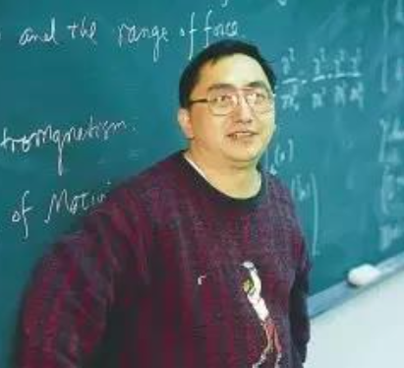
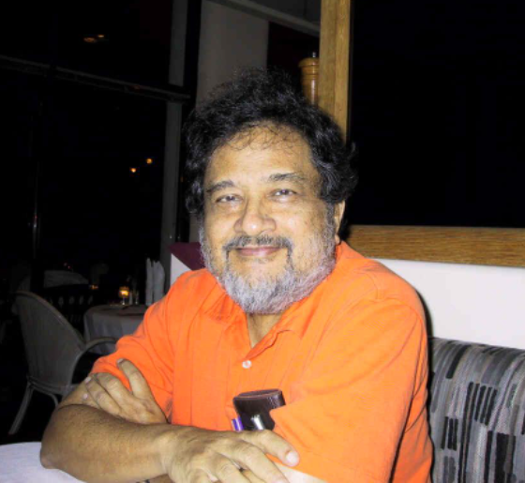
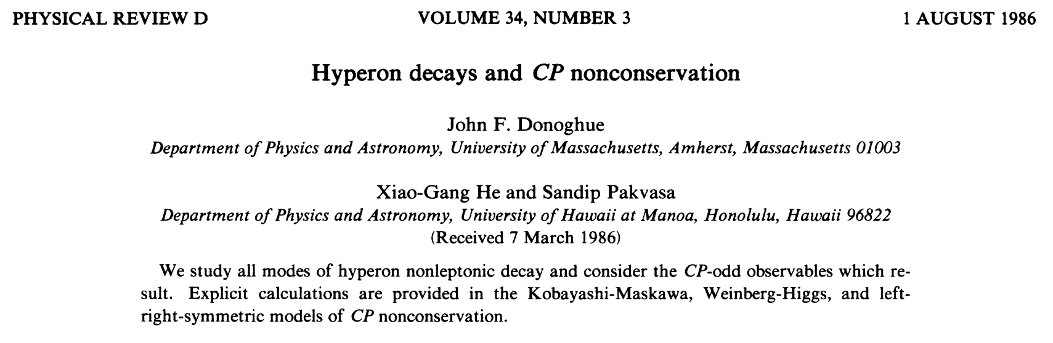


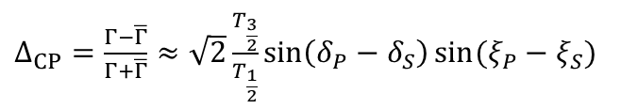







CP observables in hyperon decay
John F.
Donoghue
Xiao-Gang He
Sandip Pakvasa
PRD 34,833 1986
SM Prediction of
$Λ$ decay
strong phase
$CPV$ phase
$Δ_{CP}=\frac{Γ−\overline{Γ}}{Γ+\overline{Γ}}≈\sqrt{2}\frac{T_{\frac{3}{2}}}{T_{\frac{1}{2}}}sin\left(δ_{P}−δ_{S}\right){\sin{(ξ_{P}−ξ_{S})}}$
$$−5.4×{10}^{−7}$$
Not sensitive to $CPV$
Decay width difference
Easiest to measure
Decay parameter difference
$$A_{CP}=\frac{α+\overline{α}}{α−\overline{α}}≈−tan\left(δ_{P}−δ_{S}\right)\tan{(ξ_{P}−ξ_{S})}$$
$$−0.5×{10}^{−4}$$
Polarization of decayed baryon needs to be measured
$$B_{CP}=\frac{β+\overline{β}}{α−\overline{α}}≈\tan{(ξ_{P}−ξ_{S})}$$
Decay parameter difference
$$3.0×{10}^{−3}$$
$Ξ^{−}, Ξ^{0}, Ω^{−}$ cascade decay
Notes:
这里展示了一些常见的CP破坏观测量的定义。第一个Delta_CP是通过正反超子的衰变分宽度的差别定义的，这在标准模型中被严重压低，因此对CP破坏不敏感。Acp Bcp和Delta_phi_cp都是通过衰变参数定义，通过这些定义式，我们可以发现A_cp会受到小的强相角压低，而B_cp 和phi_CP不会，因此B_cp和phi_cp要比A_cp对CP破坏更敏感。但是这两个CP破坏观测量只有在末态重子极化可以被测量时才可以被直接测量。

Slide 17
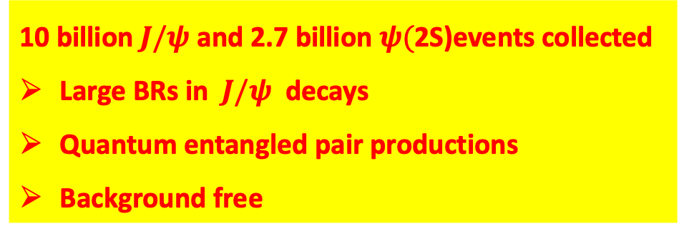
BESIII：A hyperon factory
10 billion $J/ψ$ and 2.7 billion $ψ($2S)events collected
Large BRs in $J/ψ$ decays
Quantum entangled pair productions
Background free
Hai-Bo Li, arXiv:1612.01775
A. Adlarson, A. Kupsc, arXiv:1908.03102
e+
e-
Single tag
$$Σ^{+}→pπ^{0}$$

Slide 18
Entangled and Polarized hyperon pairs produced in $e^{+}e^{−}$ collisions
m=±1
m=±1
A_{½ -½}
θ,φ
A_{½ ½}
θ,φ
J/ψ
J/ψ
A_{-½ ½}
m=±1
A_{-½ -½}
m=±1
θ,φ
θ,φ
J/ψ
J/ψ
From Steve Olsen
Parity conservation : A_{½ ½} =A_{-½ -½}
Parity conservation : A_{½} _{-½} =A_{-½ ½}
Δ$Φ$= complex phase between A_{½} _{½} and A_{½ -½}
Notes:
According to parity conservation,

Slide 19
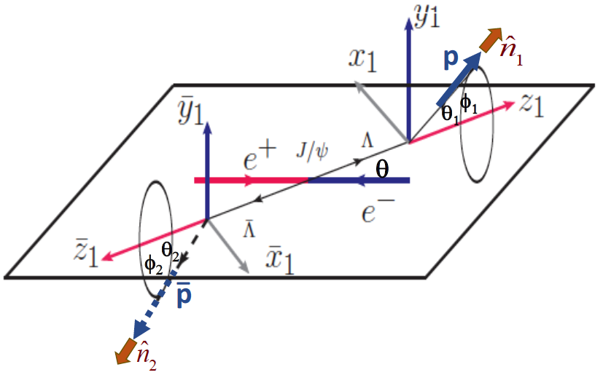
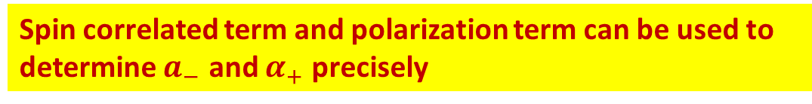

Correlated 5-dim. angular distribution in differential cross-section of this process:
If Δ$Φ$ ≠ 0, Λ and Λ are transversely polarized
Unpolarized part
Spin correlated part
Spin Polarized part
Spin correlated term and polarization term can be used to determine $a_{−}$ and $α_{+}$ precisely
Λ
Nuovo Cim. A 109, 241 (1996)
Phys. Rev.185 D 75, 074026 (2007)
Nucl. Phys. A190 771, 169 (2006)
Phys. Lett. B 772, 16(2017)
Notes:
the joint angular distribution is [

Slide 20
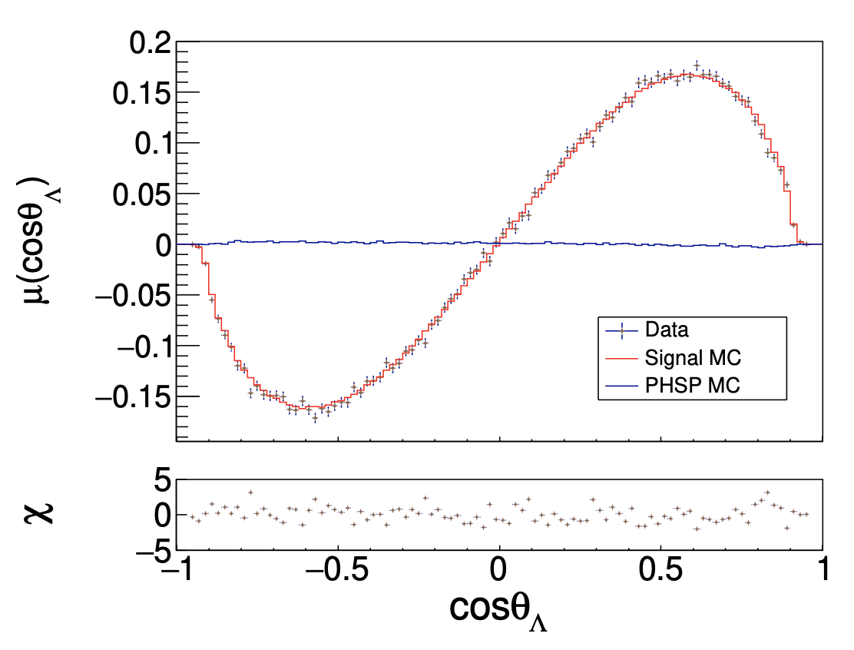
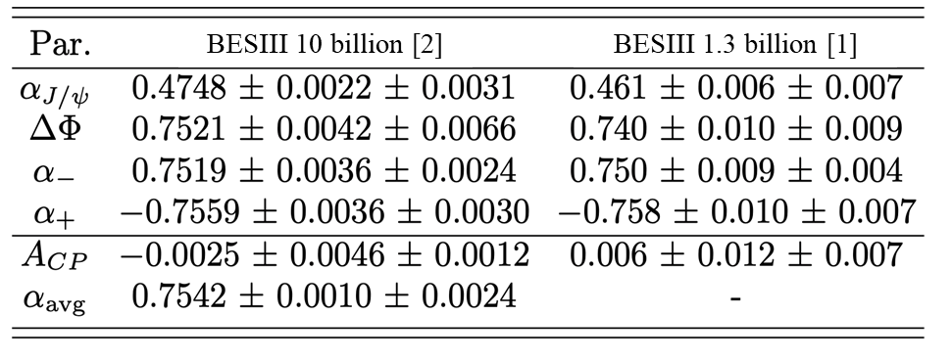
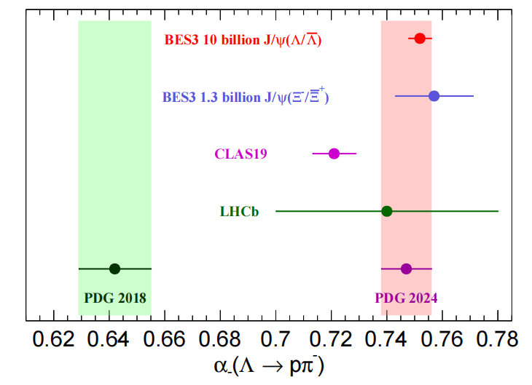

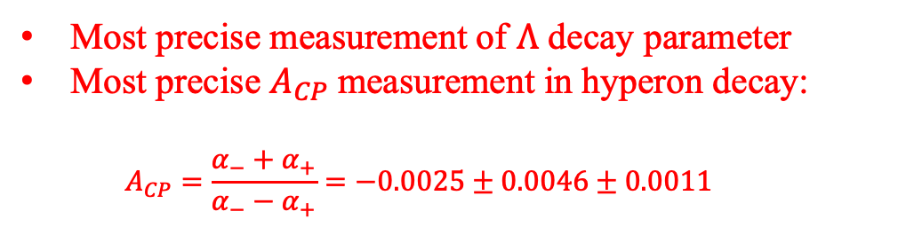
Search for CPV in $Λ→pπ^{−}$ with $e^{+}e^{−}→J$/$ψ→Λ\overline{Λ}$
Two BESIII papers have been published:
  [1] 1.3 billion: Nature Phys 15(2019)631
  [2] 10 billion: Phys. Rev. Lett. 129 (2022) 13, 131801
Phys. Rev. Lett. 129, 131801
3.2 M $Λ\overline{Λ}$ pairs were reconstructed.
Most precise measurement of $Λ$ decay parameter
Most precise $A_{CP}$measurement in hyperon decay:
  $$A_{CP}=\frac{α_{−}+α_{+}}{α_{−}−α_{+}}=−0.0025±0.0046±0.0011$$

Slide 21
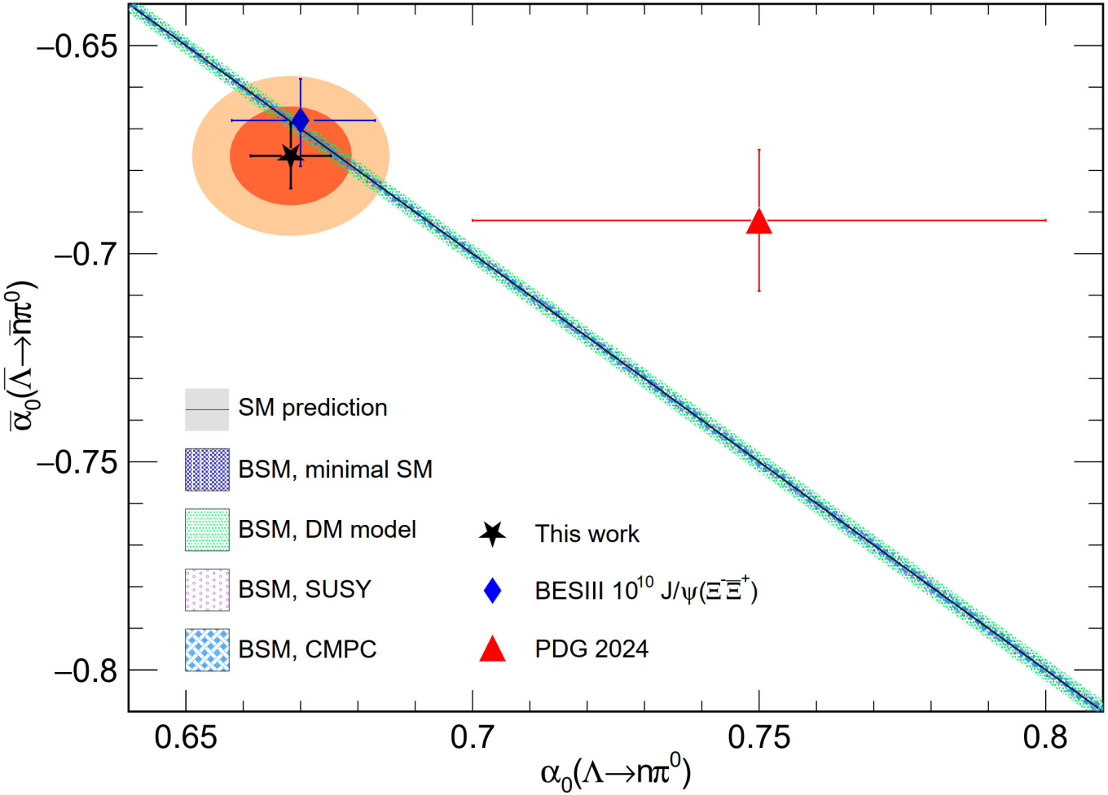
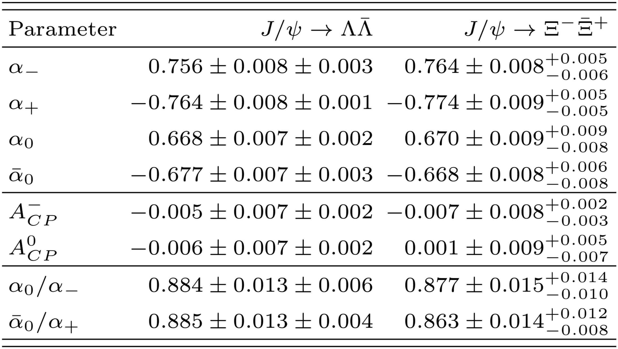
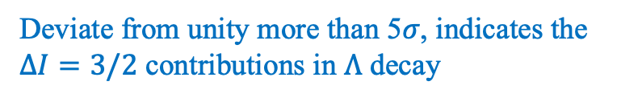

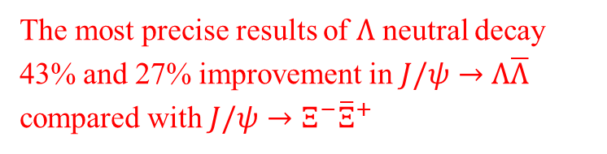
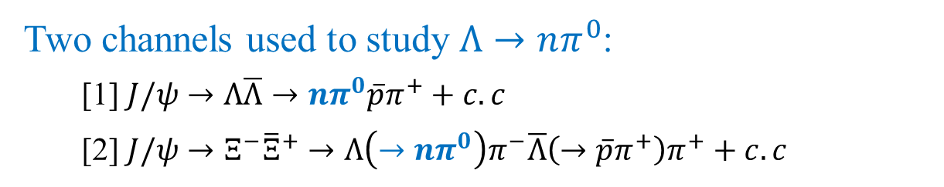



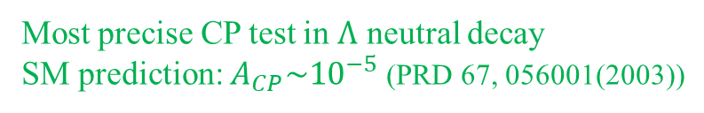
Search for CPV in $Λ→nπ^{0}$decay
[1] arXiv:2510.24333
[2] Phys.Rev.Lett. 132 (2024) 10, 101801
Two channels used to study $Λ→nπ^{0}$:
  [1] $J/ψ→Λ\overline{Λ}→nπ^{0}\overline{p}π^{+}+c.c$
  [2] $J/ψ→Ξ^{−}{\overline{Ξ}}^{+}→Λ\left(→nπ^{0}\right)π^{−}\overline{Λ}\left(→\overline{p}π^{+}\right)π^{+}+c.c$
[1]
[2]
[1] $J/ψ→Λ\overline{Λ}$
[2] $J/ψ→Ξ^{−}{\overline{Ξ}}^{+}$
The most precise results of $Λ$ neutral decay
43% and 27% improvement in $J/ψ→Λ\overline{Λ}$ compared with $J/ψ→Ξ^{−}{\overline{Ξ}}^{+}$
Most precise CP test in $Λ$ neutral decay
SM prediction: $A_{CP}\sim {10}^{−5}$ (PRD 67, 056001(2003))
Deviate from unity more than 5$σ$, indicates the $ΔI=3/2$ contributions in $Λ$ decay
$ΔI=1/2$ rule: $\frac{α_{0}}{α_{−}}=1$
Notes:
这一页我们的测量结果。Lambda衰变中的CP破坏我们一共发表了两个工作，一个是用的部分jpsi数据，一个是全数据的更新。右上角图中我们观测到了显著的Lambda横向极化现象，通过分析这些极化的Lambda超子，我们给出了世界上最精确的Lambda衰变参数测量。在我们测量之前，PDG给出的Lambda衰变参数值在0.64，我们2019年发表的结果比PDG值高了17%，推翻了之前的测量，在那之后PDG也不在采用此前的所有测量。我们利用测量到的衰变参数给出了世界上最精确的Lambda超子CP破坏观测量A_CP的值，证明在千分之5的量级上，CP守恒。

Slide 22
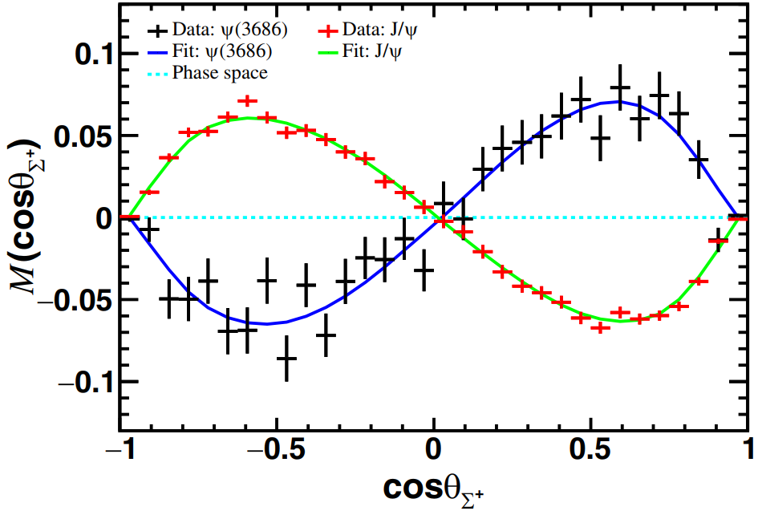
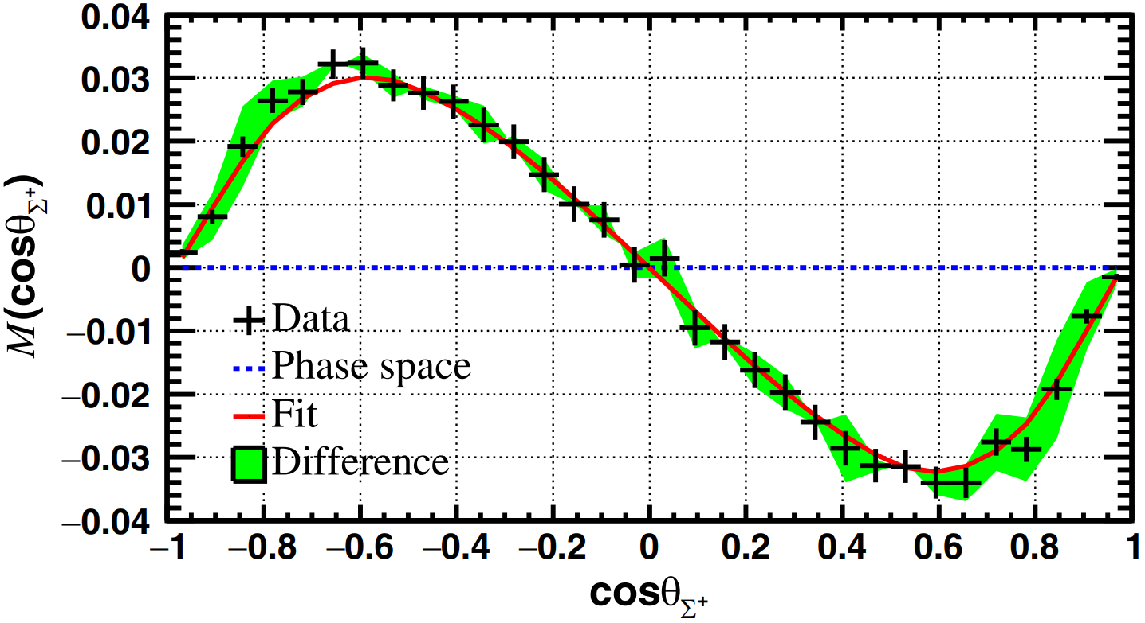



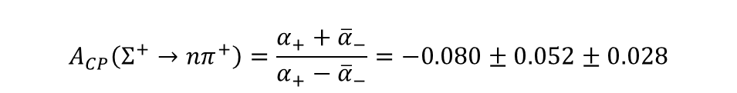
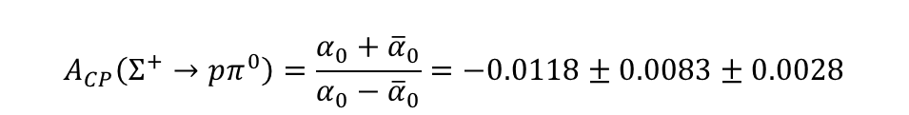
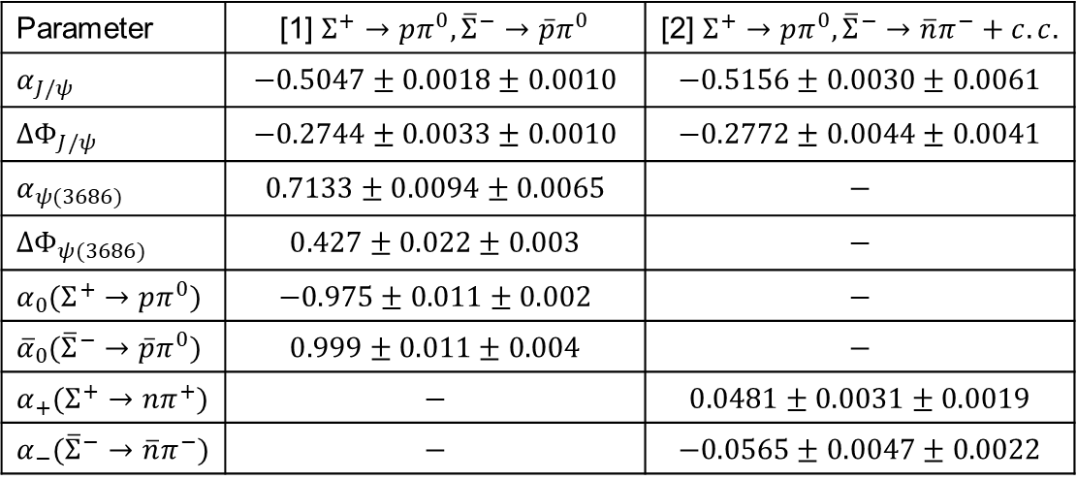

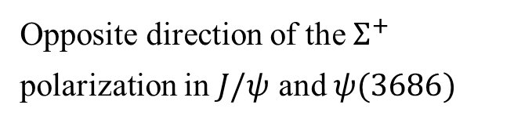


Search for CPV in $Σ^{+}$ decay
[1]
Phys.Rev.Lett. 135 (2025) 14, 141804
[2]
Phys.Rev.Lett. 131 (2023) 19, 191802
[1] $J/ψ\left[ψ\left(3686\right)\right]→Σ^{+}{\overline{Σ}}^{−}→pπ^{0}\overline{p}π^{0}$
[2] $J/ψ→Σ^{+}\left(→nπ^{+}\right){\overline{Σ}}^{−}\left(→\overline{p}π^{0}\right)+c.c.$
Polarization of $Σ^{+}$
Opposite direction of the $Σ^{+}$ polarization in $J/ψ$ and $ψ(3686)$
10B $J/ψ$ and 2.7B $ψ(3686)$
10B $J/ψ$
Parameter | [1] $Σ^{+}→pπ^{0},{\overline{Σ}}^{−}→\overline{p}π^{0}$ | [2] $Σ^{+}→pπ^{0},{\overline{Σ}}^{−}→\overline{n}π^{−}+c.c.$
$α_{J/ψ}$ | $$−0.5047±0.0018±0.0010$$ | $$−0.5156±0.0030±0.0061$$
$ΔΦ_{J/ψ}$ | $$−0.2744±0.0033±0.0010$$ | $$−0.2772±0.0044±0.0041$$
$α_{ψ(3686)}$ | $$0.7133±0.0094±0.0065$$ | $$−$$
$ΔΦ_{ψ(3686)}$ | $$0.427±0.022±0.003$$ | $$−$$
$α_{0}(Σ^{+}→pπ^{0})$ | $$−0.975±0.011±0.002$$ | $$−$$
${\overline{α}}_{0}({\overline{Σ}}^{−}→\overline{p}π^{0})$ | $$0.999±0.011±0.004$$ | $$−$$
$α_{+}(Σ^{+}→nπ^{+})$ | $$−$$ | $$0.0481±0.0031±0.0019$$
$α_{−}({\overline{Σ}}^{−}→\overline{n}π^{−})$ | $$−$$ | $$−0.0565±0.0047±0.0022$$
The most precise CP test in $Σ$ sector:
$$A_{CP}\left(Σ^{+}→pπ^{0}\right)=\frac{α_{0}+{\overline{α}}_{0}}{α_{0}−{\overline{α}}_{0}}=−0.0118±0.0083±0.0028$$
$$A_{CP}\left(Σ^{+}→nπ^{+}\right)=\frac{α_{+}+{\overline{α}}_{−}}{α_{+}−{\overline{α}}_{−}}=−0.080±0.052±0.028$$

Slide 23
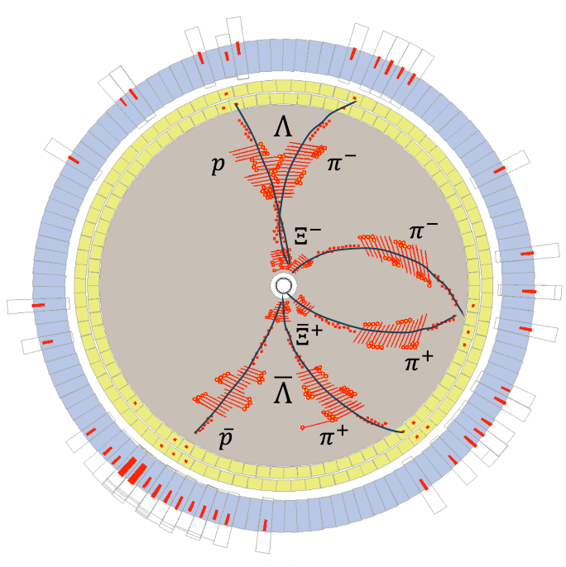
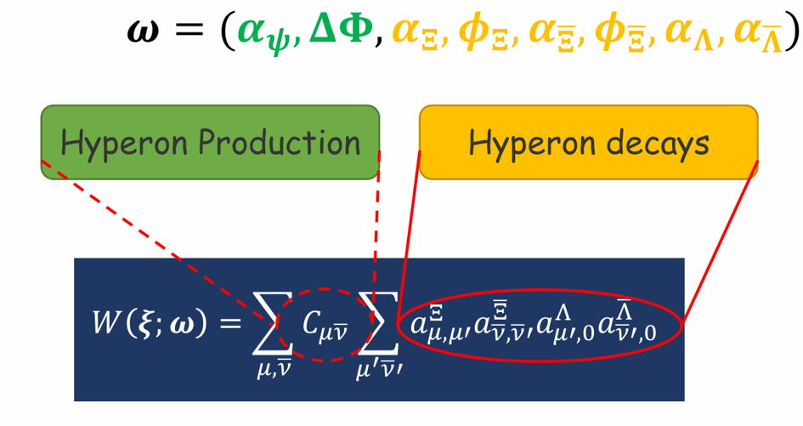










Search for CPV in $Ξ$ decay
$$pπ^{−}$$
↱
spin-aligned
quantum entangled
$$Λπ$$
Phys. Rev. D 99, 056008 (2019)
Phys. Lett. B 772, 16 (2017)
↱
$$e^{+}e^{−}→J/ψ→Ξ\overline{Ξ}$$
↳
$$\overline{Λ}π$$
↳
$$\overline{p}π^{+}$$
Through the sequential decays of $Ξ$, the $B_{CP}$ (CPV phase) can be directly measured!
The perfect reaction for hyperon $CPV$ searches!
Notes:
接下来是在双s夸克超子Xi的衰变中寻找CP破坏。BESIII上我们利用e+e- -> jpsi -> XiXibar, Xi-> Lambda pi, Lambda -> ppi这个过程，这个过程的级联角分布公式由这个式子给出，其中包含9个维度的角度信息，和8个待定参数。在前面提到过，通过Xi的级联衰变，我们可以直接去测量B_CP和Delta_phi_CP，并且这个过程有相对较大的分支比，因此这个过程可以说是寻找超子CP破坏的完美反应。

Slide 24



Search for CPV in $Ξ^{−}→Λπ^{−}$ with $e^{+}e^{−}→J$/$ψ→Ξ^{−}{\overline{Ξ}}^{+}$
BESIII Nature 606 (2022) 64-69，1.3 billion J/$ψ$ : 73 K $Ξ^{−}{\overline{Ξ}}^{+}$ pairs
BESIII arXiv:2602.20524 accepted by PRL , 10 billion J/$ψ$ : 580 K $Ξ^{−}{\overline{Ξ}}^{+}$ pairs
CP破坏敏感度： 10⁻³
弱相位差 < 0.77度
强相位差 < 1.07度
By analyzing the spin-correlated $Ξ^{−}{\overline{Ξ}}^{+}$ pairs, the $α_{Ξ}$ can be
independently measured, all other experiments can only
measure the product of $α_{Ξ}$ and $α_{Λ}$ ($α_{Ξ}α_{Λ}$).

Slide 25









Search for CPV in $Ξ^{0}→Λπ^{0}$ with $e^{+}e^{−}→J$/$ψ→Ξ^{0}{\overline{Ξ}}^{0}$
10 billion J/$ψ$
$$e^{+}e^{−}→J/ψ→Ξ^{0}{\overline{Ξ}}^{0}$$
$$Ξ^{0}→Λπ^{0}$$
320 K $Ξ^{0}−{\overline{Ξ}}^{0}$ pairs with 98% purity
$Ξ^{0}$ Polarization
The precision of the asymmetry parameter: $10^{−3}$
Measurement of the weak (CPV) phase difference in $Ξ^{0}$ decays, most precise results in weakly baryon decays:
|ξ_{P}-ξ_{S}|<1.4º (@ 90% C.L.)
Three CP tests
The precision of $⟨α_{Λ}⟩$obtained from 320K $Ξ^{0}$ is comparable to that obtained from the measurement of 3.2 million Λ decays!
Phys. Rev. D 108, L031106 (2023) Editors’ suggestion

Slide 26






Search for CPV in${ Ξ}^{−}$decay
BESIII: Nature 606 (2022) 64-69
BESIII arXiv:2602.20524
HyperCP: Phys. Rev. Lett. 93 (2004) 011802
144 M $Ξ^{−}$: $φ_{Ξ}=−0.032±0.011±0.011$ rad
0.58 M $Ξ^{−}{\overline{Ξ}}^{+}$ pairs : ${⟨φ}_{Ξ}⟩=−0.0014±0.0050±0.0007$ rad
With 0.58 million reconstructed $Ξ^{−}{\overline{Ξ}}^{+}$ pairs from 10 billion J/ψ events at BESIII, we achieved a precision for $φ$ parameter comparable to that in the HyperCP experiment in which 144 million $Ξ^{−}$ are reconstructed.
The spin correlation between the $Ξ^{−}$ and ${\overline{Ξ}}^{+}$ significantly improved the precision of the decay parameter measurements; the single-event sensitivity of BESIII is 1000 times that of HyperCP.
Notes:
这里我们比较HyperonCP和BESIII测量的phi_Xi参数。HyperCP实验一共重建了1.44亿个Xi-超子，而我们BESIII是7.3万对正反Xi-Xibar+超子，我们测量得到的phi_Xi精度与HyperCP的精度相仿，说明处在自旋纠缠态的正反超子对极大的提高了对衰变参数phi的测量精度，我们的单事例灵敏度是hyperCP的1000倍。

Slide 27











Search for Strong CPV in $Σ^{0}→Λγ$ decay
Phys. Lett. B 788, 535 (2019)
The CPV sources in SM:
  Weak interaction, CKM (observed, but too small)
  Strong interaction, $θ$-term (Not yet observed)
The Transition EDM of $Σ^{0}→Λγ$
SU(3) symmetry
Neutron EDM
10 B $J/ψ$ and 2.7 B $ψ(3686)$
Polarizations of $Σ^{0}$
$$e^{+}e^{−}→J/ψ,ψ(3686)→Σ^{0}\left(→Λγ\right){\overline{Σ}}^{0}\left(→\overline{Λ}γ\right), Λ→pπ^{−}, \overline{Λ}→\overline{p}π^{+}$$
Phys. Rev. Lett. 133 (2024) 10, 101902
Similar behavior is observed in $Σ^{+}$, but not in $Λ or Ξ$!
Opposite directions of the $Σ^{0}$ polarization
The first attempt to measure the P-violating decay parameter of $Σ^{0}→Λγ$.
The first strong-CP test in hyperon decays.
Notes:
The $θ$-term is

Slide 28



















Spin polarizations of different hyperons
$$J/ψ→Λ\overline{Λ}$$
$$ψ→Σ^{+}{\overline{Σ}}^{−}$$
$$J/ψ→Ξ^{−}{\overline{Ξ}}^{+}$$
$$J/ψ→Ξ^{0}{\overline{Ξ}}^{0}$$
PRL129, 131801(2022)
Phys. Rev. Lett. 135 (2025) 14, 141804
Nature 606, 64 (2022)
Phys. Rev. D 108, L031106 (2023)
$$ΔΦ\left(J/ψ\right)=\text{(}\text{−}\text{0.2744±0.0033±0.0010}\text{)}\text{rad}$$
$$ΔΦ\left(ψ(2S)\right)=\text{(}\text{0.427±0.022±0.003}\text{)}\text{rad}$$
$$ΔΦ={\left(0.7521±0.0042±0.0066\right)}^{ }rad$$
$$ΔΦ={\left(1.213±0.046±0.016\right)}^{ }rad$$
$$ΔΦ={\left(1.168±0.019±0.018\right)}^{ }rad$$
$$ψ(3686)→Λ\overline{Λ}$$
$$ψ→Σ^{0}{\overline{Σ}}^{0}$$
$$ψ(2S)→Ξ^{−}{\overline{Ξ}}^{+}$$
$$ψ(3686)→Ξ^{0}{\overline{Ξ}}^{0}$$
arXiv:2509.15276
Phys. Rev. Lett. 133 (2024) 10, 101902
Phys. Rev. D 106, L091101 (2022)
arXiv:2510.19571
$$ΔΦ={\left(0.366±0.064±0.013\right)}^{ }rad$$
$$ΔΦ\left(J/ψ\right)=\left(−0.0828±0.0068±0.0033\right)rad$$
$$ΔΦ\left(ψ(2S)\right)=\left(0.512±0.085±0.034\right)rad$$
$$ΔΦ={\left(0.667±0.111±0.058\right)}^{ }rad$$
$$ΔΦ={\left(0.257±0.061±0.009\right)}^{ }rad$$
Notes:
这里展示了BESIII上观测到的各个超子的极化现象。
我们可以看到，对于Lambda和Xi超子，在jpsi和pisp衰变中，他们的极化方向是一致的，而Sigma0和Sigma+在jpsi和psip衰变中的极化方向是相反的，这些极化的研究将有助于理解jpsi和psip的衰变性质。

Slide 29



Energy-dependent polarization in$e^{+}e^{−}→Λ$ $\overline{Λ}$
BESIII: Phys.Rev.Lett. 135 (2025) 191902
The modulus of the ratio between the electric and magnetic form factor,
remains fairly constant across the considered energy range, the relative
phase changes by more than 90º between 2.40 and 2.65 GeV.
Notes:
Spinning hyperons reveals their inner secrets - new measurement by the
BESIII collaboration
A surprising result is that while R is fairly constant,
the phase ΔΦ increases by about 90o between 2.396 GeV
and 2.645 GeV.
Exploring the interior of a particle that only lives a fraction of a
nanosecond may seem like an impossible task, but a new experimental
study from the BESIII collaboration shows the way. The aim is to
understand the heavy and short-lived siblings of protons and neutrons,
namely the hyperons. In electron-positron collisions at high energies,
pairs of a Lambda hyperon and its antimatter equivalent, the
anti-Lambda, can form. This is a complicated process involving strongly
interacting quarks, antiquarks and gluons, all carrying so-called colour
charge. The result is a blue-green-red quark-triplet forming a
colour-neutral Lambda, and a yellow-magenta-cyan triplet forming an
anti-Lambda. BESIII has extracted a sequence of ¡°snapshots¡± of the
time evolution of this process. These ¡°snapshots¡± are encoded as form
factors, describing the location and motion of quarks inside the
hyperons. The BESIII measurements exploit a unique feature of hyperons:
when they decay, they reveal the direction of their inner magnet - the
spin - through the emission angles of their daughter particles. This is
particularly interesting since it can be utilised in calculations of the
hyperon charge radius. The BESIII results indicate that negatively
charged quarks reside close to the centre of the hyperon, shedding new
light on how quarks form the matter we are made of.

Slide 30




Energy-dependent polarization in $e^{+}e^{−}→Λ_{c}^{+}{\overline{Λ}}_{c}^{−}$
BESIII: arXiv:2508.11400
What’s the production dynamics of charmed baryon?

Slide 31

















Radiative decay: $Λ→nγ$ in $J/ψ→Λ\overline{Λ}$
Phys. Rev. Lett. 129, 212002 (2022)
$$π^{+}$$
Single Tag
$$\overline{p}$$
$$\overline{Λ}$$
$$e^{+}$$
$$J/ψ$$
$$e^{−}$$
$$Λ→nγ$$
$$\overline{Λ}→\overline{n}γ$$
$$Λ$$
$$n$$
Double Tag
$$γ$$
Variables | $$Λ→γn(×{10}^{−3})$$ | $$\overline{\text{Λ}}→γ\overline{n}(×{10}^{−3})$$ | Combined$(×{10}^{−3})$
BF | $$0.834±0.046±0.064$$ | $$0.876±0.071±0.082$$ | $$0.832±0.038±0.054$$
$$α_{γ}$$ | $$−0.13±0.13±0.02$$ | $$0.21±0.15±0.06$$ | $$−0.16±0.10±0.05$$
$$Δ_{CP}$$ | $$−0.025±0.049±0.060$$
$$A_{CP}$$ | $$−0.25±0.61±0.15$$ | -0.249±0.608±0.147
$$5.5 σ$$
BF of $Λ→nγ,$with improved precision, smaller than PDG value by 5.5$σ$

Slide 32










Phys. Rev. Lett. 130, 211901(2023)
Radiative decay: $Σ^{+}→pγ$ in $J/ψ→Σ^{+}{\overline{Σ}}^{−}$
Single Tag
$$π^{0}$$
$$\overline{p}$$
$${\overline{Σ}}^{−}$$
$$e^{+}$$
$$J/ψ$$
$$e^{−}$$
$$Σ^{+}$$
$$p$$
Double Tag
$$γ$$
The decay rate deviates from
previous value by 4.2$σ$
The most precise branching fraction and decay parameter of $Σ^{+}→pγ$:
$ℬ\left(Σ^{+}→pγ\right)=\left(0.996±0.021±0.018\right)×{10}^{−3}$
$α_{γ}=−0.652±0.056±0.020$
4$.2 σ$
The CP asymmetry is calculated to be:
$A_{CP}=\left(α_{−}+α_{+}\right)/\left(α_{−}−α_{+}\right)=0.095±0.087±0.018$
$Δ_{CP}=\left(ℬ_{+}−ℬ_{−}\right)/\left(ℬ_{+}+ℬ_{−}\right)=0.006±0.011±0.004$
Notes:
It is noteworthy that our result of the BF has a 4.2sigma deviation from the previous measurements.

Slide 33








Radiative decay: $Ξ^{0}→Λγ$ in $J/ψ→Ξ^{0}{\overline{Ξ}}^{0}$
Sci. Bull. 70 (2025) 454-459
Single Tag
$$π^{0}$$
$$\overline{Λ}$$
$${\overline{Ξ}}^{0}$$
$$e^{+}$$
$$J/ψ$$
$$e^{−}$$
$$Ξ^{0}$$
$$Λ$$
Double Tag
$$γ$$
$$ℬ\left(Ξ^{0}→Λγ\right)=\frac{N_{DT}}{N_{ST}}×\frac{ε_{ST}}{ε_{DT}}×\frac{1}{ℬ(Λ→pπ^{−})}$$
Channels | $$Ξ^{0}→Λγ$$ | $${\overline{Ξ}}^{0}→\overline{Λ}γ$$
Individual BF$({10}^{−3})$ | $$1.348±0.090±0.054$$ | $$1.326±0.098±0.066$$
Combined BF$({10}^{−3})$ | $$1.347±0.066±0.054$$
Individual $α_{γ}({\overline{α}}_{γ})$ | $$−0.652±0.092±0.016$$ | $$0.830±0.080±0.044$$
Combined $α_{γ}$ | $$−0.741±0.062±0.019$$
First CP test in $Ξ^{0}→Λγ$: $A_{CP}=−0.120±0.084±0.029$

Slide 34






Semileptonic decay: $Λ→pe^{−}{\overline{ν}}_{e}$ in $J/ψ→Λ\overline{Λ}$
BESIII: arXiv:2509.09266
10 billion J/psi: 1854$±$49
axial vector: $g_{av}≡\frac{g_{1}}{f_{1}};$
weak magnetism: $g_{w}≡\frac{f_{2}}{f_{1}}$;
weak electricity: $g_{av2}≡\frac{g_{2}}{f_{1}}$

Slide 35

Semileptonic decay: $Λ→pe^{−}{\overline{ν}}_{e}$ in $J/ψ→Λ\overline{Λ}$
BESIII: arXiv:2509.09266

Slide 36






Search for hyperon electric dipole moments at BESIII
$μ:$ magnetic moment
$d:$ EDM
A non-zero intrinsic EDM would violate both parity (P) and time-reversal (T) symmetries.
  When CPT symmetry is conserved, T violation is equivalent to CP violation.
SM (CKM)
SM ($θ$)
$<d$ (Current data)
$<d$ (Expectations)
J. Phys. G 47 (2020) 1, 010501
Notes:
前面提到的都是在超子的衰变中去寻找CP破坏，同时我们也可以通过超子的产生机制来寻找CP破坏，也就通过jpsi->正反超子对来测量超子的EDM。

Slide 37




Traditional approach and its Limitations
$$H=−μ⋅B−d⋅E$$
Method: Measure EDM via spin precession induced by an external EM field
  ${\vec{S}}_{Λ}$ and ${\vec{S}′}_{Λ}$: Spin directions of the $Λ$ before and after precession
  $θ_{Λ}$ and ${θ′}_{Λ}$: Angles between spin and momentum
Applications: Successfully applied to electrons, neutrons, protons, etc.
Challenges:
  Short lifetime: ~${10}^{−10}$𝑠, limiting precession time
  Low polarization: Difficult to produce highly polarized hyperon beams
Current Status: Only the EDM of the $Λ$ hyperon has been explored. The most stringent upper limit, $1.5×{10}^{−16}$ e·cm, comes from a 1981 Fermilab experiment, with significant room for improvement.
Notes:
传统上，通常利用粒子在磁场中的自旋进动来测量粒子的EDM。当粒子同时处在电场和磁场中时，哈密顿量可以写作：。一个非零的电偶极矩会影响自旋进动的频率和进动平面，通过改变电场的方向可以测量出EDM对自旋进动的影响，进而测出粒子的EDM。
这个方法在电子，质子，中子这些长寿命粒子的EDM测量中取得了很大的成功。但是对于超子来说，利用这个方法来高精度测量超子的EDM是很有挑战性的，因为超子的寿命比较短，很快就衰变掉了，很难维持自旋进动状态。第二个是很难制造高极化度的超子束流。
正是因为有这样的难点，所以在超子家族中，只有最轻的Lambda超子有过EDM的测量，精度也比电子中子这些差很多，在10^-16.
所以，如果想要在超子EDM测量上有突破的话，必须要有新的研究方法。

Slide 38






Searching for hyperon EDM at BESIII
X.G. He, J.P. Ma, Phys. Lett. B 839(2023)137834
X.G. He, J.P. Ma, B. McKellar, Phys. Rev. D 47 (1993) R1744-R1746
Detailed dynamics in $J/ψ$ decay to hyperon pair, have been studied:
$$𝒜=ε_{μ}\left(λ\right)\overline{u}\left(λ_{1}\right)\left(F_{V}γ^{μ}+\frac{i}{2M_{Λ}}σ^{μν}q_{ν}H_{σ}+γ^{μ}γ^{5}F_{A}+σ^{μν}γ^{5}q_{ν}H_{T}\right)ν(λ_{2})$$
Dominant contribution
Psionic form factor
$F_{V}$ and $H_{σ}$
can also be represented as $G_{1}$ and $G_{2}$
$P$violation term
Complex form factor, $F_{A}≠0$ indicate $P$ violation
$H_{T}$ is included in this term
$$H_{T}(q^{2})=\frac{2e}{3m_{Jψ}^{2}}g_{V}d_{B}(q^{2})$$
Assuming $d_{B}(q^{2})≡d_{B}(0)$
$d_{B}(q^{2})$: electric dipole form factor
$d_{B}\left(0\right)$: electric dipole moment
Physics Letters B 551 (2003) 16–26
arXiv:hep-ph/0412158

Slide 39


Sensitivities of hyperon EDM at BESIII
J. Fu, H.B. Li, J. Wang, F. Yu, and J. Zhang,
PhysRevD.108.L091301
STCF: improved by more than one order of magnitude
Notes:
那么利用这个新方法可以达到什么样的测量精度呢？这个文章里给出了详细的预研究，在BESIII上对于Lambda的EDM测量精度可以达到10^-19，比之前Fermi实验室的测量结果可以提高三个量级，对于其他的Sigma,Xi超子，预期的精度也可以达到10^-18-10^-19之间。
在将来的超级陶粲工厂可以在提升1️⃣个量级以上。
Polar：80%的束流极化

Slide 40





$$e^{+}e^{−}→J/ψ→Λ\overline{Λ},Λ→pπ^{−},\overline{Λ}→\overline{p}π^{+}$$
World’s most precise $Λ$ EDM measurement
EDM extracted via full angular analysis of entangled decays:
$$Re\left(d_{Λ}\right)=\left(−3.1±3.2±0.5\right)×{10}^{−19} e⋅cm$$
$$Im(d_{Λ})=(2.9±2.6±0.6)×{10}^{−19} e⋅cm$$
which corresponds to an upper bound of:
$$\left|d_{Λ}\right|< 6.5×{10}^{−19} e⋅cm (95\% CL)$$
Improves sensitivity by more than 2 orders of magnitude over previous best.
BESIII: arXiv:2506.19180
  Prior direct Λ EDM limit (Fermilab, 1981): $\left|d_{Λ}\right|< 1.5 × {10}^{−16}e·cm.$
The $Λ$ EDM is sensitive to the QCD vacuum angle ($\overline{θ}$) and the strange quark EDM ($d_{s}$).
Effective EDM relation from theory:
$$d_{Λ}=\left(−2.6±0.4\right)×10^{−16}\overline{θ} e cm+d_{s}$$
$$d_{n}=−\left(1.5±0.7\right)×10^{−16}\overline{θ} e cm−\left(0.20±0.01\right)d_{u}+\left(0.78±0.03\right)d_{d}+\left(0.0027±0.0016\right)d_{s}$$
Combining $Λ$ and neutron EDM constraints allows tighter exclusion of BSM scenarios.
Notes:
利用这个新方法，我们已经完成了对Lambda EDM的测量，用到的反应过程是：。在95置信度下，给出了上限为6.5✖️10^19，比之前的测量提高了近三个量级。

Slide 41





Complementarity of $Λ$ hyperon and neutron EDMs
K. C. Chen, X. G. He, J. P. Ma, X. B. Tong, Phys. Rev. Lett. 136 (2026) 5, 051902
$\tilde{d}$: chromo-electric dipole moments
The QCD theta-term is neglected
Notes:
实验文章中用到的是基于edm来源于theta项和SU3中的夸克edm。而何老师文章中是忽略了theta项的贡献。
基于我们的测量结果，何老师他们进行了一个微扰QCD计算，并且考虑了夸克的色EDM，我们可以看到中子的EDM对上下夸克的EDM比较敏感，但对于s夸克的EDM敏感对比较低，并且s夸克的色EDM对中子EDM没有贡献。
而Lambda的EDM对s夸克的EDM和色EDM尤其敏感，可以跟中子EDM形成互补。因此结合Lambda和中子的EDM，可以对s夸克的EDM和cEDM给出更严格的限制，这两张图分别给出了Lambda和中子EDM在SU3对称和非对称的情况下，对s夸克EDM和cEDM的限制。

Slide 42


Spin correlated quark-anti-quark in $e^{+}e^{−}$ Annihilation
In $e^{+}e^{−}$ annihilation, $e^{+}e^{−}→$γ* (spin-1) → spin-1/2 q and q̅
  In a given event, the spin directions are unknown, but they must be parallel
  Exploit this correlation by using hadrons in opposite jets (hemisphere)
Using 62 pb⁻¹ @ 3.65 GeV continuum region below open-charm threshold

Slide 43









Collins Fragmentation Function (FF)
The measurement of the Collins FF provides an important test in understanding strong interaction dynamics and thus is of fundamental interest in understanding QCD
SIDIS
J. C. Collins, Nucl.Phys. B396, 161 (1993)
$e^{+}e^{−}$ collision
D₁: the unpolarized FF
H₁: Collins FF
→ describes the fragmentation of a transversely polarized quark into a spinless hadron h.
→ depends on
→leads to an azimuthal modulation of hadrons around the quark momentum.
$$z=2E_{h}/\sqrt{s}$$
Notes:
The number density for finding a hadron h produced from a transversely polarized quark q is defined.
Semi-Inclusive Deep Inelastic Scatttering
The transverse quark spin distributions (the so-called transversity)
The measurement of the Collins FF provides an important
test in understanding strong interaction dynamics and
thus is of fundamental interest in understanding QCD, the
underlying theory of the strong interaction. Because of its
chiral-odd nature, it needs to couple to another chiral-odd
function, for instance, the transversity distribution [2–4] in
semi-inclusive deep inelastic scattering (SIDIS) or another
Collins FF in e.e− annihilations, to form accessible
observables. The transversity distribution, which contributes
to the nucleon transverse spin, corresponds to the
tensor charge of the nucleon and is the least known leadingtwist
quark distribution function.

Slide 44

Importance : Q² evolution of spin dependent fragmentation function
PRD 88. 034016; arXiv:1505.05589
From Feng Yuan 2013 @IHEP, Beijing
Reliable determination of the Collins functions, and extraction of the nucleon tensor charge
Study the QCD evolution effects with global analysis
  SIDIS + $e^{+}e^{−}$: to extract the nucleon transverse spin distribution
BESIII
COMPASS
BARBAR
HERMES
BELLE
JLab
Q²(GeV²)
3-10GeV²
25GeV²
100GeV²
Notes:
Combine with SIDIS to extract the nucleon transverse spin distribution, Transversity. BESIII and SIDIS share a similar energy region, avoiding the as-yet unclear Q2Q2 evolution.
Compare with Belle/BaBar to understand Q2Q2 evolution effects and test QCD. Existing theoretical predictions:
the energy evolution of the
Collins FF at different Q2 is a key factor to evaluate the
transversity [17]. Recently, the treatment of the evolution is
developed in Refs. [18–22], which predict about a factor of
2 change in the observed asymmetries between BESIII
energy and Belle and BABAR energy but is not directly
validated by experimental data.

Slide 45



Reference frame @ BESIII
PRD 78, 032011
The Thrust frame: Method12
The second hadron frame: Method0
Thrust axis
jet1
√
jet2
At low energy:
no jet like
BESIII
Belle/ BABAR
The thrust frame
The second hadron frame
Only the second method could be performed at BESIII

Slide 46



Results of Collins asymmetry
z bins
BESIII : PRL 116, 042001 (2016)
Pt bins
Clear nonzero Collins asymmetries, increase with higher fraction energy, pt
The expected behavior of the Collins asymmetries as a function of sin²θ2/(1+cos²θ2) is linear and vanish at θ2=0
comparable with predictions from authors of PRD 93, 014009, who provided the predictions using BESIII kinematics (z,pt)
linear fit:
solid lines (constant term is free)
dashed lines (constant term=0)

Slide 47
Summary
BESIII provides huge amount quantum-correlated hyperon pairs!
BESIII has pioneered an innovative paradigm by utilizing spin-entangled hyperon-antihyperon pairs.

Slide 48

谢谢大家！

Slide 49
Backup

Slide 50

Test of $ΔI=1/2$rule in hyperon decays
In the weak interaction, the isospin is not a conserved quantity, however, there is an experimentally well-established empirical rule -- $ΔI=1/2$ rule.
The $ΔI=1/2$ rule allows only those decay transitions in which the change in the total isospin is 1/2.
Originally, this rule is found in the kaon decays $K→ππ$, which give the ratio between the $ΔI=3/2$ amplitude and the $ΔI=1/2$ amplitude: $\frac{Re\left(A2\right)}{Re\left(A0\right)}=0.0445±0.0001≈1/22.47$. In hyperon decays, there are no observations of the existence of the $ΔI=3/2$ component before the BESIII measurements.
V. Cirigliano, G. Ecker, H. Neufeld, A. Pich, and J. Portoles,
Rev. Mod. Phys. 84, 399 (2012).
Notes:
除了寻找CP破坏之外，我们还可以在超子的弱衰变中检验Delta I=1/2规则

Slide 51


Dynamics of the Standard Model, section XII–6
DOI: 10.1017/9781009291033
A stands for S-wave amplitude
B stands for P-wave amplitude
If only $ΔI=1/2$ component exists:
$A_{Λ→{pπ}^{−}}=−\sqrt{2}A_{Λ→nπ^{0}}$,
$B_{Λ→{pπ}^{−}}=−\sqrt{2}B_{Λ→nπ^{0}}$,
then $α_{Λ→{pπ}^{−}}=α_{Λ→{nπ}^{0}}$

Slide 52
Searching for hyperon EDM at BESIII
Phys.Lett.B 839(2023)137834
Detailed dynamics in $J/ψ$ decay to hyperon pair, have been studied:
$$𝒜=ε_{μ}\left(λ\right)\overline{u}\left(λ_{1}\right)\left(F_{V}γ^{μ}+\frac{i}{2M_{Λ}}σ^{μν}q_{ν}H_{σ}+γ^{μ}γ^{5}F_{A}+σ^{μν}γ^{5}q_{ν}H_{T}\right)ν(λ_{2})$$
Dominant contribution
Psionic form factor
$F_{V}$ and $H_{σ}$
can also be represented as $G_{1}$ and $G_{2}$
$P$violation term
Complex form factor, $F_{A}≠0$ indicate $P$ violation
$H_{T}$ is included in this term
$$H_{T}(q^{2})=\frac{2e}{3m_{Jψ}^{2}}g_{V}d_{B}(q^{2})$$
Assuming $d_{B}(q^{2})≡d_{B}(0)$
$d_{B}(q^{2})$: electric dipole form factor
$d_{B}\left(0\right)$: electric dipole moment
Physics Letters B 551 (2003) 16–26
arXiv:hep-ph/0412158

