Slide 1



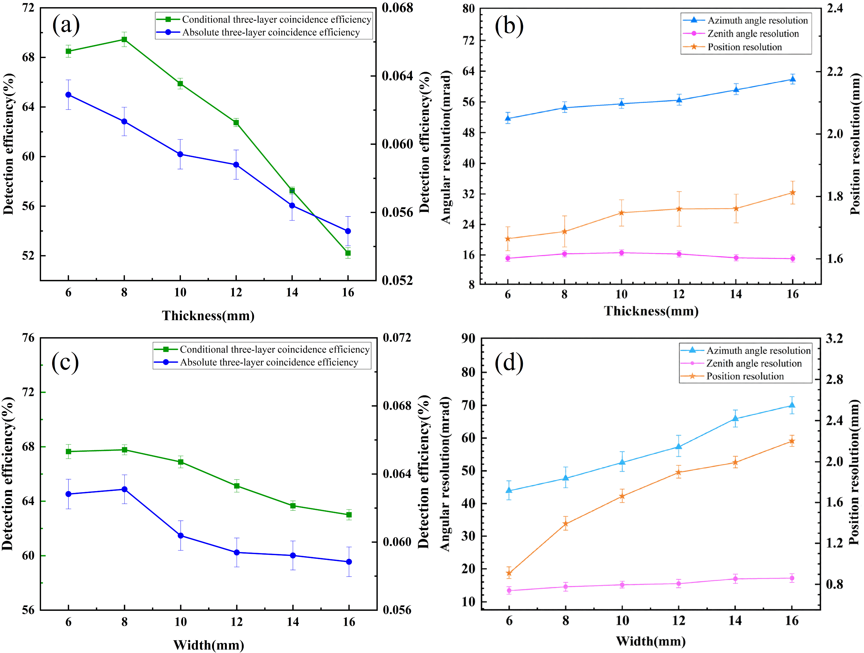
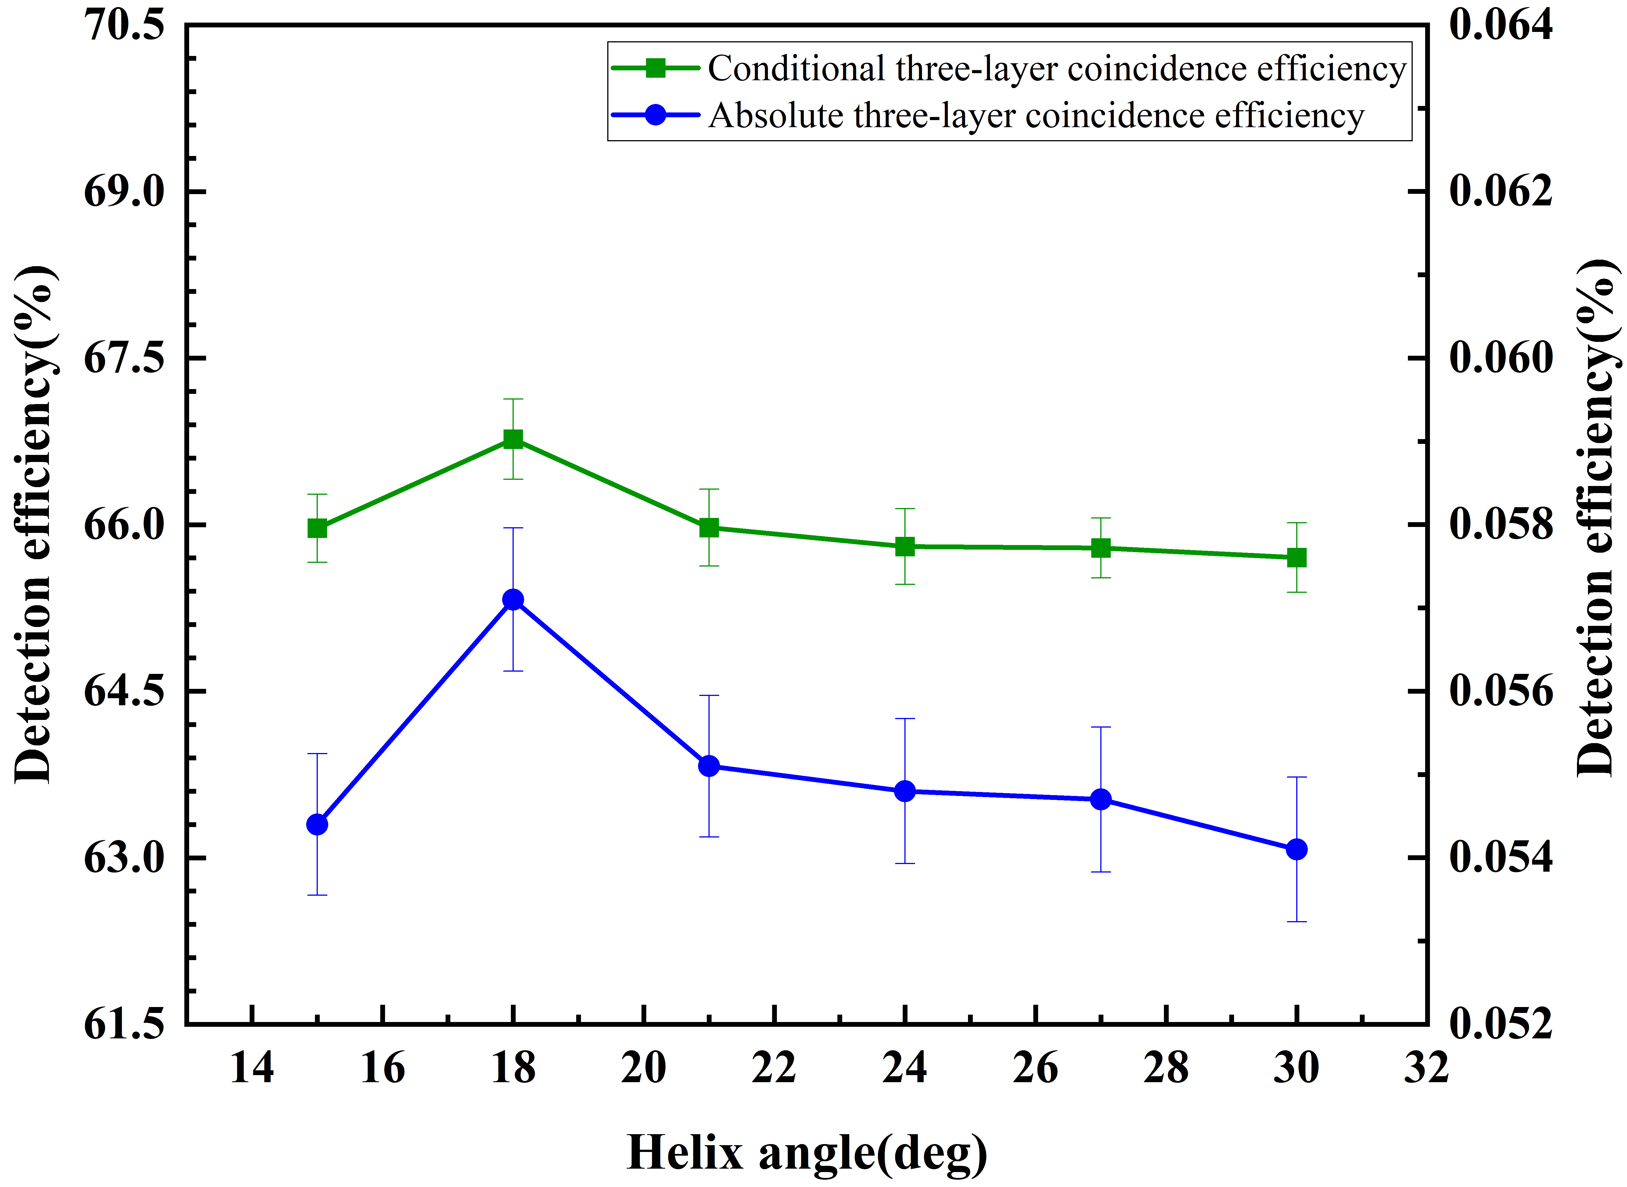
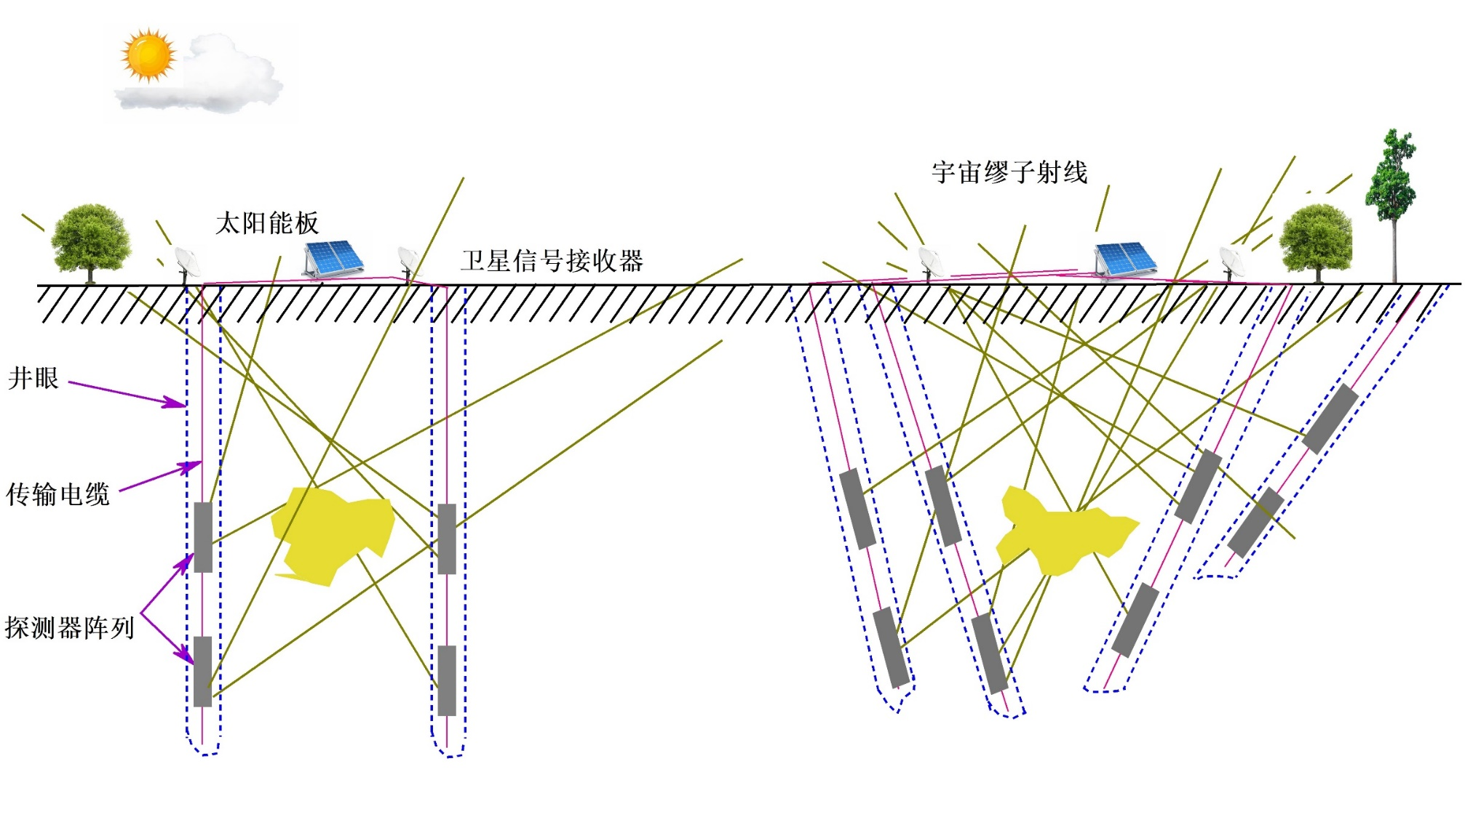
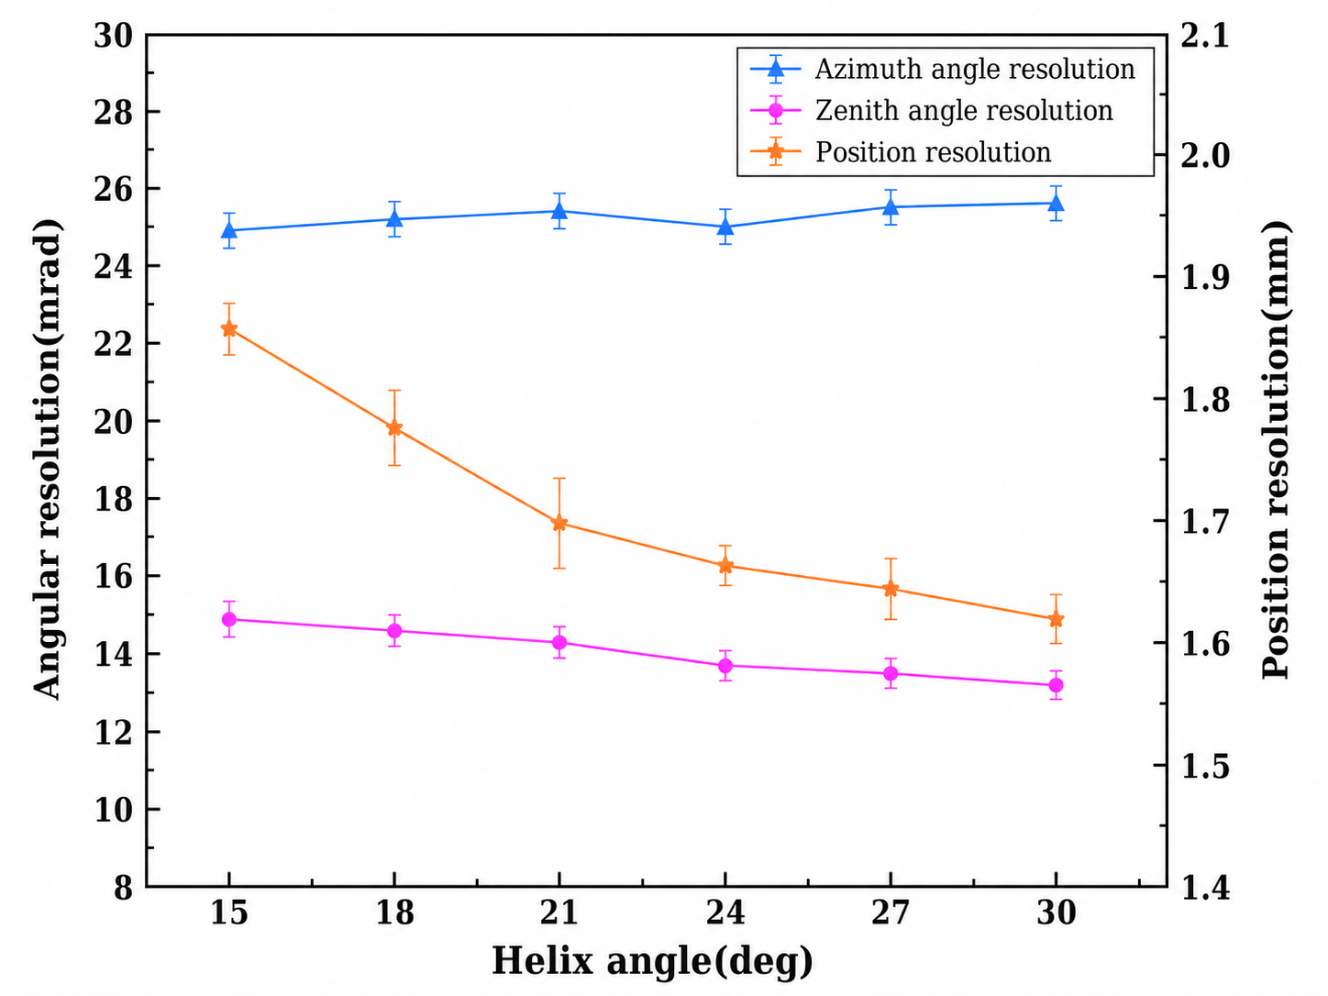
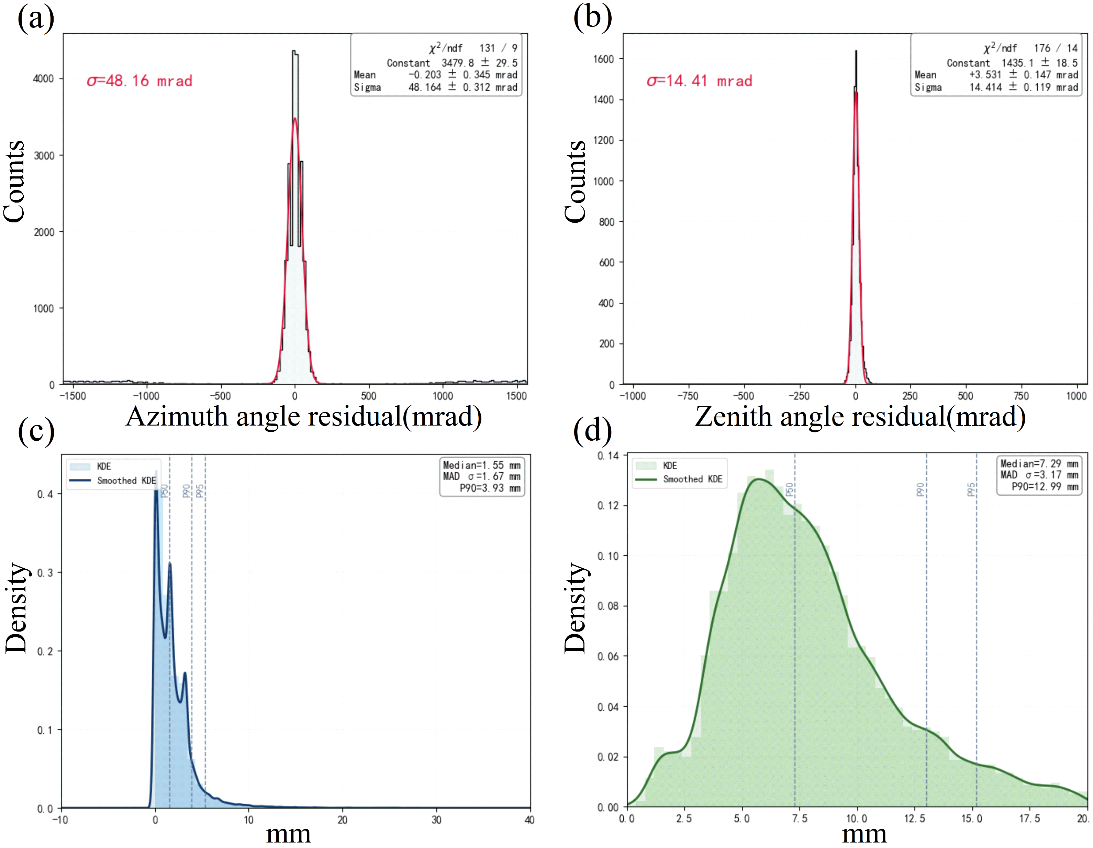
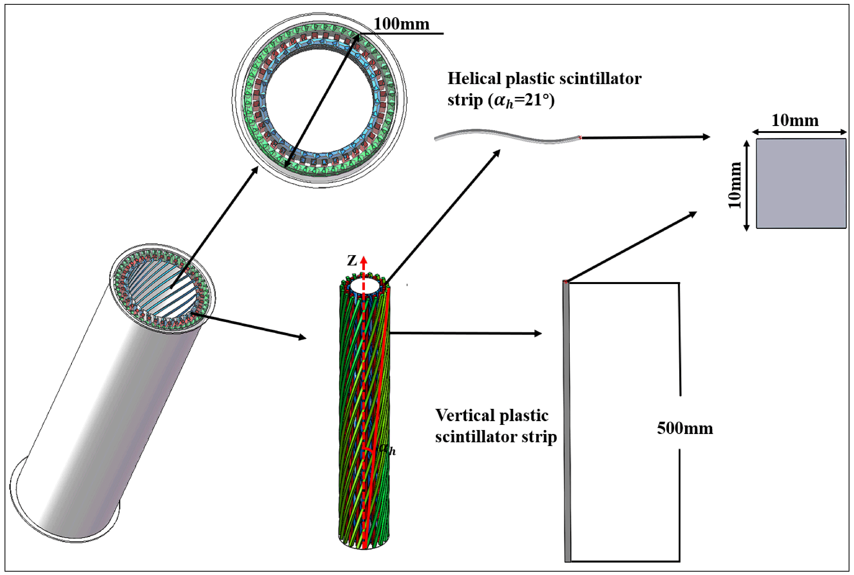
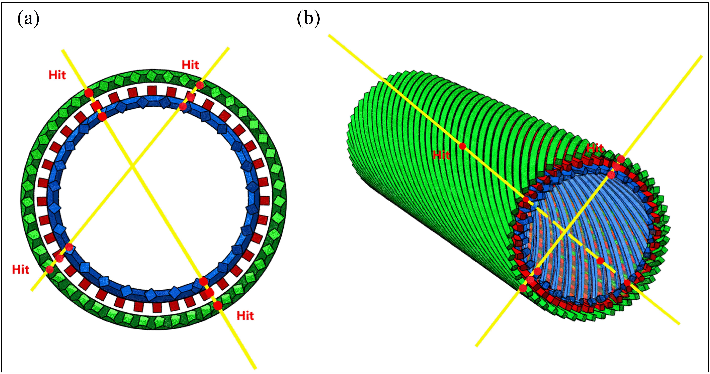
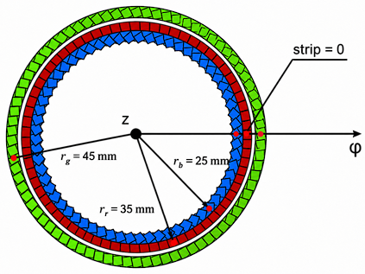
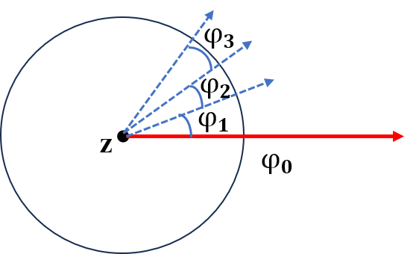
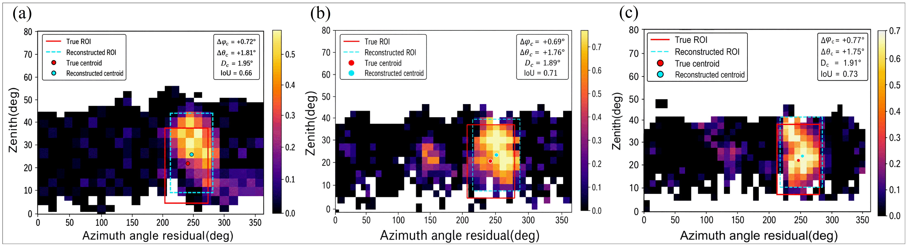
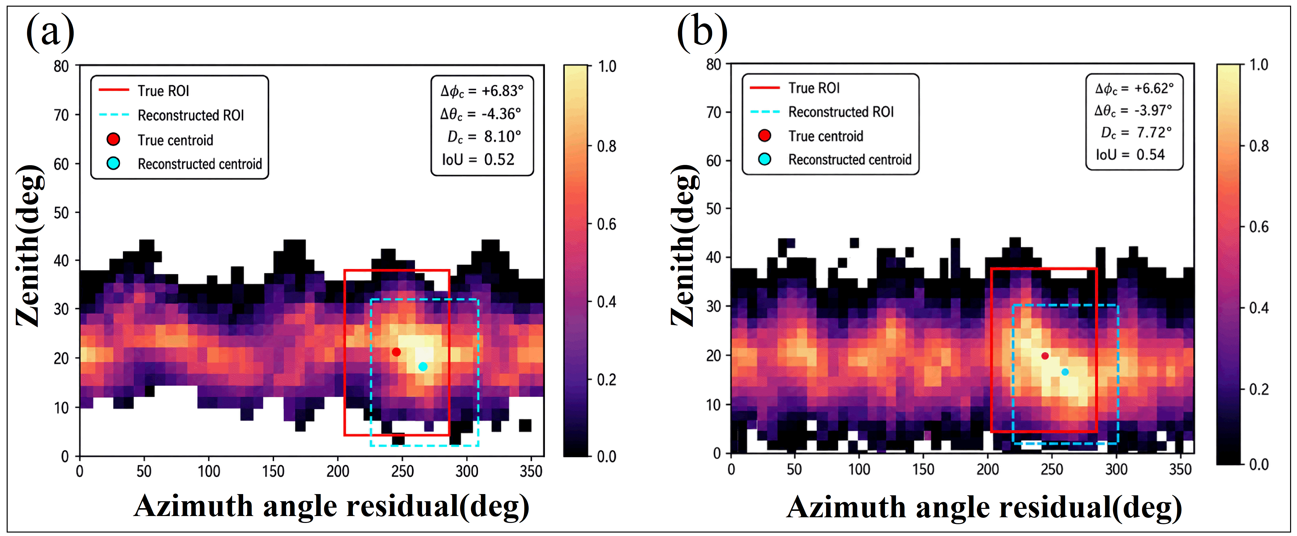
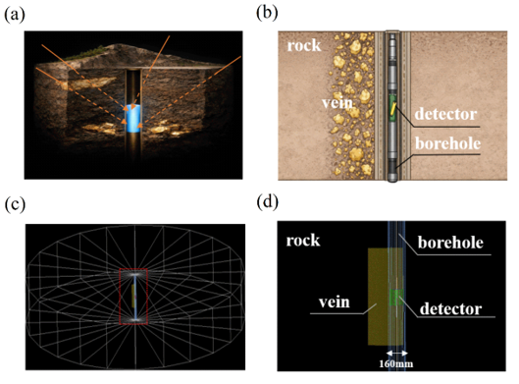
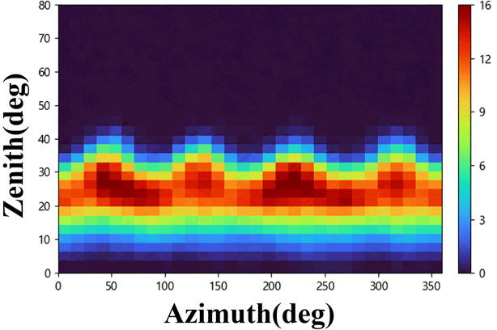
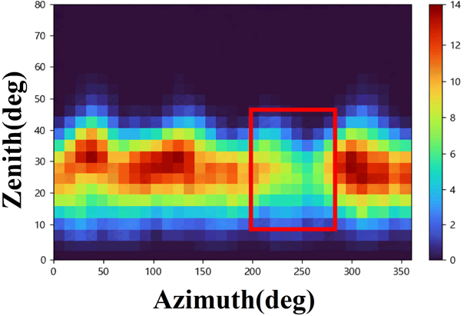
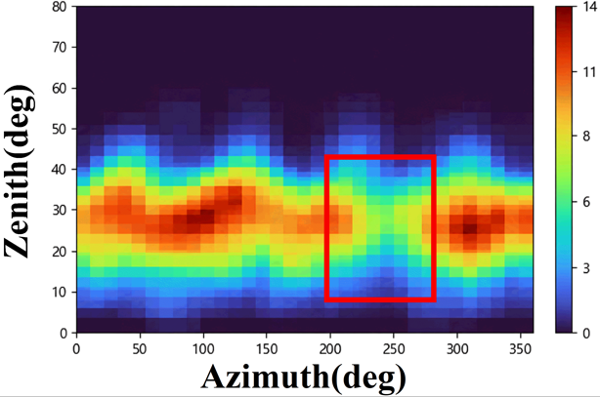
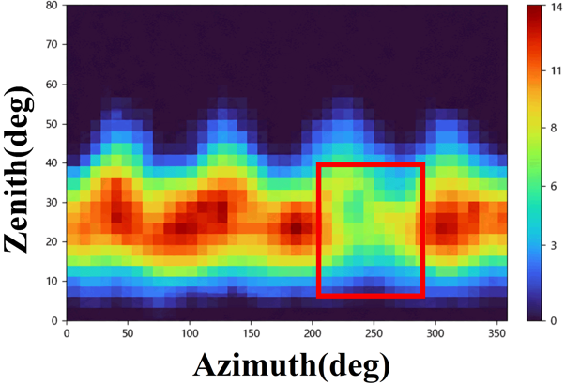
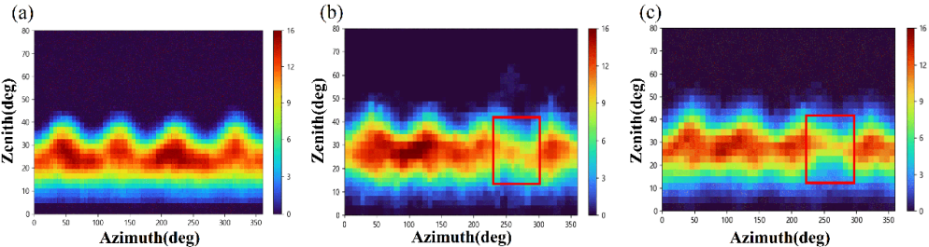
Development of a Novel Muon Detector and Imaging System for Deep Borehole Applications
LiZhi Wang. SiYuan Luo. NengBo Sui. ShuHao Zhao. XuanKai Huang. ChunTian Feng. XiaoDong Wang*
Introduction
At present, cosmic-ray muon imaging for mineral exploration mainly includes tunnel-based and borehole-based methods. In tunnel-based detection, large-area planar detectors are placed in existing galleries to image the overlying strata, which is suitable for nearly vertical ore bodies. In borehole-based detection, compact detectors are deployed at different depths to form a vertical array, allowing the surrounding strata to be scanned from multiple depths and providing more comprehensive subsurface information.
2. Simulation results
Detection efficiency and resolution of the detector for different plastic scintillator sizes and helical angles
1. Structure and imaging principle of the detector
The simulated detector exhibits an azimuthal resolution of 48.16mrad, a zenith resolution of 14.41mrad, and a position resolution of 3.17 mm
Opacity images of chalcopyrite, hematite, and uranium ore
Detector model design
Opacity image for an ore body with 5% and 10% density contrast relative to the surrounding
Muon flux map without mineral veins, chalcopyrite, hematite and uranium ore
Schematic diagram of the modeling and simulation model
Muon flux maps with and without ore bodies

