Slide 1
Weekly Report
Minghao Li 2026.03.24

Slide 2
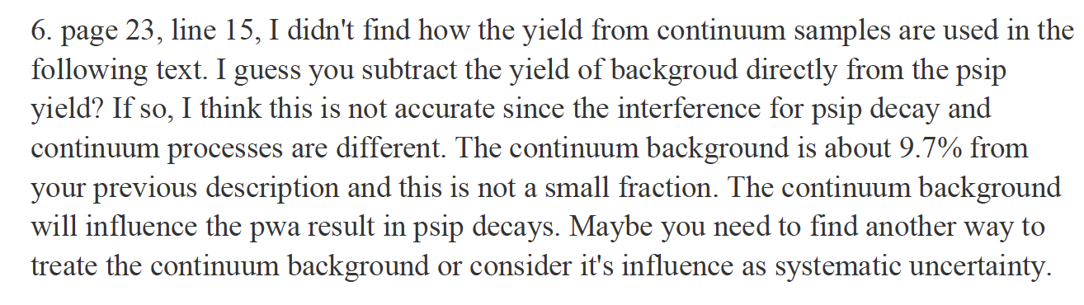
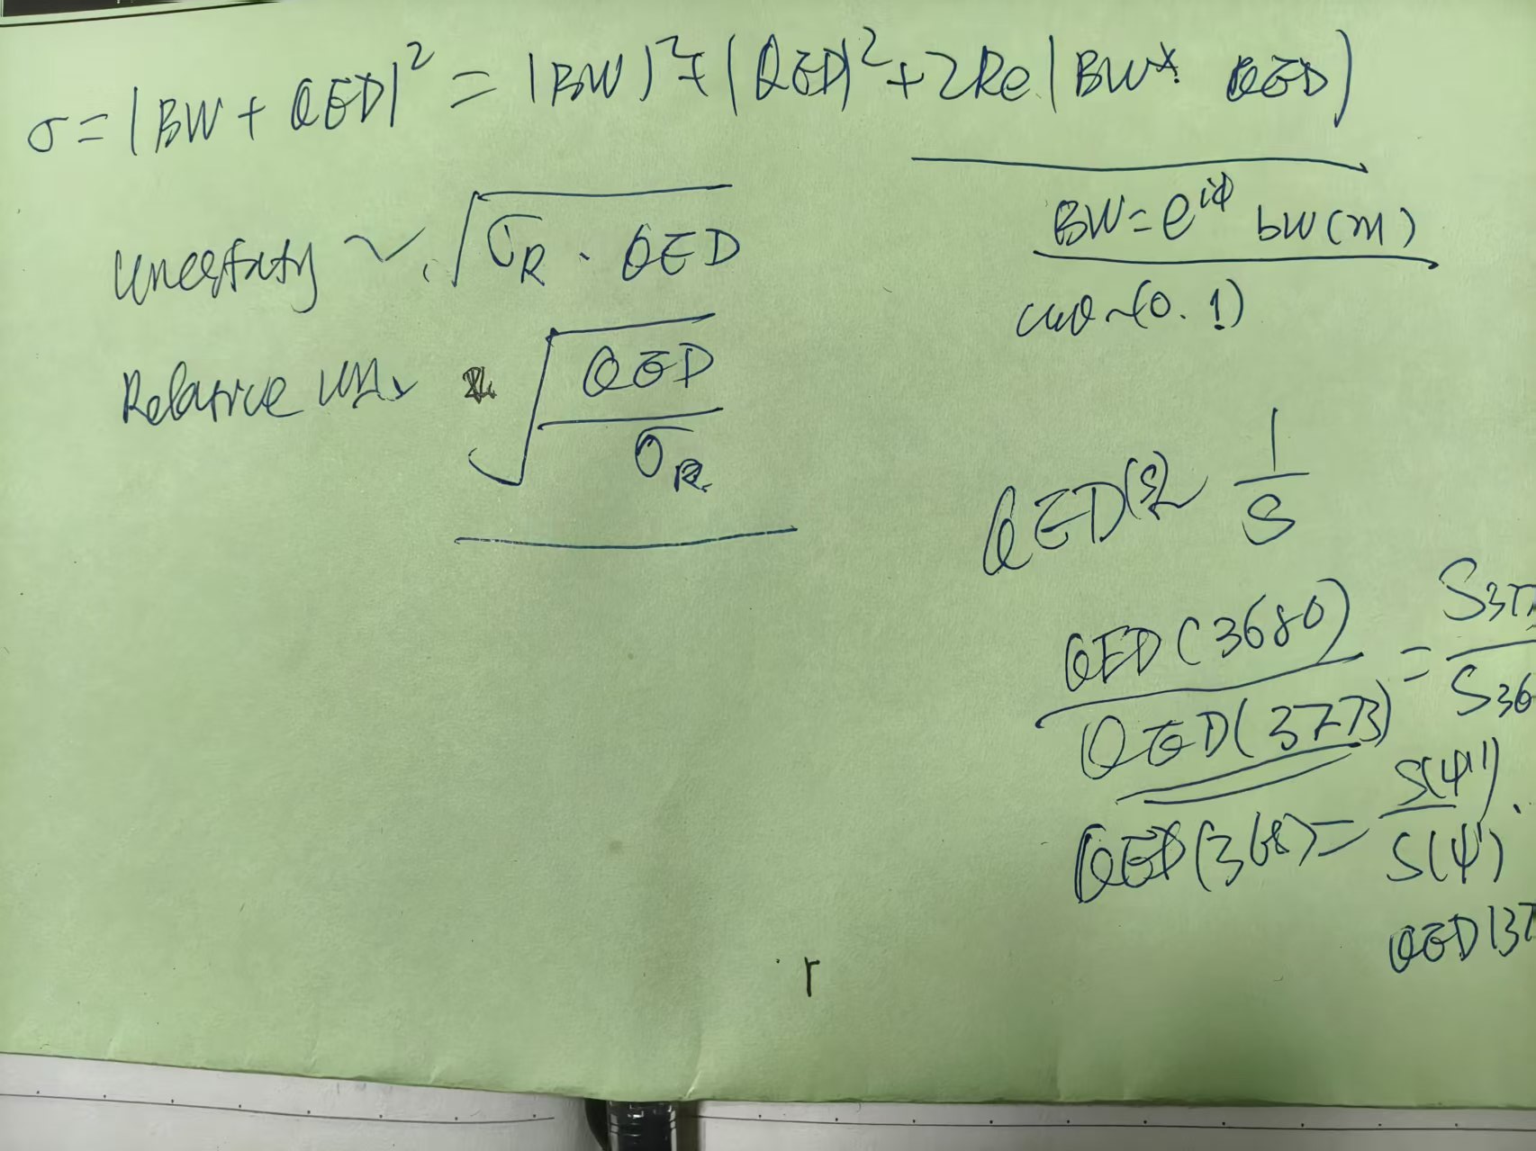
$$ψ\left(3686\right)→pK^{−}\overline{Λ}+c.c.$$
~60%

Slide 3
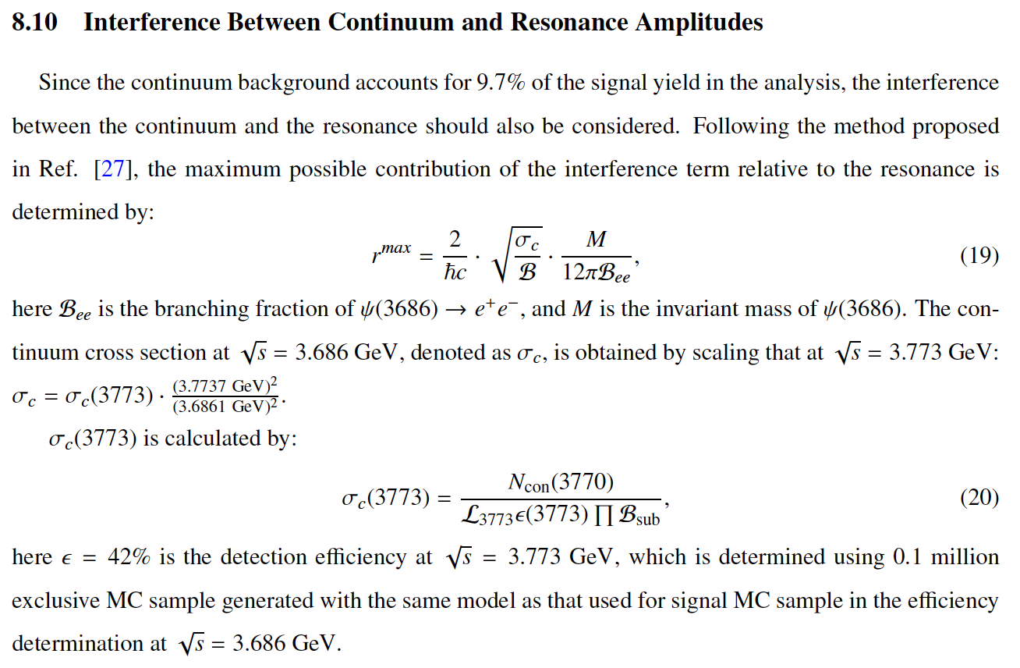
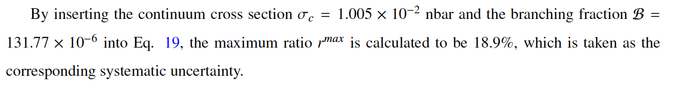
$$ψ\left(3686\right)→pK^{−}\overline{Λ}+c.c.$$
18.9%
Phys. Rev. D 105, 114001 (2022)

Slide 4
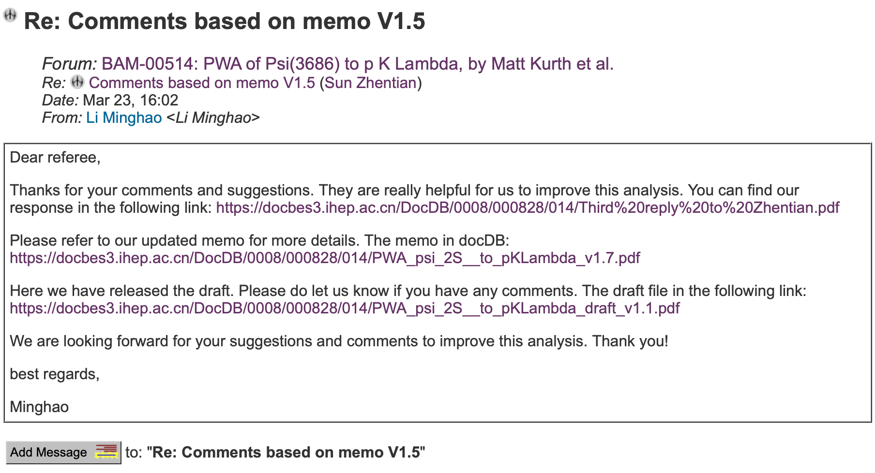
$$ψ\left(3686\right)→pK^{−}\overline{Λ}+c.c.$$

