Slide 1



The 7th Joint Workshop on the Standard Model and Beyond
2026.10.28-11.1
Nanjing Normal University
Nanjing, China
AI for High Energy Phenomenology
— What’s next?
Presented by Tianji Cai 蔡恬吉
School of Physical Science & Engineering
Tongji University, Shanghai, China

Slide 2
We’ve come a long way in the past decade.

Slide 3
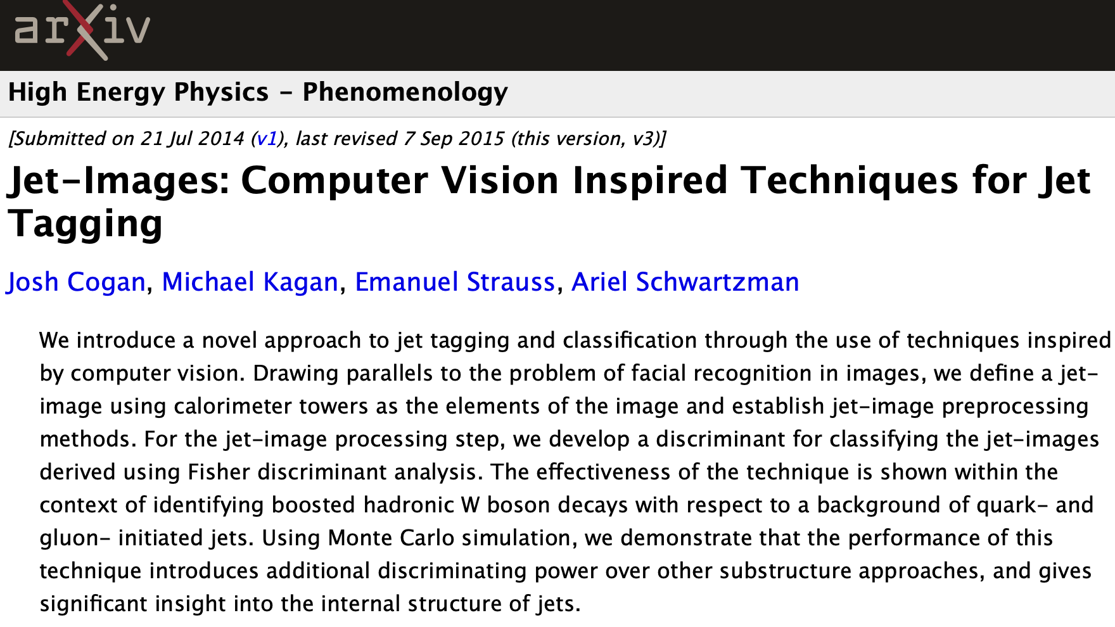
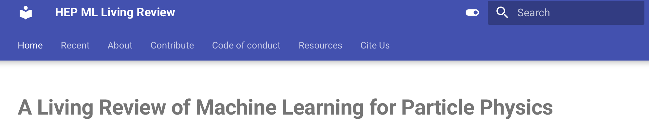
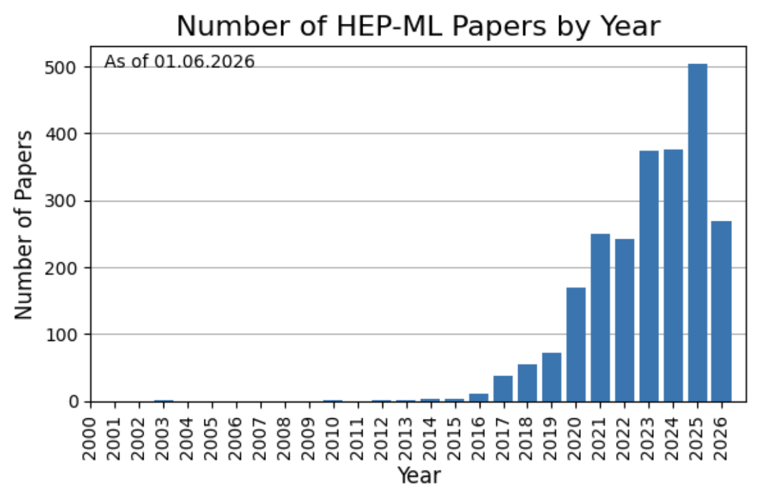
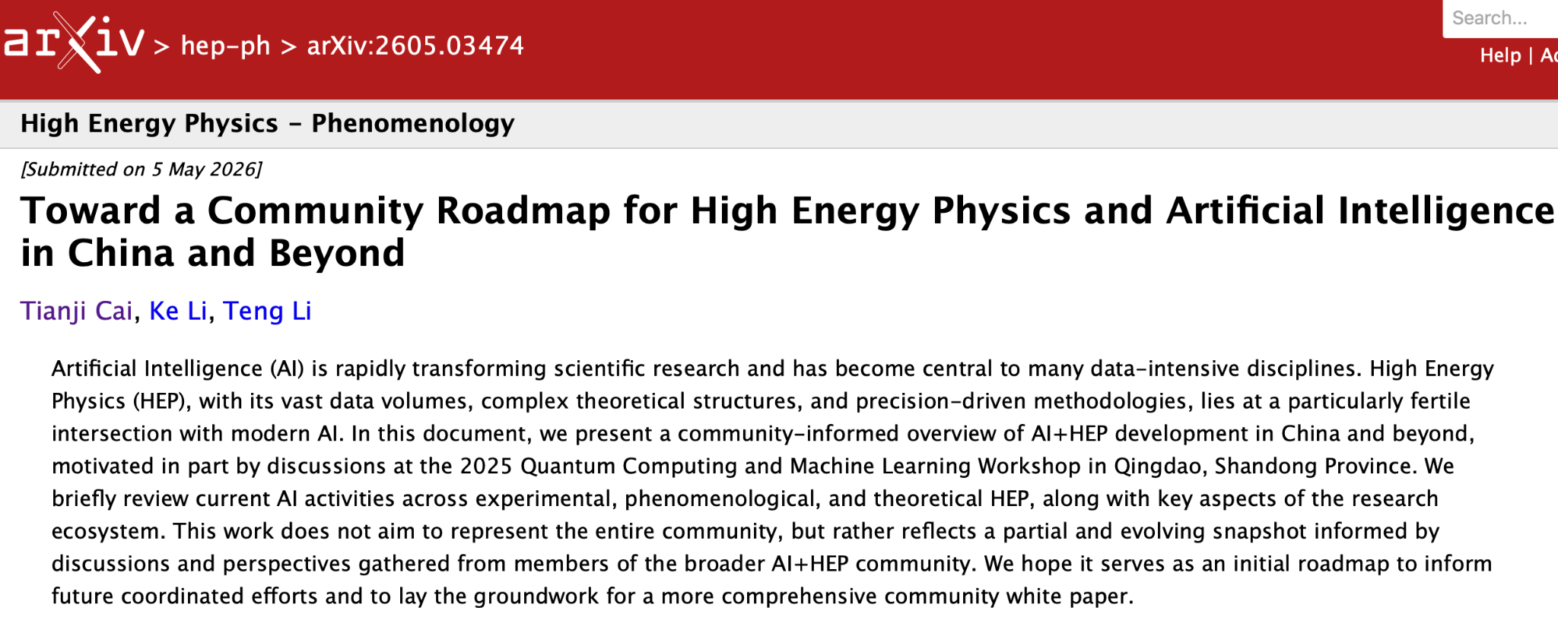
From the humble beginnings of images…
2014!!!
Subfields: hep-ex, hep-ph, hep-th, hep-lat, nucl-th, astro-ph.CO…
2026!!!
Special thanks to my co-authors Ke Li & Teng Li! 🥳
China

Slide 4
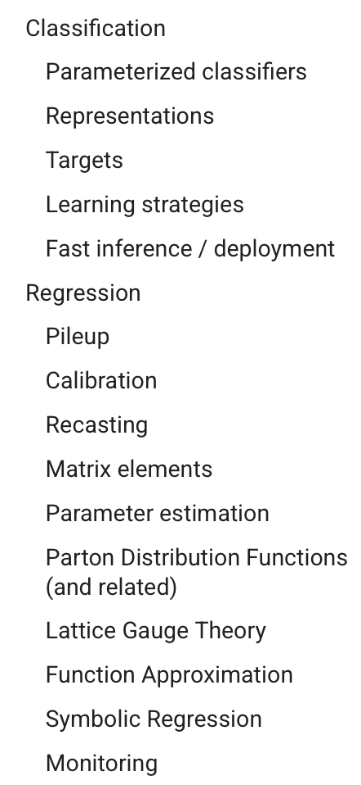
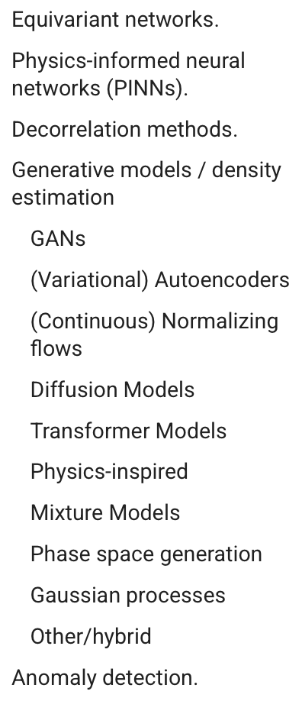
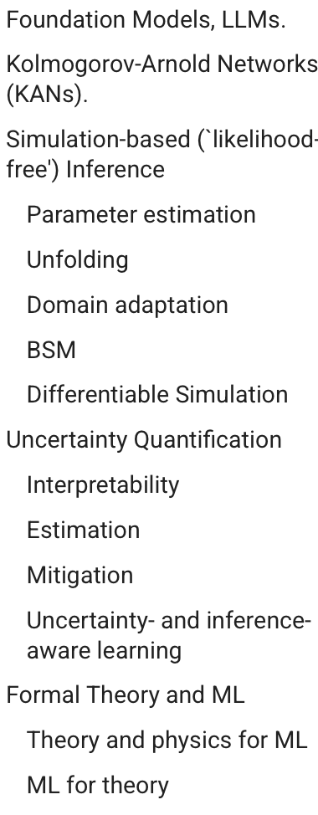
What have we explored in Phase I?
AI has proven itself to be a powerful technical tool for many individual tasks. 💪💪💪
Now it’s time to enter Phase II:
Defining unifying themes that can shape and sharpen our field.
From HEP ML Living Review.

Slide 5
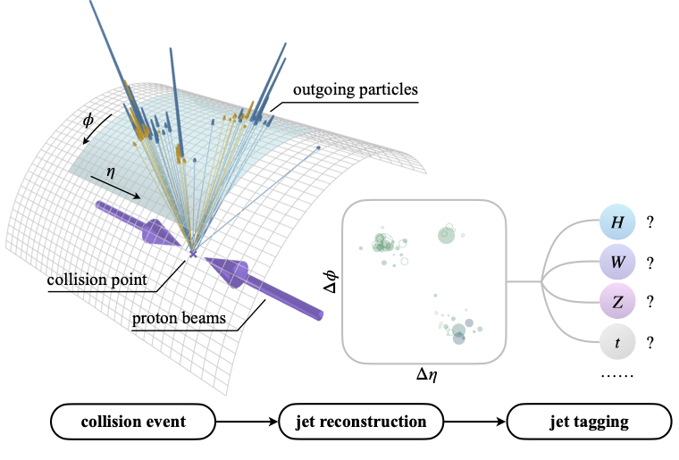
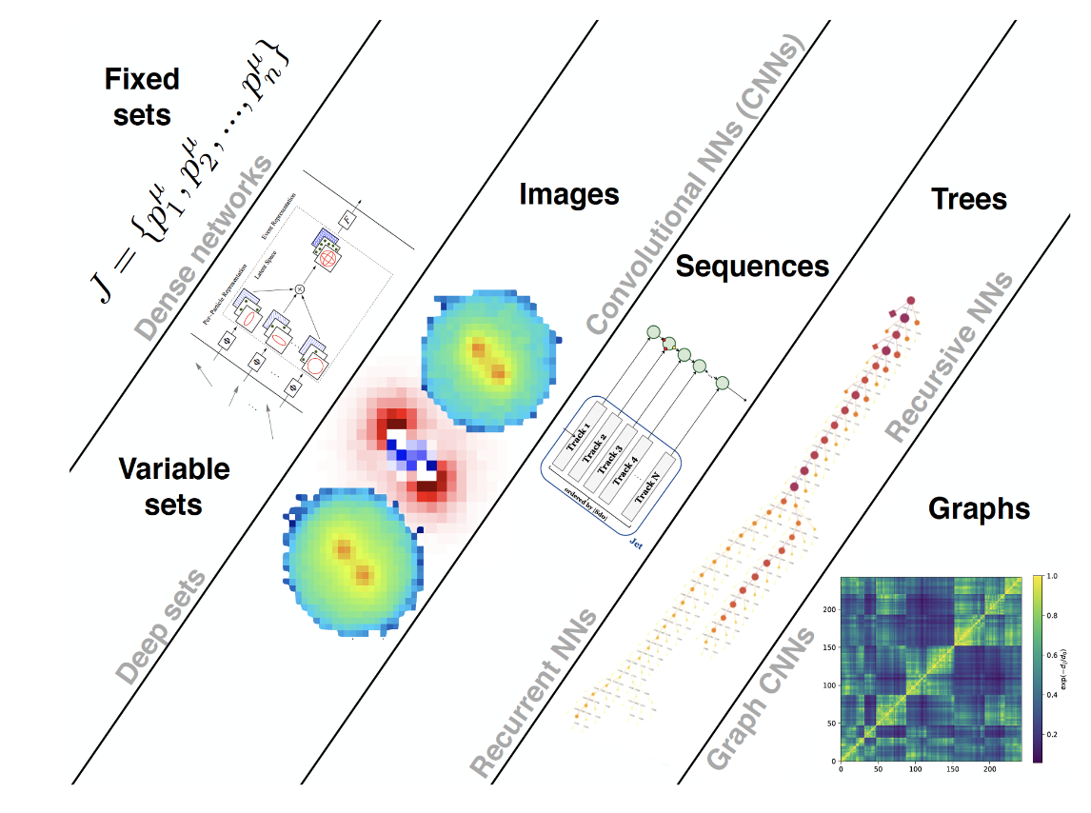
Collider jets remain the quintessential objects of study.
We also have developed a zoo of ML models to analyze jets & events.
Focus of this talk
Luckily, our community has many open datasets for (simulated) collider jets.

Slide 6
Now we are building larger and larger models…
(Mostly) from 2606.14870, 2510.24066.

Slide 7
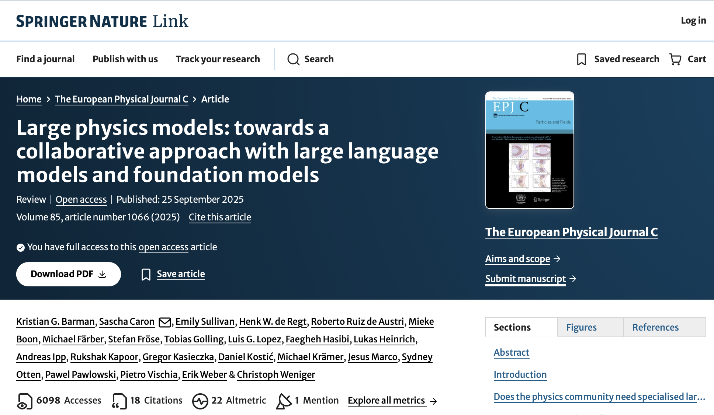
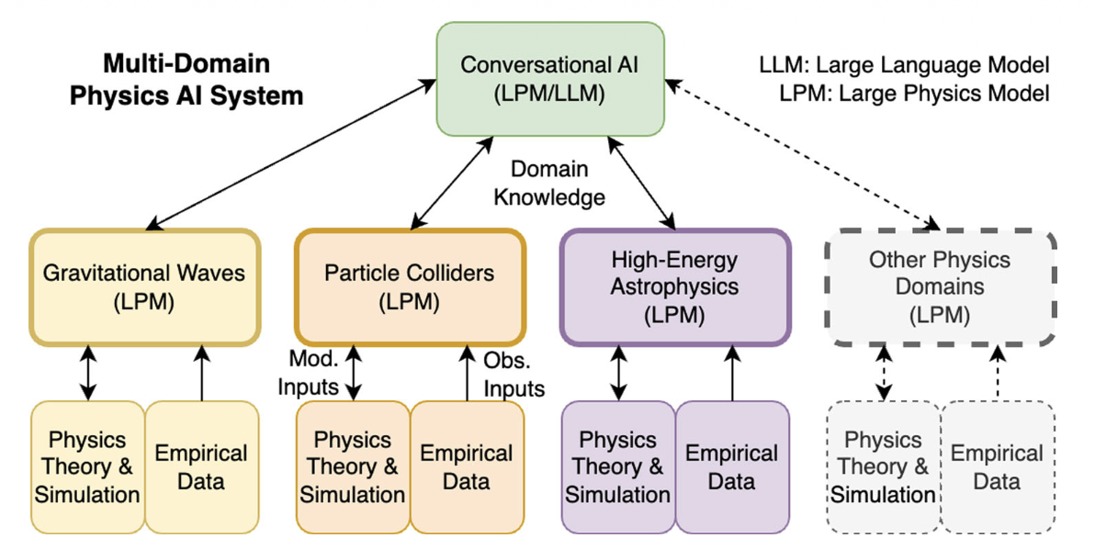
We physicists always dream big!
The dream of an automated system with collaborating LLMs and LPMs.
LPM, a foundation model built on domain-specific data.

Slide 8
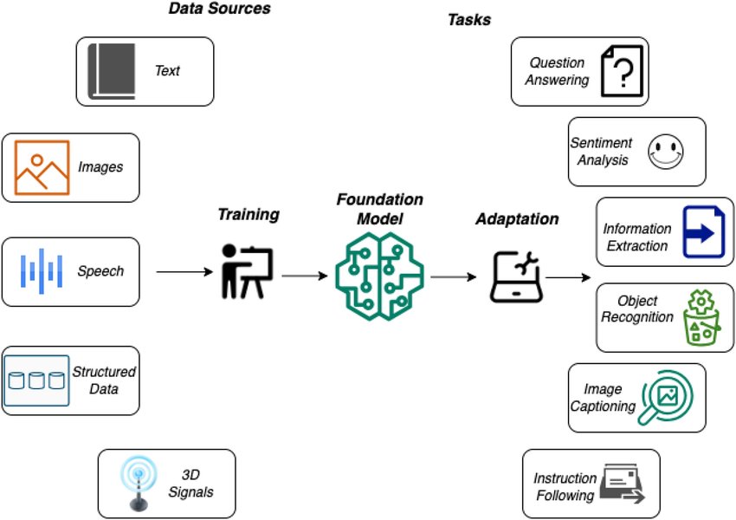
So what are foundation models (FMs)?
One model to rule them all.
FMs for Collider Jet Physics:
OmniJet-ɑ
OmniLearned
J-JEPA
HEP-JEPA
…
Pre-training paradigms include supervised learning, generative self-supervised learning, joint-embedding predictive learning…
Multi-dataset
& Multi-task

Slide 9
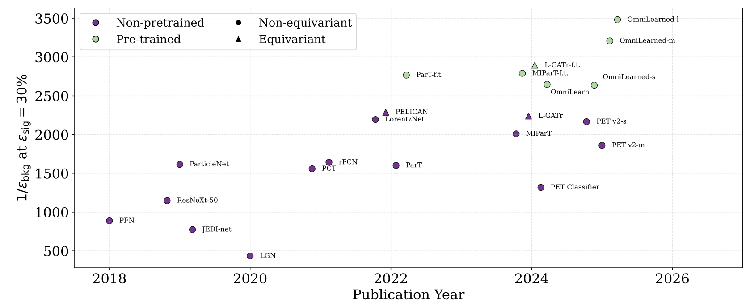
So what’s the magic?
Task: Top Tagging
Also show some advantages for predictive tasks in cosmology, neutrino physics, and molecular dynamics…
Magic comes at a cost…
E.g., OmniLearned models were trained using up to 512 A100 GPUs on NERSC. 😵

Slide 10
Now is the perfect time to understand what we have —
so that we build what we want.
Caution:
Preliminary results ahead! May contain errors. For the full story, please wait for 2612.XXXX. 😉
Ongoing work with Anna Hallin, ShivaSankar K.A., Michael Krämer.

Slide 11
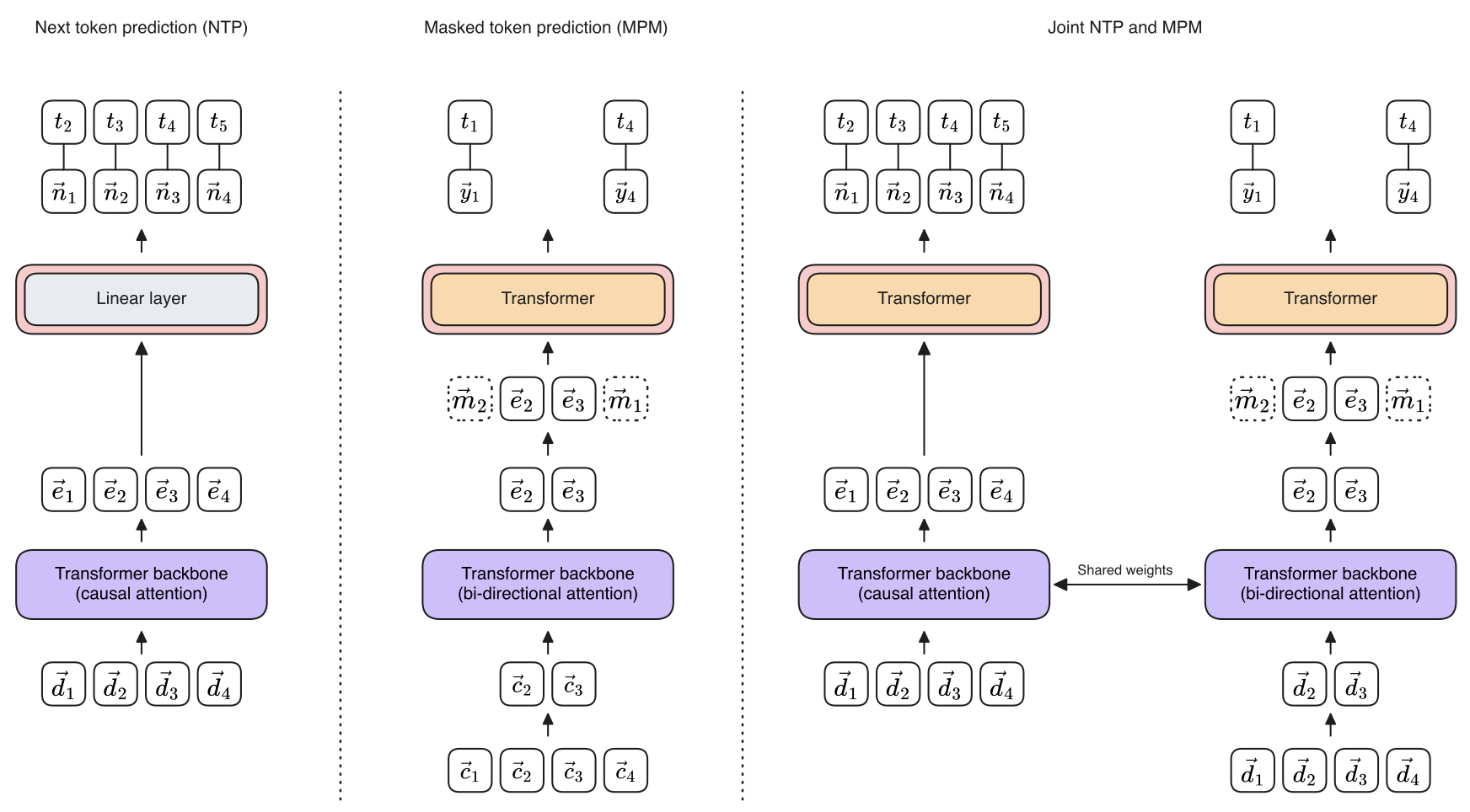
We analyze OmniJet models.
OmniJet with 3 different pre-training objectives.
1. NTP
2. MPM
3. Joint-NTP
4. Joint-MPM
For more info about OmniJet, please refer to 2512.04149 & 2403.05618.

Slide 12
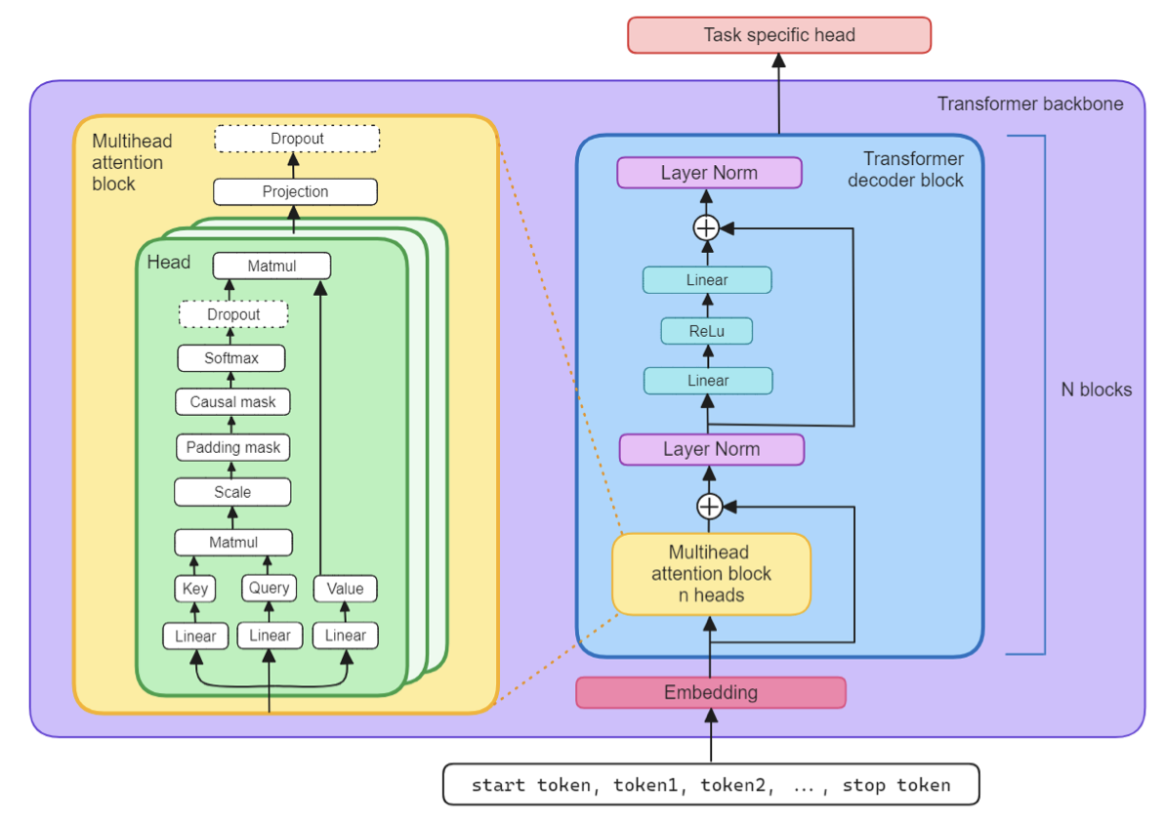
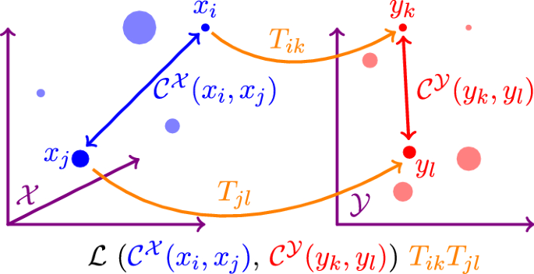
Model architecture, and how we dissect it.
H_{all}: Layer Norm
The Gromov-Wasserstein Distance (GW) to compare the intrinsic geometric structure of different rep. spaces.
H₁: Transformer Layer
Rep. Spaces
B_{all}
H₀: Transformer Layer
B₇
Layer Norm
8
Backbone Blocks
minimize over all (i, k)(j, l) combinations
500 vs 500 jets (uniform weight) at inference for rep. spaces X/Y.
Average particle rep. vectors to get jet rep. vector.
Use cosine distance between jet rep. vectors in the rep. space, i.e., C(x_{i}, x_{j}) = 1- x_{i} · x_{j} / ||x_{i}|| ||x_{j}||. L is the square loss.
To construct rep. spaces, we extract the activation after each backbone block (8; B₀-B₇) & its final norm layer (1; B_{all}), and each head layer (2; H₀-H₁) & its final norm layer (1; H_{all}).

Slide 13

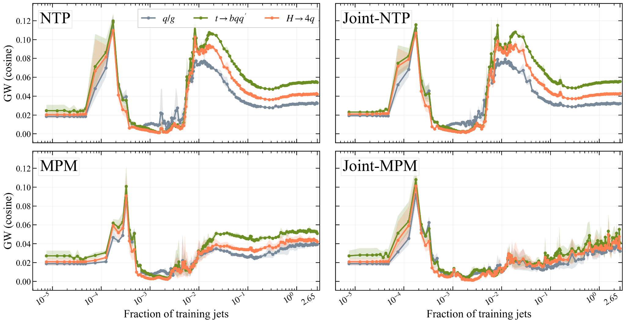
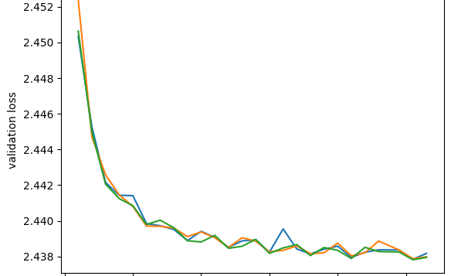
How does the model change during training?
Iconic regimes!
Regimes not visible at all in val. loss curves!

Slide 14
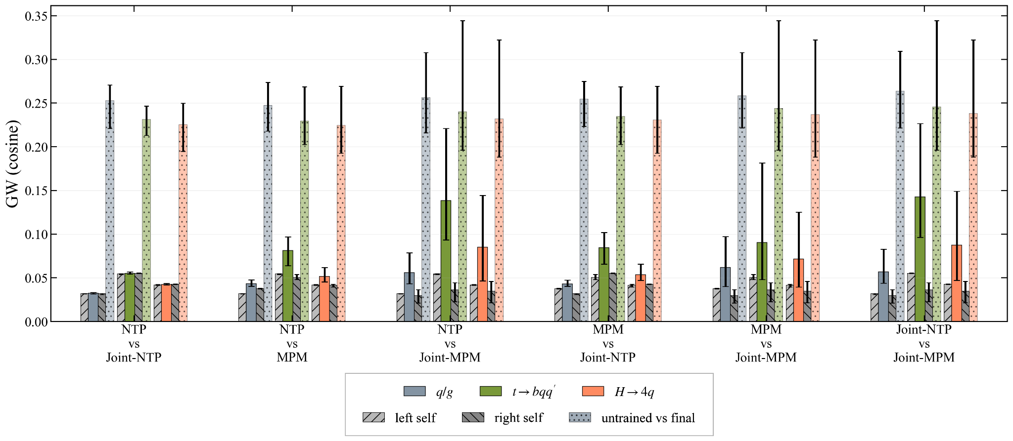

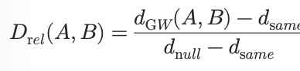
Do different models converge after being well-trained?
Error bars: min & max of 3⨉3=9 seed combinations (6⨉6=36 for “untrained vs final”).
0.000
0.084
0.277
0.090
0.175
0.278

Slide 15
AI as Our New Microscope 🔬
In my view, this is a new form of experimental physics—one in which data and AI models become the experimental system.

Slide 16
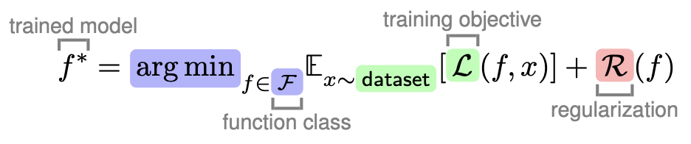
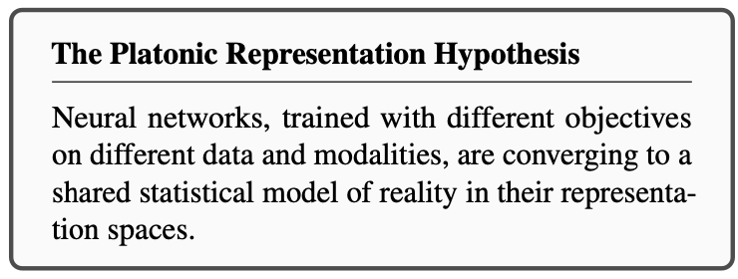
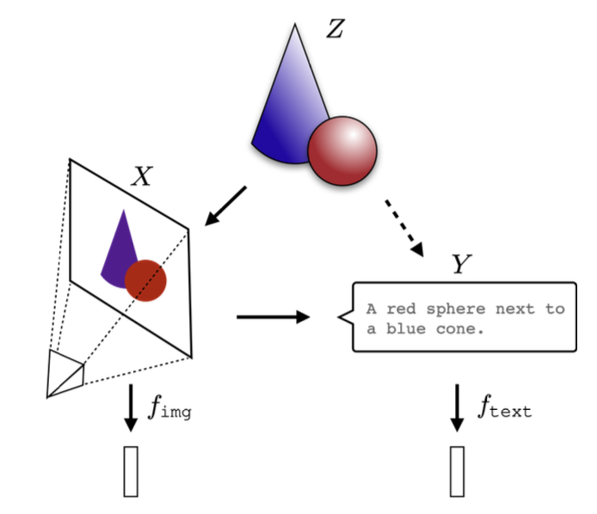
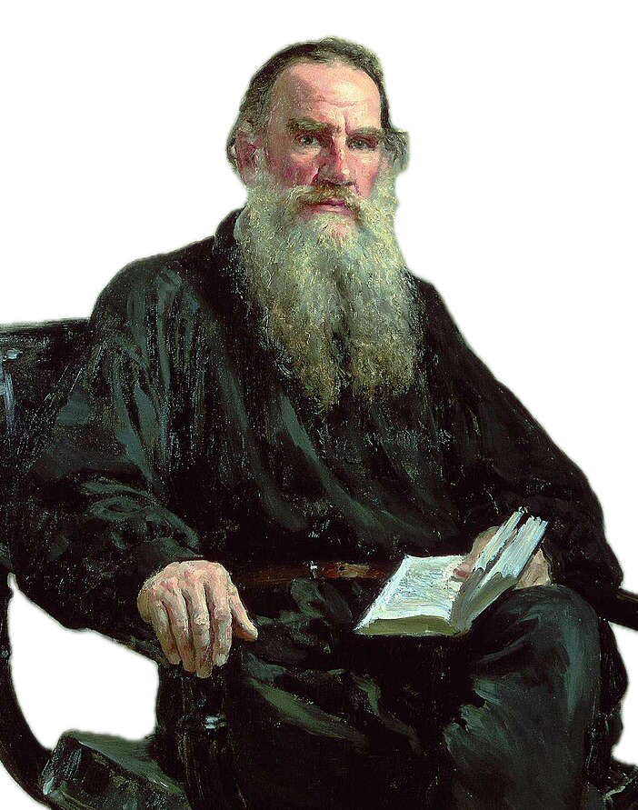
Future is in the model representation space?
Inspiration from our CS colleagues: 2405.07987
Bigger models more likely to find the min
Simplicity bias stronger for bigger models
Anna Karenina Principle:
All good models are alike; each failed model fails in its own way.

Slide 17

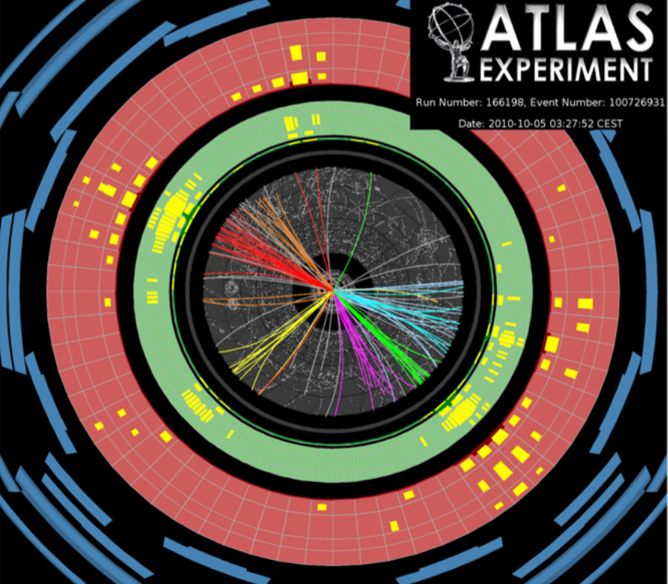
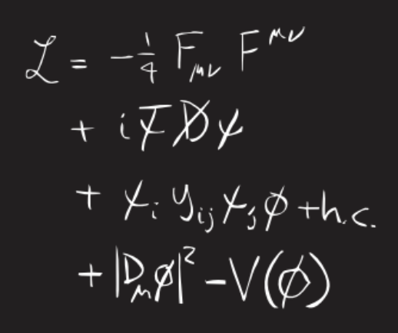
My Vision of Scientific(𝚿) AI for particle physics
Good Models for Collider Data Analysis
Now performance is a prerequisite, not the focus.
Models themselves become our discovery tool.
Or perhaps something
completely alien?

Slide 18

Thanks for your attention!
Contact Emails: tianji_cai@tongji.edu.cn / tianjiresearch@gmail.com.
Q&A?

Slide 19
Backup Slides

Slide 20
Abstract
Artificial intelligence has rapidly become an integral part of high-energy physics, evolving from specialized machine-learning tools for individual analysis tasks toward increasingly general and large-scale models for scientific data. As this field enters a new stage, an important question is not only how to build more powerful models, but also what we can learn from the models themselves. In this talk, I will review recent developments in AI for high-energy phenomenology, with a particular focus on collider physics and the emerging paradigm of foundation models. I will then discuss ongoing efforts to probe the internal representations learned by these models, using geometric approaches to study how their representations evolve during training and across architectures. More broadly, I will argue for a perspective on Scientific AI in which AI is not merely a computational tool for solving predefined physics tasks, but can increasingly serve as a new instrument for uncovering physical structures from the data itself.

Slide 21
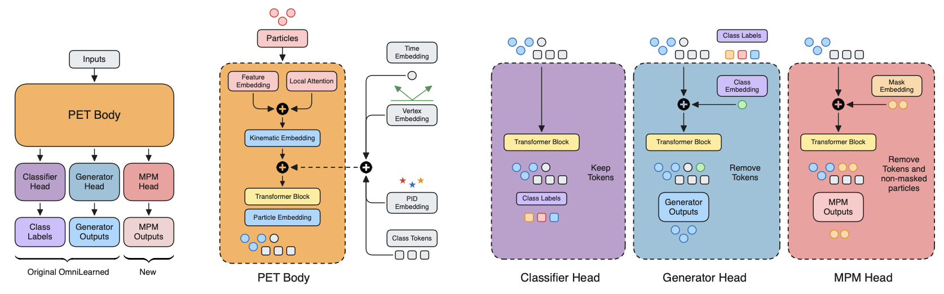
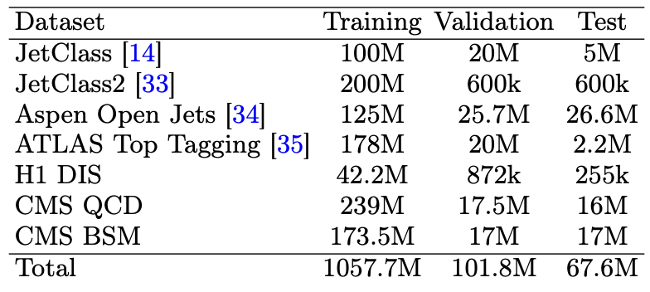
Since we’re all most familiar with supervised learning, let’s use OmniLearned as an example here.
Flow-matching
A total of ~1 billion jets used in making OmniLearned!!! 🙀

Slide 22
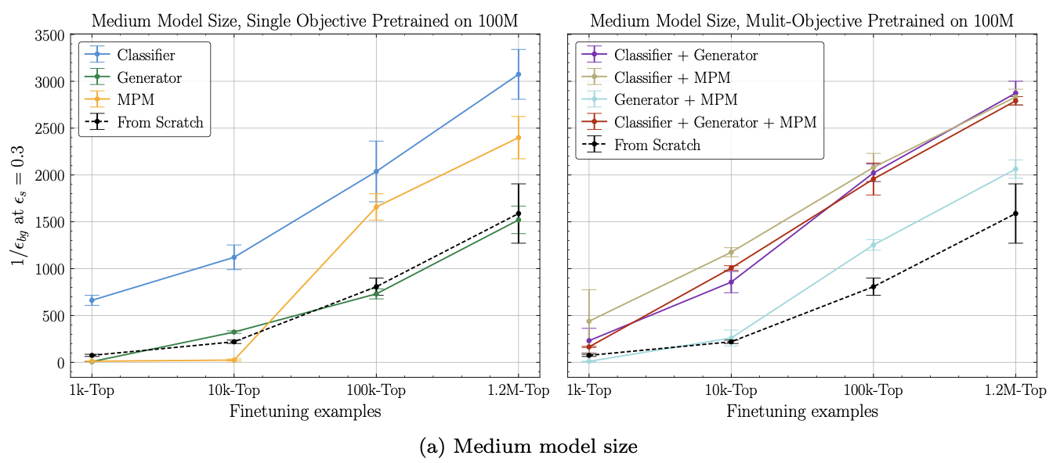
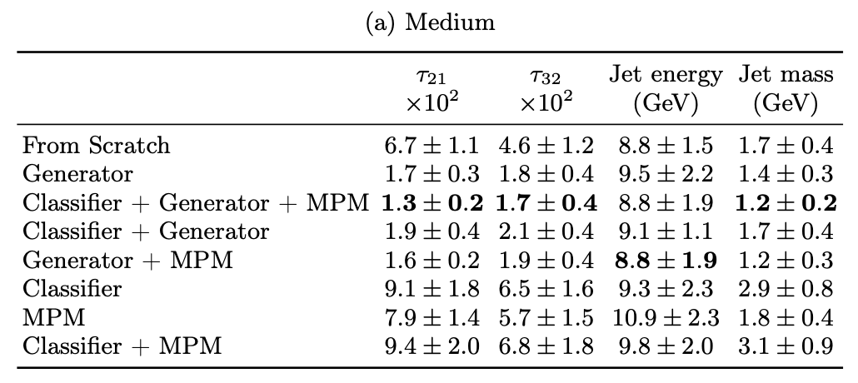
Of course, reality is much messier…
👈 Pure classifier pre-training is optimal when data & model are both big.
Generator has to be in the pre-training objective for downstream jet generation.👇
This is a bit awkward. 😿
FMs are very expensive. If they don’t show clear advantages, why do we need FMs in the first place? 🤔

Slide 23
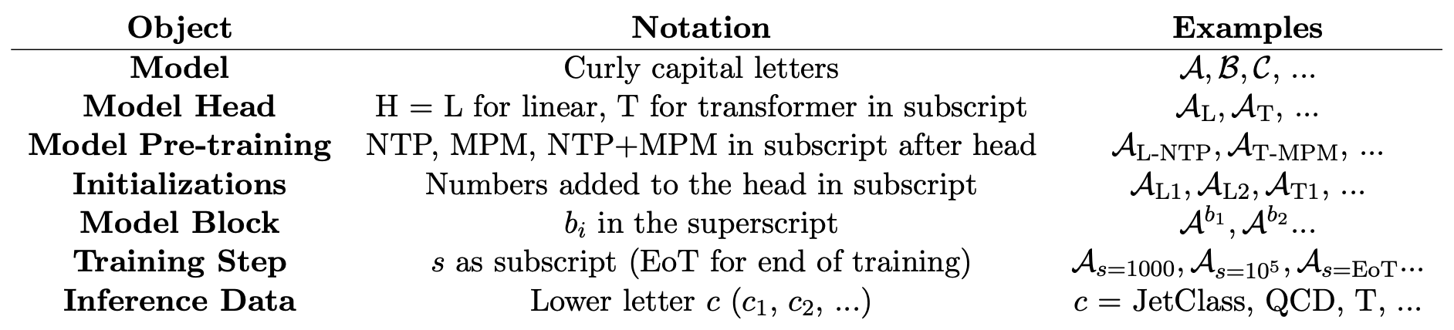
Notation & Details

Slide 24
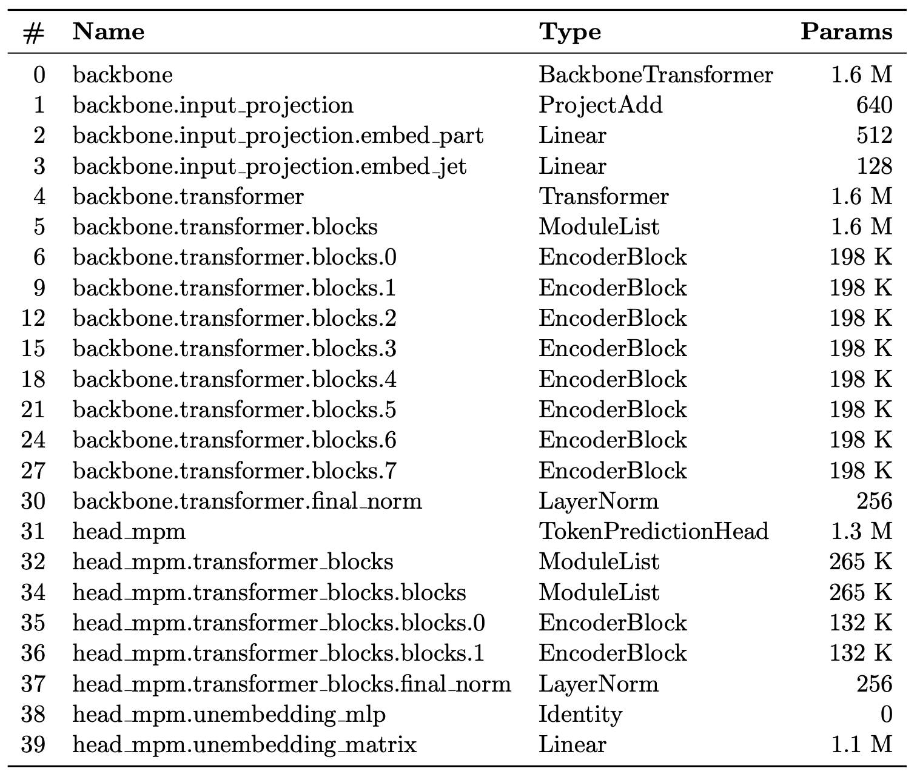

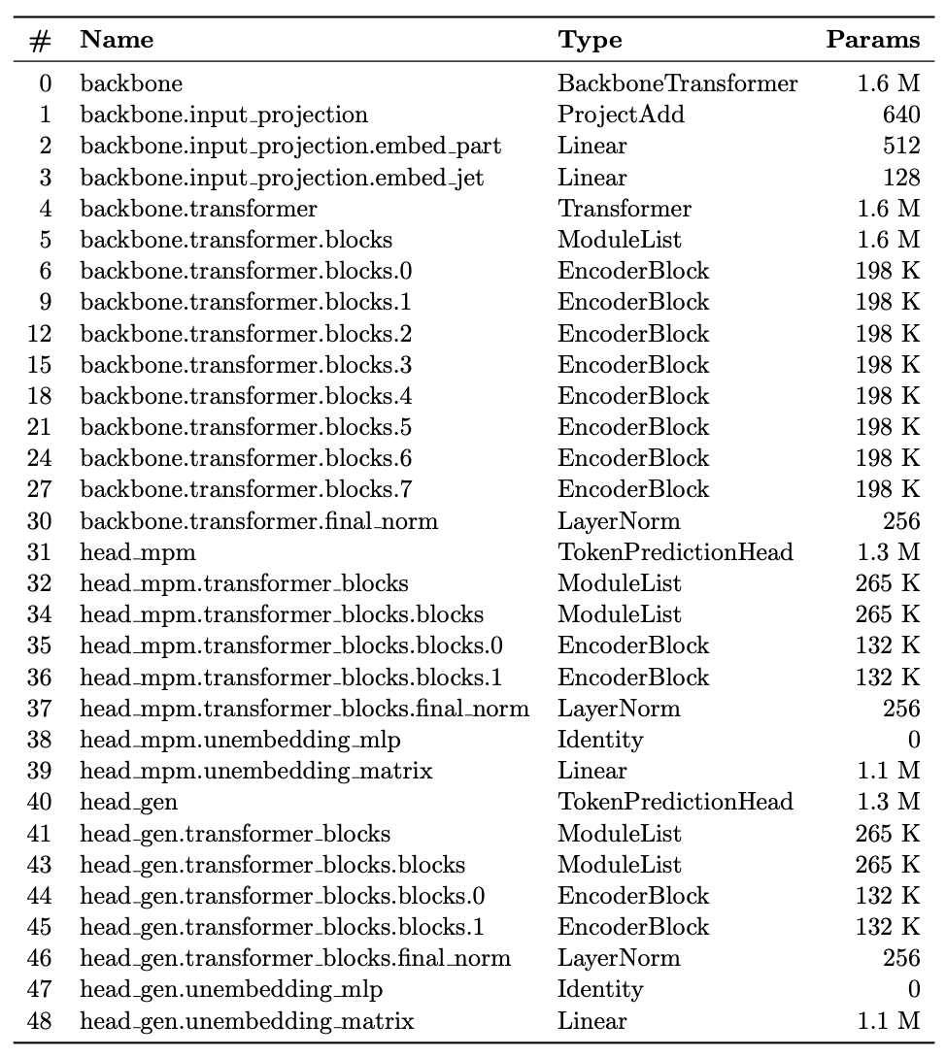
Model Architecture
MPM
NTP
Joint
shared
separate
separate

