Slide 1
Detector common cooling plan
Xiaohui Qian
On behalf of Mechanical group
202604

Slide 2
Content
Research on CO2 cooling
Microchannel cold plate design
HCAL/ECAL preliminary cooling design
Central beam pipe cooling test
Vertex cooling test

Slide 3
Research on CO2 cooling
Motivation:
TDR:
DRD8:
Innovative study of IHEP:
CEPC-TDR recommendation：
Executive Summary：Decisions on the cooling approach—particularly the choice between water and supercritical CO₂—should be guided by thermomechanical mock-ups that assess performance and long-term reliability.
ITK: A dedicated thermomechanical mock-up of the stave and endcap structures should be developed and tested to experimentally verify the cooling system’s performance and mechanical stability under realistic operating conditions. This is essential both for validating thermal simulations and for quantitatively comparing water and CO₂ cooling strategies.
OTK:
…to assess the potential benefits of the CO₂ option in terms of thermal uniformity and material budget.
and provide a solid benchmark for comparing water and CO₂ cooling strategies.
TPC: Evaluate CO₂ cooling as a potential alternative to water, taking advantage of its dielectric properties and ability to maintain constant-temperature heat removal without electrical risk.
Mechanical Integration: Pursue further studies on refrigerant choice across the various sub-detectors. The use of supercritical CO₂ (sCO₂) should be carefully evaluated as an alternative to water, given its dielectric nature, higher heat-transfer coefficient, and reduced piping requirements, which could offer clear technical and operational advantages.
Response to the Charge:
Feasibility/readiness of critical technologies toward ~2028: thermo-mechanical mock-ups to decide water versus sCO₂ cooling;
Primary technical risks and mitigation: PVTX fallback; thermal mock-ups and airflow/sCO₂ trade-offs;

Slide 4
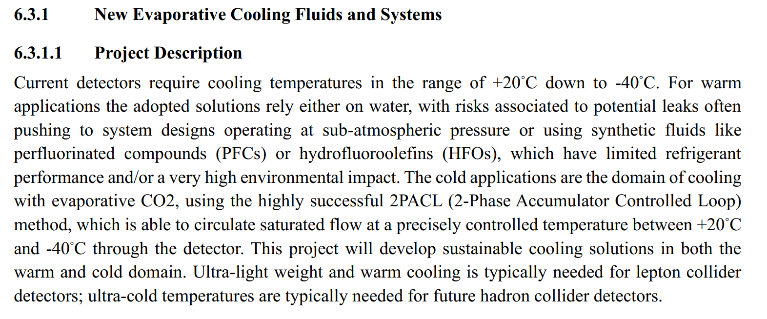
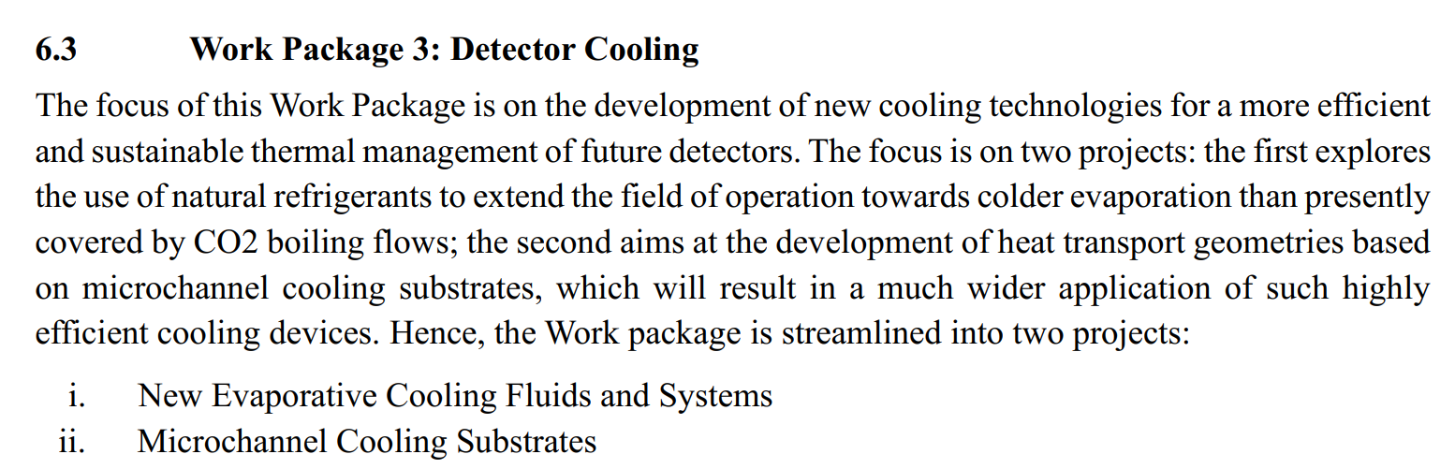
Research on CO2 cooling
Motivation:
TDR:
DRD8:
Innovative study of IHEP:

Slide 5

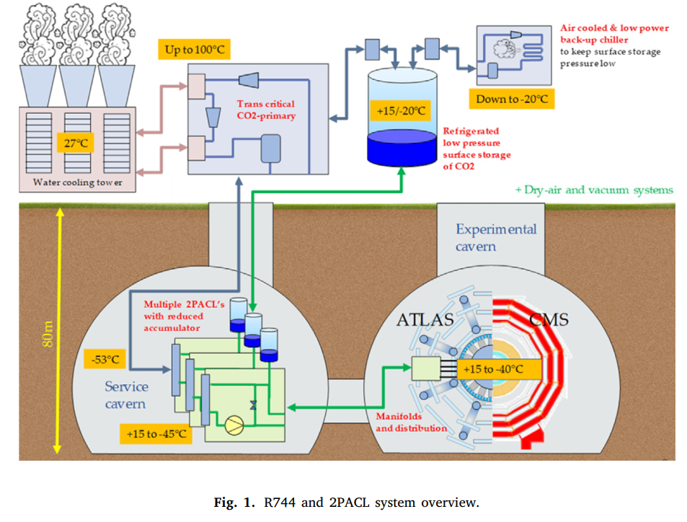
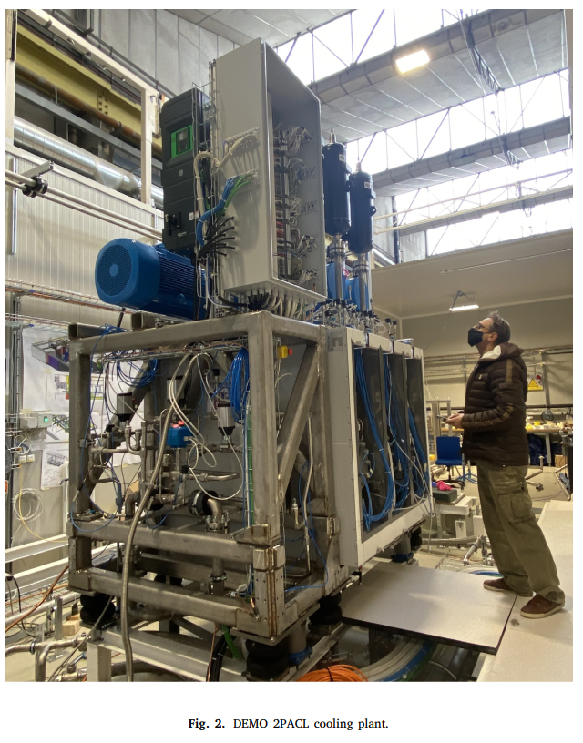
Upgraded cooling system for ATLAS and CMS
CO2 has two loops:
Trans critical CO2 refrigeration
Serves as cold medium .
300 kW
550 kW
Max. plants Power: 100 kW
CO2 cooling challenges at CERN for the future phase 2 upgrade program, 2019
Progress in new environmental friendly low temperature detector cooling systems development for the ATLAS and CMS experiments ，2023

Slide 6
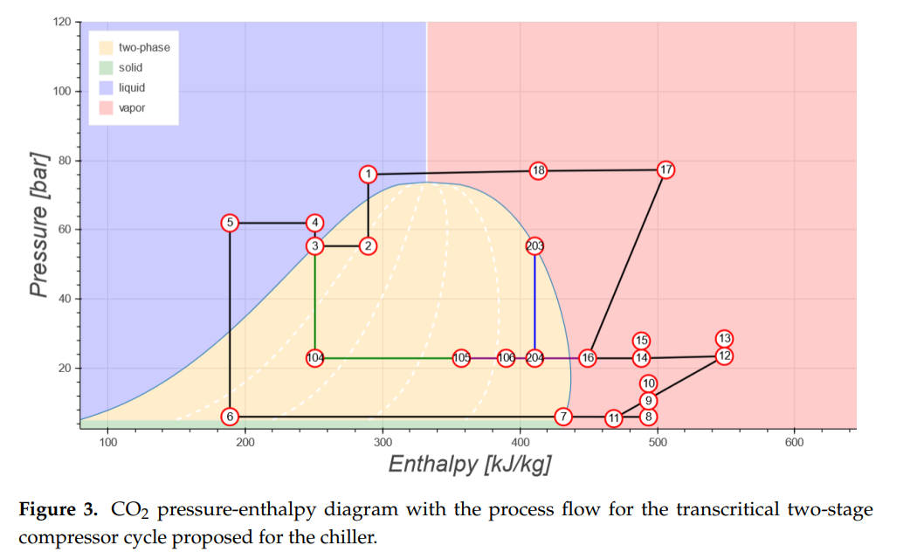
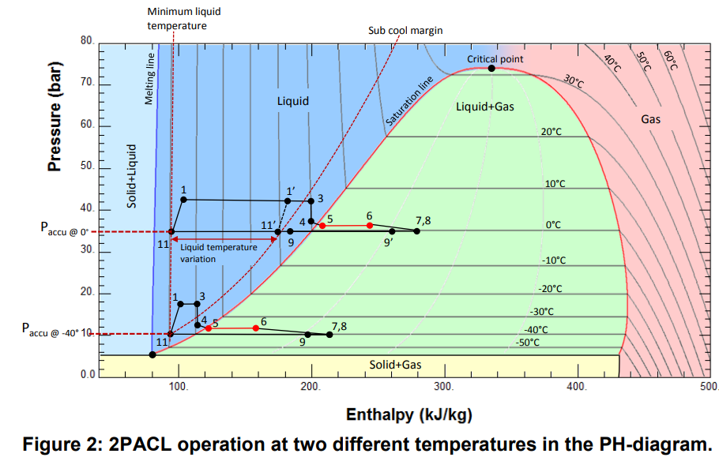
Updated cooling system for ATLAS and CMS
Condensation
Back up
Compression
Expansion
Evaporation
Cycles of CO2 as Cold Medium (refrigerant) at two temperatures
(two R744 slices)
CO2 refrigeration cycle (2PACL cooling plant)

Slide 7
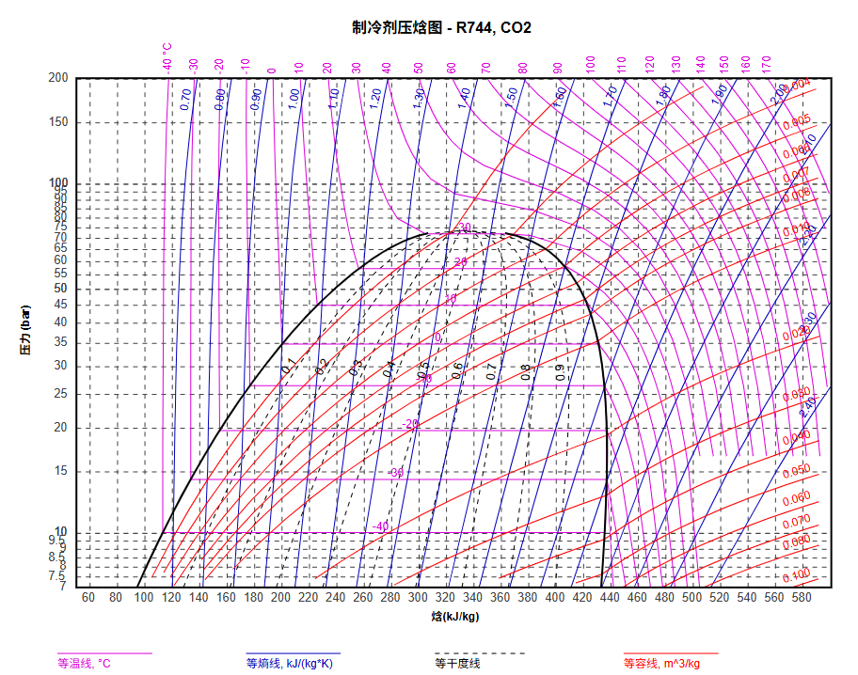
CO2 pressure-enthalpy diagram
Critical point：
Temperature(T_c)：31.1°C
Pressure(P_c)：7.38 MP
According to the phase of CO2, refrigeration is categorized into:
Supercritical refrigeration
Subcritical refrigeration
Trans critical refrigeration
Supercritical phase
Critical point： 31.1°C，7.38 MPa
Subcritical phase
Liquid
Gas
Liquid+Gas

Slide 8
Trans critical refrigeration
1→2: Compression (pressure and temperature rises)
2→3: Condensation (temperature drops)
3→4: Throttling/Expansion (pressure and temperature drop)
4→1: Evaporation (cools the R744 slice medium)
5→6: control pressure to obtain a different temperature
超临界状态
3
2
5
6
4
1
液体状态
气液两相状态
气体状态

Slide 9
Temperature requirement of CEPC sub-detector based on TDR
sub-detector | Temp. Requirement | Power /kW | Cooling medium | others
Beam pipe | <20℃ | 1.2 | 15℃ water/oil
Vertex | <30℃ | 0.3 | 5℃ air | Temp. gradient <10℃？
ITK/OTK | <30℃， Single chip gradient<5℃ | 30+300 | 5℃ water | Considering using CO2 cooling, Tem. req. -20℃
TPC | <20℃ | 10*2 | 15℃ water | Considering CO2
Cherenkov | <20℃？ | X? | 15℃ water | If CO2 available, SiPM
ECAL | <20℃ Gradient <2℃ | 43.5 (new) | 15℃ water | If needed
HCAL | Different channels： ±1.5℃ Same channel：±0.1℃ | 50 | 15℃water | If needed
Magnet | <40K? | 0.366? | 4K Liquid helium
Muon | — | — | —
The total thermal power for detector that needs CO2 to cool: >350 kW

Slide 10
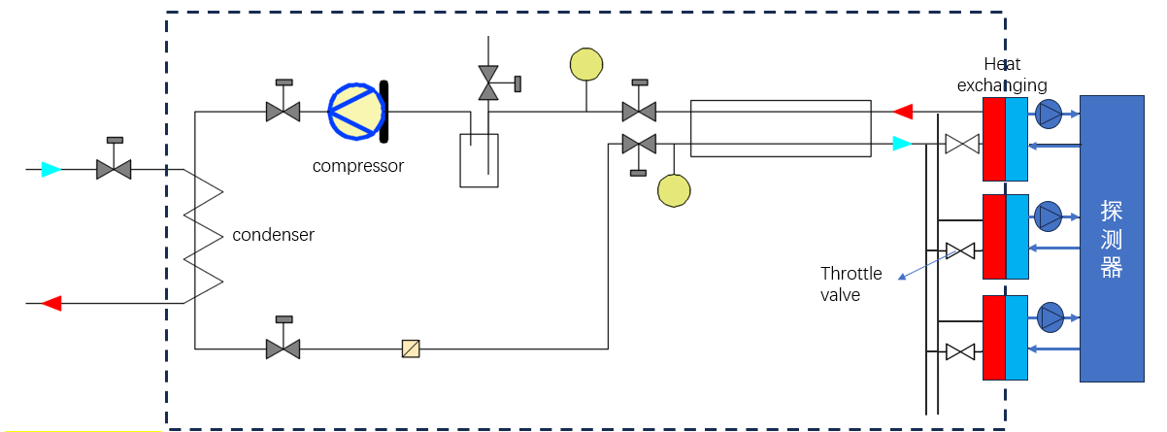
Research on CO2 cooling
Motivation:
TDR, DRD8:
Innovation program of IHEP:
Design a cooling plant system that can provide at less 350 kW power for detector
Design slice systems that can provide different temperatures for detectors
Selection of Components\equipment layout onsite
Verification of key components ——accumulator, condensation, high pressure connector and so on
Small prototype—— 3~5 kW (Applying NSFC fund)
2026
2027
2027
~1kW
CO₂
~1kW
water
Water system
Trans critical CO2 cooling plant
CO₂ & water slices: diff. Temp.
Preliminary consideration of flow diagram for small prototype of CO2 cooling system

Slide 11
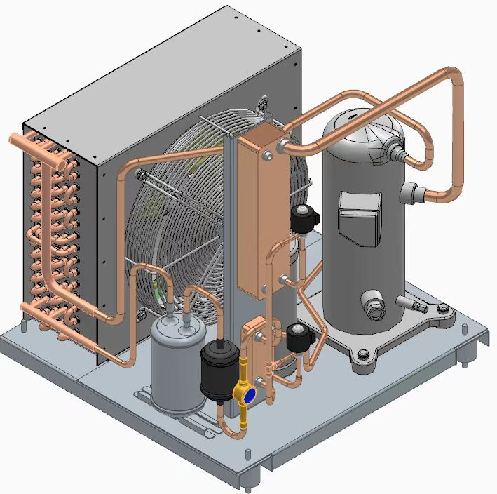
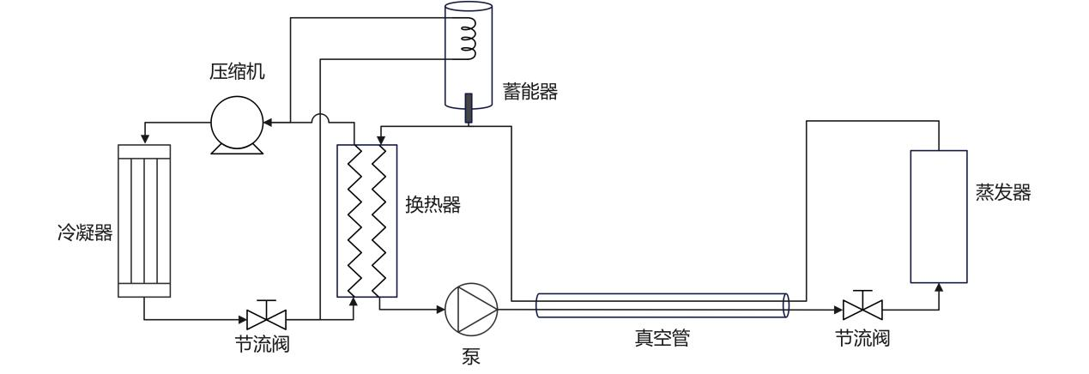
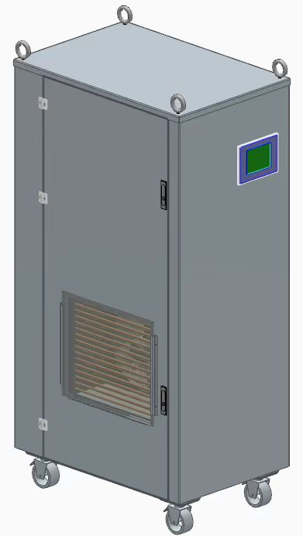
Research on CO2 cooling
Yan Qi group: cooperate with Technical Institute of Physics and Chemistry, CAS
Designing an ~1kW CO2 slices
Condenser
Freon refrigeration
Accumulator
Heat exchanging
Detector
Detector
Pump
Vacuum tube
Throttle valve
Freon refrigeration
CO2 slices
Freon refrigeration and CO2 slices design
CO2 slices

Slide 12
Microchannel cold plate design

Slide 13
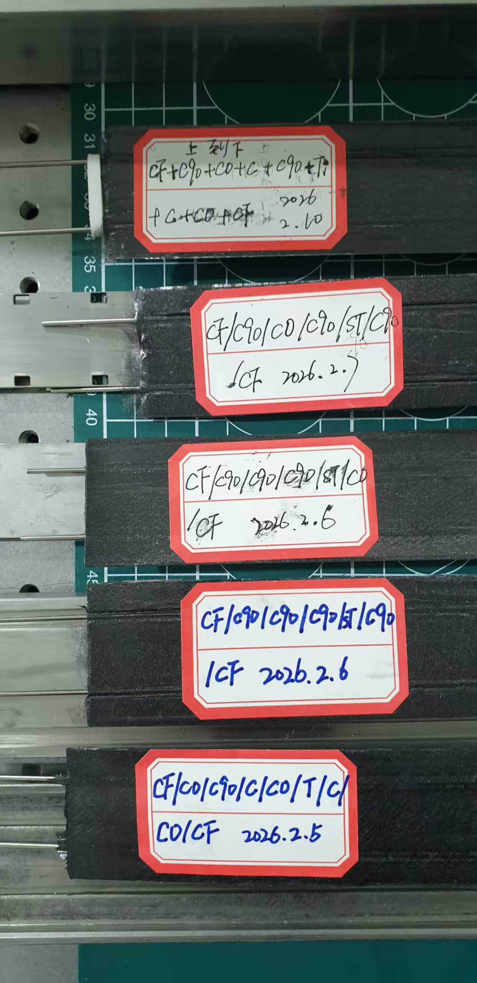
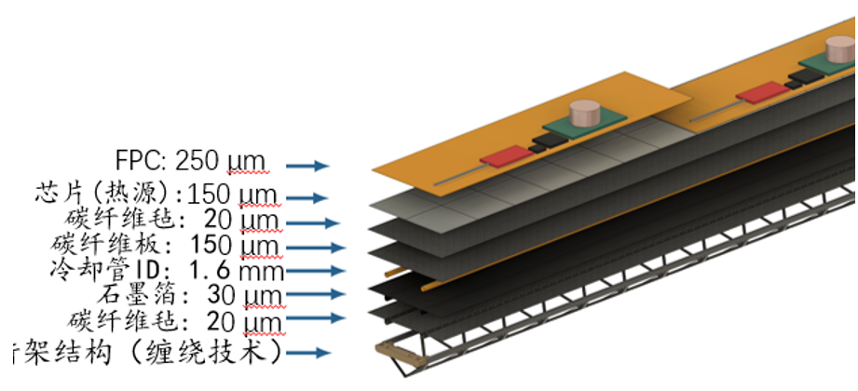
Xiaohui Qian
Microchannel cold plate design
Ultra-light weight and extremely high thermal conductivity for sensor （Innovation program of IHEP）
Cold plate: using composite material(carbon fiber, graphene and so on) ~862 – 1940 W/m·K
Cooling pipe: channel size could be ~1mm if using CO2
Sub-detector: ITK\OTK, TPC, Cherenkov, ECAL and so on
Main problem：Composite cold plate thermal conductivity
unknow exactly thermal conductivity,
interfacial thermal resistance between materials — Composite strength between different materials
Different arrangements of films
Develop thermal conductivity measurement platform — Evaluate thermal conductivity of different cold plates
Mold design for manufacturing of cold plate sample( with/without pipe)
Challenge: reduce the contact thermal resistance between the cold plate and the heat source.
Sensor(heat source)
Carbon fiber felt
carbon fiber plate
Cold plate
Cooling pipe
Graphene film
Carbon fiber felt
Triangular carbon fiber beam
Cold plate of ITK

Slide 14
Microchannel cold plate design
Idea on mold design for manufacturing of cold plate sample
Glue (epoxy) with powder (high thermal conductivity and electrical insulation)
AlN(~320 W/m·K), BN(300-600 W/m·K in-plane)
mold
Silicon rubber
Composite layer
Micro channel
mold
Mold for composite cold plate sample

Slide 15
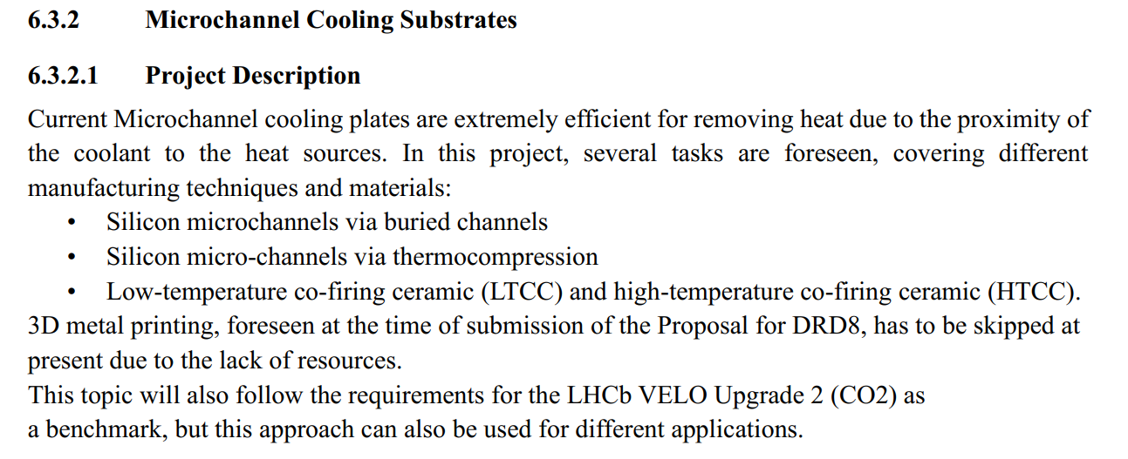
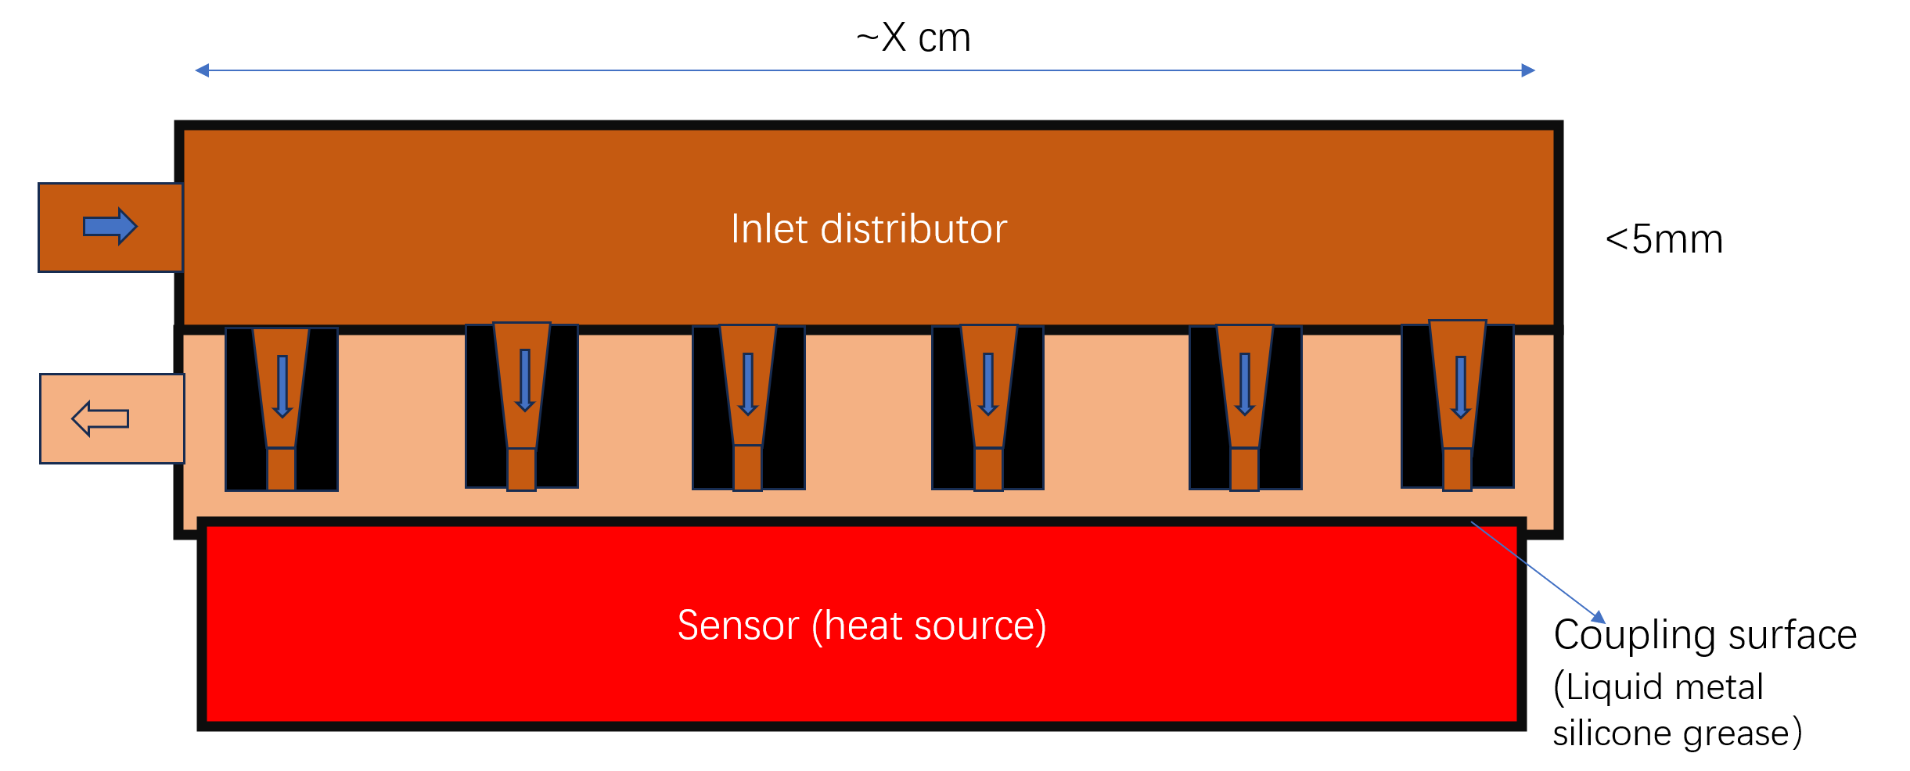
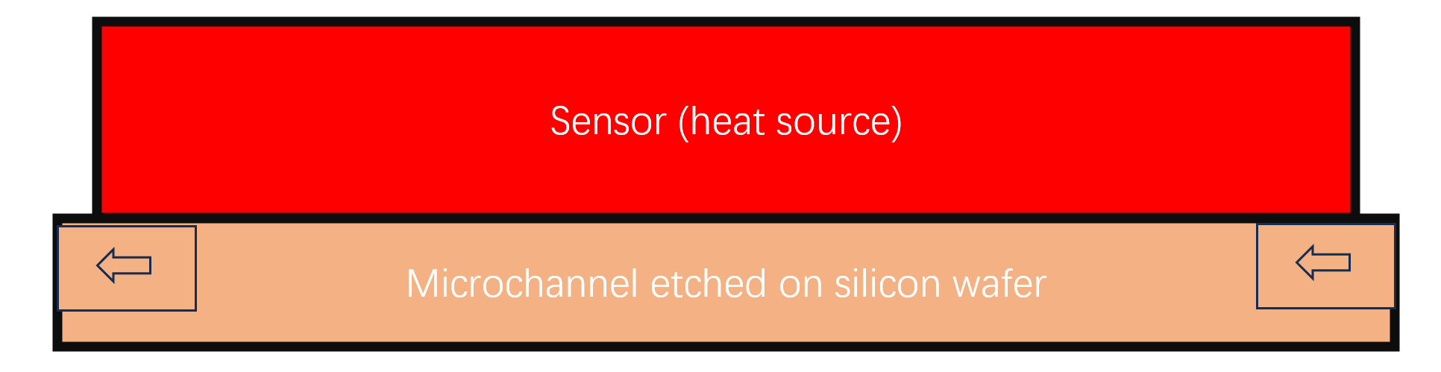
Microchannel cold plate design
DRD8:
Challenge:
Combination of components to prevent leakage
High pressure
Idea about design of cooling device
No fund
3D microchannel jet cooling technology
Silicon microchannel cooling

Slide 16
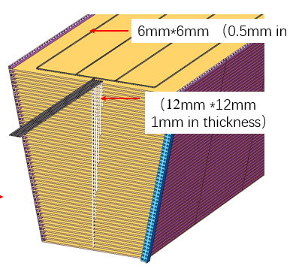
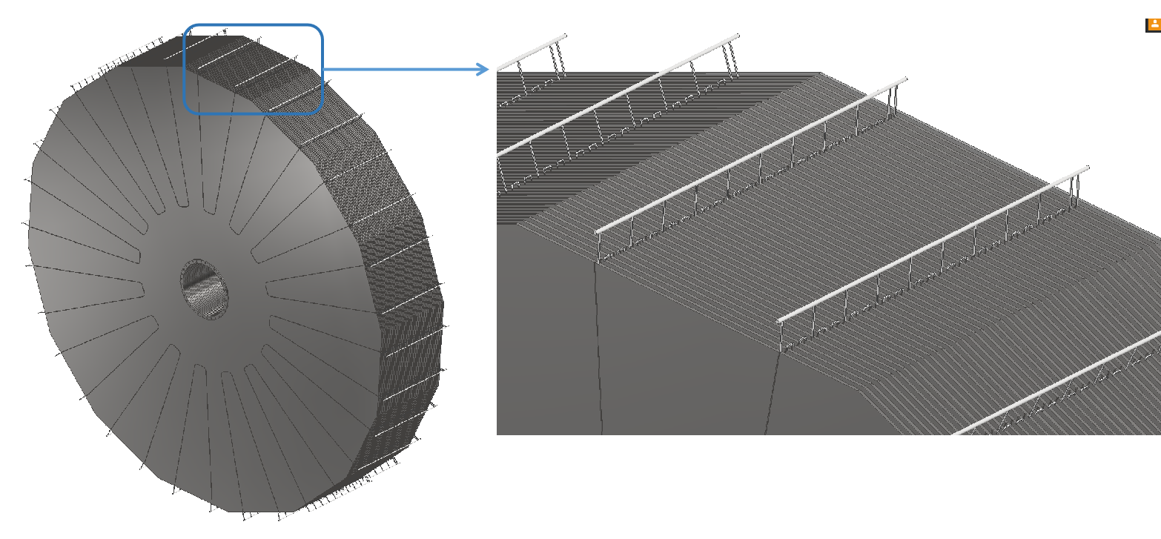
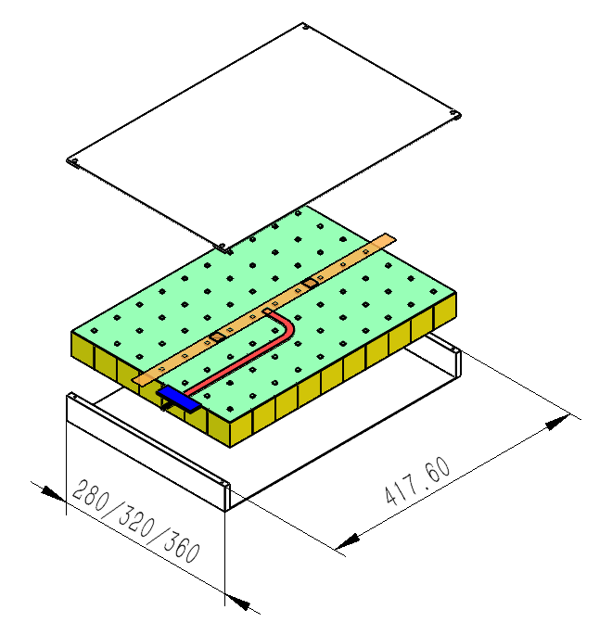
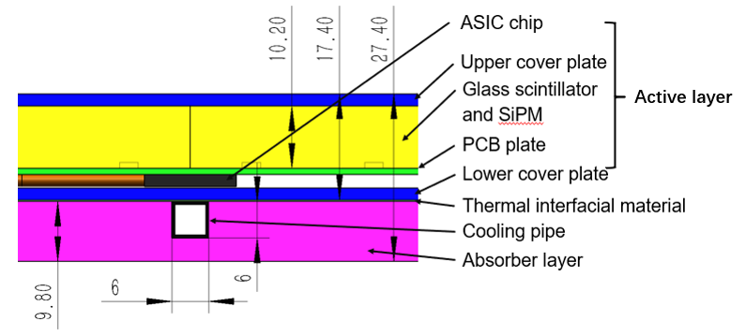
Yatian Pei
Preliminary design of HCAL cooling
Cooling structure in TDR – water cooling
Cooling structure under design
Graphene thermally conductive plastic
ASIC chips
4 pipes in each layer in parallel
8 layers gather in one pipe in parallel
One end is inlet and another end is outlet
1 pipe in each layer for one wedge
5 layers gather in one pipe in parallel for one wedge
There is one inlet and outlet for each region.
Cooling tube
Graphene thermally conductive plastic connects with the upper surface of ASIC chips
Graphene thermally conductive plastic brings out heat
Graphene thermally conductive plastic connects with the cooling tube at both ends of barrel HCAL

Slide 17
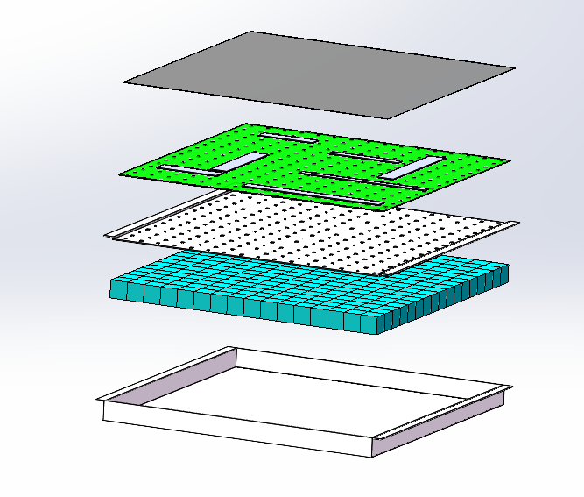
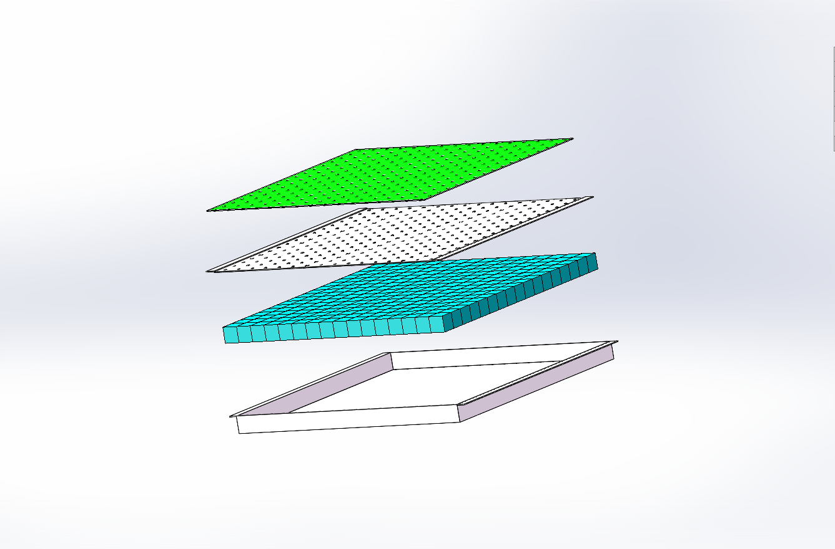
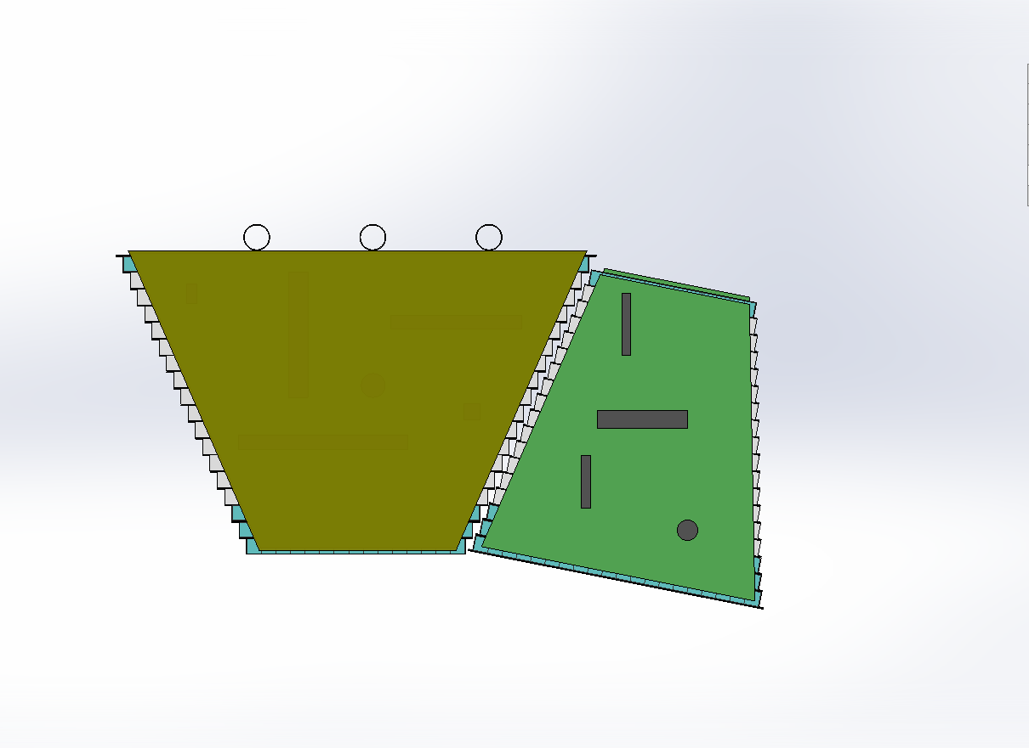
Shaojing Hou
Preliminary design of ECAL cooling
Heat source: ASIC chips, total 43.5 kW
Option2: ASIC chips in each layer
SiPMs and ASICs are distributed between each layer of scintillating glass.
Heat is conducted through graphene sheets to both end faces of the ECAL barrel
Removed via water/CO2 cooling pipes.
Option1: ASIC chips on the surface of module
18-layer glass scintillator for each module with SiPMs;
ASIC chips are placed on the both side of module (Z-direction)
Conduct heat to the top of the module by copper sheets or graphene where arrange water/CO2 cooling pipes.
Cooling pipes
Copper plate
or Graphene
Graphene
ASIC chips
SiPM+ASIC
SiPM board
Carbon fiber cover plate
Carbon fiber cover plate
Glass scintillator
Glass scintillator
Carbon fiber box
Carbon fiber box
Cooling method of ASIC chips on the surface of module
Cooling method of ASIC chips in each layer

Slide 18
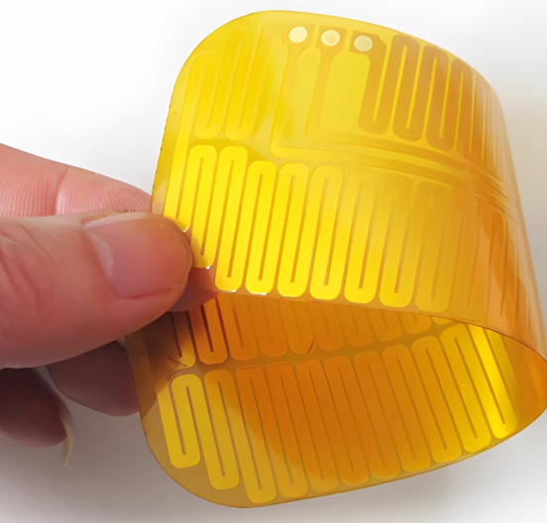
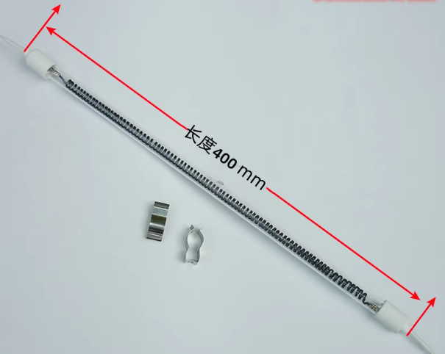
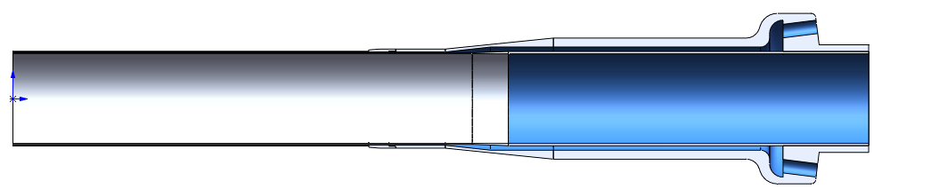
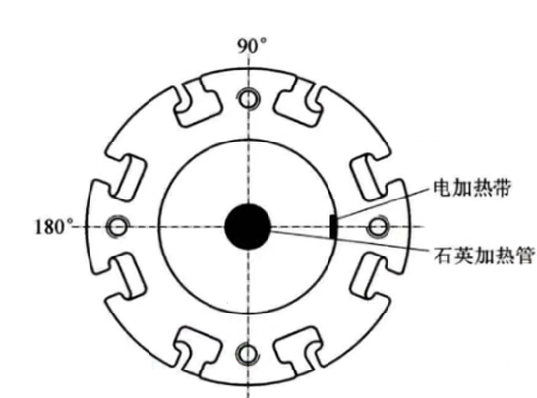
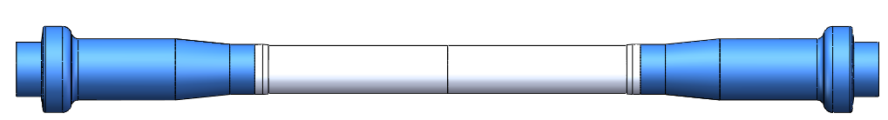
Jian Wang
Consideration of central beam pipe cooling test
Innovation program of IHEP, Xiejialin fund(Wang Jian), Applying NSFC fund
Considering using Al instead of Be for the first step test (BESIII)
— quick verify if 0.2 mm gap can be worked (pipe t= 0.2&0.15 mm)
Simulation the cooling effect between two material
Simulation the effect of uneven gap for the accuracy of manufacturing
Experiment design and component selection (pump, pressure gage… )
Experiment (this year)
Character comparison of diff. material
Parameter | Beryllium | Aluminum | Stainlees steel
Thermal conductivity W/(m・K) | 200～250 | 120～240 | 15 - 25
Density (g/cm³) | 1.85 | 2.7 | 7.93
Strength to density ratio MPa/(g/cm³) | ~120 | 114.8(6061-T6) | 65.6（304）
Difficulty of manufacturing | Very high | Low | High
Price of material | Very high | Low | Low
Electric heating belt
heating tube
Electric heating belt
heating tube
Be pipe→Al pipe
Cooling pipe interface
Central beam pipe structure
Heat source and cooling pipe interface distribution

Slide 19

Jinyu Fu
Vertex air cooling test
VTX heat source: Non-uniform
Stitching layer (sensitivity area): 40 mW/cm², left end readout block: 485 mW/cm²
Test requirement
Design and manufacturing prototype of VTX heating structure
Thin-film heater instead of sensor to generate the required heat, carbon fiber supporting structure
Volume of cooling air: flow rate 1.5 m³/min （max. velocity: 8 m/s，R=11.5~33.5mm）
Temperature of air: room temperature (air conditioner）
Innovation program of IHEP
Applying NSFC funding
Plan：
1) Flat prototype: preliminary verify the measurement system and heating layer (2026.08)
2) Single cylindrical barrel thermal prototype: verify cooling effect, optimize test system
Finish Prototype design and manufactory—2026.12
Finish test —2027.02
3) Multi-cylindrical barrel thermal prototype: combine with beam pipe
Finish test and result analysis —2027.08
Model of Vertex

Slide 20

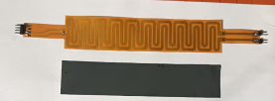
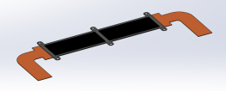
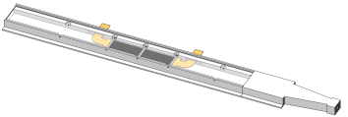
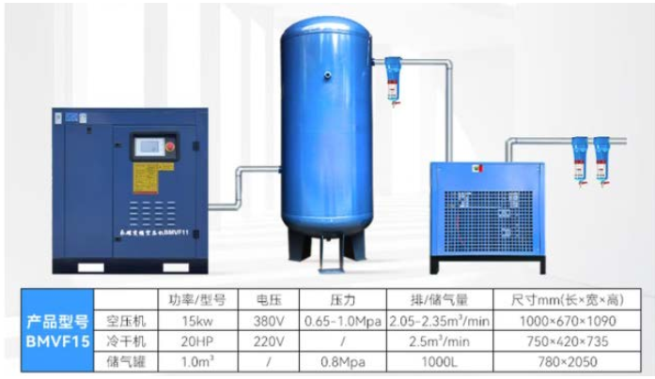
Recent Progress and plan
Thin-film heater ——Stitching layer (sensitivity area): 40 mW/cm², left end readout block: 485 mW/cm²
Finish the first version of thin-film heater (40 mW/cm2 ): design and get the sample, need to improve the heat uniformity after test——adding a thermal conductive layer, prepare for test
thin-film heater
thermal conductive layer(black)
Prototype design and manufacturing (April ~ May):
Optimize the prototype:
temperature monitoring point, heat distribution
Prototype: carbon support+ double heating layer
Design the air-cooled cavity——finish manufacturing in May
Air source and flow controller determined: purchase in April
Data acquisition system determined: pressure sensor and temperature sensor, purchase in April to May
Assembly of the Air-Cooled Test System (Air Circuit & Test Environment Setup, Control System Commissioning): in June
Thermal prototype
air-cooled cavity
Air source

