Slide 1
DiT and quantum GAN based fast simulation for the CEPC long-bar crystal electromagnetic calorimeter
Zhihao Li^{1,2}, Tao Lin², Zhengyun You³,
HaoZhi Yin³, XiaoZhong Huang², Hideki Okawa², Weidong Li^{1,2}
[1] University of Chinese Academy of Sciences, China
[2] Institute of High Energy Physics, Chinese Academy of Sciences, China
[3] Sun Yat-Sen University, China

Slide 2
Outline
Motivation
DiT-based fast simulation method
Quantum GAN
Summary

Slide 3
Outline
Motivation
DiT-based fast simulation method
Quantum GAN
Summary

Slide 4
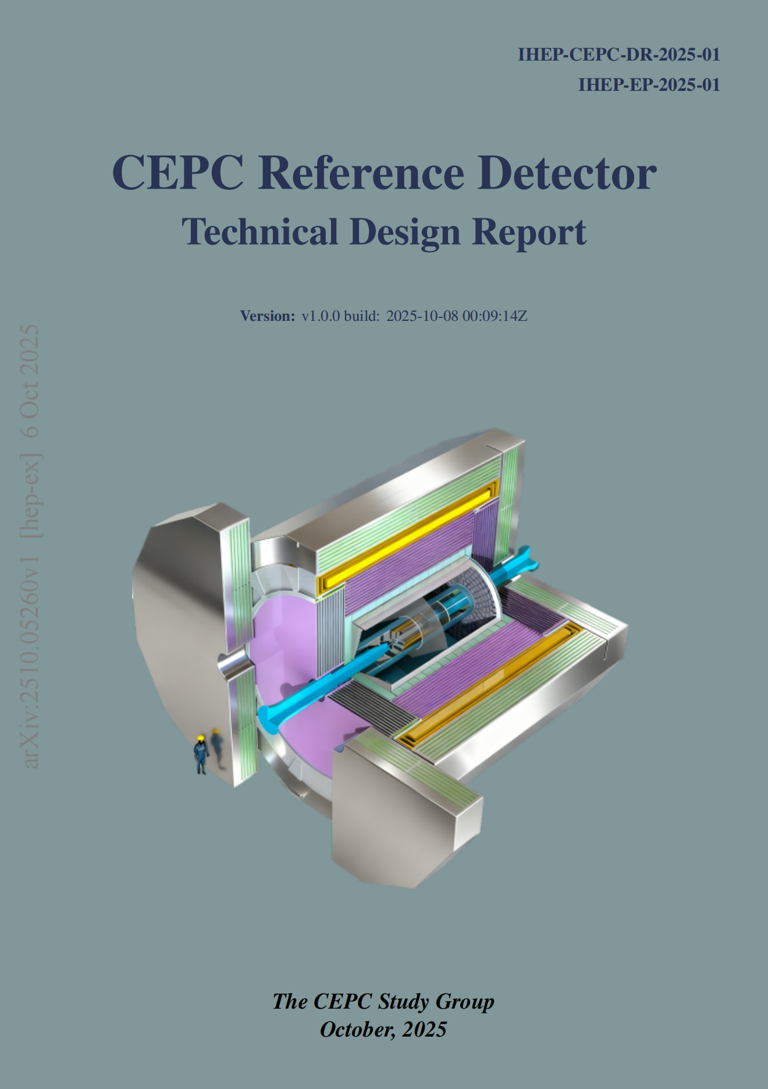
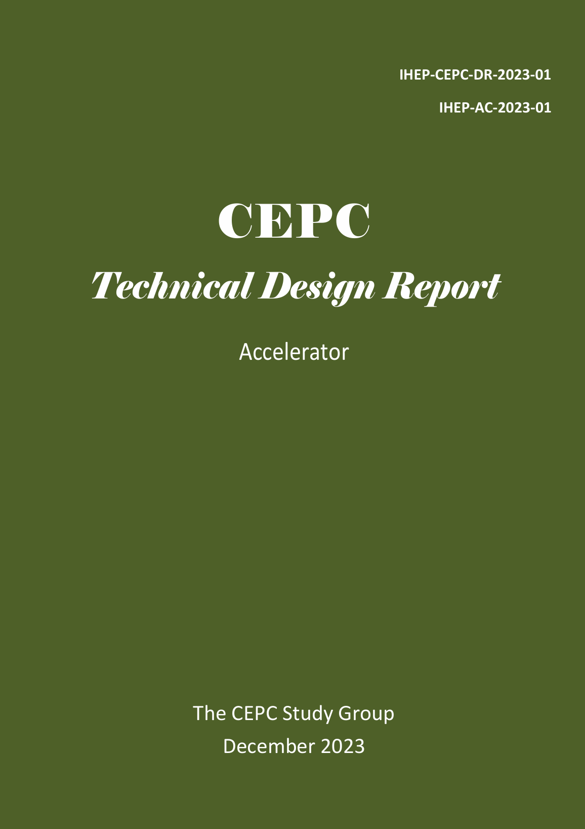
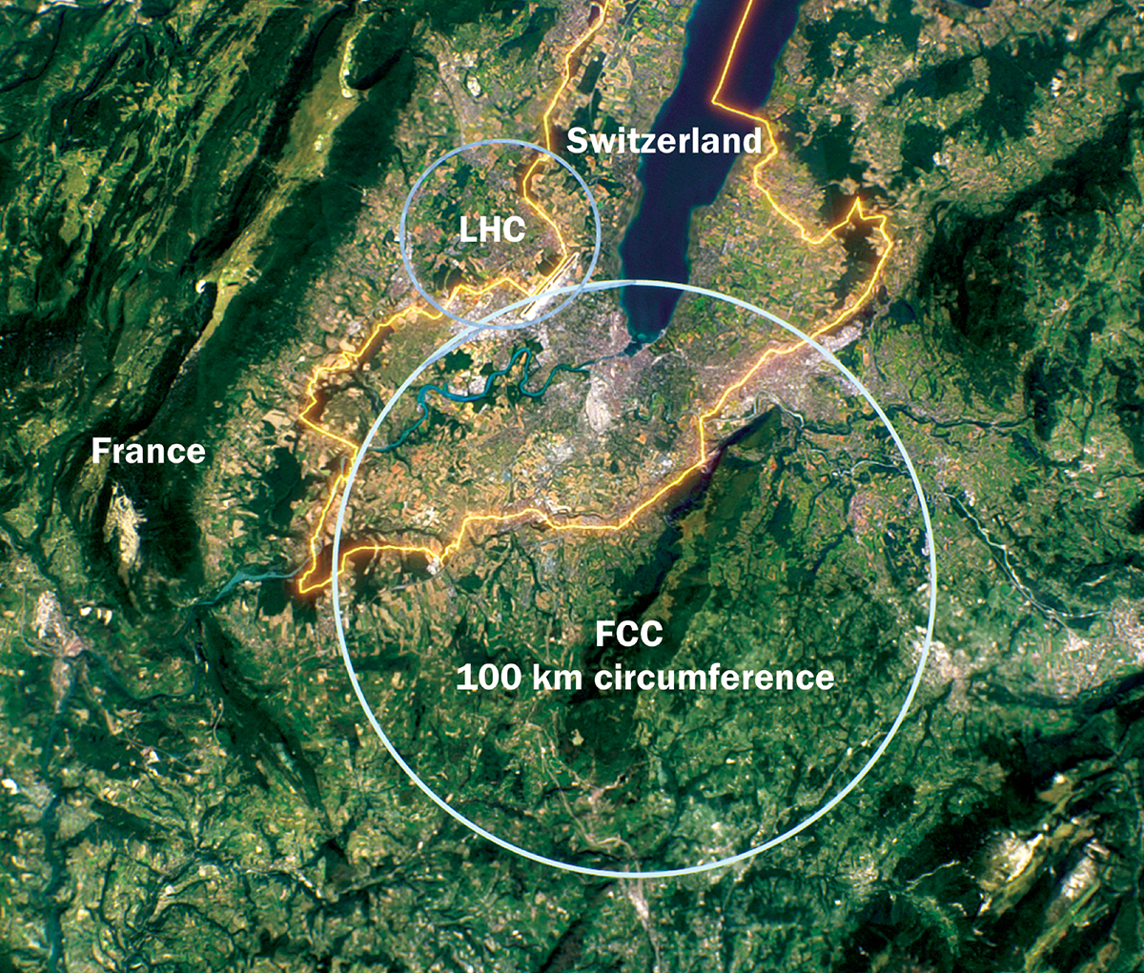
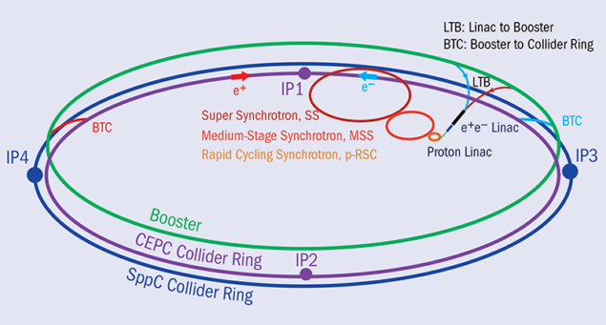
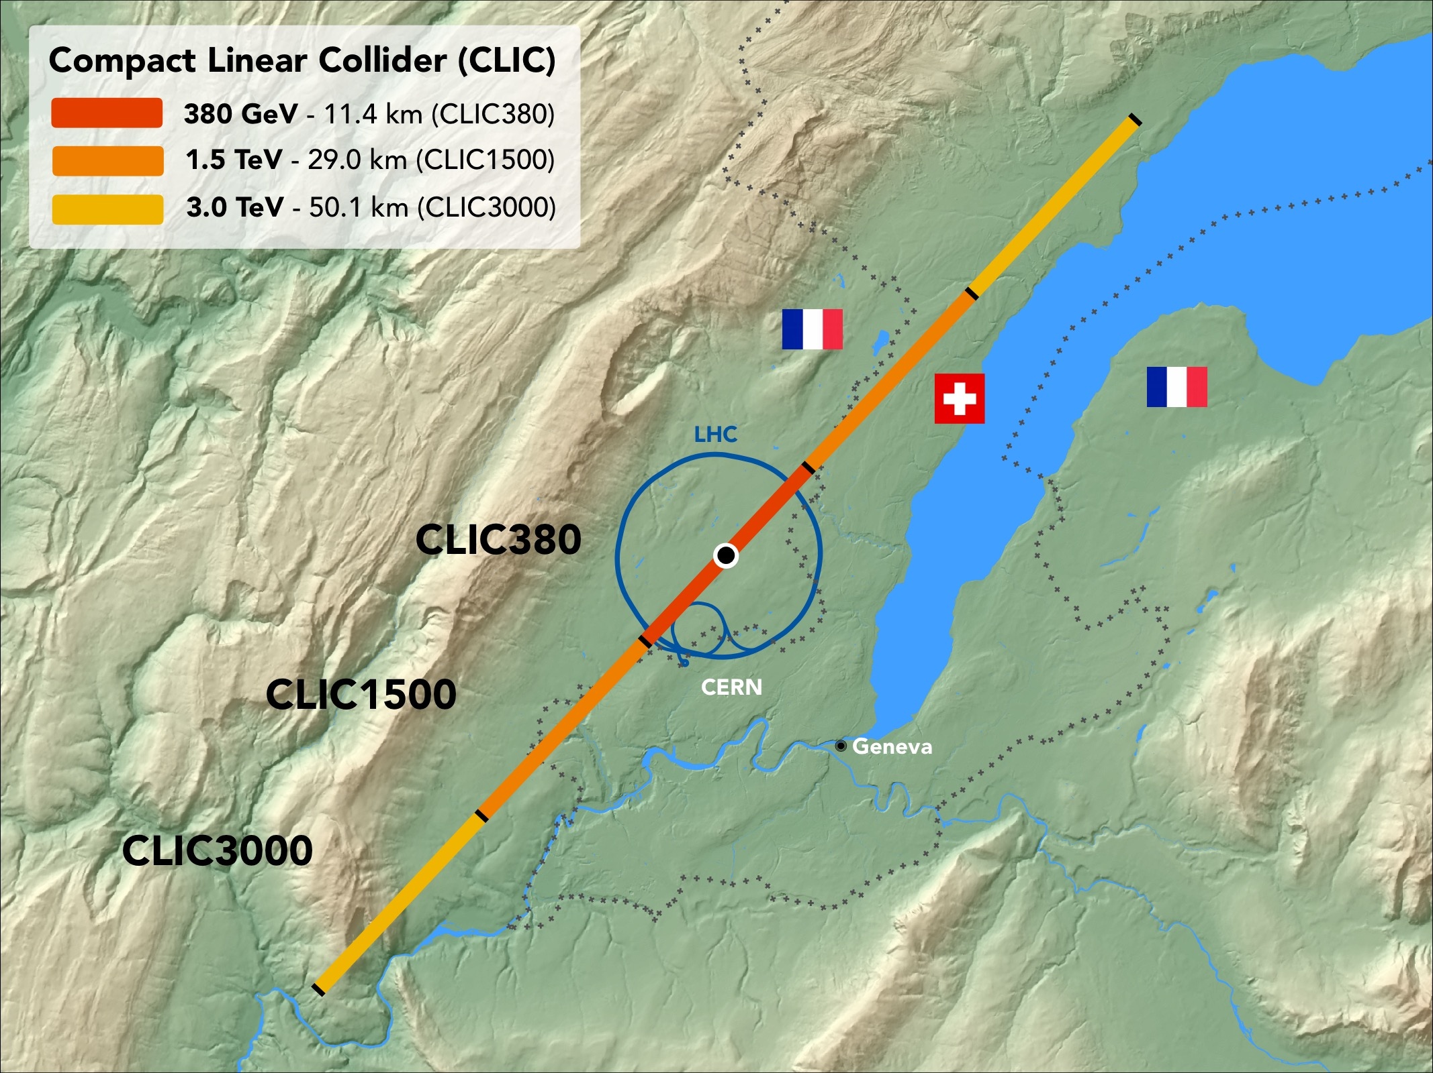
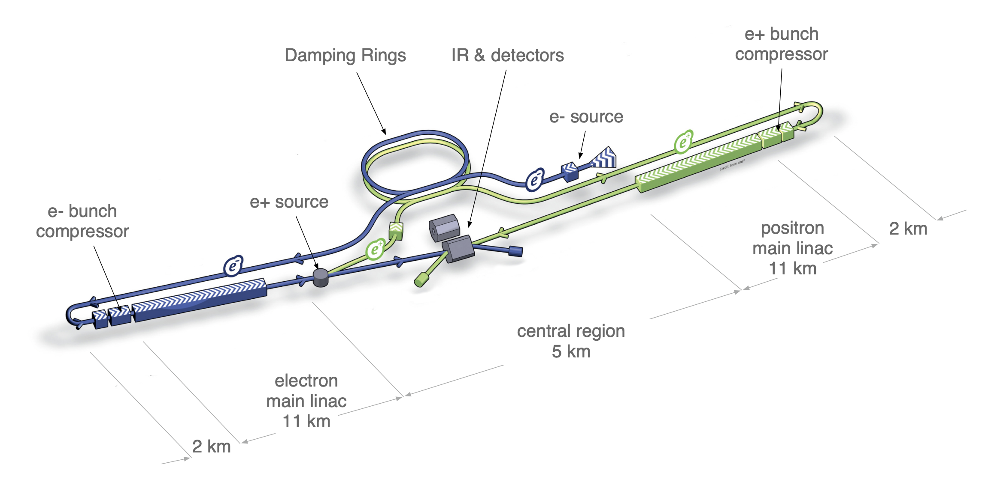
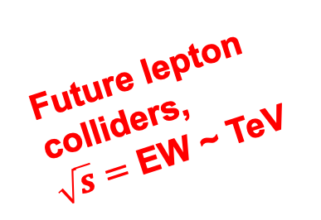
Future lepton collider
arXiv:2510.05260
Physics after Higgs discovery:
Precise measurement of Higgs, EW, top, flavor, QCD…
BSM physics (dark matter, EW phase transition, SUSY, LLP…)
Future lepton colliders,
$\sqrt{s}=$ EW ~ TeV
arXiv:2510.05260
arXiv:2312.14363
Notes:
After the discovery of Higgs Boson, there are 2 important targets in particle physics:
precise measurement of SM, such as the properties of higgs boson,
and search for physics beyond SM.
There are few projects proposed around the world for these targets, such as CEPC proposed in China, FCC-ee by CERN and linear colliders such as CLIC and ILC.

Slide 5
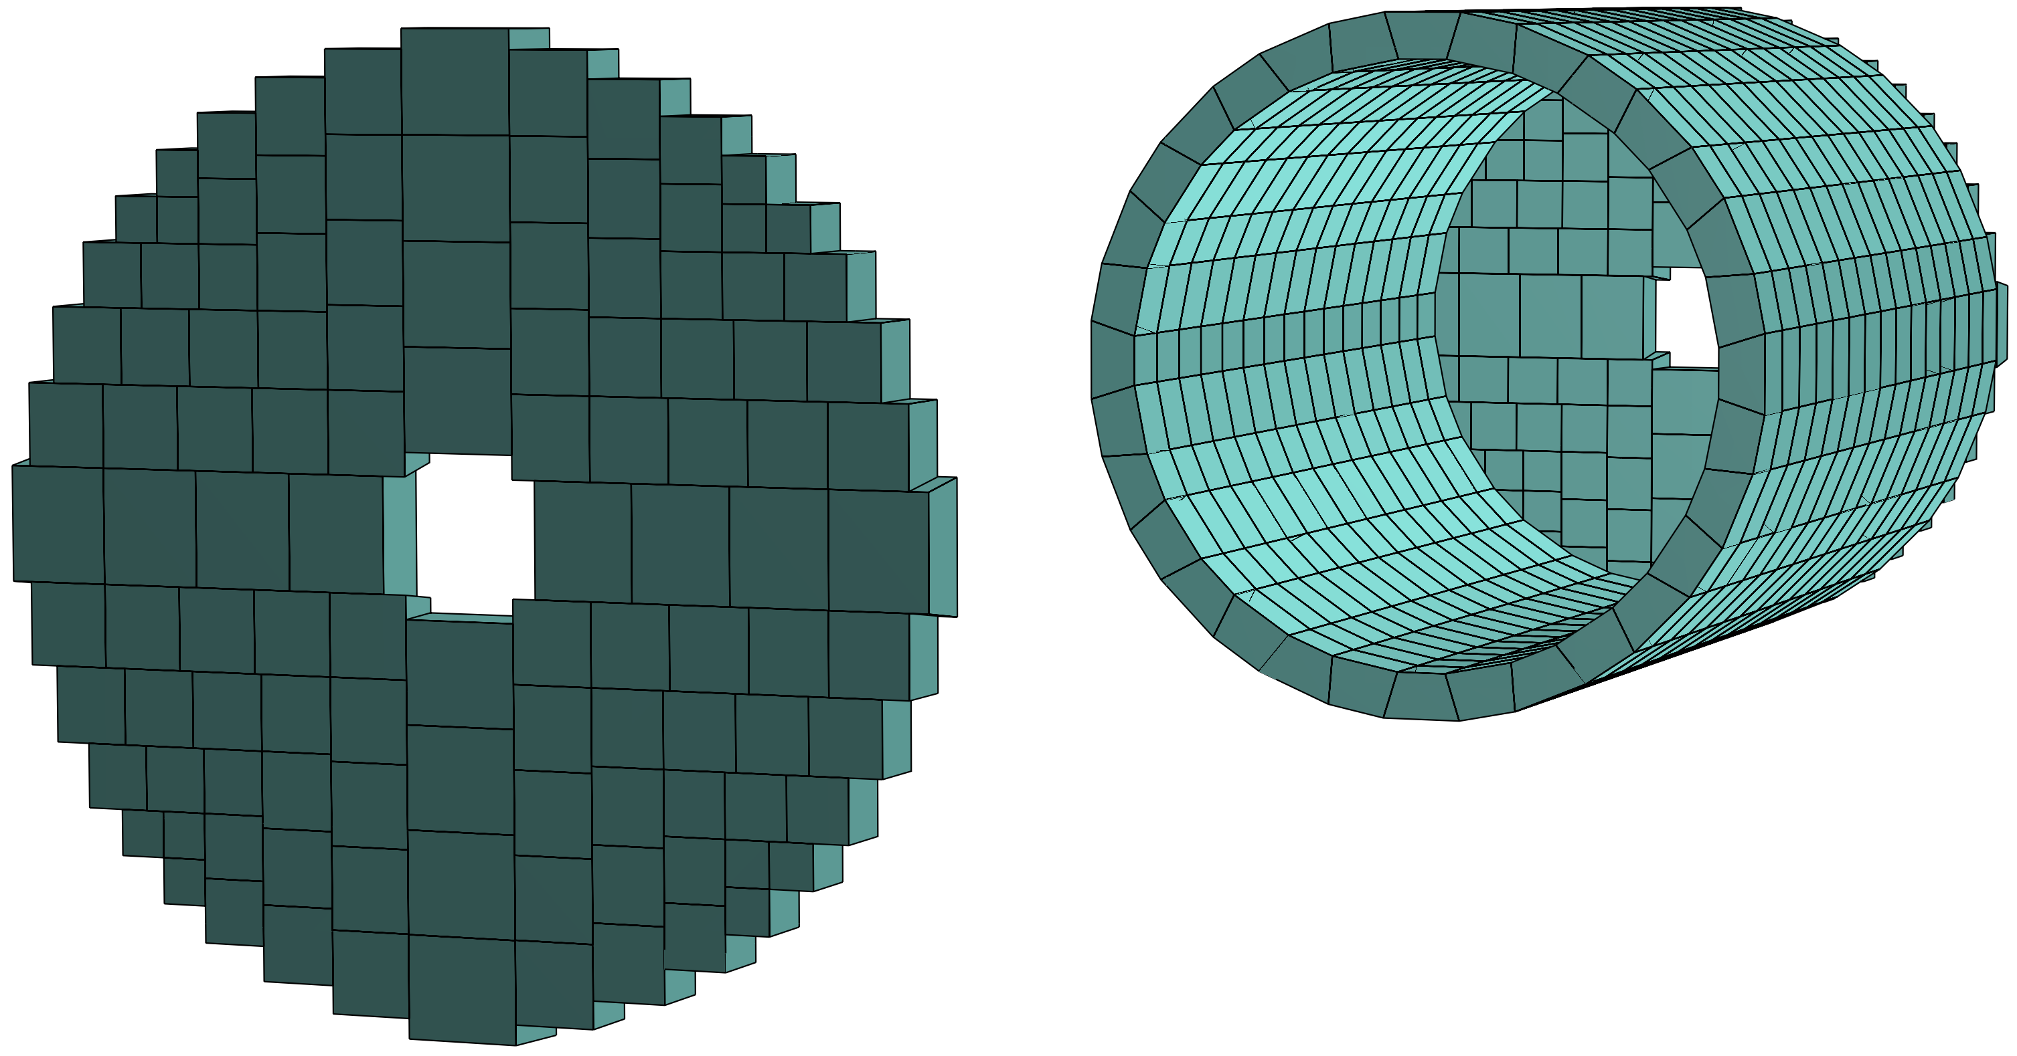
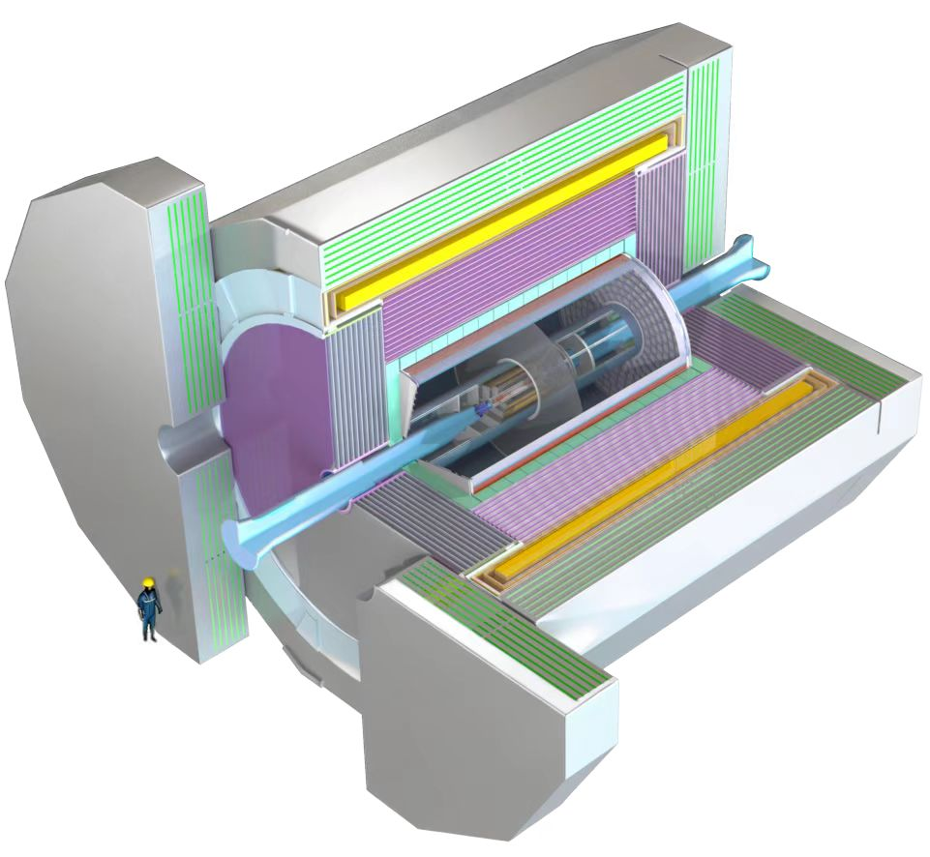
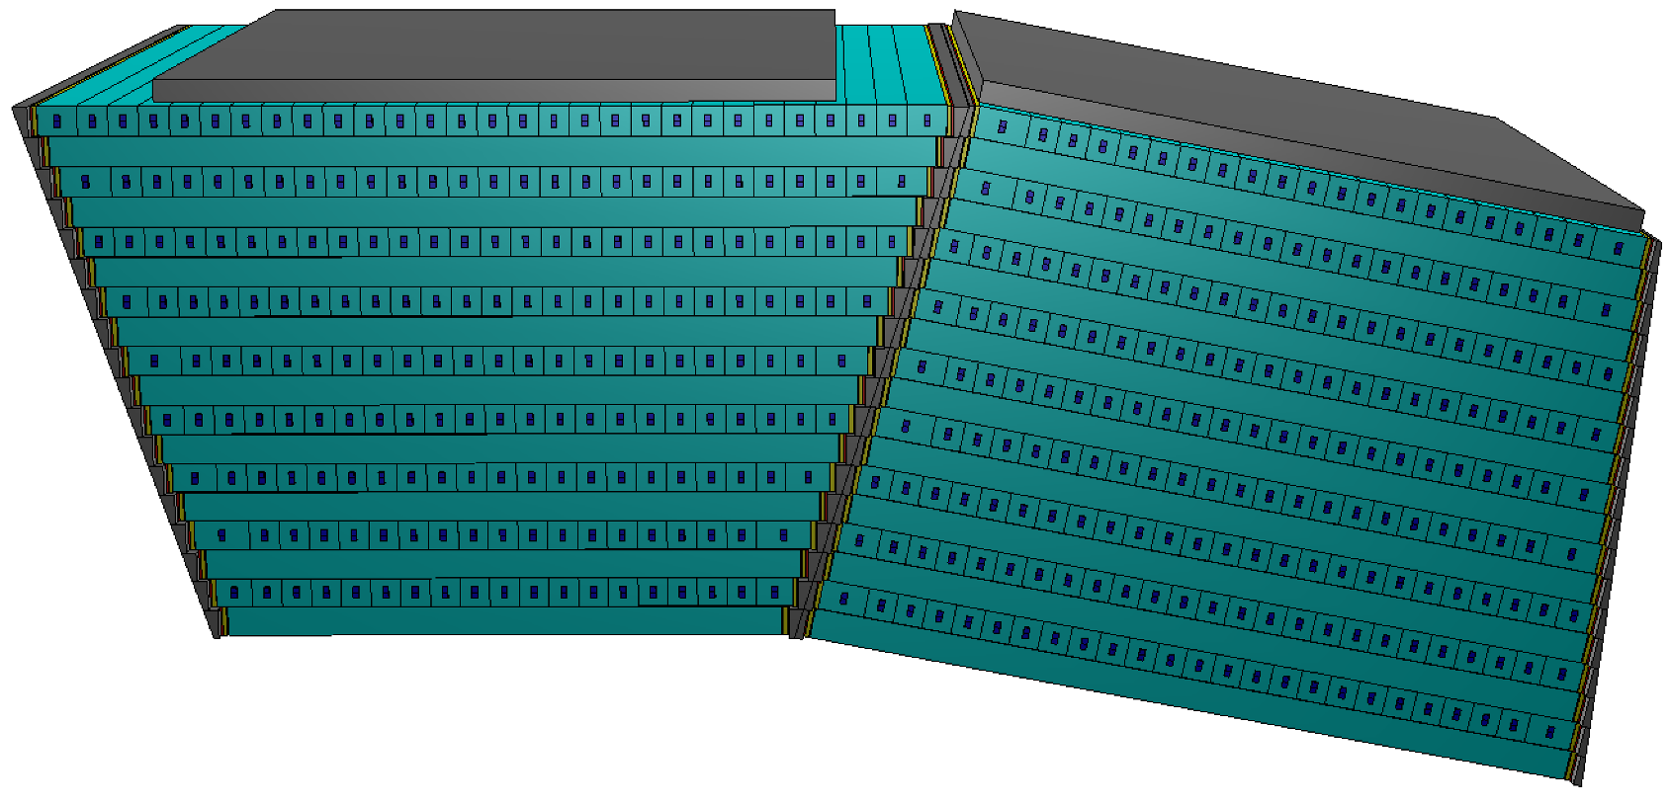

CEPC ECAL
ECAL: The long-bar crystal ECAL forms an interleaved three-dimensional mesh that delivers about 3% energy resolution with fine imaging.
$$\frac{σ_{E}}{E}≈\frac{3\%}{\sqrt{E/GeV}}$$
Reference Detector
ECAL

Slide 6
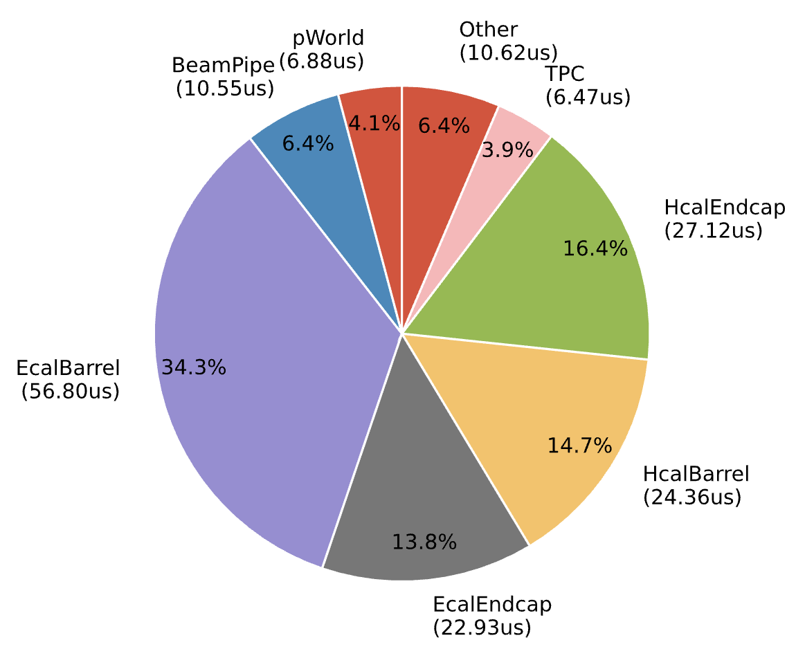
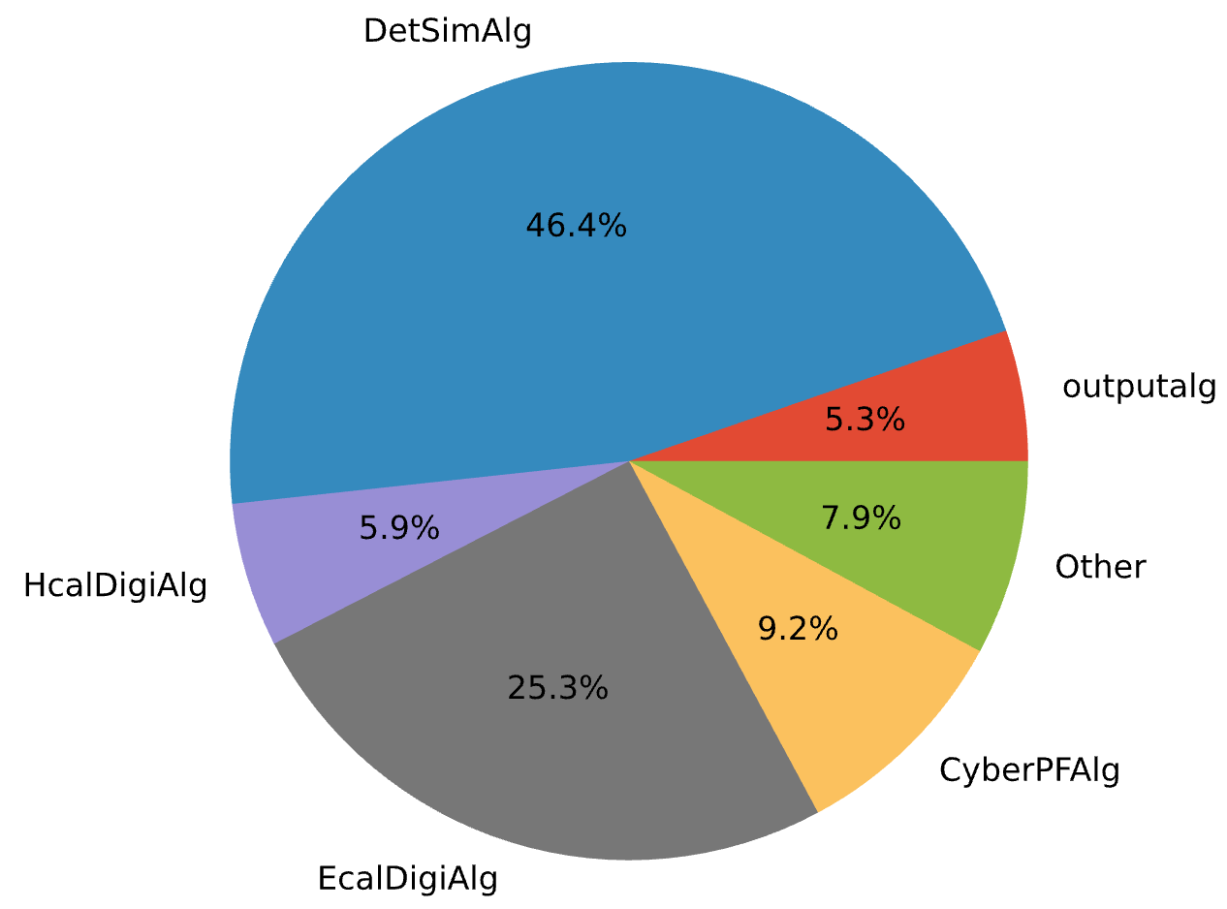
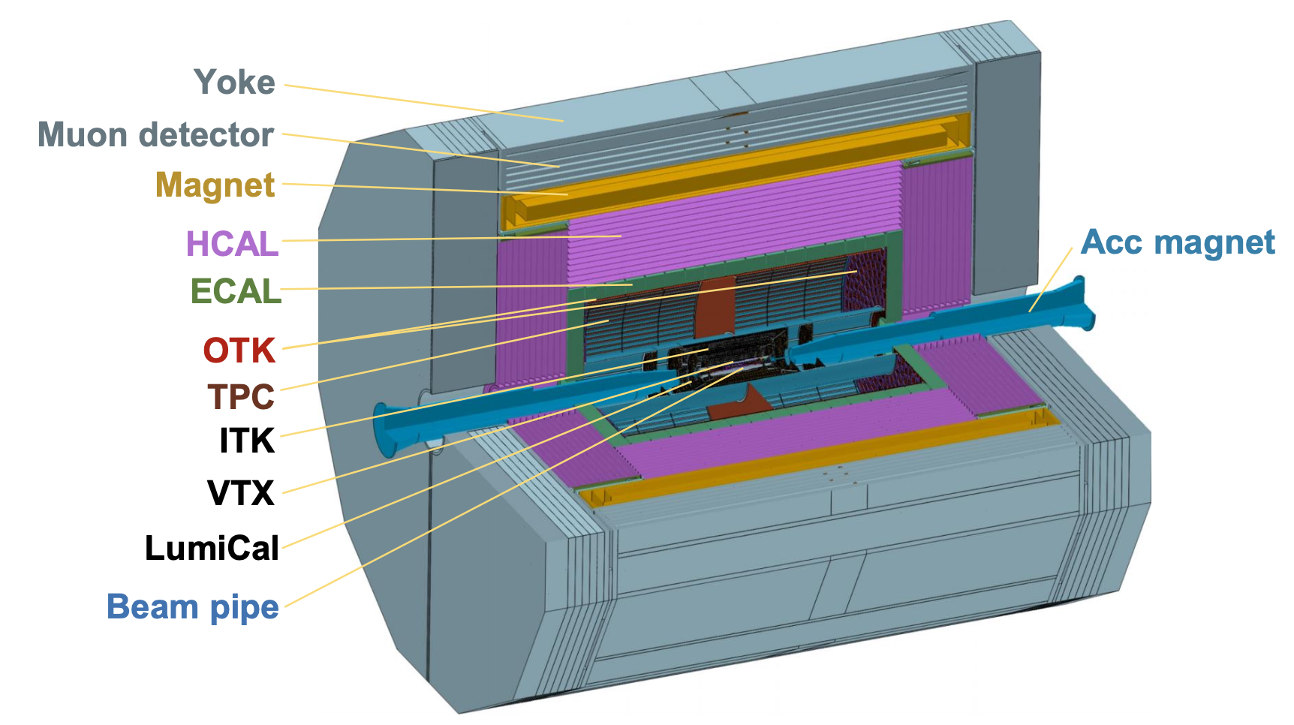
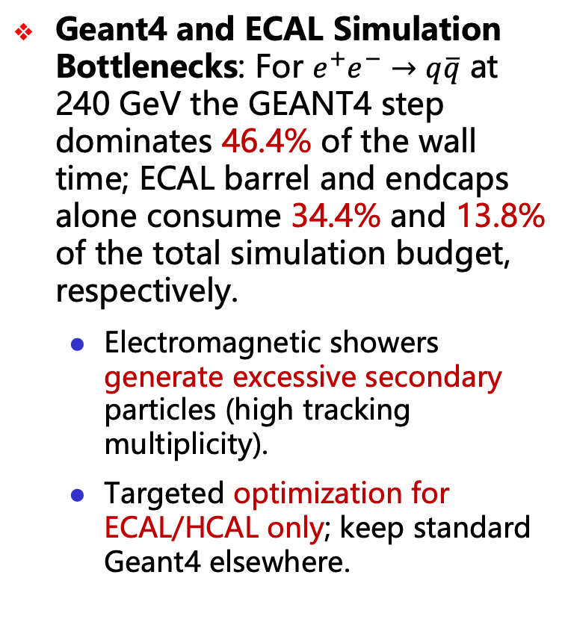
CEPCSW Computing Bottlenecks
Geant4 and ECAL Simulation Bottlenecks: For $e^{+}e^{−}→q\overline{q}$ at 240 GeV the GEANT4 step dominates 46.4% of the wall time; ECAL barrel and endcaps alone consume 34.4% and 13.8% of the total simulation budget, respectively.
Electromagnetic showers generate excessive secondary particles (high tracking multiplicity).
Targeted optimization for ECAL/HCAL only; keep standard Geant4 elsewhere.
Notes:
只解决ECAL HCAL，因为最多。其他用G4

Slide 7
Outline
Motivation
DiT-based fast simulation method
Quantum GAN
Summary

Slide 8
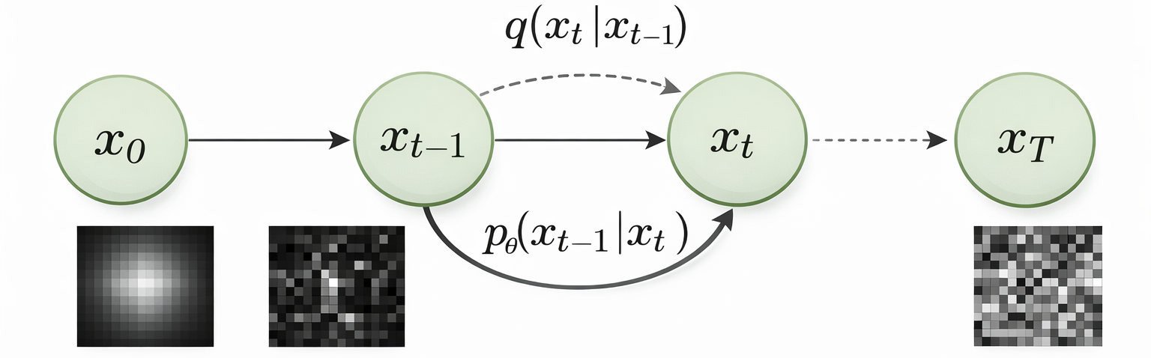
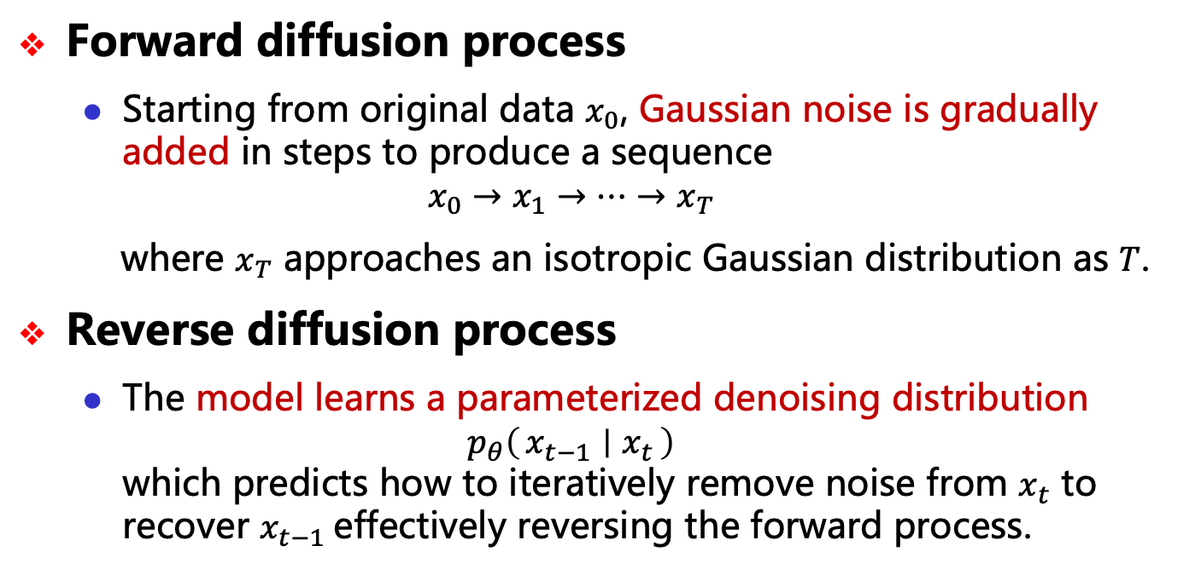
DiT II: Diffusion Process
Forward diffusion process
Starting from original data $x_{0}$, Gaussian noise is gradually added in steps to produce a sequence
$$x_{0}→x_{1}→⋯→x_{T}$$
where $x_{T}$ approaches an isotropic Gaussian distribution as $T$.
Reverse diffusion process
The model learns a parameterized denoising distribution $p_{θ}\left(x_{t−1} ∣ x_{t}\right)$ which predicts how to iteratively remove noise from $x_{t}$ to recover $x_{t−1}$effectively reversing the forward process.

Slide 9
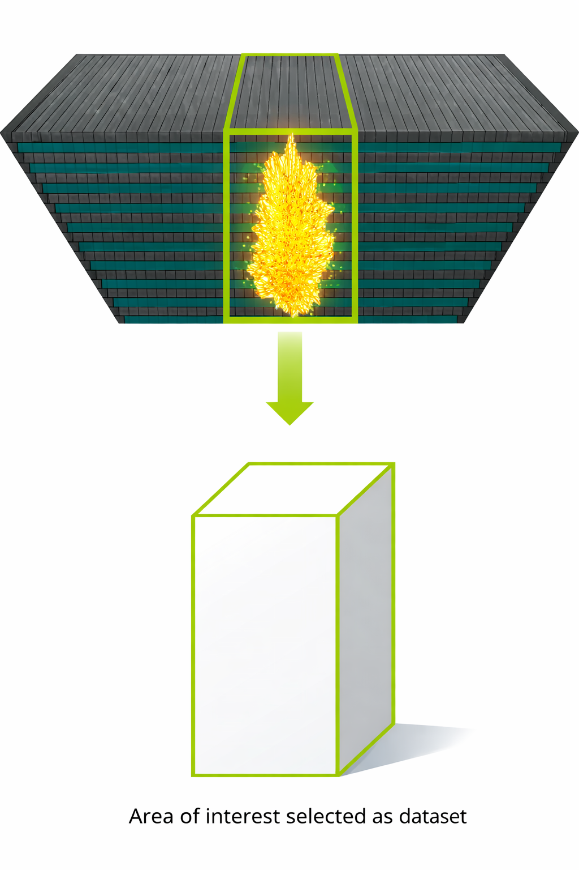
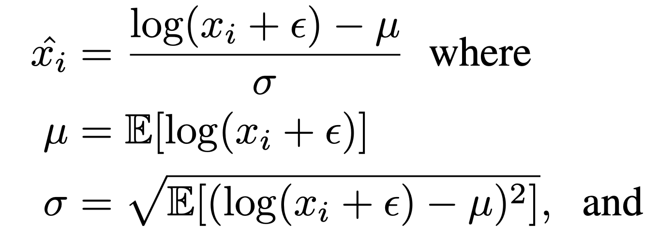
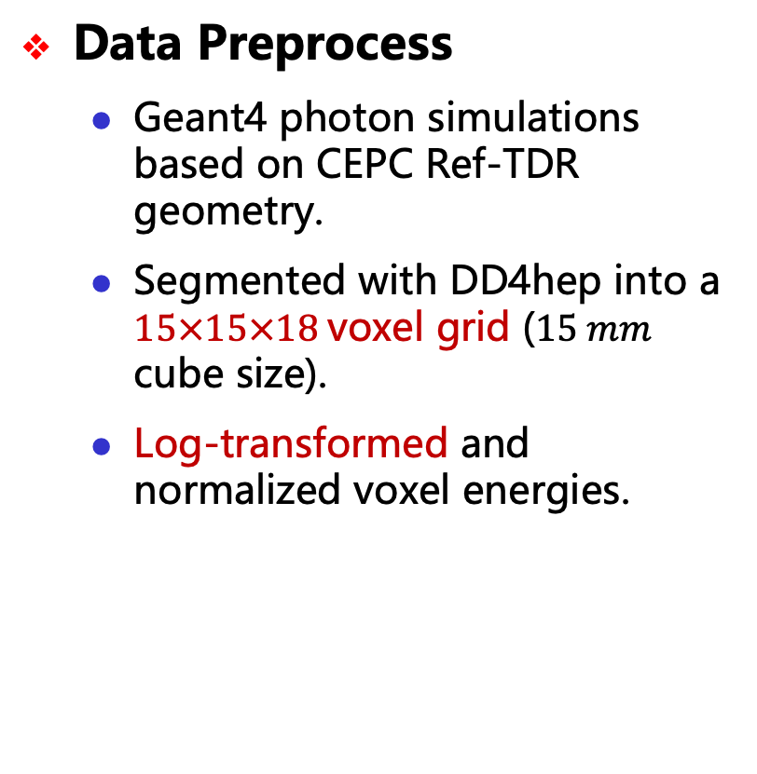

DiT III: Dataset
Data Preprocess
Geant4 photon simulations based on CEPC Ref-TDR geometry.
Segmented with DD4hep into a $15×15×18$voxel grid ($15 mm$ cube size).
Log-transformed and normalized voxel energies.
$$ε = {10}^{−7} GeV$$
Notes:
怎么映射的

Slide 10
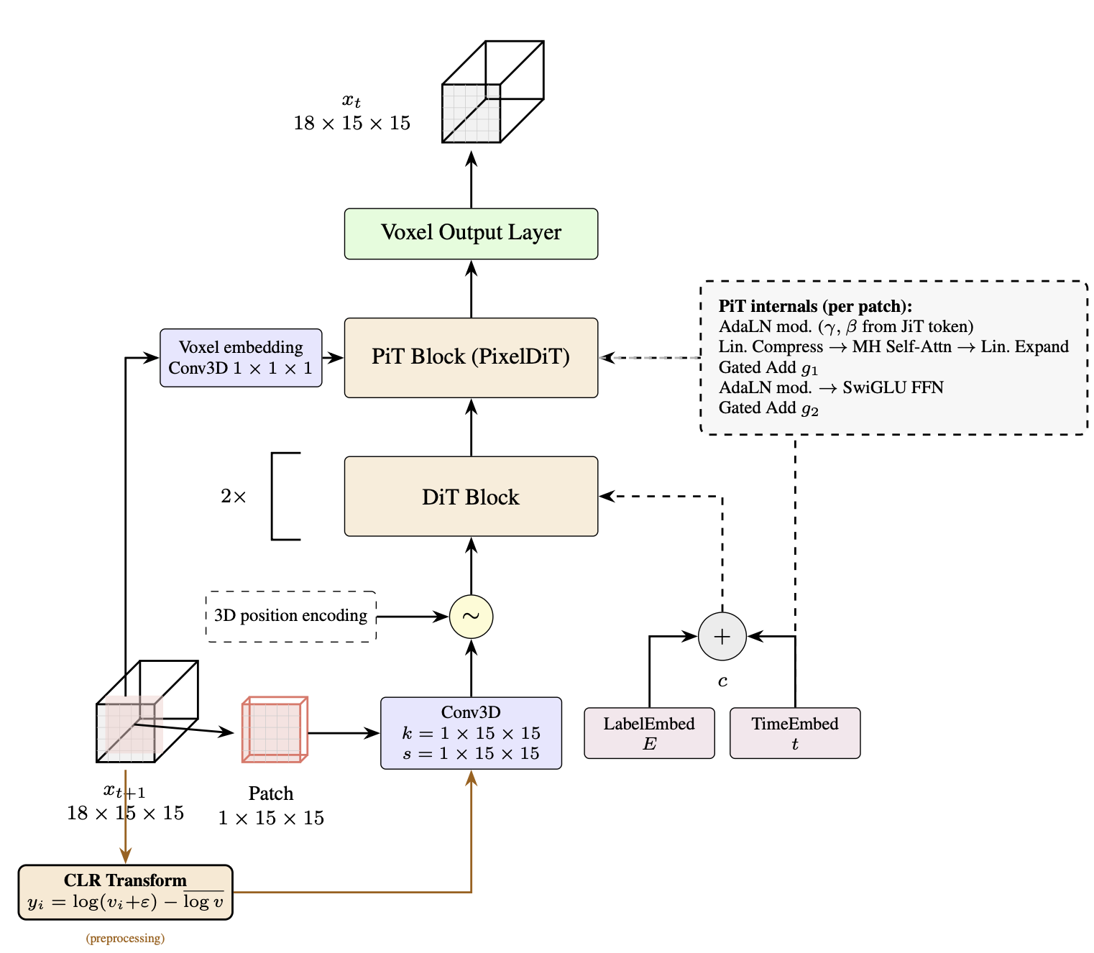
DiT IV: Model Architecture
VoDiT4CAL Architecture:
DiT Blocks: Transformer self-attention blocks exchange information across tokens globally.
PiT Blocks: Transformer self-attention blocks exchange information within each token across voxels.
Voxel Output: The final token representations are mapped back to energy space to produce voxel-level predictions.

Slide 11
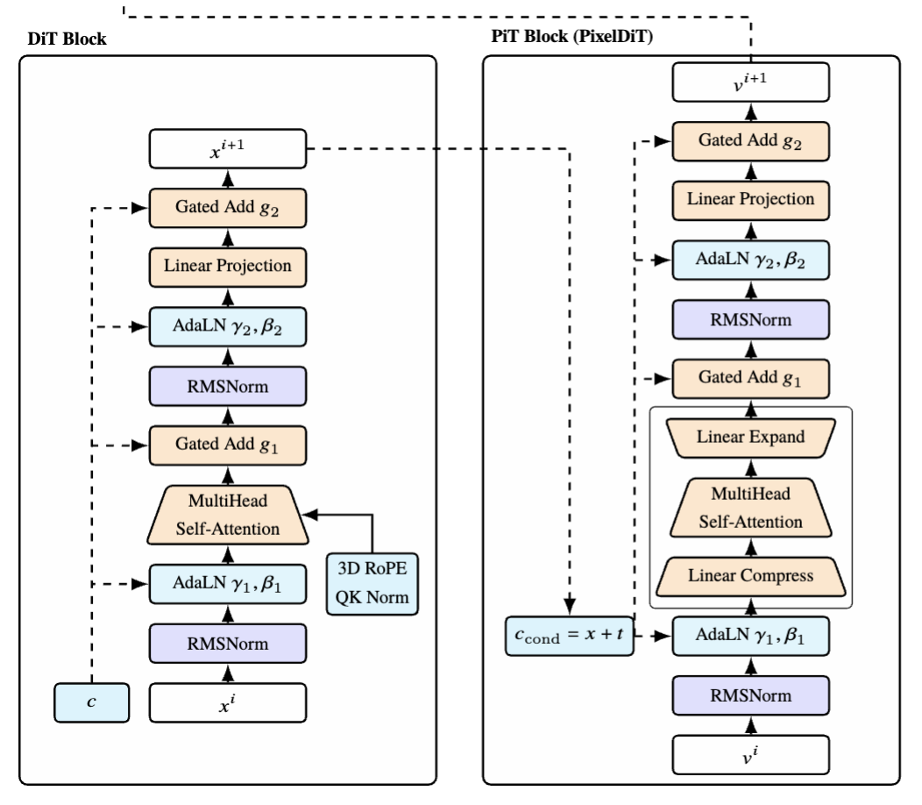
DiT IV: Model Architecture
DiT Block:
Direct multi-head attention
AdaLN conditioning + 3D RoPE
PiT Block:
Linear Compress → Attention → Expand
Same AdaLN/gating, optimized for high-res pixel-space

Slide 12
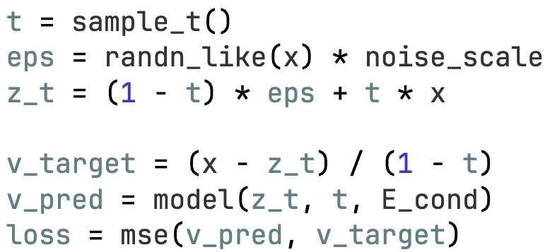


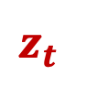


DiT V: Training
Training:
PyTorch provides tensor computation and automatic differentiation, while PyTorch Lightning offers a high-level training framework.
Training Time: The total effective training time is 3h23m19s on a single RTX 5090 GPU.
$$x$$
$$z_{t}$$
$$eps$$
$$V_{target}$$
$$V_{pred}$$

Slide 13
Result I: Generation Quality
Generate photon shower at 16 GeV for example
GEANT4
MODEL

Slide 14
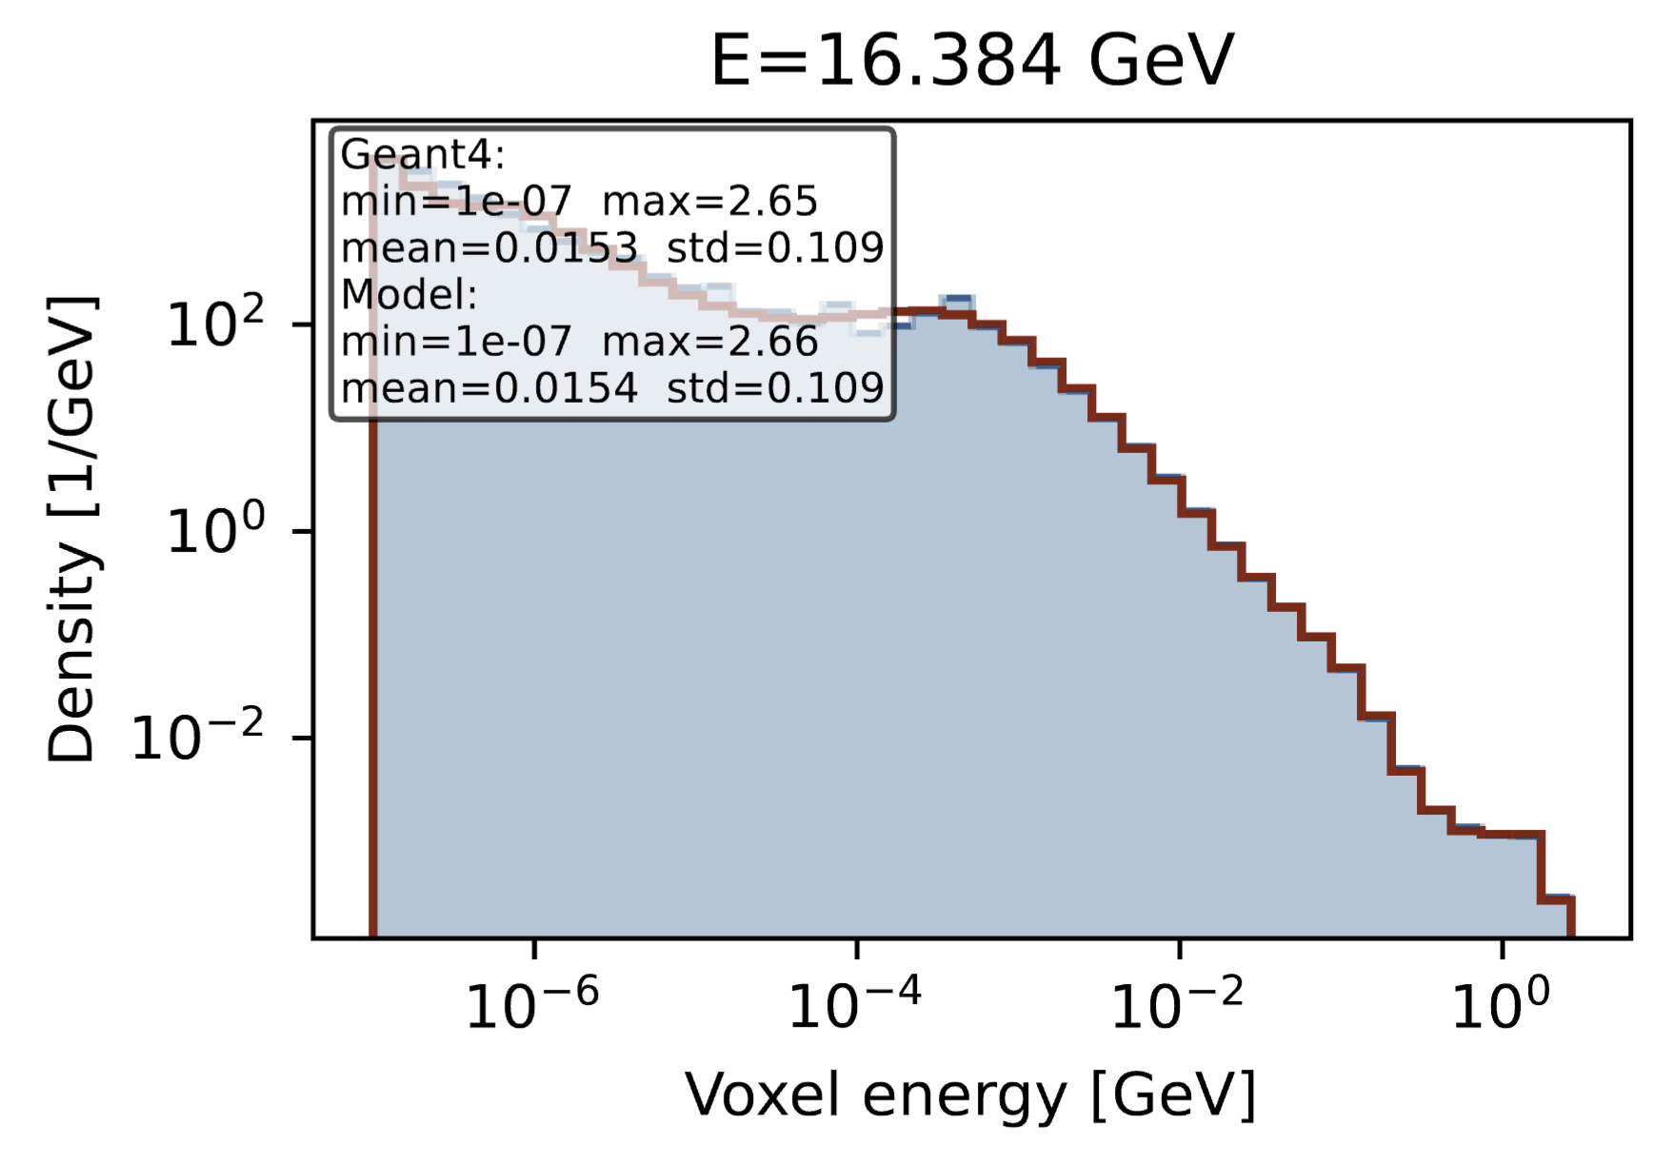
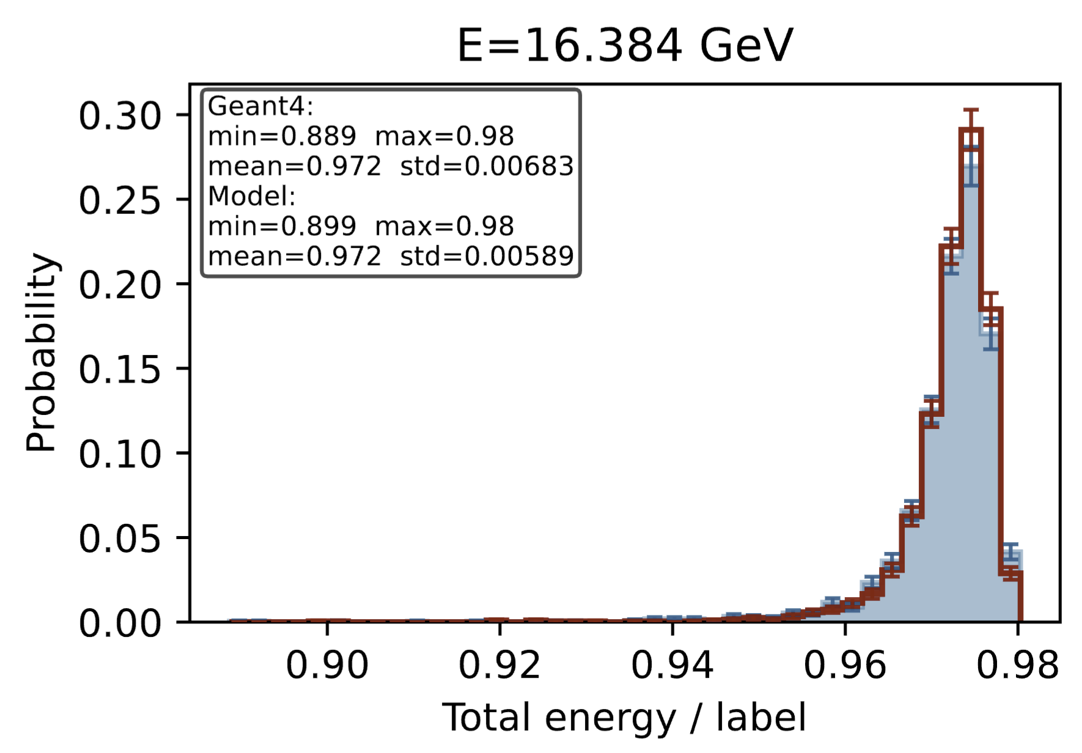
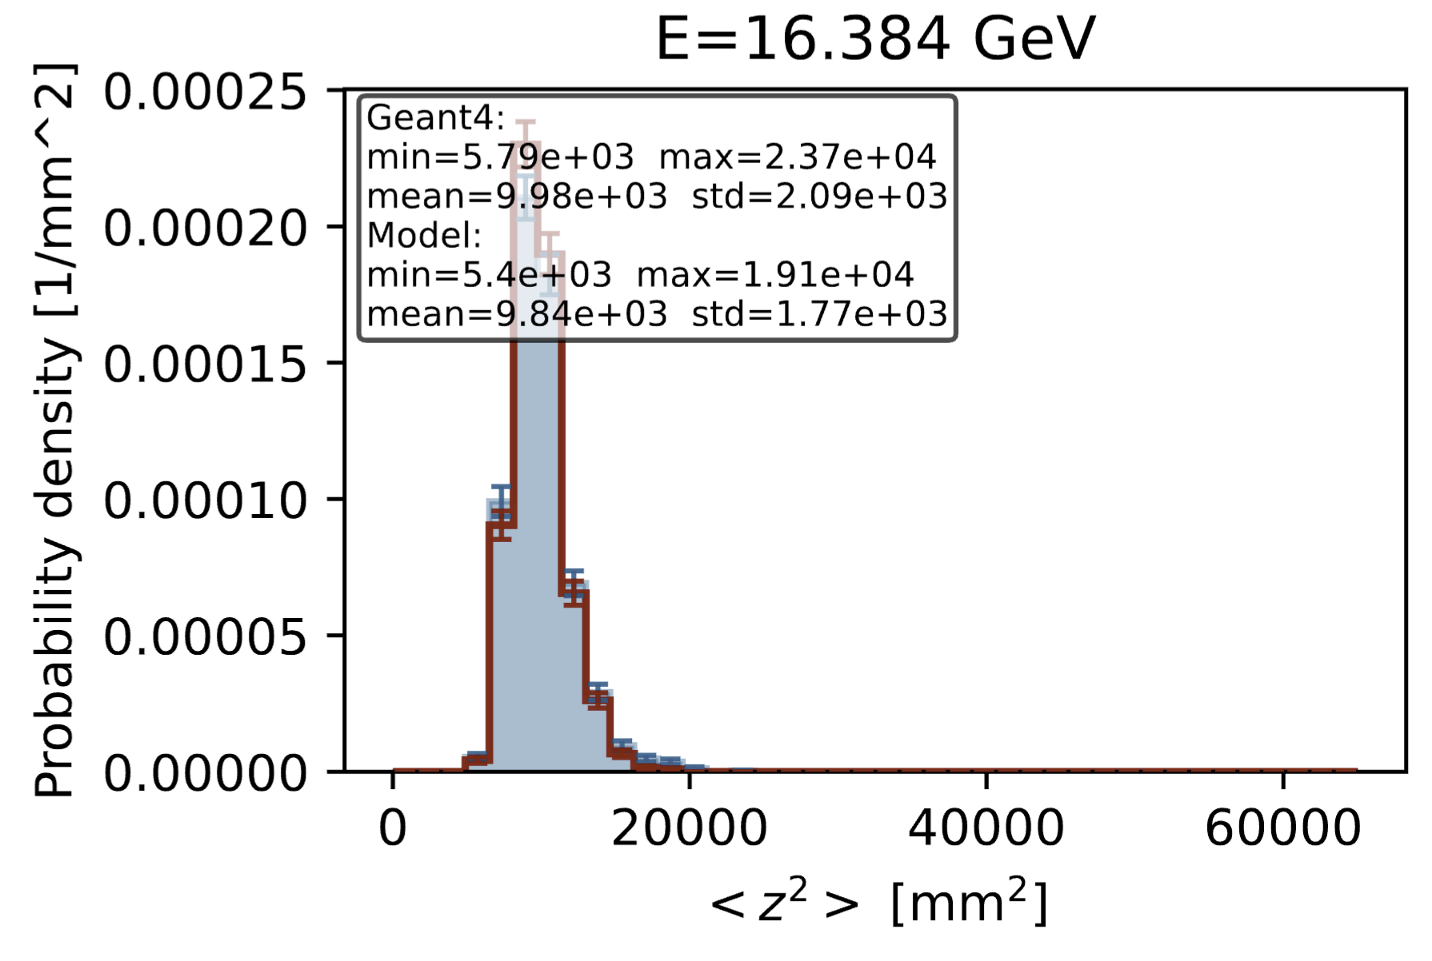
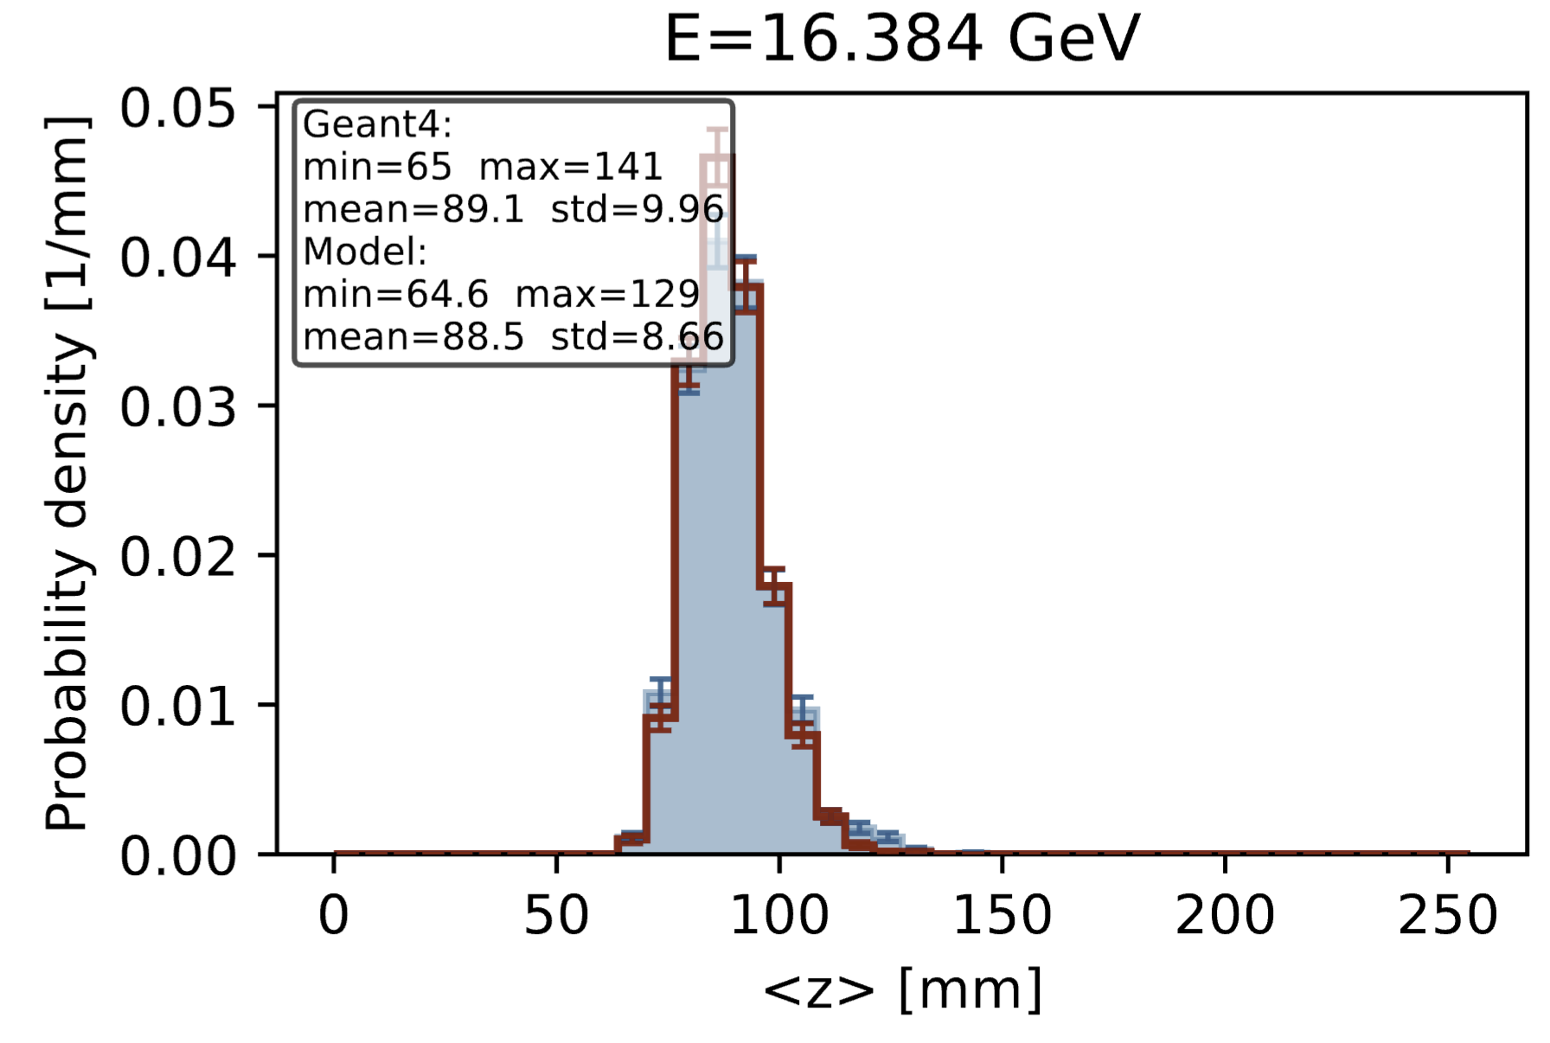
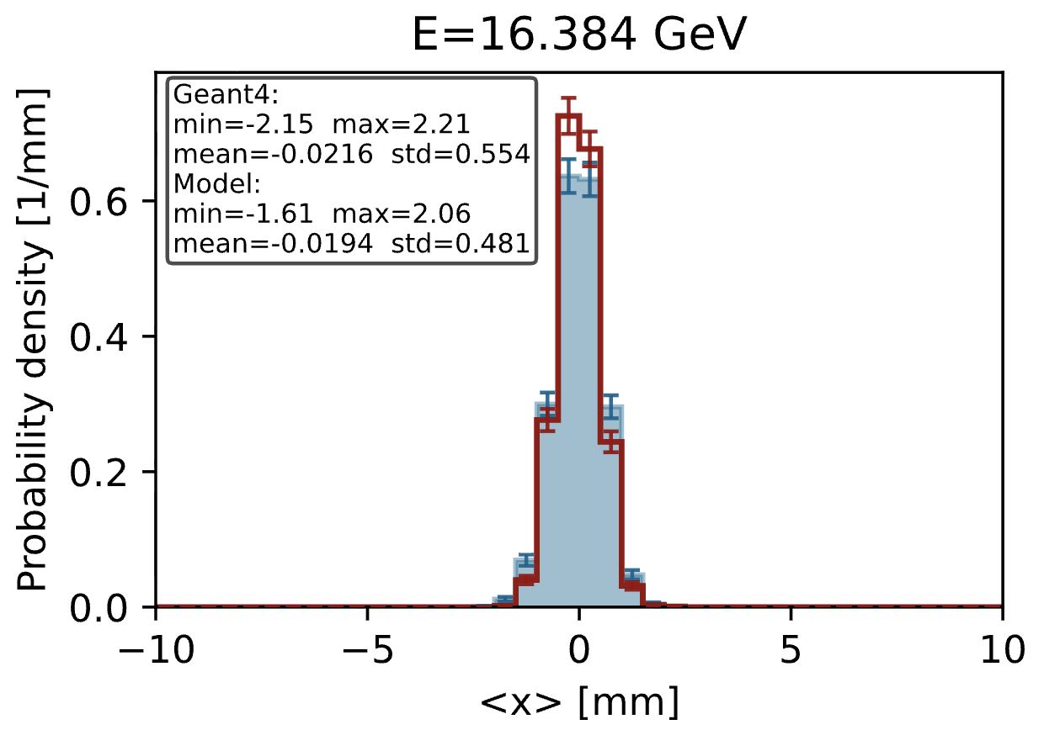
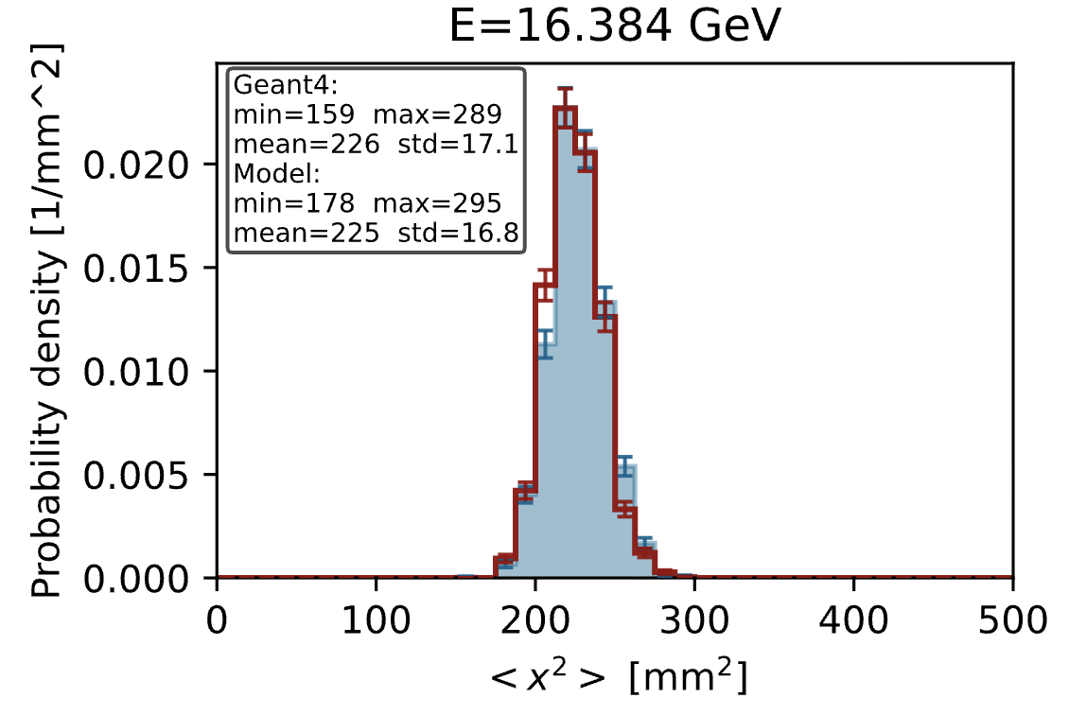
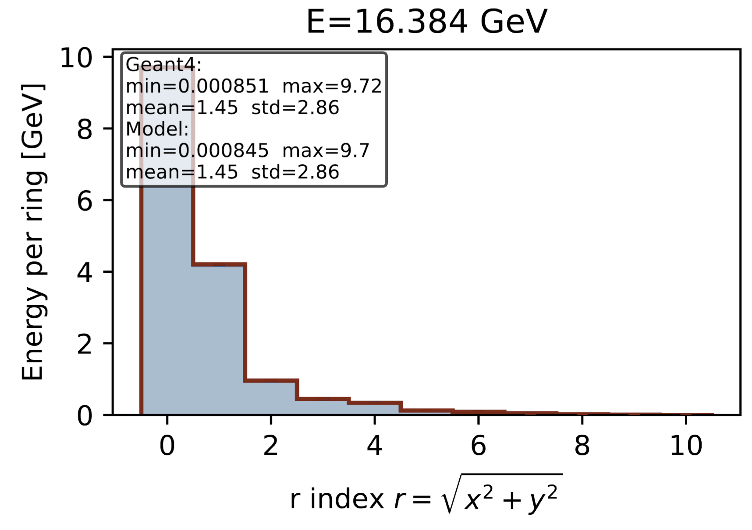
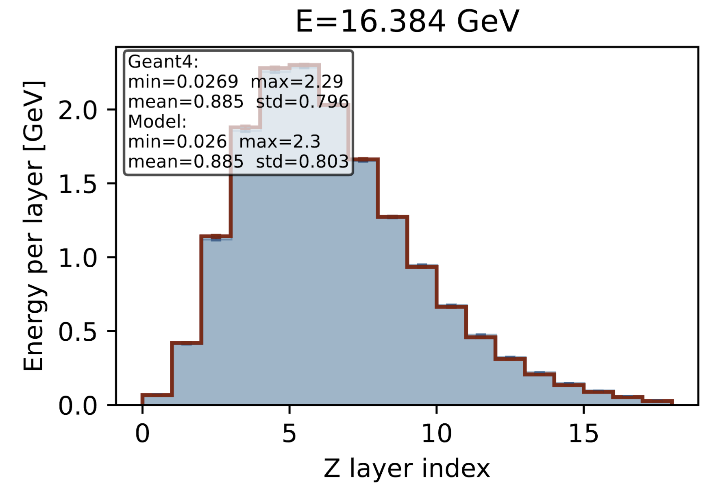
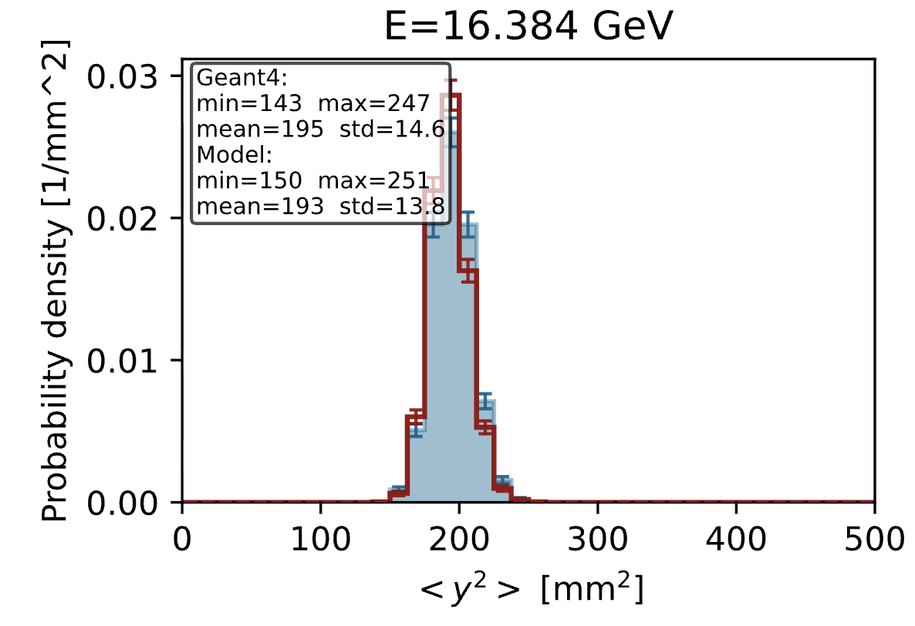
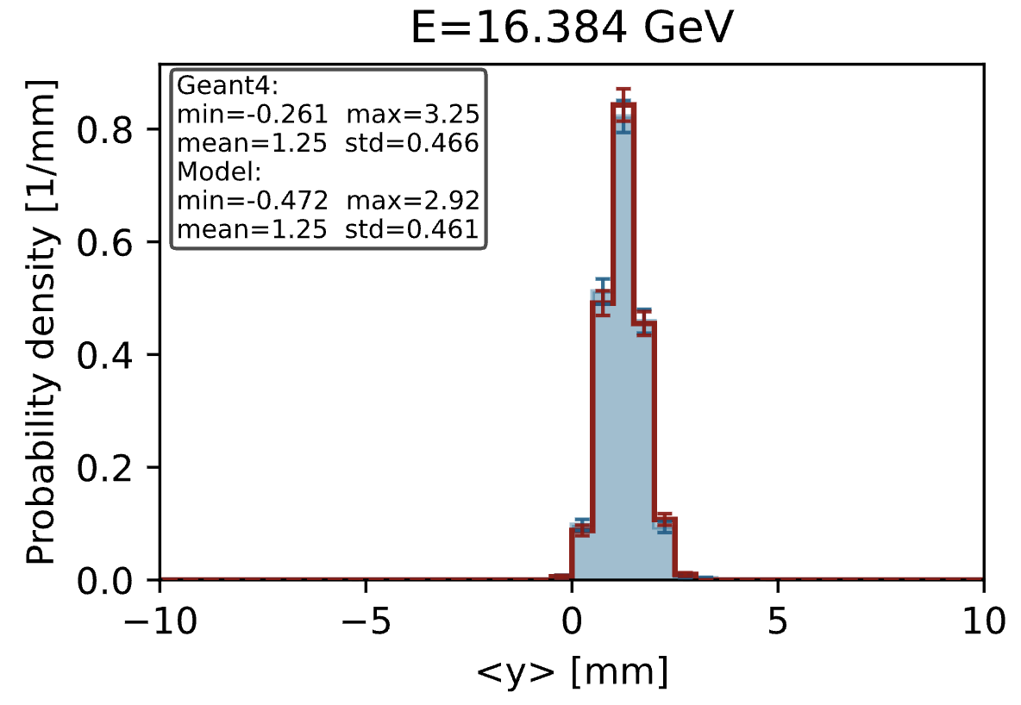



Result I: Generation Quality
$$x$$
Photon
$$y$$
$$z$$
Overview
ZXY energy center
Geometry

Slide 15
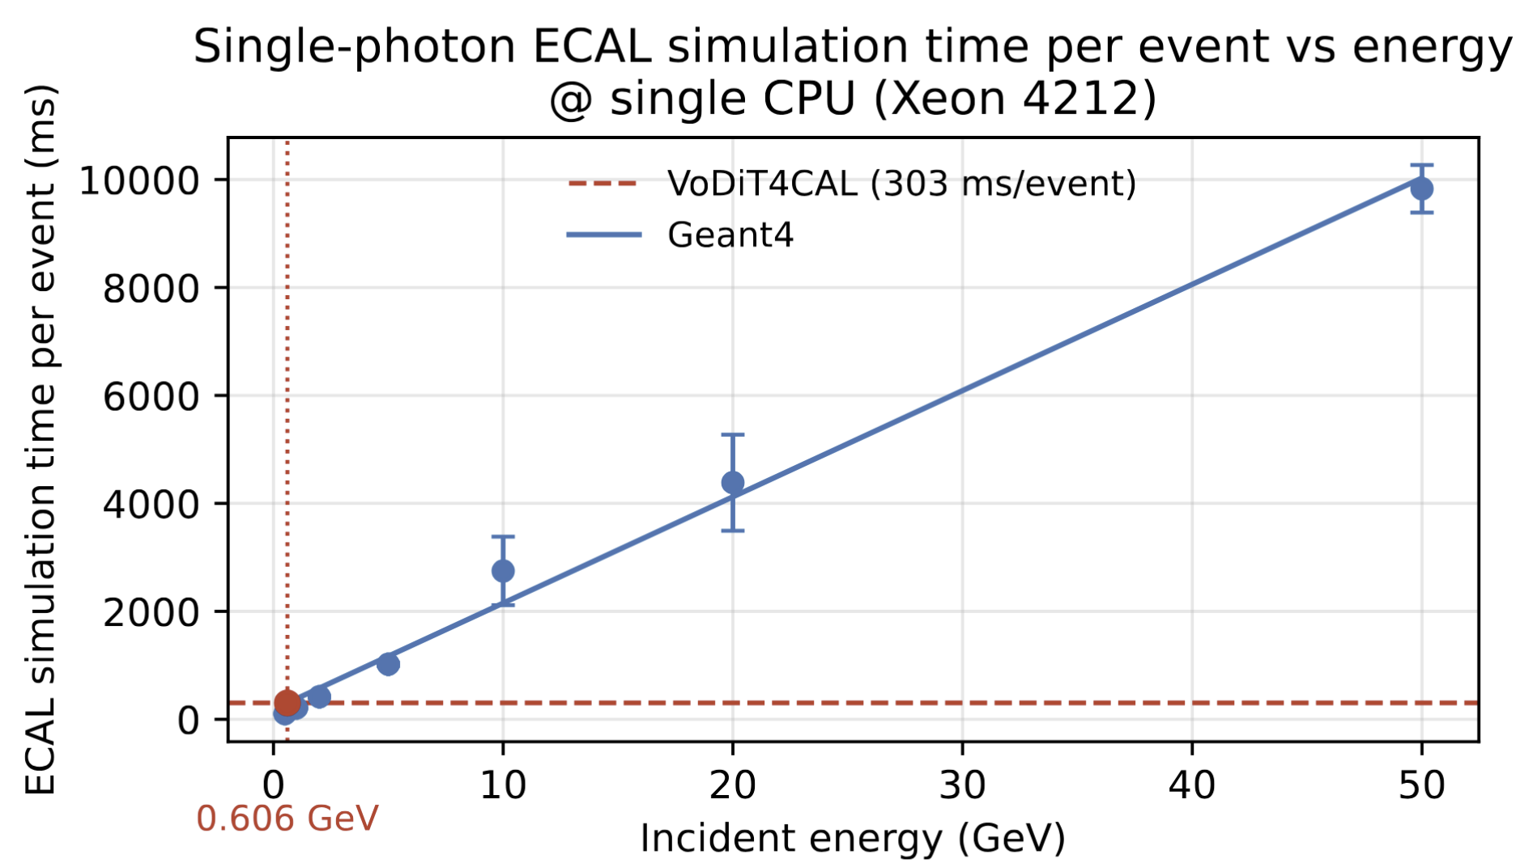

Result II: Generation Speed
Benchmark:
GPU (Nvidia RTX 8000): 3.19 ms /event
CPU (Xeon 4214, single thread): 303.45 ms /event
Geant4: generation time $T ～ E$ with particle energy $E$

Slide 16
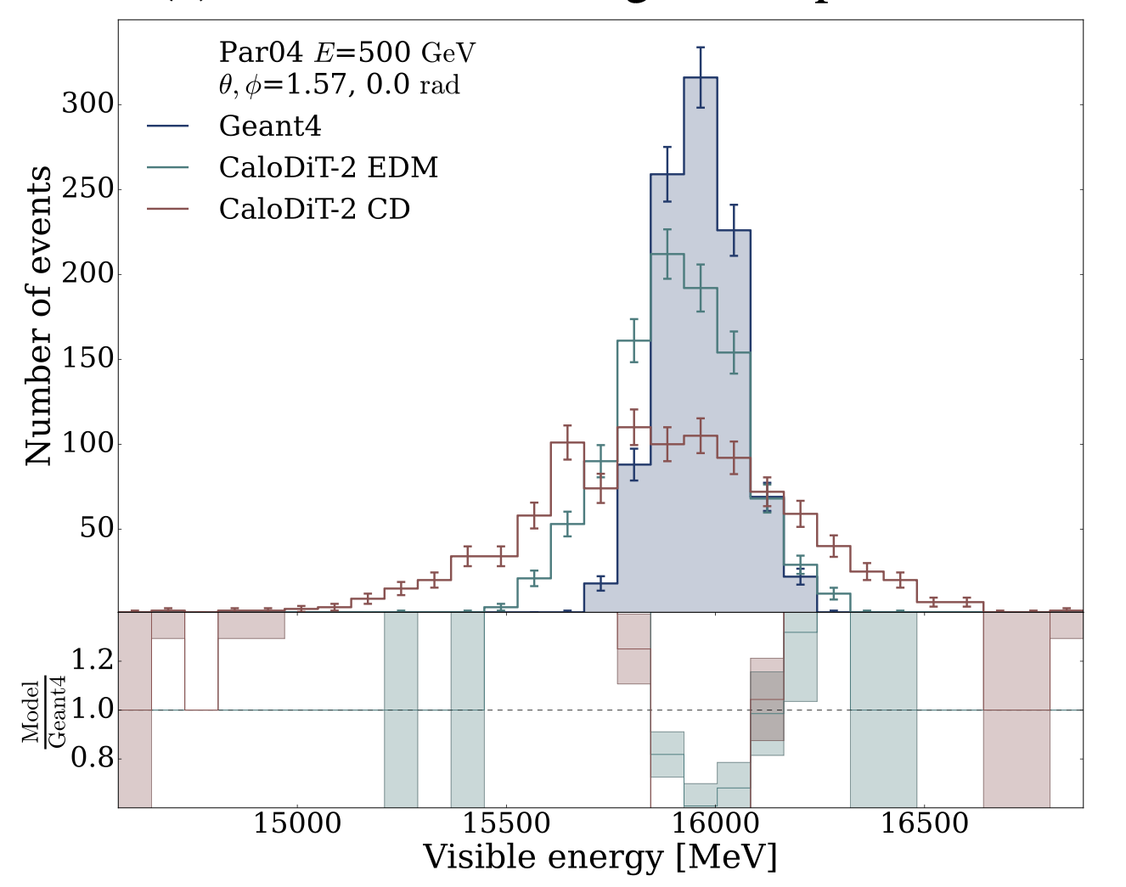
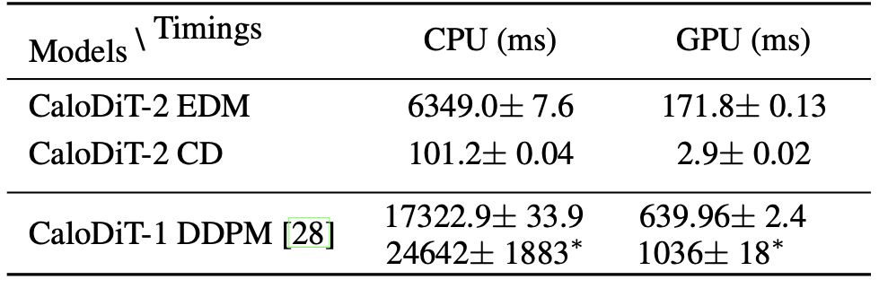
Result III: Compare with CaloDiT-2
Foundation: Extends CaloDiT-2 thought to CEPC calorimetry
CaloDiT-2 Limitations & Our Solutions:
Energy linearity issues: Improved via CLR Data Transform
Deep/slow architecture: Accelerated by PiT blocks
Scope Note:
Direct comparison with original CaloDiT-2 not performed: dataset mismatch (CaloChallenge benchmarks vs. CEPC simulation Data)
VoDiT4CAL (Ours)
CaloDiT-2
arXiv:2509.07700

Slide 17
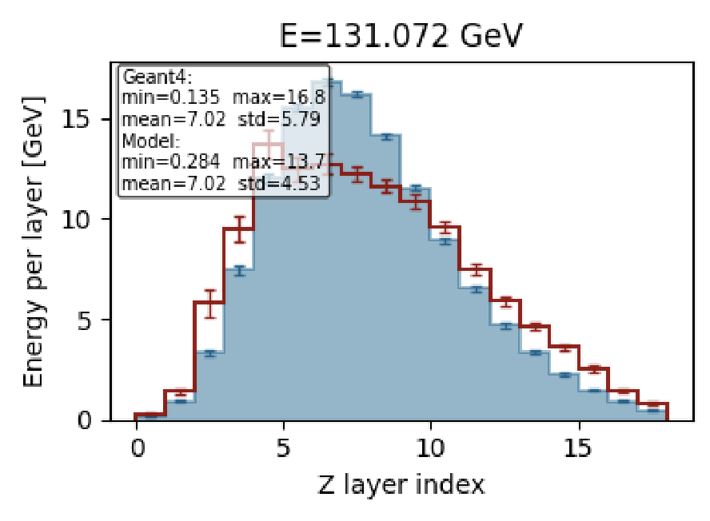
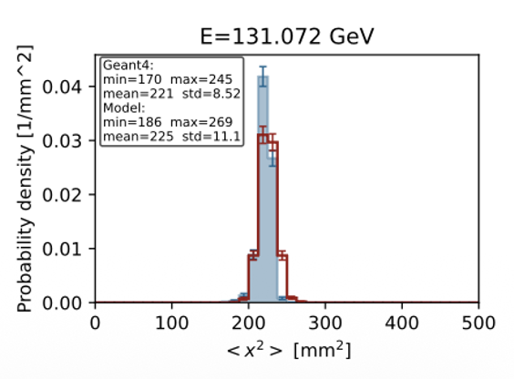
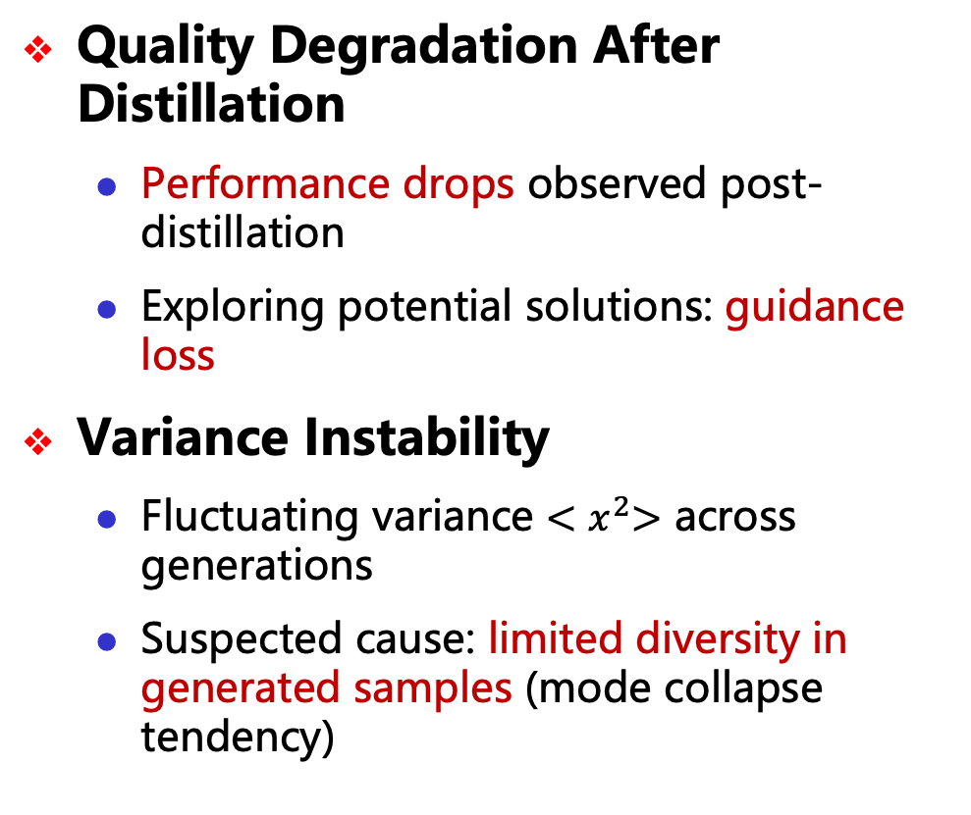
Limitation & Open Challenges
Quality Degradation After Distillation
Performance drops observed post-distillation
Exploring potential solutions: guidance loss
Variance Instability
Fluctuating variance ${<x}^{2}>$ across generations
Suspected cause: limited diversity in generated samples (mode collapse tendency)
Notes:
局限性：Limitation

Slide 18
Outline
Motivation
DiT-based fast simulation method
Quantum GAN
Summary

Slide 19
Quantum Motivation
Our classical results have already shown that DiT offers stronger stability, generation quality, and scalability than GAN.
the natural next question is: under the same diffusion/Transformer framework, quantum modules can further improve global modeling?
Early studies on quantum diffusion already suggest that this direction is promising, providing initial evidence that quantum-enhanced diffusion models are worth exploring beyond qGAN.
For example, QGDM reports faster convergence than QGAN and higher fidelity in mixed-state generation, while Quantum Latent Diffusion Models show better image-generation metrics than a comparable classical model and retain advantages in few-shot settings.
arXiv:2401.07039. arXiv:2501.11174

Slide 20
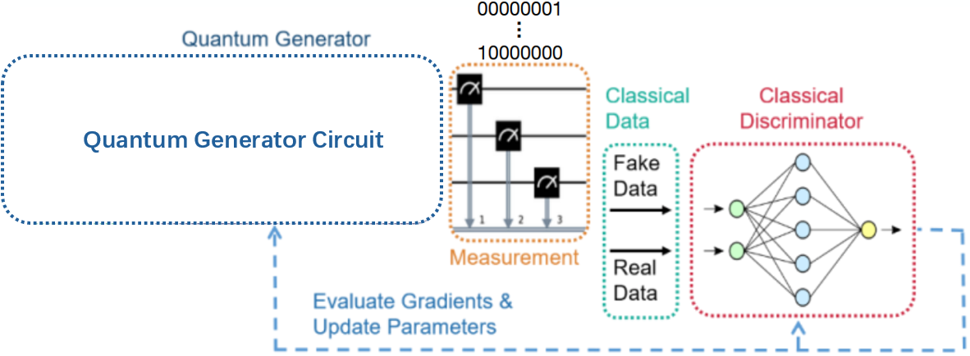
Quantum GAN for FastCaloSim
Motivation: Quantum GANs in Calorimeter Simulation
Calorimeter simulation is one of the most CPU-intensive tasks in HEP.
Overcoming computational challenges through the integration of ML and QC.
Quantum Generative Adversarial Network(GAN)
GAN is composed of two adversarial neural networks.
NISQ constraints necessitate hybrid classical-quantum algorithms.
The quantum GAN in this study adopts a quantum generator + classical discriminator.

Slide 21
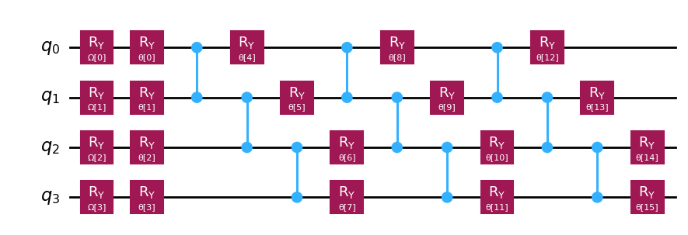
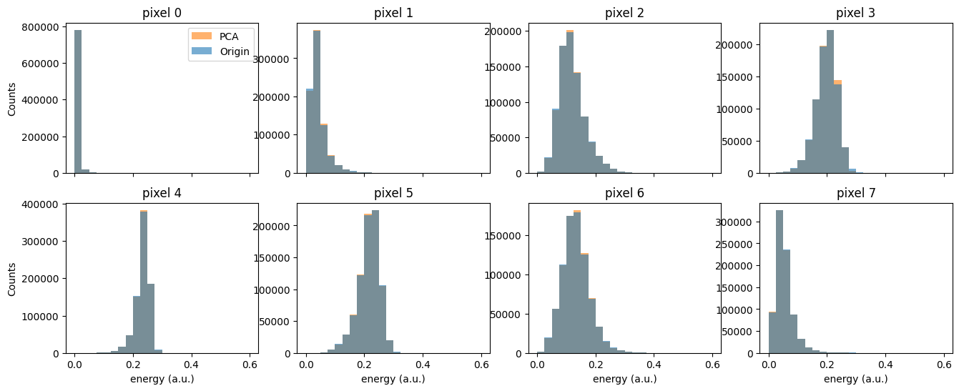
Quantum GAN for FastCaloSim
Quantum Generator Circuit
A generator circuit composed of 4 qubits.
RY gates contain trainable parameters.
Training Data and Preprocessing
Simulated electron showers from Geant4 at a fixed incident angle.
Processed into one-dimensional 8-pixel distributions as training data for the GAN.
Input training data into the quantum circuit via PCA.

Slide 22
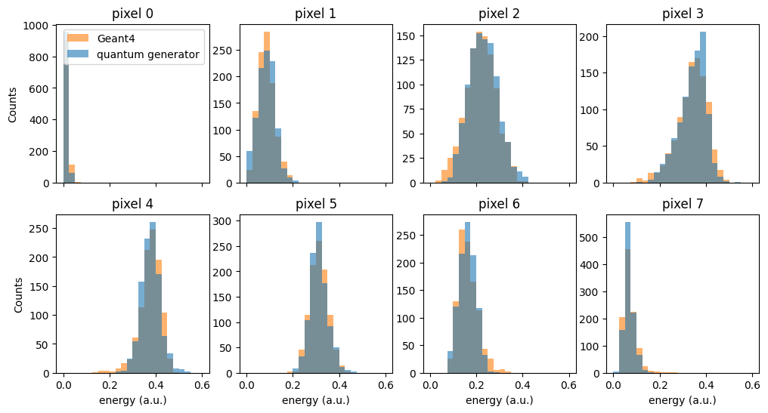
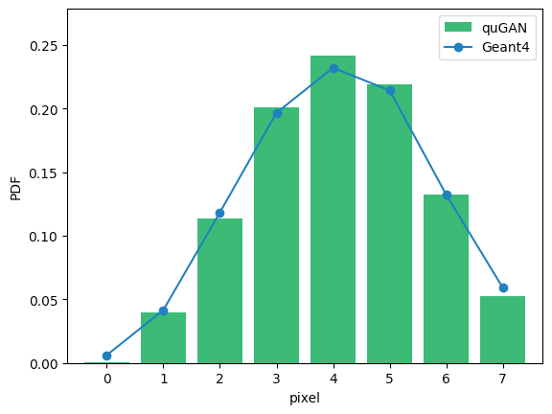
Quantum GAN for FastCaloSim
Quantum GAN Training Results
Generated data is consistent with Geant4
Ref XiaoZhong Huang, Quantum GAN for fast shower simulation

Slide 23
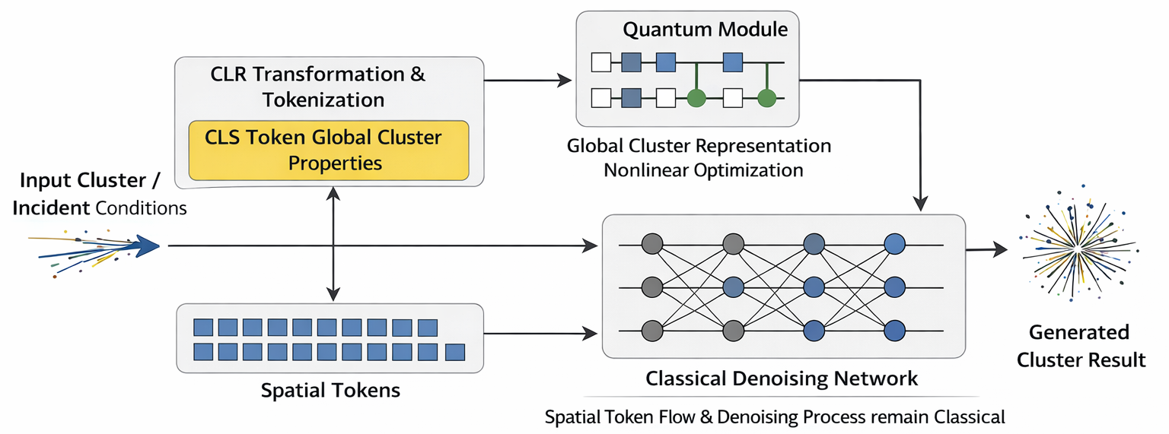
Future Plan: Quantum-DiT hybrid model
Current DiT model uses CLR transform; a dedicated CLS token captures global shower properties.
The quantum module operates exclusively on the CLS token, performing nonlinear renormalization of the global shower representation.
Spatial token flow and backbone denoising remain fully classical — minimizing quantum overhead while preserving generation fidelity
CLS and spatial tokens are jointly trained end-to-end, enabling the quantum module to meaningfully influence the denoising process

Slide 24
Outline
Motivation
DiT-based fast simulation method
Quantum GAN
Summary

Slide 25
Summary
VoDiT4CAL achieves high-precision fast simulation of the CEPC crystal ECAL at ~100ms level.
While preserving the quality of showers and key physical observables, it delivers approximately a 100× speedup for 50 GeV events on a single CPU core.
This provides a practical solution to mitigate computing bottlenecks and paves the way for larger-scale physics studies.
Will apply distillation techniques to reduce inference time while maintaining generation quality; Will extend to multi-particle and more complex incident conditions
Will try to explore Quantum Transformer
Will ultimately integrate it into CEPCSW framework to effectively replace the Geant4 ECAL simulation module
Notes:
加一些不完美的图

Slide 26
Thank you!

Slide 27
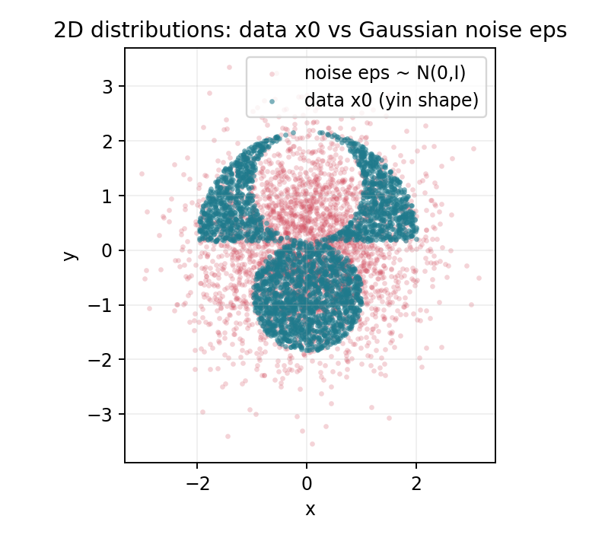
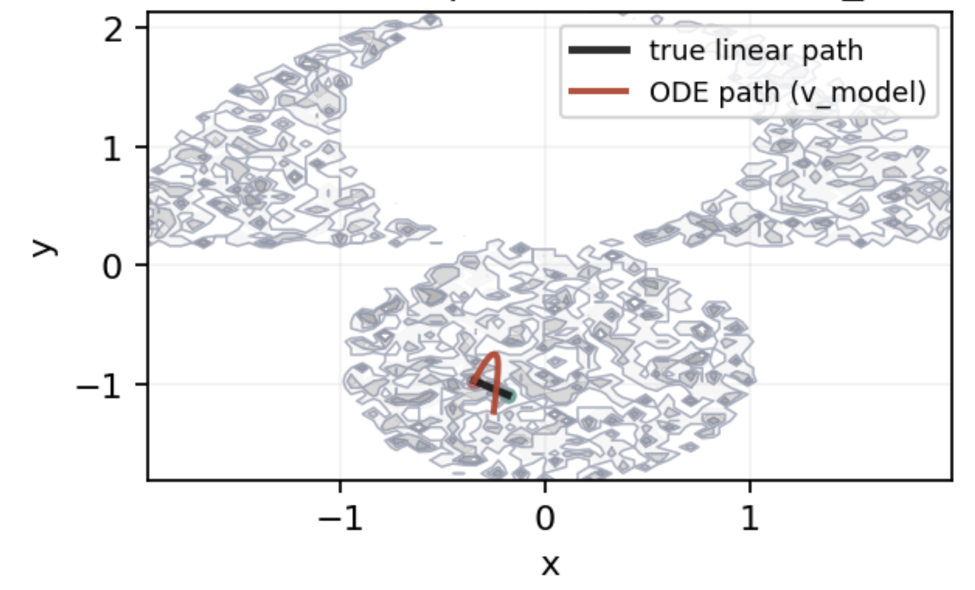
TOY Data Demo

Slide 28
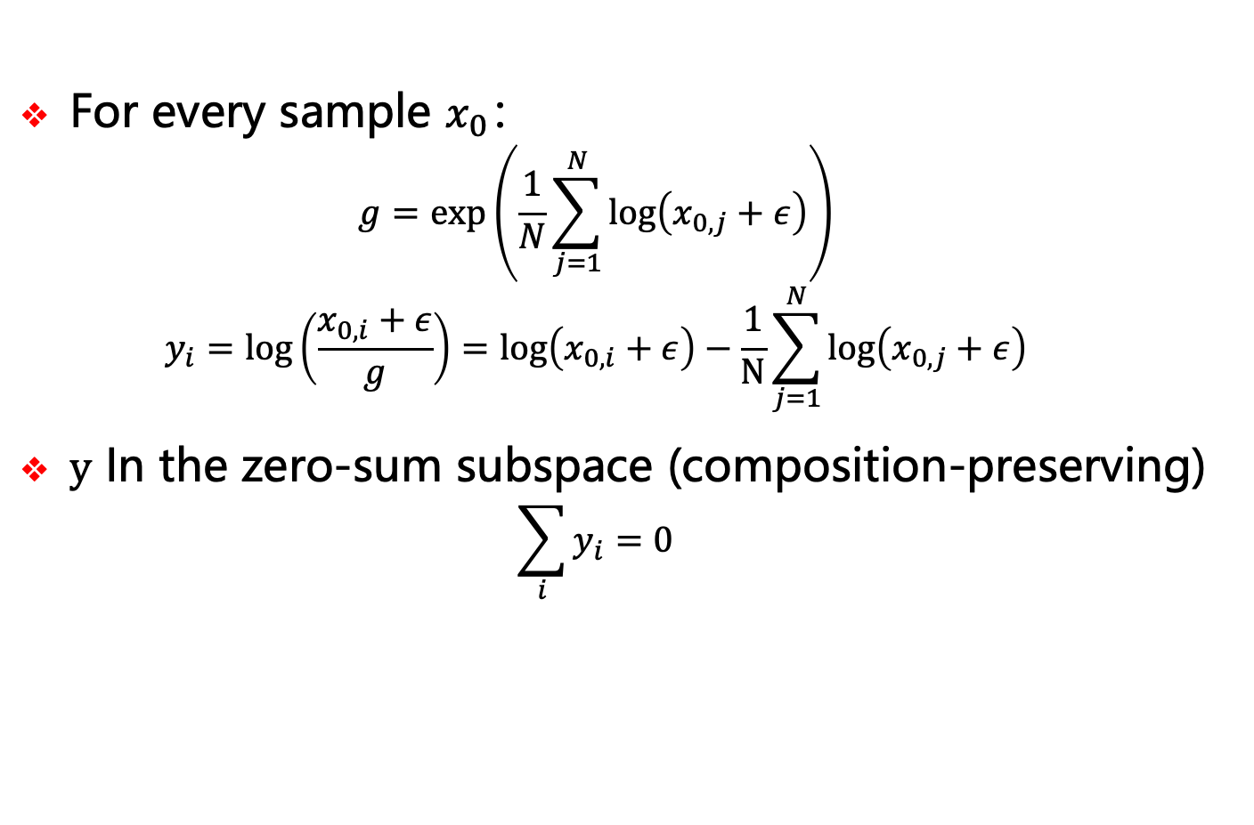
CLR Transform
For every sample $x_{0}$：
$$g=\exp\left(\frac{1}{N}\sum_{j=1}^{N}{\log\left(x_{0,j}+ε\right)}\right)$$
$$y_{i}=\log\left(\frac{x_{0,i}+ε}{g}\right)=\log\left(x_{0,i}+ε\right)−\frac{1}{N}\sum_{j=1}^{N}{\log\left(x_{0,j}+ε\right)}$$
$y$ In the zero-sum subspace (composition-preserving)
$$\sum_{i}{y_{i}}=0$$

Slide 29

Geant4 Simulation in CEPCSW
Tracking: Step-by-step particle propagation via Geant4 (physics-driven: ionization, radiation, scattering)
Energy Deposition: Step-wise energy loss → "Hit" objects (x, E, t)
Linearity: Total response is sum of individual particle responses (exploiting linear system property)
One particle in, one solution out

Slide 30


CEPCSW Computing Bottlenecks
Classical Computing Resource Bottleneck: The CEPC full-simulation program is expected to produce about ${10}^{11}$events per year, yielding $284 PB$ of full-simulation data and consuming roughly $1570$ kHS23-yr of CPU computing time annually.
Run stage | MC events | CPU time (kHS23-yr) | MC data (PB)
Higgs | $$2.0×{10}^{9}$$ | 105 | 4.00
Low Z | $$1.4×{10}^{11}$$ | 1465 | 280.00
arXiv:2510.05260
Notes:
TDR

Slide 31


Generative Models
Generative models aim to learn the true data distribution $p_{\text{data}}\left(x\right)$by approximating it with a parameterized model $p_{θ}\left(x\right)$such that
$$p_{θ}\left(x\right)≈p_{\text{data}}\left(x\right)$$
New samples are generated by sampling
$$x∼p_{θ}\left(x\right).$$
GAN
VAE
Flow
Diffusion

Slide 32

Generative Models
Year | Model | Strength | Weakness
2013 | VAE | Stable | Blurry samples
2014 | GAN | Sharp outputs | Unstable training
2015 | Flow | Exact likelihood | Expensive
2017 | Transformer | Strong long-range modeling | Slow autoregressive sampling
2020 | Diffusion | Best overall quality | Slow multi-step sampling

Slide 33
Generative Models : Timeline
Year | Model Category | Representative Work | Key Contribution
2017 | GAN | FastCaloGAN | First use of GANs for calorimeter fast simulation with very large speedup vs Geant4.
2021 | Normalizing Flows | CaloFlow | Introduced normalizing flows for calorimeter showers with high fidelity & stable training.
2022 | Normalizing Flows | CaloFlow II | Enhanced flows (v2) with probability distillation; validated on community benchmark.
2023 | Diffusion Models | CaloClouds / CaloDiffusion | Applied diffusion & point-cloud methods; geometry-independent generation.
2025 | Generalizable Diffusion | CaloDiT-2 | Transformer-based diffusion with pretraining across detectors; rapid adaptation with reduced data/time cost.
Higher accuracy
More stable generation
Better generalization
Notes:
对比别人的结果

Slide 34


DiT I: Overview
DiT (Diffusion Transformer) is a generative architecture for conditional diffusion which is particularly suitable for high-dimensional, complex, and conditional generation tasks.
Noise Tokens: Randomly initialized noise inputs representing the starting noisy state.
Condition Tokens: Tokens encoding conditioning information such as particle type, total energy, angles, etc.
Transformer Attention Block: The core of DiT, using self-attention and cross-attention mechanisms to enable interaction between different tokens.
Data Tokens: Representations of the crystal array or energy deposits, from which the model produces denoised outputs that satisfy the conditioning.

Slide 35

DiT III: Dataset
Detector Geometry Mapping：
ECAL geometry mapped to regular 3D voxel grid
DD4HEP segmentation: automated "Interesting Region" extraction
Model learns inherent geometric irregularities from data
Current Scope & Limitations
Normal incidence (θ = 0°) only for initial study
Gap handling: inter-module gaps included in voxelization; model learns zero-energy regions as structural features
Interesting Region

Slide 36


DiT IV: Model Architecture
VoDiT4CAL Architecture:
Patch Embedding: Use 3D convolutions to split the ECAL volume into small patches, mapping each patch to a high-dimensional latent token.
Conditioning: Each token is augmented with relative positional encoding, noise timestep $t$ encoding, total energy $E$ particle type, etc.

Slide 37

DiT V: Training
Training Steps:
Sample a random timestep $t ∼𝒰\left(0,1\right).$
Construct a noisy state $z_{t}$ by mixing data $x$ with Gaussian noise $ε∼𝒩\left(0,I\right)$.
$$z_{t}=\left(1−t\right)ε+tx$$
Use v-parameterization with target
$$v_{\text{target}}=\frac{x−z_{t}}{1−t}$$
$$v_{\text{pred}}=f_{θ}\left(z_{t},t,\text{cond}\right),$$
$$\text{cond}=E, \text{particle} \text{type}\text{,}…$$
Optimize with MSE loss: $ℒ=\text{MSE}\left(v_{\text{pred}},v_{\text{target}}\right)$
$$x$$
$$z_{t}$$
$$eps$$
$$V_{target}$$
$$V_{pred}$$
Notes:
具体训练的办法

Slide 38



DiT VI: Distillation-based Acceleration
Pixel Mean Flow: A one-step, latent-free generative model that maps noise directly to output.
Only one-step generation
Quality decreases
Maybe 10x speedup

Slide 39



Result I: Generation Quality
Geometry
$$x$$
$$y$$
$$z$$
Photon

Slide 40
Result I: Generation Quality
Z energy center
X energy center
Notes:
更多指标，参考calo challenge

Slide 41
Result I: Generation Quality
Y energy center
Notes:
更多指标，参考calo challenge

Slide 42
WIP: Future Plan
One-Step Distillation：
Model currently uses multi-step diffusion (16 steps).
Enable single-step generation with Pixel Mean Flow (pMF).
Deployment & Integration:
Develop interfaces for deployment within Geant4 workflows.
Multi-Particle & Incident States:
Handle different particle types and incoming states (e.g., electrons, photons, hadrons) with a unified model.
Cross-Detector Generalization:
Strengthen generalization across different detector designs and experiments.

Slide 43
Outline
Motivation
DiT-based fast simulation method
Quantum GAN
Summary

Slide 44
Integration of fast simulation
DetElem Tool
Detector Construction
PrimaryCnv Tool
Primary Generator Action
DetSimAlg
G4 Physics List Factory
Physics List
G4 Run Manager
AnaElem Tools
User Actions
(MCTruth)
DetSimSvc
FastSimG4 Tools
G4VFast Simulation Model
Gaudi Components
G4 wrapper layer
Within CEPCSW, a lightweight simulation framework has been developed to enable seamless integration of Geant4 into Gaudi framework

Slide 45


Integration of fast simulation
Region based fast simulation is adopted
When a particle enter a region, fast simulation will be triggered by Geant4.
Machine learning inference could be integrated via ONNX.
A Zaborowska 2017 J. Phys.: Conf. Ser. 898 042053
Notes:
模拟过程，多hit直接加起来，不需要关心

Slide 46


SUM

Slide 47


Slide 48



Slide 49



Slide 50



Slide 51



Slide 52



