Slide 1
Physics-informed model for Accelerating Large-scale Quantum Optimization
Yiming Huang*, Yajie Hao^{2*}, Jing Zhou⁴, Xiao Yuan^{1†}, Xiaoting Wang^{2†} ,Yuxuan Du^{3†}
¹Peking University, ²University of Electronic and Science of China,
³Nanyang Technological University, ⁴Fudan University

Slide 2
Background and motivation
Accelerate gradient-based VQAs by PINN
Conclusion

Slide 3
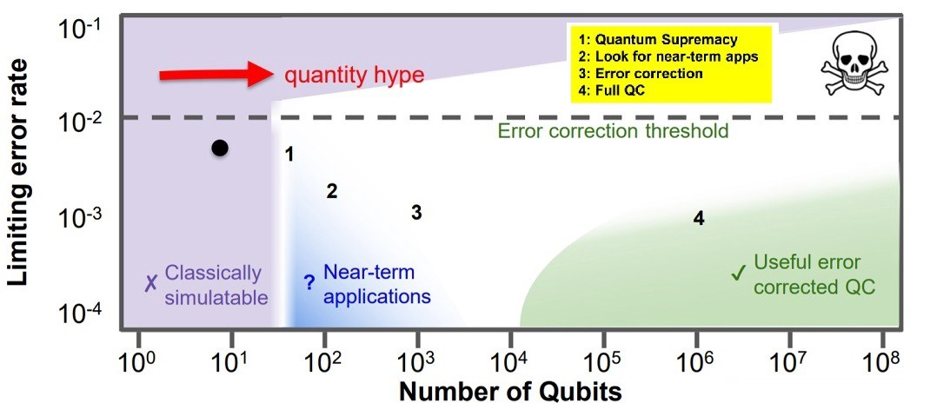
BACKGROUND AND MOTIVATION

Slide 4



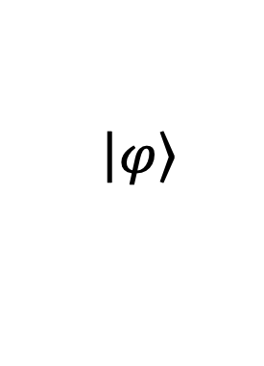
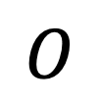


BACKGROUND AND MOTIVATION
Variational Quantum Algorithms
$$\left|\left.φ\right\rangle \right.$$
$$U_{θ}$$
$$O$$
$$×l$$
H
$$θ$$
X
$${θ_{t},∂}_{θ}L$$
H
Z
H
X
$$θ_{t+1}$$
H
Y
NISQ (Noisy Intermediate-Scale Quantum)
device
Classical device

Slide 5
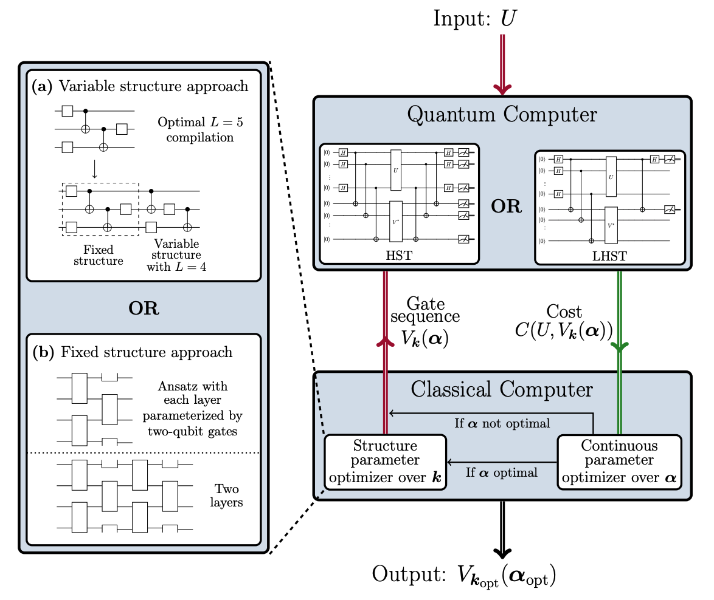
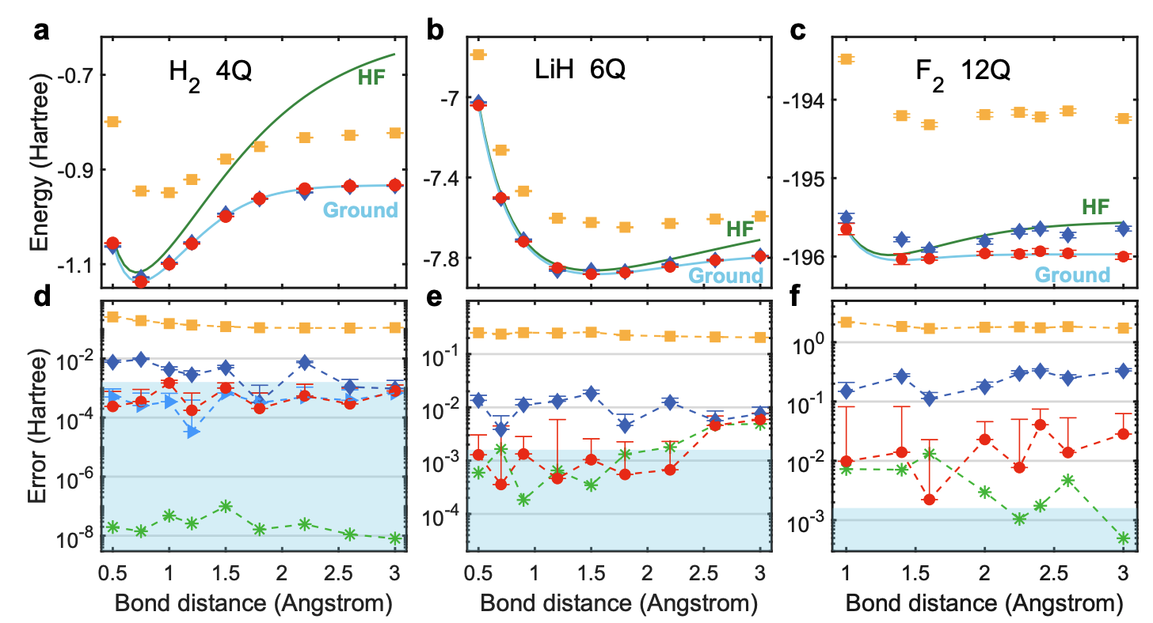
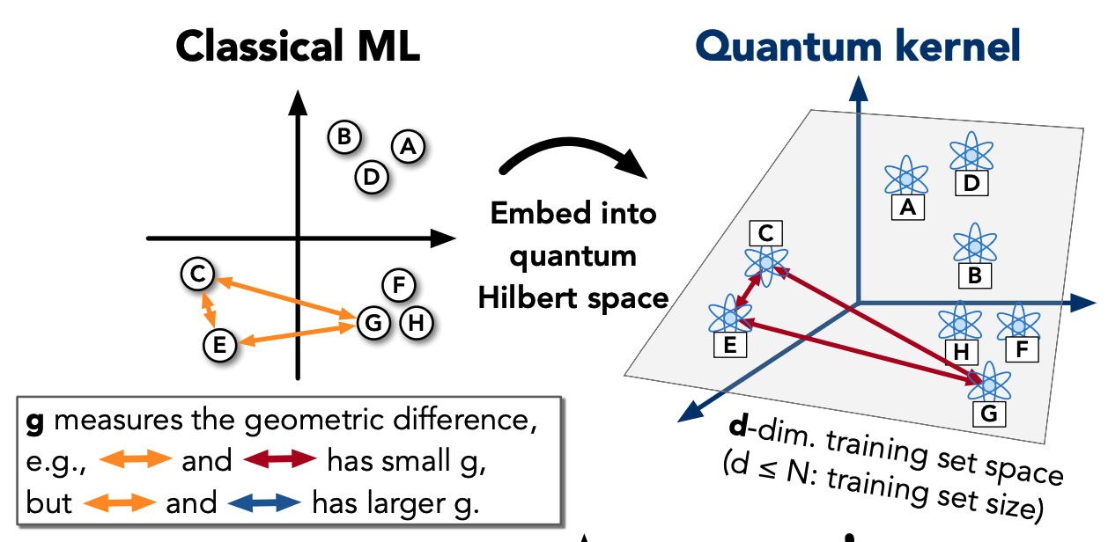
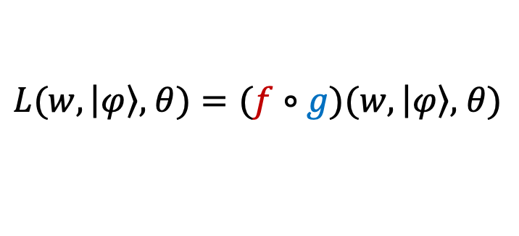
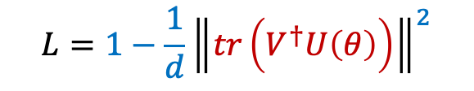
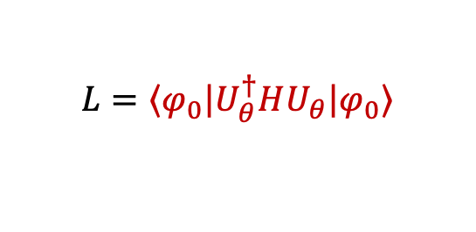
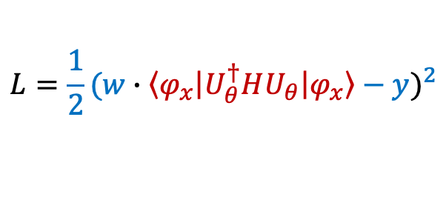
BACKGROUND AND MOTIVATION
Variational Quantum Algorithms
$$L(w, \left|\left.φ\right\rangle ,\right. θ)=(f∘g)(w, \left|\left.φ\right\rangle ,\right. θ)$$
QML
VQE
Circuit Compile
$$L=1−\frac{1}{d}{\left\|tr\left(V^{†}U\left(θ\right)\right)\right\|}^{2}$$
$$L=\frac{1}{2}{(w∙\left\langle \left.φ_{x}\right|\right.U_{θ}^{†}HU_{θ}\left|\left.φ_{x}\right\rangle \right.−y)}^{2}$$
$$L=\left\langle \left.φ_{0}\right|\right.U_{θ}^{†}HU_{θ}\left|\left.φ_{0}\right\rangle \right.$$
[Nat Commun,21,2631]
[NAT PHYS, 24,1240]
[Nat Commun,22,4919
Quantum 19, 3,140]

Slide 6

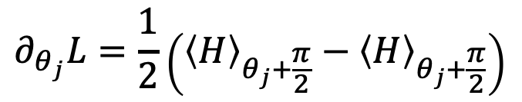



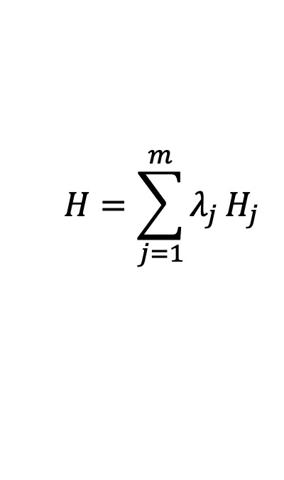

BACKGROUND AND MOTIVATION
Gradient Estimation
Phase Shift Rule
$$×l$$
H
$$θ$$
X
$$∂_{θ_{j}}L=\frac{1}{2}\left({\left\langle H\right\rangle }_{θ_{j}+\frac{π}{2}}−{\left\langle H\right\rangle }_{θ_{j}+\frac{π}{2}}\right)$$
H
Z
$$∂_{θ}L$$
H
X
$$H=\sum_{j=1}^{m}{λ_{j}}H_{j}$$
H
Y
No-cloning
theorem
$$O(pN_{H}/ε^{2})$$
+
LARGE-SCALE UNFRIENDLY
!
$$N_{H}\sim O(n^{4})$$

Slide 7




PALQO- ACCELERATE VQAs BY PINN
Challenges:
No-cloning theorem and unitary constraints prevent backpropagation.
Conventional method such as phase shift rule to estimate the gradient leads to high measurement and resource costs.
Goal :
Improving optimization efficiency while reducing the measurement and resource costs.
Training dynamics
$${θ_{t+1}⟵θ_{t+1}−η∂}_{θ}ℰ$$

Slide 8
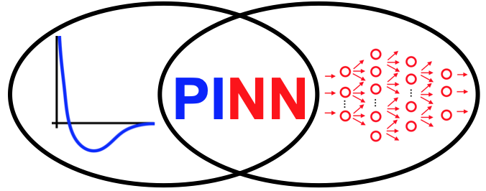
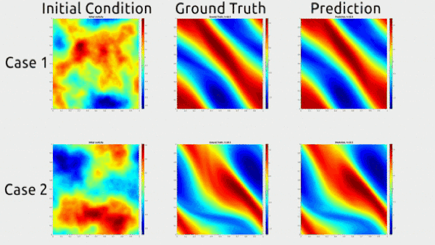
PALQO- ACCELERATE VQAs BY PINN
Physical-Inspired Neural Network
PINN - Neural networks that are trained to solve supervised learning tasks while respecting physical laws.
Physics-informed Machine Learning study potential benefits for machine learning models by incorporating the physical prior such as
Differential Equations: ODEs, PDEs, S(P)DEs
Law of conservation, Symmetry ...
Applications include
2D Navier-Stokes equation for a viscous
Turbulence Models
Chaotic System
Hao Z, Liu S, Zhang Y, et al. Physics-informed machine learning: A survey on problems, methods and applications.
https://zongyi-li.github.io/neural-operator/

Slide 9
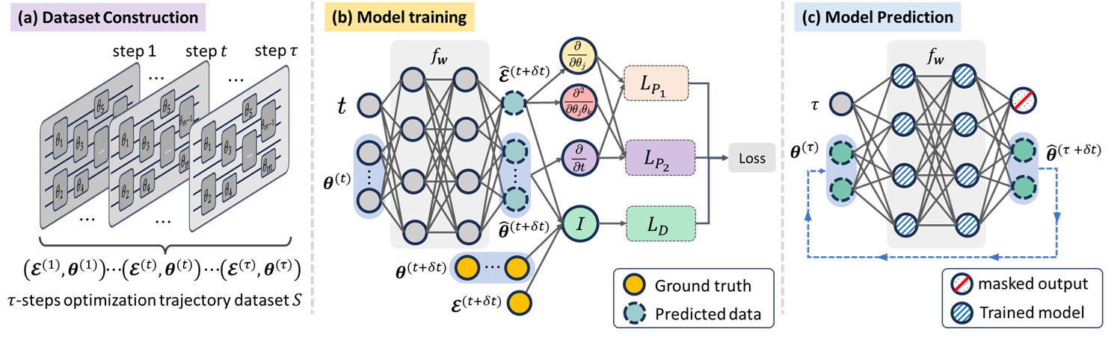
PALQO- ACCELERATE VQAs BY PINN
Framework of PALQO

Slide 10

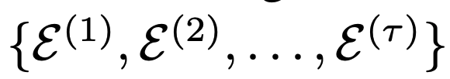



PALQO- ACCELERATE VQAs BY PINN
+
$τ$ steps of VQE
Quantum device
Classical device
$τ$ steps optimization trajectory data

Slide 11
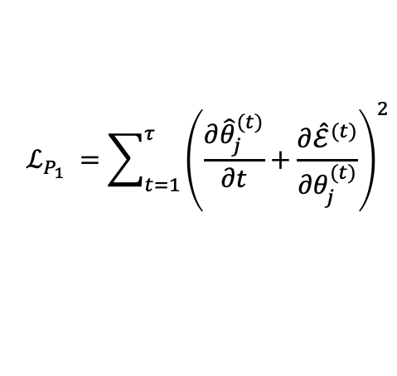
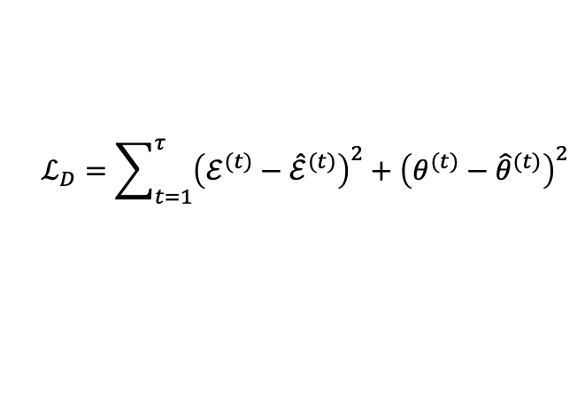

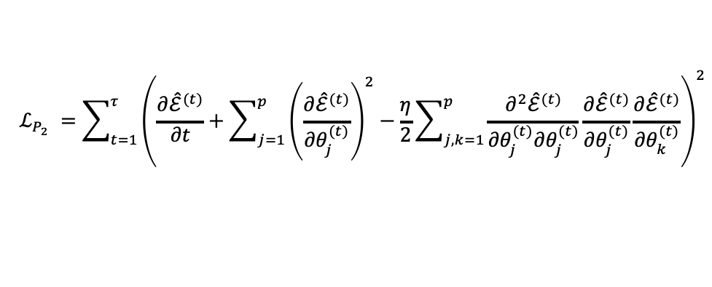
PALQO- ACCELERATE VQAs BY PINN
Loss function
$$ℒ=λ_{D}ℒ_{D}+{λ_{P_{1}}ℒ}_{P_{1}}+λ_{P_{2}}ℒ_{P_{2}}$$
Training dynamics
$$ℒ_{D}=\sum_{t=1}^{τ}{{\left(ℰ^{(t)}−{\hat{ℰ}}^{(t)}\right)}^{2}+{\left(θ^{(t)}−{\hat{θ}}^{(t)}\right)}^{2}}$$
$$ℒ_{P_{1}} =\sum_{t=1}^{τ}{{\left(\frac{{∂\hat{θ}}_{j}^{(t)}}{∂t}+\frac{{∂\hat{ℰ}}^{(t)}}{{∂θ}_{j}^{(t)}}\right)}^{2}}$$
$$ℒ_{P_{2}} =\sum_{t=1}^{τ}{{\left(\frac{{∂\hat{ℰ}}^{(t)}}{∂t}+\sum_{j=1}^{p}{{\left(\frac{{∂\hat{ℰ}}^{(t)}}{{∂θ}_{j}^{(t)}}\right)}^{2}−\frac{η}{2}}\sum_{j,k=1}^{p}{\frac{{∂^{2}\hat{ℰ}}^{(t)}}{{∂θ}_{j}^{(t)}{∂θ}_{j}^{(t)}}\frac{{∂\hat{ℰ}}^{(t)}}{{∂θ}_{j}^{(t)}}\frac{{∂\hat{ℰ}}^{(t)}}{{∂θ}_{k}^{(t)}}}\right)}^{2}}$$

Slide 12
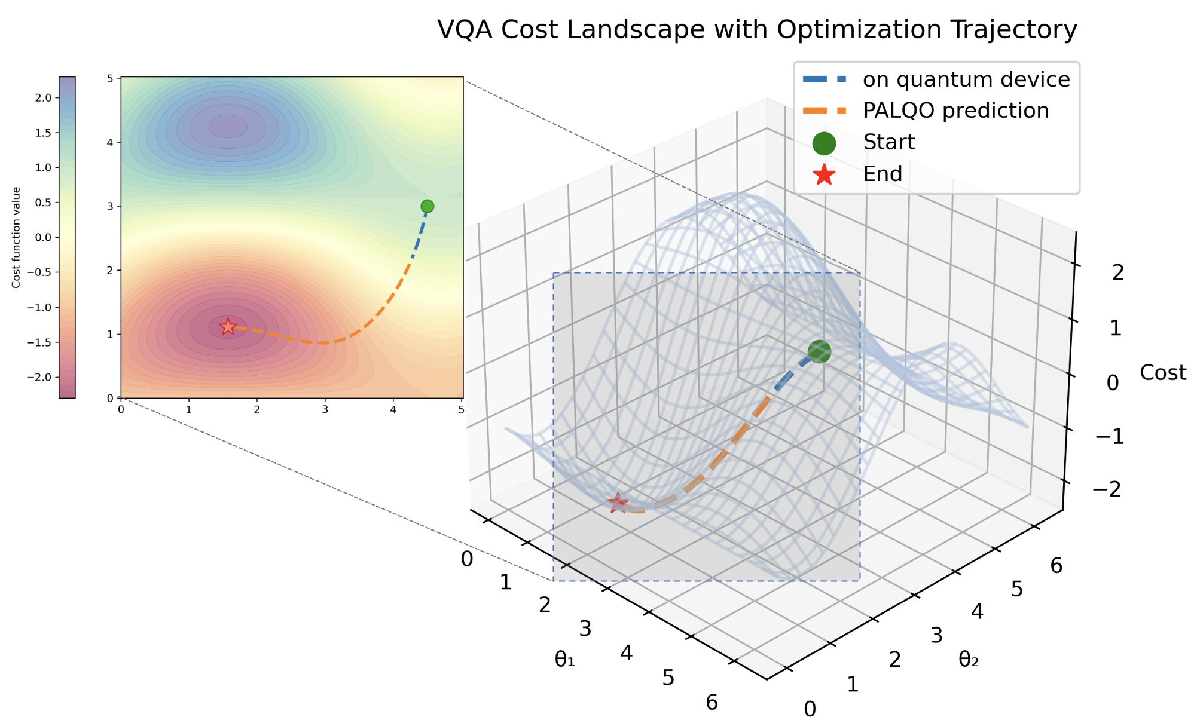
PALQO- ACCELERATE VQAs BY PINN
Sliding window
Energy
steps

Slide 13
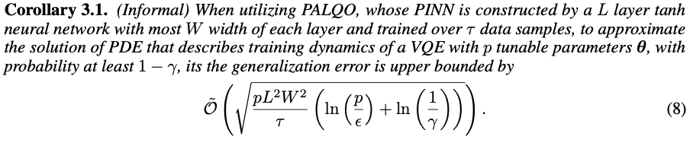
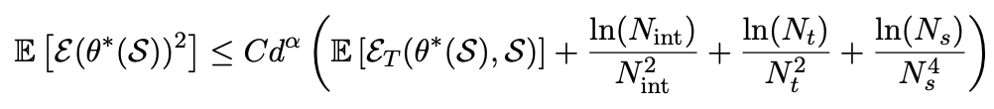
PALQO- ACCELERATE VQAs BY PINN
Generalization error analysis

Slide 14
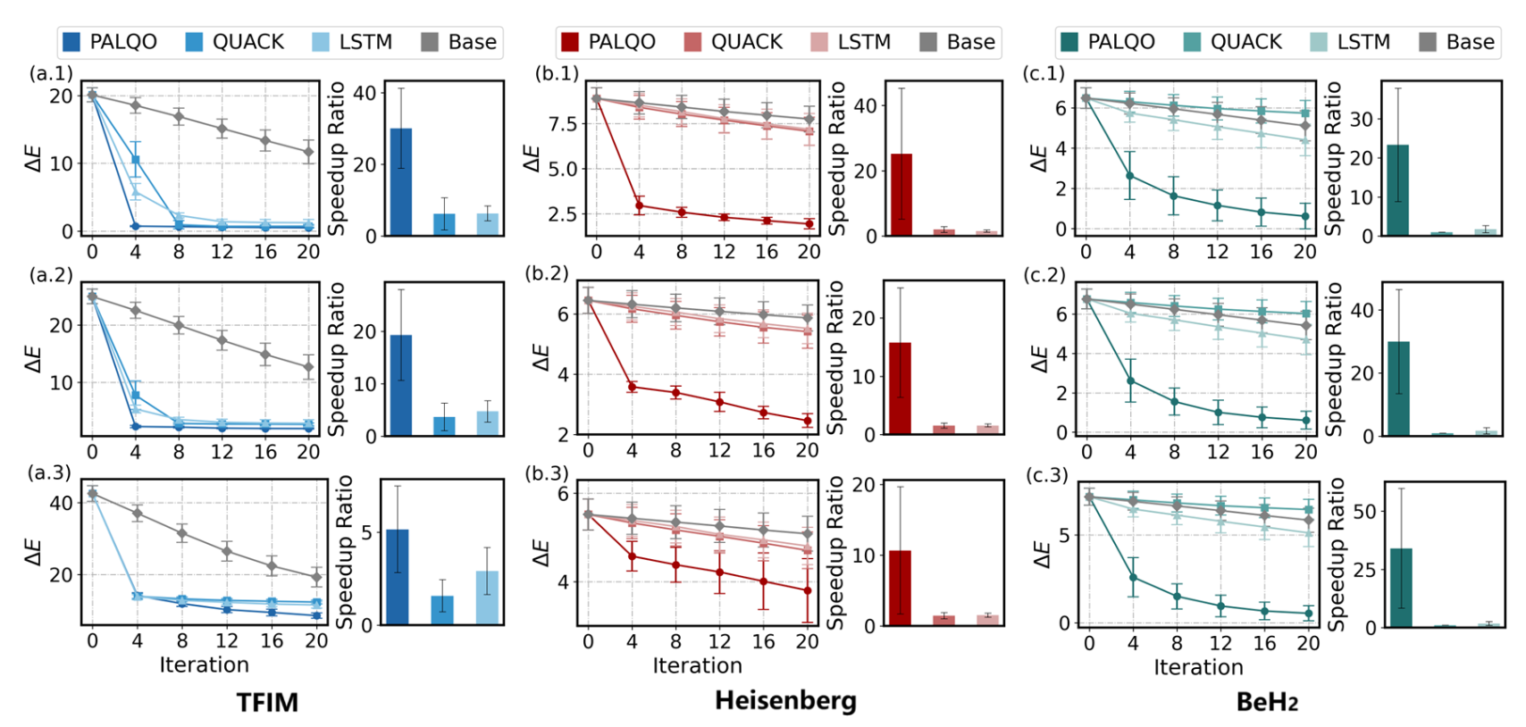
NUMERICAL RESULTS

Slide 15
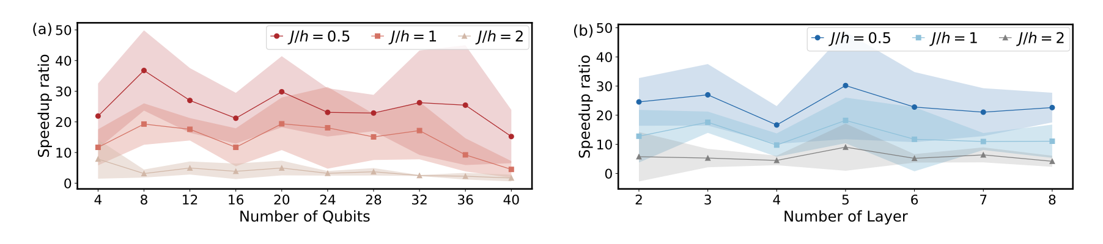
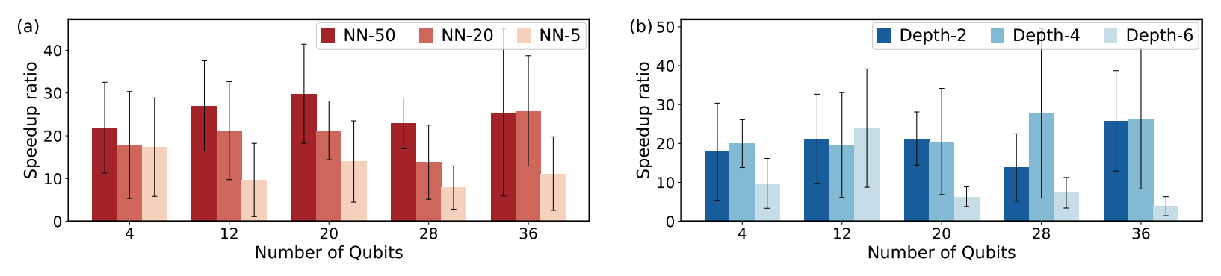
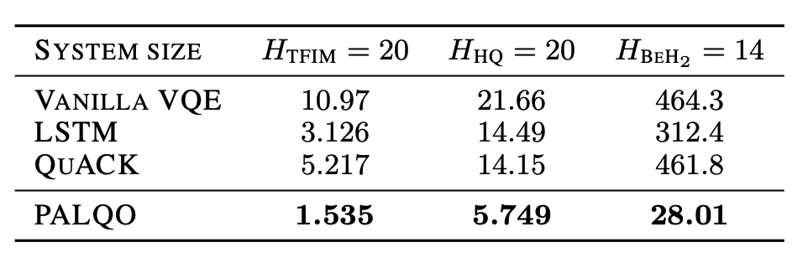
NUMERICAL RESULTS
Scalability of PALQO.
Performance on varying the size of PALQO.
PALQO significantly reduces
the measurement overhead.

Slide 16
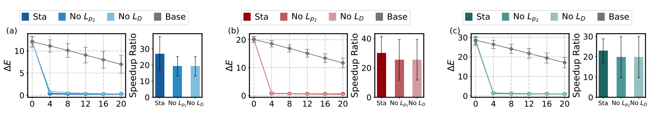
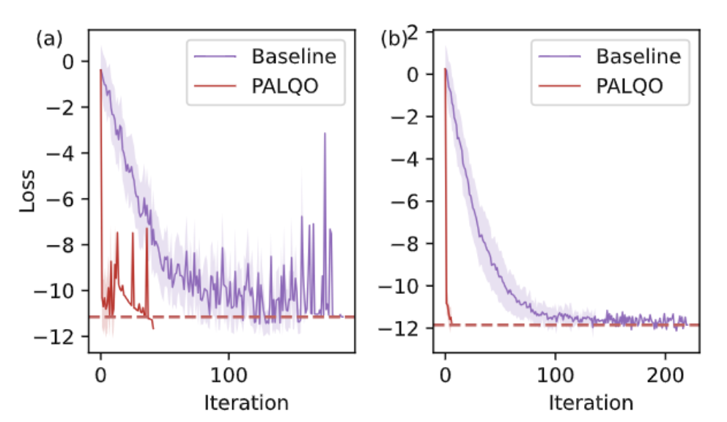
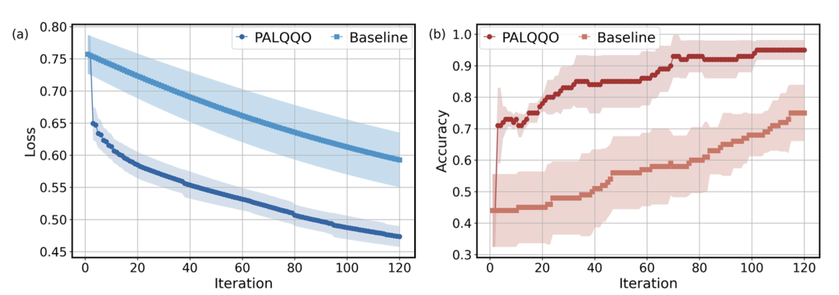
NUMERICAL RESULTS
Ablation studies on loss function.
Performance under noise
Performance for QML model

Slide 17
CONCLUSION
General framework
the first general framework between the optimization trajectory of VQAs and PDE.
Effective physics-informed model for improving training efficiency
the first general framework between the optimization trajectory of VQAs and PDE.
Rigorous generalization error analysis
Provide the related analysis of the generalization ability for the proposed protocol.
Extensive numerical studies
Validate the advancements of PALQO up to 40 qubits, providing valuable insights to further improve the optimization efficiency of VQAs at scale.

Slide 18
Thank you for listening!
Q & A

