Slide 1
Using LLM for paper classification
UCAS : Ziyue Chen
2026/4/16

Slide 2
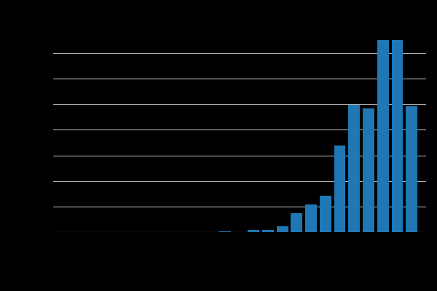
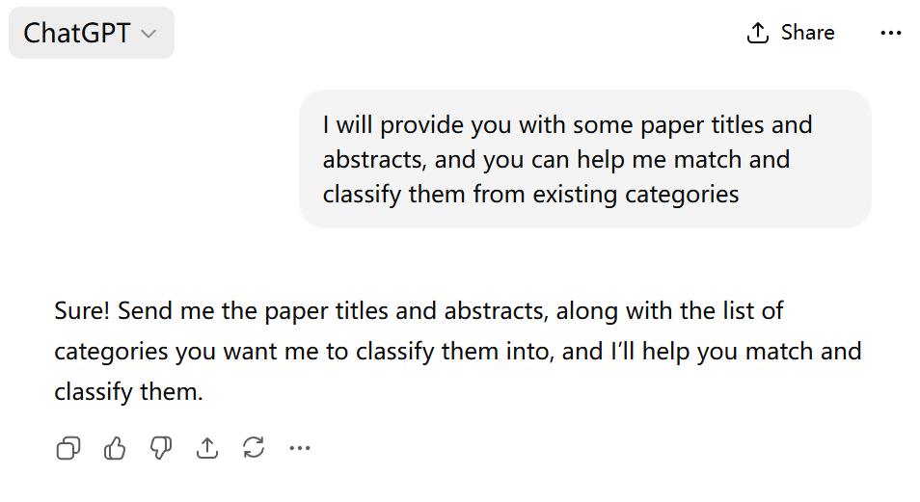
Task
Create a classification website for papers in the field of machine learning and high-energy physics, so that people can search for the papers they need. But now there are more and more papers, relying on manual classification is too troublesome.
Implementing automatic paper classification using a big language model.

Slide 3
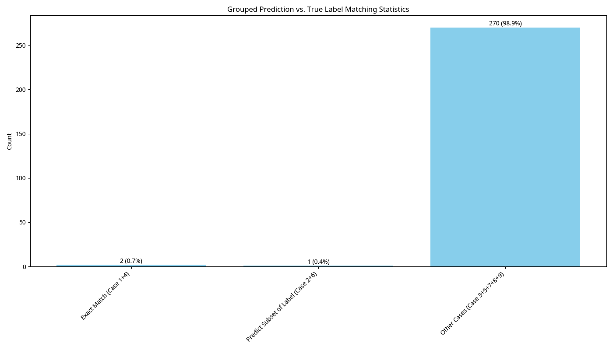
Why fine-tuning?
In most cases, LLM has poor performance in certain specific fields.
Fine tuning is one of the most commonly useful and effective methods to enhance LLM's capabilities in specific fields
Qwen2.5 7B

Slide 4
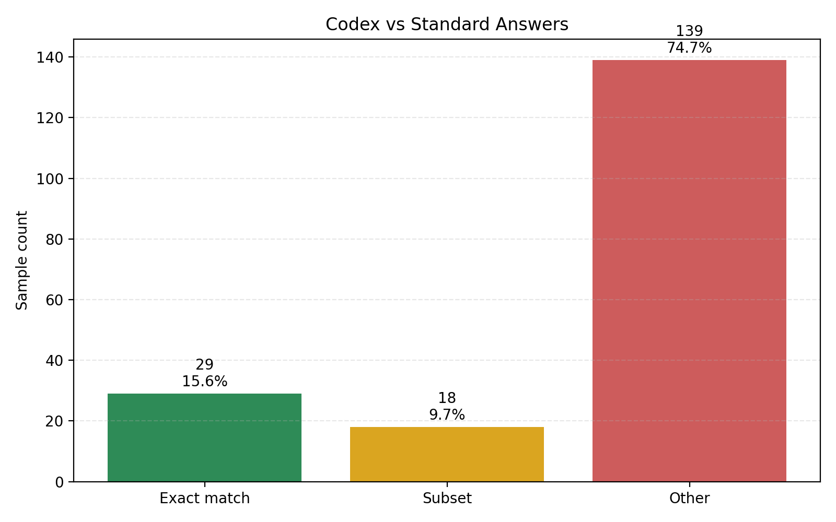
Why fine-tuning?
ChatGPT 5.4 xhigh

Slide 5
Preparation
LLM : Qwen2.5-7B-Instruct
Method : LoRA (Low-Rank Adaptation) , LoRA is a lightweight fine-tuning technique that updates only a small set of trainable parameters by injecting low-rank matrices into a pre-trained model.
Full fine-tuning updates almost all of the model’s parameters, overwriting the original weights.This requires a lot of GPU memory and compute, making training slower but producing a fully specialized model.
LoRA fine-tuning, on the other hand, keeps the original weights frozen and only trains a few small low-rank matrices, which makes it much faster, cheaper, and allows you to easily swap adapters for different tasks.
Datasets number : 1819 (75% is used as the training set, 10% as eval set, 15% as test set.)
GPU : NVIDIA A800 80GB PCIe
Time : About 1 hour of training, about 8 minutes to generate

Slide 6
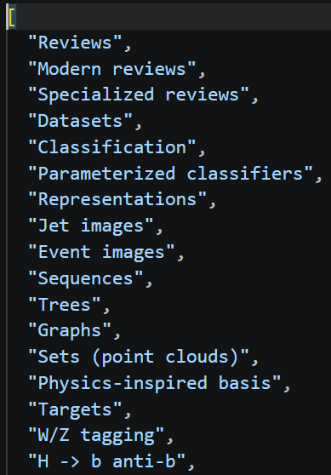
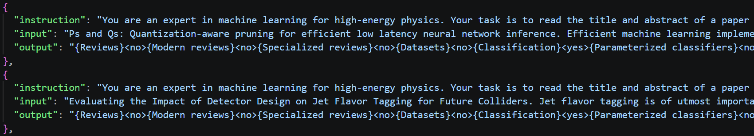
Dataset
Prompt word、input (article title+abstract)、output (article tag)
75% is used as the training set, 10% as eval set, 15% as test set.

Slide 7
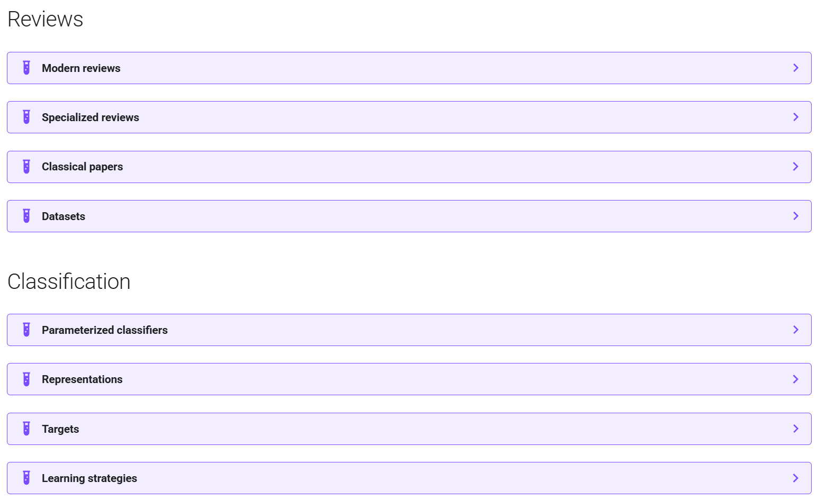
Dataset

Slide 8
Prompts
1. Role & Task
You are an expert in machine learning for high-energy physics. Your task is to read the title and abstract of a paper and perform STRICT hierarchical multi-label classification over the 91 predefined labels below.
2. Label Assignment Rules
Assign <yes> ONLY when there is strong, explicit evidence in the title/abstract;
never guess or infer.
If uncertain, prefer <no>.
A paper may belong to multiple labels simultaneously.
3.Hierarchical Consistency Rules
HIERARCHICAL CONSISTENCY RULES:
(1) If ANY sub-label is <yes>, ALL parents must be <yes>.
(2) If a parent is <no>, ALL sub-labels must be <no>.
(3) For overlapping labels, choose the MOST SPECIFIC explicitly supported ones; assign multiple only if independently evidenced.

Slide 9
Prompts
4. Output Format
OUTPUT FORMAT:
For EACH label in the EXACT order of the predefined list,
output the FULL label name immediately followed by <yes> or <no> with NO spaces.
No explanations, no extra text, no missing or reordered labels.
Example: {Reviews}<yes>{Modern reviews}<yes>{Specialized reviews}<no>{Datasets}<no>.
5. Predefined Label Space
PREDEFINED LABEL SPACE (exact order, 91 labels):
{'Reviews': ['Modern reviews', 'Specialized reviews', 'Datasets']}......

Slide 10
Dataset
Prompt word、input (article title+abstract)、output (article tag)
75% is used as the training set, 10% as eval set, 15% as test set.

Slide 11
Supervised Fine-Tuning
SFT (Supervised Fine-Tuning) is a crucial stage after LLM pre-training, which uses high-quality human-annotated instruction-following data to further train the model, enabling it to follow instructions and generate human-aligned responses.
Loss: Standard Cross-Entropy Loss (CE)
Objective: Maximize the likelihood of ground-truth responses, token-by-token fitting.
Only learns from positive examples; no contrast, no ranking of good/bad.

Slide 12
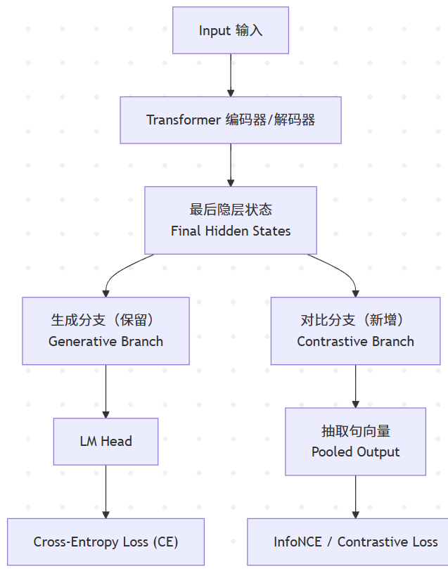
Contrastive Loss Supervised Fine-Tuning
CLS (Contrastive Loss Supervised Fine-Tuning)is an LLM multi-task training paradigm that adds contrastive learning loss on top of standard generative Supervised Fine-Tuning (SFT). It constrains the representation space with positive/negative pairs, pulling similar samples closer and pushing dissimilar ones apart.

Slide 13
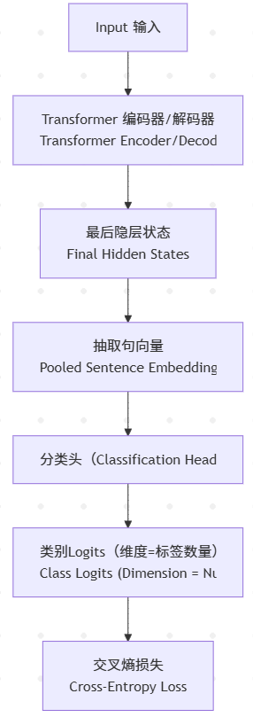
Classification-Specialized SFT
Classification-Specialized Supervised Fine-Tuning is a task-specific paradigm exclusively designed for classification. By attaching a dedicated classification head with output dimension equal to the number of labels, it directly optimizes decision boundaries via cross-entropy loss, effectively captures fine-grained features, and naturally supports multi-label and hierarchical classification. However, it suffers from limited generalization, sensitivity to data quality and label distribution, and easy overfitting. Since it is optimized only for discriminative classification, it lacks general text generation and representation abilities, resulting in poor cross-task transferability.

Slide 14
Limitations
Limitations of Standard Supervised Fine-Tuning (SFT) for Classification：
Binary treatment of confidence: Classification confidence should be a continuous probability, but standard SFT binarizes it into “present” or “absent”, losing nuanced probabilistic information.
Inefficient use of model capacity: A large portion of training effort is wasted on learning how to “generate responses” (style, format, verbosity) rather than focusing on discriminative “classification” itself.
The Loss Function in Standard SFT is Not Classification-Specific. Focuses on generative next-token modeling instead of discriminative class separation

Slide 15
Limitations
Limitations of CLS (Contrastive Loss Supervised Fine-Tuning)：
CLS only optimizes semantic similarity and does not directly optimize classification.
The semantic of texts is compressed into low dimensional vectors, which is weak in the face of a large number of complex tag spaces.

Slide 16
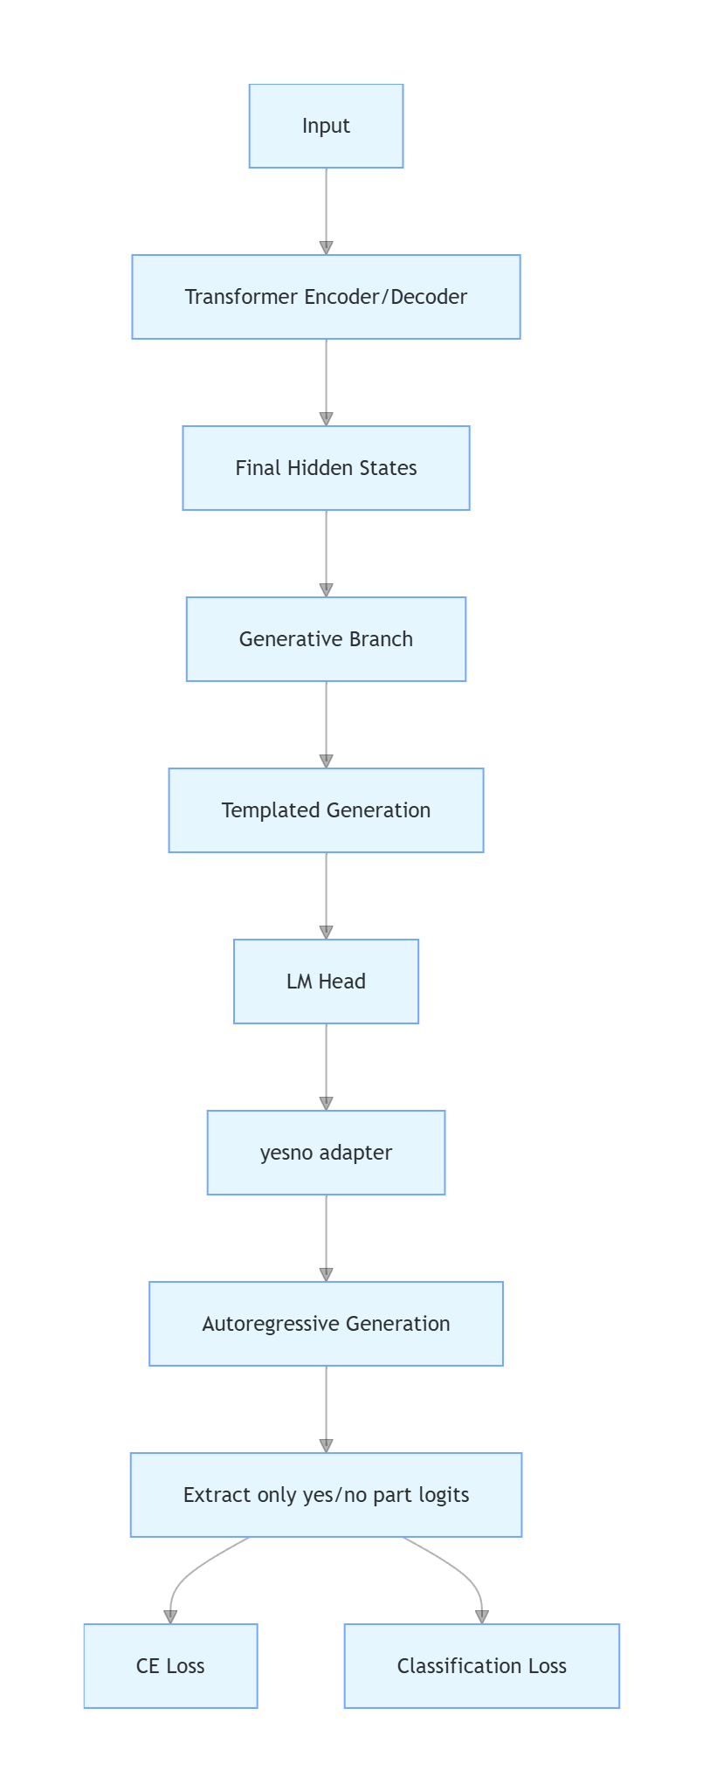
Classification-Generative SFT
1. Highly templated. only care about <yes><no> these two decision tokens
2. The Logits of<yes><no>token can be used as the score of this tag
3. it not only retains the ability of large model reasoning according to semantics, but also retains the ability of classification task to directly optimize classification.

Slide 17
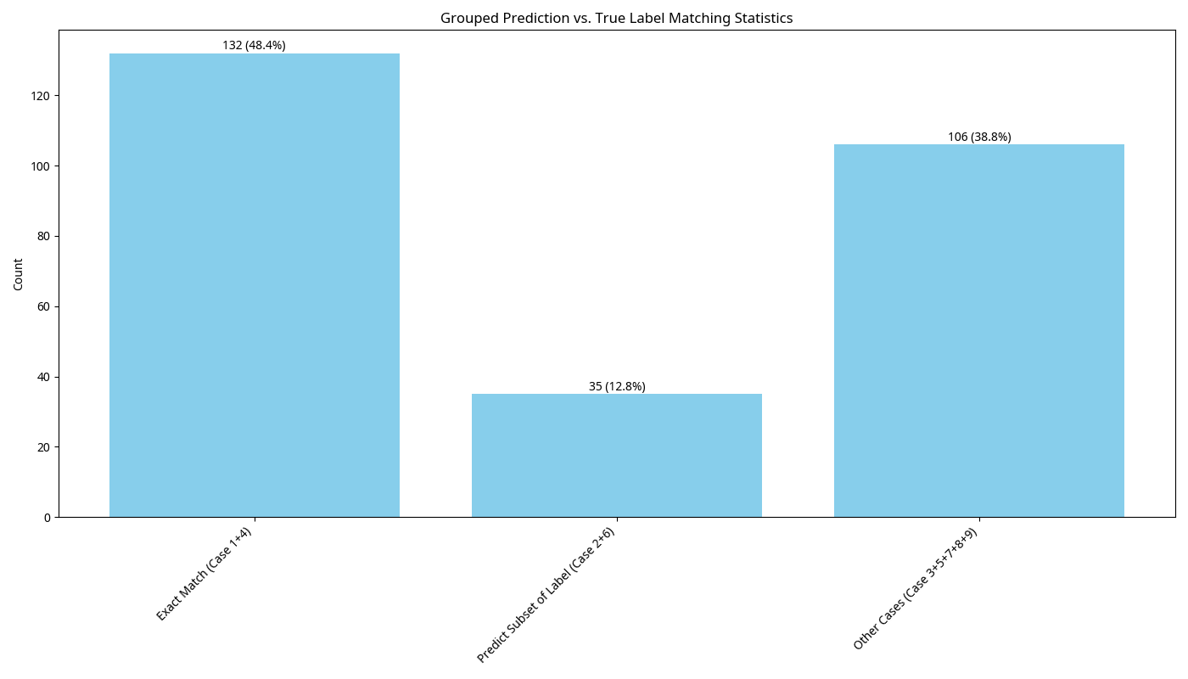
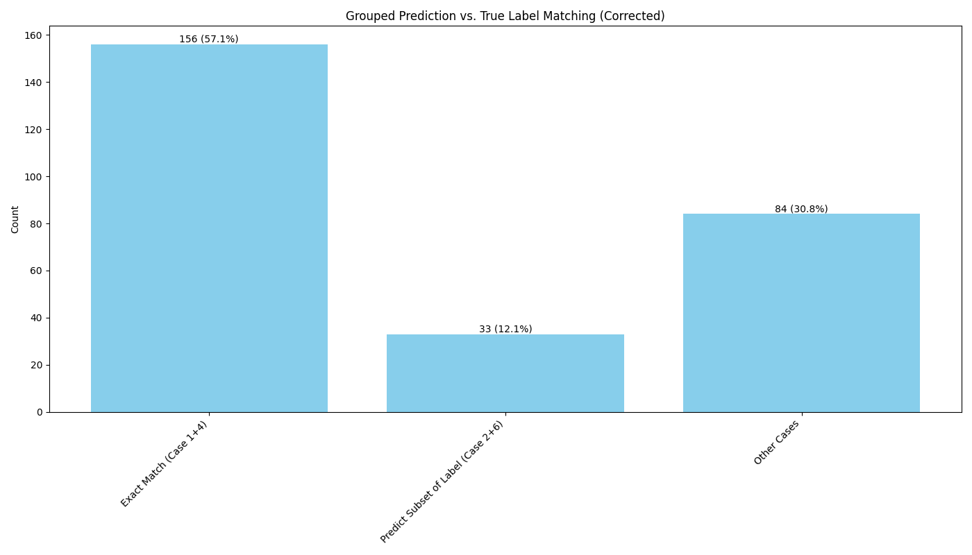
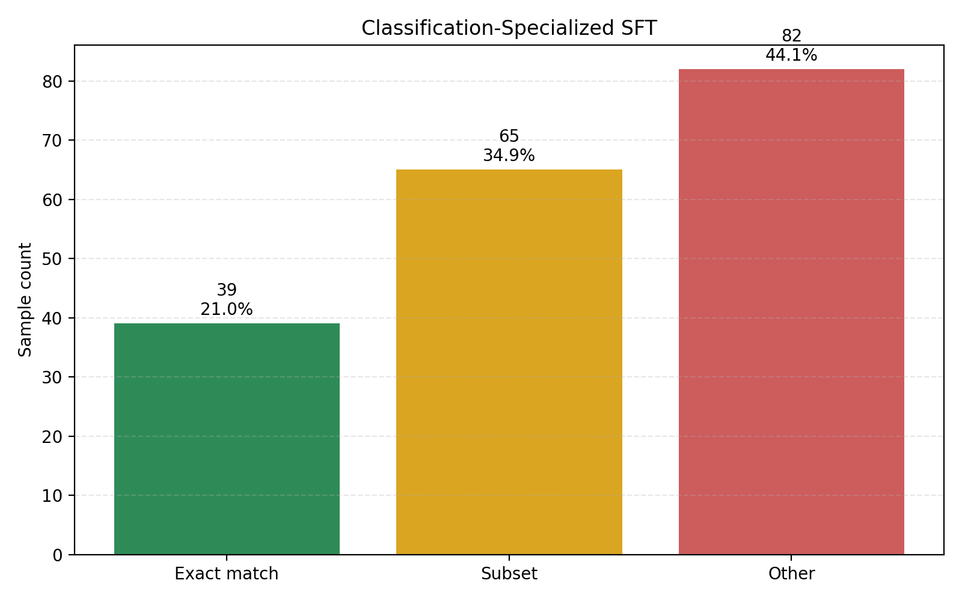
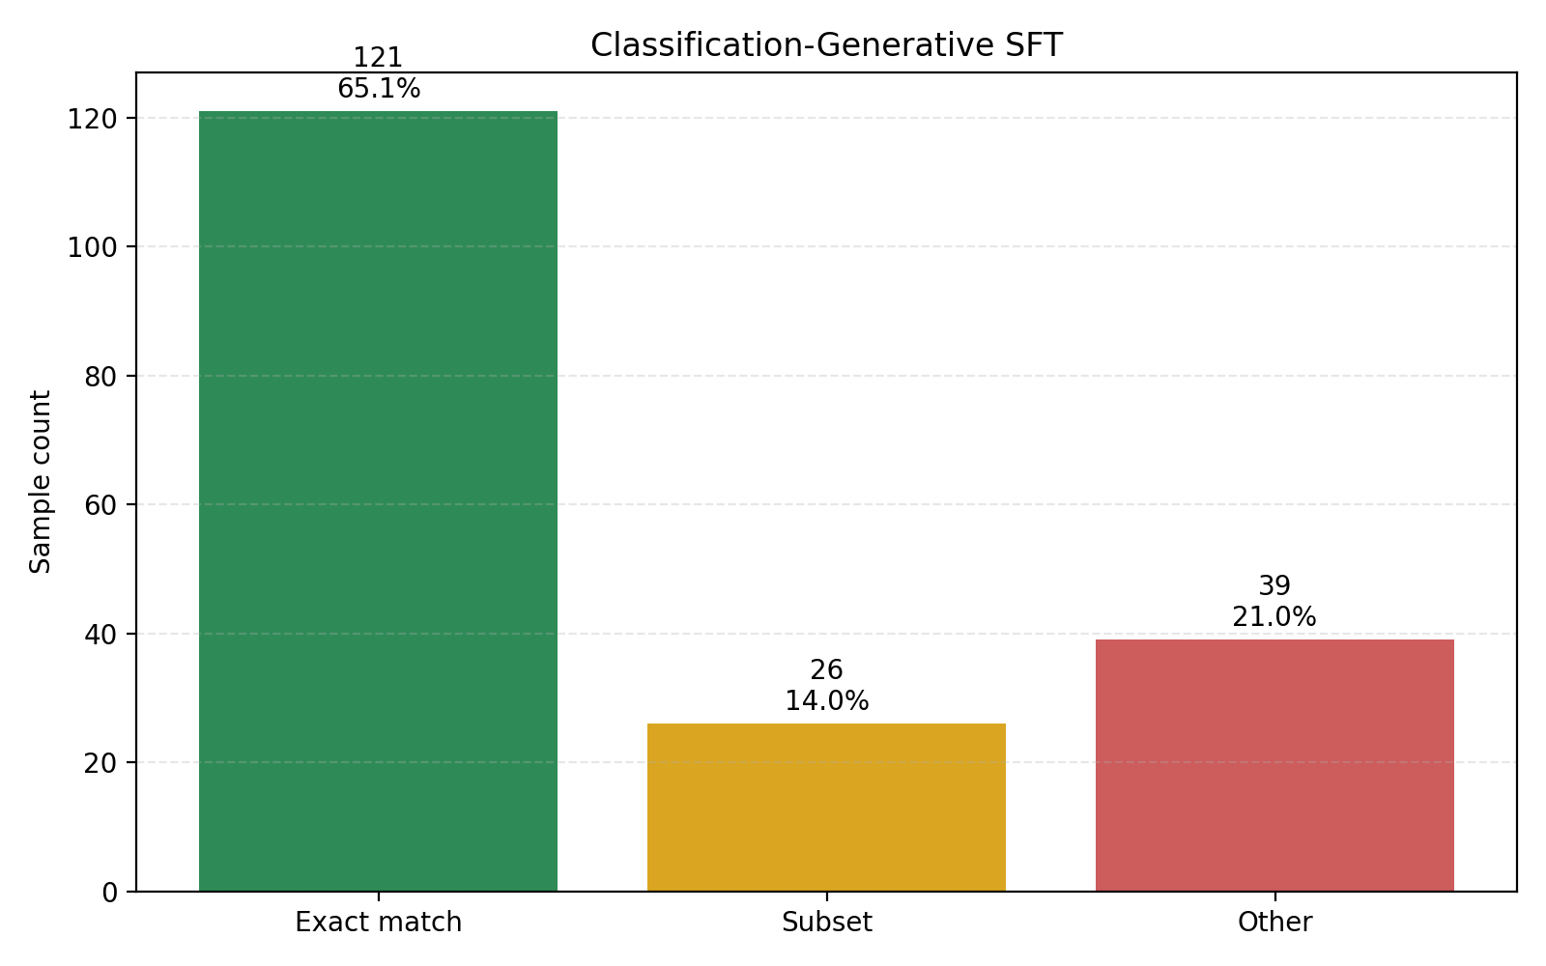

Slide 18
summary
A new fine-tuning method for classification is proposed, which is greatly improved compared with the traditional method

