Slide 1

Computation of correlation function in Gauge Field Theory
Juzheng Liang (梁居正)
2026. 4. 16

Slide 2
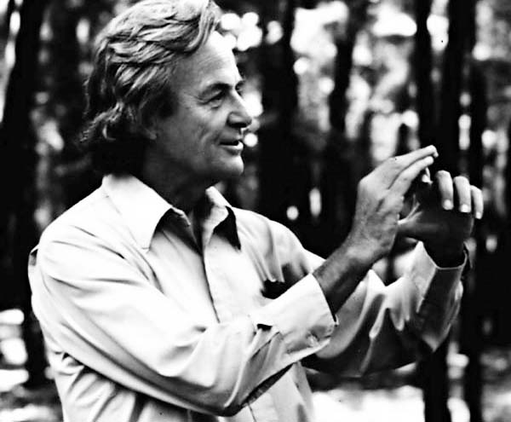
Quantum simulation and quantum computation
The Hilbert space of a quantum system is exponential in its size, making it hard to simulate on a computer
Quantum computing operates by manipulating qubits.
Leveraging the exponentially large Hilbert space of quantum states, it can also achieve speedups for problems that are classically hard
If you want to make a simulation of nature, you‘d better make it quantum mechanical, by golly it's a wonderful problem because it doesn't look so easy.
--R. P. Feynman (1982)

Slide 3
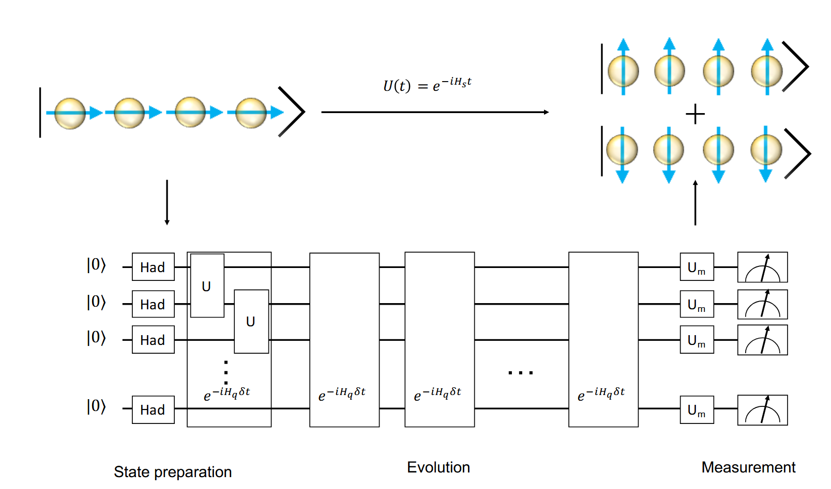
Application of quantum computation
Quantum chemsitry
S. McArdle, S. Endo, A. Aspuru-Guzik, S. C. Benjamin, and X. Yuan, Rev. Mod. Phys. 92, 015003 (2020).
Solve energy level of chemistry system
Investigating Molecular Vibrational Spectra
Condensed matter physics
Simulate Ising model, Hubbard model
Calculate electron band
Computation math
Speedup in factoring number，Shor’s algorithm
Combinatorial Optimization Problems ，MAXCUT problem
Quantum evolution of spin chain

Slide 4
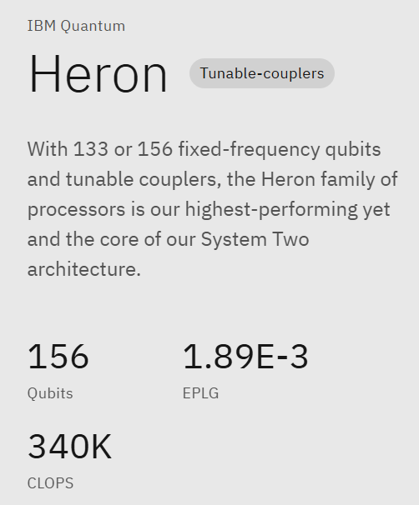
NISQ Era
Current quantum computers are still not powerful enough.
NISQ Era
J. Preskill, Quantum 2, 79 (2018).
Limited quantum qubits ~100 —— Reduce the d.o.f
High error rates and noise —— Error mitigation
Low circuit depth ~ 1000 —— Design new algorithm
Current Focus:
Solving Practical Problems with NISQ-era Quantum Computing
IBM quantum chip

Slide 5
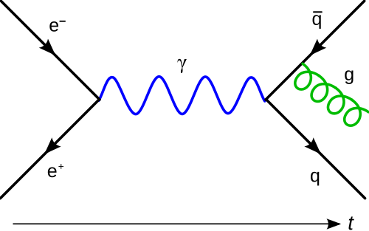
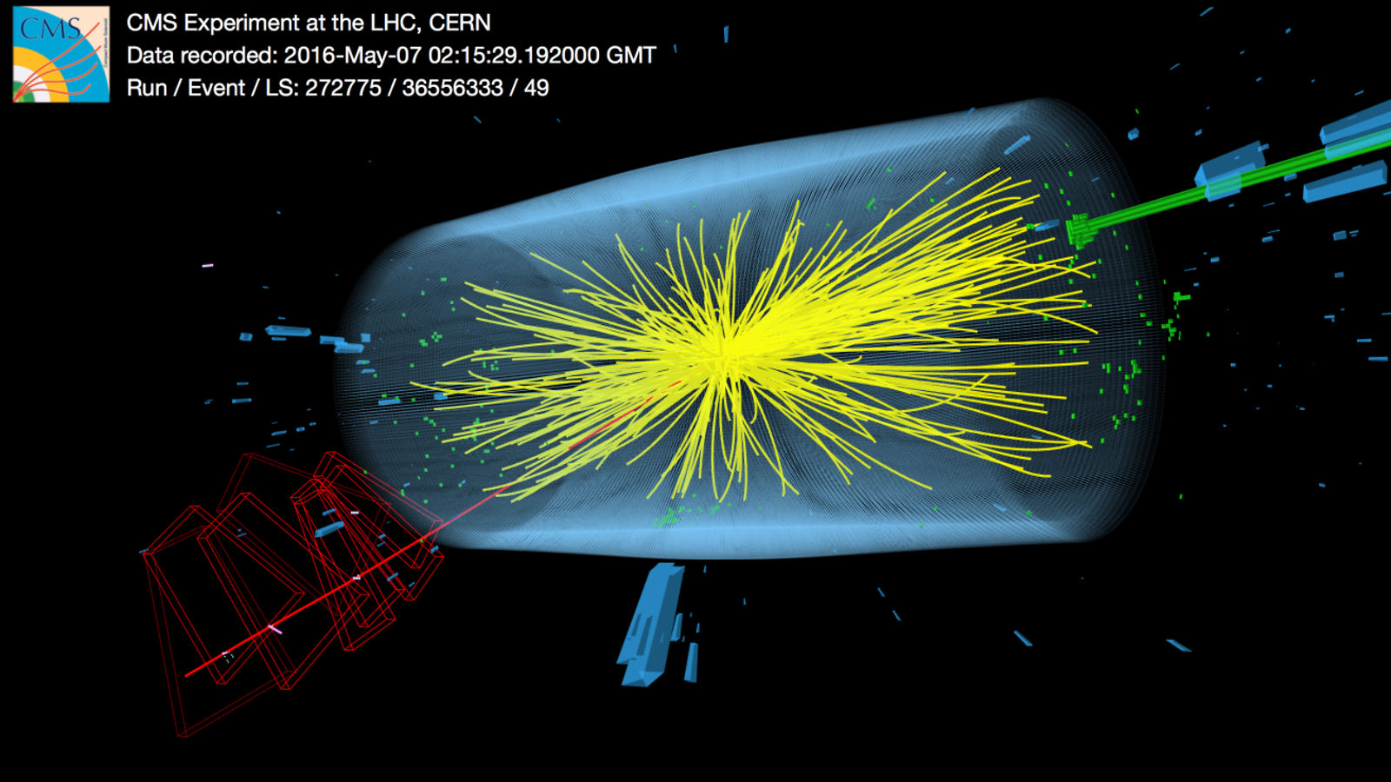
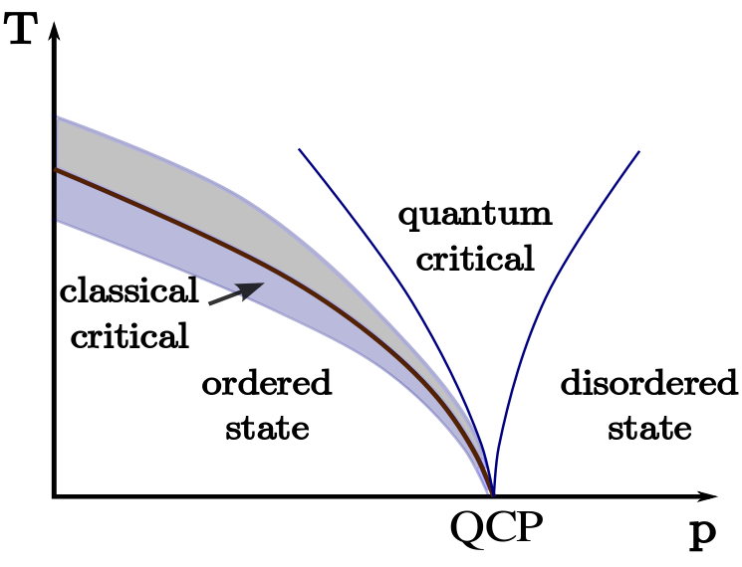
Correlation function
In high energy physics
  Scattering amplitude (by LSZ reduction)
  Parton distribution function
  Hadron spectrum
  etc …
In condensed matter physics
  Critical phase transition
  Energy gap (in Ising model / spin glass)
In quantum optics
  Response function (by Kubo formula)

Slide 6
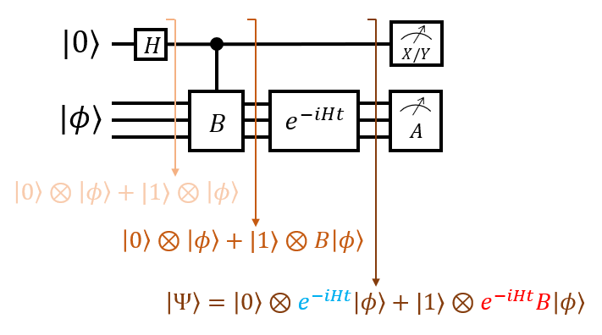
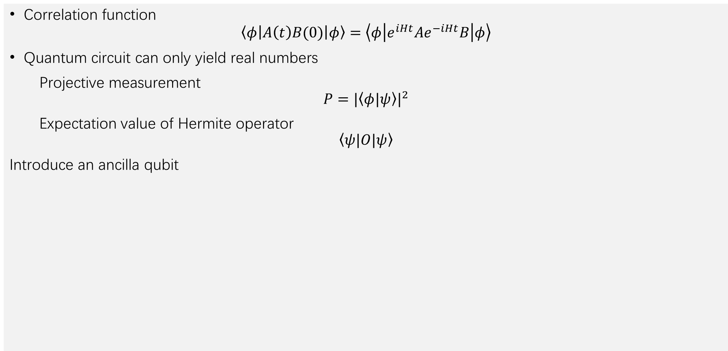


Hadamard test
Correlation function
$$\left\langle φ\left|A\left(t\right)B(0)\right|φ\right\rangle =\left\langle φ\left|e^{iHt}Ae^{−iHt}B\right|φ\right\rangle$$
Quantum circuit can only yield real numbers
Projective measurement
$$P=|\left\langle φ|ψ\right\rangle |^{2}$$
Expectation value of Hermite operator
$$\left\langle ψ|O|ψ\right\rangle$$
Introduce an ancilla qubit
$$\frac{1}{2}\left\langle Ψ\left|\left(X+iY\right)⊗A\right|Ψ\right\rangle =\left\langle Ψ\left| |0⟩⟨1|⊗A\right|Ψ\right\rangle$$
$$=\left\langle φ\left| e^{iHt}A e^{−iHt}B\right|φ\right\rangle$$

Slide 7
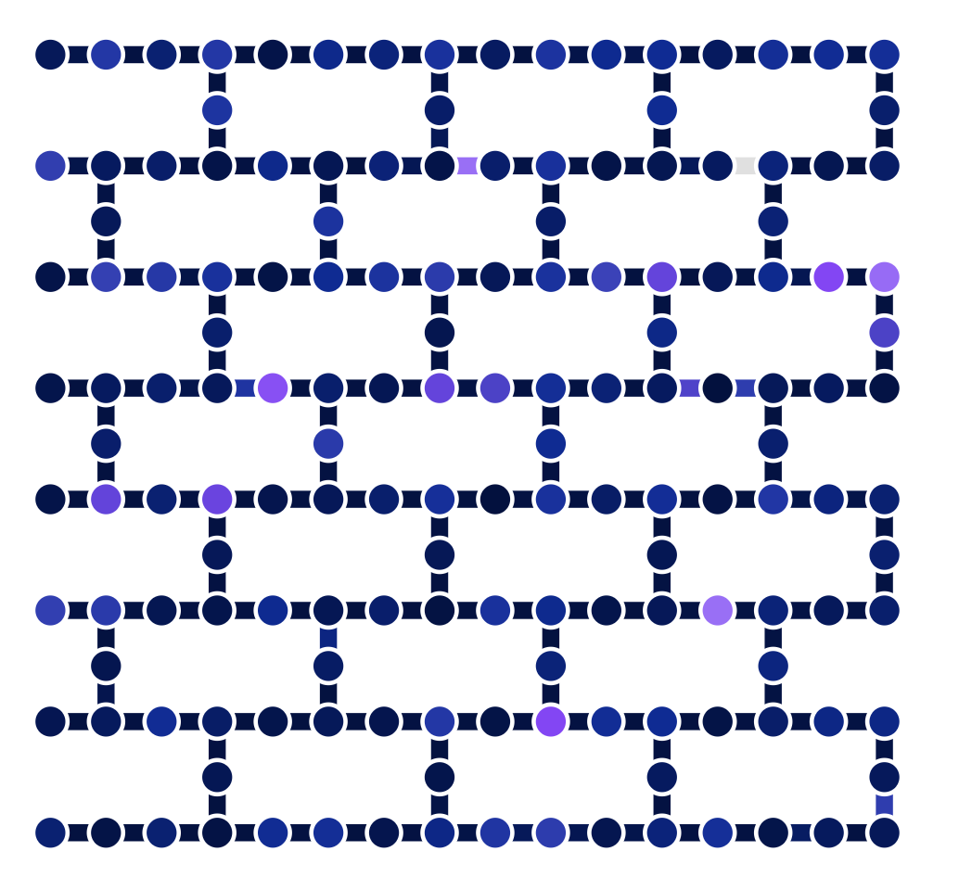
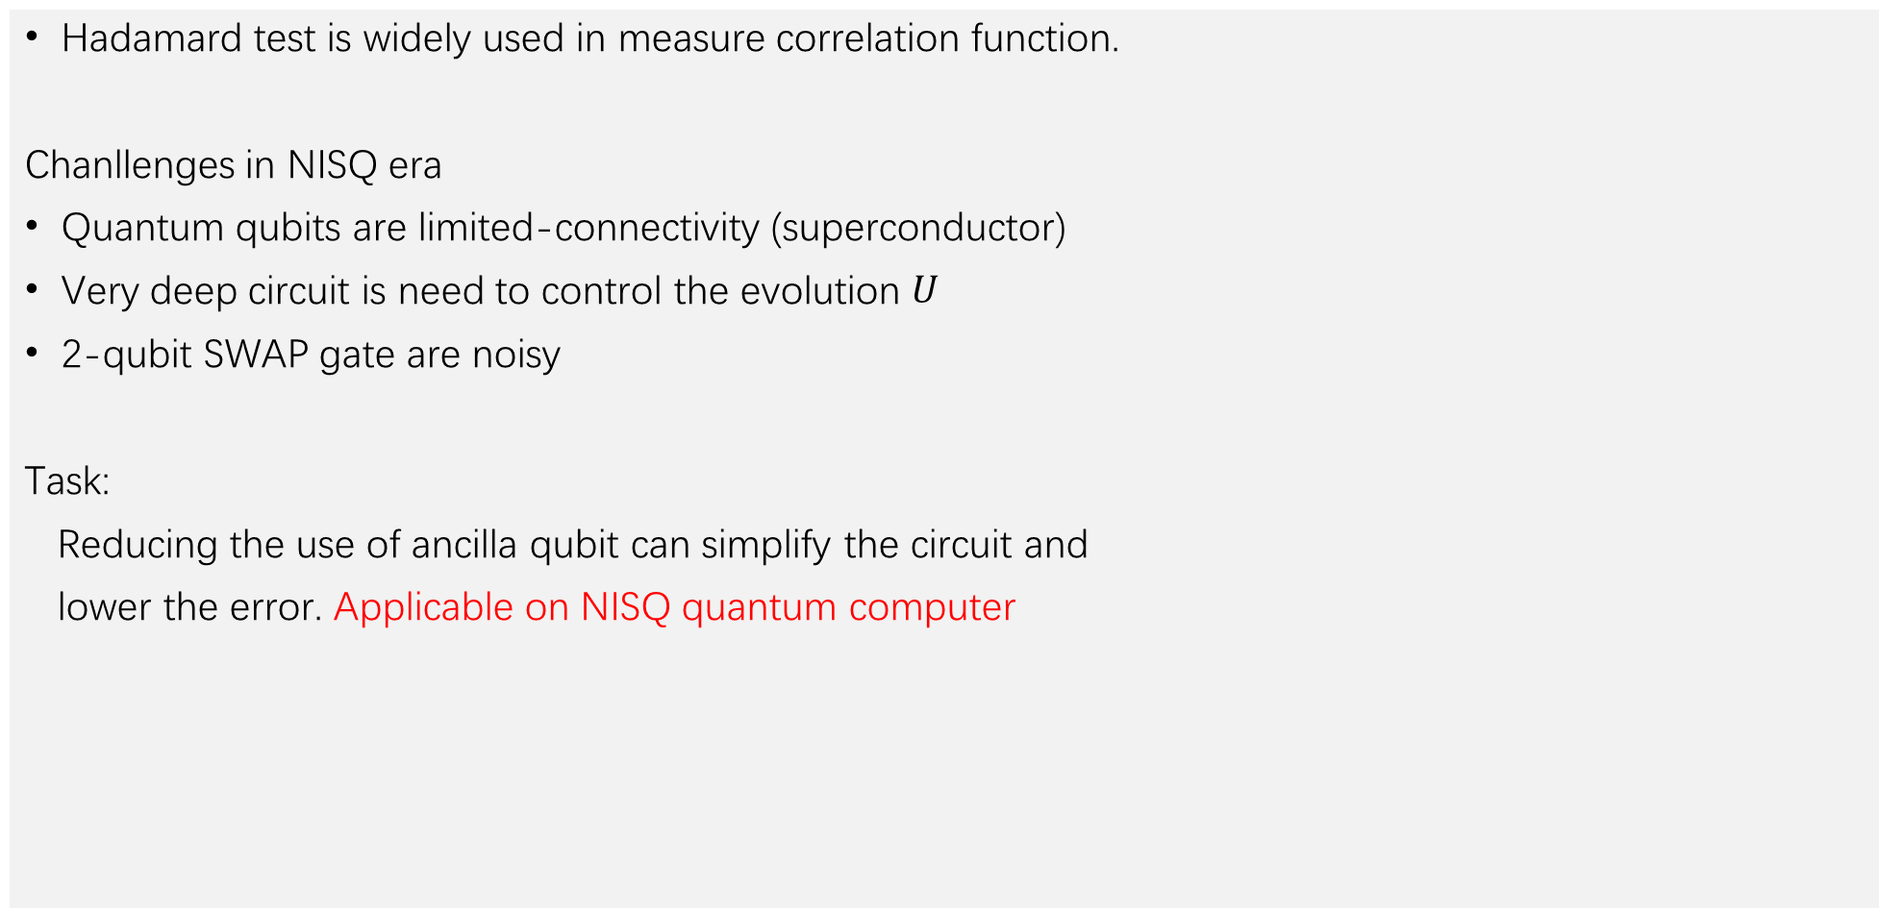
Hadamard test
Hadamard test is widely used in measure correlation function.
Chanllenges in NISQ era
Quantum qubits are limited-connectivity (superconductor)
Very deep circuit is need to control the evolution $U$
2-qubit SWAP gate are noisy
Task:
Reducing the use of ancilla qubit can simplify the circuit and
lower the error. Applicable on NISQ quantum computer
IBM superconduct quantum circuit

Slide 8
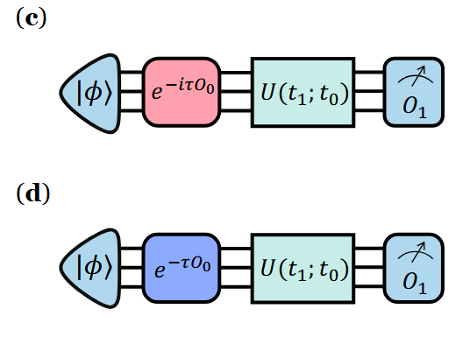
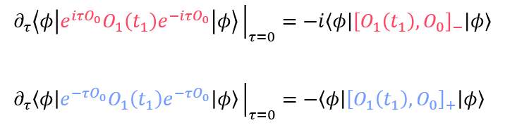
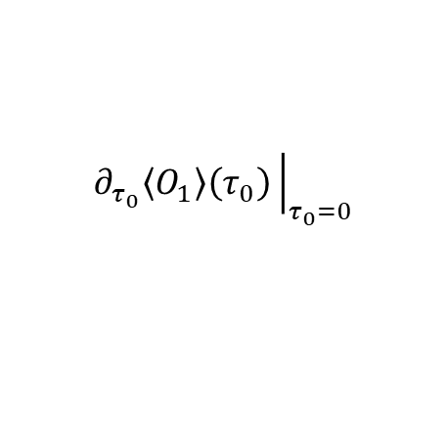

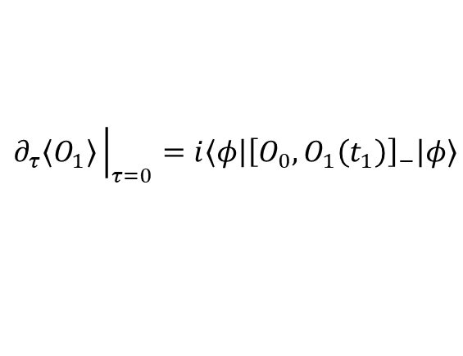
Computing n-point correlation function
Computing 2-point correlation function
The partial derivative
can be evaluated accurately using parameter-shift rule.
$$∂_{τ}\left\langle O_{1}\right\rangle {\left.​\right|}_{τ=0}=i\left\langle φ\left|{\left[O_{0},O_{1}\left(t_{1}\right)\right]}_{−}\right|φ\right\rangle$$
$$\left\langle O_{1}\right\rangle \left(τ=\frac{π}{4}\right)−\left\langle O_{1}\right\rangle \left(τ=−\frac{π}{4}\right)$$
$$∂_{τ_{0}}\left\langle O_{1}\right\rangle \left(τ_{0}\right){\left.​\right|}_{τ_{0}=0}$$
X. Wang, L. Xiong, X. Cai, and X. Yuan, Phys. Rev. Lett. 135, 230602 (2025).

Slide 9
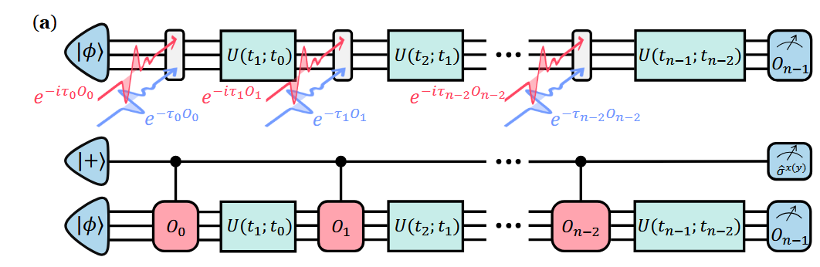
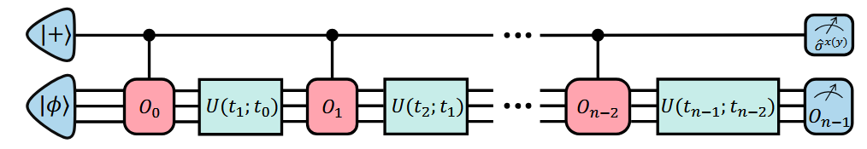
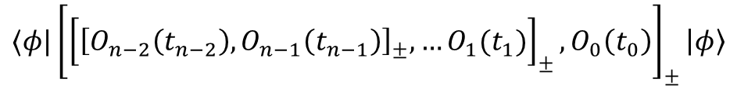


Computing n-point correlation function
Generalization to n-point correlation function
$$⟨φ|{\left[{\left[{\left[O_{n−2}\left(t_{n−2}\right),O_{n−1}\left(t_{n−1}\right)\right]}_{±},…O_{1}(t_{1})\right]}_{±},O_{0}\left(t_{0}\right)\right]}_{±}\left|φ\right\rangle$$
${\left[⋅\right]}_{−}$: commutator;
${\left[⋅\right]}_{+}$: anti-commutator
Compared with Hadamard test

Slide 10
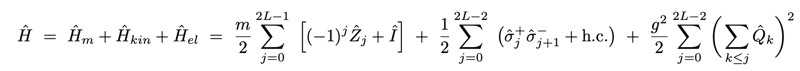


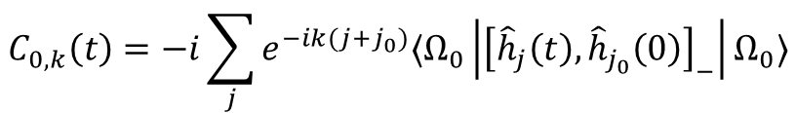


Application: Hadron mass
Schwinger model:
fermionic mass
kinematic term
electric energy
Lattice (12 qubits):
$$m{\overline{ψ}}_{x}ψ_{x}$$
$$−i{\overline{ψ}}_{x}{ γ}^{1}\left(∂_{1}−igA_{1}\right)ψ_{x}$$
$$\frac{1}{2}{\left({\hat{E}}_{x}\right)}^{2}$$
$${\hat{h}}_{j}={\overline{ψ}}_{j}{ γ}^{5}ψ_{j}$$
Our method
Hadamard test
measure 2-time correlation function:
$$C_{0,k}\left(t\right)=−i\sum_{j}{e^{−ik(j+j_{0})}⟨Ω_{0}\left|{\left[{\hat{h}}_{j}\left(t\right),{\hat{h}}_{j_{0}}\left(0\right)\right]}_{−}\right|Ω_{0}⟩}$$
9

Slide 11


Application: Hadron mass
Schwinger model:
$${\hat{h}}_{j}={\overline{ψ}}_{j}{ γ}^{5}ψ_{j}$$
Fitting:
$${E(k)}_{ }^{2}={(m}_{h}c^{2})^{2}+{\left(ck\right)}^{2}$$
hardware demonstration on ibm_torino
Number of qubits: 12
Fourier transform

Slide 12
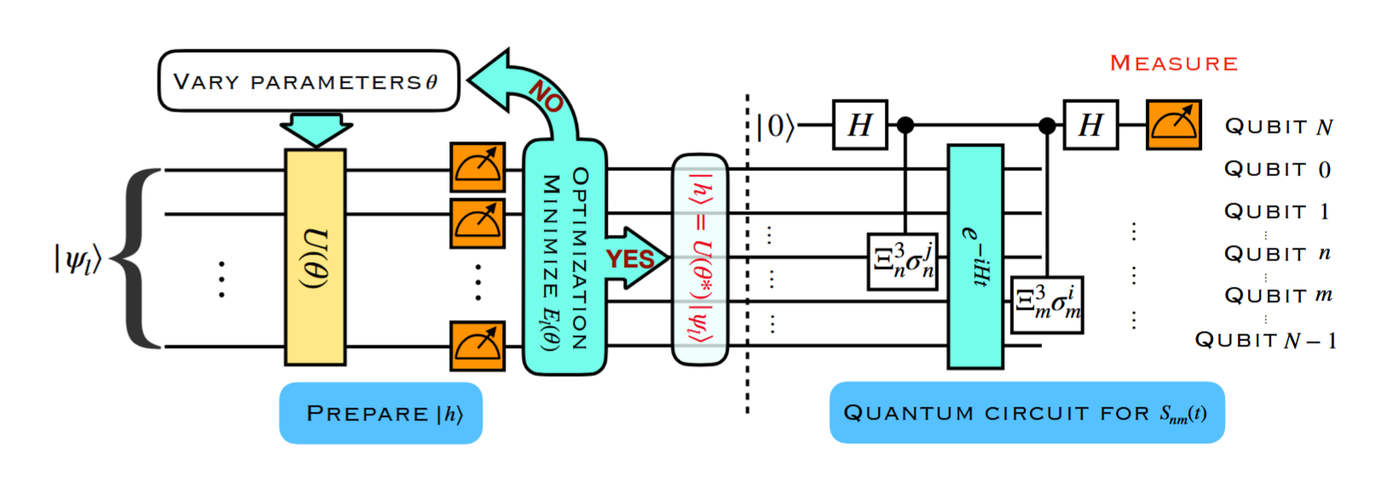
Correlation function in Gauge theory
Classical
The calculation of correlation function cost exponential resource
Sign problem: real evolution is hard
Quantum
Hadamard test need a very deep control circuit
Hadamard test circuit
T. Li, X. Guo, W. K. Lai, X. Liu, E. Wang, H. Xing, D.-B. Zhang, and S.-L. Zhu, Phys. Rev. D 105, L111502 (2022).

Slide 13
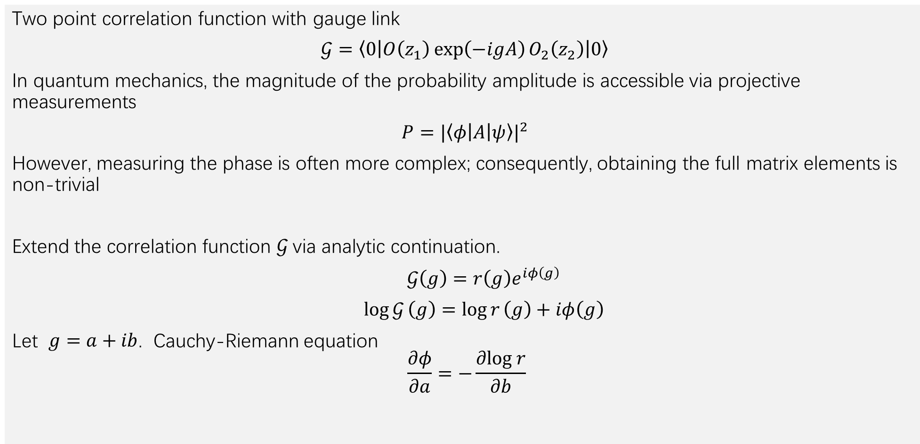
Computing correlation function with gauge link
Two point correlation function with gauge link
$𝒢=\left\langle 0\left|O\left(z_{1}\right)\exp\left(−igA\right)O_{2}\left(z_{2}\right)\right|0\right\rangle$
In quantum mechanics, the magnitude of the probability amplitude is accessible via projective measurements
$P={|\left\langle φ\left|A\right|ψ\right\rangle |}^{2}$
However, measuring the phase is often more complex; consequently, obtaining the full matrix elements is non-trivial
Extend the correlation function $𝒢$via analytic continuation.
$𝒢\left(g\right)=r\left(g\right)e^{iφ\left(g\right)}$
$\log{𝒢}\left(g\right)=\log{r}\left(g\right)+iφ\left(g\right)$
Let $g=a+ib$. Cauchy-Riemann equation
$$\frac{∂φ}{∂a}=−\frac{∂log r}{∂b}$$
Y. Yang, A. Christianen, M. C. Bañuls, D. S. Wild, and J. I. Cirac, Phys. Rev. Lett. 132, 220601 (2024).

Slide 14
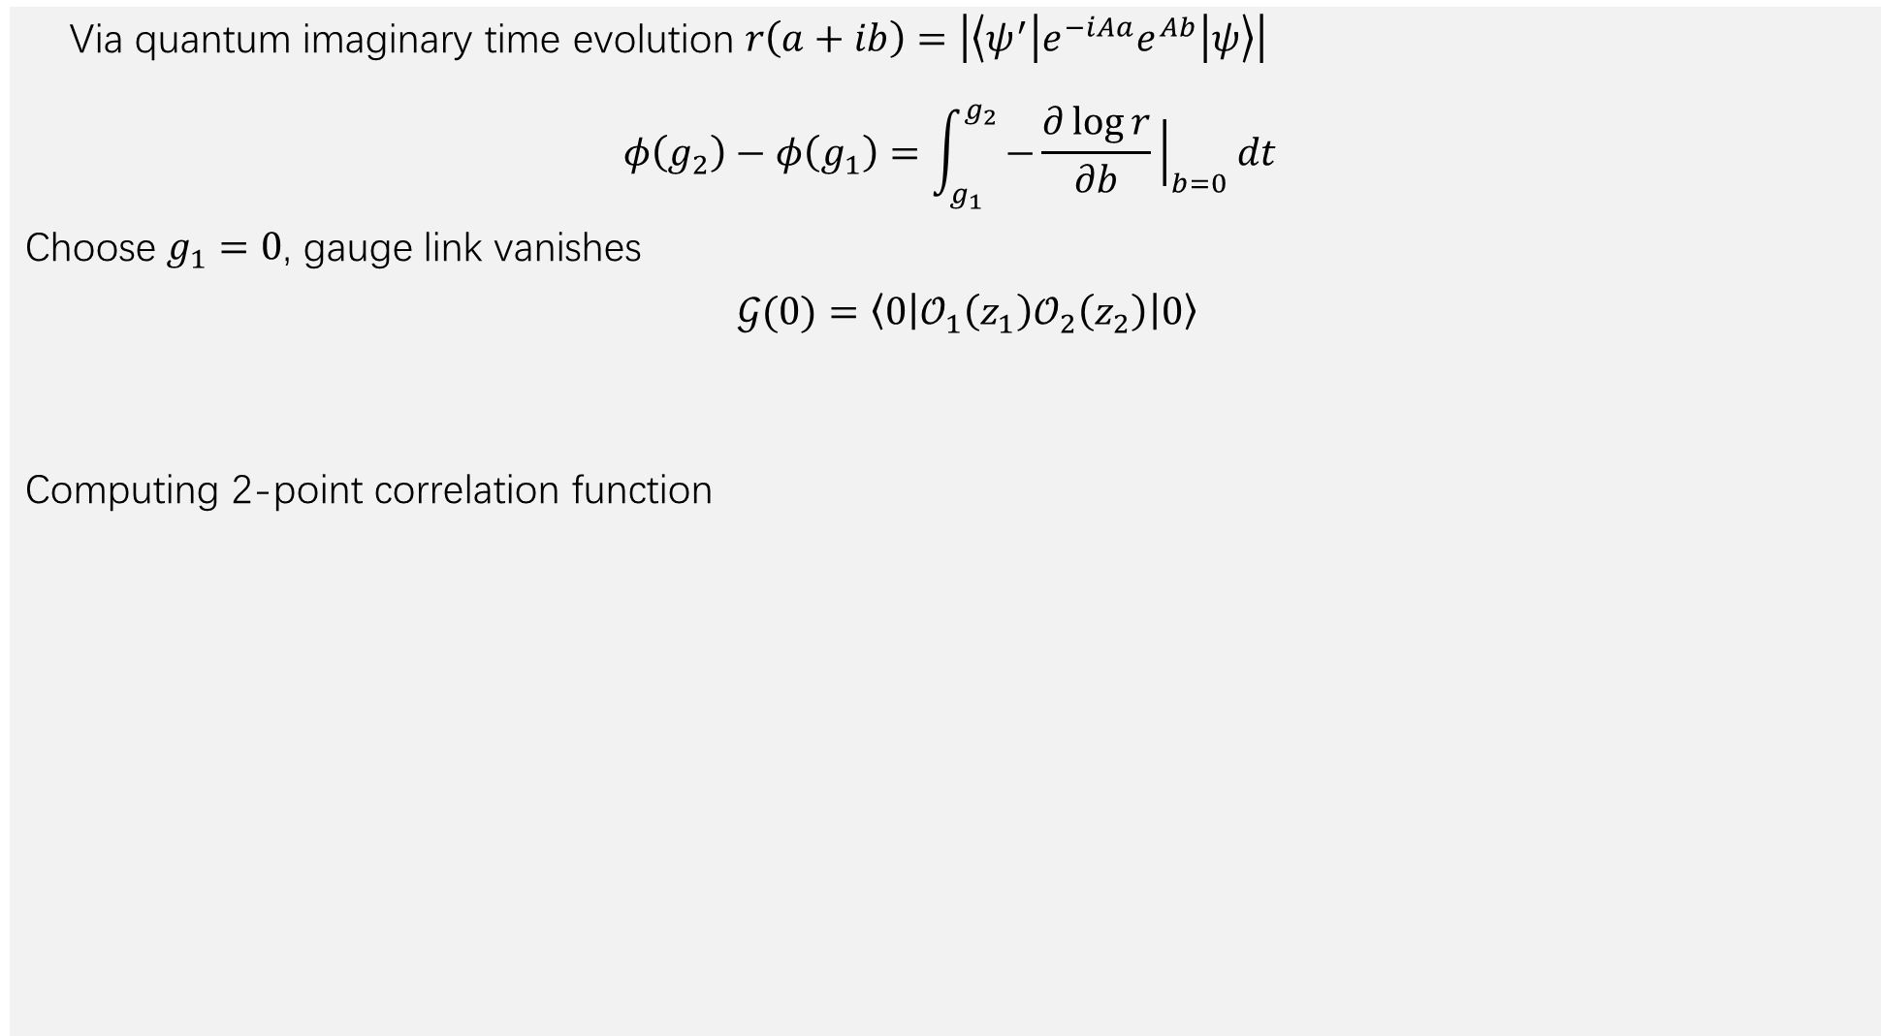
Via quantum imaginary time evolution $r\left(a+ib\right)=\left|\left\langle ψ^{′}\left|e^{−iAa}e^{Ab}\right|ψ\right\rangle \right|$
$$φ\left(g_{2}\right)−φ\left(g_{1}\right)=\int_{g_{1}}^{g_{2}}{−\frac{∂\log{r}}{∂b}{\left.​\right|}_{b=0}}dt$$
Choose $g_{1}=0$, gauge link vanishes
$𝒢(0)=\left\langle 0\left|𝒪_{1}\left(z_{1}\right)𝒪_{2}\left(z_{2}\right)\right|0\right\rangle$
Computing 2-point correlation function
2-point correlation function

Slide 15
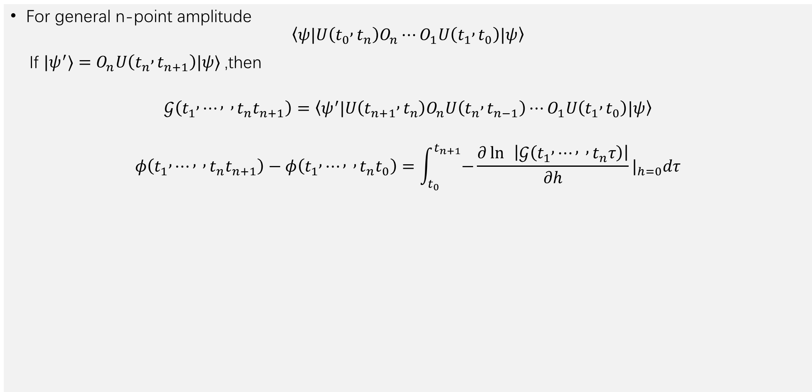
Computing n-point amplitude
For general n-point amplitude
$$\left\langle ψ|U\left(t_{0} , t_{n}\right)O_{n}⋯O_{1}U\left(t_{1} , t_{0}\right)|ψ\right\rangle$$
If $|ψ^{′}⟩=O_{n}U\left(t_{n} , t_{n+1}\right)|ψ⟩$ ,then
$$𝒢\left(t_{1} , ⋯ , , t_{n}t_{n+1}\right)=\left\langle ψ^{′}|U\left(t_{n+1} , t_{n}\right)O_{n}U\left(t_{n} , t_{n−1}\right)⋯O_{1}U\left(t_{1} , t_{0}\right)|ψ\right\rangle$$
$$φ\left(t_{1} , ⋯ , , t_{n}t_{n+1}\right)−φ\left(t_{1} , ⋯ , , t_{n}t_{0}\right)=\int_{t_{0}}^{t_{n+1}}{−}\frac{∂\ln{ }\left|𝒢\left(t_{1} , ⋯ , , t_{n}τ\right)\right|}{∂h}|_{h=0}dτ$$

Slide 16
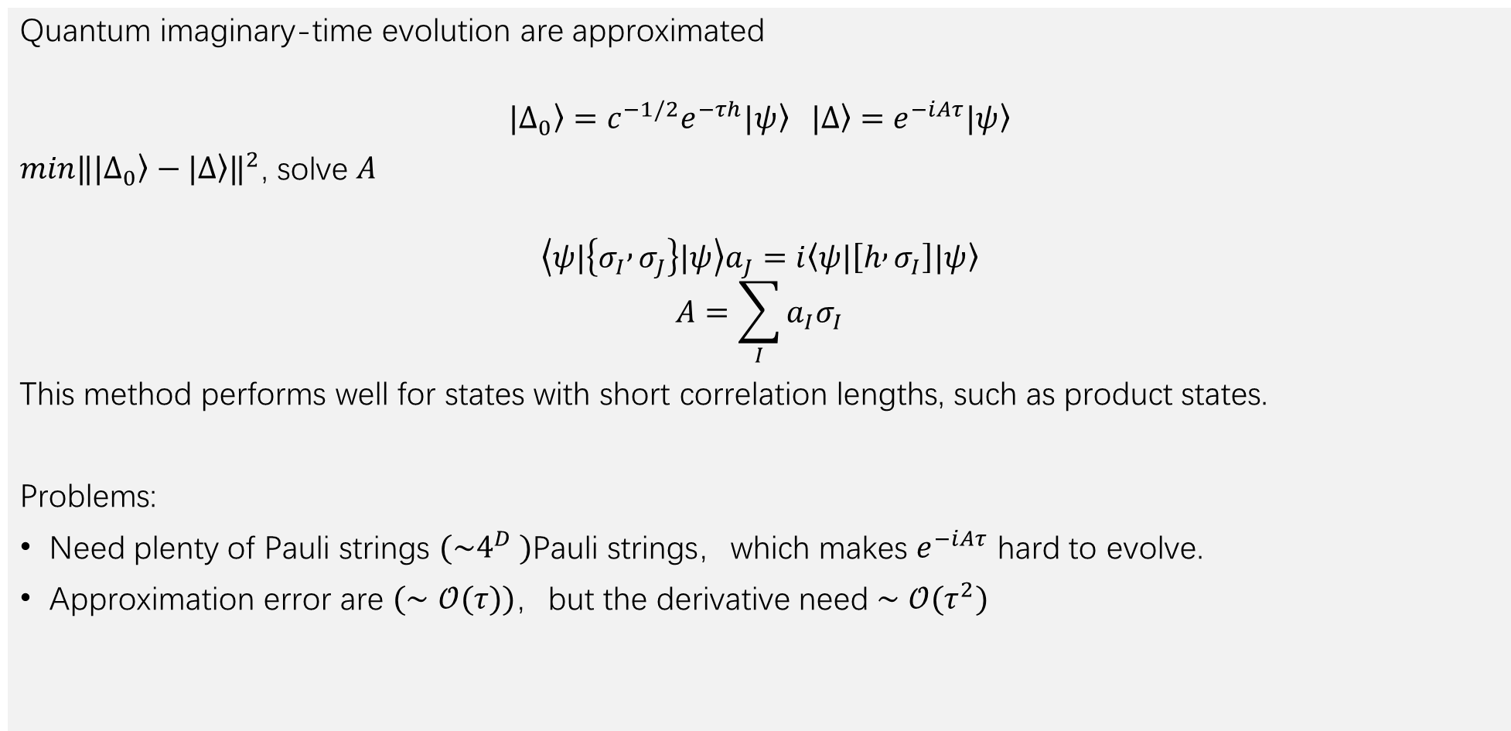
Quantum imaginary-time evolution
Quantum imaginary-time evolution are approximated
$$\left.|Δ_{0}\right\rangle =c^{−1/2}e^{−τh}\left.|ψ\right\rangle \left.|Δ\right\rangle =e^{−iAτ}\left.|ψ\right\rangle$$
$min‖\left.|Δ_{0}\right\rangle −\left.|Δ\right\rangle ‖^{2}$, solve $A$
$$\left\langle ψ|\left\{σ_{I} , σ_{J}\right\}|ψ\right\rangle a_{J}=i\left\langle ψ|\left[h , σ_{I}\right]|ψ\right\rangle$$
$$A=\sum_{I}{a_{I}σ_{I}}$$
This method performs well for states with short correlation lengths, such as product states.
Problems:
Need plenty of Pauli strings $(\sim 4^{D} )$Pauli strings，which makes $e^{−iAτ}$ hard to evolve.
Approximation error are $(∼𝒪(τ))$，but the derivative need $∼𝒪(τ^{2})$
M. Motta, C. Sun, A. T. K. Tan, M. J. O’Rourke, E. Ye, A. J. Minnich, F. G. S. L. Brandão, and G. K.-L. Chan, Nat. Phys. 16, 205 (2020).

Slide 17
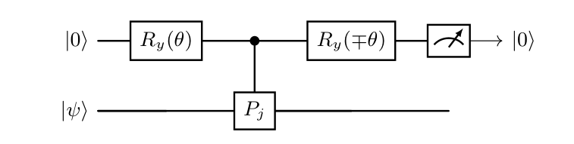
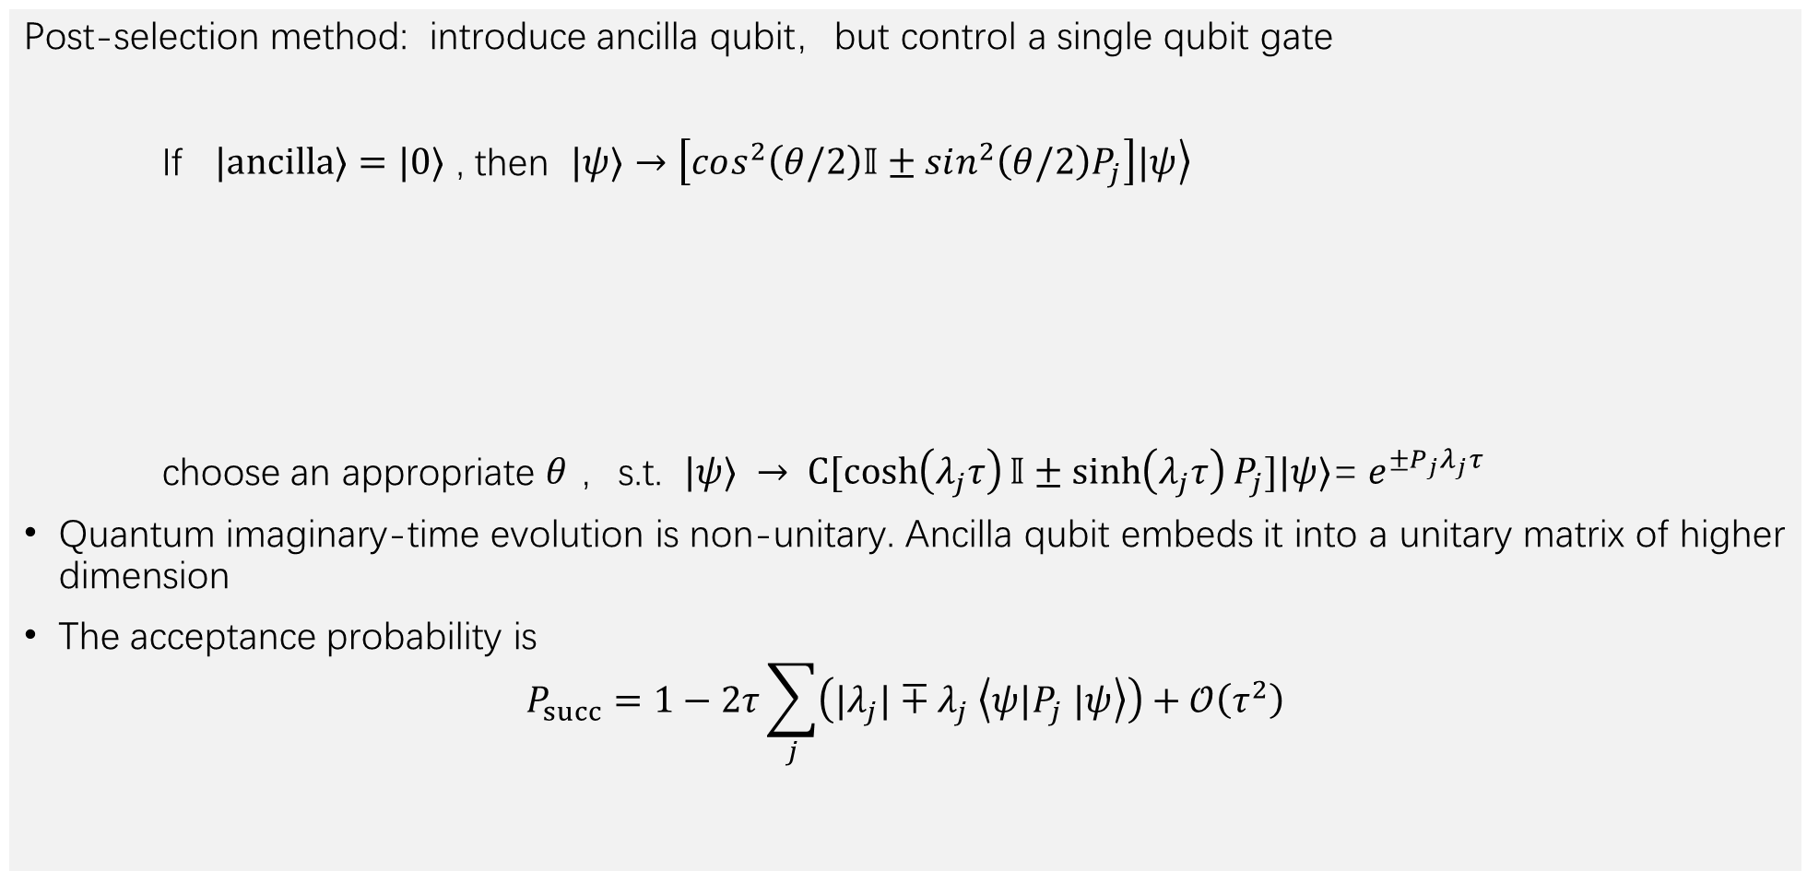
Quantum imaginary-time evolution
Post-selection method: introduce ancilla qubit，but control a single qubit gate
If $|ancilla〉=|0〉$ , then $|ψ〉→\left.\left[cos^{2}\left(θ/2\right)𝕀±sin^{2}\left(θ/2\right)P_{j}\right]|ψ\right\rangle$
choose an appropriate $θ$ ，s.t. $|ψ〉 → C[\cosh\left(λ_{j}τ\right)𝕀±\sinh\left(λ_{j}τ\right)P_{j}]|ψ〉$= $e^{±P_{j}λ_{j}τ}$
Quantum imaginary-time evolution is non-unitary. Ancilla qubit embeds it into a unitary matrix of higher dimension
The acceptance probability is
$$P_{succ}=1−2τ\sum_{j}{\left(|λ_{j}|∓λ_{j} \left\langle ψ|P_{j} |ψ\right\rangle \right)}+𝒪\left(τ^{2}\right)$$

Slide 18
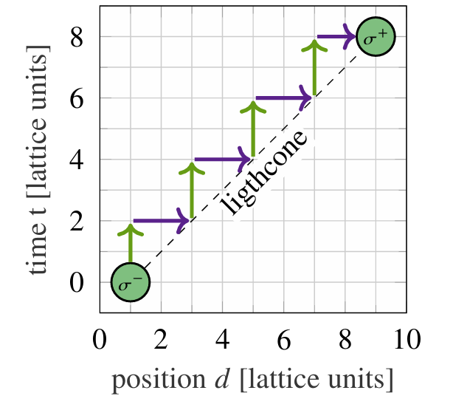
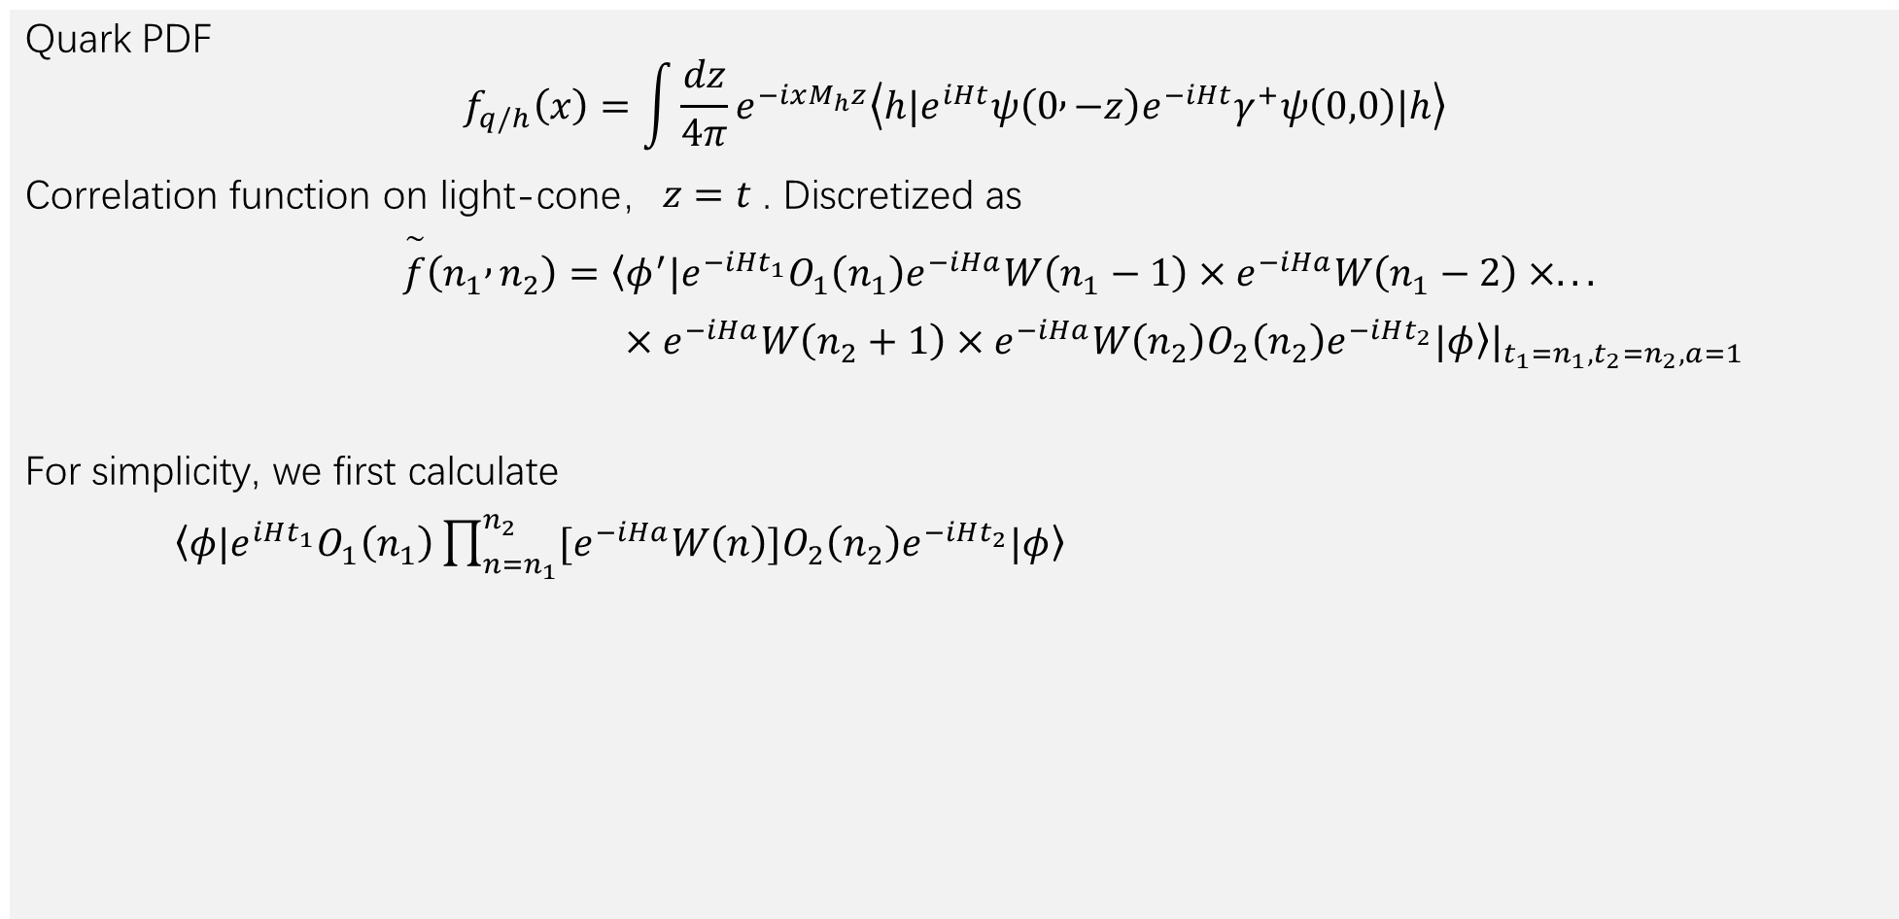
Application：Parton Distribution Function
Quark PDF
$$f_{q/h}\left(x\right)=\int{\frac{dz}{4π}}e^{−ixM_{h}z}\left\langle h|e^{iHt}ψ\left(0 , −z\right)e^{−iHt}γ^{+}ψ\left(0,0\right)|h\right\rangle$$
Correlation function on light-cone，$z=t$ . Discretized as
$\overset{\sim }{f}\left(n_{1} , n_{2}\right)=\left\langle φ^{′}|\right.e^{−iHt_{1}}O_{1}\left(n_{1}\right)e^{−iHa}W\left(n_{1}−1\right)×e^{−iHa}W\left(n_{1}−2\right)×...$
$×e^{−iHa}W\left(n_{2}+1\right)×e^{−iHa}W\left(n_{2}\right)O_{2}\left(n_{2}\right)e^{−iHt_{2}}\left.|φ\right\rangle |_{t_{1}=n_{1},t_{2}=n_{2},a=1}$
For simplicity, we first calculate
$\begin{matrix} & \left\langle φ|\right.e^{iHt_{1}}O_{1}\left(n_{1}\right)\prod_{n=n_{1}}^{n_{2}}{[e^{−iHa}W\left(n\right)}]{O_{2}\left(n_{2}\right)e}^{−iHt_{2}}\left.|φ\right\rangle & \end{matrix}$
T. Li, X. Guo, W. K. Lai, X. Liu, E. Wang, H. Xing, D.-B. Zhang, and S.-L. Zhu, Phys. Rev. D 105, L111502 (2022).

Slide 19
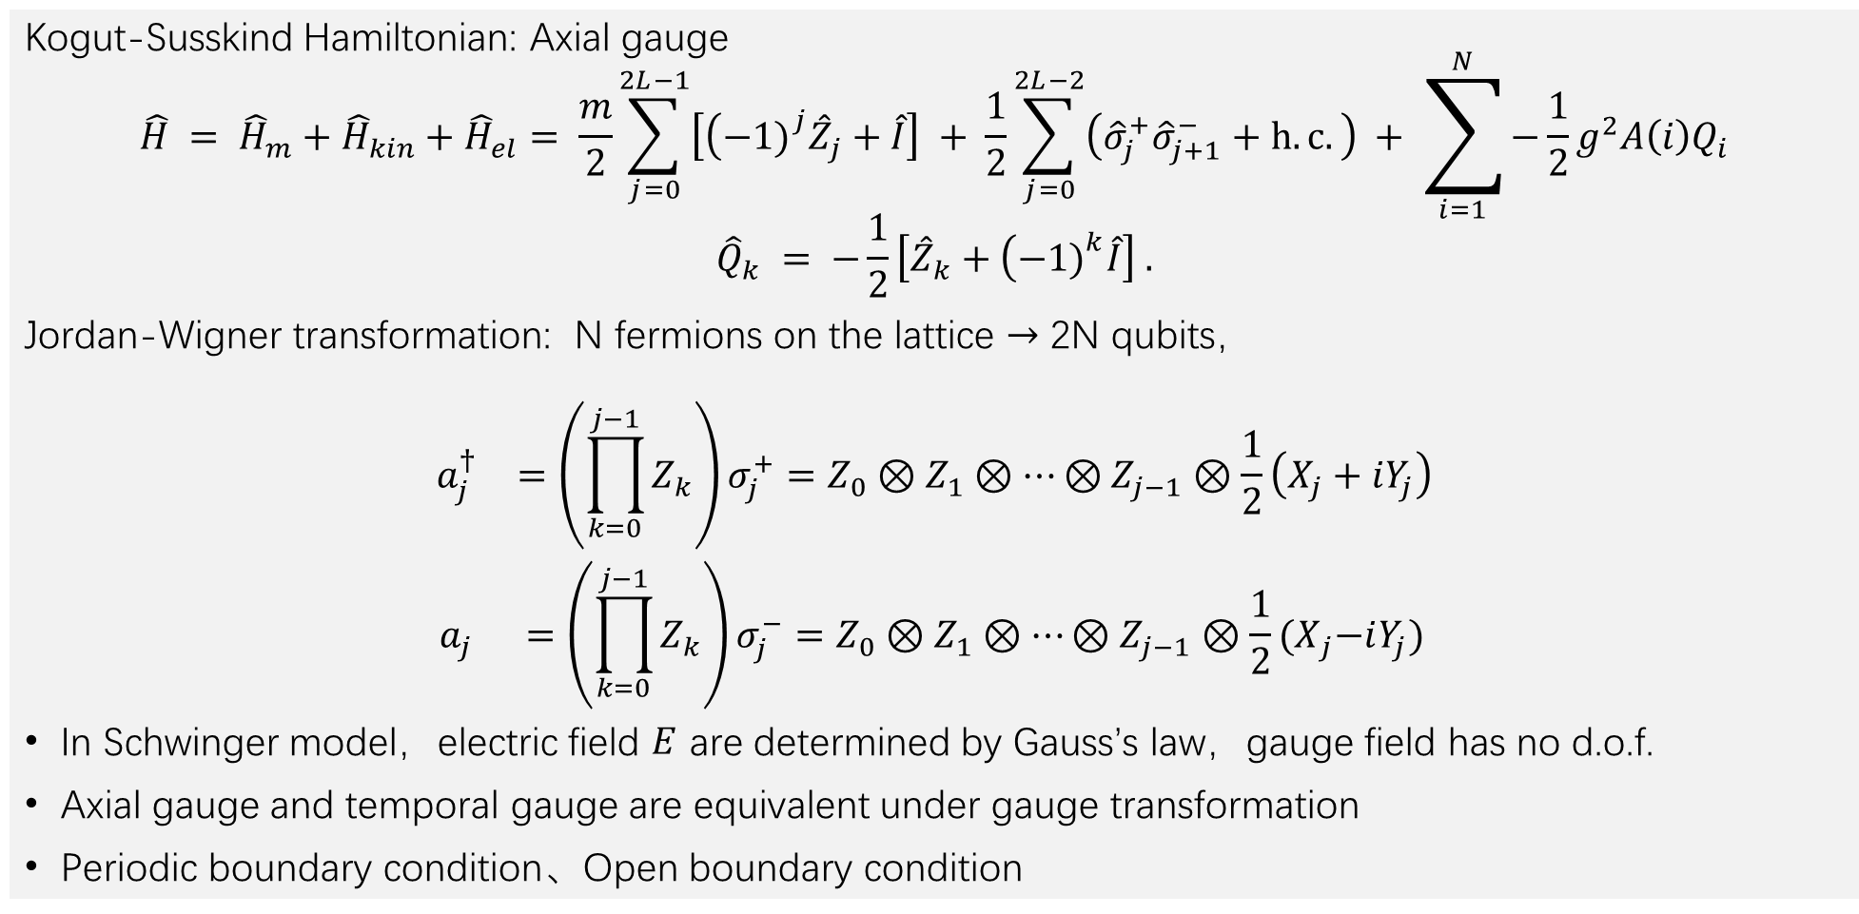
Schwinger model on the lattice
Kogut-Susskind Hamiltonian: Axial gauge
$$\hat{H} = {\hat{H}}_{m}+{\hat{H}}_{kin}+{\hat{H}}_{el}= \frac{m}{2}\sum_{j=0}^{2L−1}{\left[\left(−1{\left.)\right.}^{j}{\hat{Z}}_{j}+\hat{I}\right]\right.} + \frac{1}{2}\sum_{j=0}^{2L−2}{\left({\hat{σ}}_{j}^{+}{\hat{σ}}_{j+1}^{−}+h.c.\right)} + \sum_{i=1}^{N}{−\frac{1}{2}g^{2}A\left(i\right)Q_{i}}$$
$${\hat{Q}}_{k} = −\frac{1}{2}\left[{\hat{Z}}_{k}+\left(−1{\left.)\right.}^{k}\hat{I}\right]\right. .$$
Jordan-Wigner transformation: N fermions on the lattice $→$ 2N qubits，
$$\begin{matrix} & \begin{matrix}a_{j}^{†} & =\left(\prod_{k=0}^{j−1}{Z_{k}}\right)σ_{j}^{+}=Z_{0}⊗Z_{1}⊗⋯⊗Z_{j−1}⊗\frac{1}{2}\left(X_{j}+iY_{j}\right) \\ a_{j} & =\left(\prod_{k=0}^{j−1}{Z_{k}}\right)σ_{j}^{−}=Z_{0}⊗Z_{1}⊗⋯⊗Z_{j−1}⊗\frac{1}{2}{(X}_{j}−iY_{j})\end{matrix} & \end{matrix}$$
In Schwinger model，electric field $E$ are determined by Gauss’s law，gauge field has no d.o.f.
Axial gauge and temporal gauge are equivalent under gauge transformation
Periodic boundary condition、Open boundary condition

Slide 20
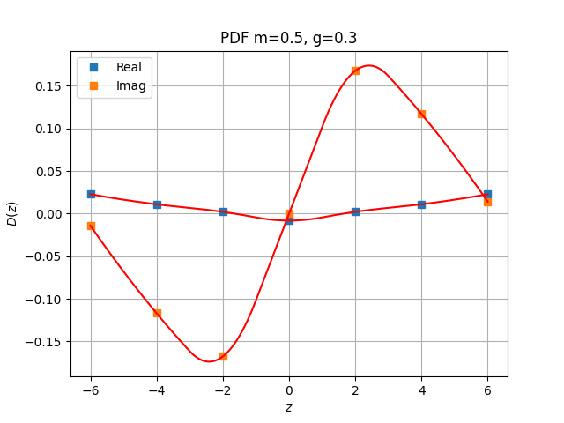
Numerical Demonstration
Algorithm validation on classical computer
Periodic boundary condition
Approximating hadronic states via Dicke states

Slide 21
Conclusion & Outlook
Conclusion
We proposed an algorithm of n-time correlation function without ancilla qubit
For correlation function in gauge field theory, the gauge link can be added via quantum imaginary-time evolution
Outlook
Perform the quantum algorithm on a quantum computer (10~12 qubits)
Generalized to other gauge theory in high energy physics and condensed matter physics

