Slide 1
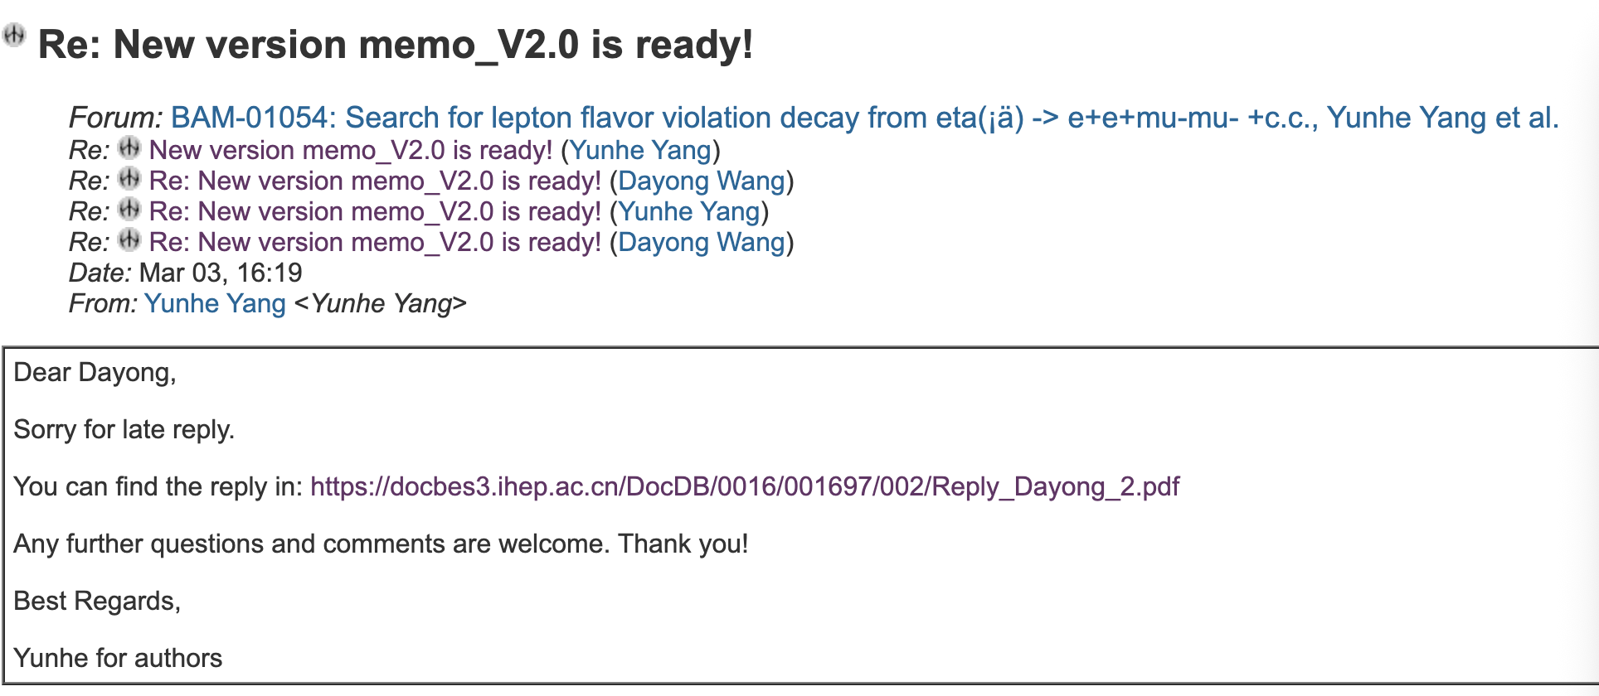
CLFV

Slide 2
CPV
Prepare prof. You’s question.

Slide 3
DC ML tracking
The data cleaning has been completed. Next, start training the GNN model.

Slide 4
2026.3.10
Nankai Group Meeting

Slide 5
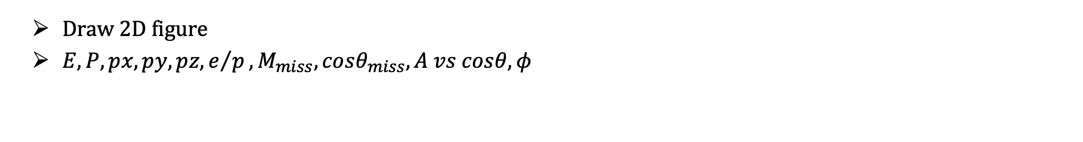
CPV
Draw 2D figure
$E, P, px, py, pz, e/p, M_{miss},cosθ_{miss},A vs cosθ, φ$

Slide 6
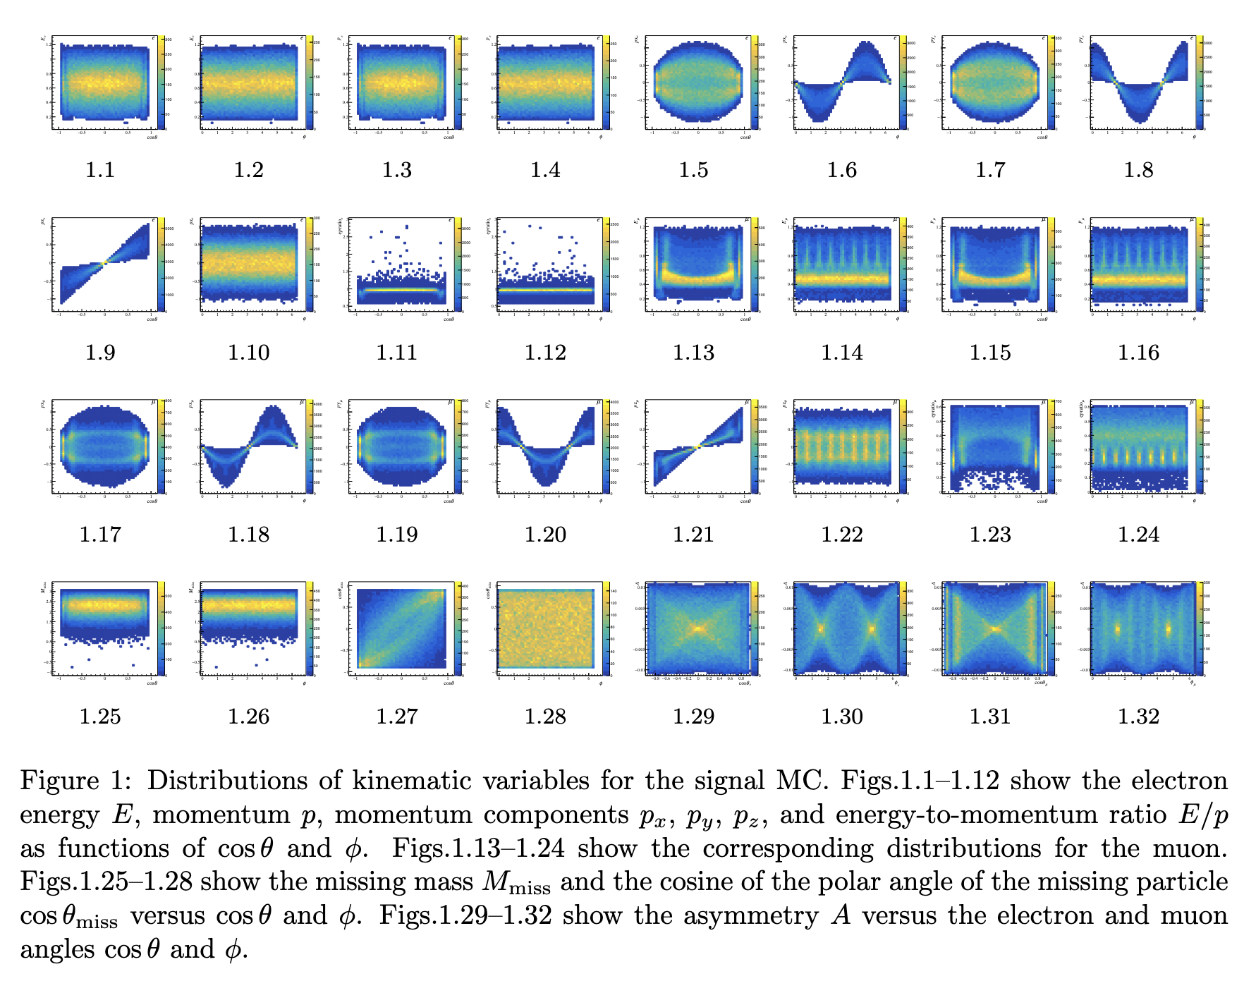

Slide 7
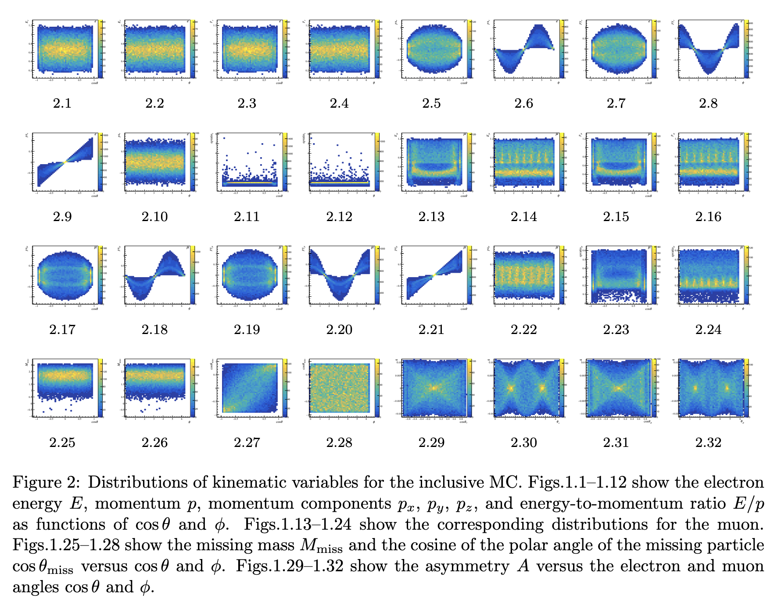

Slide 8
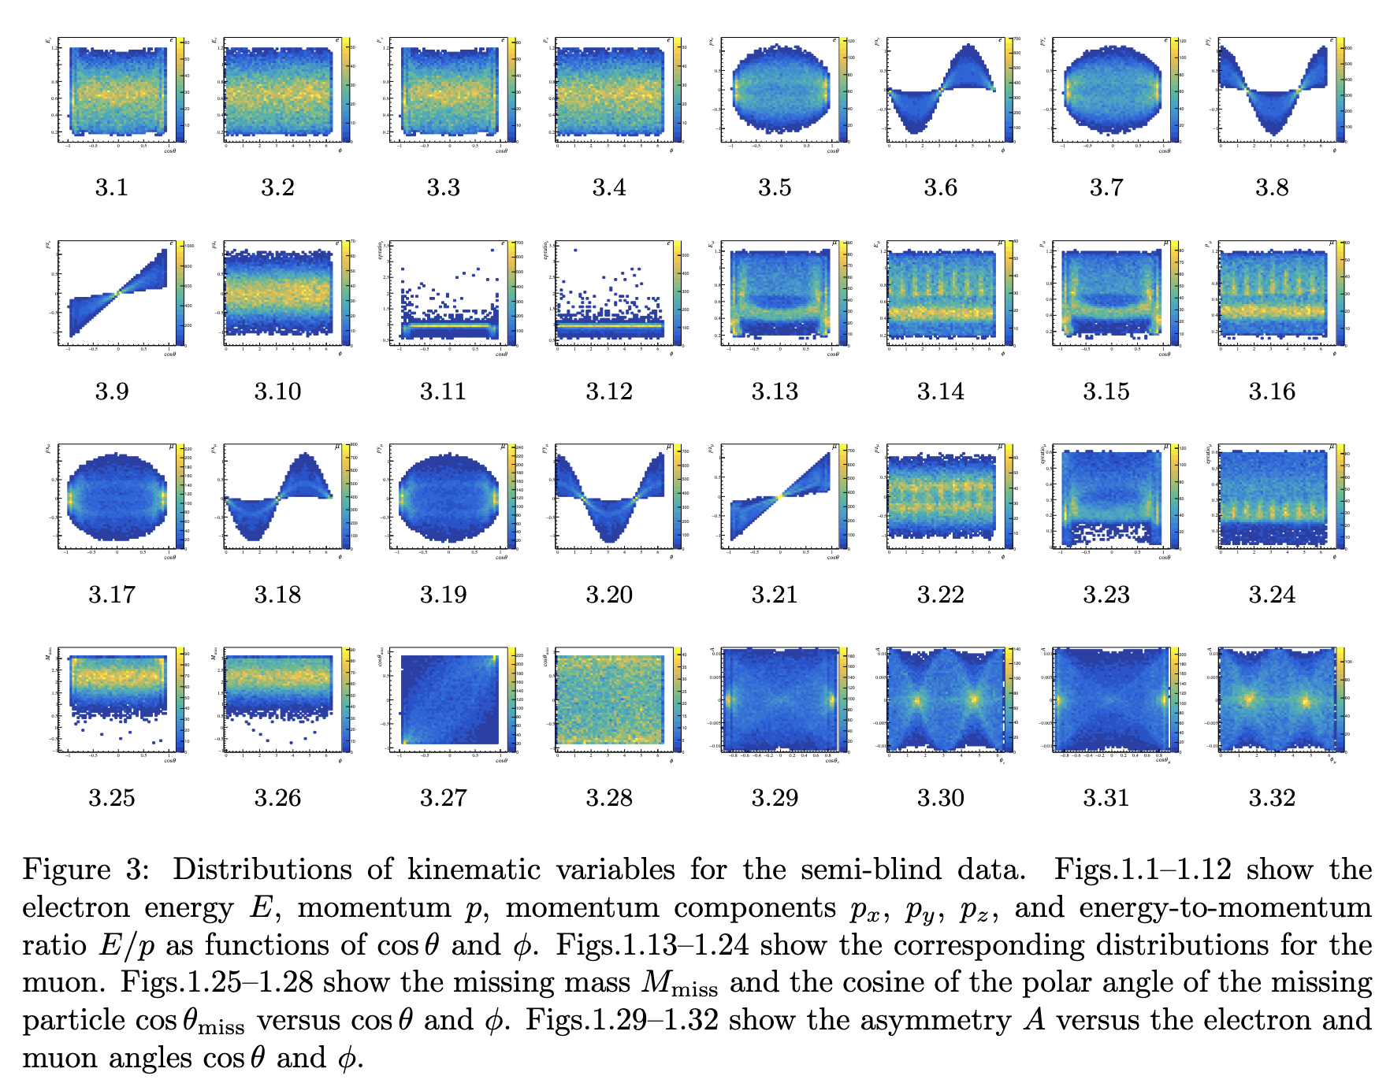

Slide 9
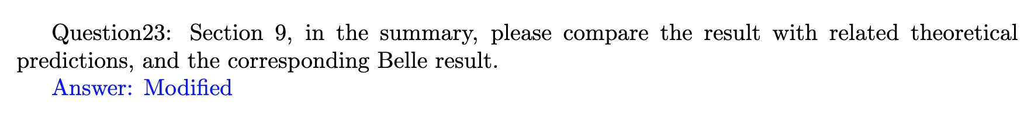
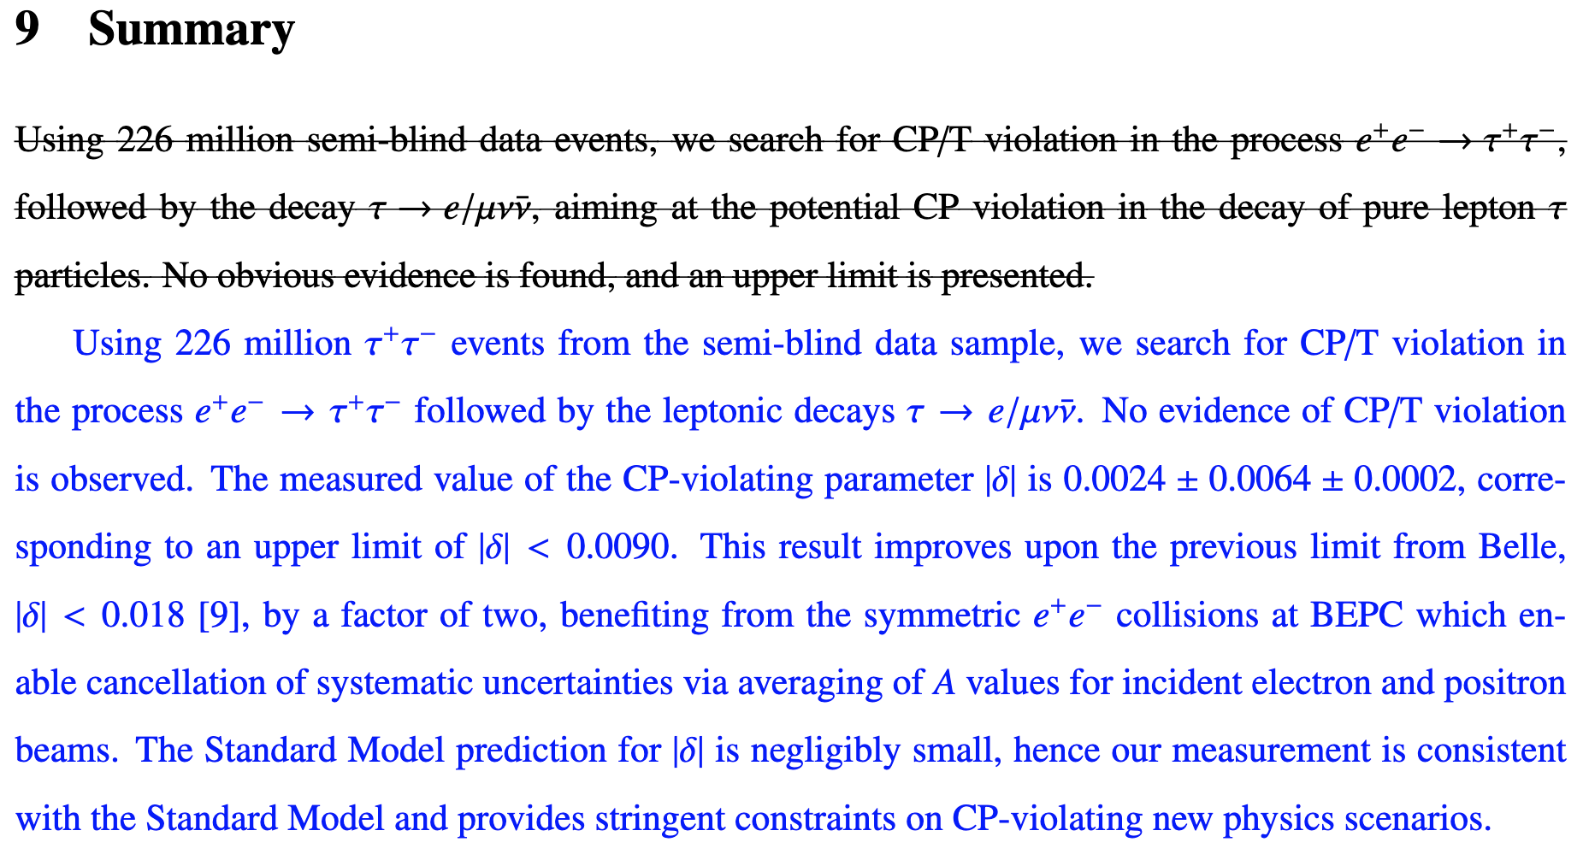
CPV

Slide 10
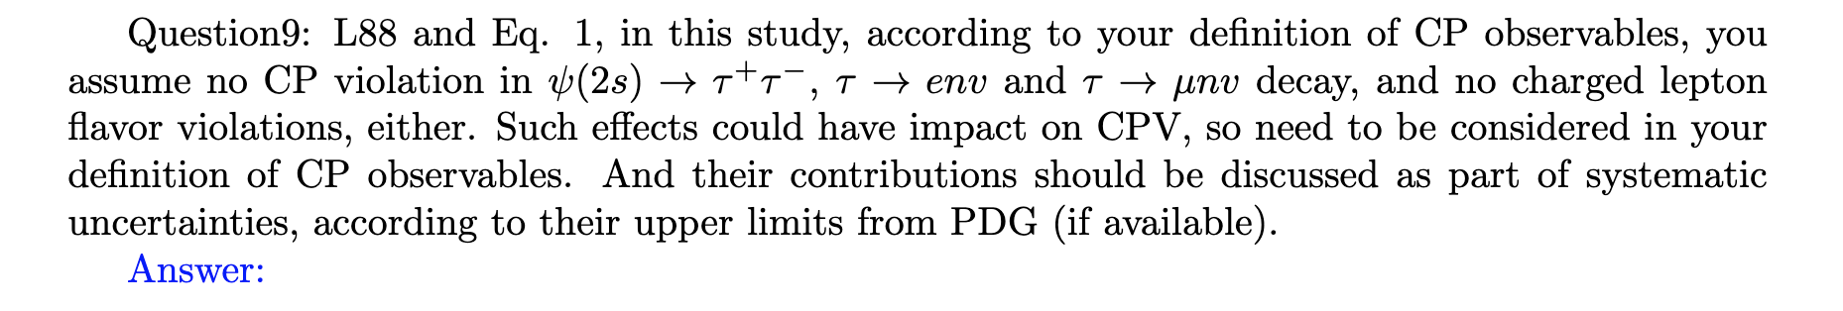
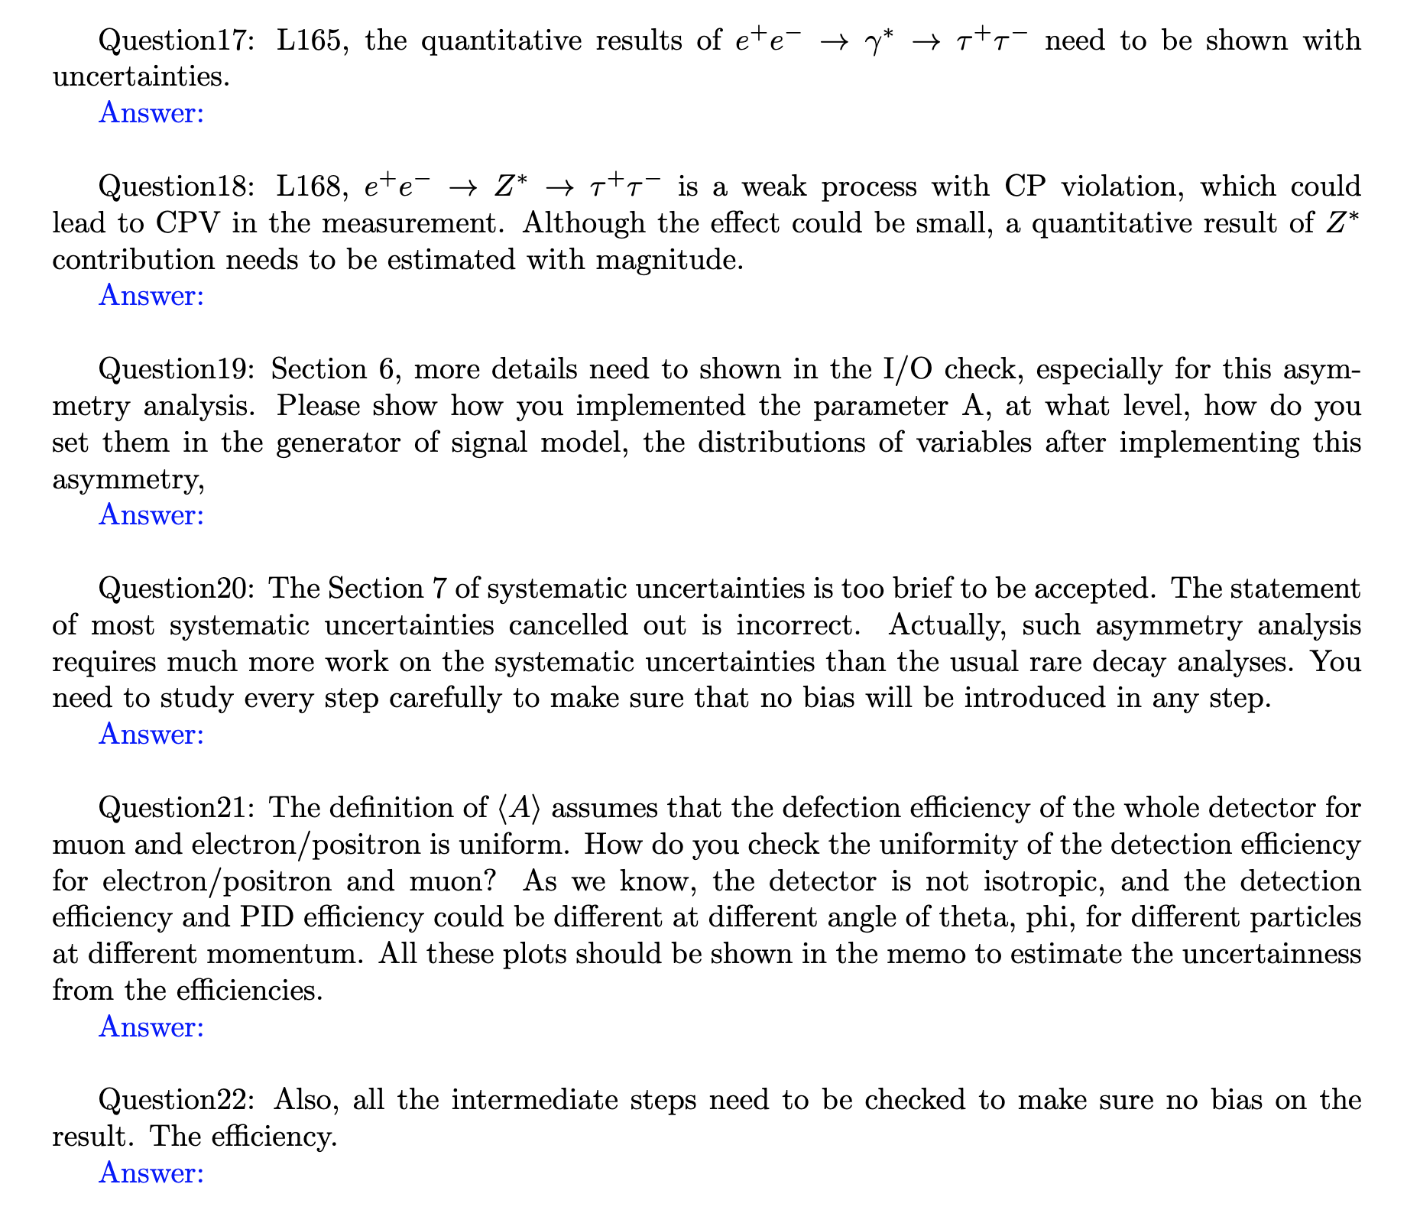
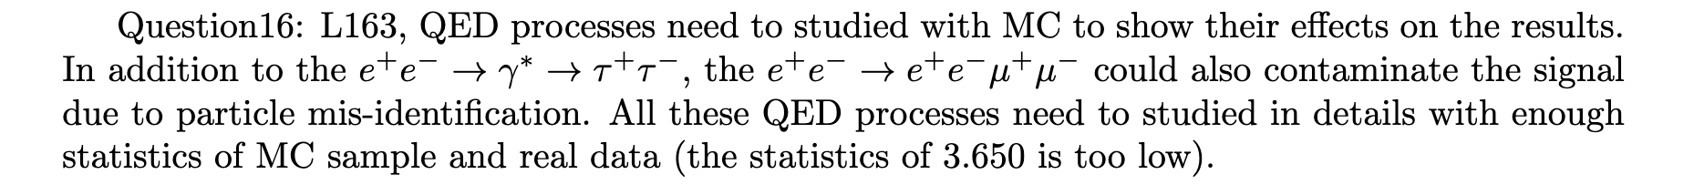
CPV
Next week
There are still 8 questions that we need to respond to.

Slide 11
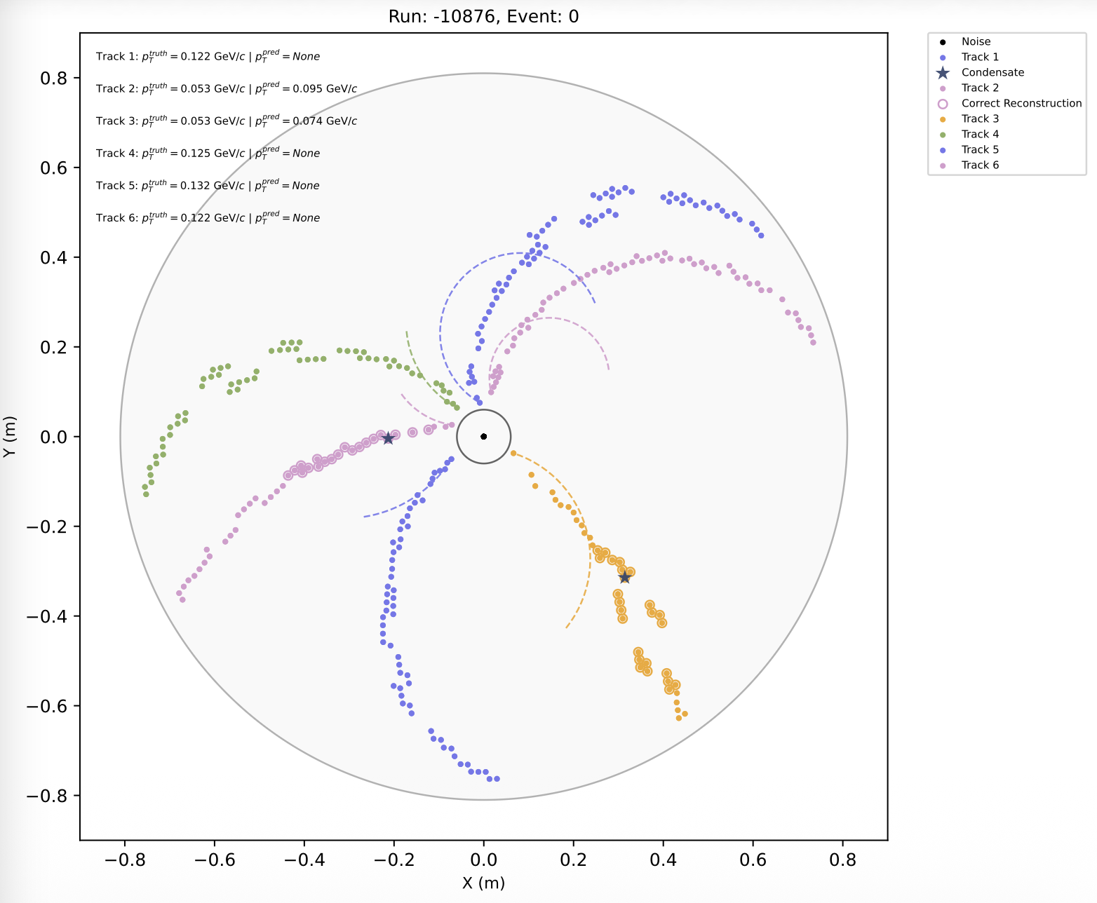
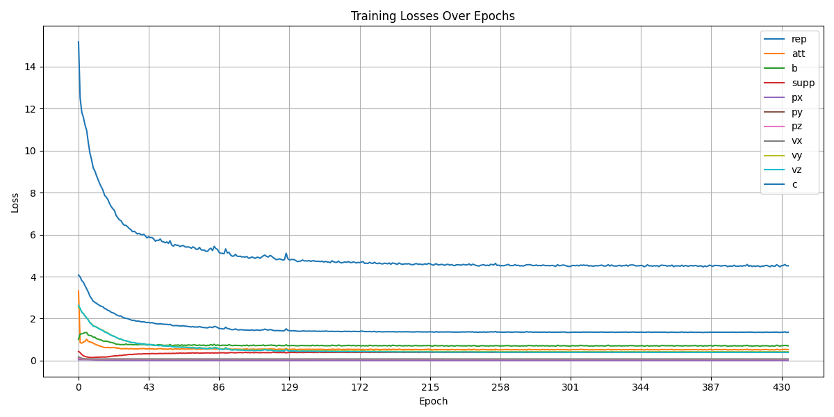
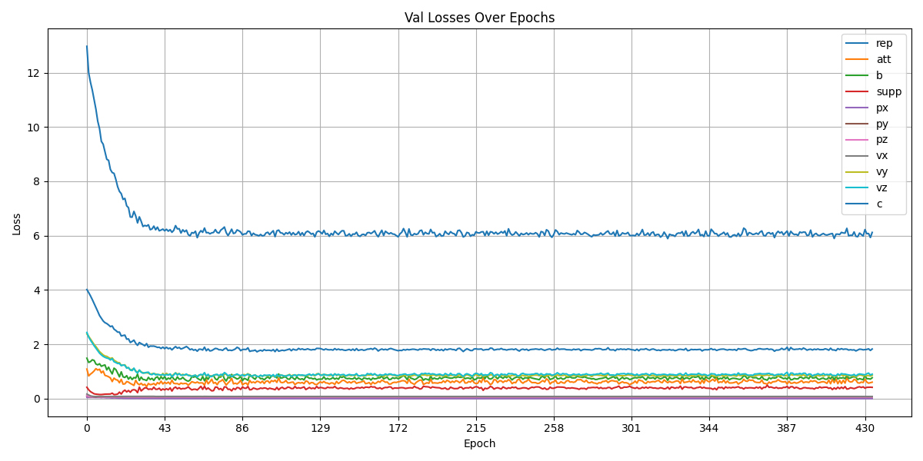
DC ML tracking
Train model: use 9,000 training samples and 1,000 validation samples.
After completing one round of training, the results were not satisfactory.
We think this is due to the small sample size. The high-momentum training used approximately 200,000 samples for training, while the low-momentum samples were more complex, so more samples should be used.

Slide 12
2026.3.17
Nankai Group Meeting

Slide 13
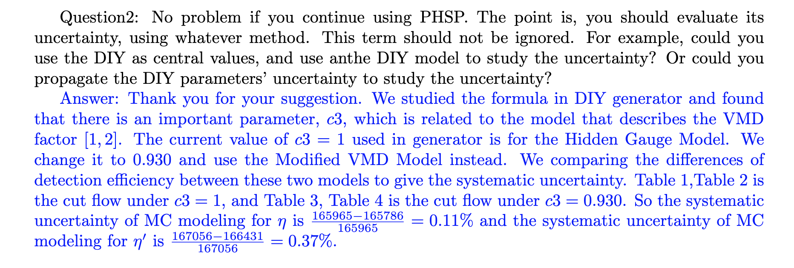
CLFV
After Prof. Wang check it, I will reply it on HyperNews.

Slide 14
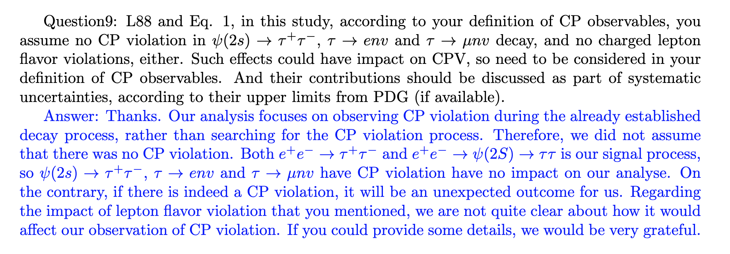
CPV

Slide 15
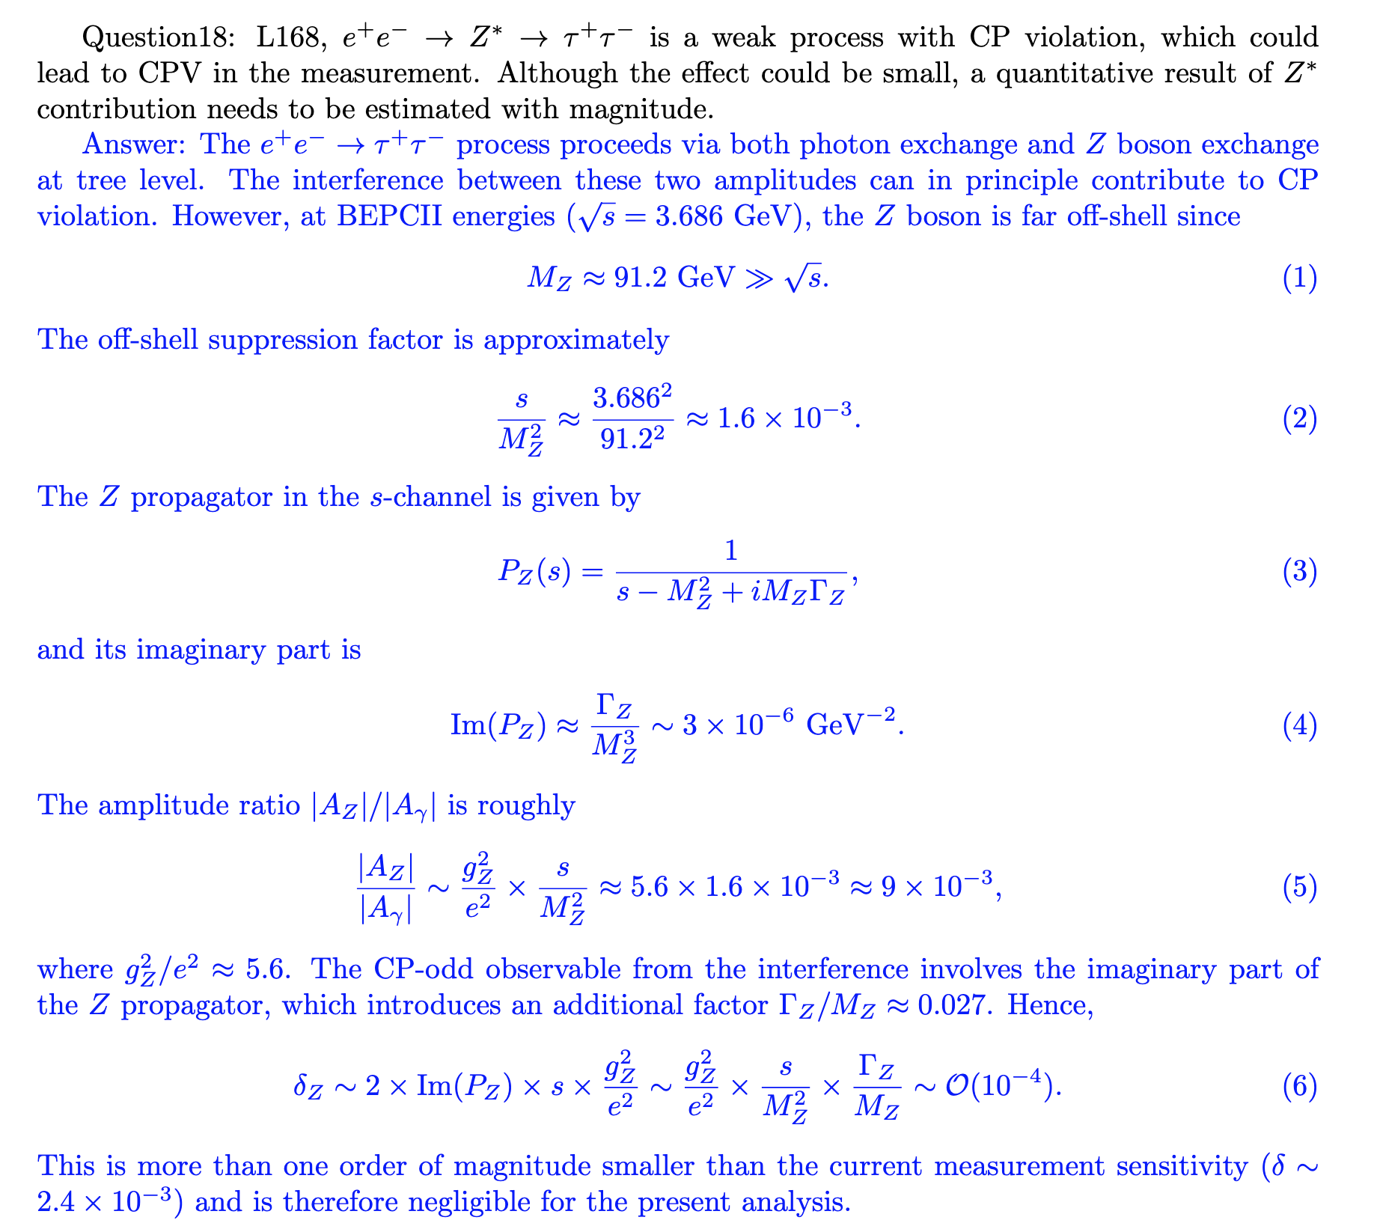
CPV

Slide 16
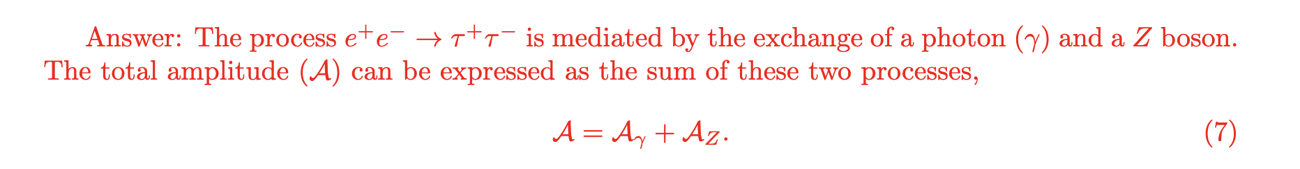
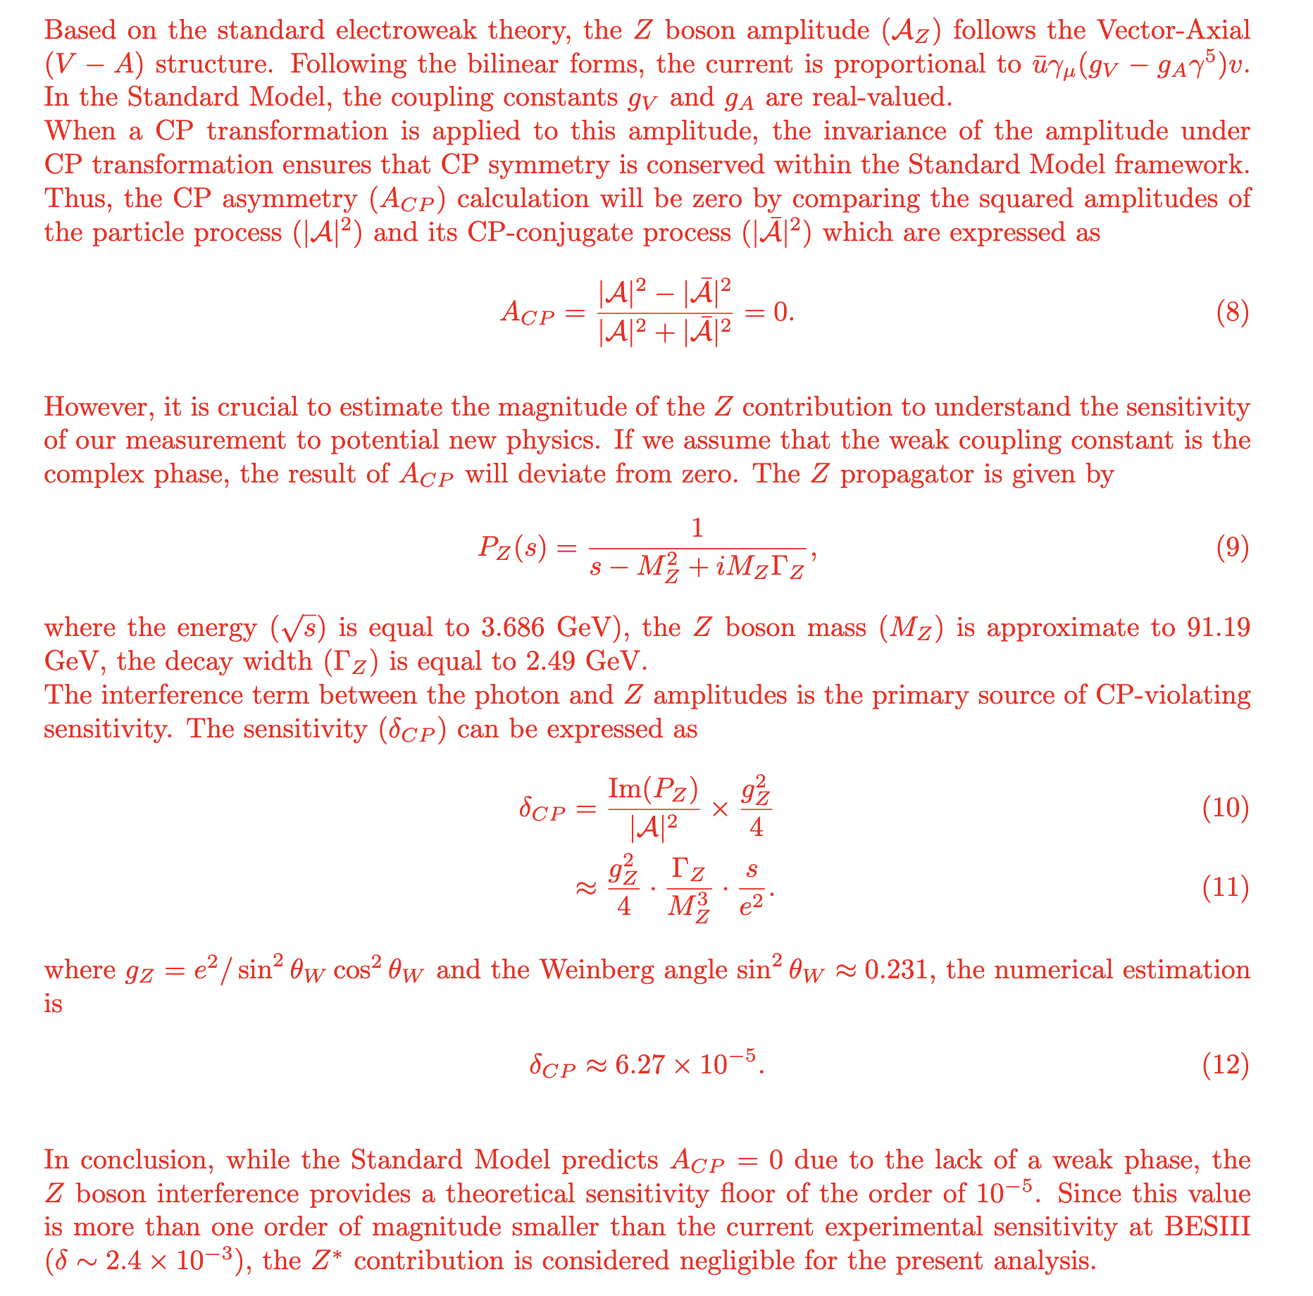

Slide 17
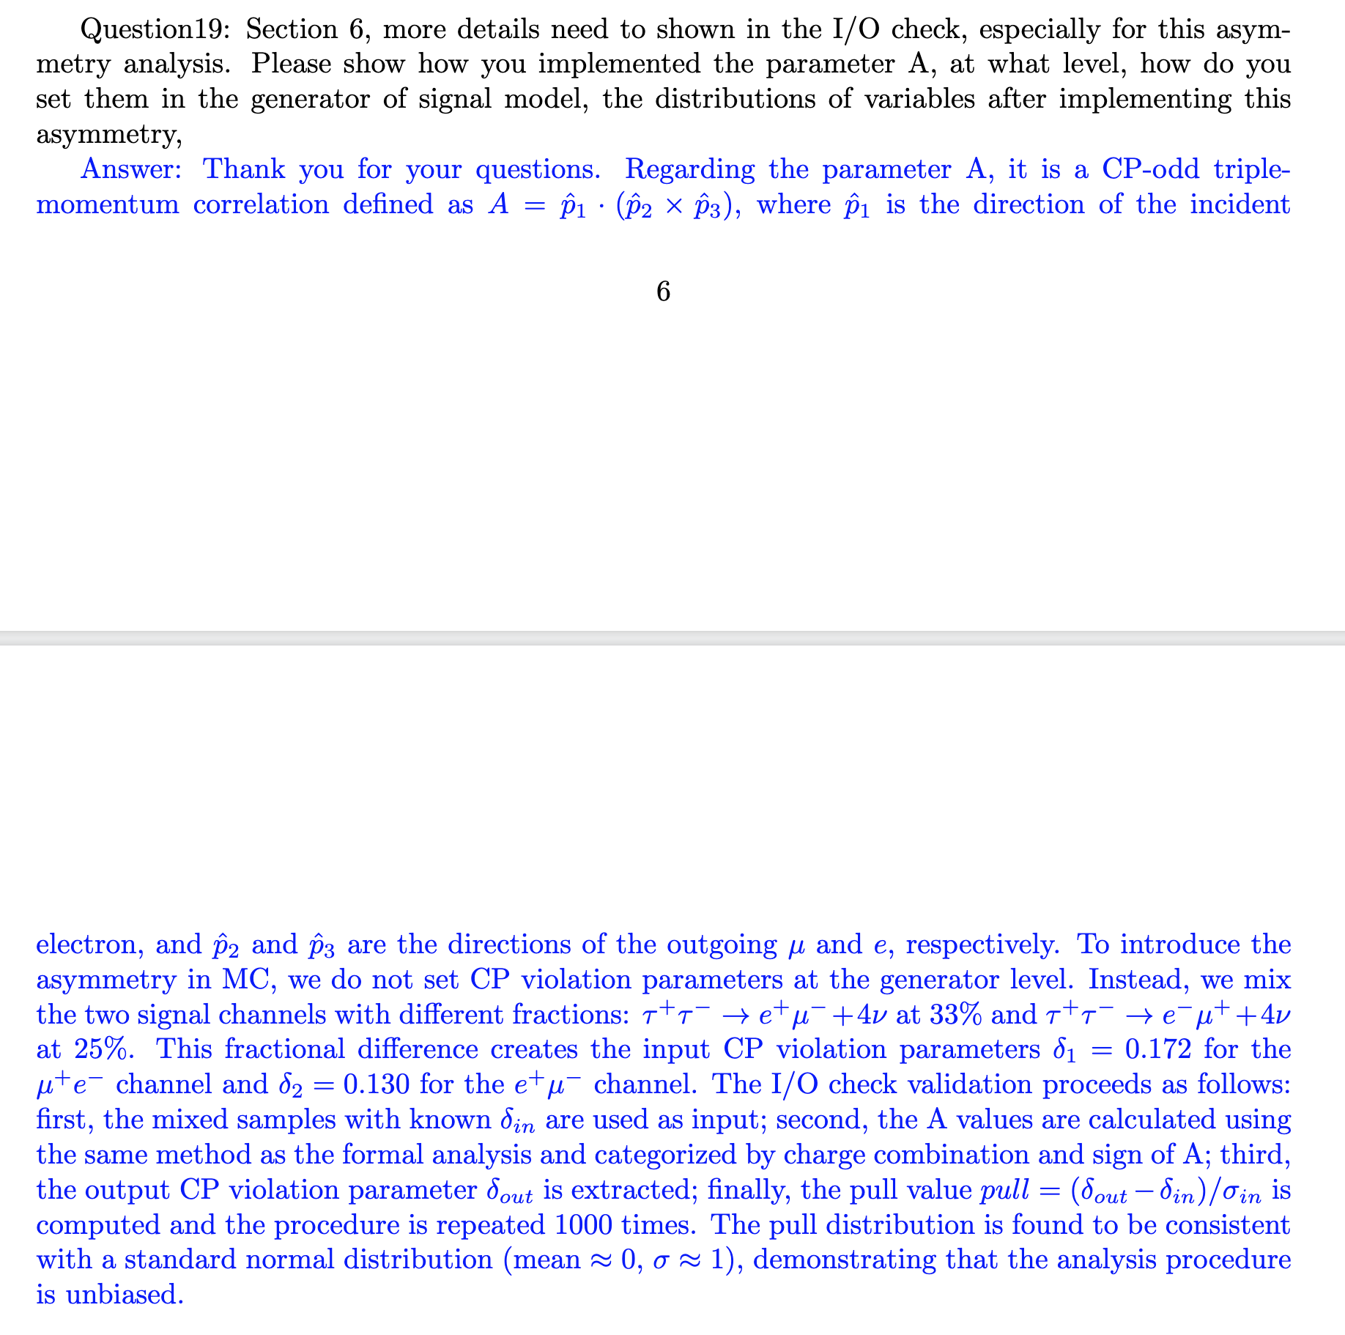
CPV

Slide 18
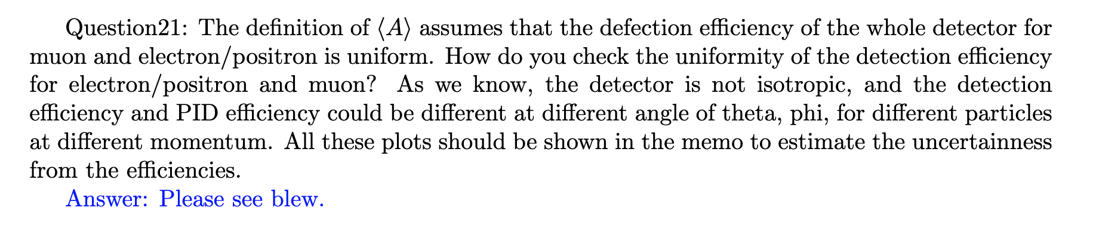
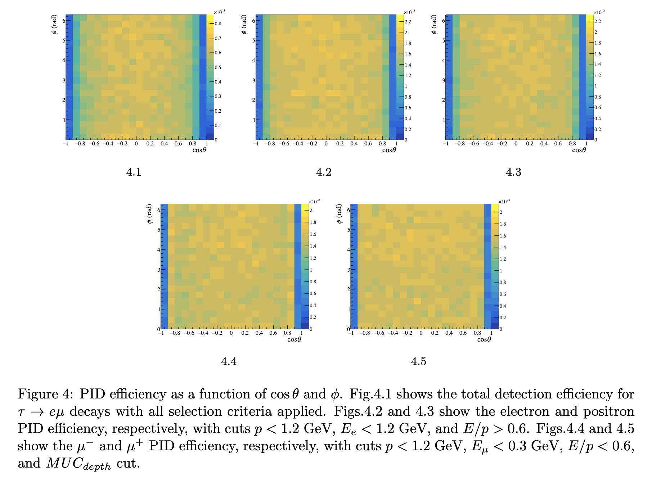
CPV

Slide 19
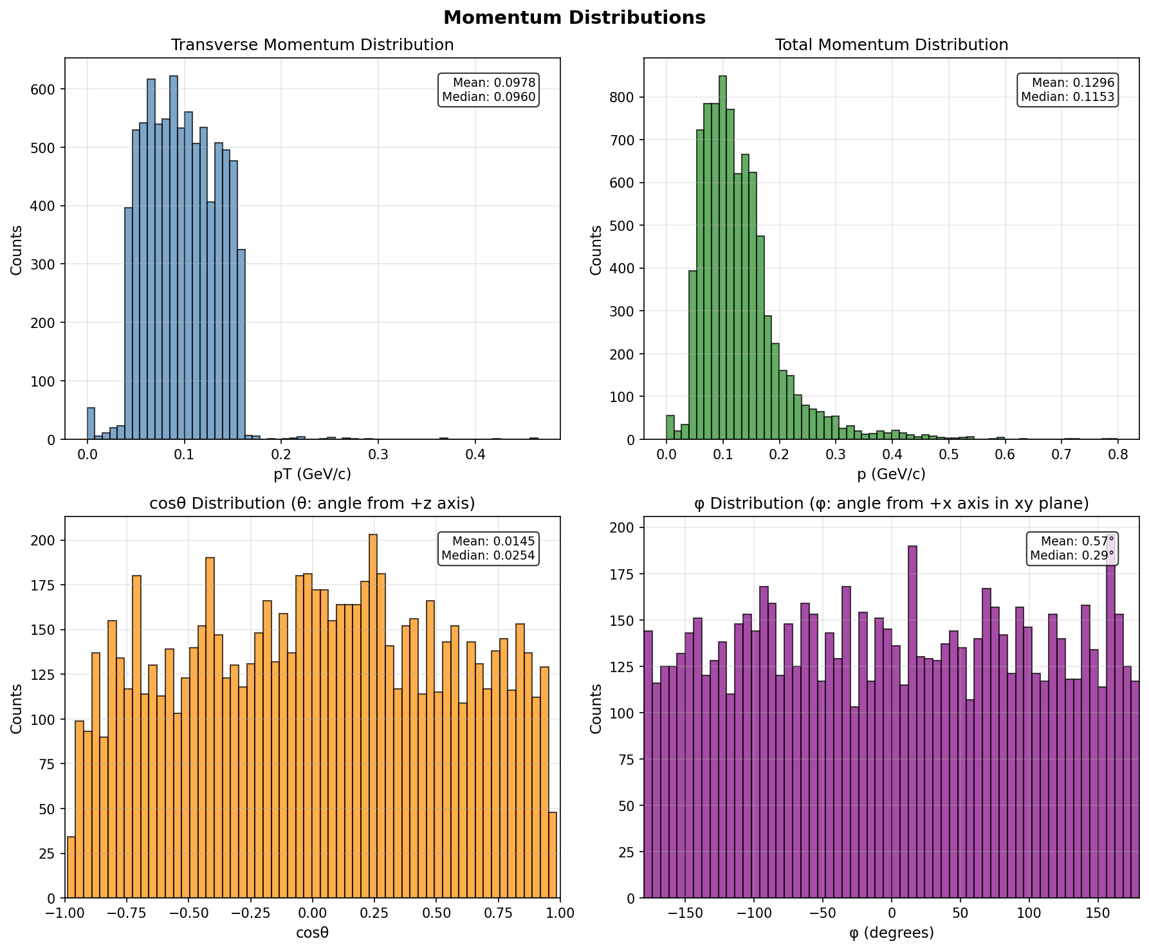
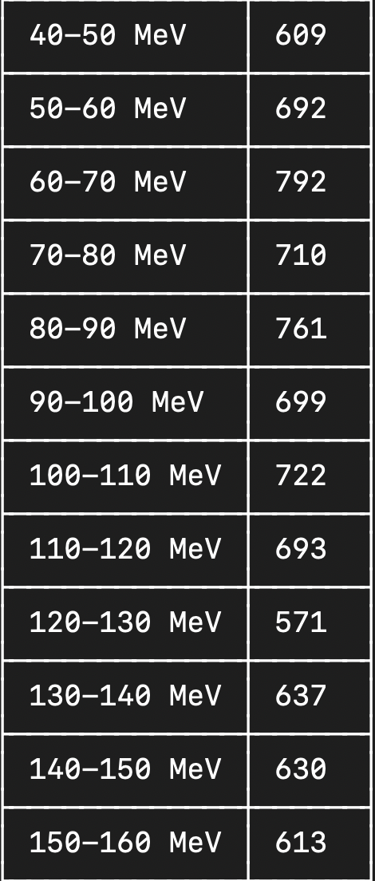
横动量统计（1000个事例中不同横动量track的数量）

Slide 20
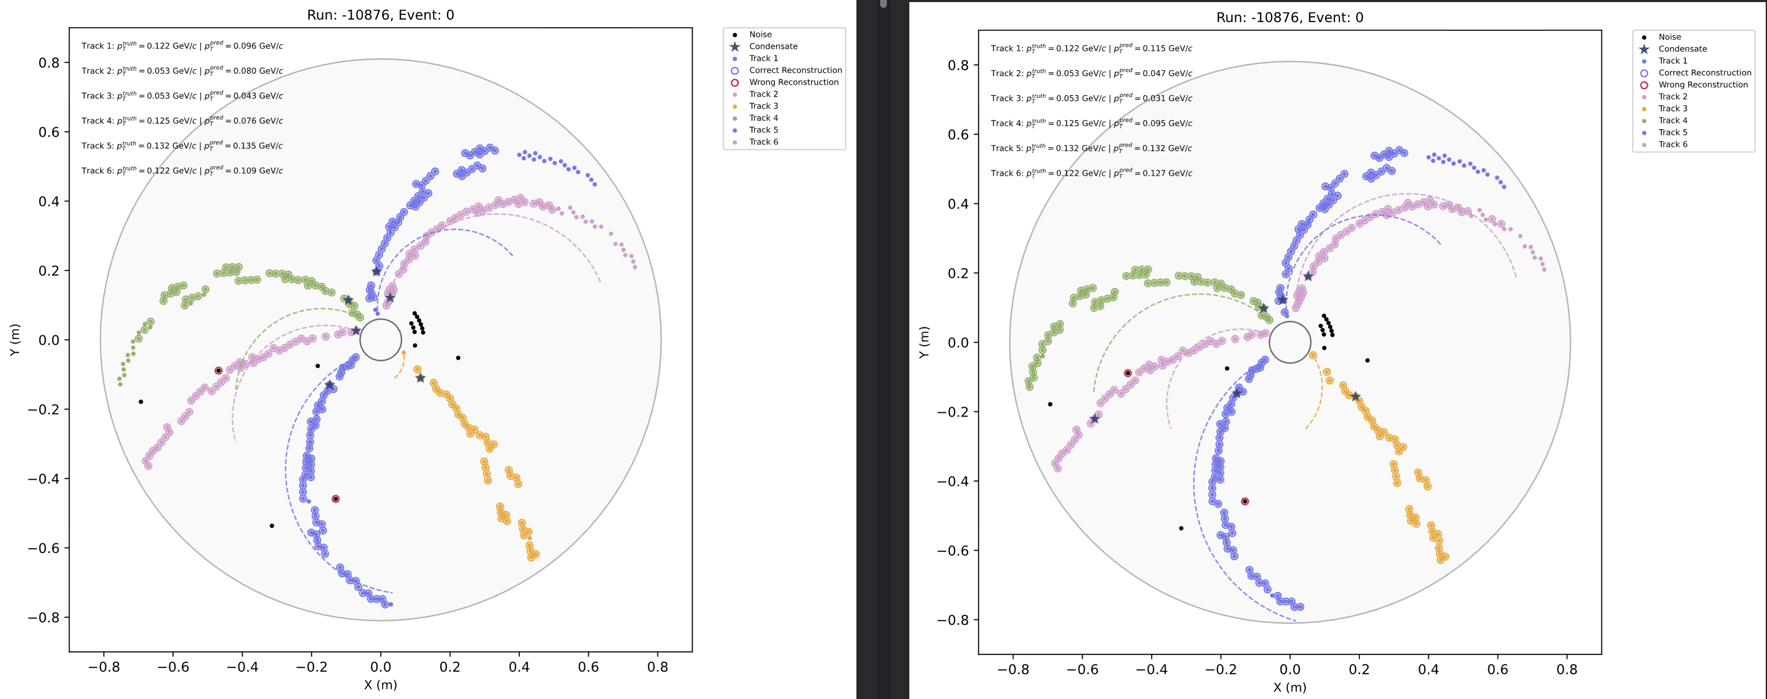
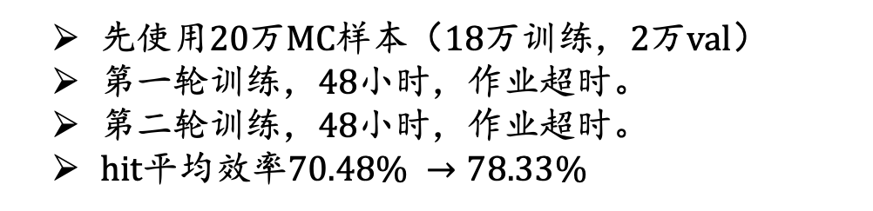
先使用20万MC样本（18万训练，2万val）
第一轮训练，48小时，作业超时。
第二轮训练，48小时，作业超时。
hit平均效率$70.48\% →78.33\%$
Main problem: Modify the model.

Slide 21
2026.3.24
Nankai Group Meeting

Slide 22
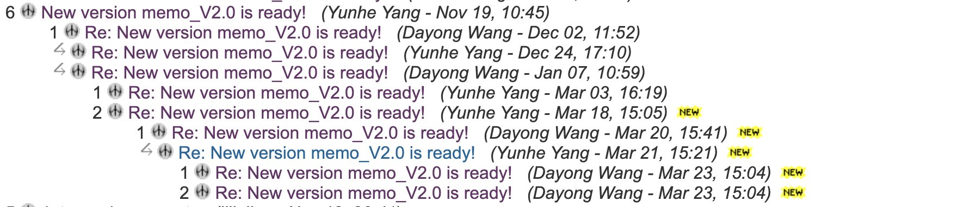
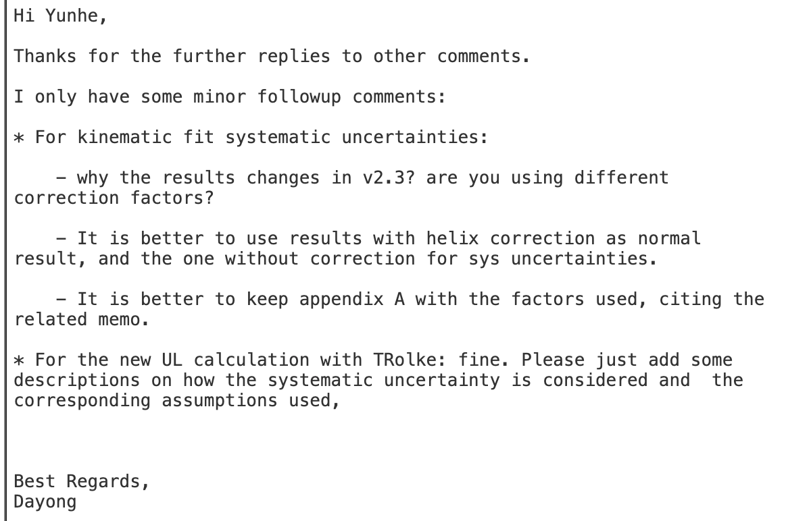
CLFV

Slide 23
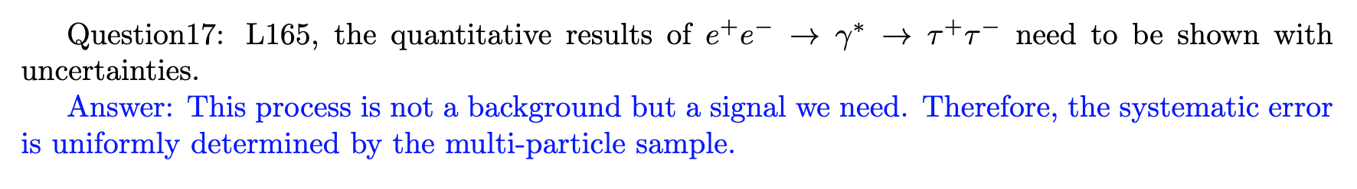
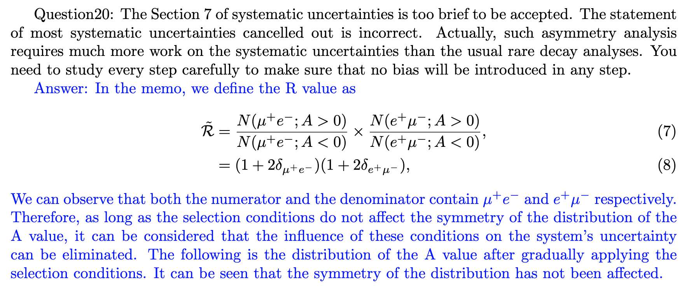
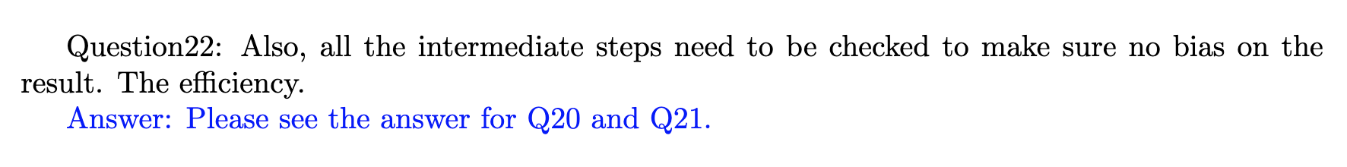
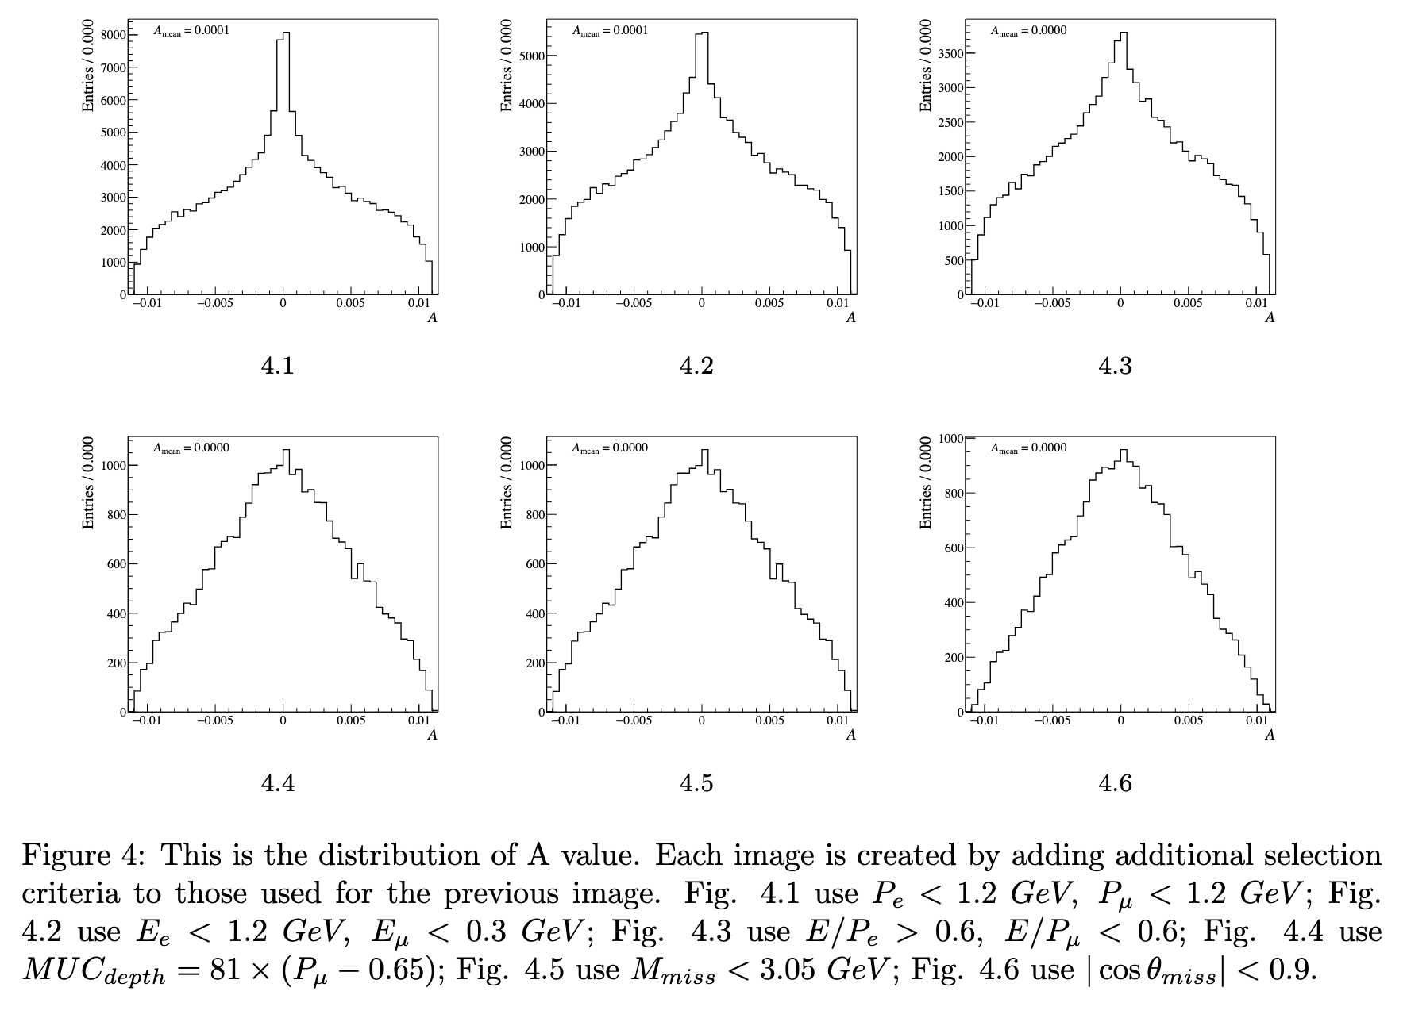
CPV

Slide 24
2026.3.24
Nankai Group Meeting

Slide 25
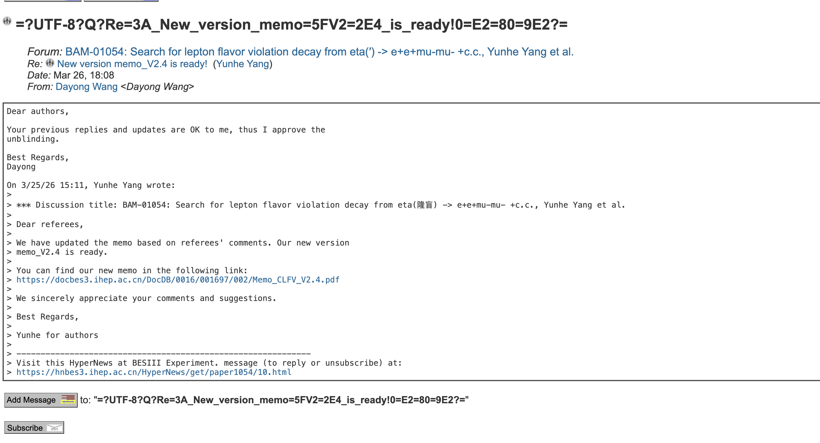
CLFV

