Slide 1




第九届强子谱和强子结构研讨会
Magnetic Moments and Radiative Decays of the $T_{cc}{\left(3875\right)}^{+}$and its partner states
武敬
山东建筑大学
合作者：Yan-Rui Liu, Jian-Bo Cheng

Slide 2

CONTENTS|
1. Background
2. Formalism
3. Results & discussion
4. Summary

Slide 3
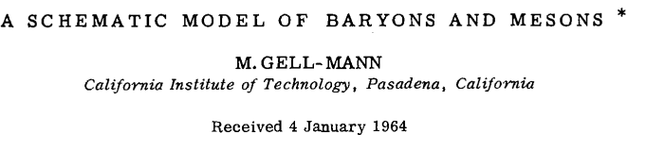
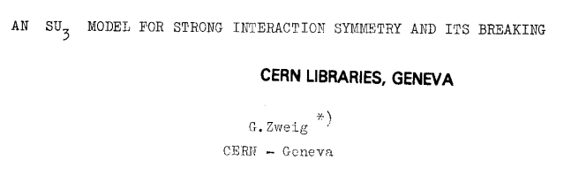
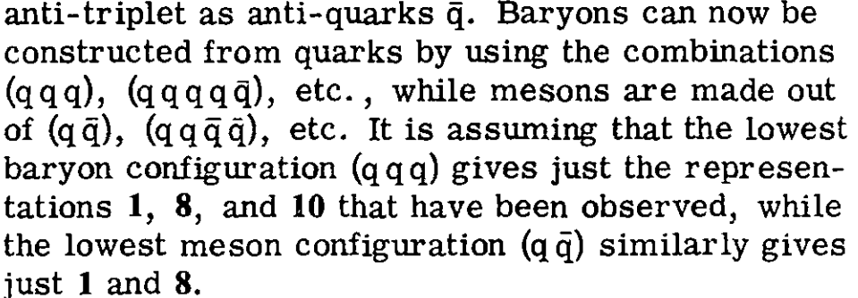
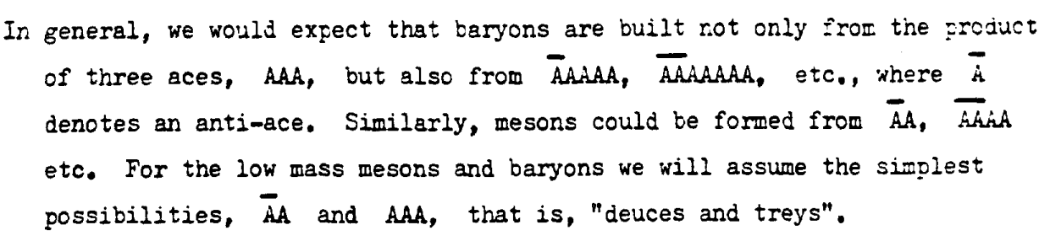
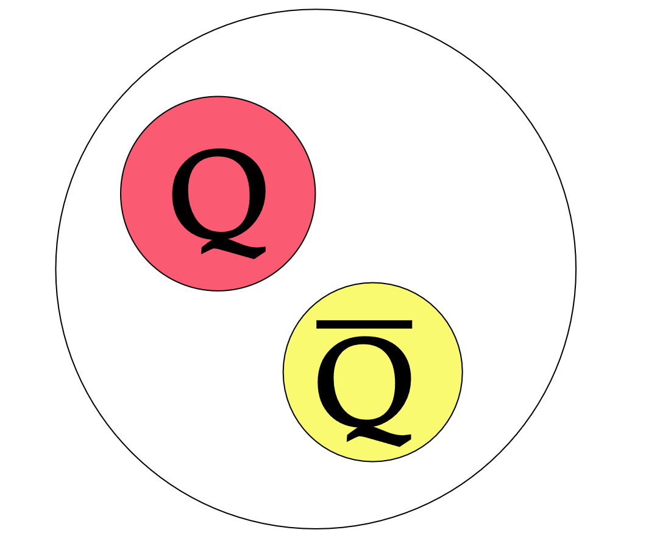
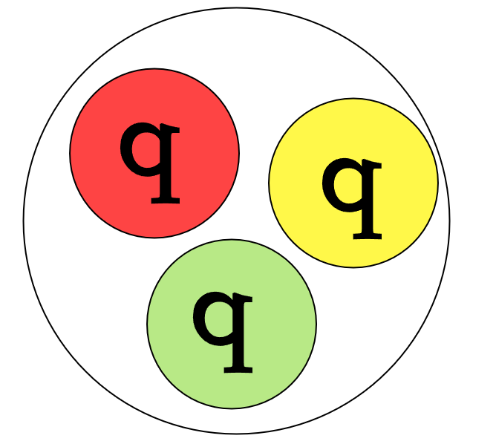
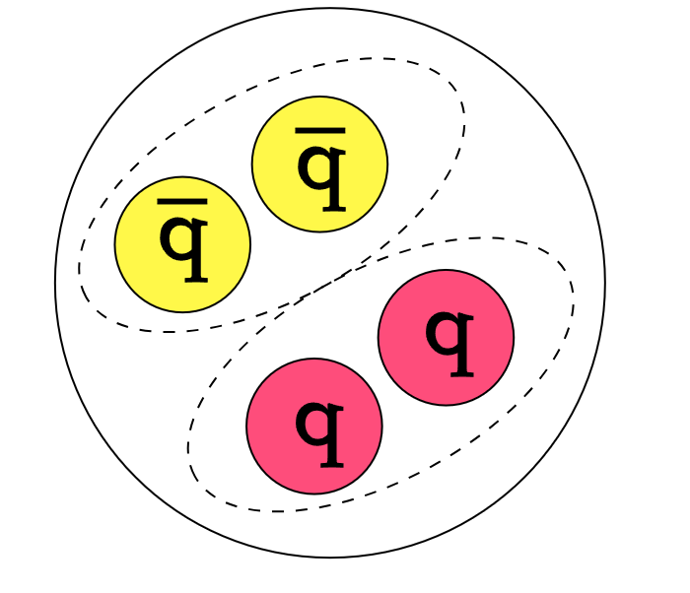
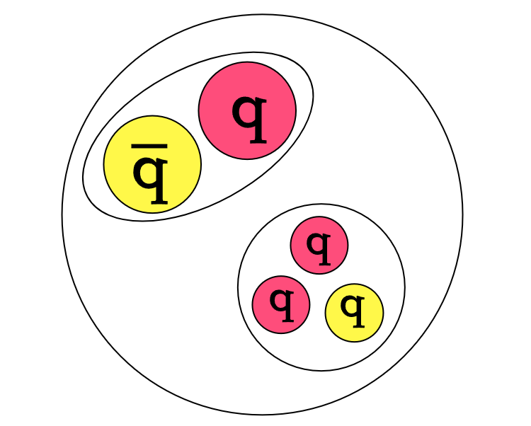
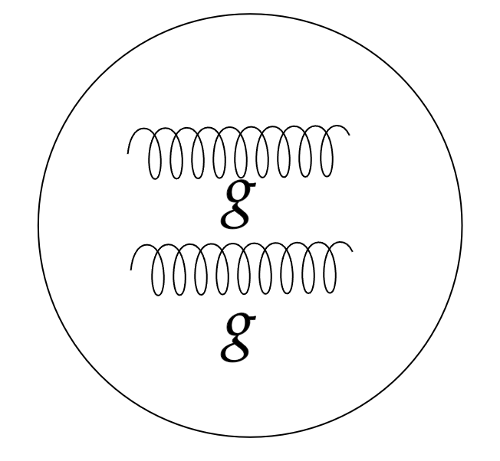
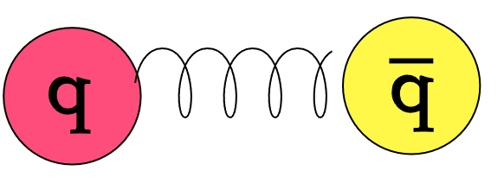
Background
2
Pauli principle
color singlet
Traditional hadron
Meson
Baryon
Hadron
Exotic states
Compact tetraquark
Molecular state
Hybrid state
Glueball
2
Notes:
盖尔曼、兹温格在建立夸克模型之初就曾预言四夸克、五夸克等结构的存在。我们现在知道，在泡利原理以及色单态的限制下，还存在紧致结构、分子态、混杂态以及胶球等奇特强子态。

Slide 4
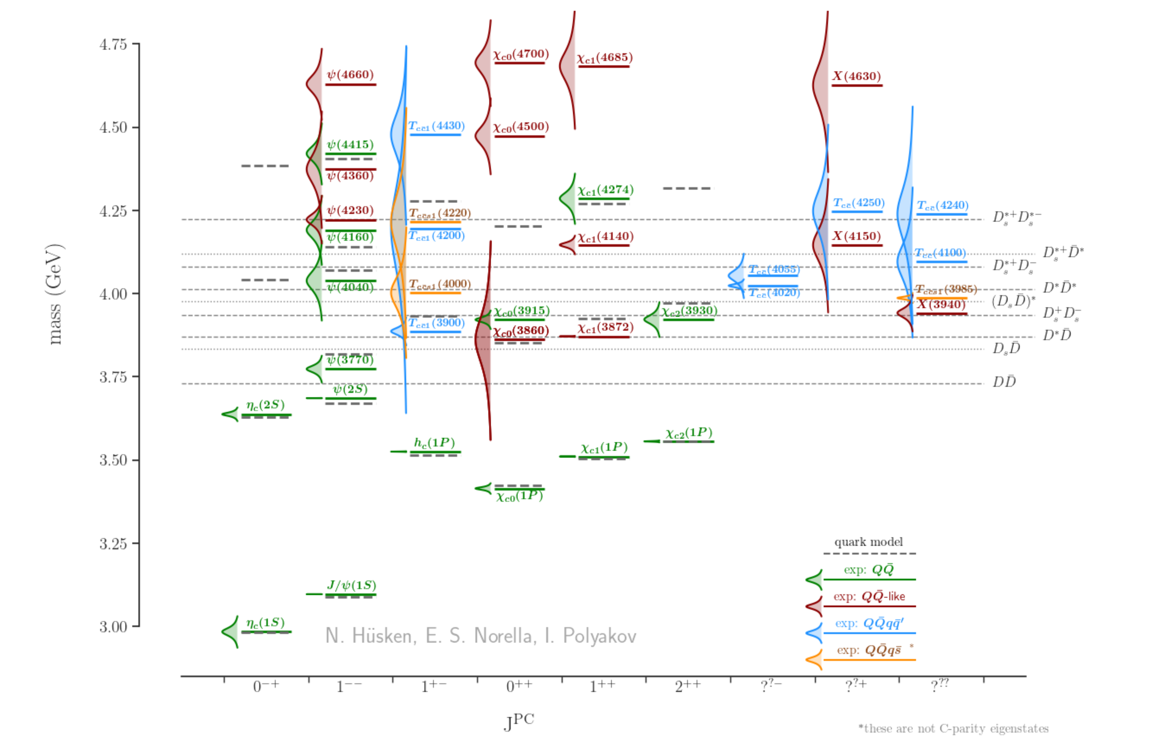
Background| Exotic charmonium(-like) states
Mod. Phys. Lett. A 40 (2025) 17n18, 2530002
3
Notes:
从2003年至今，仅在hidden charm侧，实验上就发现了三十多种奇特态，
粲偶素激发态、紧致四夸克态、分子态一直以来是人们十分关心和讨论的问题
对这些类粲偶素结构的认识将对我们理解强相互作用有着很大的意义。

Slide 5
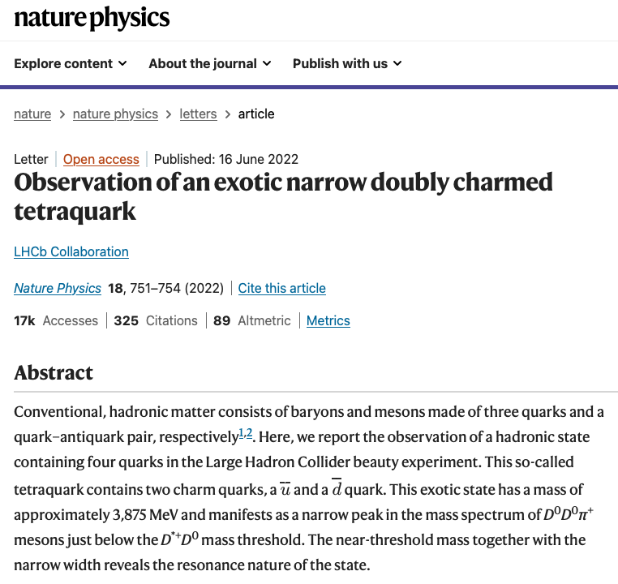
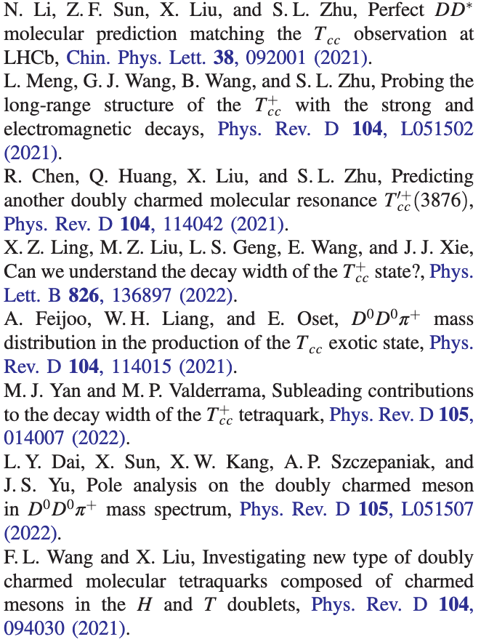
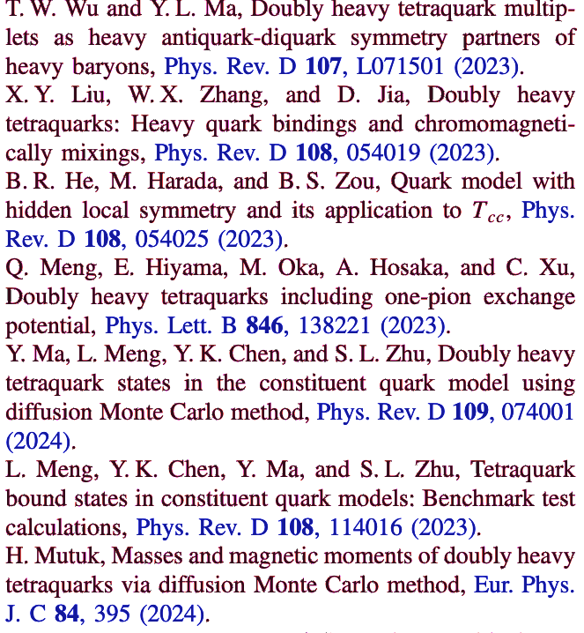





















Background
Molecular state
Compact tetraquark
$$\overline{C}$$
$$\overline{u}$$
$$\overline{C}$$
$$C$$
$$\overline{u}$$
$$C$$
$$C$$
$$C$$
$$S$$
$$C$$
$$C$$
$$\overline{d}$$
$$S$$
$$\overline{S}$$
$$C$$
$$\overline{C}$$
$$C$$
$$\overline{d}$$
$$\overline{S}$$
$$\overline{C}$$
$$T_{cc}(3875)$$
4
Notes:
LHCb在DD\pi不变质量谱中观测到了含有两个粲夸克的四粒子结构，为研究强子物理提供了新的平台。
T_cc(3875)^+是DD介子的分子态还是紧致四夸克态，人们在谱学、衰变、电磁性质等方面做了大量的研究工作。

Slide 6
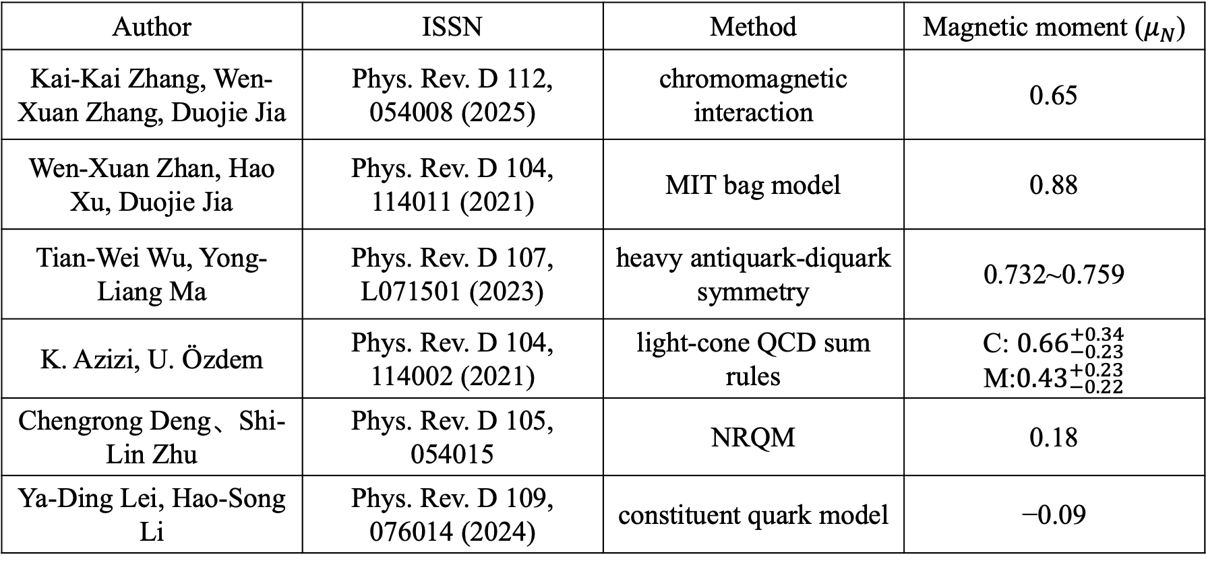
Background| The magnetic moment of $T_{cc}{\left(3875\right)}^{+}$
Author | ISSN | Method | Magnetic moment ($μ_{N}$)
Kai-Kai Zhang, Wen-Xuan Zhang, Duojie Jia | Phys. Rev. D 112, 054008 (2025) | chromomagnetic interaction | 0.65
Wen-Xuan Zhan, Hao Xu, Duojie Jia | Phys. Rev. D 104, 114011 (2021) | MIT bag model | 0.88
Tian-Wei Wu, Yong-Liang Ma | Phys. Rev. D 107, L071501 (2023) | heavy antiquark-diquark symmetry | 0.732~0.759
K. Azizi, U. Özdem | Phys. Rev. D 104, 114002 (2021) | light-cone QCD sum rules | C: ${0.66}_{−0.23}^{+0.34}$ M:${0.43}_{−0.22}^{+0.23}$
Chengrong Deng、Shi-Lin Zhu | Phys. Rev. D 105, 054015 | NRQM | 0.18
Ya-Ding Lei, Hao-Song Li | Phys. Rev. D 109, 076014 (2024) | constituent quark model | −0.09
5
Notes:
磁矩作为能够直接反映物质结构性质的客观测量，理论学家应用紧致态模型和分子态模型，对T_{cc}(3875)^+的磁矩进行了讨论，
分子态和紧致态的数据具有比较大的差别，
但在同一种结构模型下，不同的方法给出的数据具有较大的差异，削弱了理论对后续实验测量的分析能力，有必要从更多的角度对T_{cc}(3875)^+进行研究，
于是我们对T_{cc}(3875)^+的磁矩和其相关的电磁辐射衰变过程进行了研究。

Slide 7
CONTENTS|
1. Background
2. Formalism
3. Results & discussion
4. Summary

Slide 8
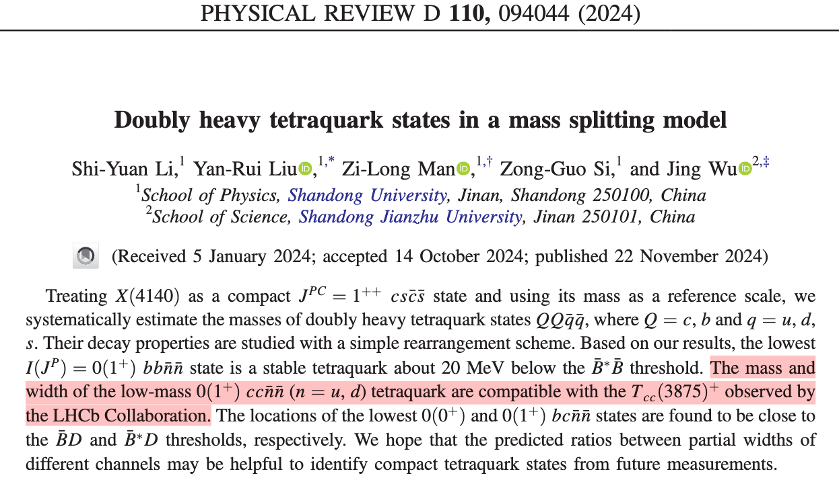
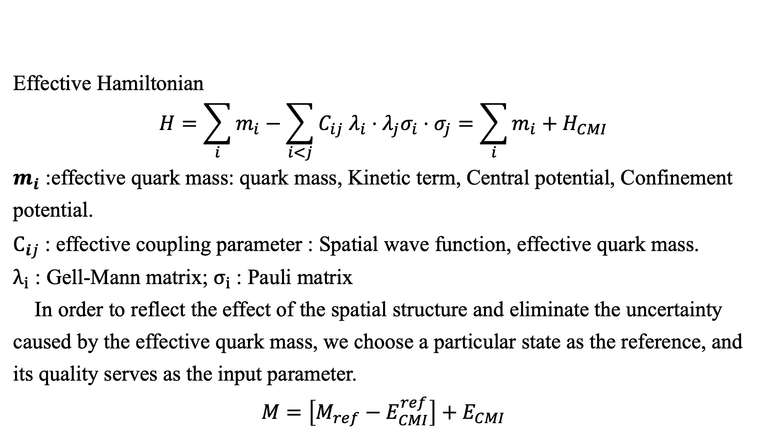
Formalism| Hamiltonian
Effective Hamiltonian
$$H=\sum_{i}{m_{i}−\sum_{i<j}{C_{ij} λ_{i}⋅λ_{j}σ_{i}⋅σ_{j}}}=\sum_{i}{m_{i}}+H_{CMI}$$
$m_{i}$ :effective quark mass: quark mass, Kinetic term, Central potential, Confinement potential.
$C_{ij}$: effective coupling parameter : Spatial wave function, effective quark mass.
$λ_{i}$ : Gell-Mann matrix; $σ_{i}$: Pauli matrix
In order to reflect the effect of the spatial structure and eliminate the uncertainty caused by the effective quark mass, we choose a particular state as the reference, and its quality serves as the input parameter.
$$M=\left[M_{ref}−E_{CMI}^{ref}\right]+E_{CMI}$$
7

Slide 9
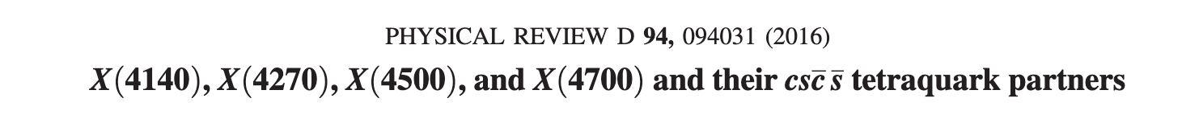
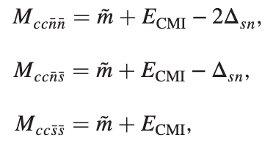
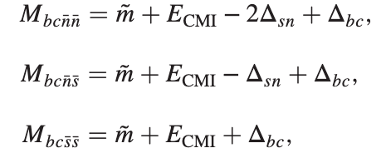
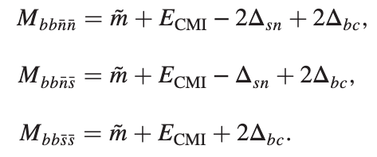
Formalism| Mass splitting model
X(4140)：$J^{PC}=1^{++}$ S-wave $c\overline{c}s\overline{s}$ compact tetraquark , its mass as inputting
where：$\tilde{m}=M_{X(4140)}−E_{CMI}^{X\left(4140\right)}=4231.05 MeV$, $Δ_{ij}$is the mass difference of quarks.
8

Slide 10
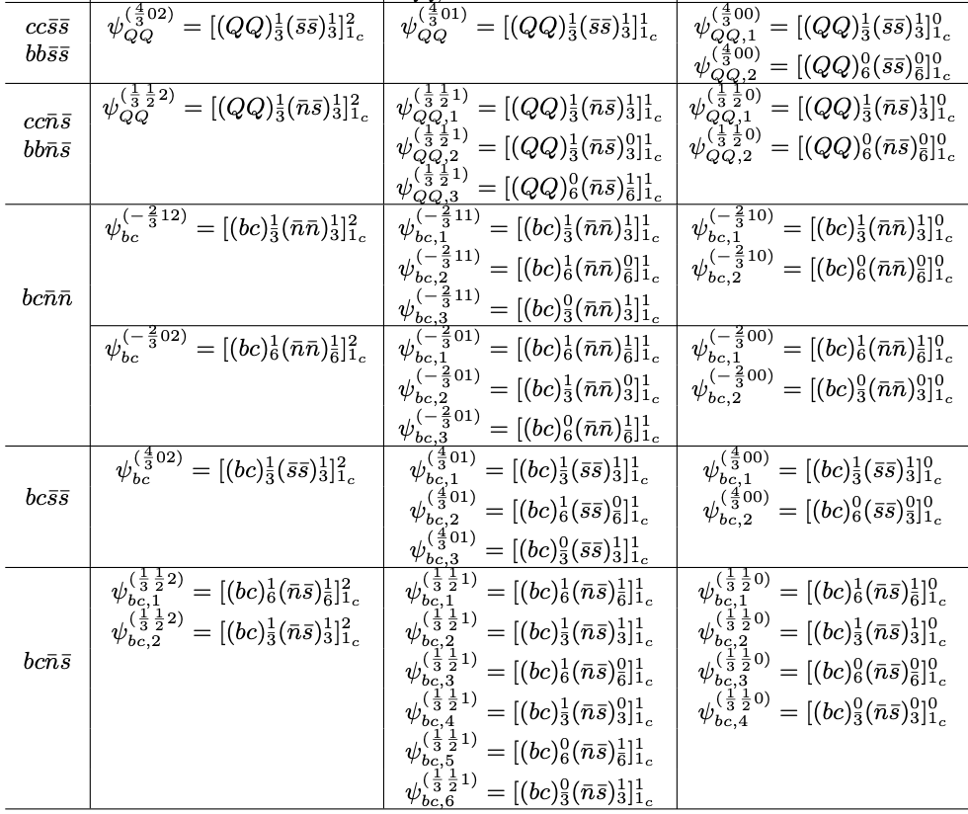
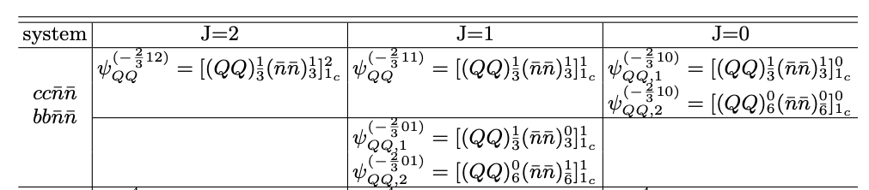
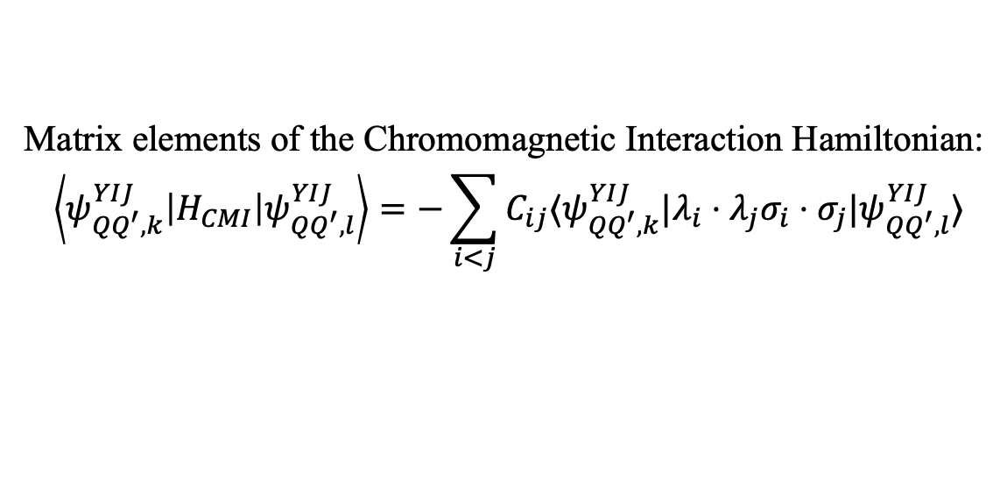
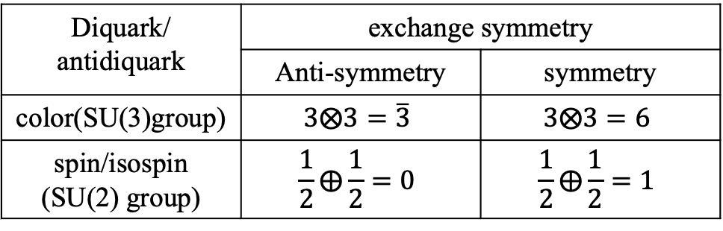
Formalism| S-wave tetraquark functions
Wave function：$Ψ=Φ\left(r\right)⨂Flavor⨂Spin⨂Color$
Diquark/ antidiquark | exchange symmetry
 | Anti-symmetry | symmetry
color(SU(3)group) | $$3⨂3=\overline{3}$$ | $$3⨂3=6$$
spin/isospin (SU(2) group) | $$\frac{1}{2}⨁\frac{1}{2}=0$$ | $$\frac{1}{2}⨁\frac{1}{2}=1$$
Following Pauli principle and color singlet
Matrix elements of the Chromomagnetic Interaction Hamiltonian:
$$\left\langle ψ_{QQ^{′},k}^{YIJ}\left|H_{CMI}\right|ψ_{QQ^{′},l}^{YIJ}\right\rangle =−\sum_{i<j}{C_{ij}⟨ψ_{QQ^{′},k}^{YIJ}|λ_{i}⋅λ_{j}σ_{i}⋅σ_{j}|ψ_{QQ^{′},l}^{YIJ}⟩}$$
9

Slide 11
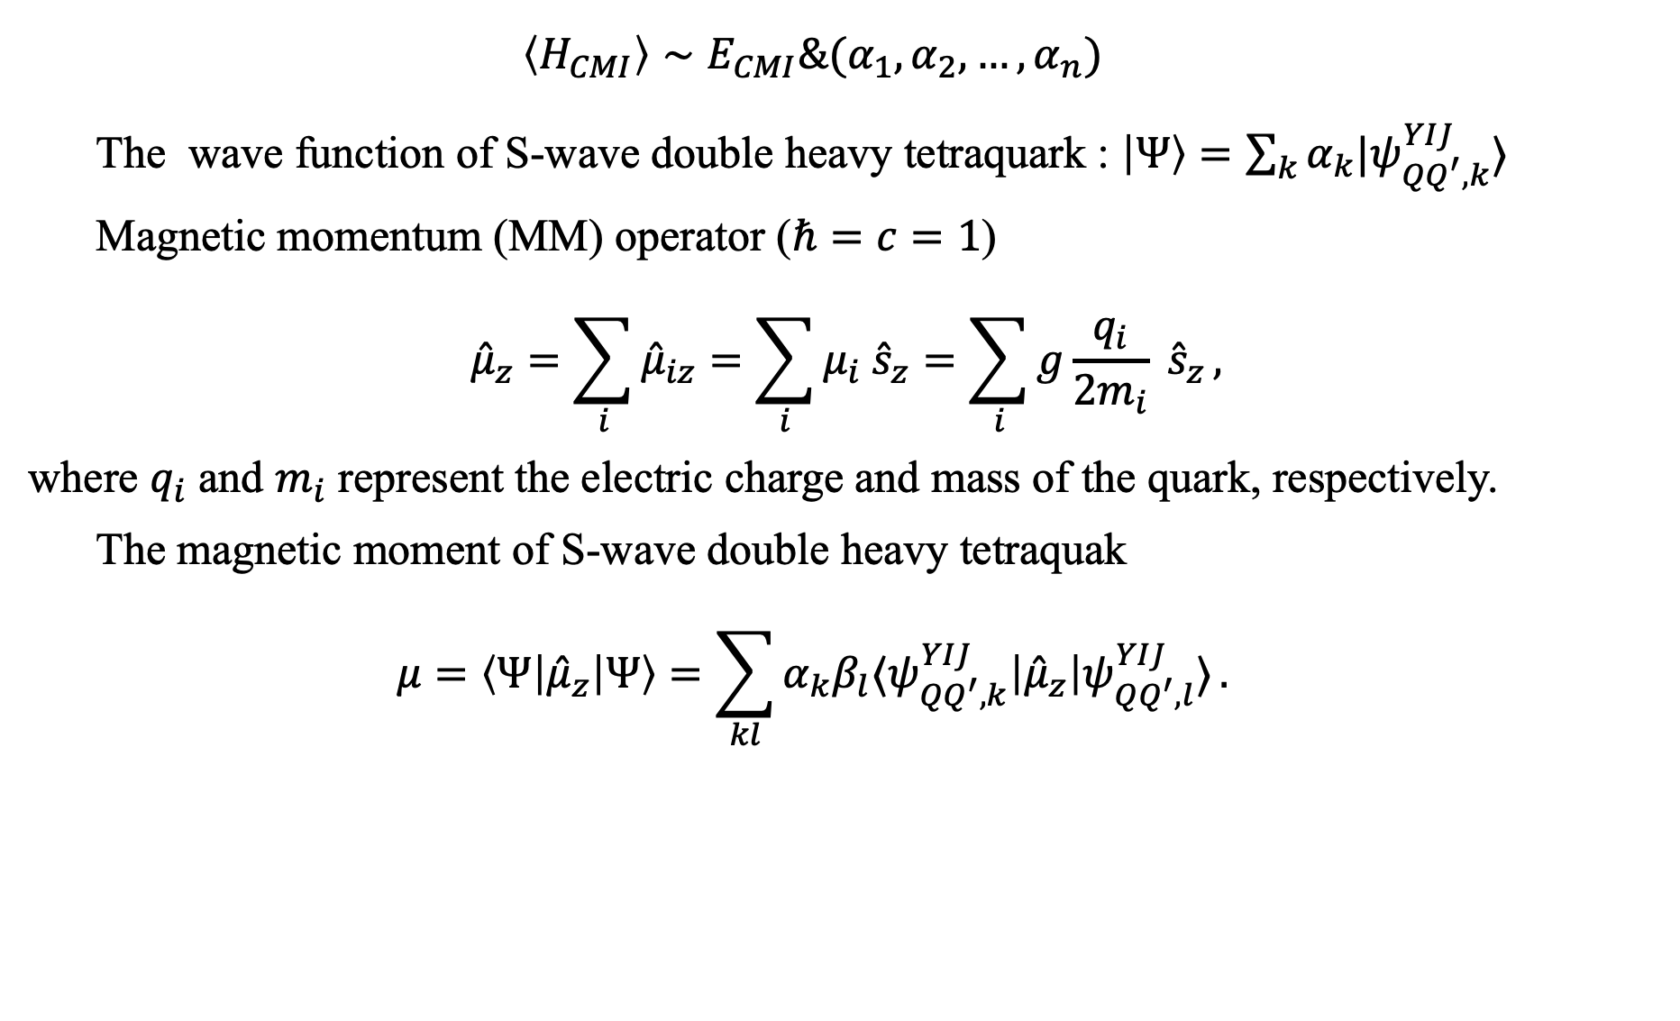
Formalism|Magnetic moment & Radiative decay
$$\left\langle H_{CMI}\right\rangle ∼E_{CMI}\&(α_{1},α_{2}, …,α_{n})$$
The wave function of S-wave double heavy tetraquark : $\left|Ψ\right\rangle =\sum_{k}{α_{k}|ψ_{QQ^{′},k}^{YIJ}⟩}$
Magnetic momentum (MM) operator ($ℏ=c=1$)
$${\hat{μ}}_{z}=\sum_{i}{{\hat{μ}}_{iz}}=\sum_{i}{μ_{i} {\hat{s}}_{z}}=\sum_{i}{g\frac{q_{i}}{2m_{i}} {\hat{s}}_{z}},$$
where $q_{i}$ and $m_{i}$ represent the electric charge and mass of the quark, respectively.
The magnetic moment of S-wave double heavy tetraquak
$$μ=\left\langle Ψ\left|{\hat{μ}}_{z}\right|Ψ\right\rangle =\sum_{kl}{α_{k}β_{l}⟨ψ_{QQ^{′},k}^{YIJ}\left|{\hat{μ}}_{z}\right|ψ_{QQ^{′},l}^{YIJ}⟩}.$$
10
Notes:
\mu_i为夸克磁矩，与夸克电荷和质量相关。\alpha\beta权重因子表征紧致结构对磁矩的影响。

Slide 12
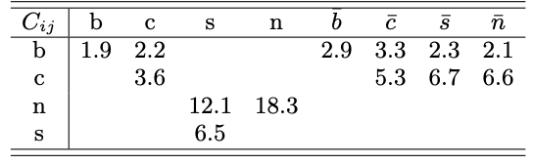
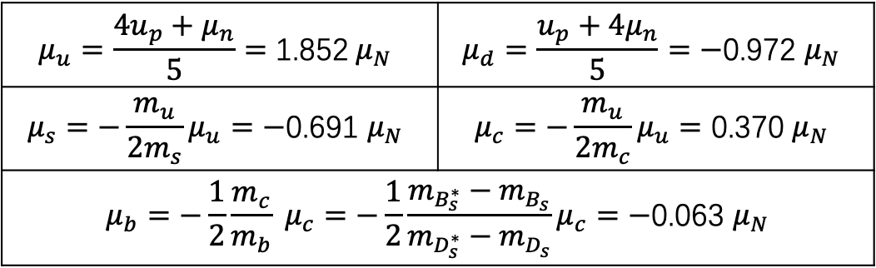
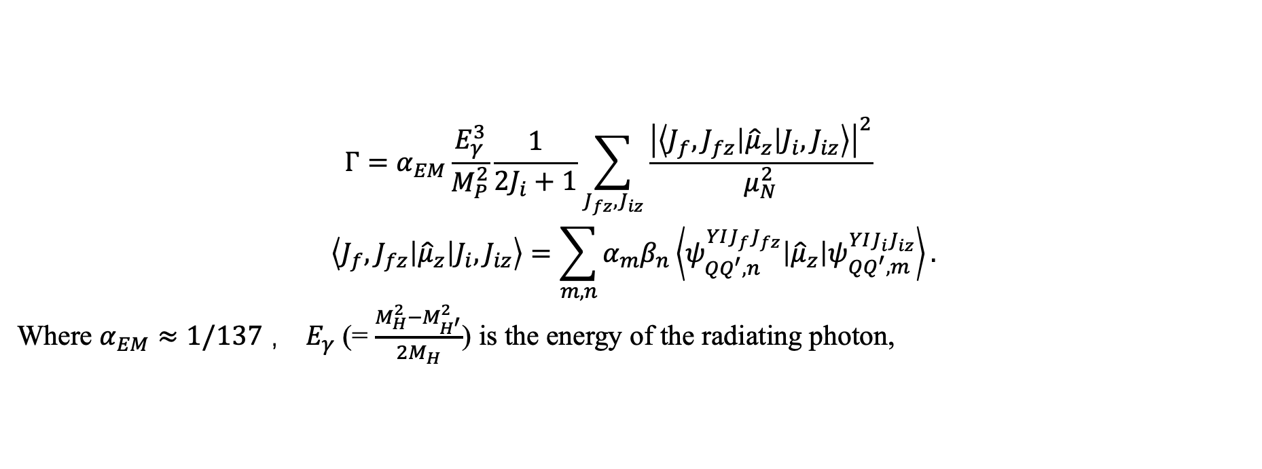
Formalism|Magnetic moment & Radiative decay
Radiative decay (F. L. Wang, S. Q. Luo, H. Y. Zhou, Z. W. Liu and X. Liu Phys. Rev. D 108, no.3, 034006 (2023))
$$Γ=α_{EM}\frac{E_{γ}^{3}}{M_{P}^{2}}\frac{1}{2J_{i}+1}\sum_{J_{fz},J_{iz}}{\frac{{\left|\left\langle J_{f},J_{fz}\left|{\hat{μ}}_{z}\right|J_{i},J_{iz}\right\rangle \right|}^{2}}{μ_{N}^{2}}}$$
$$\left\langle J_{f},J_{fz}\left|{\hat{μ}}_{z}\right|J_{i},J_{iz}\right\rangle =\sum_{m,n}{α_{m}β_{n}\left\langle ψ_{QQ^{′},n}^{YIJ_{f}J_{fz}}\left|{\hat{μ}}_{z}\right|ψ_{QQ^{′},m}^{YIJ_{i}J_{iz}}\right\rangle .}$$
Where $α_{EM}≈1/137$ ， $E_{γ}$ (= $\frac{M_{H}^{2}−M_{H^{′}}^{2}}{2M_{H}}$) is the energy of the radiating photon,
$$μ_{u}=\frac{4u_{p}+μ_{n}}{5}=\text{1.852} μ_{N}$$ | $$μ_{d}=\frac{u_{p}+4μ_{n}}{5}=\text{−}\text{0.972 }μ_{N}$$
$$μ_{s}=−\frac{m_{u}}{2m_{s}}μ_{u}=\text{−}\text{0.691} μ_{N}$$ | $$μ_{c}=−\frac{m_{u}}{2m_{c}}μ_{u}=\text{0.37}\text{0 }μ_{N}$$
$$μ_{b}=−\frac{1}{2}\frac{m_{c}}{m_{b}} μ_{c}=−\frac{1}{2}\frac{m_{B_{s}^{∗}}−m_{B_{s}}}{m_{D_{s}^{∗}}−m_{D_{s}}}μ_{c}=\text{−}\text{0.063} μ_{N}$$
$m_{u}=336$ MeV, $m_{s}=450$ MeV, $m_{c}=1680$ MeV
F.L. Wang, H.Y. Zhou, Z.W. Liu, and X. Liu Phys. Rev. D 106, no.5, 054020 (2022)
11

Slide 13
CONTENTS|
1. Background
2. Formalism
3. Results & discussion
4. Summary

Slide 14
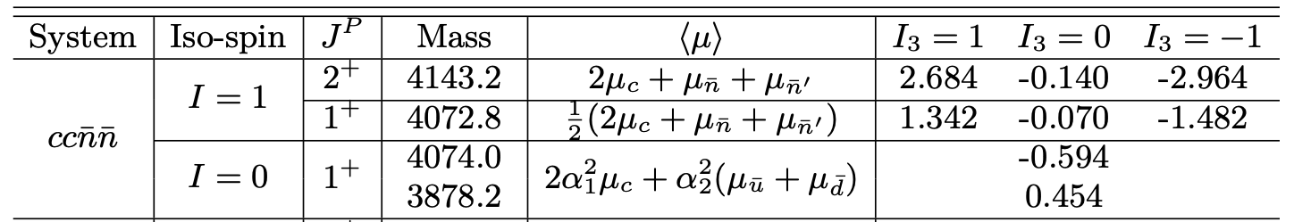
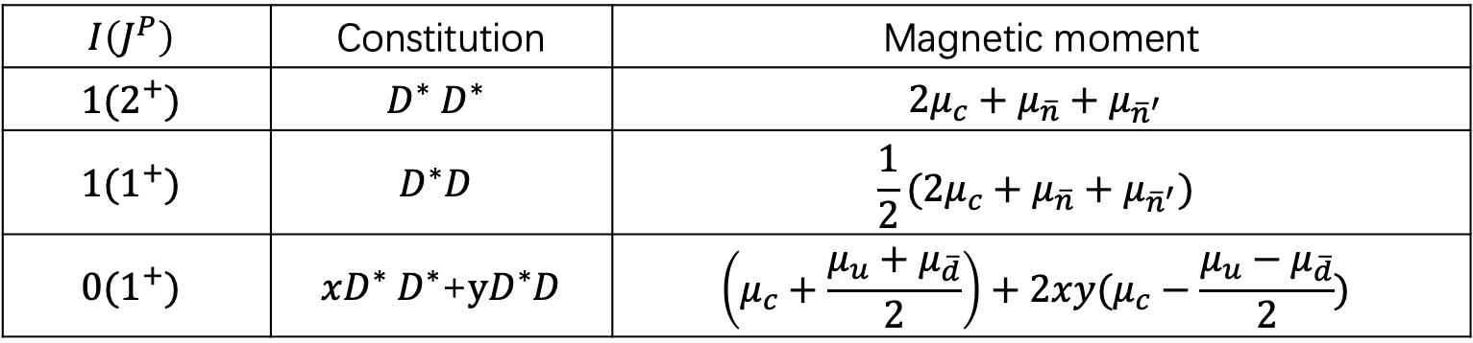

Results & discussion | $QQ\overline{q}\overline{q}$ system
The magnetic moments of $cc\overline{n}{\overline{n}}^{′}$ system ($μ_{N}$)
The magnetic moments of $D^{(∗)}D^{(∗)}$($μ_{N}$)
$$I\left(J^{P}\right)$$ | Constitution | Magnetic moment
$$1(2^{+})$$ | $$D^{∗}{ D}^{∗}$$ | $$2μ_{c}+μ_{\overline{n}}+μ_{{\overline{n}}^{′}}$$
$$1(1^{+})$$ | $$D^{∗}D$$ | $$\frac{1}{2}(2μ_{c}+μ_{\overline{n}}+μ_{{\overline{n}}^{′}})$$
$$0(1^{+})$$ | $xD^{∗}{ D}^{∗}$+$yD^{∗}D$ | $$\left(μ_{c}+\frac{μ_{u}+μ_{\overline{d}}}{2}\right)+2xy(μ_{c}−\frac{μ_{u}−μ_{\overline{d}}}{2})$$
(N. Li, Z. F. Sun, X. Liu and S. L. Zhu Phys. Rev. D 88, no.11, 114008 (2013))
13

Slide 15

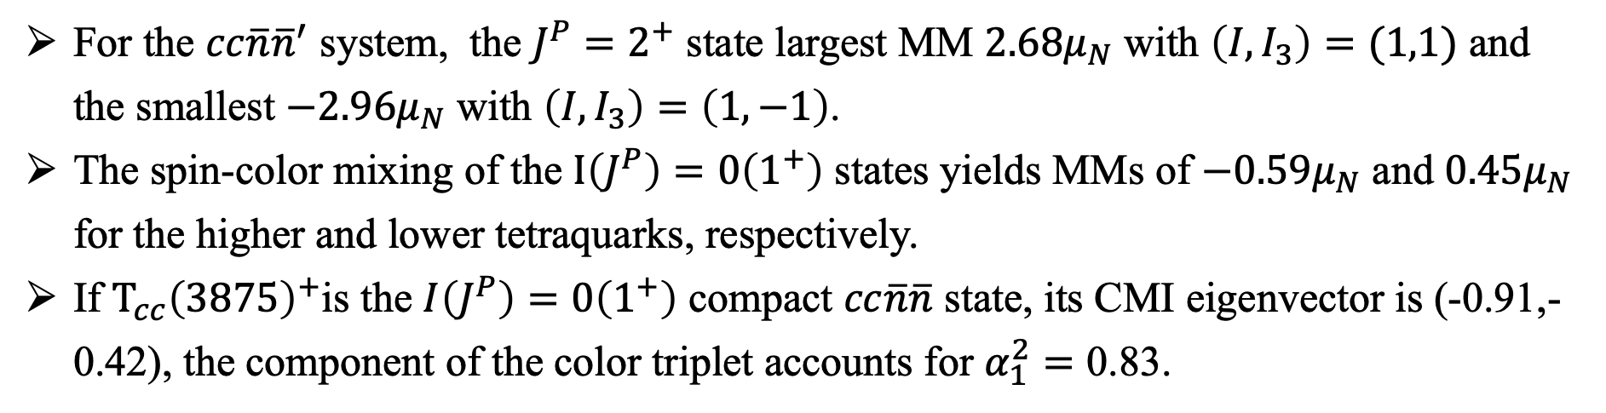
Results & discussion | $QQ\overline{q}\overline{q}$ system
The magnetic moments of $cc\overline{n}{\overline{n}}^{′}$ system ($μ_{N}$)
For the $cc\overline{n}{\overline{n}}^{′}$ system, the $J^{P}=2^{+}$ state largest MM $2.68μ_{N}$ with $\left(I,I_{3}\right)=(1,1)$ and the smallest $−2.96μ_{N}$ with $\left(I,I_{3}\right)=\left(1,−1\right)$.
The spin-color mixing of the $I\left(J^{P}\right)=0\left(1^{+}\right)$ states yields MMs of $−0.59μ_{N}$ and $0.45μ_{N}$ for the higher and lower tetraquarks, respectively.
If $T_{cc}{\left(3875\right)}^{+}$is the $I\left(J^{P}\right)=0\left(1^{+}\right)$ compact $cc\overline{n}\overline{n}$ state, its CMI eigenvector is (-0.91,-0.42), the component of the color triplet accounts for $α_{1}^{2}=\text{0.83}$.
14

Slide 16
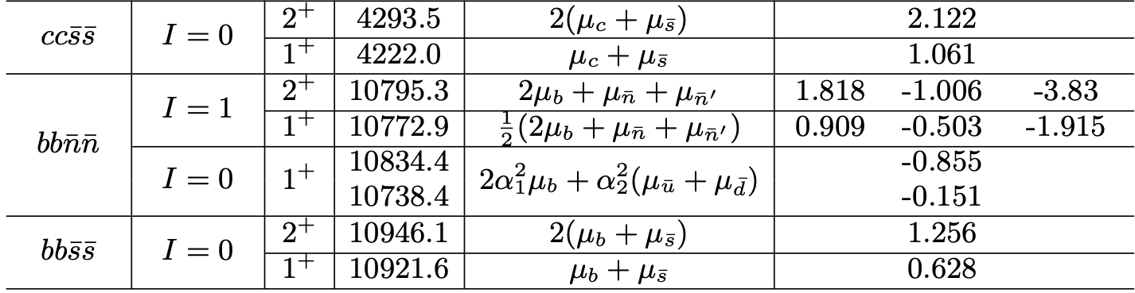
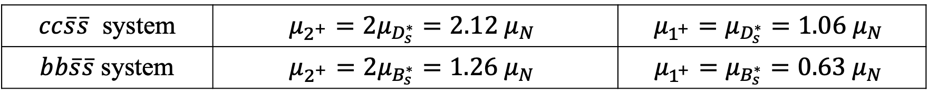
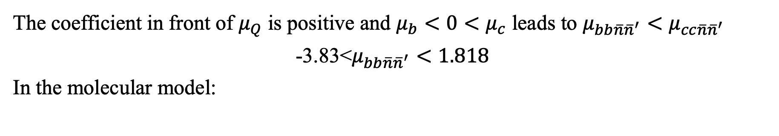
Results & discussion | $QQ\overline{q}\overline{q}$ system
The coefficient in front of $μ_{Q}$ is positive and $μ_{b}<0<μ_{c}$ leads to $μ_{bb\overline{n}{\overline{n}}^{′}}<μ_{cc\overline{n}{\overline{n}}^{′}}$
$${\text{−3.83}\text{<}μ}_{bb\overline{n}{\overline{n}}^{′}}<1.818$$
In the molecular model:
$cc\overline{s}\overline{s}$ system | $$μ_{2^{+}}=2μ_{D_{s}^{∗}}=2.12{ μ}_{N}$$ | $$μ_{1^{+}}=μ_{D_{s}^{∗}}=1.06{ μ}_{N}$$
$bb\overline{s}\overline{s}$ system | $$μ_{2^{+}}=2μ_{B_{s}^{∗}}=1.26 μ_{N}$$ | $$μ_{1^{+}}=μ_{B_{s}^{∗}}=0.63{ μ}_{N}$$
15

Slide 17
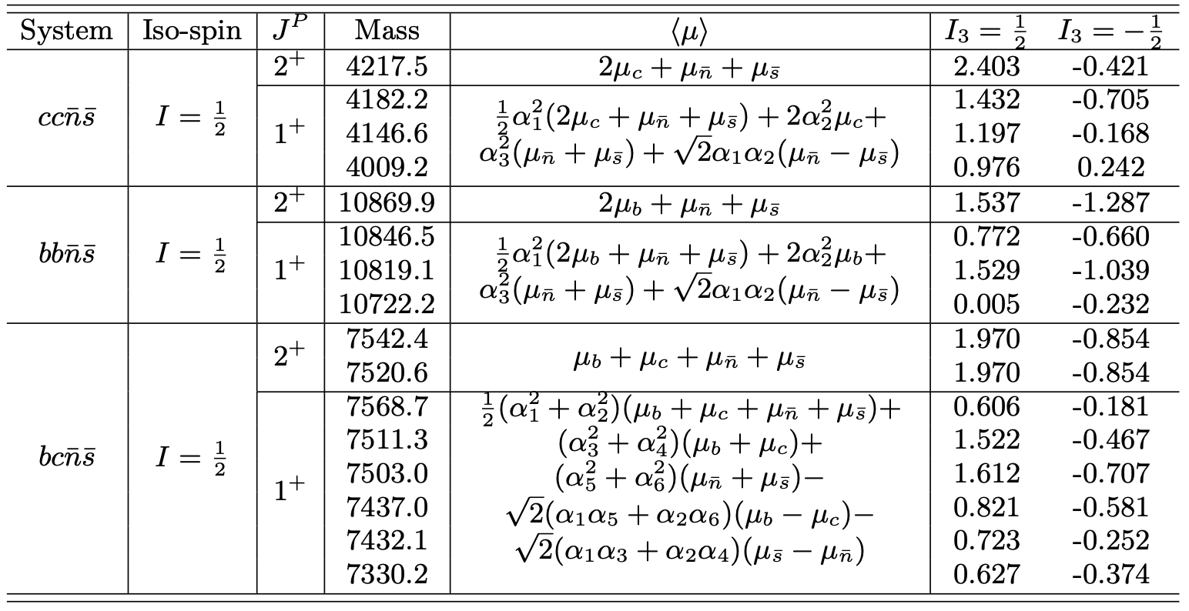

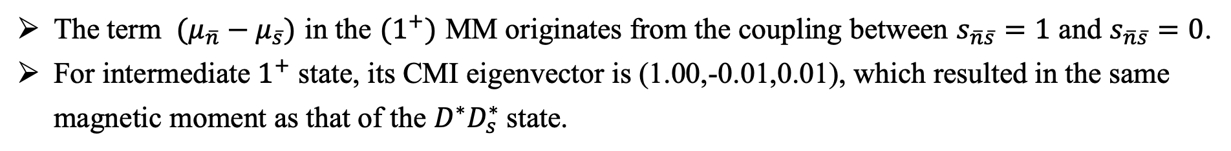
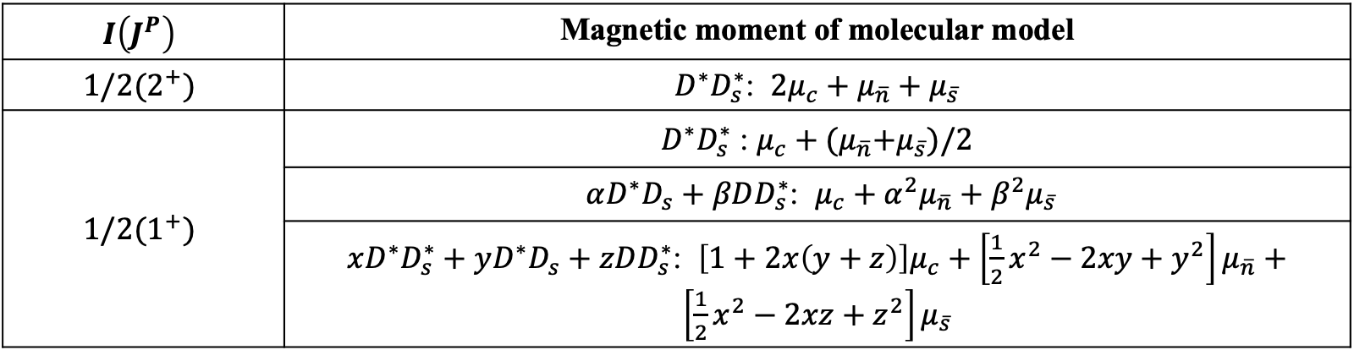
Results & discussion | $QQ^{′}\overline{n}\overline{s}$ system
The magnetic moments of $cc\overline{n}\overline{s}$ system ($μ_{N}$)
$$I\left(J^{P}\right)$$ | Magnetic moment of molecular model
$$1/2(2^{+})$$ | $D^{∗}D_{s}^{∗}$: $2μ_{c}+μ_{\overline{n}}+μ_{\overline{s}}$
$$1/2(1^{+})$$ | $D^{∗}D_{s}^{∗}$ : $μ_{c}+{(μ}_{\overline{n}}+μ_{\overline{s}})/2$
 | $αD^{∗}D_{s}+βDD_{s}^{∗}$: $μ_{c}+α^{2}μ_{\overline{n}}+β^{2}μ_{\overline{s}}$
 | $xD^{∗}D_{s}^{∗}+yD^{∗}D_{s}+zDD_{s}^{∗}$: $\left[1+2x\left(y+z\right)\right]μ_{c}+\left[\frac{1}{2}x^{2}−2xy+y^{2}\right]μ_{\overline{n}}+\left[\frac{1}{2}x^{2}−2xz+z^{2}\right]μ_{\overline{s}}$
The term $(μ_{\overline{n}}−μ_{\overline{s}})$ in the $(1^{+})$ MM originates from the coupling between $s_{\overline{n}\overline{s}}=1$ and $s_{\overline{n}\overline{s}}=0$.
For intermediate $1^{+}$ state, its CMI eigenvector is (1.00,-0.01,0.01), which resulted in the same magnetic moment as that of the $D^{∗}D_{s}^{∗}$state.
16
Notes:
我们计算了ccns系统的磁矩，发现与ccnn系统相比，在1^+态的磁矩中出现了交叉项，它来自于ns自旋三重态与单态的耦合。
对了对比，我们给出来DDs分子态图像下的磁矩表达式，2+的磁矩相同；如果DDs态仅含有D*Ds*成份，我们发现对于1+的中间质量态（4146），它的CMI本征态为（1，0，0），代入磁矩表达式，除了第一项，其余项都近似为零，则它的磁矩与D*Ds*分子态的磁矩几乎相同。若果DDs分子态是D*Ds与DD*s的混合，则紧致态和分子态的磁矩可能具有比较大的差距；DDs分子态如果是三者的混合，从紧致态和分子态磁矩表达式上看，也有希望能够通过磁矩来区分这两种模型。

Slide 18
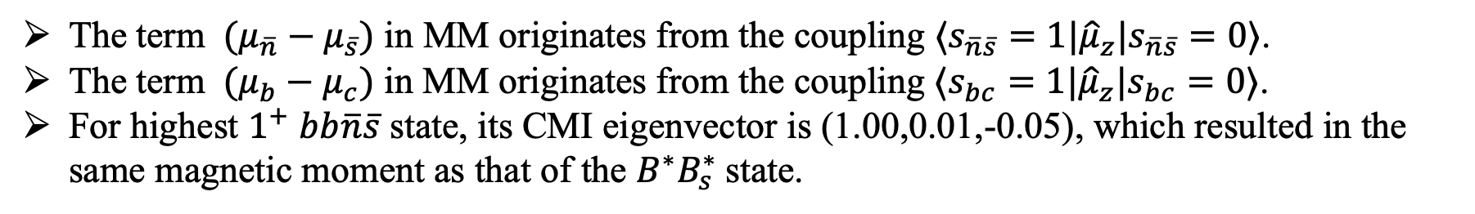
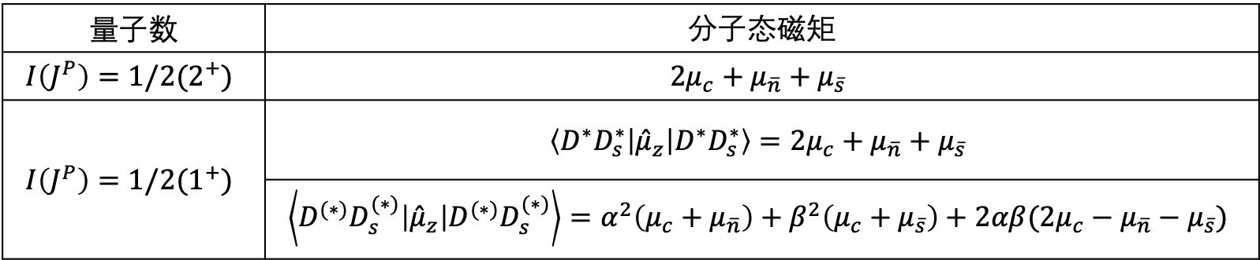

Results & discussion | $QQ^{′}\overline{n}\overline{s}$ system
The magnetic moments of $QQ^{′}\overline{n}\overline{s}$ system ($μ_{N}$)
量子数 | 分子态磁矩
$$I\left(J^{P}\right)=1/2(2^{+})$$ | $$2μ_{c}+μ_{\overline{n}}+μ_{\overline{s}}$$
$$I\left(J^{P}\right)=1/2(1^{+})$$ | $$\left\langle D^{∗}D_{s}^{∗}\left|{\hat{μ}}_{z}\right|D^{∗}D_{s}^{∗}\right\rangle =2μ_{c}+μ_{\overline{n}}+μ_{\overline{s}}$$
 | $$\left\langle D^{(∗)}D_{s}^{(∗)}\left|{\hat{μ}}_{z}\right|D^{(∗)}D_{s}^{(∗)}\right\rangle =α^{2}\left(μ_{c}+μ_{\overline{n}}\right)+β^{2}\left(μ_{c}+μ_{\overline{s}}\right)+2αβ(2μ_{c}−μ_{\overline{n}}−μ_{\overline{s}})$$
The term $(μ_{\overline{n}}−μ_{\overline{s}})$ in MM originates from the coupling $⟨s_{\overline{n}\overline{s}}=1|{\hat{μ}}_{z}|s_{\overline{n}\overline{s}}=0⟩$.
The term $(μ_{b}−μ_{c})$ in MM originates from the coupling $⟨s_{bc}=1|{\hat{μ}}_{z}|s_{bc}=0⟩$.
For highest $1^{+}$ $bb\overline{n}\overline{s}$ state, its CMI eigenvector is (1.00,0.01,-0.05), which resulted in the same magnetic moment as that of the $B^{∗}B_{s}^{∗}$state.
17

Slide 19
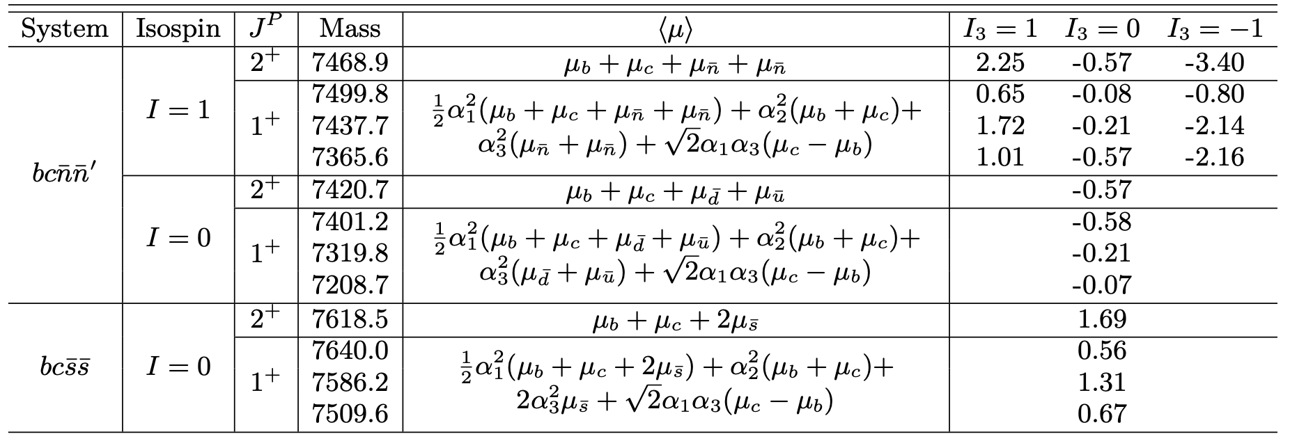

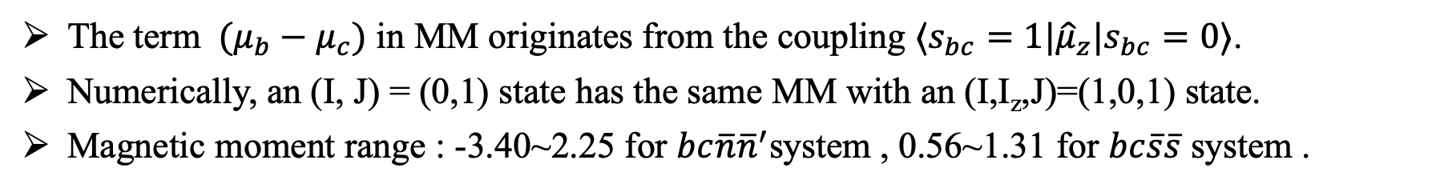
Results & discussion | $bc\overline{q}\overline{q}$ system
The magnetic moments of $bc\overline{q}\overline{q}$ system ($μ_{N}$)
The term $(μ_{b}−μ_{c})$ in MM originates from the coupling $⟨s_{bc}=1|{\hat{μ}}_{z}|s_{bc}=0⟩$.
Numerically, an (I, J) = (0,1) state has the same MM with an (I,I_{z},J)=(1,0,1) state.
Magnetic moment range : -3.40~2.25 for $bc\overline{n}{\overline{n}}^{′}$system , 0.56~1.31 for $bc\overline{s}\overline{s}$ system .
18
Notes:
同位旋三重态和单态的权重因子\alpha 不同，但也可能给出相同的磁矩。

Slide 20
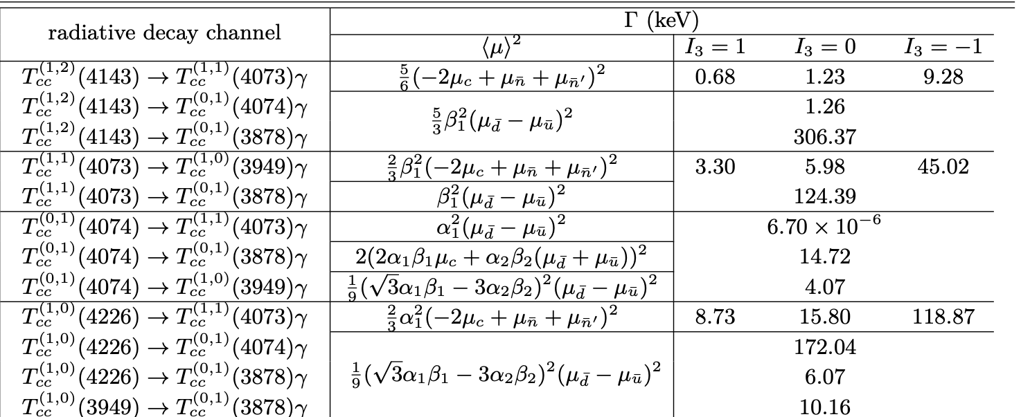
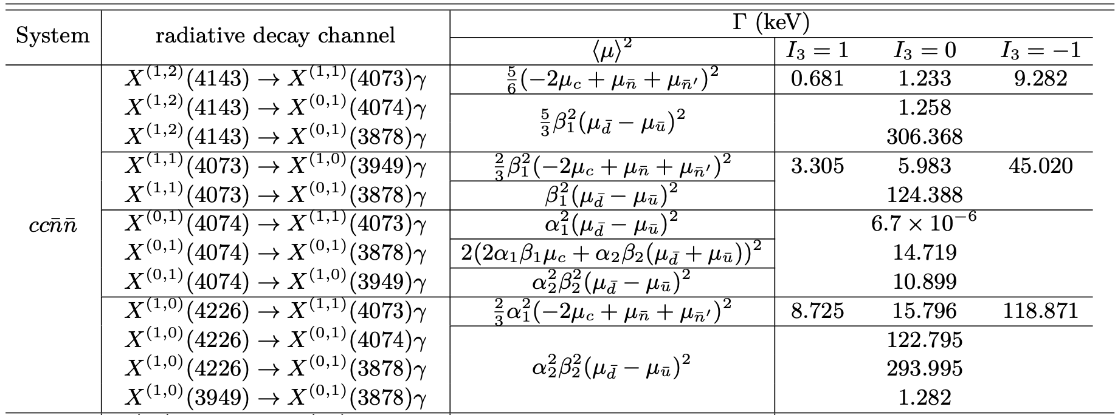
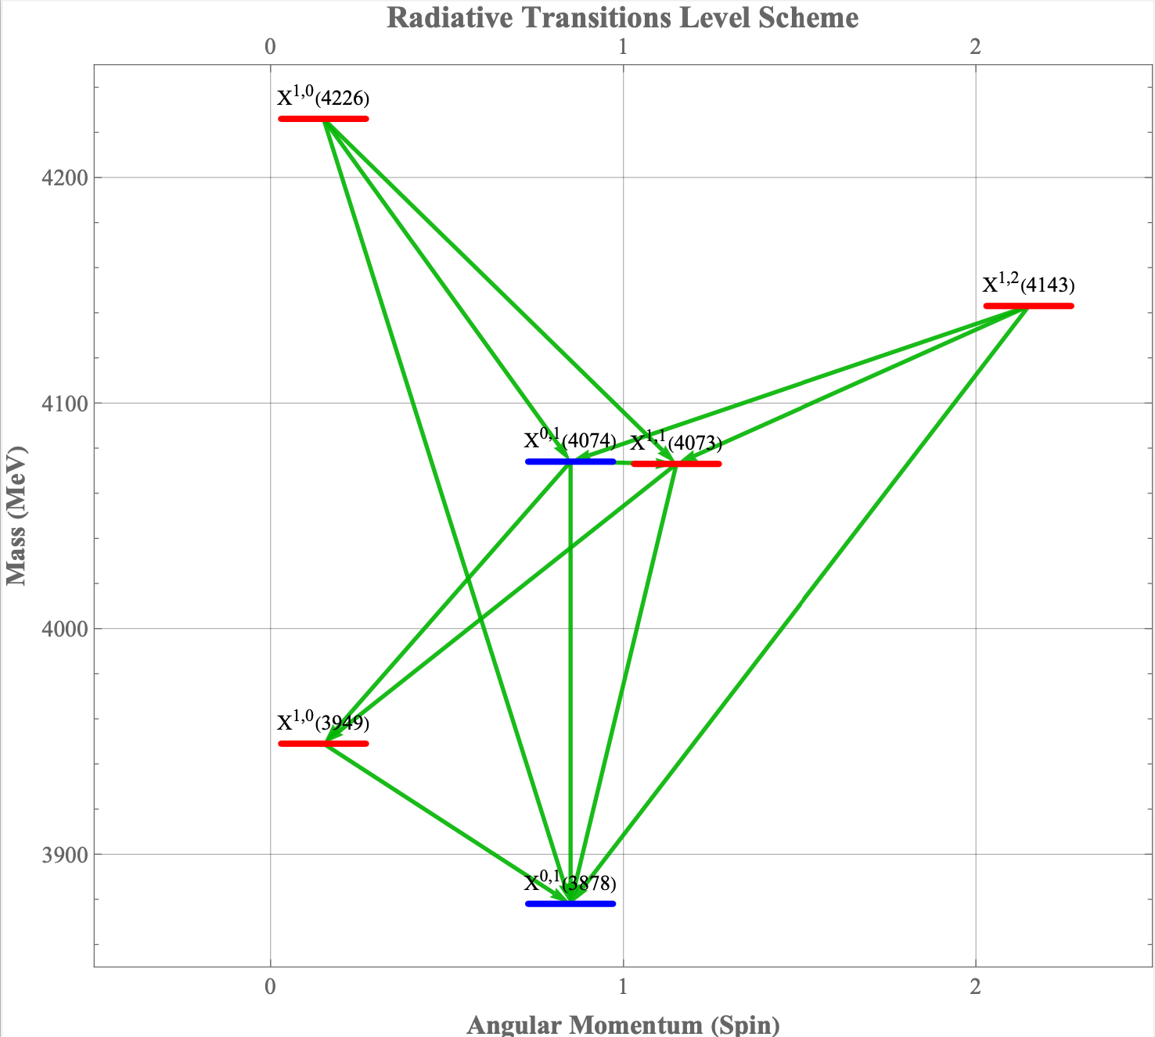
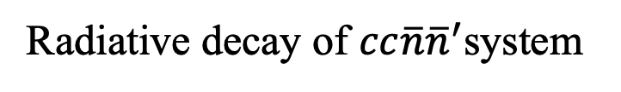
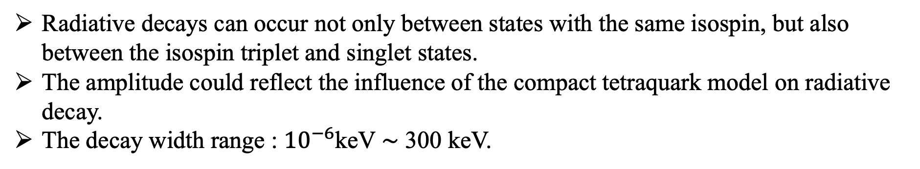
Results & discussion | $QQ\overline{q}\overline{q}$ system
Radiative decay of $cc\overline{n}{\overline{n}}^{′}$system
Radiative decays can occur not only between states with the same isospin, but also between the isospin triplet and singlet states.
The amplitude could reflect the influence of the compact tetraquark model on radiative decay.
The decay width range : ${10}^{−6}$keV $∼$ 300 keV.
19
Notes:
存在通过磁矩无法区分紧致态和分子态的情况，为了解决这个问题，我们对双重四夸克态之间的辐射衰变过程进行了研究。辐射衰变也能给出奇特态之间的关系
1、介绍表格：列出了双粲四夸克态之间可能的辐射衰变道、振幅、各同位旋第三分量对应的宽度。
2.辐射衰变不仅可发生于同位旋相同的态之间，也可发生于同位旋三重态与单态之间。
3、振幅能够直观反映紧致结构对双粲四夸克态辐射衰变的影响：\beta_1^2表示0(1^+)态中色三重态成份的比重，体现出了不同自旋-颜色结构混合对衰变的影响，实验上对这两个道宽度的比值的测量能够给出X(4074)和X(3878)态中各自色三重态比重的比值信息；两磁矩的差表示两个反轻夸克自旋三重态和自旋单态的耦合。
3、双粲系统衰变宽度变化较大：${10}^{−6}$keV $∼$ 300 keV；X(4143)->X(3878)宽度达到300KeV，是整个双粲辐射衰道中的“最强信号”；相空间对X(4074)->X(4073)有很强的压低。

Slide 21
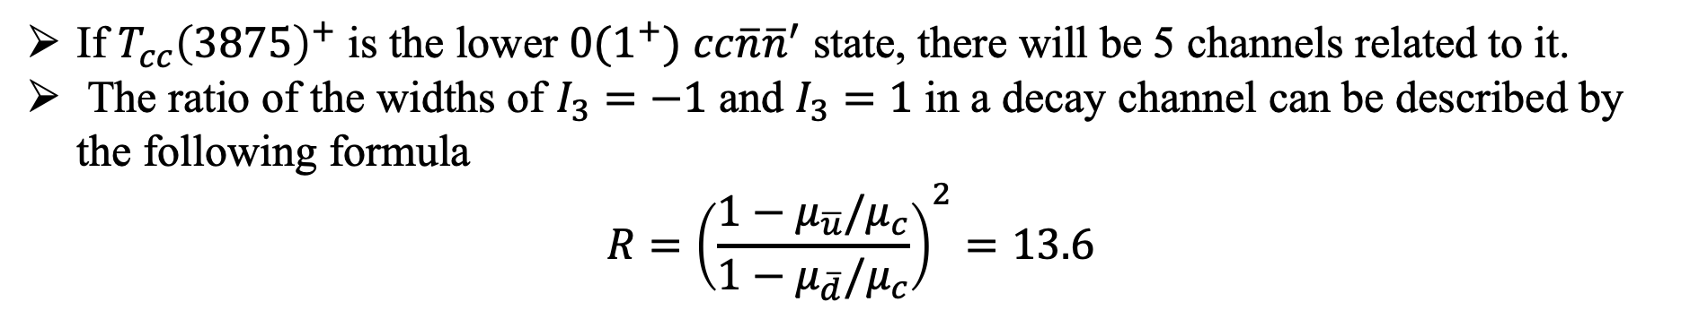
Results & discussion | $QQ\overline{q}\overline{q}$ system
Radiative decay of $cc\overline{n}{\overline{n}}^{′}$system
If $T_{cc}{\left(3875\right)}^{+}$ is the lower $0(1^{+})$ $cc\overline{n}{\overline{n}}^{′}$ state, there will be 5 channels related to it.
The ratio of the widths of $I_{3}=−1$ and $I_{3}=1$ in a decay channel can be described by the following formula
$$R={\left(\frac{1−μ_{\overline{u}}/μ_{c}}{1−μ_{\overline{d}}/μ_{c}}\right)}^{2}=13.6$$
20
Notes:
1、如果$T_{cc}{\left(3875\right)}^{+}$是 低质量的$0(1^{+})$ $cc\overline{n}{\overline{n}}^{′}$态，其余5个态都能通过辐射衰变道与它关联，可以利用这种关联来寻找其它可能存在的$T_{cc}{\left(3875\right)}^{+}$自旋伴随态。
2、我们发现对于同一衰变道，它$I_{3}=−1$与$I_{3}=1$的宽度比值可由下式描述，对双粲R=13.6，

Slide 22
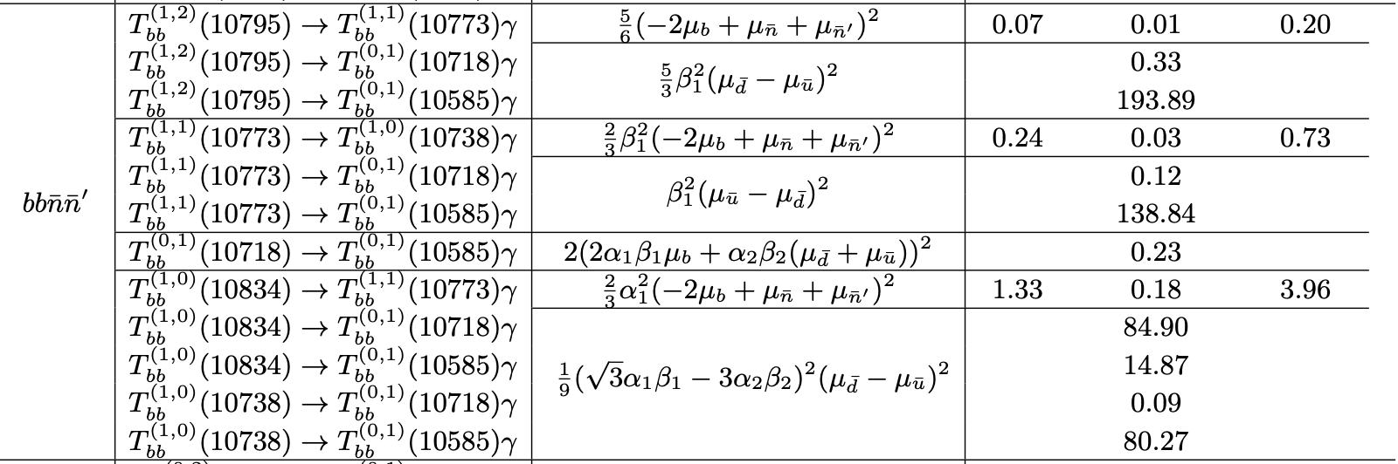
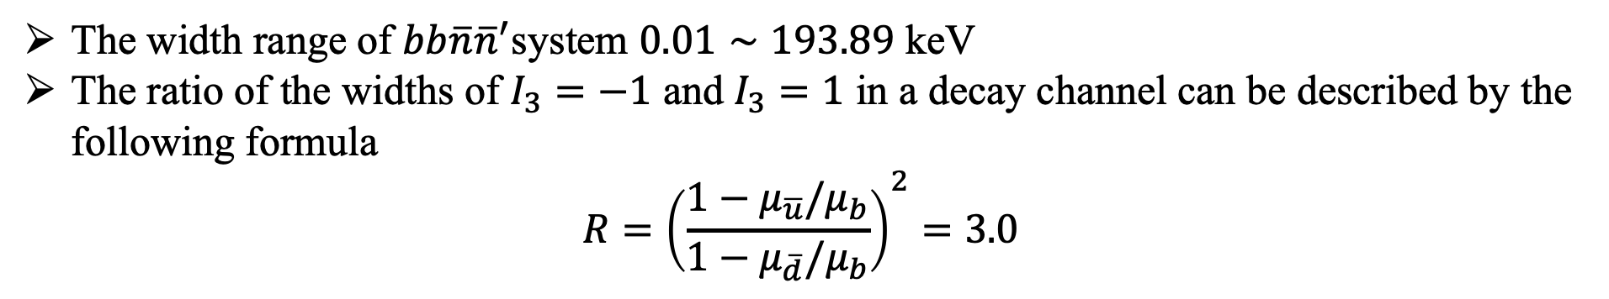
Results & discussion | $QQ\overline{q}\overline{q}$ system
The width range of $bb\overline{n}{\overline{n}}^{′}$system $0.01∼193.89$ keV
The ratio of the widths of $I_{3}=−1$ and $I_{3}=1$ in a decay channel can be described by the following formula
$$R={\left(\frac{1−μ_{\overline{u}}/μ_{b}}{1−μ_{\overline{d}}/μ_{b}}\right)}^{2}=3.0$$
21

Slide 23



Results & discussion | $QQ\overline{q}\overline{q}$ system
Radiative decay of $cc\overline{s}\overline{s}$ and $bb\overline{s}\overline{s}$ systems
For the $cc\overline{s}\overline{s}$ and $bb\overline{s}\overline{s}$ systems, the radiative decays between $0\left(1^{+}\right)$ and $0\left(0^{+}\right)$states can stabilize the compact structure of those states.
The decay width range: 0.20~2.27 for $cc\overline{s}\overline{s}$ system, 0.05~.062 for $bb\overline{s}\overline{s}$ system.
22
Notes:
权重系数——对这些道的测量数据能够反映态的结构信息

Slide 24


Results & discussion | $QQ^{′}\overline{n}\overline{s}$ system
The contribution to the decay widths from $⟨s_{\overline{n}\overline{s}}=1|{\hat{μ}}_{z}|s_{\overline{n}\overline{s}}=0⟩$: $μ_{\overline{n}}−μ_{\overline{s}}$.
The range of $Γ=2.9×{10}^{−4}∼111.16$ keV.
There is a trend: $Γ\left(I_{3}=−\frac{1}{2}\right)>Γ\left(I_{3}=\frac{1}{2}\right)$
23

Slide 25



Results & discussion | $QQ^{′}\overline{n}\overline{s}$ system
The contribution to the decay widths from $⟨s_{\overline{n}\overline{s}}=1|{\hat{μ}}_{z}|s_{\overline{n}\overline{s}}=0⟩$: $μ_{\overline{n}}−μ_{\overline{s}}$.
The range of $Γ=1.1×{10}^{−4}∼52.12$ keV.
There are four channels avoid the trend: $Γ\left(I_{3}=−\frac{1}{2}\right)>Γ\left(I_{3}=\frac{1}{2}\right)$
24
Notes:
“avoid the trend”体现了bbns系统强相互作用的复杂性，这些特殊的衰变道或许可以用来鉴别四夸克态的结构。

Slide 26






Results & discussion |$bc\overline{n}\overline{s}$ system
The amplitudes of radiative decays for the $bc\overline{n}\overline{s}$ system:
$$ℳ^{2}(J=2↔J=1)$$
$$ℳ^{2}(J=1↔J=1)$$
$$ℳ^{2}(J=1↔J=0)$$
Contribution from $⟨s_{bc}=1|{\hat{μ}}_{z}|s_{bc}=0⟩$, $⟨s_{\overline{n}\overline{s}}=1|{\hat{μ}}_{z}|s_{\overline{n}\overline{s}}=0⟩$
25

Slide 27


Results & discussion |$bc\overline{n}\overline{s}$ system
There are 51 radiative decay channels in $bc\overline{n}\overline{s}$ system.
The range of $Γ=1.2×{10}^{−6}∼79.52$ keV.
There are ten channels avoid the trend: $Γ\left(I_{3}=−\frac{1}{2}\right)>Γ\left(I_{3}=\frac{1}{2}\right)$
26

Slide 28
CONTENTS|
1. Background
2. Formalism
3. Results & discussion
4. Summary

Slide 29

Summary
The $J=2$ states have identical magnetic moments in both the compact and molecular models. The MM of a $J=0$ state is always zero. Only J=1 states deserved to study because of their difference MMs in the compact and molecular models.
If $T_{cc}{\left(3875\right)}^{+}$is identified as the lower-mass $I\left(J^{P}\right)=0\left(1^{+}\right)$ compact $cc\overline{n}\overline{n}$ state, its magnetic moment is $0.45 μ_{N}$, while its MM is -0.07 $μ_{N}$ in $DD^{∗}$ molecular model.
In radiative decays, the spin coupling term $⟨S_{QQ^{′}/\overline{q}{\overline{q}}^{′}}=1\left|{\hat{μ}}_{z}\right|S_{QQ^{′}/\overline{q}{\overline{q}}^{′}}=0⟩$ is a distinctive feature of compact tetraquark systems. A signature channel is $T_{cc}^{1,2}\left(4143\right)→T_{cc}^{0,1}\left(3878\right)γ$ , with a width of $Γ=\text{306.37}$ keV. The other five $cc\overline{n}\overline{n}$ states can relate to $T_{cc}{\left(3875\right)}^{+}$ through radiative decays.
28

Slide 30
第九届强子谱和强子结构研讨会
Thanks for your attention

Slide 31


Results & discussion | $QQ\overline{q}\overline{q}$ system
CMI matrices, eigenvectors, and mass spectrum (in units of MeV) for the $QQ\overline{q}\overline{q}(Q=b,c;q=n,s)$

Slide 32

Results & discussion | $QQ^{′}\overline{n}\overline{s}$ system
CMI matrices, eigenvectors, and mass spectrum (in units of MeV) for the $QQ^{′}\overline{n}\overline{s}(Q=b,c;)$

Slide 33

Results & discussion | $bc\overline{q}{\overline{q}}^{′}$ system
CMI matrices, eigenvectors, and mass spectrum (in units of MeV) for the $bc\overline{q}{\overline{q}}^{′}(Q=b,c;)$

Slide 34


