Slide 1
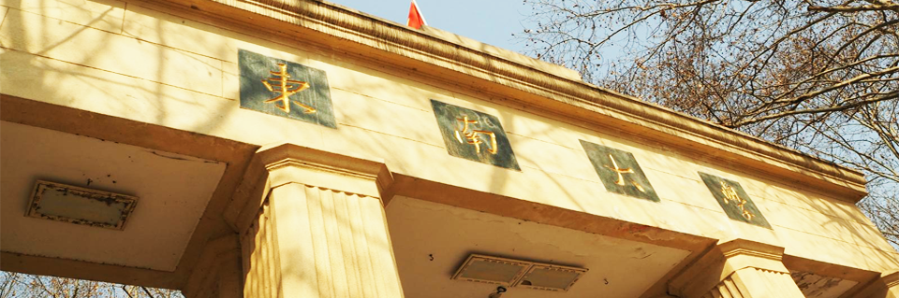




SOUTHEAST UNIVERSITY
Gluon TMDs for tensor polarized deuterons in a spectator model
报告人：谢修鹏 时间：2026年08月20日
第九届强子谱和强子结构研讨会，河南新乡

Slide 2

目 录
1
  Background
2
  Gluon TMDs
3
  Drell-Yan phenomenology
4
  Summary

Slide 3

PART ONE
Background

Slide 4

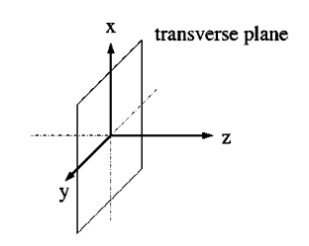
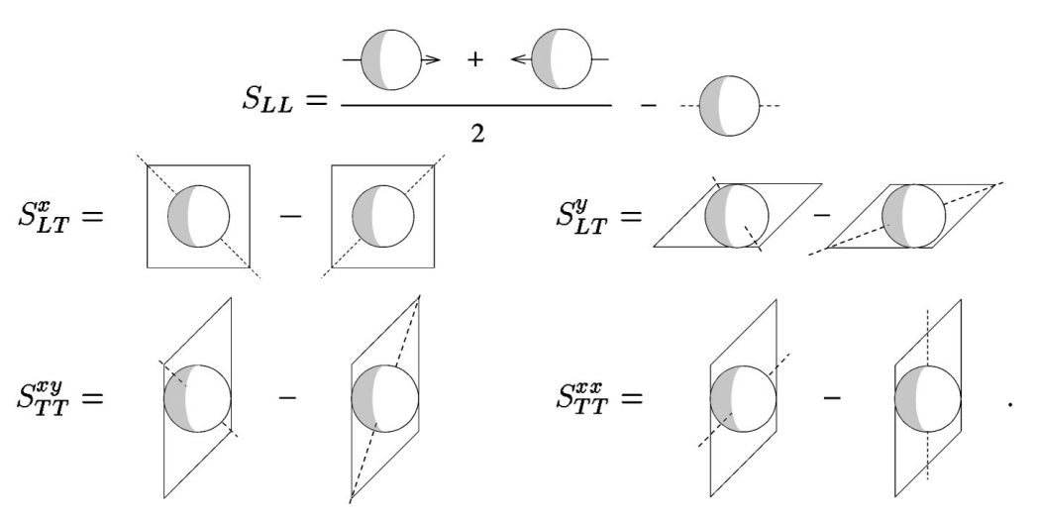
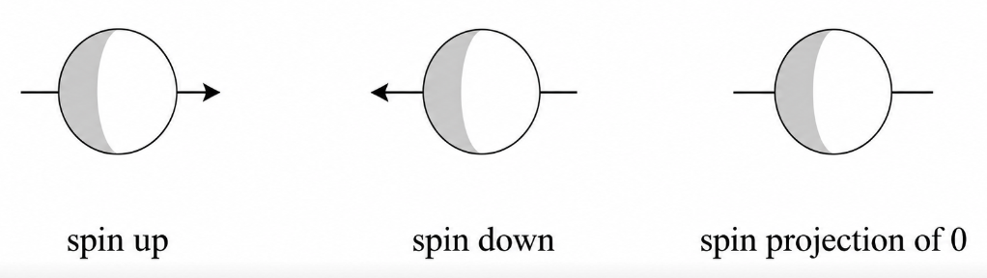
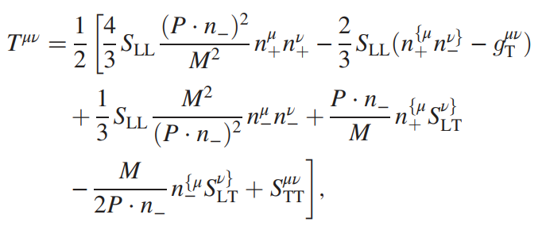
Background
Spin vector:
Description of spin-1 particles
A. Bacchetta and P. J. Mulders, Phys.Rev.D 62 (2000) 114004
Spin tensor:

Slide 5
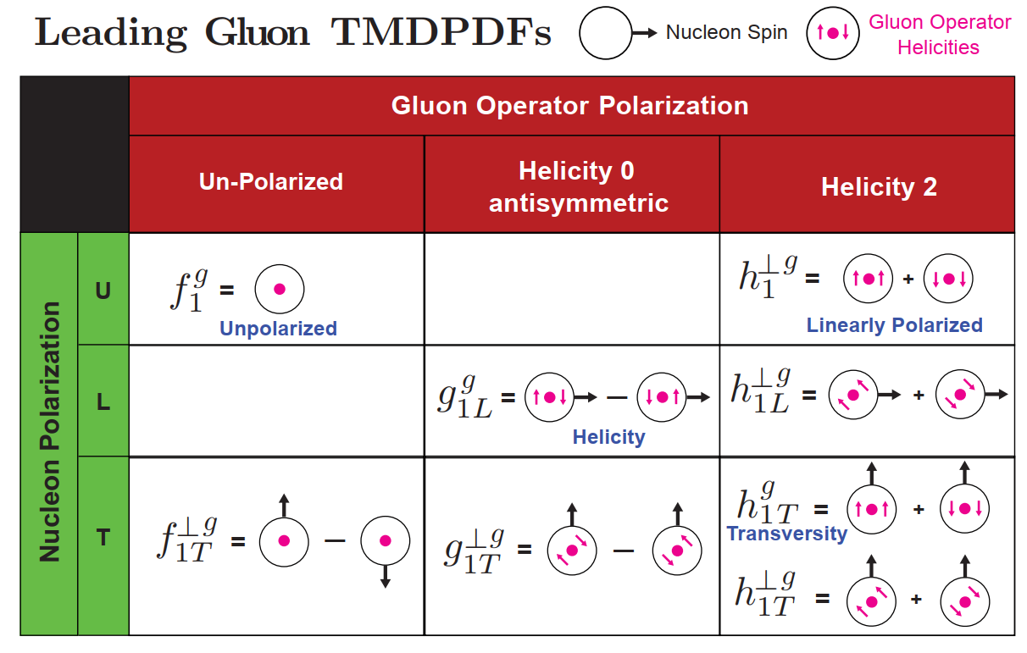
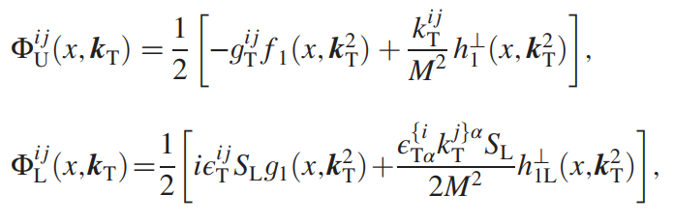
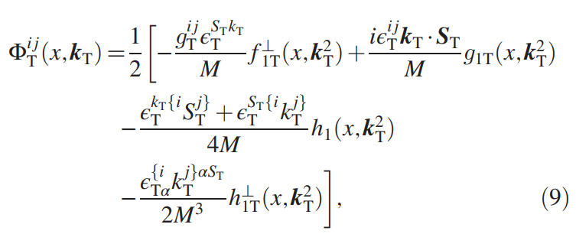
Gluon TMDPDFs (spin-1/2)

Slide 6
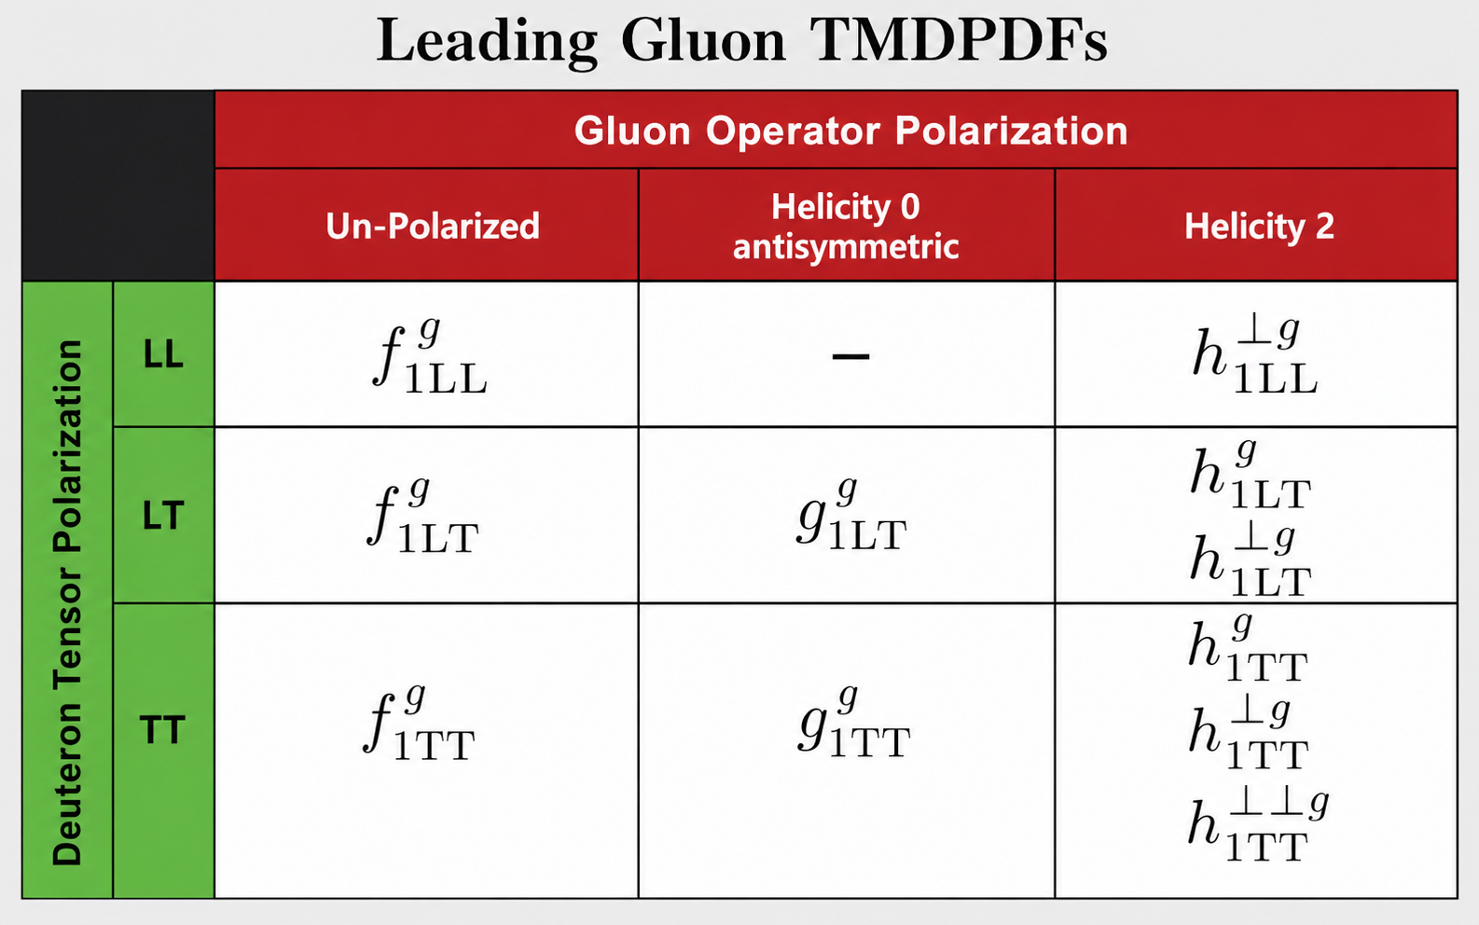
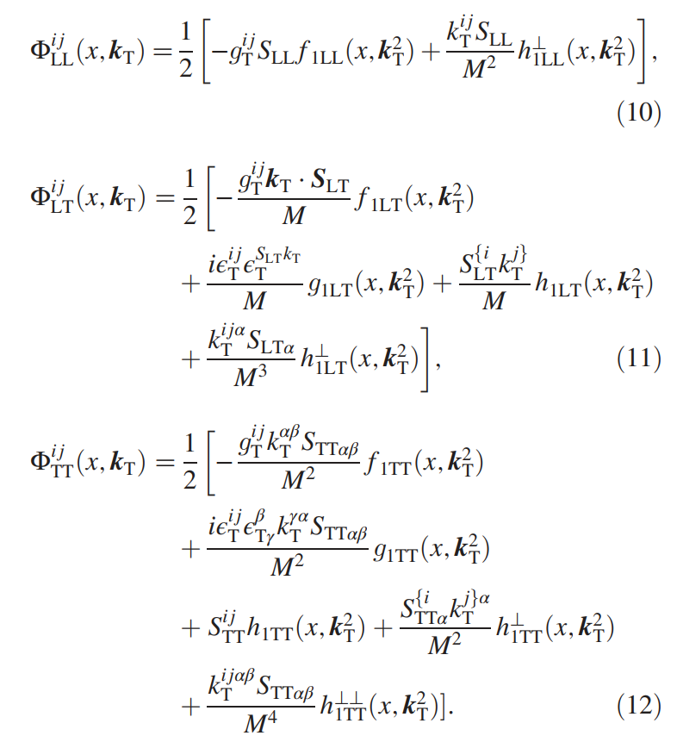
Tensor-polarized Gluon TMDPDFs (spin-1)

Slide 7
PART TWO
Gluon TMDs
X. Xie, D. Y. Chen and Z. Lu, Phys.Rev.D 114 (2026) 3, 034003
X. Xie, Z. Lu, arXiv:2607.23692

Slide 8



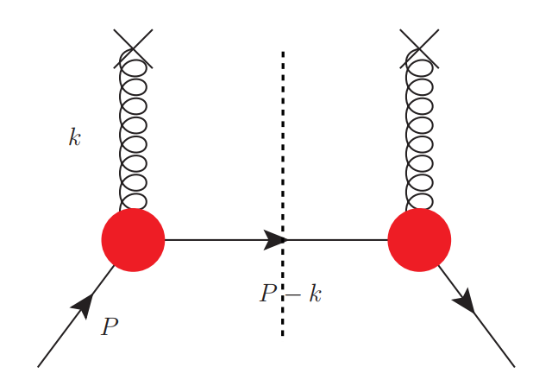
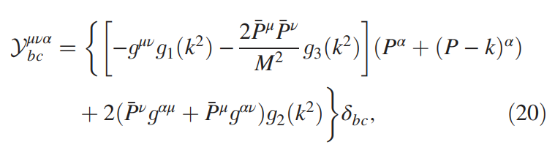

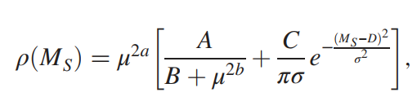

Spectator model
The gluon-gluon TMD correlator for spin-1 hadrons is given by
Effective vertex
Form factors
Spectral function

Slide 9
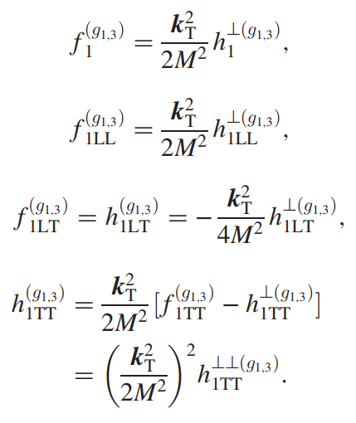
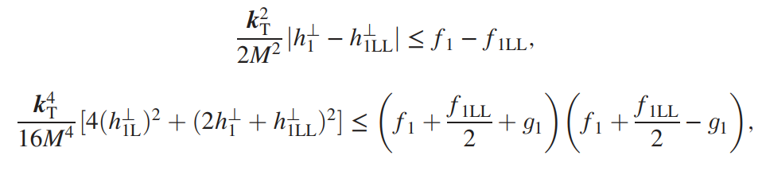
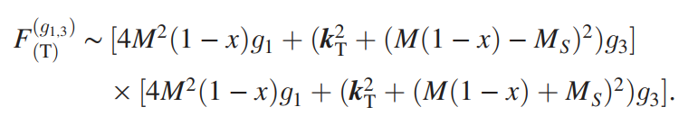
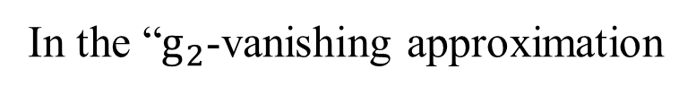

Model-dependent relation
In the “$g_{2}$-vanishing approximation
Positivity bounds
S. Cotogno, T. van Daal, and P. J. Mulders, J. High Energy Phys. 11 (2017) 185
The tensor polarized TMDs exhibit the same functional dependence:
$$g_{1L}^{(g_{1,3})}=g_{1T}^{(g_{1,3})}=0$$

Slide 10
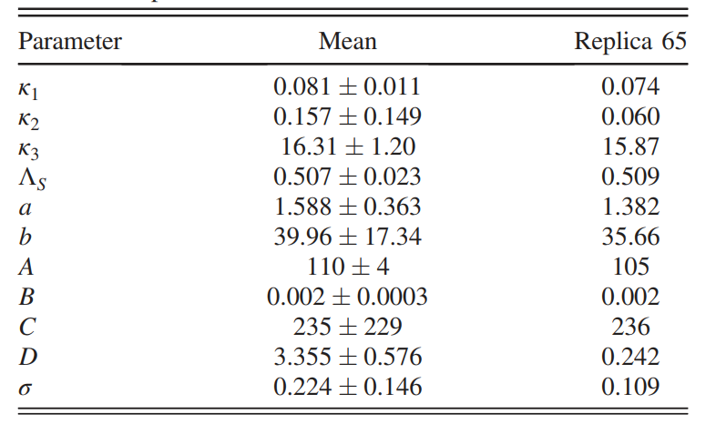
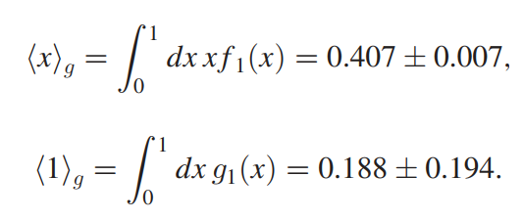
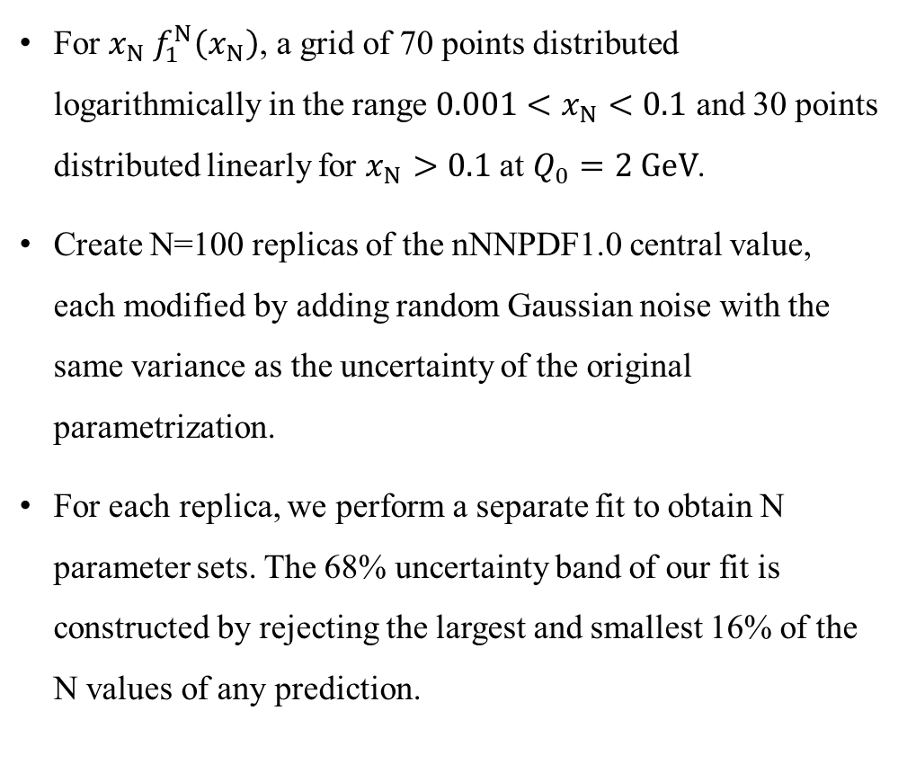

Bootstrap method
For $x_{N} f_{1}^{N}\left(x_{N}\right)$, a grid of 70 points distributed logarithmically in the range $0.001<x_{N}<0.1$ and 30 points distributed linearly for $x_{N}>0.1$ at $Q_{0}=2 GeV$.
Create N=100 replicas of the nNNPDF1.0 central value, each modified by adding random Gaussian noise with the same variance as the uncertainty of the original parametrization.
For each replica, we perform a separate fit to obtain N parameter sets. The 68% uncertainty band of our fit is constructed by rejecting the largest and smallest 16% of the N values of any prediction.
Fit quality:
$$χ^{2}/d.o.f.=1.53±0.23$$
Momentum fraction:
The contribution of the gluon helicity:

Slide 11
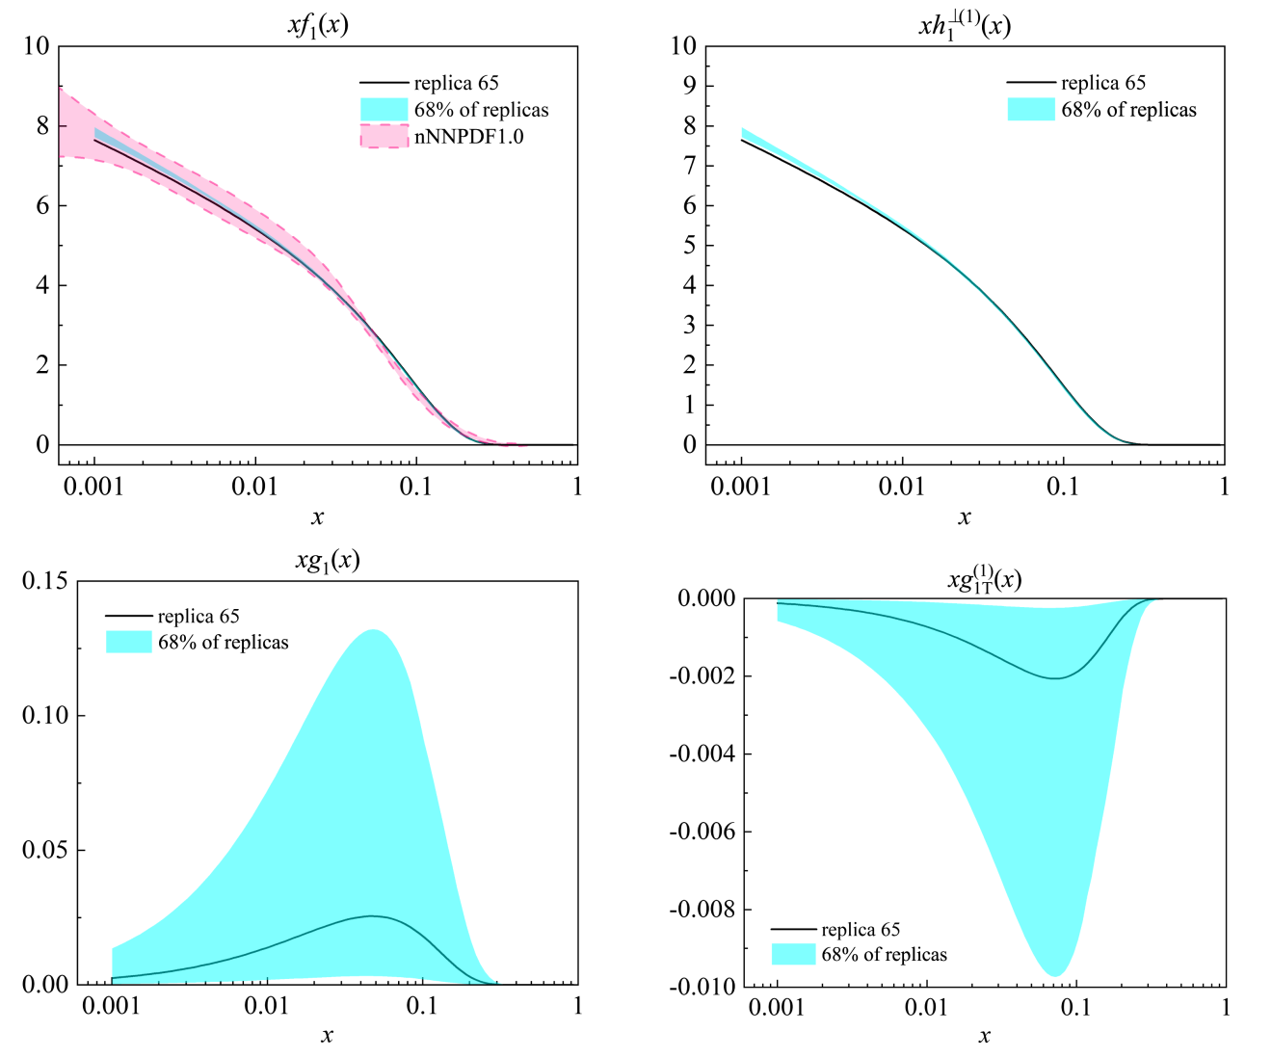
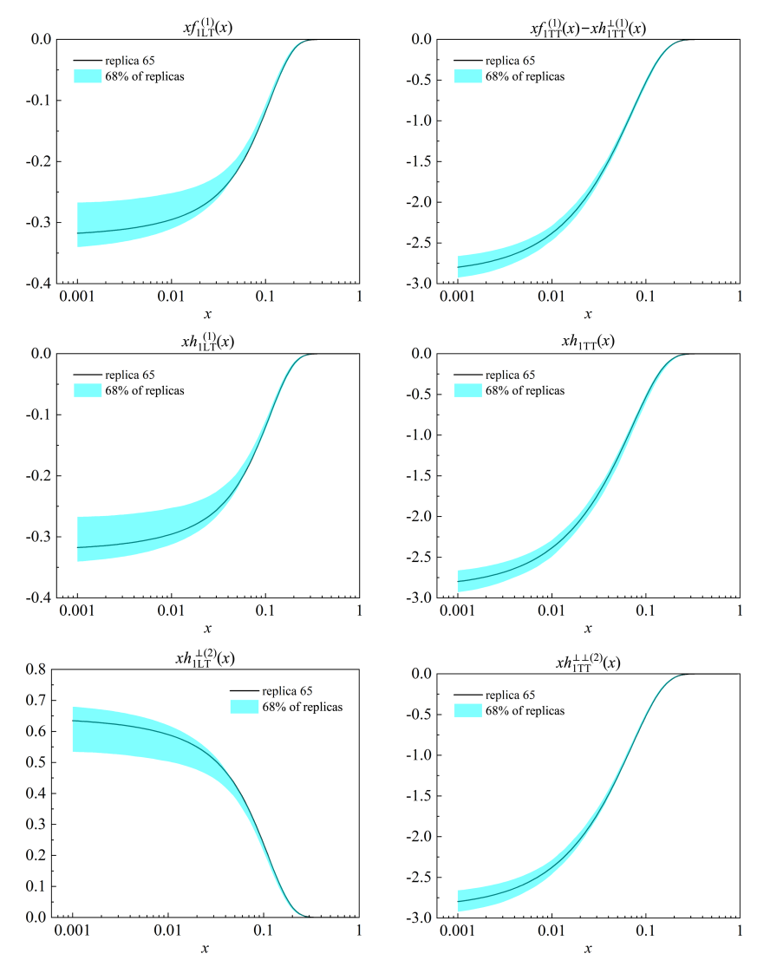
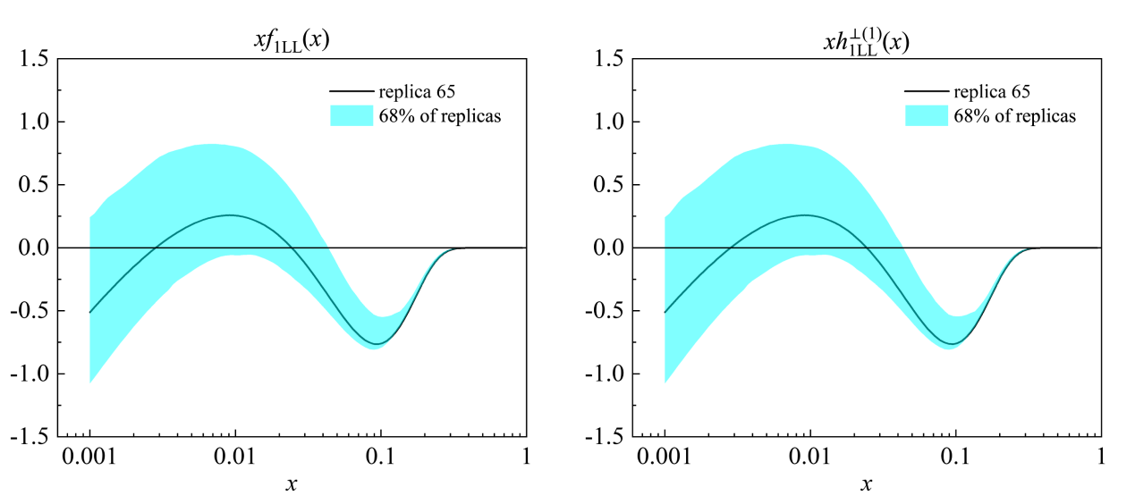
Integrated TMDs

Slide 12
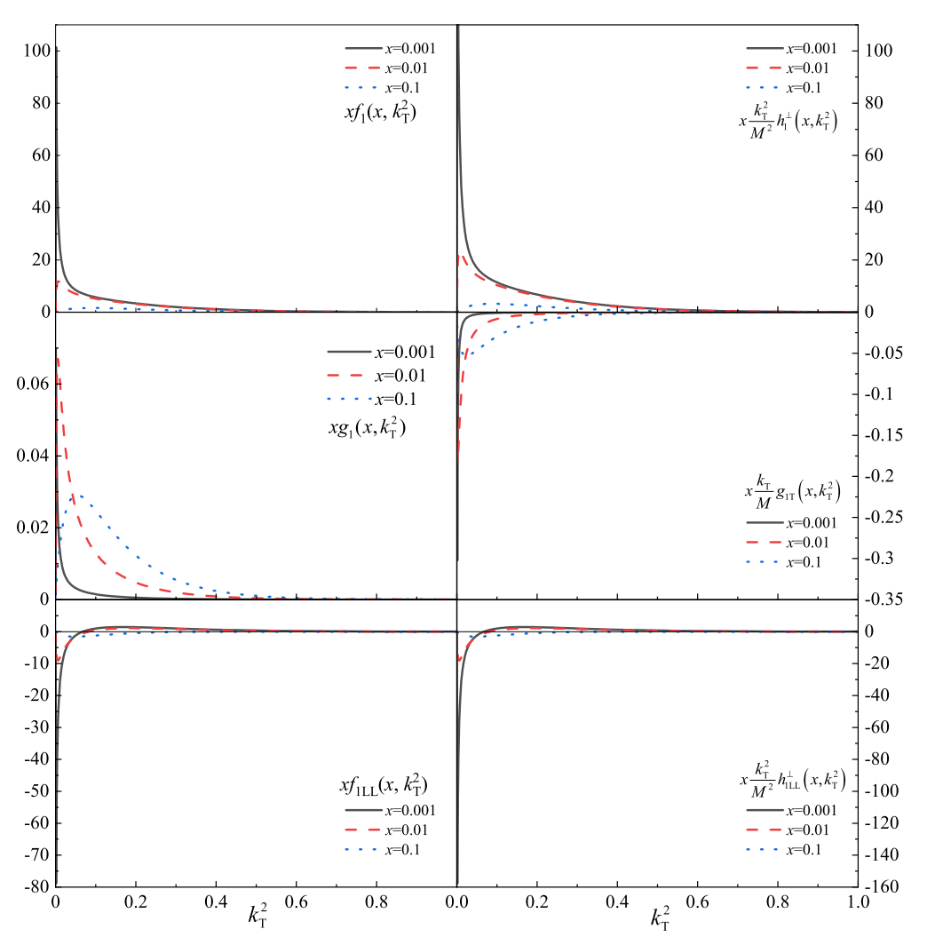
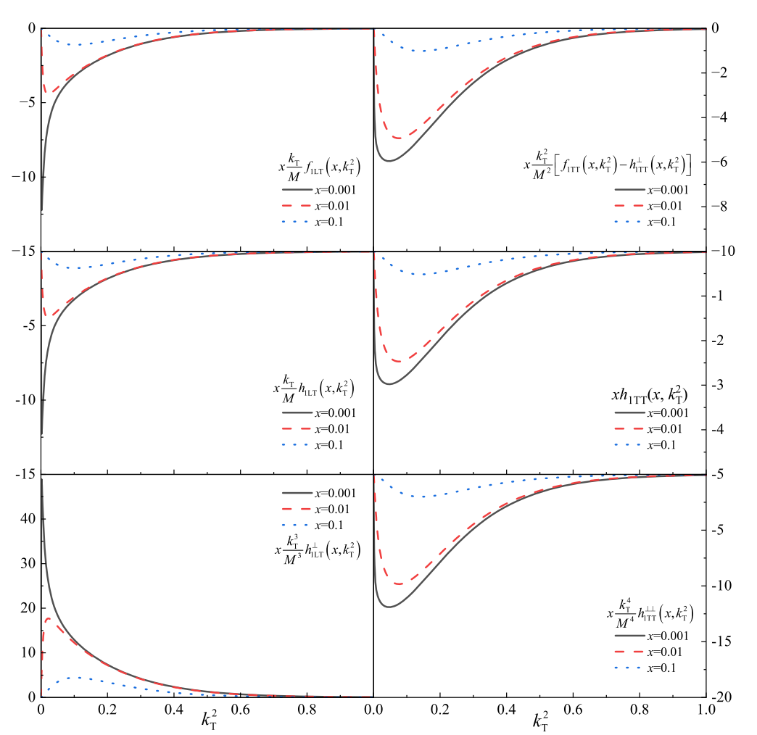
TMDs

Slide 13
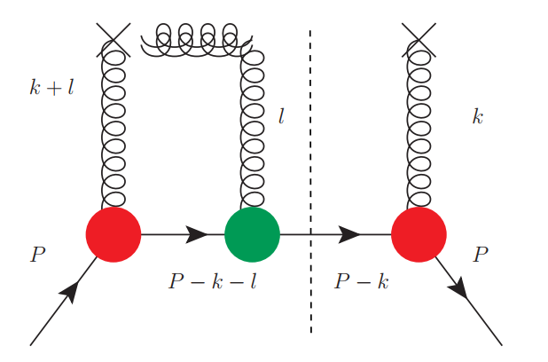
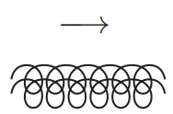
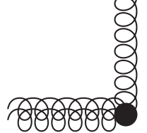



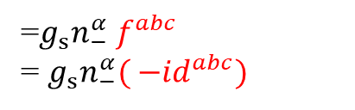
T-odd gluon TMDs
Gauge link
$$l$$
=$g_{s}n_{−}^{α}{ f}^{abc}$
= $g_{s}n_{−}^{α}{( −id}^{abc})$
$$=\frac{−i}{l_{+}±iε}$$
Spectator-gluon-spectator vertex
f-type and d-type

Slide 14
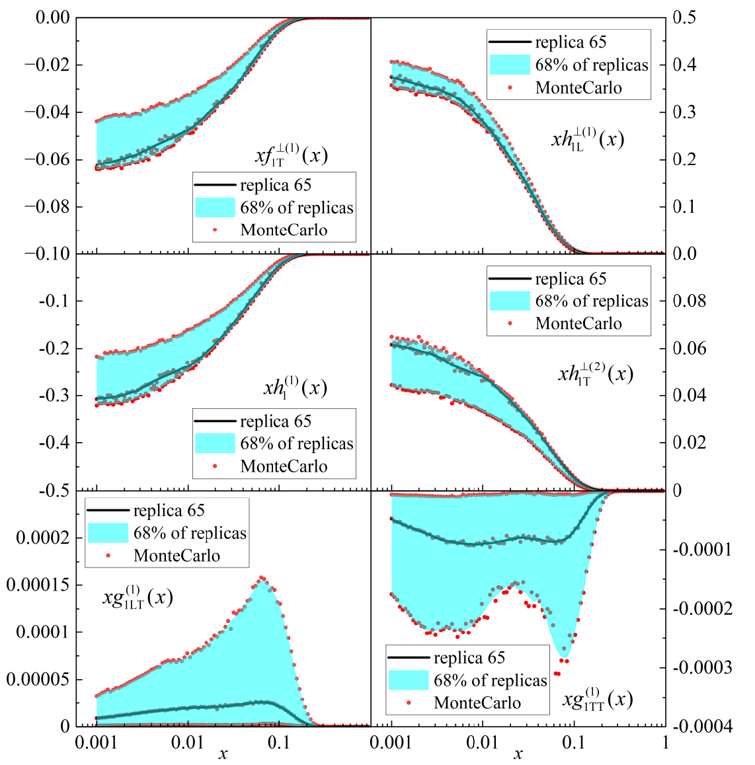
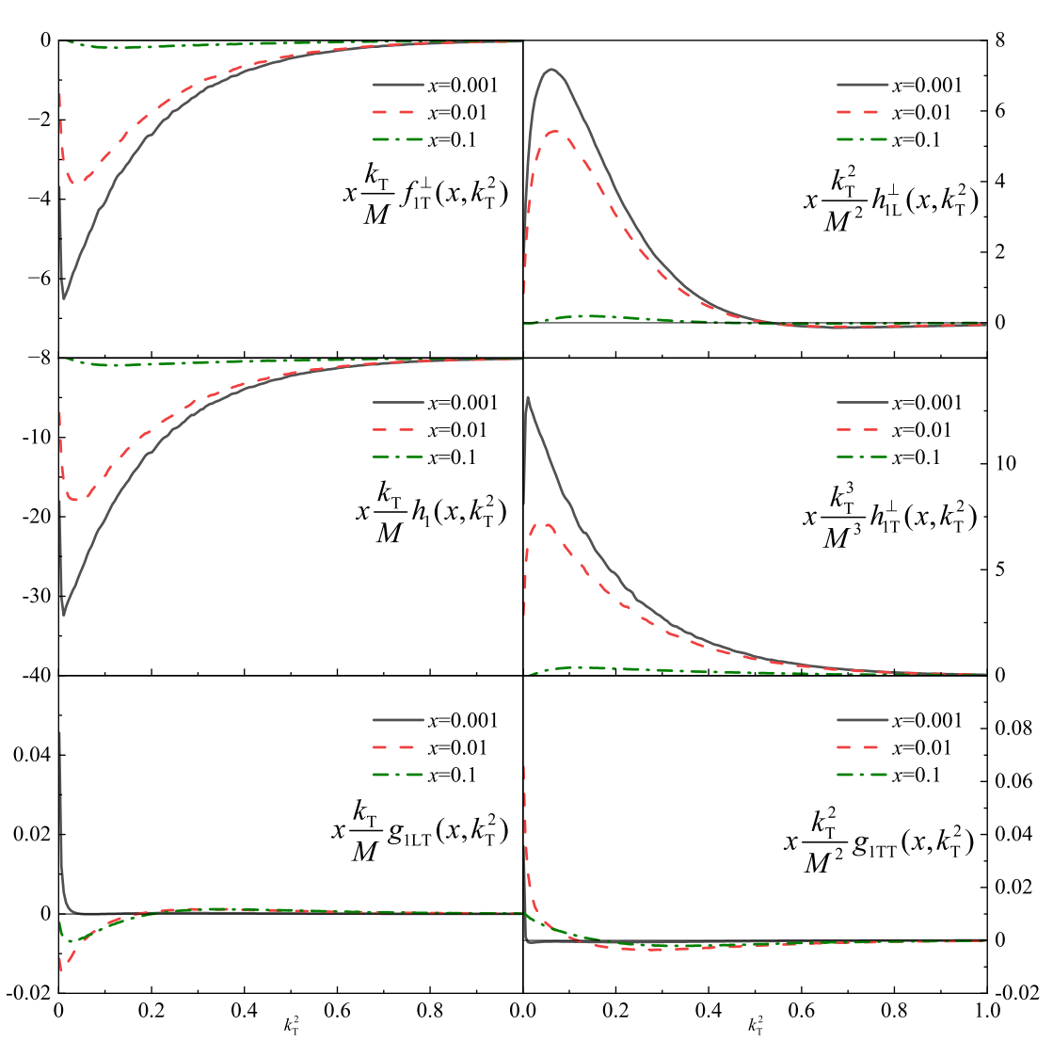
T-odd TMDs

Slide 15
PART THREE
Drell-Yan phenomenology
X. Xie, Z. Lu, arXiv:2609.XXXXX

Slide 16
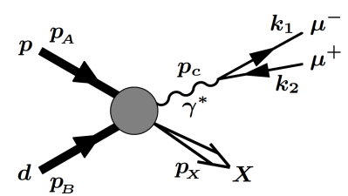
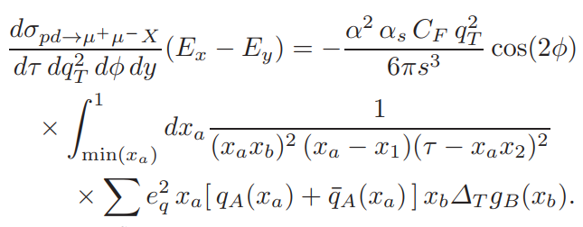
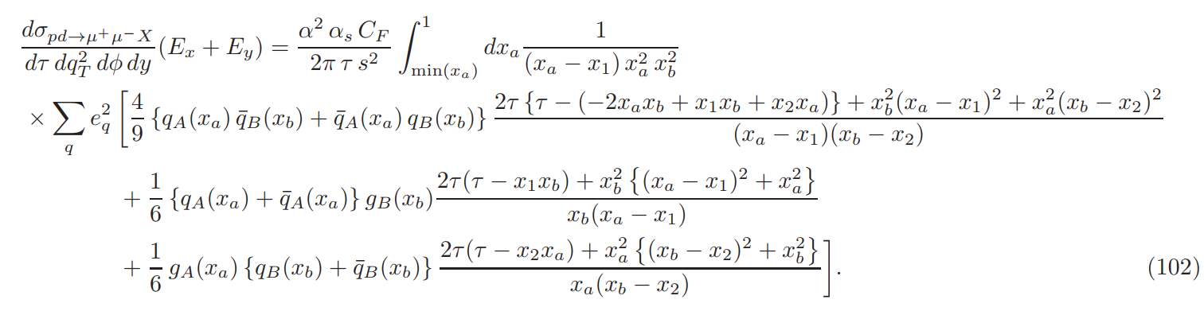


Drell-Yan process
The proton-deuteron Drell-Yan cross sections:
$${−x}_{b} h_{1TT}^{g}(x_{b})$$
S. Kumano and Q. T. Song, Phys. Rev. D 101, 054011 (2020).
$$f_{1}^{g}(x_{b})+S_{B, LL}f_{1LL}^{g}(x_{b})$$

Slide 17
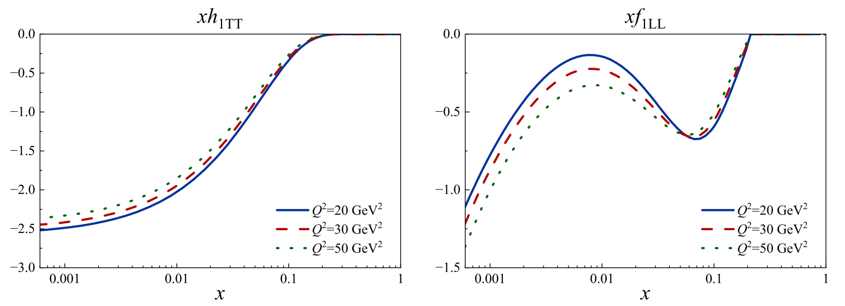
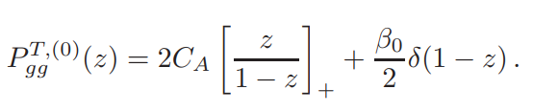
Evolution
X. Artru and M. Mekhfi, Z. Phys. C 45 (1990)

Slide 18
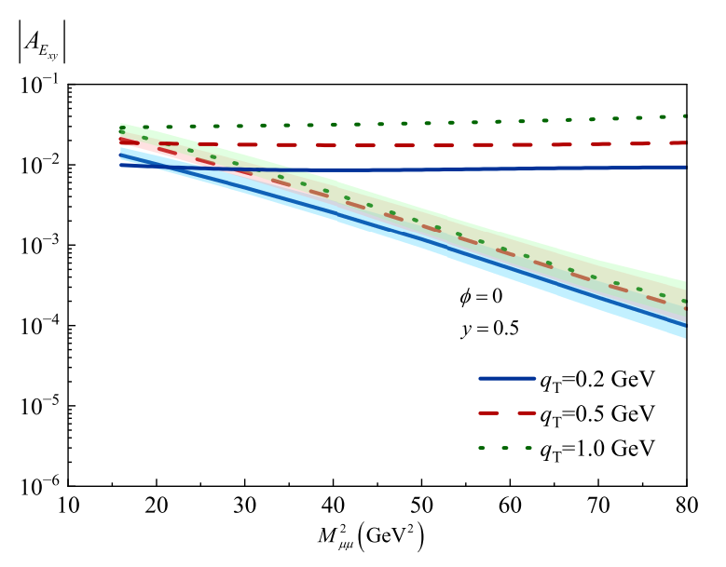
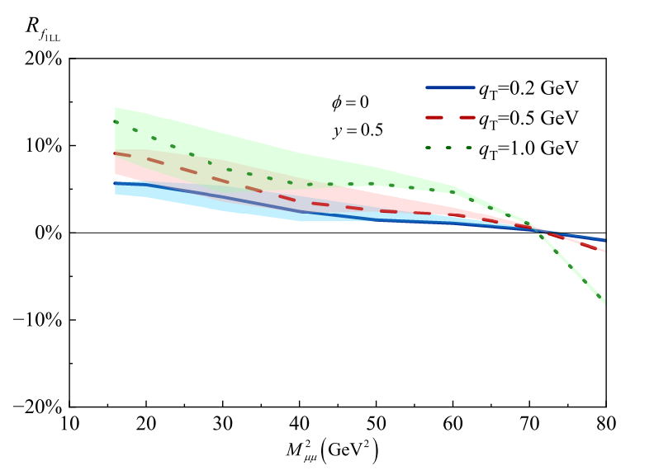
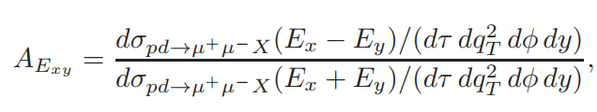
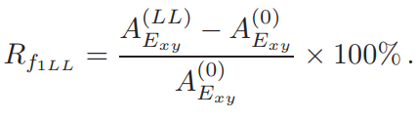
Results

Slide 19
PART FOUR
Summary

Slide 20
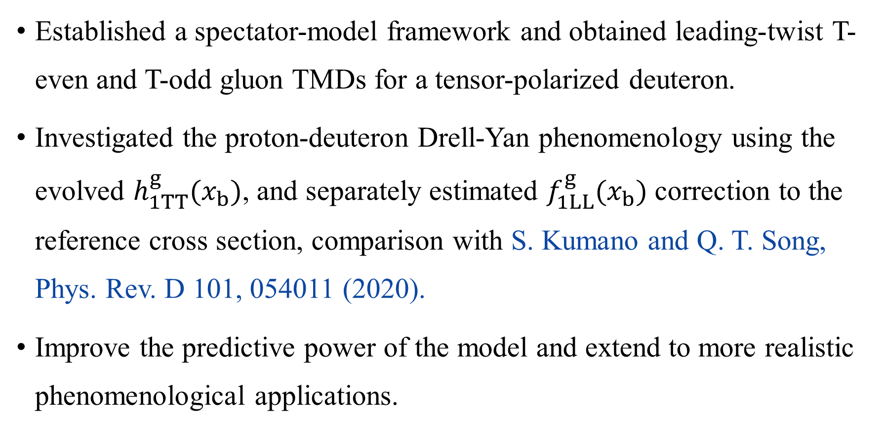
Summary
Established a spectator-model framework and obtained leading-twist T-even and T-odd gluon TMDs for a tensor-polarized deuteron.
Investigated the proton-deuteron Drell-Yan phenomenology using the evolved $h_{1TT}^{g}(x_{b})$, and separately estimated $f_{1LL}^{g}(x_{b})$ correction to the reference cross section, comparison with S. Kumano and Q. T. Song, Phys. Rev. D 101, 054011 (2020).
Improve the predictive power of the model and extend to more realistic phenomenological applications.

Slide 21

SOUTHEAST UNIVERSITY
欢迎各位老师批评指正！

