Slide 1
Welcome to join the Workshop for Two-Photon Physics and New Detection Technology
Xiaolong Wang
Fudan University
5/15, Shanghai

Slide 2
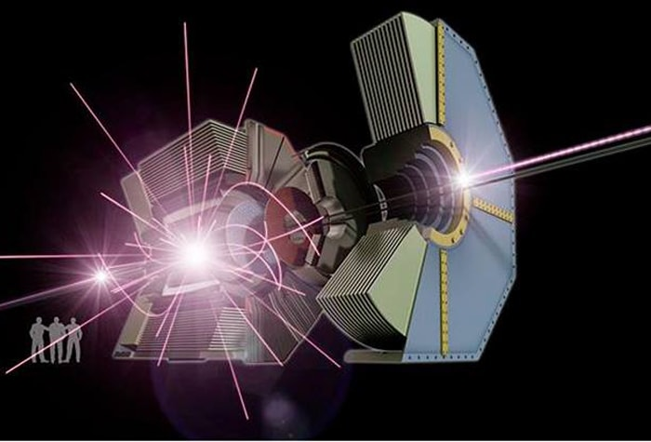
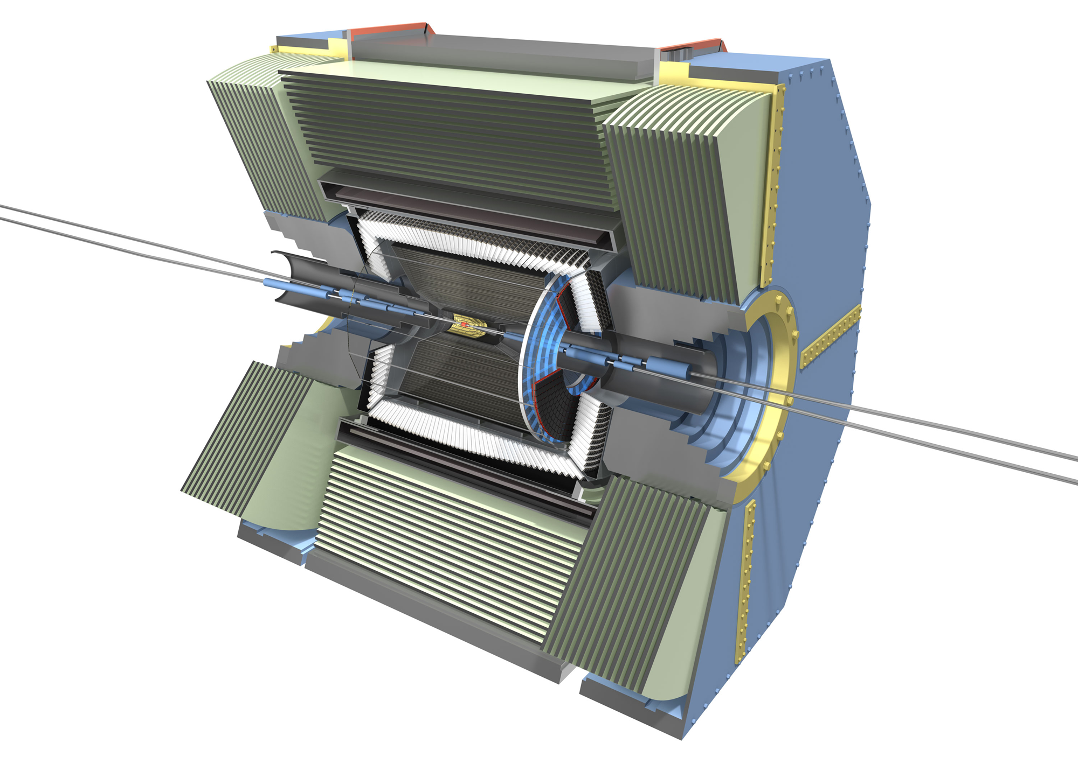
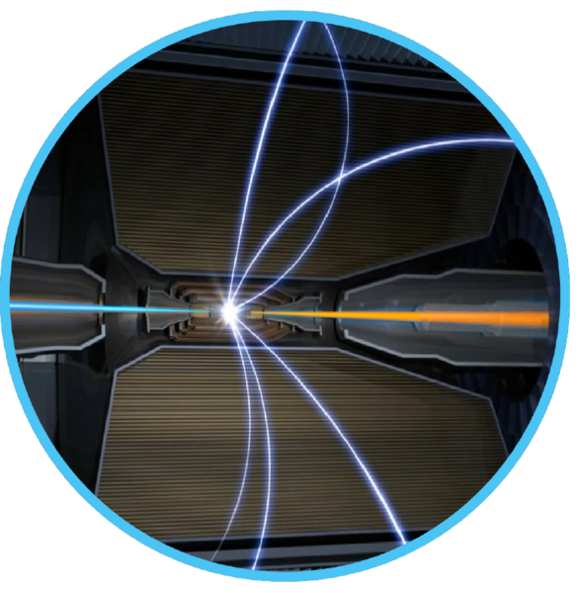
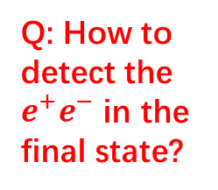

$e^{+}e^{−}$ collision vs $γγ$ collision
Q: How to detect the $e^{+}e^{−}$ in the final state?

Slide 3
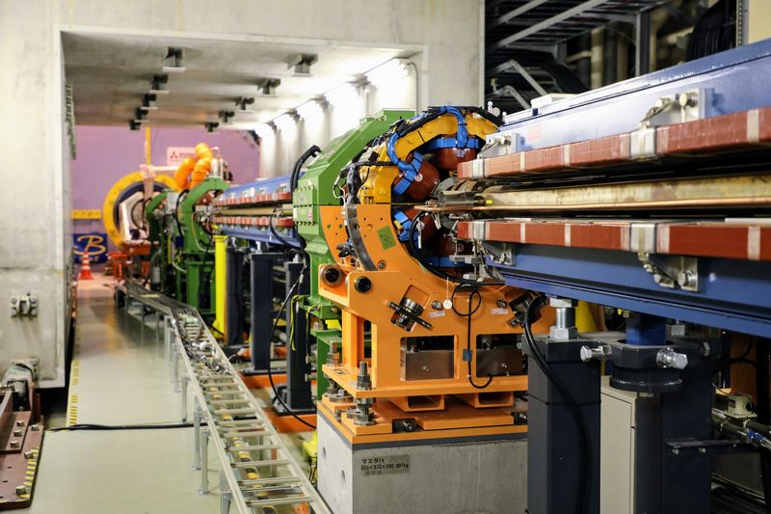
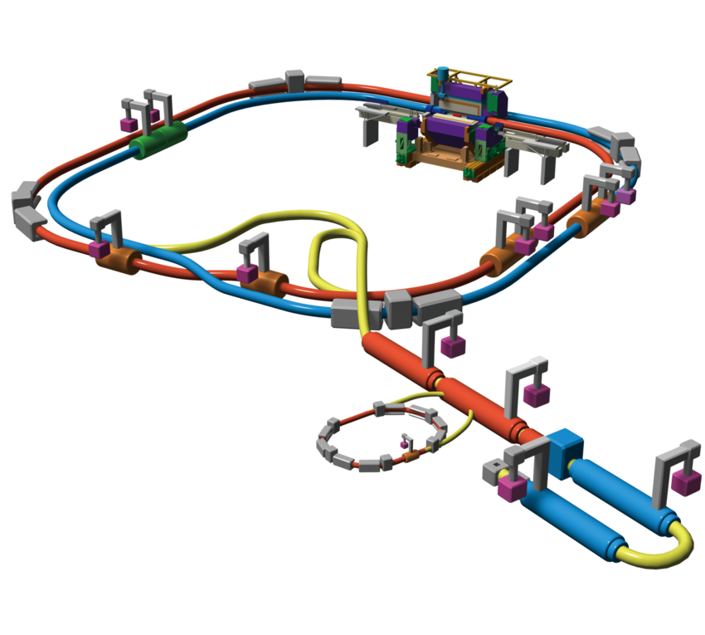


Detector(s) for tagging $e^{+}e^{−}$
Bending magnet
$γ_{ISR}$ or SR
Can we build a new detector for two-photon physics? More than tagging.

Slide 4
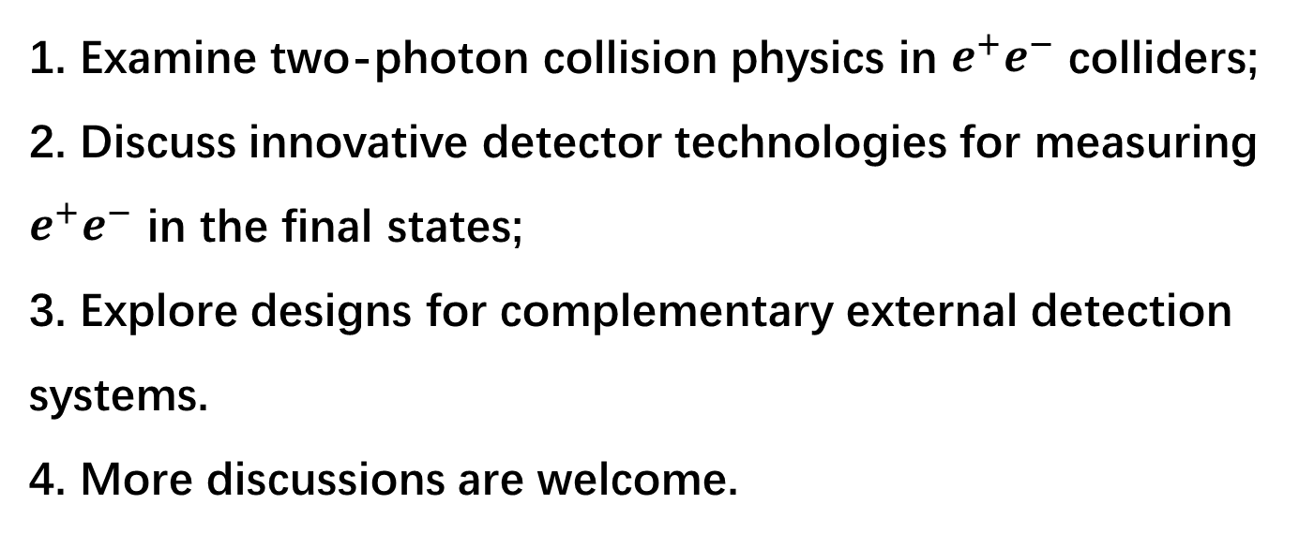
For this workshop
1. Examine two-photon collision physics in $e^{+}e^{−}$ colliders;
2. Discuss innovative detector technologies for measuring $e^{+}e^{−}$ in the final states;
3. Explore designs for complementary external detection systems.
4. More discussions are welcome.

Slide 5
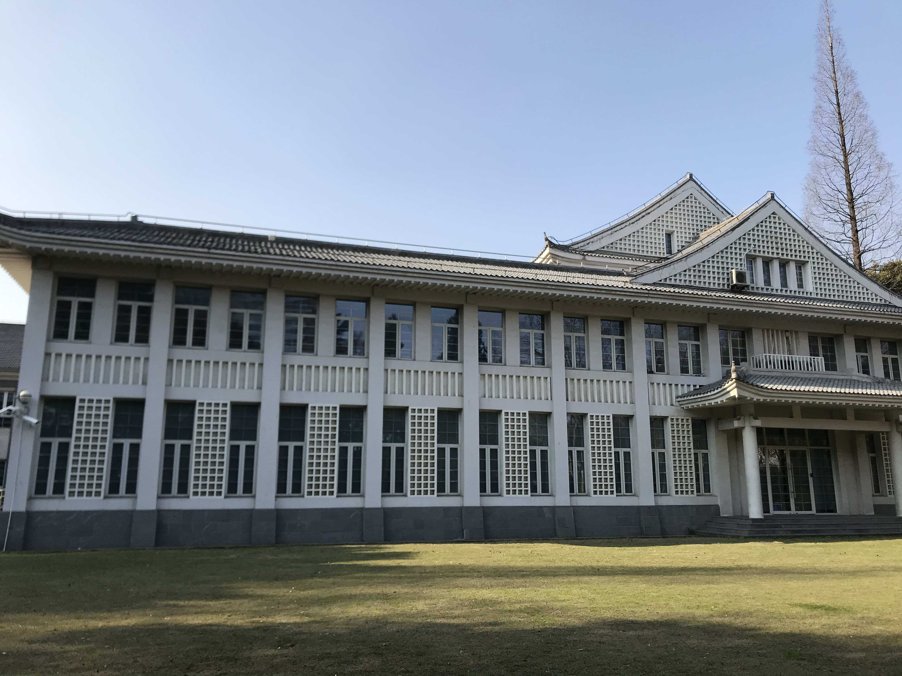
Welcome to Fudan University
Enjoy the discussions at the original and most beautiful garden of Fudan University!

