Slide 1
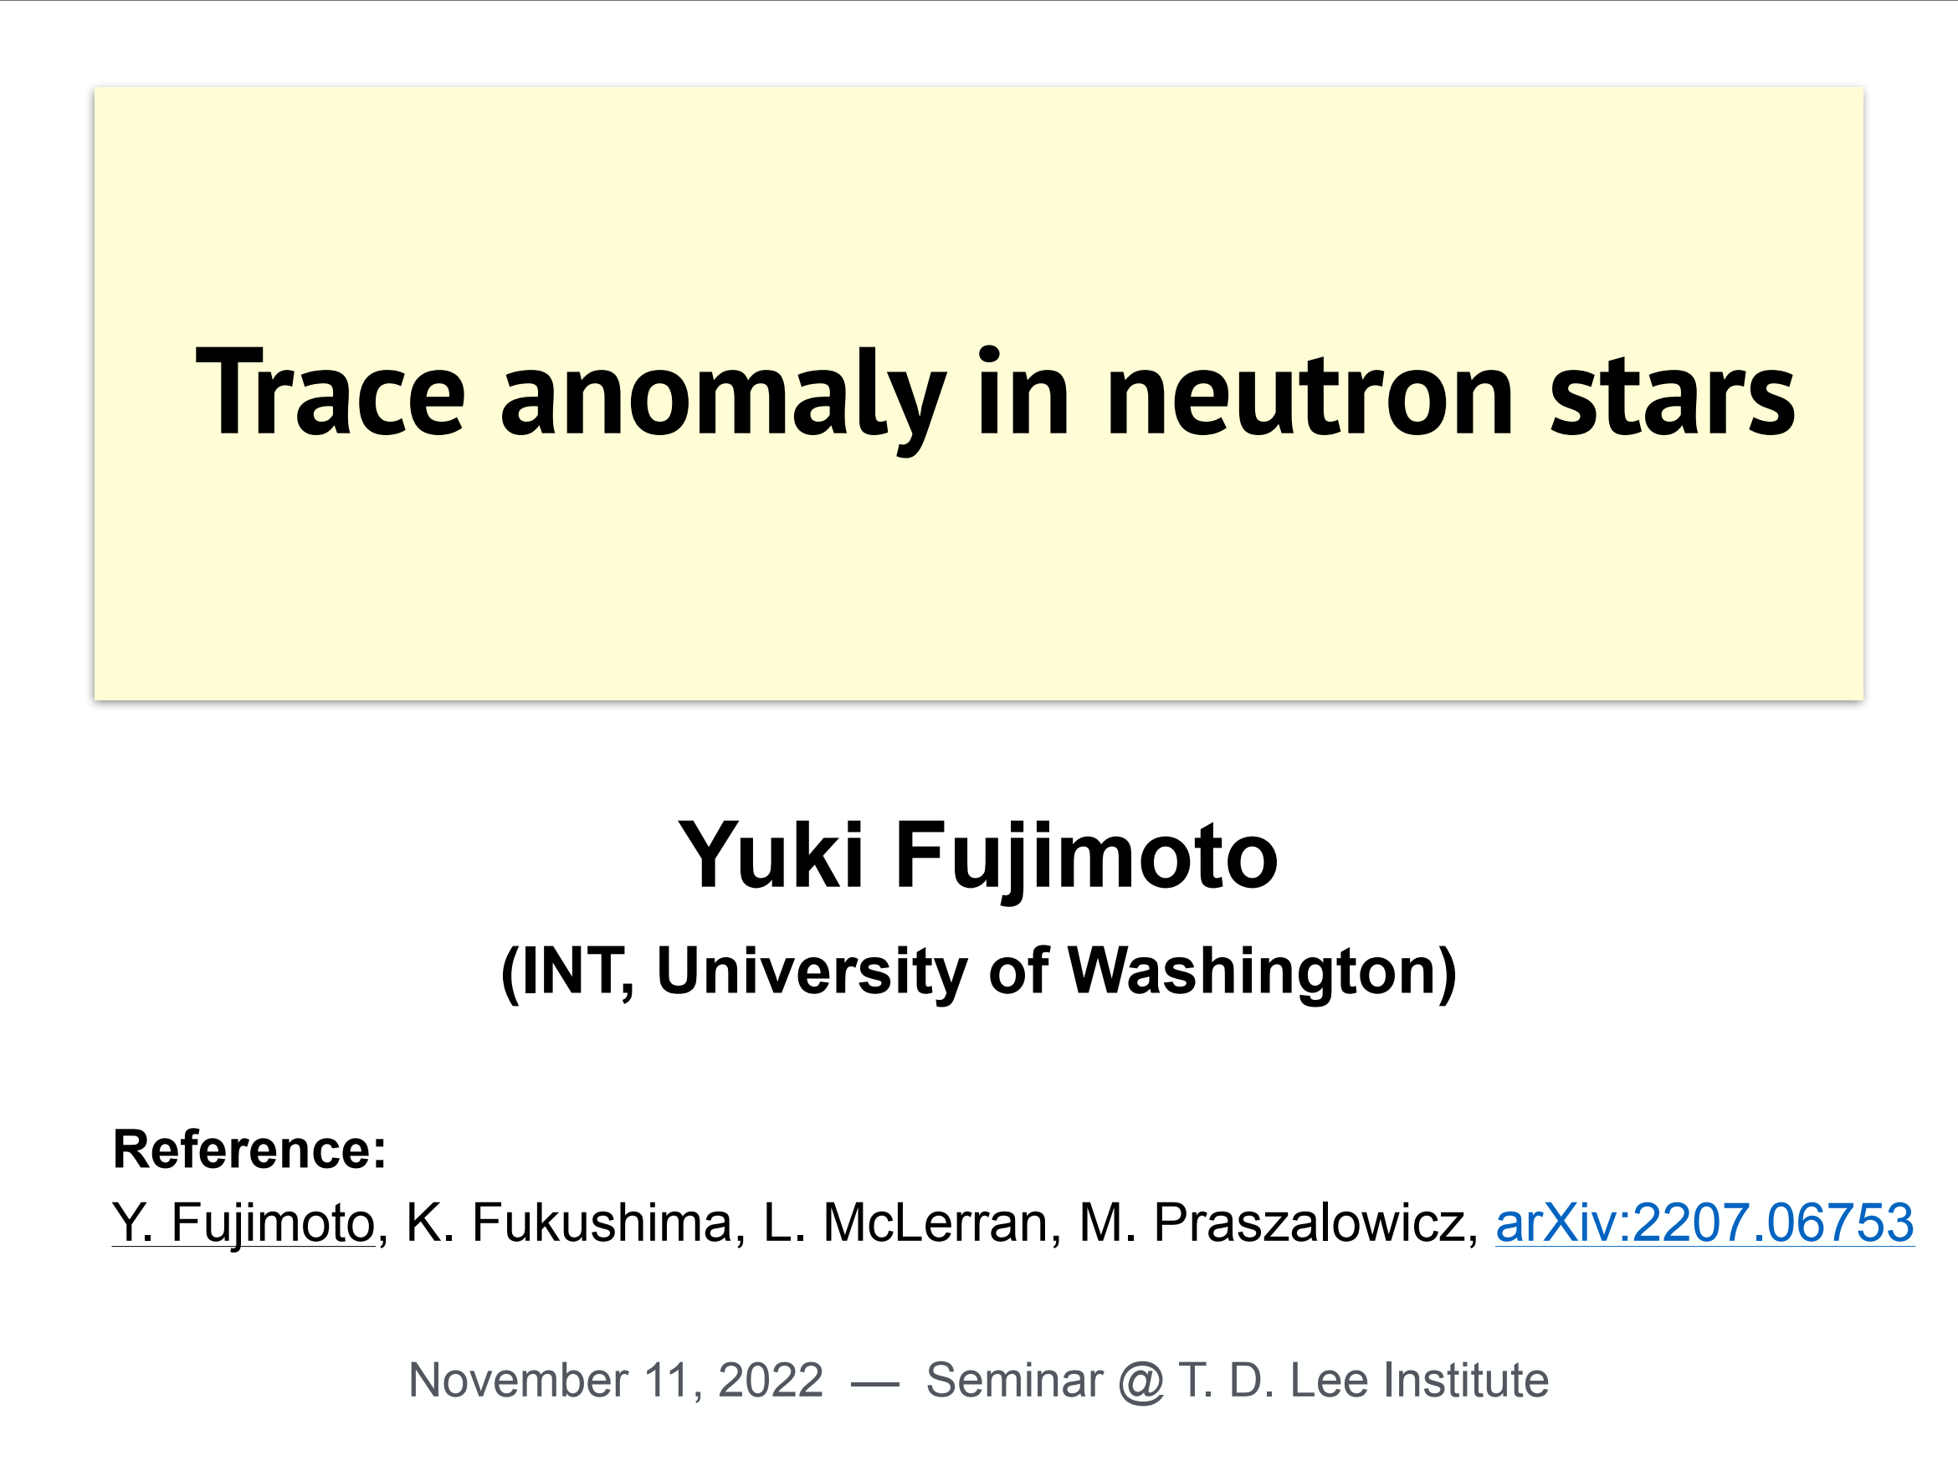

Slide 2
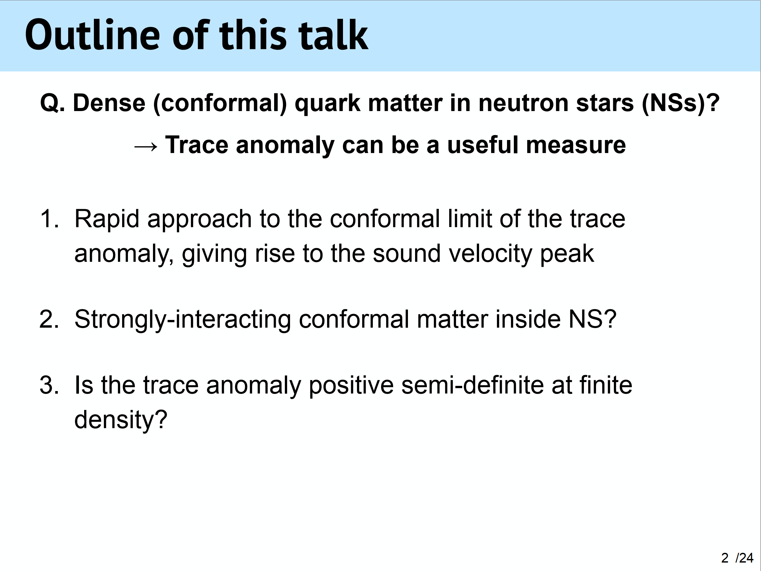

Slide 3
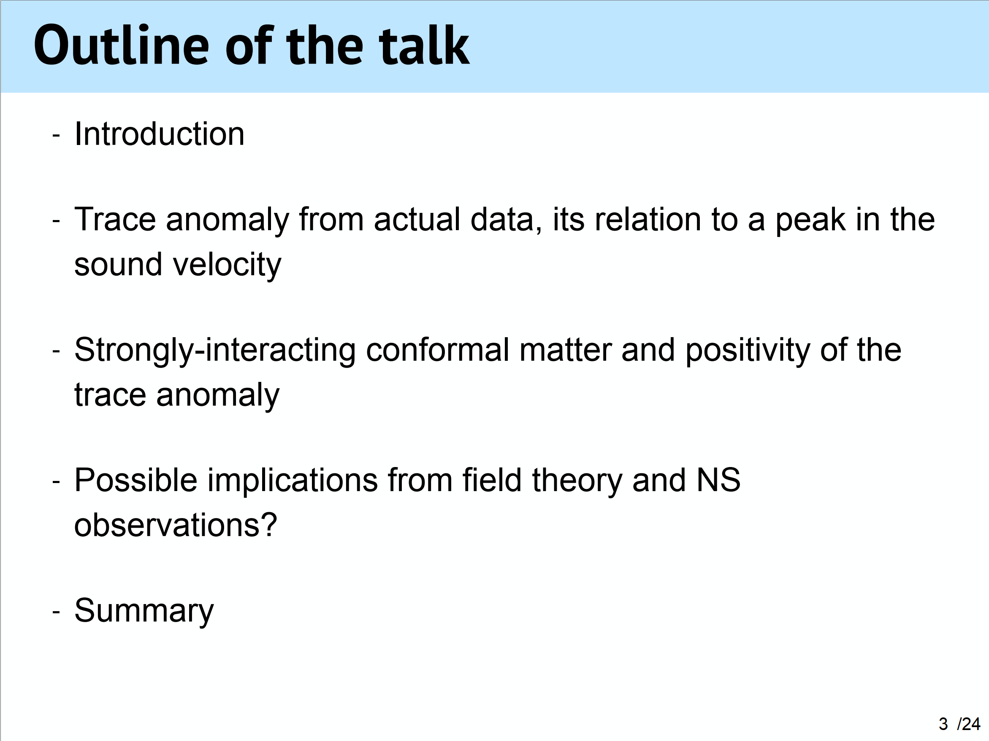

Slide 4
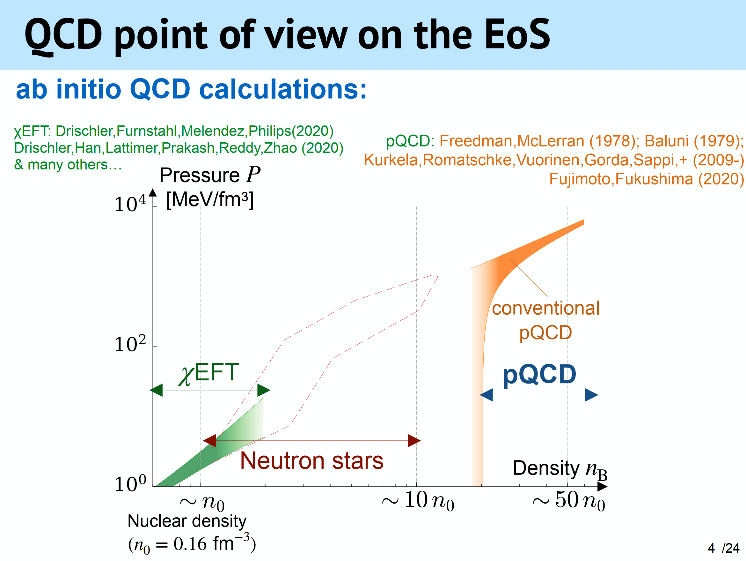

Slide 5
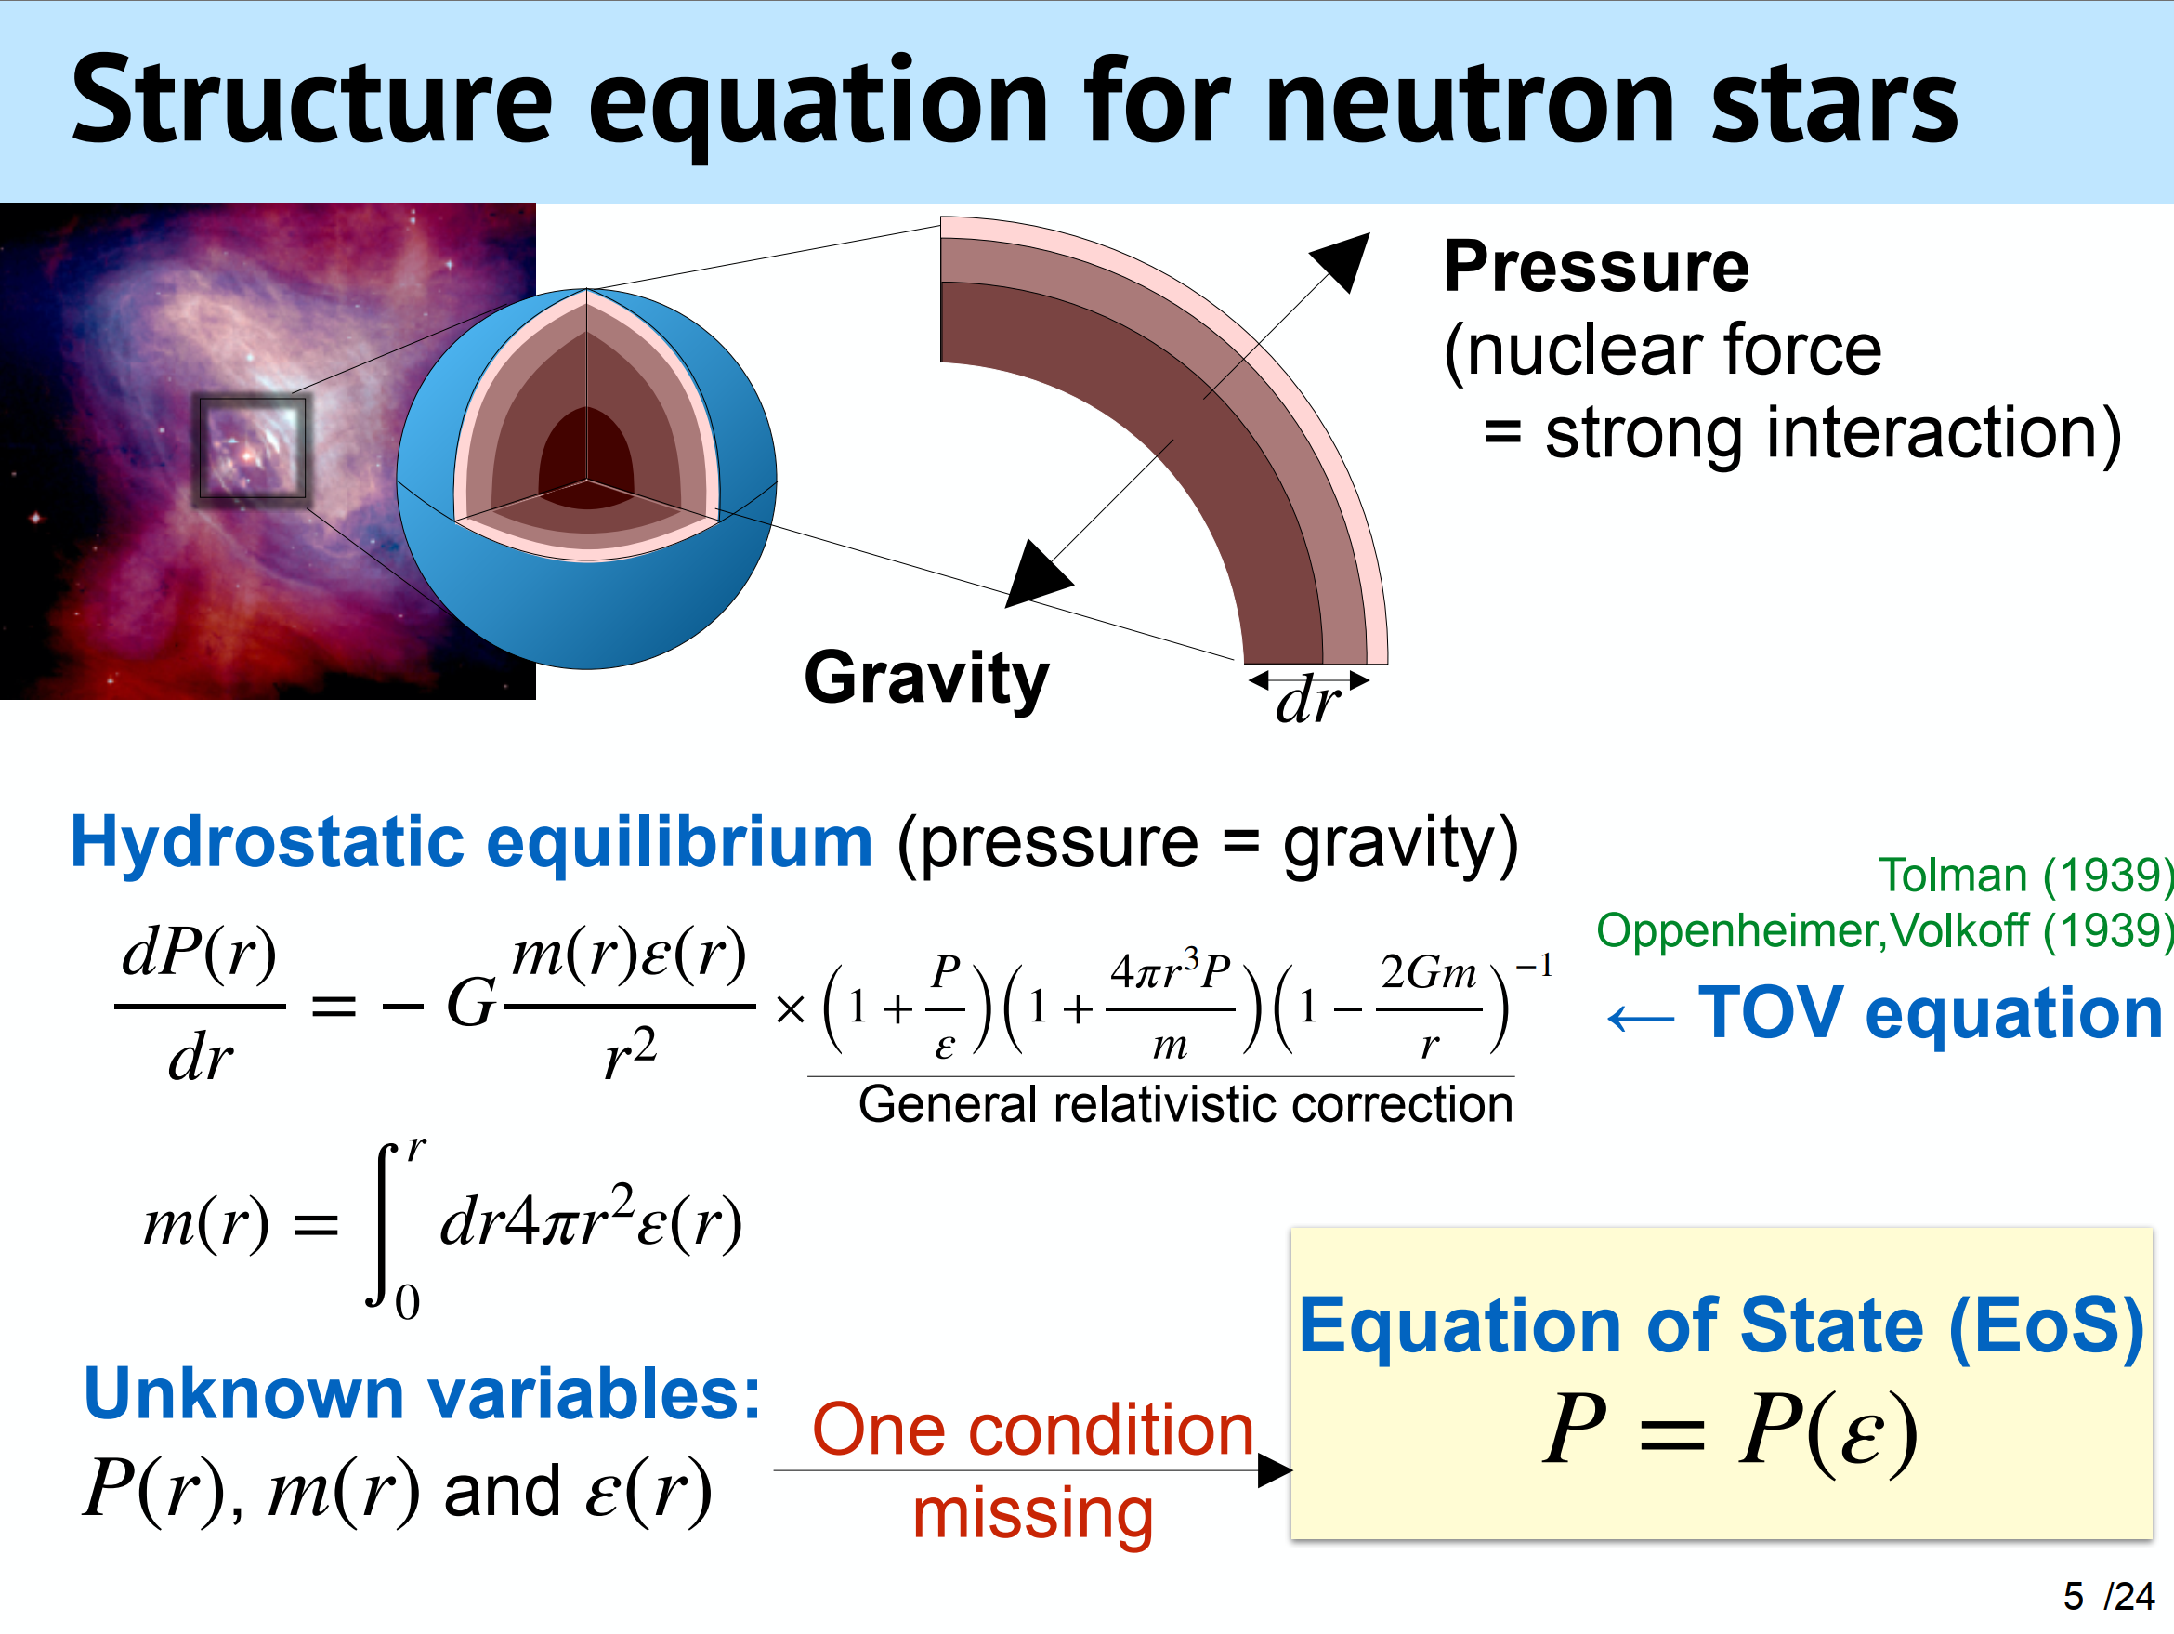

Slide 6
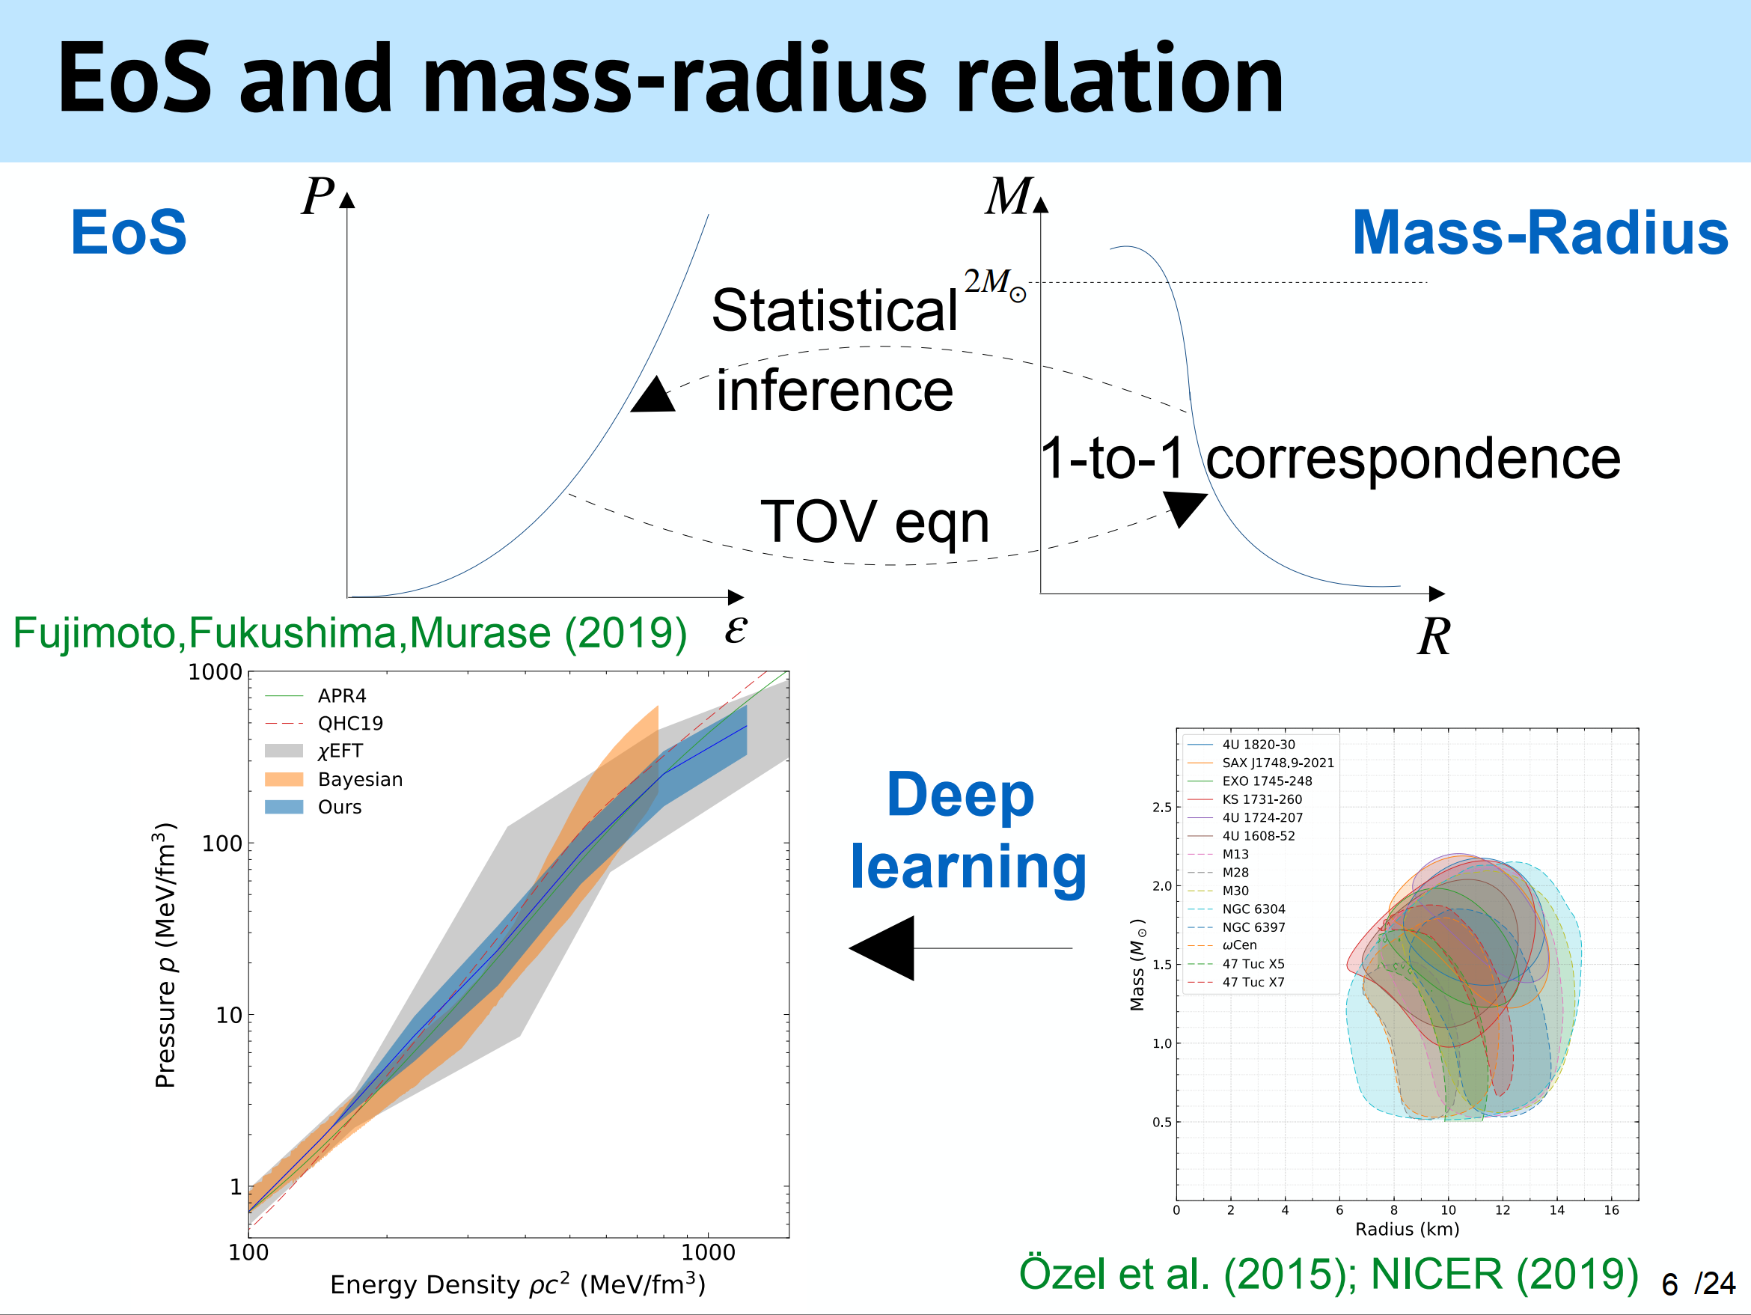

Slide 7
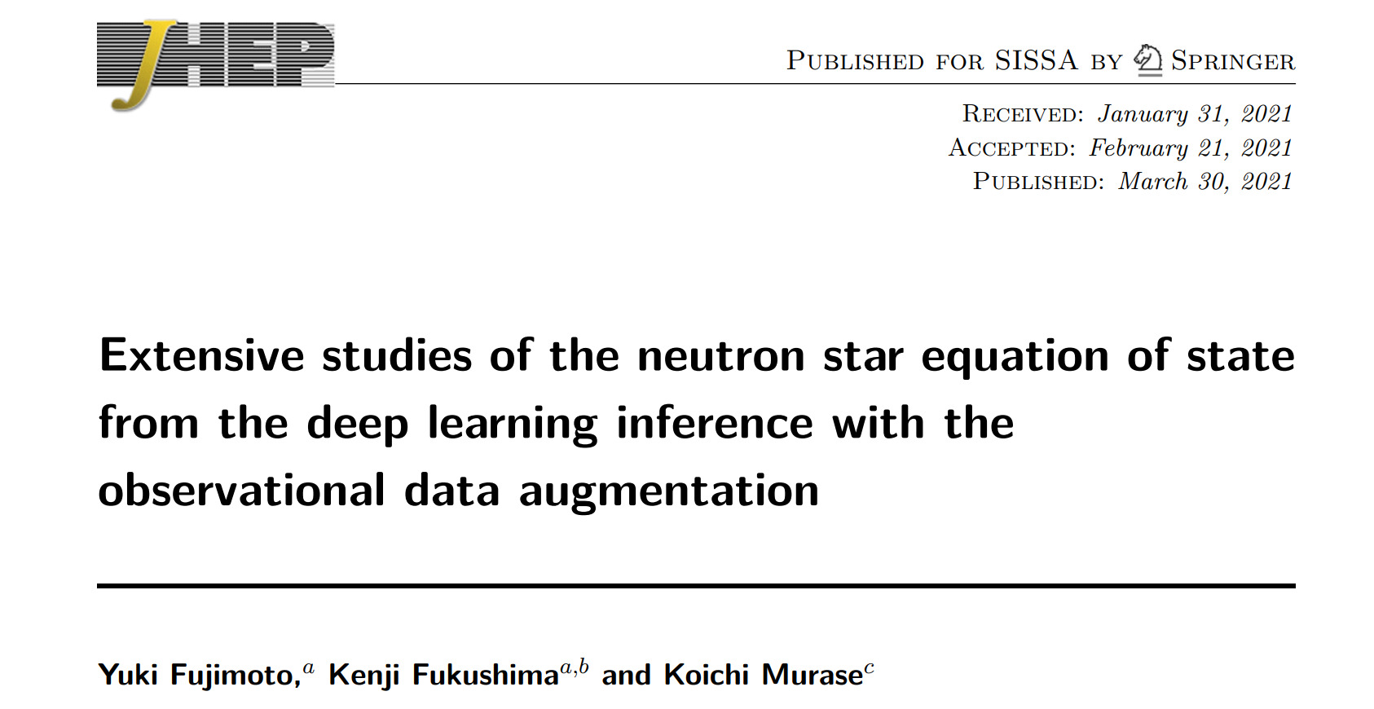
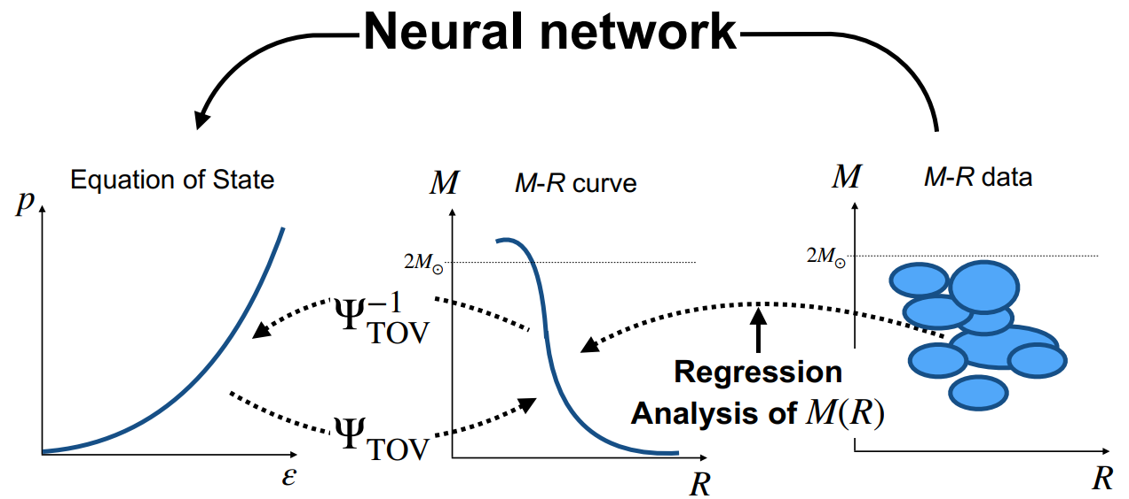


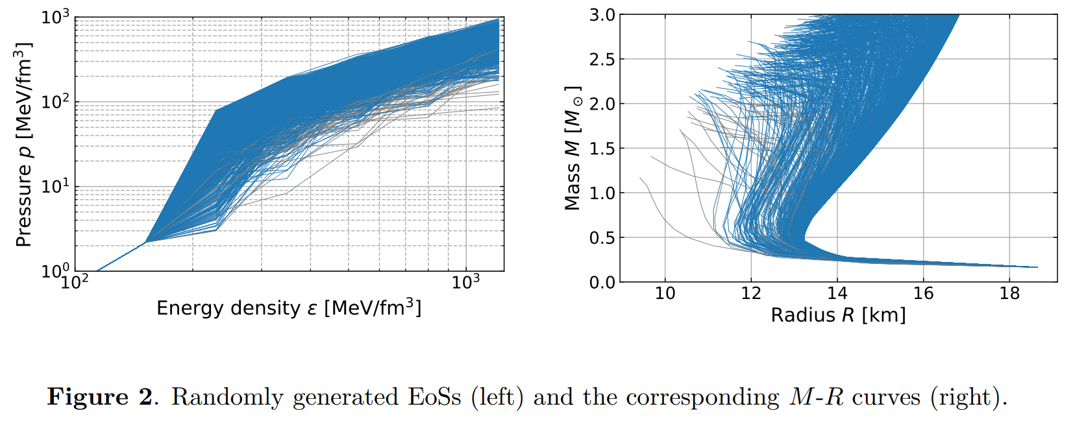


Using regression technique to infer EoS
Target function: $c_{s}^{2}=\frac{∂p}{∂ε}$
$p\left(ε\right)$ is given by
SLy4 EoS for crust

Slide 8
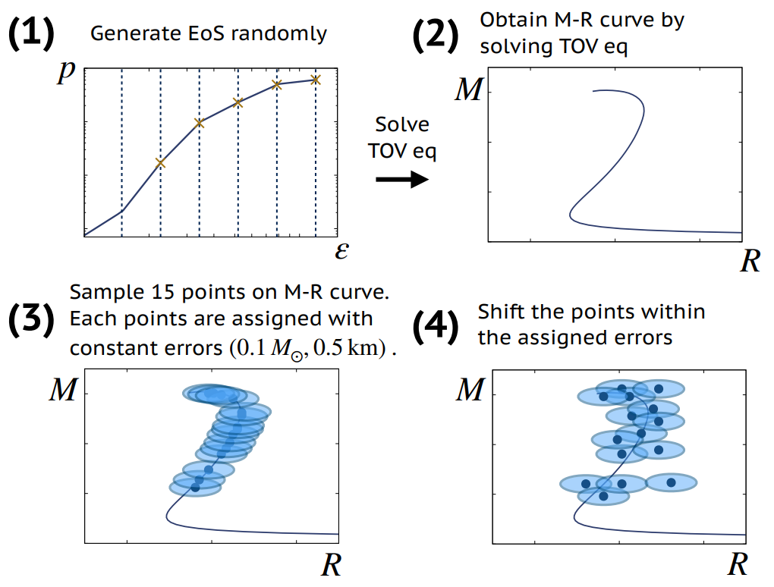

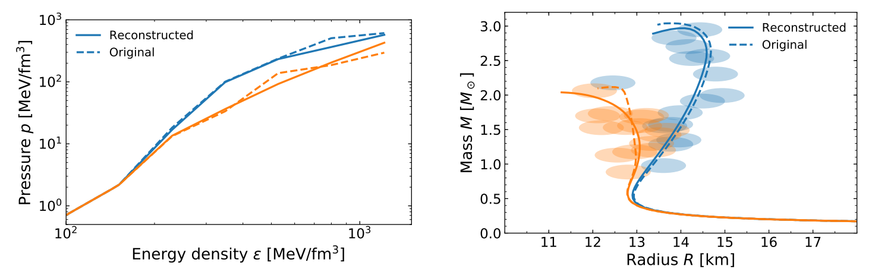

To train NN to predict EoS from NS data with large uncertainty
Data generation
Input: “observation” of 15 NS
output: 5 parameters for $c_{s}^{2}$

Slide 9
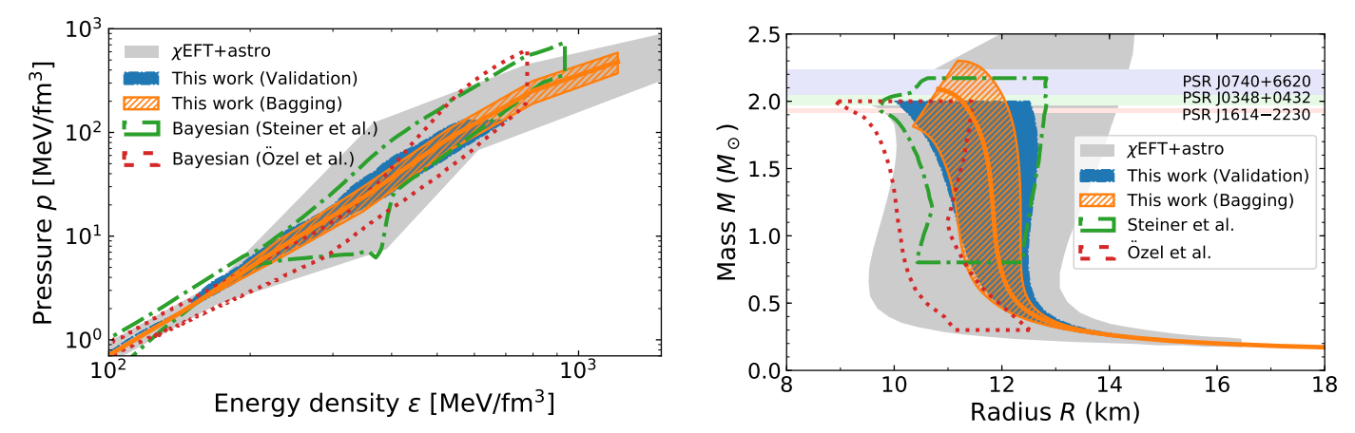
Error calculation

Slide 10
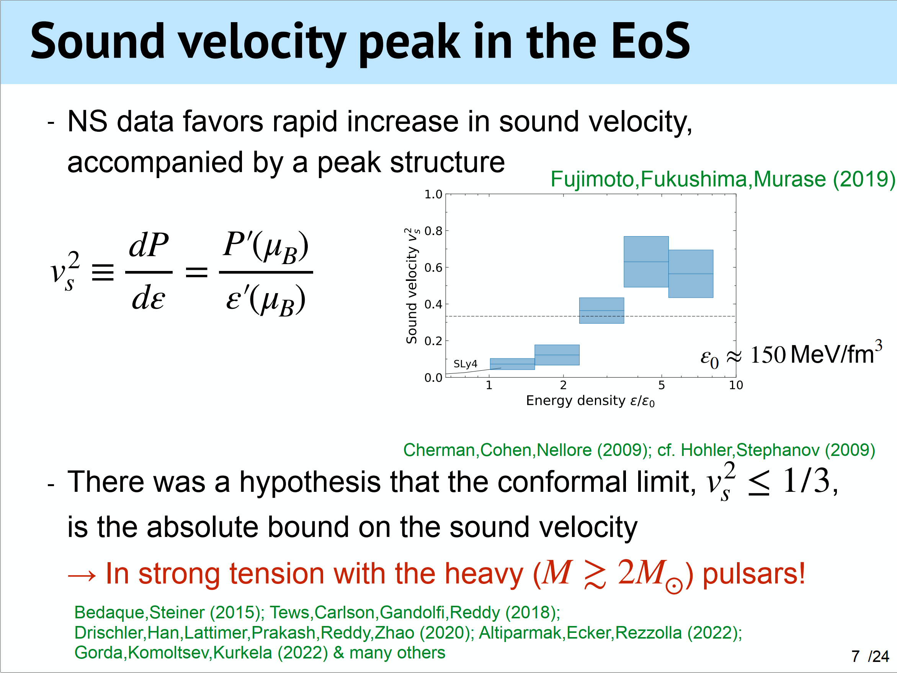

Slide 11
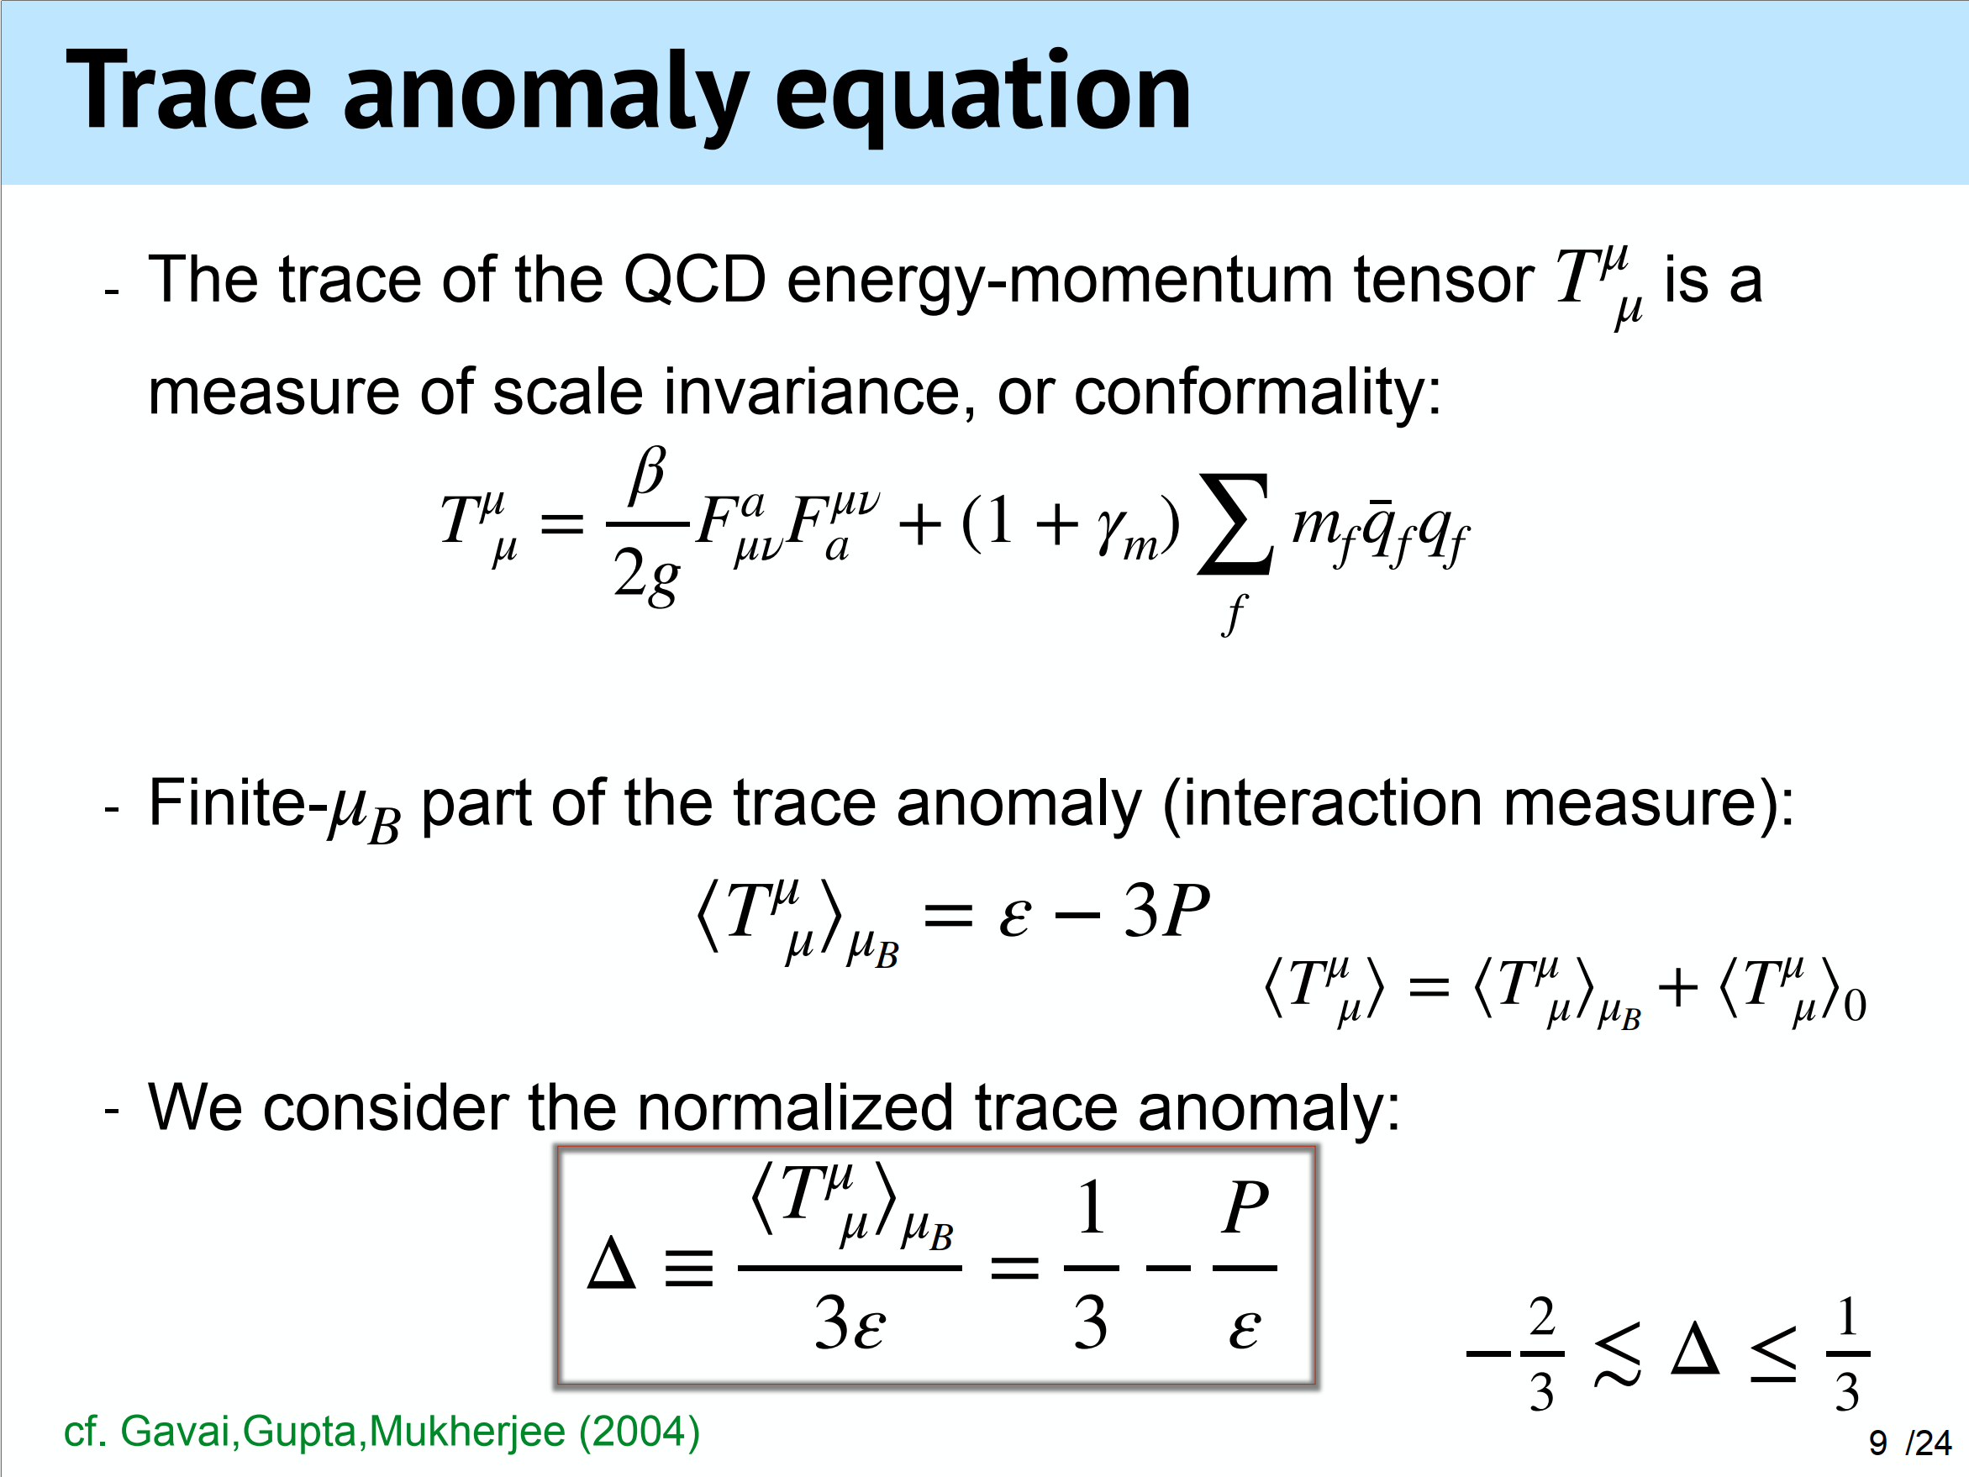

Slide 12
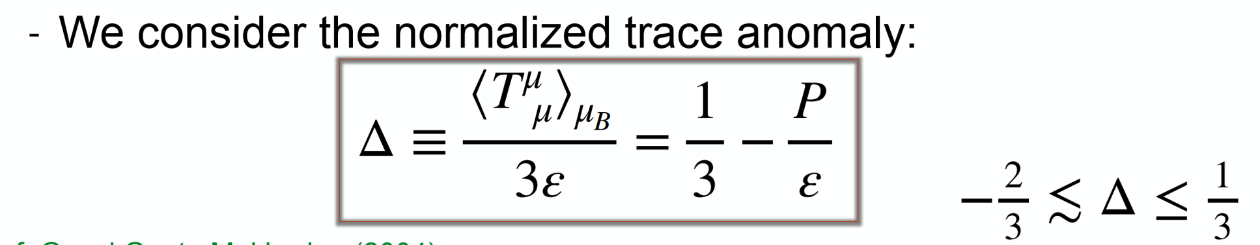



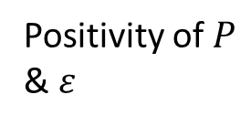
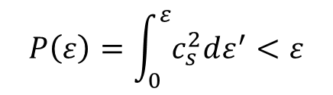

Required by causality
Positivity of $P$ & $ε$
$c_{s}^{2}=\frac{dP}{dε}$ & $c_{s}^{2}<1$
$$P_{T=μ_{B}=0}=ε_{T=μ_{B}=0}=0$$
$$P\left(ε\right)=\int_{0}^{ε}{c_{s}^{2}dε^{′}}<ε$$
Is the condition $Δ≥0$ also come from $c_{s}^{2}≤1/3$?

Slide 13
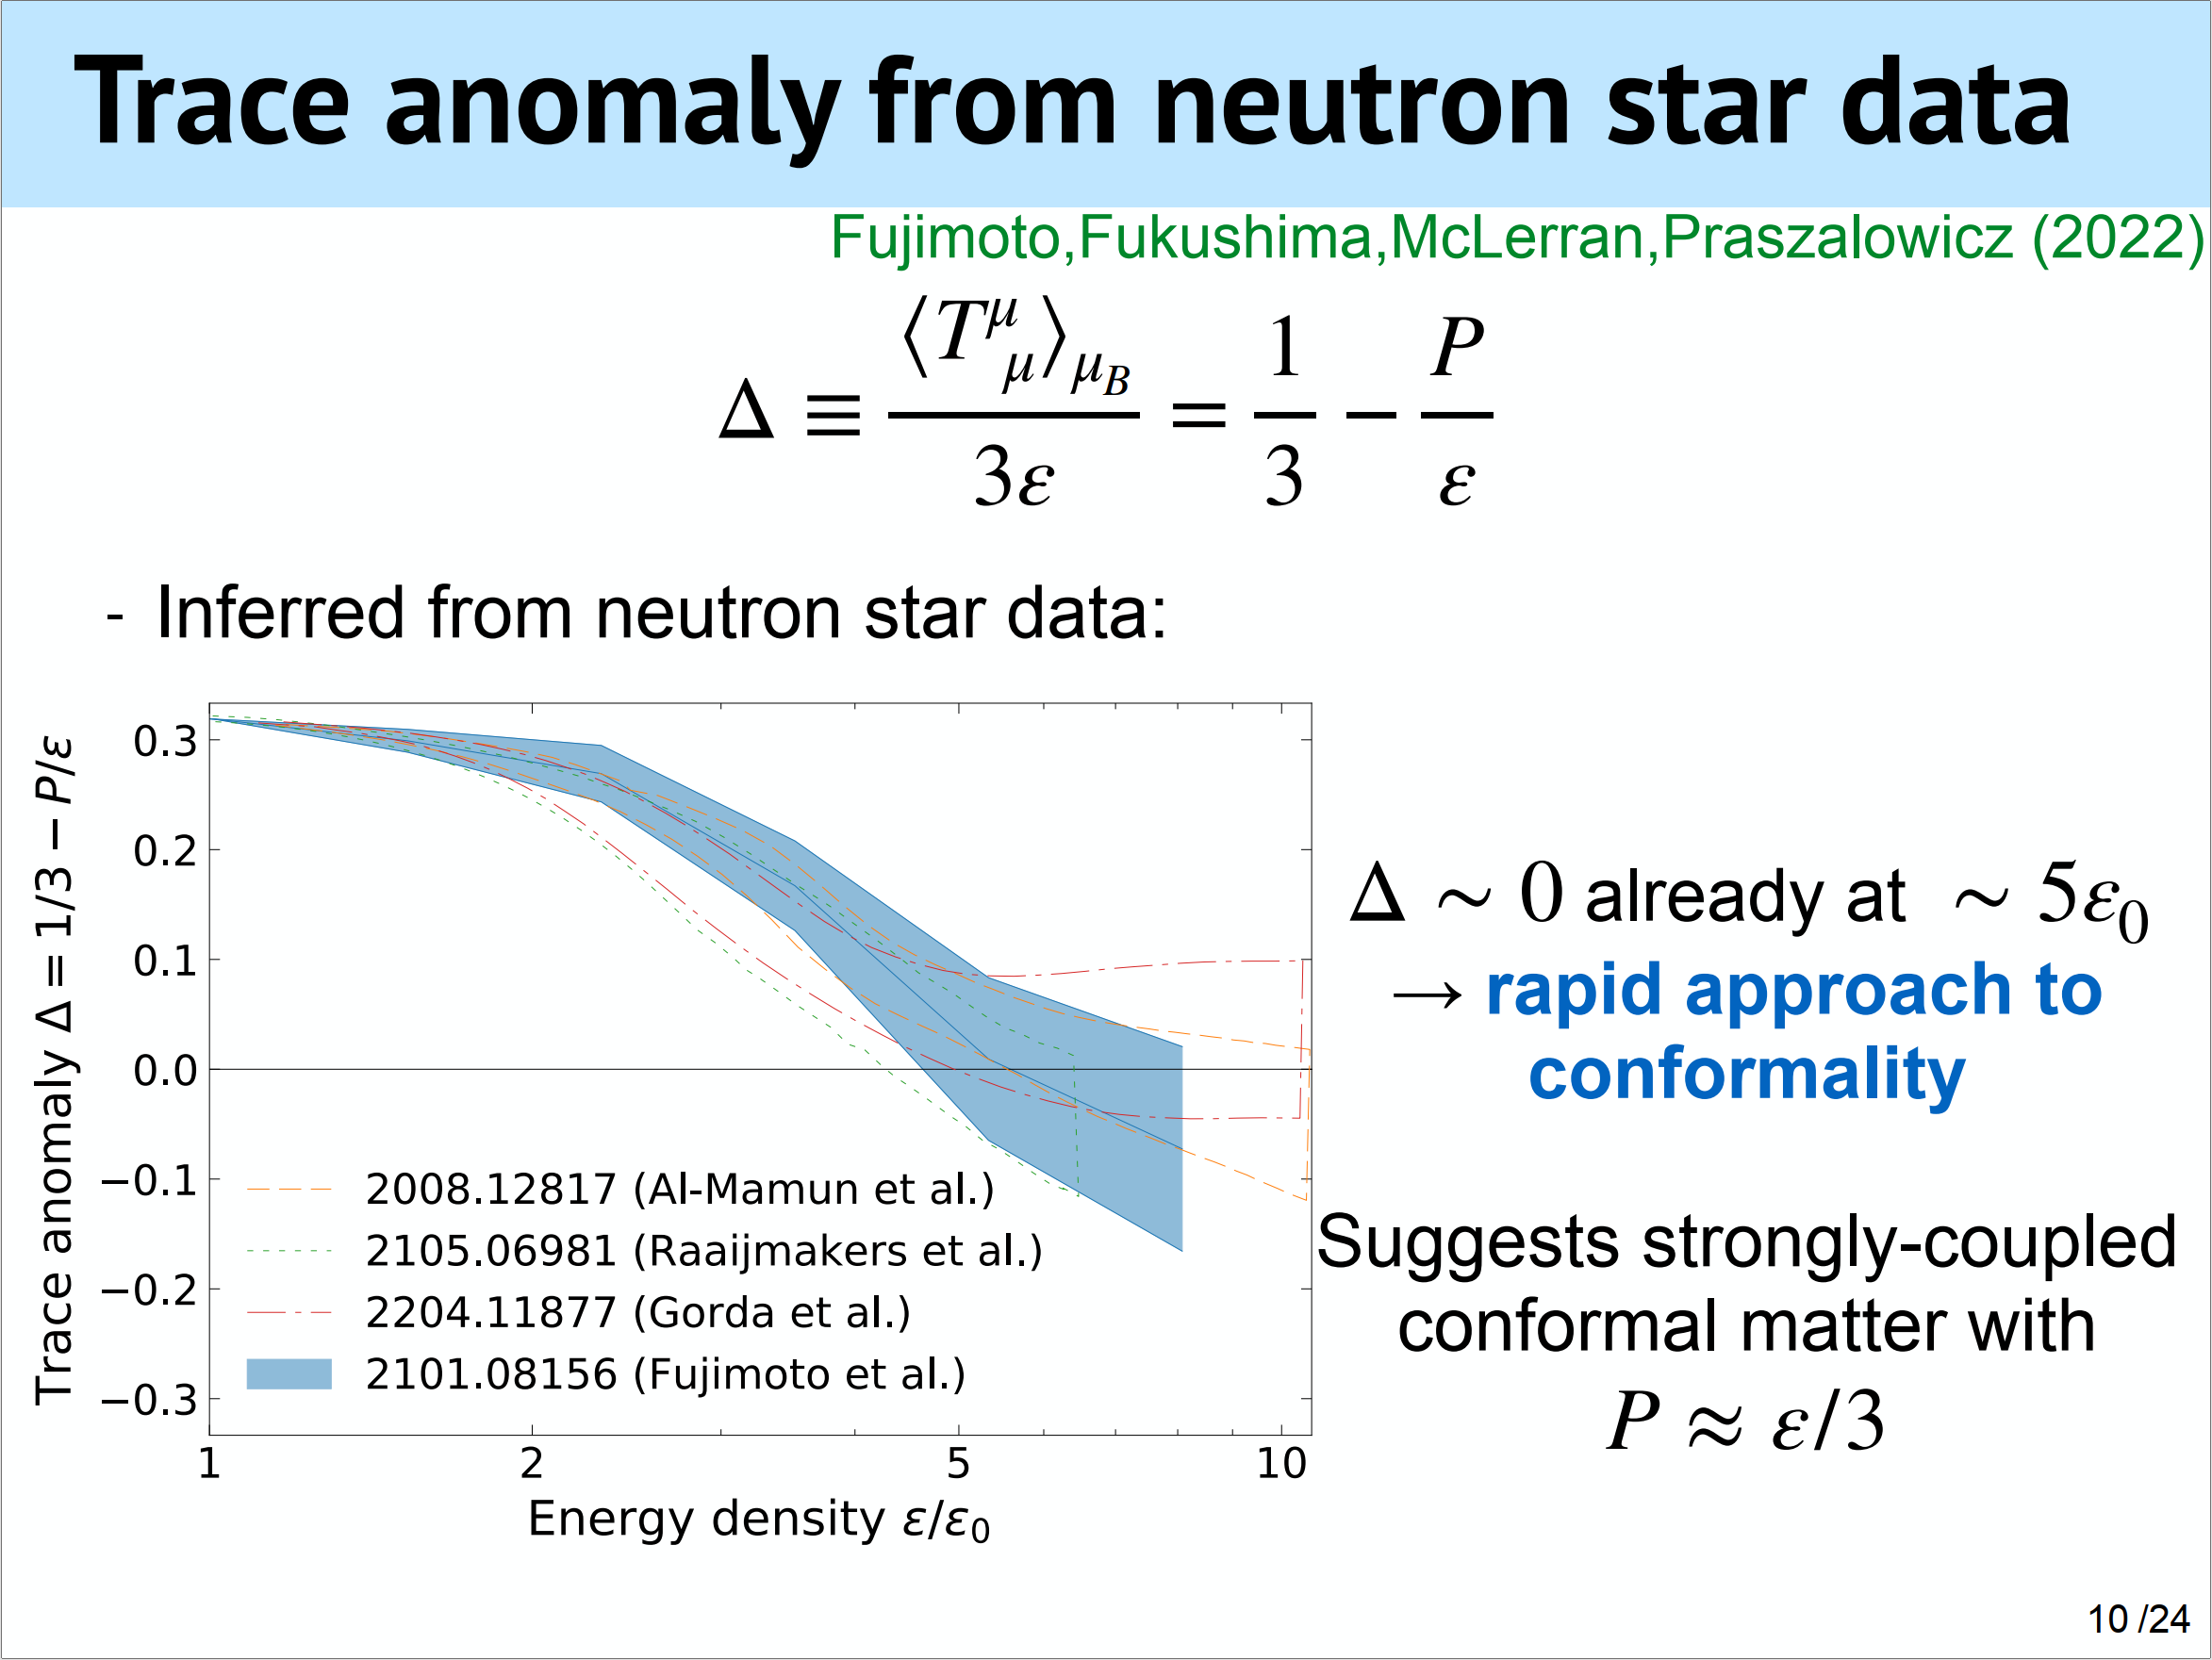

Slide 14
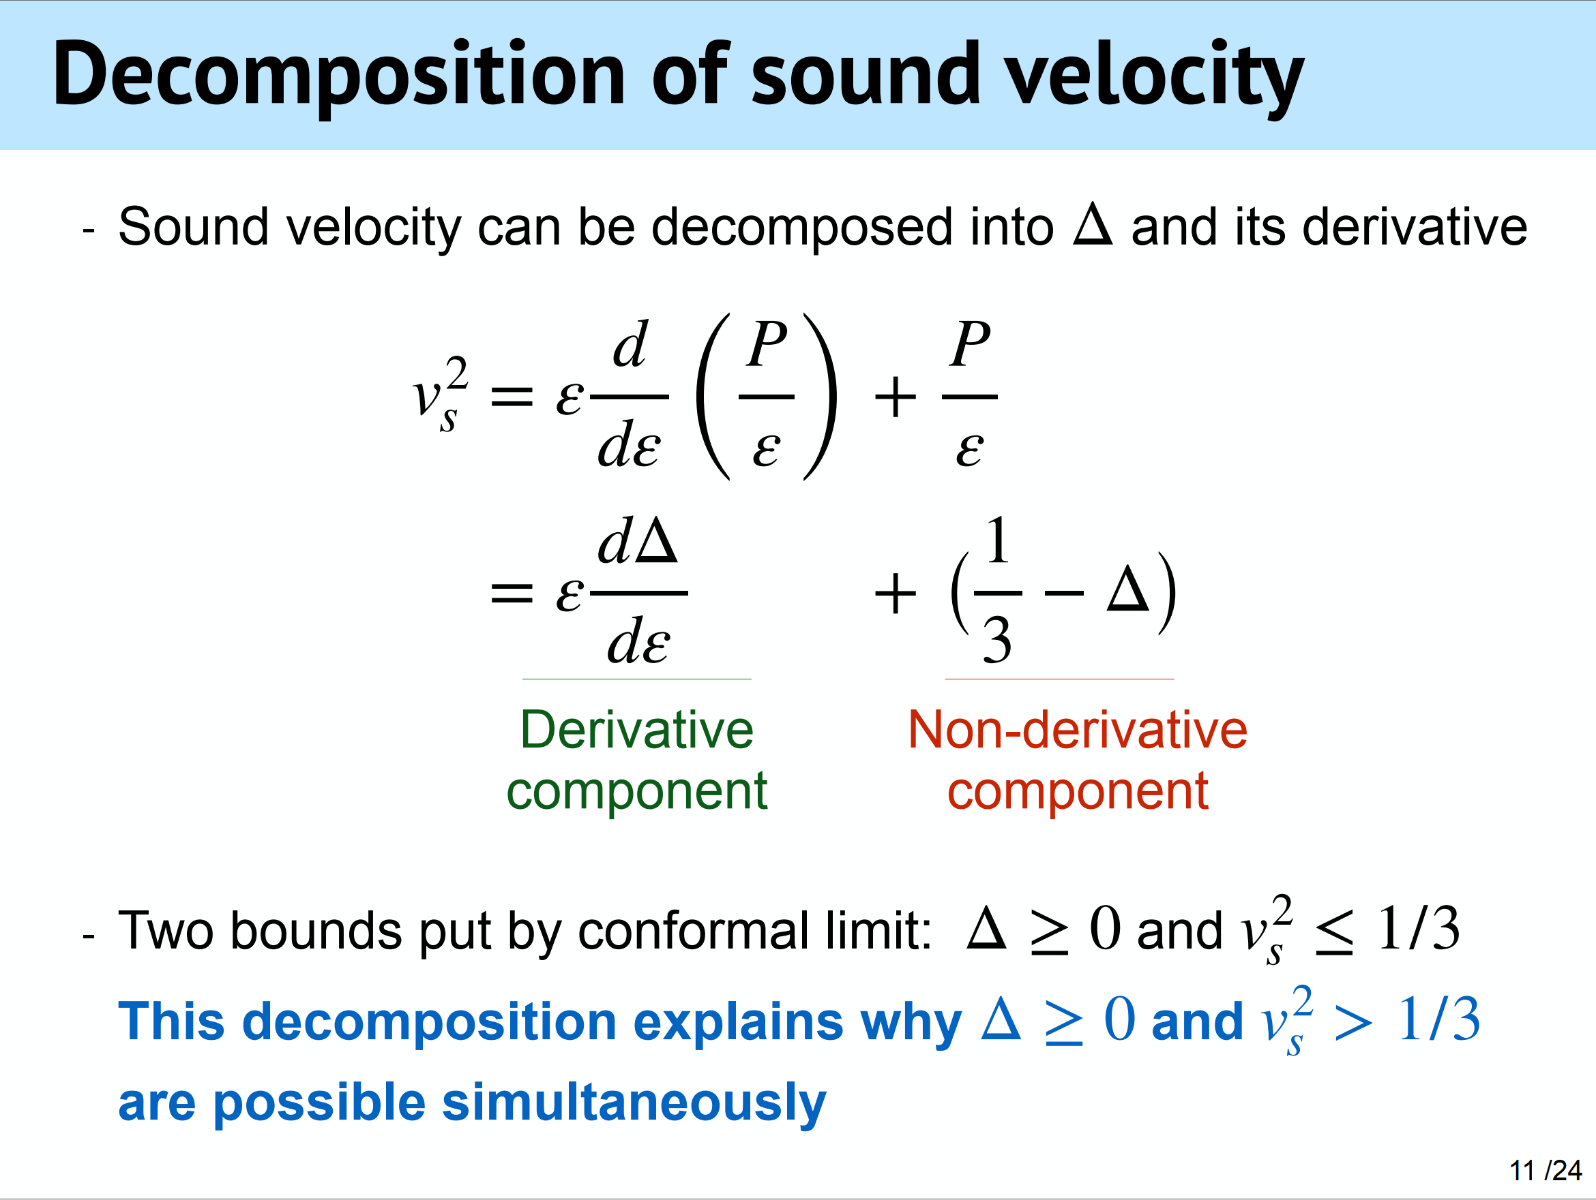

Slide 15
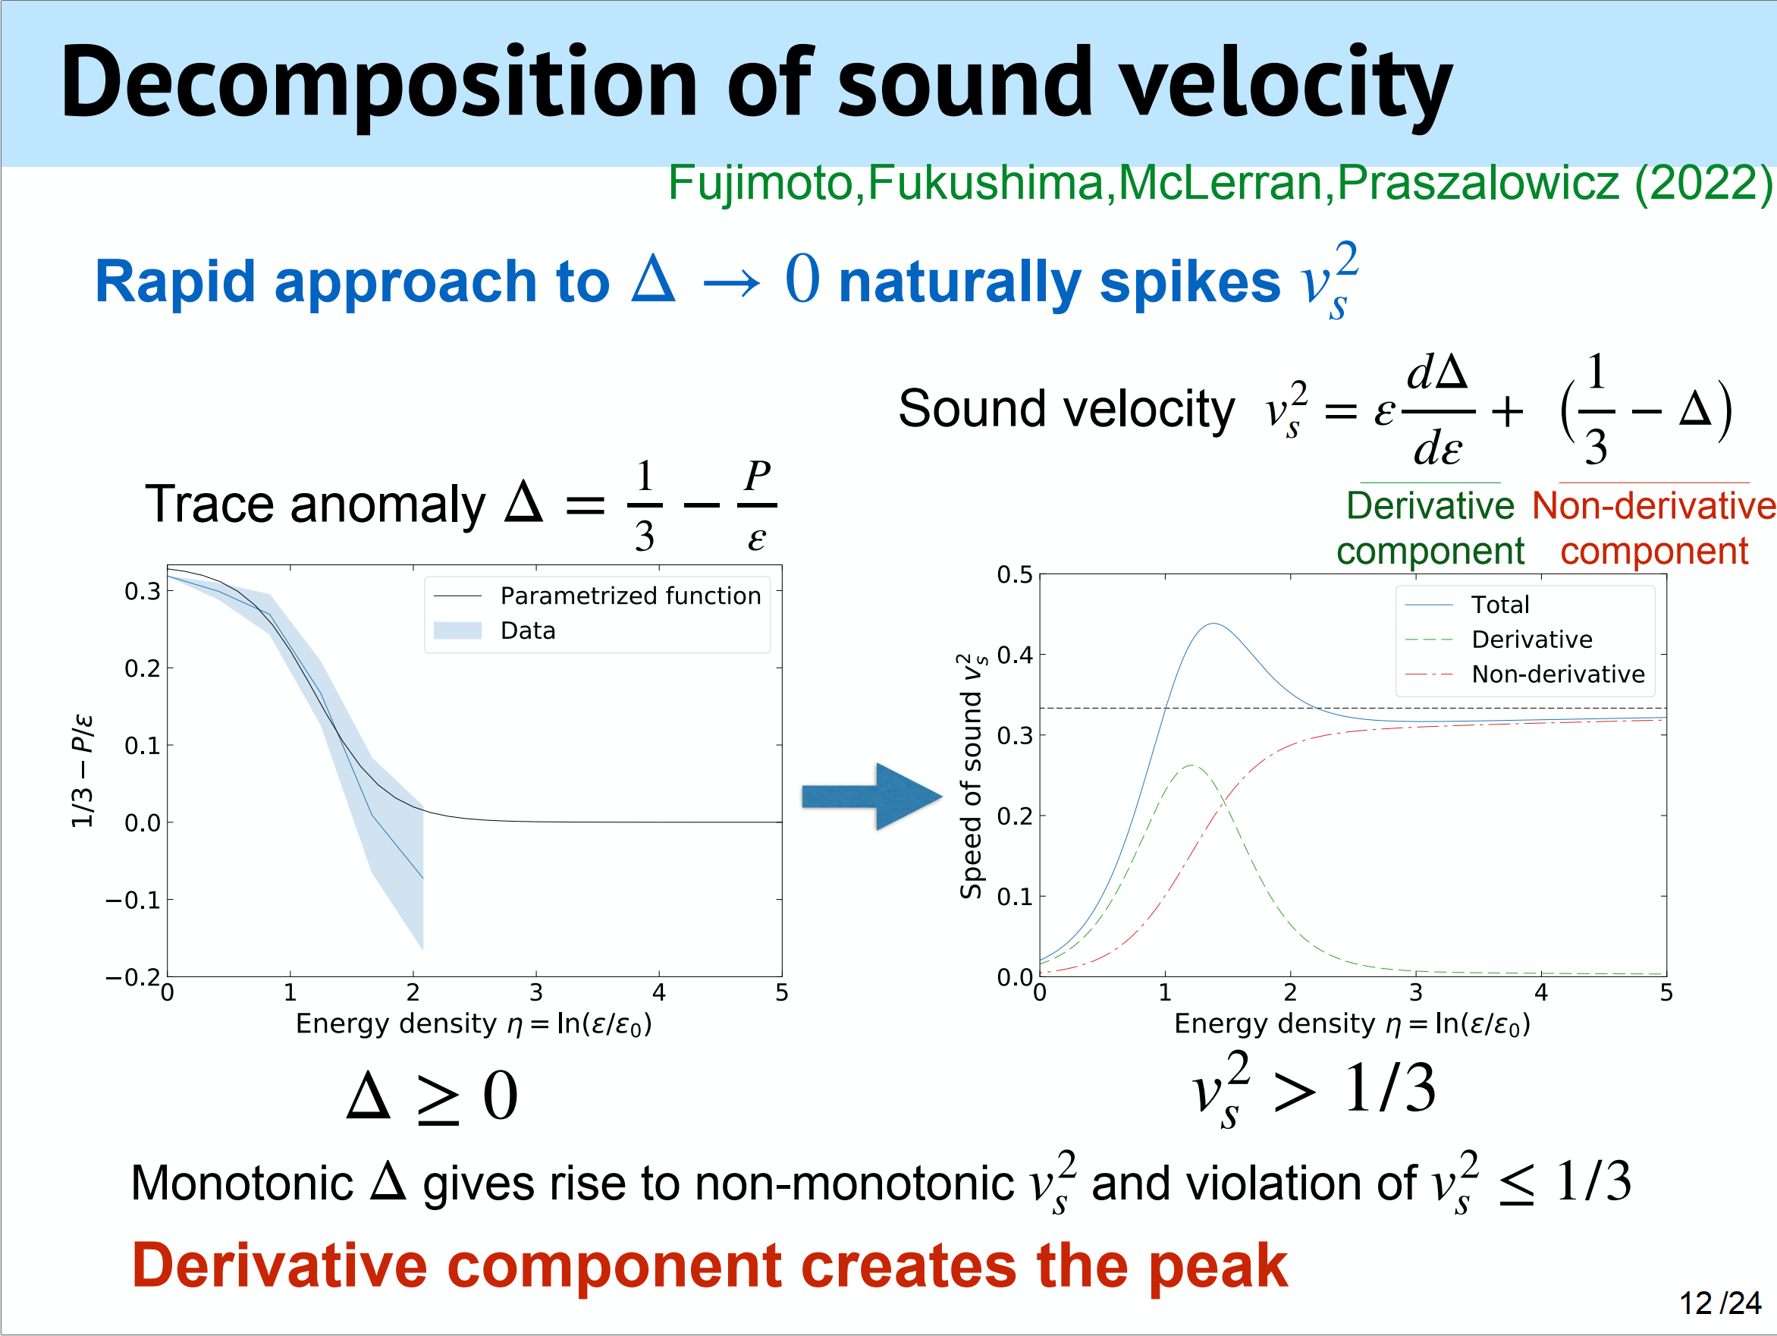

Slide 16
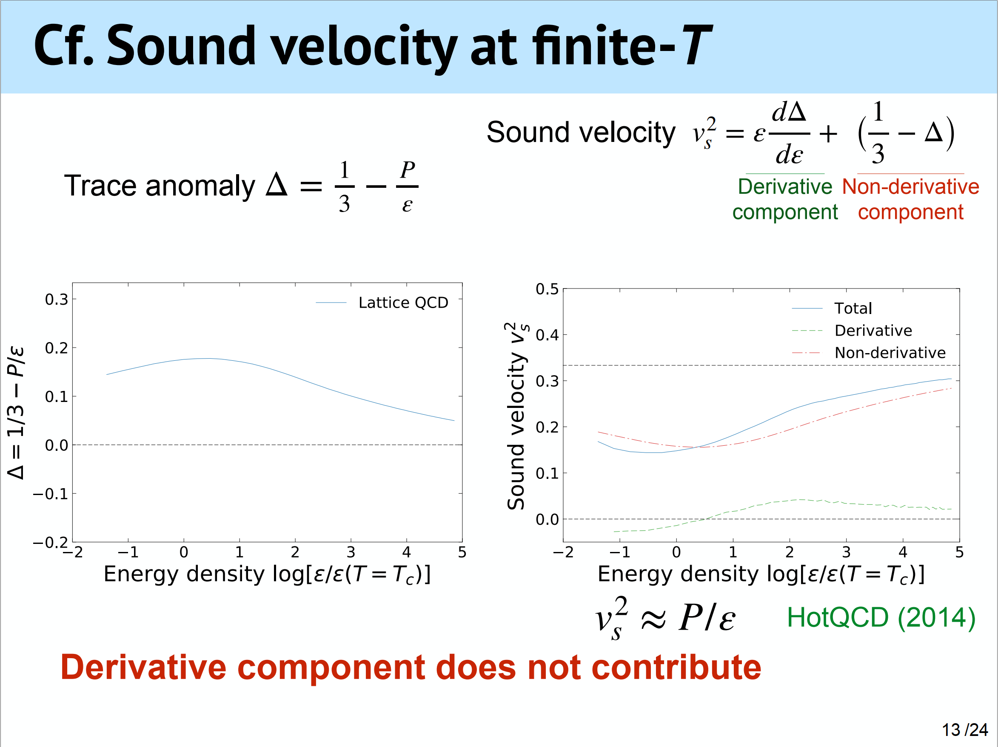

Slide 17
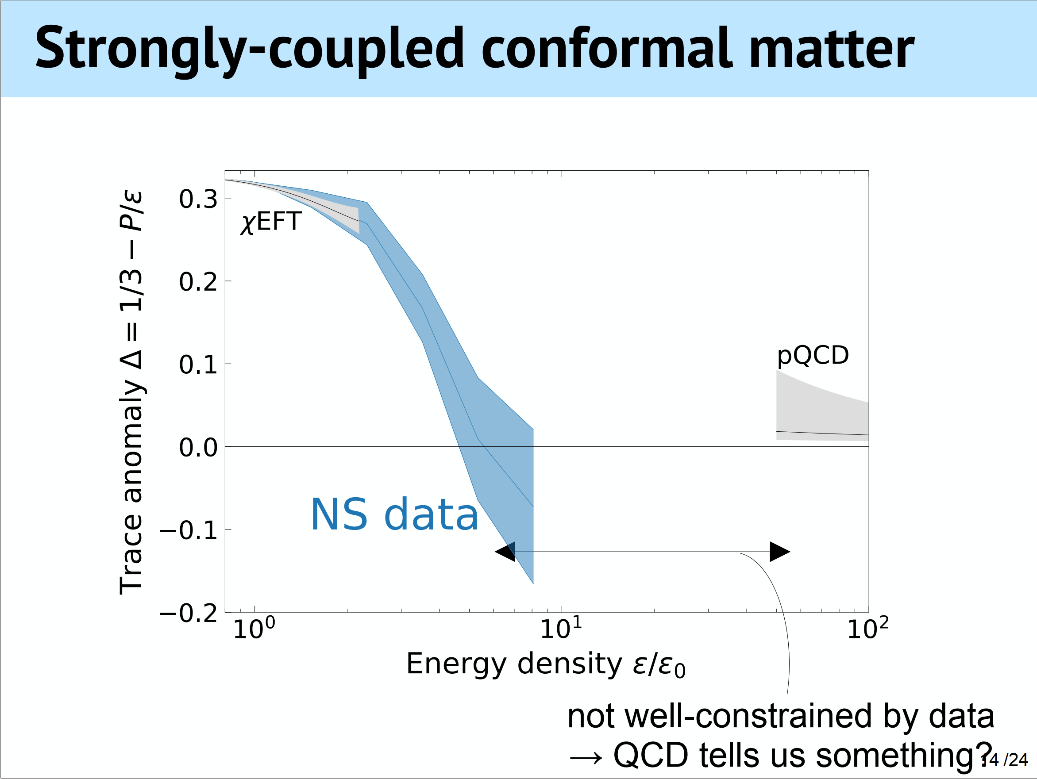

Slide 18
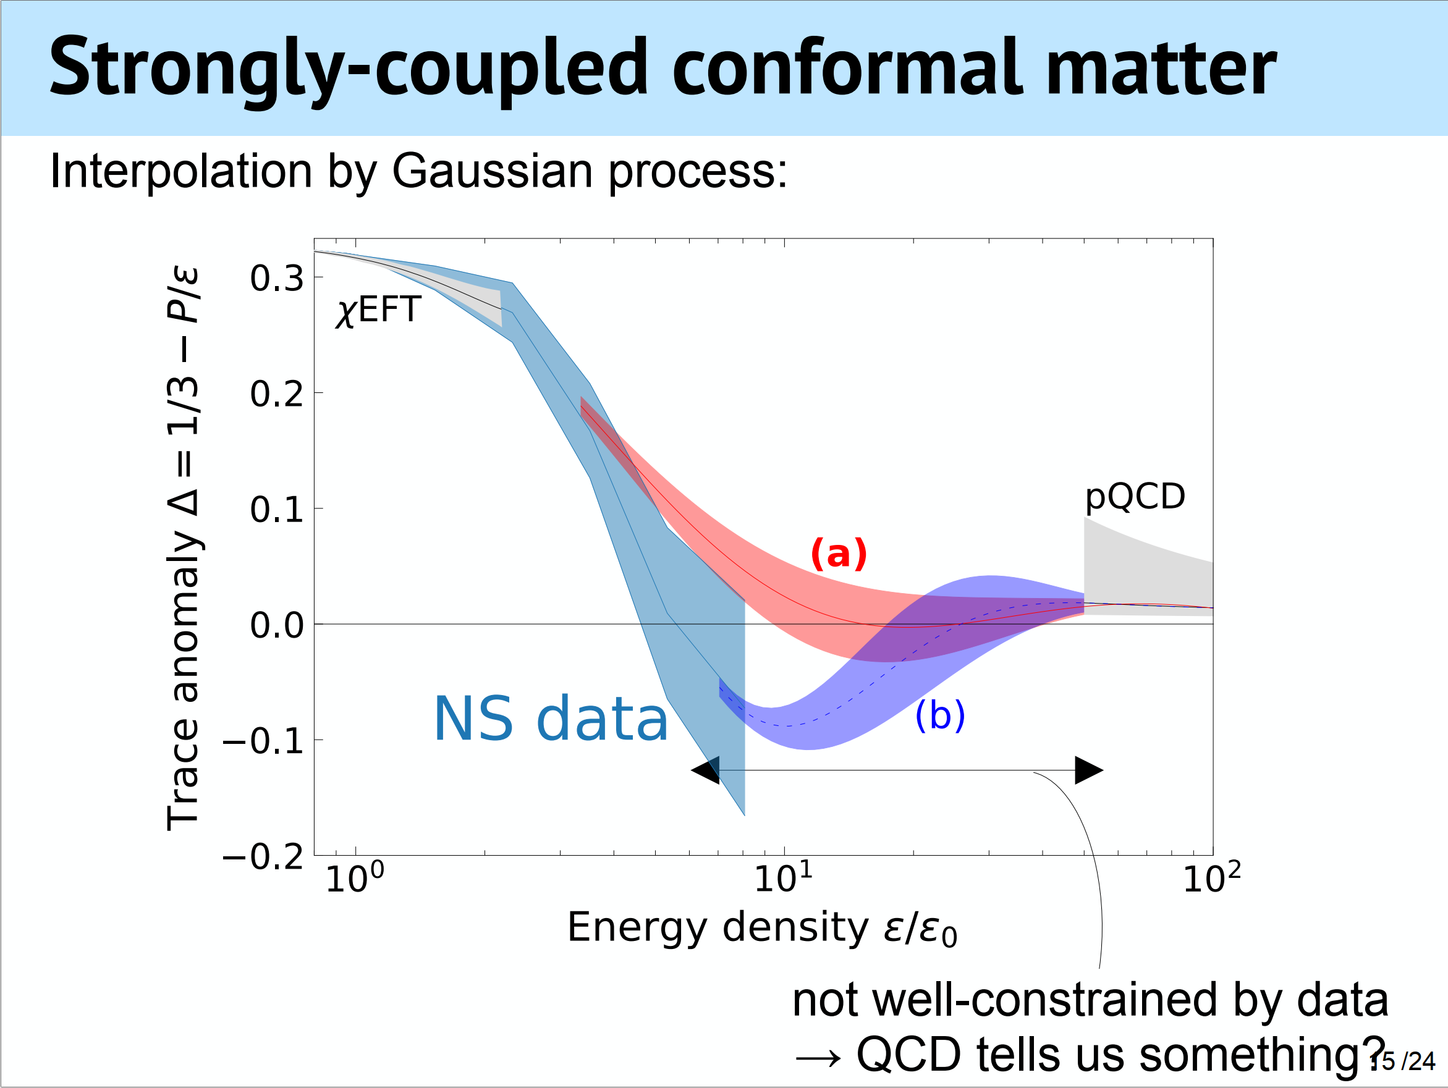

Slide 19
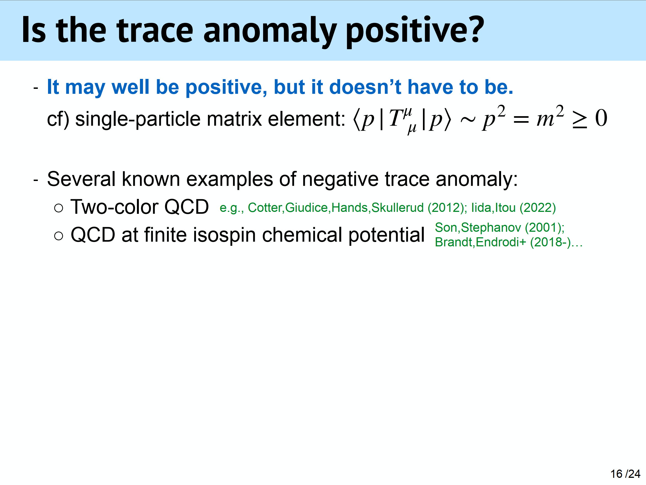

Slide 20
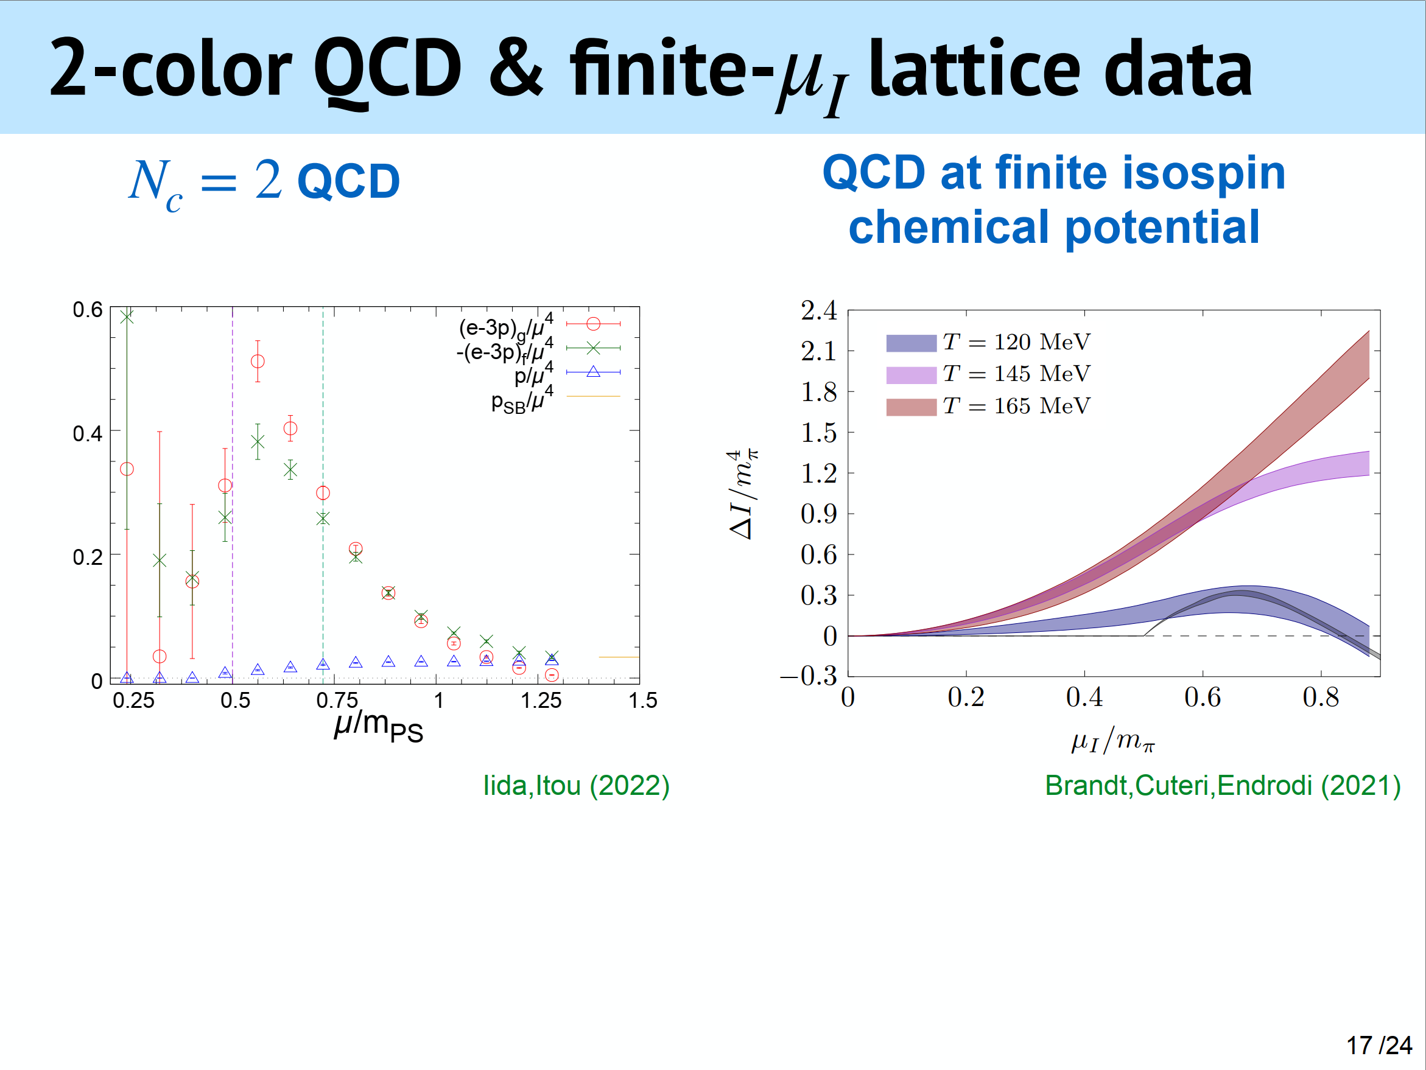

Slide 21
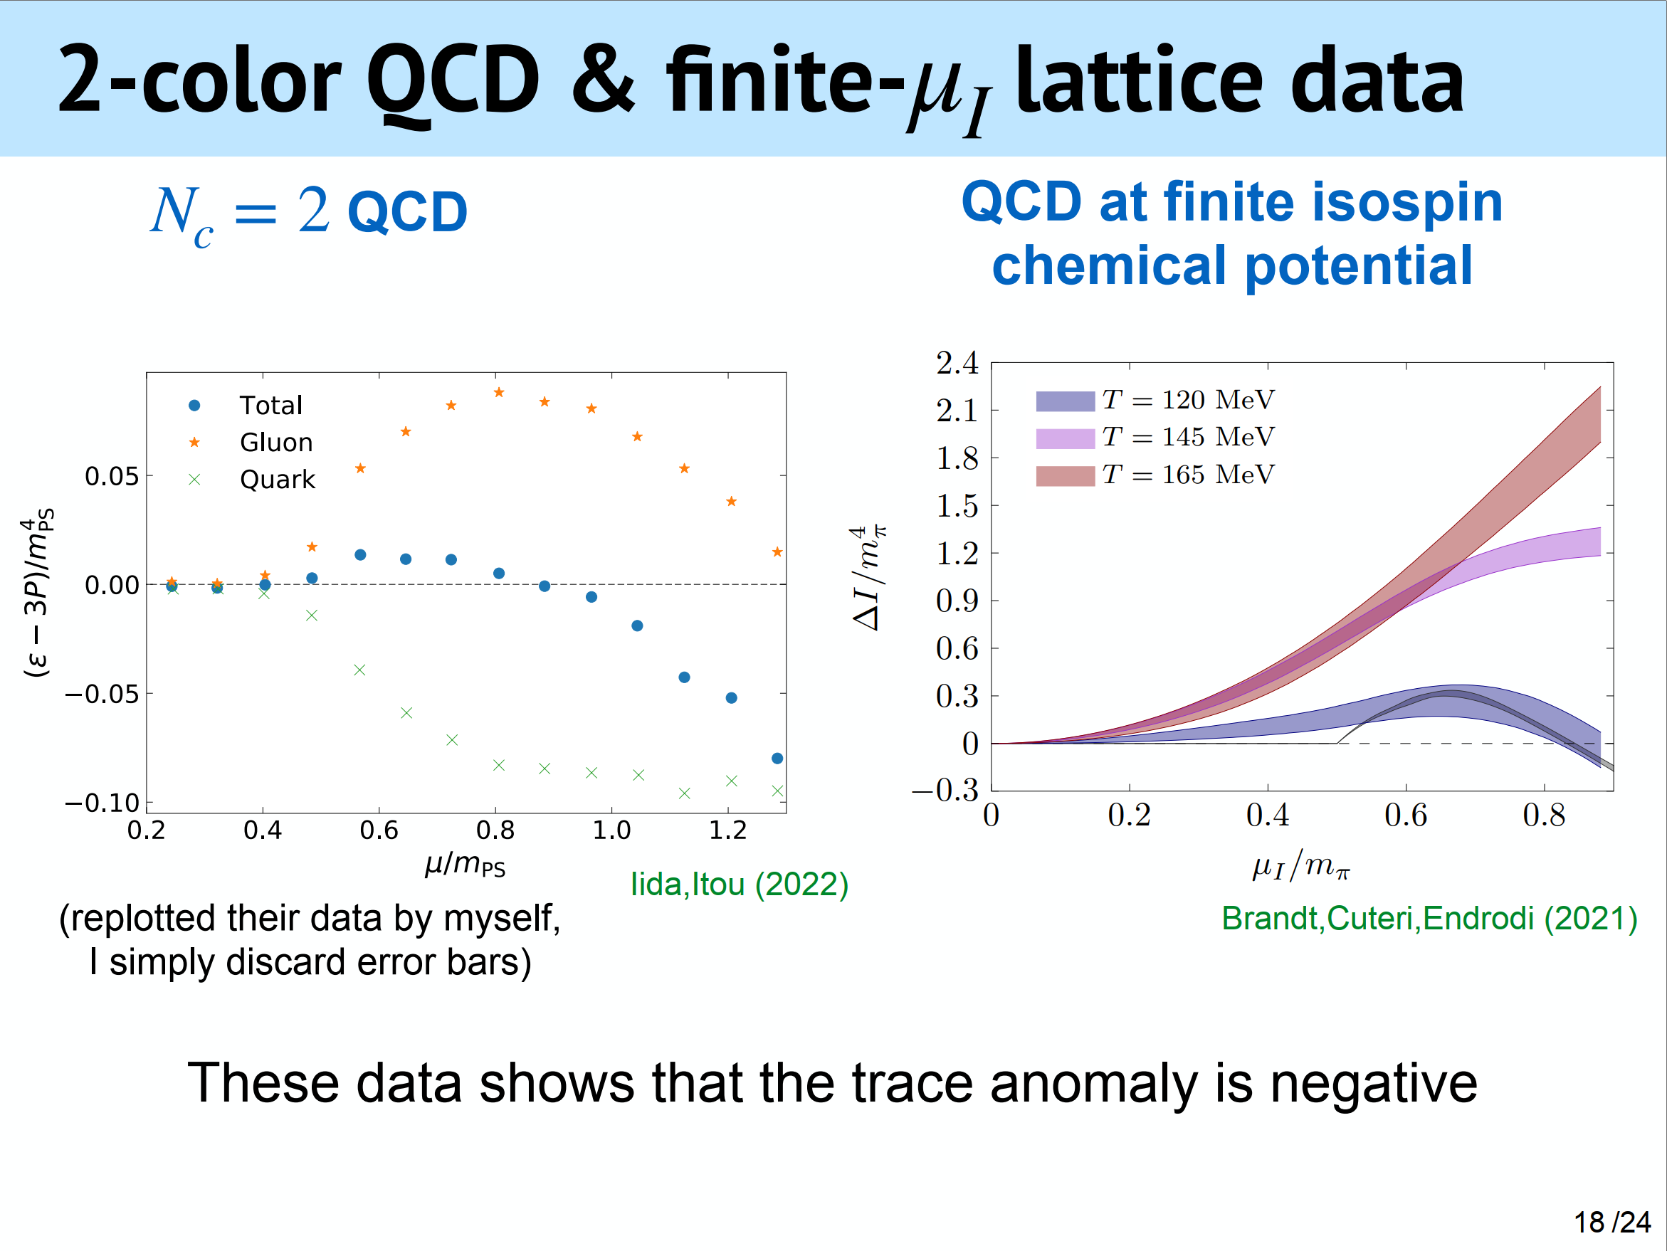

Slide 22
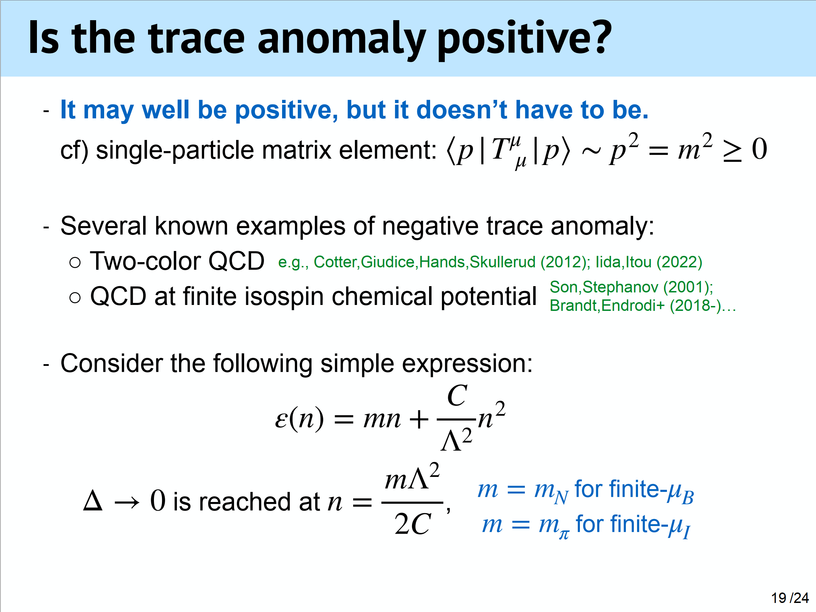

Slide 23
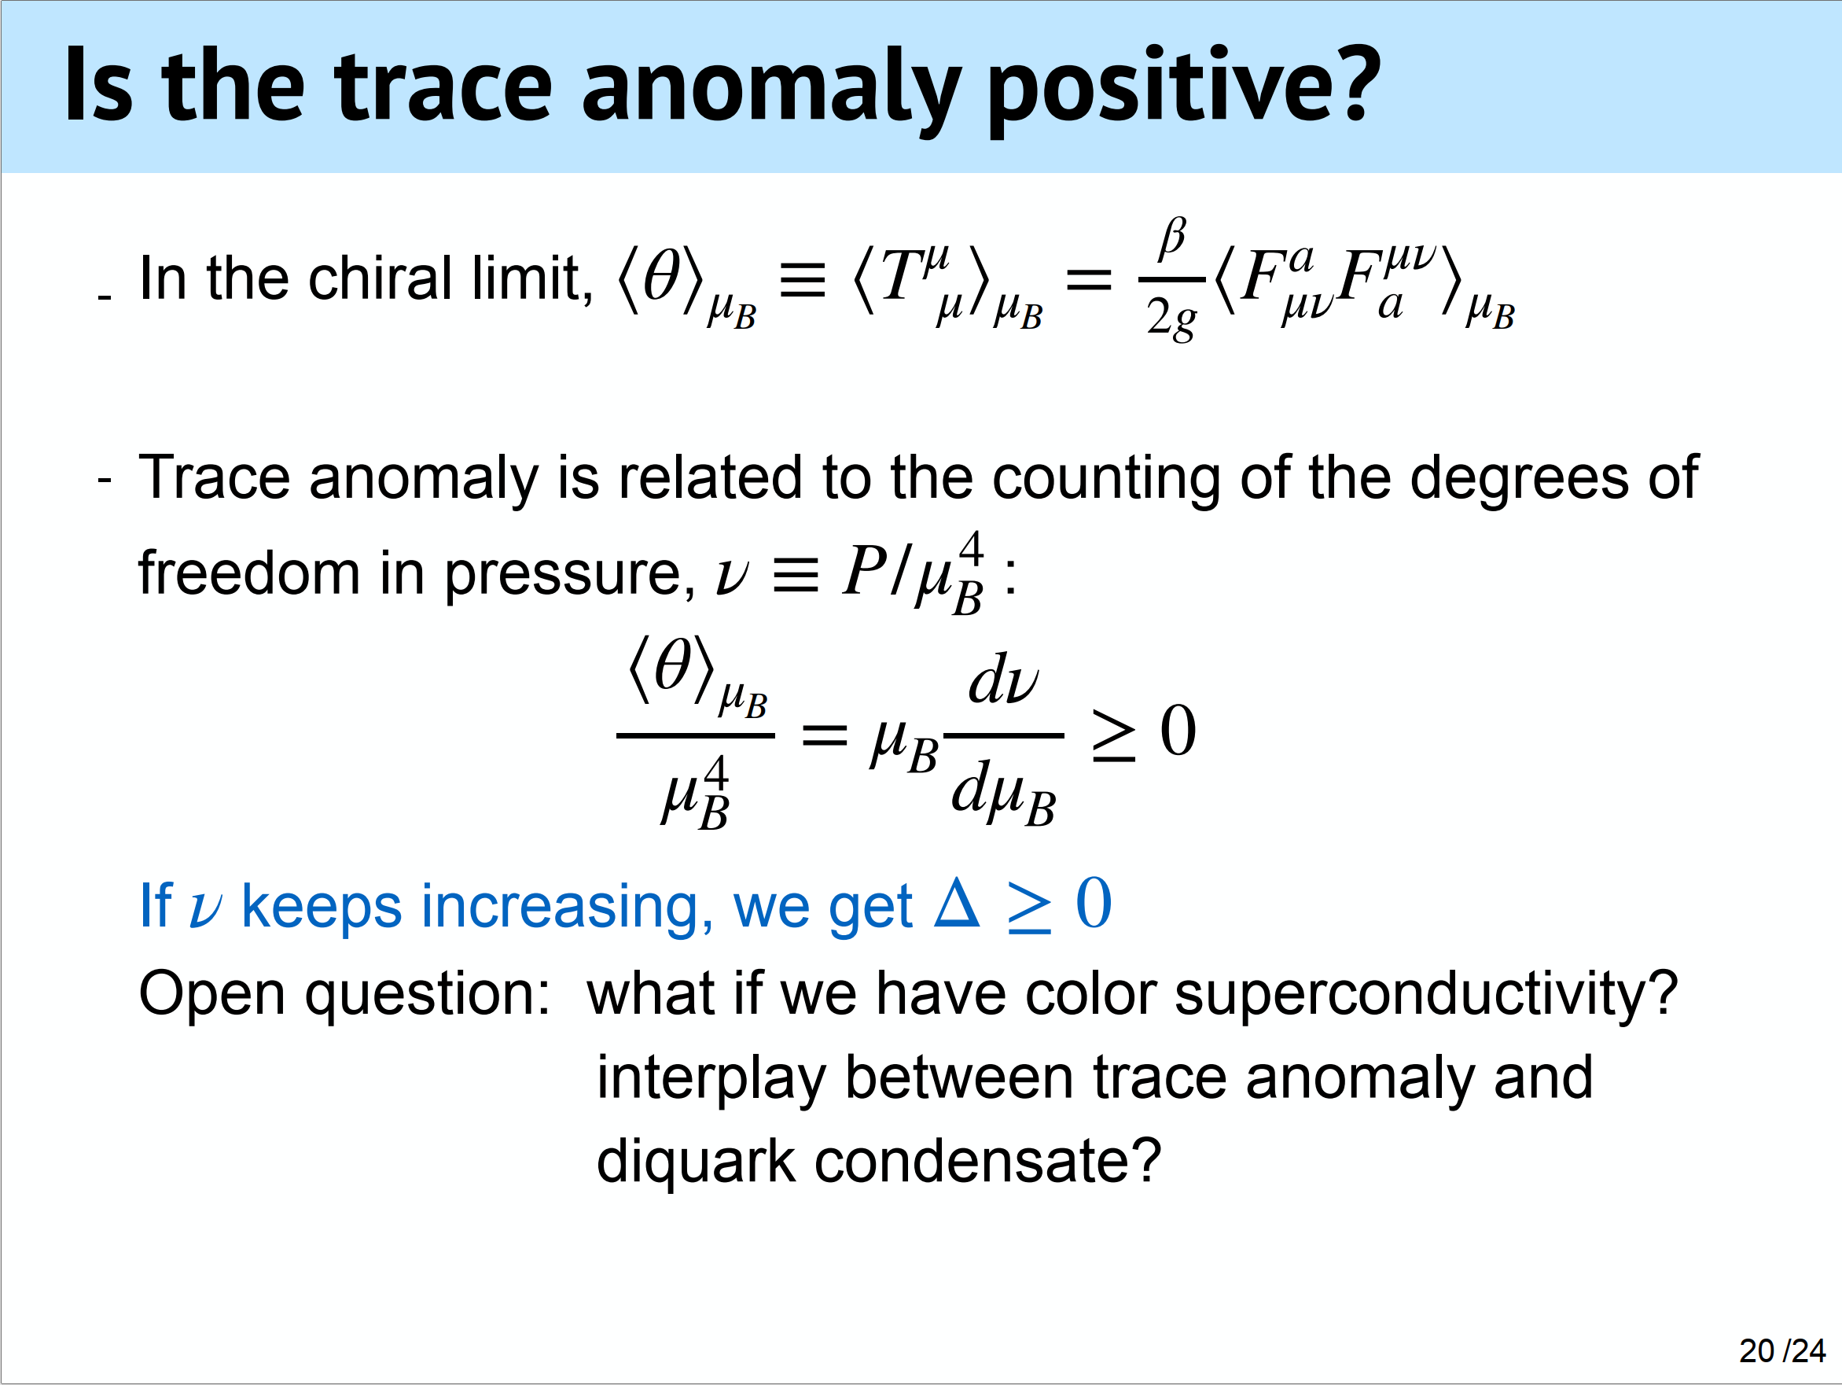

Slide 24
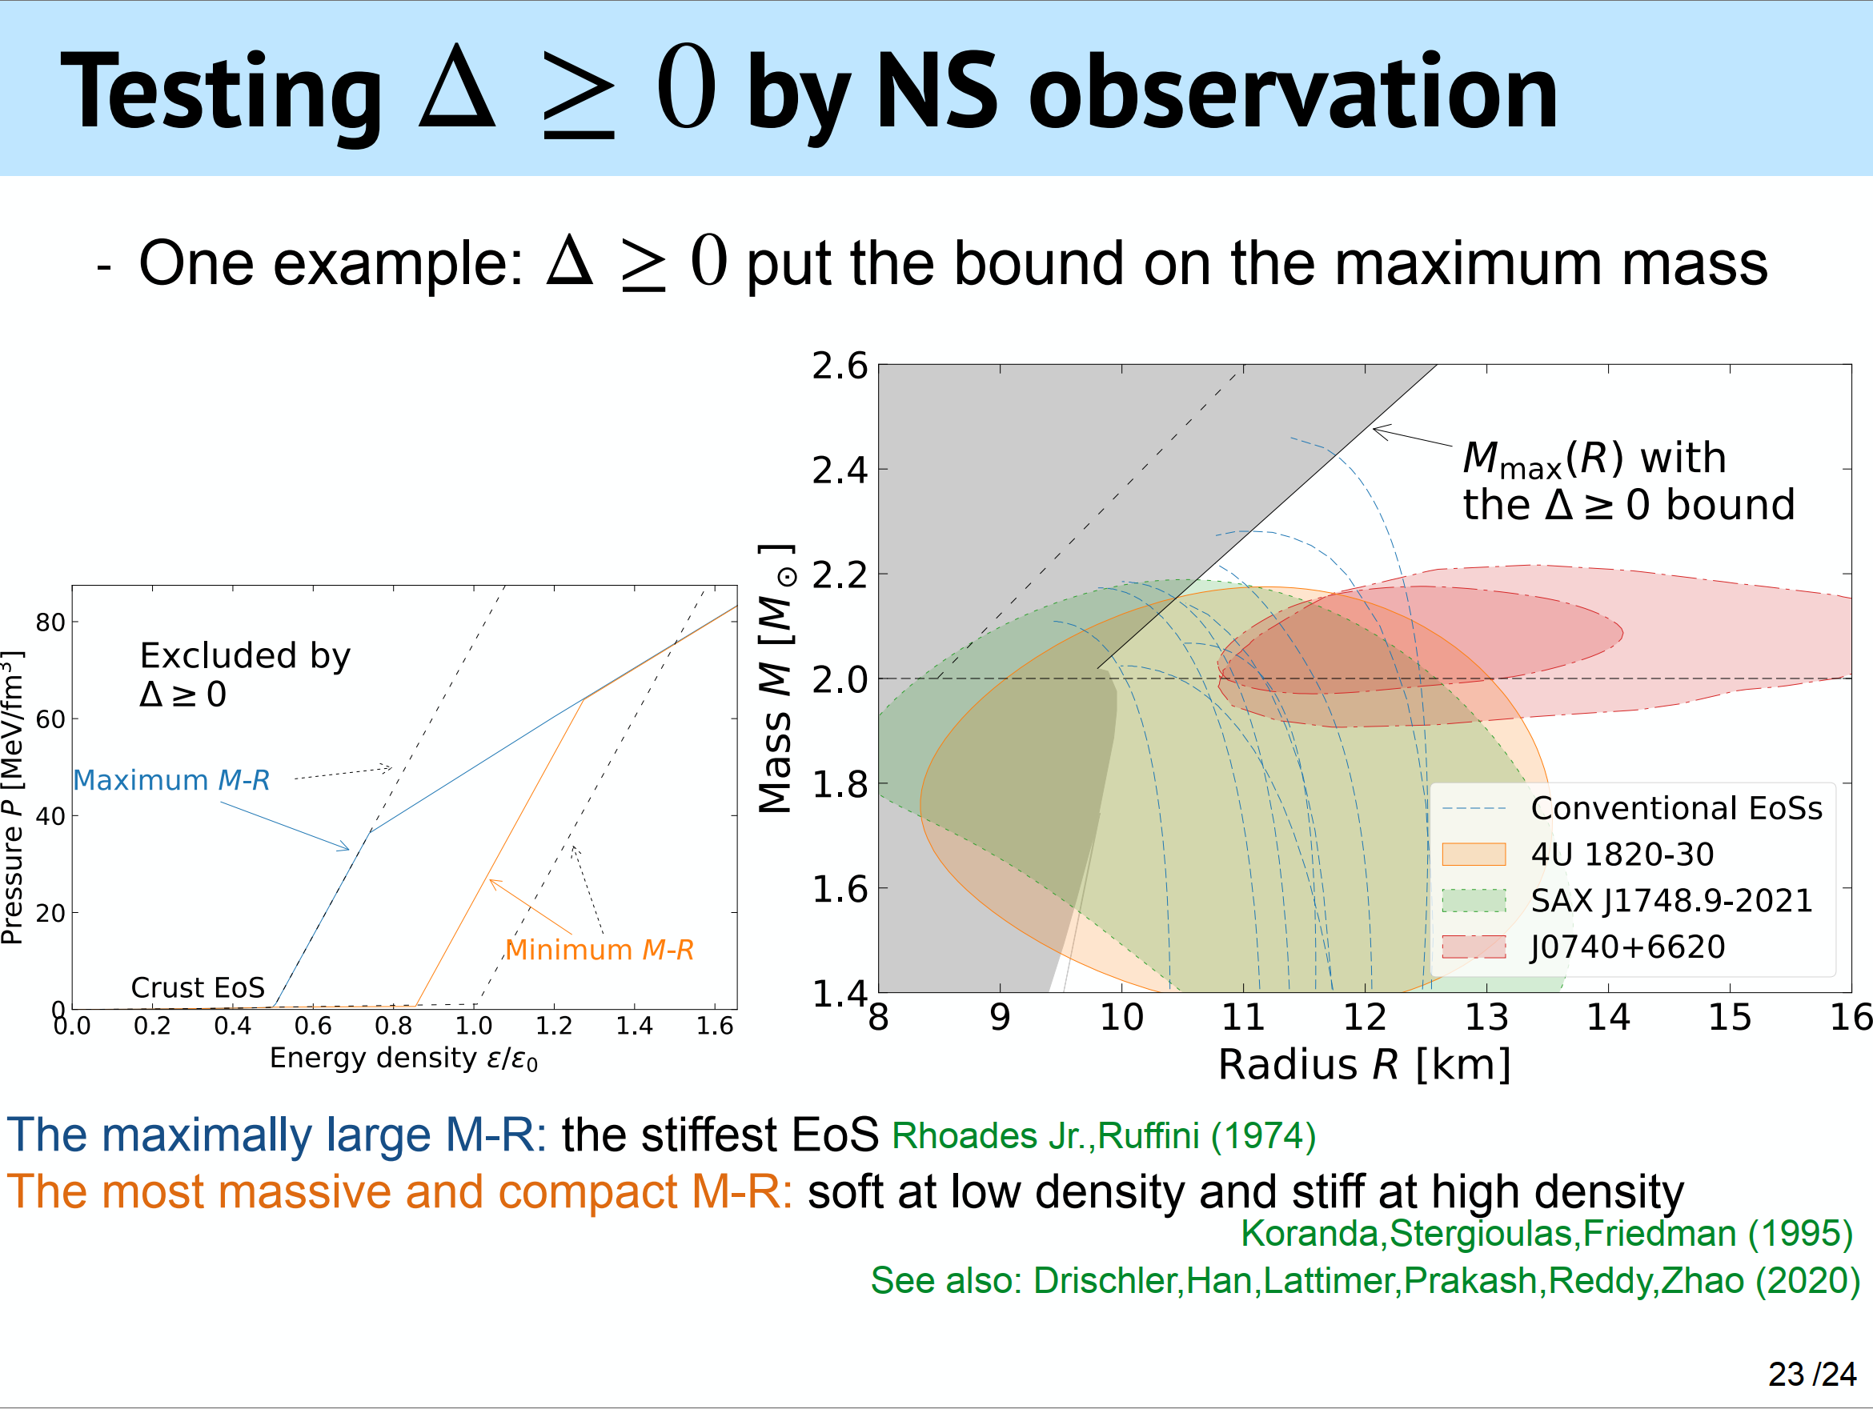

Slide 25
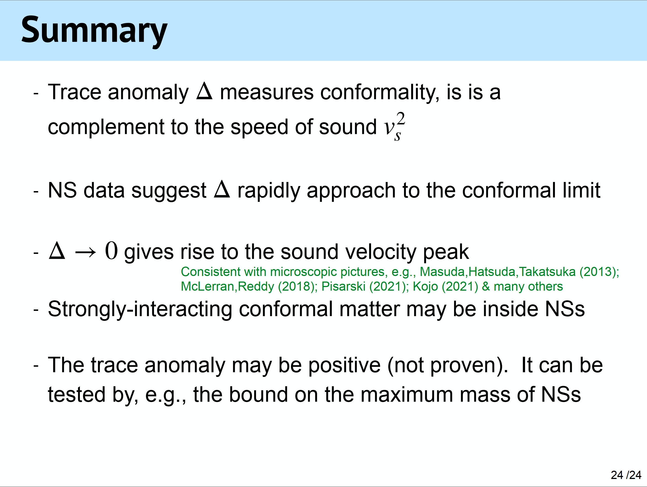

Slide 26
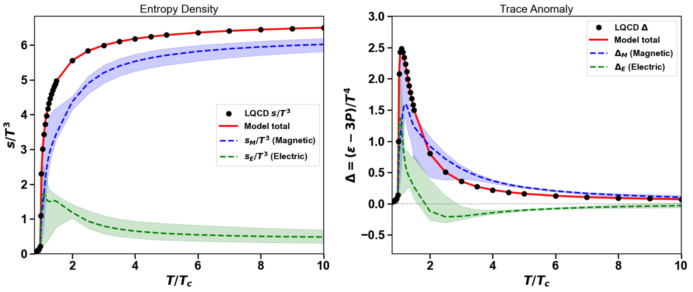


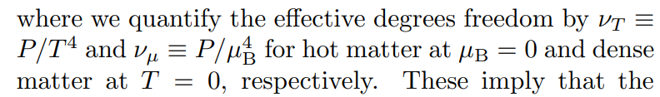
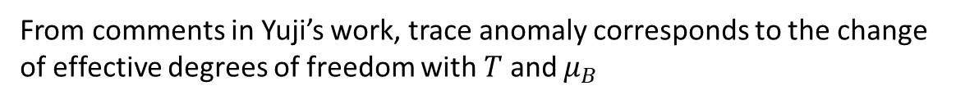
For our current work
Ideal gas
From comments in Yuji’s work, trace anomaly corresponds to the change of effective degrees of freedom with $T$ and $μ_{B}$
For gluon system
T
Polarization modes:
3
2
Transverse modes (chromo-elec) vanishing

