Slide 1
Update on GAGG
Zhiyang Yuan (Peking University)，Chencheng Feng (Peking University)

Slide 2
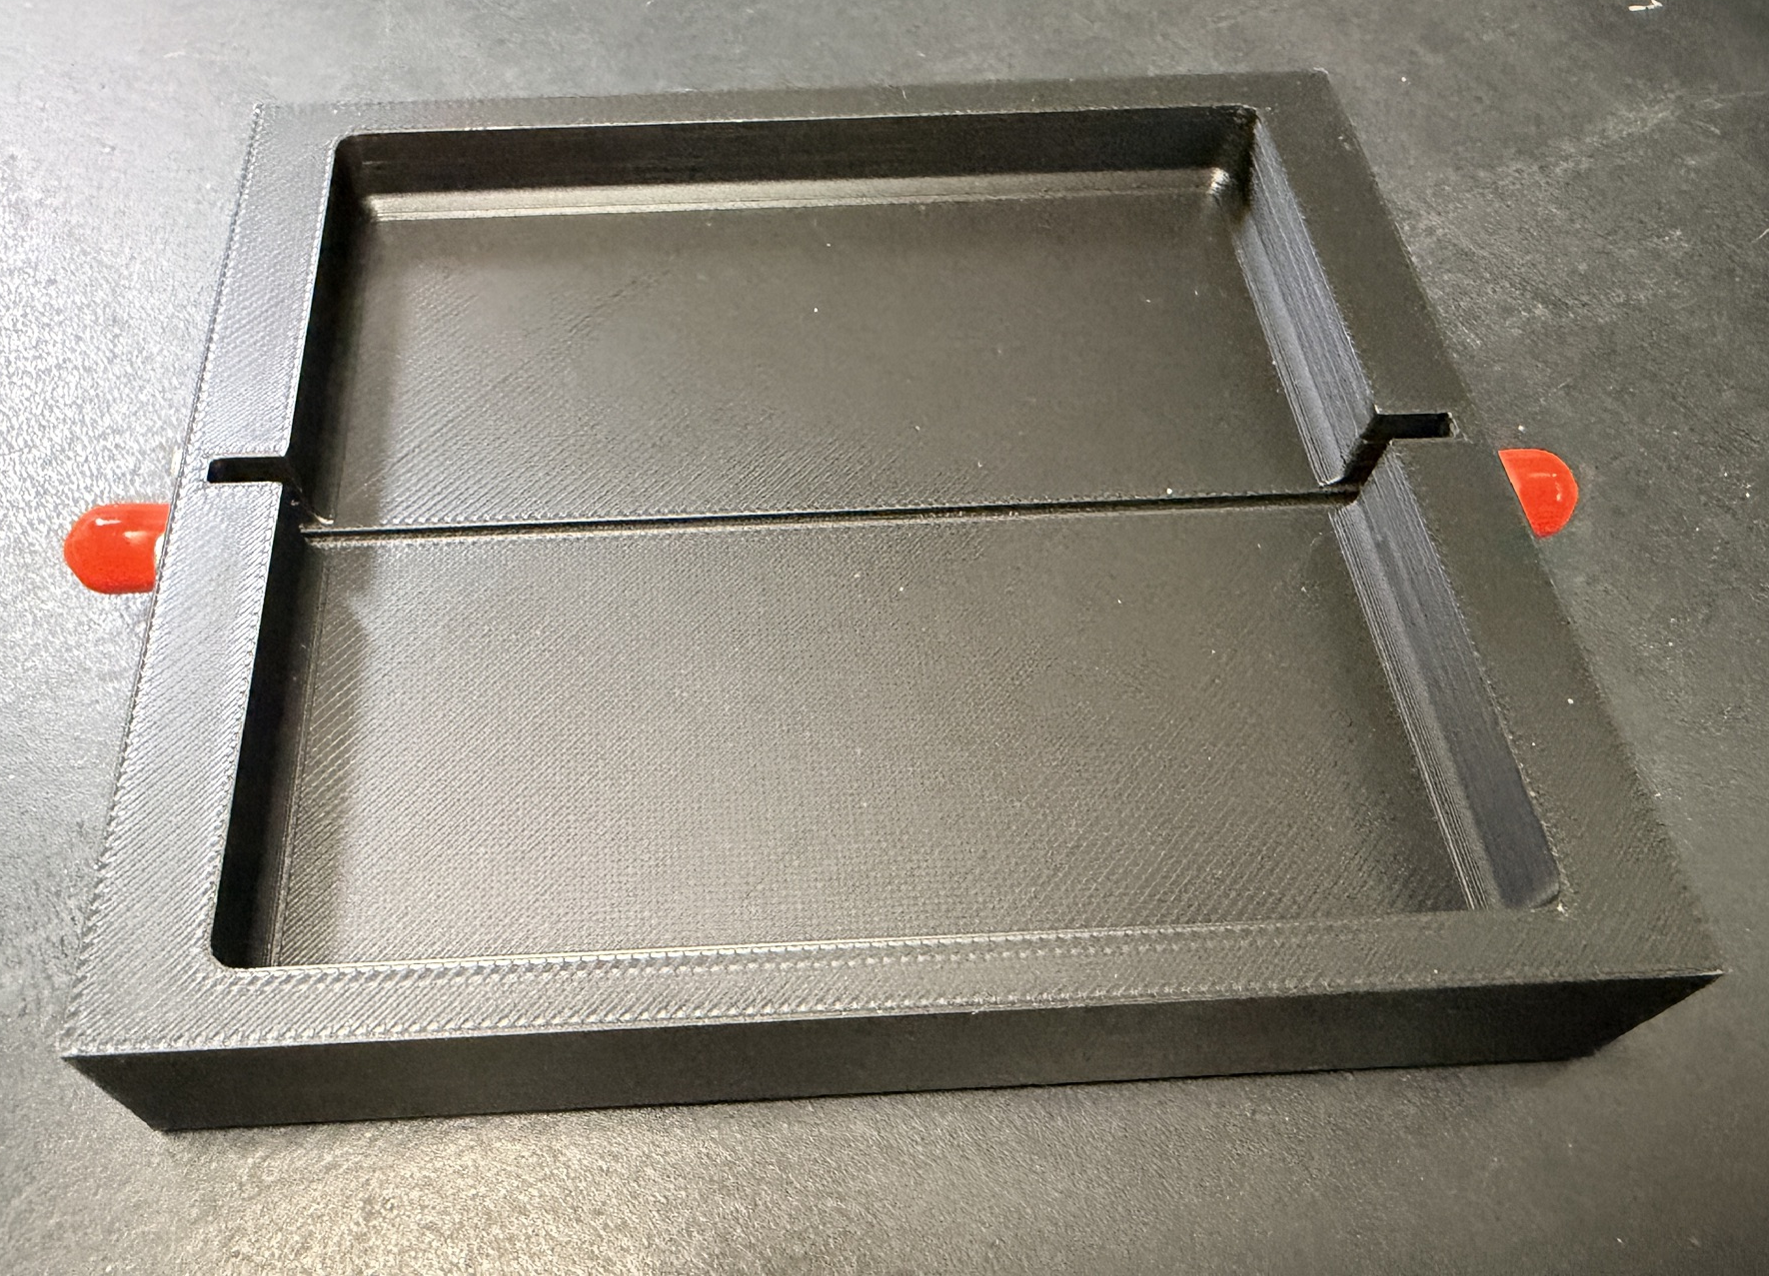
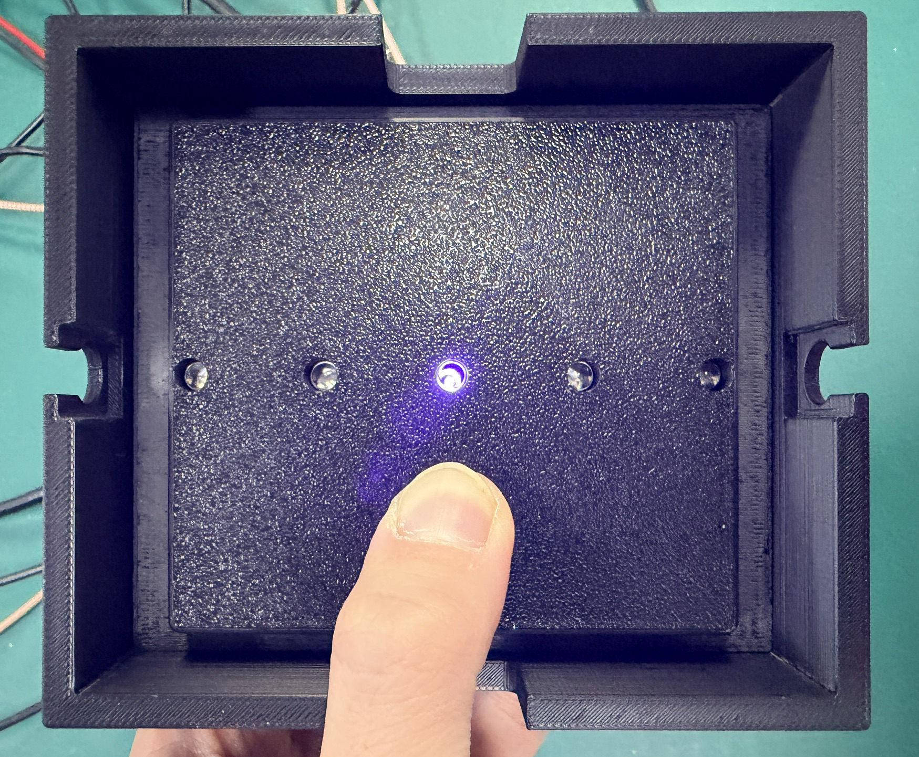
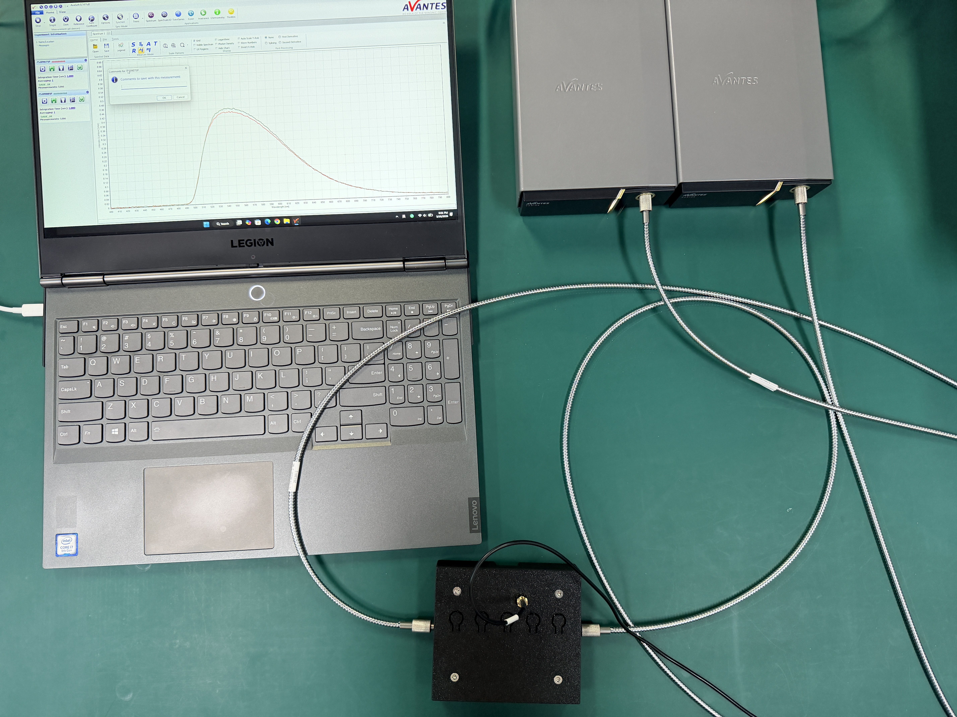
Attenuation length: bench
Five 430nm LEDs (VISHAY THLB5800) at fixed positions 10,30,50,70,90 mm
From one end, excite scintillations. Used in DC mode, fired one by one;
Two SMA905 fiber connector at the two ends of a fiber;
Use a 5V power supply for LEDs and a dual channel spectrometer(AvaSpec VRS2048);

Slide 3
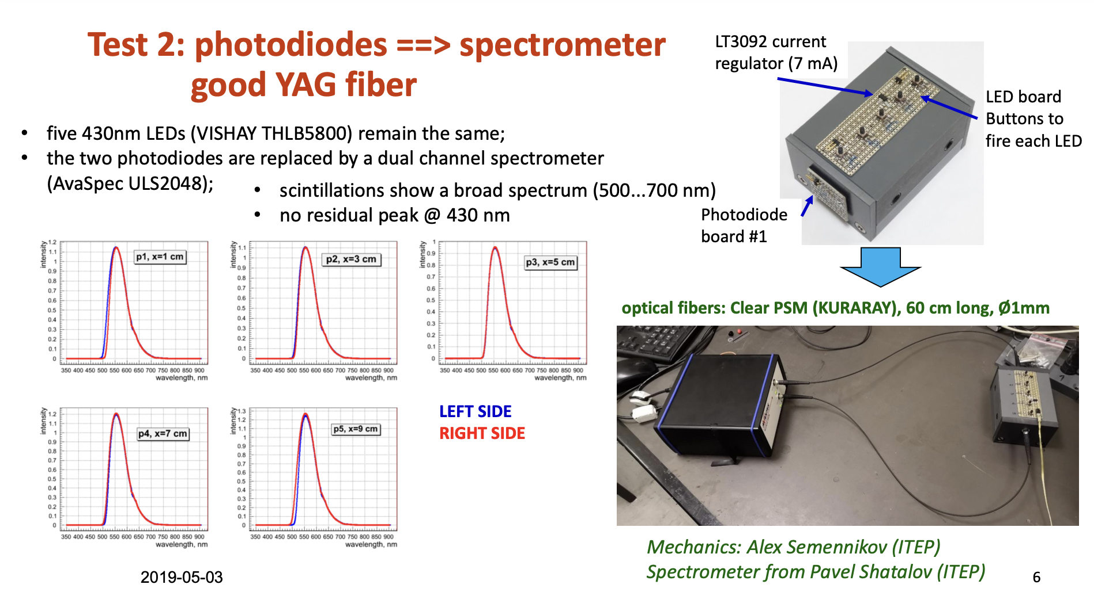
Attenuation length: bench
More details in: https://indico.cern.ch/event/818222/contributions/3417315/attachments/1838192/3012620/fiberQCstudy.pdf

Slide 4
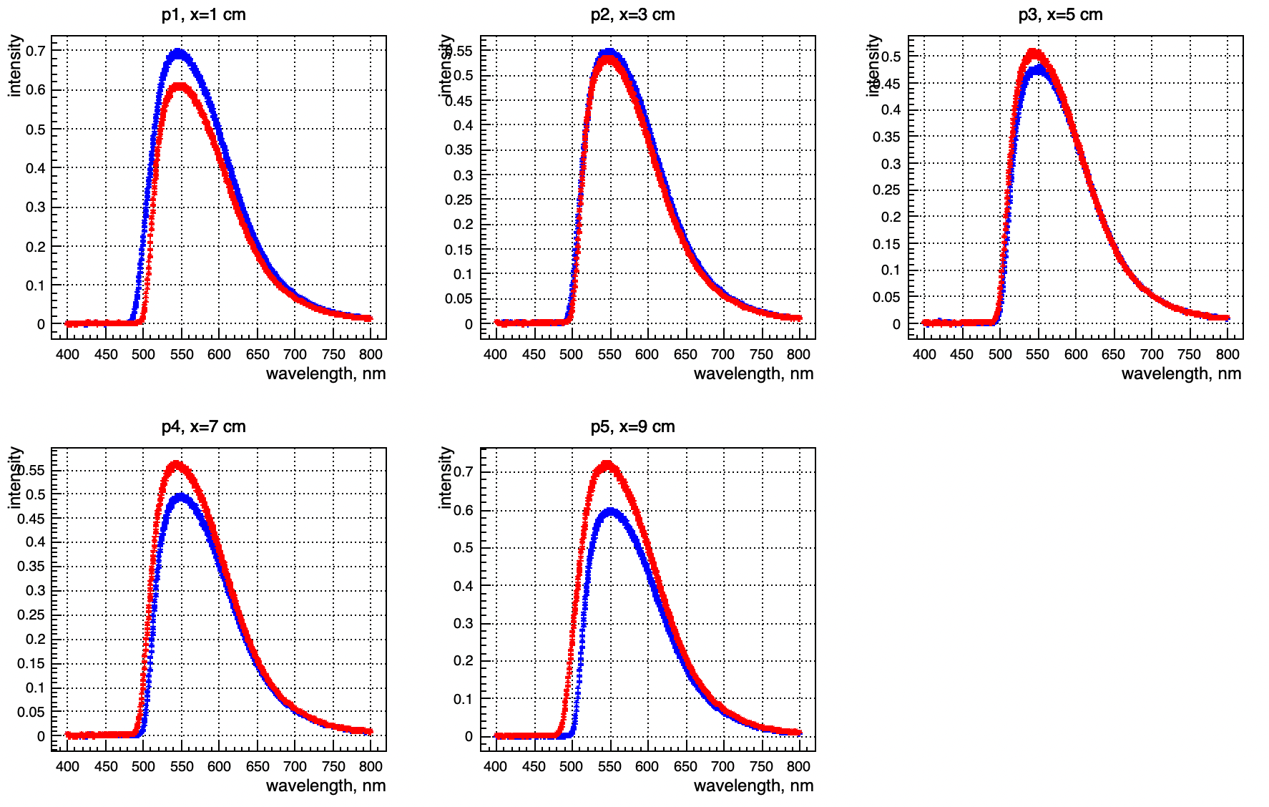
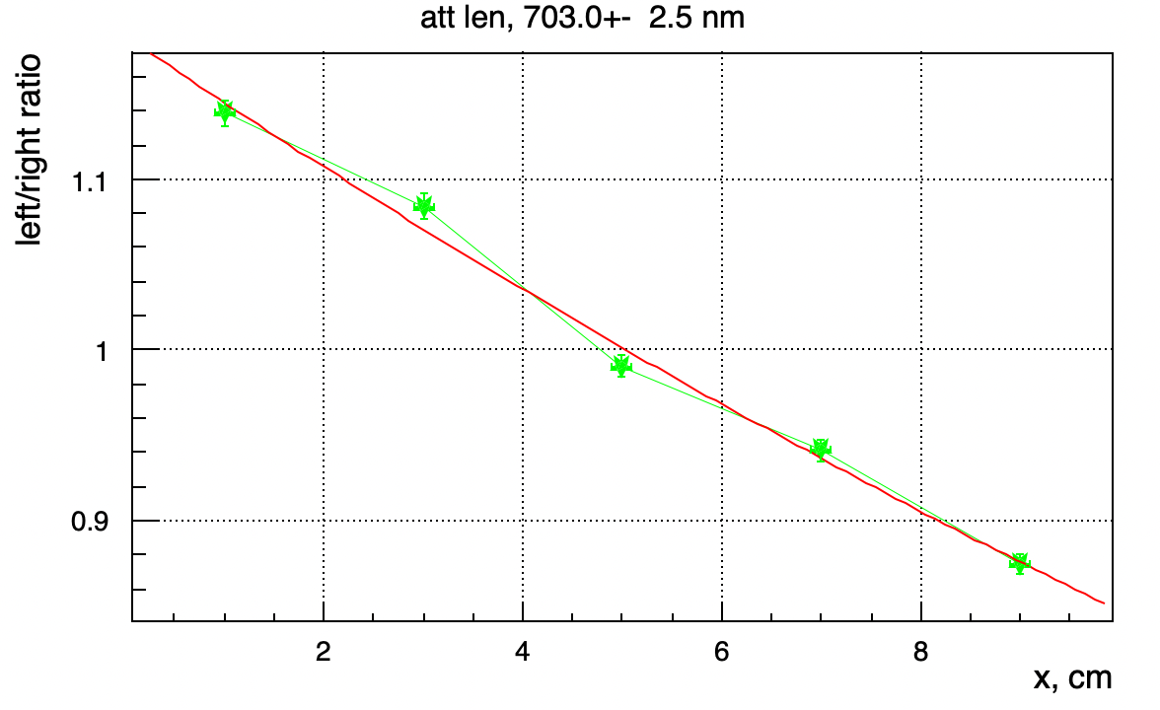

Attenuation length
GAGG16 #200
$$R=A_{0}∙exp⁡(−2x/L)$$

Slide 5
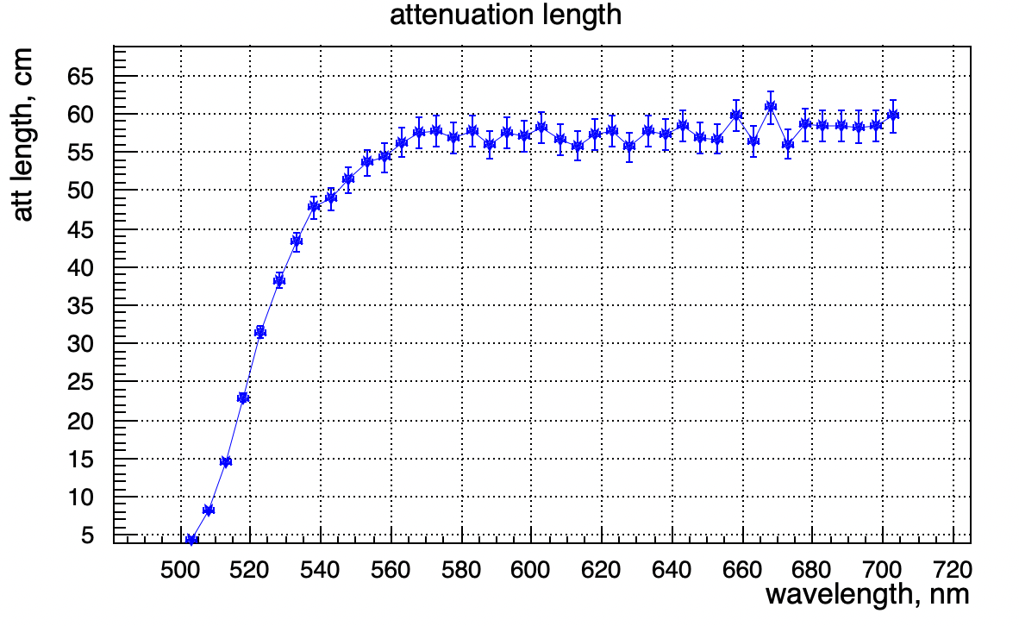
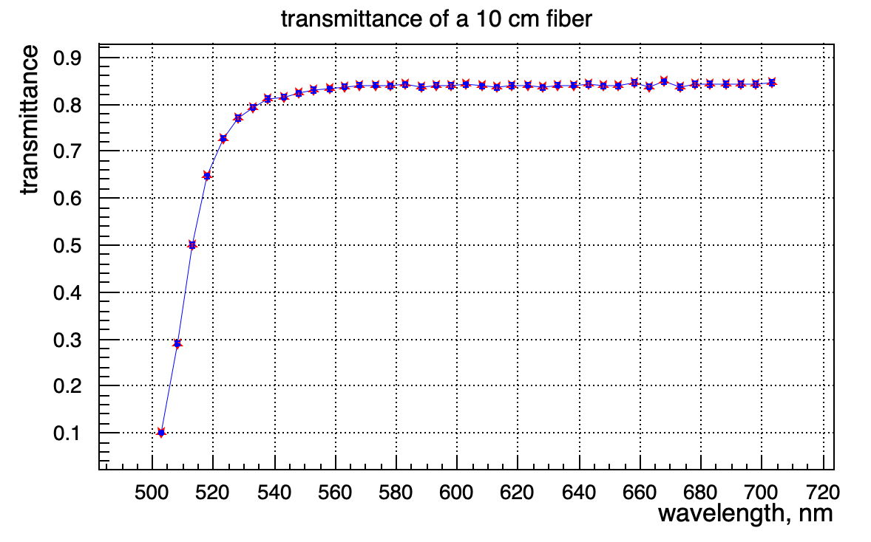


Attenuation length
GAGG16 #200
$$T= e^{−10∙2/L}$$
$$R=A_{0}∙exp⁡(−2x/L)$$
$$R=A_{0}∙T^(−2x/10cm)$$

Slide 6
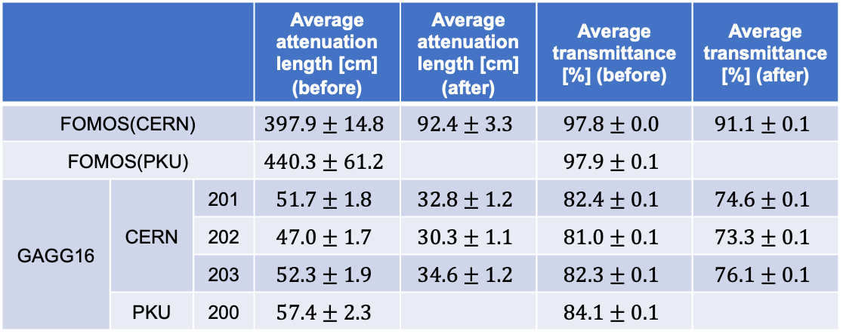
Attenuation length
 |  |  | Average attenuation length [cm] (before) | Average attenuation length [cm] (after) | Average transmittance [%] (before) | Average transmittance [%] (after)
FOMOS(CERN) |  |  | $$397.9±14.8$$ | $$92.4±3.3$$ | $$97.8±0.0$$ | $$91.1±0.1$$
FOMOS(PKU) |  |  | $$440.3±61.2$$ |  | $$97.9±0.1$$
GAGG16 | CERN | 201 | $$51.7±1.8$$ | $$32.8±1.2$$ | $$82.4±0.1$$ | $$74.6±0.1$$
 |  | 202 | $$47.0±1.7$$ | $$30.3±1.1$$ | $$81.0±0.1$$ | $$73.3±0.1$$
 |  | 203 | $$52.3±1.9$$ | $$34.6±1.2$$ | $$82.3±0.1$$ | $$76.1±0.1$$
 | PKU | 200 | $$57.4±2.3$$ |  | $$84.1±0.1$$
It remains to be established whether the attenuation length and transmittance are within the acceptable range.
Effective decay time: FOMOS ~ 70 ns; GAGG16 ~ 25 ns
Light yield: FOMOS ~ 37000 ph/MeV; GAGG16 ~ 15000 ph/MeV
Light output: https://doi.org/10.1016/j.nima.2021.165231
Decay time: https://doi.org/10.1039/d2ma00626j
Notes:
Rise time and decay time
transmission
summary

Slide 7
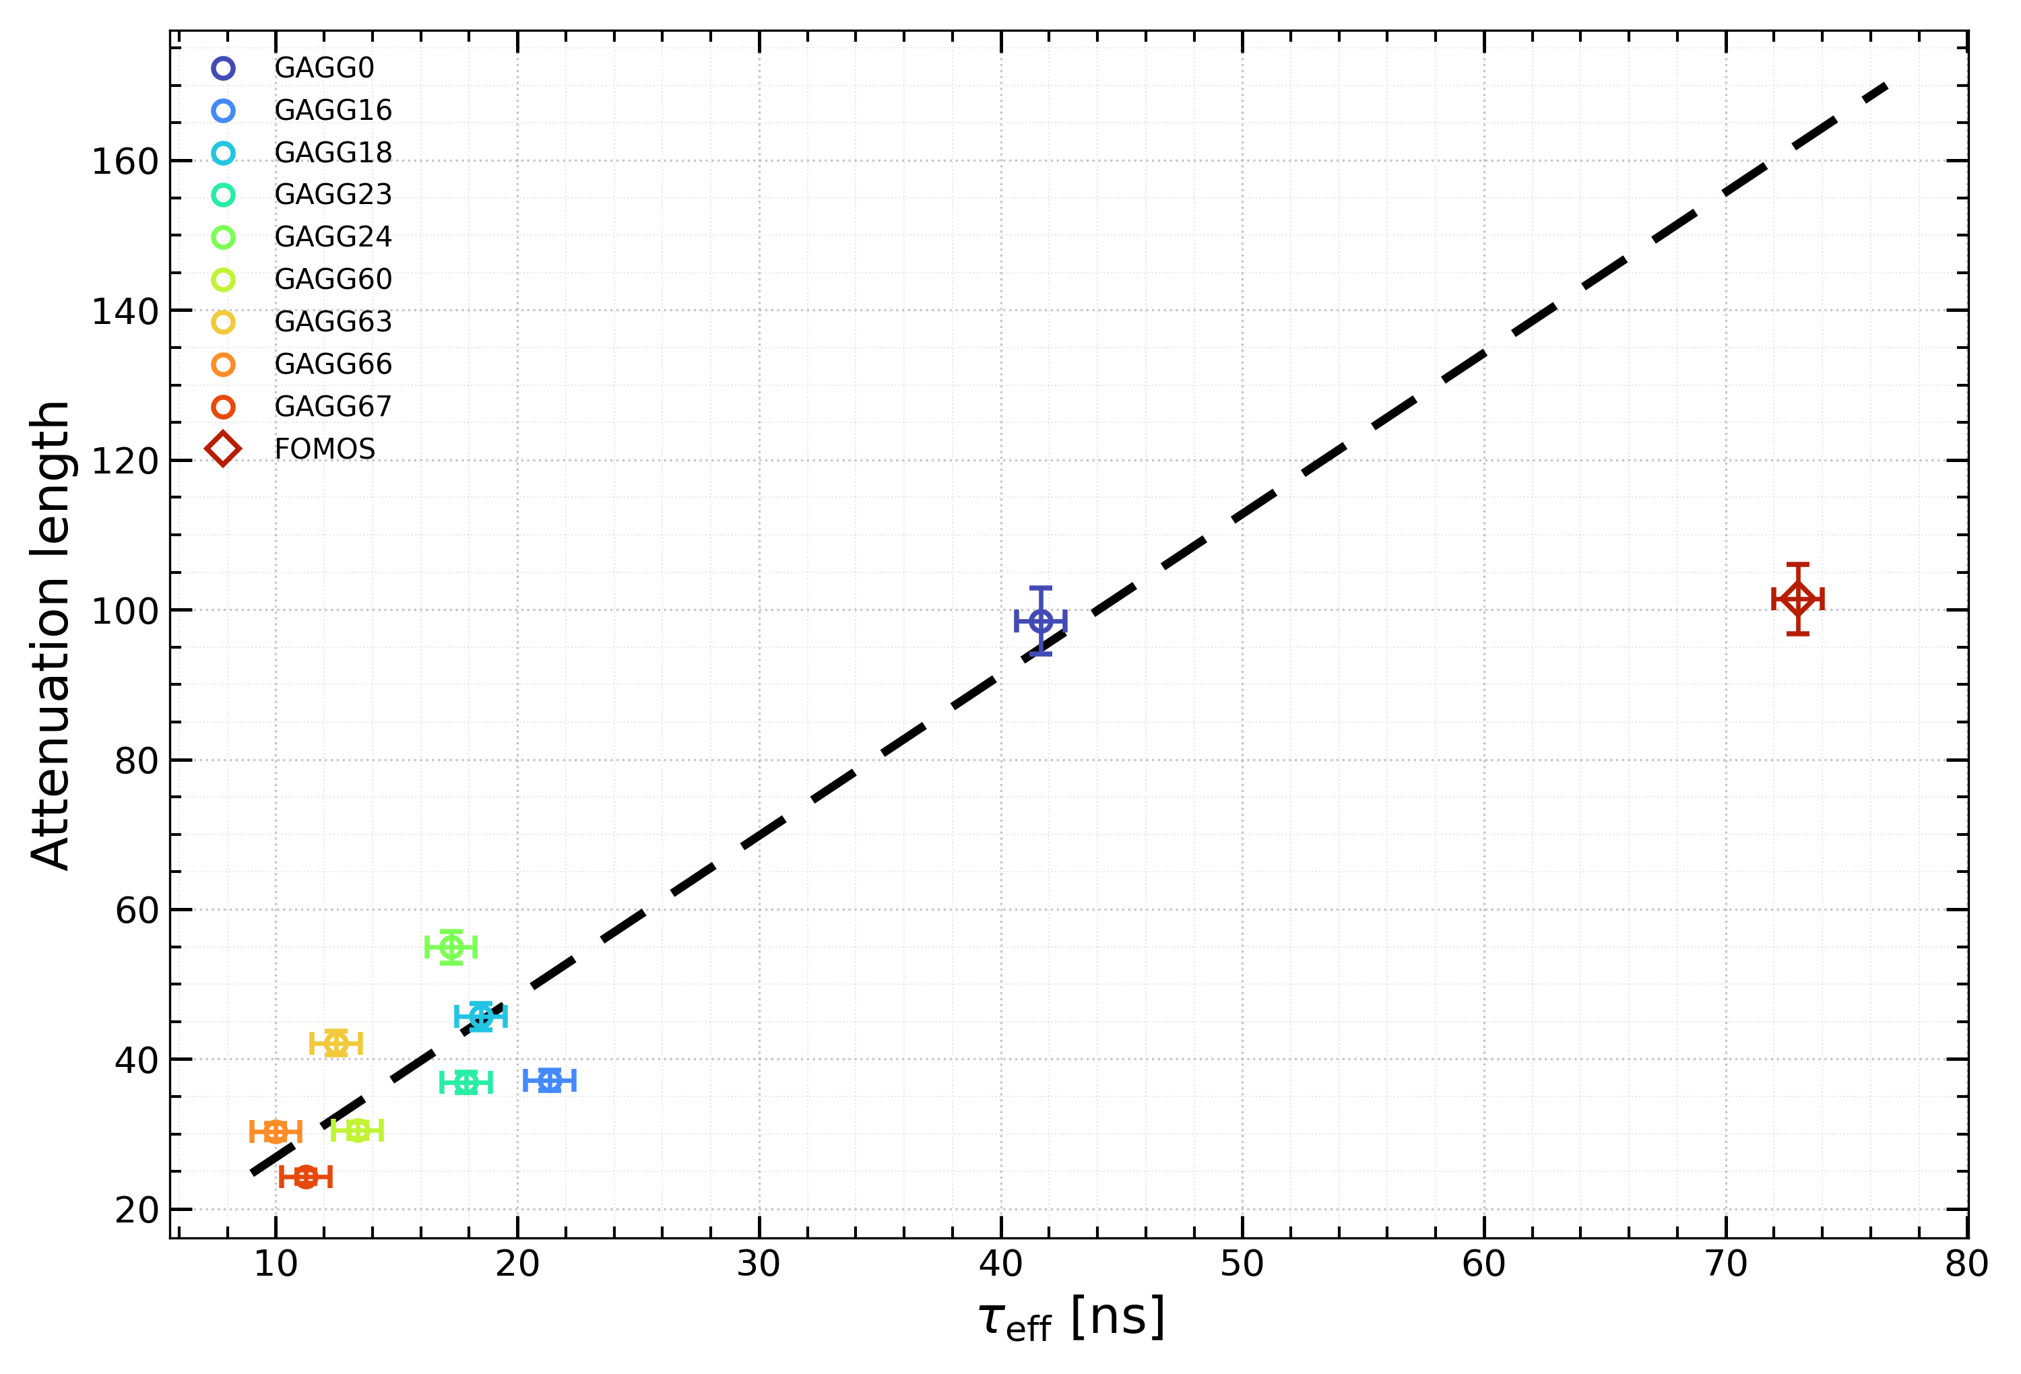
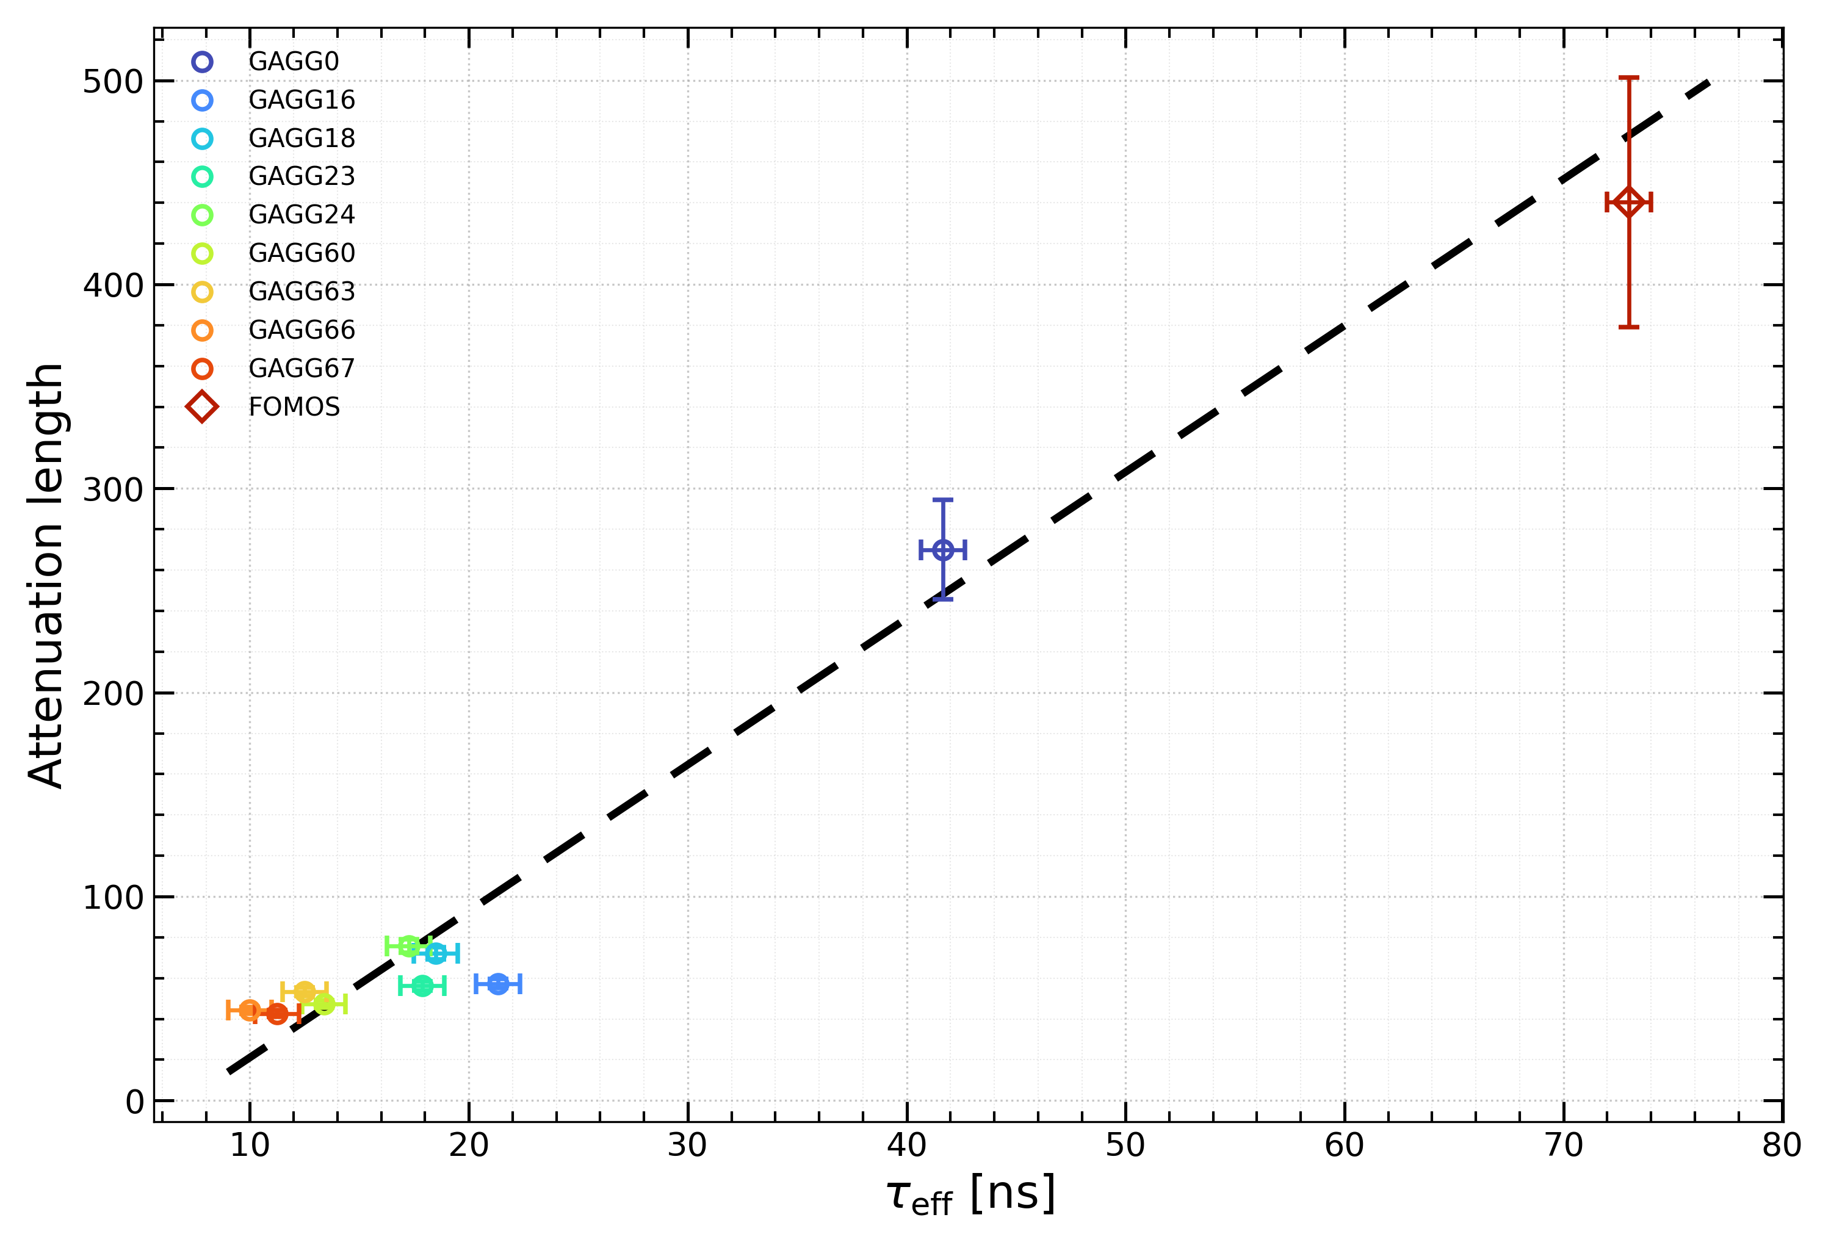
Attenuation length
Attenuation length shows a clear positive correlation with the effective decay time in both wavelength ranges.
[500nm,600nm]
[600nm,700nm]
Notes:
Rise time and decay time
transmission
summary

Slide 8
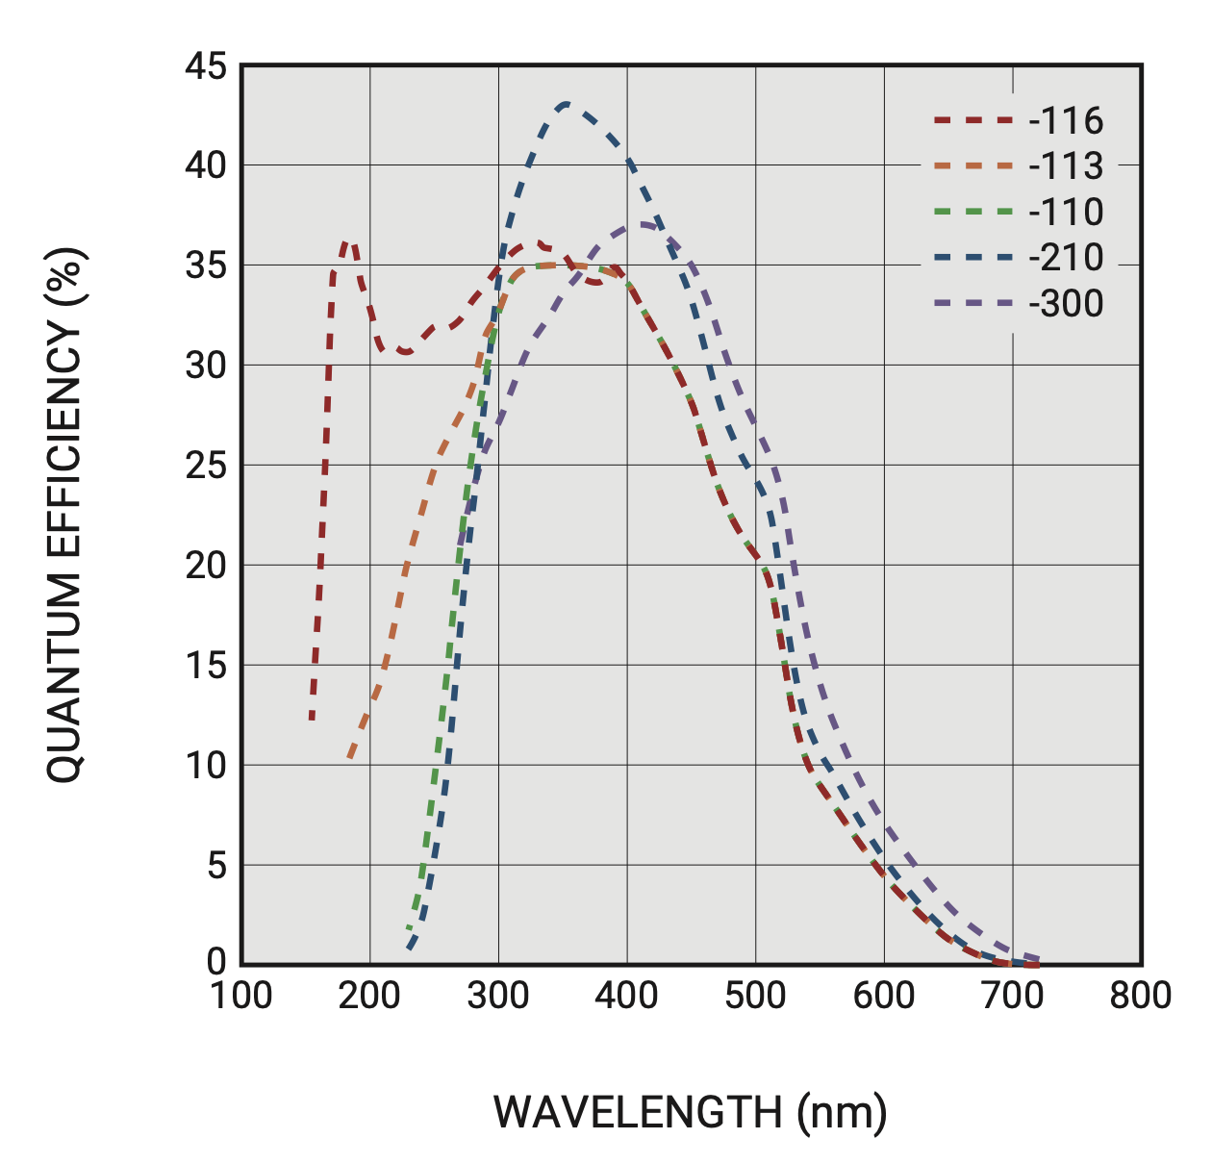
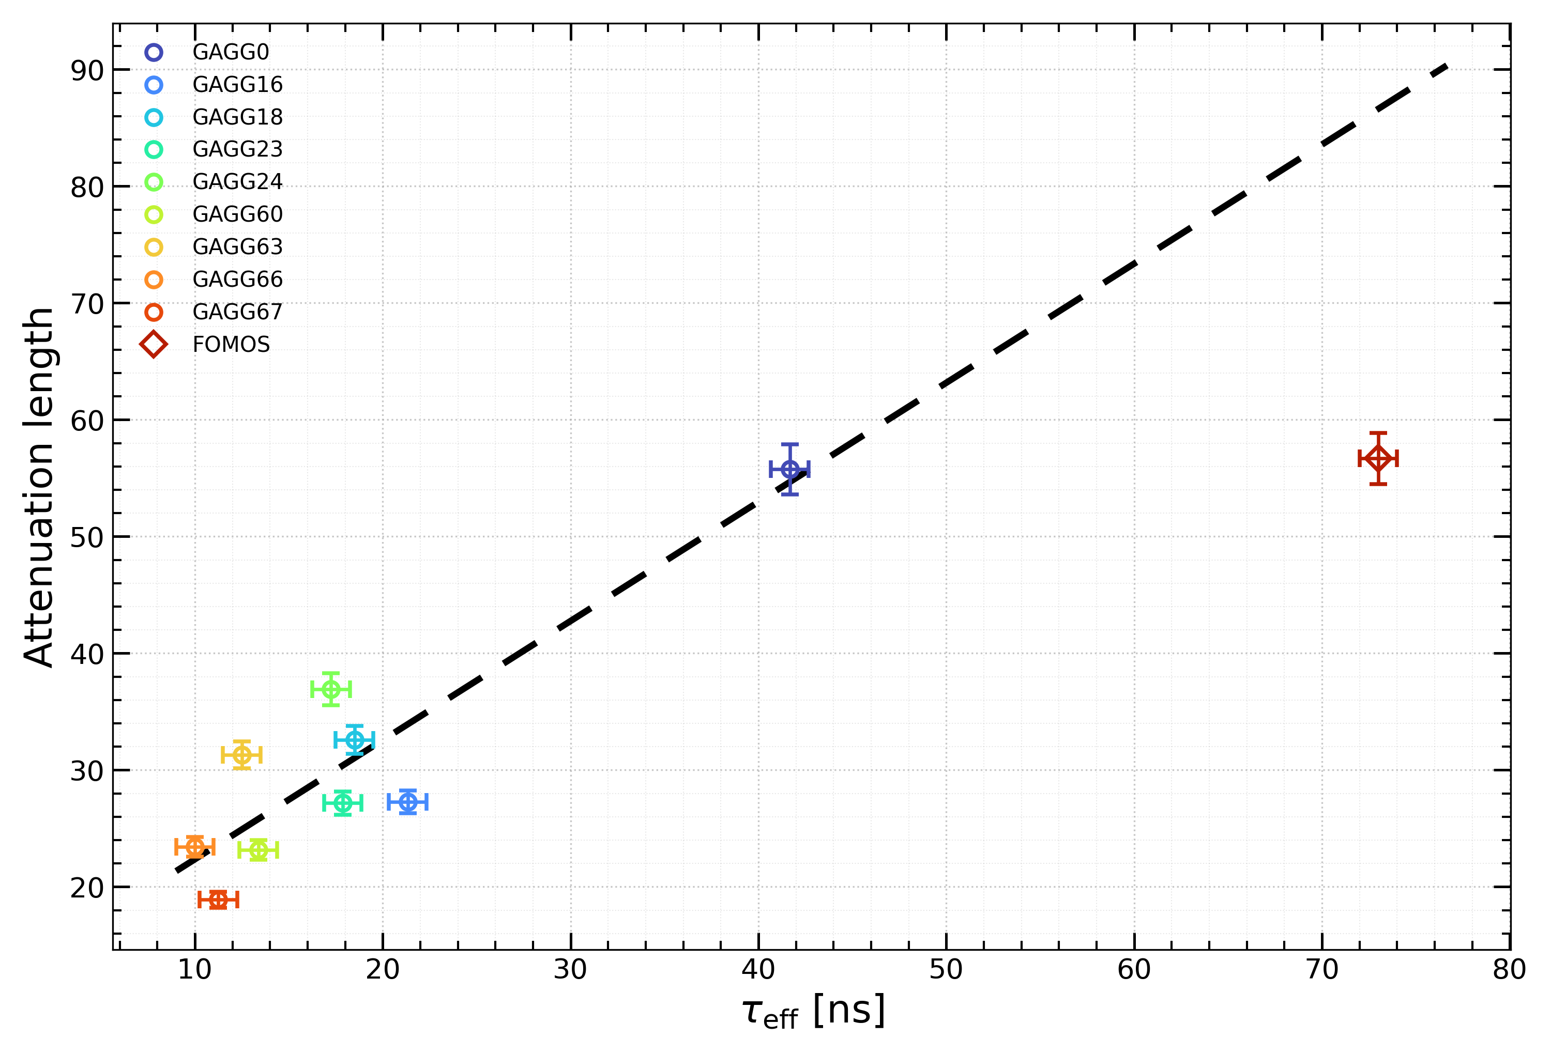
Attenuation length
The attenuation length was convolved with the quantum efficiency curve of the R9880U-210 to show the impact of the readout detector on the effective attenuation-length measurement.
Notes:
Rise time and decay time
transmission
summary

Slide 9
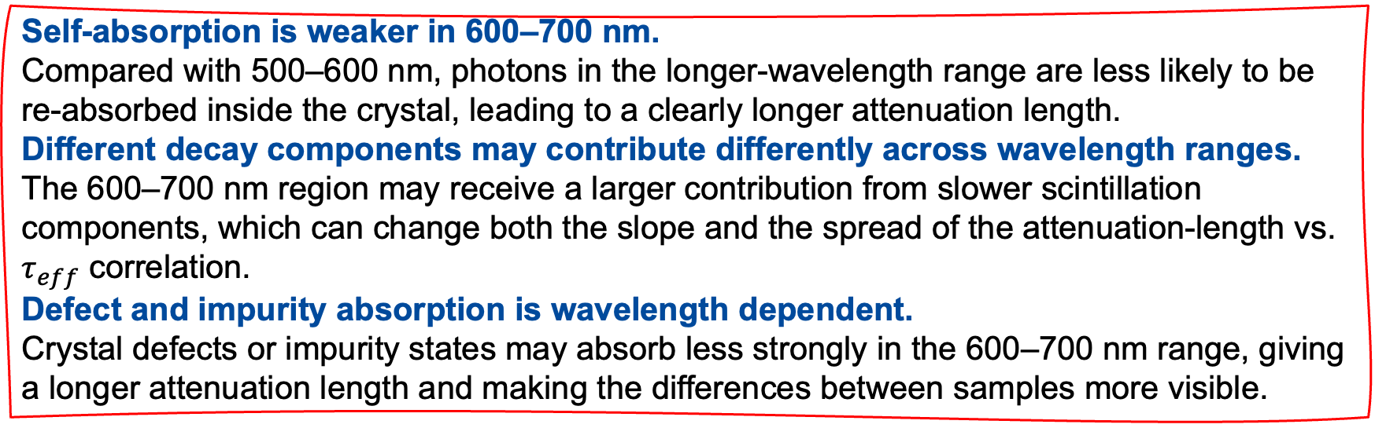
Summary
The attenuation-length measurements obtained with the PKU test bench are consistent with the CERN results.
The attenuation length of the crystal is reduced after irradiation compared with that before irradiation.
Self-absorption is weaker in 600–700 nm.
Compared with 500–600 nm, photons in the longer-wavelength range are less likely to be re-absorbed inside the crystal, leading to a clearly longer attenuation length.
Different decay components may contribute differently across wavelength ranges.
The 600–700 nm region may receive a larger contribution from slower scintillation components, which can change both the slope and the spread of the attenuation-length vs. $τ_{eff}$ correlation.
Defect and impurity absorption is wavelength dependent.
Crystal defects or impurity states may absorb less strongly in the 600–700 nm range, giving a longer attenuation length and making the differences between samples more visible.
Notes:
Rise time and decay time
transmission
summary

Slide 10
Thanks for your attention!

Slide 11
Back up

Slide 12


$$R=A_{0}∙exp⁡(−2x/L)$$
$$R=A_{0}∙T^(−2x/10cm)$$
Left(ch0) ←————————————————————→ Right(ch1)
| | | | |
x=1 x=3 x=5 x=7 x=9 (cm)
p1 p2 p3 p4 p5
The light source is placed at position x, the total fiber length is 10 cm, and one detector is installed at each end.
Step1:Signals at the two ends
Light emitted from position x travels a distance x to the left and a distance (10-x) to the right.
Define α as the linear attenuation coefficient of the fiber (/cm). Then:
Left-end signal： S_L(x) = S₀ · exp(-α·x)
Right-end signal： S_R(x) = S₀ · exp(-α·(10-x))
Define T as the transmittance of a 10 cm fiber:
T = exp(-α·10) → α = -ln(T)/10
Then：
rr(x) = exp(10α) · exp(-2αx)
= exp(-10 · (-ln(T)/10))
· exp(-2·(-ln(T)/10)·x)
= T^(-1) · T^(x/5)
= A · T^(x/5)
Step2:Left-to-right ratio
rr(x) = S_L(x) / S_R(x)
= exp(-α·x) / exp(-α·(10-x)) = exp(-α·x + α·(10-x))= exp(α·(10-2x))
= exp(10α) · exp(-2αx)
Let A = exp(10α)，L = 1/α，Then, rr(x) = A · exp(-2x/L)

