Slide 1

ACADEMIC SEMINAR · SEPTEMBER 2026
Study of the Low-Light Background for HUNT
Measurement, calibration and spectral reconstruction of the optical background in natural water
PRESENTER
Weijie Wang(王伟杰)
AFFILIATION
Guangxi University / Institute of High Energy Physics, CAS
SUPERVISORS
Yongbo Huang · Mingjun Chen
VENUE
Cosmic Ray Research Center, Sichuan Tianfu New Area · Chengdu

Slide 2
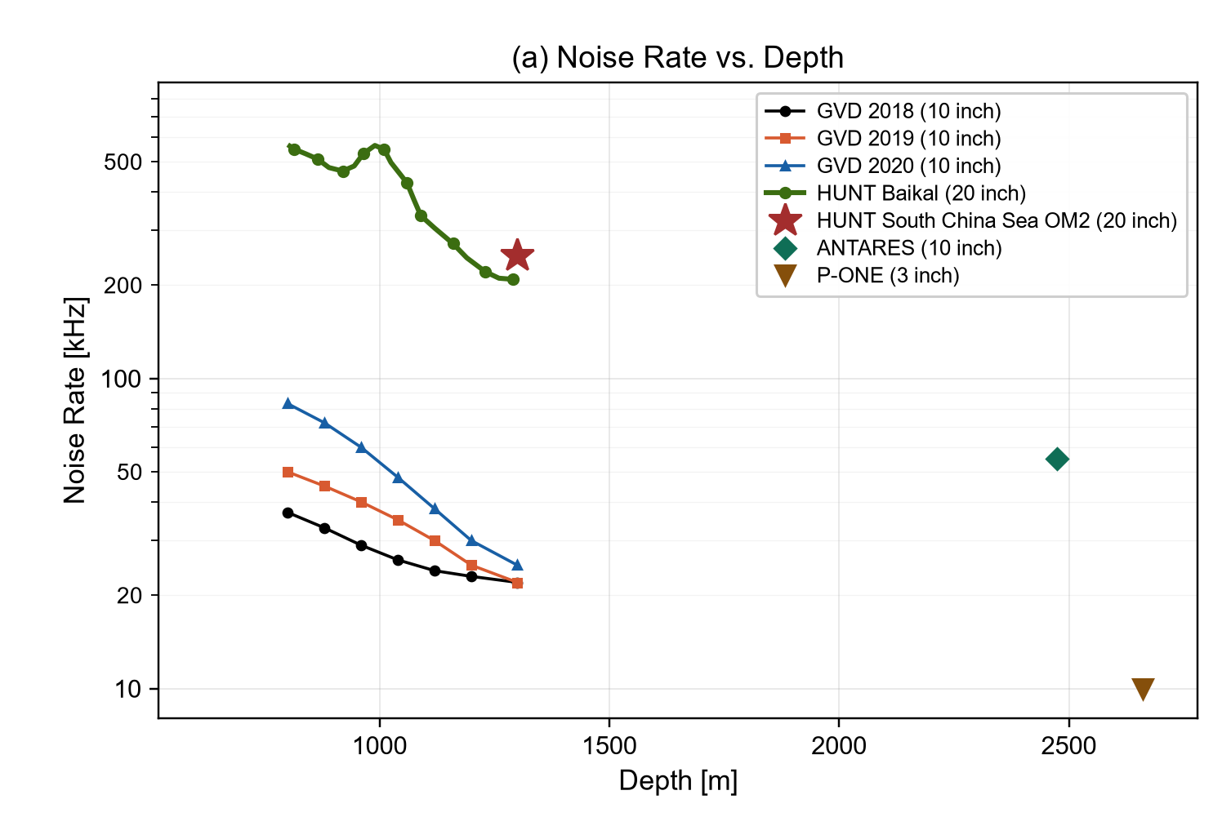
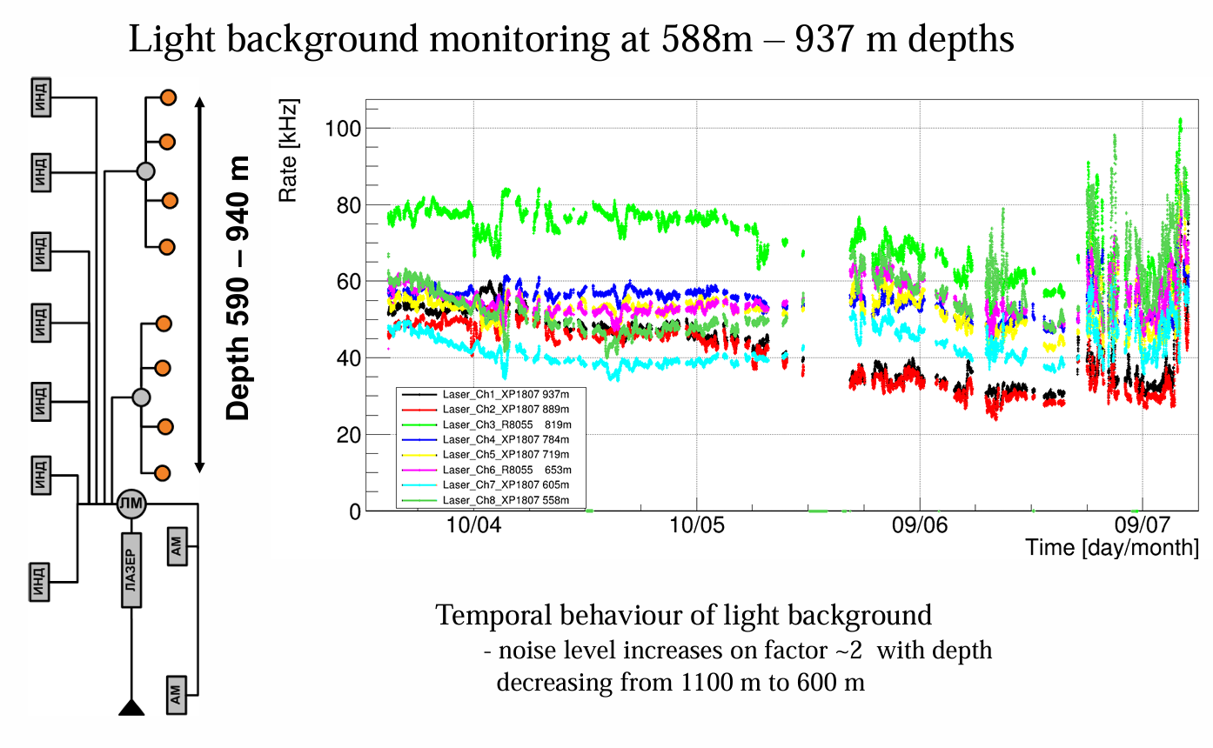
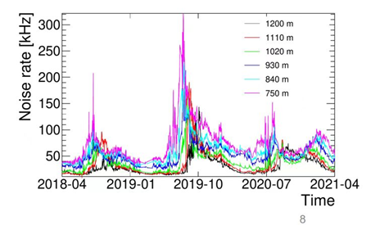
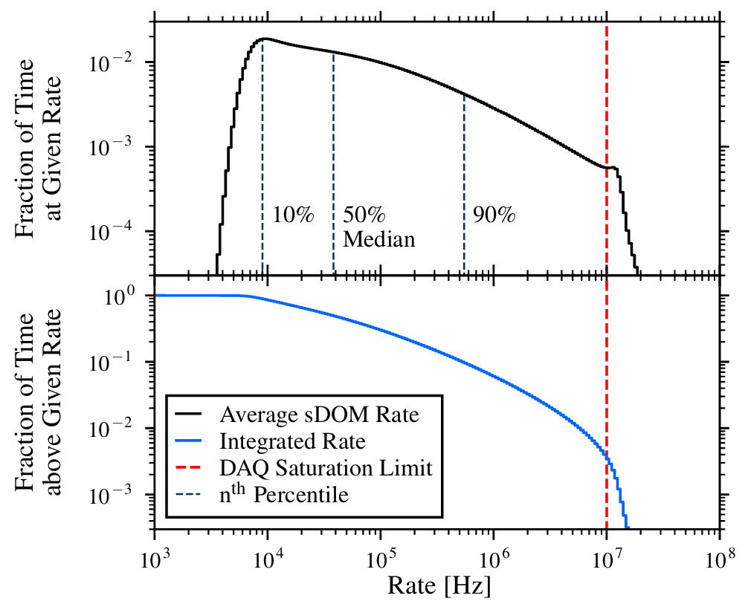
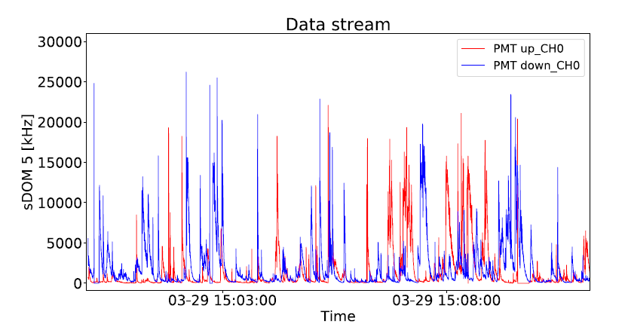
BACKGROUND LIGHT AT EXISTING SITES
HUNT
EXAMPLES — SITE MEASUREMENTS
Baikal — optical background
Pacific NE — P-ONE
Baikal-GVD
KM3NeT
P-ONE
HUNT 20"
10-inch · 20–50 kHz
3-inch · ≈ 7 kHz
3-inch · 9–12 kHz
200–500 kHz · bursts ≈ 900 kHz
bursts ≈19MHz
Baselines span three orders of magnitude · bursts reach 10–20MHz — diverse, complex, time-variable. Measure it in situ.
HUNT Underwater Background Light · Weijie Wang
02 / 09

Slide 3
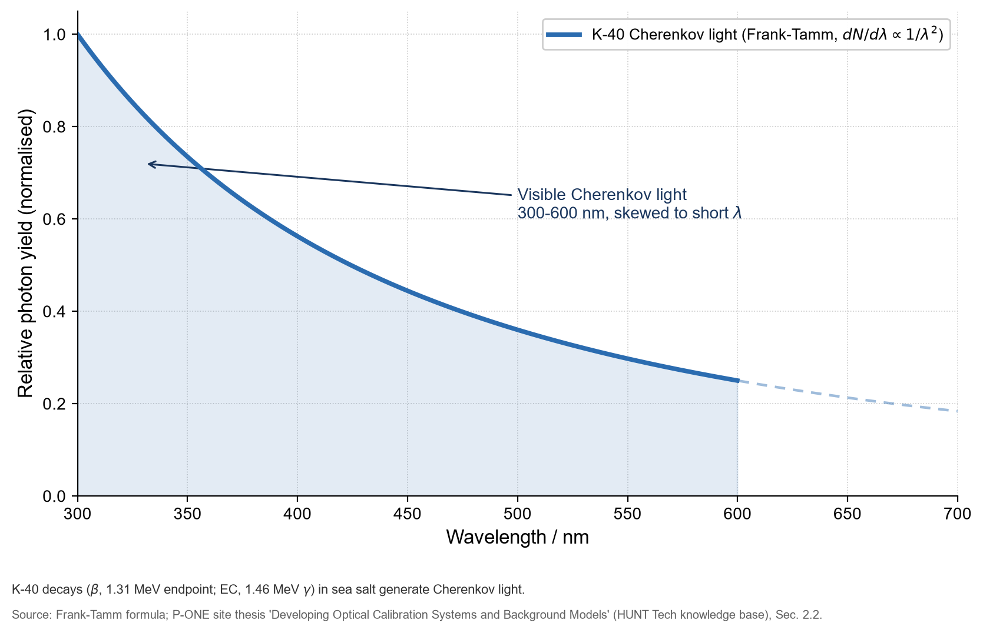
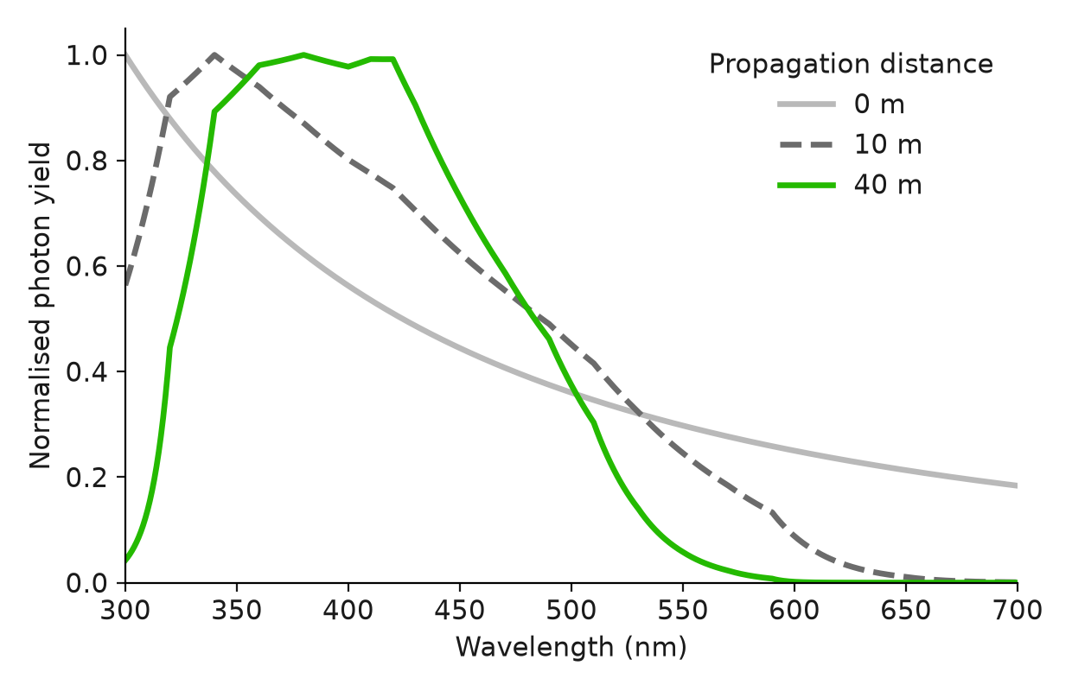
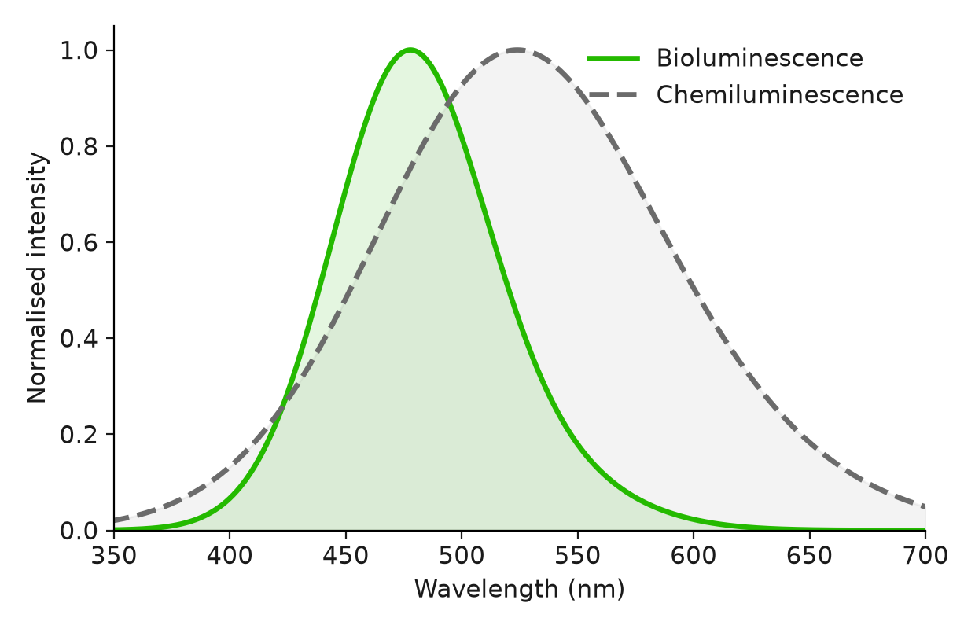
UNDERWATER OPTICAL BACKGROUND
HUNT
K-40 Cherenkov spectrum — Frank–Tamm 1/λ²
Spectrum at 0 / 10 / 40 m — water absorbs red first
Bioluminescence ≈ 475 nm vs chemiluminescence ≈ 520 nm
K-40 → CHERENKOV
BIOLUMINESCENCE
CHEMILUMINESCENCE
stable baseline
bursts 10–19 MHz
≈ 520 nm · faint
sets the trigger floor
bacteria & plankton flashes
spectrally distinct from bio-light
Background light has three parts. Potassium-40 produces a constant, ever-present glow that sets the noise floor. Bioluminescence from plankton flashes near 475 nm, in bursts. Chemiluminescence is a weak, steady glow near 520 nm. Separating them needs a band-resolved, calibrated counter
03 / 09

Slide 4
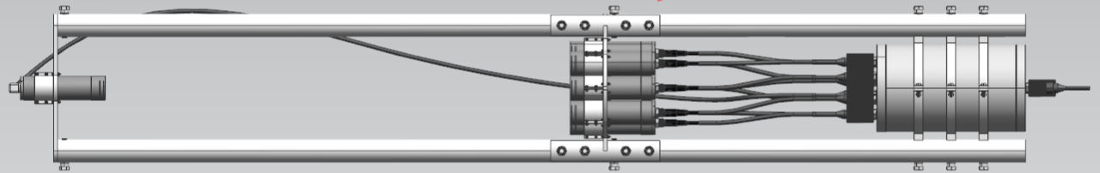
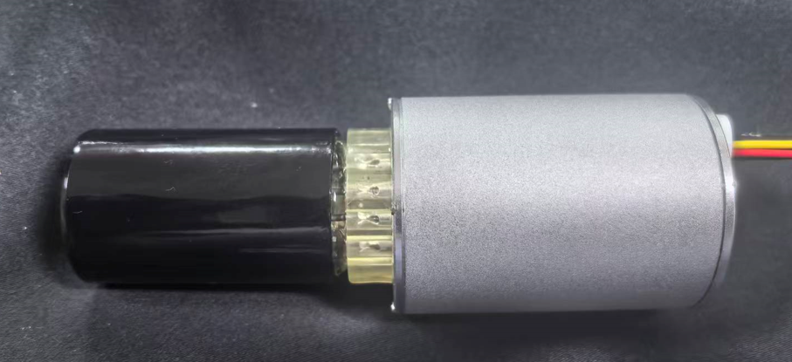
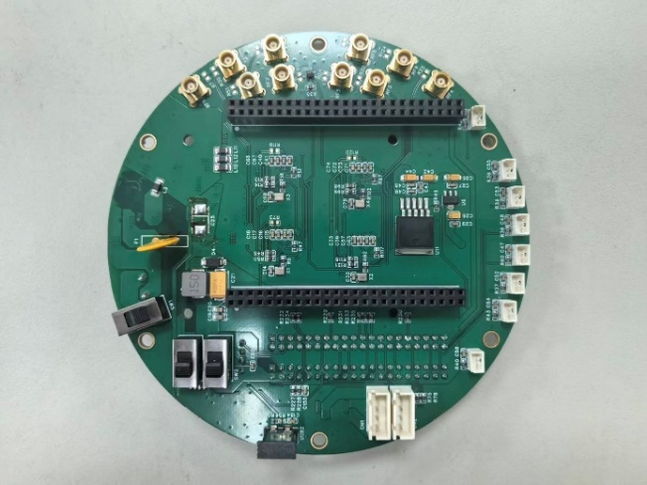
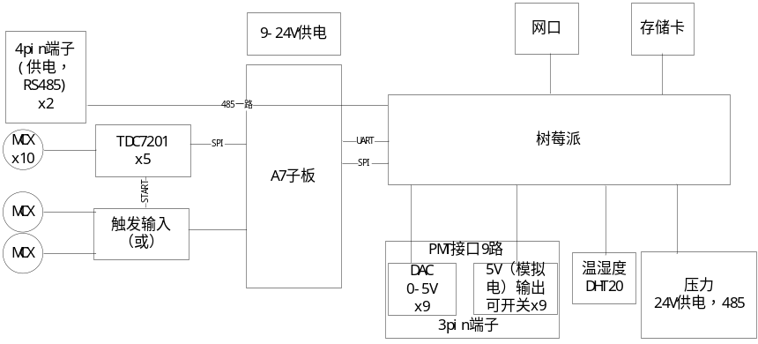
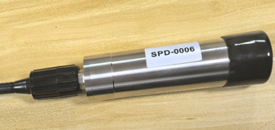
TECHNICAL SCHEME
HUNT
PHOTON COUNTING
INPUT
Ambient light + LED source
↓
1.0 m frame — LED source · detector modules · electronics cabin
FILTER
HARDWARE
Narrow-band · 365–570 nm
↓
DETECT
1-inch PMT · single photon
↓
High Voltage
DAC threshold · 0–2.5 V / 0-1200V
↓
COUNT
N2014 1-inch
2.2 V TTL · 15 ns
50 ps · 20 MHz / ch
Rate per band
detector module
TDC readout board (max 163MHz / ch)
Scheme
Our approach is single-photon counting: light passes a narrow-band filter, and a 1-inch PMT counts single photons band by band. The one-metre frame houses a multi-wavelength LED calibration source, eight counting modules, and a self-contained electronics cabin; each module carries an N2014 1-inch PMT whose output is a clean 2.2-volt TTL pulse, 15 nanoseconds wide — one pulse per photon. The front-end electronics provide 50-picosecond resolution and 20 megahertz per channel, with eight channels on a single board.
04 / 09

Slide 5
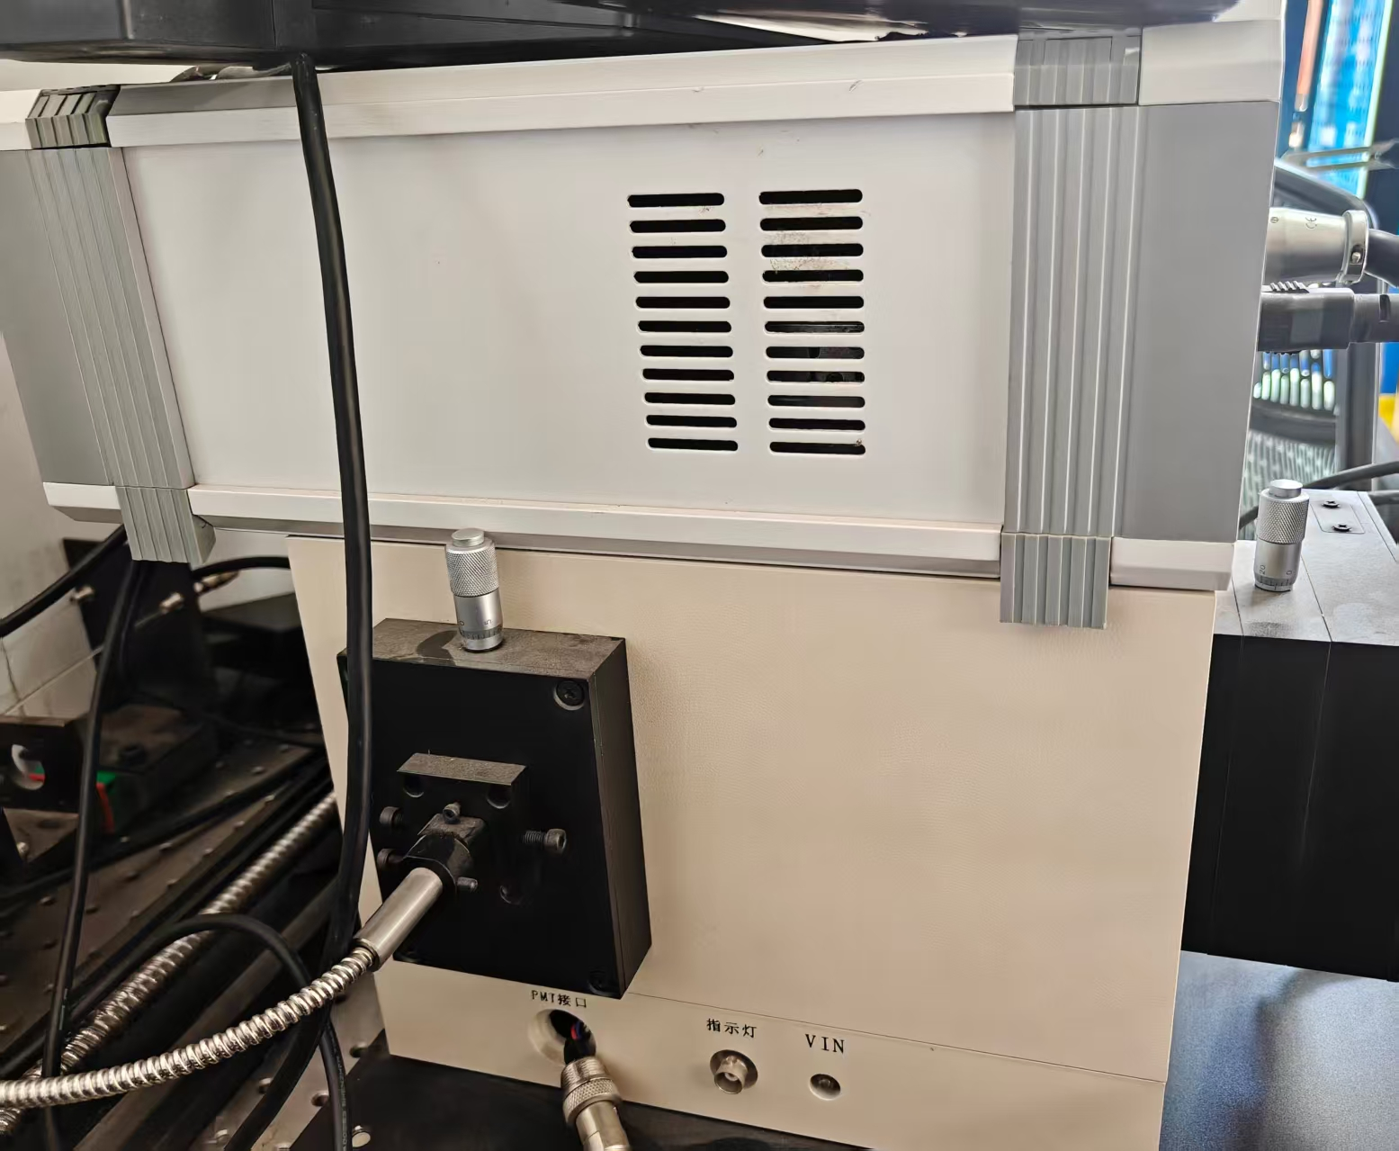
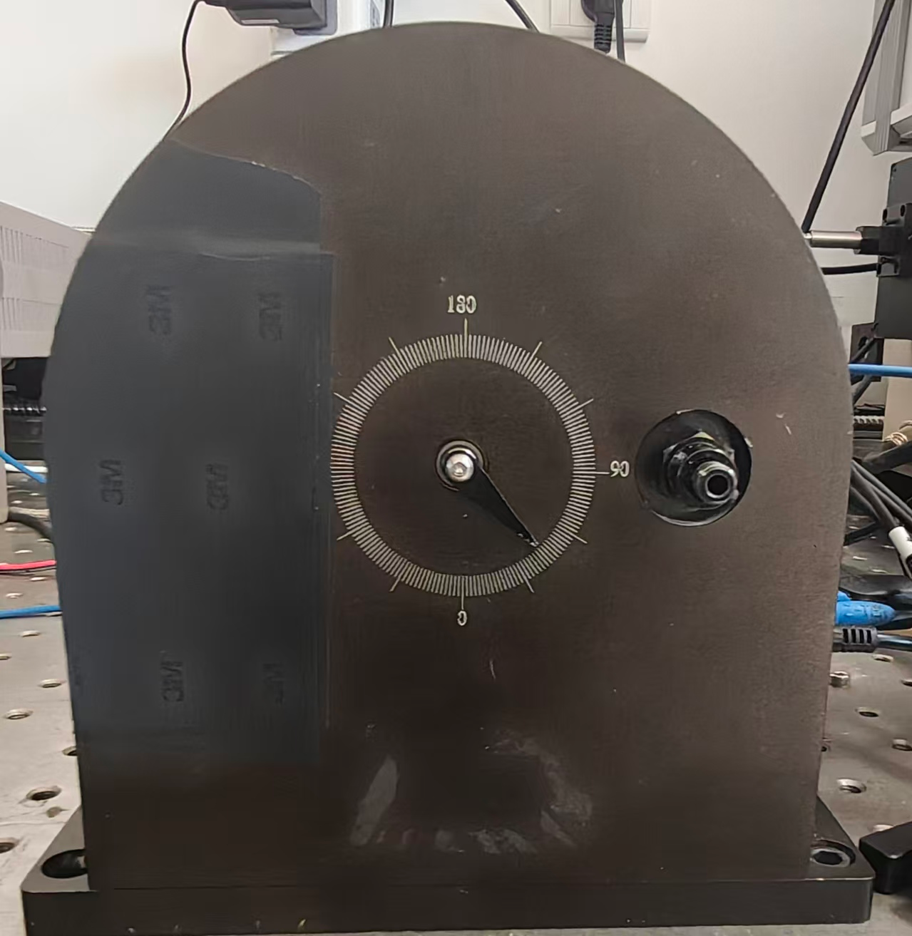
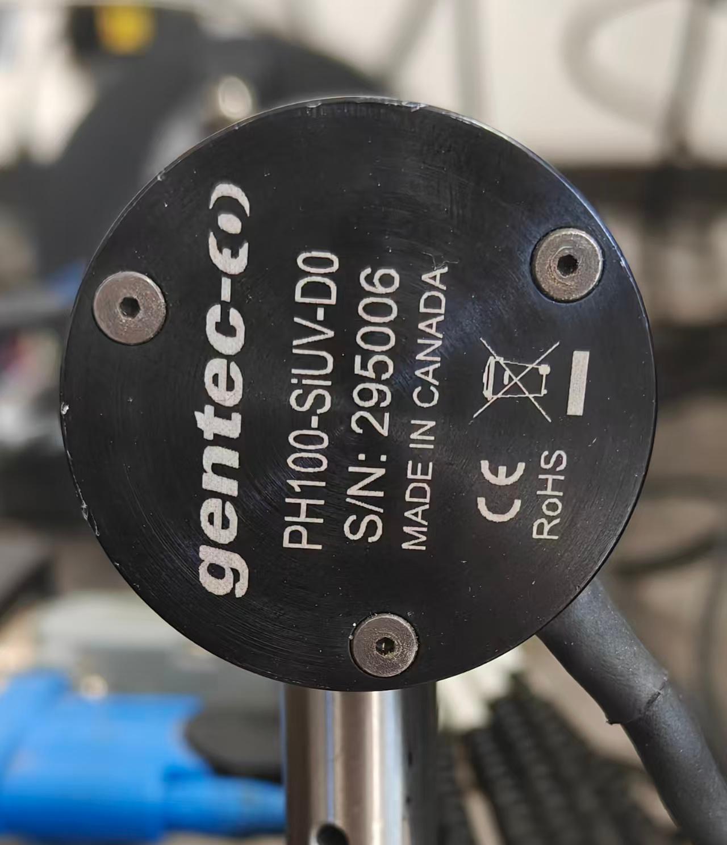
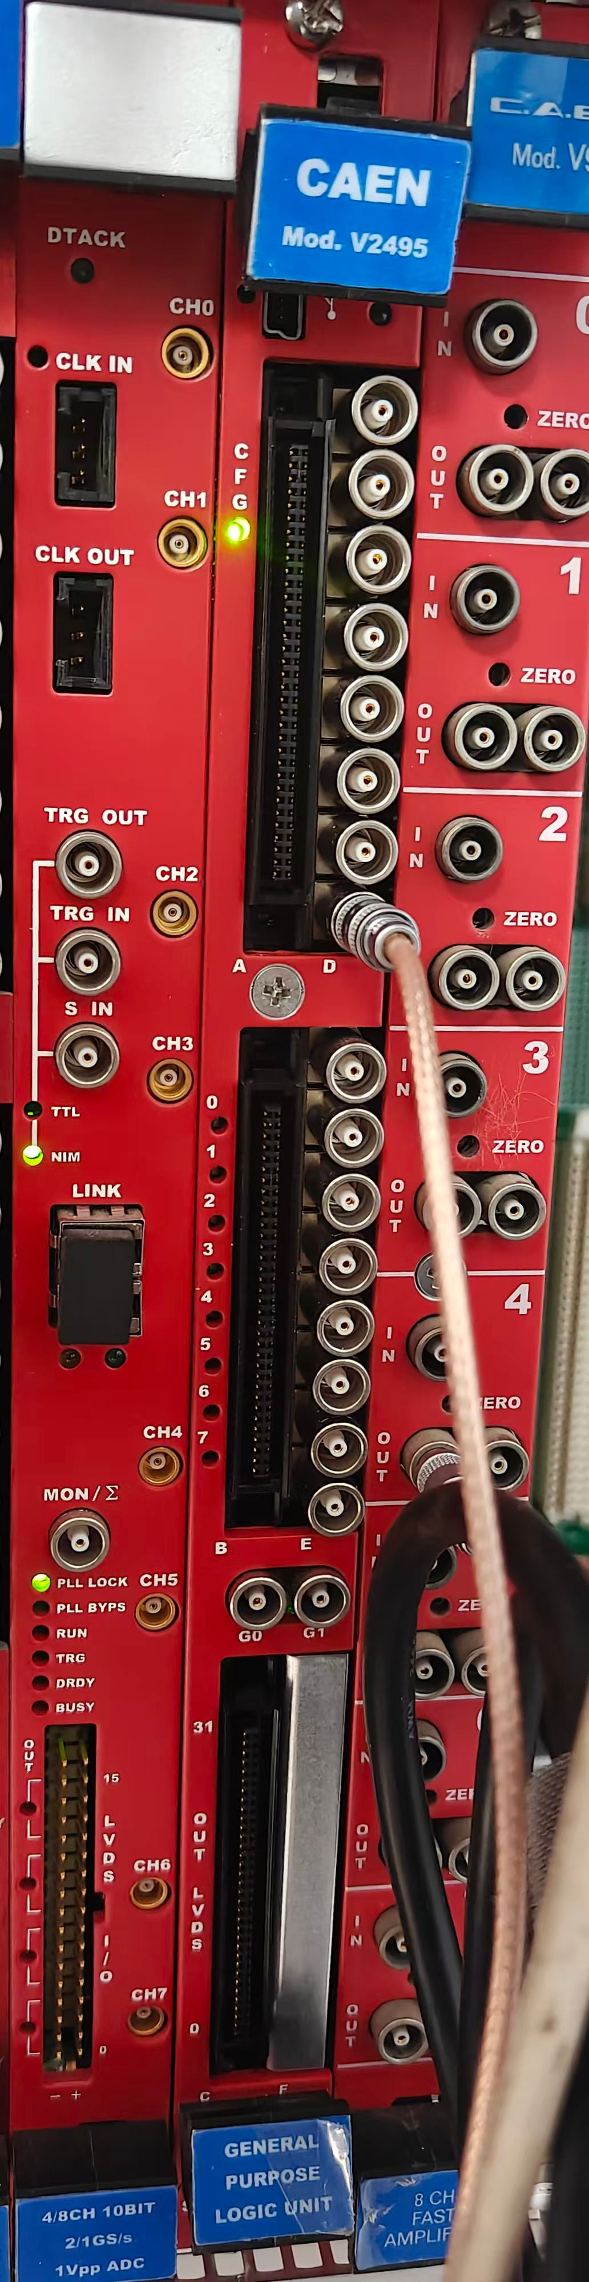
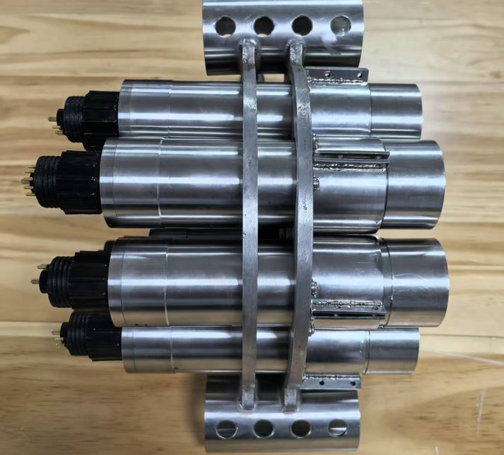
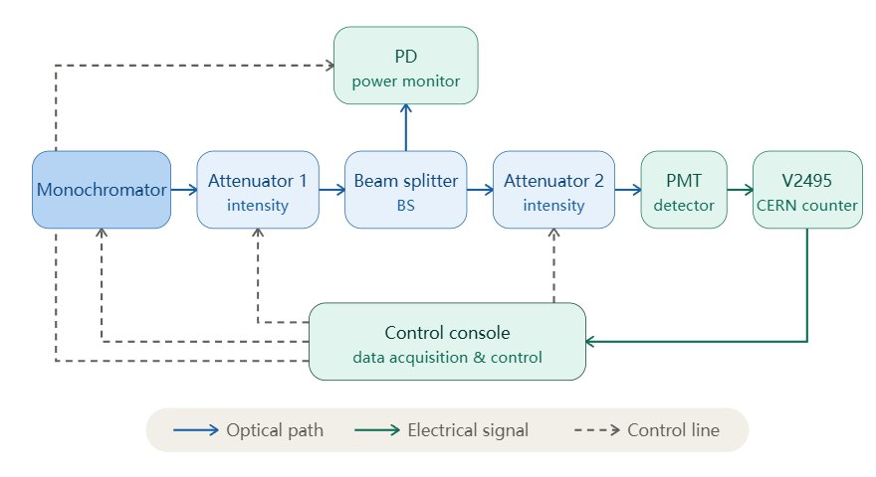
TEST AND CALIBRATION SCHEME
HUNT
TEST PLATFORM — HARDWARE
monochromator
attenuator wheel 4OD
reference photodiode
CAEN V2495 + A395D (200MHz)
photon-counting modules
Before taking the system into the water, we calibrated it in the laboratory. The light path runs from a monochromator through two attenuator stages, separated by a beam splitter, to a reference photodiode that monitors the optical power, and finally to the PMT under test. This way, the incident photon flux is known at every point along the chain.
05 / 09

Slide 6
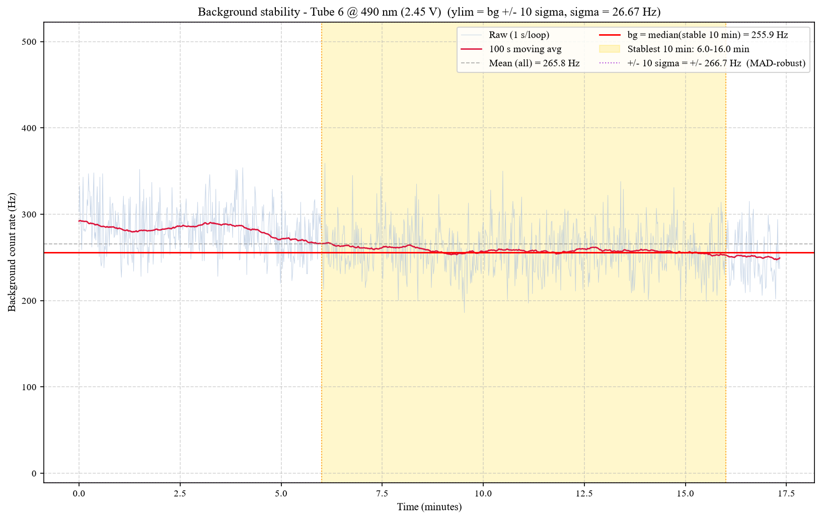
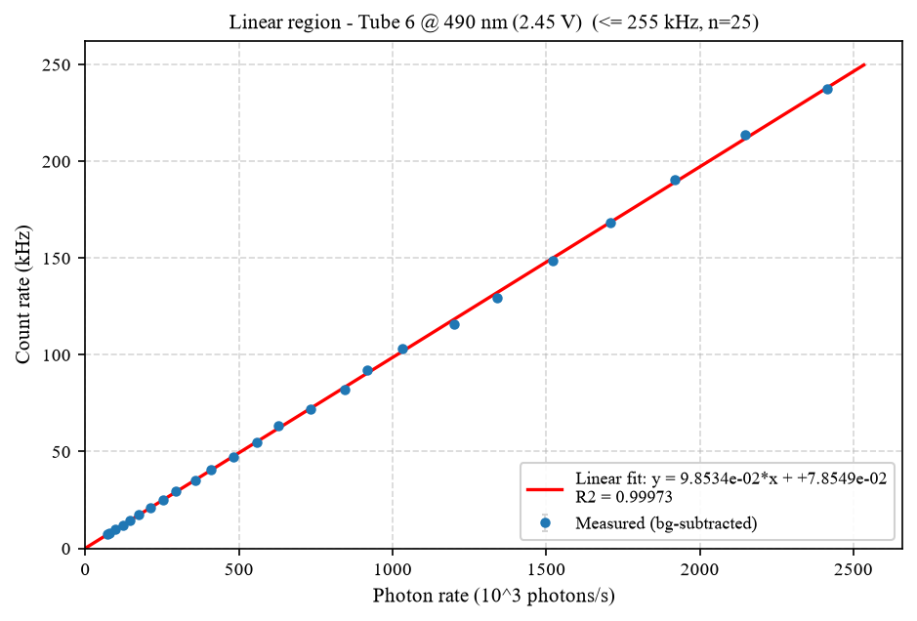
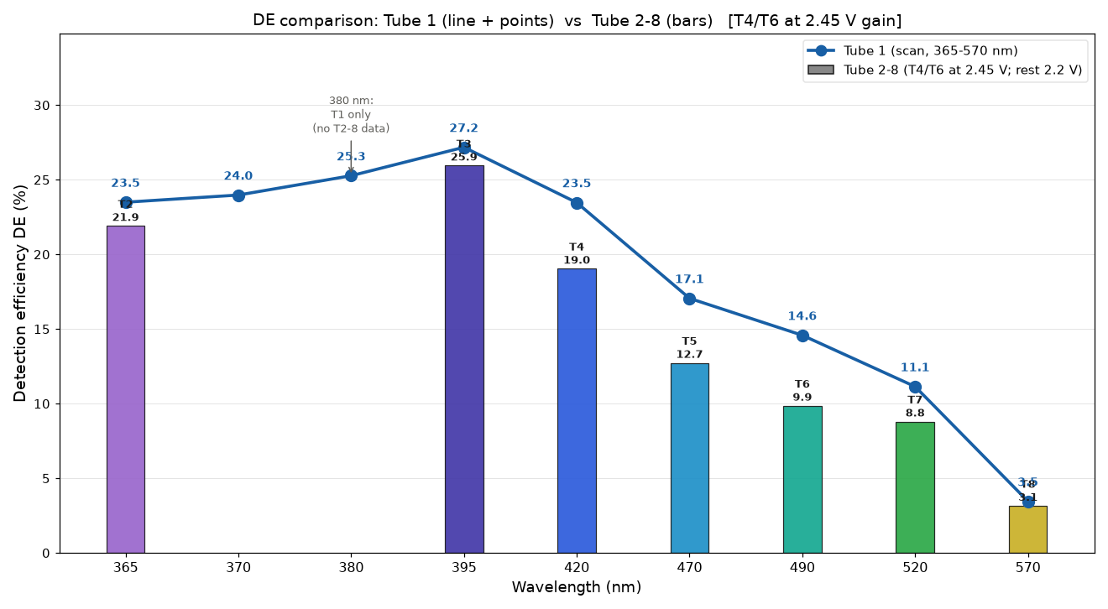
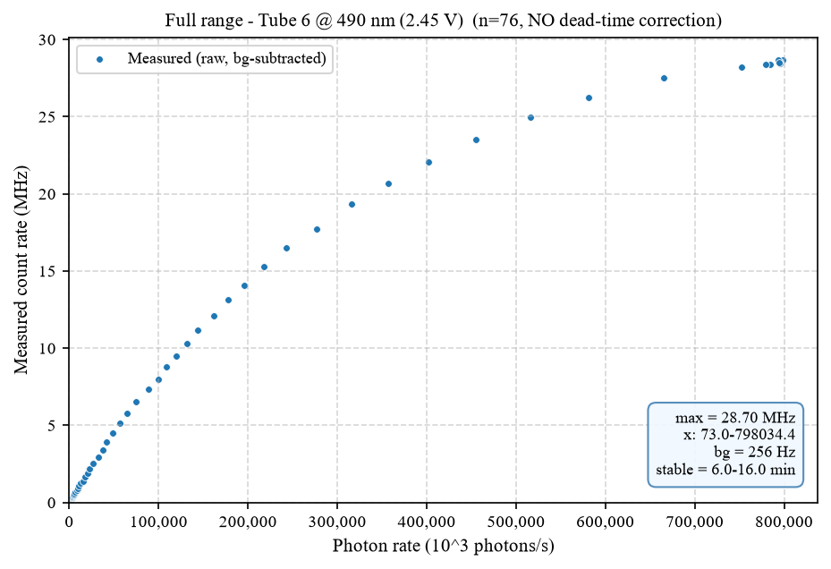
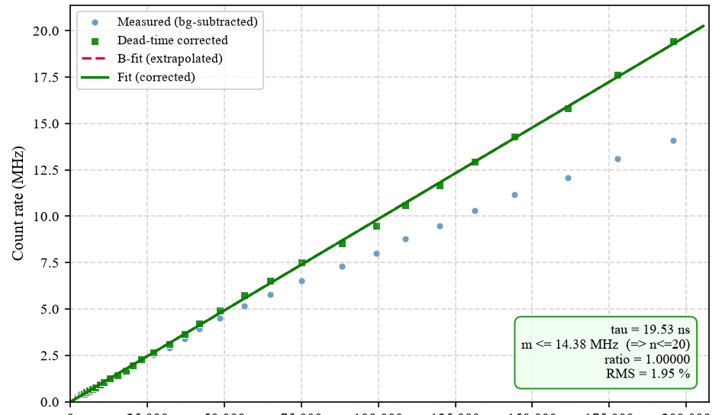
CALIBRATION RESULTS
HUNT
TUBE 6 @ 490 nm — ONE COUNTER
EIGHT COUNTERS — 365–570 nm
BACKGROUND — 255.9 Hz, RMS 1.95 %
LINEARITY — R² = 0.99973
DEAD TIME — τ = 19.53 ns
This calibration yields the detection-efficiency curve from 365 to 570 nm, together with a calibration coefficient for each tube, providing the conversion from count rate to incident photon rate for all subsequent measurements.
06 / 09

Slide 7
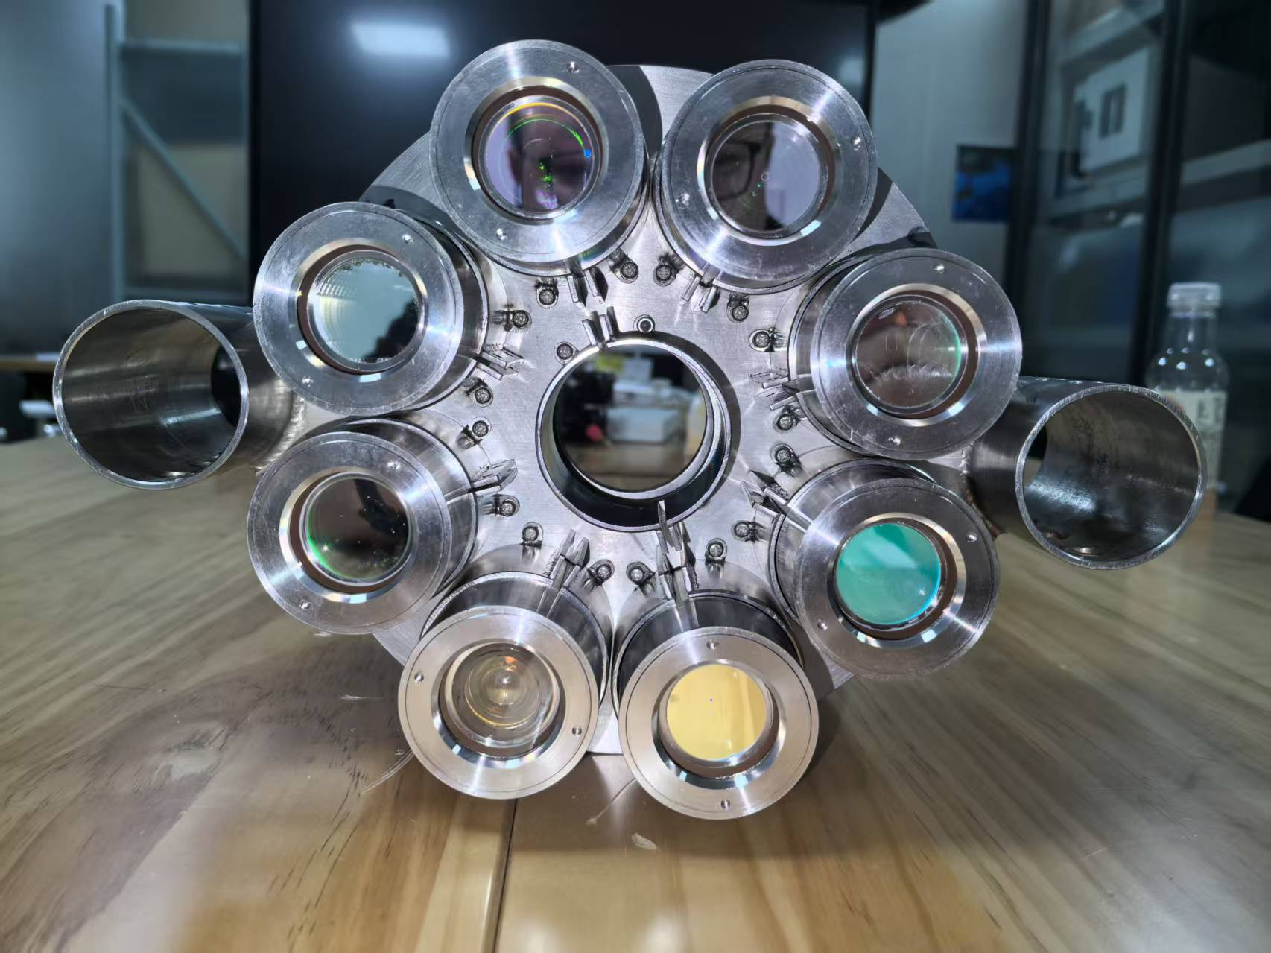
SUMMARY AND OUTLOOK
HUNT
SUMMARY
Natural-water background: ≈ 7 kHz → 500 kHz baselines, bursts to 10–25 MHz — diverse, complex, time-variable.
It sets the trigger threshold and data rate — directly affecting event selection and reconstruction.
Eight counters calibrated band by band — a flux traceable to absolute photon rate.
OUTLOOK
South China Sea — campaign with the SeaStar Array.
Lake Baikal — targeted study alongside GVD.
08 / 09

Slide 8
Thank you !

