Slide 1
On the extra-galactic sources of high-energy neutrinos
the China - Europe Neutrino Astronomy Summer School
2026.9.14-23, Chengdu
Xiang-Yu Wang
Nanjing University, China

Slide 2
Outline
Brief introduction to neutrino
2. Extragalactic neutrino source candidates, blazar flares and Seyfert galaxies, and the underlying physics
3. Other possible sources
4. Future prospect

Slide 3
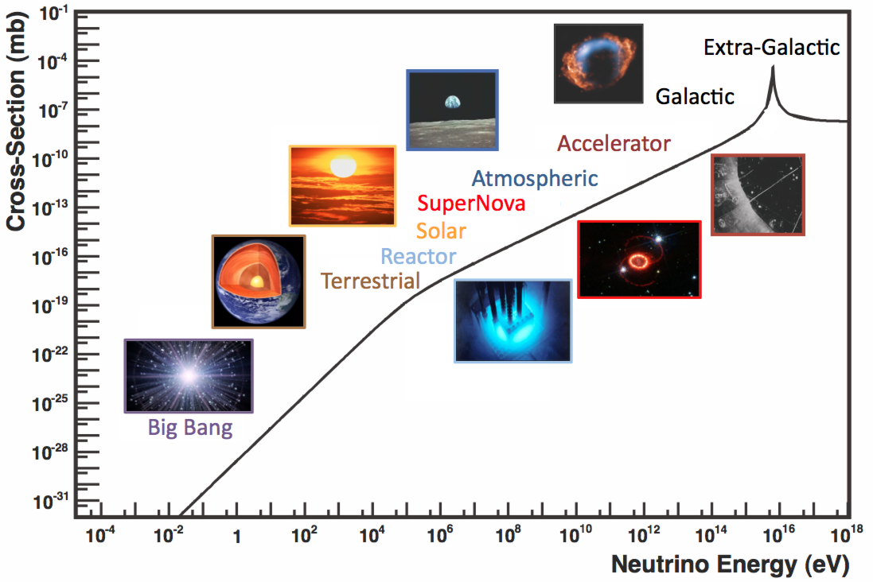
Neutrinos from low to high energy
From Big Bang CνB to cosmic-ray neutrinos
From 10⁻³eV to 10¹⁷eV
Solar neutrino：MeV
p + p → ²H + e⁺ + νₑ
Supernova : MeV
p + e⁻ → n + νₑ

Slide 4
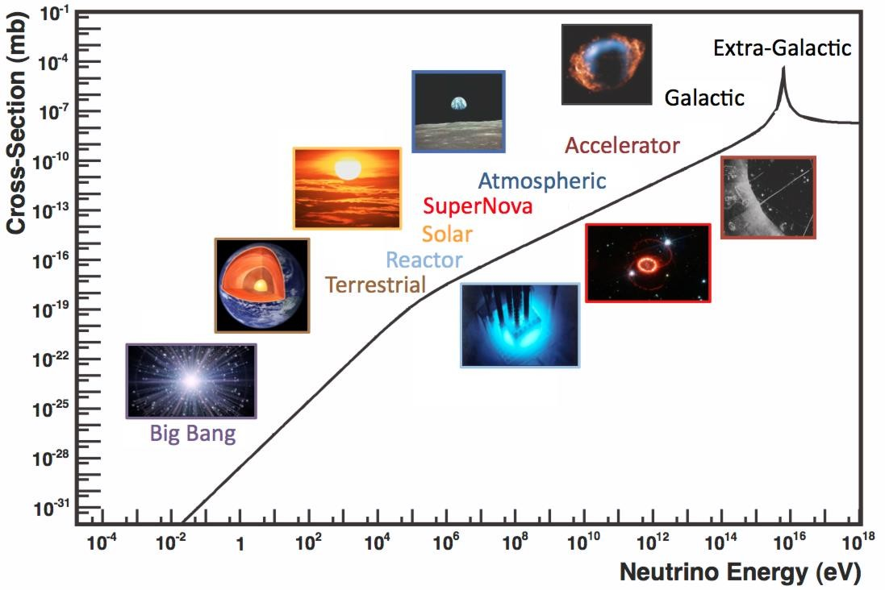
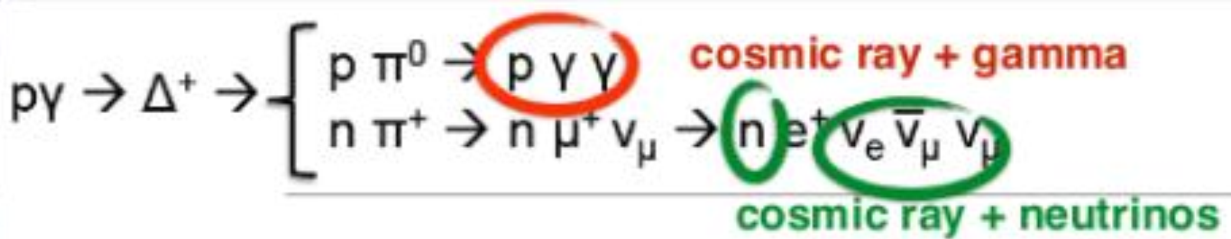
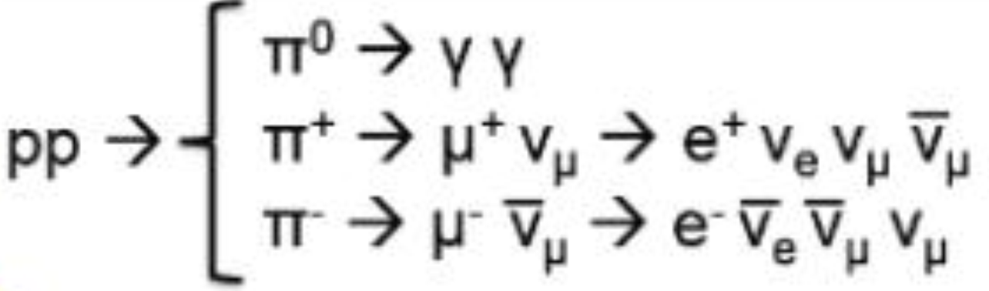
TeV-PeV neutrinos probe the origin of cosmic-rays
Neutrinos provide the smoking-gun evidence for cosmic ray sources
4

Slide 5
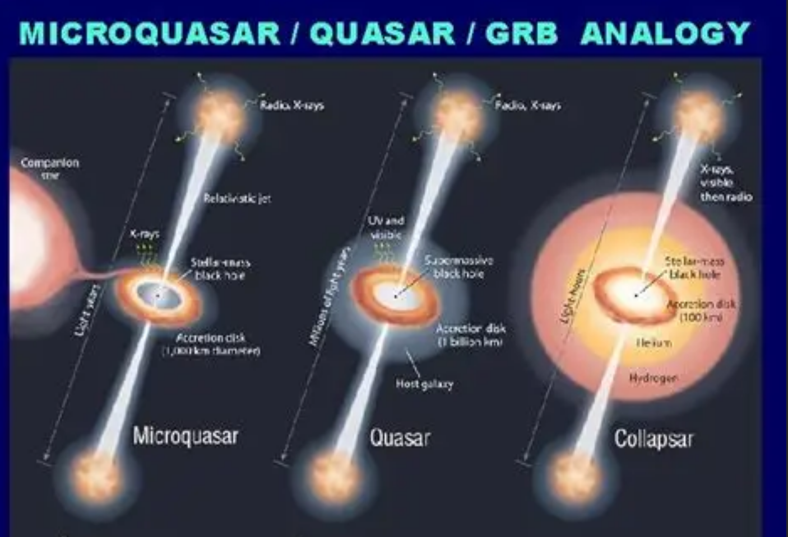
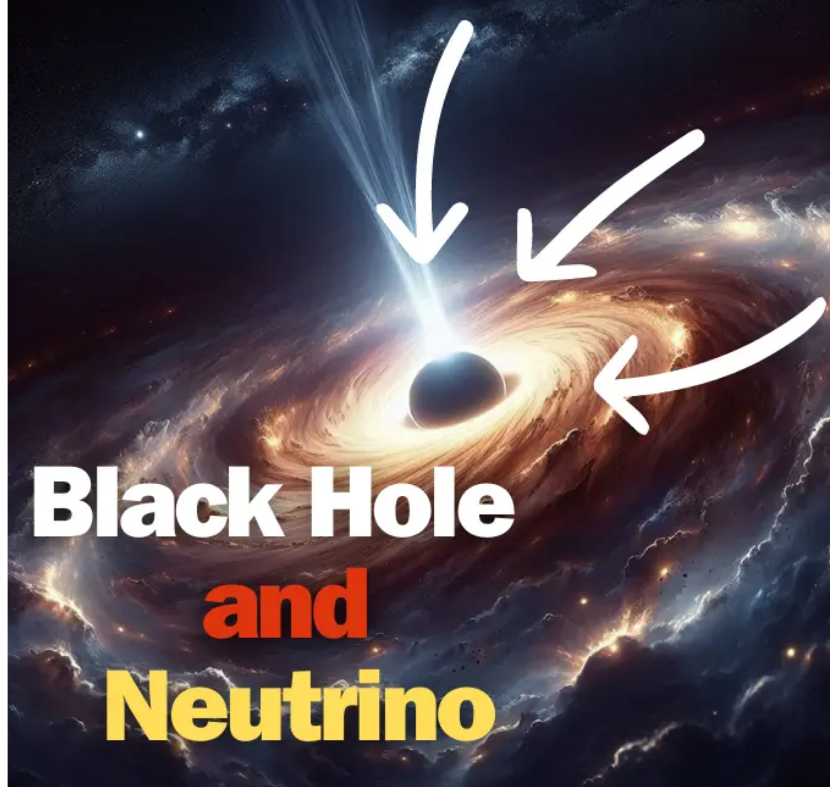
Astrophysical implications
The composition of relativistic jets
Proton-electron vs. Poynting flux
The physics of the vicinity of the black hole (obscured region)
Neutrinos can escape
5

Slide 6
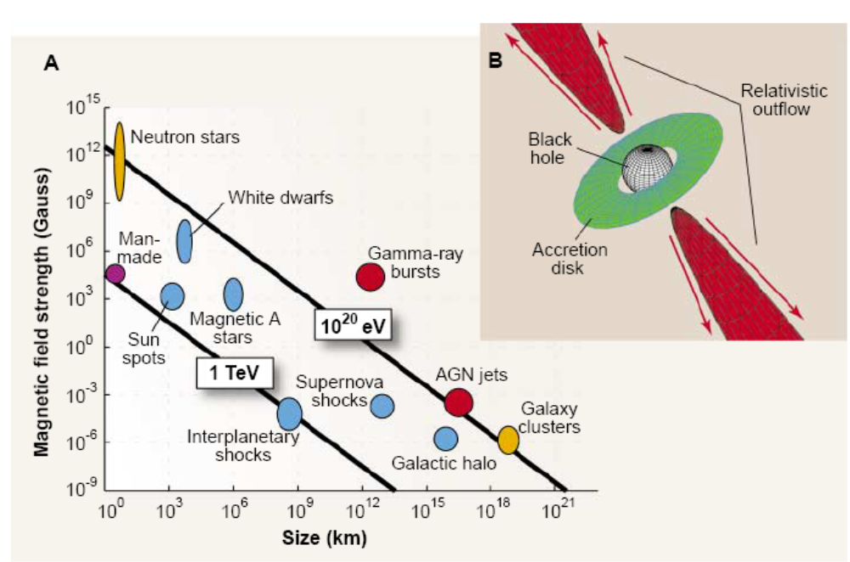
Theoretical models for neutrinos before IceCube detection
1. AGN with jets or without jets (Stecker et al. 91; Kalashev et al. 13)
2. GRB (Waxman & Bahcall 97)
3. Starburst galaxy (Loeb & Waxman 2006)
4. Tidal disruption events (Wang & Liu 16)
5. …
Hillas’s criterion

Slide 7
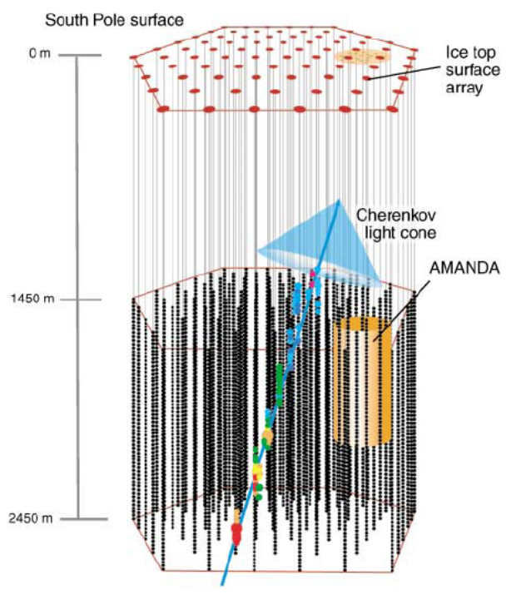
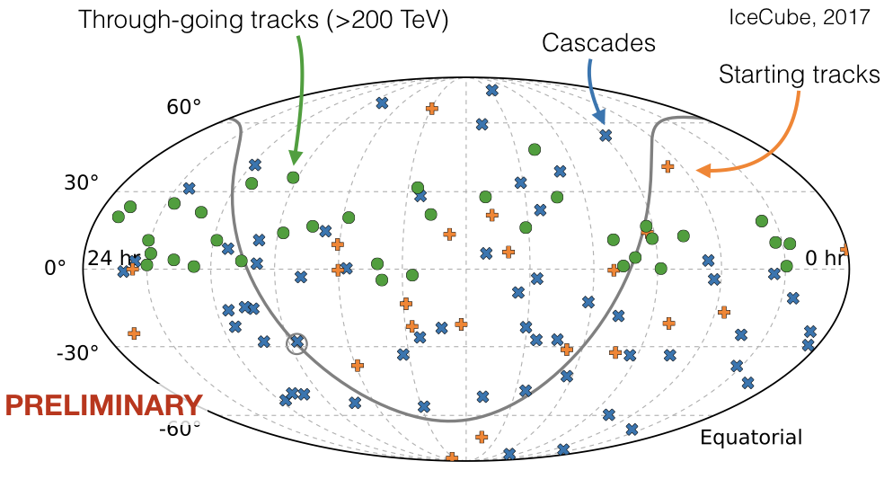
Breakthrough：IceCube discovery of HE neutrinos in 2013
Nearly isotropic, should be dominated by extragalactic neutrinos
The Galactic plane has a flux about 10% of the extragalactic flux
May imply the existence of sources of high-energy neutrinos in other galaxies that are not present in our own
IceCube coll., Science 342 (2013)

Slide 8
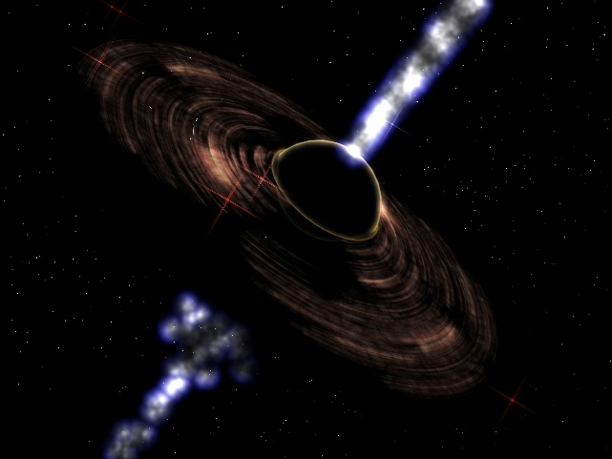
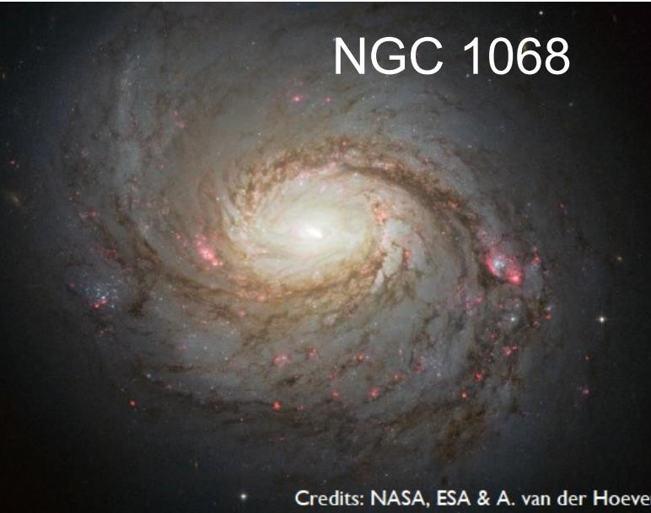
Two extragalactic source candidates
TXS0506+056
Blazar flare: strong jet pointing to us
Seyfert galaxy: jet is weak

Slide 9
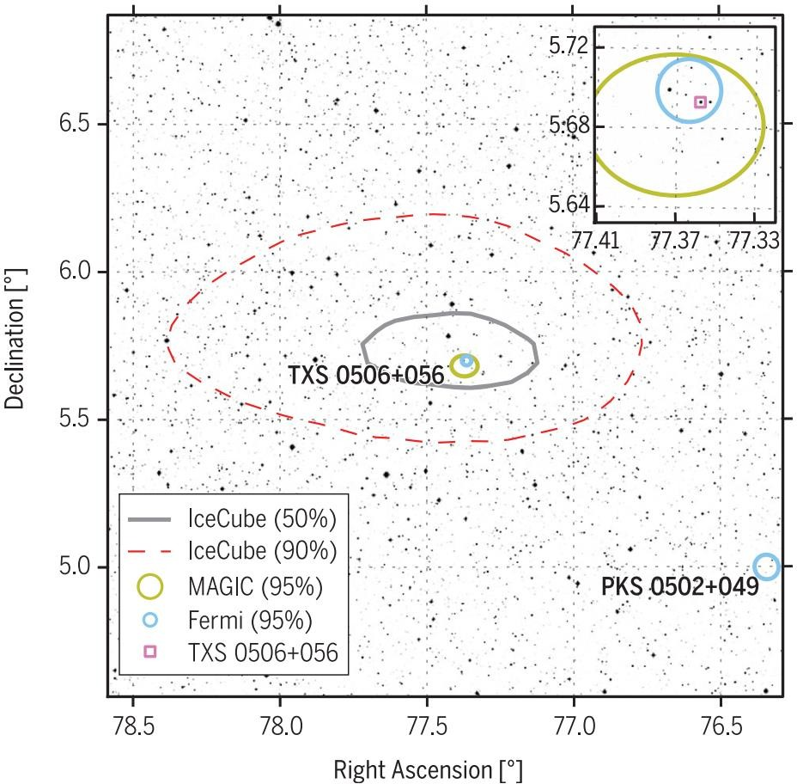
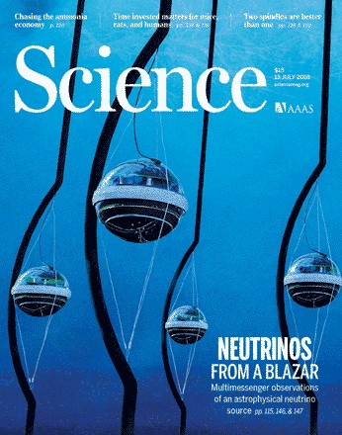
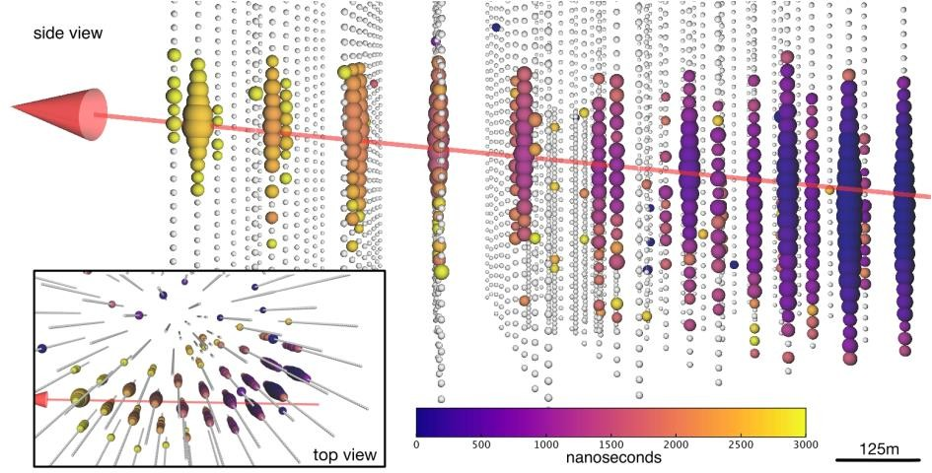
1. IceCube detected a neutrino from a blazar flare (TXS0506+056)
The estimated energy of neutrinos:290TeV (>180TeV)
*Blazars are a kind of AGNs with jet pointing to the observer

Slide 10
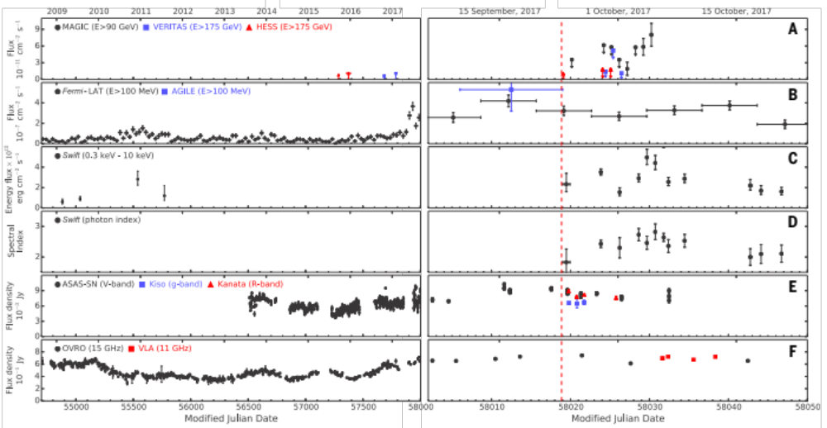
Multi-wavelength flare
The top 50th brightest BL Lac, z=0.3365
Confidence level of ~3σ

Slide 11
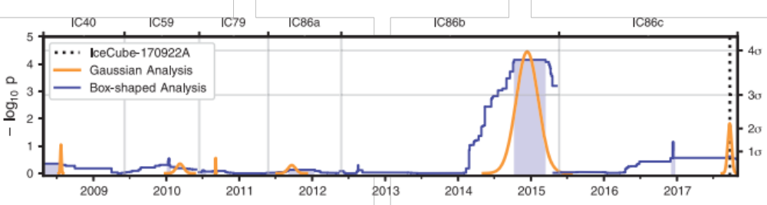
A neutrino flare also seen in 2014-2015
2014-2015 neutrino flare!
But, no obvious coincident gamma ray flare!?
IceCube Collaboration,
Science 361, eaat2890 (2018)

Slide 12
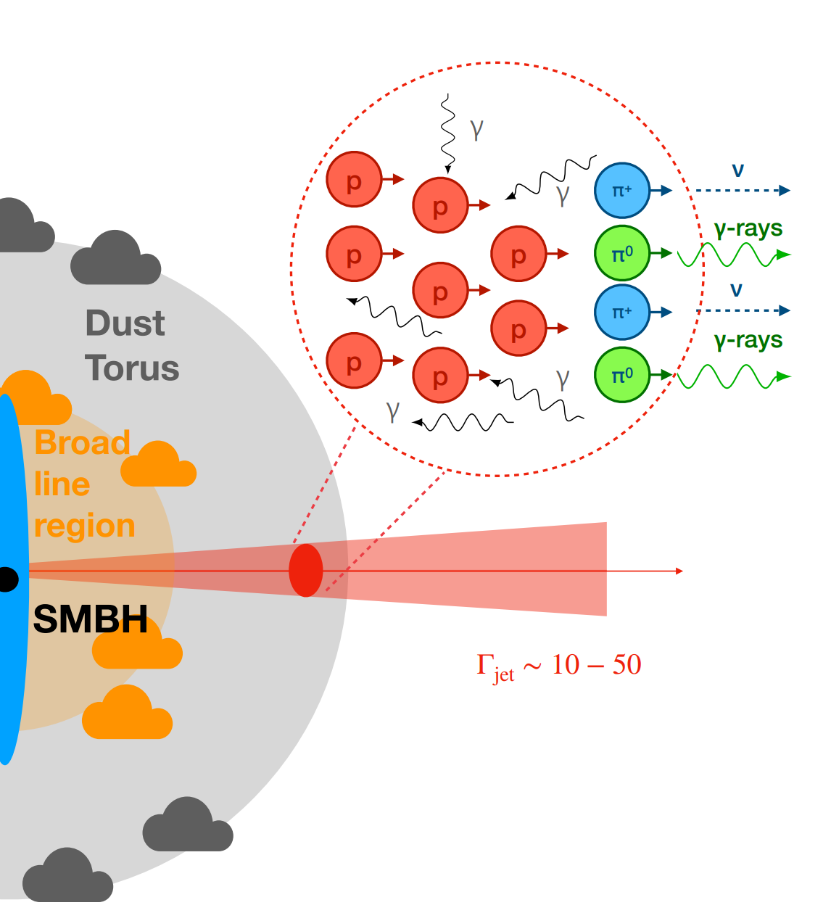
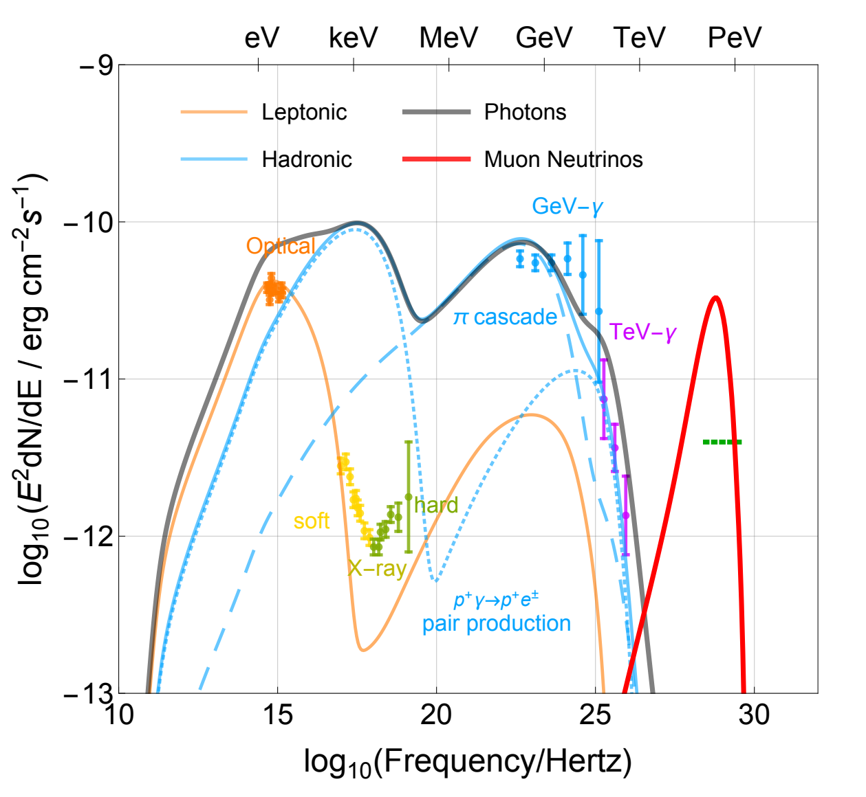
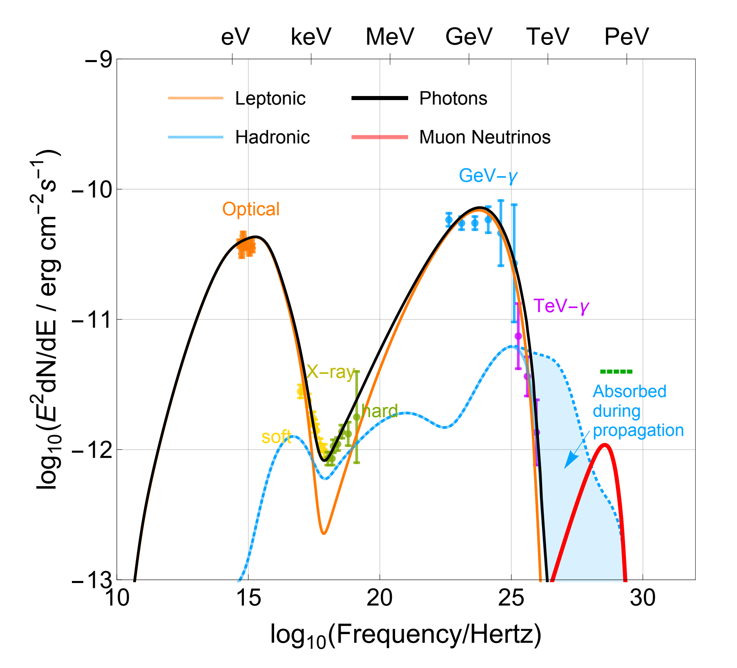

One-zone pγ model
pγ interaction with uv photons:
Problem: cascade emission accompanying the neutrino production exceeds the observed X-ray flux
Need to be lucky event!
Gao, et al., 2019

Slide 13
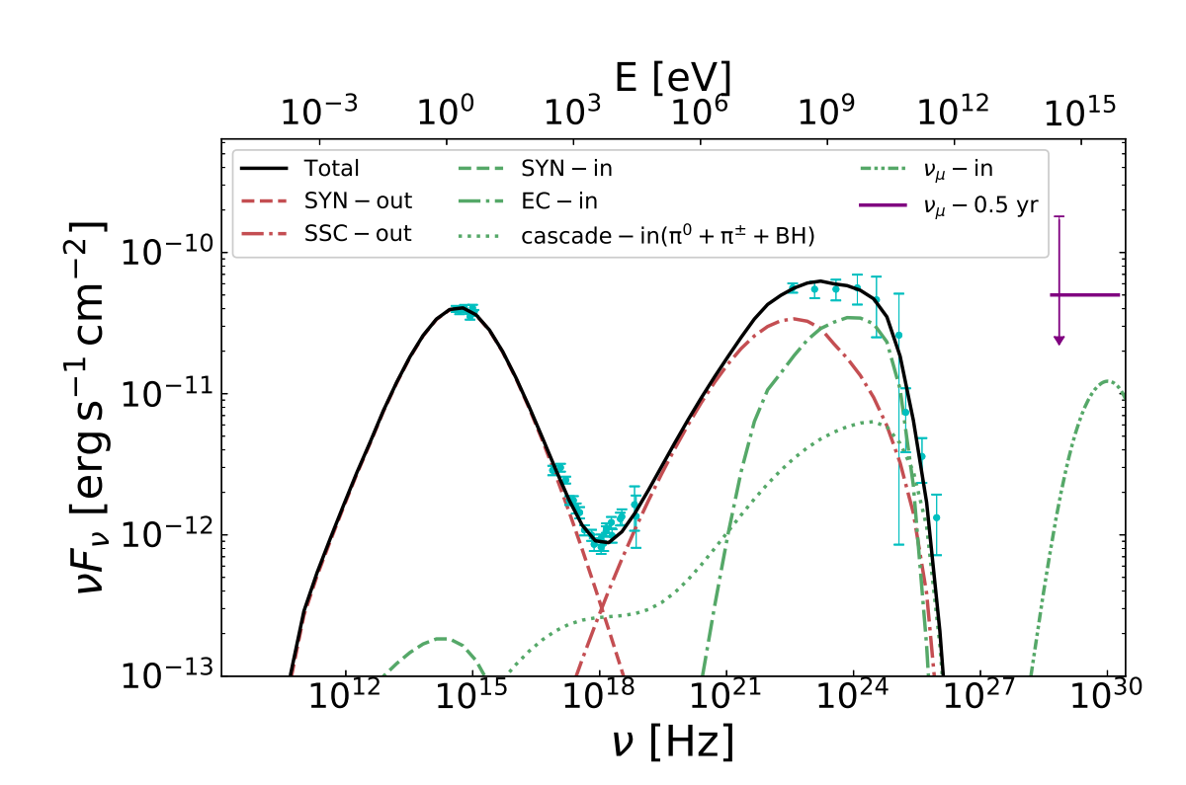
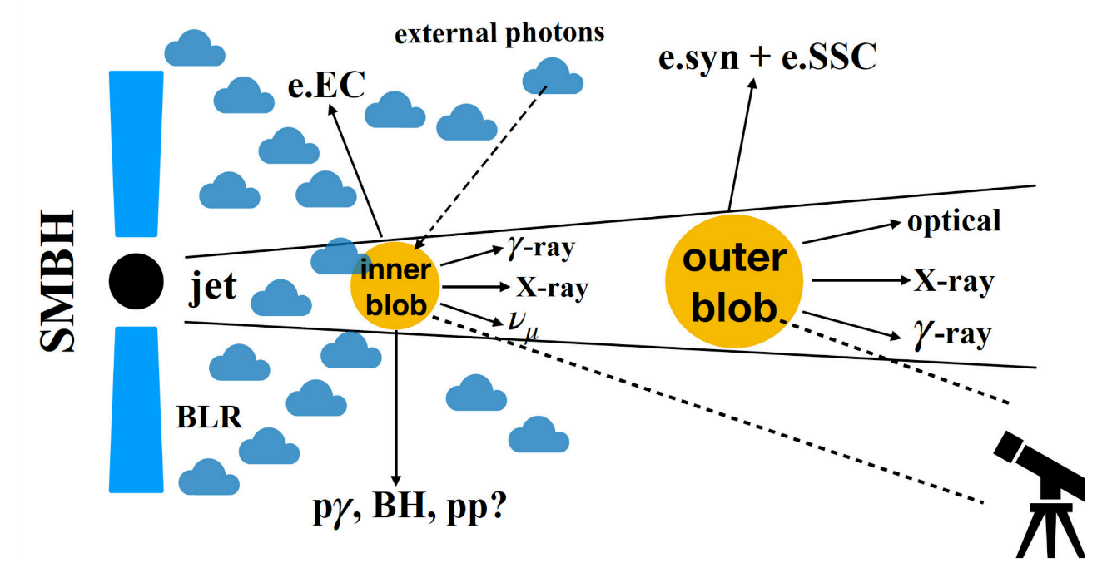
Two-zone pγ model
Two zones: inner blob within the BLR，outer blob far from BLR
Neutrinos are produced in the inner blob(pγinteraction with BLR photons)，while X-rays come from the outer blob (syn.+SSC)
Gamma-rays accompanying neutrinos cascade down to GeV-TeV energy, allowing for a higher neutrino flux
Xue，Liu, et al. 2019, ApJ

Slide 14
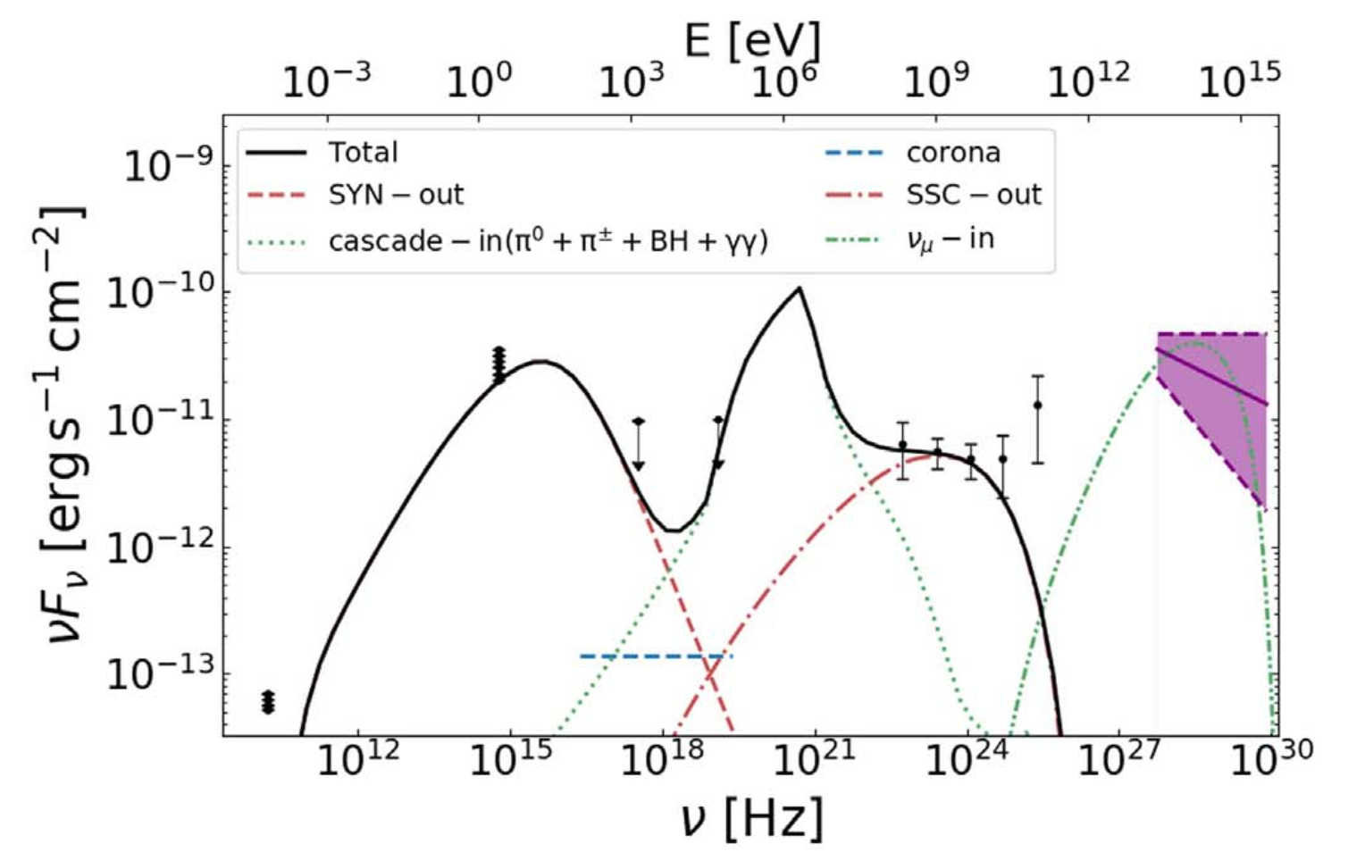
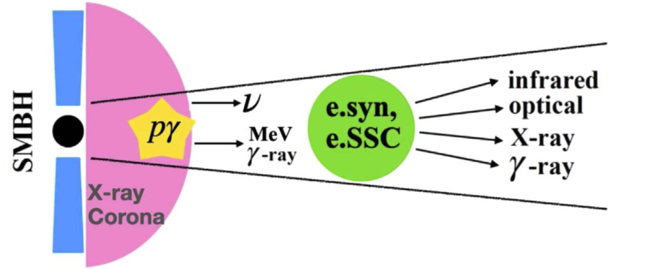
A Two-zone Model for “Orphan” Neutrino Flares
Xue，Liu, et al. 2021, ApJ
Particle acceleration/injection takes place in the inner blob at the jet base, where the X-ray corona provides target photon fields for efficient neutrino production and strong GeV gamma-ray absorption
May explain the 2014–2015 neutrino flare associated with the blazar TXS 0506+056 and other cases

Slide 15
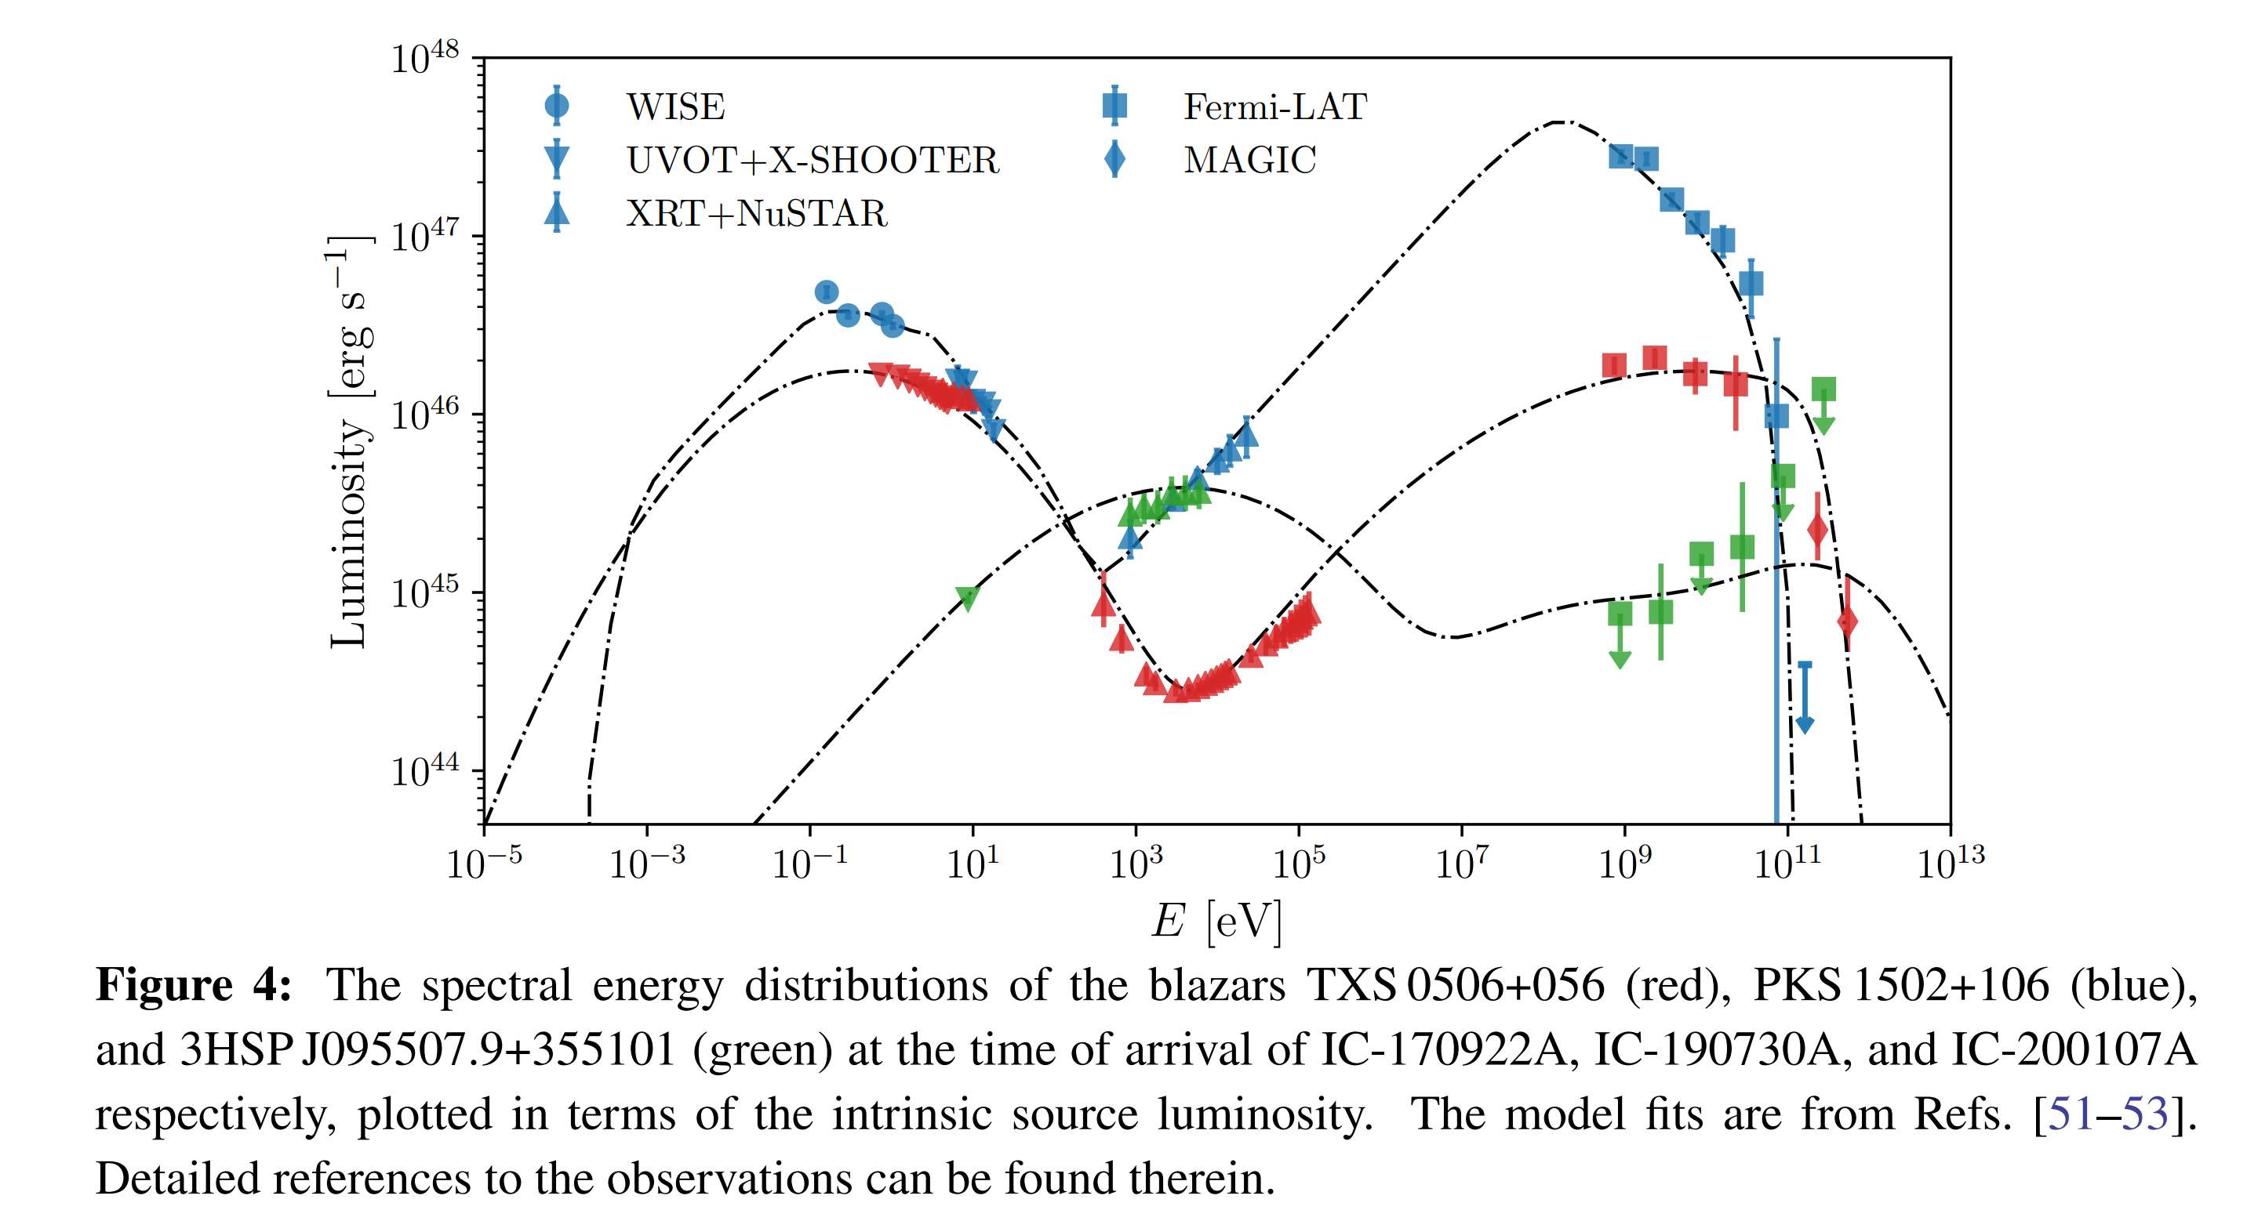
Other neutrinos possibly associated with blazar flares
Since the observation of IC-170922A, more blazars have been found in the error circles of high-energy alert neutrinos, albeit with lower significance individually.

Slide 16
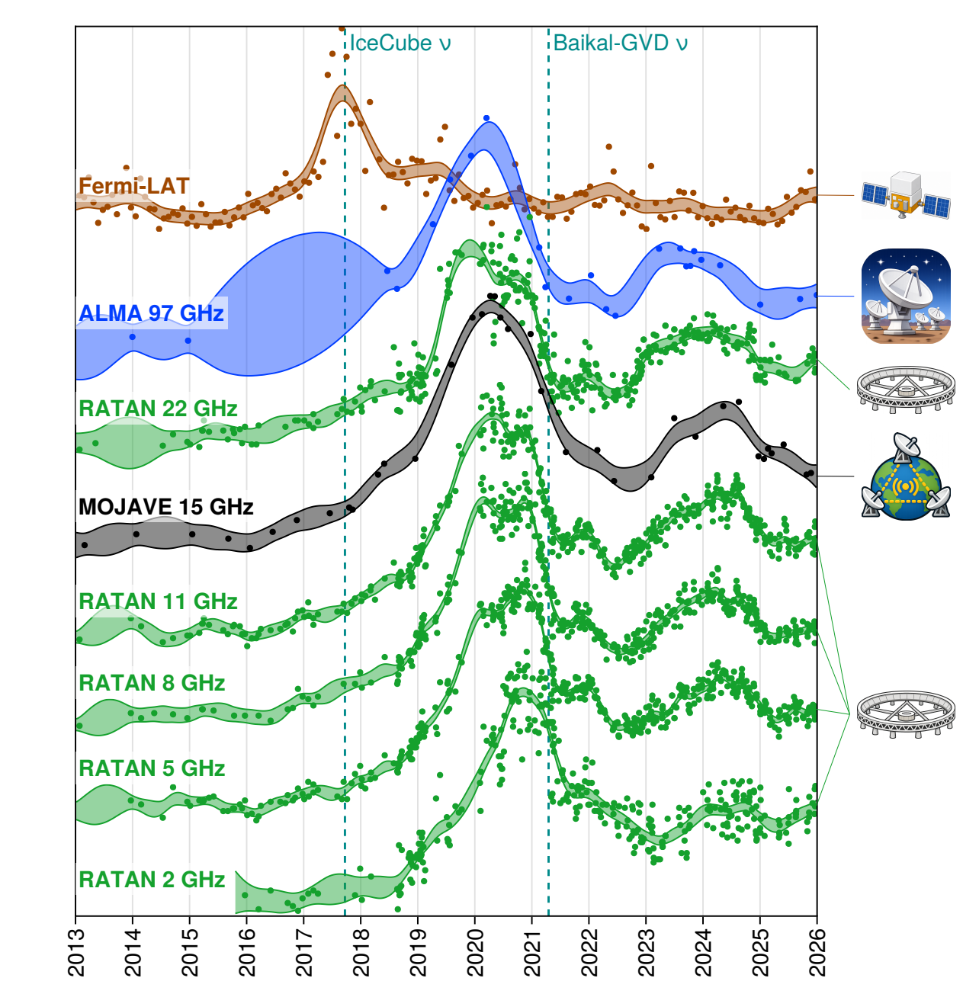
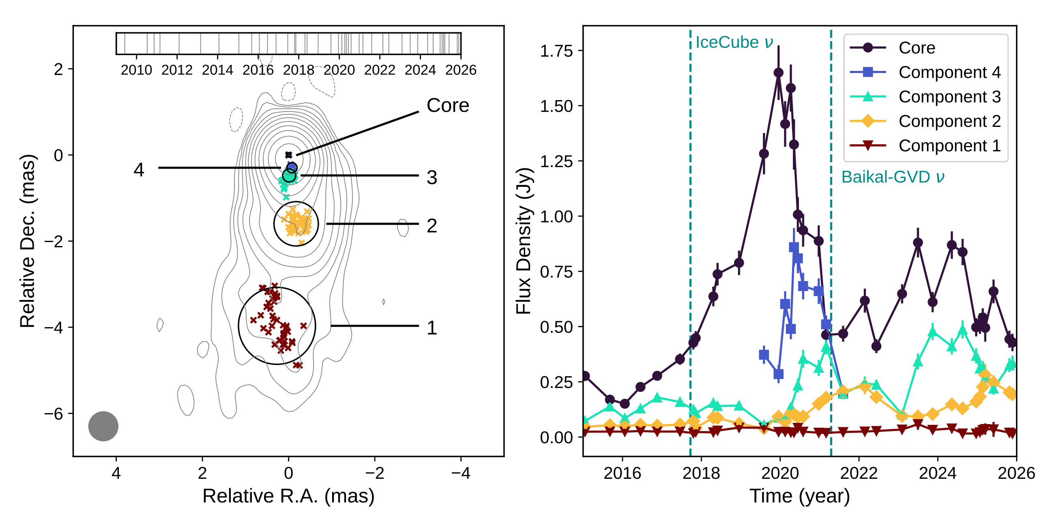
A hidden ultra-relativistic spine in the jet of TXS0506+056
GVD event: 210418CA
Very Long Baseline Interferometry (VLBI) imaging
Light curves of model-fit components, showing a progressive delay of flare peaks with distance from the core
Multi-band light curves showing the temporal evolution from gamma-rays to radio frequencies.
Y. Kovalev et al 2026

Slide 17
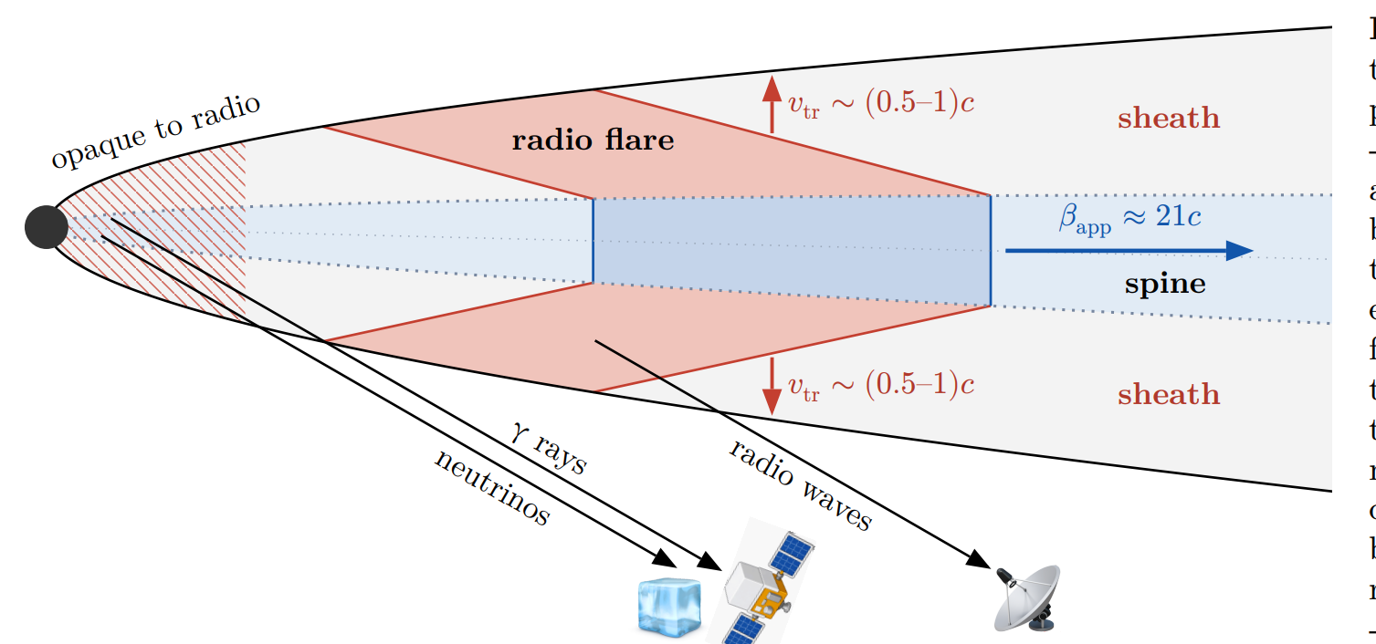
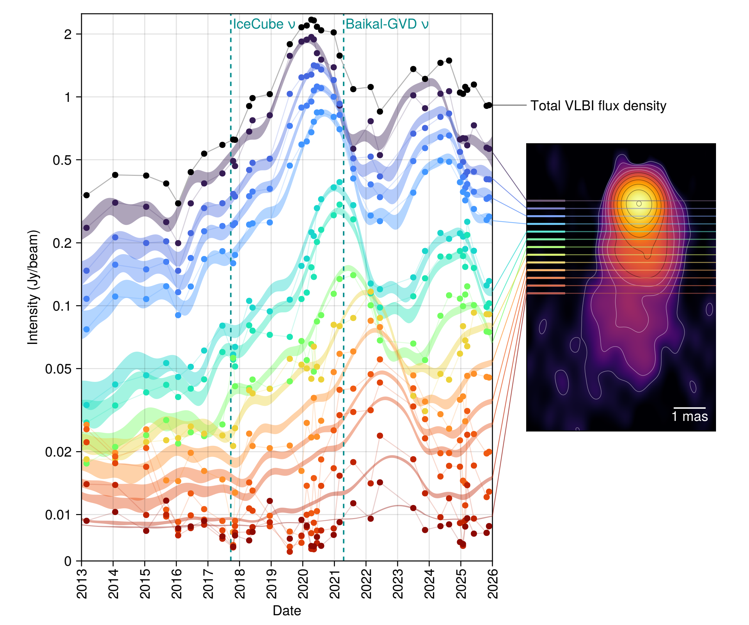
Spin-sheath explanation
A disturbance propagating along the spine triggers a transverse expansion of enhanced emission into the sheath, forming a conical brightening pattern moving downstream.
The neutrino and gamma-ray flare originates near the jet base, while the radio flare peaks only after the disturbance has crossed the sheath, naturally producing the observed multi-year delay.

Slide 18
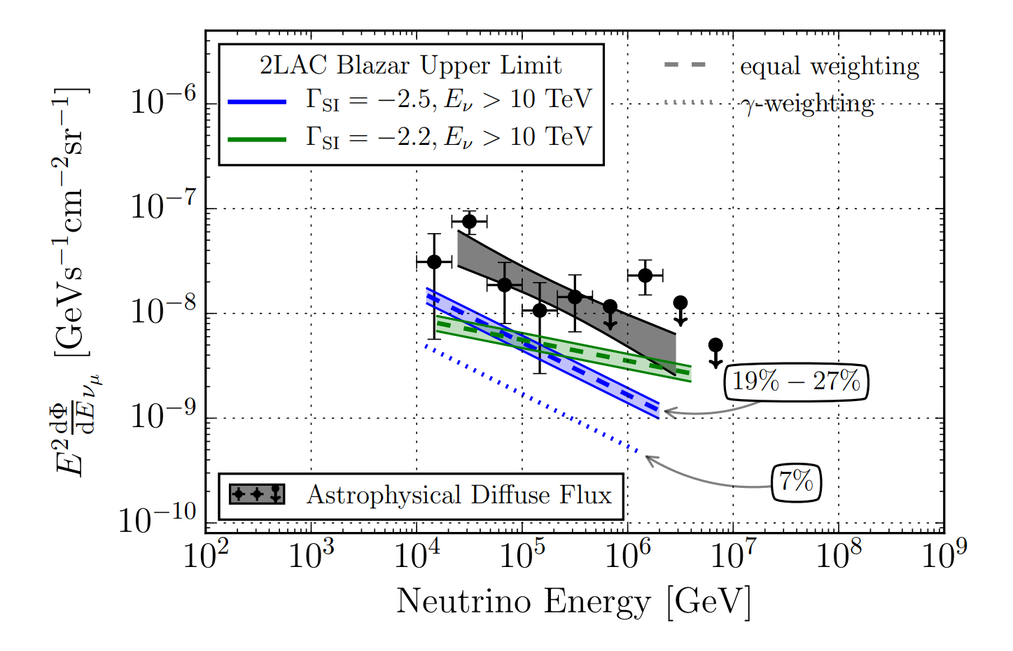
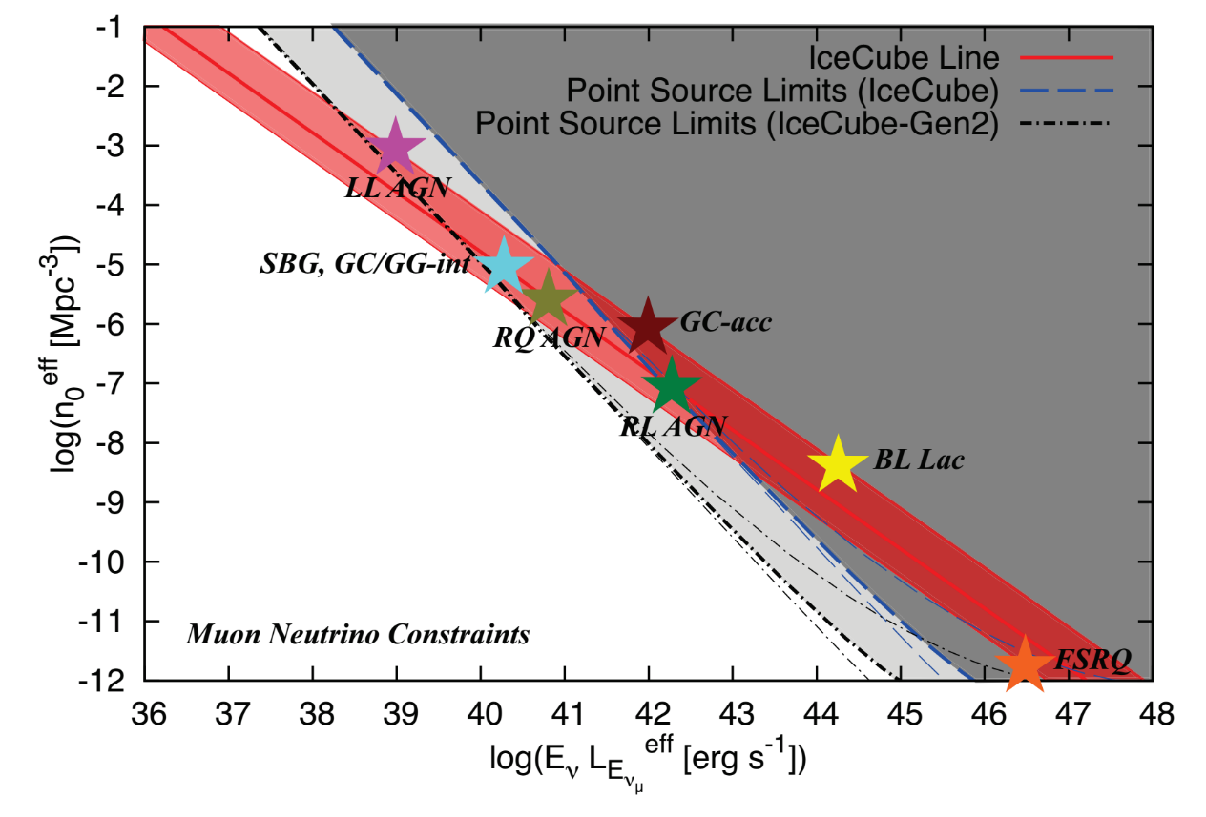
But, blazars can not be the dominated neutrino source
1. Stacking constraints on Blazars
2. Multiplet & Auto-Correlation Constraints
Searching for cumulative neutrino emission from blazars in the 2nd Fermi-LAT AGN catalogue (2LAC)
No significant excess is observed and upper limits for the cumulative flux from these populations are obtained
The density of neutrino source should be high！
Murase & Waxman 2016

Slide 19
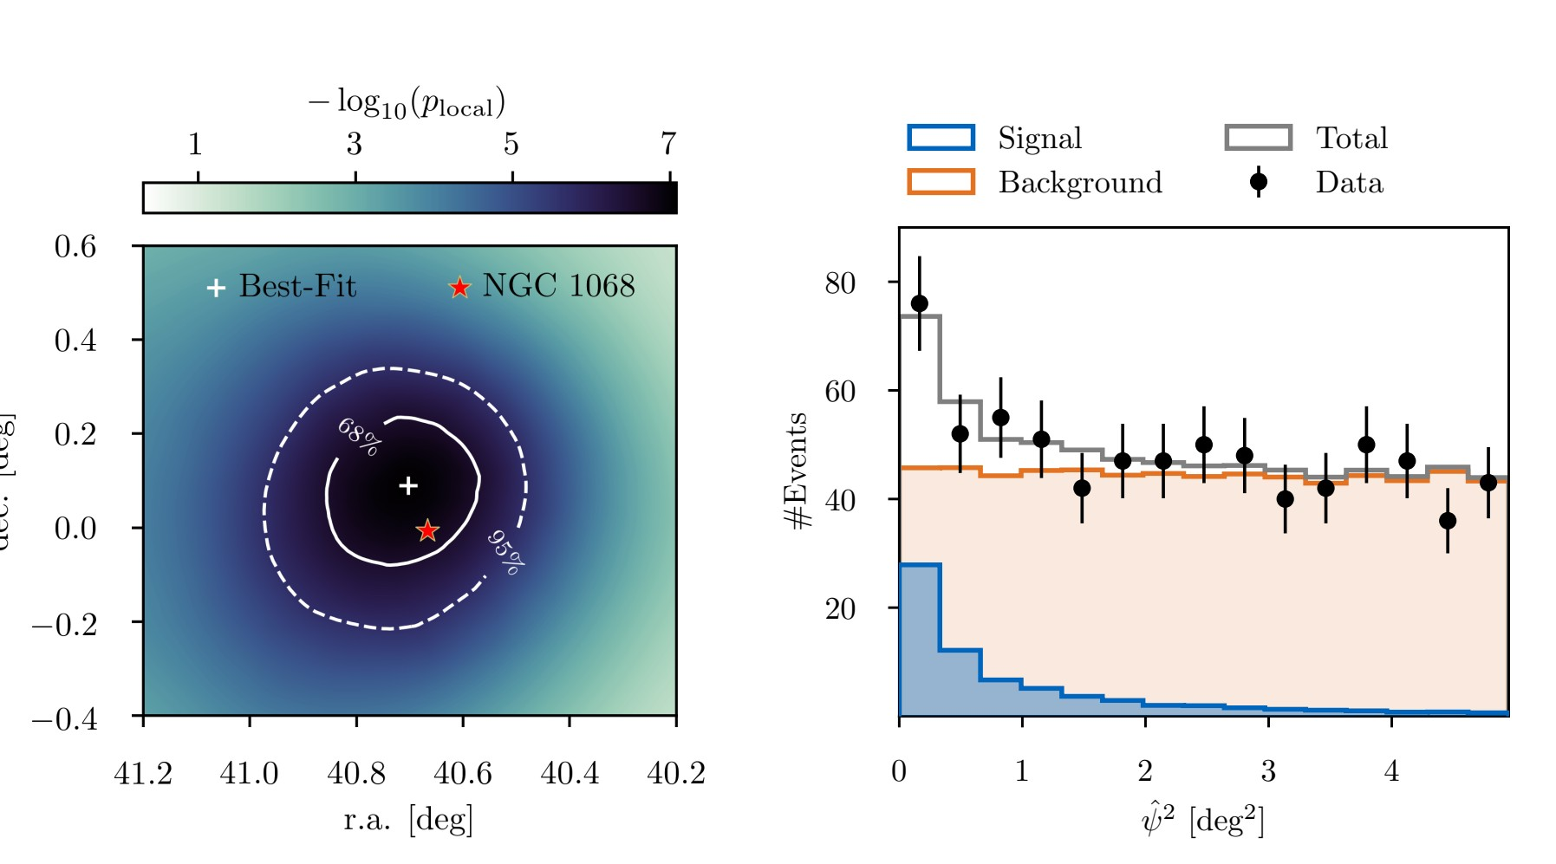
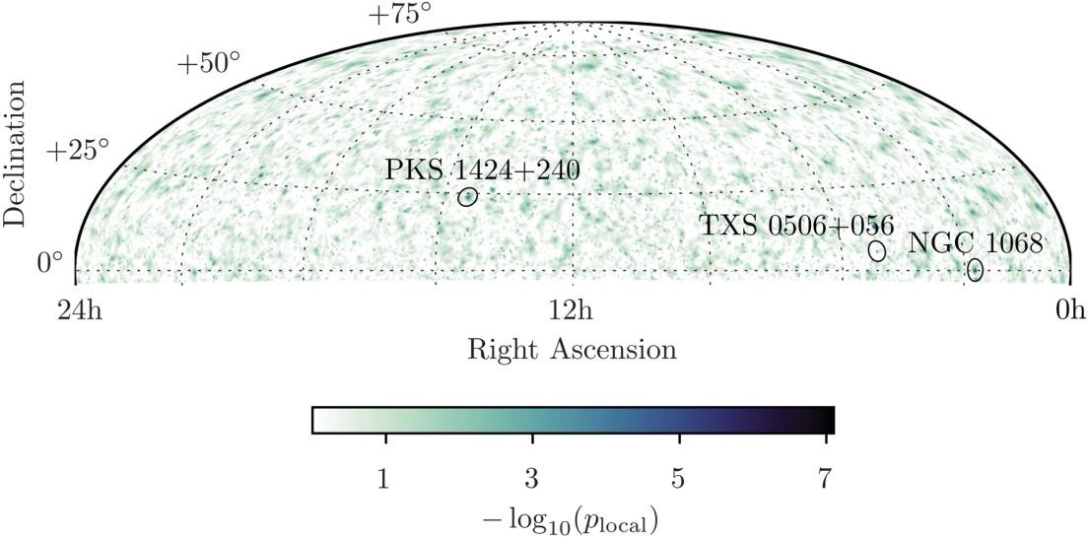
2. A hot spot in the neutrino sky: Seyfert galaxy NGC1068
Seyfert NGC1068：4.2σ excess
D=14 Mpc

Slide 20
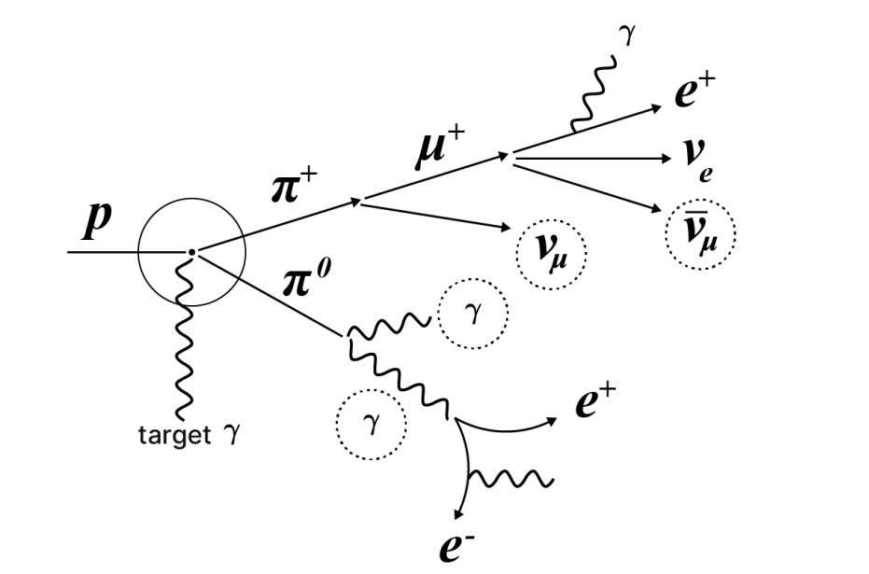
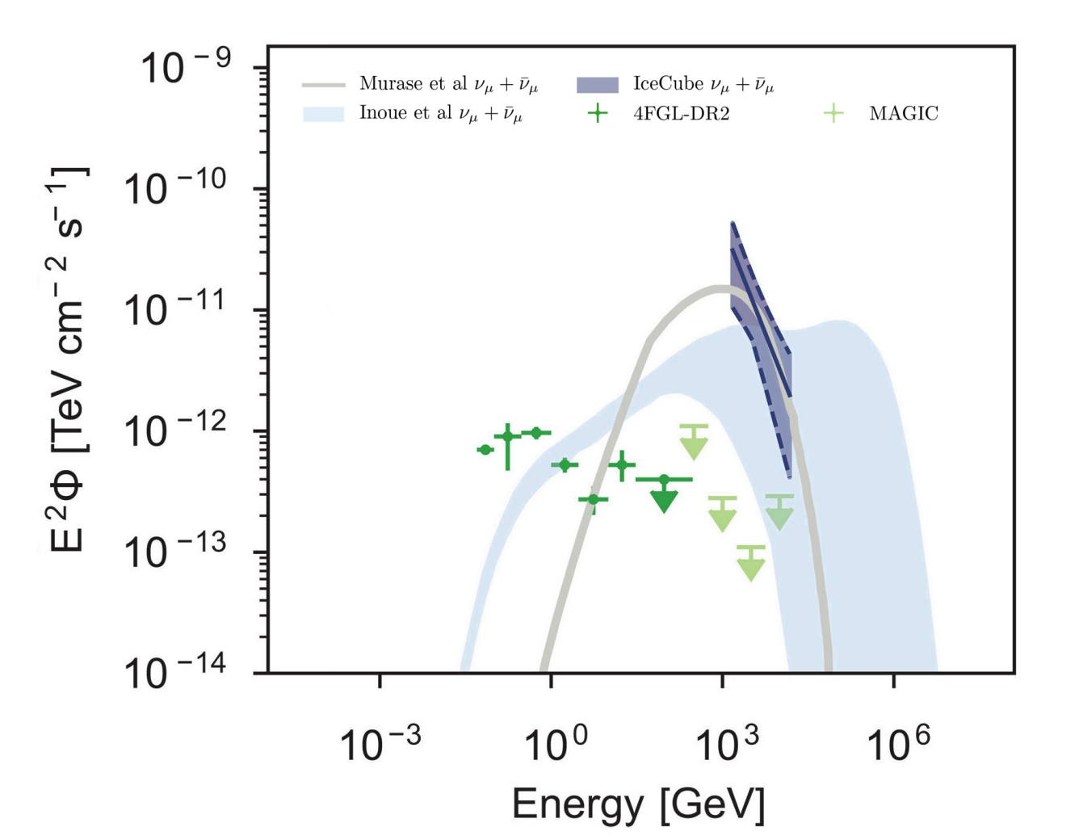
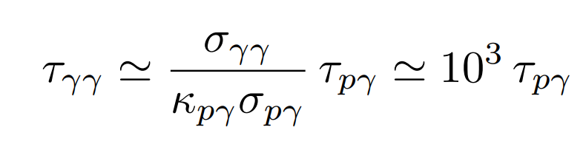
Multi-messenger SED of NGC1068
The neutrino flux exceeds the TeV gamma-ray flux limit by at least one order of magnitude.
Hidden sources： AGN core ?
But, this is Not a surprise !

Slide 21
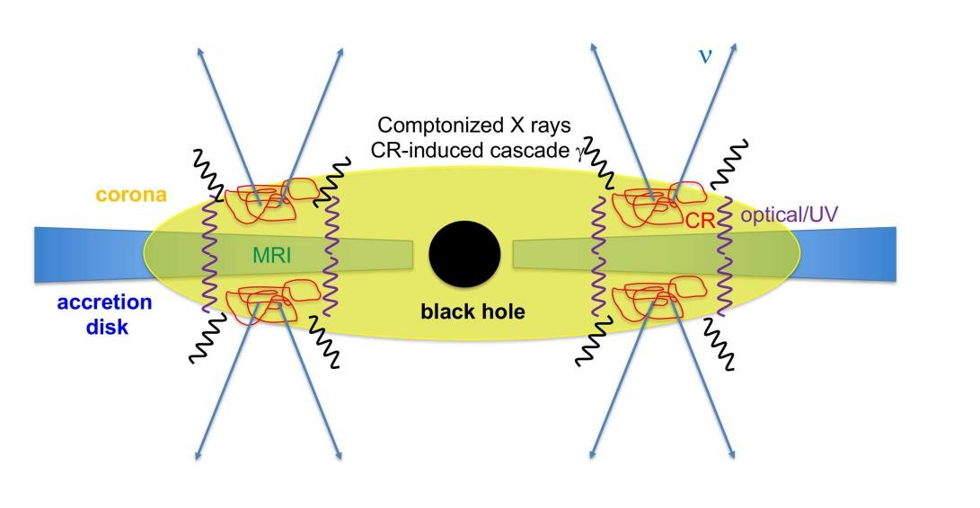
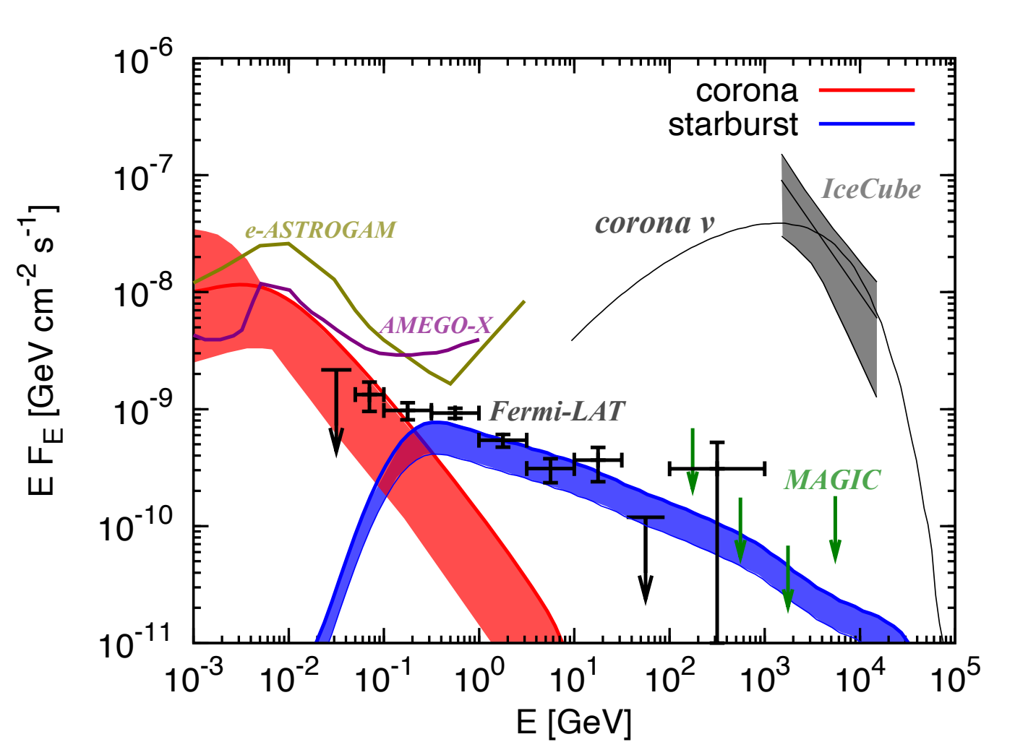
Model：black hole disk/corona
AGN corona is a hidden source：gamma-rays are absorbed，while neutrinos can escape
Acceleration of CR：turbulence acceleration or magnetic reconnection
Murase et al. 2022

Slide 22
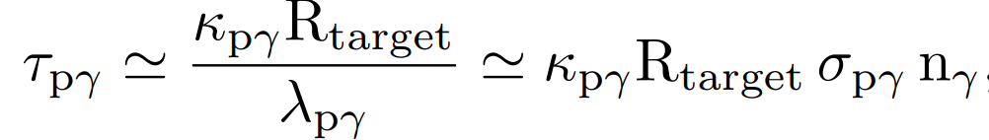
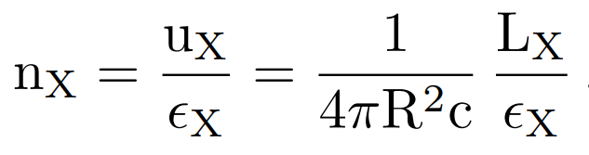
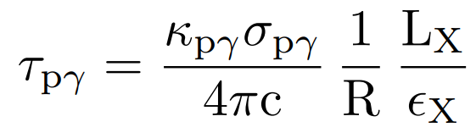
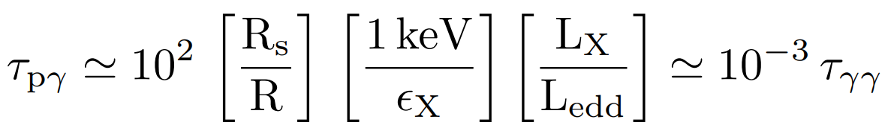
Corona model for NGC1068
NGC 1068, L_{X} ∼ 10⁴³ erg/s at keV energies, yields L_{X} ≃ 10⁻² L_{edd}
Even for a relative modest opacity of τ_{pγ} ≳ 0.1, the above result requires that the X-rays be confined to a radius of R ≃ 10 R_{s} (i.e., the size of corona)
This automatically guarantee the suppression of the pionic gamma-ray flux by more than one order of magnitude relative to neutrinos

Slide 23
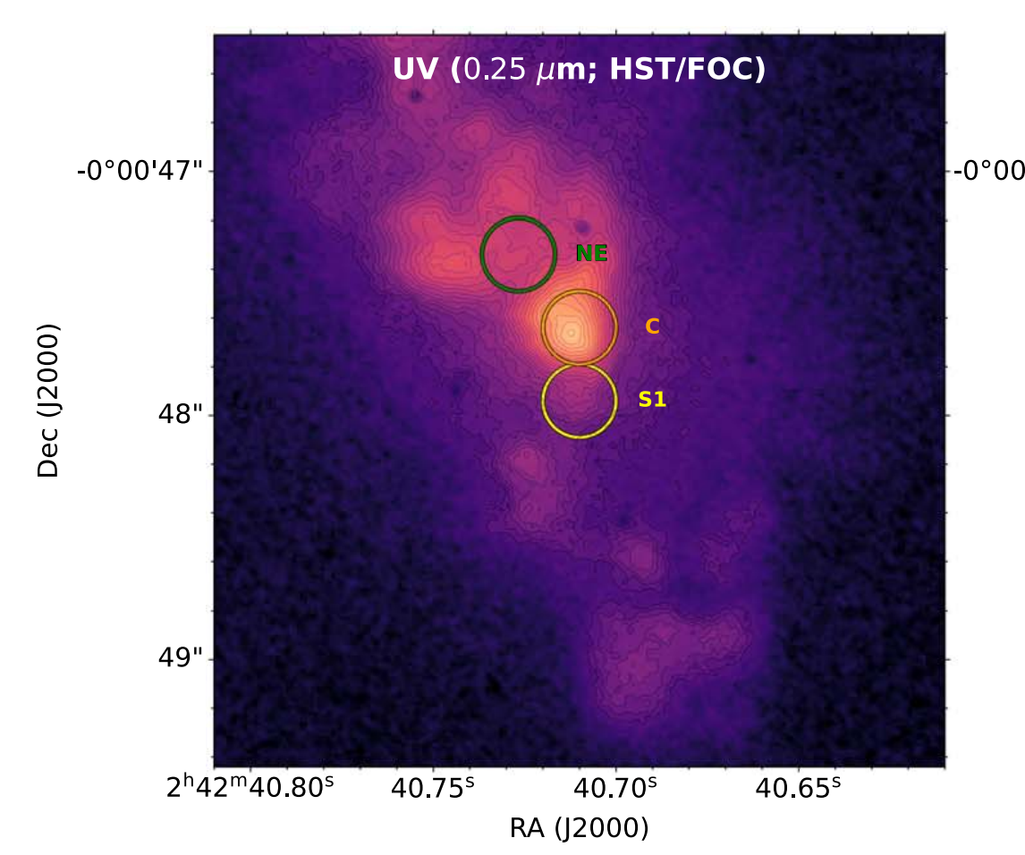
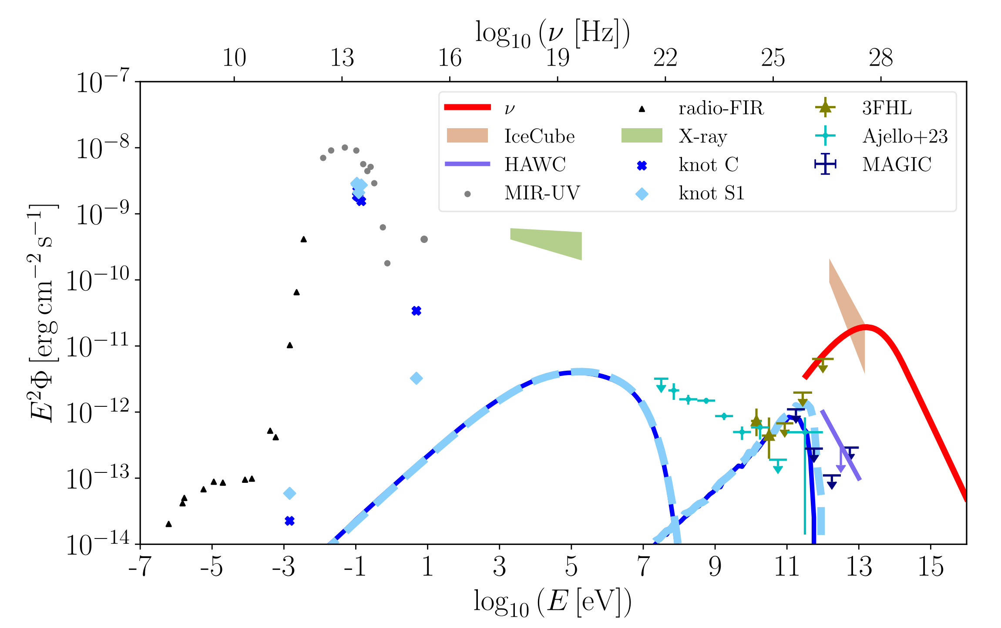
Jet-interacting knot model
Inner Circumnuclear Region of NGC 1068
Fang et al. 2023

Slide 24
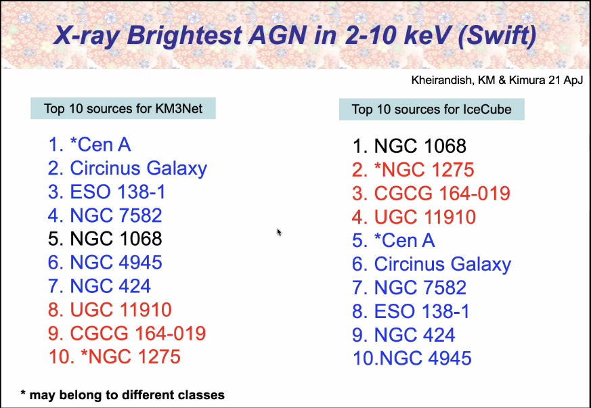
Why NGC1068?
High X-ray brightness after correcting the NH absorption
Other reasons (e.g. Zhou+ et al. 2025)

Slide 25
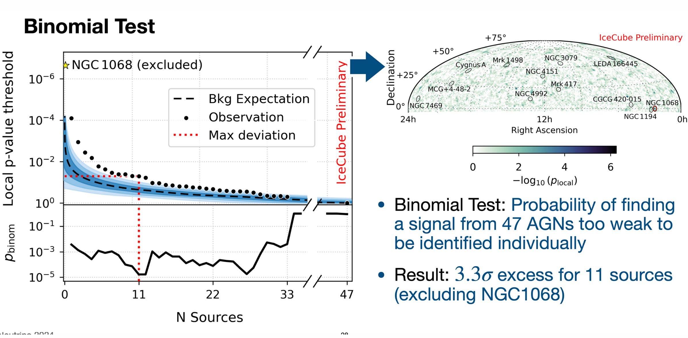
Other X-ray AGNs with neutrino excess
selected 47 X-ray bright Seyfert galaxies from the Swift/BAT survey that were not included in the list of gamma-ray emitters.
IceCube coll. 2025

Slide 26
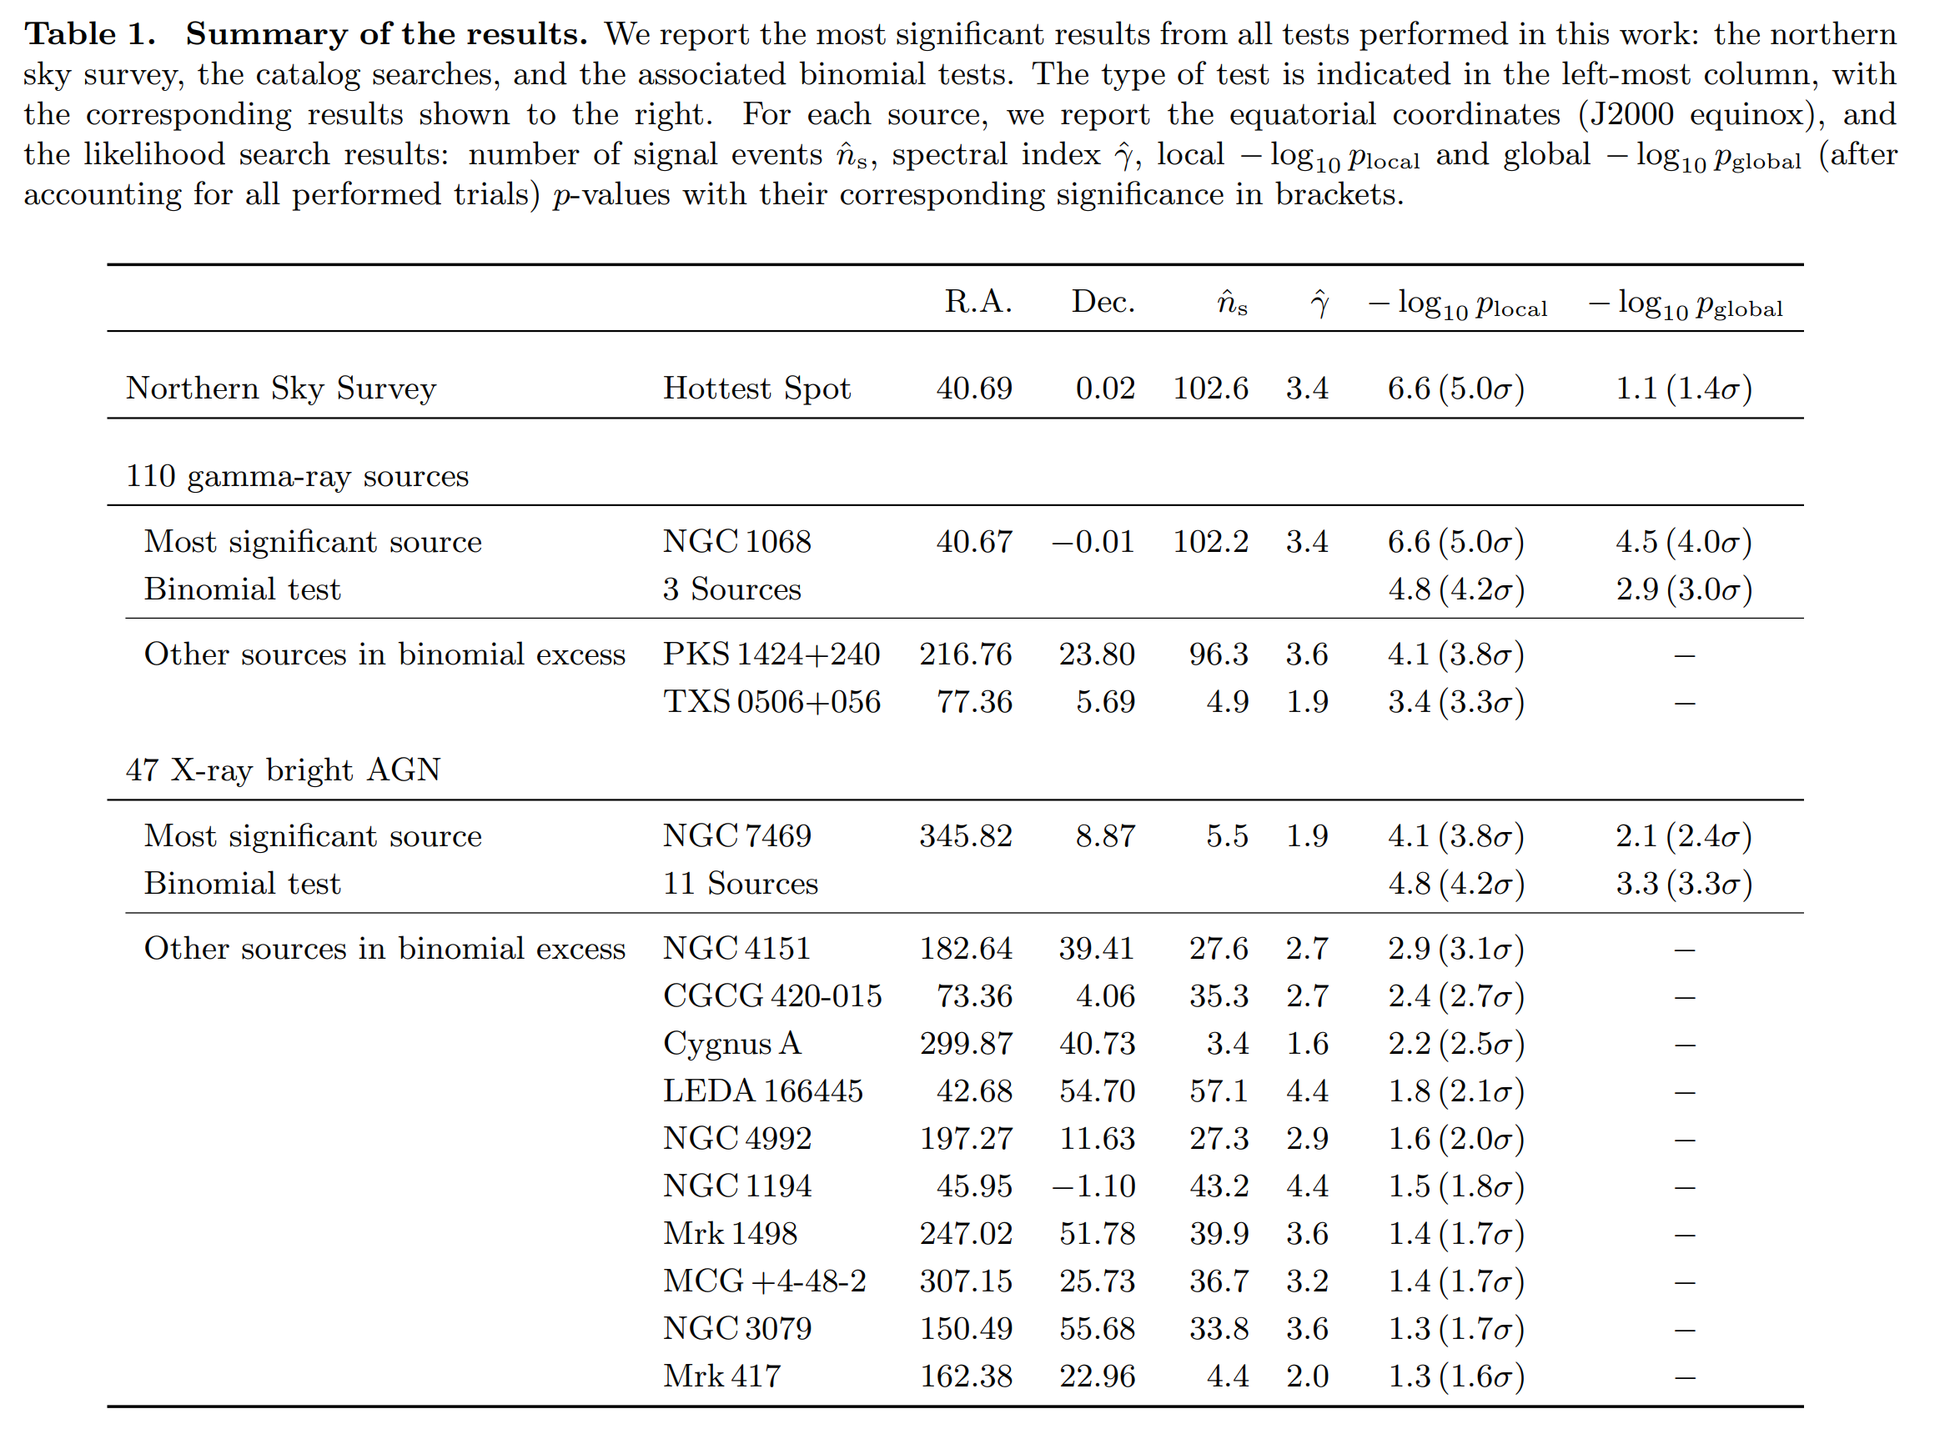
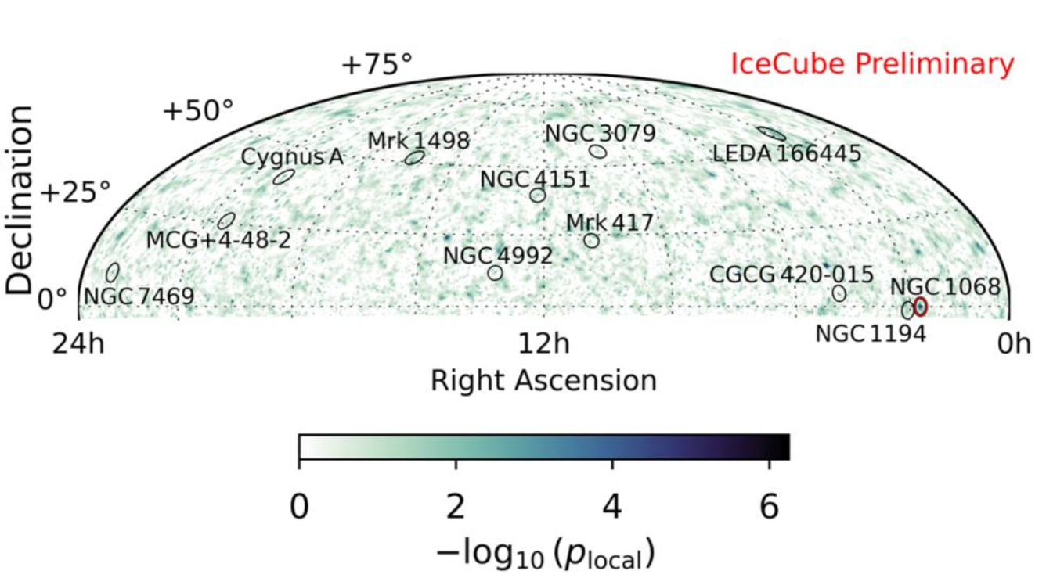
Other X-ray AGNs with neutrino excess
The 2nd most significant source is NGC 7469
The results strengthen the evidence that X-ray bright cores of active galactic nuclei are neutrino emitters

Slide 27
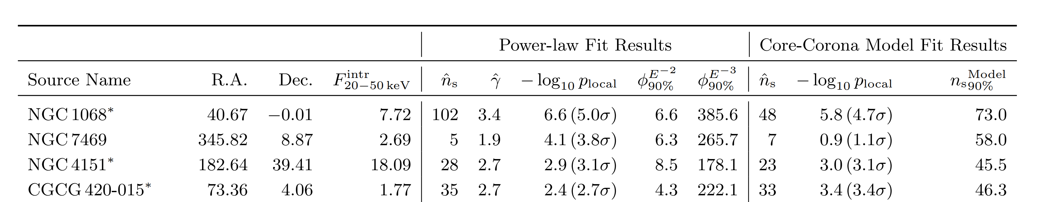
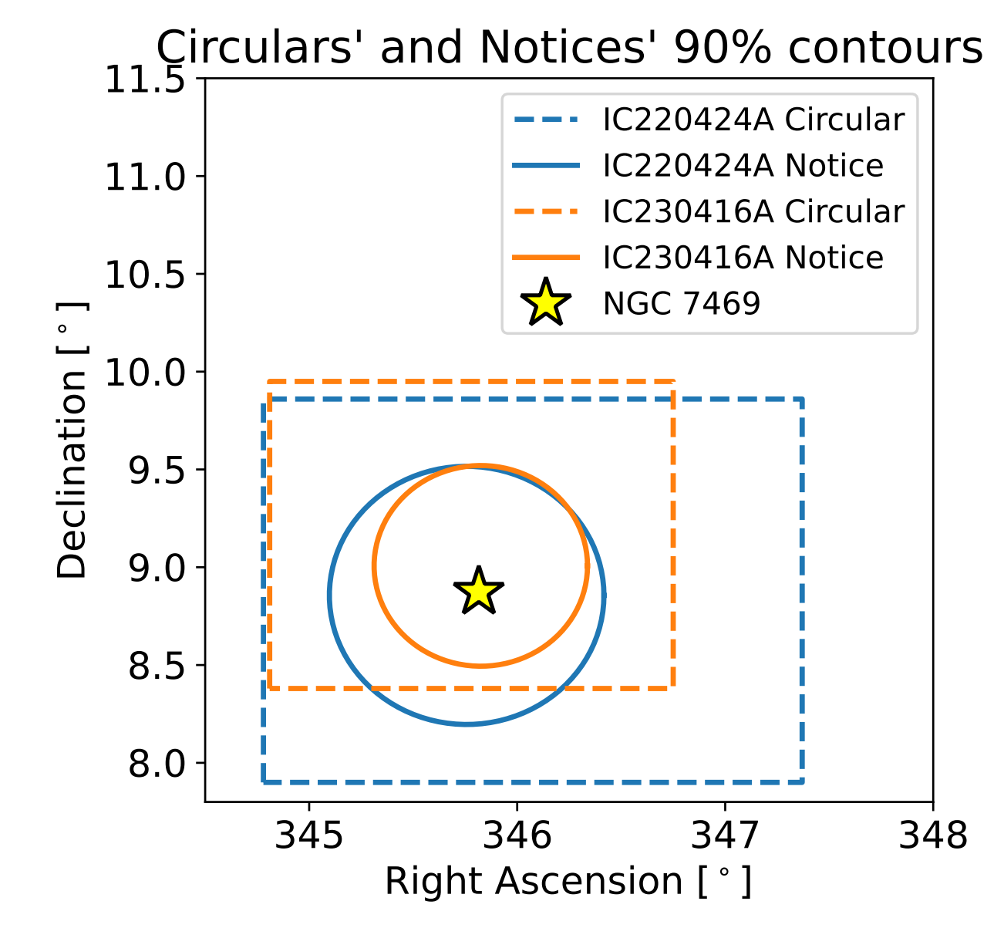
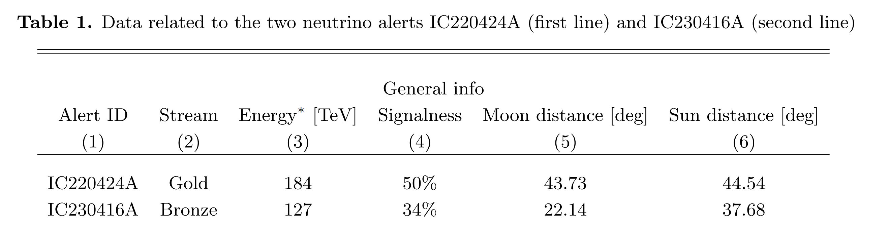
NGC7469: two high-energy neutrinos

Slide 28

Comparison among the neutrino sources
the top 4 sources in the list of X-ray bright AGN.

Slide 29

NGC7469 neutrino：high- σ corona ?
a maximum proton energy Ep,max > 2 PeV
The lack of lower-energy neutrinos from NGC 7469 also suggests a neutrino spectrum harder than that of NGC 1068
Two acceleration mechanism in the corona: both need a high σ
Turbulence acceleration
Magnetic reconnection acceleration
arXiv:2510.19662

Slide 30

All-sky diffuse neutrino
We find that AGN coronae could account for the diffuse neutrinos up to PeV energies if a significant fraction of AGNs have magnetizations as large as σ ∼ 1−10.
Pγ interaction with X-ray photons produce neutrinos peaking at energy of approximately 30 TeV.
Yang et al. 2016

Slide 31

A break in the neutrino spectrum
reject a single power-law， with significance > 4 σ in favor of a broken power law.
A break in the neutrino spectrum may favor pγ process over pp process
IceCube col. 2025, PRL

Slide 32

3. Other possible neutrino sources (1)：tidal disruption events
No TDE found in the stacking analysis (IeeCube 2026)
IC-191001A

Slide 33


Diffuse neutrinos from successful and choked jets
Successful jets -> diffuse PeV neutrinos
More numerous choked jets -> 10 TeV neutrinos
γ-rays are absorbed: hidden source
TDE might contribute a fraction of neutrinos
Wang & Liu 2016, PRD

Slide 34


4. Other possible neutrino sources (2)：starburst galaxy
Starburst galaxy: hadronic GeV emission
CR accelerators: SNR, hypernova remnant, galactic wind…

Slide 35


4. Other possible neutrino sources (3) ：low-luminosity GRBs
Normal-luminosity GRBs contribute to <1% neutrino background
No neutrinos from the BOAT GRB 221009A: put useful constraints on the dissipation model
(Ai & Gao 2023; Liu et al. 2023)
Low-luminosity GRBs are still possible neutrino sources: high event rate (e.g., Liu, Wang, Dai 2013; Yu & Zhang 2015)
GRB
GRB221009A
Ai & Gao 2023

Slide 36



220PeV neutrino: GZK neutrinos?
220PeV neutrino corresponds to proton of 4*10¹⁸eV
Origin unknown：1）cosmogenic (GZK) neutrinos?
2）or from a special transient?

Slide 37
2. Future prospect of extragalactic neutrino sources

Slide 38

The source for the bulk of neutrinos are unknown
NGC1068 and TXS 0506+056 only 1% of the all-sky diffuse neutrino flux，
A popular viewpoint: the majority of neutrinos may come from weak sources
To detect these weak sources, we need a neutrino telescope with angular better than 0.1 degree and high sensitivity

Slide 39





Next-generation neutrino telescopes
IceCube Gen-2
Baikal-GVD
Huge Underwater high-energy Neutrino Telescope (HUNT)

Slide 40

Sensitivity and angular resolution are crucial
More sensitive：1e-13 TeV/cm^2/s （30KM³）
Better angular resolution: 1º -> 0.1º
Will be very useful to for follow-up observations

Slide 41

Prospect for Seyfert AGNs
30KM³ telescope can detect
NGC1068 >5σ within 3yr
Could detect neutrino sources weaker than NGC1068
0.1 degree resolution is useful for EM follow-up
The era of HE neutrino astronomy!
30KM³
PRELIMINARY

Slide 42


One example: Neutrino alert follow-up with Einstein Probe
EP/FXT follow-up to one neutrino alert (Golden event)

Slide 43

Prospect for cosmogenic neutrinos
UHECR+CMB ->cosmogenic neutrinos
Distinguish between GZK cutoff or maximum acceleration energy

Slide 44
Summary
Extra-galactic/Galactic neutrino backgrounds have been detected by IceCube, but the sources are not firmly identified
There is evidence/hints of neutrino association with blazars and Seyfert galaxies (3-4σ level); originate from relativistic (choked) jets
Neutrino flux is higher than gamma-ray flux: hidden sources (e.g., AGN corona)
Next-generation neutrino telescopes are expected to truly discover extragalactic neutrino sources (at >5σ confidence)
The higher spatial resolution will greatly increase the chances of finding multiwavelength electromagnetic counterparts, bringing neutrino astronomy into a new era.

Slide 45

Astro2020 decade survey
Future prospect
展望：宇宙线多信使研究
Notes:
在美国十年规划的报告中提到了多信使研究。这张图列出了近期和未来的主要设备：在伽马射线方面

