Slide 1

Light propagation in water
- absorption, attenuation, diffusion, ...
Optical background
- ⁴⁰K, bioluminescence
Inherent water optical properties
Water optical properties in a Cherenkov Neutrino Telescope
Antonio Capone
University ‘La Sapienza’
Roma – Italy

Slide 2
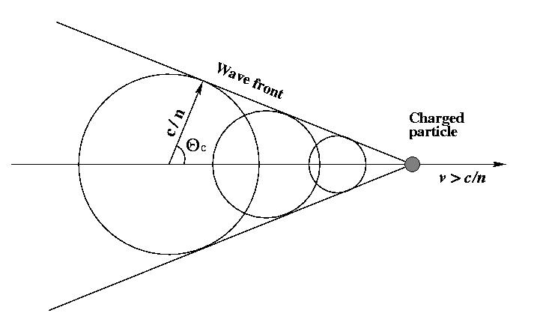
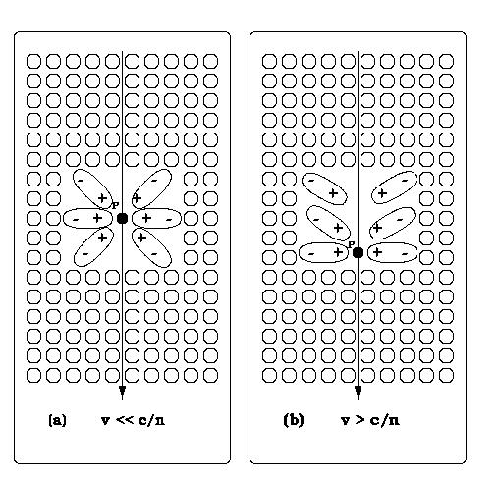
Cerenkov effect
The "basic principle" for a Cherenkov Neutrino Telescope

Slide 3
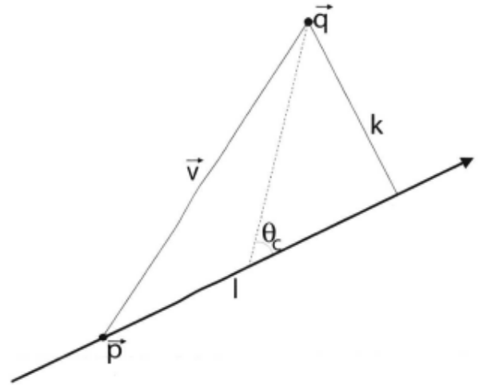
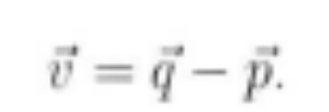
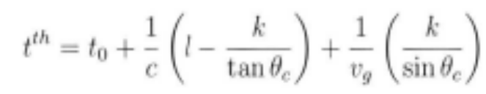

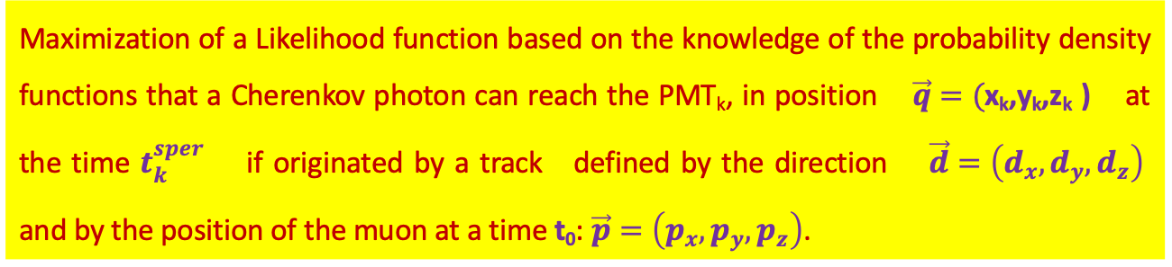



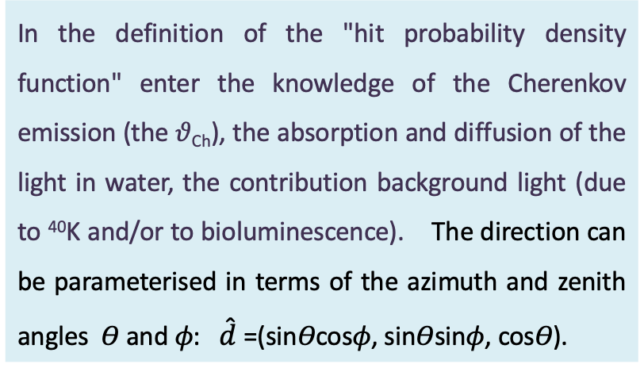

Reconstructing the muon track: Max. Likelihood strategy - 1
Maximization of a Likelihood function based on the knowledge of the probability density functions that a Cherenkov photon can reach the PMT_{k}, in position $\vec{q}=($x_{k},y_{k},z_{k} ) at the time $t_{k}^{sper}$ if originated by a track defined by the direction $\vec{d}=\left(d_{x},d_{y},d_{z}\right)$ and by the position of the muon at a time t₀: $\vec{p}=\left(p_{x},p_{y},p_{z}\right)$.
In the definition of the "hit probability density function" enter the knowledge of the Cherenkov emission (the 𝜗_{Ch}), the absorption and diffusion of the light in water, the contribution background light (due to ⁴⁰K and/or to bioluminescence). The direction can be parameterised in terms of the azimuth and zenith angles 𝛳 and 𝜙: $\hat{d}$=(sin𝛳cos𝜙, sin𝛳sin𝜙, cos𝛳).
B
$$\vec{w}$$
$\vec{v}=\vec{q}$- $\vec{p}=\vec{OB}$
$$\left|\vec{l}\right|=\vec{q}∙\hat{d}=\left|\vec{OC}\right|$$
C
A
O
$$\vec{k}=\sqrt{{\left|\vec{OC}\right|}^{2}−{\left|\vec{OC}\right|}^{2}}$$
$$\hat{d}$$
Notes:
3

Slide 4

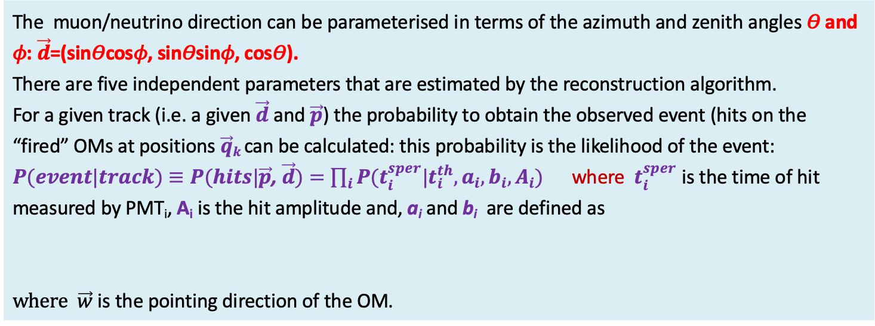


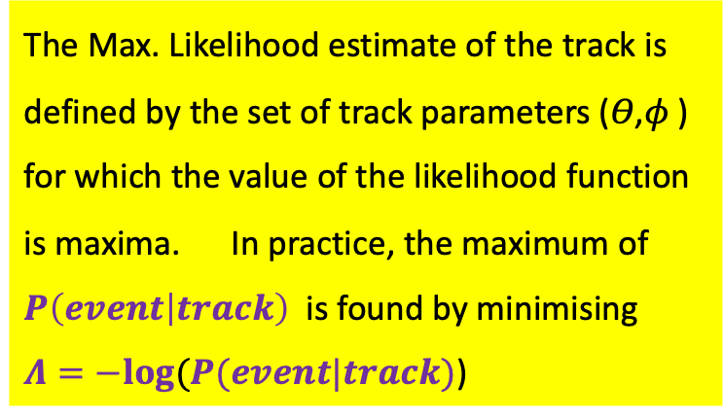



Reconstructing the muon track: Max. Likelihood strategy - 2
The muon/neutrino direction can be parameterised in terms of the azimuth and zenith angles 𝛳 and 𝜙: $\vec{d}$=(sin𝛳cos𝜙, sin𝛳sin𝜙, cos𝛳).
There are five independent parameters that are estimated by the reconstruction algorithm.
For a given track (i.e. a given $\vec{d}$ and $\vec{p}$) the probability to obtain the observed event (hits on the “fired” OMs at positions $\vec{q}k$can be calculated: this probability is the likelihood of the event: $P(event|track)≡P(hits|\vec{p}$, $\vec{d})=\prod_{i}{P(t_{i}^{sper}|t_{i}^{th},a_{i},b_{i},A_{i})}$ where $t_{i}^{sper}$ is the time of hit measured by PMT_{i}, A_{i} is the hit amplitude and, a_{i} and b_{i} are defined as
$where \vec{w}$ is the pointing direction of the OM.
$a=\left[\vec{v}−\vec{d}\left(l−\frac{k}{tanθ_{Ch}}\right)\right]∙\vec{w}$;$b=$ $\frac{k}{sinθ_{Ch}}$
B
$$\vec{w}$$
The Max. Likelihood estimate of the track is defined by the set of track parameters (𝛳,𝜙 ) for which the value of the likelihood function is maxima. In practice, the maximum of $P\left(event | track\right)$ is found by minimising $Λ=−log⁡(P(event|track)$)
$\vec{v}=\vec{q}$- $\vec{p}=\vec{OB}$
$$\left|\vec{l}\right|=\vec{q}∙\hat{d}=\left|\vec{OC}\right|$$
b
C
A
O
$$\vec{k}=\sqrt{{\left|\vec{OC}\right|}^{2}−{\left|\vec{OC}\right|}^{2}}$$
$$\hat{d}$$
Notes:
4

Slide 5
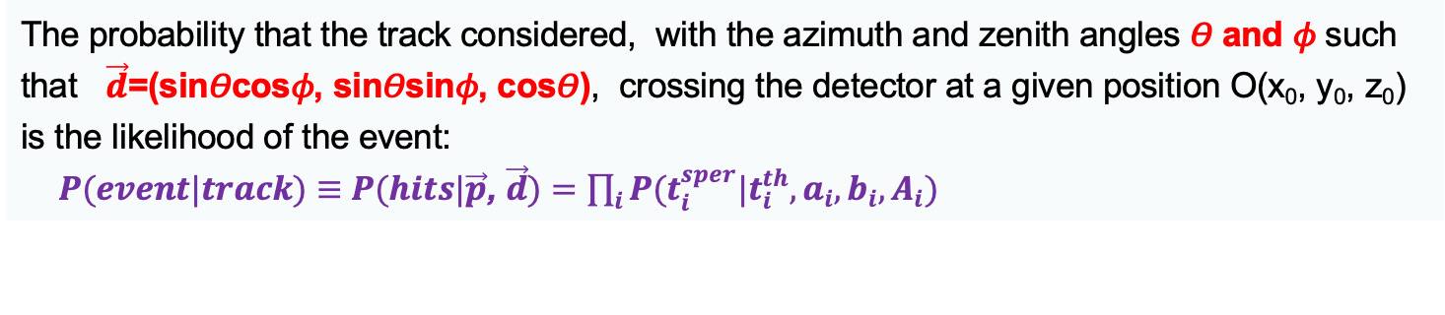
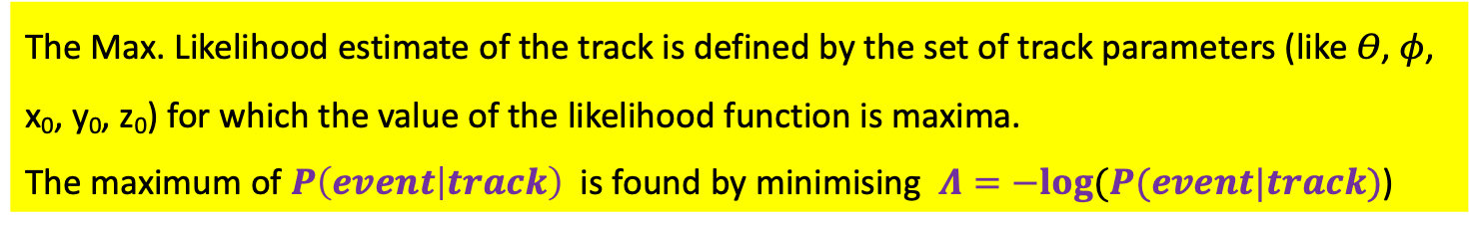
Reconstructing the muon track: Max. Likelihood strategy - 3
The probability that the track considered, with the azimuth and zenith angles 𝛳 and 𝜙 such that $\vec{d}$=(sin𝛳cos𝜙, sin𝛳sin𝜙, cos𝛳), crossing the detector at a given position O(x₀, y₀, z₀) is the likelihood of the event:
$P(event|track)≡P(hits|\vec{p}$, $\vec{d})=\prod_{i}{P(t_{i}^{sper}|t_{i}^{th},a_{i},b_{i},A_{i})}$
The Max. Likelihood estimate of the track is defined by the set of track parameters (like 𝛳, 𝜙, x₀, y₀, z₀) for which the value of the likelihood function is maxima.
The maximum of $P\left(event | track\right)$ is found by minimising $Λ=−log⁡(P(event|track)$)
data
ANTARES data
accept events with
Λ > - 5.1
M.C. simulations allow to characterize the Λ value distribution for signal (muons from up-going neutrino interaction) and for background (atmospheric muons).
Atmospheric
muons
«down-going»
Muons from
«up-going» neutrinos
Accepting events with Λ > cut is possible to reduce the background to an appropriate amount.
Notes:
5

Slide 6
What affects the track angular resolution?
Production and propagation of Cherenkov light
Optical properties of transparent natural media: water/ice:
  Absorption
  Attenuation
  Diffusion
  Techniques for measuring optical properties at sea/ice and results obtained
Dispersion of Cherenkov light:
  Speed of Cherenkov light in water
  Times of propagation of Cherenkov photons
Refractive index and its dependence on environmental parameters
Natural optical noise from ⁴⁰K and bioluminescence
Other environmental features of a site for a Cherenkov Neutrino Telescope:
  Submarine currents
  Sediments, biofouling, ...

Slide 7
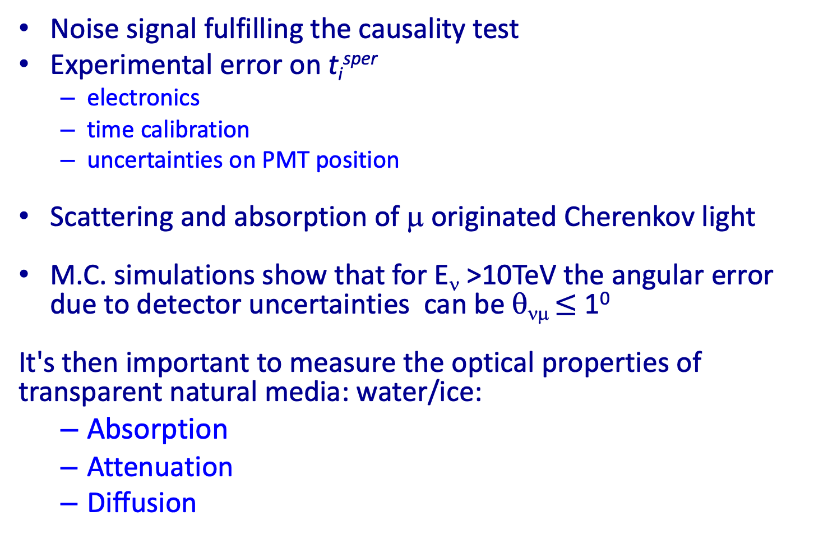
What affects the track angular resolution?
Noise signal fulfilling the causality test
Experimental error on t_{i}^{sper}
  electronics
  time calibration
  uncertainties on PMT position
Scattering and absorption of μ originated Cherenkov light
M.C. simulations show that for E_{ν} >10TeV the angular error due to detector uncertainties can be θ_{νμ} $≤$ 1⁰
It's then important to measure the optical properties of transparent natural media: water/ice:
  Absorption
  Attenuation
  Diffusion

Slide 8
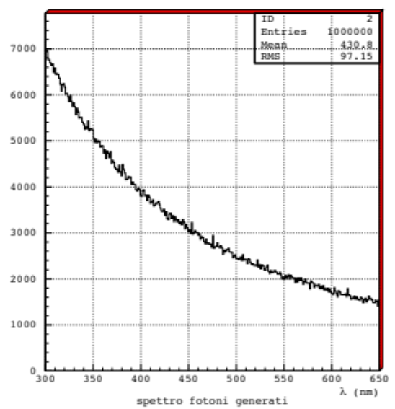
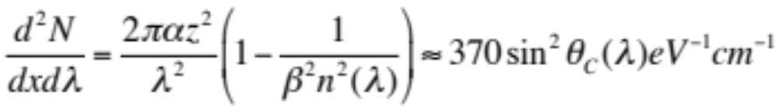
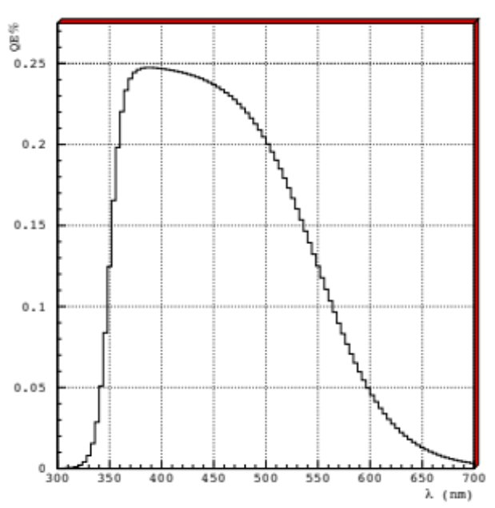
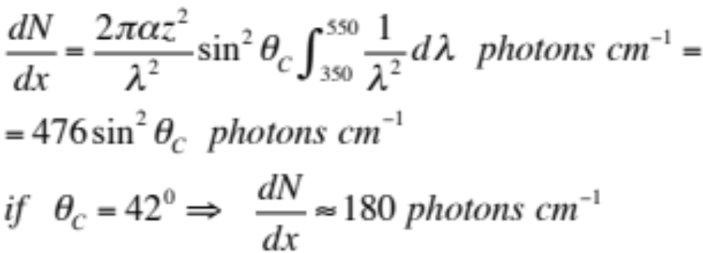
Cerenkov effect
Cerenkov radiation is emitted when a charged particle travels with v>c/n in the medium.
Cherenkov radiation is distributed over all λ: its detection is affected by the properties of the radiator medium (absorption, diffusion, attenuation, refractive index, …)
The number of photons produced per unit path length of a particle with charge ze and per unit energy interval of the photons
Integrating on λ, for 350 < λ < 550 nm, best window in
  λ for PMTs, we obtain:
Cherenkov radiation intensity ~ independent by the particle energy.

Slide 9
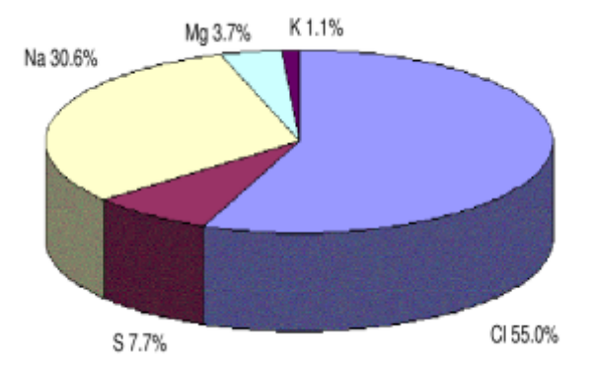
The water, the transparent physical medium we are studying
Water covers almost 75% of the surface of our planet, regulates climate change and is a fundamental element for the birth and development of life
Our current knowledge of the marine environment is certainly not enough. To measure the physical properties of seawater, in addition to the macroscopic parameters (T, P, S.), it is necessary to analyse the presence of dissolved particles and salts.
The main constituents are chlorine (55.0%), sulfur ions (7.7%), sodium ions (30.6%), magnesium ions (3.7%) and potassium ions (1.1%).
These concentrations, and the temperature that varies at different marine sites, influence the propagation of light in water and depend on various environmental factors (biological activity, underwater currents...). Therefore, their measurement cannot be carried out in the laboratory on properly collected water samples: a continuous characterization of the various environmental properties is necessary with in situ measurements.

Slide 10

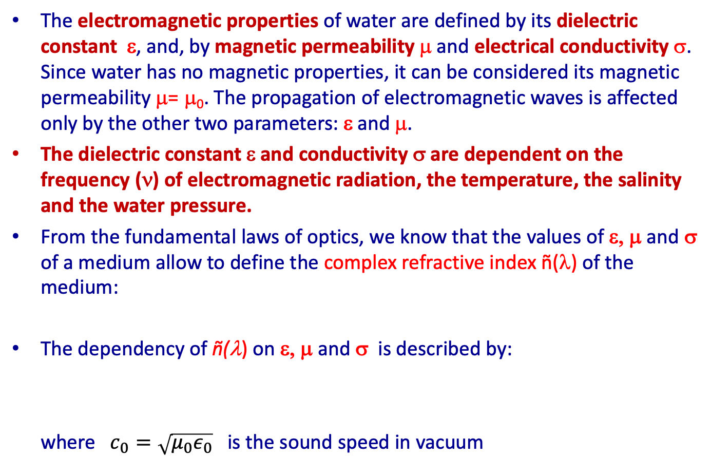
Electromagnetic properties of water (1)
The electromagnetic properties of water are defined by its dielectric constant ε, and, by magnetic permeability μ and electrical conductivity σ. Since water has no magnetic properties, it can be considered its magnetic permeability μ= μ₀. The propagation of electromagnetic waves is affected only by the other two parameters: ε and μ.
The dielectric constant ε and conductivity σ are dependent on the frequency (ν) of electromagnetic radiation, the temperature, the salinity and the water pressure.
From the fundamental laws of optics, we know that the values of ε, μ and σ of a medium allow to define the complex refractive index ñ(λ) of the medium:
The dependency of ñ(λ) on ε, μ and σ is described by:
where $c_{0}=\sqrt{μ_{0}ε_{0}}$ is the sound speed in vacuum

Slide 11
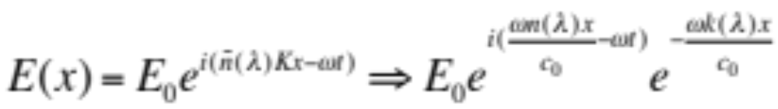
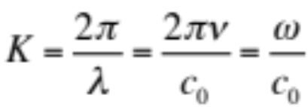
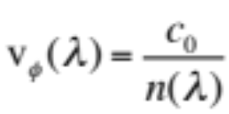
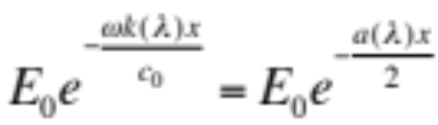
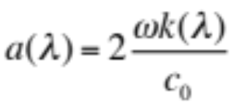
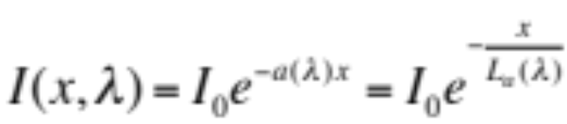
Electromagnetic properties of water (2)
The real part of the refractive index n(λ) measures the deflection of the monochrome wavefront in the passage from one medium to another (refraction) and within the medium itself (diffusion). The imaginary part k(λ) is introduced to take into account the absorption of light in the middle crossed.
Let us consider a plane electromagnetic wave of amplitude E₀ propagating along the x-axis, in a dielectric of complex refractive index ñ(λ), the amplitude that describes it after traveling the distance x:
where K is the wave number
The term , phase velocity, in the expression of the plane wave characterizes the propagation of the wave, while
describes the attenuation of the wave amplitude, indicating an absorption of energy from the medium. [m⁻¹] is the absorption coefficient.
The intensity of the wave therefore decreases with the law where L_{a}(λ) is the absorption Length L_{a}(λ) .

Slide 12
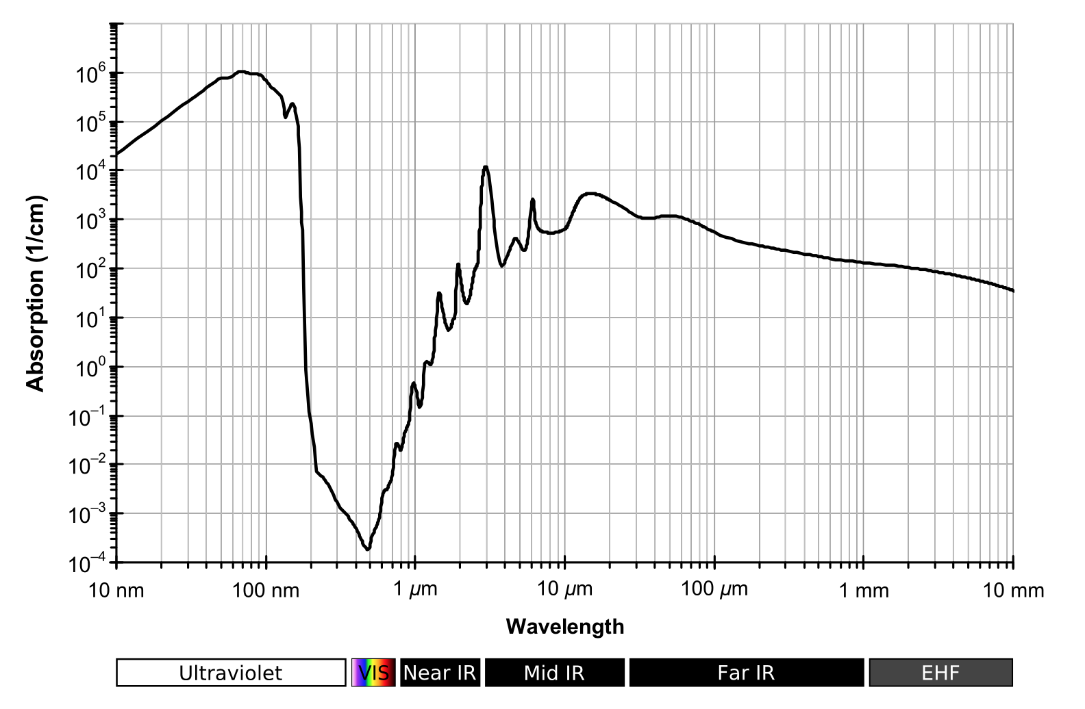
Electromagnetic properties of water (3)
The absorption length therefore indicates that after traveling a distance of L_{a}(λ) in the dielectric, the intensity of the electromagnetic radiation is I₀/e ~ 0.37 I₀. The main cause of light absorption in water is the excitation of the vibrational states of molecules by incident photons.
a(λ)

Slide 13
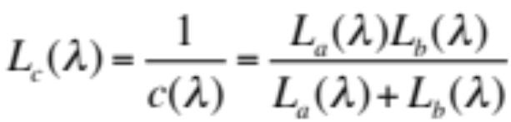
"Inherent" optical properties of water/ice
The propagation of a collimated light beam in a transparent medium is then affected by absorption, characterized by the parameter a(λ), and by the diffusion that can be quantified by the diffusion coefficient b(λ).
In reality, when evaluating the propagation of light in a transparent medium, it is preferred to define an attenuation coefficient: c(λ)=a(λ)+b(λ) [m⁻¹]
ψ
dx
Therefore, by analogy with the definition of L_{a}(λ)=1/a(λ) we can define the diffusion length L_{b}(λ)=1/b(λ) and the attenuation length L_{c}(λ)=1/c(λ)
a(λ), b(λ) and c(λ) which represent the properties of absorption, diffusion and attenuation per unit of path, are defined as the inherent optical properties of the transparent medium.

Slide 14
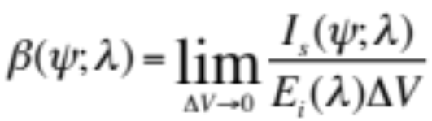
Diffusion processes in water (1)
The diffusion processes in water are due to the interaction of photons both with water molecules, dissolved salts and with particulate matter present in suspension.
If the scattering is elastic, the photon is scattered along a different direction than the incident one and retains its energy and impulse. Elastic scattering phenomena have different characteristics depending on the size of the scattering centre:
  for dimensions comparable with the wavelength of incident light, i.e. water molecules and dissolved salts, diffusion (called Rayleigh scattering) is characterized by a symmetrical front-back angular distribution
  for dimensions greater than the wavelength of the incident photon, i.e. organic and inorganic particulates, the scattering (called Mie scattering) is characterized by small deflection angles.
The two phenomena have profoundly different effects on photon propagation. When we talk about pure seawater, we mean exclusively the diffusion phenomena due to the interaction with water molecules (H2O) and ions (Cl-, Na+, ..) distributed in an isotropic way.
To describe the transmission of light in the medium we introduce the volume diffusion function β(ψ;λ). It defines the distribution of the diffuse flow, per unit of incident flow and per unit volume:
where I_{s}(ψ;λ) is the intensity of the diffuse flow of an angle ψ crossing the ΔV volume of water, and E_{i}(λ) it is the incident energy.

Slide 15
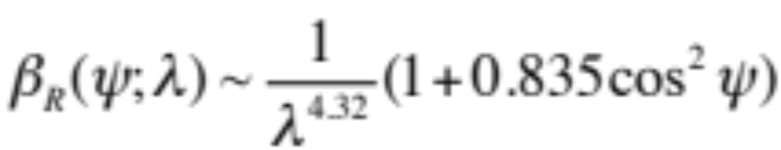
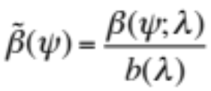

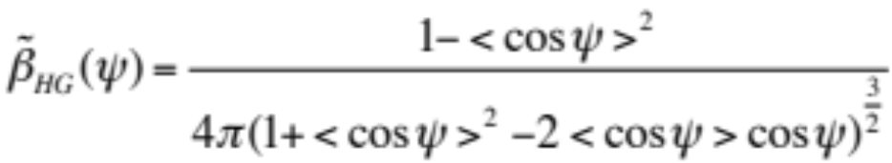
Diffusion processes in water (2)
Rayleigh diffusion is characterized by a volume diffusion function expressed by law:
The phase volume diffusion function is also defined, as: which in the case of Rayleigh diffusion in water takes the expression:
A diffuse photon "Rayleigh" therefore has an angular distribution with a forward-backward symmetry (the average angle of scattering is zero) and has a low probability of continuing to propagate at a small angle with respect to the initial direction.
In the case of Mie diffusion, the angular distribution function is well approximated by the Henyey–Greenstein function:
  where <cosψ> It is the average angle of diffusion that in the ocean (at great depths) takes on a value between 0.9 and 0.995. It is the classic value that must be measured in situ.
In the case of Mie scattering, i.e. diffusion on particulate, the angular distribution of the scattered photons shows an evident forward peak.

Slide 16
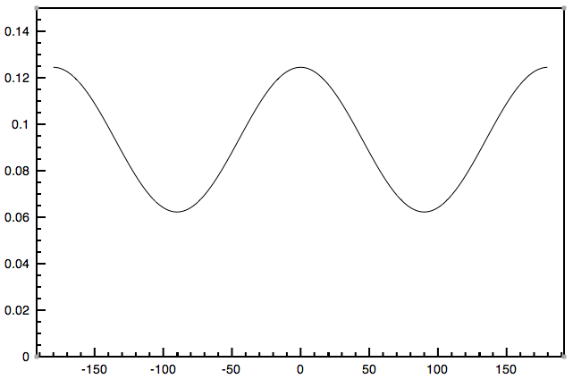
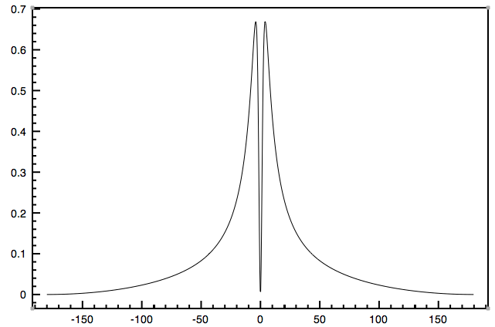
Angular distributions by diffusion Rayleigh and Mie
Rayleigh
Mie
Mie
<cosψ>=0.952
ψ=angolo di diffusione
ψ=angolo di diffusione

Slide 17
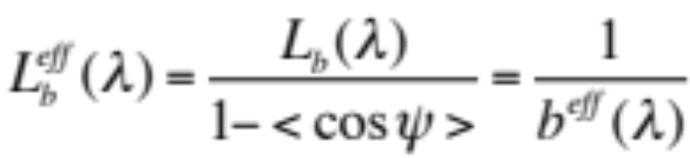
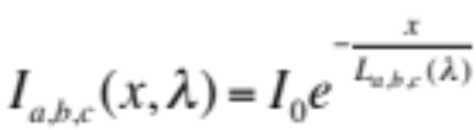
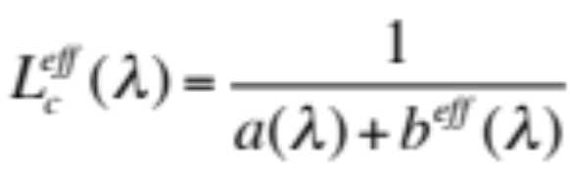
Diffusion processes in water (3)
Under experimental conditions, the different modes (Rayleigh, Mie) of light scattering are not separable, and the overall effect is described by the total scattering coefficient b(λ). Currently, there are no experimental results that give the distribution β(ψ;λ) for underwater sites. Light scattering is quantified in the literature through the effective diffusion length L_{b}^{eff}(λ) defined as:
The absorption therefore sets a limit to the maximum distance from the apparatus from which a photon can be detected, the scattering modifies the angular distribution of the photons. The variation of the intensity as a function of λ and the distance travelled (x ), due to the various phenomena under examination is therefore given by the expression:
We define the effective attenuation length, function of λ as:

Slide 18
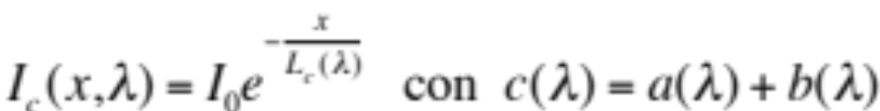
Reduction of light intensity (1)
Actually L_{a}(λ), L_{b} (λ), L_{c} (λ) and L_{b}^{eff} (λ) do not always fully describe the change in light intensity in the transparent medium.
L_{c} (λ) for example, describes quite well the variation of light intensity in the case of source and directional detectors:
Measurement in “good geometry”
Photon Absorbed
Laser/collimated source
collimated sensor
photon scattered twice to the detector
diffused photon
but it does not describe photons entering the detector having undergone more than one scattering (second-order effect that would imply the knowledge of the volume scattering function and a complete MC simulation)

Slide 19
Reduction of light intensity (2)
L_{b}^{eff} (λ) can partially take into account the geometry of the detector by counting as "detected" photons that arrive on the sensitive surface (non-point and non-unidirectional) of a "real" detector (we are no longer in "good geometry").
Photon Absorbed
Sensor
Laser/collimated source
"Not lost" photon scattered in the detector
photon scattered outside the detector
... more effects at the second order than the estimation of which would imply the knowledge of the volume diffusion function and a complete M.C. simulation ...
Antonio Capone - LNS - 16/12/2013
Tecniche di rivelazione di neutrini di alta energia con Telescopi sottomarini
19

Slide 20
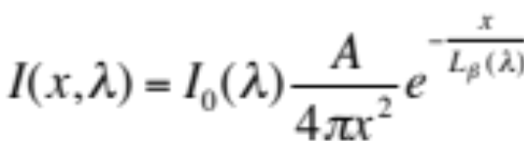
Reduction of light intensity (3)
But more often the geometry is different: the source can be diffused and the detector extended with surface "A" ("open geometry"): in this case is better to use the “Transmission Length” L_{β}. For isotropic source and detector:
sorgente
Photon Absorbed
sensore
"Not lost" photon scattered in the detector
photon scattered outside the detector
L_{β} (λ) can be estimated in an apparatus knowing I₀ (λ) measuring I(λ,R) with intercalibrated sensors at different distances R.
For a collimated source L_{β} (λ) = L_{c}^{eff}(λ), for a non-collimated source, the relationship between L_{β} (λ) and L_{c}^{eff}(λ) is not immediate: it can be calculated with a MC knowing how to parameterize, for each λ the diffusion of light (<cosψ>) or knowing the b(ψ;λ).
Antonio Capone - LNS - 16/12/2013
Tecniche di rivelazione di neutrini di alta energia con Telescopi sottomarini
20

Slide 21
Measurement techniques adopted
Laboratory measurements of water samples taken at different depths and at different sites
  NESTOR
"In situ" measurements with dedicated instrumentation
  ANTARES, BAIKAL, NEMO, NESTOR
Estimates of optical parameters from measurements carried out "in situ" with equipment "internal" to the Neutrino Telescope
  AMANDA, ANTARES, IceCube, ...
Antonio Capone - LNS - 16/12/2013
Tecniche di rivelazione di neutrini di alta energia con Telescopi sottomarini
21

Slide 22
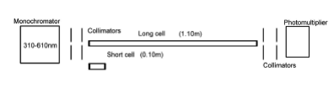
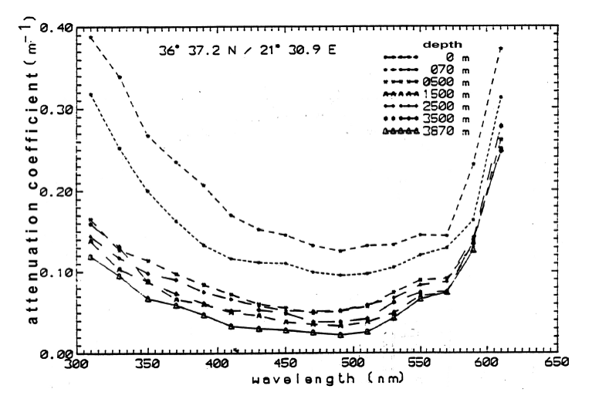
NESTOR: measurement with "good" geometry photometry
The light transmissivity of water samples collected at several depth and several different locations in the "NESTOR site" has been measured with a "well collimated" light beam.
The light transmissivity of water samples collected at several depth and several different locations in the "NESTOR site" has been measured with a "well collimated" light beam.
For each sample the light attenuation coefficient was measured, using the monochromator, for several wavelengths 310 < λ < 610 nm.
Results for water samples collected at different depths have been reported separately.
22

Slide 23
NESTOR: results with "good" geometry photometry
attenuation length [m]
10.
25.
50.

Slide 24
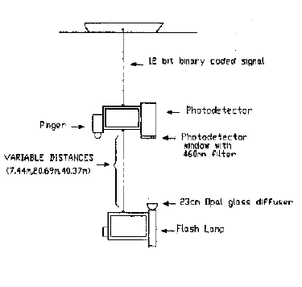
NESTOR: measurements with "open" geometry
NESTOR site
Non collimated source
460 nm filter
Photo-detector
Several distances
3 different locations
fbit binary coded signal
12 bit binary coded signal
Pinger
Photodetector
Photodetector window with 460nm filtre
VARIABLE DISTANCES
7.44m, 20.69m, 40.37m
23cm Opal glass diffuser
Flash lamp
Schematic diagram of the detector

Slide 25
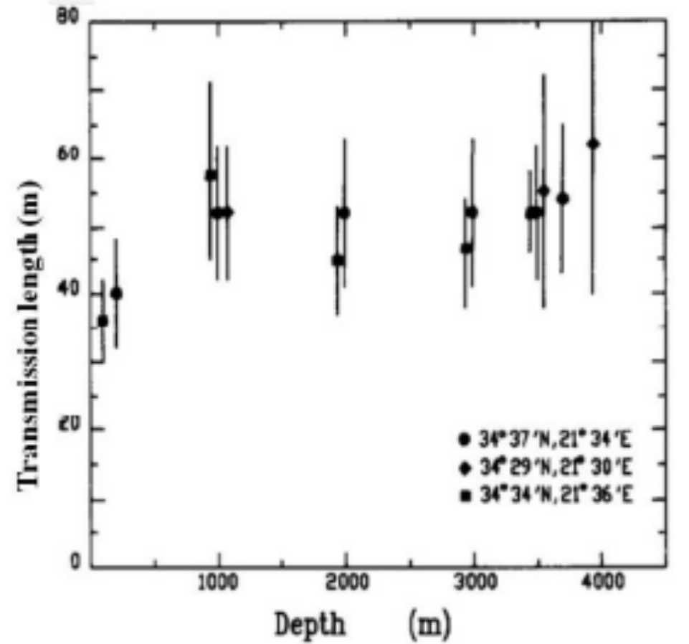
NESTOR: measurements with "open" geometry
Result: Transmission length ≈ 55±10 m describes the data satisfactorily
E.G. Anassontzis et al. (NESTOR collaboration), Nucl. Instrum. and Meth., A349(1994)242.

Slide 26
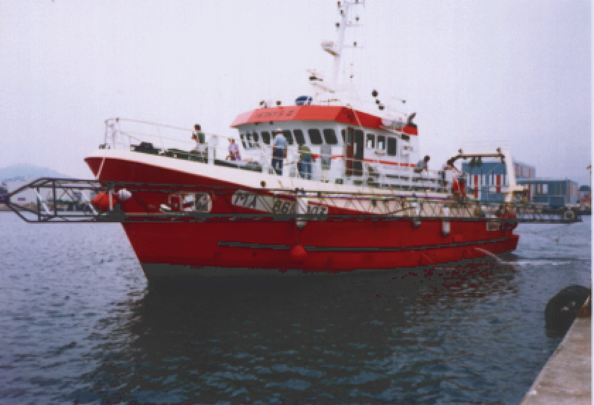
ANTARES in situ measurements
A dedicated measurement set-up (source + sensor at variable distance) deployed in ANTARES site at the proper depth.
Measures of N_{pe} as a function of distance.
Measurement of light attenuation as a function of the distance source-sensor
4 deployments
33 m long structure operated on a 25 long boat !!

Slide 27
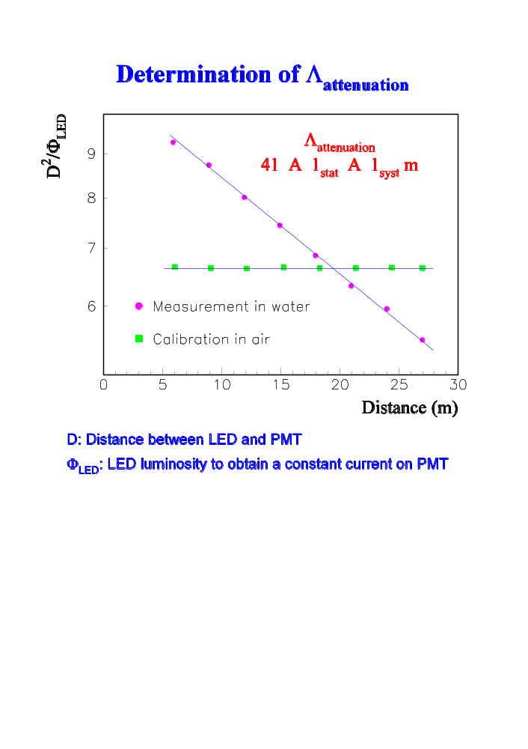
The detector is calibrated in air (attenuation length ≈ ∞): the number of photons decrease as D²
The detector in water measures the water attenuation length.
~ 41 m

Slide 28
Test based on the measurement of the arrival time of photons on the PMT
Schematically:
CPU
Trigger
Start
2 distances
Spectrum in air
Simulation
Absorption
Diffusion
Stop
TDC
1" PMT
Area comparison → absorption
2 distances
44 & 24 m
(after normalisation)
Tail + MC → diffusion
Led’s
isotropic light source
2 types of LED’s
Blue & UV

Slide 29
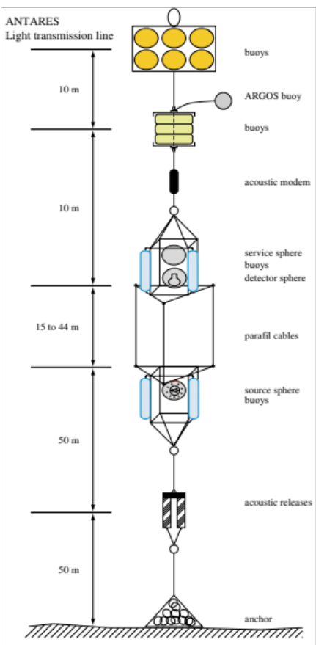
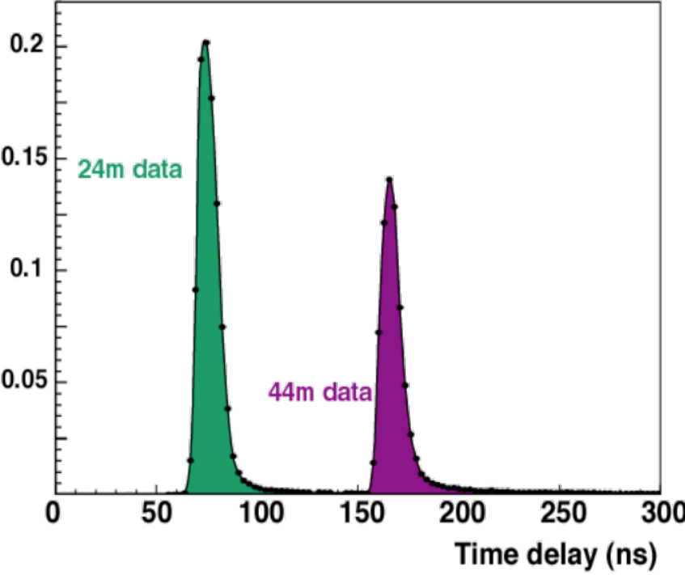
Optical properties of sea water
Water transparency
At 24m, 95% within
  Δt = 10 ns (B)
  Δt = 30 ns (UV)
- Blue light (470 nm)
λ_{abs} ~ 50 m
λ_{scat eff} ~ 300 m
- UV light (370 nm)
λ_{abs} ~ 25 m
λ_{scat eff} ~ 120 m
λ_{scat eff =}
λ_{scat}
Photon arrival times
(pulsed LED sources)
1 - < cos θ >
The 24 m distribution is normalised to unity. The 44 m distribution is normalised with respect to the one at 24 m, in addition to a (44/24)² factor, so the difference between the two peaks is entirely due to the exponential attenuation factor.

Slide 30
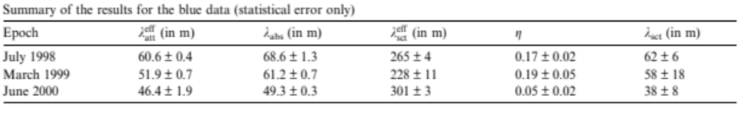
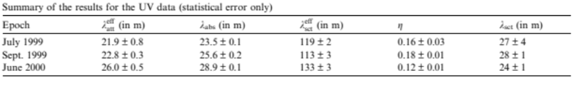
ANTARES Test 3' Results
J.A. Aguilar et al. / Astroparticle Physics 23 (2005) 131–155

Slide 31
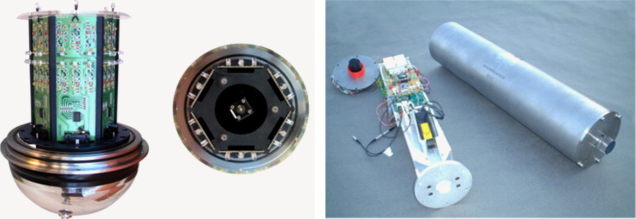
ANTARES and Optical Beacon System (1)
Pulses with RMS rise time 0.15 ns
Light flashes light with an energy per pulse ~150 pJ
The ANTARES optical beacon (OB) system consisted of a set of light sources (Lasers and LED) used for time calibration but also to perform water optical properties measurements and monitoring.
Along each ANTARES line there were located 4 LED-OB, emitting at different wavelengths: 400nm, 470 nm, one OB was emitting six wavelengths 384 < λ <518 nm.
Two Laser OB (RMS rise time 0.33 ns) with an emission peak of 532nm, placed at the bottom of two central lines, did complete the ANTARES optical calibration system (in total it used eight different wavelengths).

Slide 32
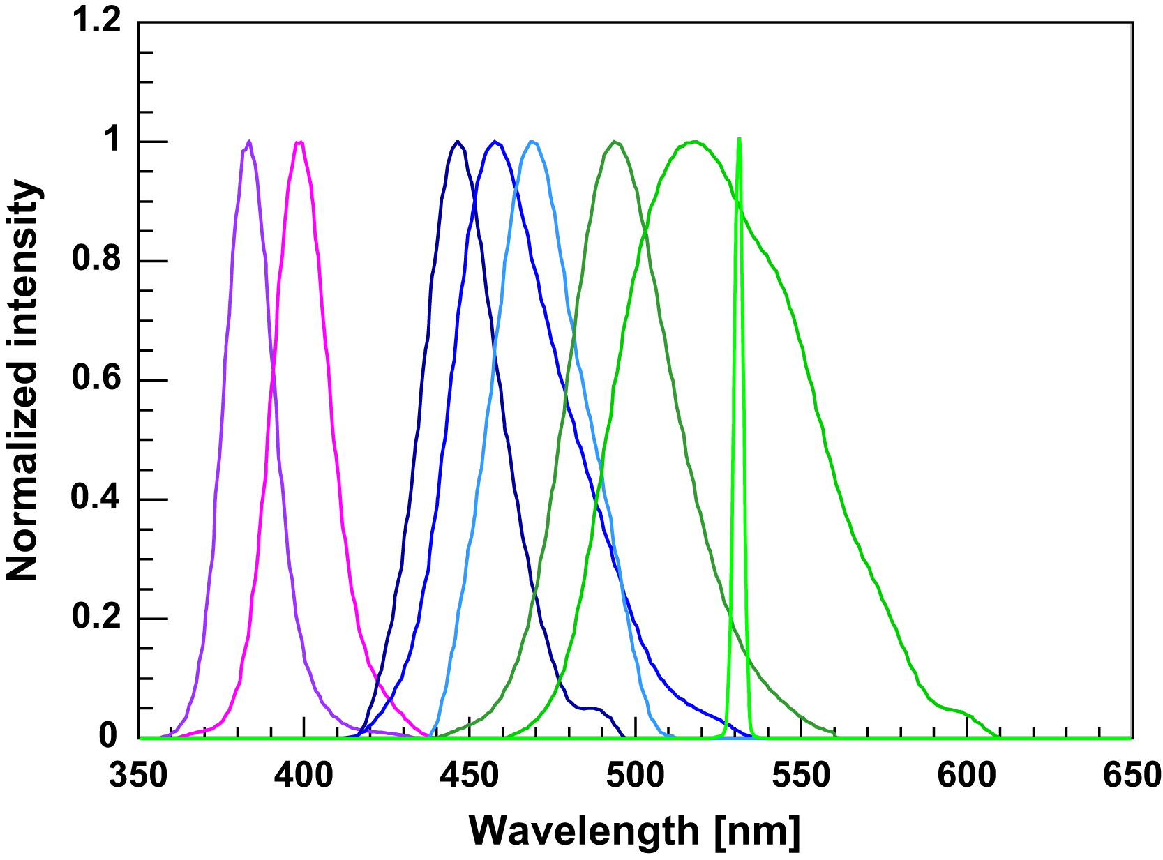
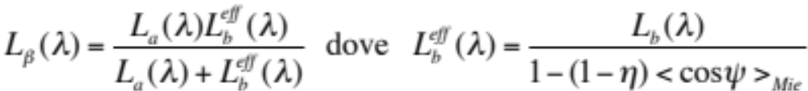
ANTARES and Optical Beacon System (2)
ANTARES Optical beacons light spectra, maximum normalized to the unit.
Laser - OB
This system made by Sources and Detectors placed at several distances allows ANTARES to evaluate the “Transmission length” L_{β}(λ).
where η represent the fraction of diffusions due to Rayleigh scattering and 1-η accounts for the contribution of Mie scattering. The value assumed by ANTARES for <cosψ>=0.924 comes from A. Morel, H. Loisel, Applied Optics 37 (1998) 4765 and is valid for an average amount and size of sediments in the water.

Slide 33


ANTARES: how L_{β} (λ) affects track reconstruction
Let's remind
The volume scattering function, the value of η (fraction of Rayleigh scattering), the size and amount of the particulate are unknown and variable with time/site.
In order to study the effect of the water model in track reconstruction ANTARES has simulated (by MC) five water models: three water models with the same η value and different scattering spectra for a given absorption length, and in addition two models with different η values were computed in such a way that three models will have the same effective scattering length at 470nm.
Models with lower effective scattering do not agree with experimental data.

Slide 34


Polar ice optical properties
AMANDA/IceCube and polar ice optical properties
Scattering
Absorption
ice
bubbles
dust
dust
Average optical ice parameters:
λ_{abs} ~ 110 m @ 400 nm
λ_{sca} ~ 20 m @ 400 nm
λ_{prop} ~ 27 m @ 400 nm
Measurements:
►in-situ light sources
►atmospheric muons

Slide 35
NEMO Optical measurements of deep Sea water:
Absorption and Attenuation Coefficients.
When a collimated light spot is used:
I = I_{o} e^{-c(λ)x} (attenuation)
I = I_{o} e^{-a(λ)x} (absorption)
b(λ) = c(λ) - a(λ) (scattering)
Attenuation, absorption, scattering lenght:
L_{c}(λ) = 1/c(λ)
L_{a}(λ) = 1/a(λ)
L_{b}(λ) = 1/b(λ)
Measurement technique:
c = (1/x) log (I_{o}/I)

Slide 36




NEMO: in situ Measurements of Inherent Optical Properties
AC9: absorption(a), scattering (b) and attenuation (c=a+b) for
9 wavelengths: 412, 440, 488, 510, 532, 555, 650, 676, 715 nm
Internal black surface “Flow tube”
“c” measurement
angular acceptance 0.7°
25cm long flow tube
I_{c}(x)=I₀e^{-c•x}
I_{a}(x)=I₀e^{-a•x}
Deep sea set-up:
AC9, CTD, battery pack,
PC on ship deck
Internal reflecting surface “Flow tube”
“a” measurement

Slide 37

Optical Properties of Deep Sea Water
- λ_{absorption} , λ _{attenuation} for 9 wave lengths
Measurements of optical properties and of Salinity, Temperature, Depth
Planning to measure the angular distribution of diffused light
AC9 →λ_{absorption}

Slide 38


Deep Sea Cerenkov Light attenuation versus depth
Measurements carried out in Ponza site
(m⁻¹)
Salinity (P.S.U)
Temperature (°C)
raw data of attenuation coefficient at 412,488,510 nm
Surprise (for me)! The Tyrrhenian Sea is made by layers of different waters in equilibrium

Slide 39

Water optical properties in Capo Passero site: seasonal dependence
Seasonal dependence of optical (absorption, attenuation) and oceanographic (Temperature, Salinity) properties has been studied in Capo Passero
Variations have been observed only in shallow water layers
Data taken in:
Aug 03 (2 profiles superimposed)
Aug 02 (3 profiles superimposed)
Mar 02 (4 profiles superimposed)
May 02 (2 profiles superimposed)
Dec 99 (2 profiles superimposed)
temperature
salinity
a440
c440

Slide 40


Seasonal dependence of optical properties in Capo Passero
Capo Passero 2850-3250 m

Slide 41

Seasonal dependence of optical properties in Capo Passero
λ _{absorption}
λ _{attenuation}
Capo Passero 2850-3250 m, wavelength 440nm

Slide 42

Joint Sea Campaign ANTARES-NEMO: Toulon site
temperature
salinity
c440
a440
AC9 + CTD
Profiles of the water column in Toulon Region
Water is colder and less salty than in Capo Passero
Attenuation coeff.
Absorption coeff.
Temperature
Salinity

Slide 43

AC9 and ANTARES Test 3’ data

Slide 44

Water optical properties: comparison Toulon-Capo Passero
Data measured with two different instruments:
the AC9 transmissometer (NEMO) and the Test 3 (ANTARES)
Absorption lengths measured in Capo Passero are compatible with optically pure sea water data
Large differences between Toulon and Capo Passero are observed in the blue region
Values measured with the Antares Test 3’ setup are in good agreement with the AC9 data
The Toulon data are similar to those measured in the Catania Test Site (coastal waters)

Slide 45

BAIKAL : "Burhan" and "AC9" to measure absorption and scattering lengths
Burhan set-up
19 wavelengths:
UV (291nm) – IR (750nm)
Isotropic source:
r⁻² dependence
Variable distance:
Few cm-20m at step 1 m
(no calibration required)
Strongly dependent on
light source intensity:
Large errors in IR and UV
Measurements carried out at fixed depth
Absorption and scattering cannot be measured at the same time

Slide 46

BAIKAL - AC9 profiles: coefficients at λ=488nm
Thermocline

Slide 47

BAIKAL - AC9 profiles: length at λ=488nm
NT200

Slide 48

BAIKAL: Absorption 1000 m
AC9 data (2 measurements)
perfect agreement
Very good agreement with Burhan data
Dispersion in Burhan data (20%) due to different time of operation:
biological components change
Maximum L_{a}~ 28m
(at ~ 490 nm)
For both instruments

Slide 49

BAIKAL: Absorption 200 m
AC9 data (2 measurements)
perfect agreement
Very good agreement with Burhan data (better than at 200m)
Only 1 measurement for Burhan
Maximum L_{a}~ 28m
(at ~ 490 nm)
For both instruments

Slide 50

BAIKAL: Scattering 1000 m
For the first time
scattering accurately calculated from AC9 data
b = c-a
a_{baikal},c_{baikal}>>a_{pw},c_{pw}
Good agreement AC9 burhan
b ~ 0.04 m⁻¹ (λ=412-440 nm)
b ~ 0.02 m⁻¹ (λ>490 nm)
b(λ) ~ λ⁻³
(Rayleigh: λ⁻⁴; Mie: λ⁻¹--λ⁻²)
We imposed a fit:
A λ^{-B} + Rayleigh on purewater

Slide 51

BAIKAL: Attenuation 1000m

Slide 52

Absorption lengths in NEMO sites and in Baikal lake
A. Capone et al., NEMO Collaboration,
Nucl. Inst. & Methods A,
487 (2002) 423-424.
V. Balkanov et al.
Baikal & Nemo Coll.
astro-ph/0207553
Baikal March 2001

Slide 53

BAIKAL : "Burhan" and "AC9" to measure absorption and scattering lengths
Great measure, fantastic experience !

Slide 54
Other properties required for the Cherenkov medium
  The Cherenkov light has to propagate in a medium with low optical noise:
  best light transmission properties of deep sea water: low absorption, low scattering
  absence of other light sources: NO/LOW optical background
  The environment should not deteriorate the detector:
  Optical Modules transparency should be preserved: no/low sedimentation of organic/inorganic material
  the position of the "optical modules" should be known with precision: no/low deep sea currents
  stability (Earthquakes) and flatness of the seabed over large area (A> 10 km²)
  Expected differences between Ice-Deep Sea-Lakes
  Deep-Sea sites properties are also different: characterization needed with "in situ" instruments.

Slide 55
Required properties for the Cherenkov medium
  We also need to know: the speed of light propagation in the water: v=v(λ) ?
  How this light dispersion affects the performances of the detector ?

Slide 56





Measuring Site qualities for a Cherenkov ν Telescope site
  light transmission properties of deep sea water (AC9 transmissometer)
    Photon collection efficiency, angular resolution, light velocity dispersion vs λ, ...
  optical background (long time data tacking with optical modules)
    Noise in tracks/events reconstruction
  deep sea currents (RCM11 and RCM8 current metre)
    Knowledge of the O.M.
  nature and quantity of sediment material (Sediment trap)
    Reduction of O.M. surface transparency
  seabed characteristics (cores and bottom profile)
    Deep sea bottom nature and stability
AC9
AC9
Biofouling
Sediments
Optical background

Slide 57

Oceanographic data measured in Capo Passero
Two current metres and a sediment trap moored in Capo Passero Region since 1998.
Current metre 2900 m
Sediment trap 3000 m
Current meter 3050 m
Sea bed 3350 m

Slide 58



Deep sea current in KM4
~ 3 years data acquisition with two current metres moored at 100m and 400m above the sea bottom
1999-2000
Two RCM8 mechanical current metres: sensitivity 1.1cm/s
Since 2001
Two RCM11 Doppler current metres with ~0.5 cm/s sensitivity
RCM8: Mechanical current meter
RCM11: Doppler current meter
Data available up to Nov. 2003, current meeters still in data taking

Slide 59

Deep sea currents in Capo-Passero site
About 3 full years of deep sea current data acquisition in Capo Passero KM4.
Average current velocity ~3 cm/sec (rms ~0.7 cm/s). Max. current ≤16 cm/sec.
The 2 current metres moored at different depths show the same behaviour
90%
95%

Slide 60


Effect of biofouling on optical module transparency in Capo Passero site
Setup realized by the ANTARES collaboration
Four glass spheres with blue LED emitters and 28 PIN diodes
Allows measurement at different polar angles of the transparency loss due the bio-film growth
Immersed at the Capo Passero site for 18 months (April 2003 - October 2004)
A
B
+90°
θ
0°
Transparency after 1 year
-90°
D
C

Slide 61

Effect of biofouling on optical module transparency in ANTARES site
A
B
D
C
+90°
θ
0°
-90°
Periods of high current velocity, indicated at the bottom of the figure, can remove the fouling from the OM surface.

Slide 62


Natural brightness in the depths of the ocean:⁴⁰K
Seawater is a complex solution made up of many elements; the salinity of the site indicates precisely the amount of dissolved salts. The contribution of potassium to the total salinity is about 1.1% and, as for the other elements, this contribution does not undergo temporal variations.
In seawater there are also radioactive isotopes which, as they decay, emit relativistic charged particles capable of inducing the Cherenkov effect: the optical modules installed in abyssal sites therefore also record signals of this origin.
Almost all of the radioactive activity is due to the decays of the ⁴⁰K.
⁴⁰K has two main decay channels:
It may decay β⁻ (B.R.=89.28%) emitting electrons in the final state with a spectrum in energy peaked at E_{e}~MeV which can directly induce Cherenkov radiation
It can catch an electron (B.R.=10.72%) producing energetic photons that can make Compton scattering or create pairs

Slide 63
Estimation of optical background intensity from ⁴⁰K
The number of decays of an isotope, per unit volume and time, can be calculated with the relation:
ε_{K} = percentage of potassium compared to all other elements
η40_{K} = the relative abundance of the isotope ⁴⁰K
A = Mass number of the element.
If S=38.44 psu the expected number of decays of ⁴⁰K is equal to ~ 13000 Bq m⁻³.
An estimate of the Cerenkov photon flux in an infinite volume of water, with the optical properties typical of the Cape Passero site, leads to Φ∞ = 425 ± 43 cm⁻²s⁻¹
The estimation of the frequency of signals expected in optical modules with PMT 8" (such as those used during the NEMO tests), taking into account the "transmissivity" of glass, gel and the quantum efficiency of PMTs, is equal to
F∞ ^{8”} =33.6 ± 3.5 kHz.

Slide 64





Optical background in Capo Passero and Toulon
PMT 1+ DAQ
NEMO device (8’’ PMT at 0.3 spe)
Toulon 58.0±3.0 kHz
Capo P. 28.5±2.5 kHz
PMT 2+power
To the luminous background from ⁴⁰K a background due to the emission of light from luminescent organisms is added: bioluminescence
PMT dark current 7 kHz

Slide 65

ANTARES, bioluminescence rate vs deep-sea current velocity
Correlation between the burst fraction and the sea water current velocity. The burst fraction is the fraction of time with count rates exceeding 120% of the baseline rate. Data sample has been collected from summer 2005 to summer 2006 in Toulon site.

Slide 66







Other source of optical noise in deep sea: bioluminescence
No luminescent bacteria have been observed in Capo Passero below 2500 m
Counting rate (kHz)
10000
.35 spe
1000
100
10
1
0
5
10
15
20
25
30
Time (mn)
Typical time sequence of
Optical noise rate in Capo Passero
Measured with test 1
Courtesy J.P. Schuller

Slide 67



Photon propagation velocity in water
In underwater telescopes, the reconstruction of the tracks takes place by combining the information, given by the positions and the PMTs hits time.
The Cherenkov light induced directly by muons can be detected up to a distance comparable to the absorption length L_{a}, of the site.
At these distances (50-70 m) the difference between the group and phase velocity of light is not negligible. It has been pointed out* that the use of phase velocity is not correct.
In simulations and data analysis, the group velocity must be attributed to the propagation of photons.
The propagation of a light pulse with pulsation ω and wave number K=2π/λ in matter, is given by the speed with which the wave packet propagates in the dispersive medium, i.e. by the group velocity :
  where v_{ϕ}=c₀/n_{ϕ} is the phase velocity, that is, that of a monochromatic wave.
  We remind that ω=Kv_{ϕ}=Kc₀/n_{ϕ} so
  and similarly we can define the group refractive index .
*L.A. Kuzmichev arXiv:hep-ex/0005036 (2000) "On the Velocity of Light Signals in the Deep Underwater Neutrino Experiments"

Slide 68
Phase velocity and group velocity in water
We have obtained while v_{ϕ}=c₀/n_{ϕ} .
v_{gr} and v_{ϕ} do not coincide in dispersive media !!!.
In particular, the value dn_{ϕ}/dλ for water in the range 300 < λ < 600 nm is negative, so the propagation time of Cherenkov light is higher than that evaluated with the phase velocity.
Up to now we have considered the refraction index, and therefore the speed of propagation, as function exclusively of the wavelength: this is actually not correct since the environmental parameters that characterize the abyssal site (including temperature, salinity and pressure) affect the transport properties of light in the water, i.e. the refractive index, and therefore the propagation speed v_{gr} of photons is also a function of them.
For this reason, at the site of an underwater Cherenkov Telescope we have to measure these environmental parameters.

Slide 69
The refractive index n_{ϕ} in an abyssal site
In the literature there are several empirical functions of n_{ϕ}= n_{ϕ}(T,S,P,λ), often obtained from measurements made in regions with limited ranges of T, P, S. However, there is no universally adopted analytical expression.
It is interesting to see how variations of n_{ϕ} can influence the propagation speed of Cherenkov light (and therefore the timing of hits in PMTs) under different environmental conditions.
Some authors have provided algorithms to describe the variability of n(λ) in different environmental sites:
  Millard e Seaver ^{[1]} provided an expression for the refractive index, with an accuracy of one part per million, through a 27-term algorithm valid over a wide range of temperature, salinity and pressure values (0< S < 40 psu ^{[2]}, 0< T < 30 ºC, 0< P <1080 atm) but valid for 500< λ < 700 nm. Not appropriate for an underwater Cherenkov telescope;
  Quan & Fry ^{[3]} provided an empirical equation for the refractive index n_{ϕ}= n_{ϕ}(T,S,λ) in water for 400< λ < 700 nm, more appropriate for an underwater Cherenkov telescope. In this case, a dependence of n_{ϕ} by pressure.
[1] R.C. Millard & G. Seaver (1990) An index of refraction algorithm over temperature, pressure, salinity and wavelength Deep Sea Rev. 37,12
[2] psu (pratical salinity unit) is defined by the ratio (K) between the electrical conductivity of a sample of seawater, at the temperature of 15 ⁰C and pressure of 1 atm, and the conductivity of a solution of known concentration of KCl under the same temperature and pressure conditions. If the ratio K is equal to 1, the salinity value is defined as equal to 35 psu.
[3] X. Quan e E.S. Fry (1995) Appl. Opt. 34,18 3477-3480

Slide 70

The refractive index n_{ϕ} in an abyssal site
Where λ [nm]
The limits of validity of the empirical law are for 0 < S < 35 psu, 0 < T < 30 ºC.
For Baikal lake S ∼0.05 psu, in the sea S ∼38 psu.
Coefficient
Value
It is possible to introduce a pressure dependence into the Quan & Fry equation to extend its validity to different depths:
We can evaluate the variation of the propagation speed of Cherenkov light as a function of temperature, salinity and pressure of the experimental site.

Slide 71

Dependence of the of light group velocity on environmental parameters (ANTARES site)
<T> [⁰C]=13.1, σ_{T} = 0.1
<S> [psu]=38.44, σ_{S} =0.02
<P> [atm]=221.6, σ_{S} =1.5

Slide 72



Estimation of the effect of T, P, S and light transmission properties in water on the propagation of Cherenkov photons
Propagation speed
Phase Refractive Index
Phase velocity
Group velocity
Cherenkov photon spectrum
Values are calculated for T =13.1 ⁰C, S=38.44 psu and P=221,6 atm typical for the ANTARES/KM3NeT-ORCA site

Slide 73


Measurement of the speed of light in ANTARES- 1
A measurement of the group velocity of light has been made using the optical beacon system of ANTARES. This system consists of a set of pulsed light sources (LEDs
and lasers) which are distributed throughout the detector and illuminate the PMTs with short duration flashes of light. Eight different wavelengths are used between 385 nm and 532 nm.
Due to the wavelength dependence of the absorption of light in water, the spectra change as a function of the distance travelled by the light. The expected wavelength distributions as a function of distance have been estimated by Monte Carlo simulations using the dependence of absorption length on wavelength given by Smith and Baker.
in air
            a) Wavelength spectra of the light sources as measured in air with a calibrated spectrometer.
b) Simulated light spectra, in water, at a distance of 120 m the highest value renormalized to 1

Slide 74



Measurement of the speed of light in ANTARES- 2
Example of a distribution of arrival times observed at a distance of 100m from an LED. The inset shows a zoom around the signal region. The solid curve corresponds to the fit function:
So it is possible to measure arrival times as a function of the distance between the optical beacon and the PMT .
A linear function has been fitted to the data to extract the group velocity of the light.

Slide 75


Comparison simulation-experimental result for ANTARES
Propagation velocity
Phase Velocity
Group velocity
Values calculated for T =13.1 ⁰C, S=38.44 psu, P=221,6 atm typical of the ANTARES site
(a) ANTARES, "Measurement of the group velocity of light in sea water at the ANTARES Site", Astroparticle Physics Volume 35, Issue 9, April 2012, Pages 552–557

Slide 76


A check: comparison with BAIKAL data
Also in the case of BAIKAL the experimental apparatus is composed of a monochromatic light source (LED) and a photomultiplier placed at a known distance. Measuring the Δt between the times of emission and detection of photons, known the distance Δd between the LED and the PMT, the transmission rate of the light pulse at the wavelength of the LED ( v(λ)=Δt/Δd ).
The comparison between the Monte-Carlo results and the experimental data is possible only by fully simulating the experimental situations (LEDs, distances, T=3.4⁰C, P=110atm , S=0.053 psu, ...) for three different wavelengths: λ = 370, 470 e 520 nm.
Measured times Δt were corrected by evaluating the delay due to electronics and its fluctuations (previously measured in the laboratory). The accuracy in time measurements is better than ±2ns. The distance between the source and the optical module is defined with an accuracy of ~10cm.
The data were acquired in Lake Baikal:
BAIKAL experimental results
BAIKAL simulation results

Slide 77



Photon propagation times in water: dispersive medium
In a Cherenkov neutrino Telescope, in addition to information on the amount of photons transmitted (absorption, scattering, attenuation) we need to know how the transparent medium affects the propagation times and in particular what is the temporal dispersion of photons coming from the same point of the submarine site.
Photons, of different λ, originating at a given point in the muon's trajectory, they do not arrive at the same instant having different speeds.
The temporal dispersion of the photons detected by the PMTs is obviously a function of absorption, scattering, attenuation.

Slide 78




Photon propagation times in water: dispersive medium
Simulation Ingredients:
Cherenkov light
PMT Q.E.
L_{a}(λ)
L_{c}(λ)
P, S, T for the estimation of n(λ) and v(λ)

Slide 79




Photon propagation times in water: dispersive medium
A complete simulation of the generation of Cherenkov light and its propagation in the medium allows us to estimate the intrinsic temporal dispersion of the radiation detected by the single PMTs at various distances from the point of generation and how the various effects related to the propagation and detection of photons contribute to this dispersion.
θ_{c} per sito con
T=13.1 ⁰C
P=221.6 atm
S=38.44 psu
Config. 1: only intrinsic fluctuation caused by v_{gr}(λ)
Config. 2: Propagation in water also simulated (λ), c(λ)
Config. 3: also including the quantum efficiency of the PMT Q.E. (λ)

Slide 80

Refractive index for a dispersive medium
Index of refraction corresponding to the measured group velocity of light as a function
of the wavelength. The grey band shows the systematic uncertainty. The two solid lines correspond to a parametrisation of the index of refraction evaluated at a pressure of 200 atm (lower line) and 240 atm (upper line)
https://doi.org/10.1016/j.astropartphys.2011.12.003

Slide 81




The Acoustic Positioning System (APS) for KM3NeT
DAR
DAR
To monitor DUs motion, due to sea currents, KM3NeT uses an acoustic positioning system composed of emitters (Acoustic Beacons, AB) anchored to the seafloor in known positions and Digital Acoustic Receivers (DARs)
hydrophone
synchronized with detector Master Clock
Piezo sensors glued inside each DOM glass sphere

Slide 82
The Acoustic Positioning System (APS) for KM3NeT
DAR
DAR
Combining the Time of Arrival (ToA_{i} ) of a signal emitted by one Ab_{i} on a DAR in fixed position with the knowledge of their distance → Time of emission of the signal from the Ab_{i}
From the Time of arrival of the same signal on a piezo mounted on a DOM, knowing ToA_{i} we can evaluate the distance DOM-Ab_{i}
Combining the information with the ones obtained with the other AB we can evaluate the position, in 3D, of the OM.

Slide 83


The Acoustic Positioning System (APS) for KM3NeT
A mechanical model is used to describe the DU deformation, under the combined effect of sea-water current, anchor weight and buoyancy.
A fit of the data, taking into account the sound velocity as a function of the depth allows to reconstruct the position of each DOM with an accuracy of ~10cm.
Notes:
The accuracy in the measurements of the signal time for KM3NeT is better then 1 ns. In 1 ns the light in water crosses about 40 cm. Having from the position calibration an accuracy of 10 cm will give us expected angular resolution

