Slide 1
The First China-Europe Neutrino Astronomy Summer School
Potenial sources of cosmic rays around knee and Galactic high-energy neutrinos
Ruo-Yu Liu
Nanjing University
2026.09.14-23

Slide 2
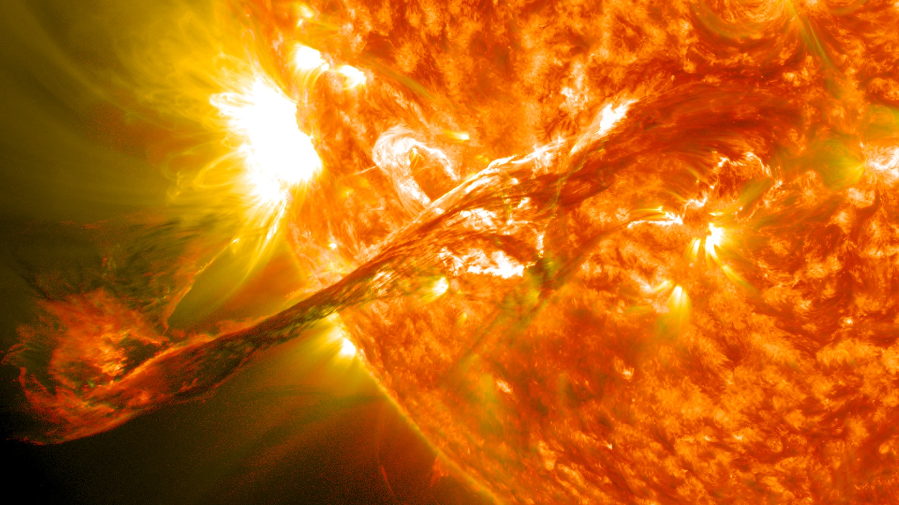
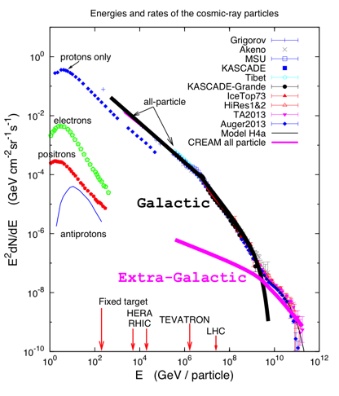
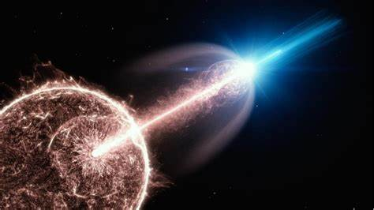
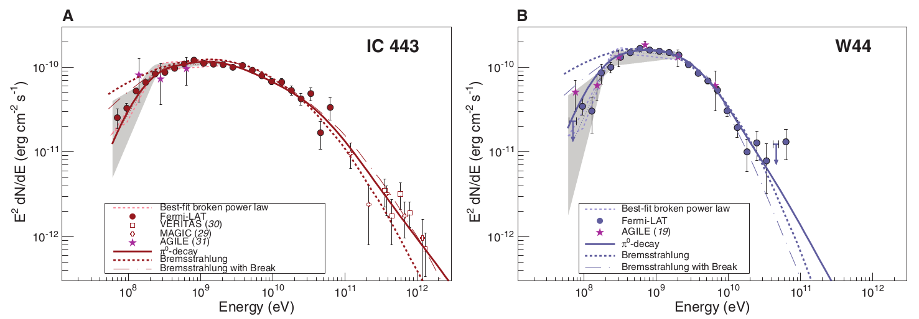
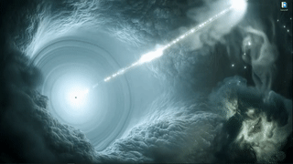
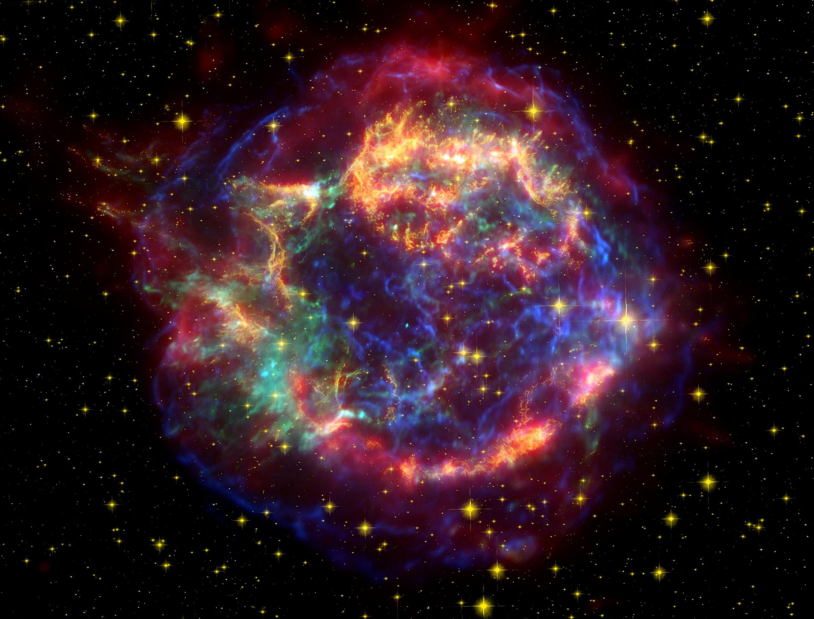
Origin of Cosmic Rays
Sun
GRBs
?
AGNs
SNRs

Slide 3




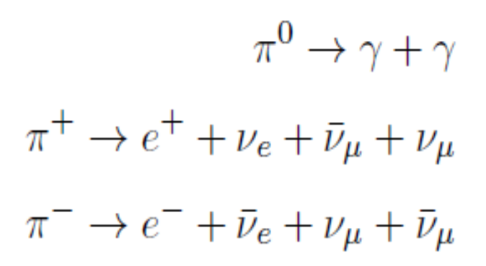
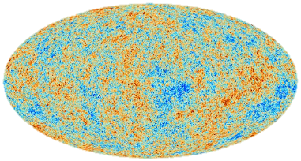
UHE gamma-ray observations provides critical information of candidate PeV CR sources
/
γ
γ
π⁰
π⁰
p
p
H
γ
γ
Competing UHE gamma-ray radiation mechanism:
Inverse Compton Scattering
@100 TeV, effective area for gamma: 1 km²=10⁶ m²
for neutrino: 100 m²
γ
e

Slide 4
Relation between UHE gamma-ray source and HE neutrino source
 : promising PeV CR accelerator : candidate PeV CR accelerator : not PeV CR accelerator
 | Yes | No
Yes | dense target within sources  | compact radiation zone with severe gamma-ray attenuation 
No | few target, leptonic radiation (IC) dominates  | inefficient particle acceleration 
Gamma-ray Sources?
Neutrino
Sources?

Slide 5
Particle Acceleration Mechanism
Energy Sources | Fermi Type repeated interactions with moving magnetic structures | Non-Fermi Type mostly by (quasi-)coherent electric field
Bulk kinetic energy | diffusive shock acceleration(DSA) shear acceleration | shock drift acceleration
turbulence/plasma wave | stochastic acceleration | surfatron acceleration wakefield acceleration
magnetic energy | contracting islands and turbulence generated in reconnection events | direct electric field acceleration
rotational energy/EM potential | / | magetosphere gap centrifugal acceleration

Slide 6
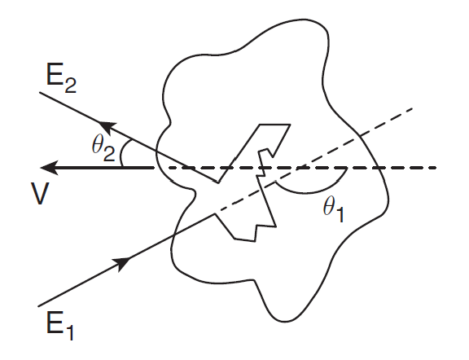



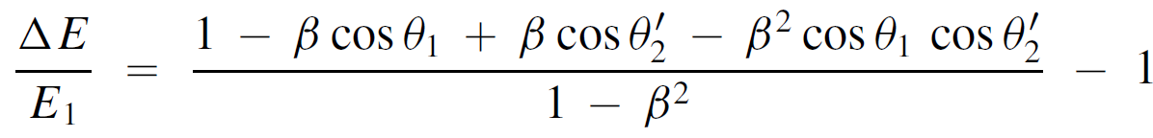
Fermi-type acceleration
a particle of energy E₁ in the lab frame, encoutering a move magnetic structure of Lorentz factor Γ
E₁’: energy view in the rest frame of the moving MS before scatter
E₂’: energy view in the rest frame after scatter
E₂: energy view in the lab frame after scatter
to get energy growth per encounter, we need to average over the incident angle and emergent angle

Slide 7
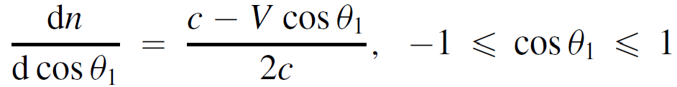
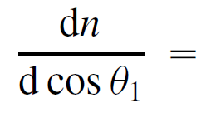


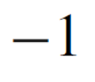

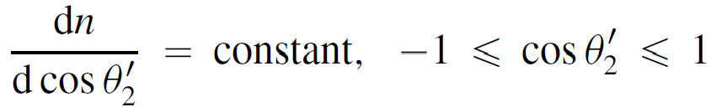
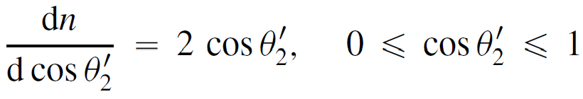
Fermi-type acceleration
for plasma wave
for plane shock
for shearing flow
for plasma wave
for plane shock
Δt = λ/c, for plasma wave and shearing flow
Δt = 4D/u₁, D=λc/3
dE/dt = ΔE/Δt

Slide 8
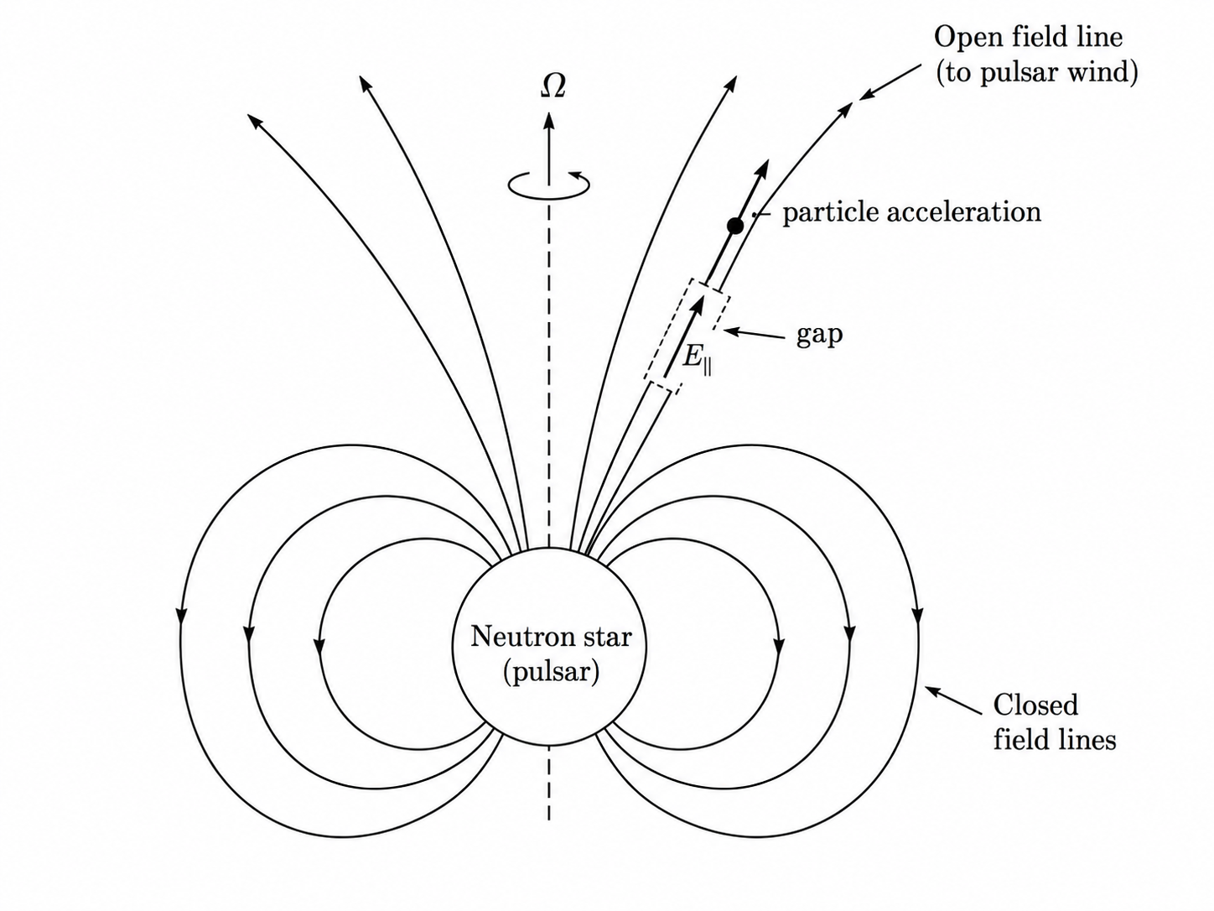
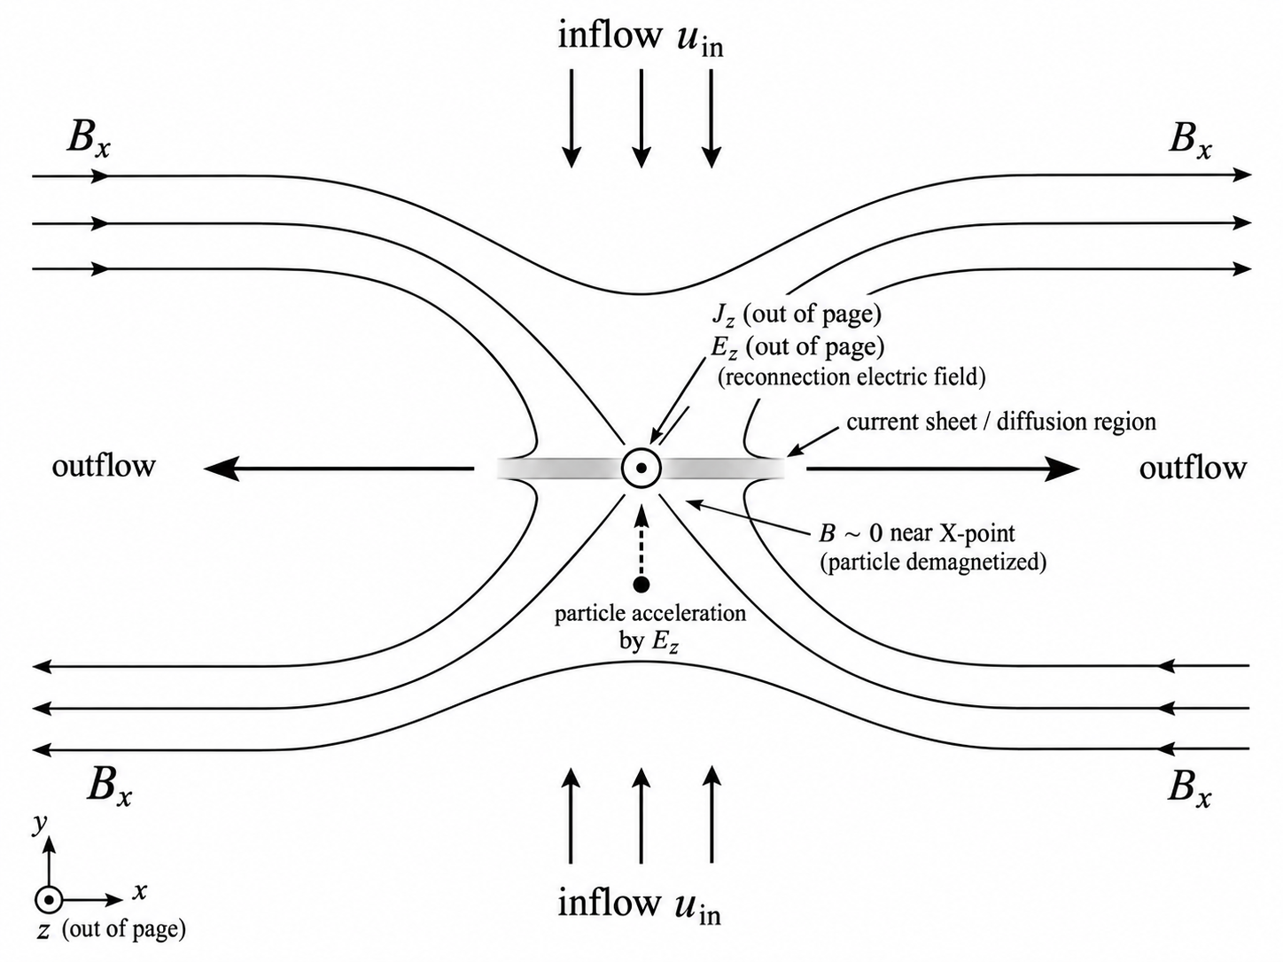
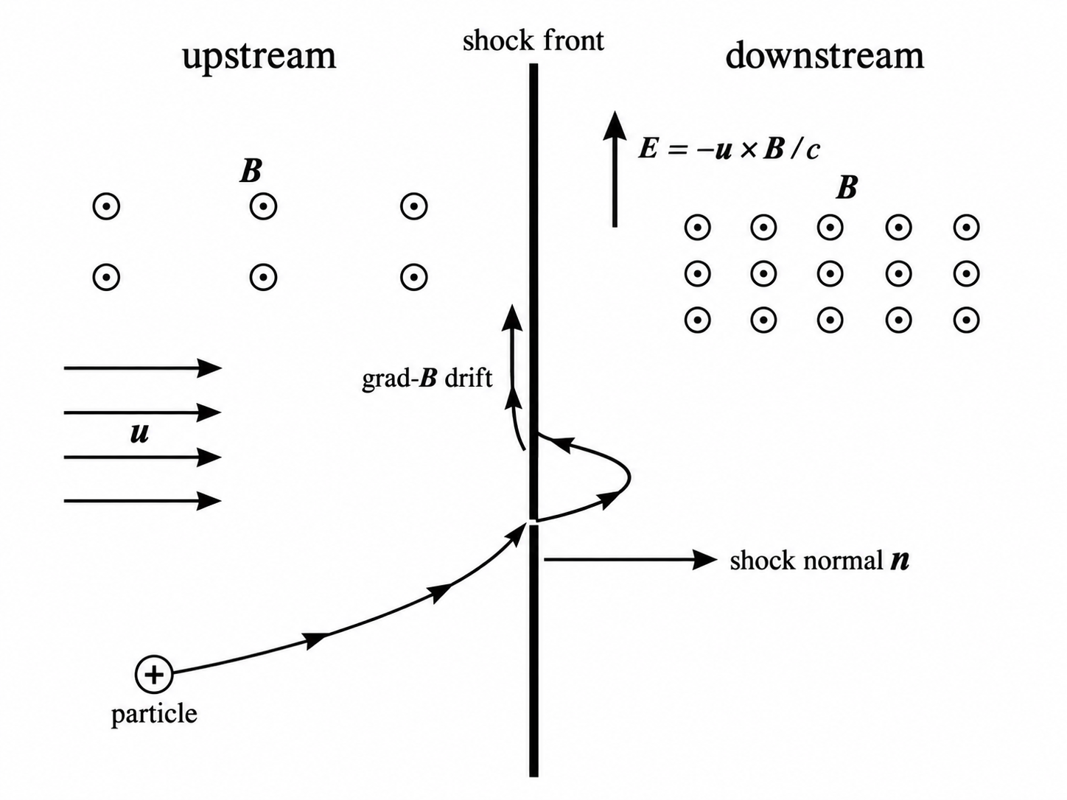
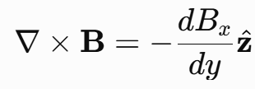
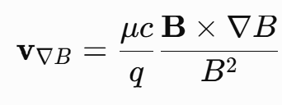
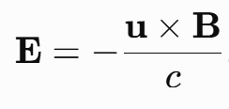
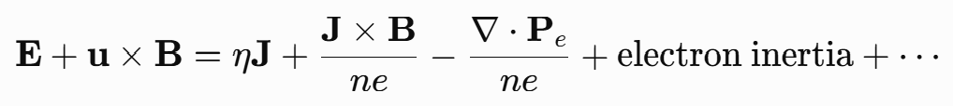
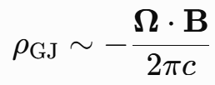

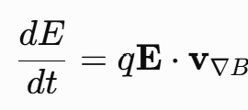
Shock drift acceleration
reconnection direct E-field acceleration
reconnection direct E-field acceleration
~0
drift direction is consistent with electric force direction
non-ideal MHD condition

Slide 9
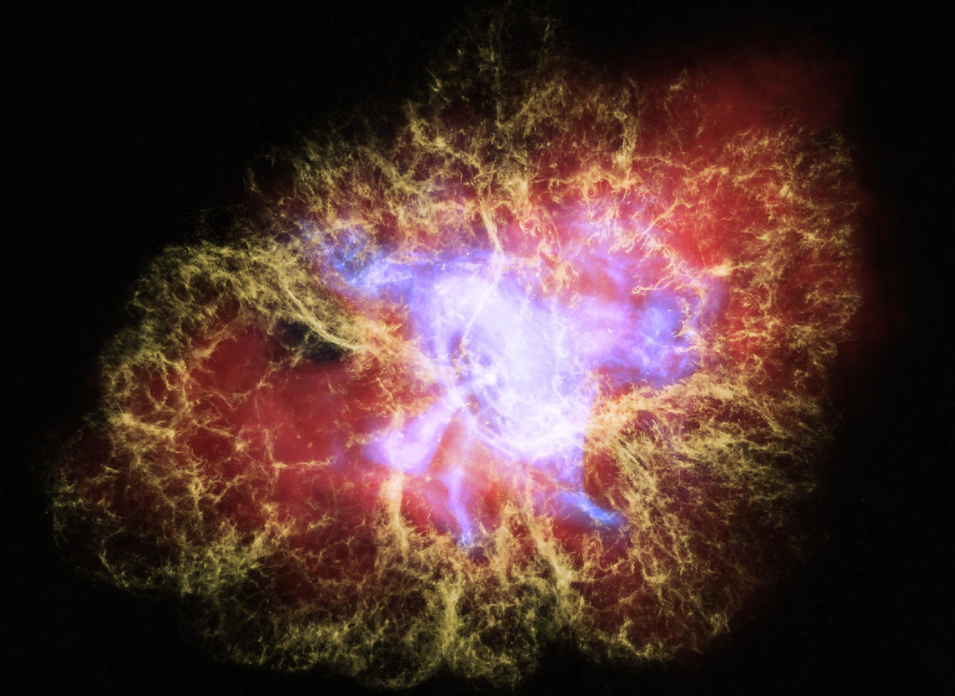
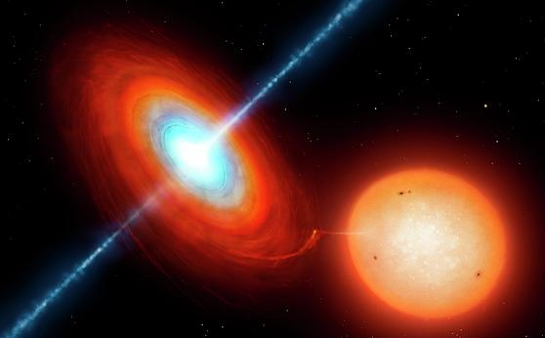
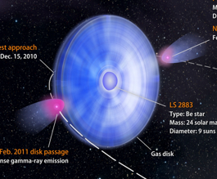
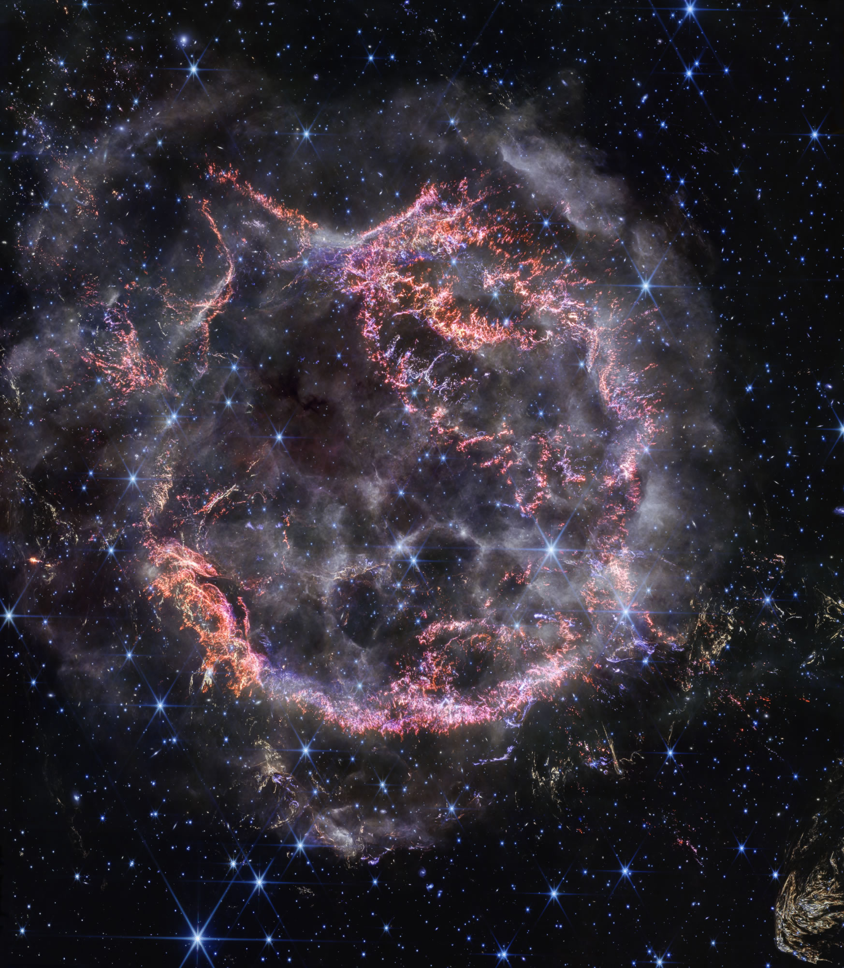
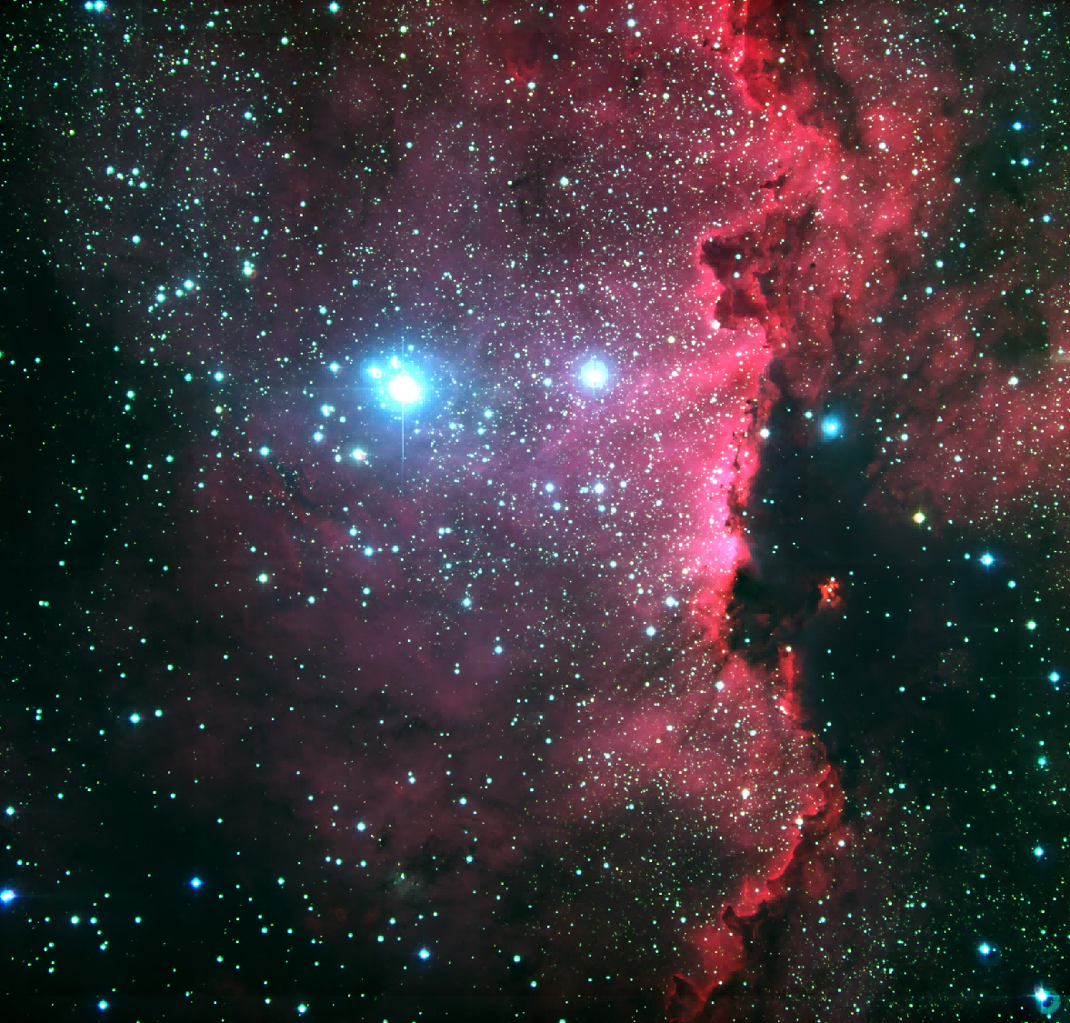
UHE gamma-ray sources detected by LHAASO
Pulsar Wind Nebula | Microquasar | Gamma-ray Binary | Supernova Remnant | Massive Star Cluster
Most numerious UHE sources; Mostly leptonic origin, hadronic possible at highest energies | hard spectrum extending to UHE regime (or even to PeV), indication of hadronic emission | LS I +61◦303 UHE emission with orbital modulation; both leptonic and hadronic possible | mostly around middle-aged SNR; spectrum softenning or cutoff before 100 TeV | Cygnus Bubble, likely powered by Cygnus OB2; association with gas

Slide 10
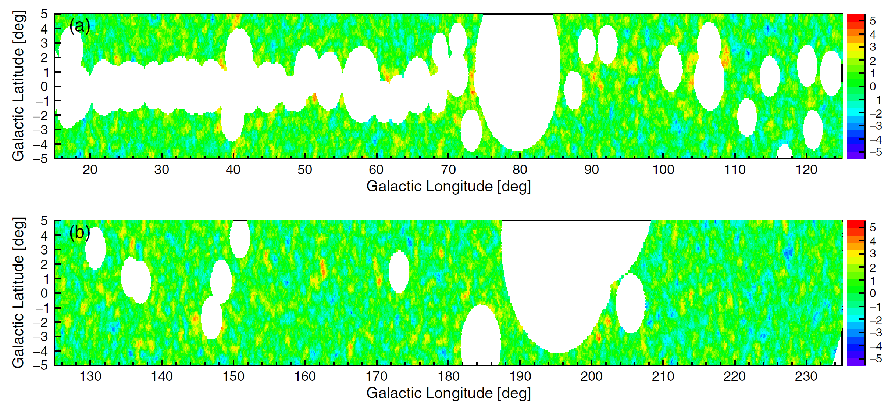
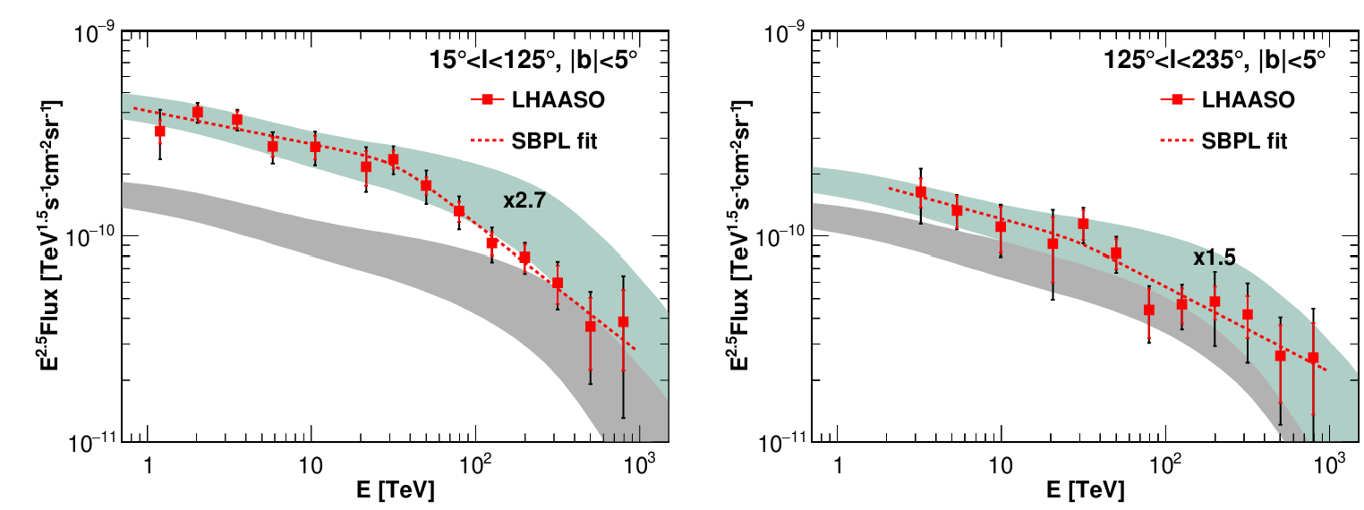
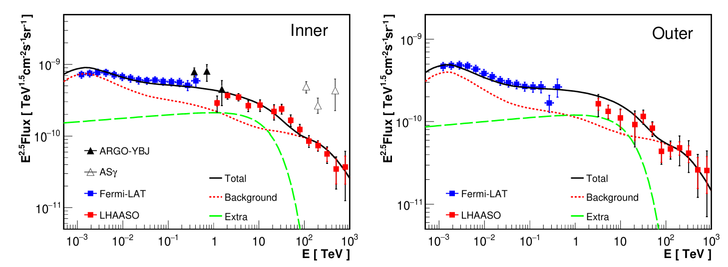
Diffuse Gamma-ray Emission
diffuse emission above 100 TeV is consistent with hadronuclear interactions between CRs + gas

Slide 11
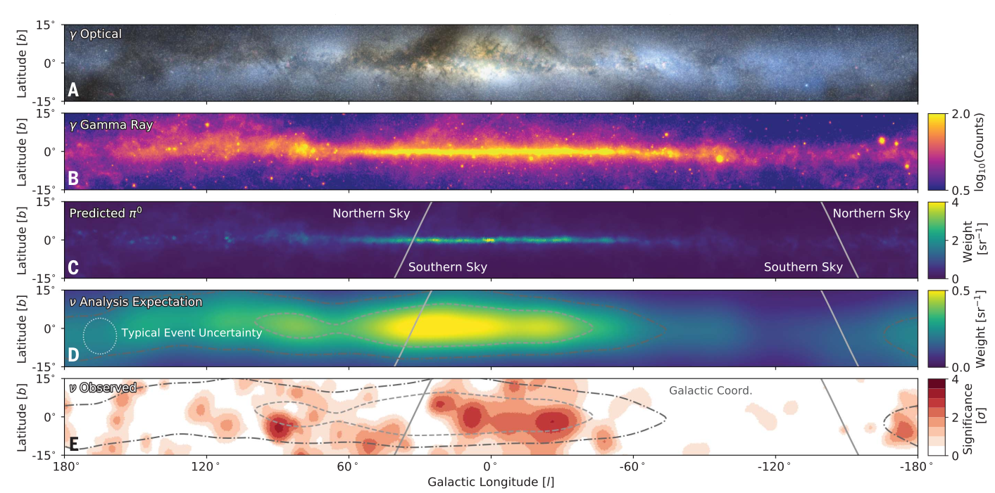
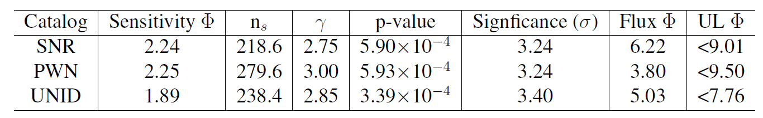
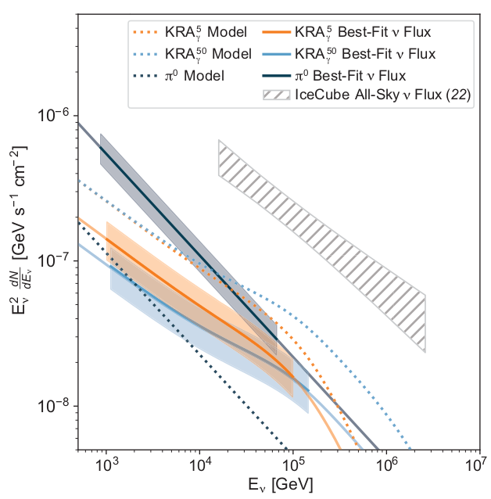
Neutrino detection from our Galaxy
IceCube Collaboration 2023, Science
a significance over 4σ

Slide 12
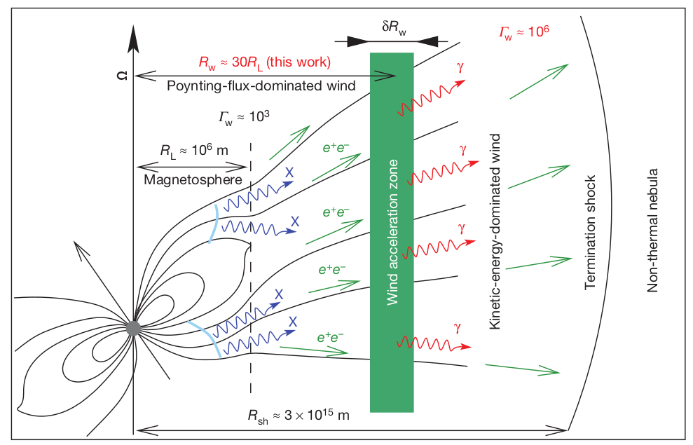


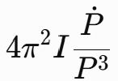

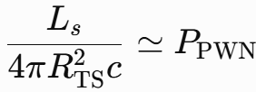

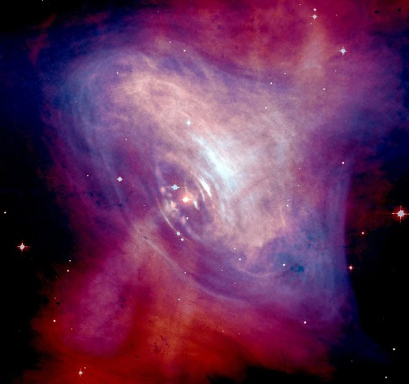
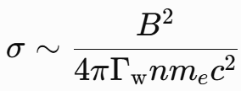



Pulsar Wind Nebula
magnetic dominant
particle dominant
如果不是各向同性星风: 4π→4πf_{ω}
磁化因子=坡印廷流/粒子能流
rotational energy→EM energy（Poynting flux）→kinetic energy→nonthermal energy

Slide 13

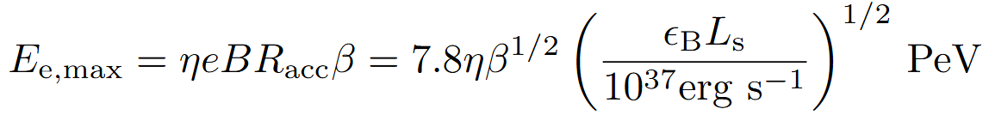
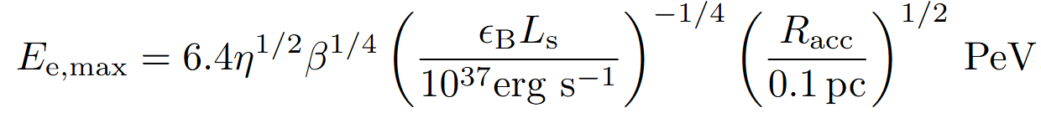
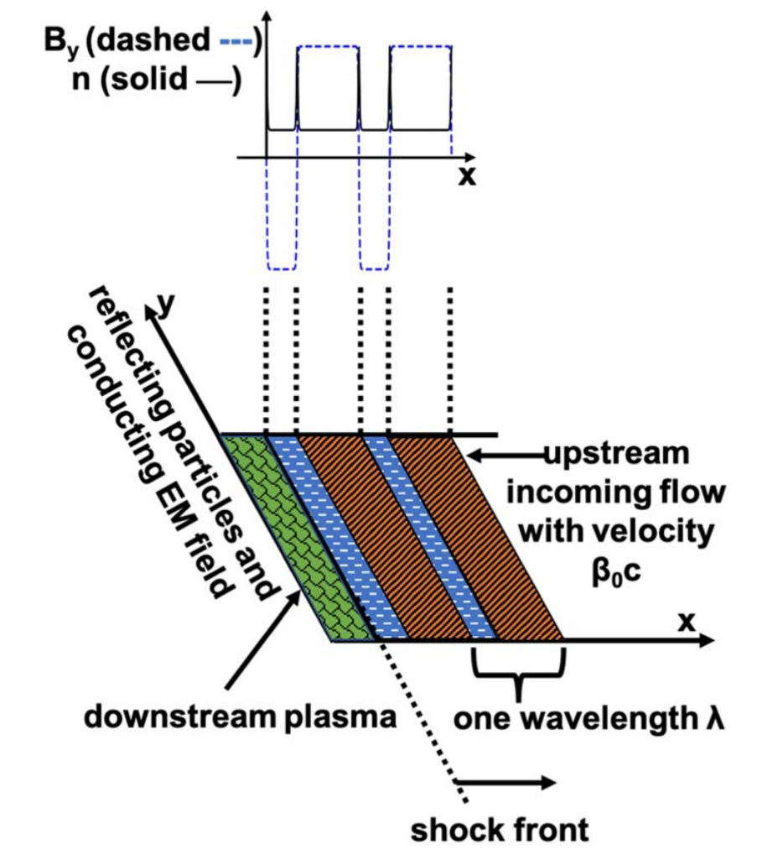
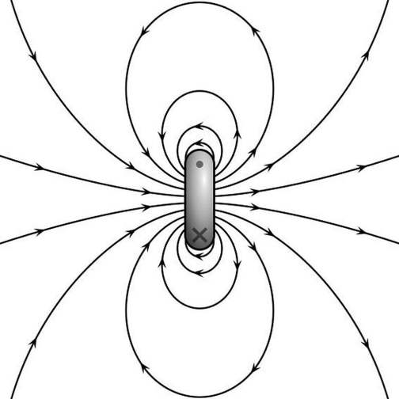
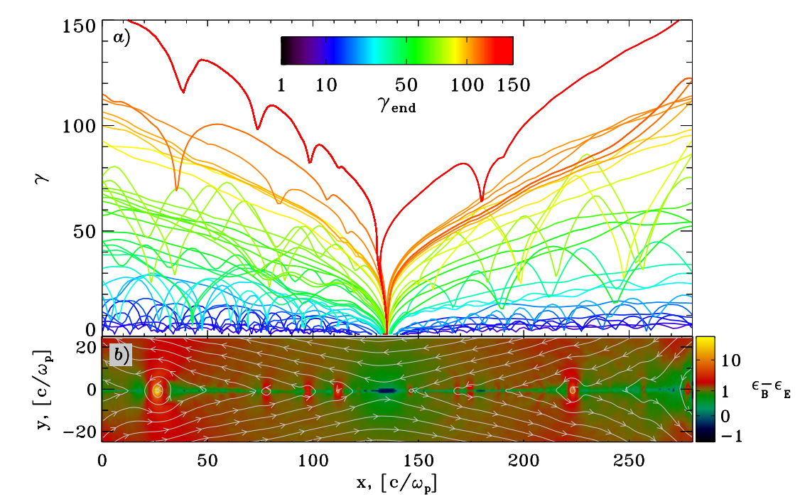
Maximum Energy
Limit from Electric Potential
Limit from Synchrotron Cooling
η: acceleration efficiency = E_{eff} /B
X-points electric field
Sironi & Spitkovsky 2014
Lu et al. 2021

Slide 14
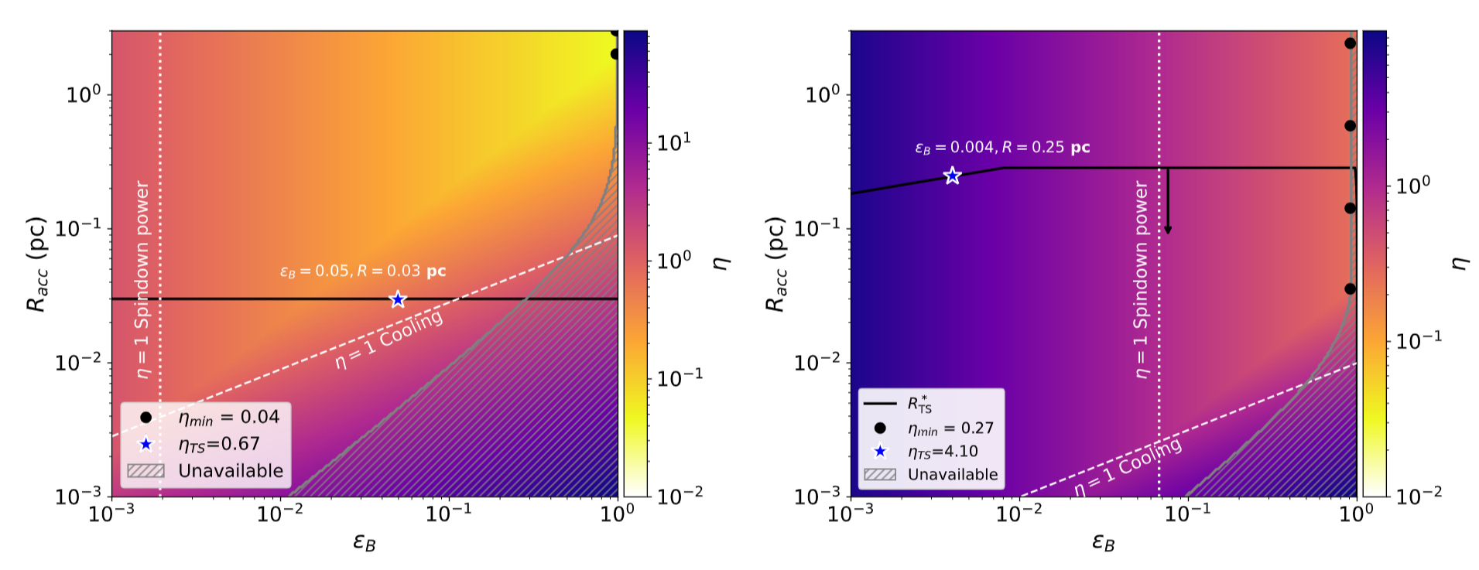
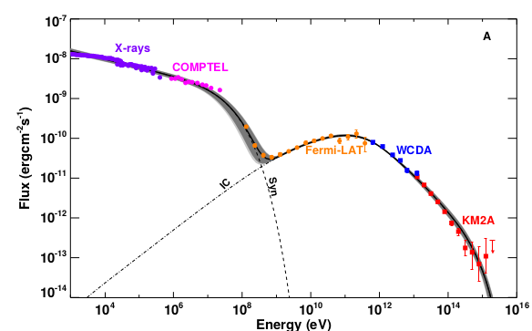
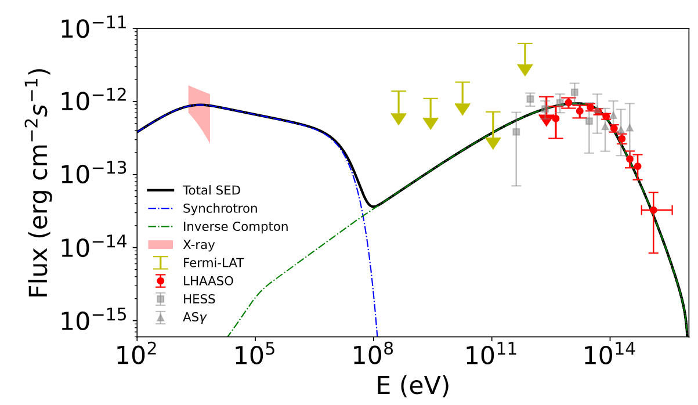
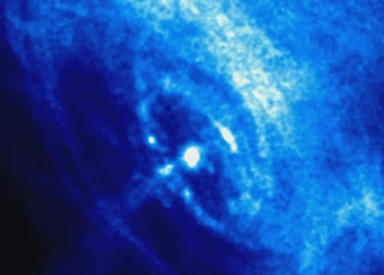
Extreme Particle Acceleration Efficiency
Crab Nebula
Aquila Booster
Crab Nebula (PSR J0534+2200)
Aquila Booster (PSR J1840-0001)
B~100μG
Radiative cooling constrains the maximum particle energy
B~3μG
Spindown Luminosity constrain the maximum particle energy

Slide 15
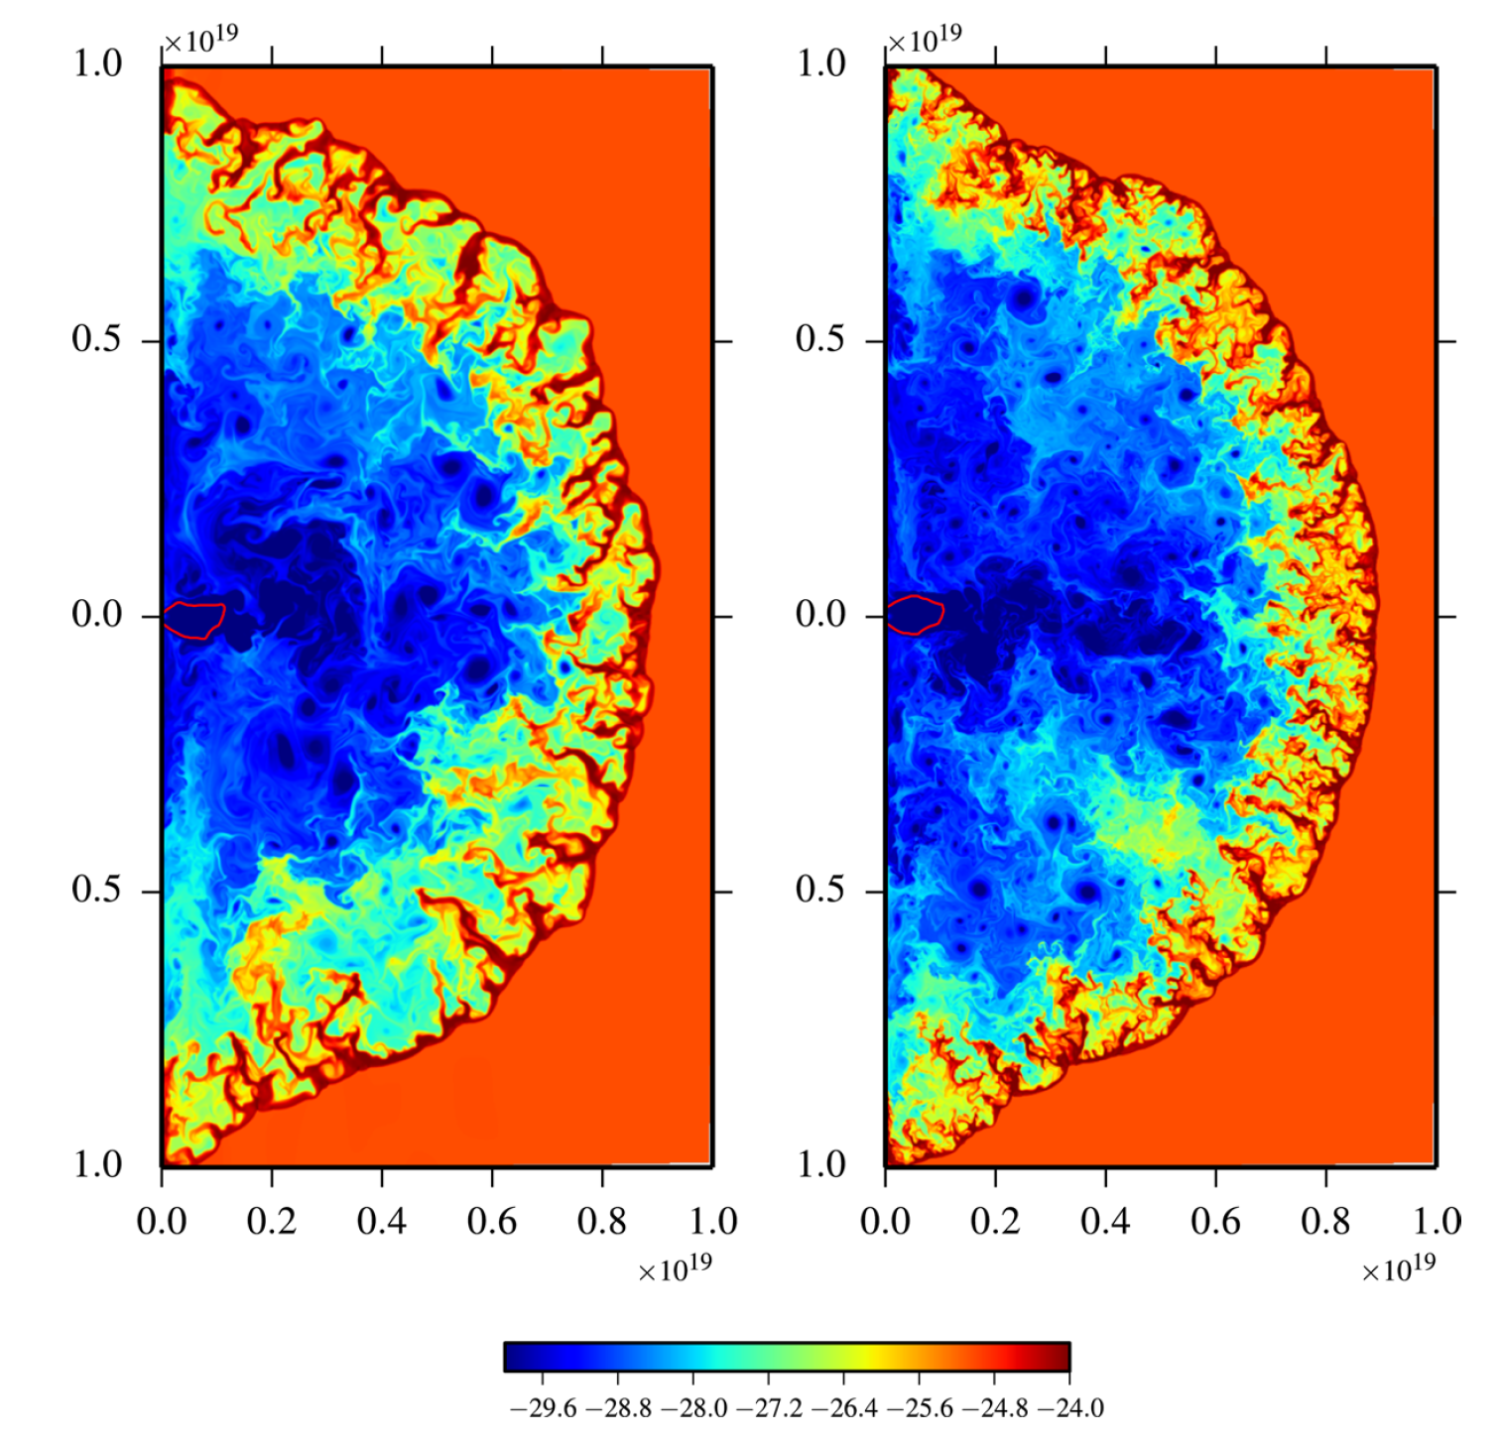


Are PWNe proton/nuclei accelerator？
the TeV-PeV spectrum is not fully consistent with the one-zone leptonic model

Slide 16





Modeling SED of Crab Nebula with protons
Liang et al. 2025, ApJ, 983, 170
dynamical evolution
SED can be reproduced with a hadronic component contributing at the highest energy.
At most ~5% of the spindown power is allowed to be converted to relativistic protons in the Crab Nebula
particle evolution

Slide 17




birht rate: 0.015/yr
If each PWN can convert 5% pulsar’s spindown power to relativistic protons, young PWNe (before RS encountering) population may contribute a few % neutrino flux at 100 TeV and more at PeV depending on the spectral shape.

Slide 18



Cygnus Star-forming region
Cygnus X: an intense star-forming region close to Earth (1.4-1.7 kpc)
extension ~ 200 pc
hundreds of O stars, thousands of B stars
several x10⁶ M$⨀$ solar mass in gas
Credit：ESA/Herschel Space Observatory
Wright et al. 2015

Slide 19






Previous Gamma-ray Observation of Cygnus Star-forming region
Fermi-LAT Collaboration 2011
Asgamma Collaboration 2021
ARGO Collaboration 2014

Slide 20



SNR γCygni
Dragonfly Nebula
& Cygnus OB1
LHAASO Collaboration
2023
90
80
70
Binary system composed of PSR J2032+4127 & Be Star

Slide 21


66 photon-like events within a radius of 6 degree with an estimated background of 9.5
7/66 from central 0.5 deg region v.s. 66*(0.5/6)²≈0.5
2/8 PeV event from central 0.5 deg region
Overdensity at the centre – injection!

Slide 22


Energy-independent size
Leptonic scenario: r~(Dt_{c})^{1/2}~ decrease with E increase
Spectrum goes up to 2.5 PeV, without significant softening or cutoff feature
Favor hadronic origin

Slide 23




Physical Picture
Spectra of different components
Radial surface brightness profile
Cygnus Cocoon measured by Fermi-LAT
Gas distribution
Radial distribution
2D projection

Slide 24






1% of mechanical power of OB2
Excess of CR density up to 600 pc at 1PeV

Slide 25


Predicted Neutrino Flux
Li et al. 2024
29/7.7/0.36 (anti-)muon neutrino events above 1/10/100 TeV for 10-yr IceCube operation

Slide 26


Microquasars
stellar wind
Binary + Mildly-relativistic Jets
jet termination
NS or stellar-mass BH + a donor star
Potential extreme particle accelerator where and how? maximum energy?
persistent or episodic jet
BH
accretion disk
Centrifugal force
at BH magnetosphere
NOT TO SCALE
disk wind
wind-driven shock
shear acceleration
v_{jet}

Slide 27

12 BH microquasars in LHAASO’s FoV, 5 associated with UHE gamma-ray sources
All five detected microquasars show persistent or remarkable outbursts of BH activities in recent years
All seven undetected microquasars do not show notable BH activities in recent years
cooling time of particles responsible for UHE emission is > kyrs
is it just coincidence?
Resolved: SS 433; V4641 Sgr; GRS 1915+105
Unresolved: MAXI J1820+070; Cygnus X-1
Is a BH’s recent activity (over past decades) a proxy of UHE emission?

Slide 28

SS 433, V4641 Sgr, GRS 1915+105: extended sources
Cygnus X-1, MAXI J1820+070:
point-like source with spatial offset
Cygnus X-3:
point-like source with temporal variation
particle acceleration at multi-scales

Slide 29


SS 433
energy dependent morphology, in particular above 100 TeV
a second component is required to explain the UHE emission
either leptonic or hadronic is Ok from the perspective of spectral fitting
morphological study consistent witih hadronic origin
E_{max}=10PeV
p=2.5

Slide 30




Early Observation on Cyg X-3
PeV流量接近10⁻¹⁰erg/cm²s， 具有轨道调制
Samorski & Stamm 1983, ApJ
Fermi-LAT观测
Evans-Lloyd et al. , 1983, Nature
Kiel air shower array
Leeds air shower array

Slide 31


LHAASO Observations of Cygnus X-3
Cygnux X-3: HMXB; Orbit radius: 2.7x10¹¹cm ~0.02 au; Orbit period: 4.8 hr
require BH > 10¹⁵ G cm

Slide 32




Temporal Variation
>100TeV
orbital modulation
emission zone should be at or within the binary scale
UHE emission is variable at month scale, and temporally correlated with GeV emission
Must be hadronic radiation！

Slide 33




PeV radiation mechanism
/

Slide 34




Implication from Fermi-LAT
GeV’s modulation comes from anisotripic IC scattering
MCMC fitting gives the best-fit parameters

Slide 35




Constraining the PeV emission zone
Assume B field evolves as
B(H) = B₀(H/H₀)^{-δ}
go to smaller region to get higher E_{H}
process provide another constraint
in GeV emission region, BH<10^{13.3}G cm
E_{max}<10^{14.5}eV (for R~0.1H, β=0.5)

Slide 36


Implication from phase lag
GeV peak
PeV peak
phase lag infers the distance between the two emission zones
Phase lag between GeV and PeV independent indicates that the PeV emission zone is closer to CO than GeV emission zone

Slide 37


to observer
stellar wind
r_{L}= 0.2 au (E/10PeV) (B/10G)⁻¹

Slide 38



Main CR accelerators
伽马射线暴
太阳
活动星系核
超新星遗迹
年轻大质量星团
微类星体

Slide 39
Summary
LHAASO observations of UHE gamma-ray sources provide candidates of PeV CR accelerators and Galactic HE neutrino sources
PWNe are extreme particle accelerators. Once protons are loaded into their acceleration zone, young PWNe can be proton accelerator. Nevertheless, they are not expected the dominating contributors of PeV CR and Galactic HE neutrinos given their energy budget.
Cygnus Bubble is likely powered by young massive star cluster. Association between gamma-rays and gas indicate hadronic origin. Acceleration mechanism is under debate. Only one case
Miccoquasars are the most promising PeV CR contributors. V4641 Sgr, GRS 1915+105, Cygnus X-3 present spectra extending to PeV. Cygnus X-3’s UHE emission is of hadronic origin.

Slide 40

Paper Walkthrough: Chen et al. 2026
ApJ, 1007, 165 (2026), arXiv: 2512.19403

Slide 41




IceCube observations
Point-source search identifies NGC 1068 as promising candidate source of high-energy neutrinos
NGC 4151 and NGC 7469 also show tentative excess of HE neutrino signal

Slide 42

Disk-Corona Model
related to accretion power and hence proton power
L_{X}
related to target density for neutrino production

Slide 43

X-ray bright AGN as high-energy neutrino emitters
Stacking analysis suggest bright X-ray AGNs may be HE neutrino emitters
Question: are X-ray-selected AGNs main contributors of diffuse neutrino background? or how much fraction is contributed by them?
need to probe contribution from fainter but more numerious X-ray-selected AGNs
IceCube Coll. 2025

Slide 44







Test X-ray-selected AGN as neutrino emitters
all detected neutrinos→ a fraction of β is astrophysical neutrinos → a fraction of α comes from AGNs
in reality, those faint AGNs (F_{X}<F_{min}) cannot be detected
neutrino sky = AGN template $⨂$ PSF + isotropic component
isotropic component = atmospherical events + non-AGN contribution + faint AGNs
maximize likelihood ratio (or test statistic) to estimate f
assume F_{v}$∝$F_{x}

Slide 45


X-ray Survey
eFEDs ( eROSITA Final Equatorial Depth Survey): 22,079 AGNs within 142 deg²

Slide 46





X-ray Luminosity Function and Flux distribution
f → f_{tot} (the higher F_{cut}, the larger uncertainty from extrapolation)
Ueda et al. 2014

Slide 47




Source Confusion
F_{min} → F_{cut}
d=40, σ=10
d=40, σ=20

Slide 48







Significance
IceCube-Gen2: 0.2°@ 100 TeV
involving ~150 AGNs
HUNT: 0.04°@ 300 TeV
involving ~3200 AGNs
assume f_{tot}=0.5 (α=1, β=0.5)
Huang 2025, ICRC
smaller PSF: sharper signal/background contrast + lower flux cut (= involving more sources = less XLF uncertainties)

Slide 49

Energy dependence
IceCube-Gen2
HUNT
tradeoff between less background+better PSF and loss of statistics

Slide 50


Statistical and systematic uncertainties

Slide 51

Influence of pre-assumptions
if there are other source classes for high-energy neutrinos (α<1)
if neutrino flux is not linearly correlated with X-ray flux for a AGN (s≠1)

Slide 52

Application to gamma-ray blazars

Slide 53




Consistency Check I
Test for souce-by-source scatter

Slide 54

Consistency Check II
bright source stacking ≠ population-level correlation
Application to Swift/BAT Seyfert AGN catalog (the brightest end)

