Slide 1

Baikal-HUNT Optical Module Studies
in the Photon-Counting Mode
Daniil Trofimov
Work with: Mingjun Chen, Bo Gao, Yijiang Peng
Absolute detection efficiency · Count-rate behavior · fW – 100 fW weak-light control
Institute of High Energy Physics (IHEP) · Tianfu Cosmic Ray Research Center (CRRC)
16 September 2026

Slide 2
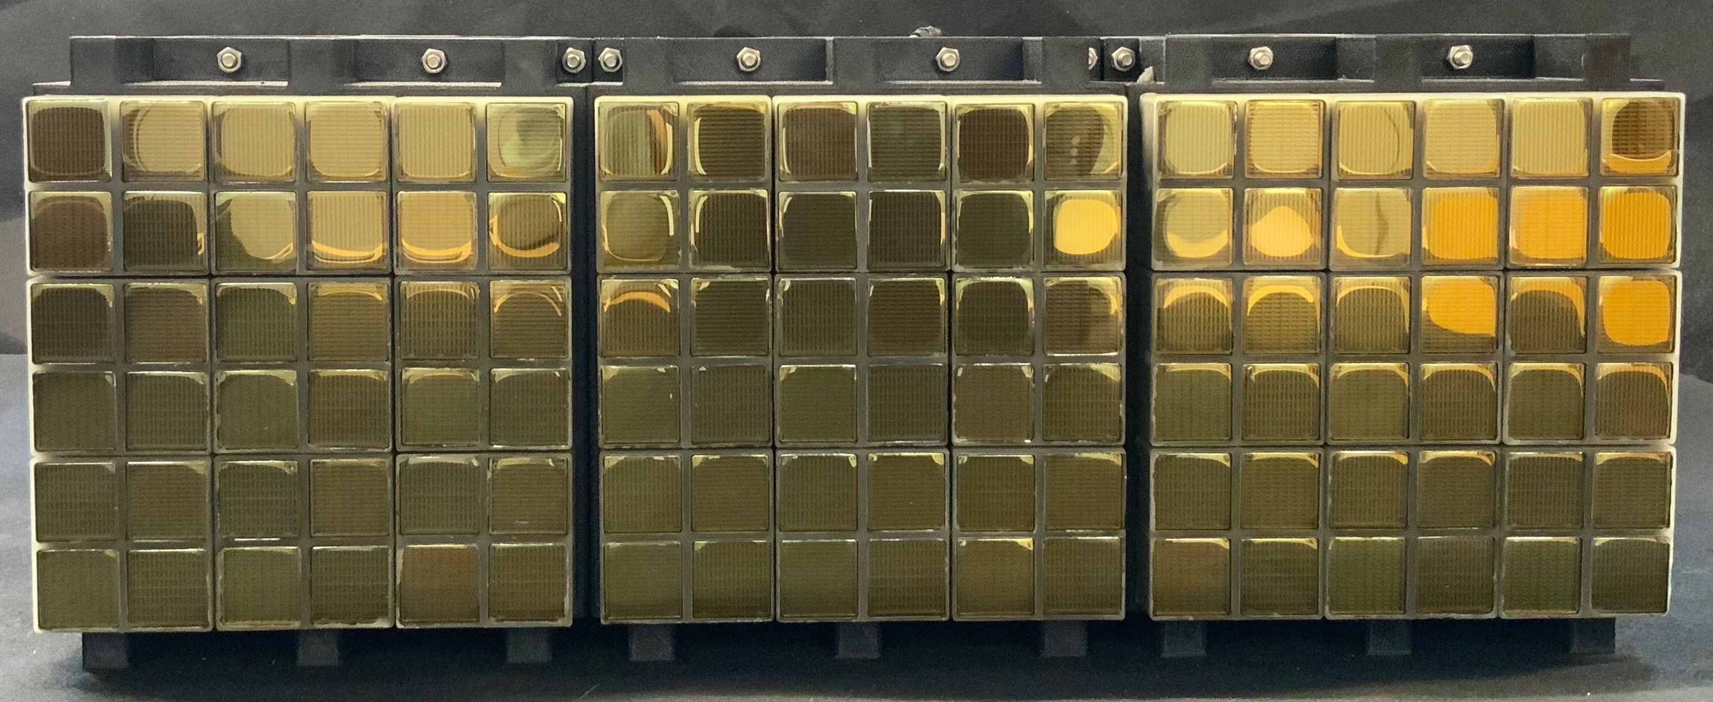
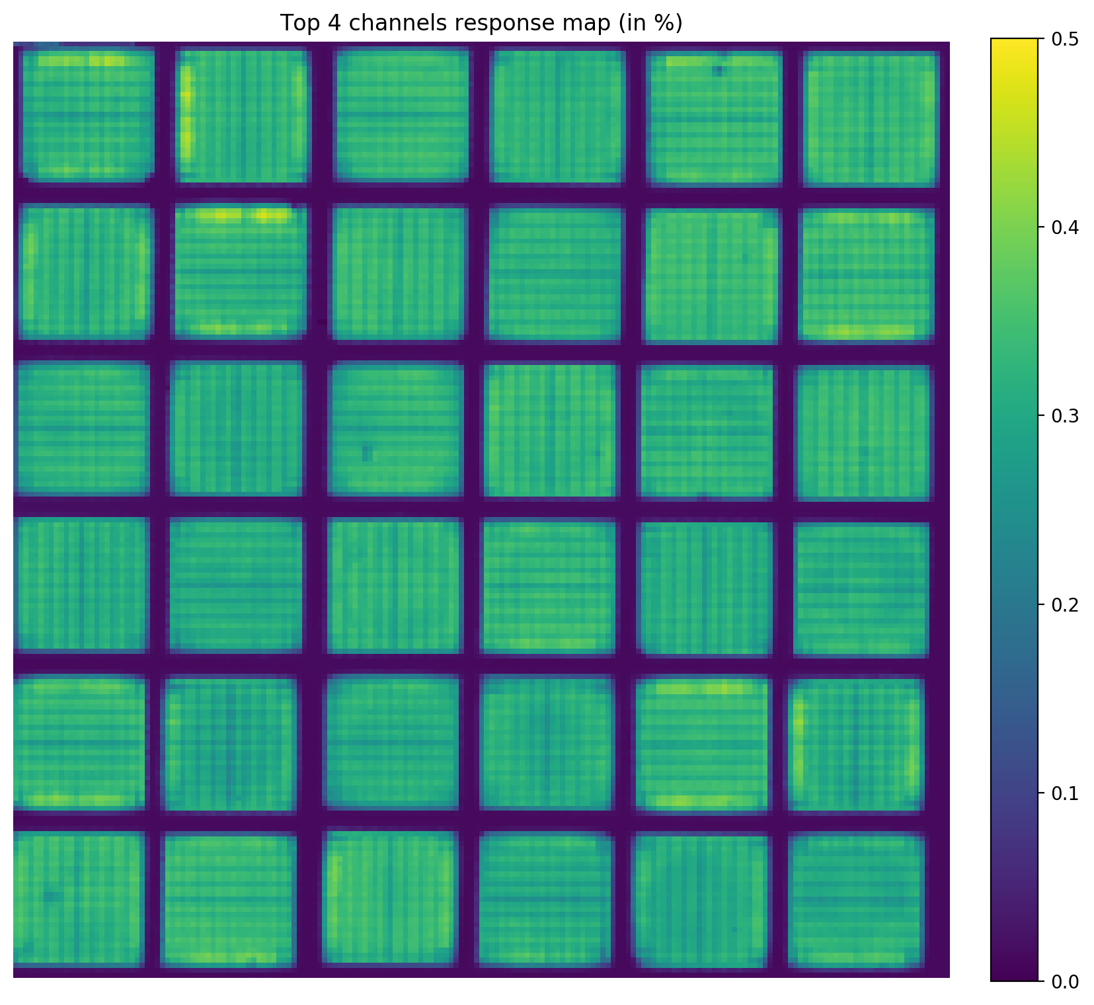
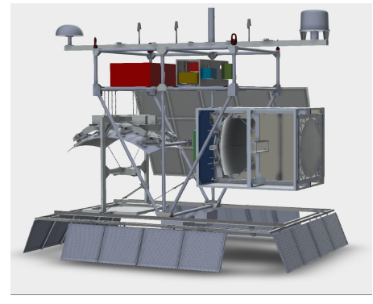
Previous Work · JEM-EUSO Collaboration
BACKGROUND
PhD IN PHYSICS OF THE UNIVERSE
Tests and calibration of multi-channel photodetectors for the JEM-EUSO balloon and space missions
MAPMT ABSOLUTE CALIBRATION
Hamamatsu R11265: efficiency vs wavelength, pile-up effect, double-pulse resolution with the SPACIROC-3 ASIC
PDM camera — 64-channel MAPMT modules
108
APPLIED TO EUSO-SPB2
Fluorescence telescope, launched May 2023 — pathfinder of the orbital mission for UHECR detection
MAPMTs
6912-pixel camera
photon-counting mode
Pixel efficiency scan
EUSO-SPB2 instrument
avg. SPE efficiency ≈ 32%
Institute of High Energy Physics · Tianfu Cosmic Ray Research Center
02 / 12

Slide 3
Motivation · PMT Operation in Baikal-HUNT
MOTIVATION
01
02
03
Short timescale
Long timescale
Operating mode
Near-DC weak background light at extremely low flux
Background light level changes significantly over time
PMT works with single-photon detection capability
↓
SO WE APPLY THE PHOTON-COUNTER APPROACH TO STUDY
≈
This is exactly the operating regime of a photon counter
Absolute detection efficiency
Detector count-rate behaviour
Calibration must be performed in counting mode at extremely low optical power — the standard bench approach for PMTs does not directly apply.
CONSEQUENCE
Institute of High Energy Physics · Tianfu Cosmic Ray Research Center
03 / 12

Slide 4
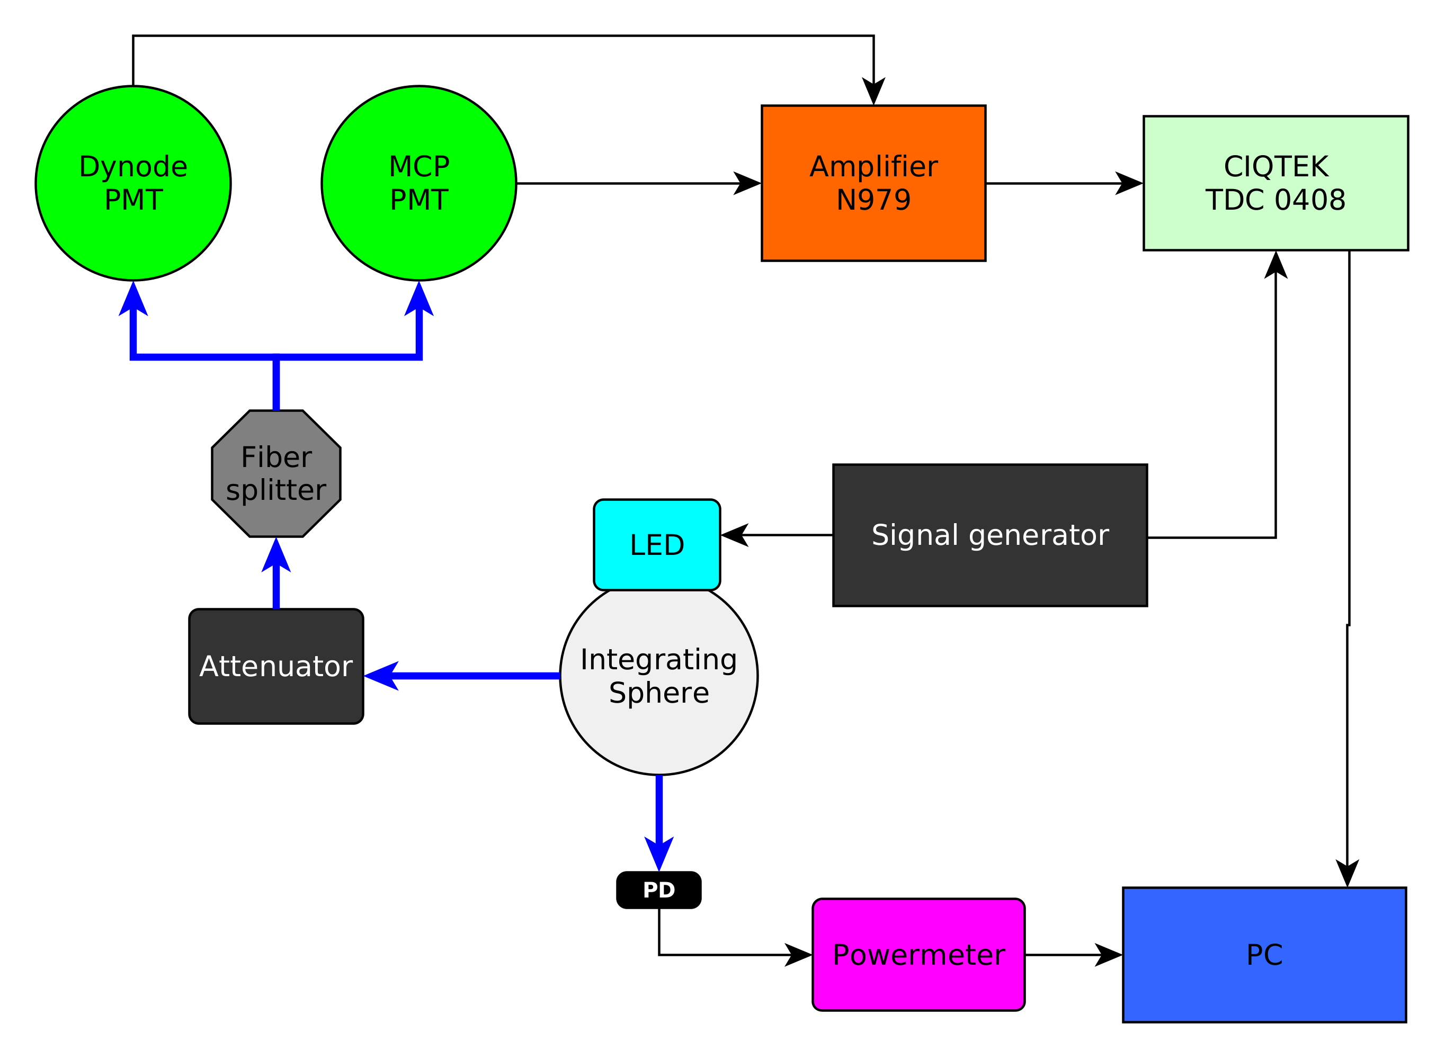
Challenge · Ultra-Weak Light Control
APPROACH
REQUIREMENT
1 fW – 100 fW
optical power at the PMT — kept so low that photons arrive one by one
SOLUTION
LED + pulse generator
↓
Integrating sphere
↓
Continuously variable attenuator
↓
Fibre splitter → PMT & photodiode
Measurement layout — blue: optical fibres; black: electrical cables
fW – 100 fW illumination achieved with an integrating sphere + continuously variable attenuator
Institute of High Energy Physics · Tianfu Cosmic Ray Research Center
04 / 12

Slide 5
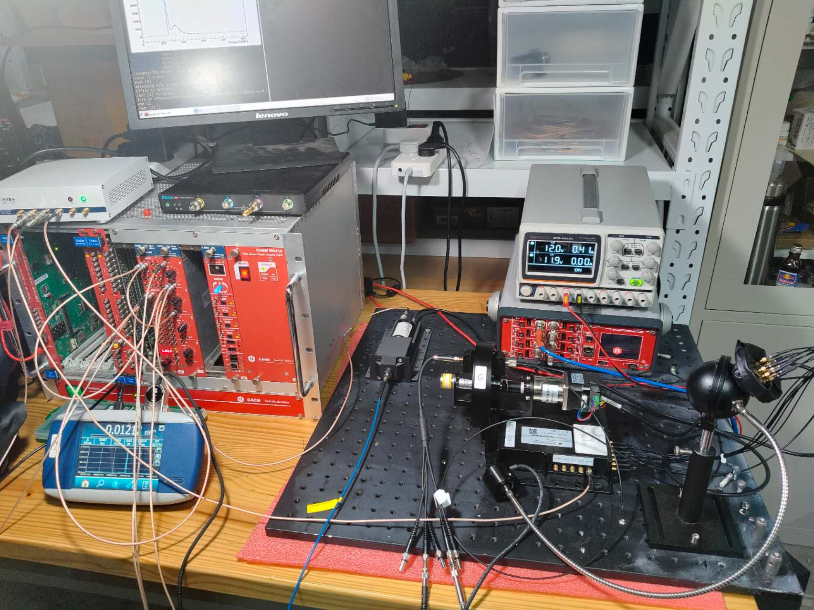
Experimental Setup · Photo
SETUP
Bench equipment:
LED source + pulse generator
Integrating sphere + continuously variable attenuator (3OD)
Fibre splitter → double PMT test
Dynode PMT (CR364)
CAEN amplifier (N978, 1X-10X)
TDC0408 readout (8ps/LSB, 5ns deadtime)
HV supply (DT8033M)
Test bench — LED, integrating sphere, attenuator, readout electronics, 20-inch MCP-PMT
The bench provides the flux cross-calibration and the photon-counting measurements
Institute of High Energy Physics · Tianfu Cosmic Ray Research Center
05 / 13

Slide 6
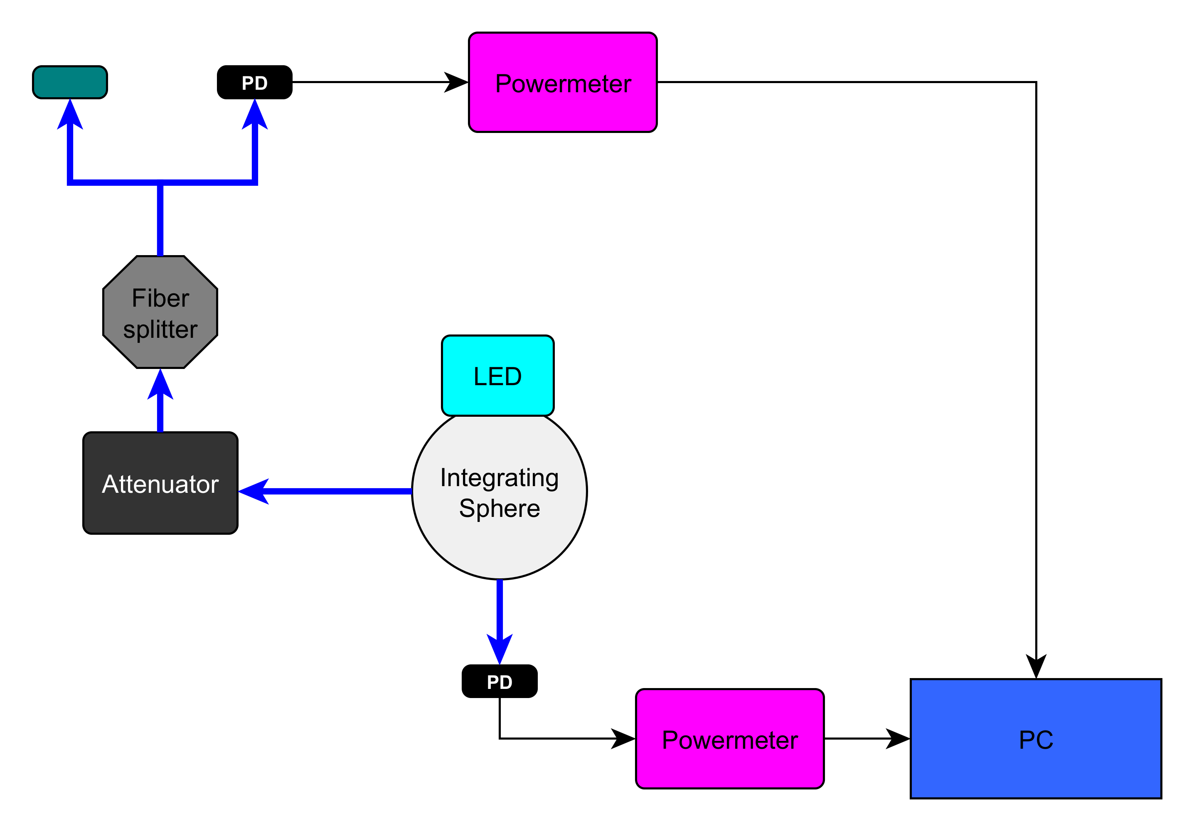
Step ① · Flux Cross-Calibration
METHOD
STEP 1 — CROSS-COEFFICIENT
Two photodiodes are cross-calibrated at the lowest attenuator step — the PMT-exit power can only be measured directly at low attenuation
STEP 2 — RELATIVE POWER
Relative power is then measured for every attenuator step, transferring the absolute scale downwards
Working point: ~ pW optical power
LED → integrating sphere → attenuator → fibre splitter → PDs / powermeters
Cross-coefficients stored for each attenuator position → final photon rate at the PMT
Every attenuator step is referred to an absolute standard → the photon rate at the PMT is known
Institute of High Energy Physics · Tianfu Cosmic Ray Research Center
06 / 13

Slide 7
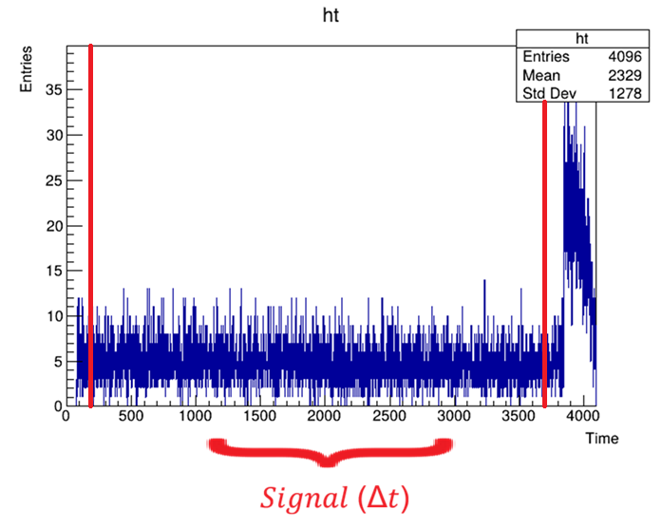
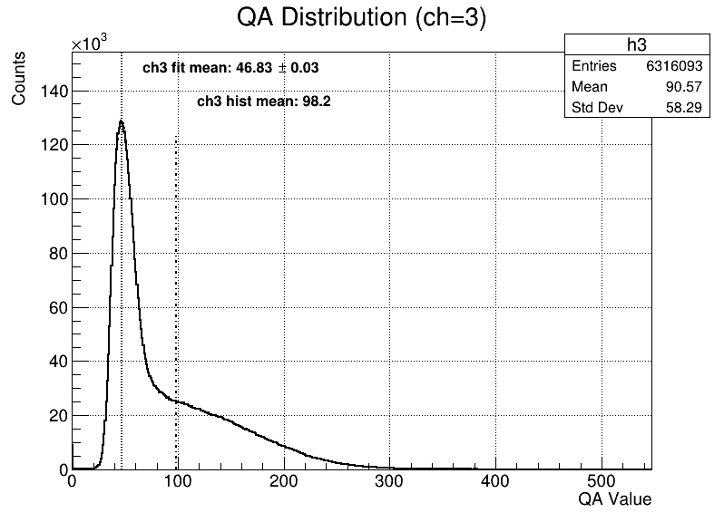
Step ② · Single-Photoelectron Measurement with TDC
METHOD
TDC time histogram — signal events
selected within the Δt window
SPE charge spectrum — single-photoelectron
peak identified, gain monitored
Known photon rate × selected signal window → the PMT is measured as a photon-counting detector
Institute of High Energy Physics · Tianfu Cosmic Ray Research Center
07 / 13

Slide 8
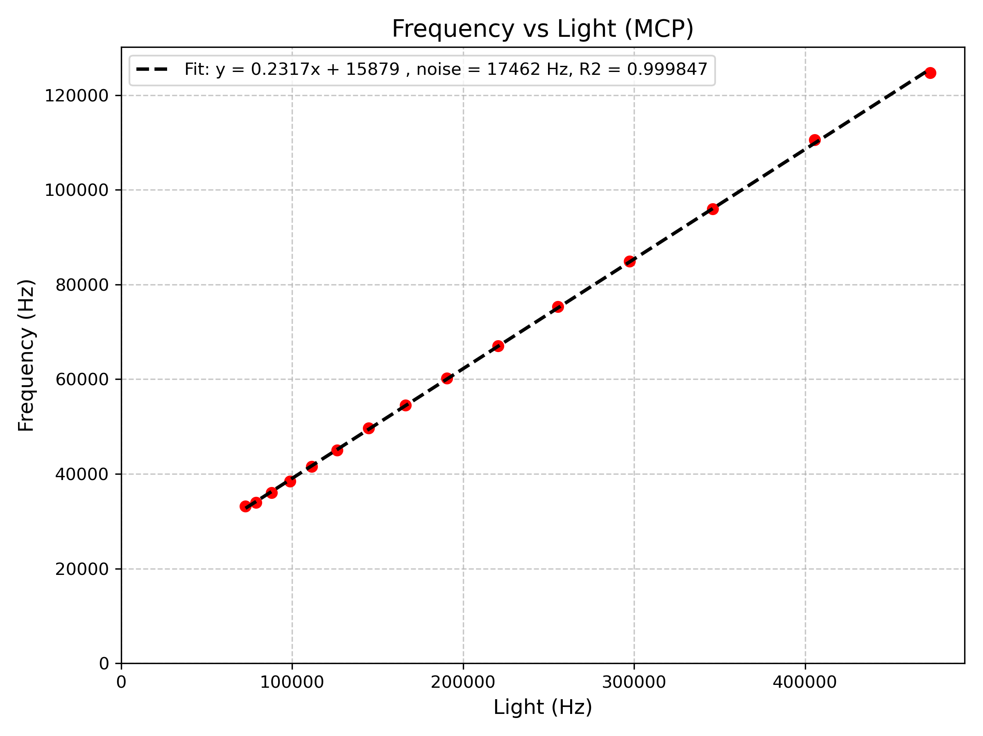
Result ① · Absolute Detection Efficiency
RESULTS · 1/3
FIRST RESULT · MCP-PMT
23.17%
at 405 nm
Local illumination — centre of the MCP-PMT
Low-rate regime — single-photon counting
Rate linear in photon rate, R² = 0.9998
Count rate vs photon rate (405 nm) — the slope gives the absolute efficiency
Absolute detection efficiency of the MCP-PMT: 23.17% at 405 nm
Institute of High Energy Physics · Tianfu Cosmic Ray Research Center
08 / 13

Slide 9
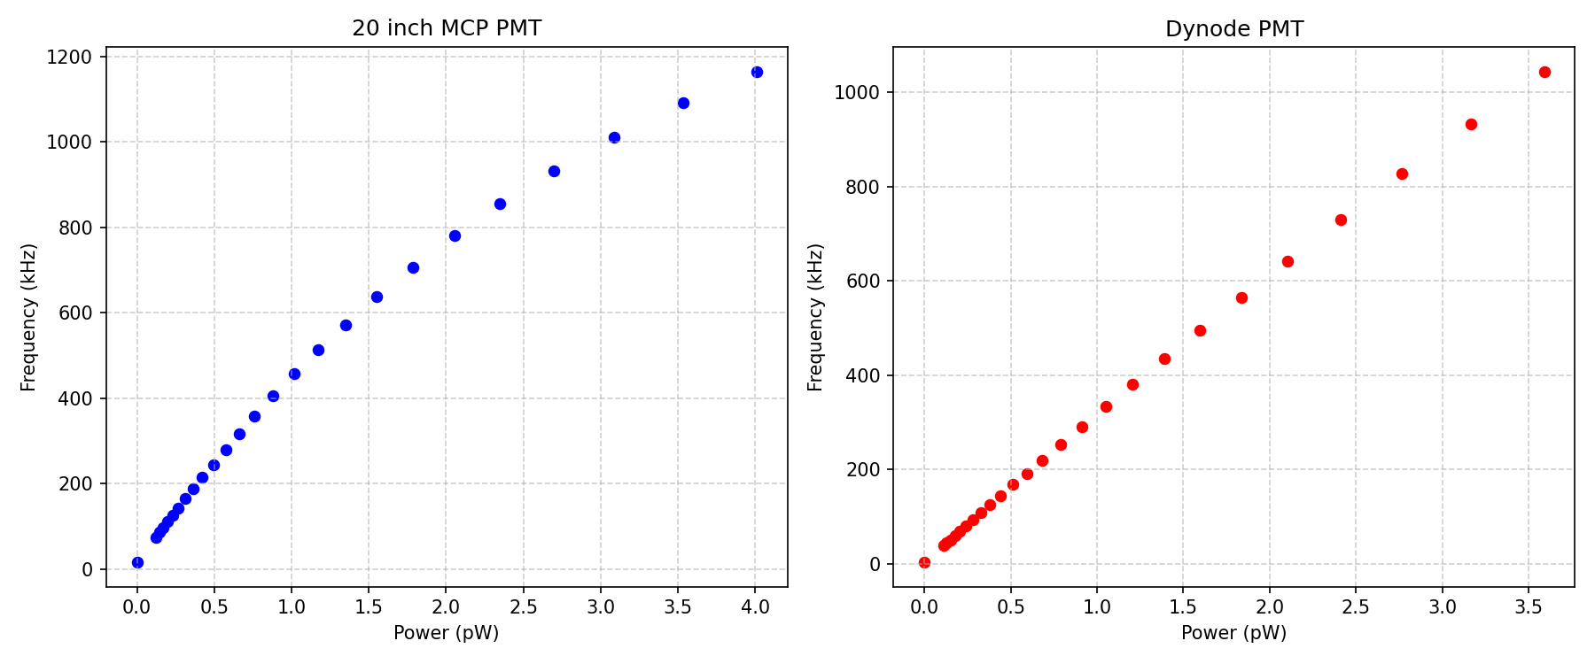
Result ② · Count-Rate Nonlinearity: MCP vs Dynode
RESULTS · 2/3
Count rate vs optical power — almost identical light input for both tubes (left: 20-inch MCP-PMT; right: 1-inch dynode PMT)
MCP-PMT: count rate falls below the light level — nonlinear already at moderate rates
Dynode PMT: rate follows the light — linear behavior
Institute of High Energy Physics · Tianfu Cosmic Ray Research Center
09 / 13

Slide 10
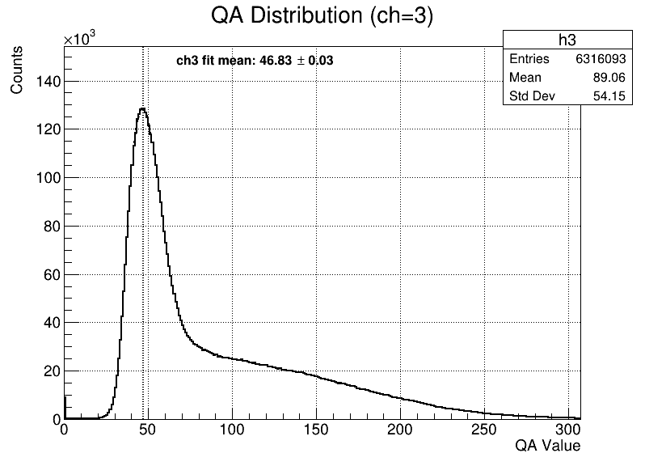
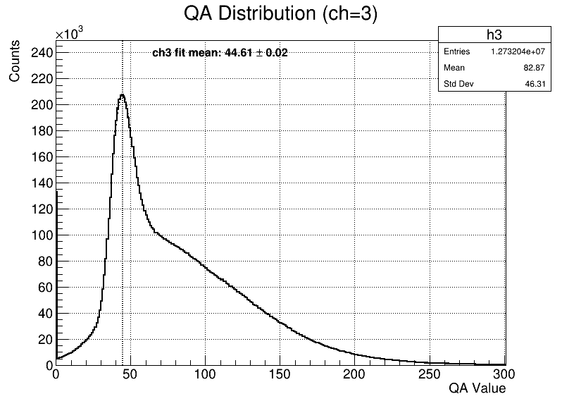
Result ② · Charge Spectra: Gain vs Count Rate
RESULTS · 2/3
20-inch
MCP-PMT
Low rate (78 kHz)
High rate (643 kHz)
Low rate (74 kHz)
fit mean 46.83 ± 0.03
fit mean 44.61 ± 0.02 — −4.7%
Charge peak shifts 4.7% for the MCP-PMT
Institute of High Energy Physics · Tianfu Cosmic Ray Research Center
10 / 13

Slide 11
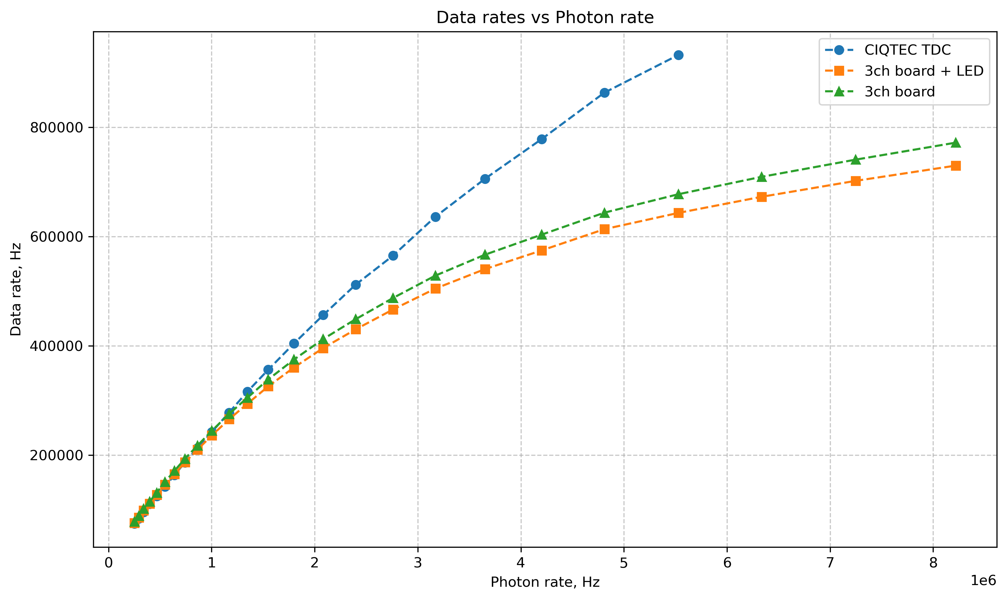
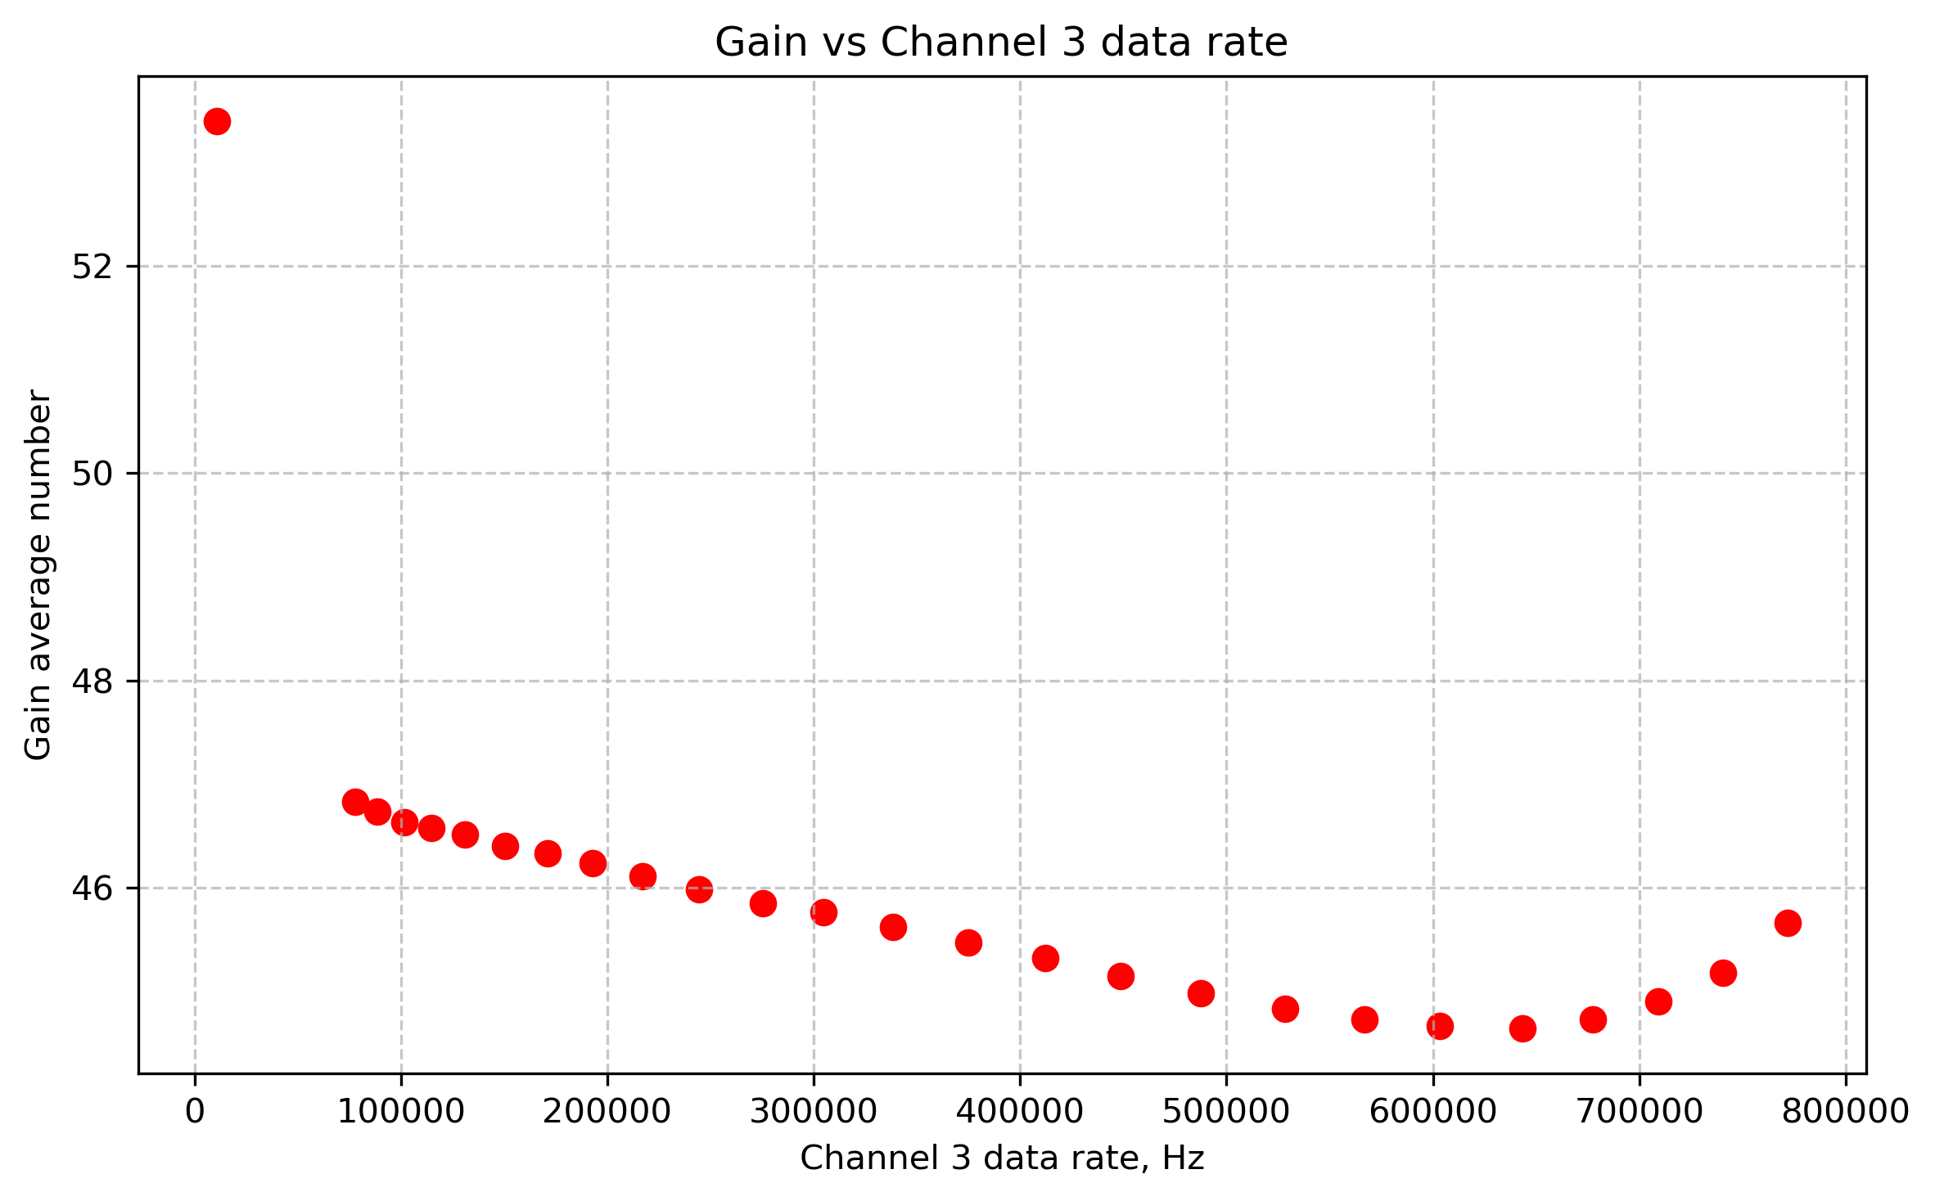
Result ③ · Dead-Time Effect on Count Rate
RESULTS · 3/3
640 ns
dead time of the 3-channel readout board (WCDA) — events are lost at high count rates
5 ns
TDC0408 — count rate remains linear,
no measurable data loss
Data rate vs photon rate — TDC stays linear; the 3-channel board saturates
Gain drops as the channel data rate increases
Small-dead-time electronics (5 ns) are essential for photon counting at high rates
Institute of High Energy Physics · Tianfu Cosmic Ray Research Center
11 / 13

Slide 12
Summary & Outlook
CONCLUSIONS
Absolute detection efficiency (DE) is the key parameter of the optical module
We designed and experimentally validated a photon-counting method to measure it
① METHOD
② DETECTOR
③ ELECTRONICS
Absolute DE — designed & validated
MCP-PMT vs dynode in counting mode
Dead time shapes the rate measurement
fW–100 fW light control, flux cross-calibration and TDC counting
Identical illumination — the dynode PMT counts linearly beyond 3 MHz, the MCP-PMT departs earlier
The 640 ns readout board loses events; sub-5 ns TDC keeps the count rate linear
23.17% @ 405 nm
> 3 MHz linear range
640 ns → < 5 ns
THE NEXT STEPS
STEP 1
STEP 2
Calibrate the 50+ existing optical modules with the count-rate method
In-situ calibration of Baikal-HUNT using the background light
Bring the validated technique from single-tube tests to the full OM batch
Study how the natural underwater optical background can serve as the calibration source
Institute of High Energy Physics · Tianfu Cosmic Ray Research Center
12 / 13

Slide 13
Thank you for your attention
Questions & discussion are welcome
Daniil Trofimov
Institute of High Energy Physics (IHEP) · Tianfu Cosmic Ray Research Center (CRRC)

