Slide 1
Estimation of the Blazar Contribution to the Astrophysical Neutrino Flux Observed with the Baikal-GVD Using the FIRESONG Package
Aleksandra Bychkova
Undergraduate student at the Department of General Nuclear Physics, Faculty of Physics, Lomonosov Moscow State University
Research conducted at the Institute for Nuclear Research of the Russian Academy of Sciences within the Baikal-GVD collaboration
Research interests: high-energy astrophysical neutrinos and the identification of their sources, population studies of active galactic nuclei, in particular blazars
The First China-Europe Neutrino Astronomy Summer School | September 2026

Slide 2
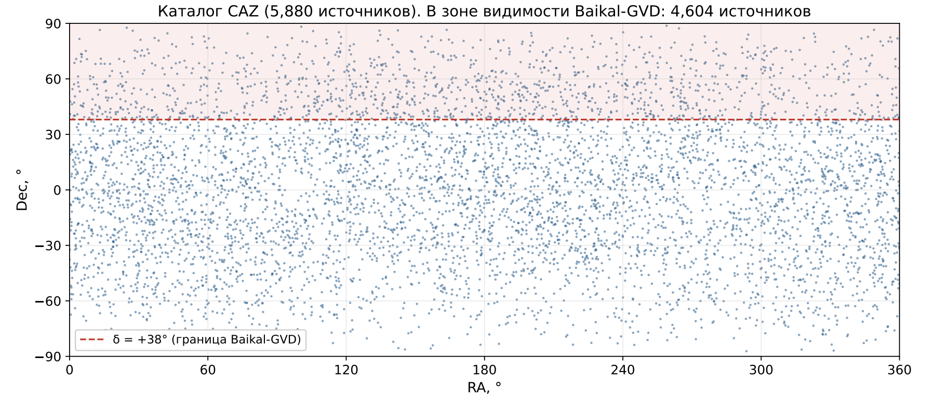
Recent work: blazar contribution to the Baikal-GVD neutrino flux
Goal: to estimate the contribution of the blazar population to the astrophysical neutrino flux detected by the Baikal-GVD (16 clusters in the current configuration).
Part I. Synthetic source populations generated with FIRESONG are compared with the CAZ blazar catalog (Kouch et al. 2026): the subsample of 5880 sources, of which 4604 lie in the Baikal-GVD visibility zone
(δ < +38°).
Part II. The expected number of neutrino events is computed for different population models

Slide 3
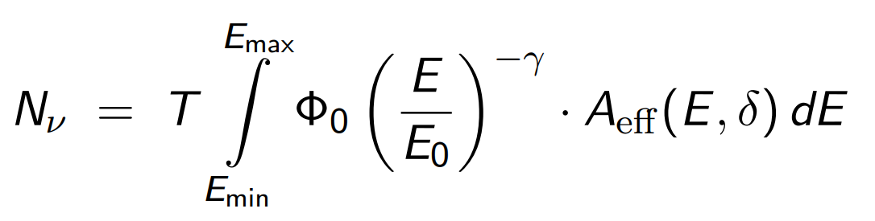
Results
Expected number of events per source over exposure T, integrated over the Baikal-GVD effective area:
Dependence on the spectral index γ
Dependence on the local density ρ₀
γ | ΣNν, 1 cluster | ΣNν, 16 clusters
2.0 | 0.78 | 12.5
2.28 | 0.46 | 7.4
2.5 | 0.31 | 5.0
ρ₀ [Mpc⁻³] | ΣNν, 1 cluster | ΣNν, 16 clusters
10⁻⁸ | 0.08 | 1.3
10⁻⁷ | 0.46 | 7.4
10⁻⁶ | 6.07 | 97
For the 16-cluster configuration, registration of neutrinos from the blazar population is attainable already at the baseline parameters (ΣNν ≈ 7.4 over 5 years)

Slide 4
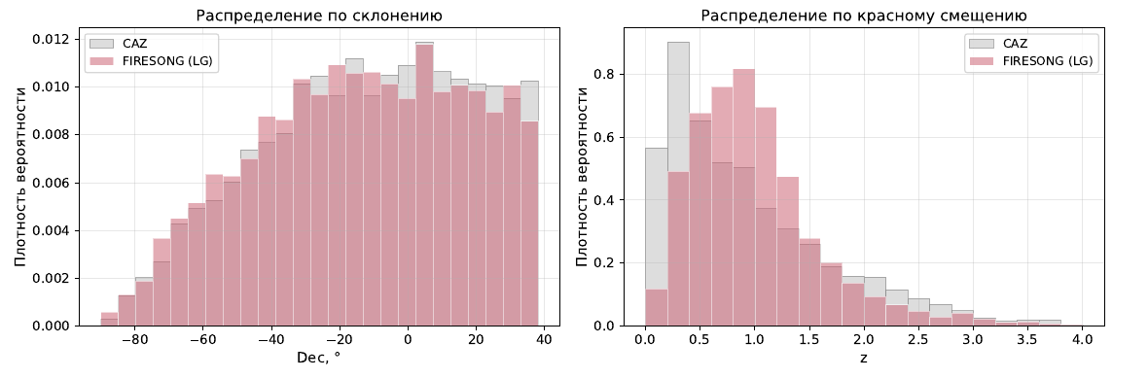
Validation of the population models
The declination and redshift distributions of the baseline FIRESONG population reproduce the corresponding distributions of the CAZ catalog within the Baikal-GVD visibility zone.
Declination distribution
Redshift distribution
Probability density

Slide 5
Future plans
Directions of further research:
  Estimation the uncertainty of the expected number of neutrinos
  Including the flaring activity of blazars in addition to the constant flux
  Separate analysis of the FSRQ and BL Lac subpopulations
  Event-rate predictions for the full Baikal-GVD configuration

