Slide 1



Spin Entanglement in QCD
from Parton Scattering and Topological Fluctuations
Guowei(国维) Yan(严)$^{1}$
1 School of Physics and Astronamy, SYSU
2 Institute of Modern Physics,Fudan University
with Chenxi(晨曦) Liang(梁)$^{2}$, Zhishun(志顺) Chen(陈)$^{1}$, Shu(树) Lin(林)$^{1}$, Li(力) Yan(严)$^{2}$
10.19 at Wuhan
1/18

Slide 2
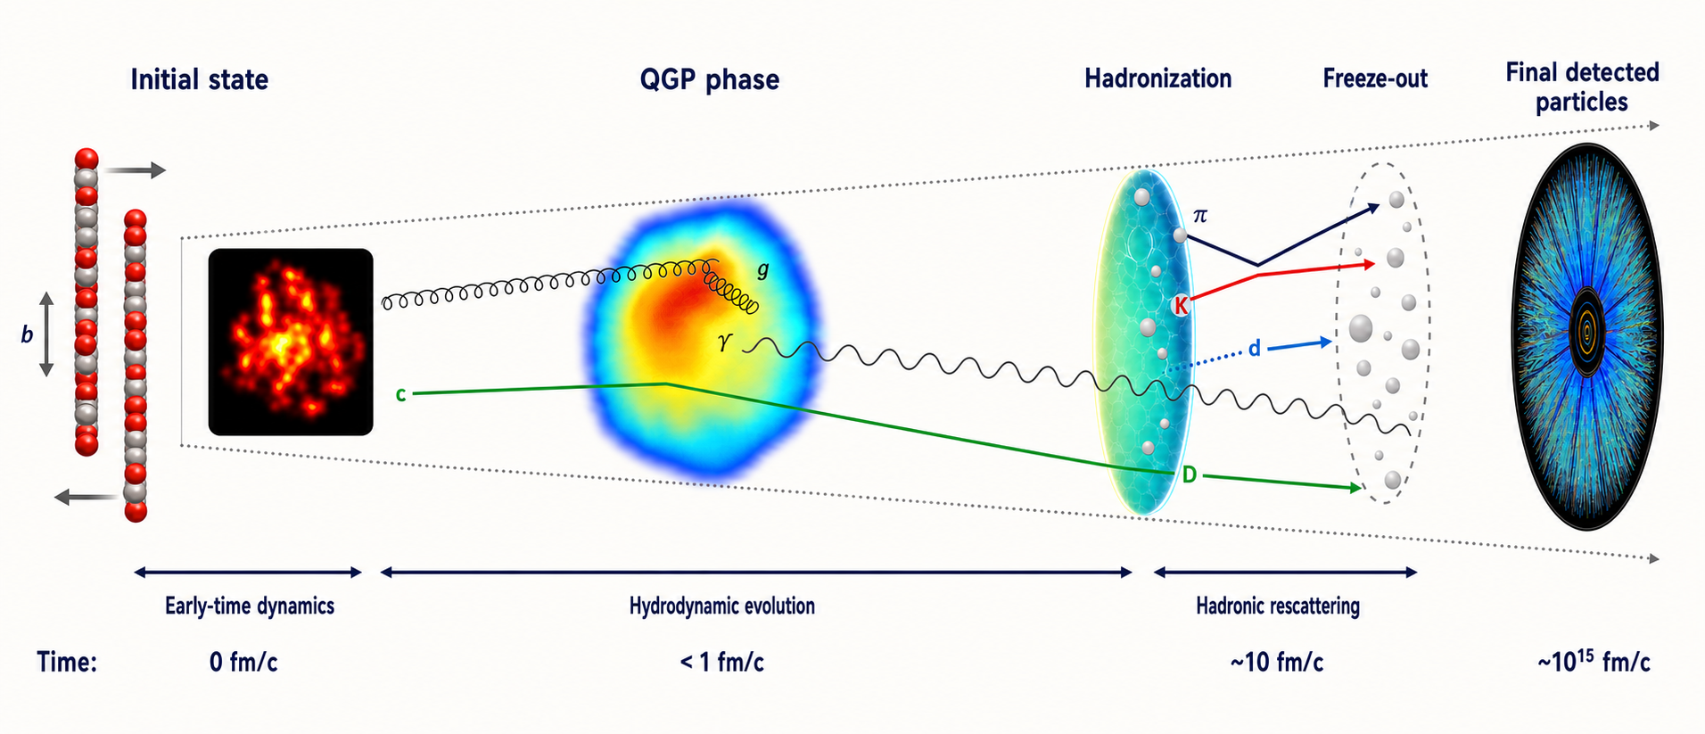
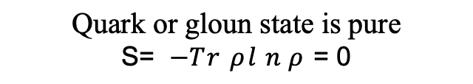
Entropy paradox in QCD matter
Melting nuclei
in relativistic heavy ion collision
new state of QCD matter
fast equilibrium~1 fm/c
unitary evolution
Quark or gloun state is pure
S= $−Tr ρln ρ$ = 0
?
locally thermalized final state
with HUGE entropy
Lorentz boost
......
A Mismatch between Quantum and Classical entropy for an isolated matter.
2/18

Slide 3
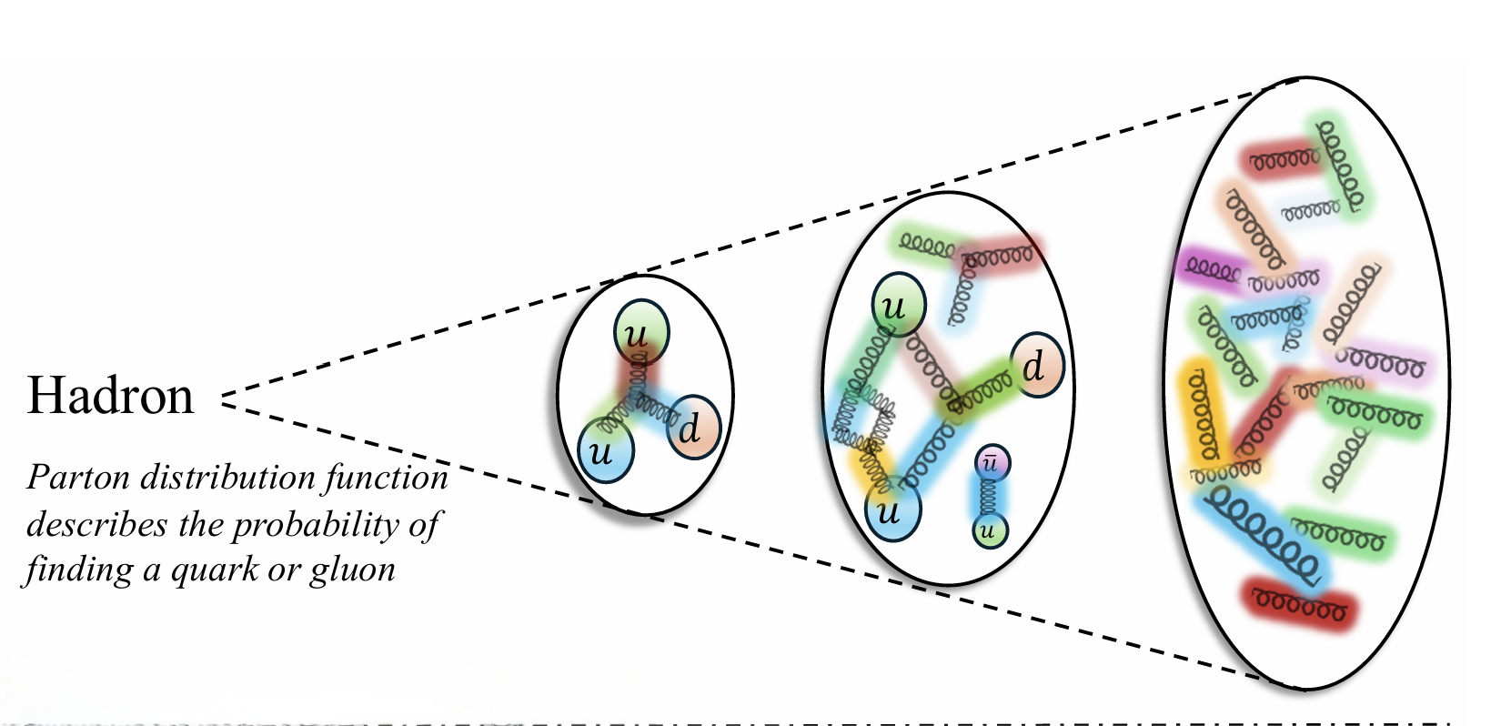
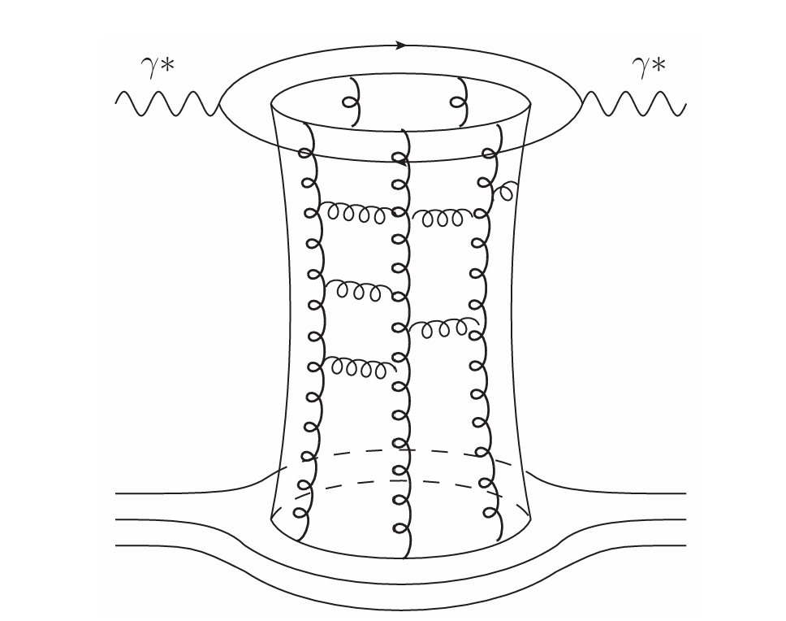
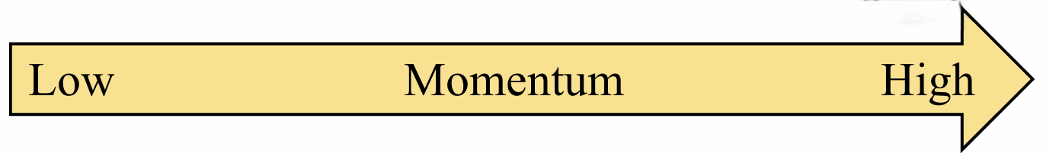
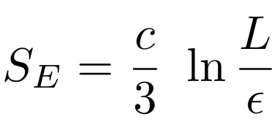

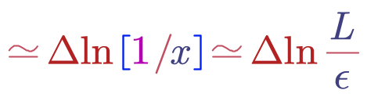
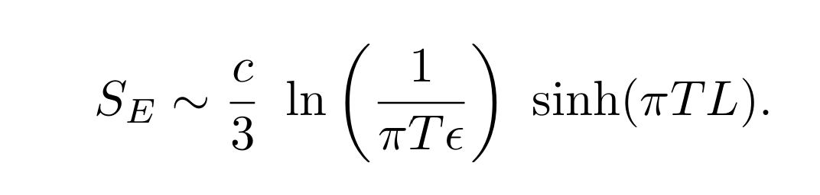
Entropy Paradox in QCD Matter
D.Kharzeev e.t. al:2410.22331v2
:1702.03489v3
Non-linear evolution of QCD gives maximum of entanglement entropy among partons, under limit of high momentum scale and small x.
Entangle Entropy in CFT
Scale-dependent entropy is natural in DIS picture.
CFT
finite temperature
Problems Not Solved: Entanglement entropy$≠$ thermal entropy
How to evolve entanglement entropy into thermal entropy?
In which process does Entanglement among partons come from?
3/18

Slide 4
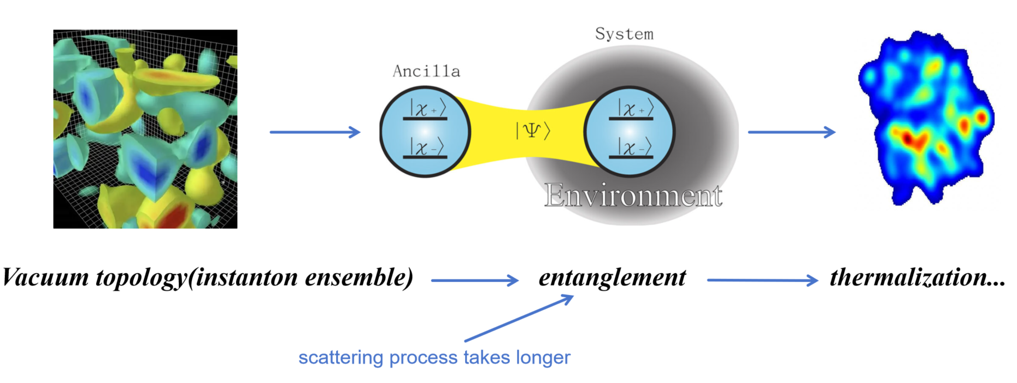
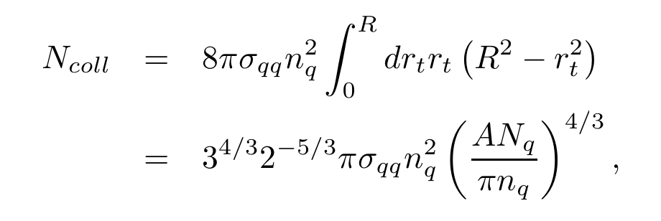
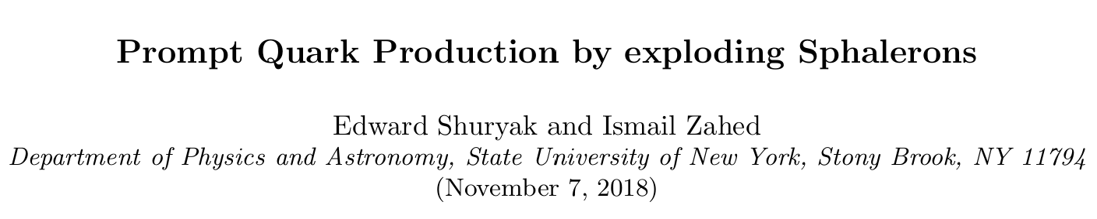
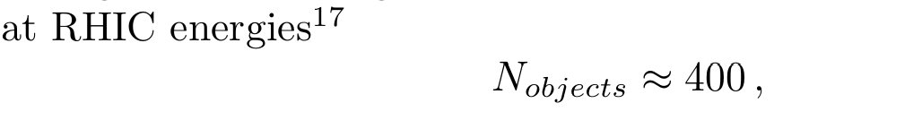
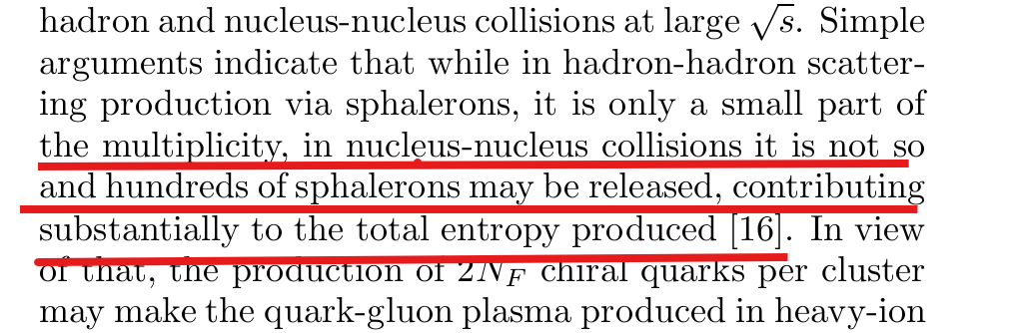
Entanglement from Topological Effect
total number of qq collision, the production of sphaleron-like:
E. Shuryak. hep-ph/0205031
hep-ph/0206022
In evolution of Sphalerons, they explode into many partons, which potentially leads to entropy production
Entanglement as a novel probe of early QCD matter
Not only providing entropy among partons
But also reflecting the non-comutative Topo effects
4/18

Slide 5
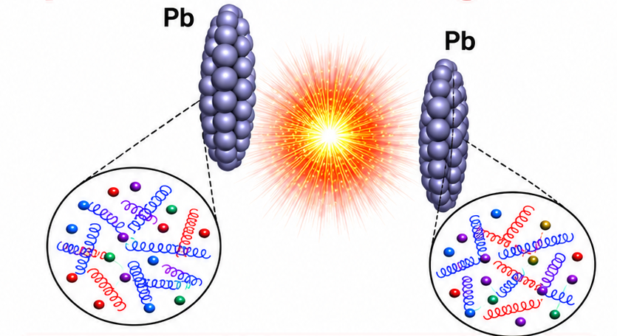
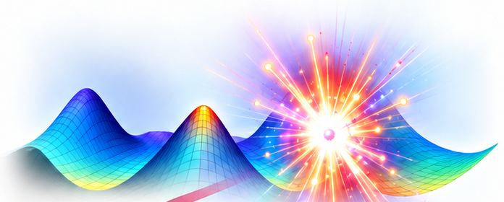
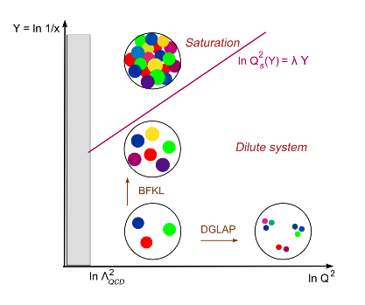

Entanglement From Parton Scattering
Two sources of Parton:
Nucleus & Sphaleron
Color Glass Condensate (CGC)
Partons scatter to form entanglement in the strong colour backgrond.
Scattering induced entanglement is dominant for heavy flavours due to low production rate from Sphaleron.
5/18

Slide 6
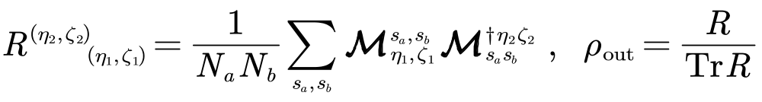
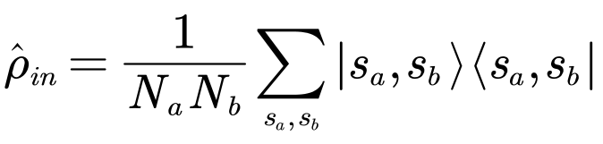

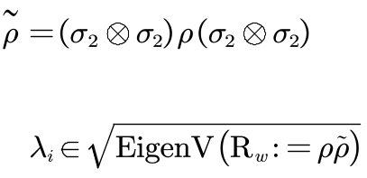
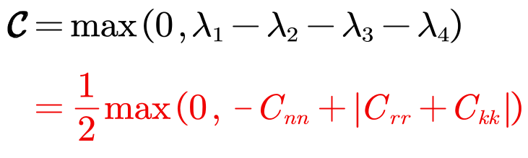
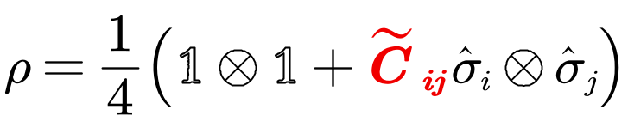

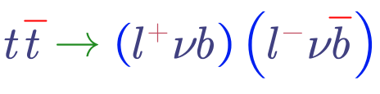
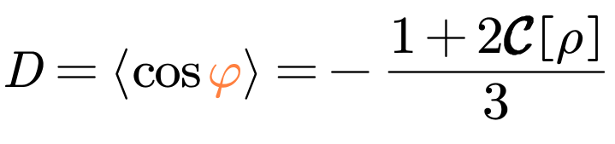
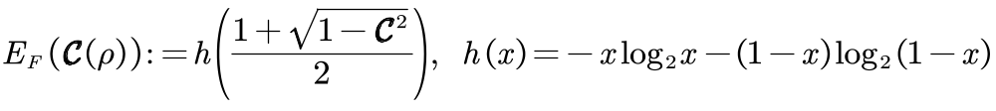
Amplitude to Concurrence WorkFlow
Initial (4 x 4)
Final state Density Matrix
evolve by scattering
Concurrence (并发度)
Decompose it with Correlation
W.K. Wooters, Phys. Rev. Lett. 80, 2245 (1998)
Concurrence is measurable
Nature 633, 542-547 (2024) ATLAS
Entanglement of Formation (Free From Ambience & Projective to trivial knot)
6/18

Slide 7
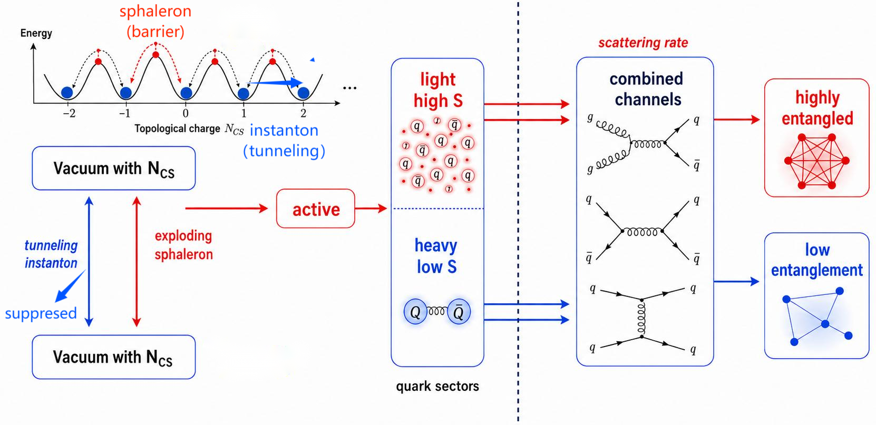
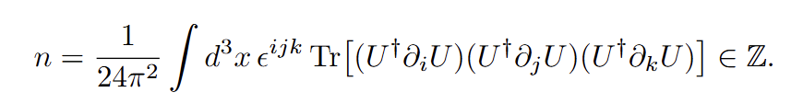
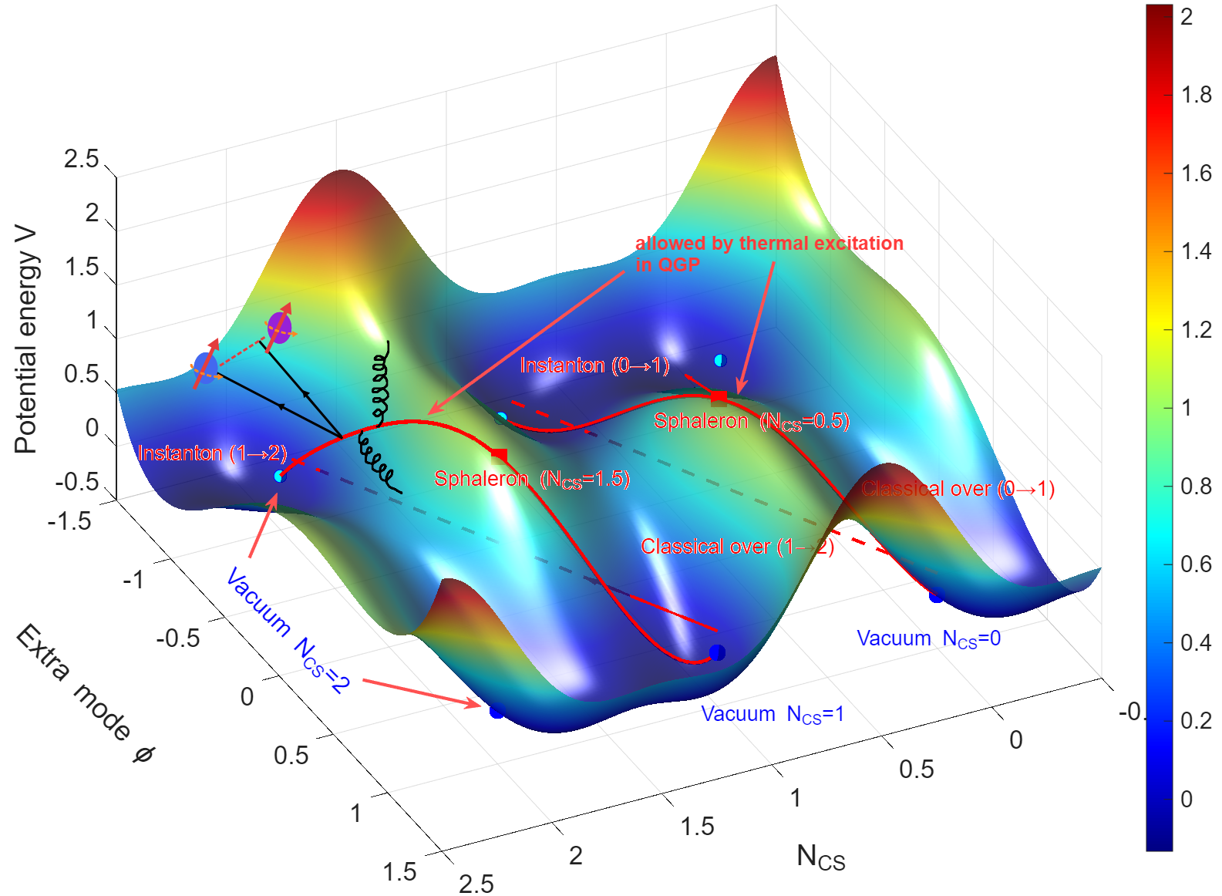
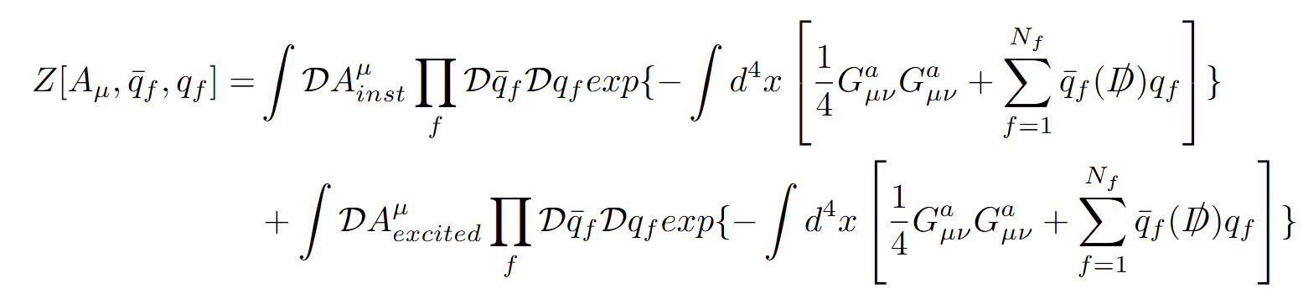
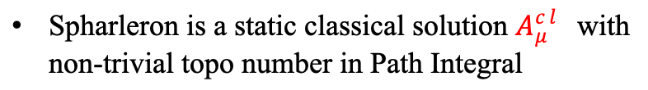
QCD Topo-induced Entanglement
Each field configuration of QCD vacuum is a valley labelled with Chern-Simon number:
Spharleron is a static classical solution $A_{μ}^{cl}$with non-trivial topo number in Path Integral
Fermi zero mode leads to divergence in second part of path integral, absorbed by external quark line,which gives rise to real quarks production.
7/18

Slide 8
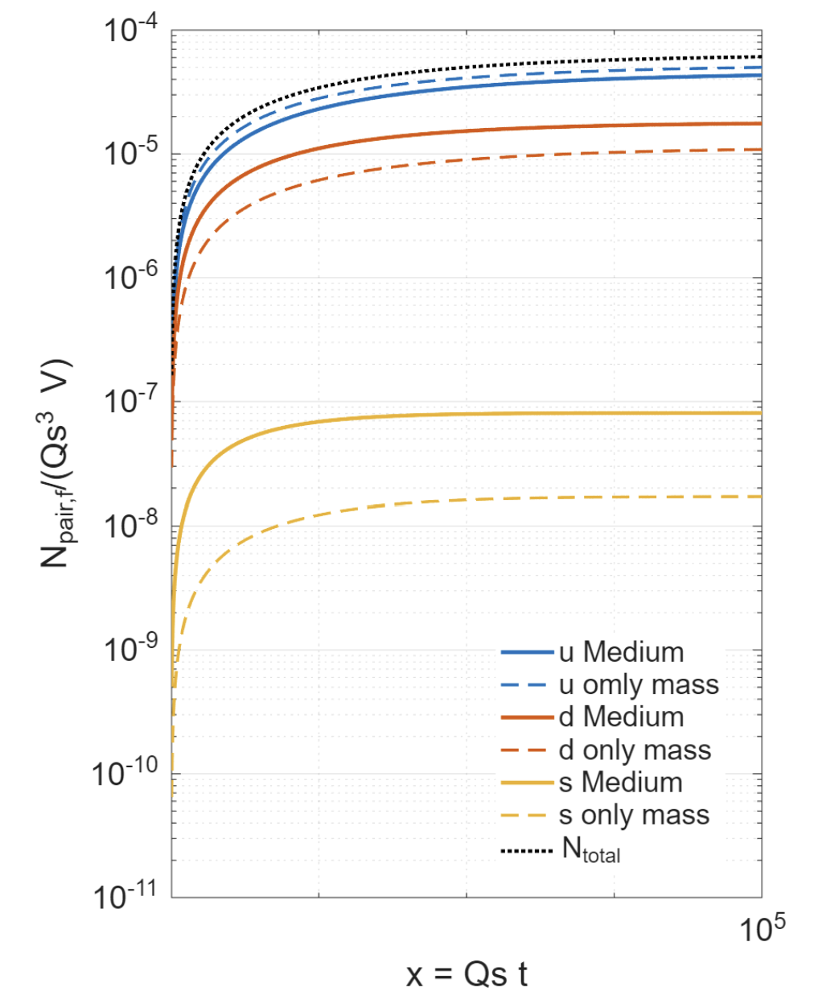
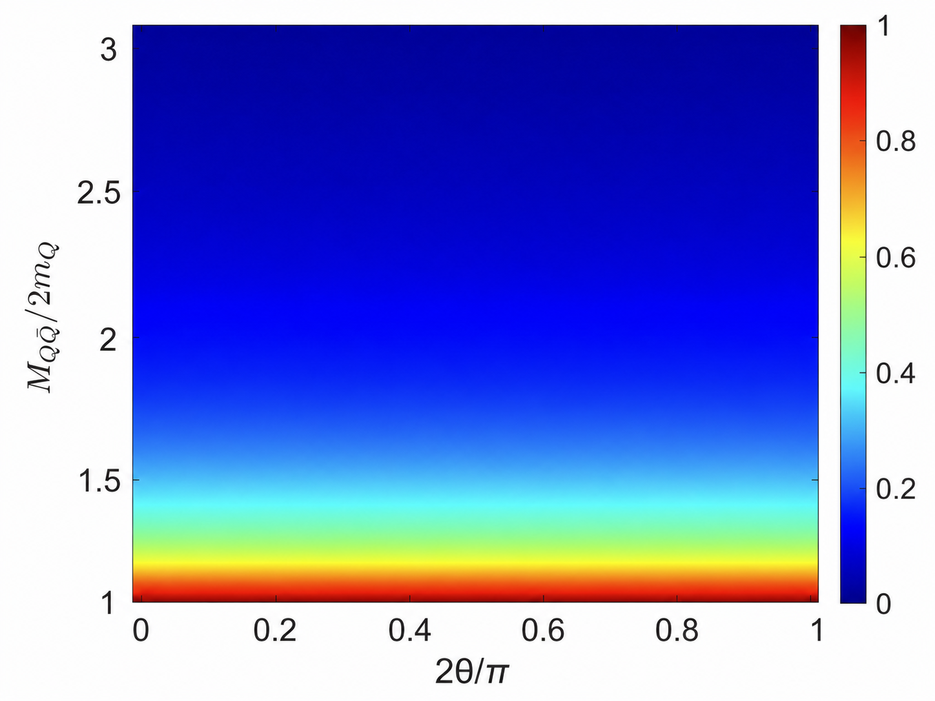
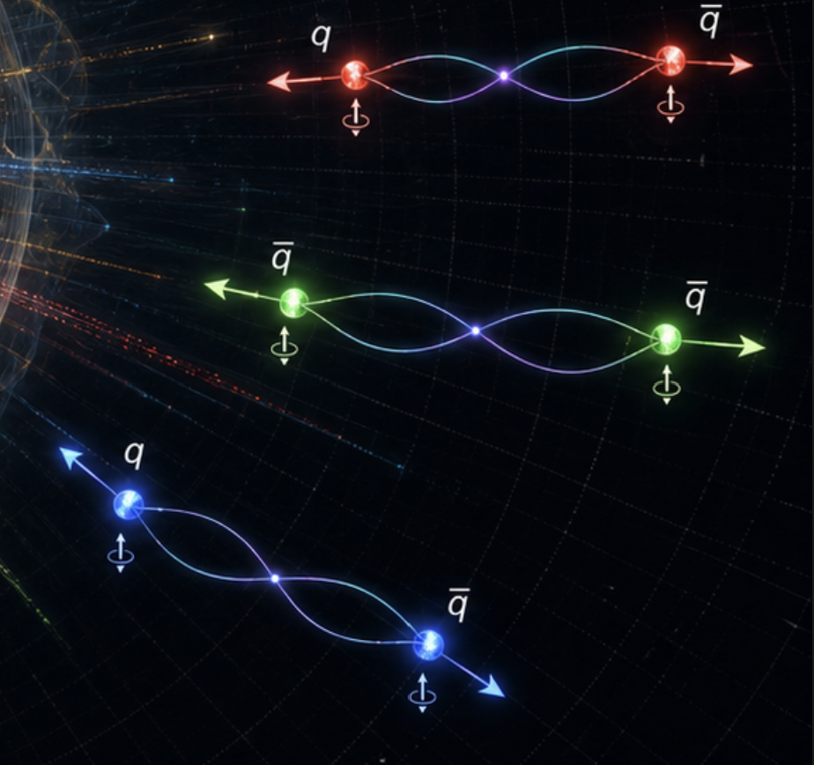
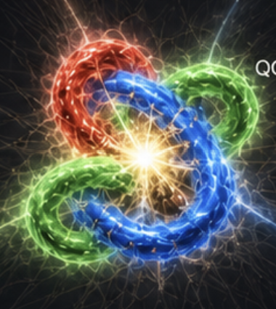

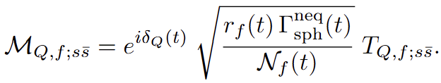
$Q\overline{Q}$ Entanglement from Sphaleron
quark pair concurrence
maximum entangled pair
Mulitplicity from Sphaleron
Spin entanglement can be extracted fromquark pair state, with amplitude M matched using spaleron rate.
Spectator flavor and Schwinger–Keldysh propagators are included in T matrix，non-equilibrium medium effect enhances the pair production.
8/18

Slide 9
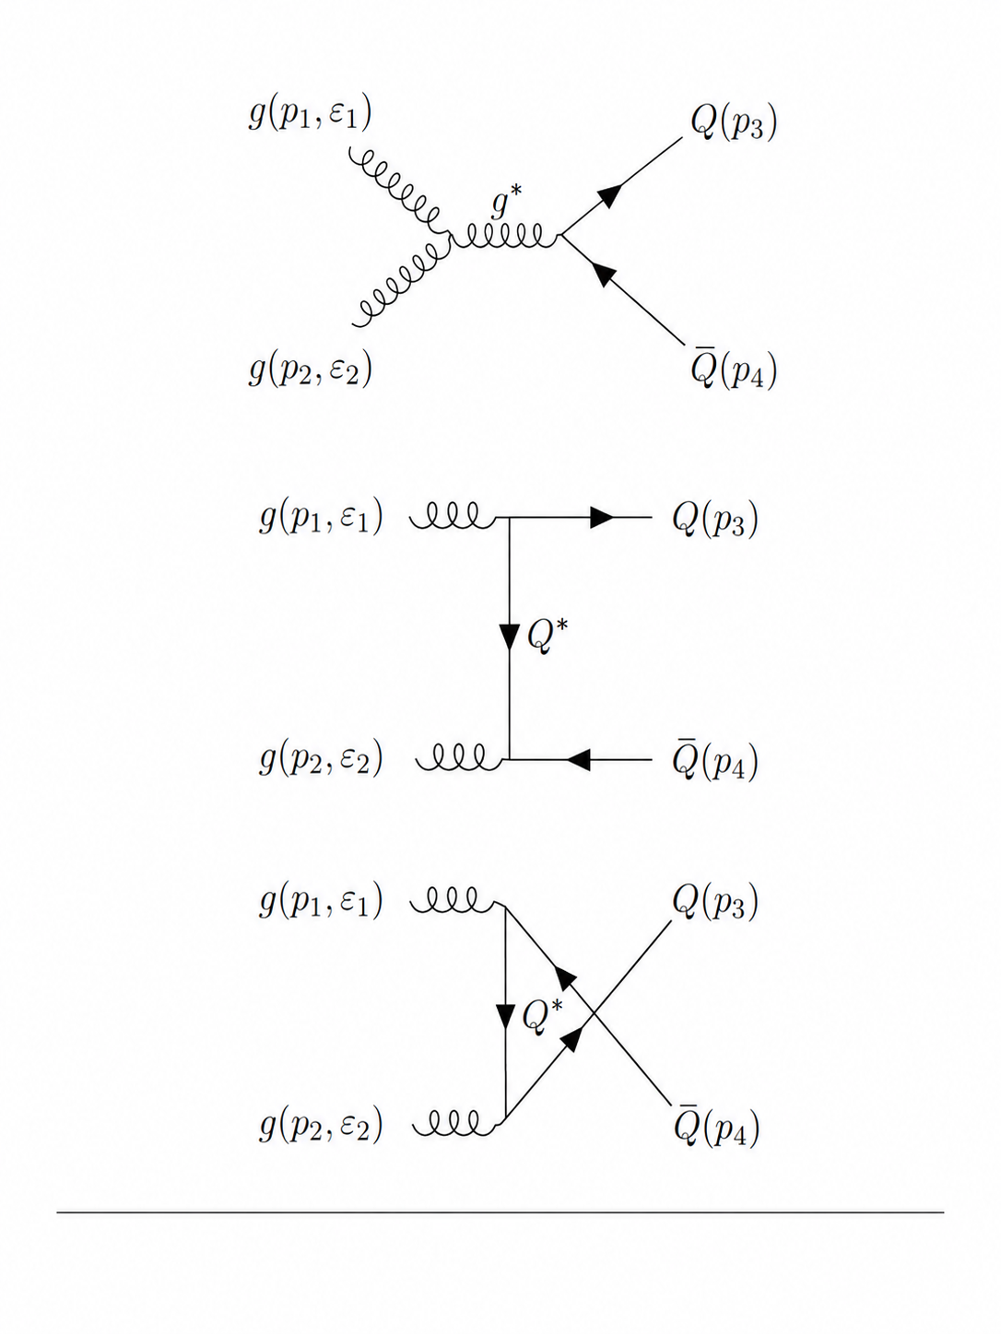
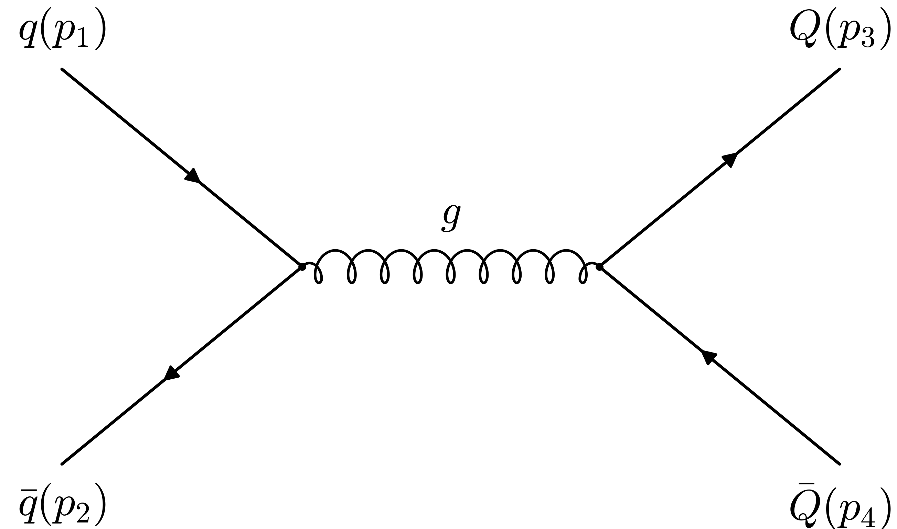
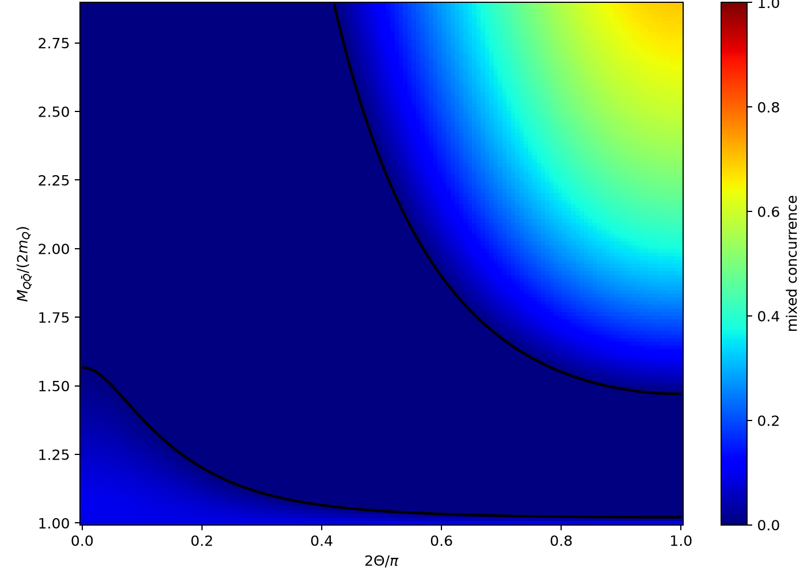
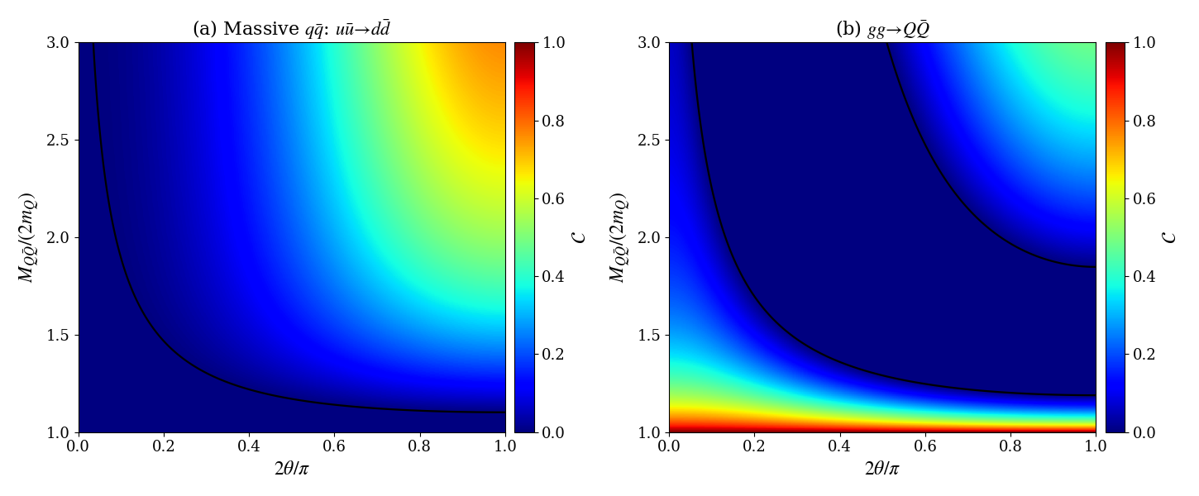

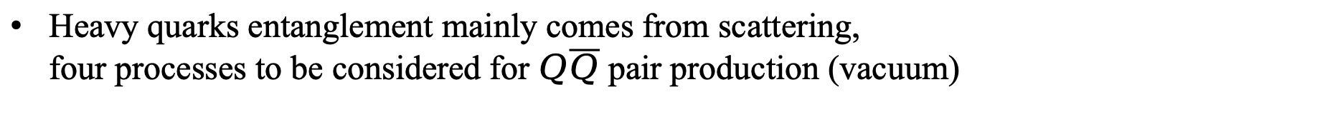
Entanglement from Parton Scattering
Heavy quarks entanglement mainly comes from scattering,
four processes to be considered for $Q\overline{Q}$ pair production (vacuum)
Amplitude of scattering is used to extract the concurrence as:
EPS09LO
Pb+Pb
at 5.02 TeV
nPDF
Weighted
9/18

Slide 10
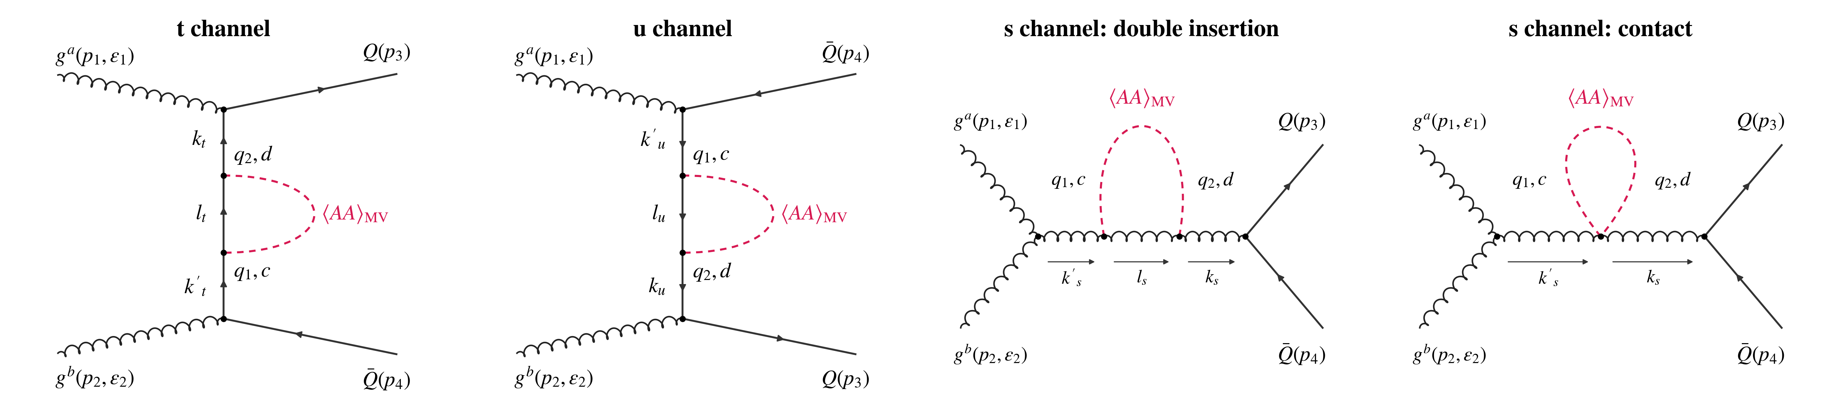
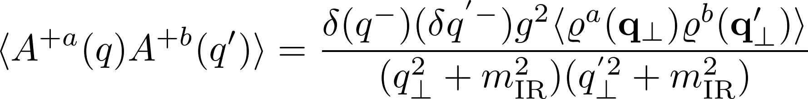
Entanglement from Scattering in CGC
Partons scatter under the strong colour background, whose effects are to be considered as propagator correction with insertion of two BG averaged fields
Correction to $q\overline{q}$is reduced in normalizing the density matrix
Background is considered with MV model of CGC
two point function of colour source
BG strength
two point function of classical field
Invared cutoff
10/18

Slide 11
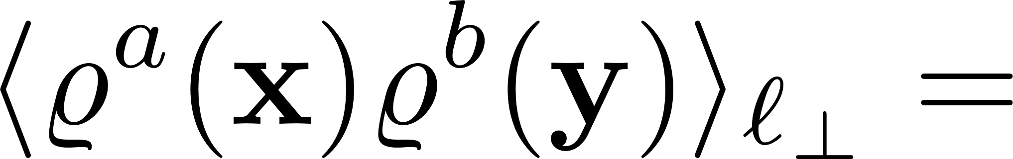
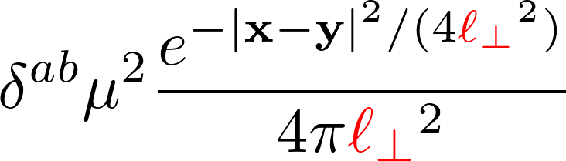
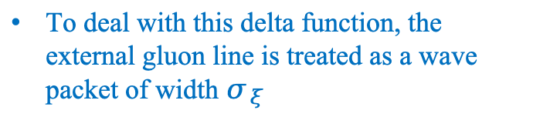
Entanglement from Scattering in CGC
Partons scatter under the strong colour background, whose effects are to be considered as propagator correction with insertion of two BG averaged fields
As an example, propagator correction to t,u channel can be computed as
To deal with this delta function, the external gluon line is treated as a wave packet of width $σ_{ξ}$
Divergence in this integral can be regulated assuming finite correlation length for MV model
11/18

Slide 12
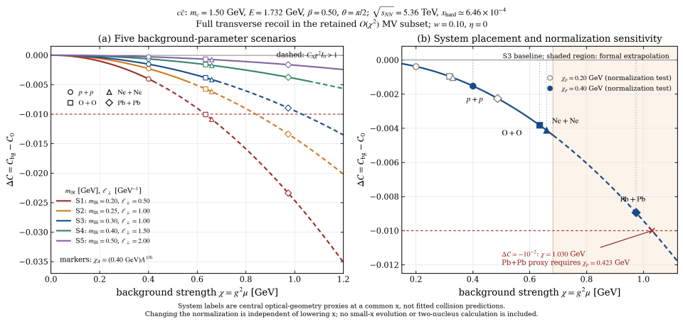

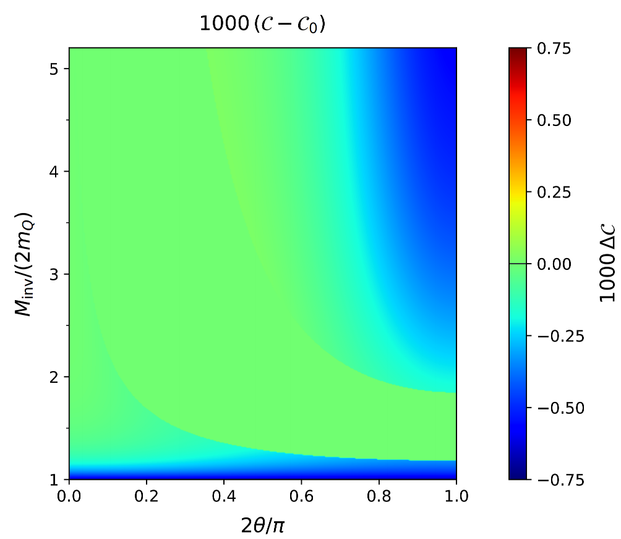
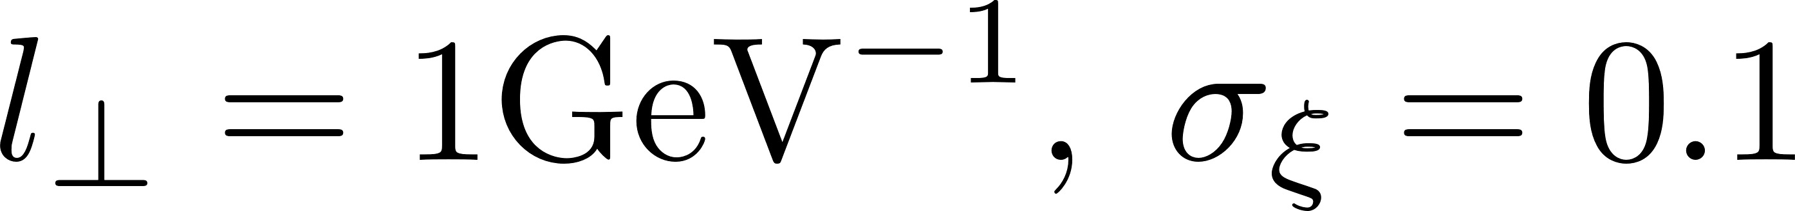
Entanglement from Scattering in CGC
After arduous calculations of amplitude, they give the concurrence correction as:
Reduced !
The size of collided nuclei is associated with BG strength, stronger background reduces more entanglement
As partons traverse the nuclei background, this reduction accumulates,
i.e. the two body entangled entropy is reduced in the evolution of the QCD matter!
12/18

Slide 13
Entropy Relation in quantum thermalization
Where does the generated entanglement go？
What is the quantitative relation of entropy in thermalization?
Is the entanglement entropy partial or all of the thermal entropy?
Eigenstate Thermalization Hypothesis
merge
Quantum Entropy
Local Thermalization
scramble
13/18

Slide 14
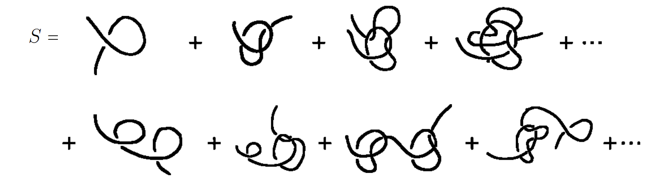
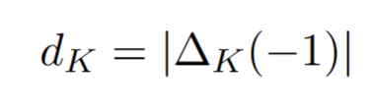
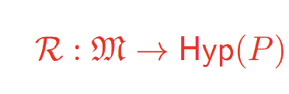








Entropy Relation in Quantum Thermalization
R generating rules for general entanglement
$$E^{irr}$$
Thermalization rigorous condition in terms of entanglement:
14/18

Slide 15








SU(3) link Quantum Simulation
effective model:
TEBD evolution gate：
$$|\left.ᴪ‘(+∆t)\right\rangle$$
15/18

Slide 16



Quantum & Thermal Entropy Evolution
In entropy evolution, few-body entanglement “disperse” into many-body entanglment by quantum scambling.
Quantum entropy merges and matches the thermal entropy in window, a signal of thermalization
16/18

Slide 17


Quantum & Thermal Entropy Evolution
We interprete the time of merging of quantum entropy as the thermalization time.
Background strength facilitates the merging process for different quarks.
For lighter sector and larger system, by action, quantum and thermal entropy can reach the matching window within shorter time . ($τ$ in unit of 1/Q )
17/18

Slide 18
Summary
We Propose that entanglement entropy can provide a new perspective for the thermlization time problem in HIC.
Entanglement entropy can come from QCD topological sphaleron effects and parton scattering at the early stage of collisions.
By quantum simulation, we find that quantum entanglement entropy can evolve to thermal entropy by quantum scrambling.
The time for thermalization can be estimated by quantum scrambling time that merges the many body entangled entropy.
18/18

