Slide 1
One-Loop Pinch Technique(PT)
in the Refined Gribov–Zwanziger(RGZ) Framework
Native calculations, mass-limit cancellations and gauge checks
Wan Wu
October 2026
Notes:
Suggested speaking time: 15 seconds.
A 20-minute progress report on one-loop PT construction in the local RGZ framework. The latest attached notebook supersedes older progress statements. Distinguish the current self-energy-like candidate from the complete quark-scattering amplitude and a verified S matrix.

Slide 2
Outline
01
Infrared QCD and the RGZ framework
3–7
02
Pinch Technique and gauge consistency
8–13
03
RGZ action, kernels and program workflow
14–22
04
Gauge cancellations and quark scattering
23–31
05
Conclusions and next steps
32
Technical details and references follow in the appendix.
02
Notes:
Present the infrared background, PT method, RGZ construction and current results. The latest presenter update adds the gauge-invariant qq-to-qq S matrix. End with PT decomposition and the running coupling constant as next steps.

Slide 3
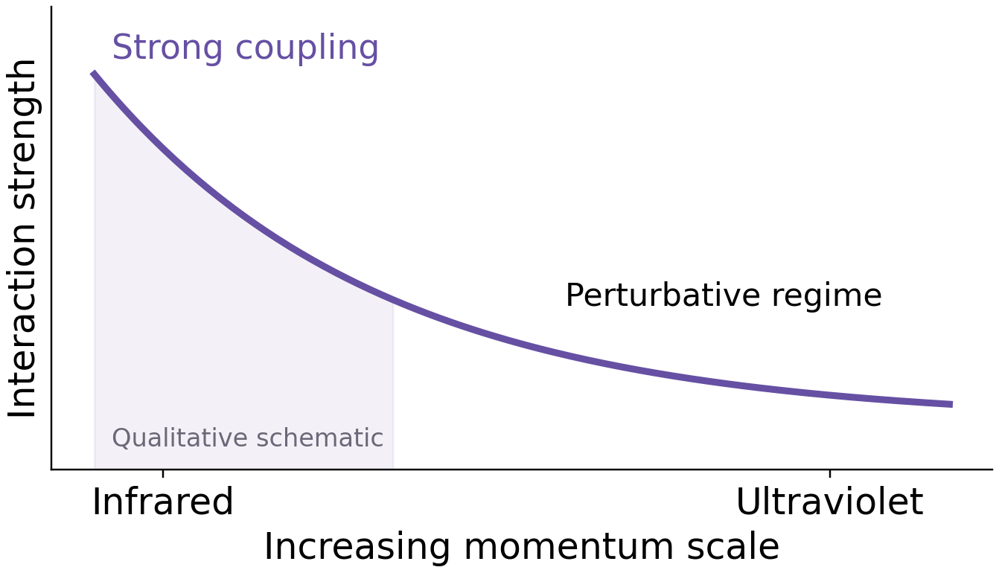
Infrared QCD and Confinement
Why the infrared is difficult
Strong coupling limits fixed-order perturbation theory.
Confinement requires a nonperturbative description.
Color-singlet hadron
RGZ target: an infrared gluon propagator consistent with lattice data.
[9] Gross & Wilczek (1973). [7] Dudal et al. (2008). Diagram and curve are qualitative schematics.
03
Notes:
The curve illustrates asymptotic freedom qualitatively and contains no fitted or computed RGZ running-coupling values. The hadron sketch indicates a color-singlet three-quark state. Sources: references [9] and [7].

Slide 4
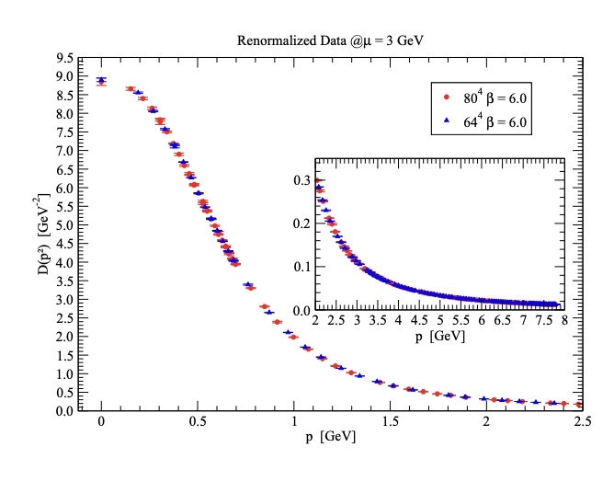
Infrared Gluon Propagator and Lattice Data
Tree level: D(p²) ∝ 1/p²
The tree-level propagator diverges as p → 0.
Original GZ: D(0) = 0
The horizon parameter suppresses the zero-momentum propagator.
RGZ: finite, nonzero D(0)
Dimension-two condensates describe
the lattice data at p ≲ 1 GeV.
Landau-gauge lattice data: Dudal et al., arXiv:1803.02281
[7] Dudal et al., PRD 78 (2008) 065047. [8] Dudal et al., arXiv:1803.02281.
04
Notes:
Suggested speaking time: 45 seconds.
Start with the infrared propagator as the physical motivation. The lattice plot is the original Landau-gauge data from the supplied deck, not a new fit. The refined GZ tree-level form describes the cited data up to roughly 1 GeV. The original GZ and RGZ zero-momentum limits are different. References [7] and [8].

Slide 5
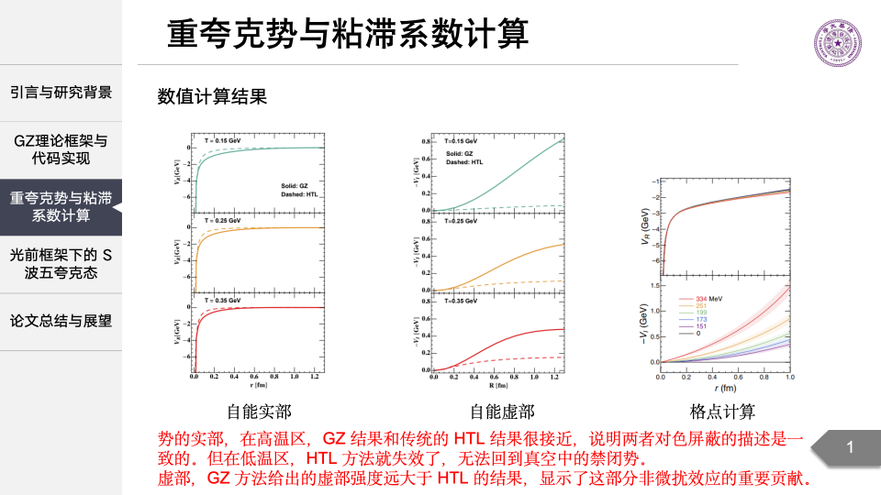
RGZ conforms to lattice results
Heavy-Quark Potential: Numerical Results
Real part: GZ and HTL [11]
Imaginary part [11]
Lattice-informed DNN [13]
Screening at high T
Confining trend at low T
Stronger damping than HTL
The plot shows −Im V ≥ 0
Reconstruction from lattice
quarkonium masses and widths
[11] Wu et al., PRD 107 (2023) 114033, Figs. 6–7. [13] Shi et al., PRD 105 (2022) 014017.
05
Notes:
Allow about 60 seconds. All three plot groups come from the supplied thesis screenshot. Left and middle correspond to the GZ-versus-HTL comparisons in Wu et al., Figs. 6 and 7. Solid lines are GZ and dashed lines HTL, at T=0.15, 0.25 and 0.35 GeV. Real potentials agree more closely at higher temperature, while the GZ result gives a larger damping magnitude in the displayed range. The right panel comes from Shi et al., whose deep-neural-network analysis reconstructs the potential using lattice QCD quarkonium masses and widths. It is not a direct point-by-point lattice determination of the static potential. The plots are qualitative comparisons and use different inputs and potential-offset conventions. Stronger damping in these results motivates a controlled treatment of the RGZ self-energy and vertices.
[11] https://doi.org/10.1103/PhysRevD.107.114033
[13] S. Shi, K. Zhou, J. Zhao, S. Mukherjee and P. Zhuang, Heavy quark potential in the quark-gluon plasma: Deep neural network meets lattice quantum chromodynamics, Phys. Rev. D 105, 014017 (2022), https://doi.org/10.1103/PhysRevD.105.014017.

Slide 6
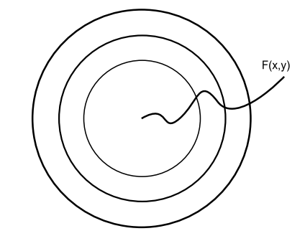
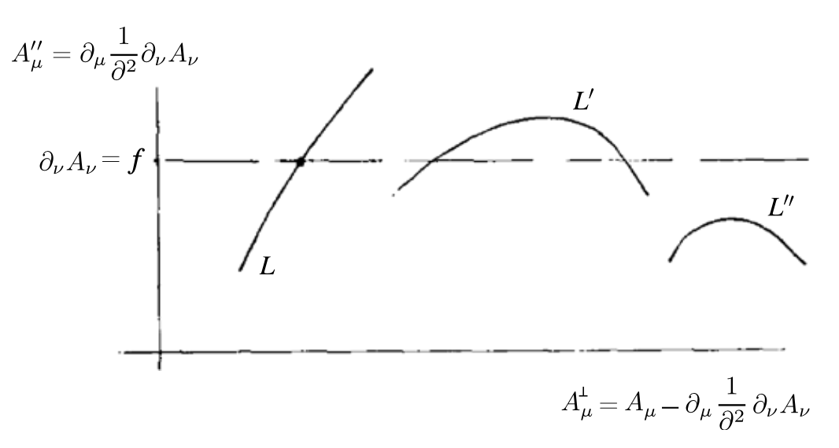
Gauge Fixing and Gribov Copies
Gauge orbit and condition
Multiple intersections
A gauge orbit may cross the gauge-fixing surface more than once.
[6] Gribov, Nucl. Phys. B 139 (1978) 1–19.
06
Notes:
Suggested speaking time: 40 seconds.
Explain why a gauge condition does not uniquely fix a non-Abelian gauge orbit. The diagrams illustrate multiple intersections. The Gribov ambiguity motivates a restriction on the functional integration domain. Reference [6].

Slide 7
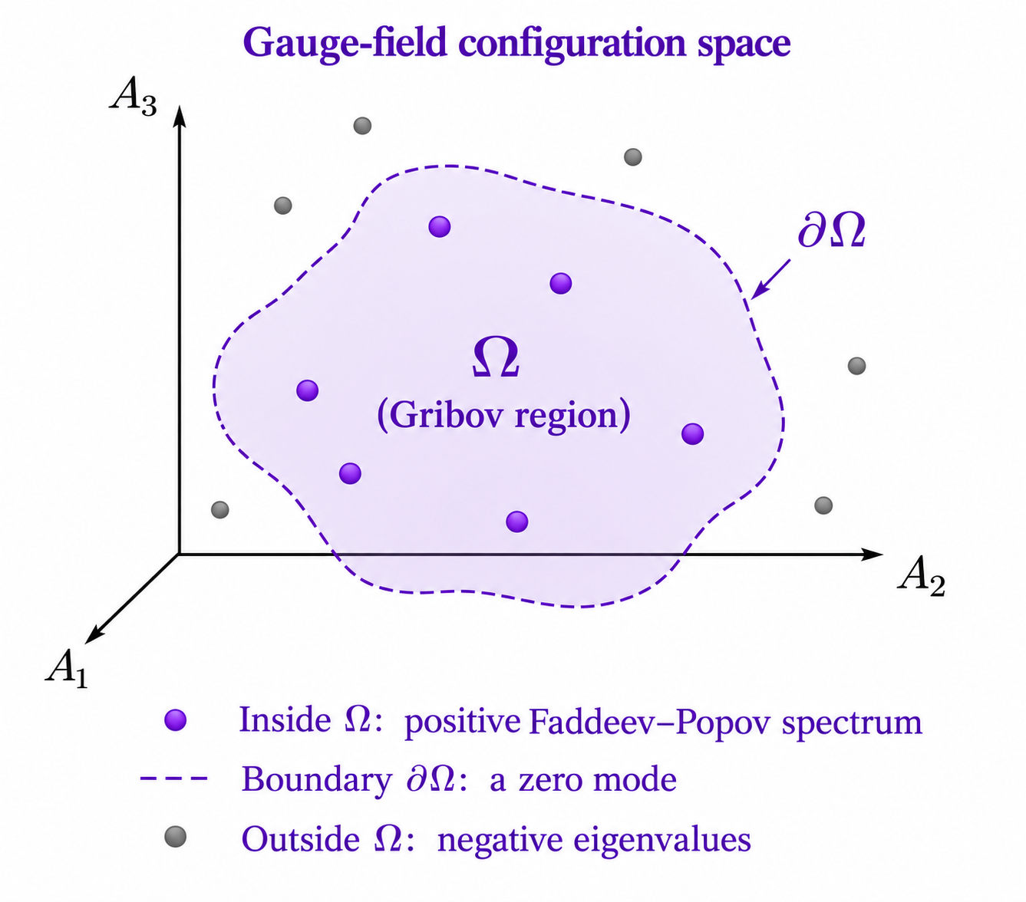
The Gribov Region and the RGZ Framework
Restriction in Landau gauge
Ω = { A : ∂·A = 0, M(A) > 0 }
M(A) is the Faddeev–Popov operator.
GZ: the horizon term
Auxiliary fields localize the horizon term
and mix with the gluon.
RGZ: dimension-two condensates
m² and μ² modify the infrared propagator
and provide input for the one-loop calculation.
Restricting to Ω can still leave Gribov copies.
[6] Gribov (1978). [7] Dudal et al., PRD 78 (2008) 065047.
07
Notes:
Suggested speaking time: 45 seconds.
Define the first Gribov region in Landau gauge through positivity of the Faddeev–Popov operator. The horizon term localizes through auxiliary fields. Dimension-two condensates generate the refined propagator. Restriction to this region does not remove all copies. The image is an English adaptation of the supplied qualitative schematic. References [6] and [7].

Slide 8
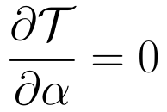


Why the Pinch Technique Is Needed
Physical scattering amplitude
Gauge dependence cancels after all diagram classes are combined.
Pinch rearrangement
Longitudinal momenta
Ward / ST identities
Propagator-like terms
Effective PT self-energy
Gauge-parameter independent
[2] Binosi & Papavassiliou (2009), Sec. 2. [4] Cornwall (1982).
08
Notes:
Conventional off-shell self-energies depend on gauge fixing. In QCD the complete on-shell amplitude is gauge independent, and PT identifies propagator-like pieces in vertices and boxes to construct effective Green functions. The diagram states the PT motivation, not a completed RGZ PT decomposition.
Typography update: displayed equations use consistent LaTeX / Latin Modern math. Scientific content follows the supplied deck.

Slide 9
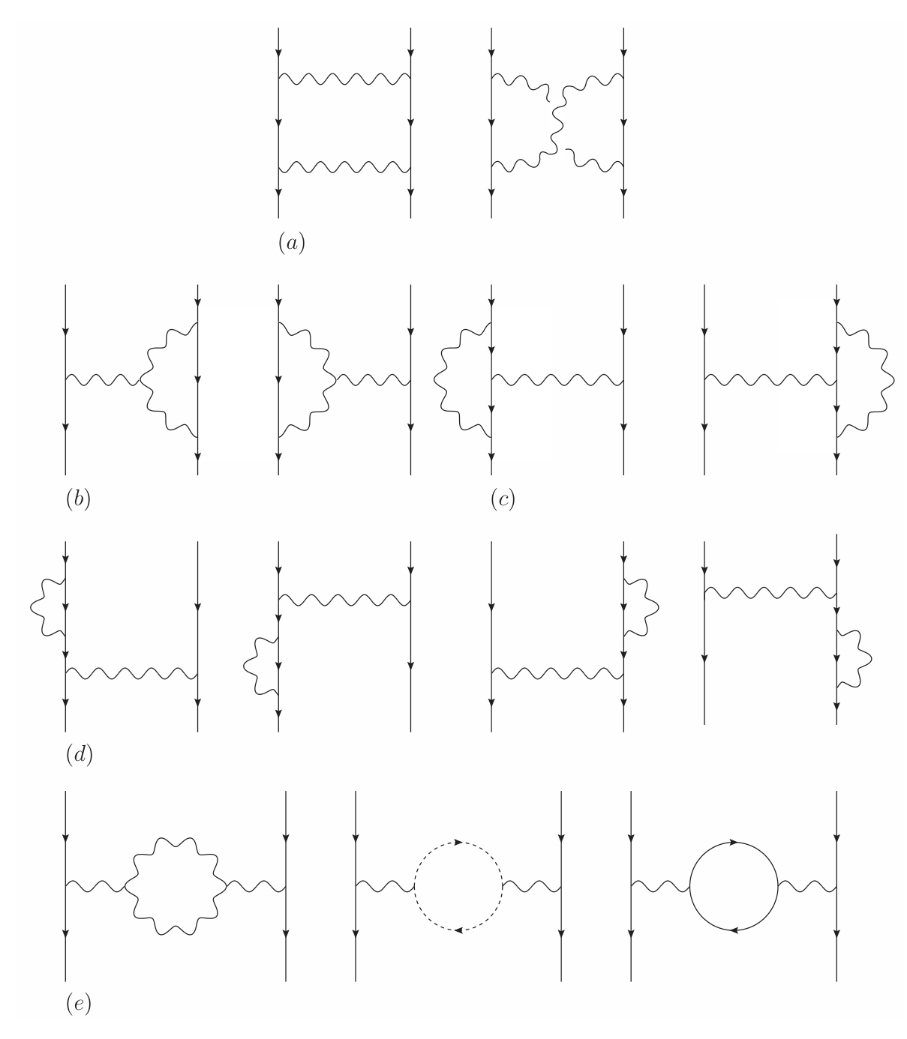
Five Diagram Classes in the QCD Benchmark
box: direct and crossed boxes
nav: non-Abelian vertex
av: Abelian vertex
qse: external quark self-energy
gse: gluon self-energy
Include mirror graphs, external-leg multiplicities and diagram symmetry factors.
Figure: [2] Binosi & Papavassiliou (2009), Fig. 2.
09
Notes:
Suggested speaking time: 45 seconds.
Identify direct and crossed boxes, non-Abelian and Abelian vertices, external quark self-energies and gluon self-energy graphs in ordinary QCD. Include mirror graphs and all multiplicities. This is a QCD topology benchmark, not a complete RGZ graph enumeration. Reference [2], Figure 2.

Slide 10
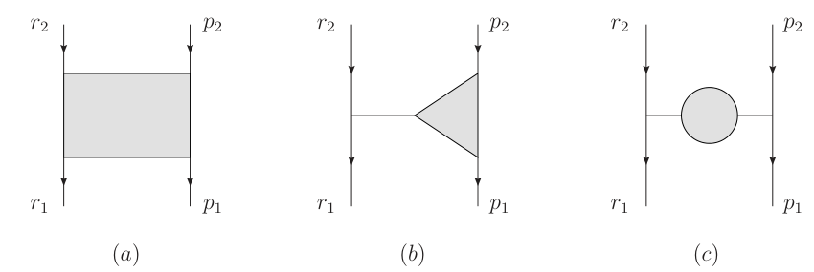
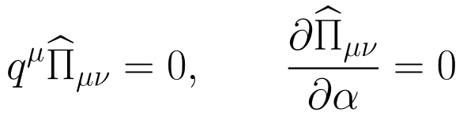
PT: Reorganizing the Scattering Amplitude
box
vertex
self-energy
Longitudinal momenta trigger Ward/ST identities and redistribute propagator-like terms.
QCD checks:
Figure and method: [2] Binosi & Papavassiliou (2009), Fig. 1, Secs. 2.2–2.4.
10
Notes:
Suggested speaking time: 50 seconds.
The figure classifies scattering graphs by kinematics. Longitudinal momenta trigger Ward or ST identities and move propagator-like pieces between diagram classes. The PT self-energy combines the conventional self-energy with all required pinch terms. The QCD checks are transversality and gauge-parameter independence. Reference [2], Fig. 1 and Secs. 2.2–2.4.
Typography update: displayed equations use consistent LaTeX / Latin Modern math. Scientific content follows the supplied deck.

Slide 11
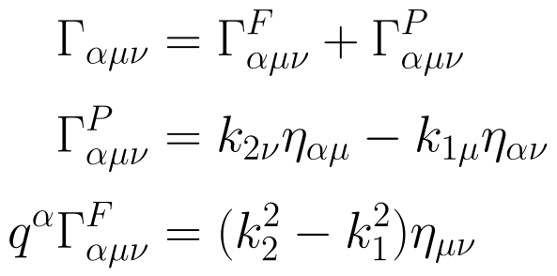
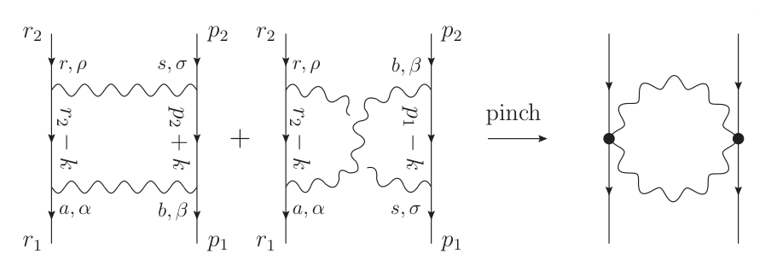

The Pinch Mechanism and Vertex Decomposition
All momenta are incoming: q + k₁ + k₂ = 0.
Inverse Dirac operators cancel internal quark propagators.
The on-shell Dirac equation removes external inverse-propagator terms.
[2] Binosi & Papavassiliou, Phys. Rept. 479 (2009) 1, Sec. 2.
11
Notes:
Suggested speaking time: 65 seconds.
All vertex momenta are incoming. The longitudinal part of the three-gluon vertex triggers inverse-propagator identities. The quark Ward identity cancels internal propagators, while on-shell external spinors remove external inverse propagators. The source tensor formulas and pinch diagram are retained. Reference [2], Section 2.
Typography update: displayed equations use consistent LaTeX / Latin Modern math. Scientific content follows the supplied deck.

Slide 12
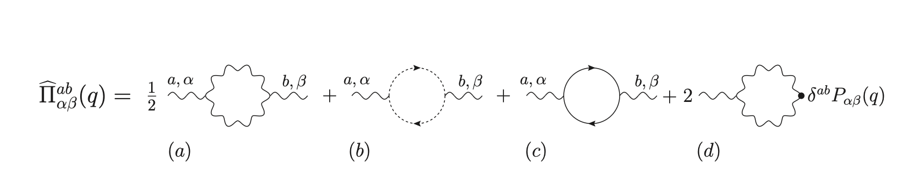
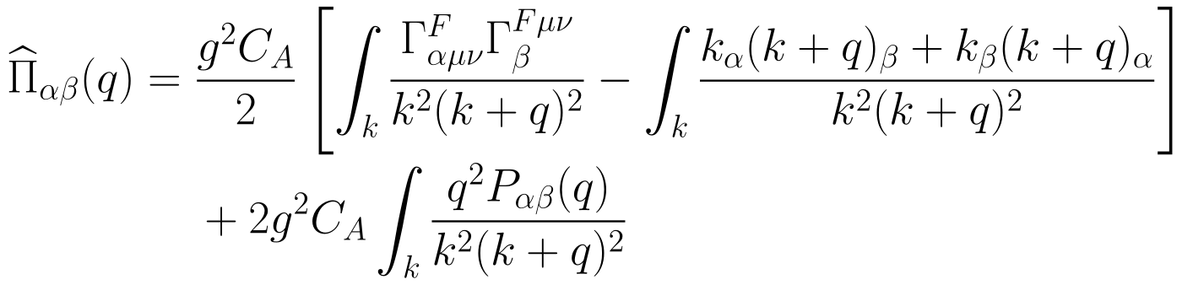
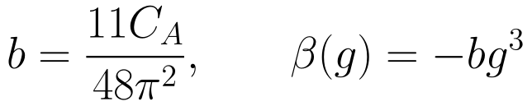
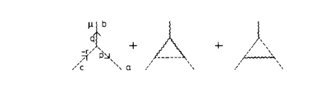
PT Self-Energy and the Running Coupling
One-loop QCD benchmark: pure gauge, MOM subtraction
Finite-T vertices:
gauge / kinematics
PT motivation.
[2] Binosi & Papavassiliou (2009). Thermal context: [10] Baier, Pire & Schiff, PLB 238 (1990) 367.
12
Notes:
Suggested speaking time: 55 seconds.
This is an ordinary pure-gauge QCD benchmark and a motivation for a coupling defined through the PT self-energy. The one-loop coefficient b=11 C_A/(48 pi squared) uses beta=-b g cubed. The supplied deck does not show a new finite-temperature RGZ numerical curve. Conventional thermal vertex definitions can depend on gauge and subtraction kinematics. Thermal context: R. Baier, B. Pire and D. Schiff, High temperature behaviour of the QCD coupling constant, Physics Letters B 238 (1990) 367–372, reference [10]. PT reference [2].
Typography update: displayed equations use consistent LaTeX / Latin Modern math. Scientific content follows the supplied deck.

Slide 13
PT, BRST/BV, and the RGZ Extension
BRST/ST and the BV formalism
ST identities organize cancellations between diagrams.
BV antifields provide a systematic framework for intrinsic PT.
The PT/BFM correspondence in QCD
PT agrees with the background-field quantum Feynman gauge, ξ = 1.
It can also be constructed from conventional diagrams or intrinsic PT.
Requirement for the RGZ extension
Use ST identities with the complete local RGZ field and source content.
[1] Capri et al. (2016). [2] Binosi & Papavassiliou (2009). [5] PRD 66 (2002) 025024.
13
Notes:
Suggested speaking time: 45 seconds.
ST identities organize cancellations. The BV framework supplies antifields and source kernels that help formulate intrinsic PT. In ordinary QCD, PT agrees with the background-field quantum Feynman gauge. This correspondence does not require choosing a background-field model as the starting point of the present RGZ calculation. Its RGZ extension needs the full field and source content. References [1], [2] and [5].

Slide 14
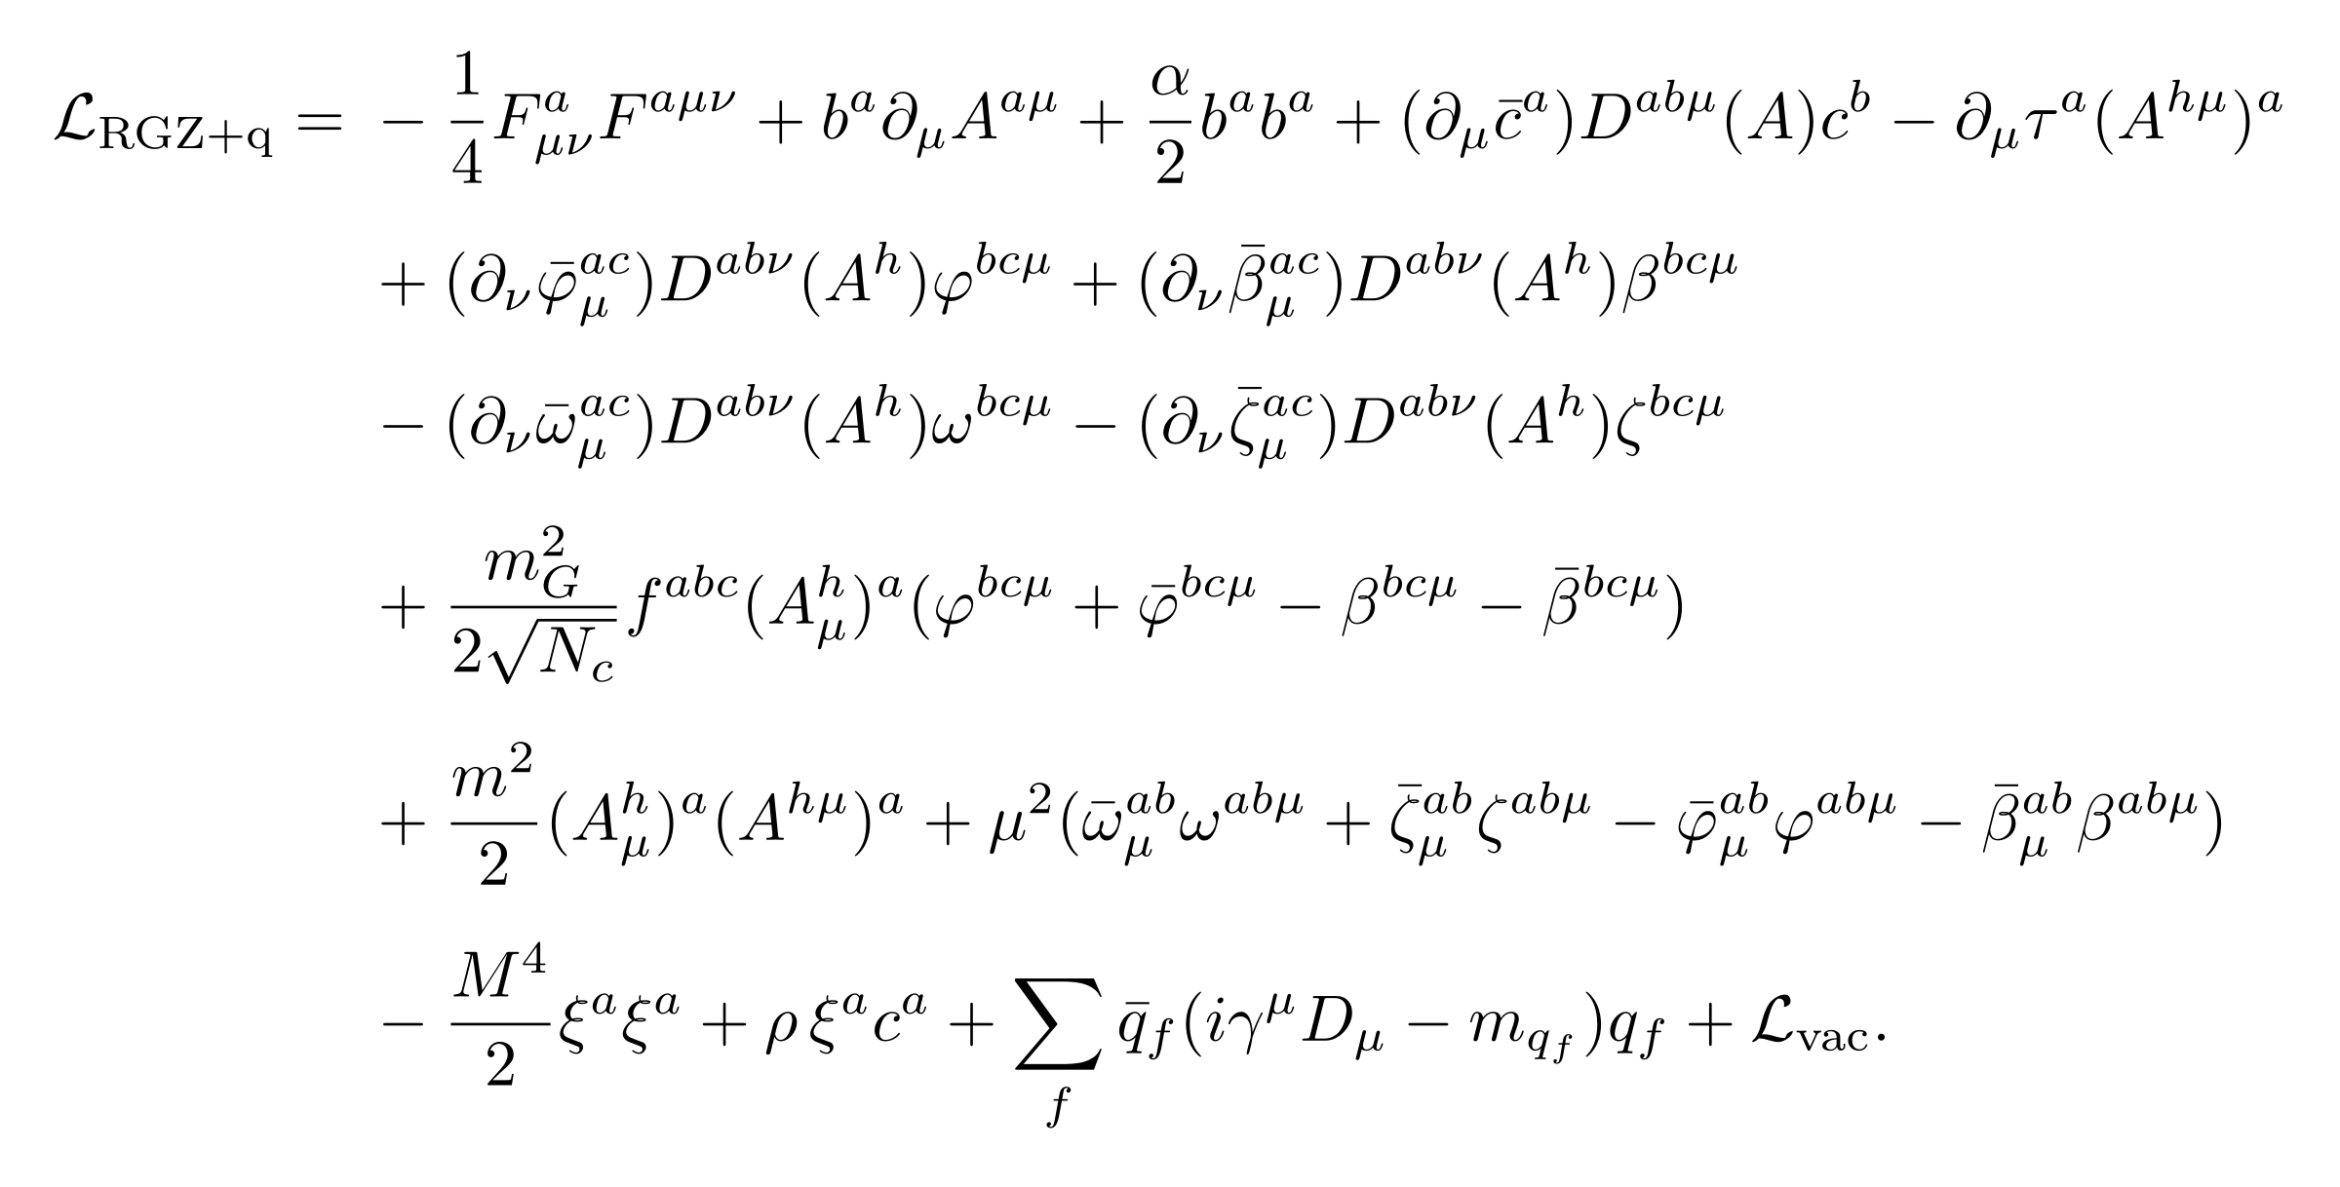
The Complete RGZ + Quark Lagrangian
Minkowski convention, with all field-dependent sectors shown.
ℒvac denotes field-independent vacuum terms; quarks couple minimally to Aμ.
[1] Capri et al. (2016), Eqs. (108)–(109). [3] Model conventions and Minkowski implementation.
14
Notes:
The explicit expression follows the Minkowski convention in the supplied deck. The auxiliary kinetic terms include both bosonic pairs and both Grassmann pairs, horizon mixing, both condensate operators, the transversality multiplier, FP ghosts, and the BRST-doublet infrared regulator. The probe quark sector is minimal coupling with D_mu=partial_mu-i g_s A_mu^a T^a and no additional matter-horizon interaction. L_vac denotes field-independent constants and possible vacuum terms used in gap-equation or thermodynamic normalization; it contributes no scattering vertex. It is not a specification of a renormalized BV action or counterterm functional. Full nonlinear Ah is defined on the next slide; the implementation may expand it through g_s squared. Source: https://arxiv.org/pdf/1605.02610, Eqs. (108)-(109), and the supplied Minkowski model.
Typography update: displayed equations use consistent LaTeX / Latin Modern math. Scientific content follows the supplied deck.

Slide 15
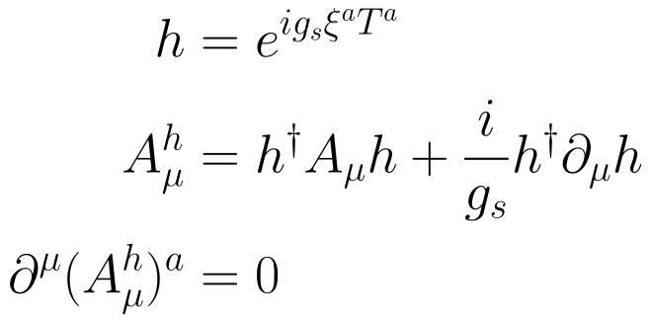
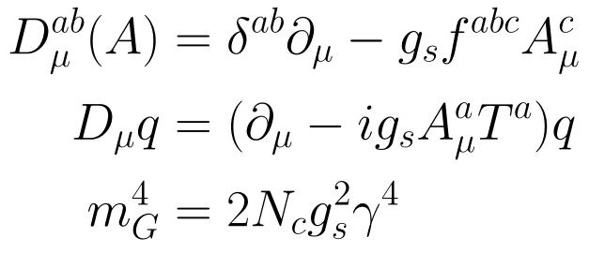
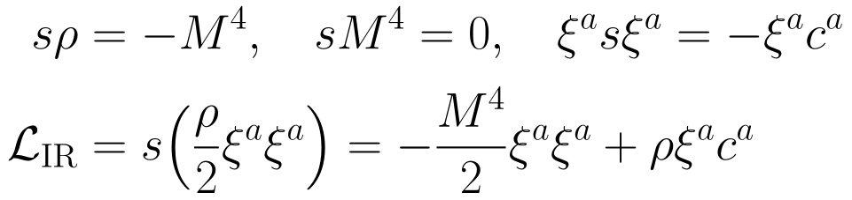

Field Definitions and the Infrared Regulator
Gauge-invariant field Aʰ
Covariant derivatives
BRST-doublet regulator
Physical regulator limit
M is distinct from the RGZ
condensate masses m and μ.
[1] Capri et al. (2016), Secs. II–V. [3] Current model uses the Minkowski regulator sign.
15
Notes:
Definitions complete the action on the preceding slide. Auxiliary fields carry Lorentz and two adjoint indices; D acts on the first adjoint index. Bosonic phi and beta pairs and fermionic omega and zeta pairs are all retained. The unexpanded h definition specifies the nonlinear action. The source rho is Grassmann odd, and s rho = -M^4 is the doublet convention consistent with the displayed Minkowski regulator. The graded product rule yields the displayed BRST-exact infrared regulator with the Minkowski sign in the supplied implementation. Vacuum constants are needed if one later derives a gap equation or thermodynamic potential, but do not affect connected scattering vertices.
Typography update: displayed equations use consistent LaTeX / Latin Modern math. Scientific content follows the supplied deck.

Slide 16
Minkowski Conventions and Model Sectors
Sector | Model content
Yang–Mills and gauge fixing | −F²/4, b∂·A + αb²/2, Faddeev–Popov ghosts
Localization and constraints | φ, φ̄, β, β̄, ω, ω̄, ζ, ζ̄, τ∂·Aʰ
Horizon mixing | Aʰ mixes with φ + φ̄ − β − β̄
Condensate masses | m²(Aʰ)²/2 and the auxiliary μ² terms
Infrared regulator | −M⁴ξ²/2 + ρξc
M regulates the infrared ξ sector. Its role differs from m, μ and mG.
Theory: [1] Capri et al. (2016), App. A. Implementation: [3] RGZWorkflow.
16
Notes:
Backup conventions. The infrared regulator M differs from the condensate masses and the horizon scale. The displayed normalization relates m_G to the horizon parameter in the current model. The table preserves the original field content and signs. References [1] and [3].
Typography update: displayed equations use consistent LaTeX / Latin Modern math. Scientific content follows the supplied deck.

Slide 17
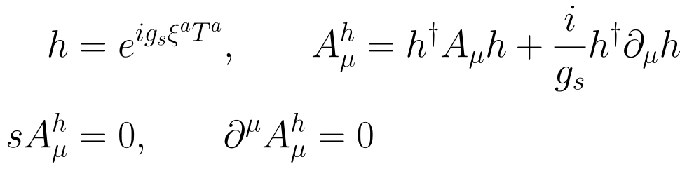
The Local BRST-Invariant RGZ Model
Localizing Aʰ with the Stueckelberg field ξ
τ enforces transversality. The φ and β sectors and their ghost partners localize the horizon term.
BRST-invariant operator correlators are gauge-parameter independent.
The conventional off-shell AA two-point function requires a separate analysis.
[1] Capri et al., PRD 94 (2016) 025035, Secs. II–V.
17
Notes:
Suggested speaking time: 55 seconds.
Explain the local BRST-invariant construction. The Stueckelberg field ξ localizes Aʰ, τ imposes transversality, and two auxiliary sectors localize the horizon term. Gauge independence of BRST-invariant operator correlators is a theorem with specific hypotheses. It does not automatically establish gauge independence of conventional AA correlators or of the full assembled scattering amplitude. Reference [1].
Typography update: displayed equations use consistent LaTeX / Latin Modern math. Scientific content follows the supplied deck.

Slide 18
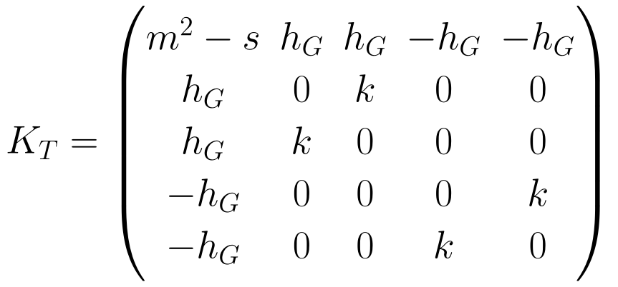
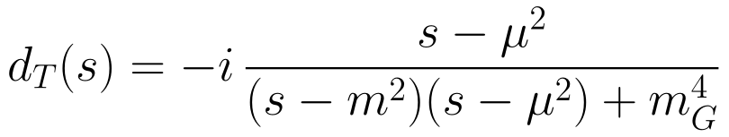
The Transverse 5 × 5 Mixed Kernel
Gluon–auxiliary-field mixing
Use a normalized adjoint basis
after color projection.
Invert the full kernel to obtain
the AA propagator.
Theory: [1] Capri et al. (2016), App. A. Explicit model: [3] RGZWorkflow.
18
Notes:
Suggested speaking time: 70 seconds.
Present the normalized adjoint transverse field basis and the 5 by 5 kernel. The AA propagator follows from inversion of the full mixed kernel. Its mass denominator and signs are retained from the supplied deck. Use the auxiliary-field mixing to motivate the later external-leg weights. References [1] and [3].
Typography update: displayed equations use consistent LaTeX / Latin Modern math. Scientific content follows the supplied deck.

Slide 19
Program Flow: From the Model to One-Loop Kernels
Load RGZWorkflow + model
Notebook Sec. 0
FeynRules session
Independent quadratic benchmark
Extract raw vertices
Export the FeynArts model
Invert T/L kernels
Compare analytic propagators
FeynCalc / FeynArts checks
Propagator checks
Vertices, permutations and field pairs
69 comparisons + 8 contact connections
Validated inputs feed diagram generation, tensor reduction and the full mixed matrix.
[3] RGZWorkflow — Start Here(4).nb, Secs. 0–4. Separate Mathematica sessions are required.
19
Notes:
Workflow reconstructed from notebook sections 0-4. FeynRules and FeynCalc run in separate sessions. Independent quadratic-kernel inversion and vertex comparison validate the inputs before full field-pair summation. The diagram represents program dependencies rather than a claim that every later calculation passed.

Slide 20
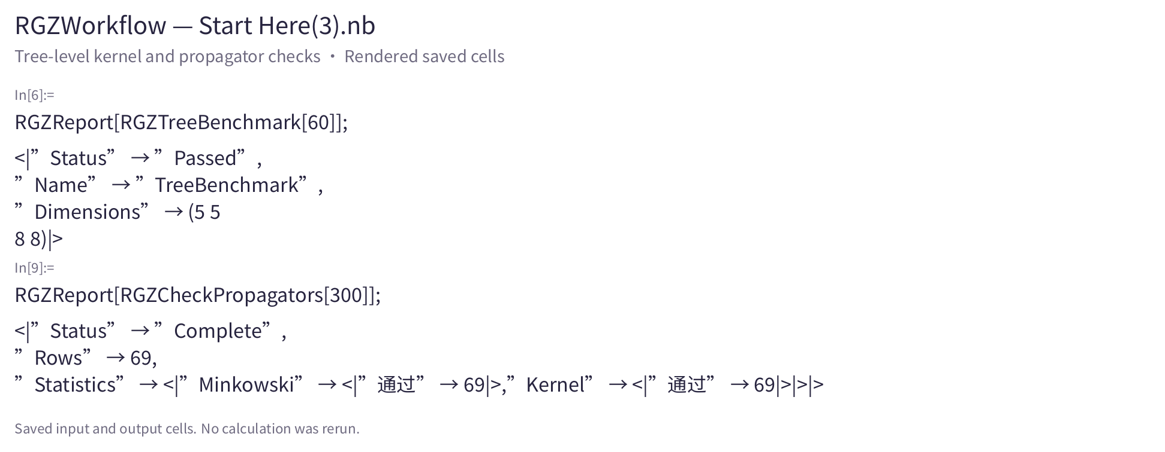
Notebook Run: Kernels and Propagators
Saved tree benchmark and 69 propagator comparisons
[3] Saved notebook cells, rendered for display. Selected input and output cells.
20
Notes:
Screenshot source: RGZWorkflow — Start Here(3).nb. Saved cells rendered read-only, not a live Mathematica Front End capture and not a rerun. Source SHA256: e7efe78bc8a1182779a5157d6ad08e3bdea76364aef45b836623b5faee5e28c5
In[6]:=: UUID 4682d872-1bf1-4bd6-ad03-2d7ba8b39b25, source line 127
During evaluation of In[6]:=: UUID 110be05c-0516-4567-993f-d878b276bbce, source line 134
In[9]:=: UUID ad66458a-e93d-47e8-a635-6879897cc580, source line 640
During evaluation of In[9]:=: UUID 8b1315d8-14b2-4333-b780-d6599bd1a748, source line 647

Slide 21
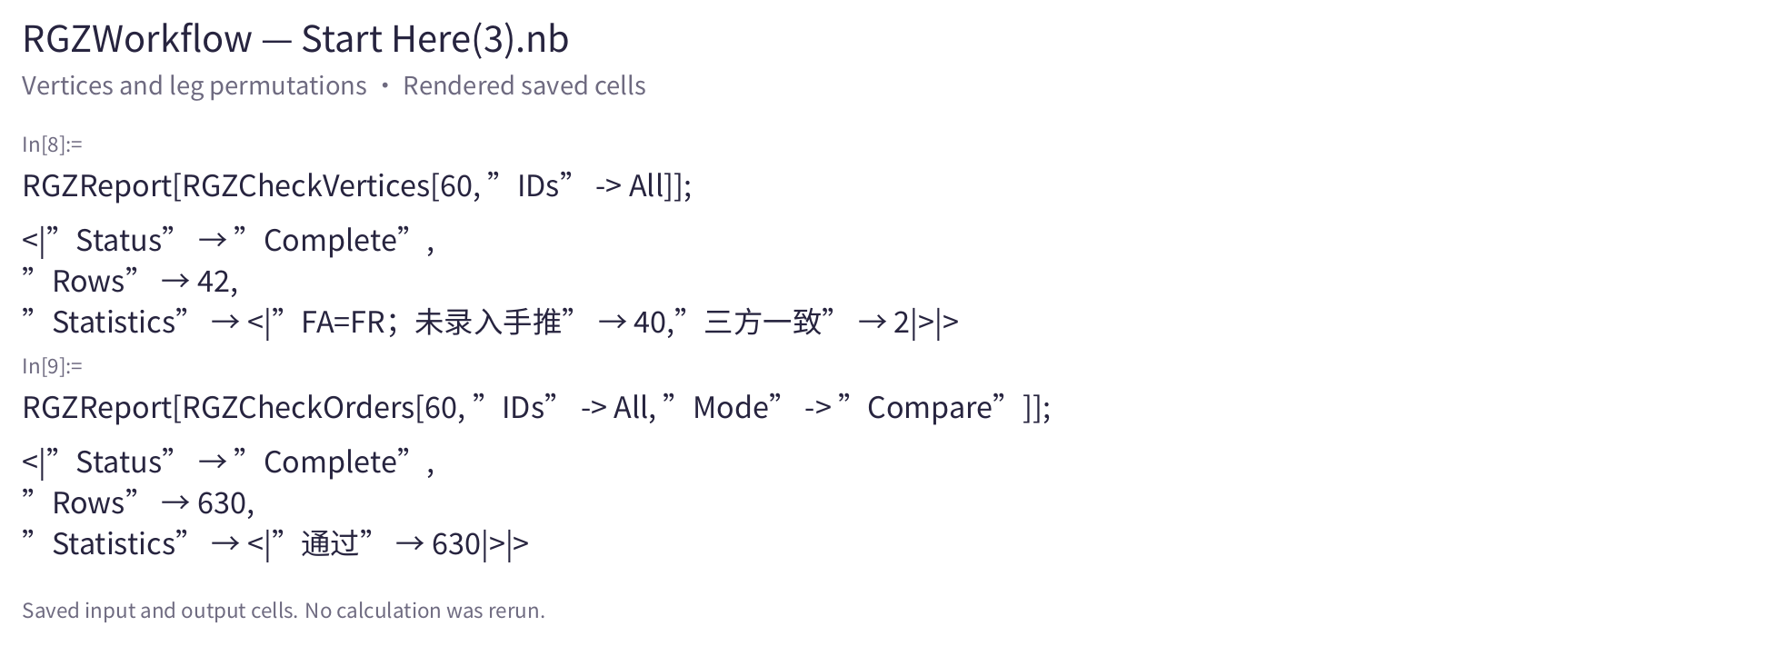
Notebook Run: Vertices and Permutations
42 vertex comparisons and 630 leg-permutation comparisons
[3] Saved notebook cells, rendered for display. Selected input and output cells.
21
Notes:
Screenshot source: RGZWorkflow — Start Here(3).nb. Saved cells rendered read-only, not a live Mathematica Front End capture and not a rerun. Source SHA256: e7efe78bc8a1182779a5157d6ad08e3bdea76364aef45b836623b5faee5e28c5
In[8]:=: UUID 3379721b-f64a-442d-a6a1-a2c99462d53f, source line 745
During evaluation of In[8]:=: UUID 338a186d-c0cc-4e67-9833-52243693ef5b, source line 757
In[9]:=: UUID 920868e0-627a-4db5-88ea-c097216075d9, source line 780
During evaluation of In[9]:=: UUID 5dea6701-1e3b-43e2-bc70-9dc9d6e6f132, source line 793

Slide 22
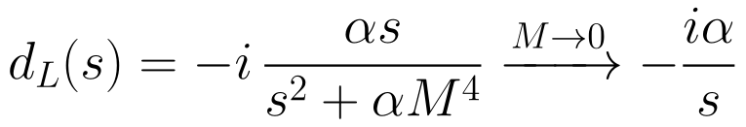
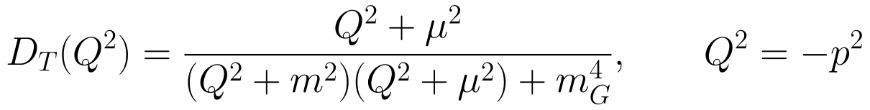
Transverse and Longitudinal Propagators
T sector
L sector
Euclidean transverse scalar
[1] Capri et al., PRD 94 (2016) 025035, App. A.
22
Notes:
Suggested speaking time: 60 seconds.
Separate transverse and longitudinal scalar propagators. M regulates the ξ sector and the longitudinal form tends to its conventional expression when M vanishes. The Euclidean transverse formula follows the source convention Q squared equals minus p squared. Reference [1], Appendix A.
Typography update: displayed equations use consistent LaTeX / Latin Modern math. Scientific content follows the supplied deck.

Slide 23
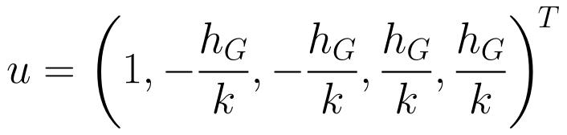
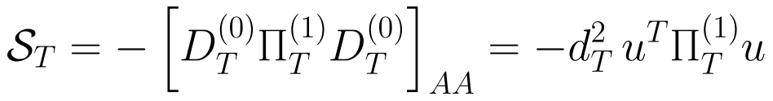
External-Leg Mixing and the RGZ Candidate
Each ordered field pair enters once. Π already contains the diagram symmetry factor.
The full mixed-matrix NAV is included. The four P terms define the current candidate.
Mixing framework: [1] Capri et al. (2016), App. A. Candidate implementation: [3].
23
Notes:
Suggested speaking time: 80 seconds.
The mixed propagator determines the external-leg weight vector. Each ordered field pair is counted once, with graph symmetry factors already included in Pi. The candidate combines the mixed self-energy with box, NAV, AV and external-quark pinch terms. The latest notebook includes the full mixed-matrix NAV. This candidate is distinct from the separately assembled full scattering amplitude. References [1] and [3].
Typography update: displayed equations use consistent LaTeX / Latin Modern math. Scientific content follows the supplied deck.

Slide 24
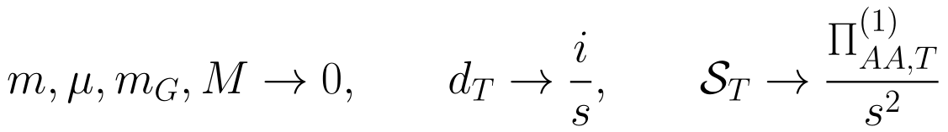

QCD-Limit Calibration: Cancellation Passed
Latest run: the QCD gauge difference vanishes
The program reports a successful QCD cancellation check.
This calibrates relative signs and normalization in the common zero-mass limit.
QCD benchmark: [2] Binosi & Papavassiliou (2009), Sec. 2. Implementation: [3].
24
Notes:
Suggested speaking time: 70 seconds.
The latest notebook reports that the complete QCD gauge-difference sum vanishes in the common zero-mass limit. This calibrates the relative signs and normalization. The gauge-difference convention on this slide uses the reference alpha=0, which differs from the alpha=1 reference on the finite-regulator residual slide. References [2] and [3].
Typography update: displayed equations use consistent LaTeX / Latin Modern math. Scientific content follows the supplied deck.

Slide 25
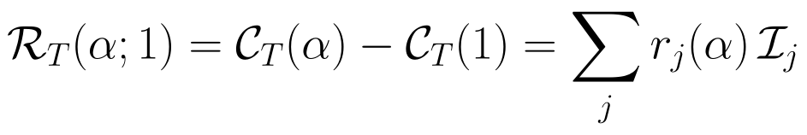
Gauge Residuals at Finite Regulator Mass
α changes both coefficients and integral masses.
Match the integral keys before summing all sectors.
Keep the pole branches fixed throughout the simplification.
Full check at finite M: 39 entries, 31 zero and 8 nonzero.
[3] Latest notebook, Sec. 6: FullMatrixNAVPinch, FullNAVIncluded = True.
25
Notes:
Suggested speaking time: 70 seconds.
The full finite-M check is the latest saved output in notebook Section 6: 39 entries, 31 zero and 8 nonzero, with FullNAVIncluded=True. Alpha changes both coefficients and integral masses, so integral keys and pole branches must be consistent before comparison. Finite-M residuals do not establish the M-to-zero limit. Source [3].
Typography update: displayed equations use consistent LaTeX / Latin Modern math. Scientific content follows the supplied deck.

Slide 26
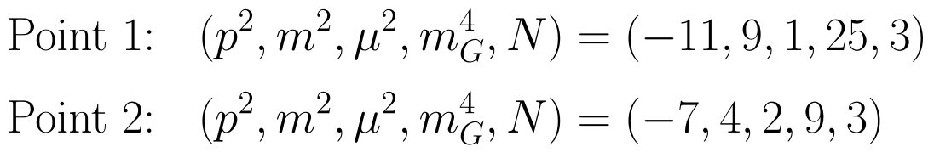
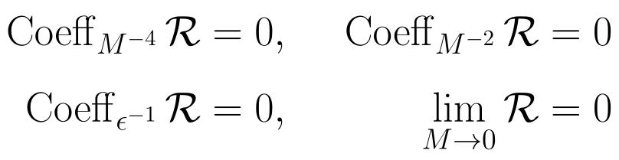
M → 0: Cancellation of the Current Candidate
Keep RGZ masses finite and remove the ξ infrared regulator.
Cancellation extends to general RGZ parameters
α remains symbolic. Section 7.1 reports the general-parameter cancellation
for the current self-energy-like candidate, not a full scattering-amplitude proof.
[3] Latest notebook, Secs. 7–7.1: Out[58], Out[61], and GeneralM0-symbolic review.
26
Notes:
Suggested speaking time: 85 seconds.
The two displayed parameter points give zero singular, UV and finite residual diagnostics while alpha remains symbolic. Notebook Section 7.1 documents a general-parameter review: M^-4, M^-2 and the finite M0 coefficient are zero for the current self-energy-like candidate. The attached notebook has a fingerprint-checking review loader, without a saved output cell for that loader. This report preserves the documented general-parameter result and distinguishes it from the complete scattering-amplitude proof. Source [3], Sections 7 and 7.1.
Typography update: displayed equations use consistent LaTeX / Latin Modern math. Scientific content follows the supplied deck.

Slide 27
Program Flow: Full qq → qq Amplitude
RGZQQStart
Choose kinematics, α and M
Mixed self-energy
AV / NAV on both sides
Direct / crossed boxes
RGZQQPrepareSelf
RGZQQRunPart
RGZQQRunPart
Invalid parts
RGZQQAmplitude
Color–spin basis
RepairIncomplete → rerun
Check all parts before assembly
RGZQQFormFactors
Save valid results. Algebraic reconstruction and S-matrix verification are separate checks.
[3] Latest notebook, Secs. 8–8.1. The saved run includes QQAmplitudeIncomplete and recovery instructions.
27
Notes:
This diagram follows the actual APIs in notebook sections 8 and 8.1. All contributions must pass validity checks before assembly. Old Complete labels can contain TerminatedEvaluation[IterationLimit]; RGZQQRepairIncomplete isolates and recomputes invalid checkpoints while preserving valid work. The attached notebook saved QQAmplitudeIncomplete for MixedSelfEnergy and Box1 and QQAmplitudeFirst on SMatrix. Form-factor reconstruction is an additional algebraic check and does not prove gauge independence or renormalization. The research conclusion supplied by the presenter remains separately attributed on the result slide.

Slide 28
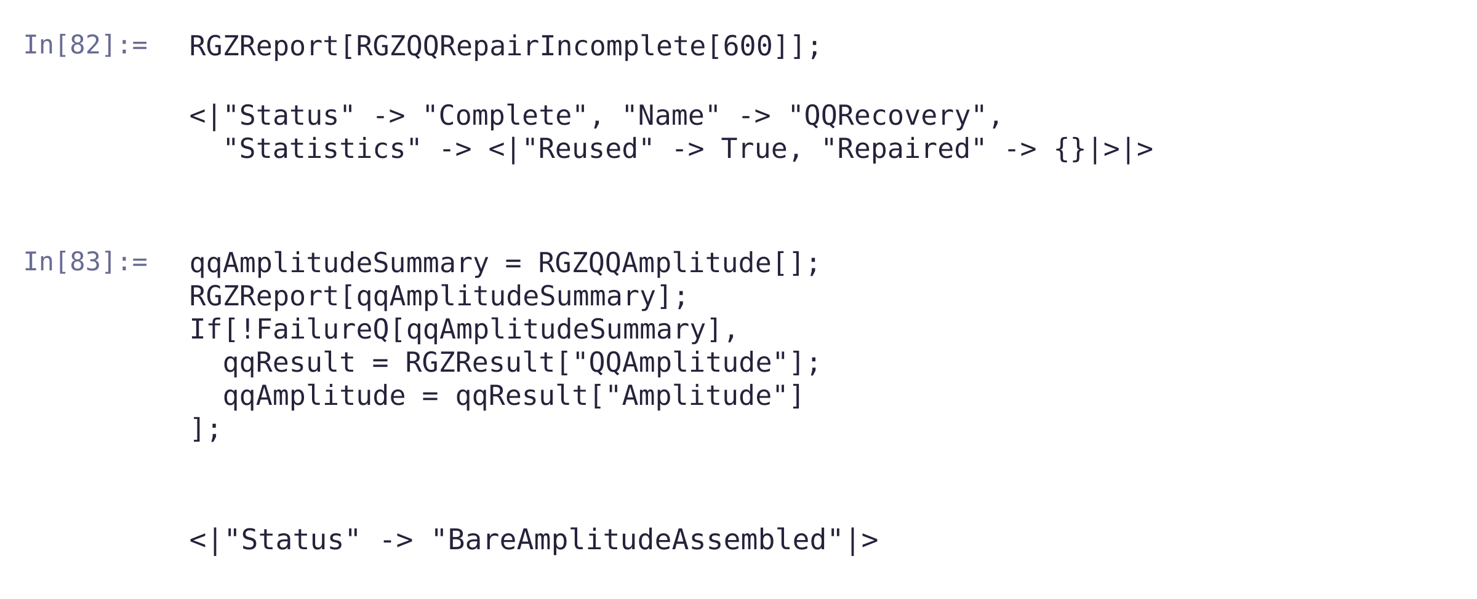
Notebook Run: Recovery and Amplitude Assembly
The saved run assembles the bare amplitude after recovery checks.
[3] Start Here(5).nb, Sec. 8.1, In[82–83]. Saved-cell rendering, not a new execution.
28
Notes:
Source input UUIDs: 5cdbf3ec-c68d-4484-af84-6e645db514f8 and f577d568-3da9-4456-9f68-283702046681. Saved outputs: QQRecovery Complete, Reused True, Repaired empty; BareAmplitudeAssembled. The image renders the exact saved content with whitespace adjusted for readability, not a Mathematica frontend capture or new evaluation. The presenter confirms that the gauge residual has already been recomputed; the older notebook header is not used as the current task status.

Slide 29
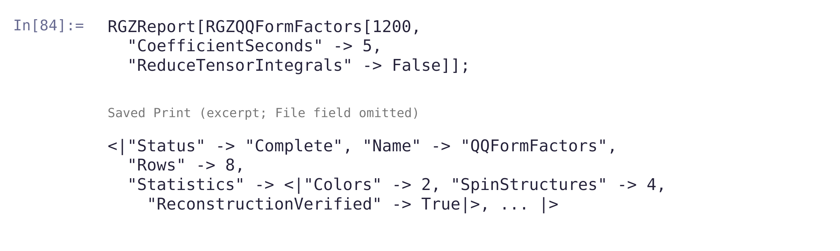
Notebook Run: Form-Factor Reconstruction
Two color structures × four spin structures give eight rows.
ReconstructionVerified = True checks the algebraic reconstruction.
Tensor-integral reduction is disabled in this call.
[3] Start Here(5).nb, Sec. 8.1, In[84]. Saved-cell rendering. Cache path omitted.
29
Notes:
Input UUID 6c281e5d-d68c-4956-96dd-1395f3f35a57, output UUID 44b8dedb-424e-42da-a603-3411ab9052d9. Output Status Complete, Rows 8, Colors 2, SpinStructures 4, ReconstructionVerified True. File path is explicitly omitted from the excerpt. These are saved results, not a new run. Reconstruction does not establish gauge independence or renormalization.

Slide 30
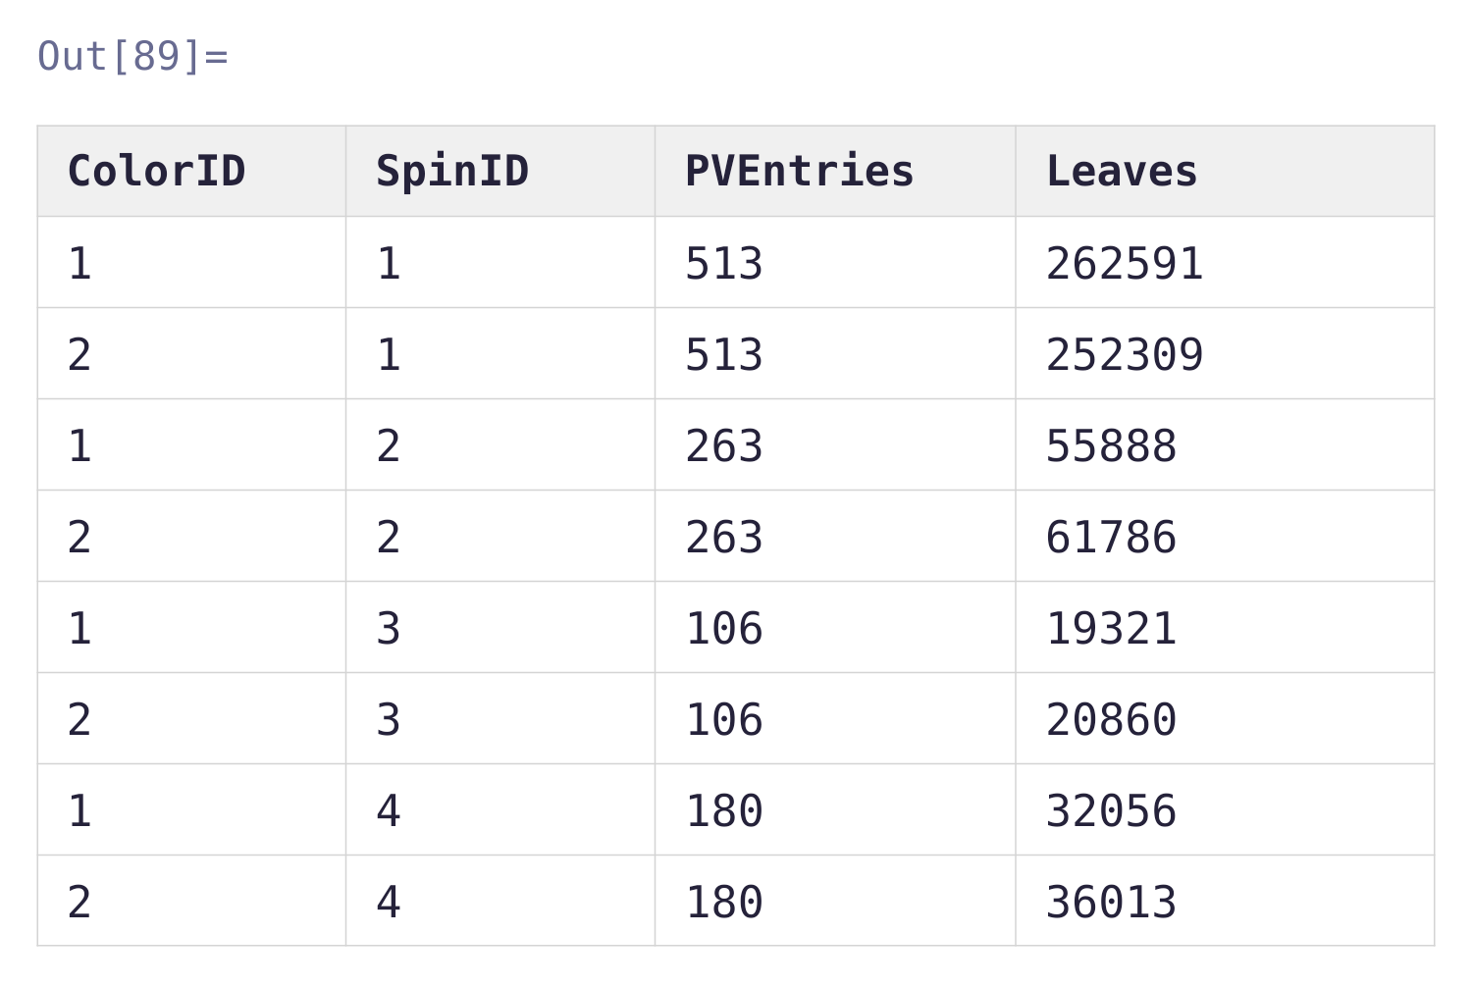
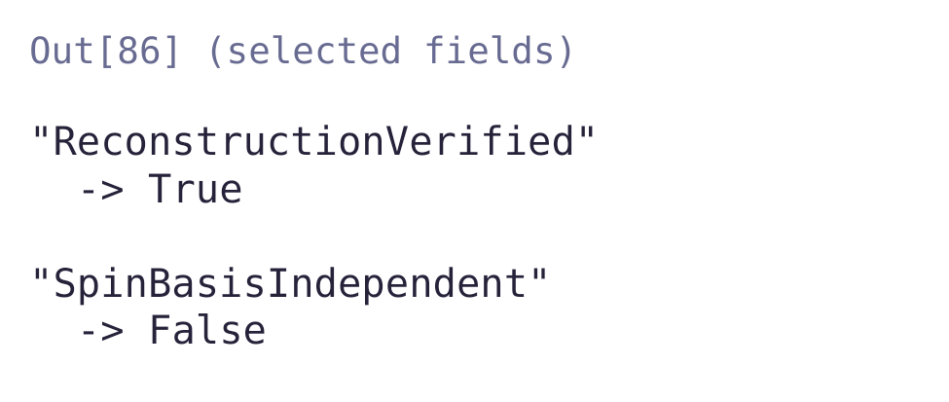
Notebook Run: Color–Spin Coefficient Table
PVEntries counts integral-function entries, not a minimal master basis.
The retained spin basis is not certified independent.
[3] Start Here(5).nb, Out[86], Out[89]. Saved-cell rendering; selected fields only.
30
Notes:
Out[89] UUID 24ba04d9-5188-45d9-8fcd-dd9fe0f66dc6, dataset InitialData transcribed programmatically without modifying values. Out[86] UUID 00ca2166-5070-4b47-8ff3-9da25b4df72e records ReconstructionVerified True and SpinBasisIndependent False. Both flags are shown. PVEntries are integral-function entries and are not the count of a minimal set of independent master integrals. No new Mathematica execution.

Slide 31
Quark Scattering: Gauge-Invariant S-Matrix Result
Complete quark–quark scattering calculation in the RGZ framework
Contribution / operation | Earlier recorded status
Mixed self-energy preparation | Complete
AV1, AV2, Box1, Box2, NAV1, NAV2 | All Complete
Assembly of the full bare amplitude | BareAmplitudeAssembled
Gauge-invariant qq → qq S matrix obtained
The complete scattering result is gauge invariant.
Next: carry out the PT decomposition and determine the running coupling constant.
[3] Notebook: amplitude assembly. S-matrix result: latest research update from the presenter.
31
Notes:
The mixed self-energy, AV, box and NAV preparations are complete in the attached notebook. The presenter now reports the subsequent gauge-invariant qq-to-qq S-matrix result. This update supersedes the earlier assembly-stage status. No new counterterm, UV/IR or renormalization result is asserted here. The next research tasks are the PT decomposition and the running coupling constant.

Slide 32
Conclusions and Next Steps
Native checks and the QCD benchmark pass
Propagator, vertex and permutation checks agree.
The QCD benchmark and the M → 0 candidate cancellation pass.
A gauge-invariant qq → qq S matrix is obtained
We have obtained the gauge-invariant S-matrix result
for quark–quark scattering in the RGZ framework.
Next: compute the PT decomposition and the running coupling constant.
Results: [3] and the latest research update. PT method: [2], [4], [5].
32
Notes:
Latest research status supplied by the presenter: the gauge-invariant qq-to-qq S-matrix result has been obtained. The next stage is to compute the PT decomposition and the running coupling constant. Earlier notebook outputs record the assembly stage. This slide incorporates the subsequent research update and does not claim that the attached notebook alone documents that subsequent verification.

Slide 33
Thank you!
Questions and discussion
33
Notes:
Thank the audience and invite questions. Technical details and references follow in the appendix.

Slide 34
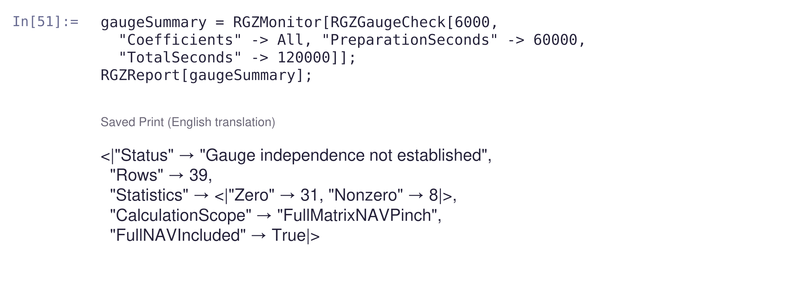
Notebook Run: Recomputed Gauge Residual
Finite M: 31 coefficients vanish and 8 remain nonzero.
The M → 0 cancellation is a separate mass-limit check.
[3] Start Here(5).nb, Sec. 6, In[51]. Saved-cell rendering; output translated to English.
34
Notes:
Input UUID 15273f14-9c68-4303-a332-e9238d86dd4c, Print UUID 774d2bc2-fca6-447e-8c69-e7f1f14de7b0. The presenter confirms that the residual has already been recomputed; this update supersedes the obsolete opening-note instruction to rerun it. Saved output: Status not yet proven gauge independent, Rows 39, 31 zero, 8 nonzero, FullMatrixNAVPinch, FullNAVIncluded True. This is the finite-M residual report. It does not contradict a separate M-to-zero result. No new evaluation performed here.

Slide 35
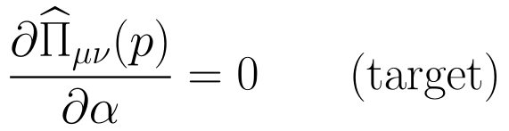
Gauge Consistency of the RGZ Calculation
Mixed fields and off-shell Green functions
The local model mixes gluons and auxiliary fields. All allowed connections must enter.
The PT target
Construct a propagator-like combination, compare gauges and calibrate the QCD limit.
Theory and method: [1] Capri et al. (2016). [2] Binosi & Papavassiliou (2009).
35
Notes:
Backup statement of the research objective. The local RGZ theory has gluon–auxiliary mixing, so the calculation must include all allowed connections. A propagator-like combination is compared between gauges and calibrated against the QCD limit. References [1] and [2].
Typography update: displayed equations use consistent LaTeX / Latin Modern math. Scientific content follows the supplied deck.

Slide 36
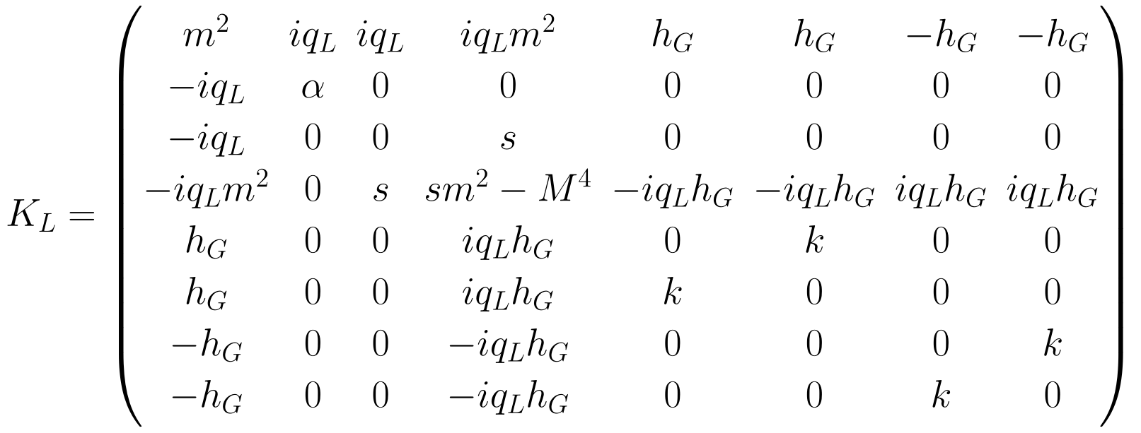
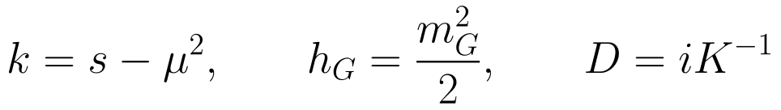
The Longitudinal 8 × 8 Kernel
Propagator benchmark: [1] Capri et al. (2016), App. A. Model kernel: [3].
36
Notes:
Backup longitudinal 8 by 8 kernel. The basis retains b, τ and ξ, which implement the constraints. The matrix and the D=iK inverse convention are unchanged from the supplied source. References [1] and [3].
Typography update: displayed equations use consistent LaTeX / Latin Modern math. Scientific content follows the supplied deck.

Slide 37
The Reproducible Symbolic Workflow
Stage | Operation
FeynRules kernel | Load the model, extract quadratic kernels and export raw vertices
FeynCalc/FeynArts kernel | Compare propagators and vertices, generate topologies and field pairs
Diagram reduction | Convert amplitudes, project T/L, decompose poles and reduce tensor integrals
Mixed-matrix assembly | Transverse 5 × 5 and longitudinal 8 × 8, with full color tensors
PT and gauge checks | QCD benchmark, candidate terms, master-integral coefficients and mass limits
Tree-level and mixed-matrix checks are complete. The gauge-invariant qq → qq S matrix is obtained.
Next: compute the PT decomposition and the running coupling constant.
[3] Latest notebook: native FR/FC output, matrix assembly and staged pinch calculations.
37
Notes:
The workflow table records the completed symbolic construction. The latest presenter update reports the gauge-invariant quark-scattering S matrix. The remaining research objectives are PT decomposition and the running coupling constant.

Slide 38
Latest Checks and Their Verification Scope
Check | Latest result and scope
Tree-level propagators | 69 comparisons pass, including Minkowski forms and quadratic kernels
Vertices / permutations | 42 vertices: 40 FA=FR, 2 three-way matches. 630 permutations pass
Mixed matrix / NAV | 64 ordered field pairs. 73 NAV connections, 44 retained by conserved currents
Residual at finite M | Full 39-entry check: 31 zero, 8 nonzero
Mass-limit checks | Current candidate: general-parameter M→0 cancellation. Joint QCD limit passes
BRST / ST identities | 4 partial checks pass. Source kernels for 5 full identity classes remain unimplemented
Full ST/Nielsen proof is pending; raw NAV sums and pinch reduction are tracked separately.
[3] Latest notebook, Secs. 2, 4.5, 5, 5.1, 6, 7 and 8.
38
Notes:
The numerical counts come from the uploaded report and the latest notebook. ClassicalBRST checks use SU(3) and the expansion through g_s squared. QuarkWard, PropagatorConstraint and NAVReconstruction complete the four partial checks. MixedVertexST, QuarkVertexST, OneLoopST, Nielsen and CompositeAh are not implemented as complete source-kernel checks. NAV reconstruction is not a mixed-vertex STI proof. Source [3], Sections 2, 4.5, 5, 5.1, 6, 7 and 8.

Slide 39
References and Computational Sources
[1] M. A. L. Capri et al.
A local and BRST-invariant Yang-Mills theory within the Gribov horizon
Phys. Rev. D 94 (2016) 025035, arXiv:1605.02610
Local BRST construction, gauge independence and propagators.
[2] D. Binosi and J. Papavassiliou
Pinch Technique: Theory and Applications
Phys. Rept. 479 (2009) 1–152, arXiv:0909.2536
One-loop QCD, the BV formalism and intrinsic PT.
[3] RGZWorkflow: 0.1.0 source and 0.2.0 development notebooks
Native runs, gauge residuals and the M → 0 / QCD limits.
39
Notes:
References [1] and [2] provide the local BRST-invariant RGZ construction and the PT review. Source [3] identifies the software and development notebook, including the newly supplied Start Here(2) notebook. Computational statuses are reported evidence, not new runs performed while editing this presentation.

Slide 40
References: PT and Thermal QCD
[4] J. M. Cornwall
Dynamical mass generation in continuum quantum chromodynamics
Phys. Rev. D 26 (1982) 1453–1478
[5] D. Binosi and J. Papavassiliou
Pinch technique and the Batalin-Vilkovisky formalism
Phys. Rev. D 66 (2002) 025024, arXiv:hep-ph/0204128
[10] R. Baier, B. Pire and D. Schiff
High temperature behaviour of the QCD coupling constant
Phys. Lett. B 238 (1990) 367–372
40
Notes:
PT and thermal-QCD references. [4] Cornwall, PRD 26 (1982) 1453–1478. [5] Binosi and Papavassiliou, PRD 66 (2002) 025024, hep-ph/0204128. [10] Baier, Pire and Schiff, High temperature behaviour of the QCD coupling constant, PLB 238 (1990) 367–372. The thermal reference is context for the source slide, not a claim of a newly computed finite-temperature RGZ result.

Slide 41
References: Gribov, RGZ and Infrared QCD
[6] V. N. Gribov
Quantization of non-Abelian gauge theories
Nucl. Phys. B 139 (1978) 1–19
[7] D. Dudal et al.
A refinement of the Gribov-Zwanziger approach in the Landau gauge:
infrared propagators in harmony with the lattice results
Phys. Rev. D 78 (2008) 065047, arXiv:0806.4348
[8] D. Dudal, O. Oliveira and P. J. Silva
High Precision Statistical Landau Gauge Lattice Gluon Propagator
Computation vs. the Gribov-Zwanziger approach
arXiv:1803.02281 (2018)
[9] D. J. Gross and F. Wilczek
Ultraviolet Behavior of Non-Abelian Gauge Theories
Phys. Rev. Lett. 30 (1973) 1343–1346
41
Notes:
[6] V. N. Gribov, Quantization of non-Abelian gauge theories, Nuclear Physics B 139 (1978) 1–19. [7] Dudal et al., PRD 78 (2008) 065047, arXiv:0806.4348. [8] Dudal, Oliveira and Silva, arXiv:1803.02281. [9] Gross and Wilczek, PRL 30 (1973) 1343–1346. Preserve the original lattice plot and its source.

