Slide 1


Multi-Point Energy Correlators
in Photon-Tagged Jet Production
Main focus: three-point energy correlators of photon-tagged jets in Pb+Pb collisions
Speaker:Hao Wang
South China University of Technology
Co-authors: Cheng Xu (SCUT), Yayun He (SCUT), Shanshan Cao (SEU)
Spicy Gluons 2026
Wuhan, October 20, 2026
Notes:
Good morning/afternoon, everyone. My name is Hao Wang, from South China University of Technology.
It is a great honor to have the opportunity to present our work today.
Today I will talk about multi-point energy correlators in photon-tagged jet production.
We focus on the three-point energy correlator, called E3C, and its change in Pb+Pb collisions.
My co-authors are Cheng Xu ，professor Yayun He , and Shanshan Cao.

Slide 2
Outline
Introduction
Methodology
E3C across angular scales and in shape space
System-Size Dependence
Summary
10/20/2026 Spicy Gluons 2026
Hao Wang (SCUT)
Outline
2 / 19
Notes:
My talk has five parts.
First, I will give an Introduction of the motivation for photon-tagged jets and energy correlators.
Then I will introduce the LBT model and our calculation workflow.
Next, I will discuss the E3C from two related perspectives: its behavior across angular scales and its structure in shape space.
And then, I will show the system-size dependence between PbPb an OO.
Finally, I will summarize the main results.

Slide 3
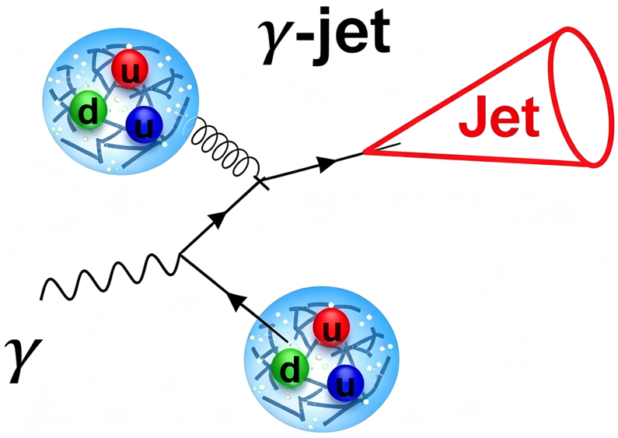
Introduction: photon-tagged jets as calibrated probes
> Prompt photon calibrates the initial hard scale.
> Tagged jet probes energy loss and medium response.
> Jet energy flow is redistributed by the medium.
What we calculate
Energy correlations among particles inside reconstructed jets.
What we want
How the medium redistributes jet energy across angular scales.
Gamma-jets provide a calibrated probe for studying medium-induced changes in jet energy flow.
10/20/2026 Spicy Gluons 2026
Hao Wang (SCUT)
Introduction
3 / 19
Notes:
Let us start with photon-tagged jets.
In the initial hard scattering, a photon can be produced together with a recoiling parton.
Since prompt photons interact only weakly with the QGP, they can escape the medium and provide a clean reference for the initial energy of that parton.
The jet on the other side travels through the QGP. It loses energy and also interacts with the medium.
This makes photon-tagged jets useful for studying how the medium changes the energy inside a jet.
Here we study energy correlations among particles in the reconstructed jet.
Our main question is: In addition to changing the total jet energy, how does the medium change the energy flow at different angles?
For this reason, we use the EEC and the EEEC.

Slide 4
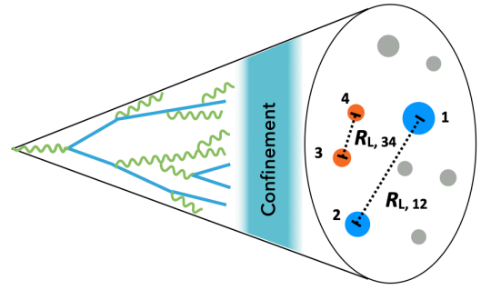
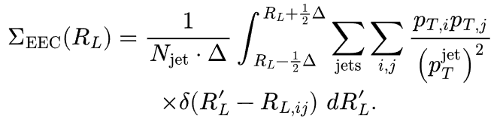

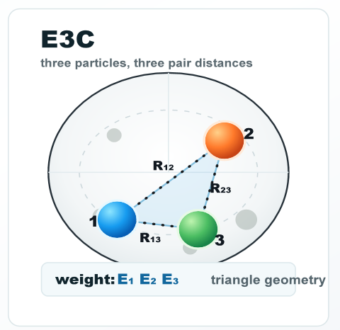
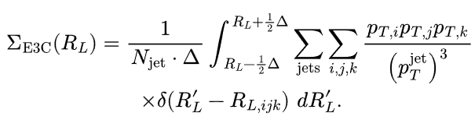

Introduction: from EEC to EEEC
EEC: two-point correlation
Measures energy flow as a function of one angular distance.
Figure from ALICE Collaboration, arXiv:2409.12687 [hep-ex] (2024).
EEEC: three-point correlation
Three ordered distances encode the triangle scale and shape.
Why EEEC?
Different medium components may populate different three-particle geometries.
Komiske et al., Phys. Rev. Lett. 130, 051901 (2023).
Bossi et al., JHEP 12 (2024) 073.
10/20/2026 Spicy Gluons 2026
Hao Wang (SCUT)
Introduction
4 / 19
Notes:
The EEC is a two-particle correlation.
It uses the energies of two particles and their angular separation. In this way, it measures energy flow as a function of one angular distance.
The EEEC is a three-particle correlation.
For three particles, there are three pairwise angular distances. We denote the longest, intermediate, and shortest distances by RL, RM, and RS , respectively.
These three ordered distances encode the triangle scale and shape.
The EEEC therefore gives more information than the EEC. It can show whether the medium affects all triangle shapes in the same way, or some shapes are affected more strongly.
This is useful because different medium components may populate different three-particle geometries.

Slide 5
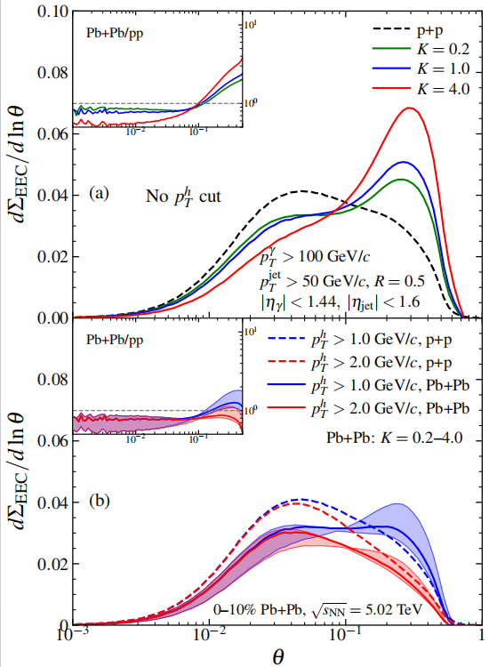
Introduction: from the established EEC pattern to EEEC
Previous EEC study
LBT reproduces the EEC:
small-angle suppression and broad-angle enhancement.
Limitation
EEC no full three-particle geometry.
Next step
Use EEEC
Reference: Yang, He, Moult, Wang, Phys. Rev. Lett. 132, 011901 (2024).
10/20/2026 Spicy Gluons 2026
Hao Wang (SCUT)
Introduction
5 / 19
Notes:
Before showing the EEEC, let us recall the known EEC result.
Previous studies show that LBT can describe the main EEC pattern in Pb+Pb collisions well.
At small angles, the Pb+Pb yield is lower than the pp yield.
At large angles, the yield is higher.
This tells us that the EEC can see energy moving from small angles to large angles.
But the EEC cannot tell us which triangle shapes are important.
We therefore extend this study from the EEC to the EEEC.

Slide 6
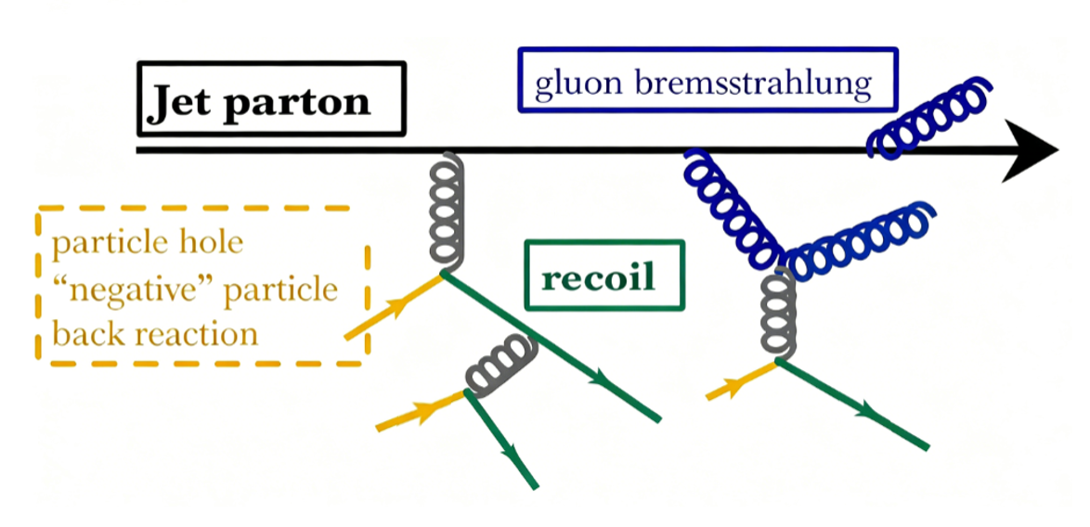
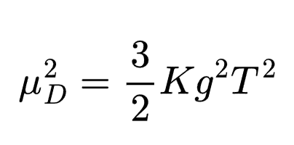
Methodology: Linear Boltzmann Transport (LBT) Model
K changes the Debye screening mass and the typical momentum-transfer scale, while the scattering rate is fixed at K = 1.
S
R
M
shower
partons
medium-induced
radiated gluons
medium response:
recoil + negative partons
LBT Code: A Color Tracking LBT Model, https://github.com/dyczzz/A-Color-Tracking-LBT-Model
J. Auvinen et al, Phys. Rev. C 82 024906 (2010); X. F. Guo and X.N. Wang, Phys. Rev. L 85 3591 (2000); Y. Dang, W.-J. Xing, S. Cao, and G.-Y. Qin, arXiv:2602.10395 [nucl-th] (2026).
B.W. Zhang, E. Wang, and X.N. Wang, Phys. Rev. L 93 072301 (2004); Y. Y. He et al, Phys. Rev. C 91 054908 (2015); T. Luo et al, Phys. Rev. C 109 034919 (2024).
10/20/2026 Spicy Gluons 2026
Hao Wang (SCUT)
Methodology
6 / 19
Notes:
Now I will briefly introduce the Linear Boltzmann Transport model.
In LBT, an incoming jet parton can scatter elastically with a thermal parton from the medium, producing a recoil parton and leaving a negative parton at the same location to represent the back reaction of the medium. The jet parton can also undergo medium-induced bremsstrahlung while it moves through the QGP.
For the later analysis, we use three groups: S means shower partons. R means medium induced radiated gluons. M means the medium response, including recoil and negative partons.
We also use a parameter called K. K changes the Debye screening mass and the typical momentum-transfer scale. By changing K, we can study how this interaction changes the EEEC.

Slide 7
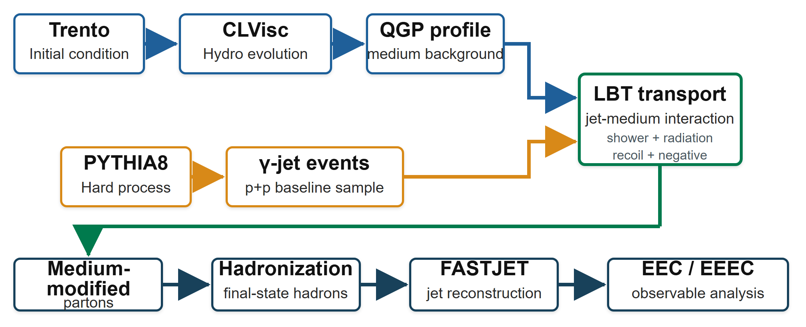
Methodology: LBT Workflow
LBT combines the hydrodynamic QGP background with PYTHIA γ-jet events;
evolves shower, radiation, recoil, and negative partons through the medium;
followed by hadronization, FASTJET reconstruction, and EEEC analysis.
10/20/2026 Spicy Gluons 2026
Hao Wang (SCUT)
Methodology
7 / 19
Notes:
This slide shows our calculation workflow.
LBT combines the hydrodynamic QGP background with PYTHIA γ-jet events;
evolving shower, radiation, recoil, and negative partons through the medium;
After that, the partons are hadronized, and the jets are reconstructed with FASTJET.
Finally, we calculate the EEC and the EEEC inside the photon-tagged jets.
This method gives us both the final hadron-level observables and parton-level analysis.

Slide 8
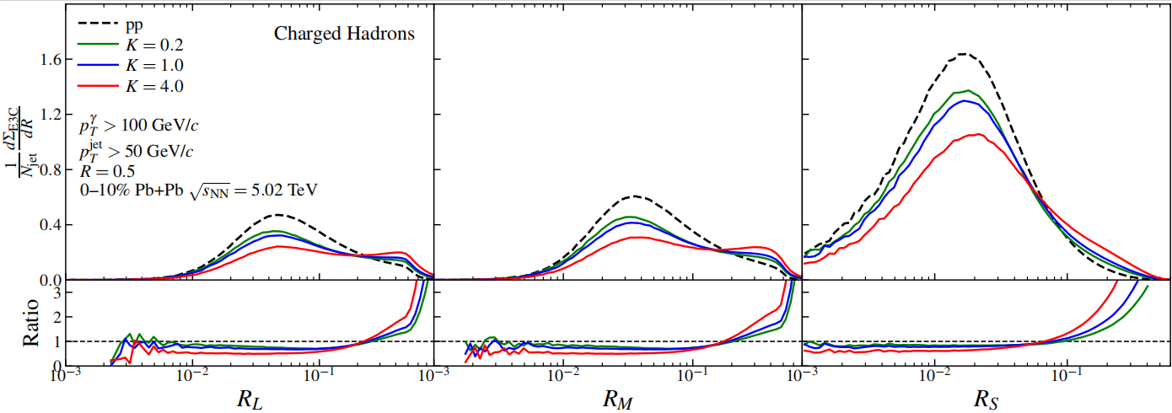
EEEC projections at different angular scales
Distributions differ among R_{L}, R_{M}, and R_{S}, the same modification like EEC: small-angle suppression and broad-angle enhancement.
10/20/2026 Spicy Gluons 2026
Hao Wang (SCUT)
E3C at different R
8 / 19
Notes:
Now let us look at the results.
Each triplet has three angular distances. We sort them from large to small and call them RL, RM, and RS.
This slide shows the EEEC as a function of these three distances.
The three plots have different shapes because they describe different edges of the same triangles.
But the main medium effect is the same in all three plots.
At small angles, the Pb+Pb result is suppressed compared with pp.
At large angles, it is enhanced.
This is the same small-angle suppression and large-angle enhancement seen in the EEC. The EEEC also shows that energy moves from small angles to large angles.

Slide 9
LBT component analysis of EEEC
Parton Level
S
R
M
shower
partons
medium-induced
radiated gluons
medium response:
recoil + negative partons
SSS
vacuum-like shower baseline
SSR
one induced radiation gluon correlated with shower partons
SRR + RRR
radiation-dominated triplets
SRM + RRM + RMM
mixed radiation-response triplets
SSM
one response parton correlated with the shower
SMM + MMM
response-dominated triplets
10/20/2026 Spicy Gluons 2026
Hao Wang (SCUT)
E3C at different R
9 / 19
Notes:
To understand this effect, we separate the triplets by their particle content.
SSS has three shower partons, so it mainly describes the shower.
SSR has two shower partons and one radiated gluon. SRR and RRR are mainly radiation terms.
SSM has two shower partons and one medium-response parton. SMM and MMM are mainly response terms.
SRM, RRM, and RMM are mixed radiation-response terms.
This separation helps us see which parts of the calculation come from the shower, from radiation, and from the medium response.

Slide 10
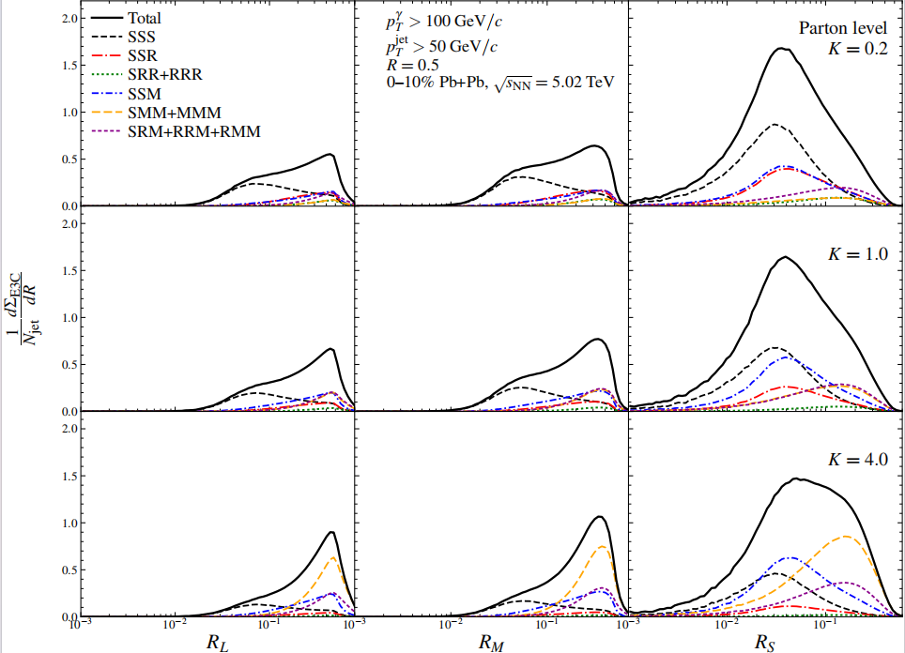
Parton-level component decomposition across angular scales
K increase:
M increases, S decreases,
R is relatively stable
Angular scale：
Double-S triplets stay closer to the shower core
Single-S / non-S triplets populate broader angles
07/15/2026 CPS HEP Annual Meeting
Hao Wang (SCUT)
E3C at different R
10 / 15
10/20/2026 Spicy Gluons 2026
Hao Wang (SCUT)
E3C at different R
10 / 19
Notes:
This slide shows the different components for RL, RM, and RS, and for several values of K.
First, let us pay attention to RS and look at K. When K becomes larger, the shower contributions become smaller, while the medium-response contributions become larger.
This means that a stronger jet-medium interaction moves more energy away from the shower core and into the medium response.
There is also an important point about the angular scale. The number of shower partons in a triplet is also important.
Terms with two shower partons, such as SSS, SSR, and SSM, are more closely related to the shower core.
Terms with one or zero shower partons are more likely to appear at wider angles.
So the main message is: increasing K strengthens the M-related terms and weakens the S-related terms. The angular scale depends on how the different partons are mixed.

Slide 11
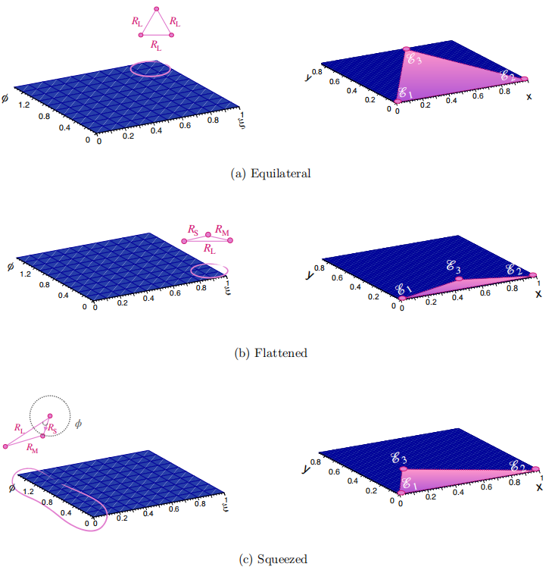
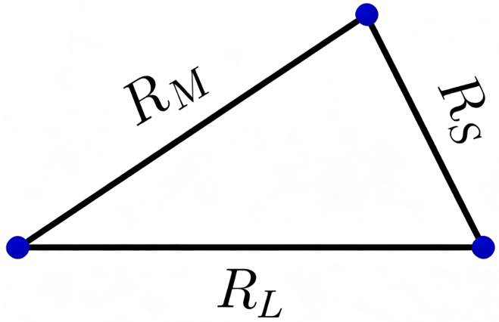
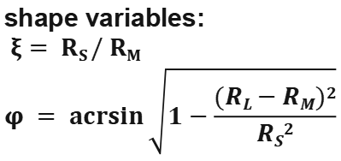
Shape-space definition: separate scale from triangle shape
Focus on ξ=1,φ=π/2,R_{L}=R_{M}=R_{S}
broad-angle and near-equilateral
ordered distances:
R_{S} < R_{M} < R_{L}
shape variables:
$$ξ= RS / RM \\ φ = \operatorname{acrsin}{\sqrt{1−\frac{(RL−RM)2}{RS2}}}$$
Komiske et al., Phys. Rev. Lett. 130, 051901 (2023).
Shape can be studied in EEEC.
Fixing R_{L}, the overall angular scale is fixed,
so we can compare different triangle shapes without mixing in scale effects
figure source: Bossi et al., JHEP 12 (2024) 073.
10/20/2026 Spicy Gluons 2026
Hao Wang (SCUT)
E3C in shape space
11 / 19
Notes:
The projections above show only one edge at a time.
We now use shape space to describe the full three-particle geometry.
For each triplet, we order the three distances as RS < RM < RL.
RL gives the overall angular scale of the triangle.
We then use two more variables, xi and phi, to describe the triangle shape.
In this way, we separate the size of the triangle from its shape.
Here we focus on the large-angle, near-equilateral region.
Near-equilateral means that RS, RM, and RL are close to each other. The three particles then form a more uniform triangle.
If the medium effect is stronger in this region, the medium is selecting some three-particle shapes more than others.

Slide 12
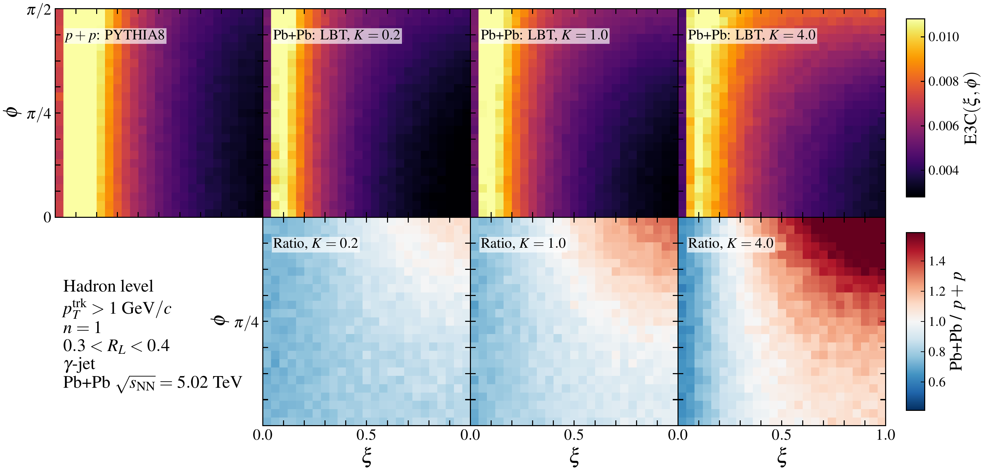
E3C in shape space: absolute yield and AA/pp ratio
Increasing K strengthens the medium modification of EEEC.
Enhancement appears in the broad-angle, near-equilateral region.
10/20/2026 Spicy Gluons 2026
Hao Wang (SCUT)
E3C in shape space
12 / 19
Notes:
This slide shows the EEEC yield and the Pb+Pb-to-pp ratio in shape space.
The upper row shows the yields for different K values. The lower row shows the ratios.
As K increases, the medium effect becomes stronger
The enhancement is also not uniform across shape space. It is mainly found in the large-angle, near-equilateral region.
Thus, the EEEC tells us more than just that energy moves to larger angles. It also tells us which three-particle shapes are favored.

Slide 13
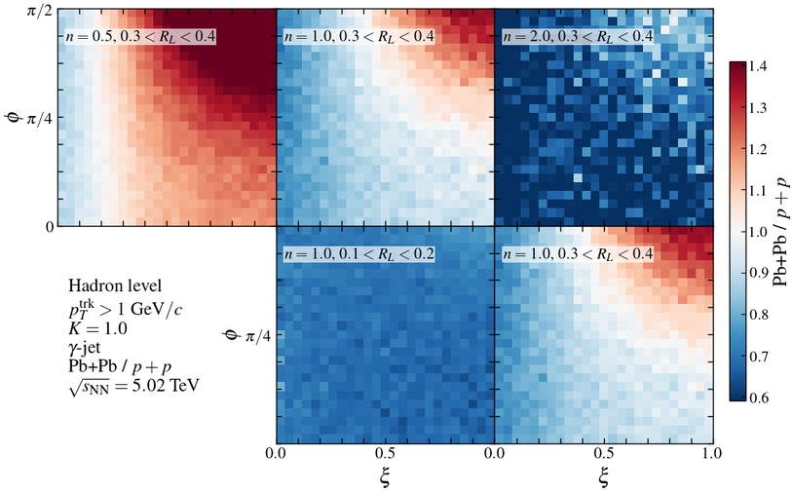
Shape-space sensitivity to n and R_{L}
n = 0.5:
soft enhanced
→ stronger broad-angle enhancement
n = 2:
soft suppressed
→ broad-angle enhancement reduced
Small R_{L}:
suppression-dominated
Large R_{L}:
near-equilateral region enhancement
medium modification:
large R and soft-sensitive
10/20/2026 Spicy Gluons 2026
Hao Wang (SCUT)
E3C in shape space
13 / 19
Notes:
Next, we study the energy exponent n and the angular scale RL.
The value of n controls how much the observable favors soft or hard particles.
For n = 0.5, soft particles have more weight, and the large-angle enhancement is clear.
For n = 2, soft particles have less weight, and the enhancement mostly disappears.
RL controls the overall size of the triangle.
At small RL, we mainly see the small-angle region near the shower core. The medium effect is weak and may be mostly suppression.
At larger RL, the enhancement in the large-angle, near-equilateral region becomes clear.
So the medium effect is easiest to see at large angles and with an observable that gives more weight to soft particles.

Slide 14
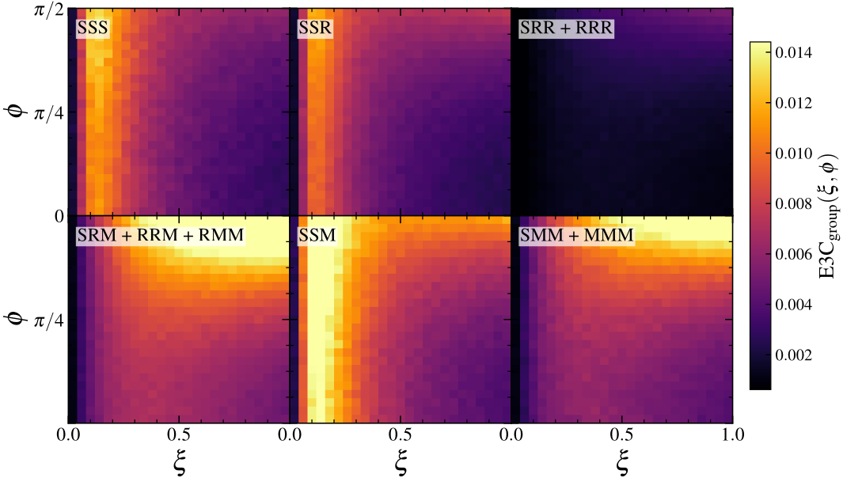
Shape-space component decomposition
n=1
K=1
0.3<R_{L}<0.4
EEEC is most sensitive to mixed radiation-response triplets
in the LBT component decomposition.
10/20/2026 Spicy Gluons 2026
Hao Wang (SCUT)
E3C in shape space
14 / 19
Notes:
This slide shows the components for n = 1, K = 1, and 0.3 < RL < 0.4.
SSS mainly comes from the shower.
The mixed terms, especially the radiation-response terms, give a large contribution in shape space.
This means that the large-angle structure does not come from only one component. It comes from correlations among the shower, radiation, and the medium response.
The mixed terms also include several channels, so they have a combinatorial enhancement.
Even so, their enhancement in particular shape regions suggests that the effect has a physical origin.

Slide 15
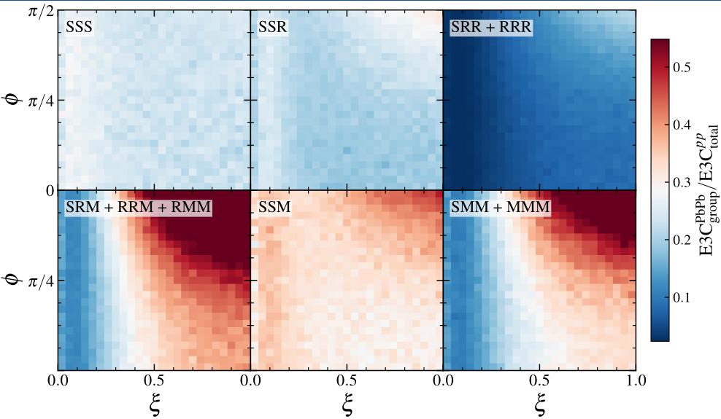
Shape-space component decomposition
Radiation and Medium response both populate broad-angle near-equilateral configurations.
10/20/2026 Spicy Gluons 2026
Hao Wang (SCUT)
E3C in shape space
15 / 19
Notes:
This slide compares the Pb+Pb components to pp ratio.
We can see both radiation-related triplets and medium-response triplets tend to appear at large angles and near-equilateral shapes.

Slide 16
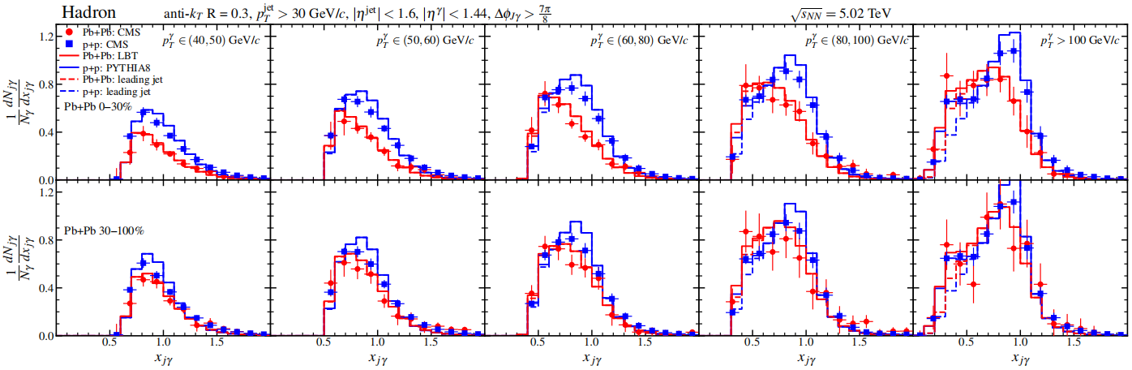
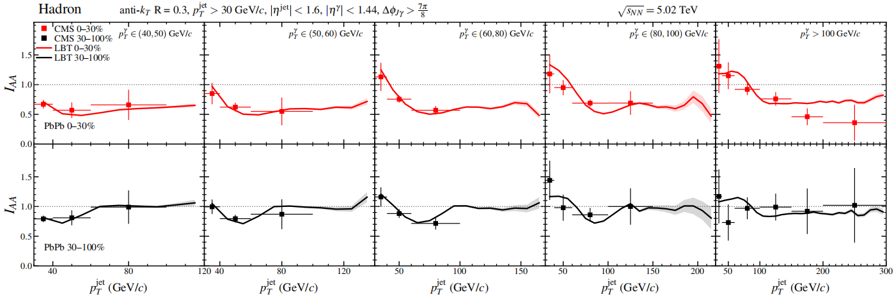
System-Size Dependence
LBT describes CMS
γ-jet observables
such as
X_{jγ} and I_{AA}
in Pb+Pb collisions.
CMS data from CMS Collaboration,
Phys. Lett. B 785 (2018) 14–39;
LBT calculations by the authors.
10/20/2026 Spicy Gluons 2026
Hao Wang (SCUT)
System-Size Dependence
16 / 19
Notes:
Finally, let us look at the system-size dependence.
We first check the LBT results against the CMS data in Pb+Pb collisions.
The upper panels show xjgamma, the ratio of the jet transverse momentum to the photon transverse momentum.
The lower panels show IAA, which compares the jet yield in Pb+Pb with that in pp.
LBT describes the main features of the CMS data for both observables.
We then use the same model to study the smaller O+O system.

Slide 17
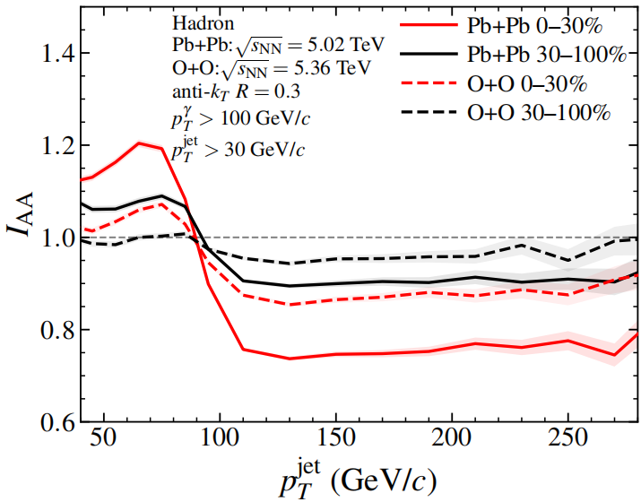
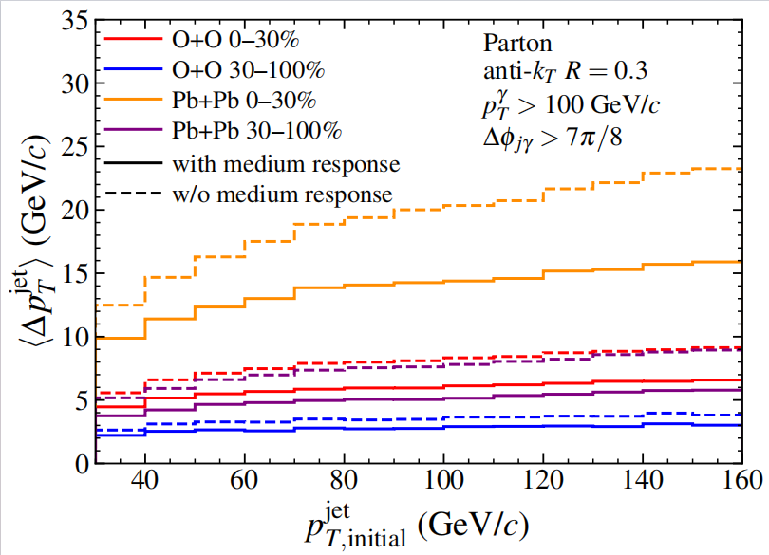
System-Size Dependence
O+O shows a weaker but still visible γ-jet modification compared with Pb+Pb.
10/20/2026 Spicy Gluons 2026
Hao Wang (SCUT)
System-Size Dependence
17 / 19
Notes:
This slide compares Pb+Pb and O+O collisions.
The left panel shows IAA. In O+O, the results are closer to one, which means weaker jet suppression.
The right panel shows the average jet transverse momentum loss. The loss is smaller in O+O than in Pb+Pb.
The solid lines include the medium response, while the dashed lines do not. Including the medium response reduces the net momentum loss.
Both panels show the same message: the jet-medium effect is weaker in O+O, but it is still visible.

Slide 18
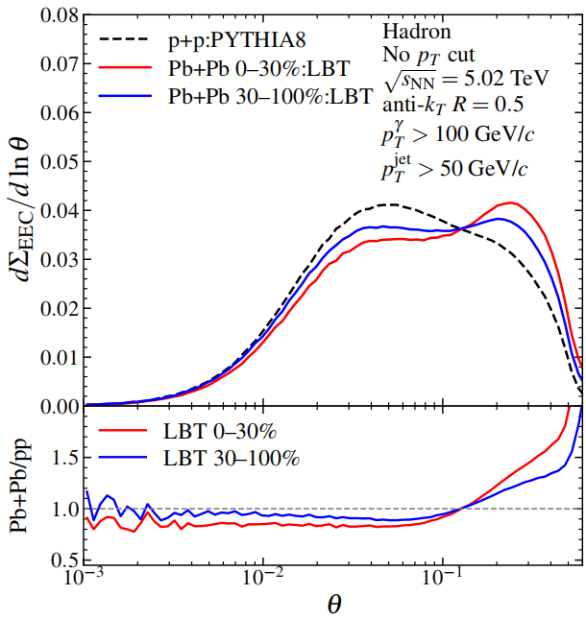
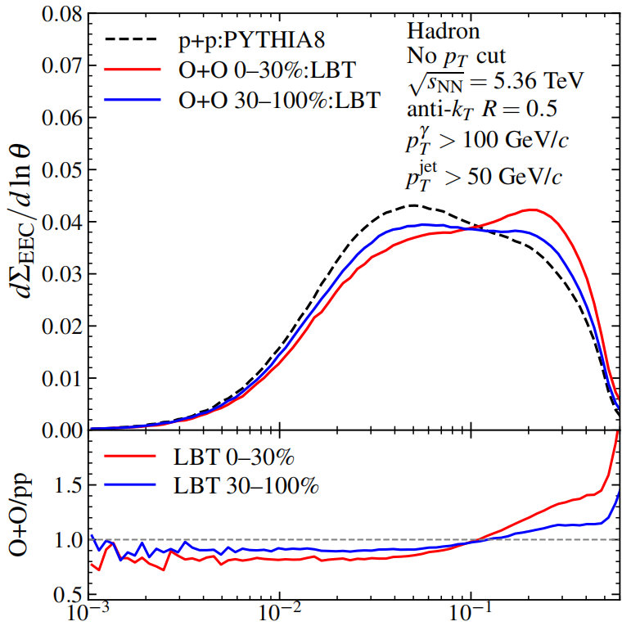
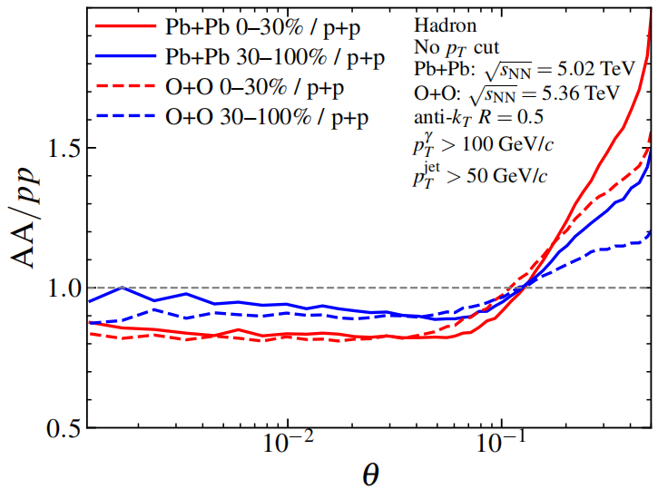
System-Size Dependence
Both Pb+Pb and O+O show the same EEC pattern: small-angle suppression and broad-angle enhancement.
The modification is weaker in O+O.
10/20/2026 Spicy Gluons 2026
Hao Wang (SCUT)
System-Size Dependence
18 / 19
Notes:
This slide shows the EEC in Pb+Pb and O+O collisions.
Both systems show the same pattern: suppression at small angles and enhancement at large angles.
But，the effect is smaller in O+O.
This shows that even a small system can leave a measurable signal of energy moving from small to large angles, although the signal is weaker than in Pb+Pb.

Slide 19
Summary
✓ EEEC extends EEC from one angular distance to full three-particle geometry.
✓ In Pb+Pb, EEEC shows small-angle suppression and broad-angle, near-equilateral enhancement.
✓ Component decomposition shows a shift from shower-correlated triplets toward radiation and medium-response-related triplets, especially in broad-angle, near-equilateral configurations.
✓ O+O predictions extend the study to a smaller collision system with weaker jet-medium modification.
Thanks for your attention
10/20/2026 Spicy Gluons 2026
Hao Wang (SCUT)
Summary
19 / 19
Notes:
Let me summarize the main points.
That concludes my presentation. Thank you for your attention.
I would be happy to answer any questions you may have.

Slide 20
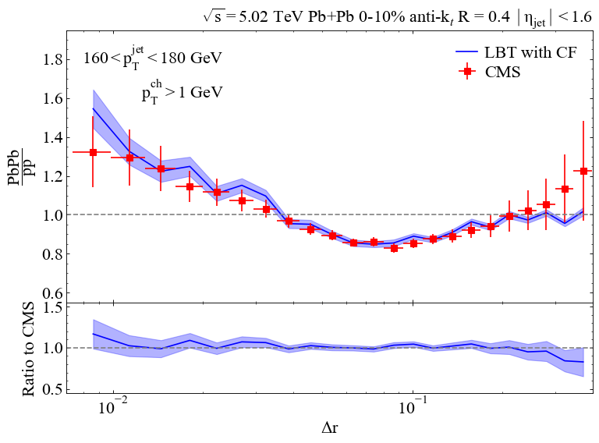
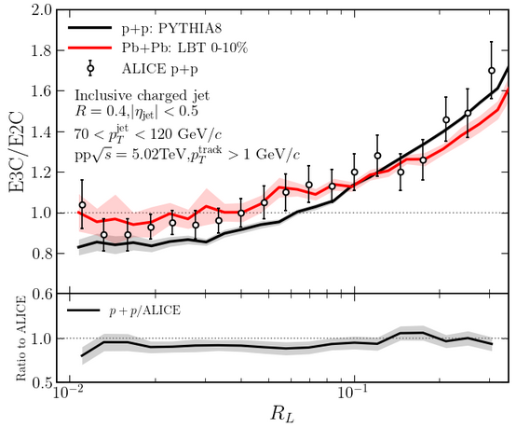
Backup: LBT comparisons with measured energy correlators
CMS data: CMS Collaboration, Phys. Lett. B 866, 139483 (2025);
LBT calculation/figure courtesy of Cheng Xu.
ALICE pp preliminary data at 5.02 TeV: ALI-PREL-604282.
PYTHIA8 and LBT curves are from this work.
10/20/2026 Spicy Gluons 2026
Hao Wang (SCUT)
Backup

