Slide 1
nMWS signal cure
R. Yang

Slide 2
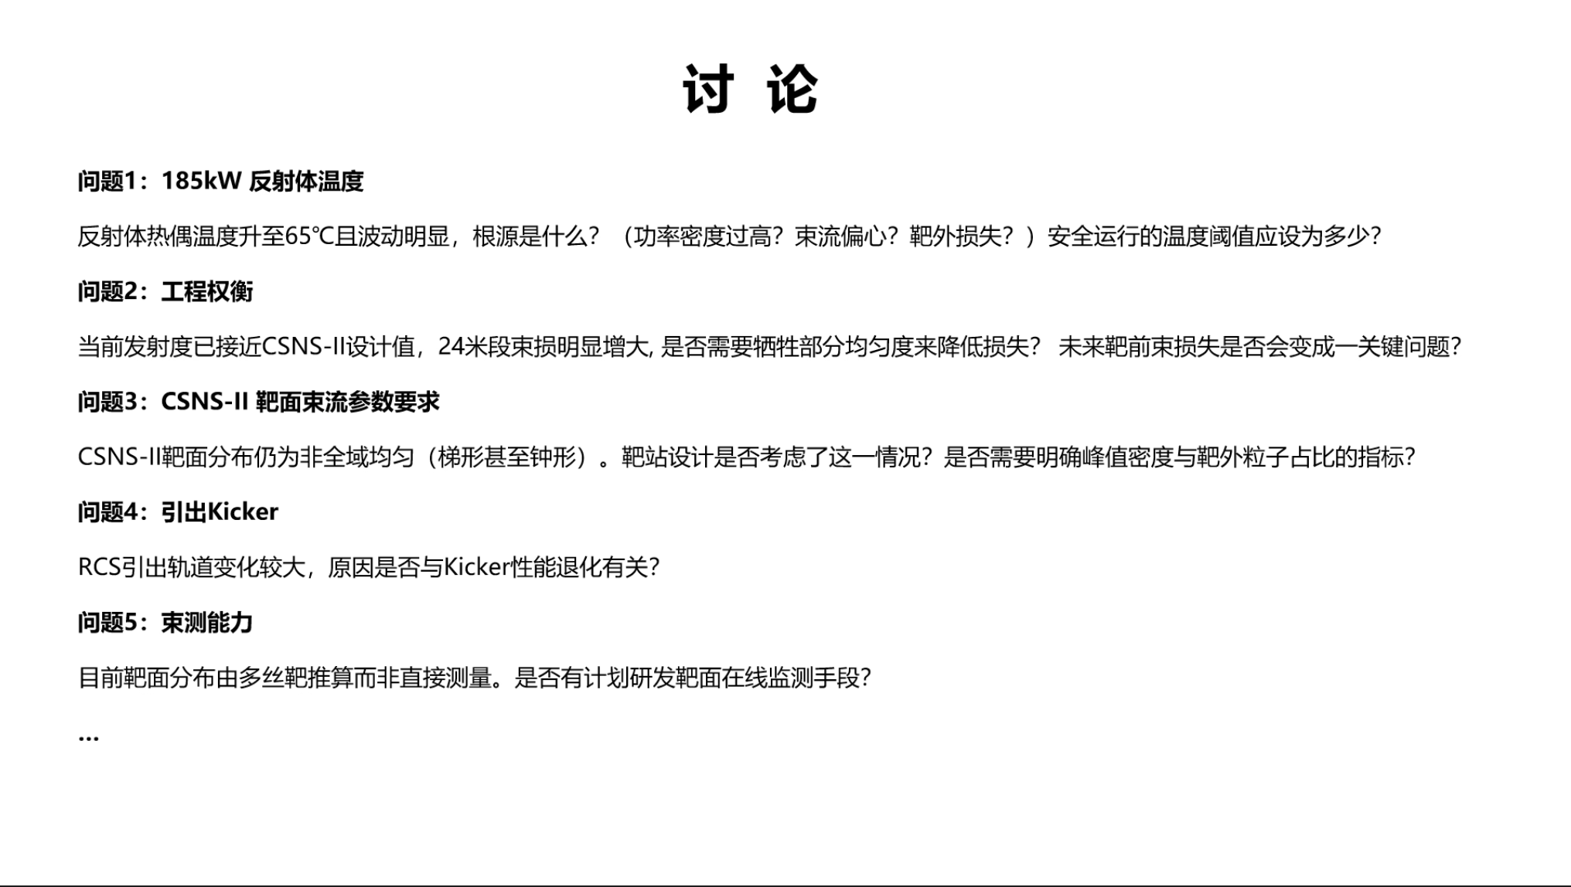
200 kW打靶讨论会
14/04/2026

Slide 3
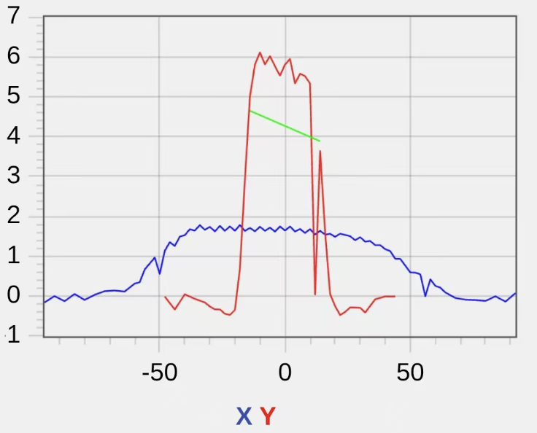
How to calibrate and rescale the wire signal?
Possible solution 1#
Keep beam power and shape at the n-MWS
Move the p+ beam vertically (+y direction) by ~10 mm, locating the weird wire around beam center (flat-top)
Acquire 50 shots p+ beam signals (at least 3 wires, around the weird wire)
Displace p+ beam by another +2 mm & -2 mm, repeat step 3#
determine the rescaling factor by comparing the aver. signal intensity of the 3 wires
Possible solution 2#
Systematic calibration of the all wire signal gain (SEM + analog)
Gaussian beam profile
+Y offset by 10 mm?

