Slide 1
ADC DAQ system firmware
Ming-Kuan Yuan
Fudan University
2026/4/17
Weekly report

Slide 2
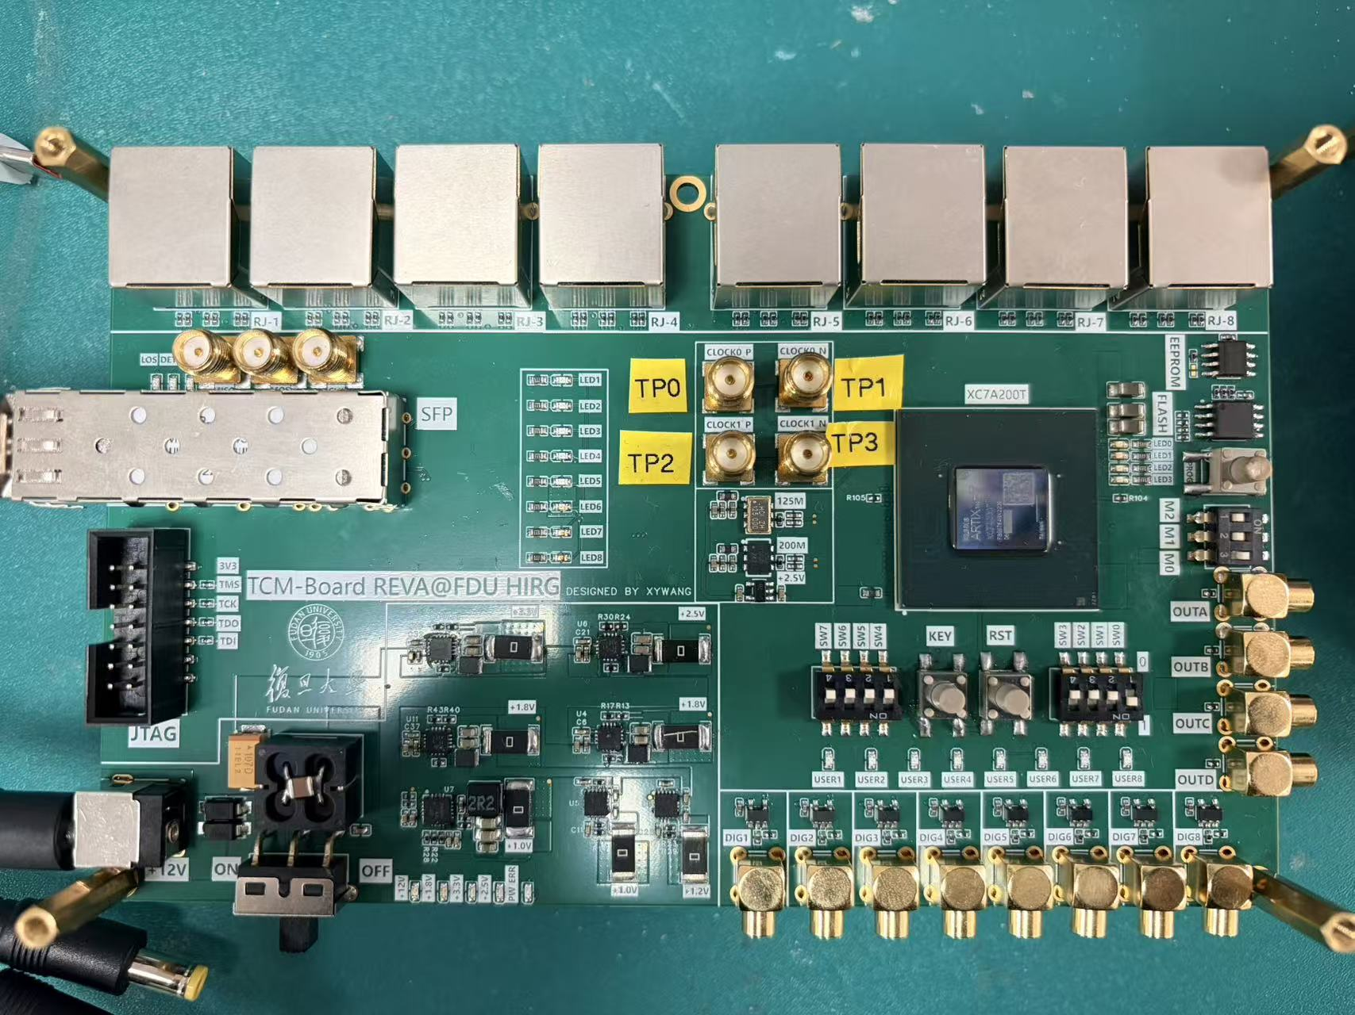
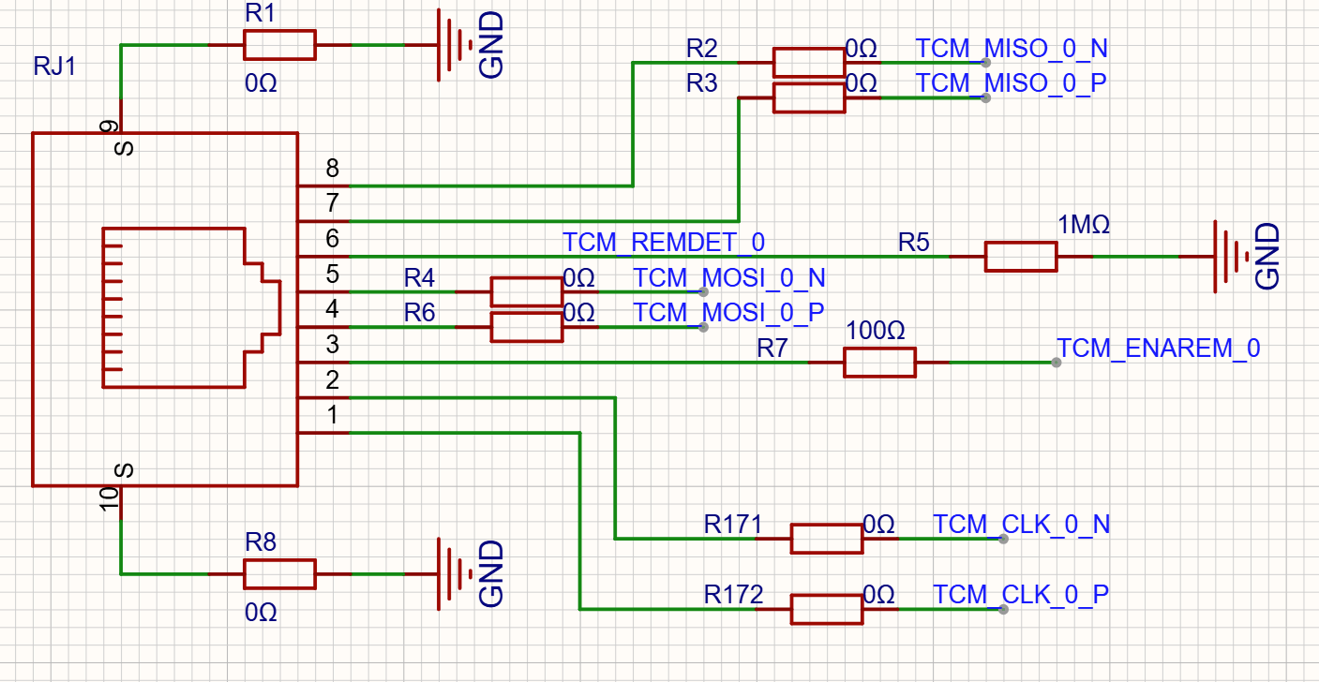
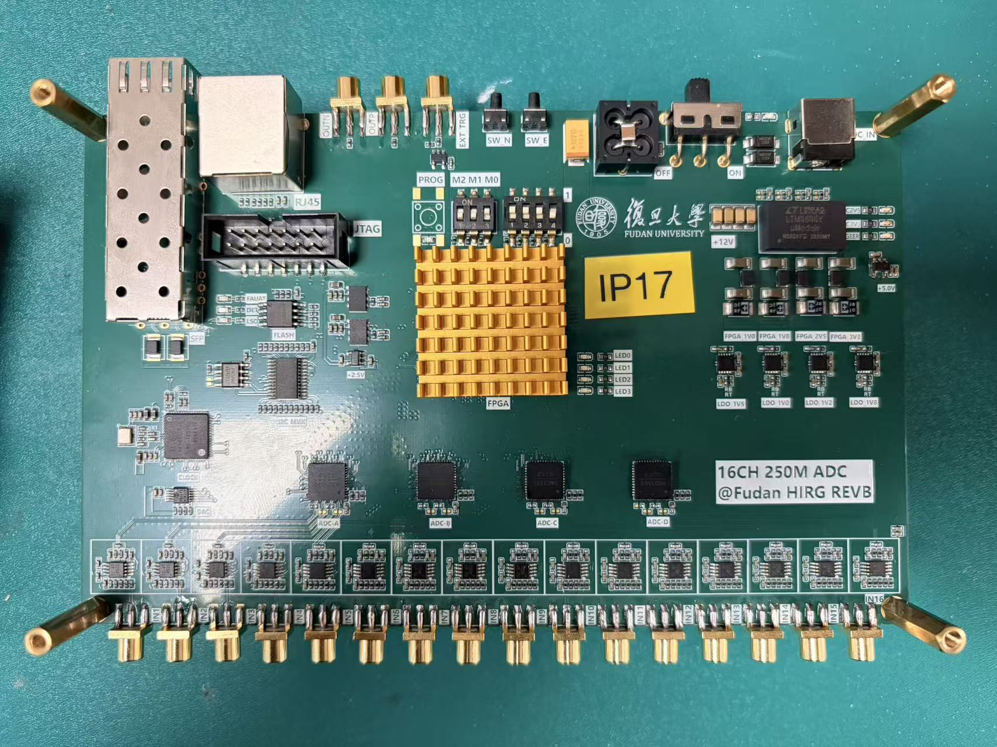
Hardware
Mother board
8 RJ45 connector
Three lvds differential pair
ADC sub-board
RJ45
4 ADC chip
Communication
One lvds for slow control
One lvds for data transfer
One lvds for clock split
Mother board
RJ45 connection
ADC sub-board

Slide 3
Firmware – mother board
Architecture
Mother board
SITCP
UDP
x8
PC
RBCP REG
Packet
dataEncode
To sub-board
Configure files
Ethernet
TCP
x8
Data form sub-board
Events data from FPGA
packet
deformat
dataDecode

Slide 4
Firmware – mother board
Control data frame
SOF0 = 0x5A
SOF1 = 0xA5
EOF = 0xc3
Control frame to sub-board
SOF0, SOF1, ADDR_L, ADDR_H, COM, DATA, EOF
Test
Board = 0, Reg ADDR = 20, COM = 1, DATA = 5A
Board = 0, Reg ADDR = 21, COM = 1, DATA = 5B

Slide 5
Firmware – sub board
Next step: finish configure side on sub-board and test the communication between mother board and sub board.
Architecture
ADC sub board
Clock chip
From mother board
dataDecode
Deformat
SUB_REG
I2C
ADC chip
Trigger
SPI
To mother board
ADC data collection
ADC data
dataEncode
Packet
byteClk = 20M
Num_byte = 4106 byte
Event rate: ~5 kHz

