Slide 1
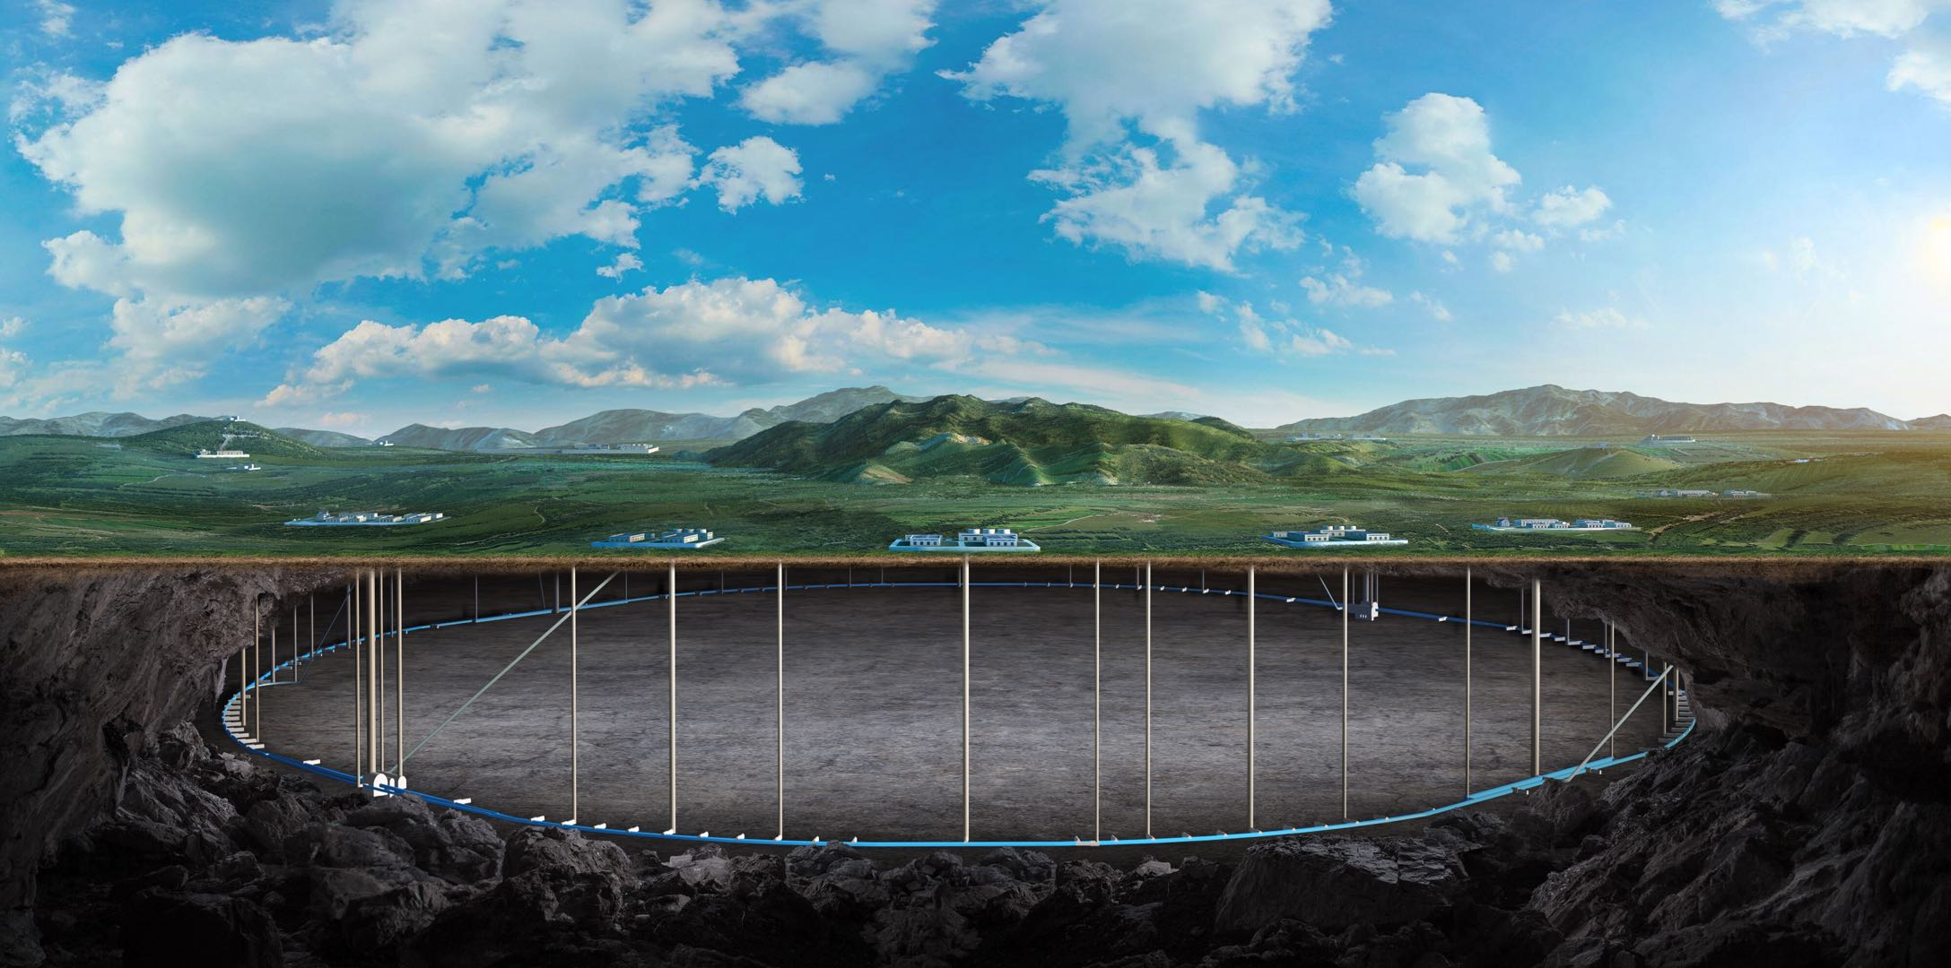


CEPC workshop tracker summary
Zhijun Liang
CEPC Workshop, April 8, 2026, Lisbon, Portugal

Slide 2
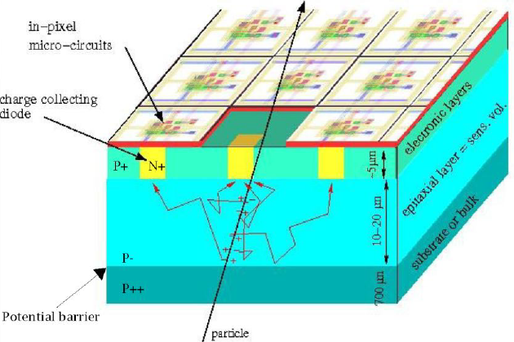
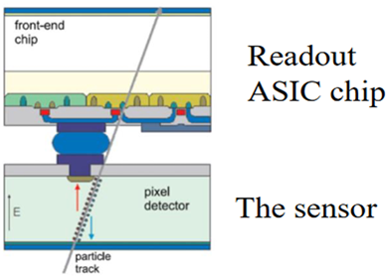
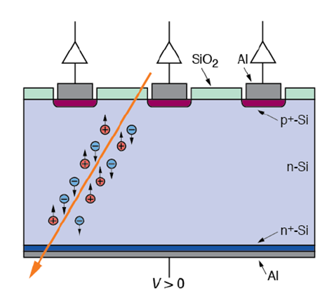
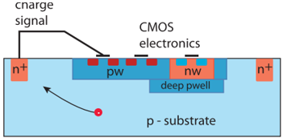
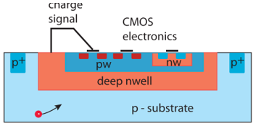
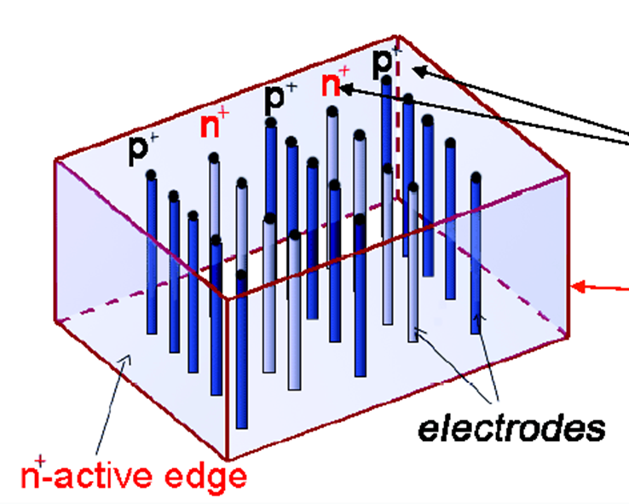
Paths of present silicon sensor R&D
From Gregor’s talk
Monolithic devices
( WG1/WP1-CMOS )
55-180 nm processes
Hybrid devices
(WG2/WP2-4D tracking)
Planar
3D devices
Small electrode device
Large electrode device
MAPS
Large area passive devices
(strips)
With Gain
(LGADs)
Trench
3D
Column 3D
with gain
DepletedMAPS
wo Gain
Depleted MAPS
wo Gain
with gain
proof of concept ongoing
With Gain
Optimized for rates/power/position resolution
Optimized for radiation hardness /timing-efficiency
recent research (working prototype)
proven/demonstrated

Slide 3






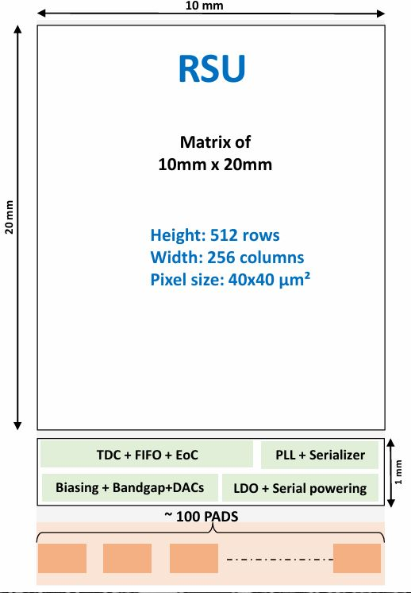
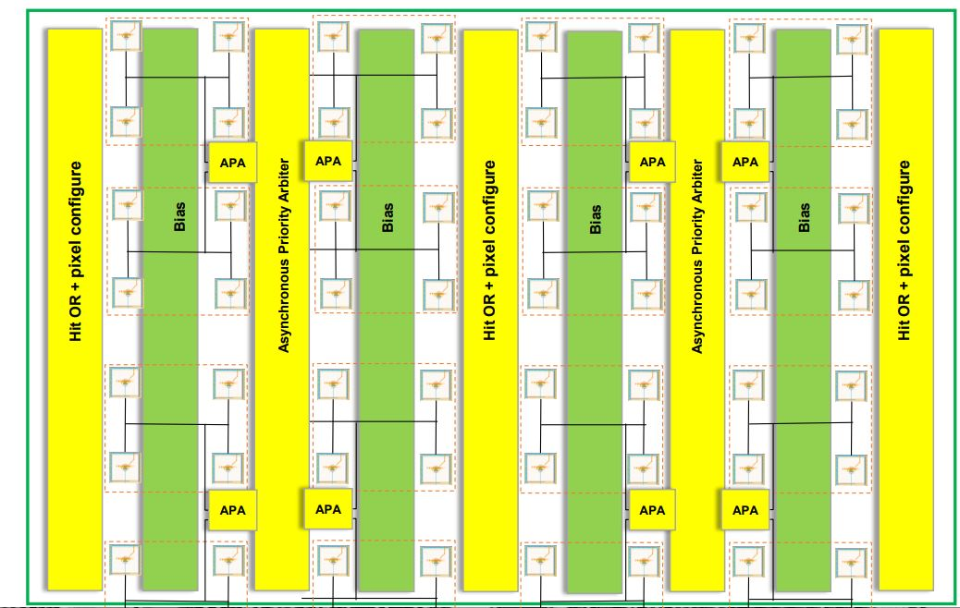
DRD3.1 Project: MANTA
Monolithic Asynchronous sensor for Next generation TrAckers
Key final development goals include:
  ~10µm position resolution
  About 100ps time resolution
  Average power consumption about 20 mW/cm²
Architecture:
Simplified and modular chip design
3-side buttable
Active matrix size : 10 mm x 20mm
Pixel grouping, pitch : 40µm
  Diode pitch: 20µm
  Digital grouping / Analog grouping
  Analog front-end :DPTS
Asynchronous Priority Arbiter
Single-Layer Multiplexer Variants
FastOR: for high-precision time stamping
  High-Resolution TDC : ~70ps
Submission plan :
  MANTA0: ER3 – Q3 2026
  MANTA1: MPR2 – Mid 2027
From Danwei’s talk
Significant overlap of IP blocks between MANTA and OCTOPUS
22/04/2026
xudanwei@cppm.in2p3.fr
3

Slide 4
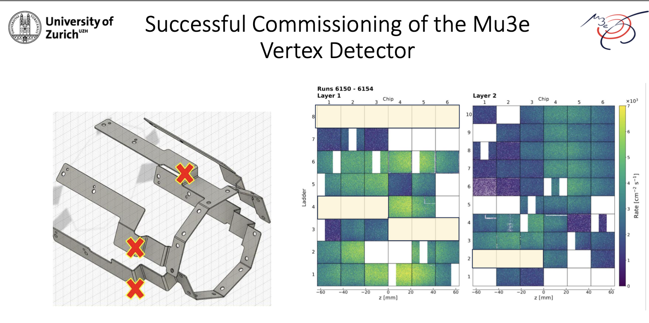
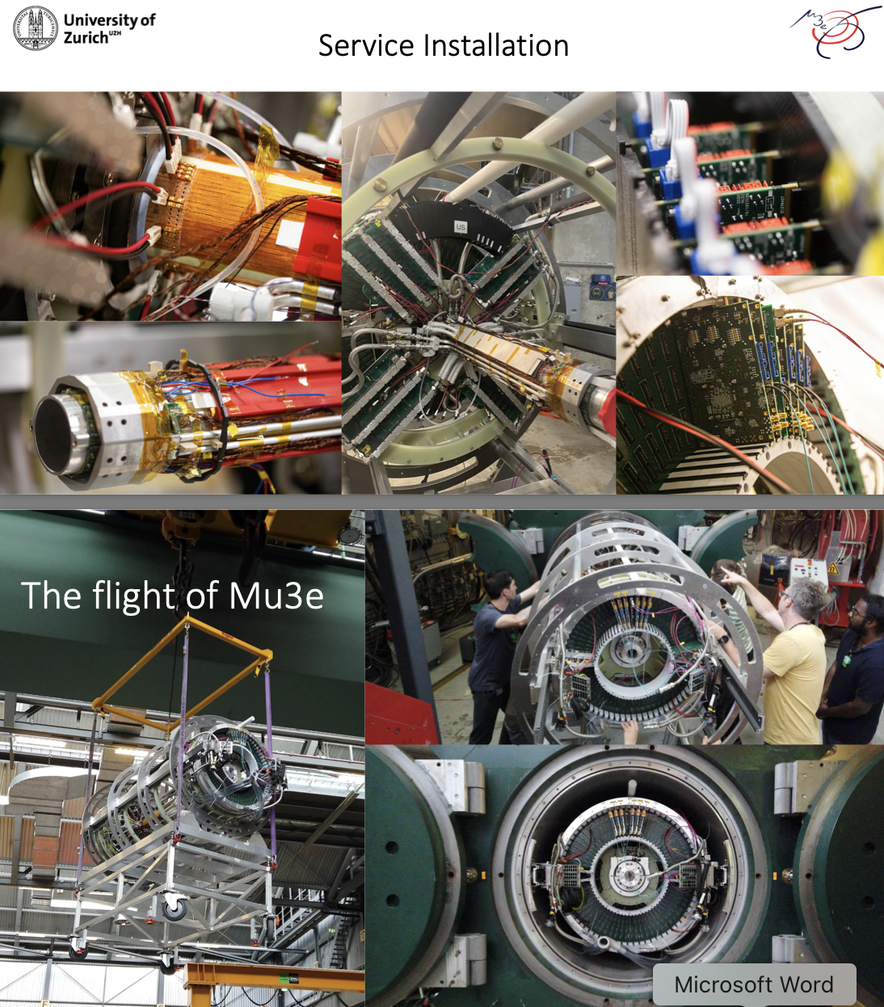
Vertex detector for Mu3E
df
From Thomas’s talk for Mu3e vertex detector

Slide 5
CEPC vertex detector Working plan
Development of 1st engineering run using MAPSs with HC90L 90nm technology
  Prototype full size RSU-like sensor
  Validate sensor and electronics performance without stitching
  Expect to finalize the design by the end of 2026
Work together with mechanics group on thermal mockup
  Test air cooling and the vibration
Longer term: Explore CIS stitching MAPSs sensor with HC90L 90nm
Final goal: Built prototype close to ref-TDR design

Slide 6
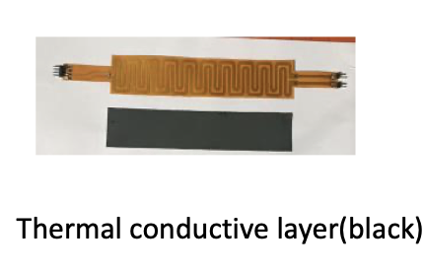
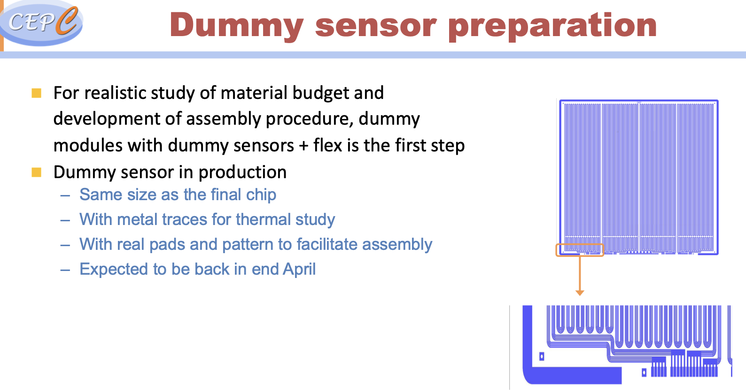
Vertex detector discussion
Discussion on cooling mockup for vertex detector
  Current plan with flex PCB, will likely to switch to silicon heater (Yiming’s talk)
Discussion about proposing HC90L technology in DRD3
Cabling may learn from Mu3E vertex prototype

Slide 7
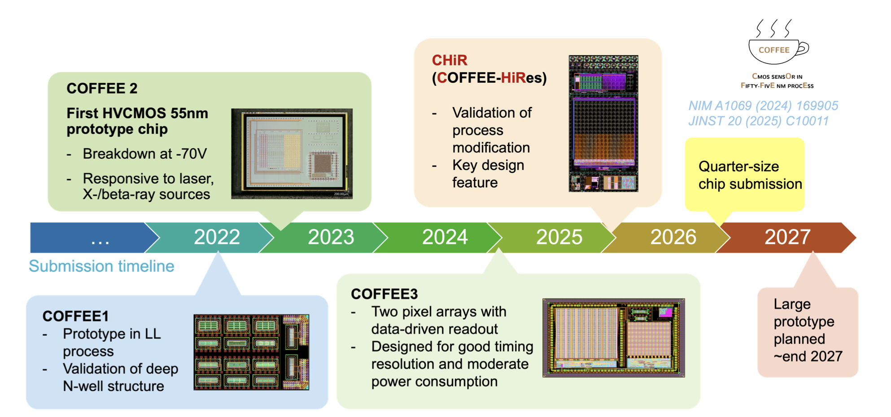
CEPC Inner tracker
ITK chip development plan by Yiming well received.
Gregor asked us to finish DRD3 proposal

Slide 8
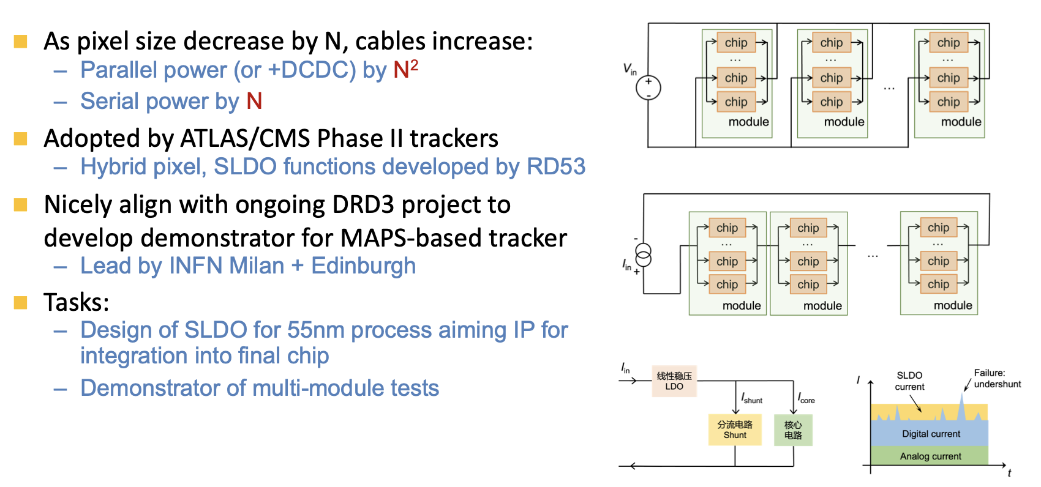
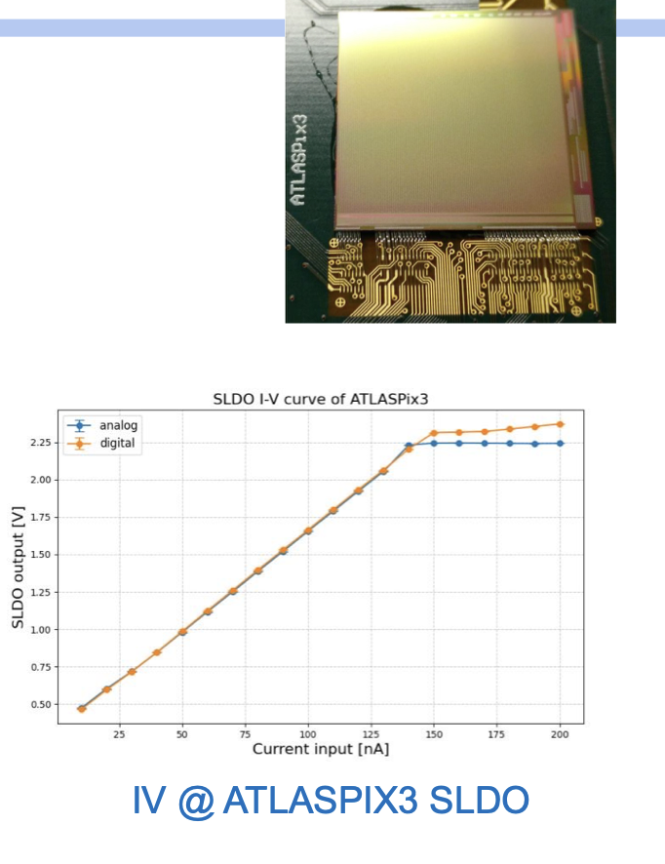
Serial powering for tracker
Collaboration with UK colleagues on serial powering
Validation with ATLASPix setup

Slide 9
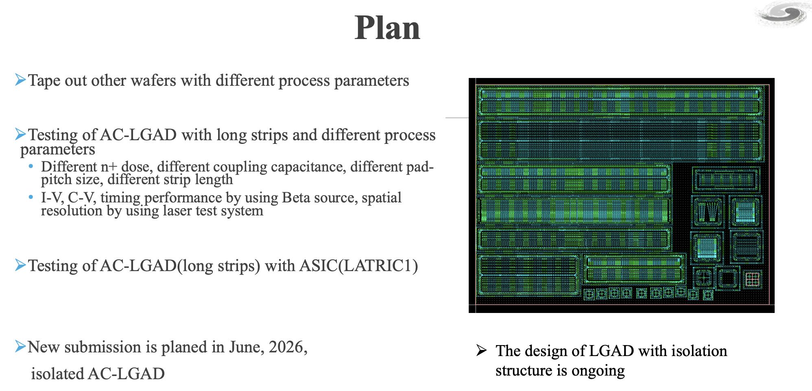
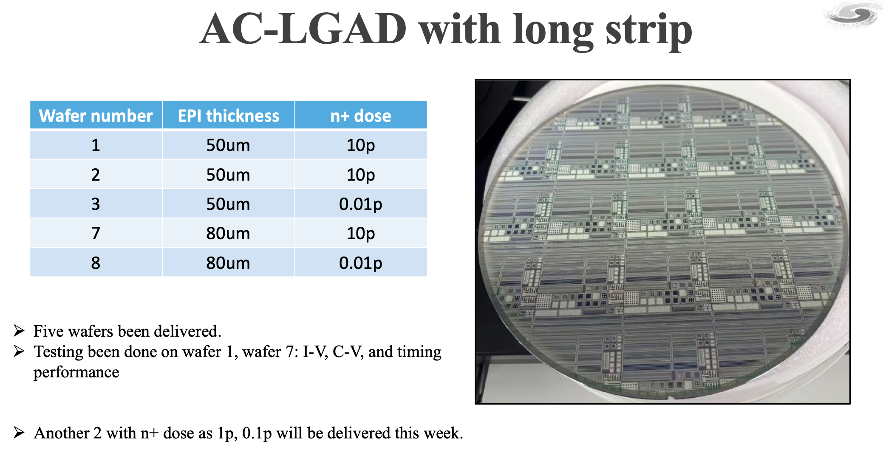
CEPC OTK
Mei Zhao’s talk
Gregor’s comments:
  Suggest to share with more groups for testing.
  More groups can cross check each other, make sure we understood sensors.
  Take times to tests new AC-LGAD in details before next submission
Other suggestion
  Use stitching to make longer strip ( 10cm )

Slide 10
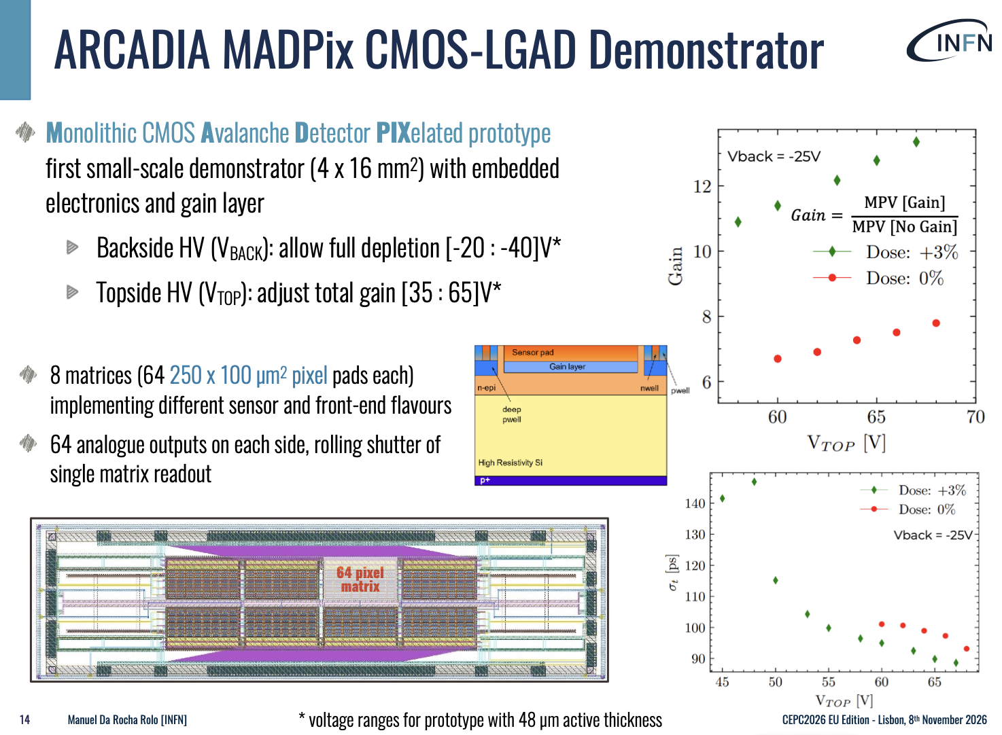
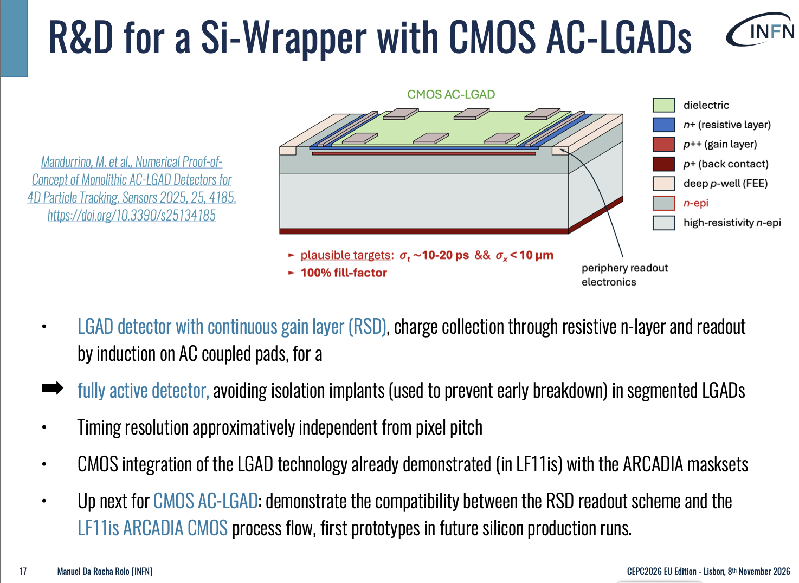
CMOS-LGAD development
INFN colleague presented nice result from CMOS-LGAD.

Slide 11
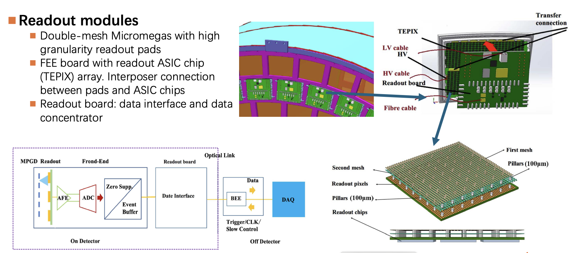
CEPC TPC
Received some requests to increase the size for Micromegas.
From mingyi: It is possible, but there is some risk

Slide 12
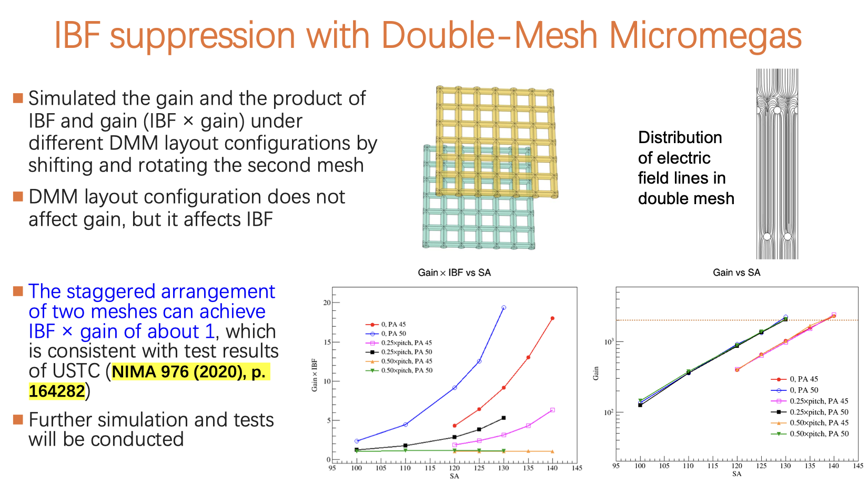
IBF for CEPC TPC
INFN colleague interested in IBL study, raised lots questions on it.

Slide 13
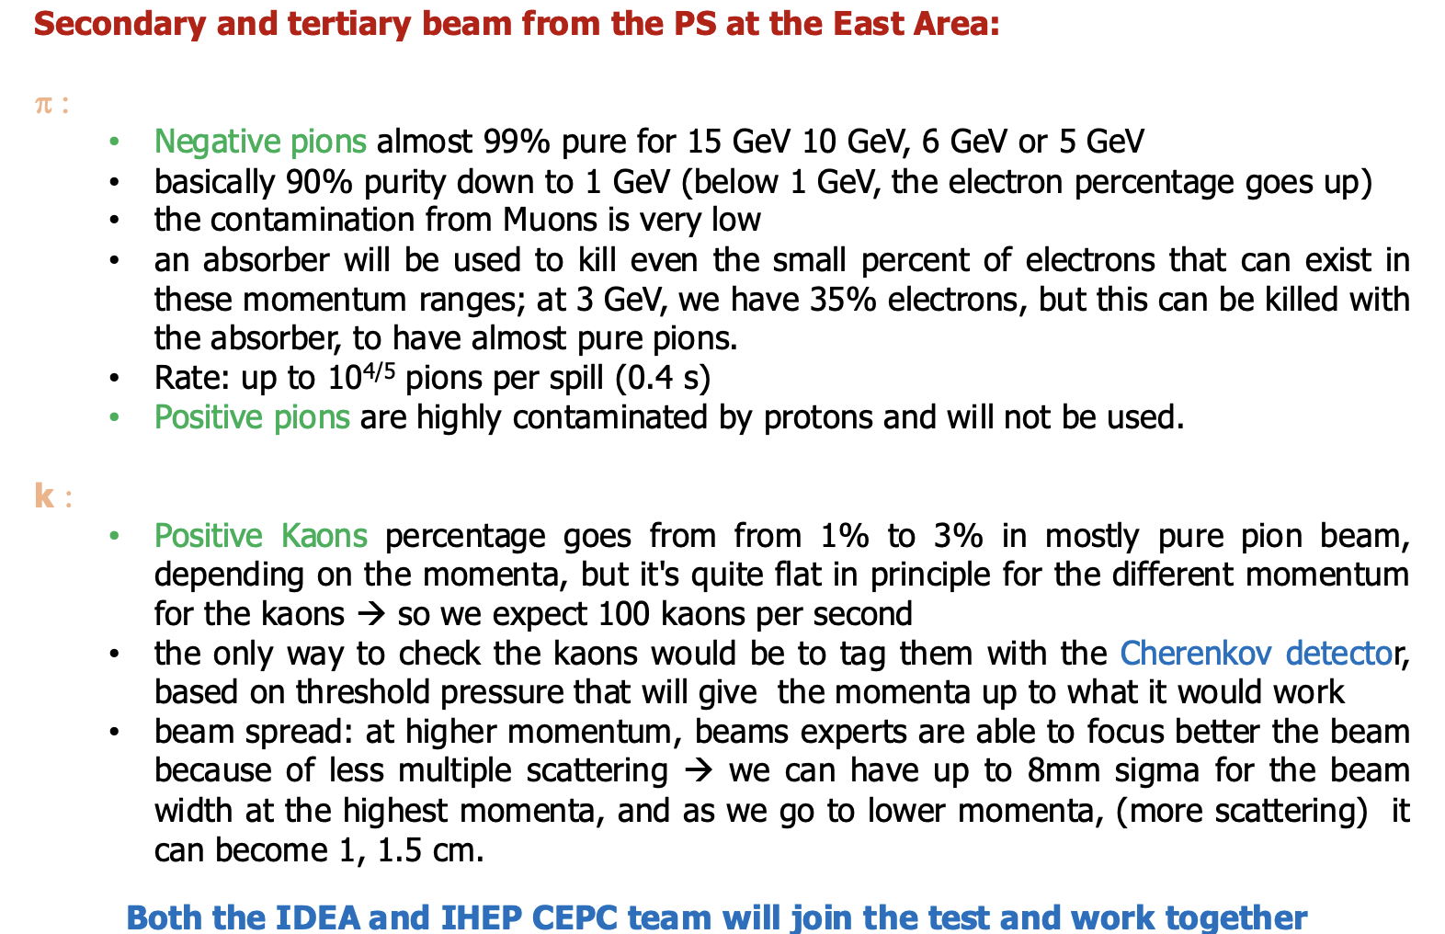
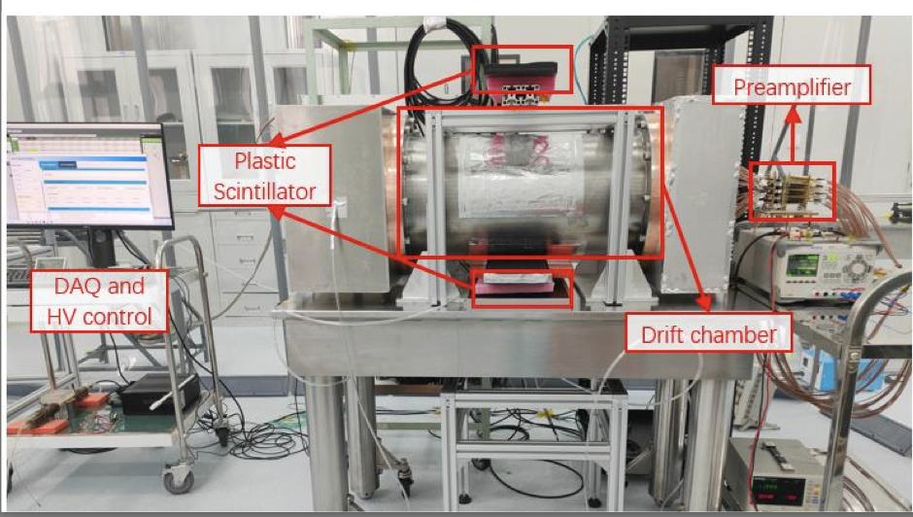
CERN Beam test for drift chamber in 2026

Slide 14
Summary
Lots of useful discussion on technology
Consolidation on international collaboration in tracker development
  Test beam for drift chamber …
  Write more proposal for DRD

Slide 15
Backup

Slide 16
technology for next R & D of CEPC vertex
Next step foundry: SK hynix system fab in Wuxi China (90nm technology with stitching feasibility
 | Requirements | TPSCo 65 nm | HLMC 55 nm | HC90L
Feature size | 55 – 90 nm | 65 nm | 55 nm | 90 nm
Epitaxial layer thickness | 10 - 25 μm | 10 μm | 3-5 μm | 4 – 8.5 μm (default) Can be changed to 20μm
Resistivity of epi-layer | > 1 kΩ•cm | ~130 Ω•cm | Low resistivity ~10 Ω•cm | 30-50 Ω•cm (default) Can upgraded to 5kΩcm
Availability of deep N-well | Yes | Yes | Yes | Yes
Availability of deep P-well | Yes | Yes | Yes | Optional
Numbers of metal layers | > 6 | Max. 7 | Max. 5 | Max. 5
Availability of stitching | Yes | Yes | Yes | Yes
Cost (NRE) |  | ~7.0 M RMB | ~6.0 M RMB | 2~3 M RMB

Slide 17
DRD1 Working Groups (WG): Highlights

