Slide 1
Summary and Highlights of Calorimeters in EU CEPC Workshop Lisbon, Portugal, April 7-10, 2026
Yuekun Heng
Institute of High Energy Physics, CAS
On behalf of CEPC calorimeter team

Slide 2
Outline
Intro: Physics and experiments requirements
Highlights of calorimeter talks
Summary

Slide 3
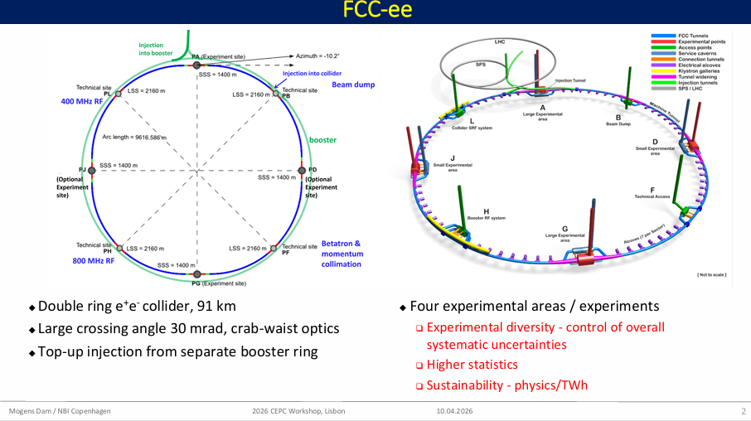
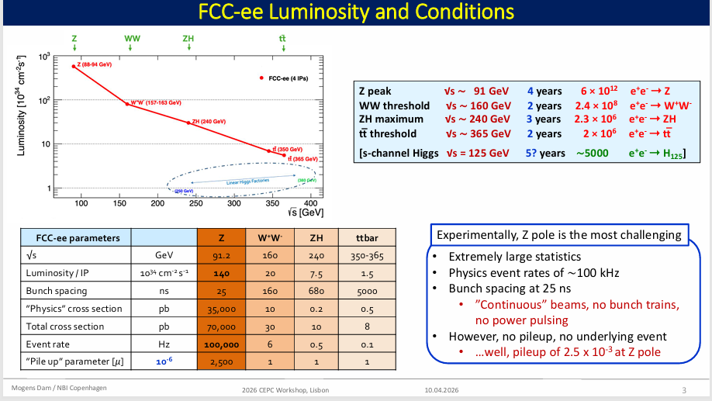
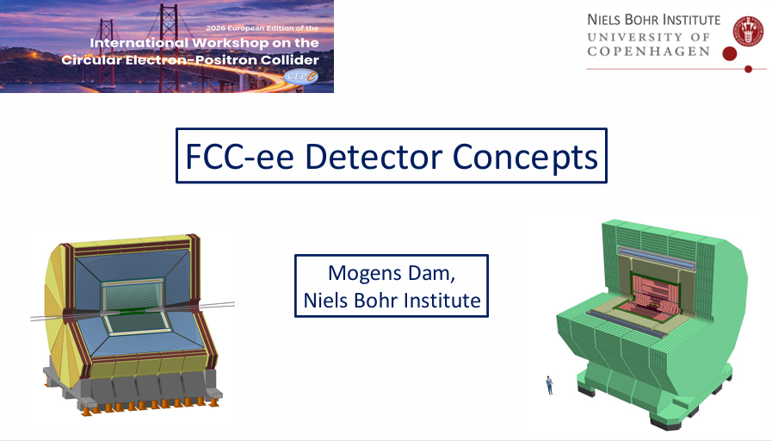
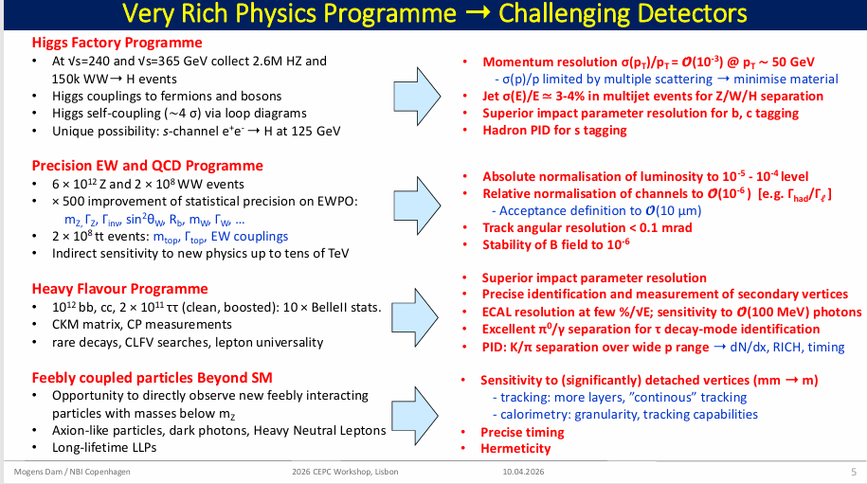
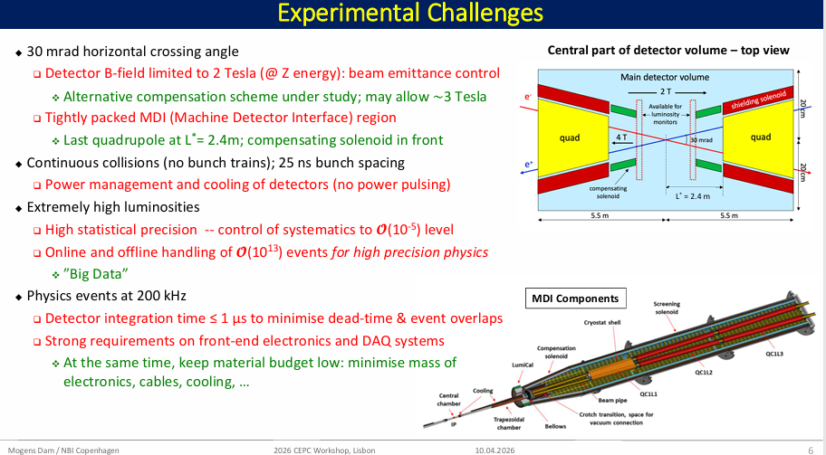
FCC-ee

Slide 4
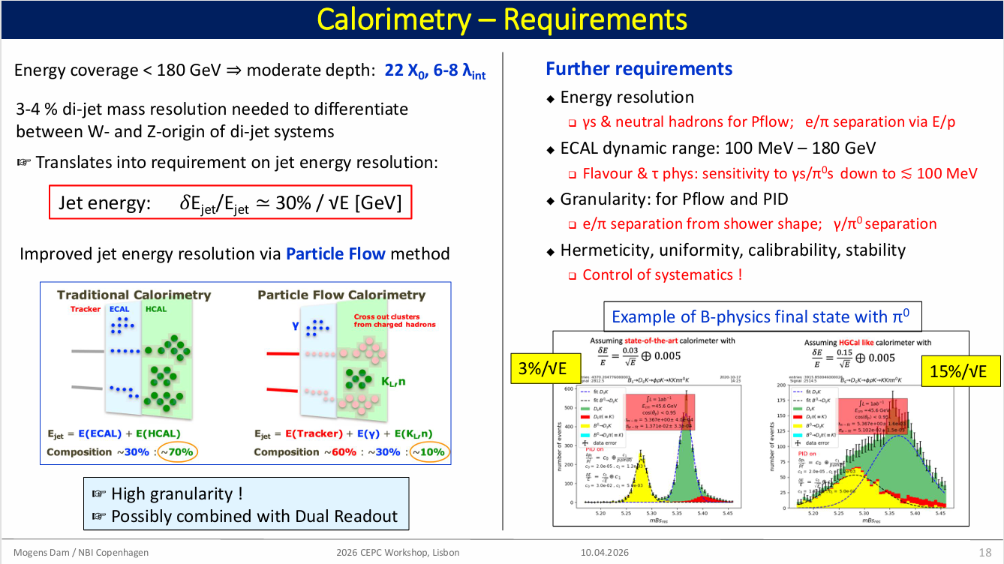

Slide 5
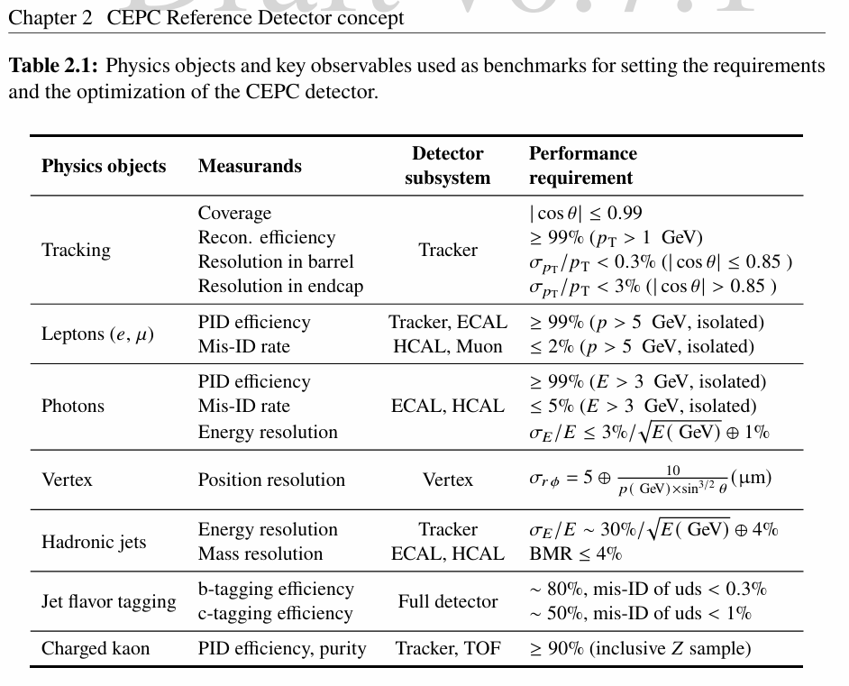
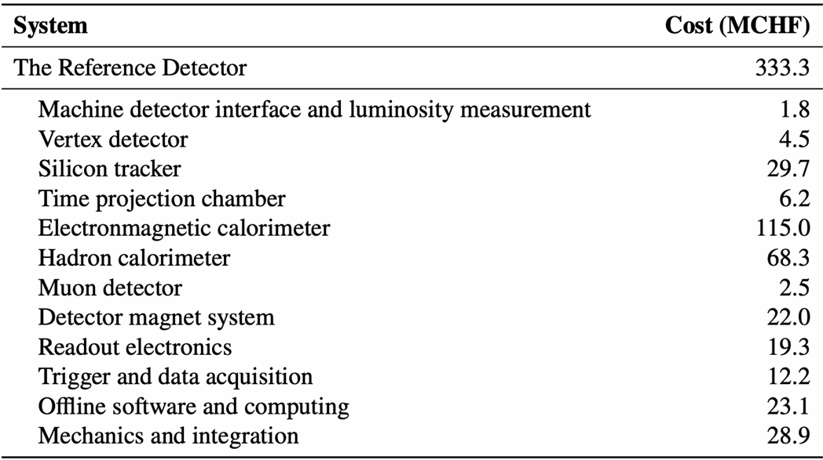
Detector requirements and cost in Ref-TDR

Slide 6
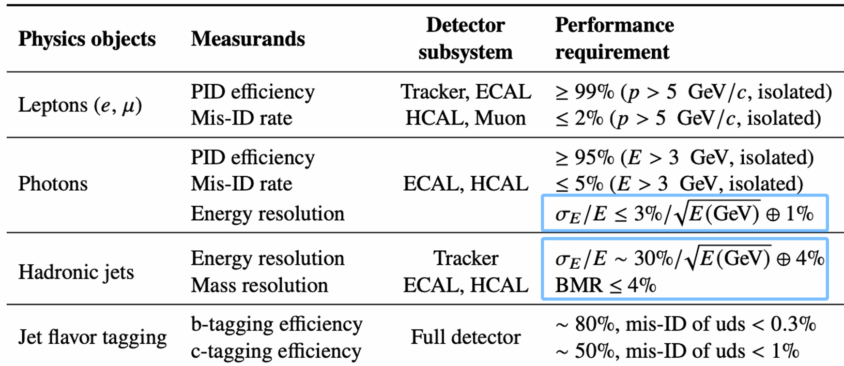
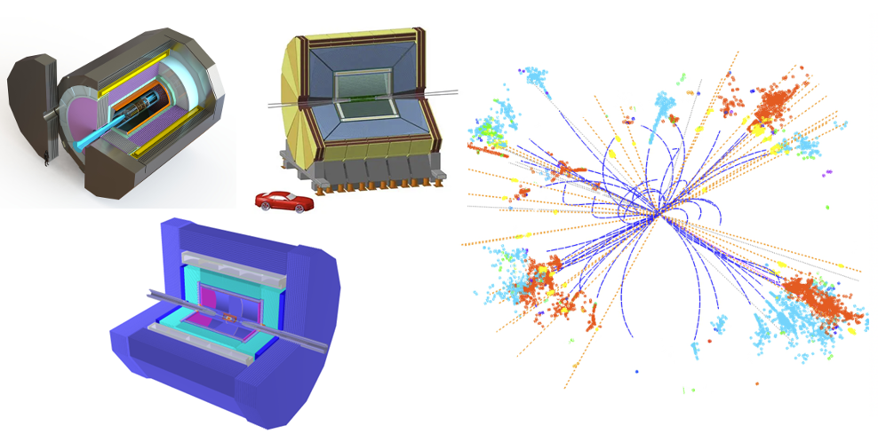
Requirements of PFA Calorimetry
Using the full detectors for ultimate performance
5D calorimeter with PFA, crucial for achieving high-precision jet reconstruction and boson mass
Energy reso.: neutral particle energy providing γ, π⁰(2γ) / K_{L}, n
Spatial reso.: granularity w/ transverse and longitudinal unit size
Timing: help to shower separation and PID

Slide 7
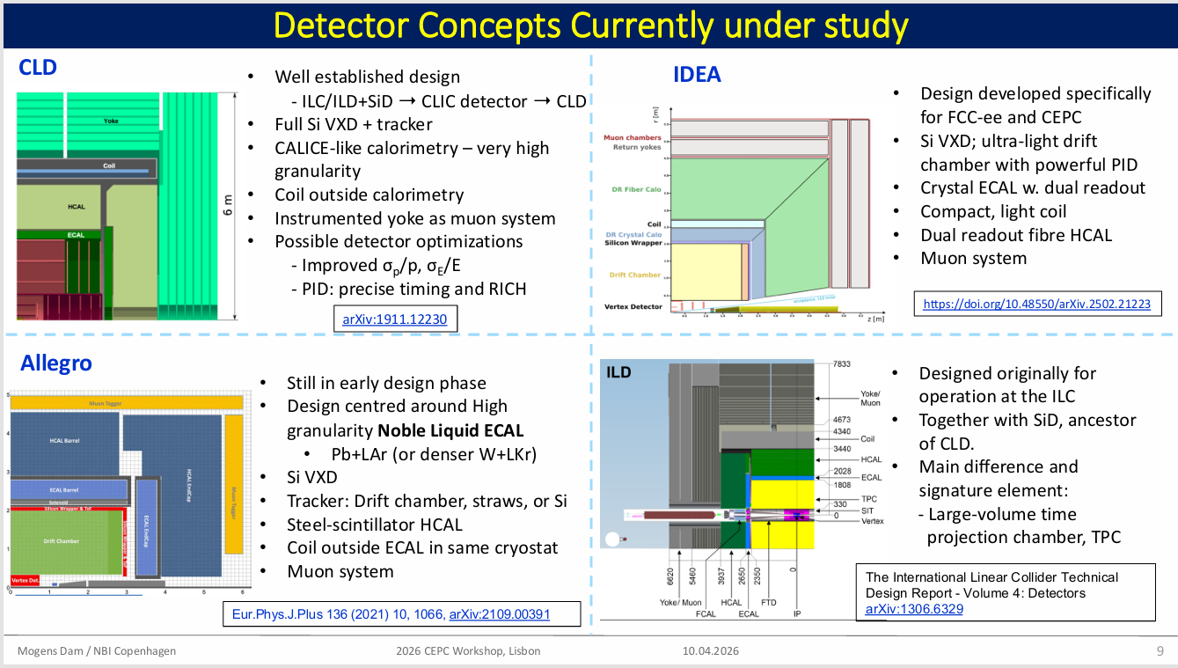
FCC-ee
Outer Coil
Middle Coil
Outer Coil
Inner Coil

Slide 8
Some highlights of calorimeter talks

Slide 9
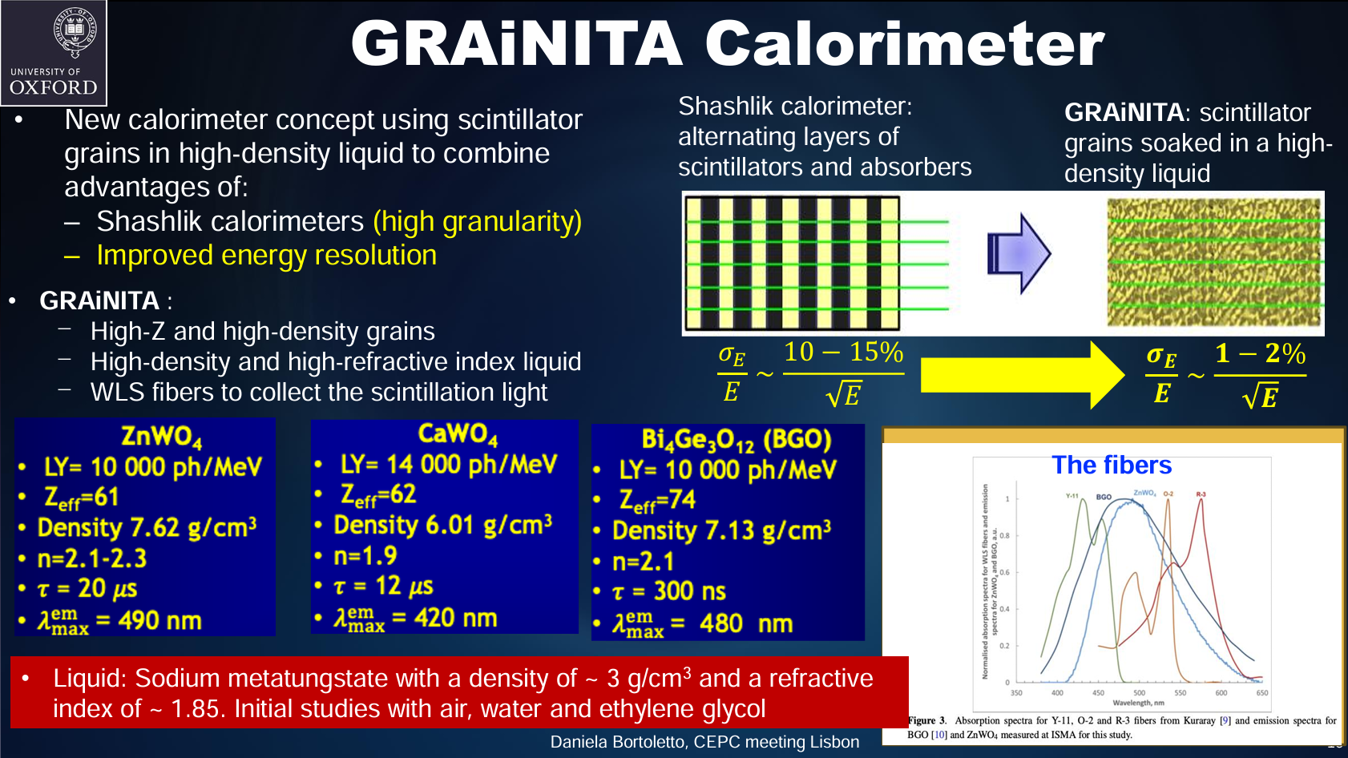

Slide 10
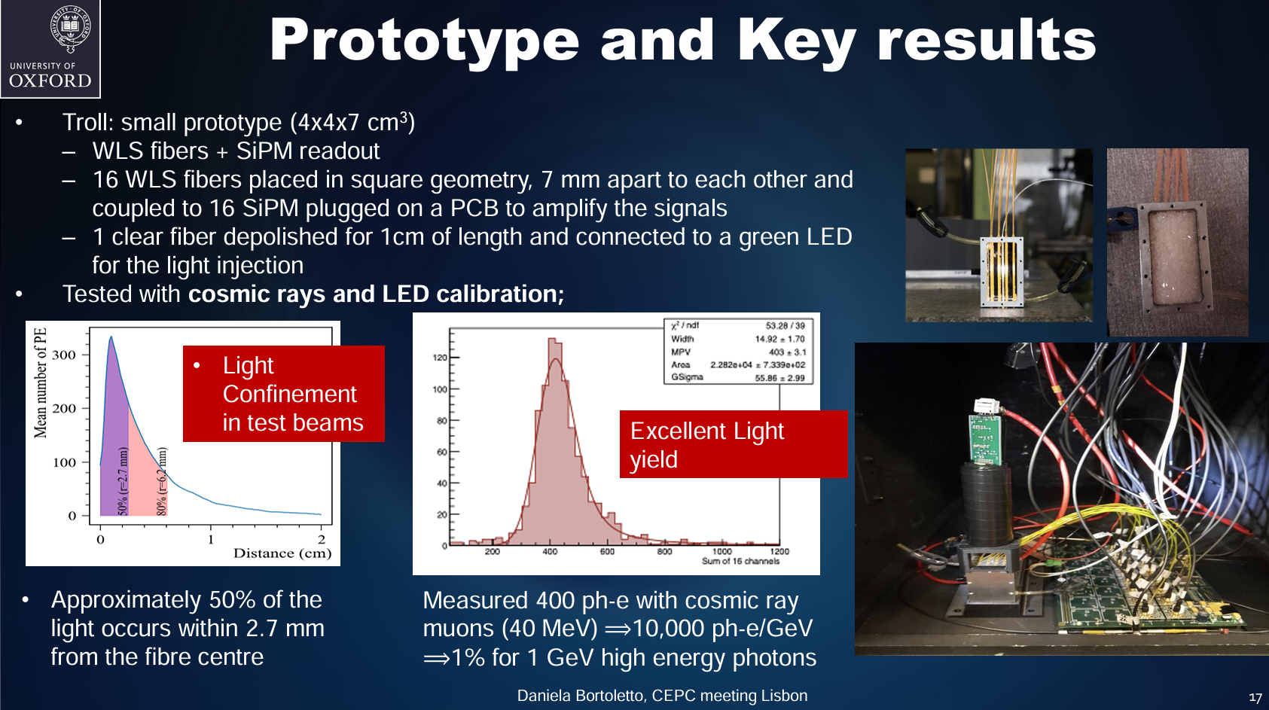

Slide 11
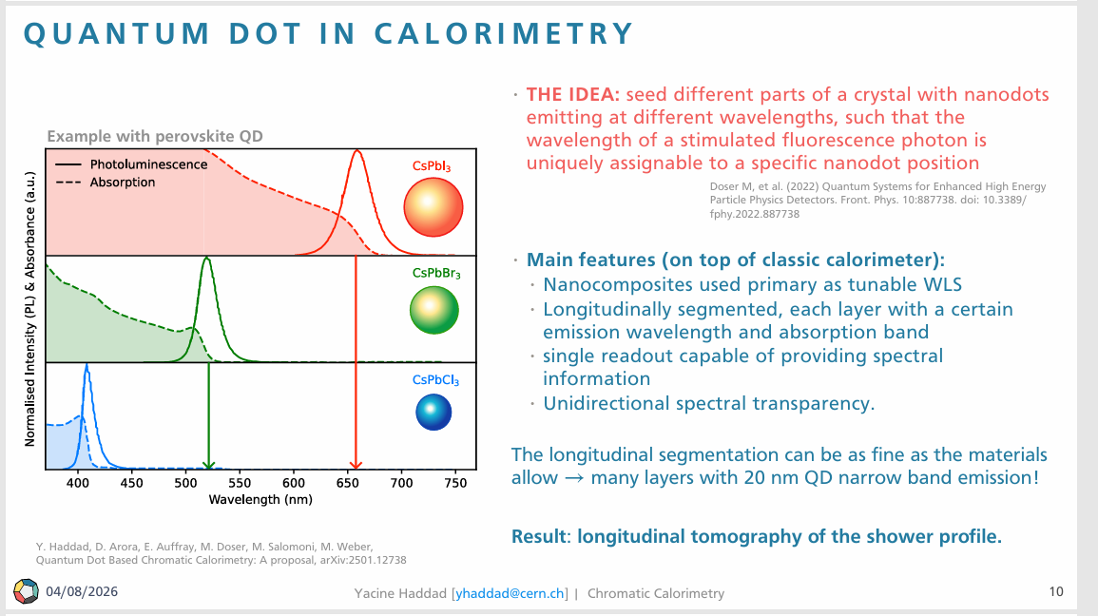
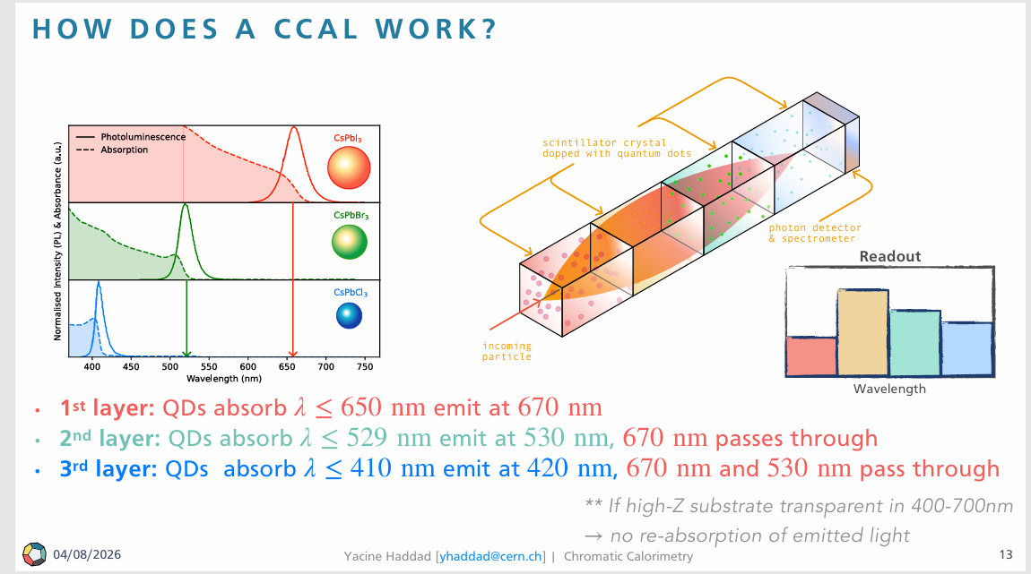
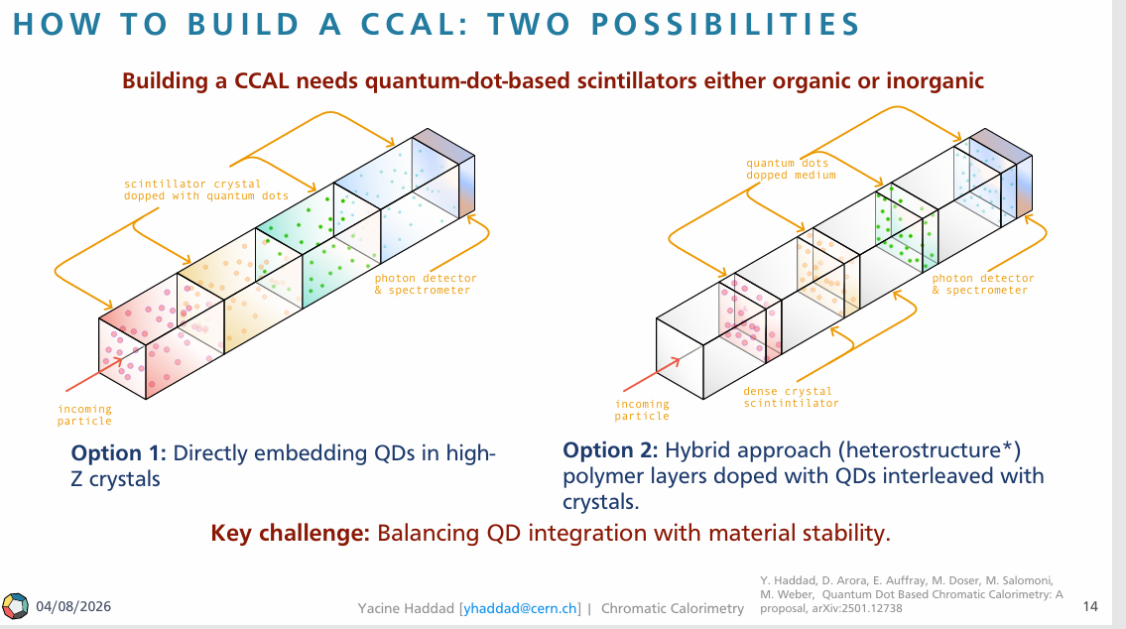
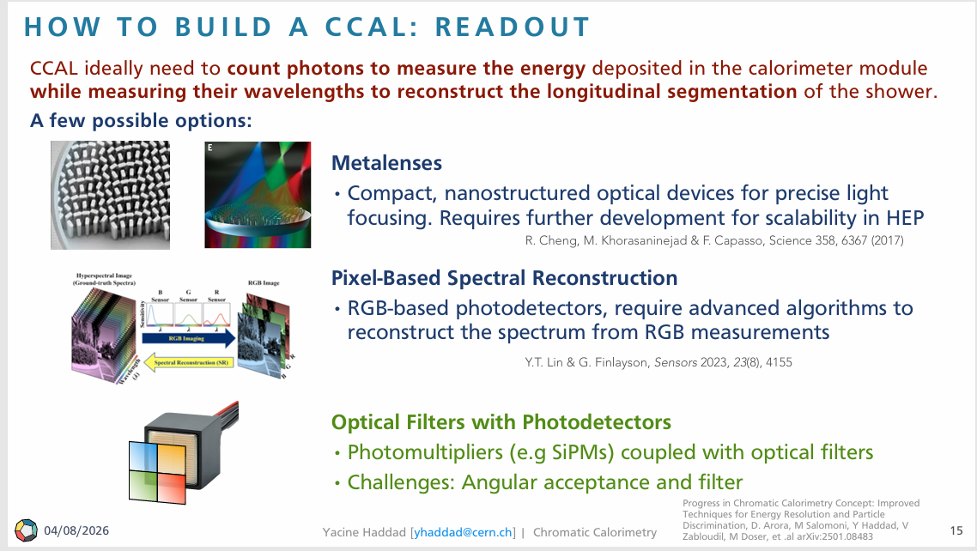
QUANTUM DOT-BASED CHROMATIC CAL
CALORIMETRY
Yacine Haddad
University of Bern, CERN, European Organization for Nuclear Researc
CHROMATIC
CALORIMETRY

Slide 12
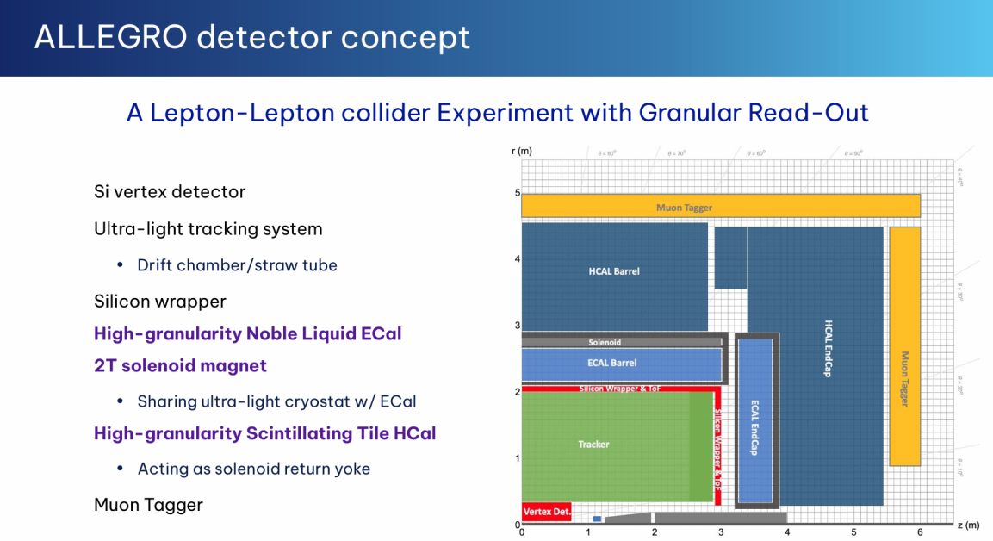
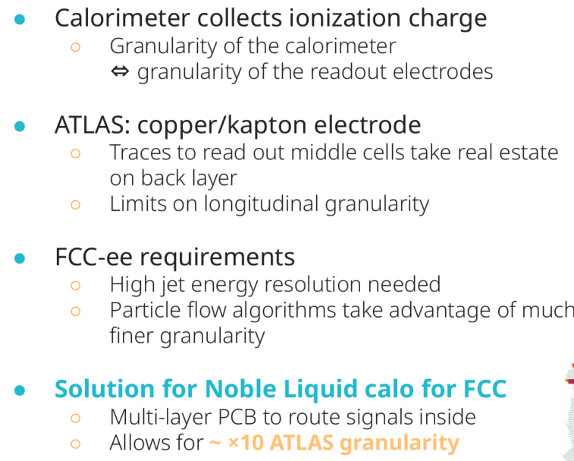
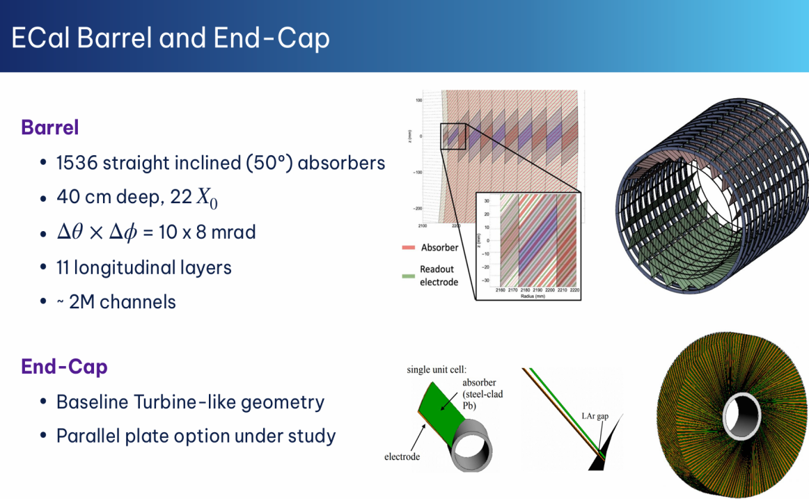
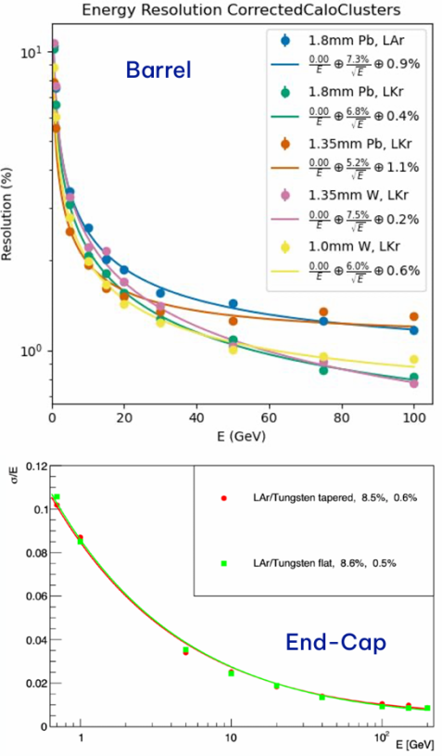
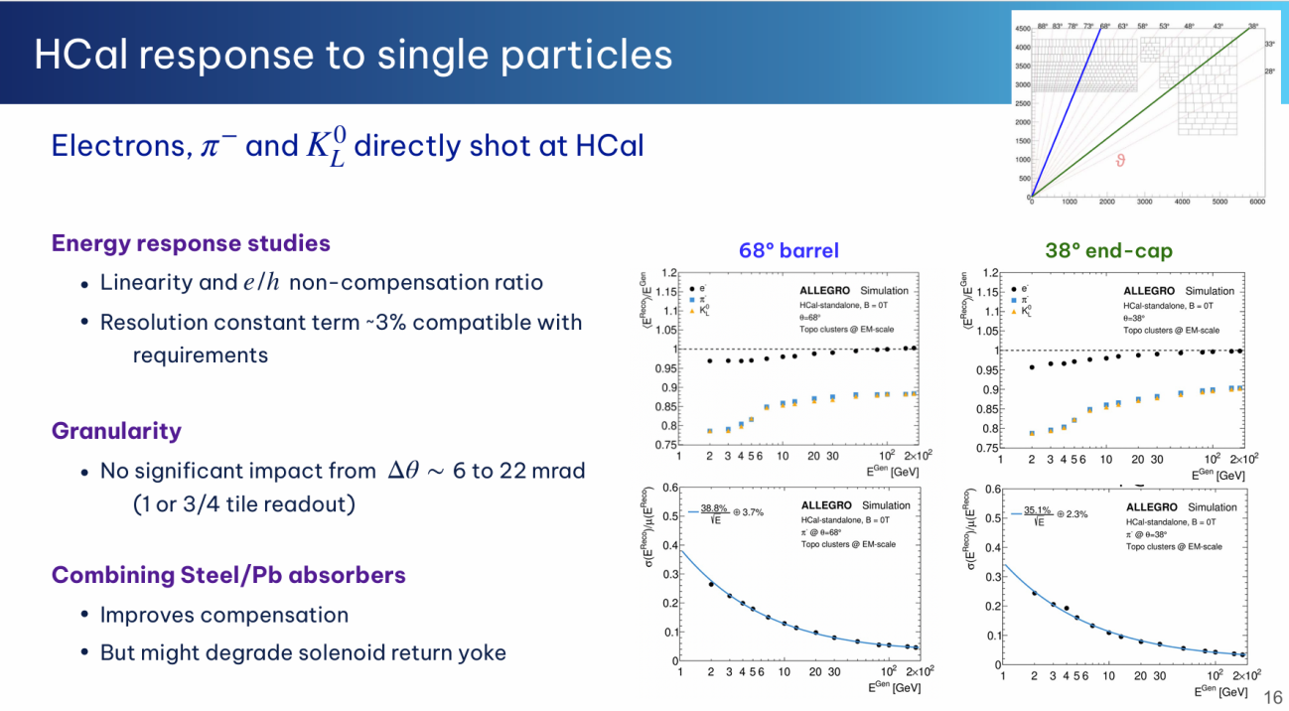
ALLEGRO Calorimeter project by Rute Pedro
Relative permeability：iron/steel: μ_{r​}≈1000∼2000，Lead μ_{r}​≈1

Slide 13
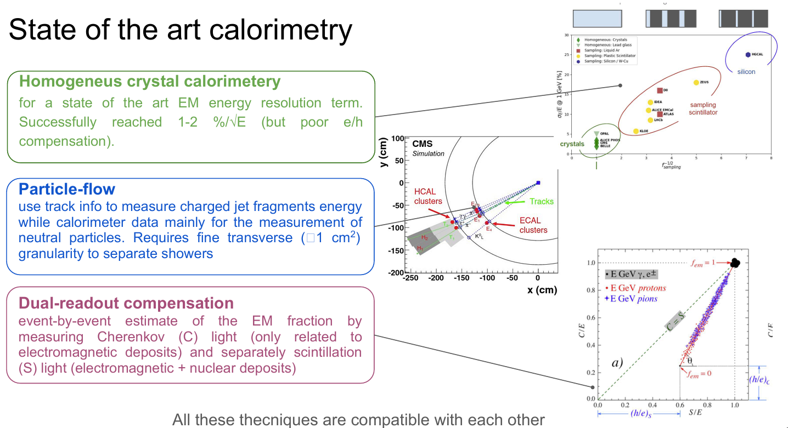

Dual-Readout Calorimetry for future e+e- colliders by Marcello Campajola
Cherenkov signal: electromagnetic-only sensitivity
Scintillation signal: sensitivity to both electromagnetic & hadronic deposits, with intrinsic e/h non-compensation​

Slide 14
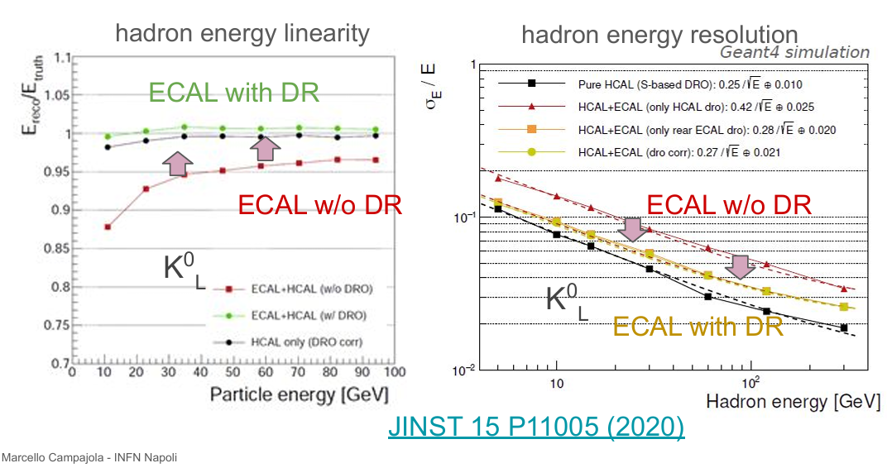
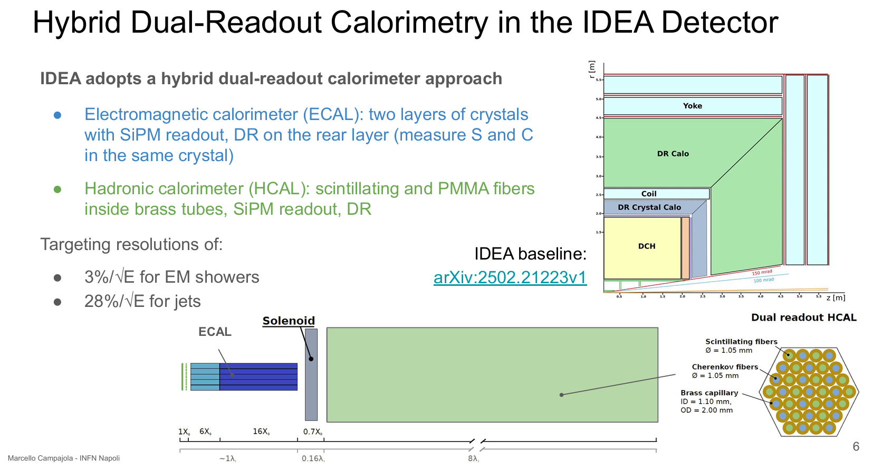
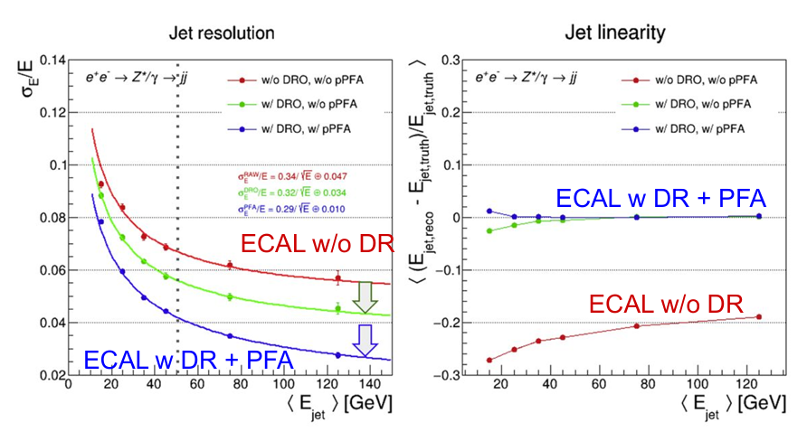

Hybrid Dual-Readout Calorimetry, baseline the IDEA Detector

Slide 15
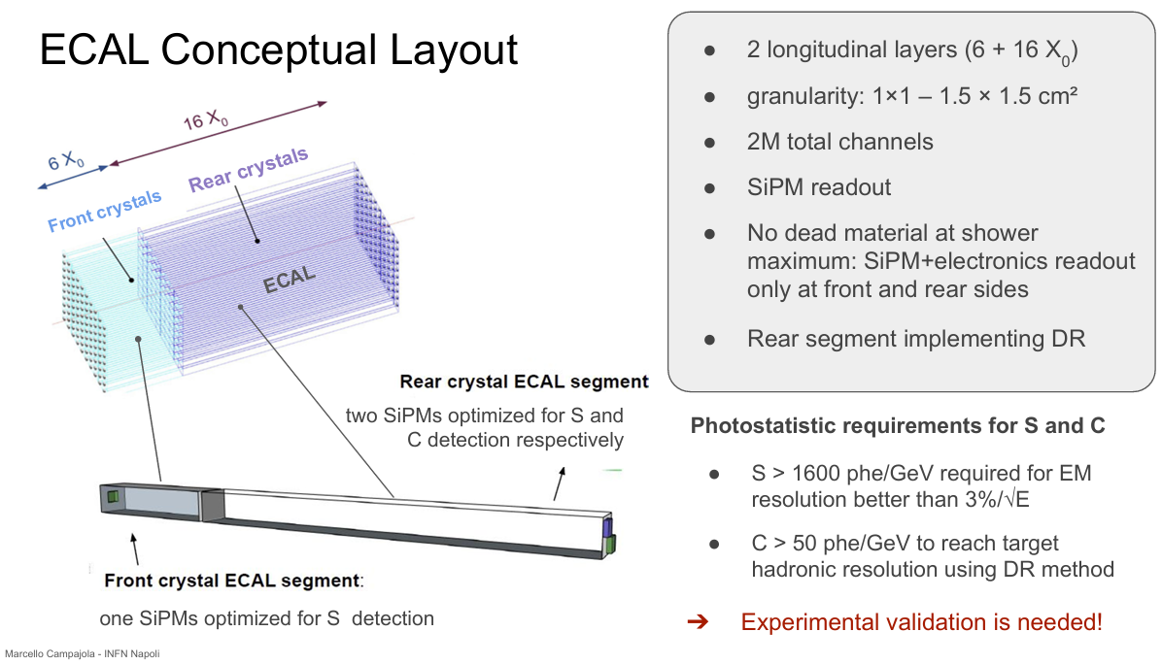
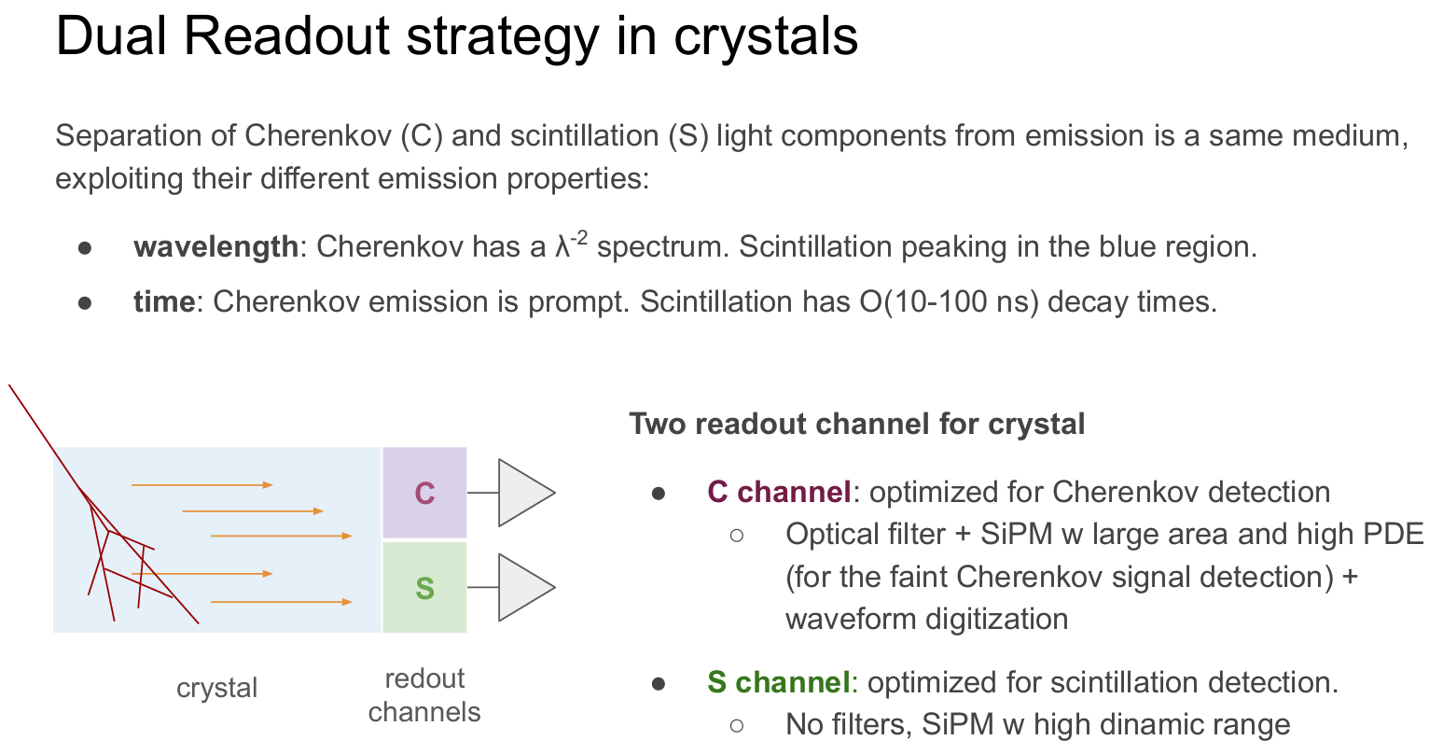
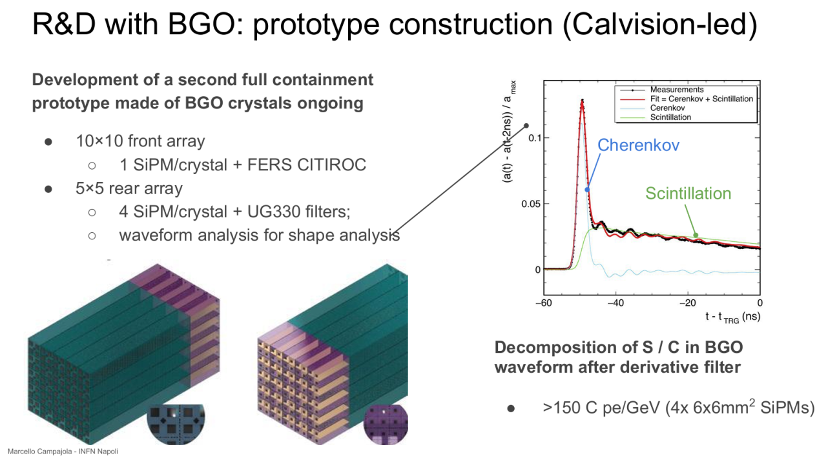
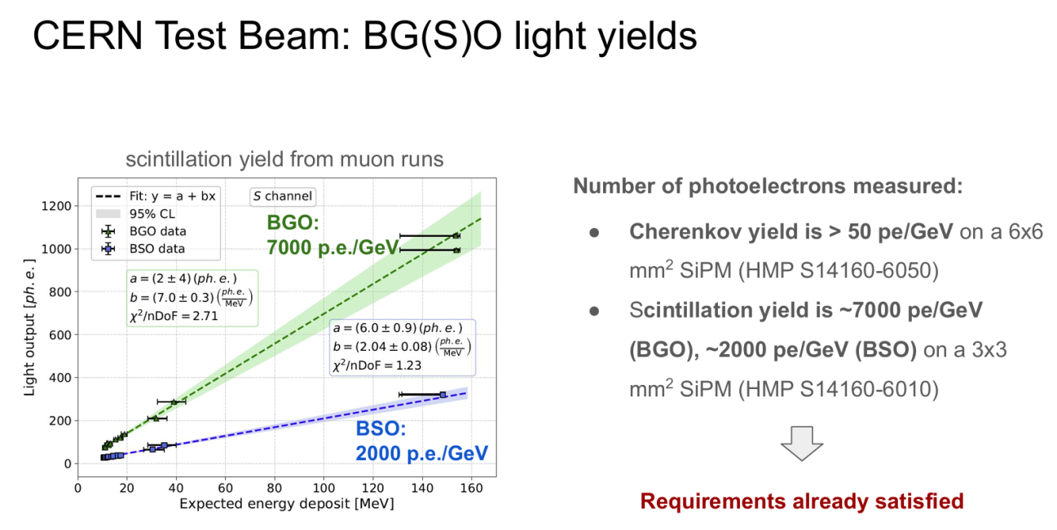
Dual-Readout Crystal Calorimetry by Rute Pedro

Slide 16
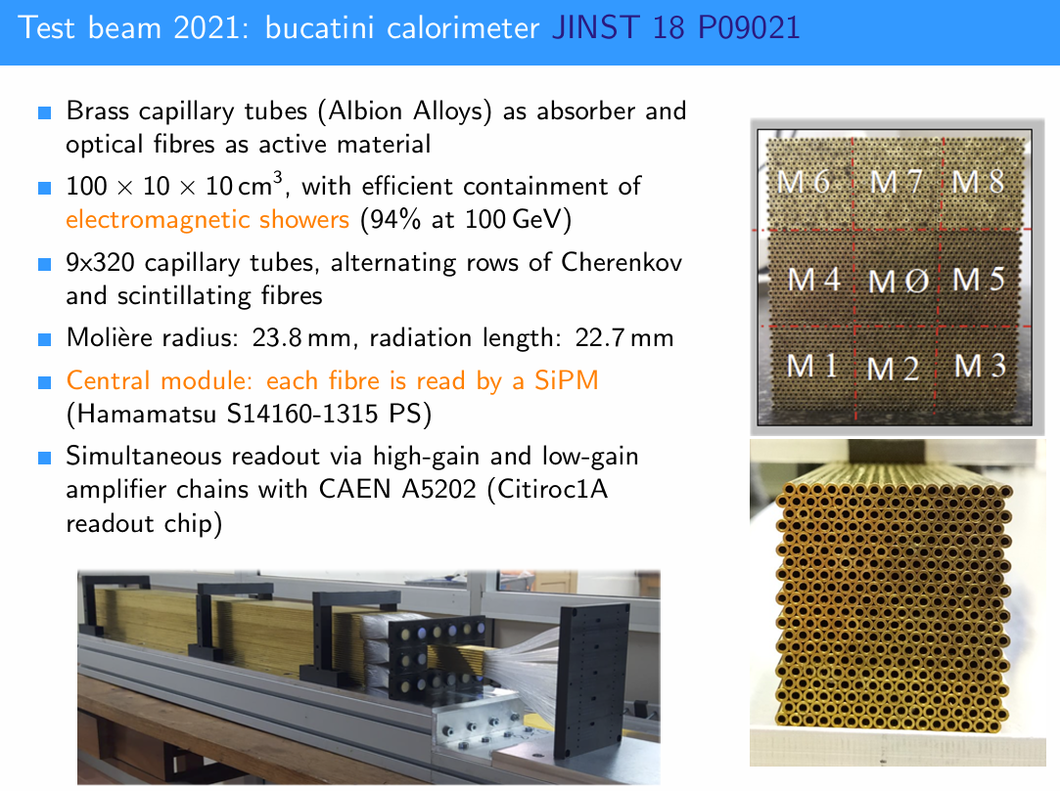
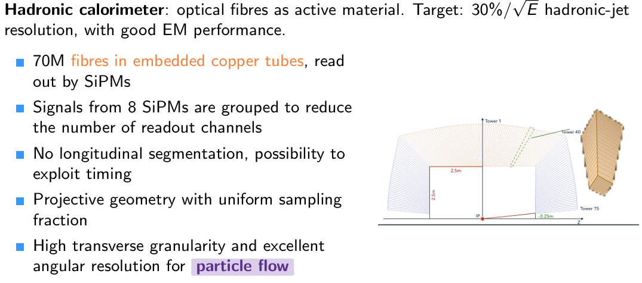
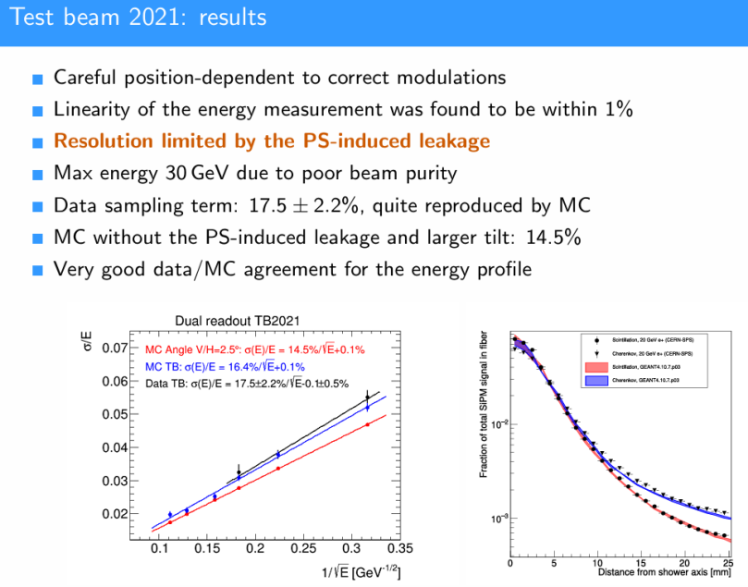
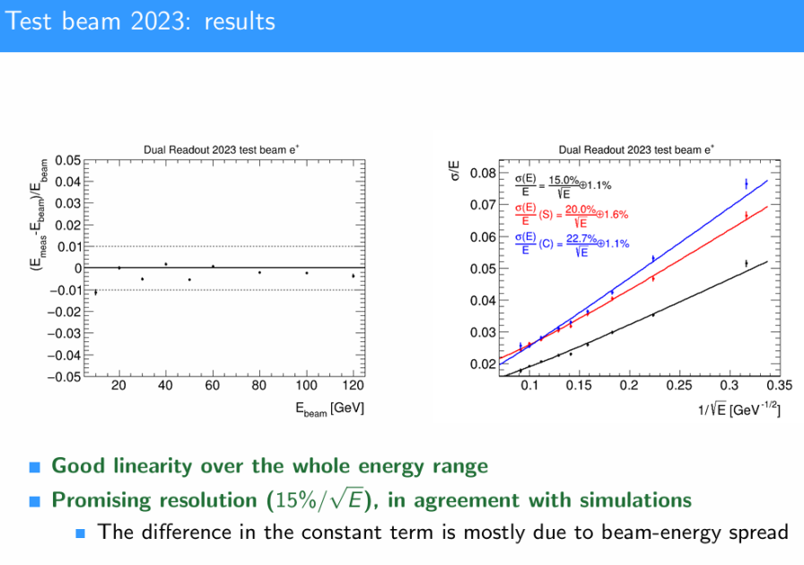
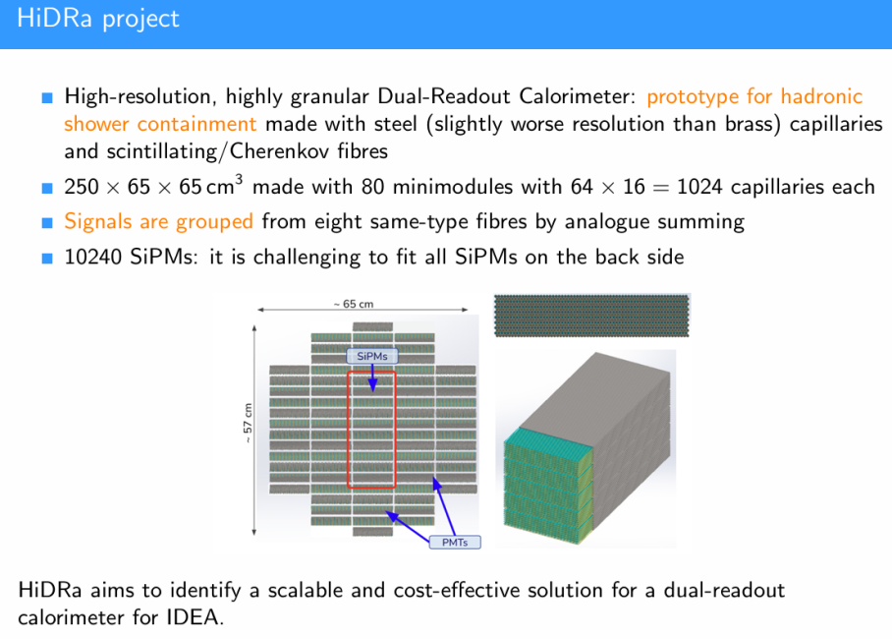
Dual-Readout HCal by Ruggero Turra

Slide 17
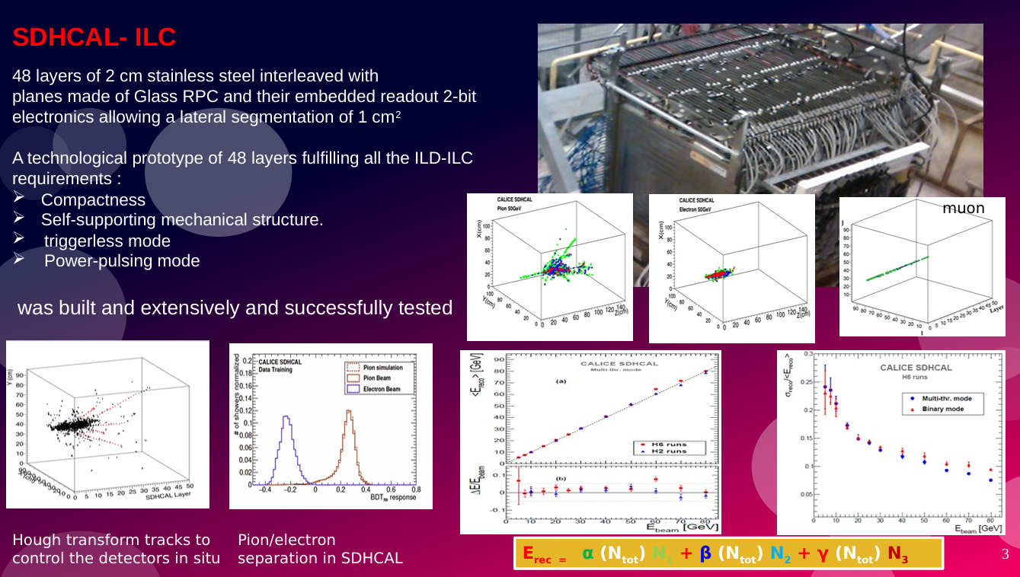

Slide 18
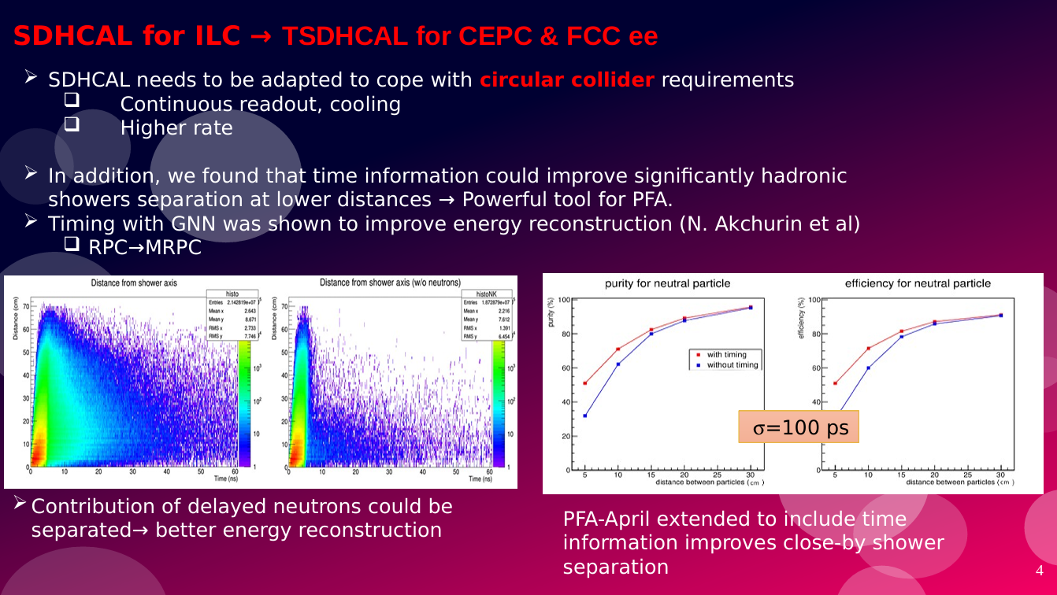

Slide 19
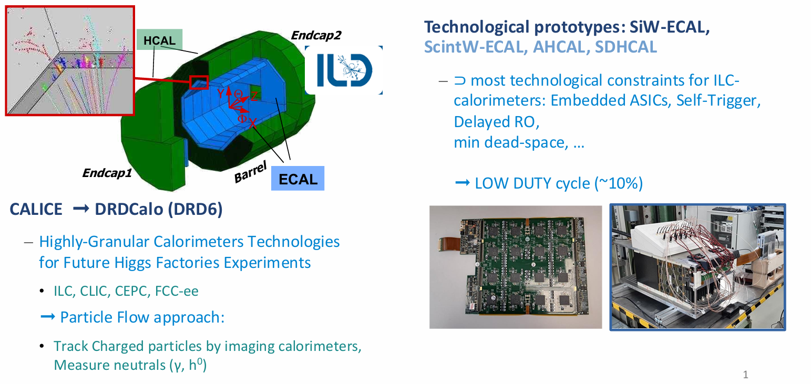

Slide 20
CEPC calorimeter talks
SiPM of CEPC calormerts , by Zhijun
SiPM non-linearity studies in beam tests with scintillating crystal， by Zhiyu
CEPC electromagnetic calorimeter R&D progress and highlights， by Yong
CEPC HCAL based on glass scintillators (GS-HCAL), by Hengna
Towards a Homogeneous Calorimeter —Integrating EM and Hadron Detection with Glass Scintillators，by Yuekun

Slide 21

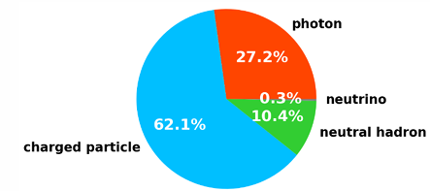

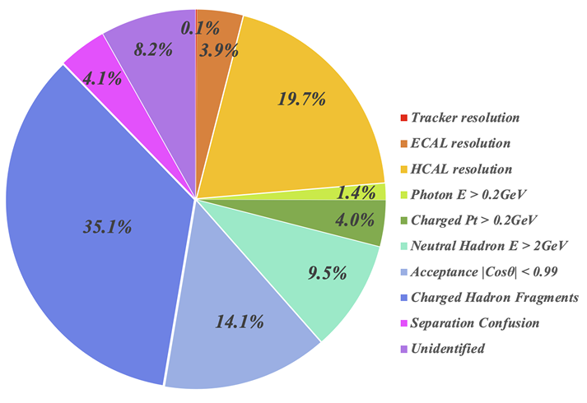
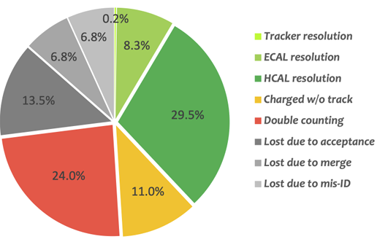
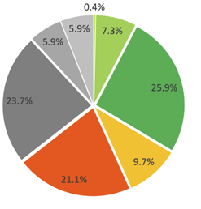
Influence factors of BMR/JER
Boson Mass Resolution (BMR) < 4% / Jet Energy Reso. (JER) < (30% / √E) ⊕ 4%
Ideal PFA：
In fact:
JER key influence factors：
1st : due to shower separation wrong, over 30%
2nd : HCAL energy reso., ~20-30%
3rd : missed energy due to acceptance/ threshold/mis-ID
Final particles energy ratio of jet
Refer to Mayqi Ruan，talk
CDR： BSM 4%
AURORA：BSM 2.7%
Future： BSM 2%

Slide 22



Motivation
Why Integrating EM and Hadron Detection with Glass Scintillators?
Ref-TDR, BGO-ECAL : good performance but 1/3 budget
18 layers of BGO crystal bars (1.5×1.5×40 cm3) ,24 m³ BGO
Very good EM energy reso.
Ref-TDR, GS-HCAL：
Unit: 40x40x10 mm³, GS sensitive layer deposit 30% energy
Energy reso. is the second JER factor，large constant item mainly due to energy leakage
Table Properties of BGO and scintillating glass
Property | BGO | Scintillating Glass
Density ρ (g/cm³) | 7.13 | 6.0
Effective atomic number Z | 72.9 | 56.9
Radiation length X₀ (cm) | 1.12 | 1.59
Molière radius R_M (cm) | 2.23 | 2.50
Nuclear interaction length λ_I (cm) | 22.7 | 24.1
λ_I / X₀ | 20.27 | 15.16
Refractive index | 2.15 | 1.74
Light yield (photons / MeV) | 7400 | 1500
Attenuation length (cm) | ~ 1000 | ~ 6 → 10,20
Cost (CHF / cm³) | 3.88 | 0.5
Refer to Yong’s talk
Can it be cheaper even with a little worse energy reso.？It is important but not so important in jet energy reso.
Can shower separation power be better?
BGO Bar -> GS cube, granularity improved ？
Can SSP and PID improved by less multiple-hit & mismatch？
Can ECAL be used for HCAL? If GS, 24 X₀, 1.5 λ_{I}, E/H ratio better
Refer to Hengne’s talk
Can the constant item improved with more GS ECAL λ_{I} ?
Can hadron energy reso. be better with thicker GS ?
Can EM/Hadron shower correction be better? EM ratio increased while hadron energy increasing due to π⁰ η？Its nonlinearity
Hadron energy reconsrruction

Slide 23
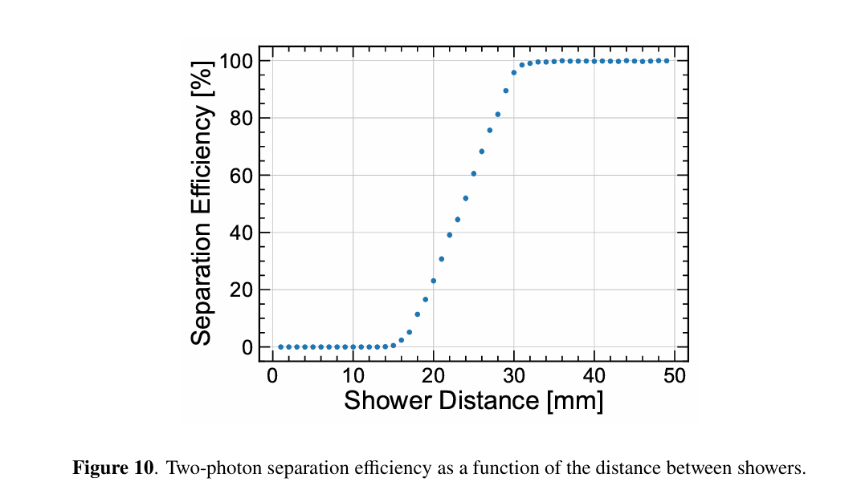
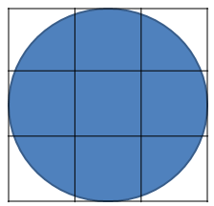
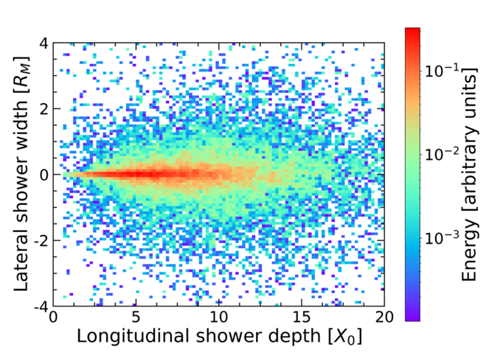
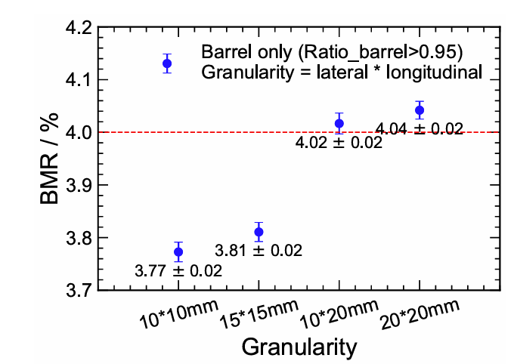
GS ECAL - Granularity
Material properties and granularity:
X₀：1.12 cm VS 1.59 cm
R_{M}：2.23 cm VS 2.50 cm
λ_{I}: 22.7 cm VS 24.1 cm
Transverse granularity: shower R_{M}
3x3 is a trade-off size for 2 R_{M}
though 4x4 or 5x5 is better
e.g. BGO: 2R_{M} /3 = 1.5cm
e.g. GS: 2R_{M} /3 = 1.7-> 2cm
π⁰ 2γ separation：
Unit size, two-peaks, mass constraint
Longitudinal granularity: ~24 X₀
18 layers x 1.5 cm = 27 cm for BGO
20 layers x 2 cm = 40 cm for GS
3x3 for 2 R_{M}
ArXiv ePrint: 2508.20728
More granularity research needs, it's a balance between physical performance, channel count, structure, heat dissipation, and cost.
Fig. 2 D energy deposit distri. of a 5 GeV photon
Fig. BMR vs granularity in Ref-TDR. By Weizheng

Slide 24
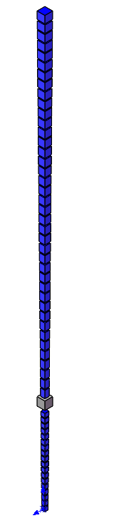
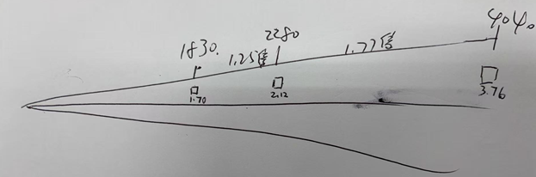
CAL Radius: 1830mm -> 2280 mm -> 4040 mm
Δθ，ΔΦ： ~9 mrad

Slide 25

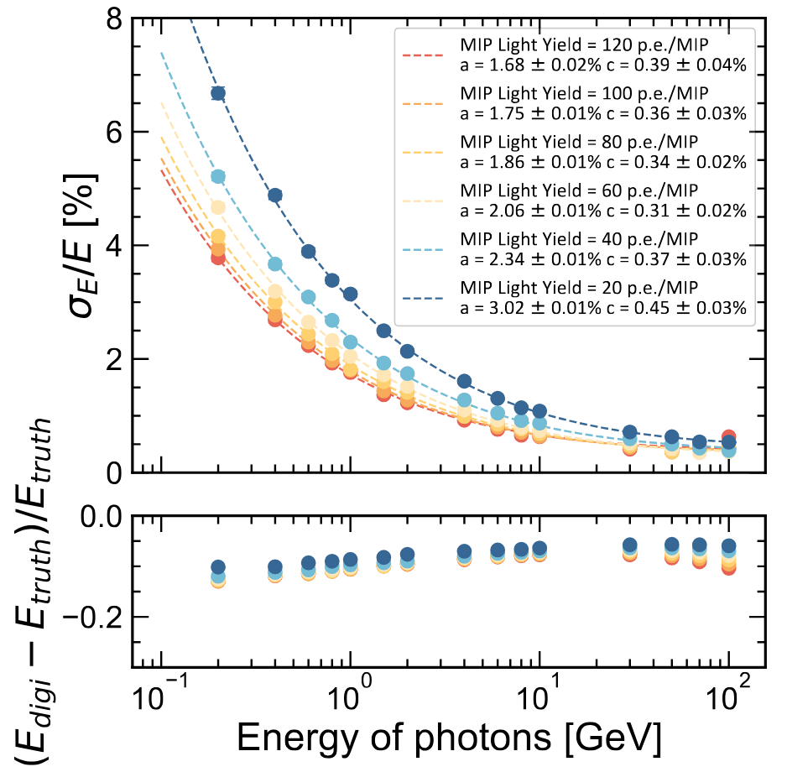
GS ECAL – Energy reso.
If GS has ideal uniformity
Ref-TDR
ECAL：300pe / MIP: 15x15x400 mm BGO, MIP=13.4 MeV
HCAL: 60pe /MIP: 10x40x40 mm GS + A.L. 80 cm, MIP=7.3 MeV
GS ECAL：2x2x2 cm
MIP：~60pe /MIP，comparing with HCAL
Stochastic term a≈2% for 60 pe / MIP
Number of pe increased with improving light yield, A.L., SiPM
By Weizheng
Fig. Ideal uniform in GS unit with 60 pe/MIP，0.1MIP threshold → a: ~2%, c: 0.3%

Slide 26
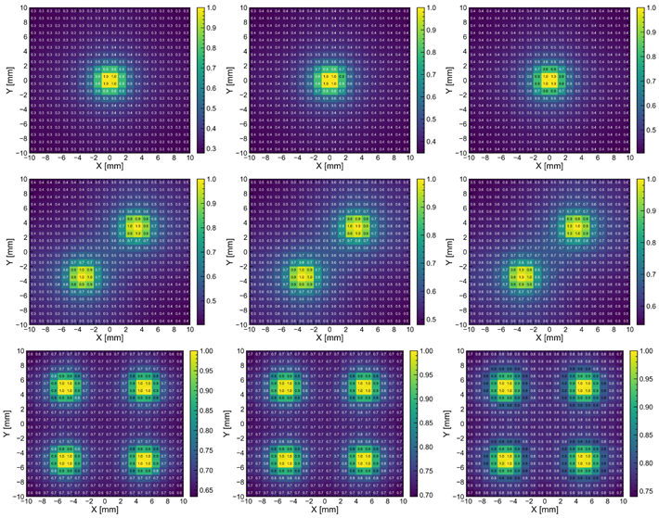

GS ECAL – Energy reso.
Energy reso. influenced much by uniformity and AL
Attenuation length: after multiple reflections, the optical path will become very long, if A.L. is long, it will improve the uniformity and energy reso.
E.g., c is 4.9% → 3.4% , a is 5.5% → 4.0% while AL 6 →10 cm with a SiPM
SiPM number affects pe and uniformity, 2 may increase the robust too.
By Weizheng
SiPM number and uniformity
SiPM number and AL VS energy reso.

Slide 27



GS ECAL – structure
Structure:
Axially 12 equal divisions / Circumferentially 32 equal divisions. radius increasing 30 cm.
Strong and light material like carbon fiber used to support.
Channels number: x ~ 7, total power: ~62 kW
Water cooling
Option1: use graphene to transfer heat to both ends, then use water cooling
Option2: similar to that in Ref-TDR
Items | Ref-TDR BGO | GS ECAL
Scintillator thickness | 15 mm | 20 mm
Layer number | 18 | 20
Total thickness | 277 mm | 465 mm
SiPM number | ~0.57M | ~4.3 M
Total power | 8.5 kw | 62.1 kw
Total scintillator volume | 24 m³ | 34 m³
ECAL outer radius | 4260 mm | 4560 mm
Dead area ratio | 12.3% | 11.6%
HCAL inner radius | 4280 mm | 4580 mm
Granphene 0.5mm
SiPM+ASIC 2mm
Plate with SiPM holes 1mm
GS 20mm
Carbon fiber support
1mm
总厚度24.5mm
Drawing by Shaojing
Fig. Unit composition
Fig. Staggered trapezoidal modules
Fig. Barrel ECAL 12 rings, each ring 32 modules

Slide 28

GS ECAL - Cost estimation
By Weizheng

Slide 29

GS HCAL – Energy reso.
Energy reso of HCAL is second important in BMR and JER
Term | Main physical factors
a/sqrt(fE)​ | Sampling fraction f Photoelectron statistics Inter-layer response non-uniformity Channel-to-channel gain variation
b/sqrt(E) | Intrinsic hadronic shower fluctuations Stochasticity of nuclear interactions Fluctuations of E/H component ratio Longitudinal and transverse shower profile fluctuations Random invisible energy leakage
c | Global detector non-uniformity Overall gain drift Calibration uncertainties systematic energy leakage

Slide 30




GS HCAL – sampling ratio and performance
Fraction of energy deposited in the sensitive layer： f
Ref-TDR: f=30%, how about increasing it?
the 1st term decrease
Totally longitudinal length: 6 λ_{I}
Sampling ratio VS reso.
f | Glass thickness in a unit(mm) | Steel thickness in a unit(mm) | Layer number (mm) | HCAL total thickness in R
30% | 10 | 14 | 48 | 1315
50% | 21 | 12.5 | 40 | 1333
70% | 29 | 7.5 | 40 | 1467
90% | 37.5 | 2.5 | 40 | 1600
Unit design in Ref-TDR
Fig. unit design for f=50%

Slide 31

GS HCAL – structure summary
Structure: similar as ECAL
Volume GS mass becomes larger and as f = 30%->50% -> 70% -> 90%
Channels number decreases due to layer number from 48->40
Barrel Part
Items | f=90% | f=70% | f=50% | f=30%
Unit number | 2990208 | 2922816 | 2865408 | 3212800
Total power/kW | 44.85 | 43.84 | 42.98 | 48.19
GS volume/cm3 | 1.79e8 | 1.36e8 | 0.96e8 | 0.51e8
GS mass/ ton | 1076 | 814 | 578 | 308
Steel mass/ton | 1161 | 1080 | 1019 | 485
Support mass/ton | 111.0 | 104.0 | 98.1 | 470
Total mass/ ton | 1272 | 1184 | 1117 | 955
by Yatian
Endcap Part
Items | f=90% | f=70% | f=50% | f=30%
Unit number | 1676800 | 1676800 | 1676800 | 2012160
Total power/kW | 25.15 | 25.15 | 25.15 | 30.18
GS volume/cm3 | ~1.01e8 | ~0.78e8 | ~0.56e8 | ~0.32e8
GS mass/ ton | 704.4 | 670.6 | 645.6 | 430
Steel mass/ton | 111 | 106 | 102 | 303.8
Total mass/ton | 815 | 776 | 748 | 734

Slide 32





GS HCAL – structure drawings
Drawing by Yatian
Barrel part
Endcap part

Slide 33


ECAL and HCAL both need timing
Manqi, https://doi.org/10.1016/j.cpc.2025.109661
Ref-TDR:
ECAL: 0.5 ns
HCAL: no timing
Separation power with timing:
Charged particles：can be separated by tracking and TOF
How about neutral particles in CAL？ PID: n/K_{L}/nbar relatively poor
HCAL fast particles: γ，e
HCAL slow particles: n p K
Hit timing: 0.1ns – 0.5 ns per hit
Shower timing: ~1/sqrt(Nhit)
Energy reso. improved with timing
Fig. PID with 0.1ns per hit
Fig. 0.01ns per cluster, roughly 0.1ns per hit

Slide 34




Dynamic range
Ref-TDR, ECAL and HCAL
low end similar 0.1 MIP, high end difference 30 times,
GS ECAL and HCAL
High end difference reduce to 3-7 times
SiPM and electronics requirements become close
Calorimeter | Sensitive size (cm) | MIP energy | High End
Ref-TDR ECAL | 1.5x1.5x40 BGO | 13.4 MeV | 3000 MIP (high energy electron)
Ref-TDR HCAL | 1x4x4 GS | 7.3 MeV | 100 MIP (high energy π± )
GS ECAL | 2x2x2 GS | 2 x 7.3 MeV | ~1400 MIP (high energy electron)
GS HCAL (new consideration) | 1.0x4x4 2.1x4x4 2.9x4x4 3.75x4x4 | N x 7.3 MeV | ~200-500 MIP may needed, need more simulation

Slide 35
Summary
Propose an integrated design for ECAL and HCAL based on GS：cost VS BMR/JER trade-off
GS ECAL: 24 X₀ , 1.5 λ_{I}
Cost: 1/3 – 1/2 of BGO, channels x ~7
W/ hadronic shower too, E/H ratio better -> need to be used
Granularity: an example 2x2x2 cm (It should be 1.7 cm if comparing with BGO )
Energy resolution, 3-4% expected. AL is also a key besides light yield.
Provided a mechanical design example
GS HCAL: 6 λ_{I}
GS ECAL considered into HCAL, to improve energy reso. (constant term 6.5% in Ref-TDR)
EM shower in HCAL need to correct
Energy reso. improved with more sampling ratio under more cost of GS
Consistent engineering design
ECAL and HCAL mechanics have similar structure, volume larger
SiPM and electronics requirements become close: pe/timing/dynamic range

Slide 36
Thank you for your attention!

Slide 37

Thank you for your attention !

Slide 38


Slide 39



Slide 40

20260416讨论

