Slide 1
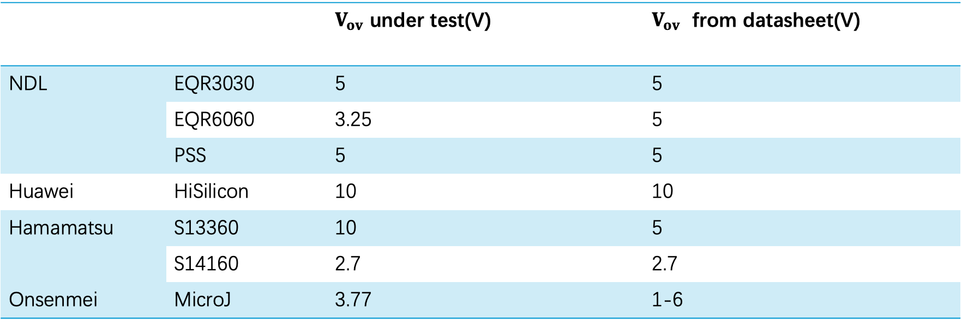
 |  | $V_{ov}$ under test(V) | $V_{ov}$ from datasheet(V)
NDL | EQR3030 | 5 | 5
 | EQR6060 | 3.25 | 5
 | PSS | 5 | 5
Huawei | HiSilicon | 10 | 10
Hamamatsu | S13360 | 10 | 5
 | S14160 | 2.7 | 2.7
Onsenmei | MicroJ | 3.77 | 1-6

Slide 2
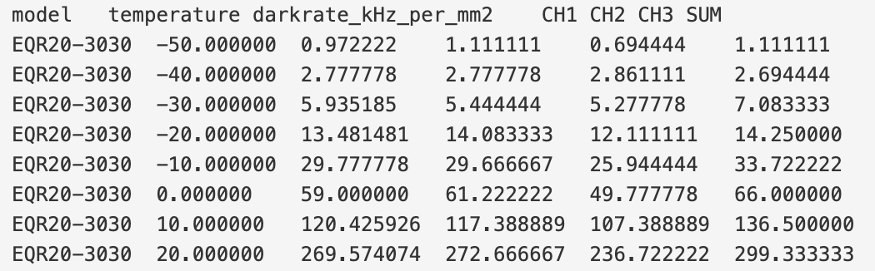
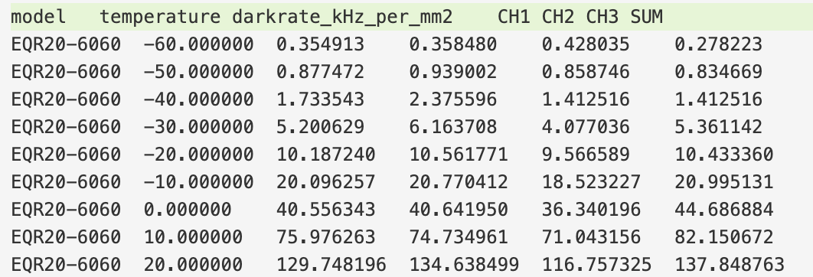
EQR20-3030
EQR20-6060

Slide 3
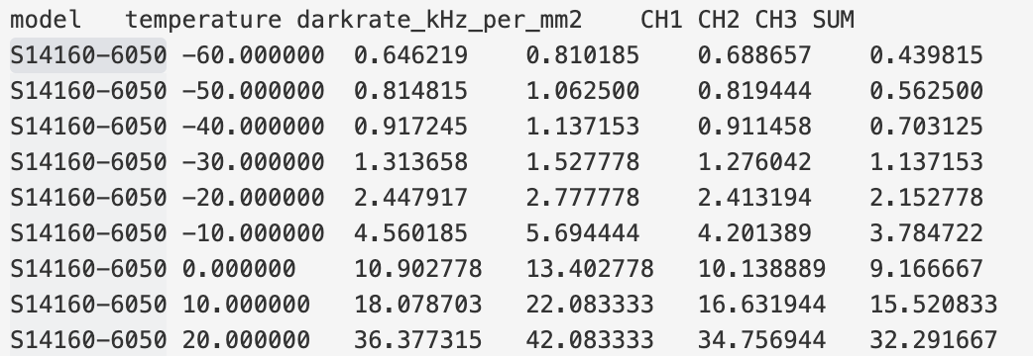
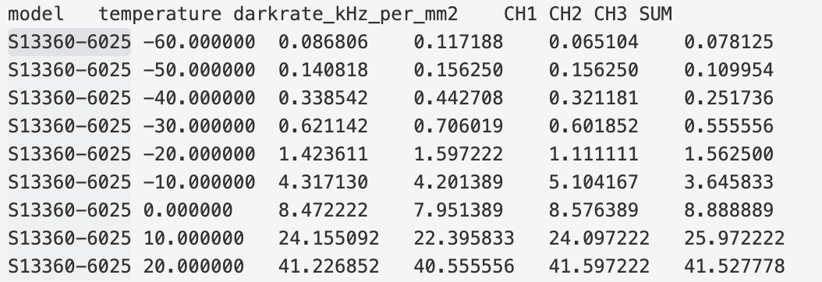
S14160-6050
S13360-6025

Slide 4
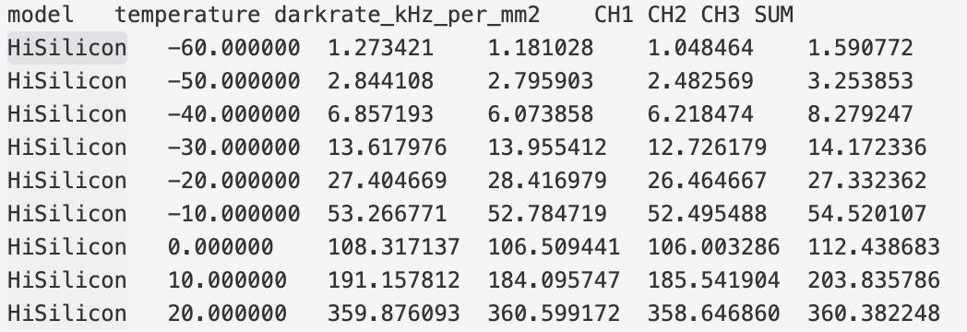
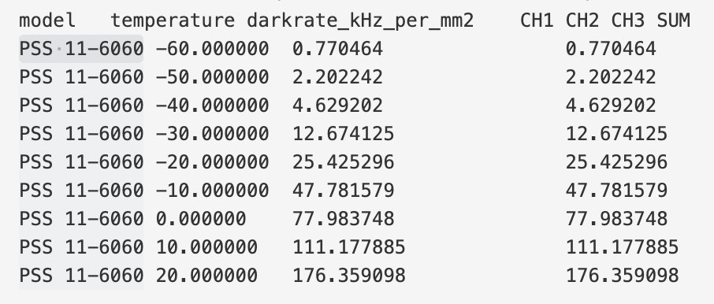
HiSilicon
PSS 11-6060

Slide 5
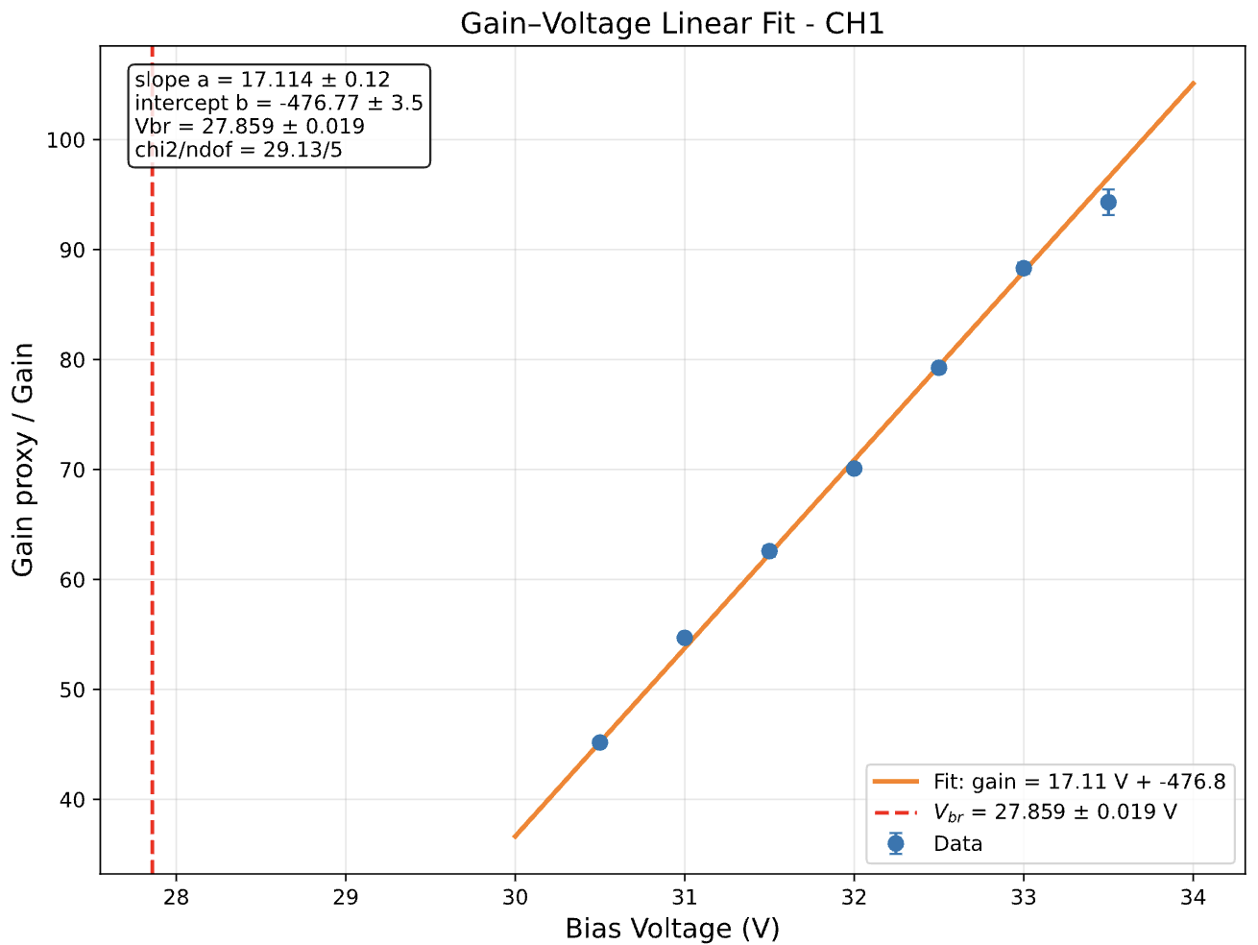
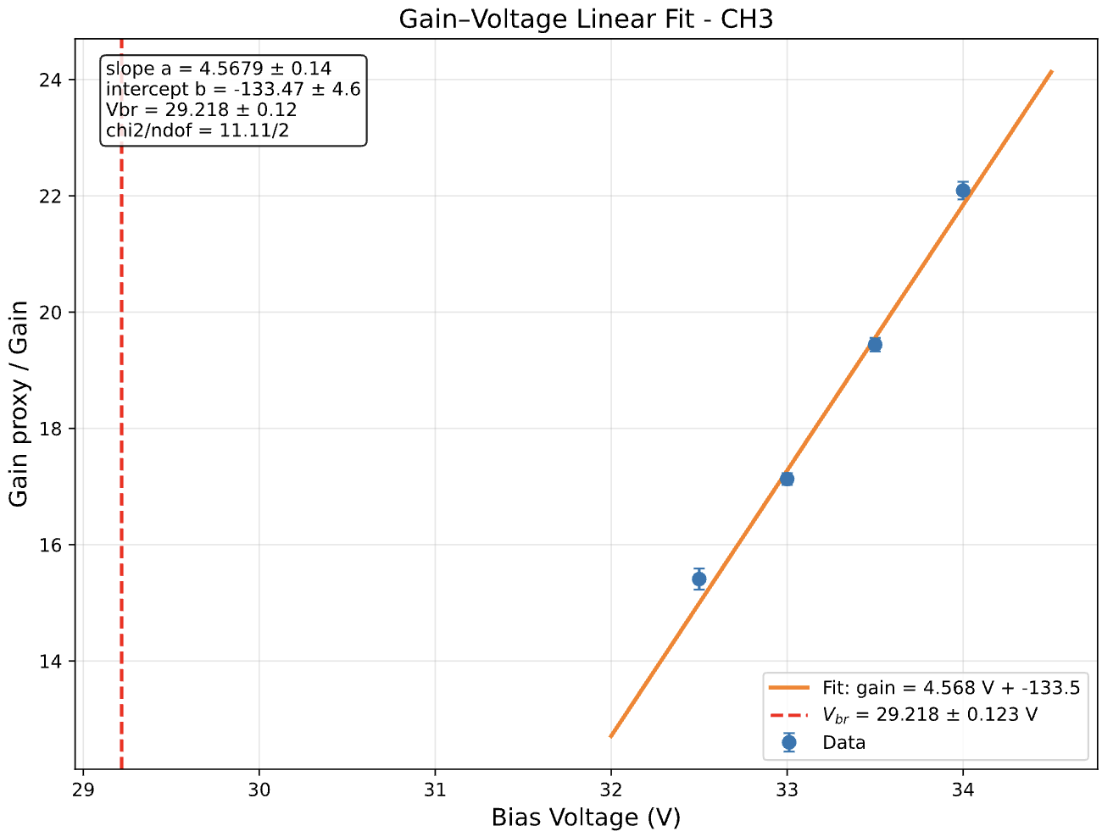
EQR3030
EQR6060

Slide 6
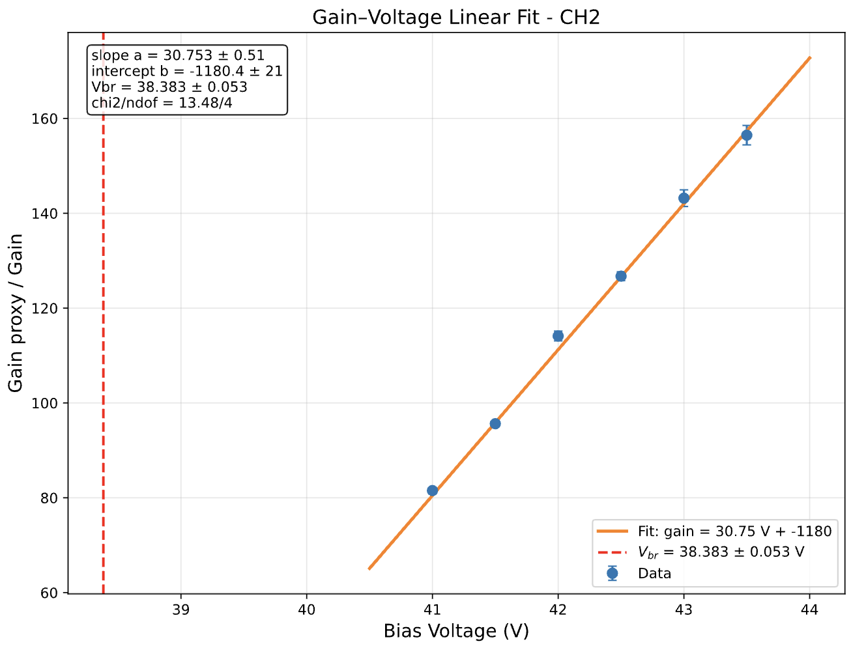
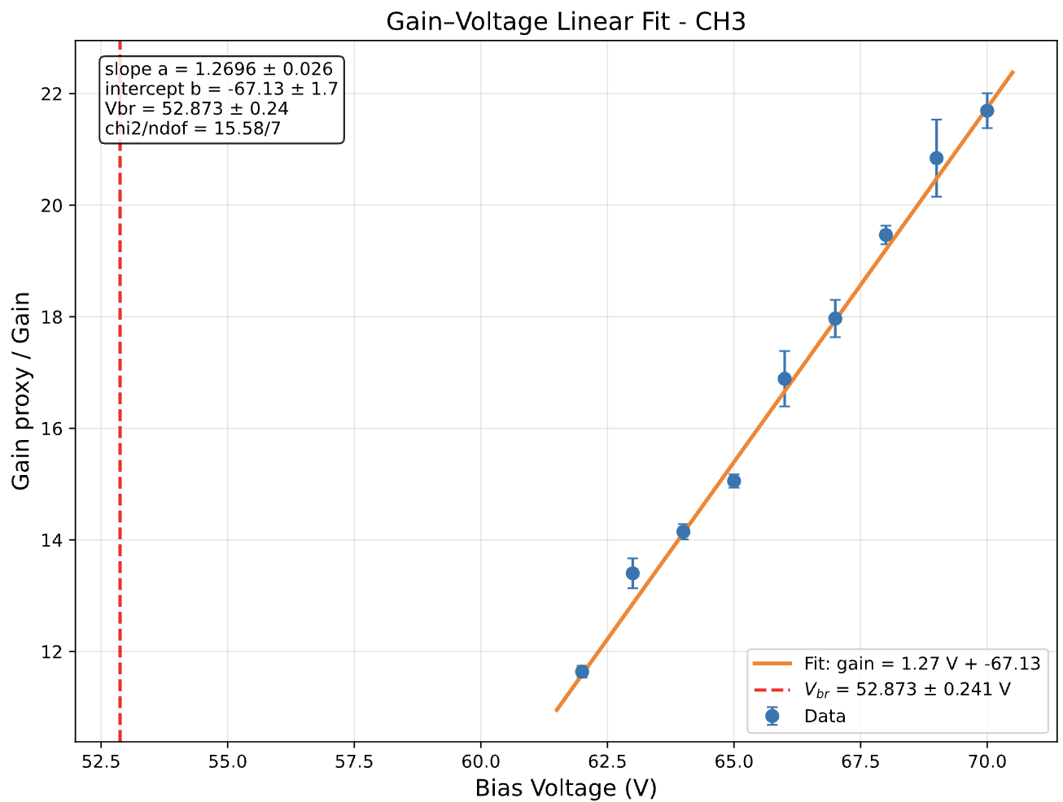
S14160-6050
S13360-6025

Slide 7
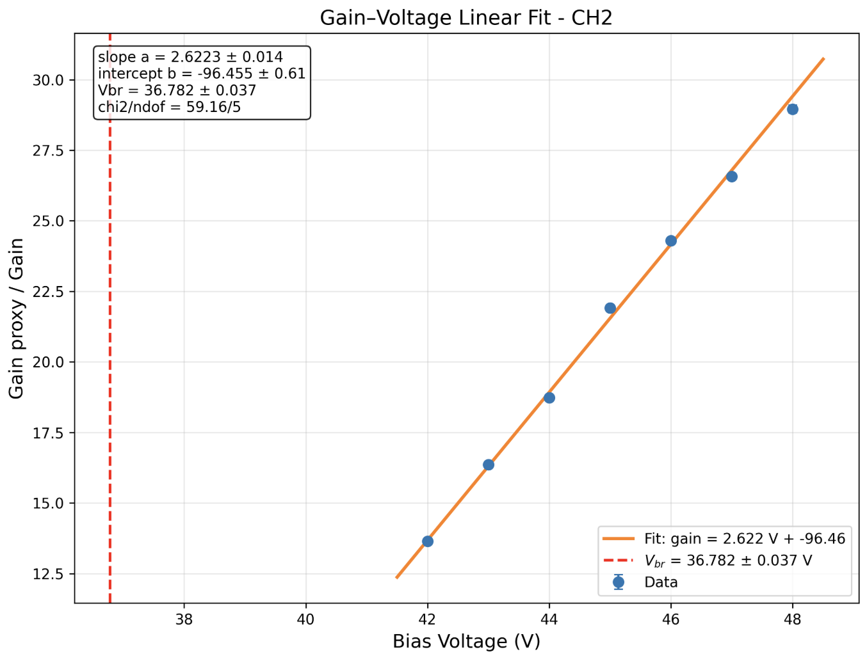
HiSilicon
PSS 11-6060

