Slide 1

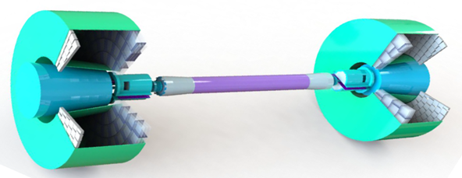
Status of Simulation of Endcap RICH at CEPC
Li Changru, Sun Shengsen, Dong Haojie,
Wang Jian, Qin Zhonghua, Wang Yifang
CEPC Physics and Detector Plenary Meeting
May 13, 2026
Notes:
Good afternoon, everyone. I'm Li Changru. Today I'll give a brief report on the current status of the Endcap RICH simulation at CEPC.

Slide 2
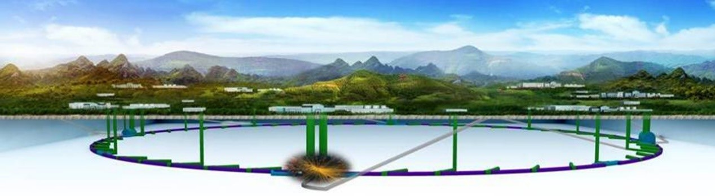
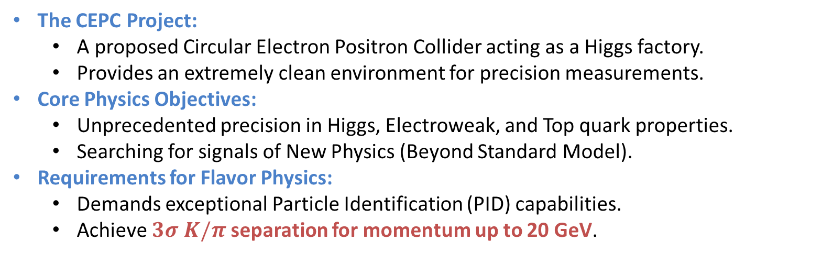
Introduction
The CEPC Project:
A proposed Circular Electron Positron Collider acting as a Higgs factory.
Provides an extremely clean environment for precision measurements.
Core Physics Objectives:
Unprecedented precision in Higgs, Electroweak, and Top quark properties.
Searching for signals of New Physics (Beyond Standard Model).
Requirements for Flavor Physics:
Demands exceptional Particle Identification (PID) capabilities.
Achieve $3σ K/π$separation for momentum up to 20 GeV.
Notes:
I'll start with the physics motivation, but keep it brief since everyone here is familiar with the CEPC physics program. The point relevant to this study is that CEPC flavor physics requires 3-sigma kaon-pion separation up to around 20 GeV/c. This requirement drives the study of an additional Endcap RICH detector.

Slide 3
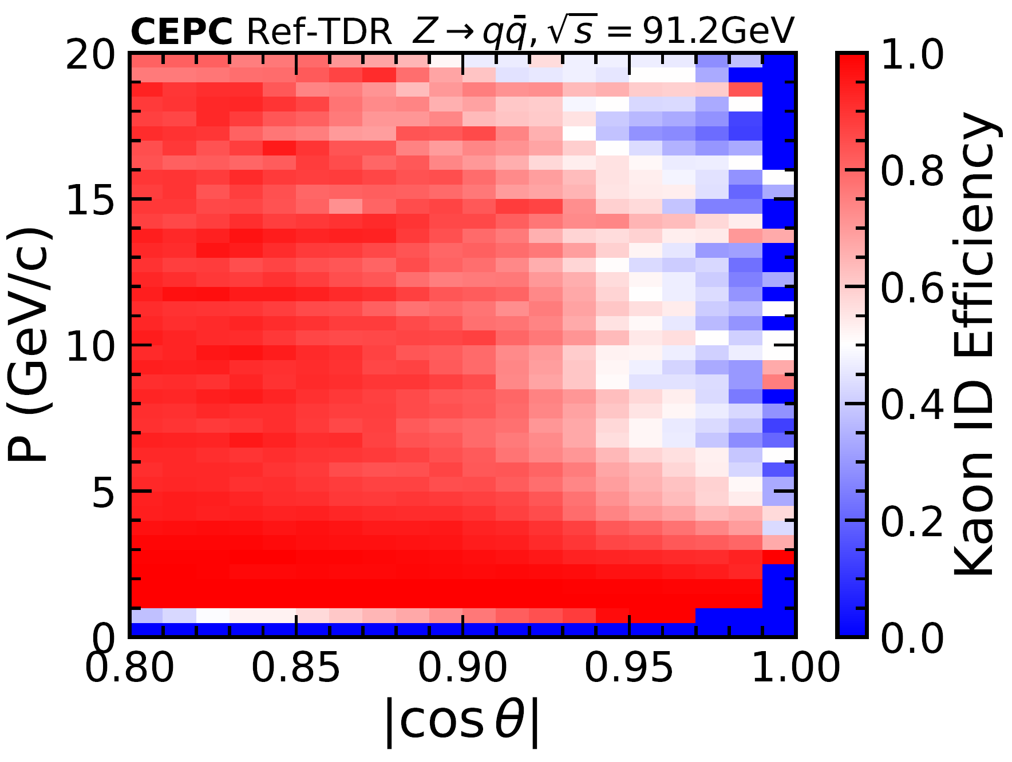
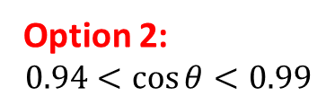
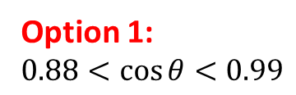
Motivation
Option 1:
$$0.88<\cos{θ}<0.99$$
Between 3rd and 4th endcap of ITK
By Ma Xiaotian
Option 2:
$$0.94<\cos{θ}<0.99$$
out of 4th endcap of ITK
Baseline PID: dE (dN) /dx + ToF.
Significant efficiency drop in the forward region for Kaons with momentum over 3 GeV.
By Wang Jian
Notes:
The baseline PID strategy at CEPC relies on dN/dx — the cluster-counting method — together with time-of-flight. This figure is a heat map of kaon identification efficiency. The horizontal axis is cosθ, where θ is the polar angle. The vertical axis is the particle momentum. The color represents kaon efficiency: blue is low, red is high. The efficiency drops significantly in the forward region — the right side of the plot, at large cosθ — for kaons above roughly 3 GeV/c. The forward region is challenging for dN/dx because tracks at small polar angles pass through fewer sensitive layers of the tracker. This is where an Endcap RICH can provide complementary information. A RICH measures the Cherenkov angle, which depends on velocity — at high momentum, velocity-based separation maintains discrimination power where dN/dx loses it. We are considering two options for the detector placement. Option 1, marked by the lined boundary, covers a larger angular range but would influence the performance of tracking system. Option 2, marked by the dotted boundary, covers a smaller angular range with less impact on the tracker. The final location has not been decided; for the studies shown today, Option 1 is used as the working baseline.

Slide 4
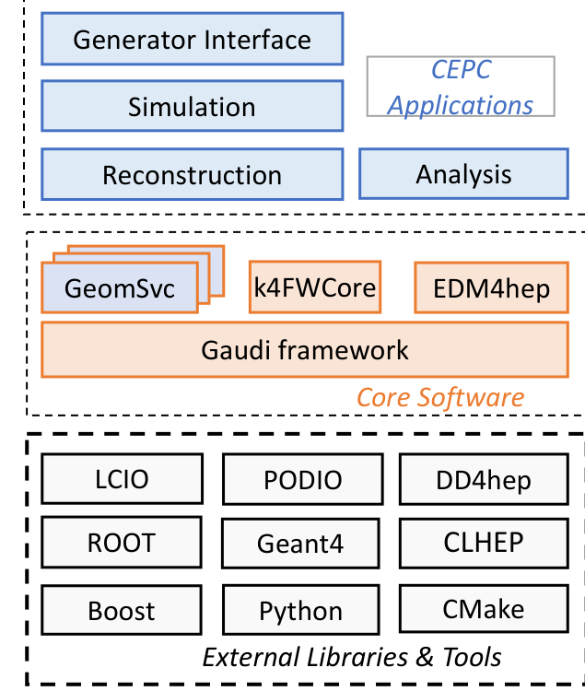
Software
CEPCSW
Optical process
Produced by the Cherenkov Transported with wavelength, time and polarization
Affected by absorption, boundary processes and Rayleigh scattering
Scintillation, WLS/WLS2 and Mie scattering are disabled
A CEPC offline software prototype based on the Key4hep common software stack.
DD4hep detector geometry, materials and optical surfaces
Geant4 tracking and optical photon transport
EDM4hep common event data model for the full chain
DD4hep
Geometry & Materials
Geant4
Optical Photons
SiPM response
PDE + Dark Noise
PID benchmark
Separation Power
Notes:
A quick word on the software we use. The simulation is built within CEPCSW, the CEPC offline software based on the Key4hep common stack. DD4hep handles the detector geometry and optical surface definitions. Geant4 handles particle tracking and optical photon transport. EDM4hep provides a common event data model across the full chain. For optical processes, we generate Cherenkov photons and transport them with full wavelength, time, and polarization information. The transport includes absorption, boundary refraction and reflection at material interfaces, and Rayleigh scattering — which I'll come back to later. Scintillation, wavelength-shifting, and Mie scattering are disabled; they are not relevant at this stage. On the detector side, the SiPM is modeled with photon detection efficiency and dark noise. The PID performance metric is separation power — the angular difference between two particle types divided by the angular resolution.

Slide 5
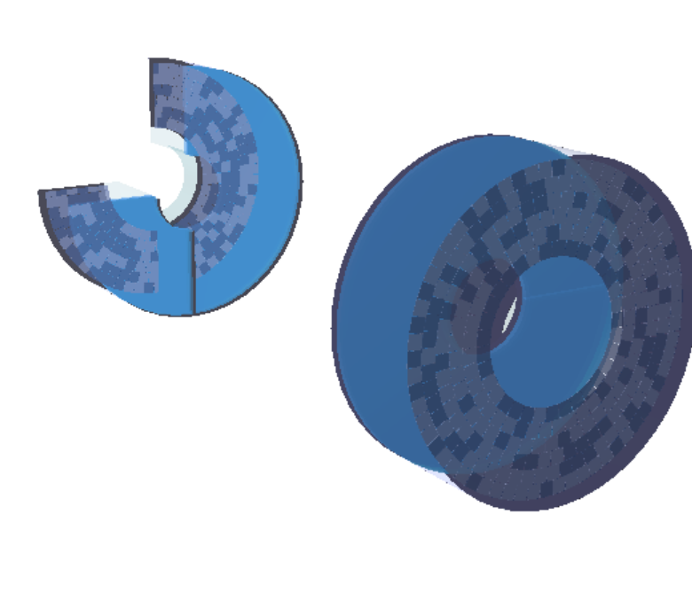
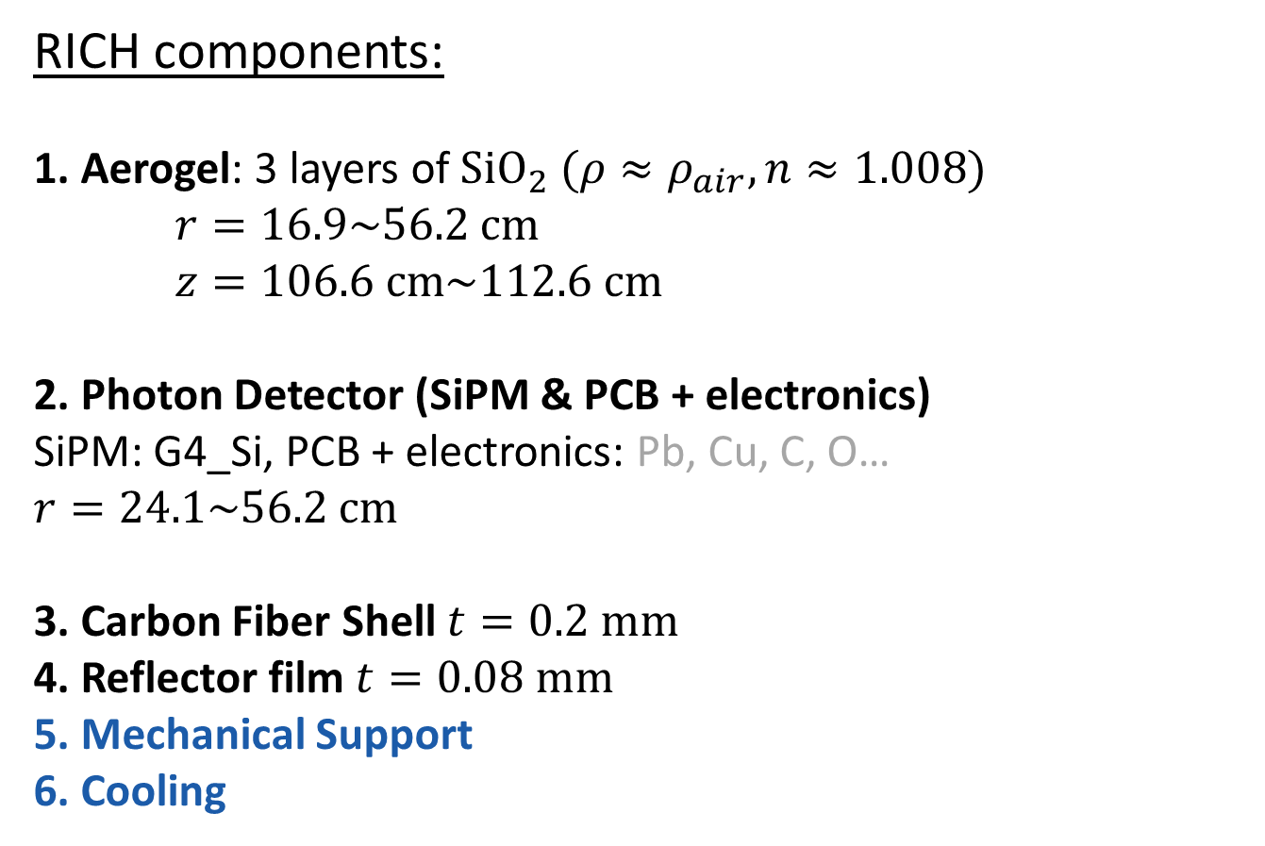
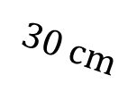
Overall Geometry & Materials
RICH components:
1. Aerogel: 3 layers of ${SiO}_{2} (ρ≈ρ_{air}, n≈1.008)$
$r=16.9\sim 56.2 cm$
$z=106.6 cm\sim 112.6 cm$
2. Photon Detector (SiPM & PCB + electronics)
SiPM: G4_Si, PCB + electronics: Pb, Cu, C, O…
$$r=24.1\sim 56.2 cm$$
3. Carbon Fiber Shell $t=0.2 mm$
4. Reflector film $t=0.08 mm$
5. Mechanical Support
6. Cooling
$$30 cm$$
 | Material | Thickness | Radiation Length | Material Budget
Radiator | Aerogel (SiO2) | 6 cm | > 700 cm | < 1% X0
SiPM | Si | 1 mm | 9.36 cm | 1.06% X0
PCB | PCB | 1 mm | 19.4 cm | 0.51% X0
Shell | Carbon Fiber | 0.4 mm | 40.0 cm | 0.10% X0
Others | Cu, Ti, … | / | / | 1~3% X0
Notes:
Here is the detector geometry as currently implemented. The model includes three aerogel layers as the radiator, a photon-detection plane of SiPMs on a PCB substrate, a carbon-fiber outer shell, a reflector lining the inner walls — the specific reflector material is still under discussion — and simplified support and cooling structures. The drift distance from the rear surface of the aerogel to the SiPM plane is 30 centimeters. The table summarizes the material budget. The aerogel — 6 centimeters of SiO2 — contributes well below 1% of a radiation length. The SiPM layer, 1 millimeter of silicon, about 1% X0. The PCB, also 1 millimeter, about 0.5%. The carbon-fiber shell, only 0.4 millimeters, about 0.1%. Support structures and other materials are estimated at 1 to 3 percent. Two things to keep in mind: the mechanical support and cooling are still simplified and will be refined with a detailed engineering design; the specific SiPM model has not been selected. The numbers here are provisional values for the current phase of the study.

Slide 6
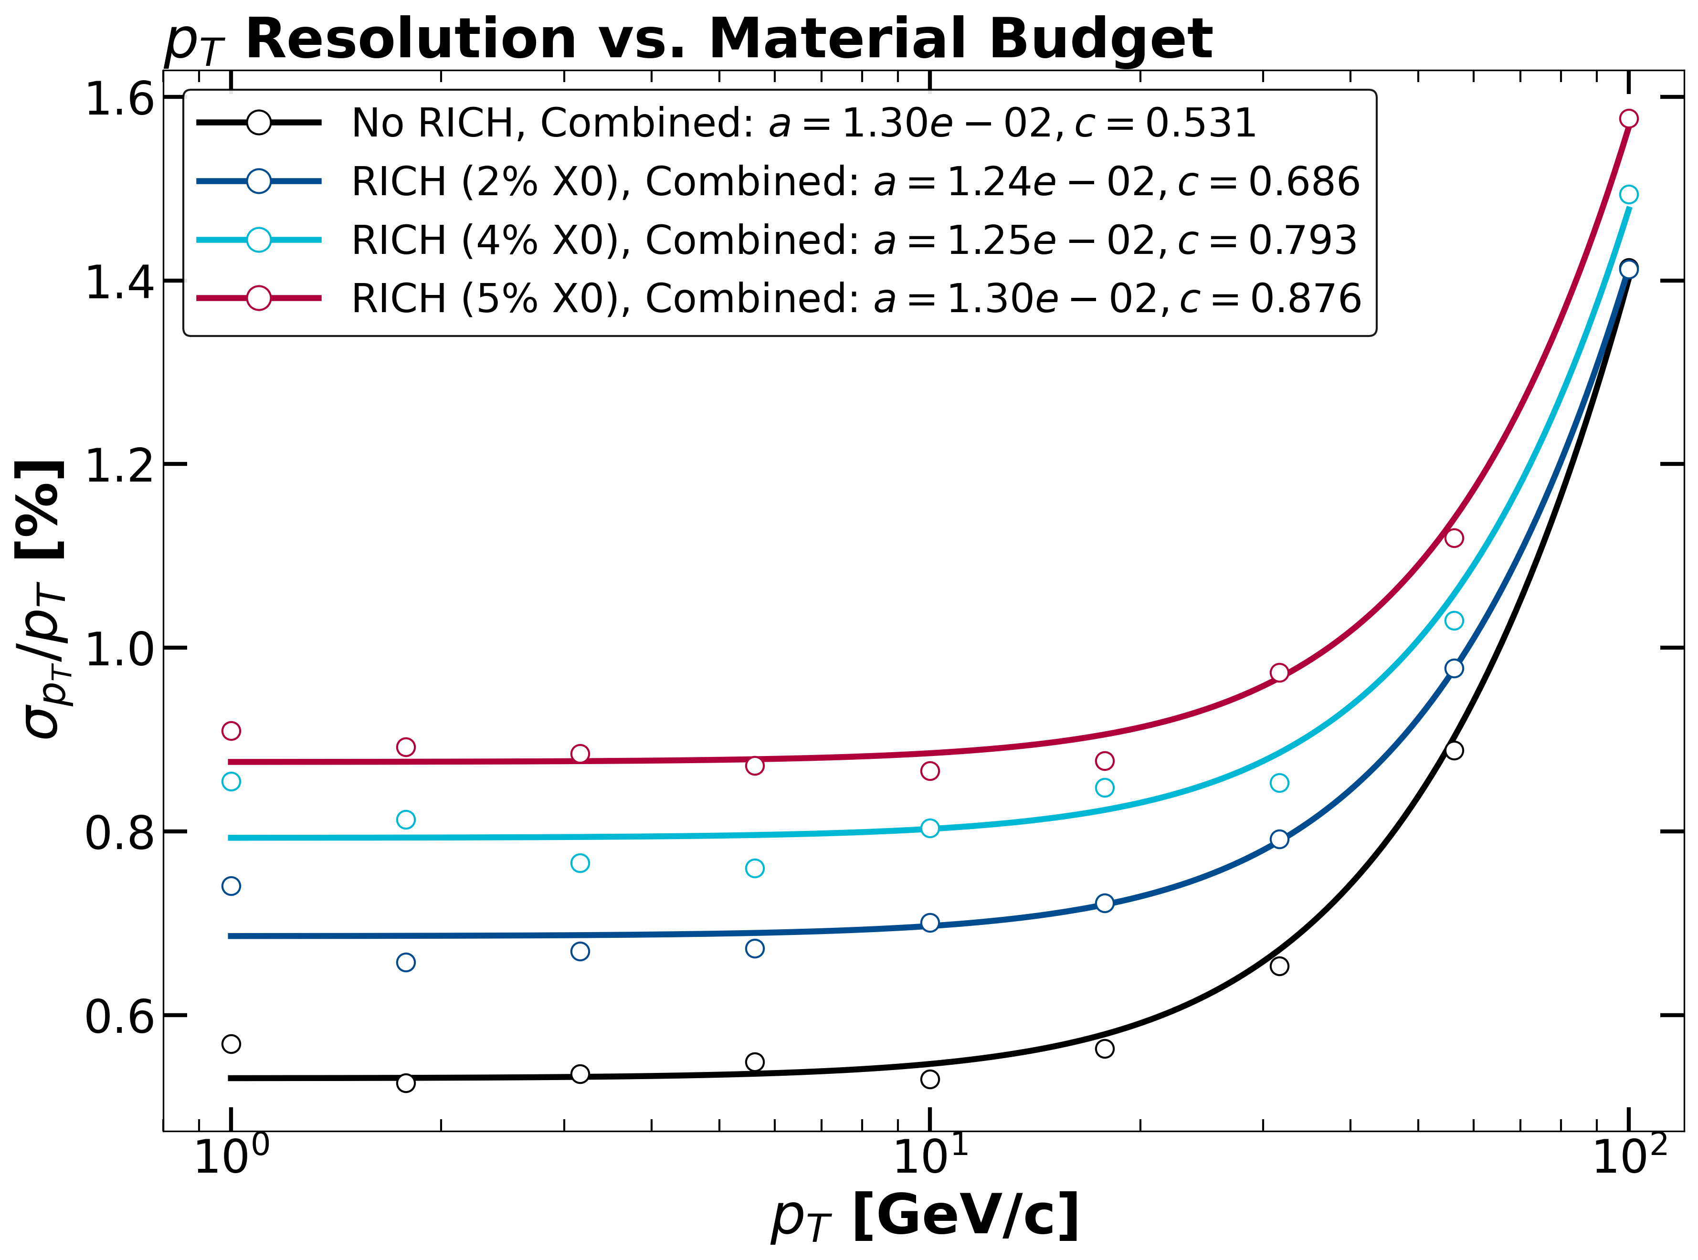
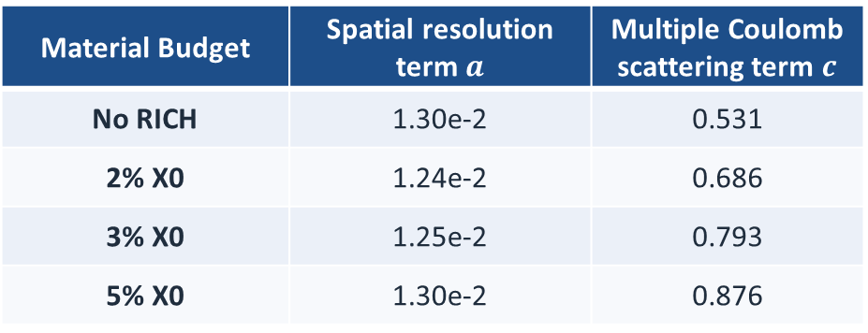

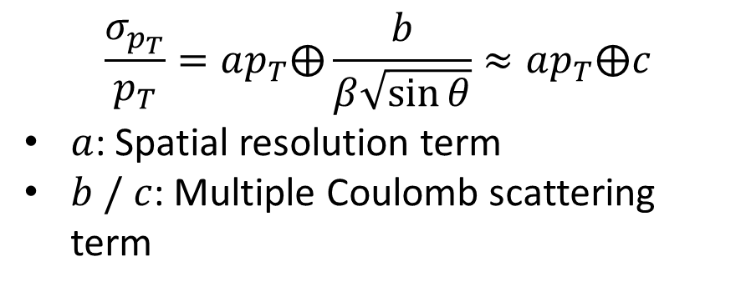
Impact on $p_{T}$ resolution
$$\frac{σ_{p_{T}}}{p_{T}}=ap_{T}⨁\frac{b}{β\sqrt{\sin{θ}}}≈ap_{T}⨁c$$
$a$: Spatial resolution term
$b / c$: Multiple Coulomb scattering term
Material Budget | Spatial resolution term $a$ | Multiple Coulomb scattering term $c$
No RICH | 1.30e-2 | 0.531
2% X0 | 1.24e-2 | 0.686
3% X0 | 1.25e-2 | 0.793
5% X0 | 1.30e-2 | 0.876
Incident angle $θ=15°, μ^{−}$
Notes:
The RICH material budget must be strictly controlled — it is a hard design constraint. The reason is that the RICH sits in front of part of the tracking system, outside the fourth endcap of the inner tracker. Any material added here increases multiple Coulomb scattering and directly degrades the transverse momentum resolution. This plot shows the tracker momentum resolution decomposed into two physical contributions. The horizontal axis is the particle momentum. The vertical axis is the transverse momentum resolution. We compare the baseline without the RICH against configurations with different assumed RICH material budgets. The spatial resolution term stays nearly unchanged while the multiple scattering term clearly increases with additional material, and the effect is most visible at lower momentum where multiple scattering dominates the total resolution. The takeaway is that the RICH cannot be optimized for PID alone. It has to coexist with the tracking system. Every fraction of a percent of radiation length we add degrades the momentum resolution — this is a central constraint on the overall design.

Slide 7
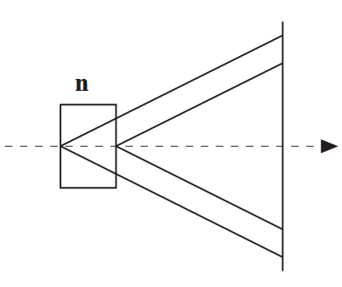
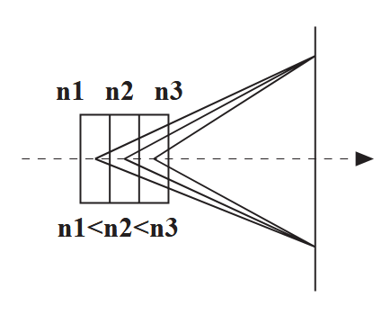


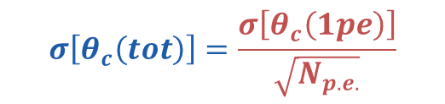



Layout of Aerogel
$$N_{σ}≈\frac{\left|m_{1}^{2}−m_{2}^{2}\right|}{2p^{2}σ\left[θ_{c}\left(tot\right)\right]\sqrt{n^{2}−1}}$$
$σ_{emission}$↗
$$σ\left[θ_{c}\left(tot\right)\right]=\frac{σ\left[θ_{c}\left(1pe\right)\right]}{\sqrt{N_{p.e.}}}$$
Aerogel with $n≈1.008$ as radiator
$l$↗
$$σ^{2}\left[θ_{c}\left(1pe\right)\right]=σ_{SiPM}^{2}+σ_{emission}^{2}+σ_{track}^{2}+σ_{chromatic}^{2}+σ_{rec}^{2}$$
Emission point uncertainty
$$N_{p.e.}∝\sin^{2}{θ_{c}}⋅l⋅ΔE⋅ε$$
$$N_{σ}↗←N_{p.e.}↗ ← l↗ →σ_{emission}\text{↗}→N_{σ}↘$$
2cm per layer to achieve best $σ\left[θ_{c}(tot)\right]$ for aerogel at Belle II
Trade off
gradient refractive index
Gradient refractive index can reduce emission point uncertainty while increasing thickness
$$n_{1}=1.007, n_{2}=1.008, n_{3}=1.009$$
Notes:
Now I'll turn to the radiator — the core of the RICH design. The key quantity is the separation power, which for two particle types — here, pion and kaon — is: N_σ = |θ_π − θ_K| / σ_θ where θ_π and θ_K are the Cherenkov angles for the two particles, and σ_θ is the single-particle Cherenkov angle resolution. The numerator — the angular difference between pion and kaon — is set by the particle masses m_π and m_K, and the momentum p at which we need the separation. These are given by the physics we are trying to measure. For a fixed momentum, lowering the aerogel refractive index n increases this angular difference — and that is why we take n around 1.008. The denominator, σ_θ, is what the detector design can control. It has several contributions. Photon statistics — more detected photons reduce the statistical uncertainty on the angle. Chromatic dispersion — the refractive index varies with photon wavelength, which broadens the ring. Emission-point uncertainty — the photon can be emitted at any depth along the track through the 6-centimeter radiator, and this depth maps into the measured Cherenkov angle. And the spatial resolution of the SiPM detection plane. Now, the straightforward way to improve photon statistics is to use a thicker radiator — the Cherenkov photon yield is proportional to thickness. But a thicker radiator also increases the emission-point uncertainty. These two effects work against each other. Our solution is a focusing aerogel with a gradient refractive index. By choosing the gradient profile appropriately, photons emitted at different layers can be focused to converge on the detection plane. This suppresses the effective emission-point uncertainty while still allowing a thicker radiator and higher photon yield.

Slide 8
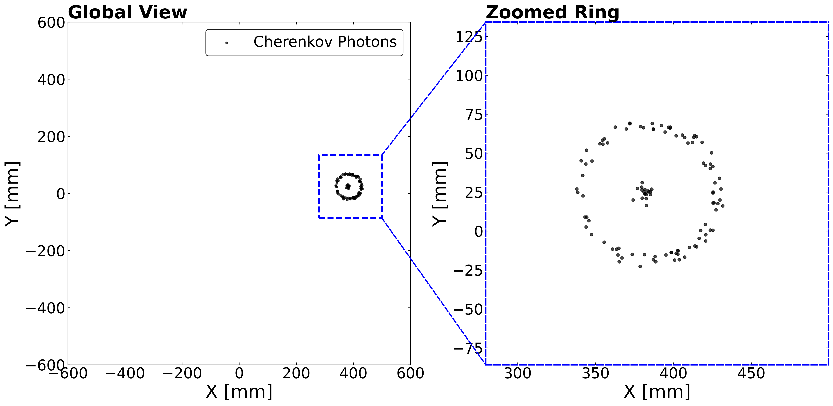
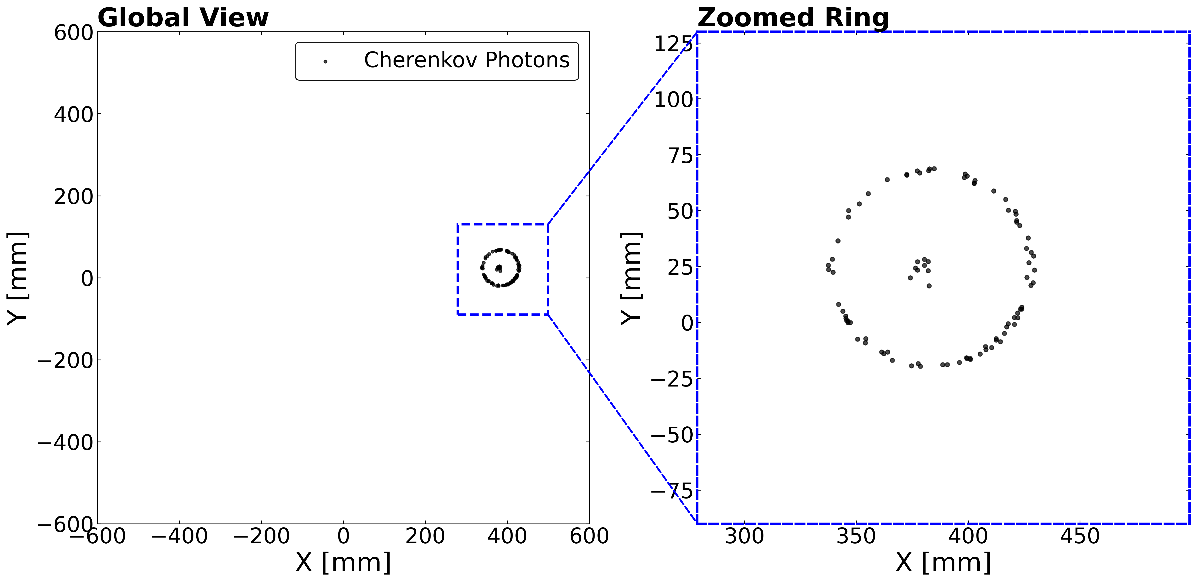


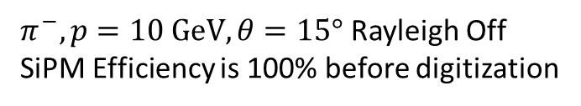
Gradient Refractive Index
$$n=1.008$$
$$n=1.007, 1.008, 1.009$$
Cherenkov ring is more “focused” after adopting gradient refractive index
$π^{−}, p=10 GeV, θ=15°$ Rayleigh Off
SiPM Efficiency is 100% before digitization
Notes:
Here we verify the focusing effect directly in the optical simulation. This example uses a 10 GeV pion at a 15-degree incident angle. To isolate the pure optical effect, Rayleigh scattering is off and the detection efficiency is 100% — before any detector response is applied. The two images show the hit distribution on the SiPM plane. Left: uniform refractive index, no gradient. Right: gradient refractive index applied. Each panel has a global view of the full detector plane and a zoomed inset focusing on the ring region. The difference is clear in the zoomed views. Without the gradient, the ring has a visible width — part of that comes from photons emitted at different depths. With the gradient, the ring is noticeably narrower and sharper. Photons from different emission depths are focused more tightly onto the same radius. This confirms the design expectation: the focusing aerogel sharpens the ring, which improves the single-photon angular resolution and in turn the PID separation power.

Slide 9
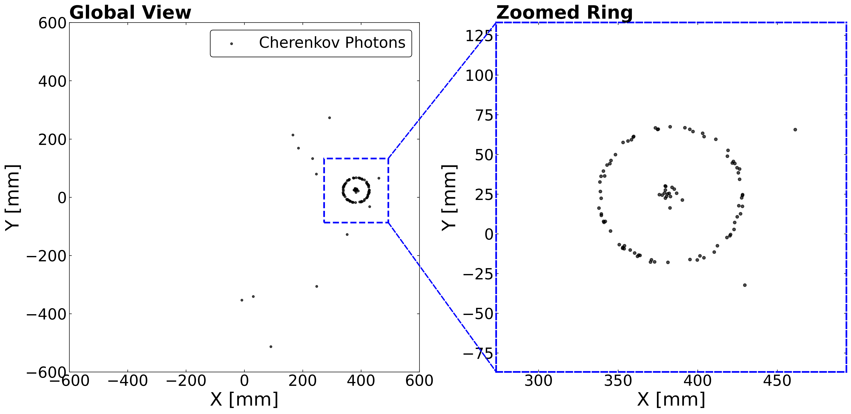
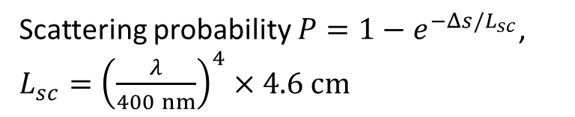
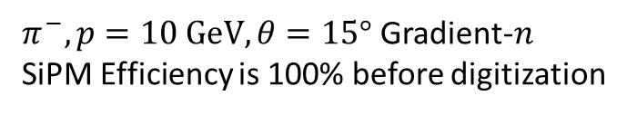
Rayleigh Scattering
Scattering probability $P=1−e^{−Δs/L_{sc}}$, $L_{sc}={\left(\frac{λ}{400 nm}\right)}^{4}×4.6 cm$
Photons elastically interact with microscopic refractive-index fluctuations, changing direction while conserving energy
Rayleigh Off
Rayleigh On
Realistic physical response, more background hits
$π^{−}, p=10 GeV, θ=15°$ Gradient-$n$
SiPM Efficiency is 100% before digitization
Notes:
Next, Rayleigh scattering. This is an optical process that is important for getting the simulation right. The aerogel, and the air is nano-porous at the microscopic level, there are unavoidable density fluctuations, which create tiny random variations in the refractive index. When a Cherenkov photon encounters such a fluctuation, it gets elastically scattered: the direction changes, but the wavelength and energy stay the same. The two images compare the same event — Rayleigh off on the left, Rayleigh on on the right. With Rayleigh active, two things happen: fewer photons land exactly on the ring, and additional background hits appear across the detector plane. The ring structure itself, though, is still clearly visible.

Slide 10
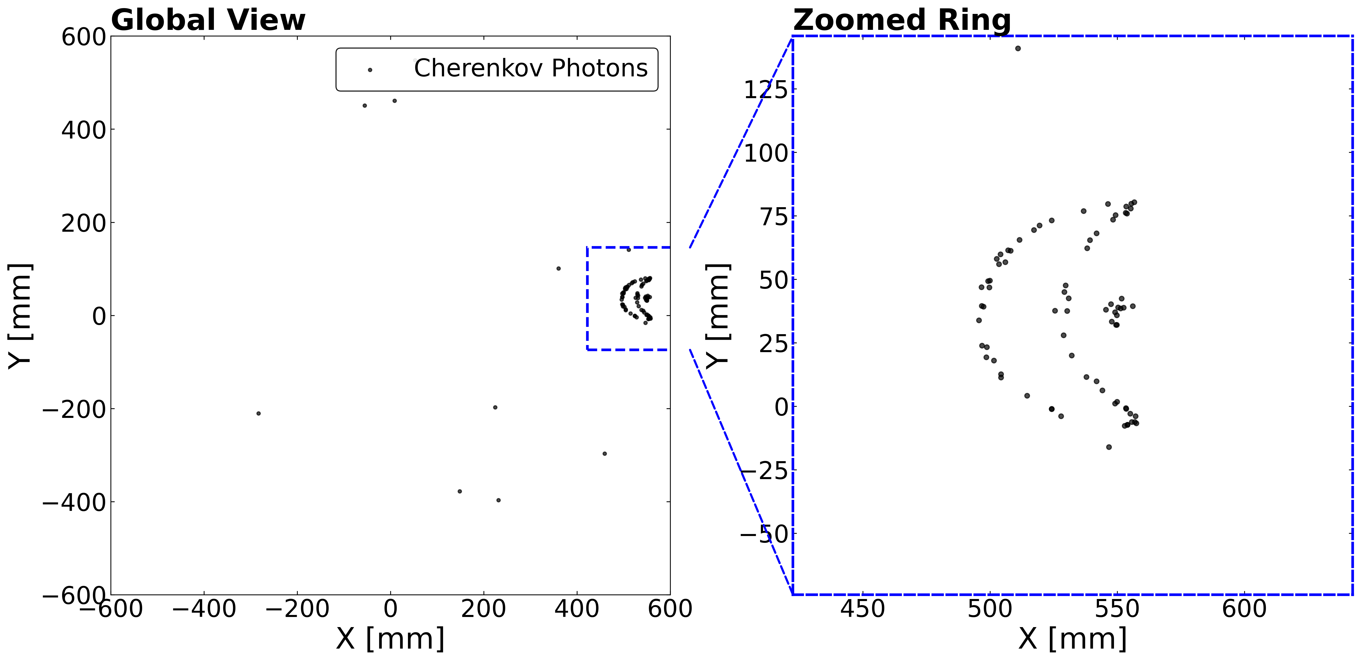
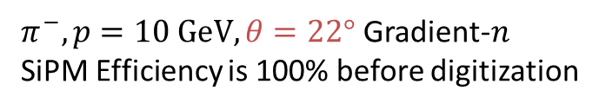
Reflection
TPC
Direct hits
Reflected hits
Direct hits
Reflected hits
Conceptual diagram, not to scale
More complex topology after reflected by ESR
$π^{−}, p=10 GeV, θ=22°$ Gradient-$n$
SiPM Efficiency is 100% before digitization
Notes:
Another important optical effect is reflection from the side walls. The inner walls of the RICH volume are lined with a reflector — and as just said, the specific material is still under discussion. The reflector is necessary because at larger incident angles, a significant fraction of Cherenkov photons would otherwise escape the detector volume without reaching the SiPM plane. The reflector redirects these photons back toward the detection plane, recovering what would otherwise be lost acceptance. The left panel illustrates this geometry. Without a reflective wall, photons emitted at larger angles simply exit the detector and are lost, creating a detection gap in some region. The right panel shows a simulated event at 22 degrees incident angle where the reflector is in place. The detected pattern is dominated by reflected photons — you can see complex, overlapping arc-like structures rather than a single clean ring. This poses a real reconstruction challenge. Algorithms that work well for clean direct rings at smaller angles will struggle with these reflected topologies. A more robust approach for the large-angle region is clearly needed, and this is part of the algorithm development in our next steps.

Slide 11

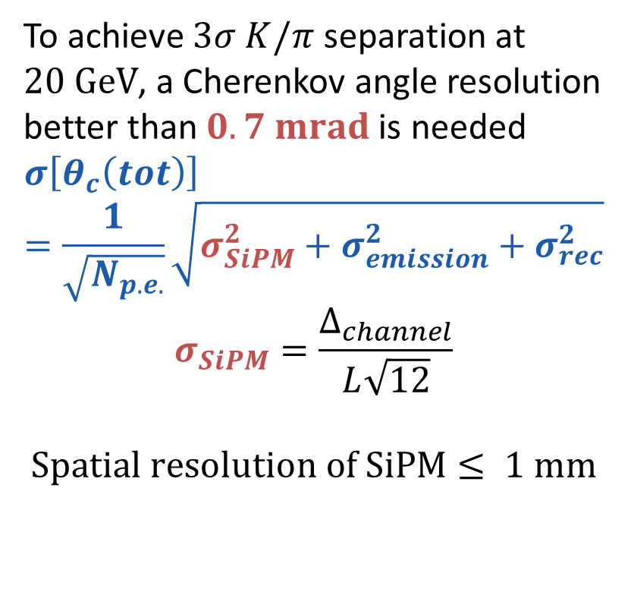
SiPM Granularity
$$N_{σ}≈\frac{\left|m_{1}^{2}−m_{2}^{2}\right|}{2p^{2}σ\left[θ_{c}\left(tot\right)\right]\sqrt{n^{2}−1}}$$
To achieve $3σ K/π$ separation at $20 GeV$, a Cherenkov angle resolution better than $0.7 mrad$ is needed
$$σ\left[θ_{c}\left(tot\right)\right]=\frac{1}{\sqrt{N_{p.e.}}}\sqrt{σ_{SiPM}^{2}+σ_{emission}^{2}+σ_{rec}^{2}}$$
$$σ_{SiPM}=\frac{Δ_{channel}}{L\sqrt{12}}$$
$$Spatial resolution of SiPM≤ 1 mm$$
By Qin Zhonghua
Notes:
Now moving to the SiPM readout. The SiPM — Silicon Photomultiplier — is an array of independent avalanche photodiodes, each operating in Geiger mode. The pixel pitch, or granularity, is the physical size of each pixel. Smaller pixels give better spatial resolution but require more readout channels. The physics target is 3-sigma K-pi separation at 20 GeV/c. Working forward from this target, the Cherenkov angle resolution must be better than roughly 0.7 mrad. Here we consider the spatial resolution depending on the pixel pitch. Given our 30-centimeter drift distance, the required angular resolution translates into a pixel pitch of about 1 millimeter. This is the value we've adopted for the current simulation. Before digitization, every optical photon reaching the sensitive plane is treated as an ideal hit. The real detector effects — PDE, dark noise, and the 1-millimeter granularity — are applied in the digitization step that follows.

Slide 12
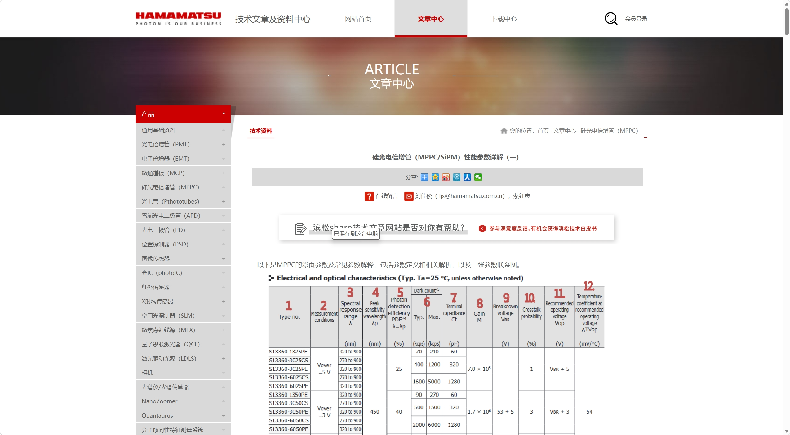
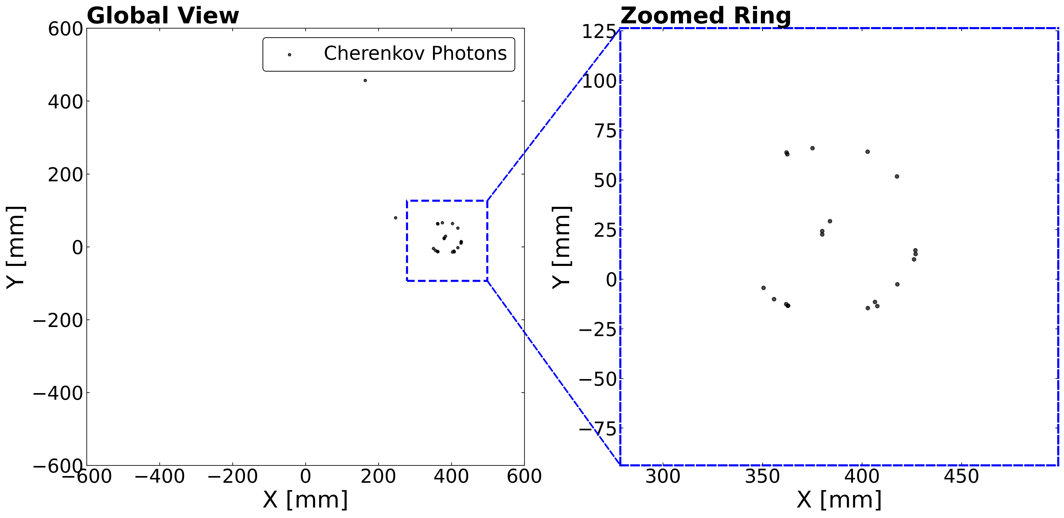
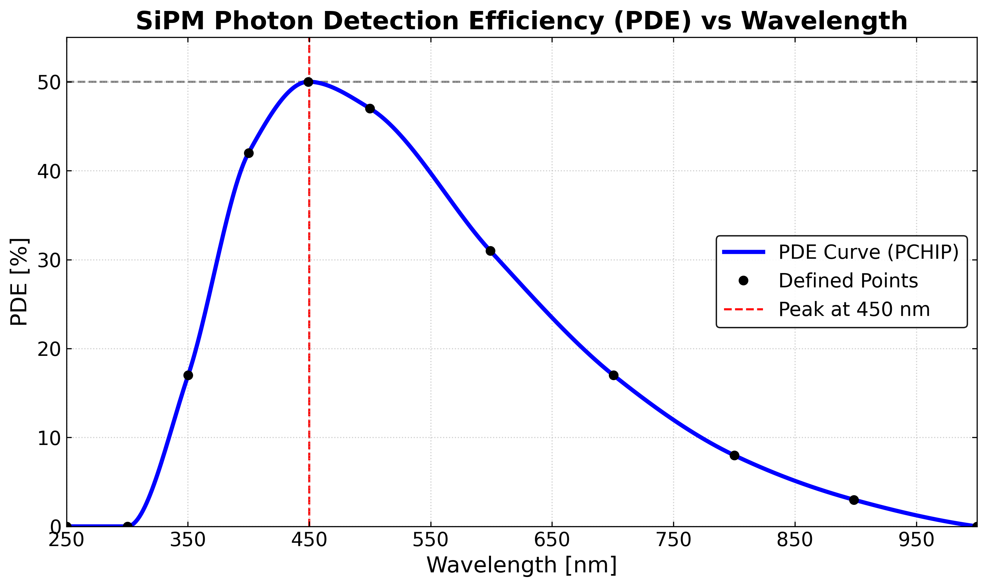
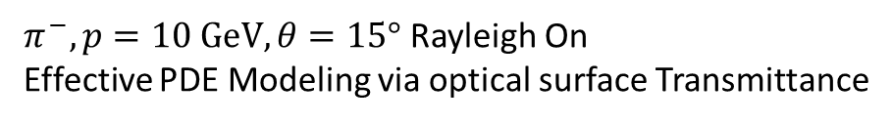
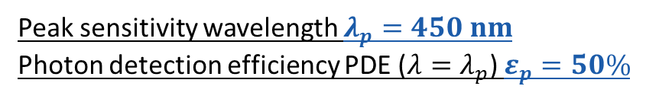
Photon Detection Efficiency
101 photons
http://share.hamamatsu.com.cn/specialDetail/2018.html
PDE
22 photons
PDE Curve
Peak sensitivity wavelength $λ_{p}=450 nm$
Photon detection efficiency PDE ($λ=λ_{p}$) $ε_{p}=50\%$
$π^{−}, p=10 GeV, θ=15°$ Rayleigh On
Effective PDE Modeling via optical surface Transmittance
Notes:
This slide shows the photon detection efficiency used in our simulation. PDE is the probability that a photon arriving at the SiPM surface actually produces a detectable signal. It combines three factors: the quantum efficiency of the silicon, the probability that this charge triggers a Geiger avalanche, and the geometric fill factor of the SiPM surface. PDE depends strongly on wavelength, so we need a curve, not a single number. The plot has wavelength on the horizontal axis, from about 200 to 900 nanometers, and PDE on the vertical axis, from zero to about 50 percent. The curve rises from low efficiency in the UV, peaks near 450 nanometers, and falls toward longer wavelengths — typical for silicon photodetectors. A word on where this curve comes from, because it's an implementation detail worth noting. Hamamatsu provides the peak wavelength — around 450 nanometers — and the peak PDE value — roughly 50 percent — directly in their specifications. The general curve shape also appears in their datasheets. But the detailed, wavelength-by-wavelength values are not tabulated. For our simulation, I read off PDE values at several specific points from the published Hamamatsu curve and interpolated to construct the continuous curve you see here. So the shape comes from Hamamatsu, but the numerical implementation is a manual interpolation. If anyone here happens to have access to more detailed Hamamatsu PDE data or functional forms, I would be grateful for the reference. In the code, PDE is implemented as an optical-surface transmittance — photons that are not detected are simply removed during optical transport. This is a computational optimization.

Slide 13
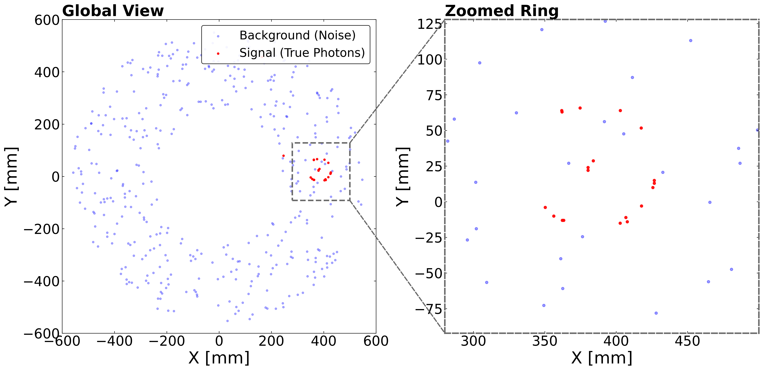

Dark Noise
Type no. | Size | Typ. Dark count (kHz / tile) | Typ. Dark count (kHz / mm^2)
S13360-1375 | 1.3 × 1.3 mm² | 90 | 53.25
S13360-3075 | 3.0 × 3.0 mm² | 500 | 55.56
S13360-6075 | 6.0 × 6.0 mm² | 2000 | 55.56
Dark count rate is independent from SiPM size
http://share.hamamatsu.com.cn/specialDetail/2018.html
Area 0.808 m^2
Time Window = 5 ns
Dark Rate = 100 kHz / mm^2
$π^{−}, p=10 GeV, θ=15°$ Rayleigh On
Notes:
After PDE, we add dark noise to the SiPM plane. A SiPM pixel in Geiger mode can fire even in complete darkness — this happens because thermal vibrations in the silicon occasionally generate an electron-hole pair that triggers an avalanche, identical to a real photon signal. These dark hits are indistinguishable from single-photon signals at the pixel level, which is why they directly affect PID performance. Dark noise is intrinsic to silicon detectors — it can be reduced by cooling, but not eliminated. The total SiPM active area is about 0.8 square meters. The readout time window is 5 nanoseconds. Cherenkov photons from a single track all arrive within a very narrow time and the SiPM itself has a fast response with a rise time of about 1 nanosecond. A 5-nanosecond window comfortably captures all signal photons while keeping the dark-noise integration short. Extending the window further would only add more dark counts without gaining signal. For the dark count rate, we use 100 kilohertz per square millimeter — a conservative estimate. The table shows typical Hamamatsu values for several tile sizes. The key point is that the dark count normalized by area is nearly constant, around 50 to 55 kHz per square millimeter across different sizes. As with other parameters, I should note that the specific SiPM model is not yet selected. The PDE curve, dark count rate, and time window are all provisional — reasonable values for this phase of the study — and will be updated when a model is chosen.

Slide 14
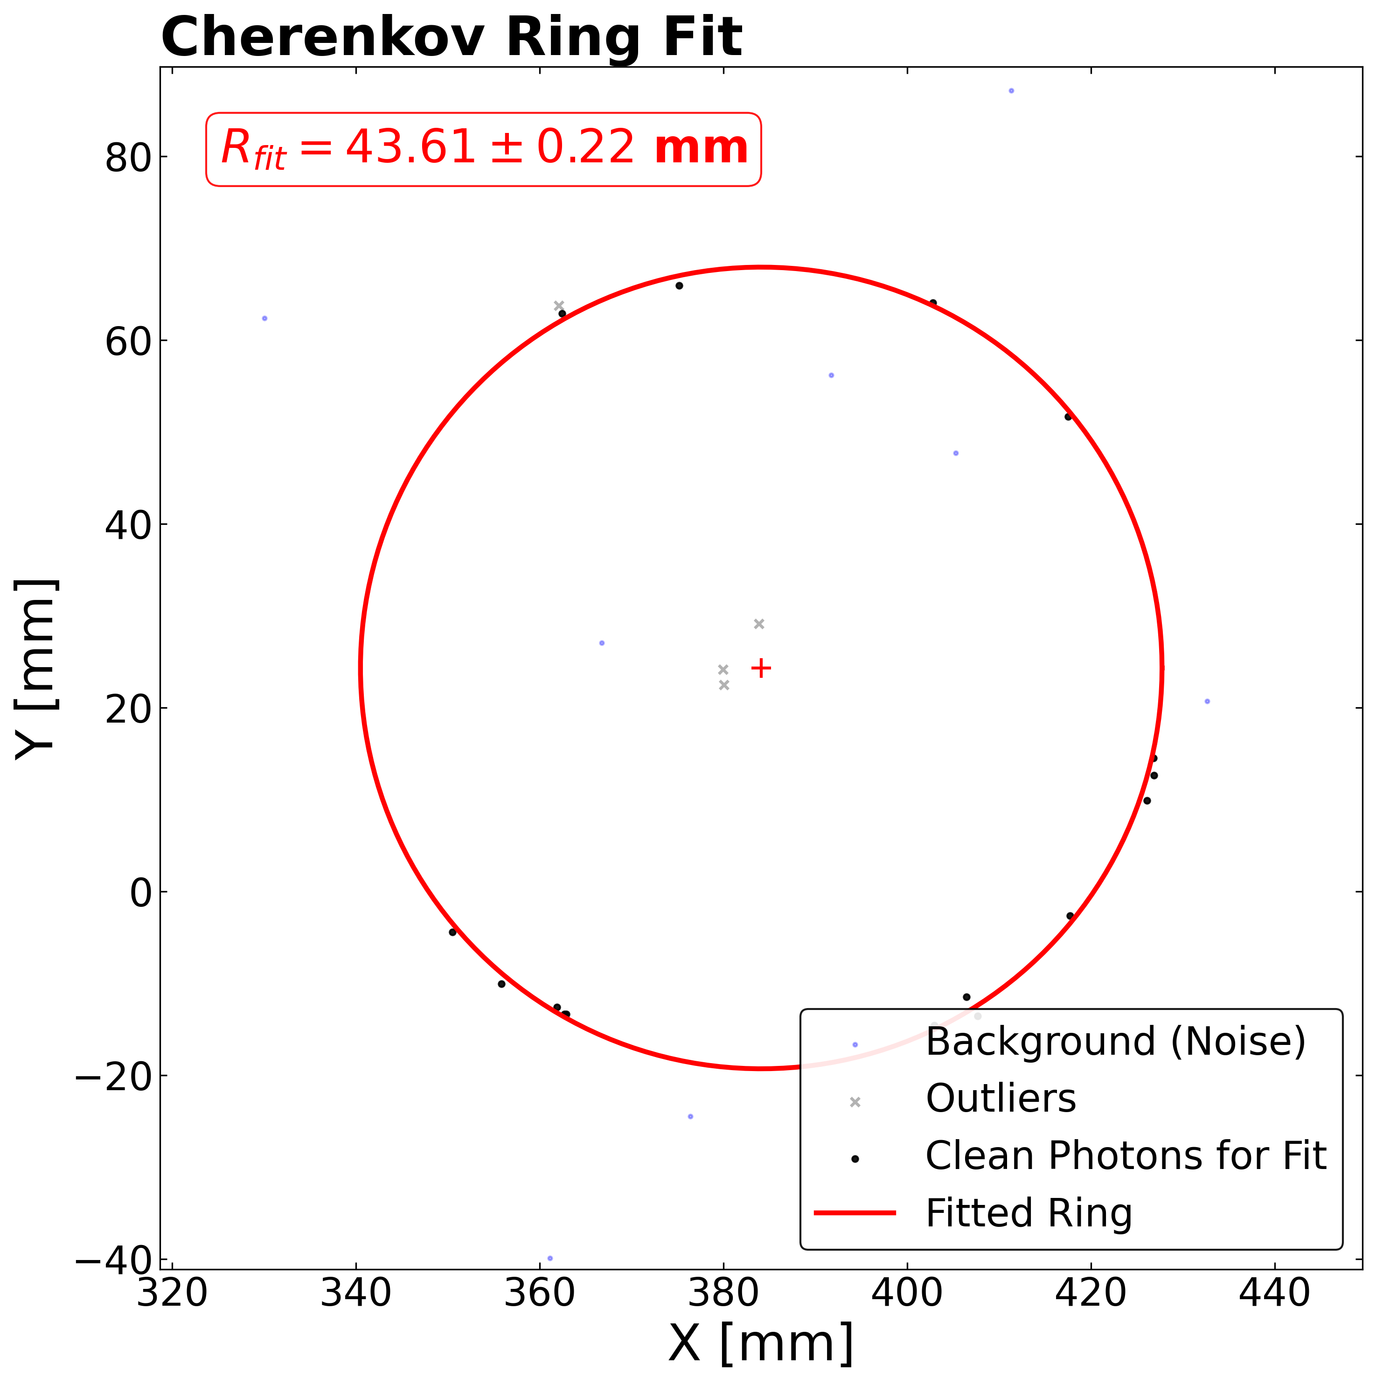
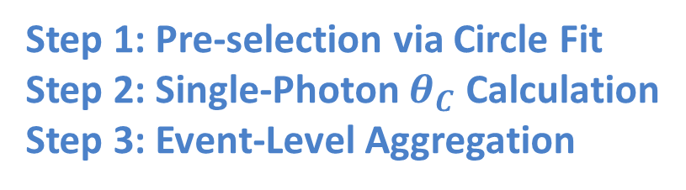
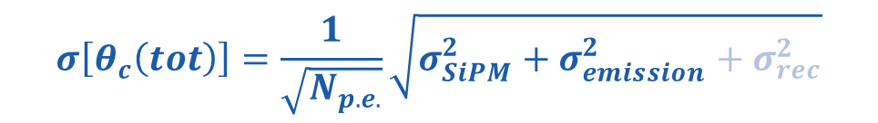
Simplified Reconstruction
Realistic detector response with:
Focusing aerogel
Rayleigh scattering
Absorption
Boundary (refraction & reflection)
SiPM PDE
Dark Noise
Assuming photon hits and dark noise can be separated completely
Step 1: Pre-selection via Circle Fit
Step 2: Single-Photon $θ_{C}$ Calculation
Step 3: Event-Level Aggregation
$$σ\left[θ_{c}\left(tot\right)\right]=\frac{1}{\sqrt{N_{p.e.}}}\sqrt{σ_{SiPM}^{2}+σ_{emission}^{2}+σ_{rec}^{2}}$$
Notes:
Before showing the performance results, I should explain the reconstruction method — This is not a mature reconstruction algorithm. It is an ideal performance benchmark — its purpose is to establish the upper limit of what the detector hardware can deliver. Any realistic reconstruction algorithm will approach this number but won't exceed it. The simulation input is realistic — it includes the focusing aerogel, Rayleigh scattering, absorption, boundary refraction and reflection, the PDE, and dark noise. Everything I've described so far is in the simulation. The reconstruction, however, makes one crucial idealization: it assumes that true signal photons and dark-noise hits can be perfectly separated. In a real detector, we don't know hit-by-hit which ones are signal and which are noise. This assumption is one of the biggest gaps between the benchmark and reality. The workflow has three steps. First, a circle fit is used as a pre-selection filter — its purpose is to reject photons with large-angle Rayleigh scattering and photons produced in air. The circle fit is not the final angle measurement. Second, for each photon that passes the pre-selection, the Cherenkov angle is computed using the hit position together with the truth-level primary-particle position and momentum at the aerogel plane — this is another idealization, since in a real experiment we don't know the exact particle trajectory. Third, the event-level Cherenkov angle is the mean of all selected photons. So the results I'll show next represent the detector hardware potential under a best-case pattern recognition assumption. They are not a prediction of final PID performance. Quantifying the gap between this benchmark and realistic reconstruction is a main focus of our ongoing work.

Slide 15
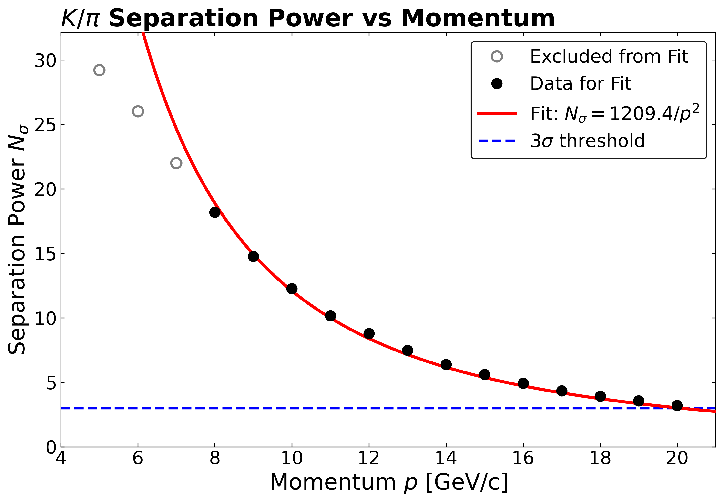
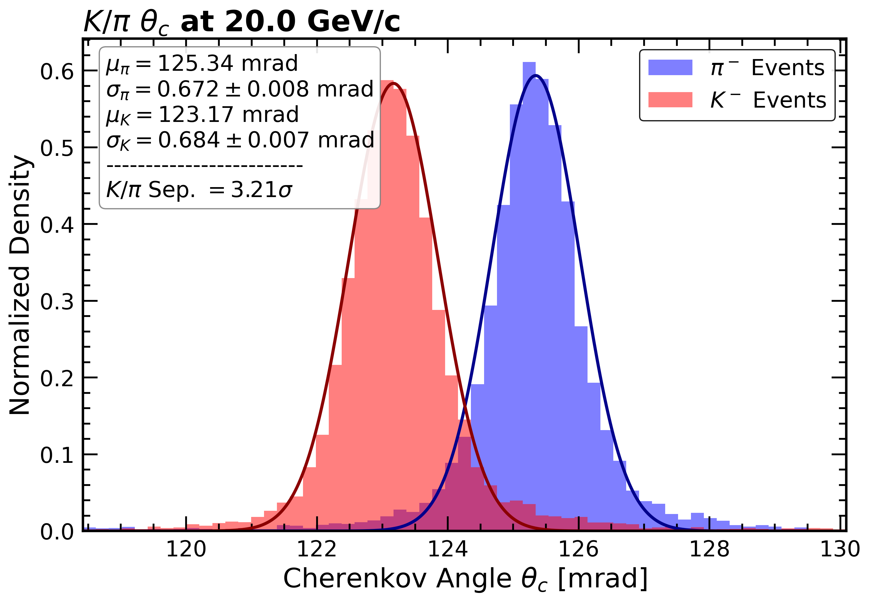
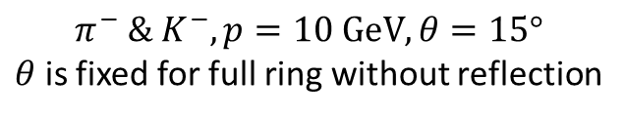

Performance Evaluation
$$N_{σ}=3.21>3 @ 20 GeV$$
$$π^{−} \& K^{−}, p=10 GeV, θ=15°$$
$θ$ is fixed for full ring without reflection
Notes:
Here are the K-pi separation results from the ideal benchmark. The horizontal axis is particle momentum in GeV/c. The vertical axis is separation power in units of sigma — the angular difference between kaon and pion Cherenkov angles divided by the angular resolution. The evaluation is at a fixed 15-degree incident angle, where the rings are direct and complete, with no wall reflection. As expected, the separation power decreases with momentum. At low momentum, the pion and kaon have substantially different velocities, so their Cherenkov angles are well separated. As momentum increases, both particles approach the speed of light, the velocities converge, and the angular difference shrinks — this is the fundamental limitation of any Cherenkov-based PID. The key number: at 20 GeV/c, the separation power is about 3.2 sigma, meeting our target. Now, this is obtained under the ideal reconstruction assumption — it shows that the detector hardware has the intrinsic capability. The actual performance after realistic reconstruction will be lower. Quantifying that degradation is what we will work on in the next stage.

Slide 16
Summary
Progress: simulation chain established
Geometry & material
Optical response
SiPM digitization
PID potential
Outlook:
Focusing aerogel: thicker radiator increases photon yield; gradient n suppresses emission-point uncertainty
Optical processes: Cherenkov, boundary (refraction / reflection), absorption and Rayleigh scattering included
1 mm spatial resolution SiPM, parameters from Hamamatsu (PDE, DCR and time window), results acceptable
K/π separation ~3.2σ @ 20 GeV achieved, Detector configuration proven feasible
Next step: evaluation + reconstruction
01
Dark-noise impact assessment
quantify PID degradation versus dark counts
02
Reconstruction algorithm development
Maximum Likelihood + Hough Transform for noisy and reflected rings
03
Full-chain PID evaluation
performance after realistic response and reconstruction
Thank you!
Notes:
To summarize what we've covered. The simulation chain is now fully established. The DD4hep geometry is implemented in CEPCSW, and the first material-budget study confirms that the RICH must coexist with the tracking system — material budget is a hard constraint. The optical response includes the focusing aerogel with gradient refractive index, Rayleigh scattering, absorption, and boundary reflection. SiPM digitization includes wavelength-dependent PDE and a dark-noise model with conservative parameters. Under the ideal reconstruction benchmark, the detector reaches about 3.2-sigma K-pi separation at 20 GeV/c. This meets the physics requirement at the level of hardware potential. Now, the next steps. First: dark noise impact quantification — we need to remove the perfect signal-noise separation assumption and systematically quantify how dark noise degrades PID. Second: reconstruction algorithm development — a realistic method combining robust ring finding with a maximum-likelihood angle fit, designed to handle both noisy direct rings and complex reflected topologies. Third: full-chain PID evaluation — realistic detector response together with realistic reconstruction, to provide the final end-to-end performance prediction. Thank you very much. I'm happy to take questions.

