Slide 1


  Progress on the CEPC collider ring beam dynamics study
Yiwei Wang, Bin Wang, Xiangyu Tan, Fang Yan, Yuanyuan Wei
CEPC day, 26 May 2026
IHEP

Slide 2
Outline
Ground motion study progress
IP tuning simulation for lattices with errors
Progress of the global static error study with solenoid field
Summary and further work

Slide 3
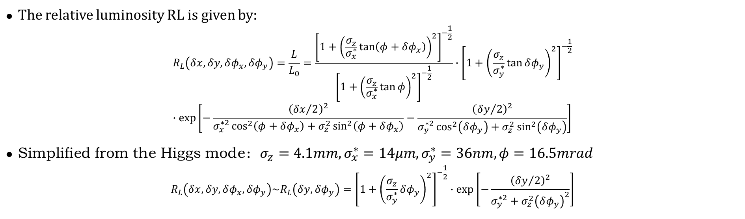
Luminosity reduction caused by displacement and angular errors
Xiangyu Tan, Fang Yan, Yiwei Wang
The relative luminosity RL is given by:
$$R_{L}\left(δx,δy,δφ_{x},δφ_{y}\right)=\frac{L}{L_{0}}=\frac{{\left[1+{\left(\frac{σ_{z}}{σ_{x}^{∗}}\tan\left(φ+δφ_{x}\right)\right)}^{2}\right]}^{−\frac{1}{2}}}{{\left[1+{\left(\frac{σ_{z}}{σ_{x}^{∗}}\tan{φ}\right)}^{2}\right]}^{−\frac{1}{2}}}∙{\left[1+{\left(\frac{σ_{z}}{σ_{y}^{∗}}\tan{δφ_{y}}\right)}^{2}\right]}^{−\frac{1}{2}} \\ ∙\exp\left[−\frac{{\left({δx}/2\right)}^{2}}{σ_{x}^{∗2}\cos^{2}\left(φ+δφ_{x}\right)+σ_{z}^{2}\sin^{2}\left(φ+δφ_{x}\right)}−\frac{{\left({δy}/2\right)}^{2}}{σ_{y}^{∗2}\cos^{2}\left(δφ_{y}\right)+σ_{z}^{2}\sin^{2}\left(δφ_{y}\right)}\right]$$
Simplified from the Higgs mode：$σ_{z}=4.1mm,σ_{x}^{∗}=14μm,σ_{y}^{∗}=36nm,φ=16.5mrad$
$$R_{L}\left(δx,δy,δφ_{x},δφ_{y}\right)\sim R_{L}\left(δy, δφ_{y}\right)={\left[1+{\left(\frac{σ_{z}}{σ_{y}^{∗}}δφ_{y}\right)}^{2}\right]}^{−\frac{1}{2}}∙\exp\left[−\frac{{\left({δy}/2\right)}^{2}}{σ_{y}^{∗2}+σ_{z}^{2}{\left(δφ_{y}\right)}^{2}}\right]$$
Reference: O. Napoly, PA 40 (1993) 180
Luminosity degradation is primarily caused by vertical (y-direction) displacement and angular errors.
The impact of angular errors on luminosity is significantly more pronounced than that of displacement errors.

Slide 4

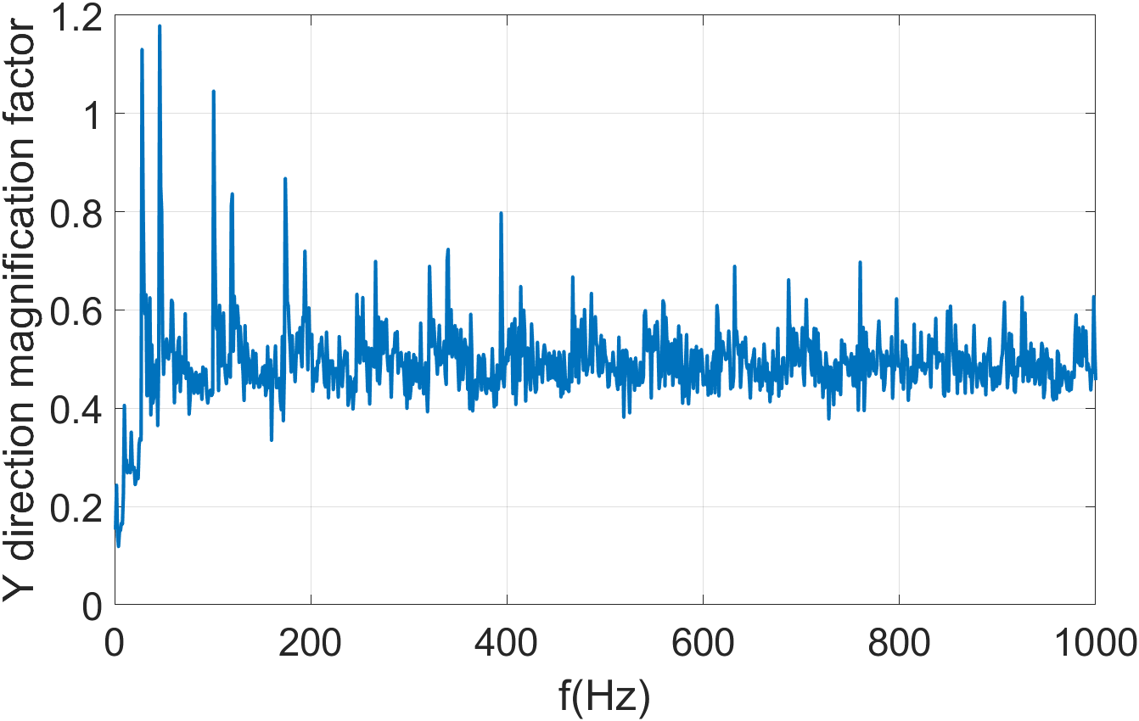
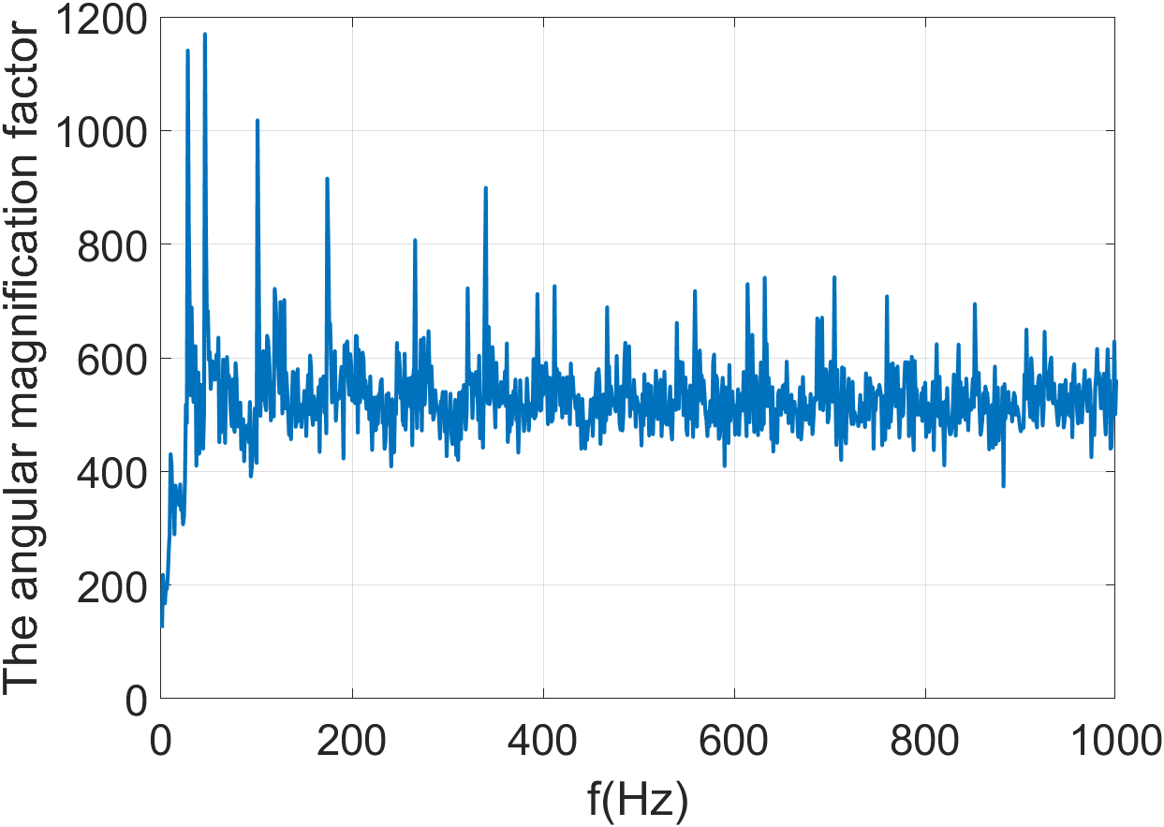
Vibration influence analysis with frequency-dependent coherences
Xiangyu Tan, Fang Yan, Yiwei Wang
Initially, the quadrupole magnets on the two rings were divided into two regions, with coherent vibrations applied to each region separately.
Region1：
IP1
Region2：
IP2
●Region1：the MDI quadrupoles
●Region2：all other quadrupoles

Slide 5
Vibration influence analysis with frequency-dependent coherences
Initially, the quadrupole magnets on the two rings were divided into two regions, with coherent vibrations applied to each region separately.
Region1：
Frequency range | Vibrations | y_rms | y'_rms | RL
1-100Hz | 4.2nm | 5e-3nm | 0.10μrad | 99.993%
0.1-100Hz | 47.3nm | 5e-3nm | 0.46μrad | 99.86%
IP1
Frequency range | Vibrations | y_rms | y'_rms | RL
1-100Hz | 4.2nm | 0.9nm | 1.1μrad | 99.24%
0.1-100Hz | 47.3nm | 3.1nm | 2.9μrad | 94.74%
1-100Hz | 16.8nm | 3.7nm | 4.7μrad | 88.18%
0.1-100Hz | 26.5nm | 4.1nm | 5.0μrad | 86.59%
Region2：
IP2
Two sets of vibration data from HEPS measurements
●Region1：the MDI quadrupoles
●Region2：all other quadrupoles
Insufficient coherence of low-frequency vibrations of the Region 2 quadrupoles causes the luminosity loss under the preset high vibration level to exceed the tolerance.

Slide 6
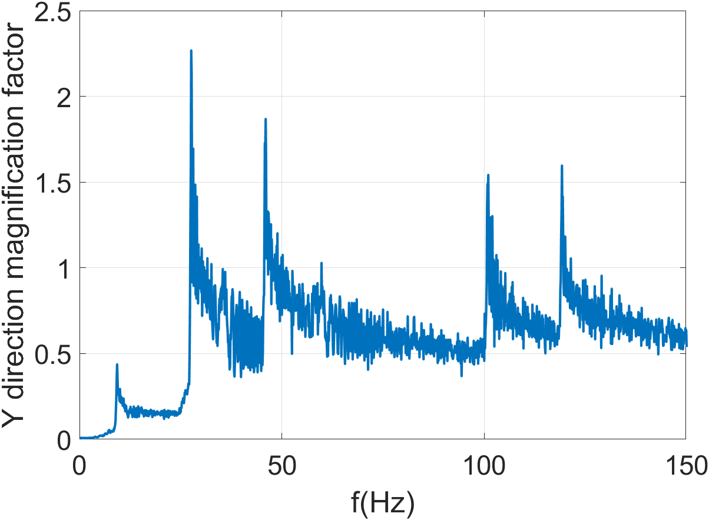



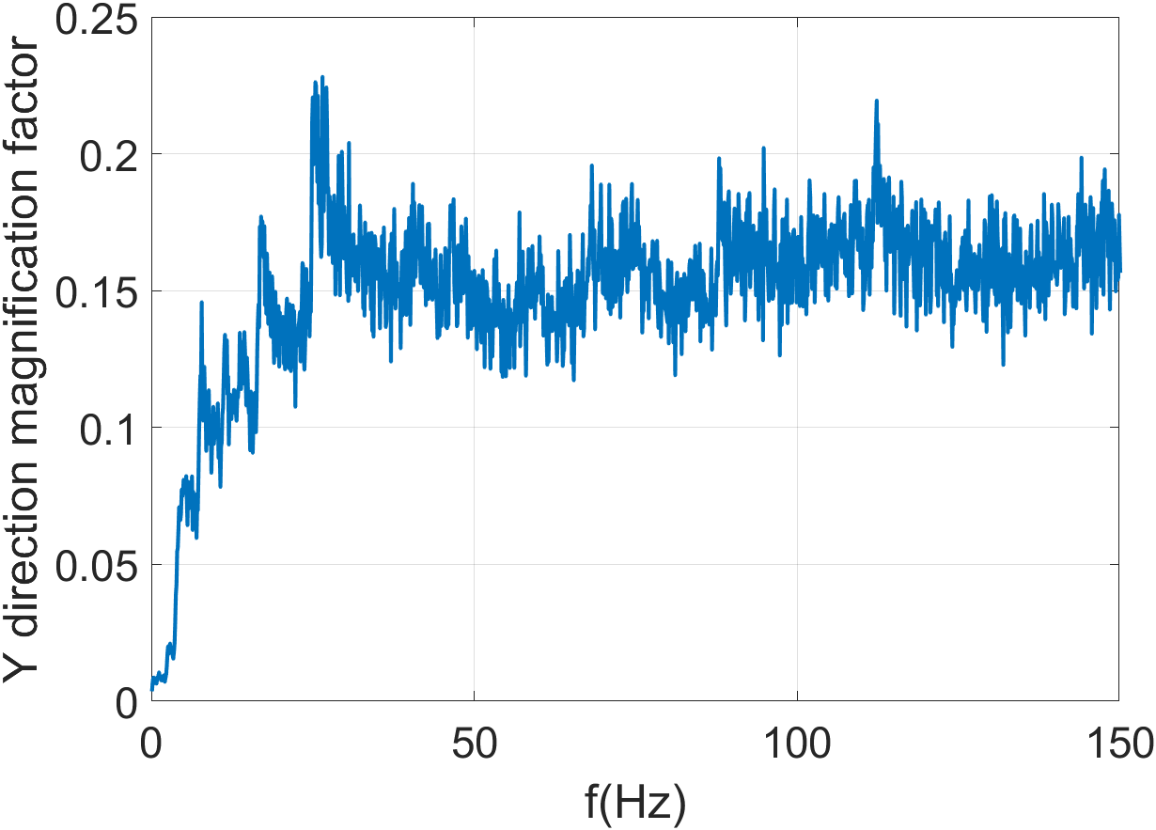
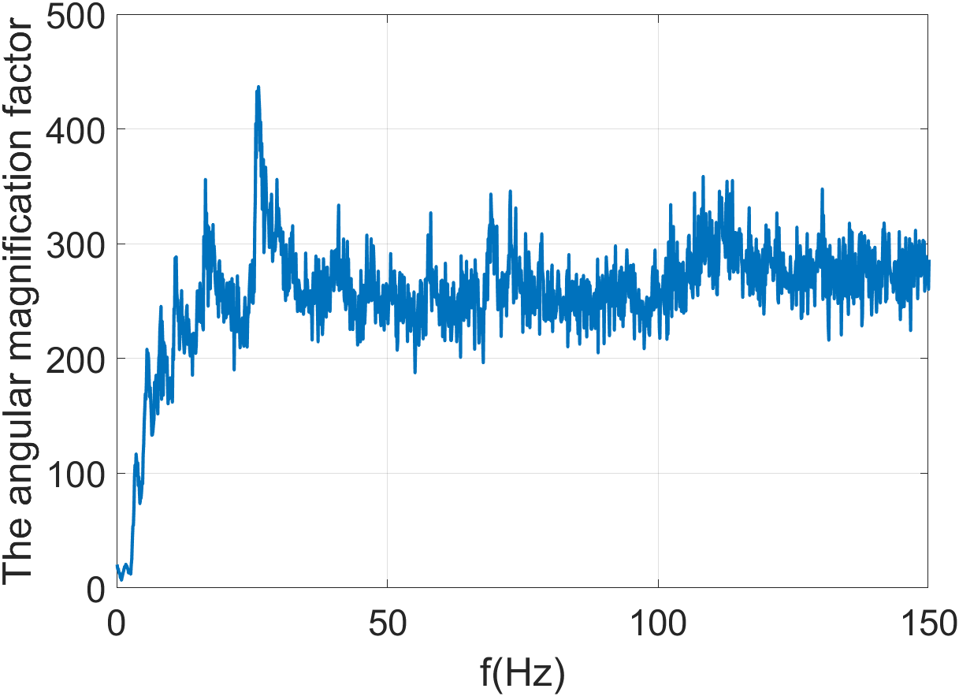
Vibration influence analysis with frequency-dependent coherences
Therefore, we further divide Region 2 into two regions.
Region2：
IP1
IP2
Region3：
●Region1：the MDI quadrupoles
●Region2：the arc quadrupoles
●Region3：all other quadrupoles

Slide 7
Vibration influence analysis with frequency-dependent coherences
Therefore, we further divide Region 2 into two regions
Frequency range | Vibrations | y_rms | y'_rms | RL
1-100Hz | 4.2nm | 0.5nm | 0.5μrad | 99.81%
0.1-100Hz | 47.3nm | 0.6nm | 0.6μrad | 99.75%
1-100Hz | 16.8nm | 2.1nm | 2.0μrad | 97.42%
0.1-100Hz | 26.5nm | 2.1nm | 2.0μrad | 97.41%
Region2：
IP1
Frequency range | Vibrations | y_rms | y'_rms | RL
1-100Hz | 4.2nm | 0.3nm | 0.7μrad | 99.70%
0.1-100Hz | 47.3nm | 0.5nm | 1.0μrad | 99.31%
1-100Hz | 16.8nm | 1.5nm | 3.2μrad | 93.85%
0.1-100Hz | 26.5nm | 1.5nm | 3.2μrad | 93.79%
IP2
Region3：
●Region1：the MDI quadrupoles
●Region2：the arc quadrupoles
●Region3：all other quadrupoles
Insufficient The region with poor low-frequency coherence is primarily located in Region 3. Therefore, the arc section can remain at a relatively high vibration level, while Region 3 must be maintained at a low vibration level.
Region 3 will be further divide into more regions for further checking the response from each regions.

Slide 8
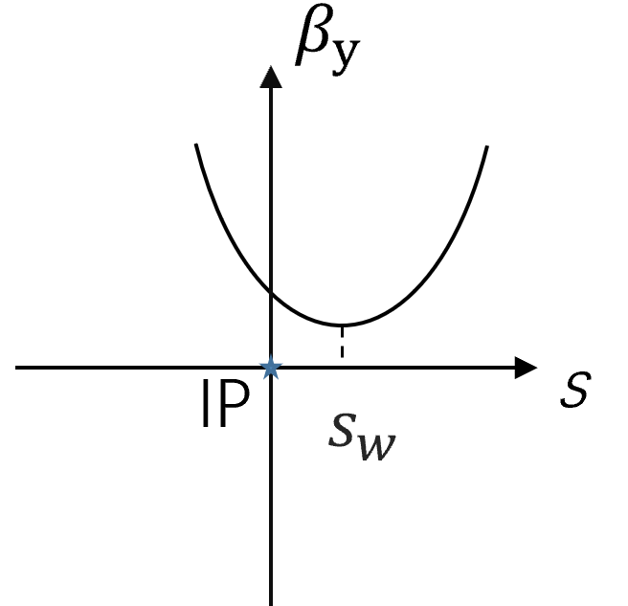

IP tuning simulation for lattices with errors
Generate 100 lattices with errors
Perform global optics corrections for the 100 lattices
IP tuning for every lattice: find the solutions of component strengths using SAD matching tool
Yuanyuan Wei, Bin Wang, Yiwei Wang
IP beta and waist knobs:
Constrains in fitting:
    β*, α*at IP
    optics (β, α and tunes not disturbed
outside the IR region)
For one side of IP including uses:
    2 Quadrupoles of FF
  dispersion free
    6 Quadrupoles in matching section
16 Quadrupoles in total
    Dispersion free region
Coupling knobs:
Constrains in fitting:
    R1，R2，R3，R4
D_{y}, D’_{y} at IP
    optics not disturbed
outside the knob region
For one side of IP including uses:
    1 skew coil on FF quadrupole
  dispersion free
    1 skew coil on sextuple
    4 skew coils on quadrupoles
  dispersive region
  12 skew components in total
$$α^{∗}=\frac{s_{w}}{β_{w}}$$
$${ β}^{∗}=β_{w}+\frac{s_{w}^{2}}{β_{w}}$$
$$γ^{∗}=\frac{1}{β_{w}}$$
Notes:
….

Slide 9
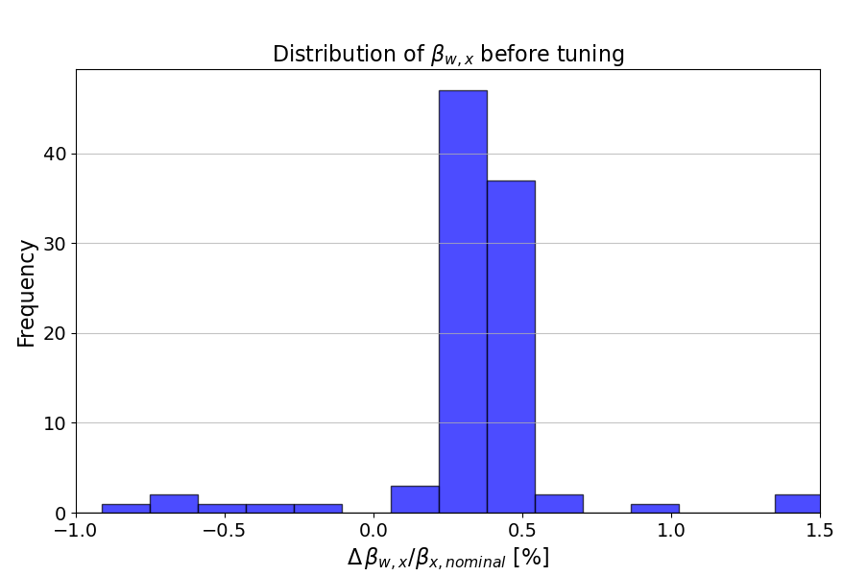
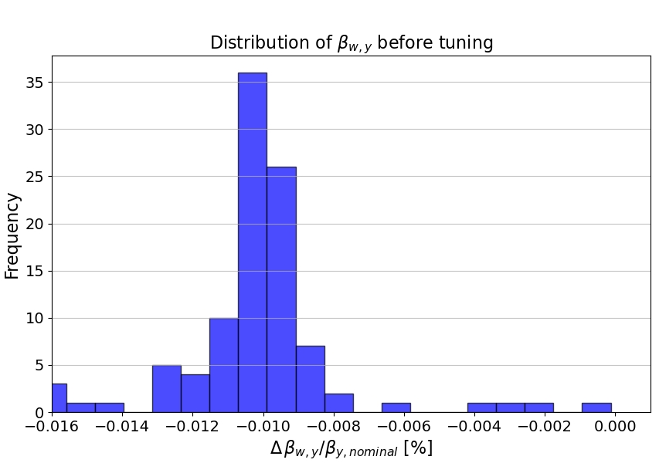
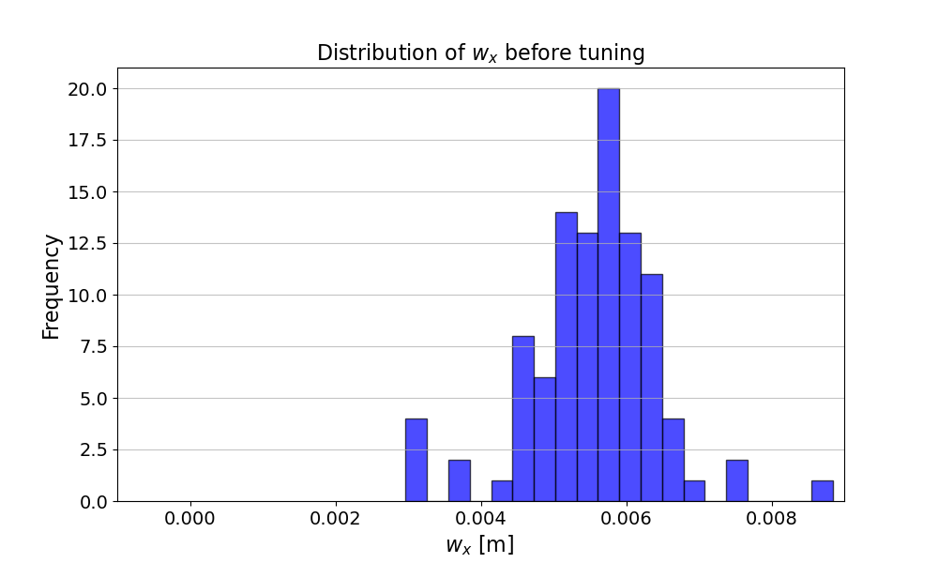
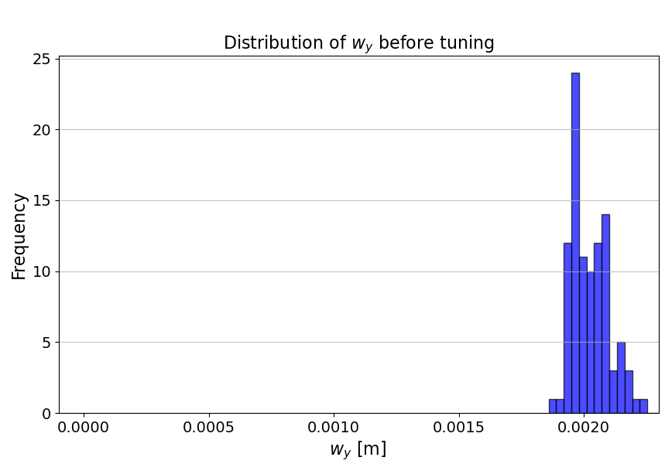
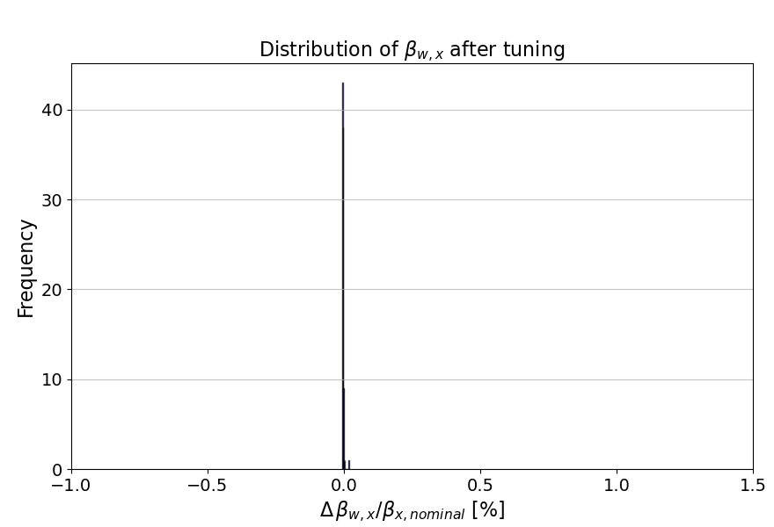
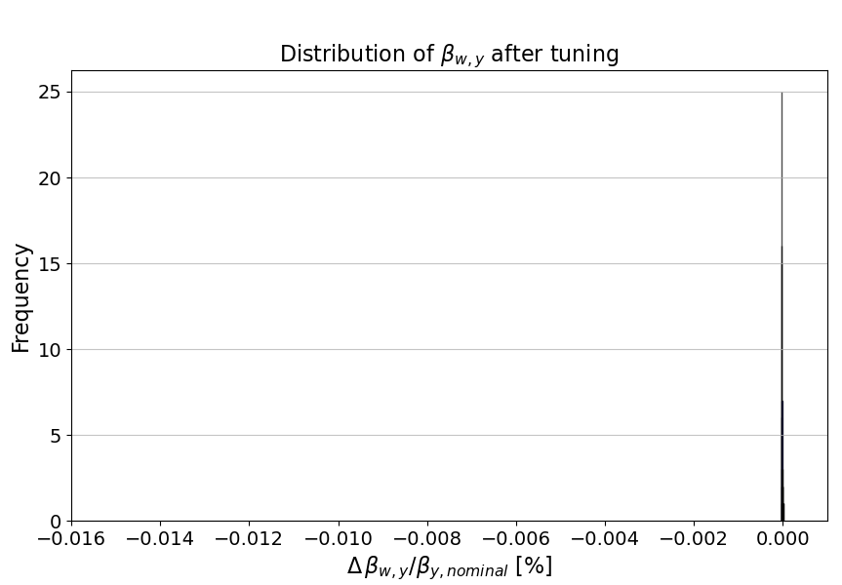
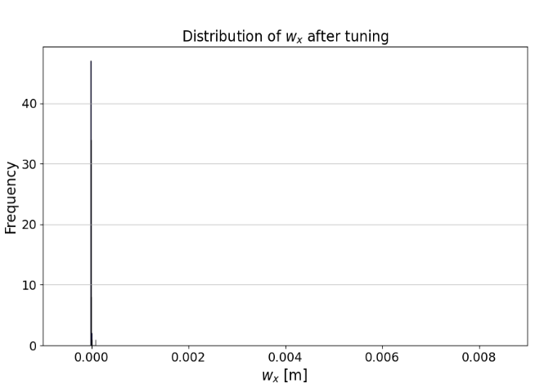
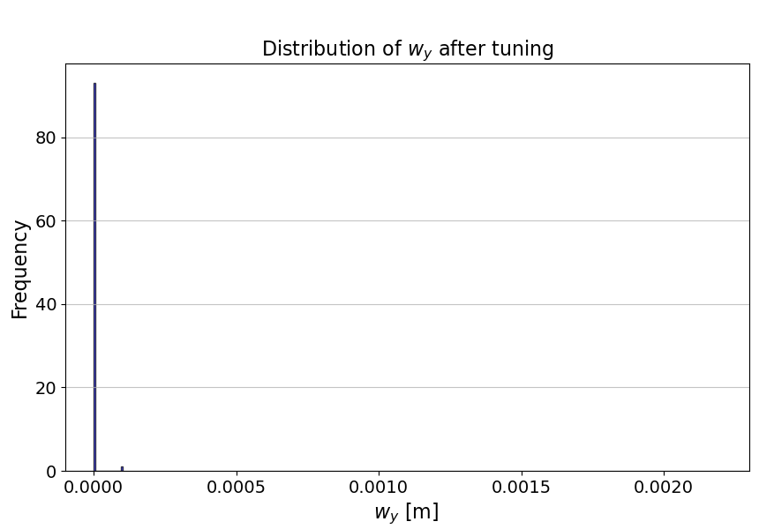
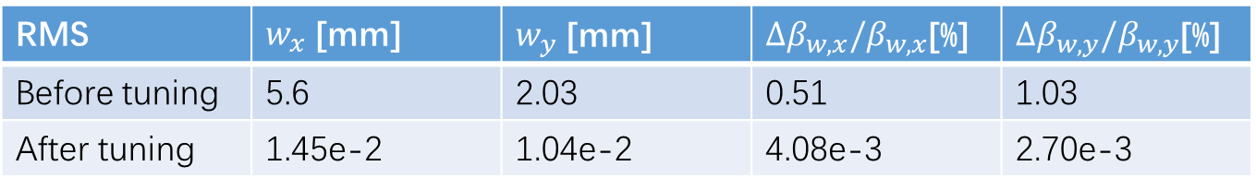
IP tuning simulation for lattices with errors
Perform waist shift and beta tuning at IP for 100 seeds after global optics correction
RMS | $w_{x}$ [mm] | $w_{y}$ [mm] | ${Δβ}_{w,x}/β_{w,x}$[%] | $Δβ_{w,y}/β_{w,y}$[%]
Before tuning | 5.6 | 2.03 | 0.51 | 1.03
After tuning | 1.45e-2 | 1.04e-2 | 4.08e-3 | 2.70e-3
The waist shift and beta can be well corrected after tuning.

Slide 10
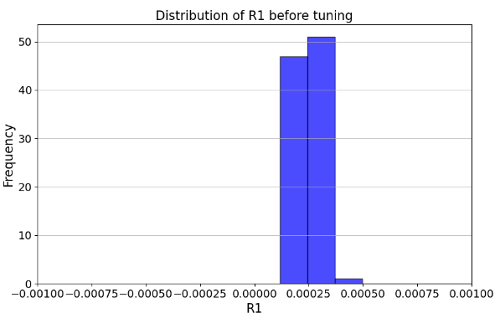
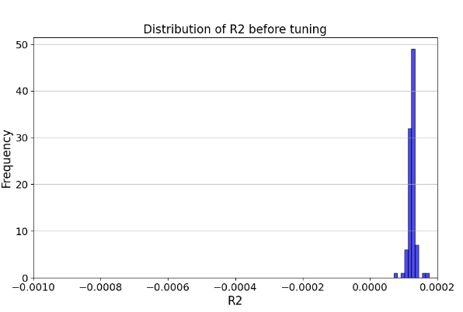
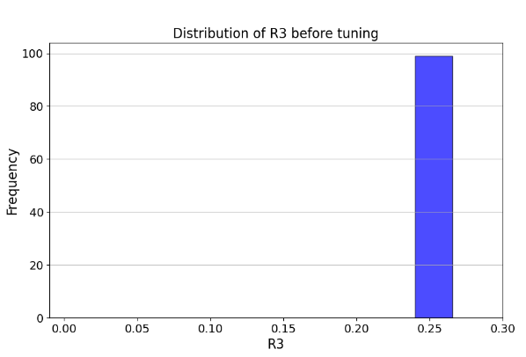
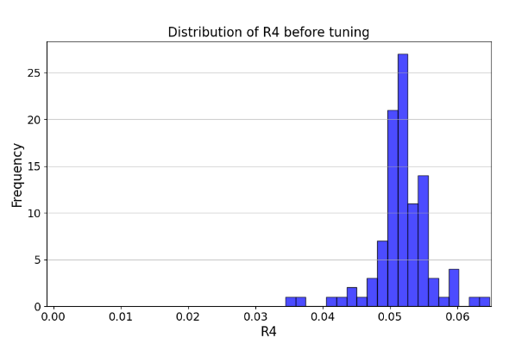
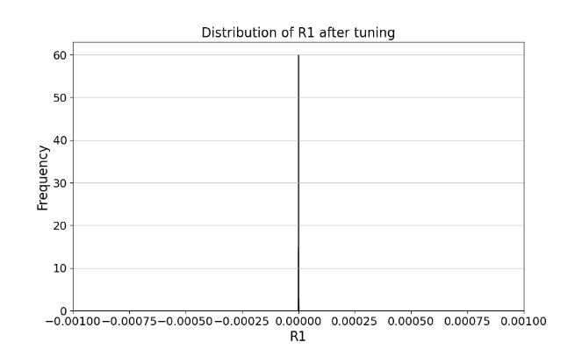
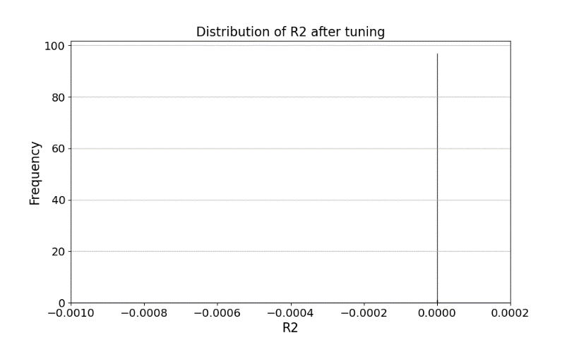
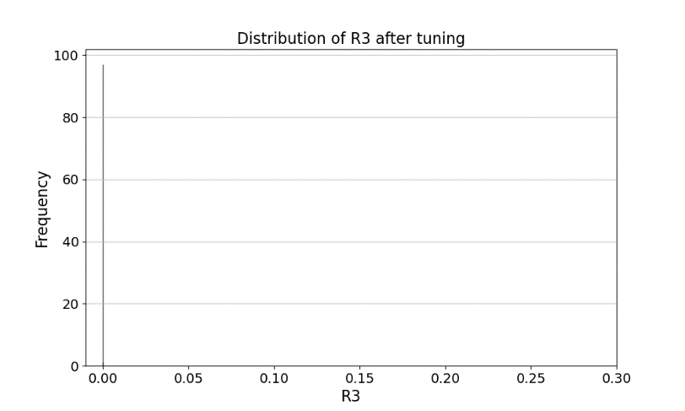
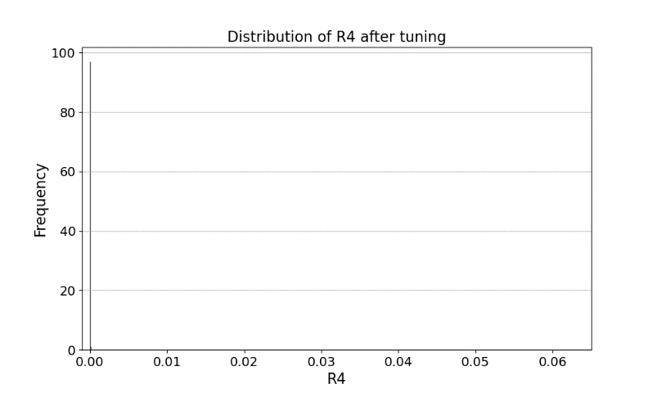
IP tuning simulation for lattices with errors
Perform coupling tuning at IP for 100 seeds after global optics correction
The coupling at IP can be well corrected after tuning.
RMS | R1 [rad] | R2 [m] | R3 [m⁻¹] | R4 [rad] | Dy [m] | Dpy [rad]
Before tuning | 3.62e-4 | 1.29e-4 | 0.25 | 0.052 | 3.40e-5 | 8.3e-3
After tuning | 8.05e-10 | 3.93e-8 | 5.41e-6 | 1.04e-5 | 3.34e-10 | 1.05e-6

Slide 11
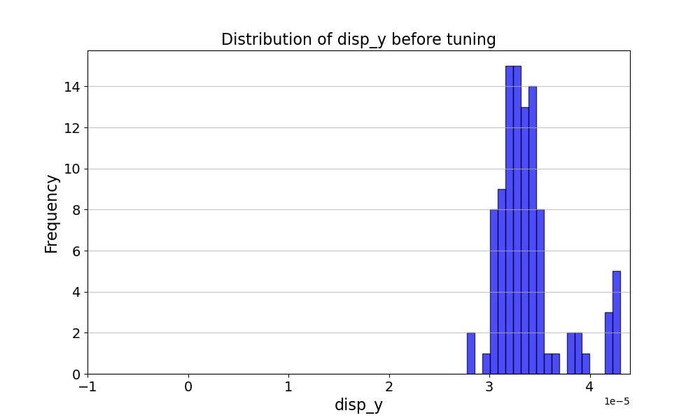
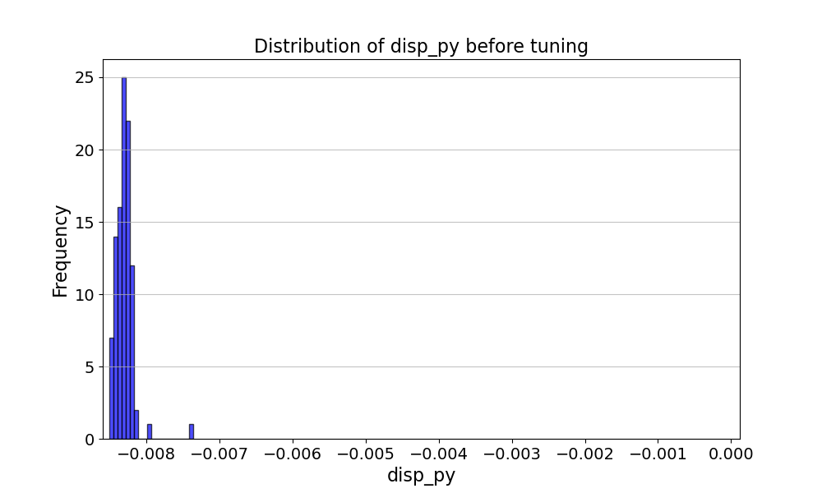
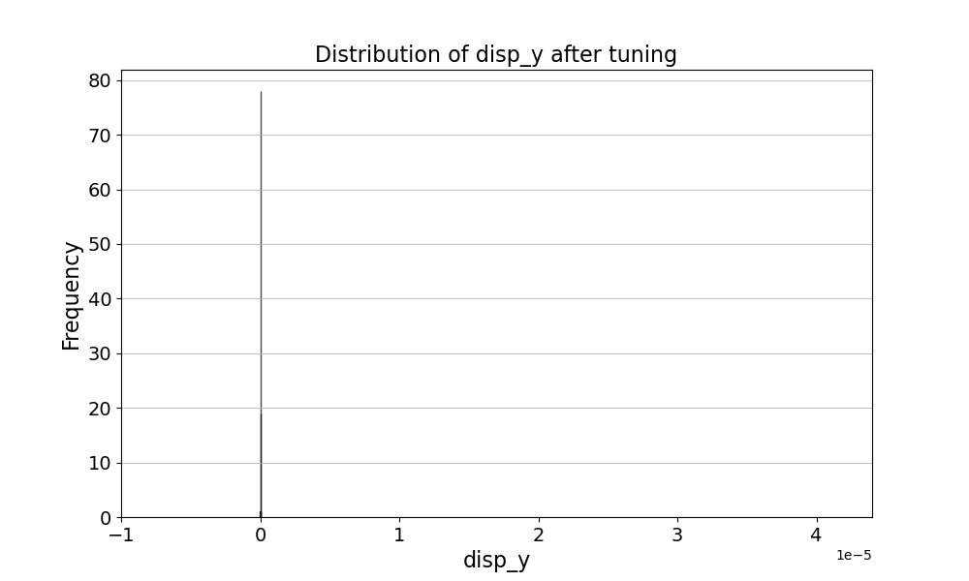
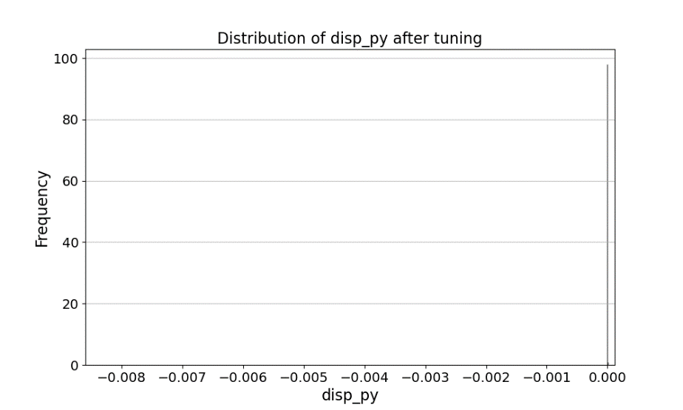

IP tuning simulation for lattices with errors
Perform coupling tuning at IP for 100 seeds after global optics correction
RMS | R1 | R2 | R3 | R4 | Dy [m] | Dpy
Before tuning | 3.62e-4 | 1.29e-4 | 0.25 | 0.052 | 3.40e-5 | 8.3e-3
After tuning | 8.05e-10 | 3.93e-8 | 5.41e-6 | 1.04e-5 | 3.34e-10 | 1.05e-6
The coupling at IP can be well corrected after tuning.
[m]

Slide 12
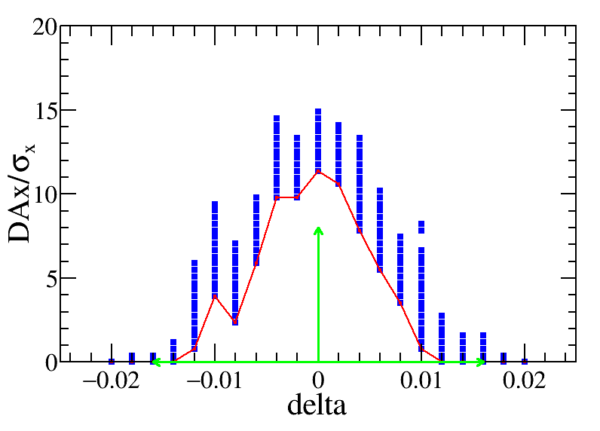
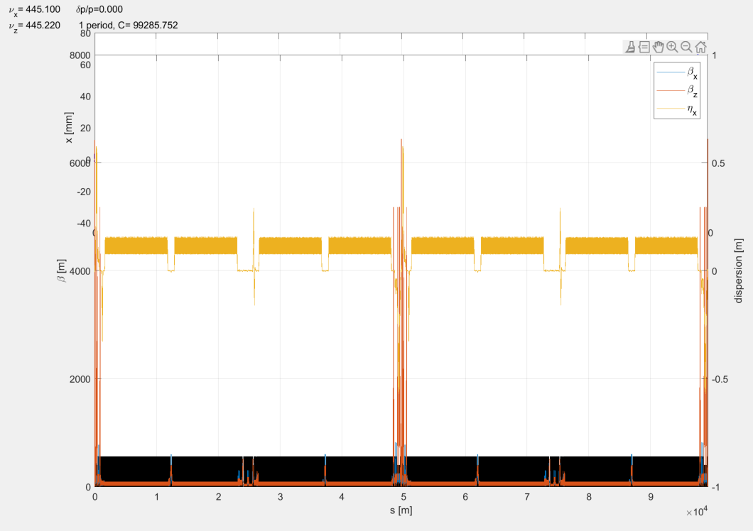
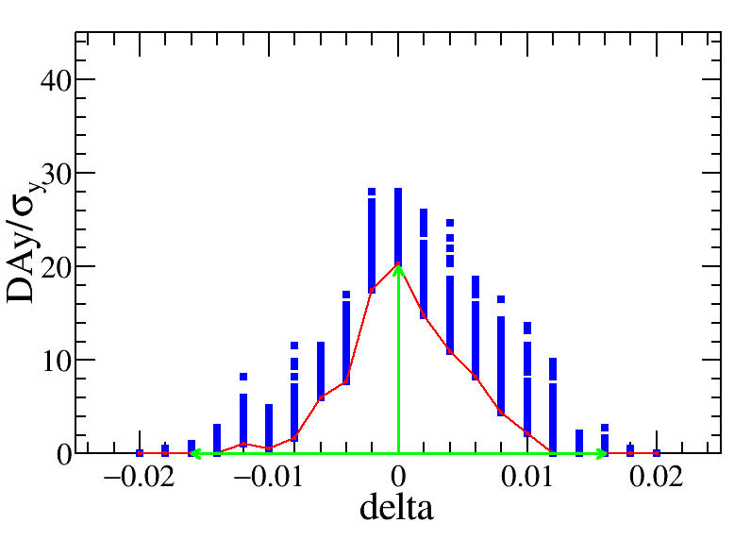
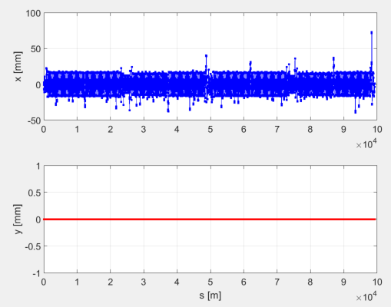
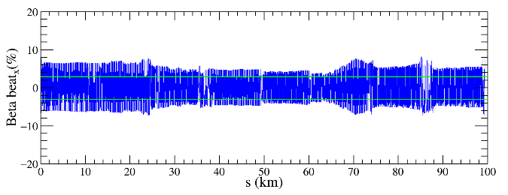
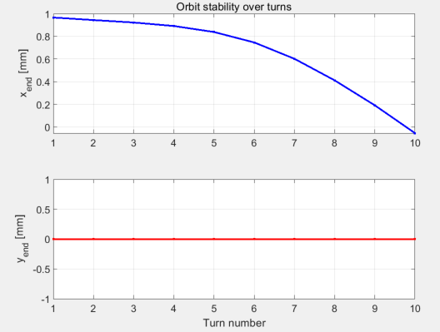
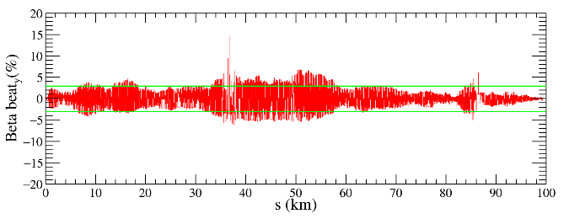

Status of the beta beating correction with solenoids
The beta beating correction is currently ongoing.
  Neglecting the impact of solenoids during LOCO correction and proceeding with the original lattice would lead to even worse results, ultimately resulting in a complete loss of DA.
  In AT simulations of lattices with solenoids, the tune and beta function agree with those without solenoids, while exhibits significant divergence of closed orbit.
  The horizontal orbit exhibits significant instability, gradually decaying towards zero over 10 turns, while the vertical orbit remains perfectly stable with no measurable deviation.
DA: the momentum acceptance is lower than that of the on-axis injection requirement. Further improvement in DA is expected once beta-beating is addressed.
$1.2\%×11σ_{x}×20σ_{y}$

Slide 13
Summary
Ground motion study
  The region between MDI quads and ARC regions need a a low vibration level.
  Next step: further divide into more regions for specific ground motion requirements.
IP tuning simulation for lattices with errors
  The waist shift, beta and coupling can be well corrected after IP tuning.
  Next step: optimize the choice of knob and simulation with APES
Beta beating correction with solenoid field is ongoing.

