Slide 1
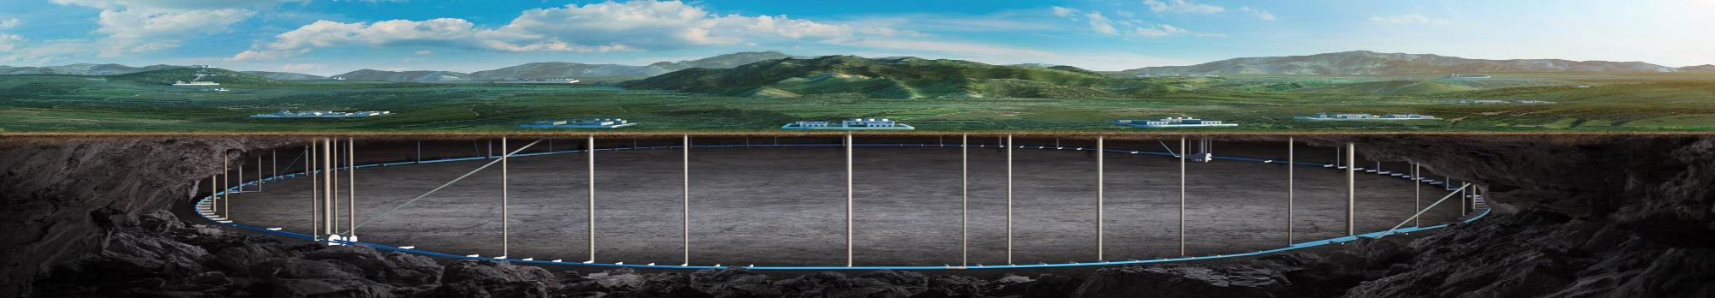


CEPC survey study status and MDI mechanics studies
Haijing Wang
CEPC DAY
2026.5.27

Slide 2
Content
CEPC layout
MDI mechanics
Summary

Slide 3
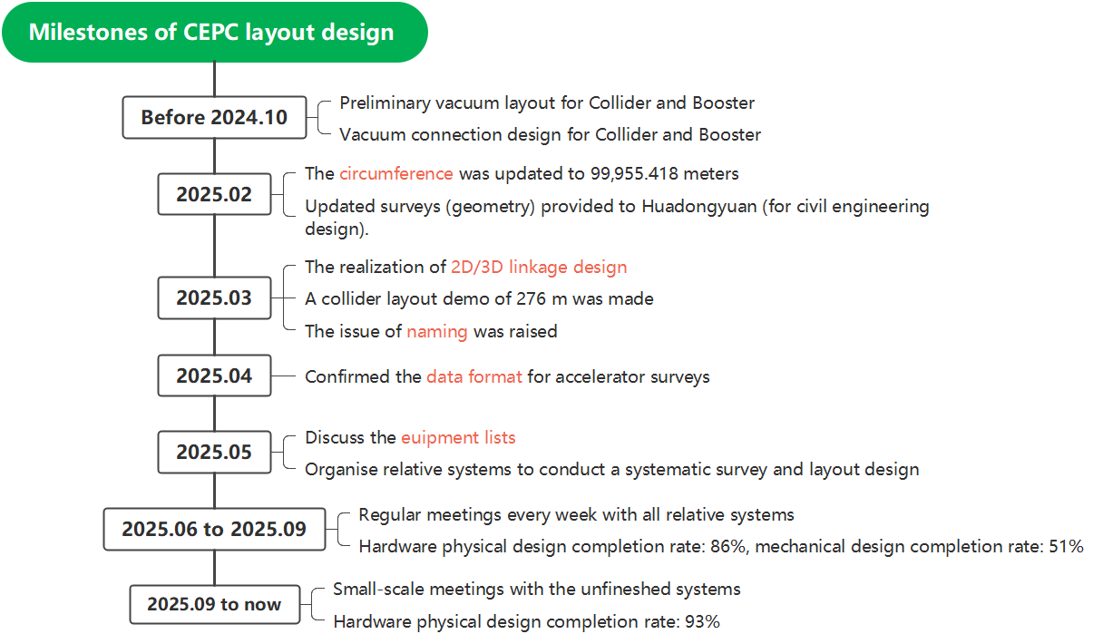
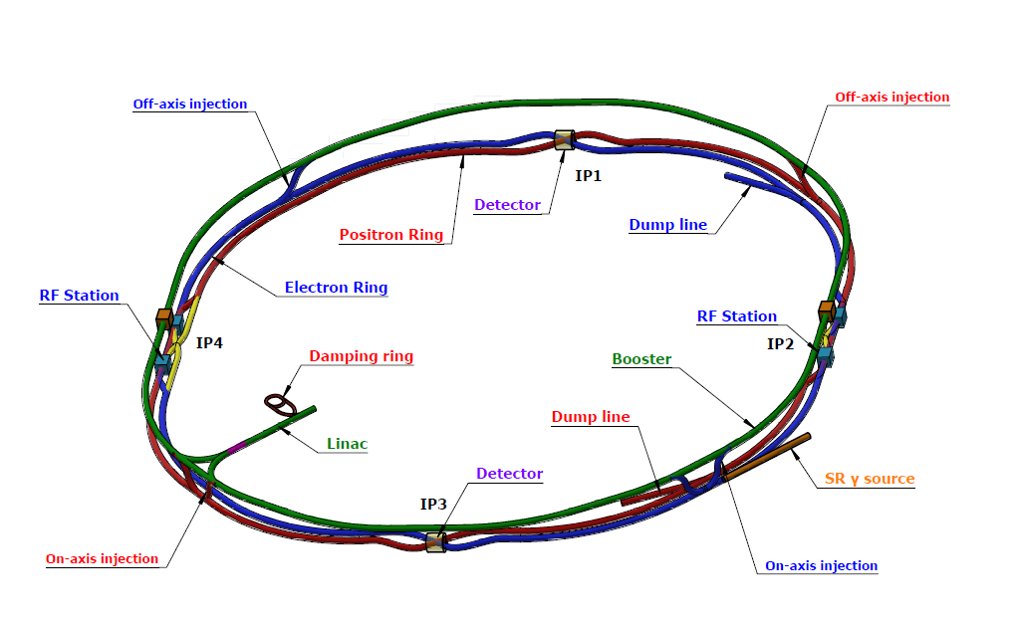
CEPC layout
CEPC layout is one of the key tasks for CEPC in EDR stage
  It makes the geometry of the accelerator physics to engineering layouts, brings CEPC towards a more systematic and optimized direction.

Slide 4
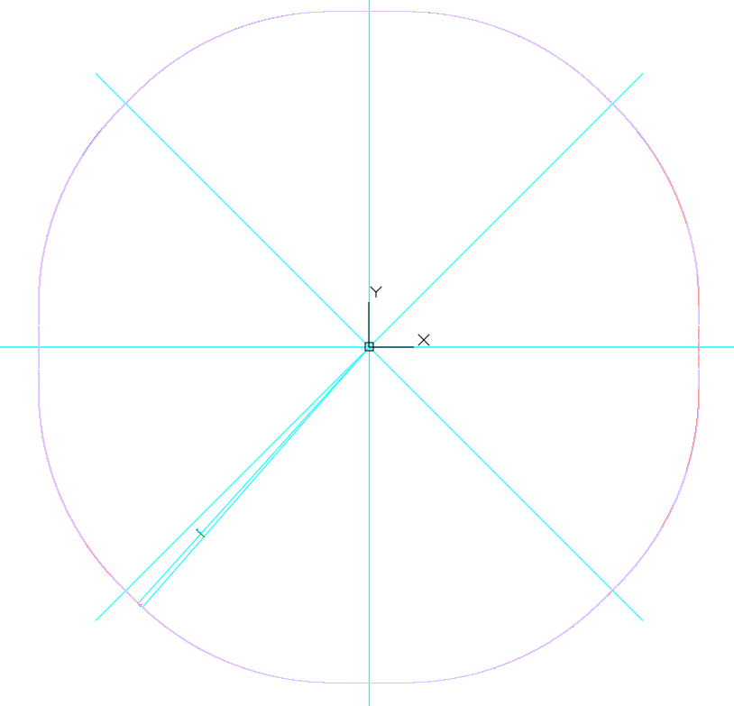
CEPC layout -overall
The coordinate origins (0,0) point is at the symmetric center of the Collider.
The survey position accuracy reaches the micrometer level.
Accelerator | Have EDR survey data? | Finish survey design? | Have layout demo? | Complete survey naming?
Collider | √ | × note 1 | √ | ×
Booster | √ | √ | √ | ×
Linac | √ | √ | √ | √
Damping Ring | √ | √ | √ | ×
Transport lines | √ | √ | √ | ×
(0,0)
  note 1&2: Under iterative discussions and optimizations
Physics design progress from May to November, 2025.
This year we are mainly focusing on detailed discussions.

Slide 5
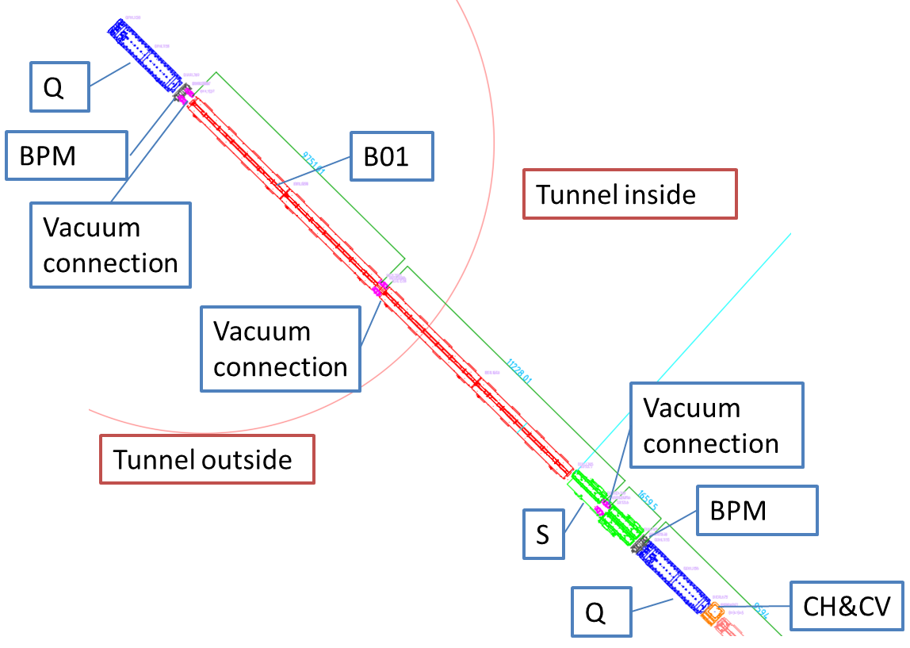
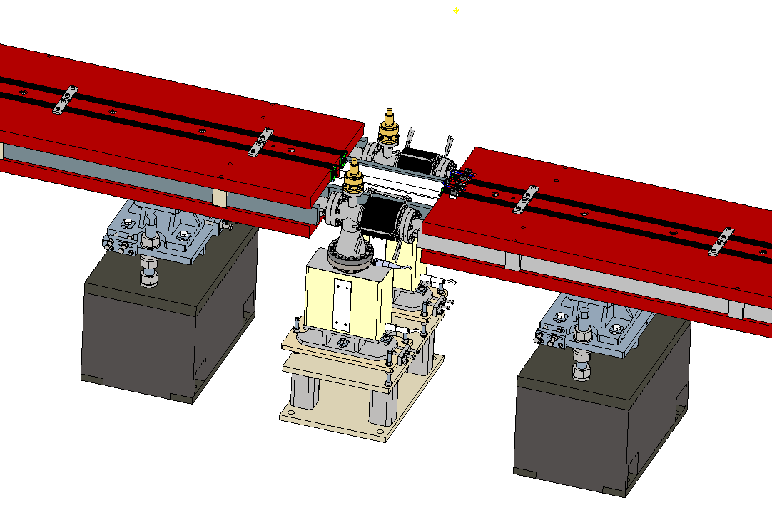
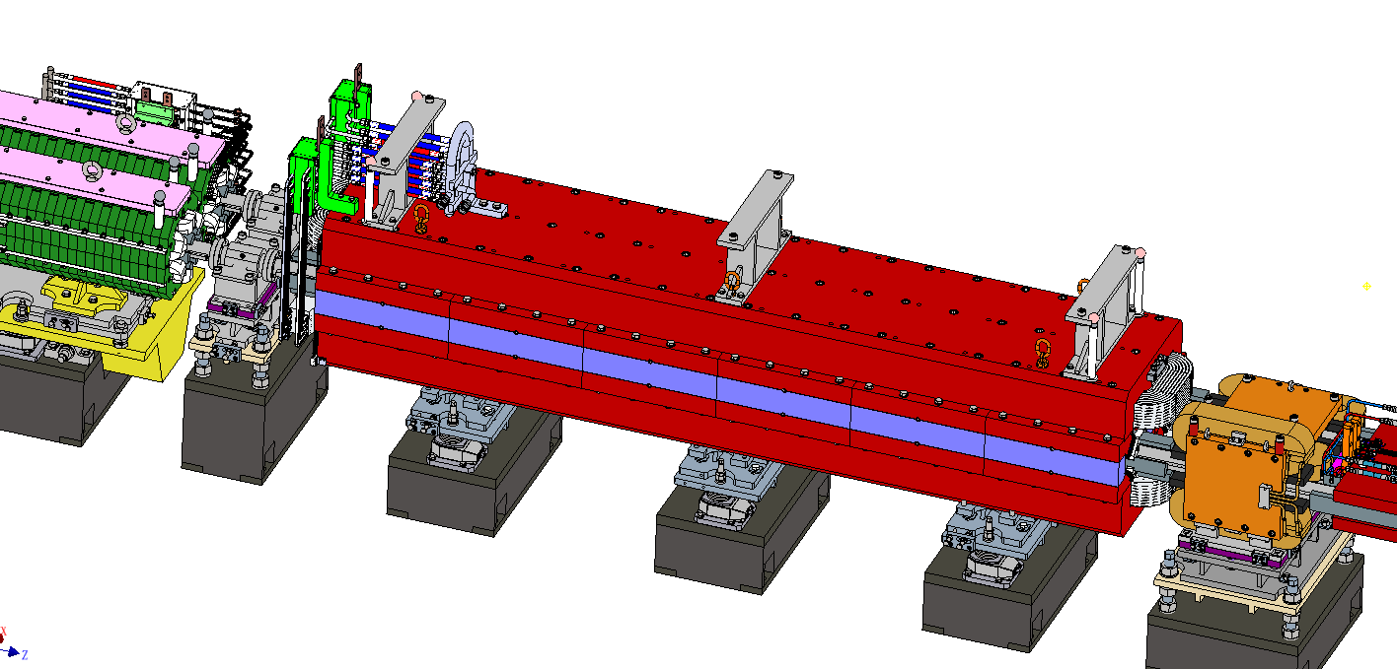
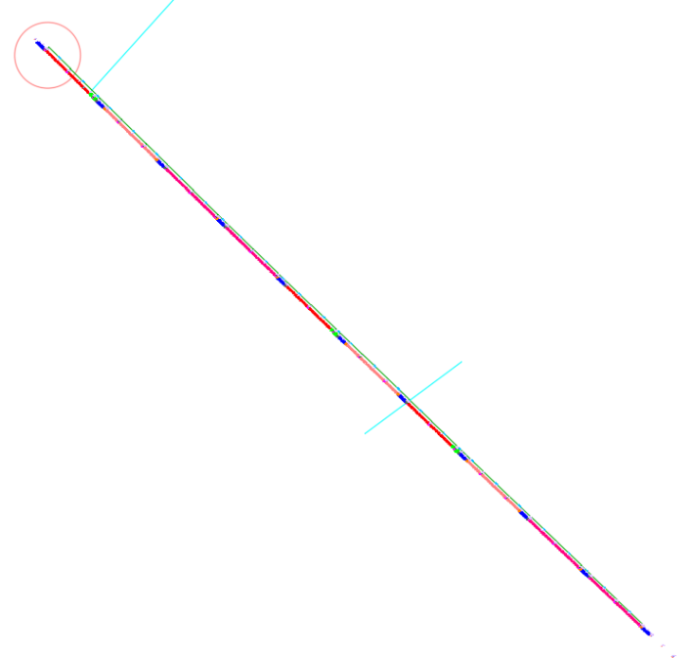
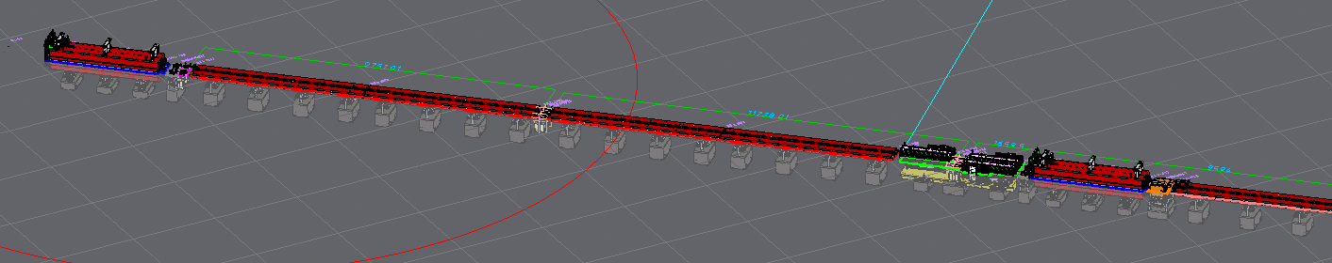
CEPC layout -Collider demo
Collider layout demo (2D/3D, arc section, 276 m)

Slide 6
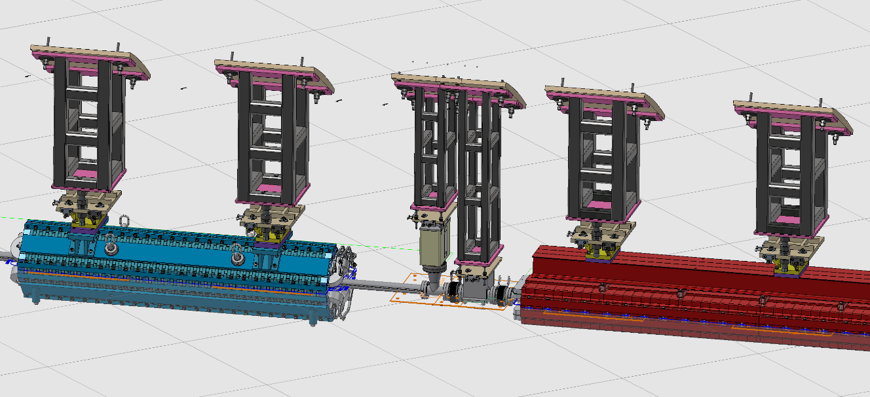
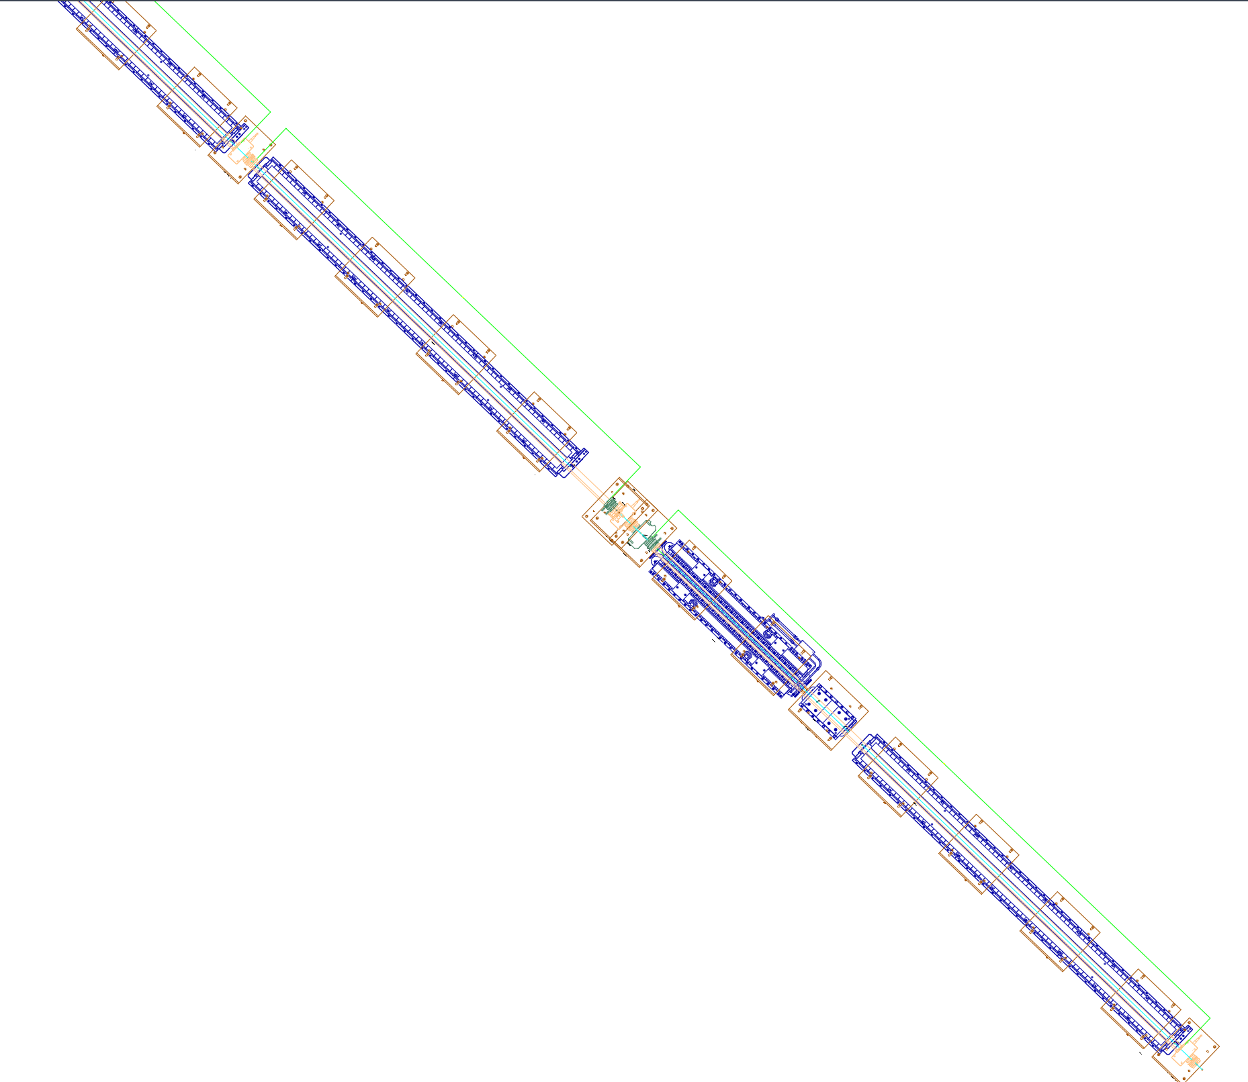
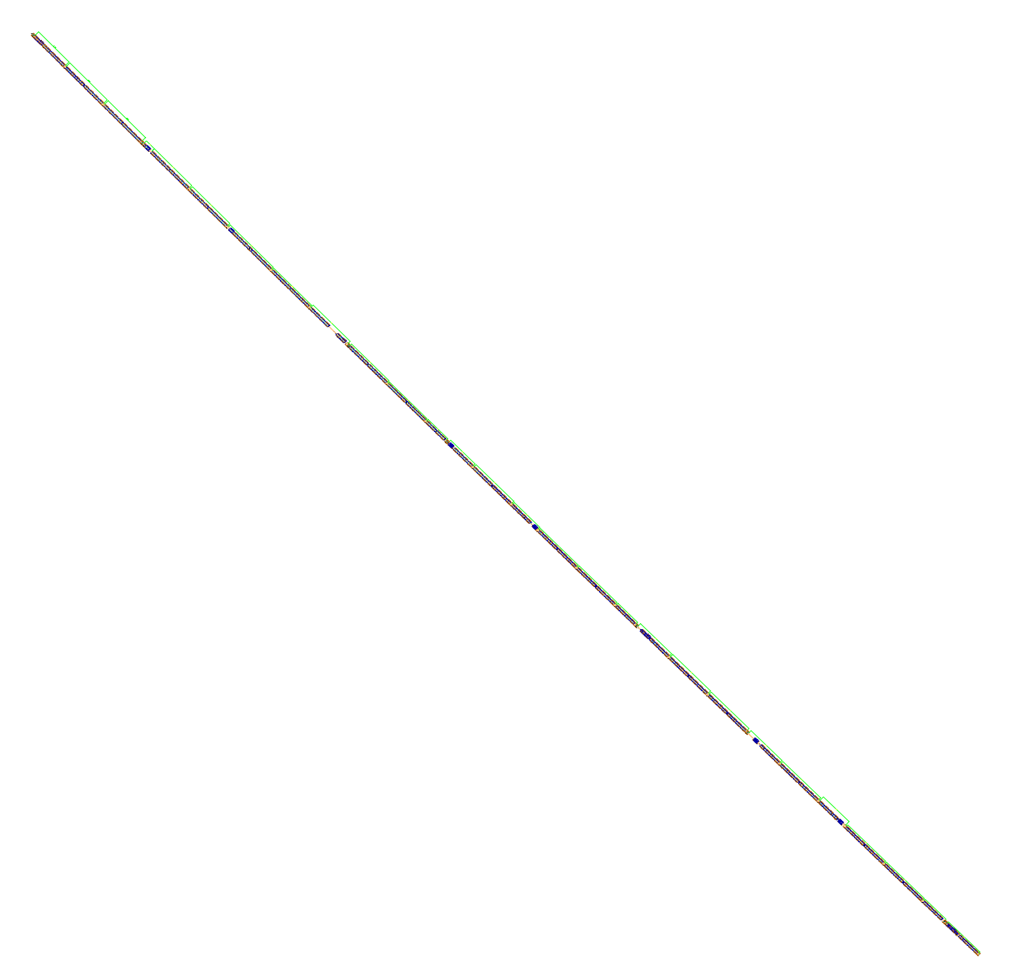
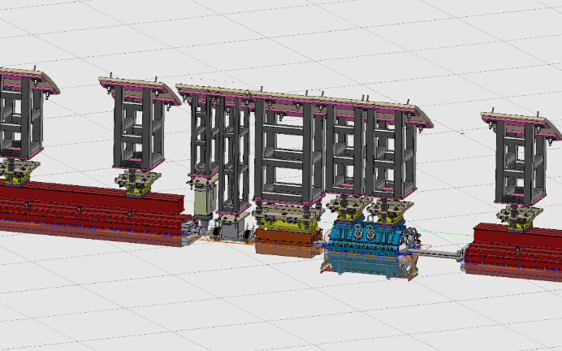
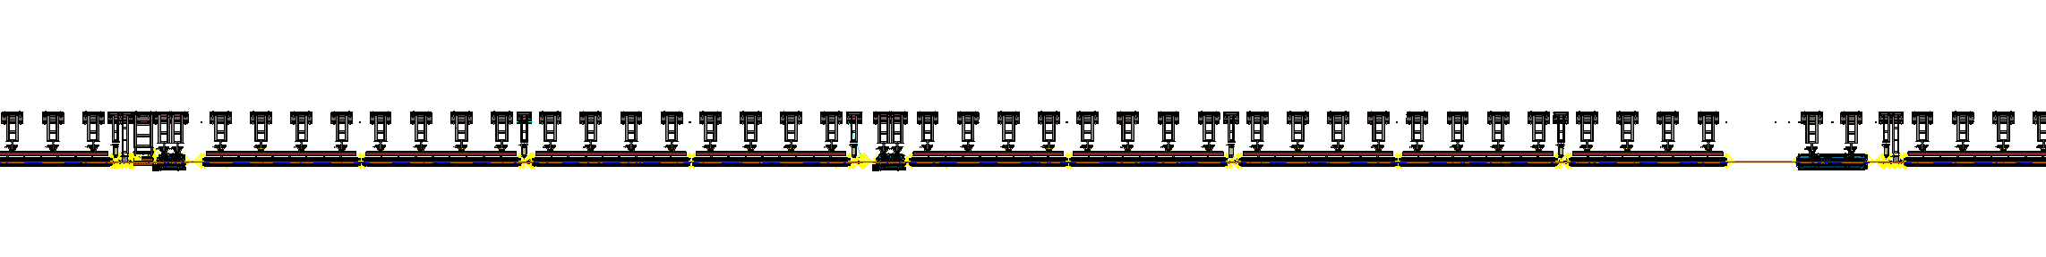
CEPC layout -Booster demo
Booster layout demo (2D/3D, arc section, 230 m)
B01
Tunnel inside
Vacuum connection
Q
Vacuum connection
Vacuum connection
Tunnel outside
CH

Slide 7
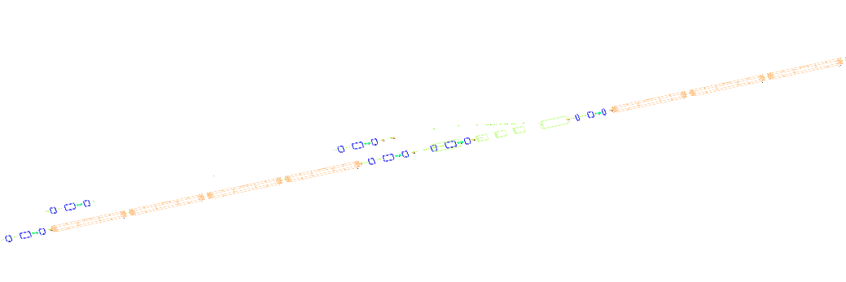
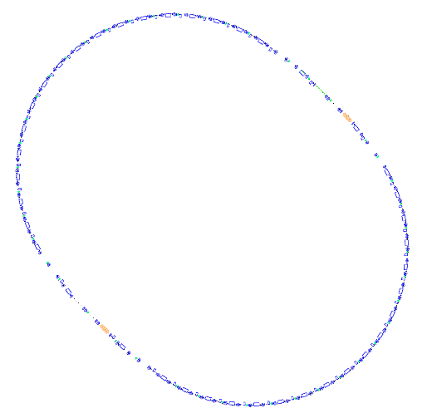
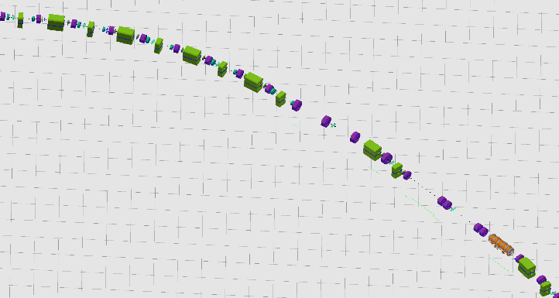
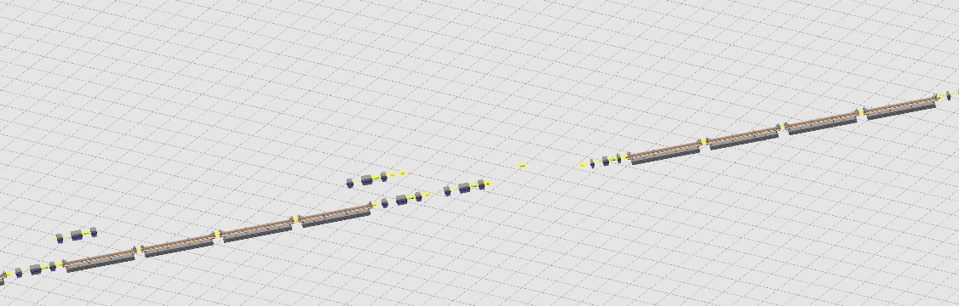
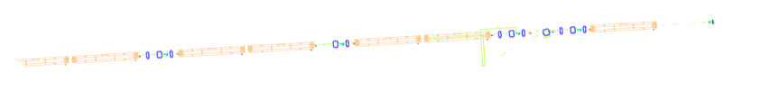
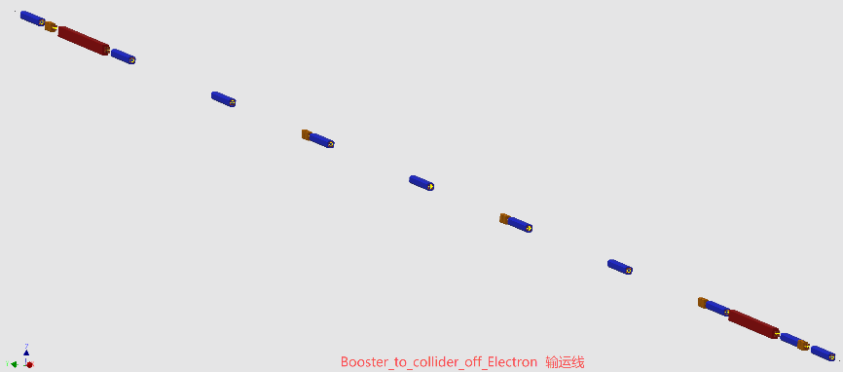
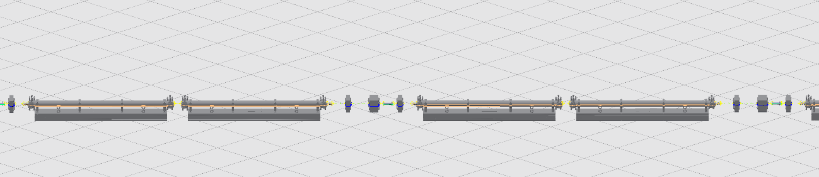
CEPC layout -other demos
Linac layout demo
Damping ring layout demo
EBTL (Electron bypass transport line)
Up: 2D layout; Down: 3D layout
3D layout
2D layout
Transport line layout demo
FAS (first accelerator section)
Up: 2D layout; Down: 3D layout
Only 3D layout owing to changing beam height

Slide 8
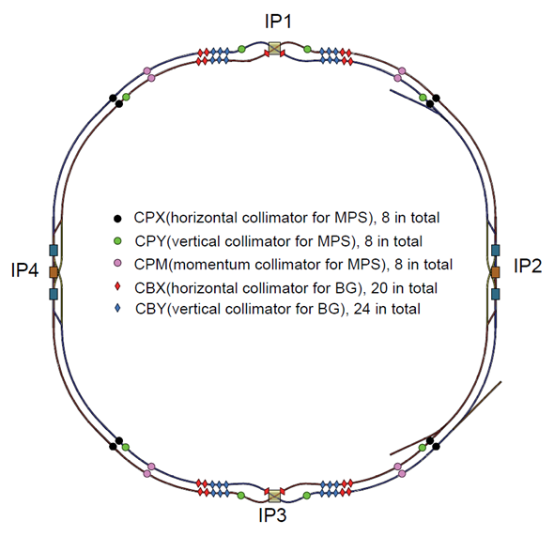
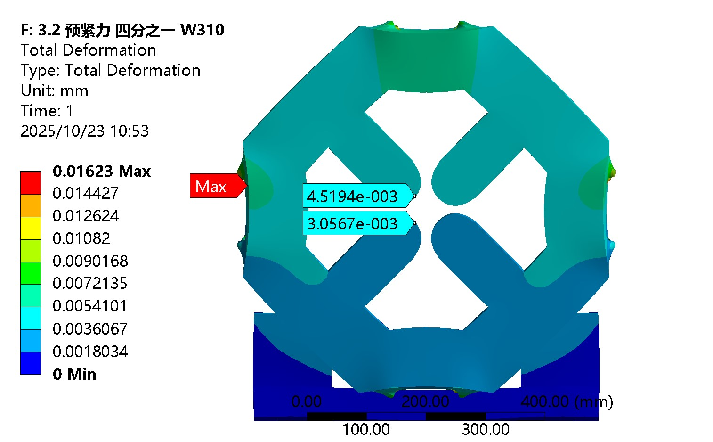
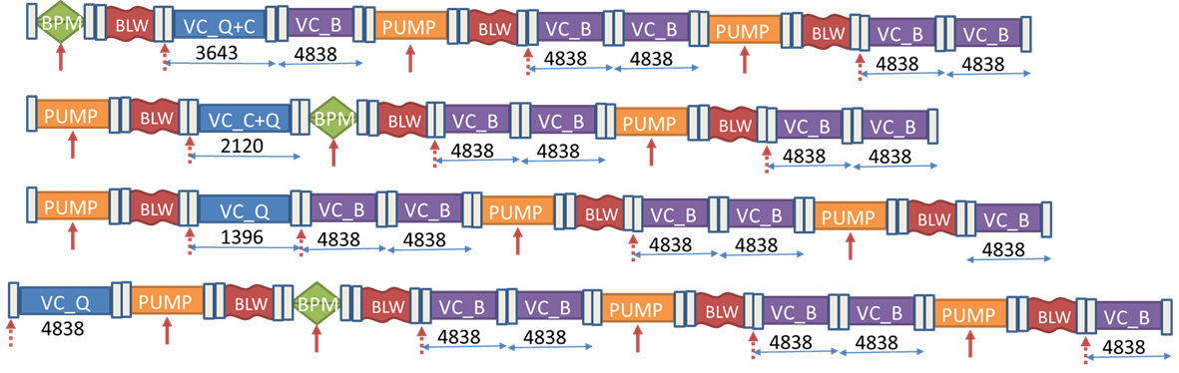
CEPC layout -Main issues
We are addressing all identified issues and completing preliminary solutions for each –– thereby driving continuous progress of the overall work.
No. | Issues（completed before Mar. 2026） | Status
1 | Replace some LMS magnets with dipoles to reduce engineering difficulty | Completed
2 | Resolve spatial interference of the Linac dump | Completed
3 | Find proper positions for all collimators | Completed
4 | Optimize quadrupole cross-section to resolve transverse interference | Completed
5 | Considering tunnel installation and other factors, design and select vacuum layout schemes for the arc region | Preliminarily completed
6 | Optimize parameters of S-Q combined magnets and finish the physics design | Completed
Completed
Positions for collimators
Cross-section optimization
Details in: Haijing Wang, CEPC survey and mechanics system. https://indico.ihep.ac.cn/event/28833/
Vacuum layout scheme

Slide 9
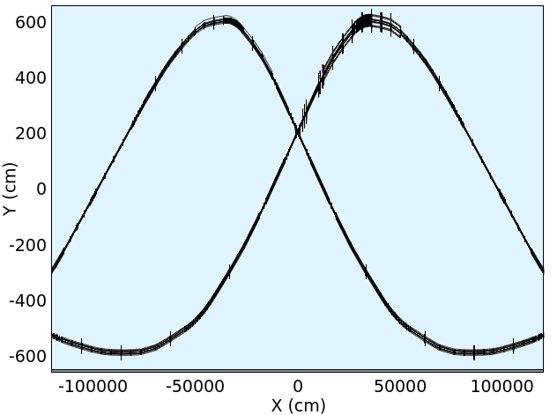
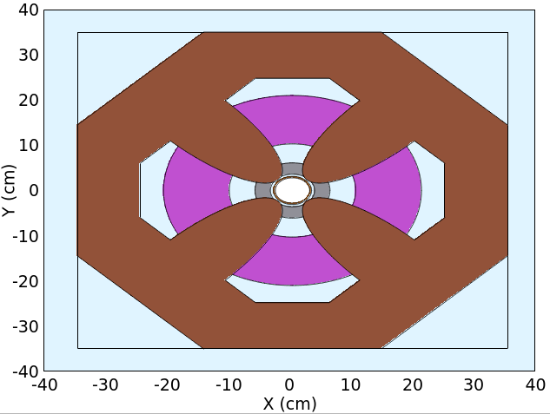
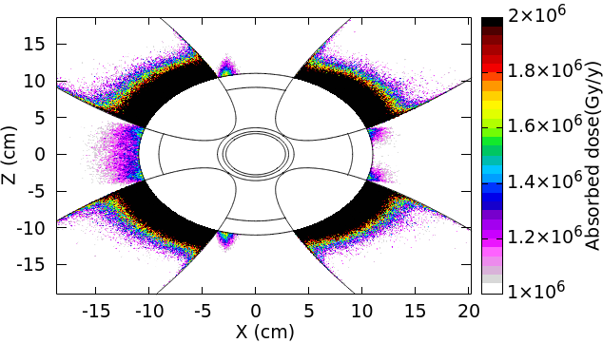
CEPC layout -Main issues
7：IP Radiation simulation
  Radiation simulation about all magnets 1.5 km from IP.
  The Max. lead shielding thickness is 55 mm in some quadrupoles, which is space feasible. Others are within 35 mm. We will make the detailed structure design further.
Completed
FLUKA model with all magnets within 1.5 km from IP
Detailed model and dose simulation

Slide 10
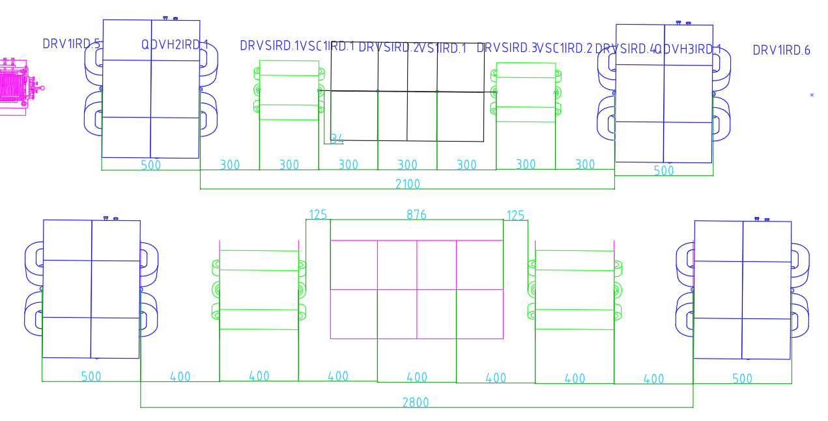
CEPC layout -Main issues
8. IP sextupoles
  There are 5 kinds of sextupoles, 2 of them are stronger.
Name | Quant | Ape[mm] | Fmax[T/m | Leff[mm] | Ftip[T]
SC0IR | 8 | 66 | -315 | 1000 | -0.17
VSCIR | 32 | 66 | -34 | 400 | -0.02
VSIR | 16 | 66 | -3608 | 400 | -1.96
HSCIR | 32 | 66 | -196 | 400 | -0.11
HSIR | 16 | 66 | 3905 | 400 | 2.13
5 kinds of sextupoles in EDR
Layout near HSIRD, form EDR-v1 to EDR-v2
Stage | Ape[mm] | Fmax[T/m] | Leff[mm] | Ftip[T] | Remark
CDR | 70 | 4442 | 300 | 2.72 | 超导，普通恒温器
 | 42 | 3658 | 400 | 0.81 | FeCoV，大幅压缩物理要求
TDR | 46 | 3494 | 400 | 0.92 | FeCoV，大幅压缩物理要求
EDR-v1 | 66 | 5207 | 300 | 2.83 | 超导，小型制冷机，恢复部分物理要求。 空间干涉，梯度高
EDR-v2 | 66 | 3905 | 400 | 2.13 | 纵向拉长，解决空间干涉，降低梯度
Note 1: For ease of parameter comparison, the aperture used is that of RT iron magnets. The aperture would be much larger with SC magnets.
Note 2: The parameters for CDR and TDR are not the same as those in the report, owing to its uncertainty and aggressivity.
History of HSIRD
SC sextupoles
Normal sextupoles with smaller apertures

Slide 11
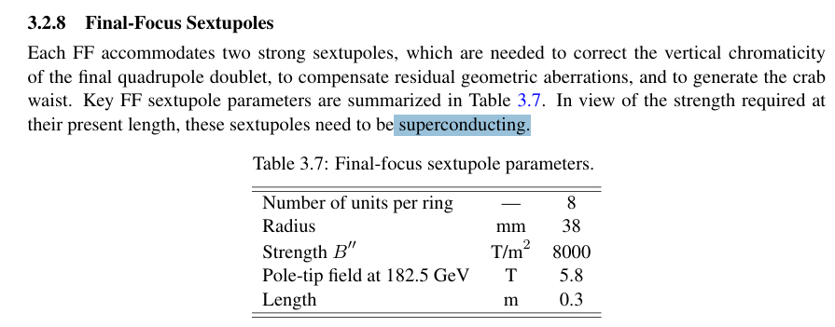
CEPC layout -Main issues
8. IP sextupoles (Cont.)
  For SC magnets, the pole-tip fields should be below 10.7 T, expected to be realized in 5 years→ the tungsten shielding should be less than 10 mm.
  For normal magnet, the pole-tip fields should be below 0.9 T, can be realized using FeCoV→ the inner radius of VC should be less than 18.5 mm, with a thickness of 1.5 mm.
Pole-tip fields with different radii
线圈内半径 (mm) | 名义极头磁场 (T) | 备注
21 | 0.86 | 常温磁铁技术可行
23 | 1.03 | 最小半径 (CEPC Day 2026.1)
59 | 6.80 | 超导技术，0 钨屏蔽+ 0水冷管
74 | 10.69 | 10mm钨屏蔽+5mm水冷管
84 | 13.78 | 20mm钨屏蔽+5mm水冷管
91 | 16.17 | 27mm钨屏蔽+5mm水冷管
FCC-ee
D=76mm，B’’=8000T/m², Leff=0.3m, Btip=5.8T，SC magnets
It seems that the space of cryogenic structures are not included

Slide 12
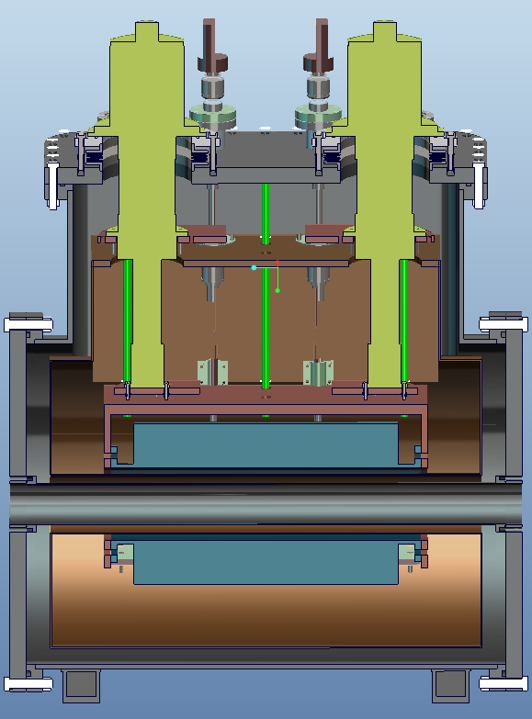
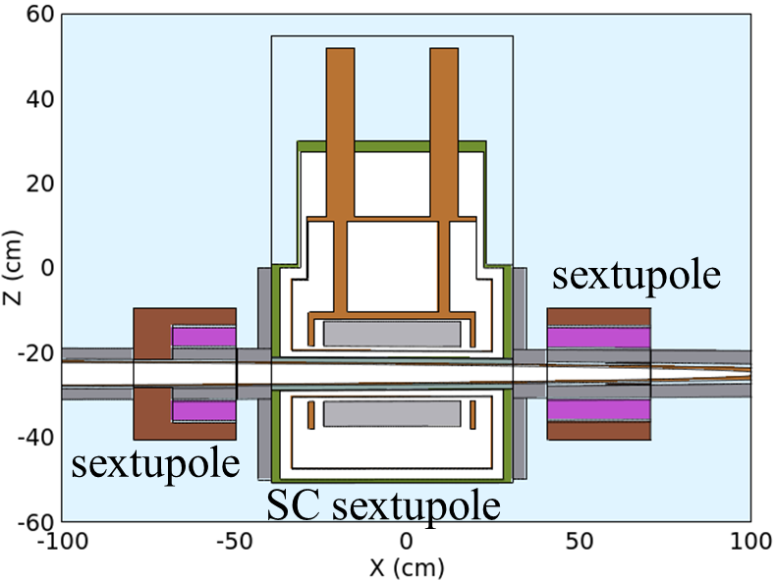
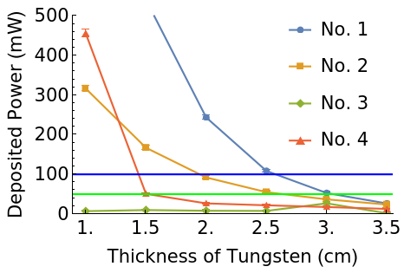
CEPC layout -Main issues
8. IP sextupoles (Cont.)
  SC scheme:
    Preliminary cryogenic design
    Radiation simulation: 10 mm tungsten ~ 1 W SR deposition, acceptable (capacity: 4 W)
    Space: acceptable
  Normal magnet scheme:
    Preliminary impedance simulation: 3% increasement for the total value
    VC thickness 1.5 mm, acceptable
    Space: acceptable
Almost completed
Preliminary cryostat design of IP SC sextupoles
Results of radiation simulation
Model of radiation simulation

Slide 13

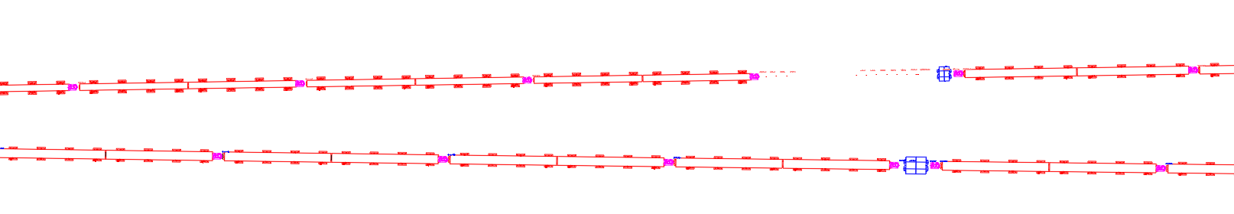

CEPC layout -Main issues
9: Spatial interference issues within 1.5 km of IP
  Spatial interference: under optimization of magnet dimensions, accelerator physics, and magnet parameters.
  Several iterations have been conducted, but a finalized issue-free version hasn’t yet been achieved.
10:Spatial interference issues at straight section
  Spatial interference: under optimization of space and four combinations: off‑axis, on‑axis, DUMP, and gamma source.
  In the 2nd round of interference check and modification iteration.
Under design
Dipole
Bellows and pumps
Quadrupole
Quadrupoles
Draft layout of short straight section
Draft layout of IP within 1.5 km

Slide 14
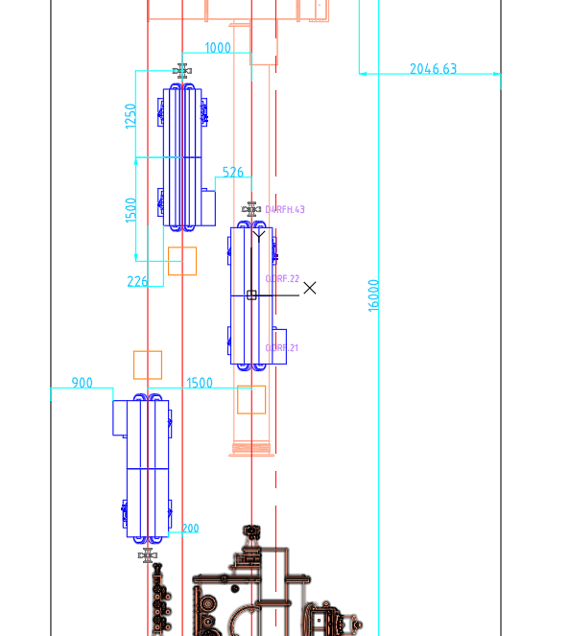
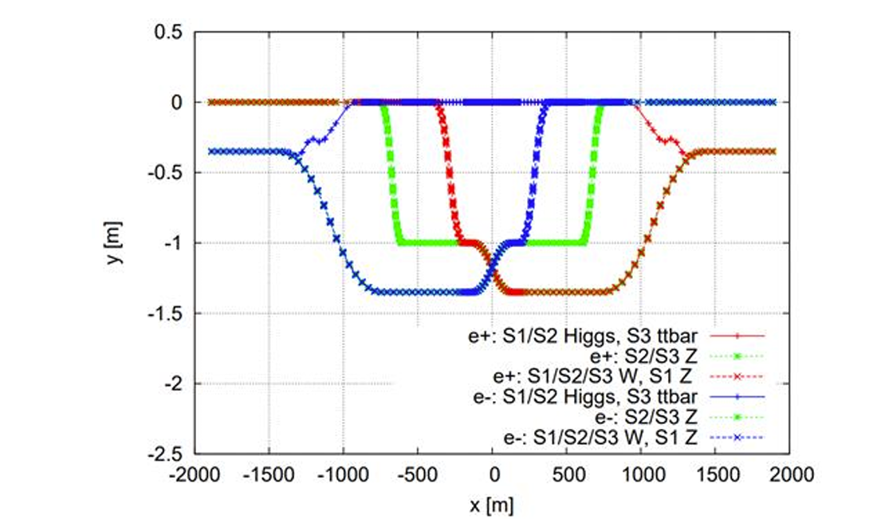
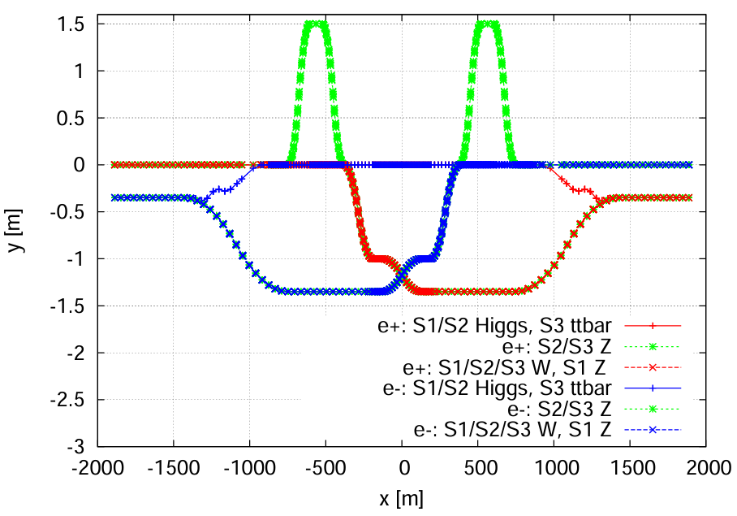
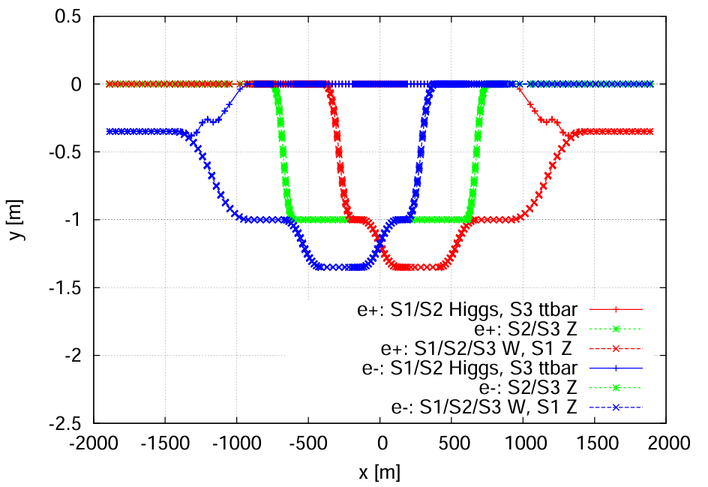
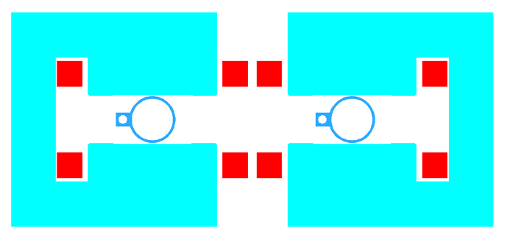
CEPC layout -Main issues
11: RF section: Collider 7 beam lines.
  Through many negotiations on the RF update strategies, space, magnet parameters, we modified the RF layout to short the ‘wider’ tunnel.----under bypass modification according to interference check.
  Model of RF module has been updated.
  The straight section region has been modified, no interference now.
  More details, especially at the bending locations, are still under-design.
quadrupole
BPM
corrector
RF module
TDR strategy
A intermediate version, not adopted
EDR strategy
2 C-type dipoles near cross point
Layout at ‘wider’ tunnel
Under design

Slide 15
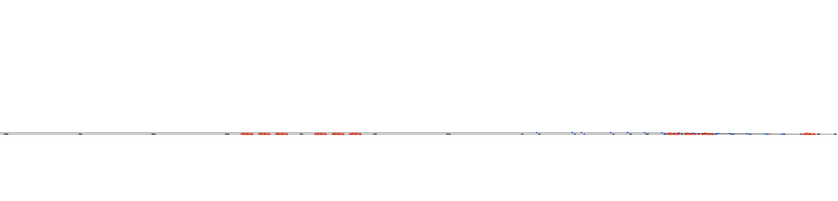
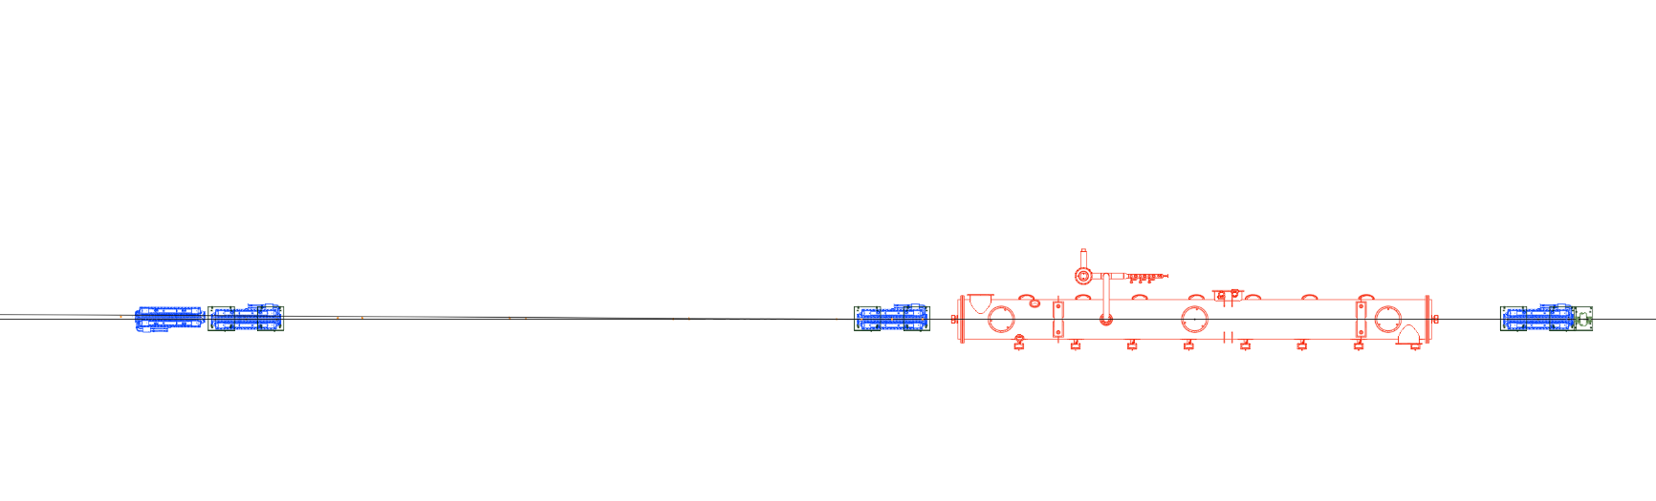
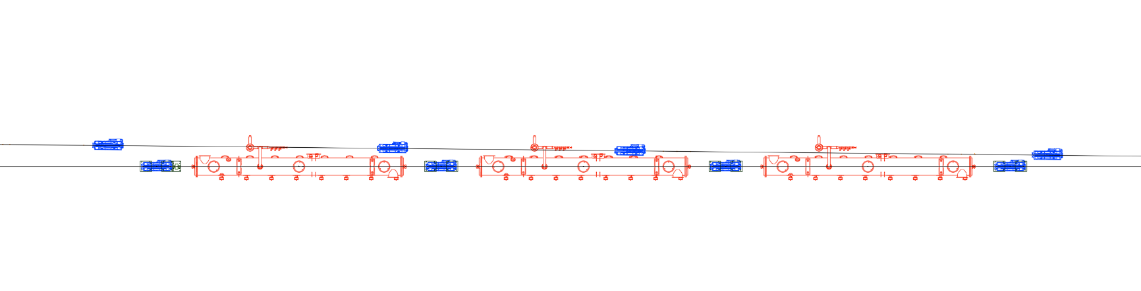
CEPC layout -Main issues
11: Space arrangement at Booster RF section, 3 beam lines.
  The Booster bypass for HL-Z at RF region has been added and survey finished.
  The bypass of ttbar is under design.
Under design

Slide 16
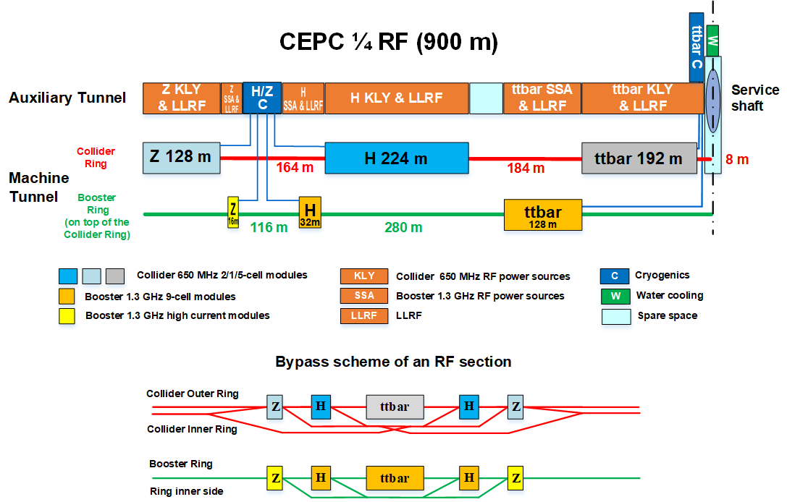

CEPC layout -Main issues
11: RF section：the beamline layout is consistent with the auxiliary tunnel layout.
900m
764m
600m
376m
192m
750~872m
385m~602m
~190m
Collider 模组survey
736~748m
610~654m
216~329m
Booster模组survey
Completed

Slide 17
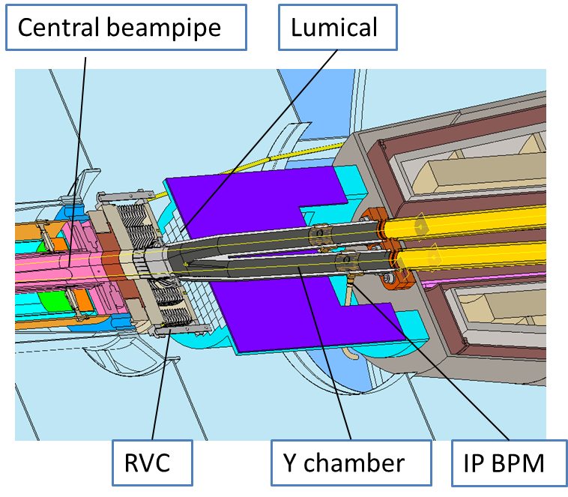
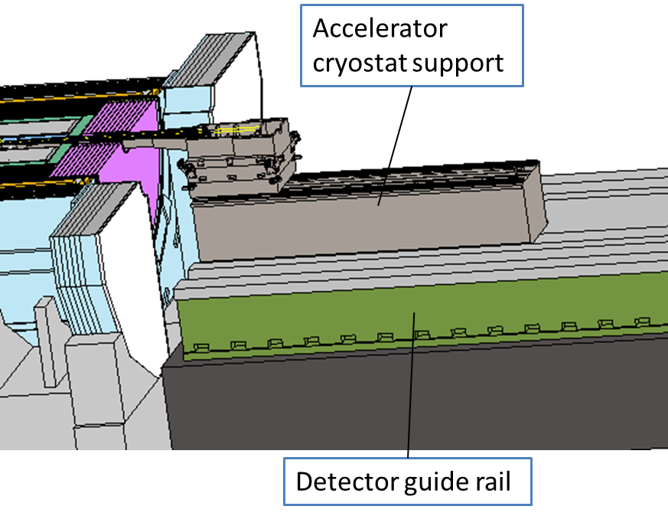
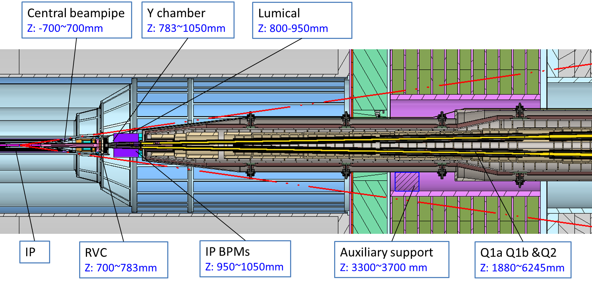
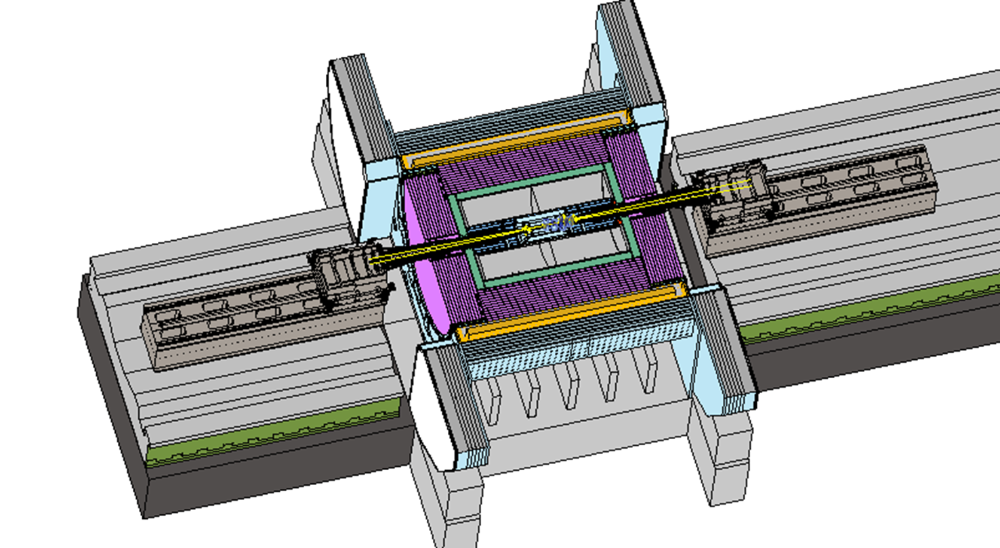
MDI mechanics progress-layout
MDI layout
  Detective angle: acos0.99
  IP chamber：±700mm
  Yoke length：11950mm
Distance to detective angle
  IP chamber flange: 5.3mm
  RVC: 14.9mm
Mechanical interface between accelerator and detector
MDI layout

Slide 18
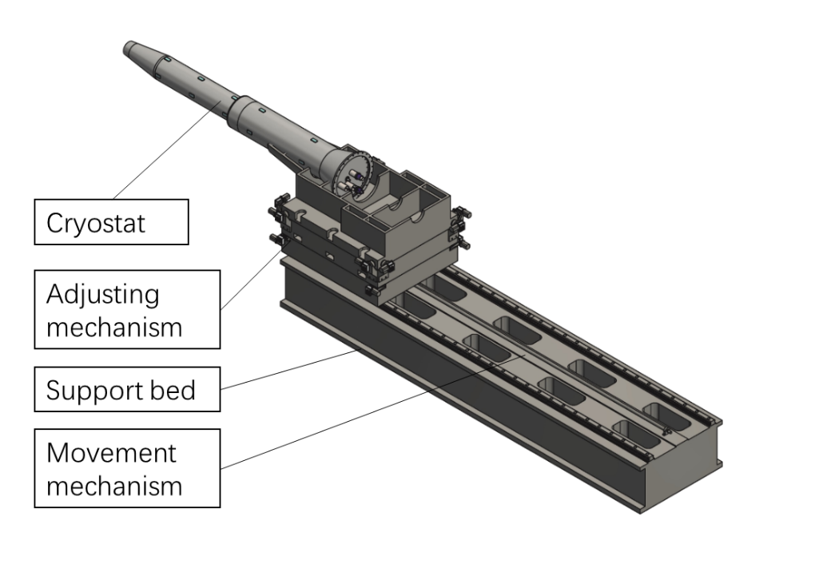
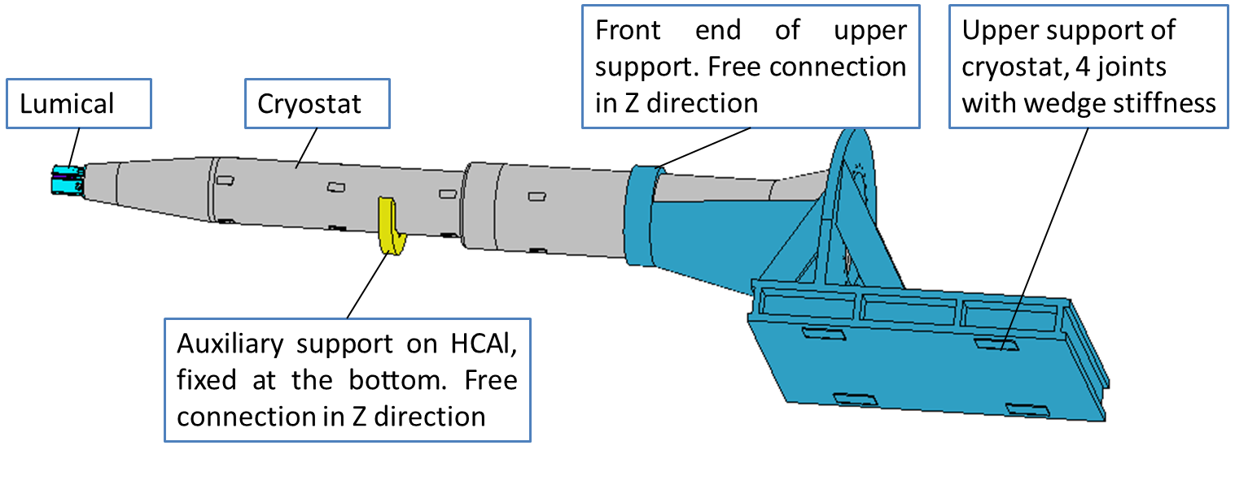
MDI mechanics progress-mechanical analyses
Mechanics and vibration analyses
  Static structure: max. deformation and displacement change with/wo Lorentz force
  Vibration analyses: natural frequency & harmonic response
  Structure optimization
 | Related requirements | Response now*
Position accuracy (X/Y) of SC quadrupoles ≤100μm | Adjusting resolution≤5μm Adjusting accuracy≤30μm | ≤5μm ≤30μm from HEPS experience
 | Max. def. and disp. change, ＜ 50μm | FEA，＜40μm
Small vibration, 1-100Hz RMS ≤4nm | High natural frequency | FEA, ~50Hz and 1 (same level to HEPS, and arc section of CEPC)
 | Low amplification factor
Designed model
The response now only considers the mechanics aspect.
Auxiliary support has significant benefits: deformation, vibration.
Analyses model

Slide 19
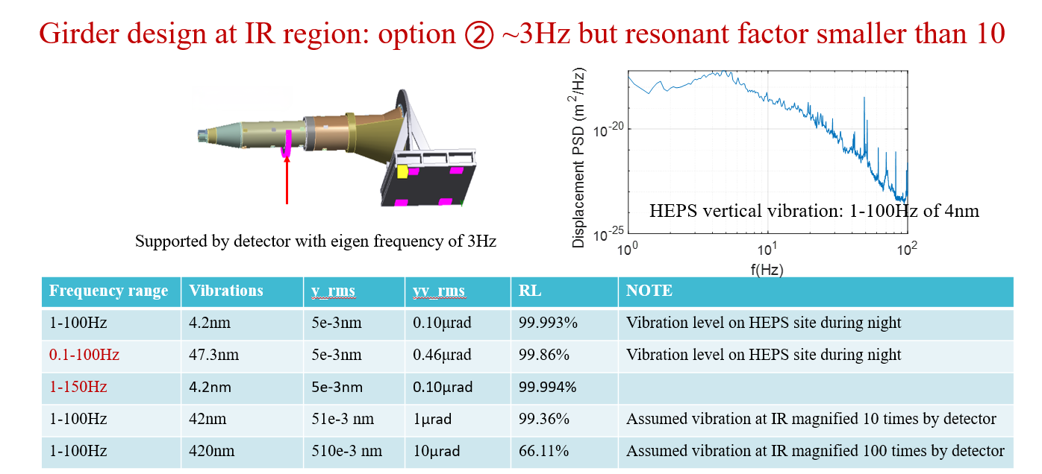
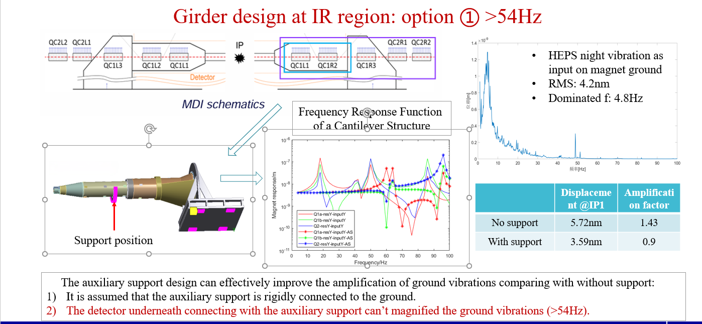
MDI mechanics progress-mechanical analyses
Assume the eigen frequency of ground is ~3 Hz, the eigen frequency of the detector should avoid 3 Hz.
Discussed with the detector mechanical colleagues recently.
From F. Yan

Slide 20


MDI mechanics progress-mechanical analyses
FEA of HCAL:
  Constraints: Fixed at the side flanges.
  Loads: ECAL is loaded as mass. Force reaction of auxiliary support on cryostat is loaded as force.
  Results: 1st eigen frequency is 40 Hz, far above 3 Hz. Max. principal stress 21.6 MPa, far below the allowable value. Max. deformation on HCAL is 0.1 mm, acceptable.
  It is a 1st step simulation. Much work to do…

Slide 21



MDI mechanics progress
The auxiliary support
  The support should fix the cryostat to HCAL, and can be adjusted. Height ~ 154mm
  Investigate and consider the form of auxiliary support
    Precision wedge jacks: experience at HEPS, adjust interface is 1.3m away
    PU (聚氨酯) quasi-hydraulic solution, pneumatic adjustment may work
HEPS 增强器用楔块剖面
PU jack for HL-LHC

Slide 22
MDI mechanics progress
The detector guide rail
  Original design: the guide rail is not permanently fixed to the ground. When the detector is under maintenance, the guide rail is removed and moved to the pre-assembly point.
  Updated design: the guide rail will be grouted directly to the bedrock of the detector hall. Thus, it can be considered the accelerator support is directly connected to the ground.
  It is unlikely that the entire detector will be dismantled and moved to the pre-assembly point for maintenance.

Slide 23
MDI mechanics progress
Work lists:
  More collaboration and discussions between detector and accelerator colleagues, closing the loop on installation and alignment strategies, including all interfaces.
  Optimize the cryostat structure and more detailed analyses.
  Optimize the detector structure and more detailed analyses.
  A whole FEA (the modes of detector and cryostat are coupled)

Slide 24



MDI mechanics progress- vibration test scheme
We want to test the ground motion on site to evaluate the vibration performance.
Test contents |  | Site requirements
Ground motion test | Amplitude of ground vibration | Close to a real tunnel site
 | Wave velocity and vertical attenuation.
Modal test on magnet & support assembly | Collider magnet & support | Good vibration performance, to validate the rationality of the design
 | Booster magnet & support
Ground motion test sites
Cost:
  Basic: 25k RMB, including a set of UPS, and travel expenses.
  It is better to buy 2 more domestic seismometer, ~ 160k RMB, for the existing two set will be installed at HEPS.
JUNO, as a comparable site

Slide 25




MDI mechanics progress-RVC
    RVC
  Leak rate requirement: 2.7 ×10–11 Pa·m3/s
  Leak rate: $Q=C∙∆P$
  Decrease $∆P$ (experience from CSNS)
    Single-layer → double layer, leak rate can be improved from 1e-6 Pa.m3/s to 8.5e-10 Pa.m3/s.
  Decrease C
    We are engaging on it
  BEPCII UP also needs RVC, so we are considering the engineering application on it, and a prototype is needed.
Inflatable seal
$$\left.C=34A^{2}（L/w）exp{[}−3F/(LwR)\right]$$

Slide 26


MDI mechanics progress-RVC
希望设计出能够满足未来对撞区“长悬臂、窄空间、远程连接、不可视”极端安装条件下的真空密封结构，实现“一次安装、终身可靠”的核心目标，揭示在远程不可视操作引入的非均匀载荷及位姿误差条件下，金属密封界面的动态生成机理及长期服役的稳定性，并建立其泄漏性能的多尺度跨物理场预测方法。
  真空密封结构的设计及漏率定性评估
  远程不可视操作下的均匀密封界面生成研究及样机研制测试
测试项目 |  | 密封界面压差（$∆P$） | 密封界面流导$C$
 |  |  | 界面粗糙度（$A$） | 密封压力（$F$） | 材料密封因子（$R$） | 密封接触宽度（$w$）
薄膜镀层方案测试 | 不同镀层材料 | √ |  | √ | √
刀口方案测试 | 不同垫片硬度 | √ |  | √ | √
 | 刀口位置 | √ |  | √ |  | √
共同测试 | 不同法兰粗糙度 | √ | √ | √
 | 镀层与刀口对比 |  |  |  | √ | √

Slide 27
MDI mechanics progress-RVC
  极端环境下的无锁紧密封界面稳定性研究
  密封动态过程模拟及真空漏率预测
测试项目 | 初步方案
初始安装误差影响 | 与研究内容2结合，在容错范围内人为调整初始安装误差
温度影响 | 整体温度变化，采用空调等进行整体温度调整，主要考虑高次模功率及环境温度波动 局部温度变化，采用激光器或电热丝等局部加热，主要模拟束流偏离轨道时的同步光辐射功率
振动影响 | 考虑运行中可能的环境噪声及突发振动，人为或激振器施加

Slide 28
Summary
We are dedicated to the detailed layout design during the EDR phase while simultaneously advancing the progress of various hardware equipment. By now, most of survey and hardware physics design have been completed. We have solved and are currently working on many problems.
The interface and future simulation method of MDI have been discussed. The preliminary FEA has been done for HCAL. Further simulation, including a whole assembly FEA, will be executed.
The experiment details of RVC has been designed and waiting for developing.

Slide 29
Thanks for your attention!
Thanks to the contributors!
  Haijing Wang, Siyu Chen, Zihao Wang, Jie Gao, Yiwei Wang, Dou Wang, Cai Meng, Xiaohao Cui, Wen Kang, Mei Yang, Yafeng Wu, Xianjing Sun, Qing Li, Yingshun Zhu, Jinhui Chen, Lihua Huo, Lei Wang, Bin Chen, Yongsheng Ma, Qi Yang, Yanfeng Sui, Jingru Zhang, Jiyuan Zhai, Guangyi Tang, Miaofu Xu, Ruixiong Han, Sha Bai, Haoyu Shi, F. Yan, X. Ma, Y. Pei

