Slide 1
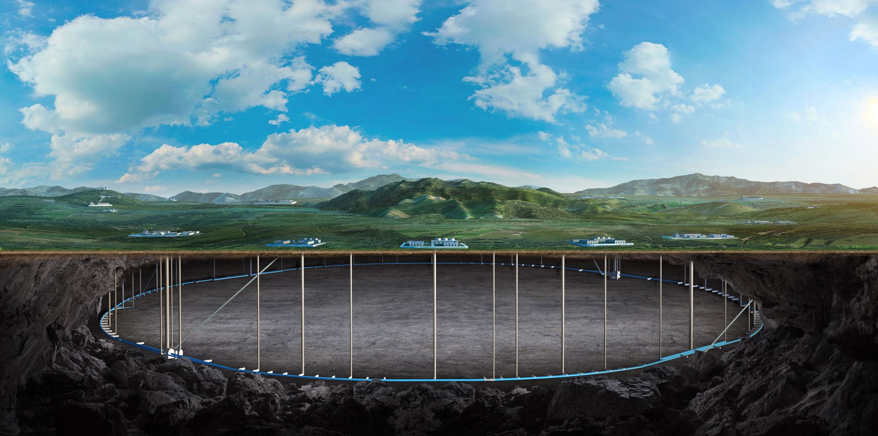


Publication status and plan for the CEPC Reference Detector
Miao He
May 27, CEPC day

Slide 2
Introduction
During the preparation of the RefTDR, publication plans were discussed.
Subgroups were encouraged to publish papers to support the RefTDR.
These papers need to be an expansion of the TDR information, or deeper studies of R&D.
For each paper after the RefTDR released, it should assume that the design of the reference detector already exists, and should refer to the RefTDR.
Simply using one chapter in the RefTDR to publish as a paper is not allowed.
Started collecting published papers and plans on May 14, and every chapter leader gave a short presentation on May 20.

Slide 3
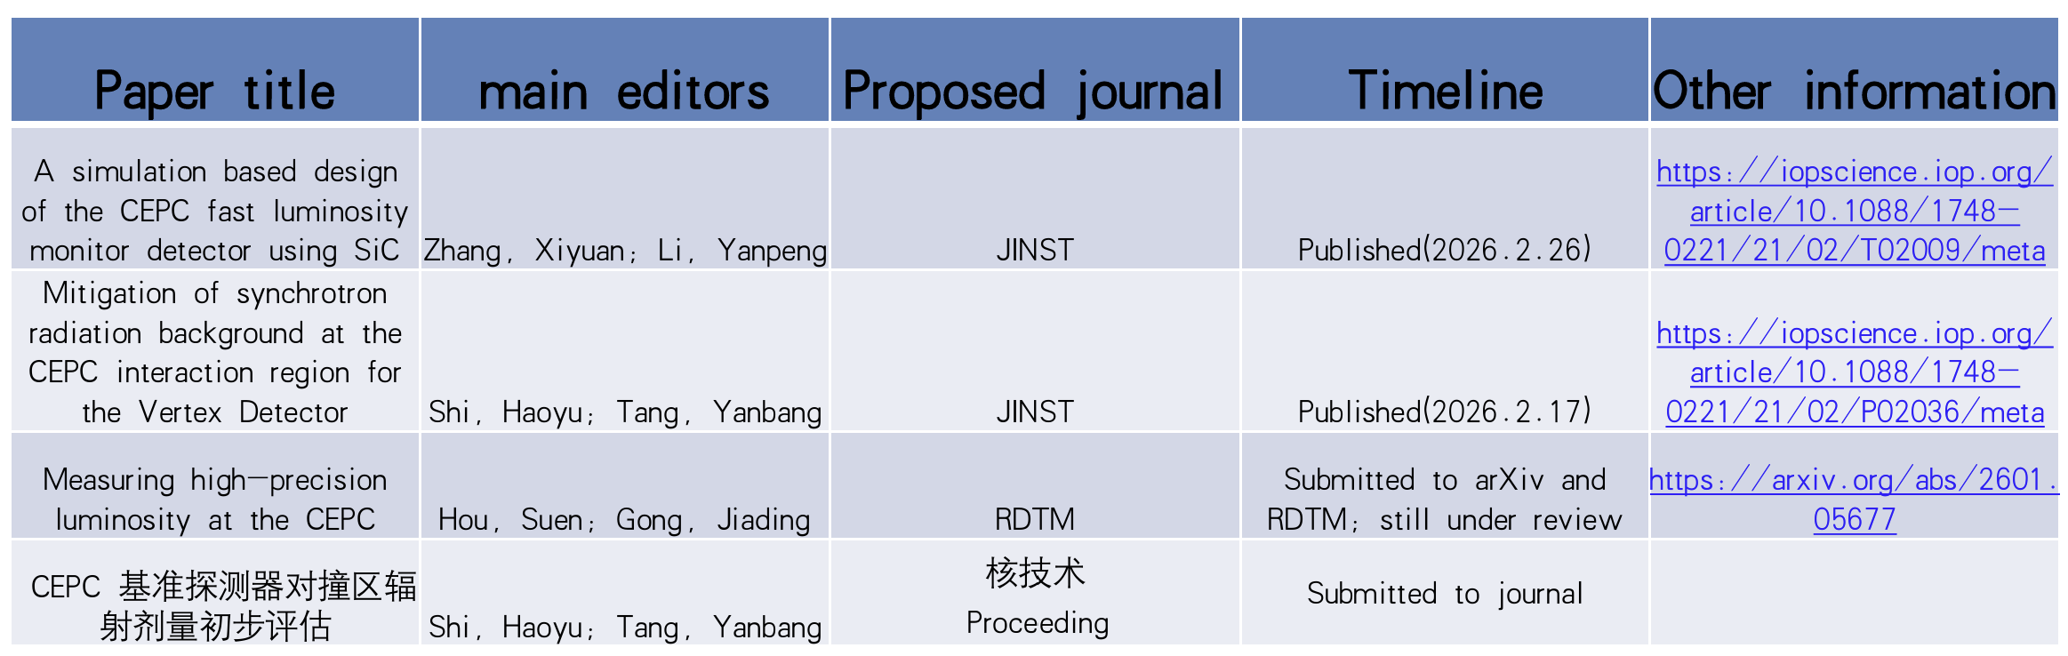
MDI

Slide 4
Vertex
Paper title | Main editors | Journal | timeline
Beam Test of a Baseline Vertex Detector Prototype for CEPC | Zhijun Liang, Wei wei, Ying Zhang, Joao et al | IEEE Trans. Nucl. Sci. 71(6), 1319–1323 (2024) | published in 2024
Characterization of the JadePix-3 CMOS pixel sensor for the CEPC vertex detector | Yunpeng Lu et al | NIMA | Published in 2024
Beam test result and digitization of TaichuPix‑3: A Monolithic Active Pixel Sensors for CEPC vertex detector | Hancen Lu , Zhijun Liang et al | NIM or JINST | to be ready in 3 months
Design and Performance Evaluation of the CEPC Vertex Detector Based on Stitching MAPS Technology | Chengdong Fu, Tianyuan Zhang et al | NIM or JINST or EPJC | to be ready in 3 months
Advanced performance evaluation and Layout optimization of the CEPC Vertex Detector | Chengdong Fu, Tianyuan Zhang et al | NIM or JINST or EPJC | to be ready in 12 months
domestic CIS technology for CEPC vertex detector | Ying Zhang, Yunping et al | IEEE TNS | to be done in late 2027
Optimisation of the vertex detector and measurement of Higgs decays to second-generation quarks at the CEPC | Jialin Li, Hao Liang , Kaili Zhang ,Yifan Zhu, Jun Guo, Haijun Yang , Manqi Ruan | JHEP 03 (2026) 141 | published in 2026

Slide 5
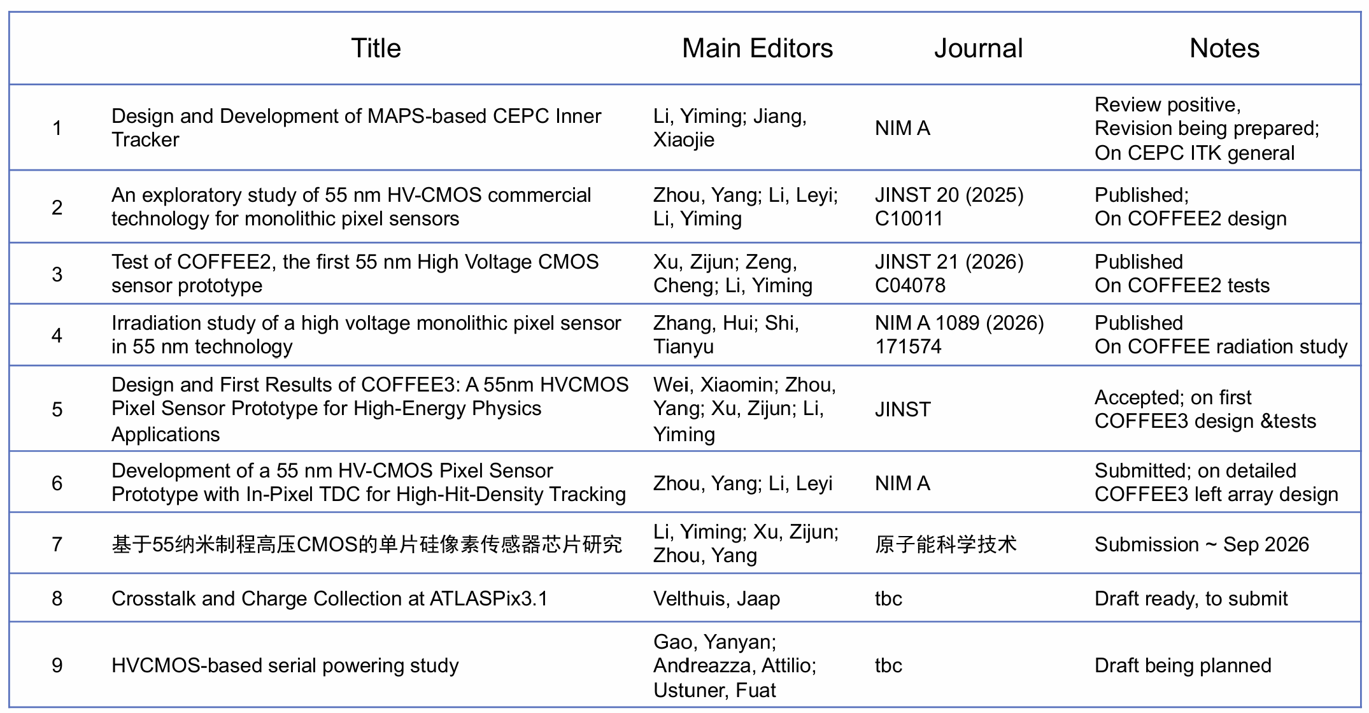
Inner tracker

Slide 6
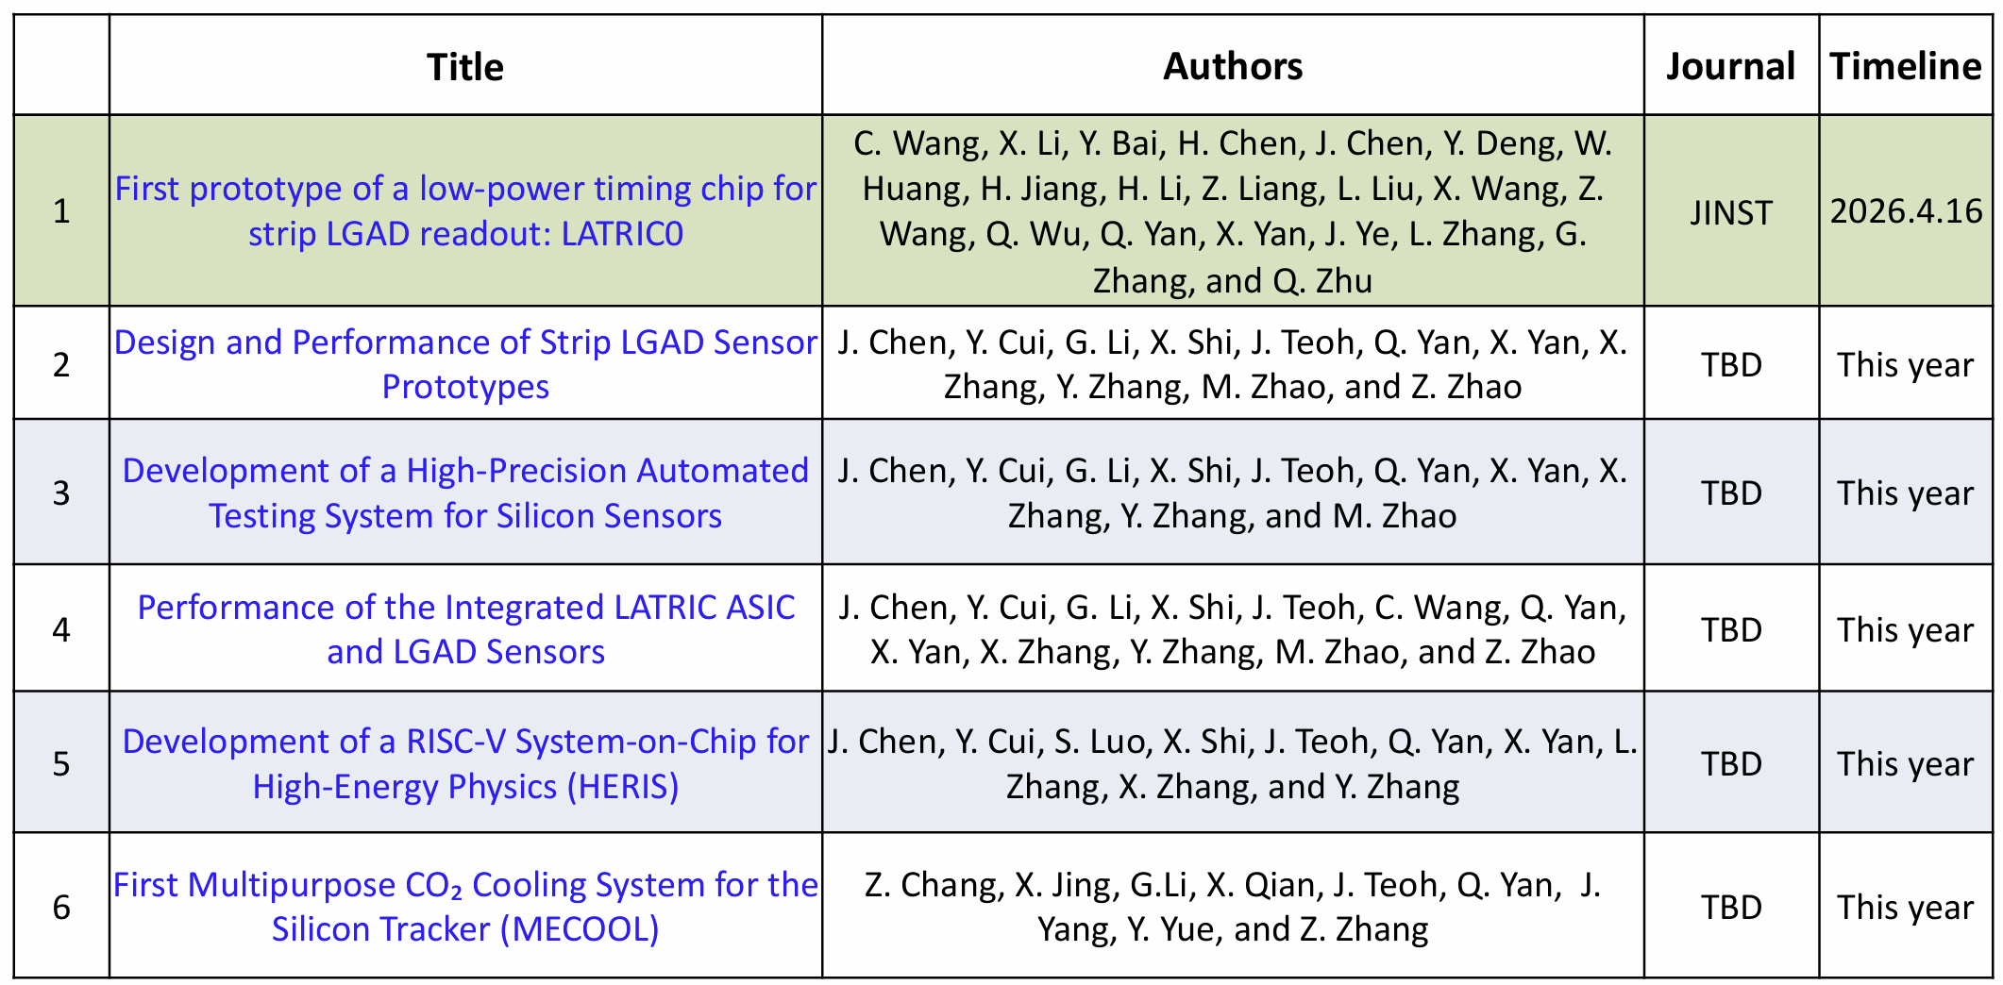
Outer tracker

Slide 7
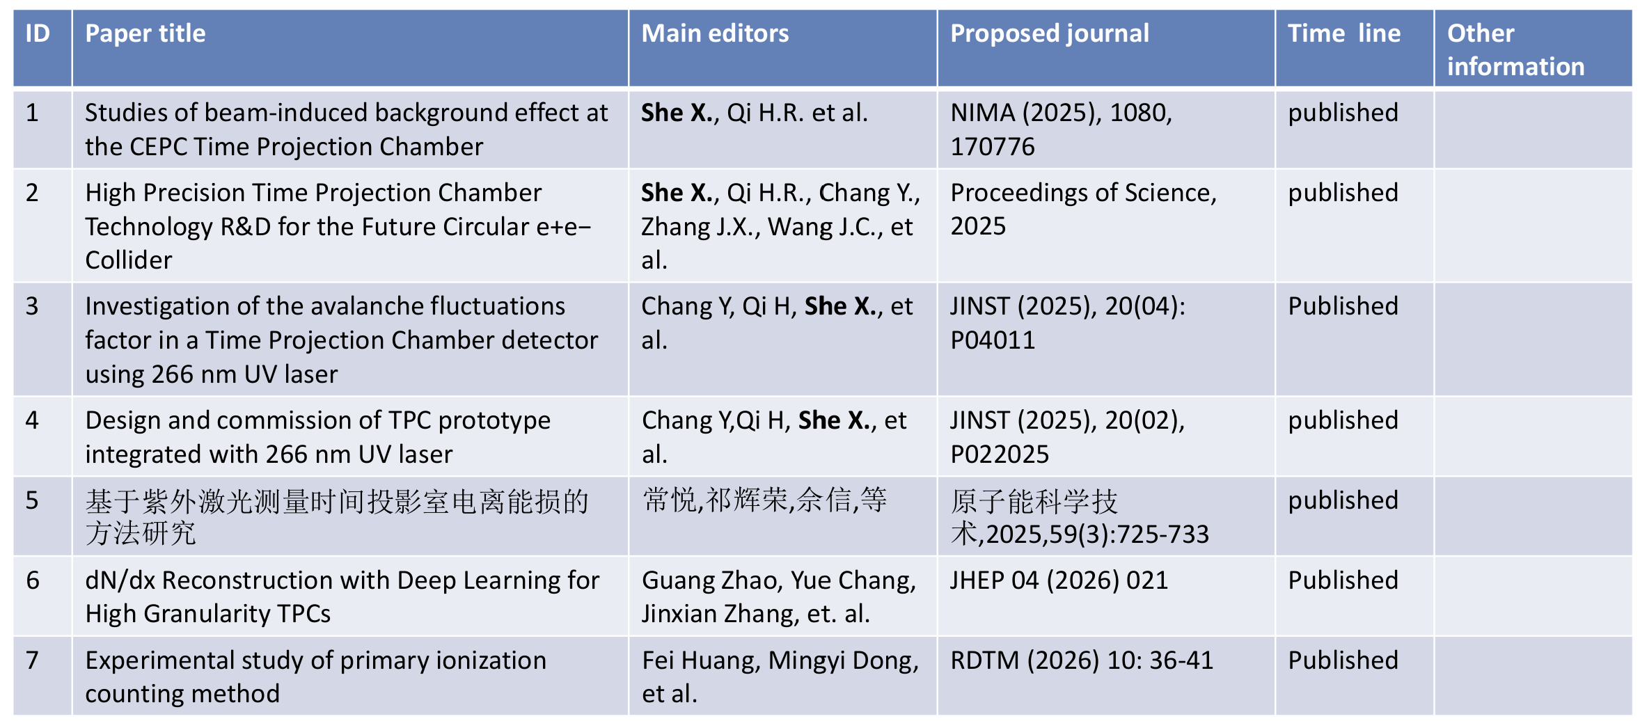
Gaseous detector (1)

Slide 8
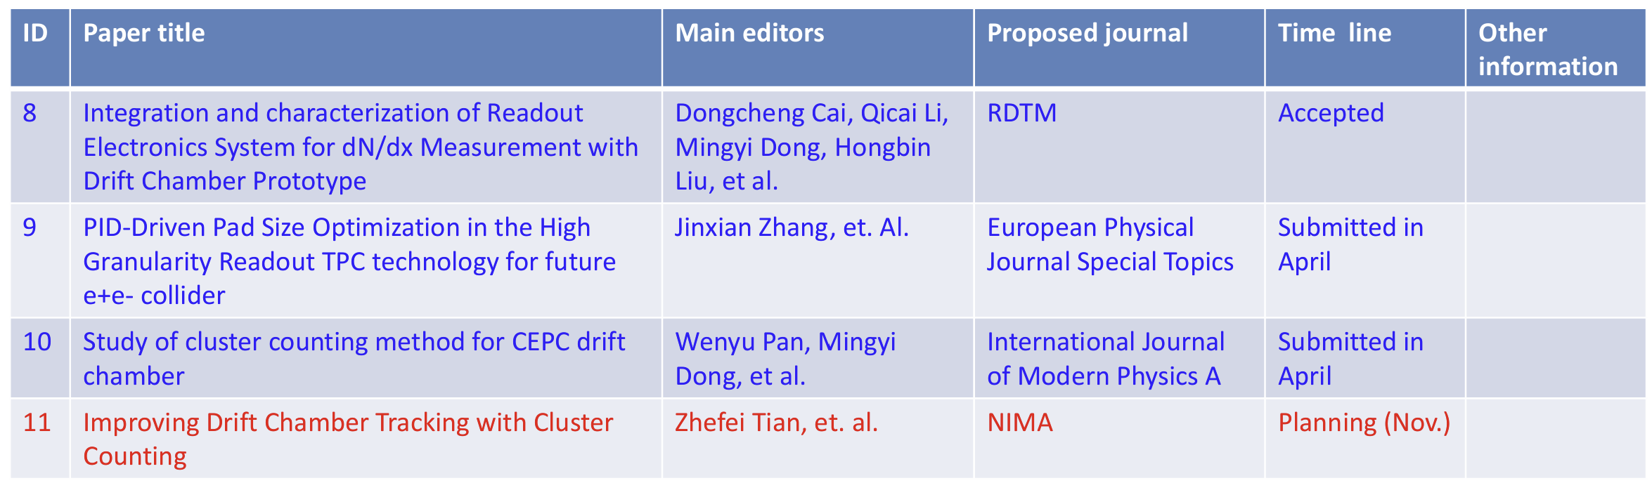
Gaseous detector (2)

Slide 9
ECAL
ID | Paper title | Main editors | Proposed journal | Timeline | Other information
1 | Simulation Studies of the Effect of SiPM Dark Noise on the Performance of a Highly Granular Crystal ECAL | Yong Liu; Jack Rolph | RDTM | Published | https://doi.org/10.1007/s41605-026-00645-w
2 | Design and Simulation Study of a High-Granularity Crystal Electromagnetic Calorimeter for Future Higgs Factories | Yong Liu; Baohua Qi; Yang Zhang | RDTM | Submitted to arXiv and RDTM; still under review | A updated version will be re-submitted with significant changes
3 | A novel perspective on crystal electromagnetic calorimeter design for the CEPC | Shengsen Sun; Weizheng Song | JINST | Submitted to arXiv and JINST; still under review | https://arxiv.org/pdf/2602.21489
4 | Measurements on Time Resolution of BGO, PWO and BSO Crystals | Yong Liu; Zhiyu Zhao | JINST | Submitted to arXiv; Sumission to Journal in one month | https://arxiv.org/abs/2503.16880
5 | SiPM non-linearity studies in beam tests with scintillating crystals | Yong Liu; Zhiyu Zhao | NIMA (TBD) | Submitted to arXiv; Sumission to Journal in one month | https://arxiv.org/abs/2603.08167
6 | Dynamic Range of SiPMs with High Pixel Densities | Yong Liu; Zhiyu Zhao | NIMA (TBD) | Submitted to arXiv; Sumission to Journal in one month | https://arxiv.org/abs/2407.17794
7 | Particle Identification Studies using a Highly Granular Crystal Electromagnetic Calorimeter | Yong Liu; Jack Rolph | JINST (TBD) | Draft ready; submission in around two weeks
8 | High-granularity crystal calorimeter prototype development and commissioning | Yong Liu; Baohua Qi | NIMA | Draft to be ready in 1 month; submission in 2 months
9 | EM performance of a high-granularity crystal calorimeter prototype with electrons in the range of 0.2 - 6.0 GeV | Yong Liu; Baohua Qi; Jack Rolph | TBD | Draft to be ready in 2 months; submission in 3 months
10 | Lab and beam-test studies of BSO crystals | Yong Liu; Yushan Liu; Baohua Qi | TBD | Draft to be ready in 2 months; submission in 3 months
11 | Simulation study of beam-induced backgrounds for the crystal electromagnetic calorimeter at the CEPC | Shengsen Sun; Weizheng Song | NST | Draft ready; submission in 1 month

Slide 10
HCAL
Paper title | main editors | Proposed journal | Timeline | Other information
Development of a Novel Highly Granular Hadronic Calorimeter with Scintillating Glass Tiles | Dejing Du; Yong Liu; | Instruments | Published | https://doi.org/10.3390/instruments6030032
Developmentofanovelhighlygranularhadronic calorimeterwithscintillatingglasstiles | Dejing Du; Yong Liu; | PoS | Published | https://doi.org/10.22323/1.414.0359
GSHCAL at future 𝑒+𝑒− Higgs factories | Peng Hu; Yuexin Wang; Dejing Du; Zhehao Hua; Sen Qian; et al.,CEPC HCAL Group； GS Group | NIMA | Published | https://doi.org/10.1016/j.nima.2023.168944
Preliminary optimization study on the PFA-based GSHCALfor the CEPC | Peng Hu; Sen Qian; Hua Cai; Danping Chen; Dejing Du; et al., | JINST | Published | https://doi.org/10.1088/1748-0221/19/06/T06008
Muon beamtest results of high-density glass scintillator tiles | Dejing Du; Yong Liu; Hua Cai; Danping Chen; Z.H. Hua; et al., | JINST | Published | https://doi.org/10.1088/1748-0221/19/05/P05039
Batch testing results of GFO glass scintillators for GSHCAL | Xingcan Li; Hua Cai; Shubin Chen; Kun Ge; Zhehao Hua; et al.,； GS Group | NIMA | Published | https://doi.org/10.1016/j.nima.2025.171274
Beam test results of high-density glass scintillator tiles | DejingDu,ZhehaoHua,YongLiu,BaohuaQi,andQianSen | EPJ | Published | https://doi.org/10.1051/epjconf/202532000040
Light attenuation and loss in Ce3+-doped dense glass scintillator | Zhehao Hua; Dong Yang; Sen Qian; Hua Cai; Danping Chen; et al., GS Group | NIMA | Published | https://doi.org/10.1016/j.nima.2024.170182
Performance study of Gd-Al-B-Si-Ce3+ glass scintillators using a 5GeV electron beam | Lingyue Chen; Hua Cai; Feng Gao; Jifeng Han; Hao He; et al.CEPC HCAL Group； GS Group | JINST | Published | https://doi.org/10.1088/1748-0221/21/02/T02001
Study of Light Output Uniformity for the CEPC-GS-HCAL Scintillator Detector Cells | Heng Zhao; Sen Qian; Boxiang Yu，CEPC HCAL Group； GS Group | JINST | Plan
Baseline design and performance studies of the glass-scintillator hadronic calorimeter for the CEPC reference detector | Hengne Li; HCAL Group | NST | Plan

Slide 11
Homogeneous calorimeter
Paper title | main editors
Study on Performance of Hadronic Calorimeter with High Sampling Rate Scintillation Glass | Heng Yuekun, Zhang Yang, Song Weizheng, Sun Shengsen, Liu Yong, Yang Haijun, Qian Sen, Wang Yifang
Study on Total-Absorption Scintillation Glass Electromagnetic Calorimeter | Liu Yong, Heng Yuekun, Song Weizheng, Qian Sen, Wang Yifang.
Study on Homogeneous Electromagnetic and Hadronic Calorimeters Based on Scintillation Glass | Heng Yuekun, Wang Yifang, Liu Yong, Qian Sen, Zhang Yang, Song Weizheng, Sun Shengsen, Yang Haijun, Li Hengne

Slide 12
Magnet
Paper title | main editors | Proposed journal | Timeline | Other information
Quench Characteristics and Protection of the CEPC Detector Magnet | Menglin Wang, Ling Zhao, Rui Kang, Zhilong Hou, Zhongxiu Liu, Qingyuan Li, Qingjin Xu and Feipeng Ning | IEEE TRANSACTIONS ON APPLIED SUPERCONDUCTIVITY | Accepted | DOI 10.1109/TASC.2026.3673668
Study on Quench Behavior of Aluminum-stabilized Stacked REBCO Tapes Cable | Qingyuan Li, Menglin Wang, Yatian Pei, Fan Ren, Yuanlong Ding, Qingjin Xu, Wei Pi and Feipeng Ning | IEEE TRANSACTIONS ON APPLIED SUPERCONDUCTIVITY | Accepted | DOI 10.1109/TASC.2026.3660145
CEPC vs FCC: Detector magnet designs for future circular electron-positron colliders | Feipeng Ning | SUPERCONDUCTIVITY | Published | DOI 10.1016/j.supcon.2026.100260
Cryogenic system design of CEPC detector magnet | Keyu Zhu, Zhengze Chang, Feipeng Ning | IEEE TRANSACTIONS ON APPLIED SUPERCONDUCTIVITY | Draft to be ready in 2 months
Study on Mechanical Characteristics of ASTC for CEPC Detector Magnet | Yatian Pei, Yuanlong Ding, Qingyuan Li, Menglin Wang,Zian Zhu, Ling Zhao, Qingjin Xu and Feipeng Ning | IEEE TRANSACTIONS ON APPLIED SUPERCONDUCTIVITY | Draft to be ready in 2 months
Research on the Dynamic Loss of ASTC Cables | Yuanlong Ding, Qingyuan Li, Menglin Wang, Yatian Pei, Qingjin Xu, Wei Pi and Feipeng Ning | IEEE TRANSACTIONS ON APPLIED SUPERCONDUCTIVITY | Draft to be ready in 2 months
Study on Quench and Excitation Characteristics of Non-Insulated Coils winding by ASTC | Qingyuan Li, Menglin Wang, Yatian Pei, Yuanlong Ding, Qingjin Xu, Wei Pi and Feipeng Ning | IEEE TRANSACTIONS ON APPLIED SUPERCONDUCTIVITY | Draft to be ready in 1 months
Conductor development for the CEPC detector magnet | Ling Zhao, Feipeng Ning | IEEE TRANSACTIONS ON APPLIED SUPERCONDUCTIVITY | Draft to be ready in 5 months

Slide 13
Electronics
Paper title | Main editors | Journal | timeline
Data & clock Free-Space Optical communication | Jun Hu | JINST | 2025 (published)
Millimeter-Wave for CEPC detector | Jun Hu | IEEE | 2026 (plan)
Clock synchronization for CEPC accelerator | Jun Hu | IEEE | 2026 (plan)
LDO design in Taichupix | Jia Wang | NIMA | plan
LATRIC0 | Xiongbo Yan | JINST | 2026 (published)
LATRIC characterization | Xiongbo Yan | IEEE | 2026 (plan)
LATRIC + LGAD prototype | Xiongbo Yan | IEEE | 2026 (plan)

Slide 14
TDAQ
Paper title | Main editors | Journal | timeline
Physical simulation study of the cepc trigger system | Boping Chen |  | 2026
GPU Track-Based Trigger Algorithms for CEPC Reference Detector | Xu Zhang/Fei Li | IEEE TNS | 2026
FPGA based RDMA readout study | Sheng Dong/Chang Xu/Hongyu Zhang | IEEE TNS | 2026
A Pre-Study of a General Purpose Trigger Processing Unit for the CEPC TDAQ System | Dong Liu/Jingzhou Zhao |  | 2027

Slide 15
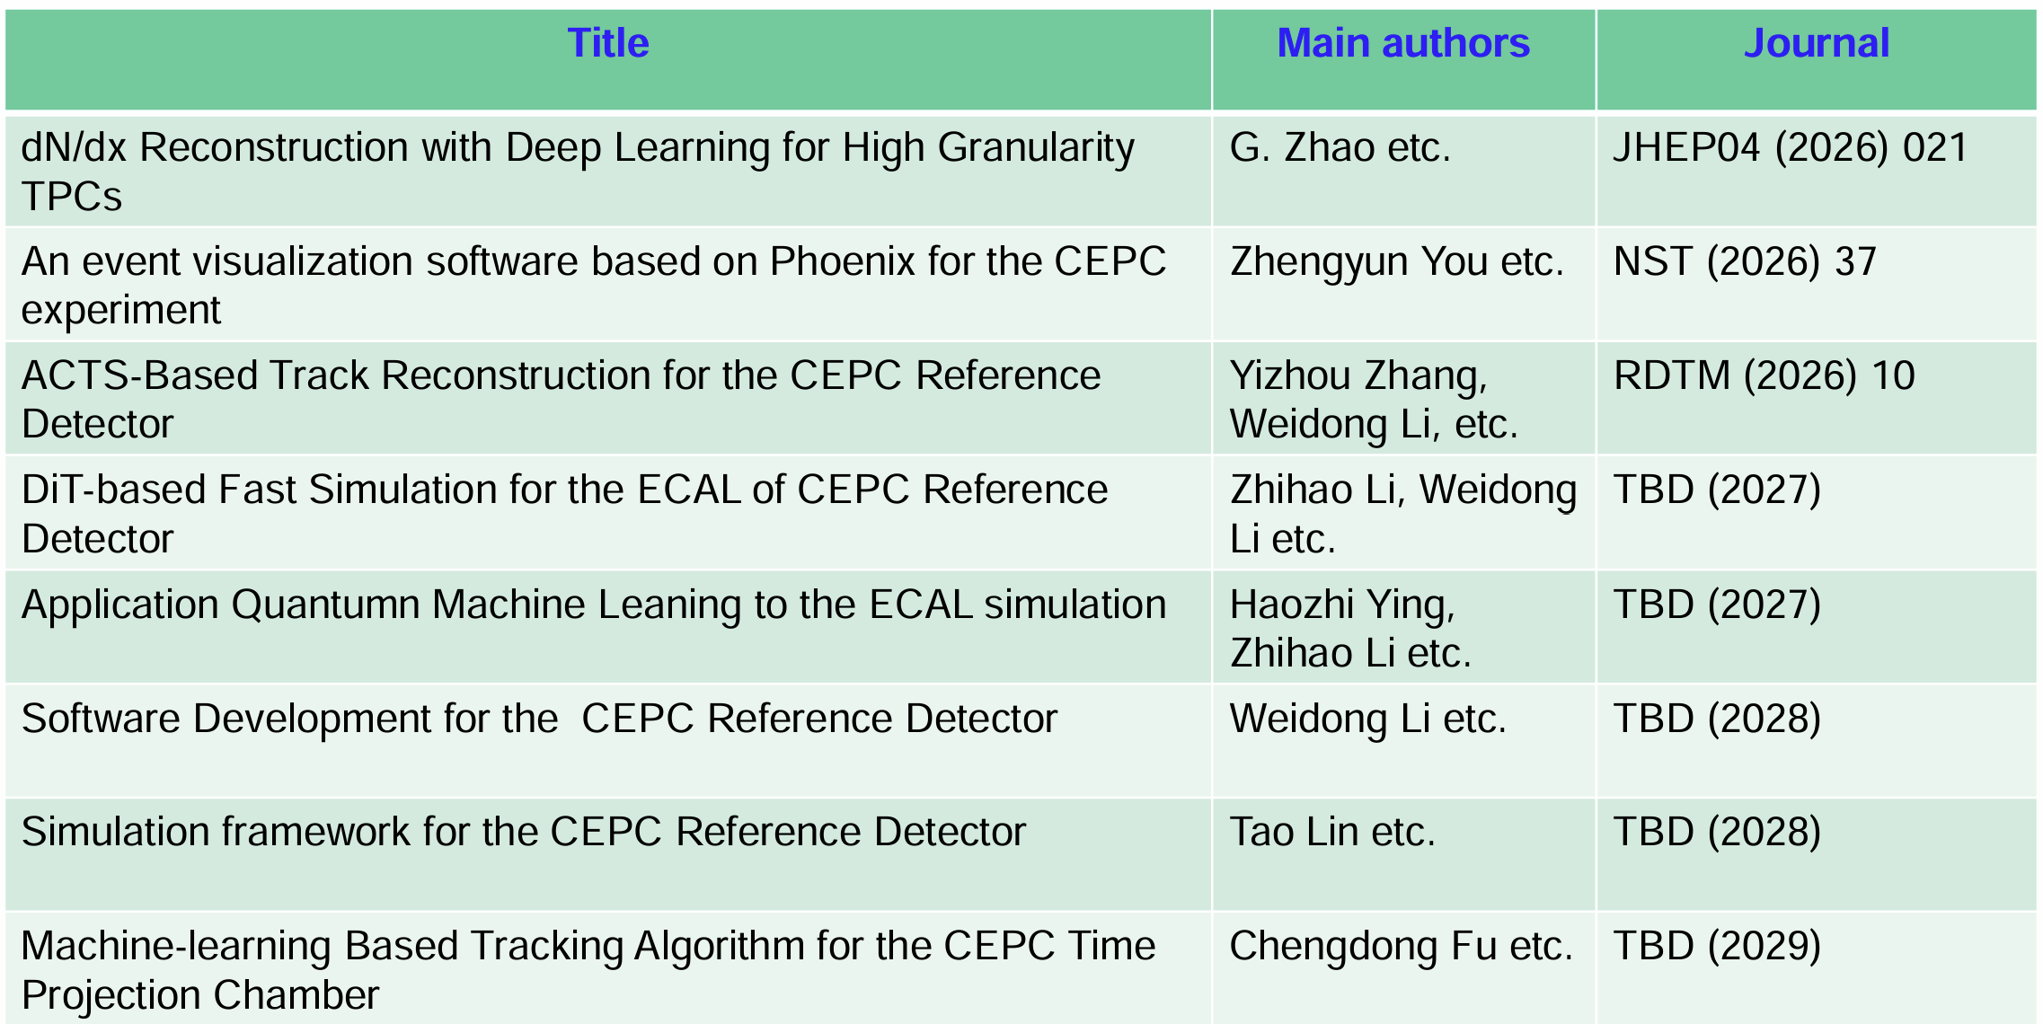
Offline

Slide 16
Mechanics (1)
Paper title | Main editors | Proposed journal | Timeline | Related Sub. D
Mechanical properties analysis and structural optimization of CEPC detector barrel iron yoke | Shi, Y., Xia, S., Ji, Q. et al. | RDTM | Published, 2025 | Yoke
The optimal design of structural stiffness for the CEPC vertex detector supports based on a multi-objective genetic algorithm | Shi, Y., Xia, S., Ji, Q. et al | RDTM | Published, 2025 | VTX
Study on Normal Bending Characteristics of Aluminum-Stabilized Stacked HTS Tape Cable for CEPC Detector Magnet | Pei Y, Cao J, Wang M, et al. | IEEE Transactions on Applied Superconductivity | Published in 2024 | Magnet
Structural optimization and mechanical properties analysis of the inter-supporting barrel yoke for the CEPC detector | Xia Shang et al. | RSI | Submitted, 2026.1 Under review | Yoke
Rapid prediction of mechanical response of CEPC detector barrel yoke based on machine learning surrogate model | Xia Shang et al. | TBD | Draft completed, submitted soon | Yoke

Slide 17
Mechanics (2)
Paper title | Main editors | Proposed journal | Timeline | Related Sub. D
Study on Mechanical Characteristics of Aluminum-stabilized Stacked REBCO Tape Cable for CEPC Detector Magnet | Yatian Pei et al. | IEEE~ | Plan to submit by this month | Magnet
Mechanical Design and Heat Dissipation Research of Hadron Calorimeter Detector Based on Glass Scintillator | Yatian Pei et al. | RDTM | Plan to submit this July | HCAL
Simulation, Fabrication, and Testing of the ITK Ultra-Light Carbon Fiber Structure | Qian Xiaohui. et al. | TBD | Plan to submit by end of this year | ITK
Finite Element Analysis and Optimization on Carbon Fiber Composite Main Supporting Structure of CEPC ECAL | Hou Shaojing. et al. | TBD | Plan to submit by end of this year | ECAL
Air cooling test of the CEPC Vertex detector thermal model | Fu Jinyu. et al. | TBD | 2027 | VTX
Structure design and thermal performance study of CEPC beam pipe | Jian Wang, Xiaohui Qian, et al. | TBD | 2027 | Beam pipe

Slide 18
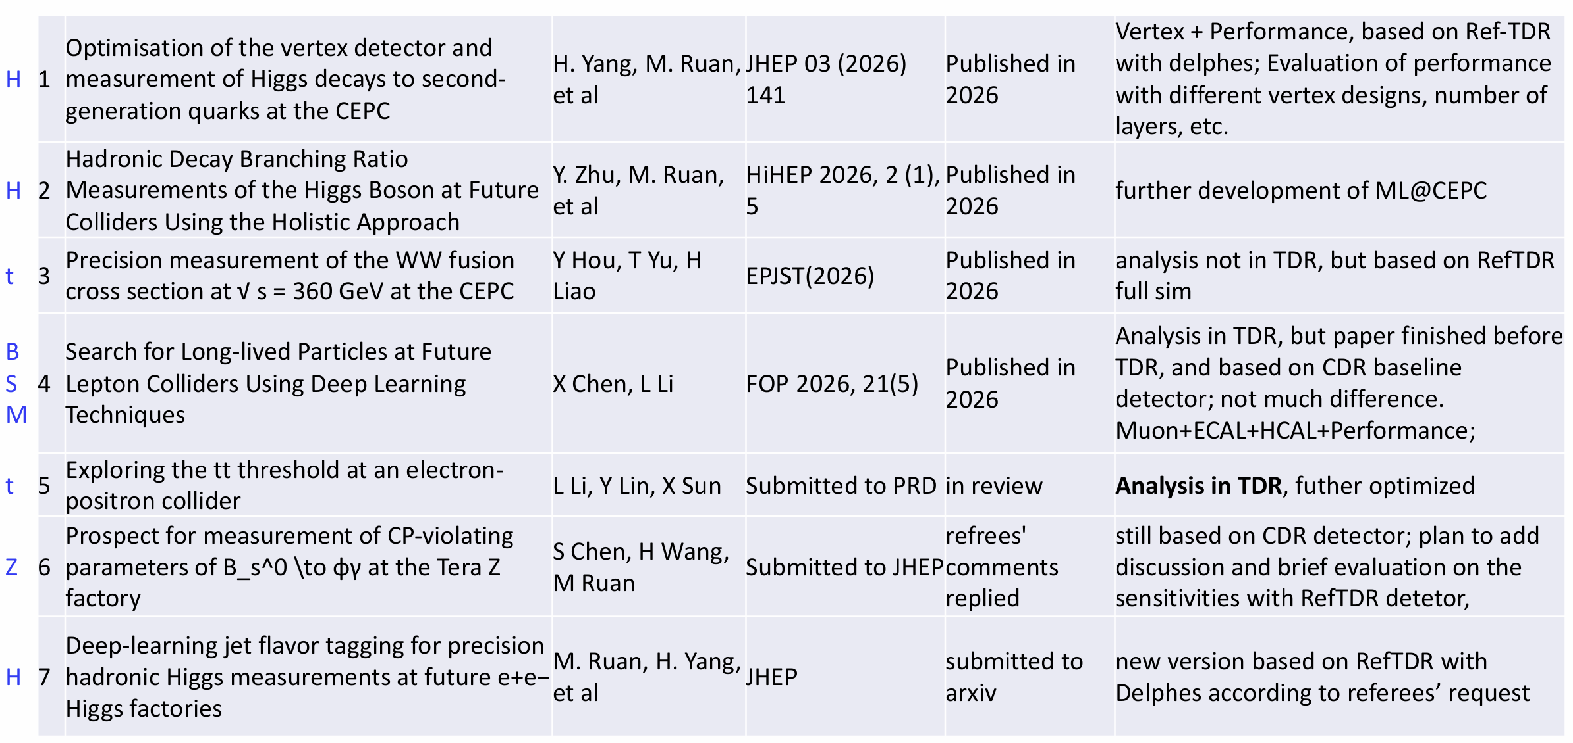
Performances (1)

Slide 19
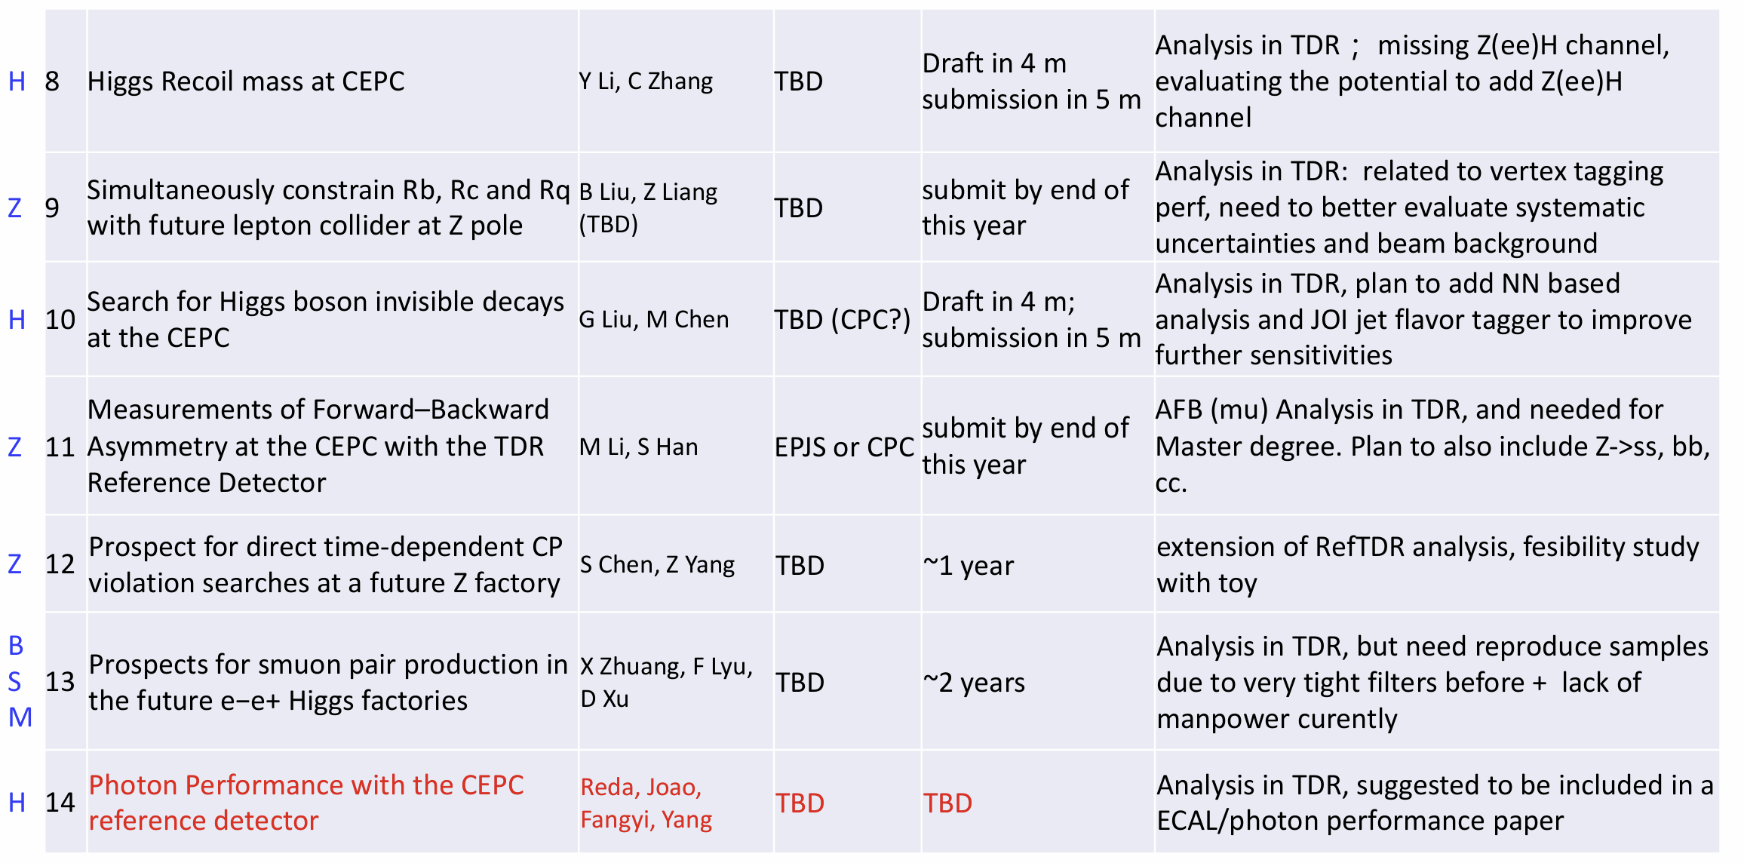
Performances (2)

Slide 20
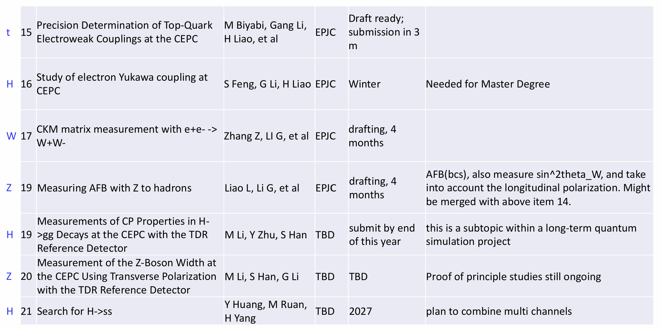
Performances (3)

Slide 21
Cherenkov detector
Not in the RefTDR, good to collect plans here.
No. | Tile of the paper | Main editors | Timeline for submission | Proposed Journal
1 | Study on the simulation of the CEPC Cherenkov detector | Changru Li, Shengsen Sun etc. | 2026 | RDTM
2 | Measurement of the optical properties of the silica aerogel | Haojie Dong, Zhonghua Qin etc. | 2027 | RDTM
3 | SiPM performance study for the CEPC Cherenkov detector | Haojie Dong, Zhonghua Qin etc. | 2027 | NIM A
4 | Study on the reflector of the Cherenkov light | Jian Wang, Haojie Dong, etc. | 2027 | RDTM
5 | Study on the event reconstruction for the CEPC Cherenkov detector | Changru Li, Shengsen Sun etc. | 2028 | TBD
6 | Construction of the prototype for the CEPC Cherenkov detector | Jian Wang, Zhonghua Qin etc. | 2028 | JINST
7 | Cosmic ray test of the CEPC Cherenkov detector prototype | Haojie Dong, Zhonghua Qin etc. | 2028 | JINST
8 | Best test of the CEPC Cherenkov detector prototype | Haojie Dong, Zhonghua Qin etc. | 2028 | NIM A
9 | Conceptual design of the CEPC Cherenkov detector | Zhonghua Qin, etc. | 2028 | TBD

Slide 22
Summary
~130 papers in total, ~40 of them published (including a few proceedings)
Better coordination is needed in the future
  Regular update of the plan and check on the status. A dedicated database?
  A presentation at the Wednesday meeting before submitting a paper?

