Slide 1
Ab initio no core shell model for light nuclei
Youngman Kim
Rare Isotope Science Project
Institute for Basic Science, Daejeon, Korea
In collaboration with:
Ik Jae Shin, RISP/IBS
James Vary, Pieter Maris, Iowa State University
Christian Forssen, Jimmy Rotureau, Chalmers University
The Seventh International Symposium on Chiral Symmetry in Hadrons and Nuclei 27-30 October 2013, BeiHang Univ. Beijing, China

Slide 3
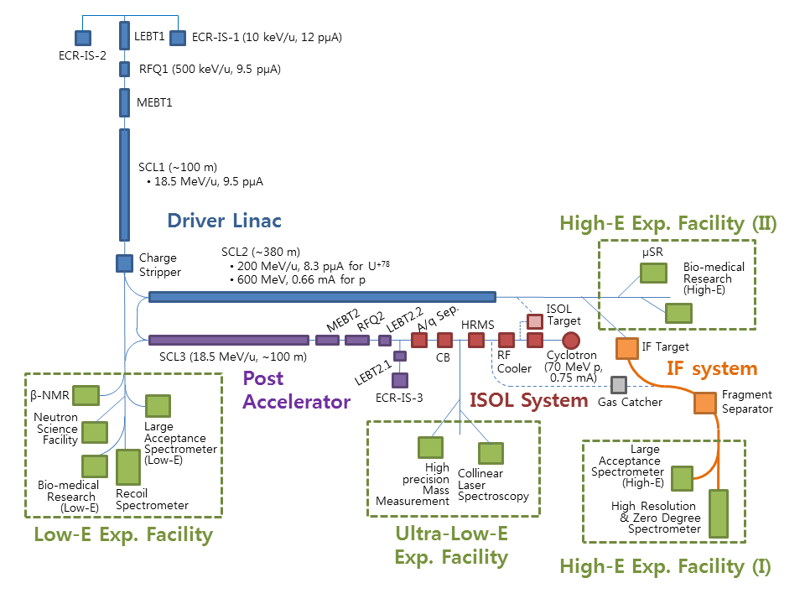
RAON : RISP Accelerator Complex
High intensity RI beams by ISOL & IF
ISOL : direct fission of ²³⁸U by p 70MeV
IF by 200MeV/u, 8.3pμA ²³⁸U
High quality neutron-rich RI beams
¹³²Sn with up to ~250MeV/u, up to 10⁸ pps
More exotic RI beams by ISOL+IF

Slide 4
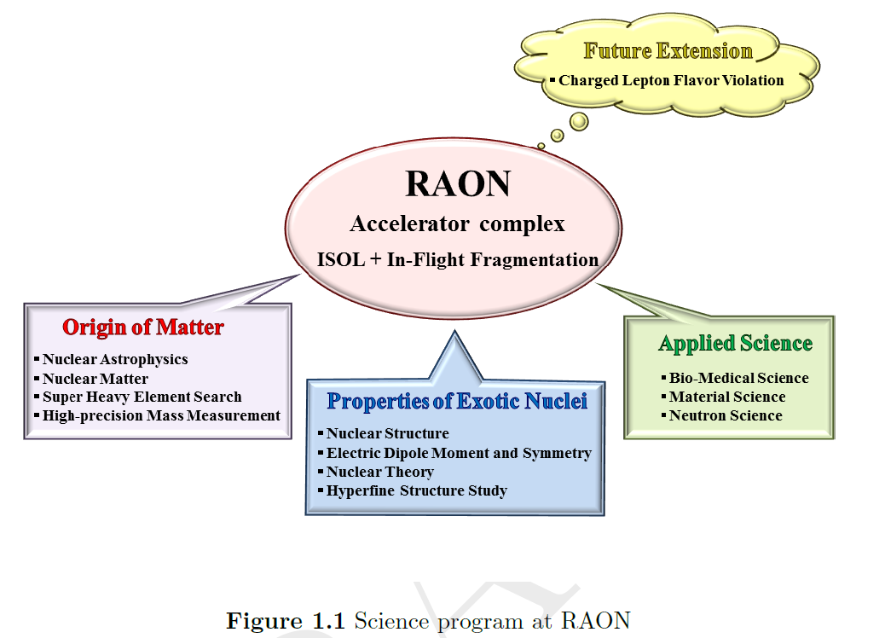

Slide 5
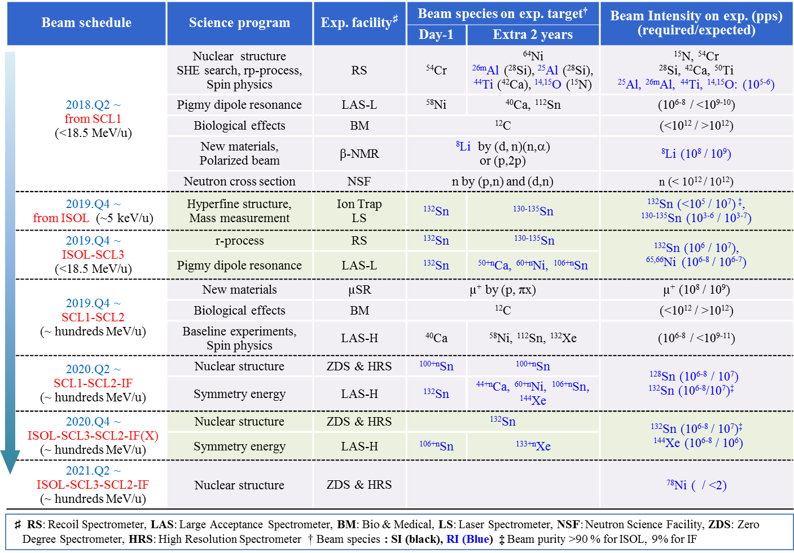
Science Program with Beam Schedule

Slide 6
Contents
Ab initio approach
Extrapolating to the infinite matrix limit
Summary

Slide 7
Ab initio No Core Shell Model
Ab initio: nuclei from first principles using fundamental interactions without uncontrolled approximations.
No core: all nucleons are active, no inert core.
Shell model: harmonic oscillator basis
Point nucleons

Slide 10
Pieter Maris

Slide 11
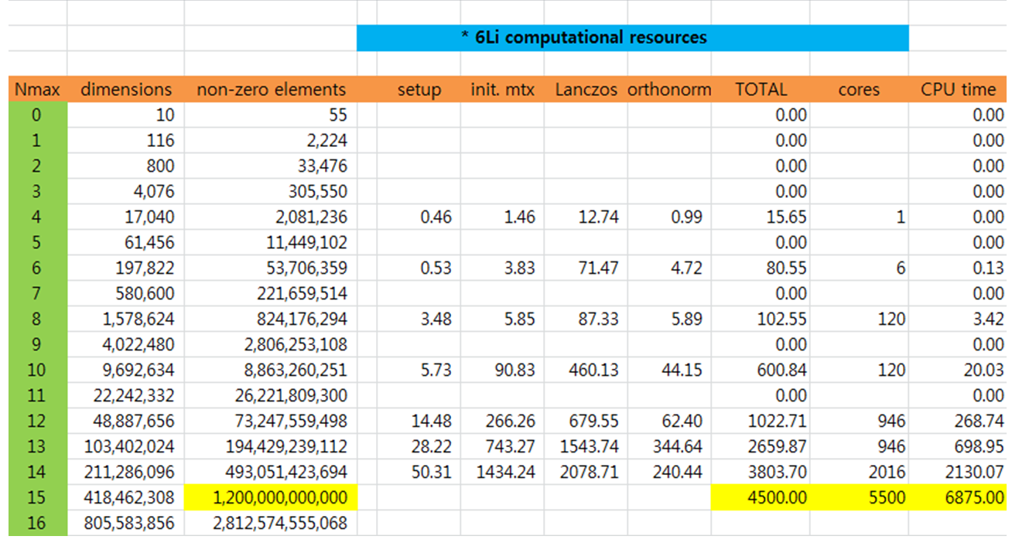
Taychon II at KISTI

Slide 12
Ab initio No Core Gamow Shell Model

Slide 14
Ab initio structure and NN interaction
NN (and NNN) interactions are essential inputs
Unfortunately, the NN interaction at low energies needed for nuclear physics applications cannot be directly derived from QCD at the moment
Ab initio theory requires, of course, a realistic NN interaction accurately describing NN scattering data and deuteron properties
We use NNLO_{OPT} and JISP16 in this study
Nice to avoid NNN forces? Yes

Slide 15
(Andrey Shirokov)

Slide 19
JISP (J-matrix Inverse Scattering Potential)
completely phenomenological
provides a good convergence of many-body calculations, eff. interaction is not needed
fitted to describe light nuclei: JISP6 up to A = 6, JISP16 up to A = 16
provides a high-quality description of NN data: chi²/datum = 1.03 up to E_{lab} = 350 MeV for the 1992 np data base (Andrey Shirokov)
A. M. Shirokov, A. I. Mazur, S. A. Zaytsev, J. P. Vary, T. A. Weber, Phys. Rev. C 70, 044005 (2004)
A. M. Shirokov, J. P. Vary, A. I. Mazur, S. A. Zaytsev, T. A. Weber, Phys. Lett. B 621, 96 (2005)
A. M. Shirokov, J. P. Vary, A. I. Mazur, T. A. Weber, Phys. Lett. B 644, 33 (2007)

Slide 20
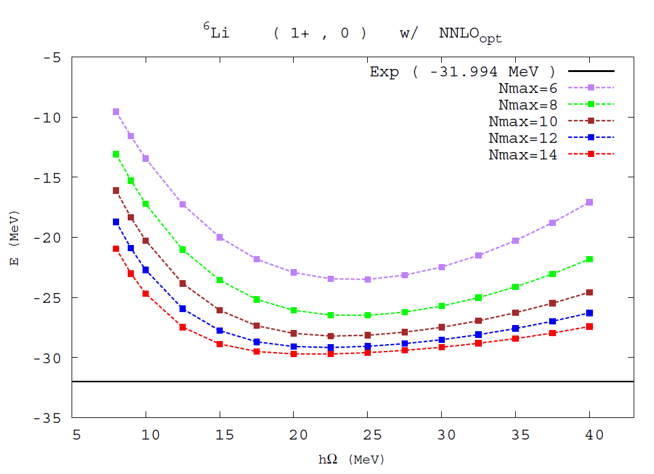
Tachyon II, Hopper, Edison, Titan, Mira

Slide 21
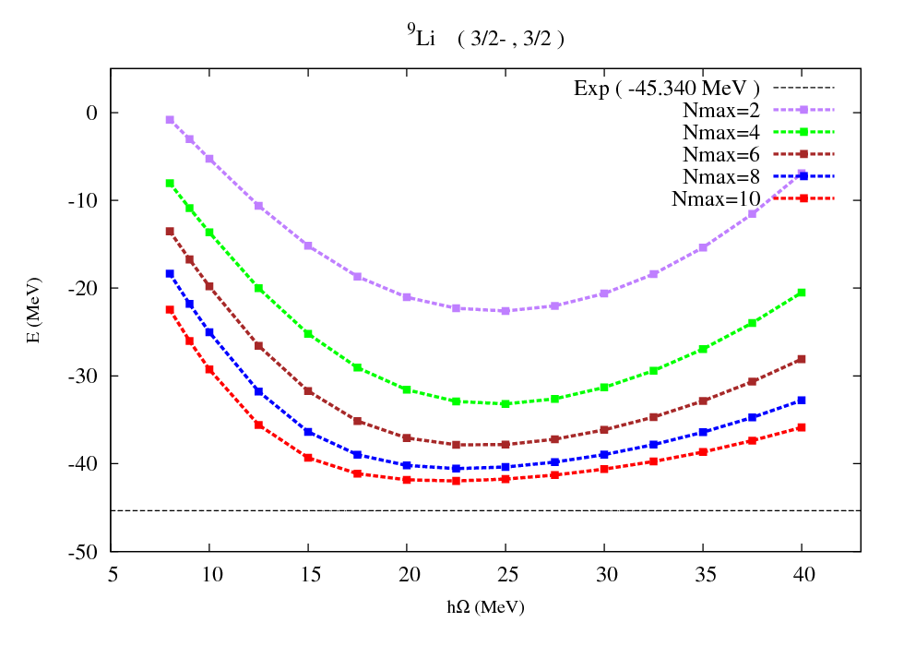
ISU-RISP collaboration
Preliminary

Slide 22
http://www.nndc.bnl.gov/chart/

Slide 23
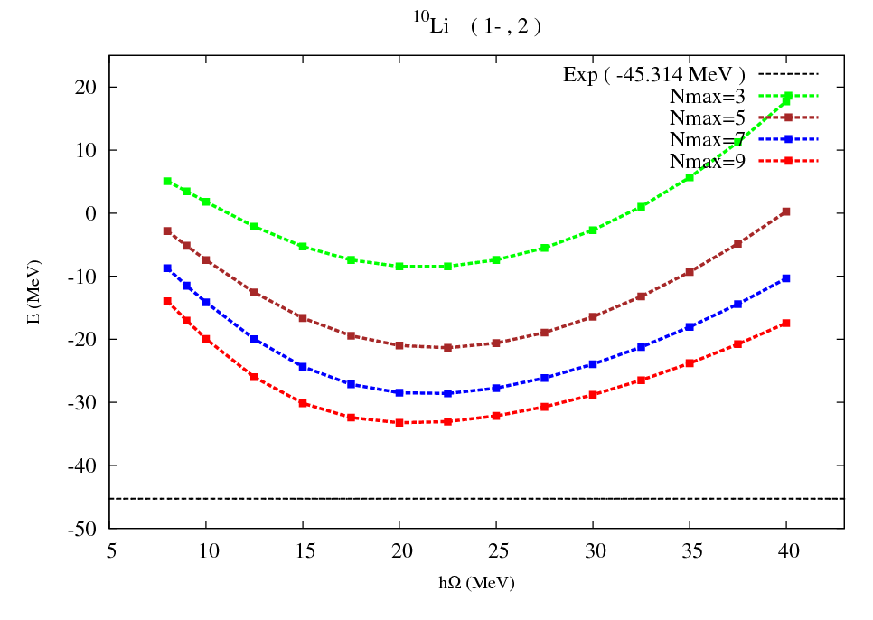
ISU-RISP collaboration
Preliminary

Slide 24
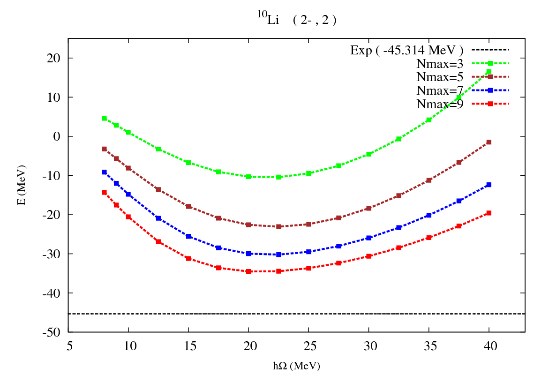
ISU-RISP collaboration
Preliminary

Slide 25
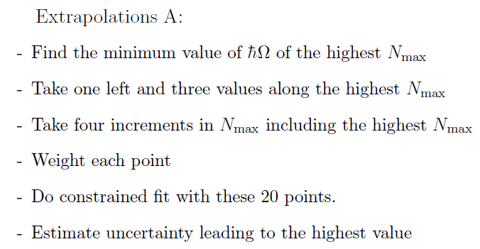
Extrapolating to the infinite matrix limit
“Extrapolations A & B”
P. Maris, J.P. Vary and A.M. Shirokov, Phys. Rev. C79, 014308 (2009)
P. Maris, A.M. Shirokov and J.P. Vary, Phys. Rev. C81, 021301(R) (2010)

Slide 26
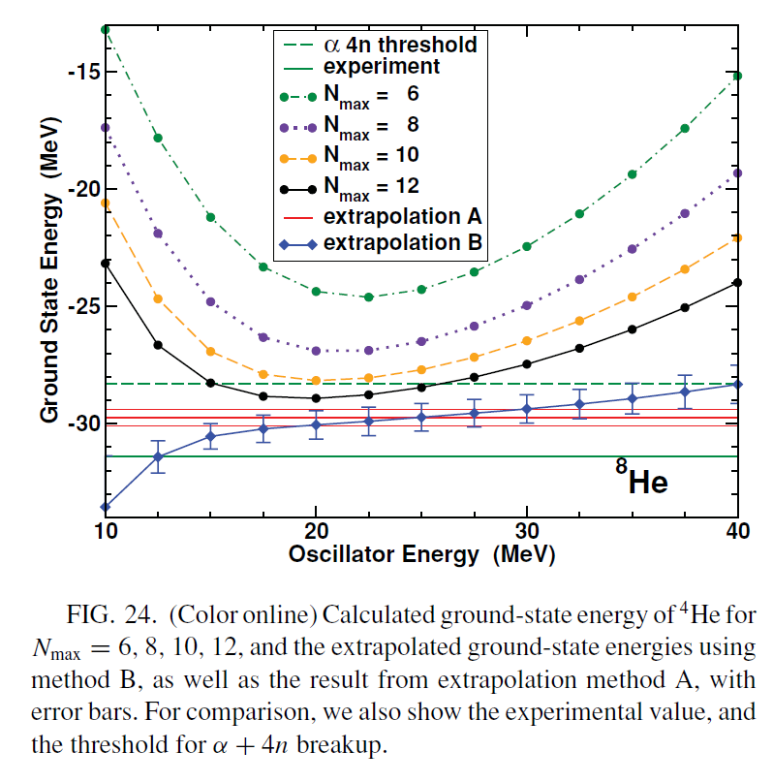
P.Maris, J.P.Vary and A.M.Shirokov, Phys.Rev.C79,014308 (2009)

Slide 27
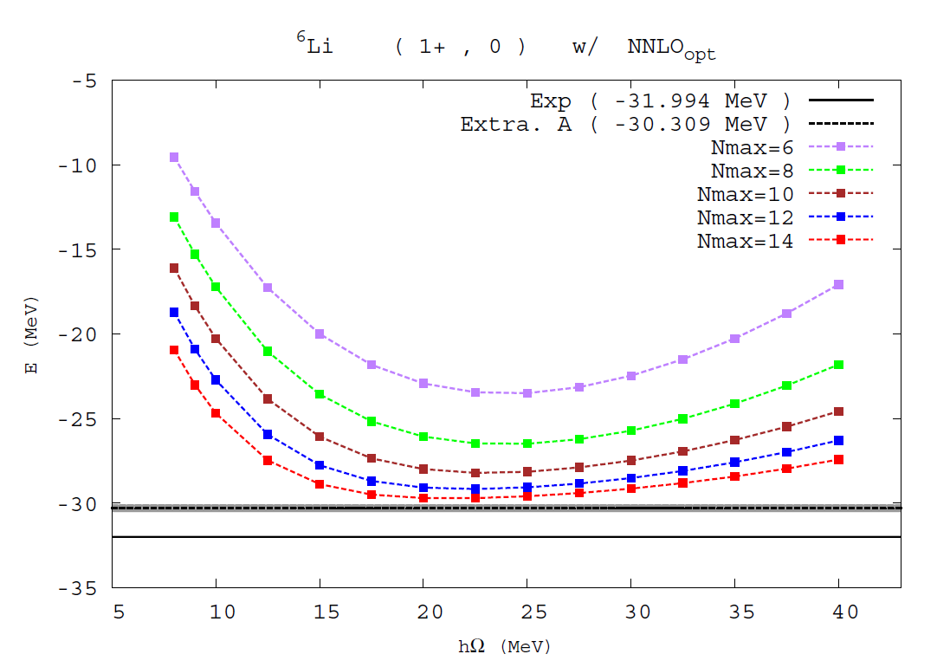

Slide 28
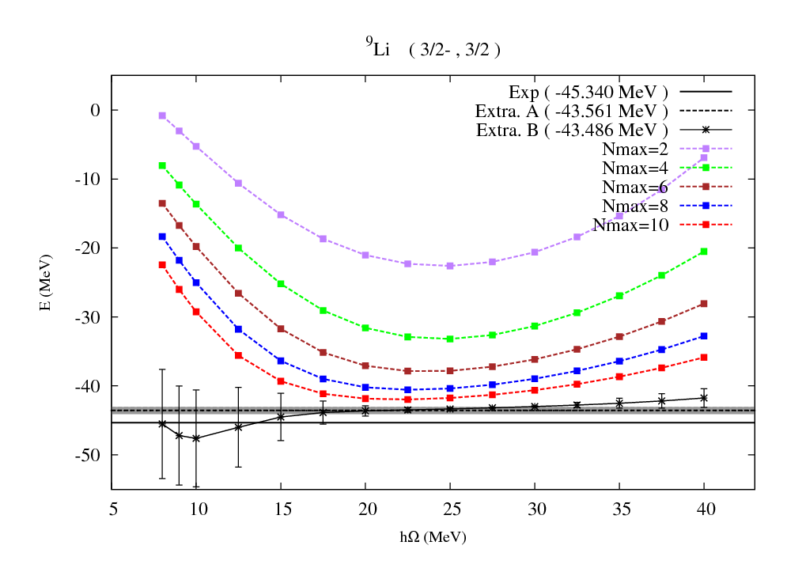

Slide 29
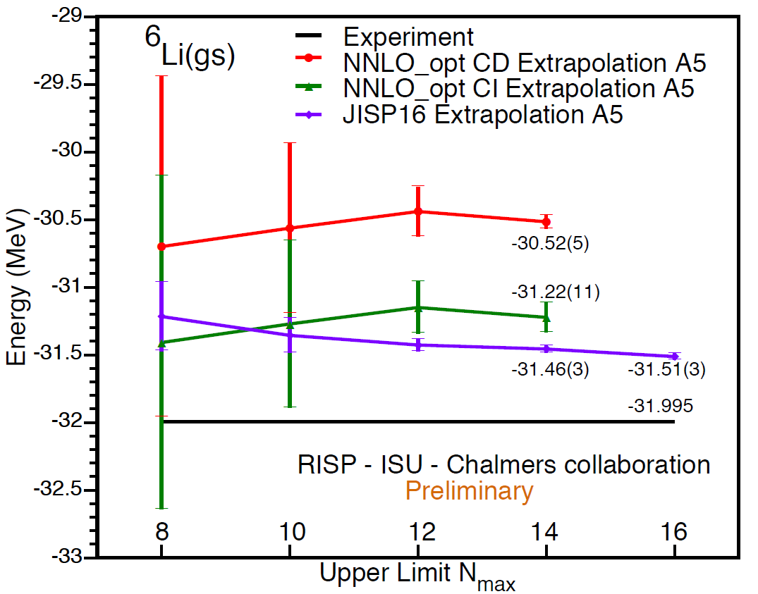
For both IR and UV extrapolations;
* S.Coon, M.I. Avetian, M.K.G. Kruse, U. van Kolck, P. Maris, and J.P. Vary, Phys. Rev. C 86, 054002 (2012); arXiv: 1205.3230
* R.J. Furnstahl, G. Hagen, T. Papenbrock, Phys. Rev. C 86 (2012) 031301; arXiv:1207.6100
* E.D. Jurgenson, P. Maris, R.J. Furnstahl, P. Navratil, W.E. Ormand, J.P. Vary, Phys.Rev. C87 (2013) 054312 ; arXiv: 1302:5473
…

Slide 30
Summary
A huge opportunity for nuclear physics in Korea with upcoming RI facility
There has been a great progress in ab initio approach for nuclear structure
(and also in understanding nuclear interactions)
We are working on ^{9,10}Li and all about ⁶Li together with various extrapolation methods
(Semi) ab initio approaches for medium mass nuclei
Ab initio nuclear reactions

