Slide 1
Studies of hypernuclei with the AMD method
Masahiro ISAKA
Institute of Physical and Chemical Research (RIKEN)
Focusing on ²⁵_{Λ}Mg, based on
M. Isaka, M. Kimura, A. Dote and A. Ohnishi, PRC 87, 021304(R) (2013)

Slide 2
Hypernuclear physics
Hypernuclei
Grand challenges of hypernuclear physics
Nuclei with hyperon(s)
Examples:
Interaction: knowledge of B-B interactions
2 body interaction between baryons
(Single) Λ hypernuclei
hyperon – nucleon (YN)
hyperon – hyperon (YY)
Λ particle
A major issue in hypernuclear physics
s
u
d
Structure: baryon many-body system
Structure change caused by hyperon(s)
No Pauli exclusion between N and Y
YN interactions are different from NN one
“Hyperon as an impurity in nuclei”
+
ΛΛ hypernuclei
Λ hypernucleus
Normal nucleus
As an impurity

Slide 3
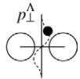
Structure of Λ hypernuclei
Λ has no Pauli blocking to nucleons
ΛN attraction (different from NN)
Unique phenomena
Structure change:
“Shrinkage effect” [1-3]
“Glue-like role” of Λ [4]
⁶Li
(α + d)
⁷_{Λ}Li
(α + d + Λ)
⁸Be
⁹_{Λ}Be
(unbound)
(bound)
Unique states in hypernuclei:
ground state
Genuine hypernuclear state [6]
(Super-symmetric state [5])
⁹Be analog
⁹_{Λ}Be
A unique probe: Λ can penetrate into nuclear interior
[1] T. Motoba, et al., PTP 70, 189 (1983). [2] E. Hiyama, et al., PR C59 (1999), 2351. [3] K. Tanida, et al., PRL 86 (2001), 1982. [4] H. Bando, et. al., PTP 69 (1982) 913. [5] R.H. Dalitz, A. Gal, PRL36 (1976) 362 [6] H. Bando, NPA 450 (1986) 217c

Slide 4
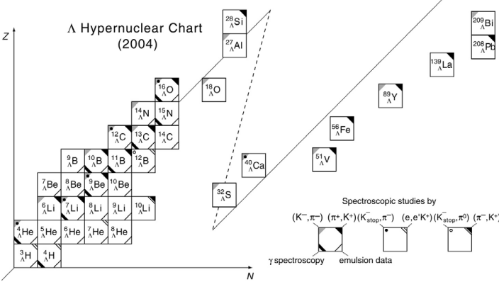
Toward heavier Λ hypernuclei
Experiments at J-PARC, JLab and Mainz etc.
Various Λ hypernuclei will/can be produced
p-sd shell Λ hypernuclei
neutron-rich Λ hypernuclei etc.
p-sd shell region
neutron-rich region
O. Hashimoto and H. Tamura, PPNP 57 (2006), 564.
Structure study of such hypernuclei becomes one of interesting topics

Slide 5
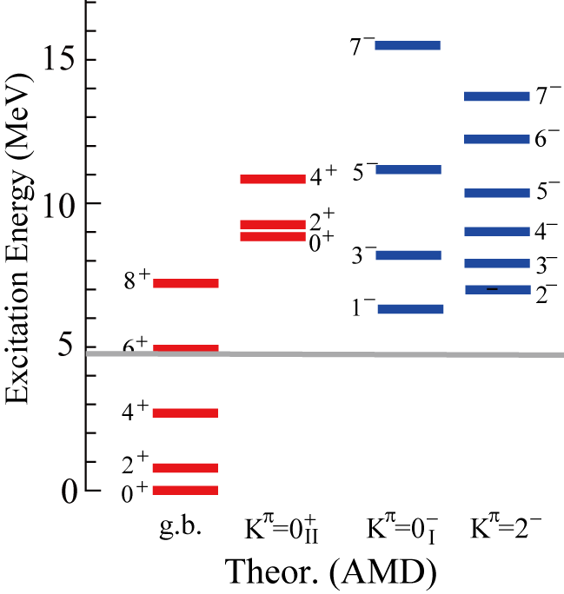
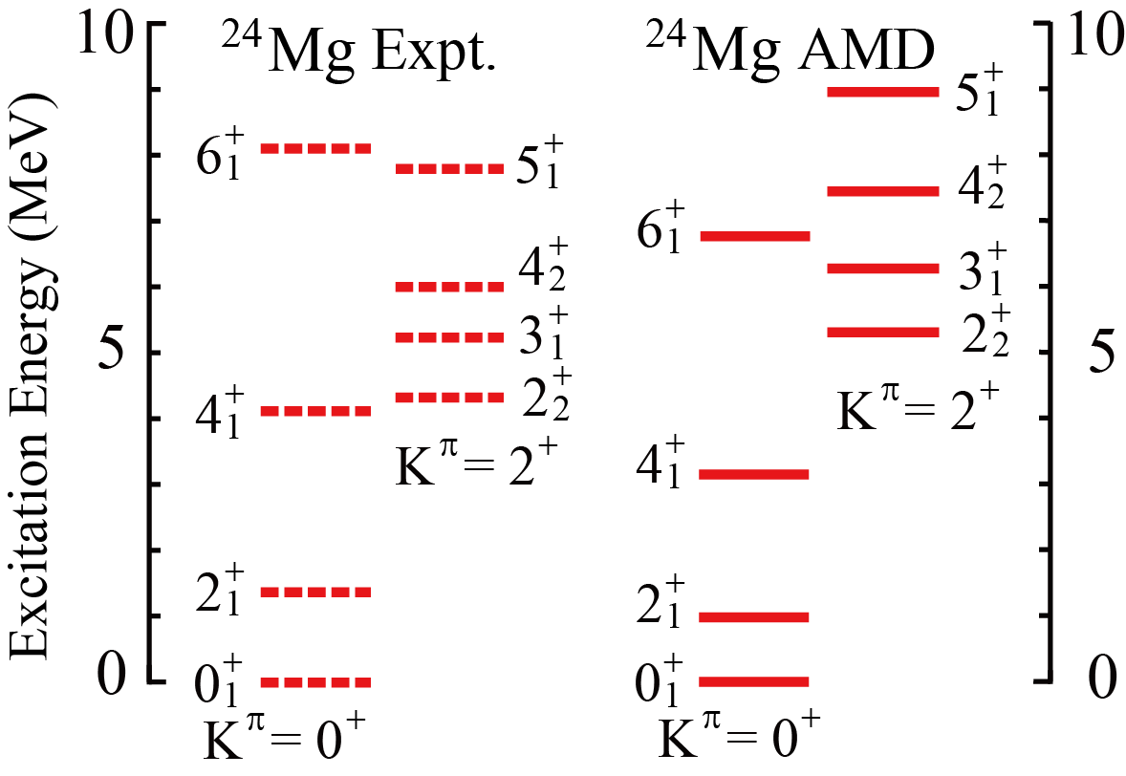
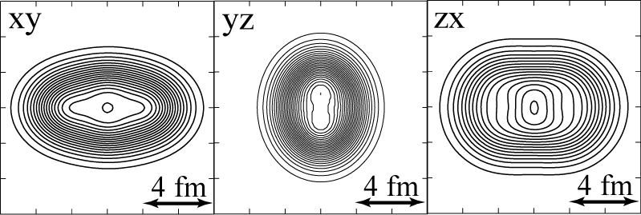
Structure of sd shell nuclei
Coexistence of structures
Various deformations
Ex) ²⁰Ne
K. Ikeda, et al., PTPS 52,(1972)
M. Kimura, PRC69, 044319(2004)
Ex) ²⁴Mg
Today’s talk
Coexistence in low-lying region
Candidate of triaxially deformed nuclei
But its identification is not easy
(deformed) mean-field
α + ¹⁶O cluster
R. Batchelor, et al., NP16, 38 (1960).
Structure changes by Λ are different ?
Λ can be a probe to identify ?

Slide 6
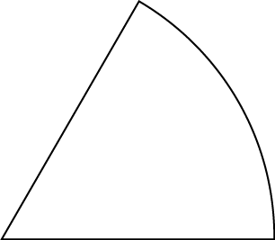
Deformation of nuclei
Many nuclei manifests various quadrupole deformation
Most are prolately or oblately deformed (axially symmetric)
Parameterized by quadrupole deformation parameters β and γ
60◦
γ
Middle
γ = 60◦
Oblate
γ ≈ 30◦
Long
Short
Triaxial
0
0◦
Candidate: Mg isotope
β
γ = 0◦
Spherical
Prolate
Triaxial deformed nuclei are not many and its (direct) identification is not easy.
“Λ in p orbit can be a probe to study nuclear (triaxial) deformation”

Slide 7
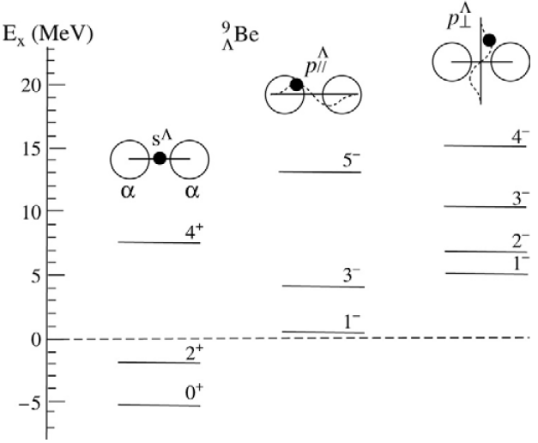
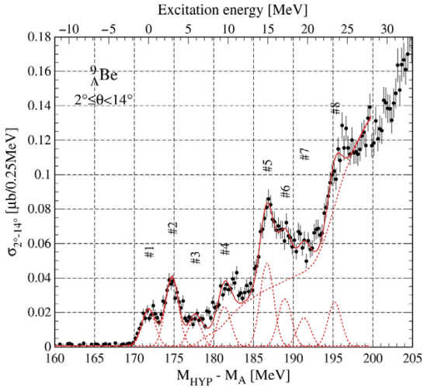
Example: p-states (Λ in p-orbit) in ⁹_{Λ}Be
⁹_{Λ}Be: axially symmetric 2α clustering
Λ in p-orbit generates two bands as p-states ^{[1,2]}
Anisotropic p orbit of Λ hyperon
Axial symmetry of 2α clustering
p-orbit parallel to/perpendicular to the 2α clustering
parallel
perpendicular
[1] R.H. Dalitz, A. Gal, PRL 36 (1976) 362.
[2] H. Bando, et al., PTP 66 (1981) 2118.;
H. Bando, et al., IJMP 21 (1990) 4021.
[3] O. Hashimoto et al., NPA 639 (1998) 93c.

Slide 8
Splitting of p-states in ⁹_{Λ}Be
⁹_{Λ}Be with 2α cluster structure
Lowest: p orbit parallel to 2α (long axis)
Large overlap
Deeply bound
2nd: p orbit perpendicular to 2α (short axes)
Small overlap
Shallowly bound
Split corresponding to long/short axes
[1] R.H. Dalitz, A. Gal, PRL 36 (1976) 362.
[2] H. Bando, et al., PTP 66 (1981) 2118.;
H. Bando, et al., IJMP 21 (1990) 4021.
p-states splits into 2 bands depending on the direction of p-orbits

Slide 9
Triaxial deformation
If ²⁴Mg is triaxially deformed nuclei
p-states split into 3 different state
Triaxial deformation
Prolate deformation
cf. prolate deformation
Ex.) ⁹_{Λ}Be
Large overlap leads deep binding
p orbit parallel to 2α (long axis)
Large overlap
Deeply bound
Middle
p orbit perpendicular to 2α (short axes)
Small overlap
Shallowly bound
Small overlap leads shallow binding
Split corresponding to long/short axes

Slide 10
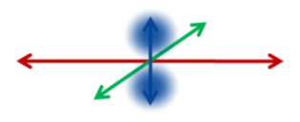
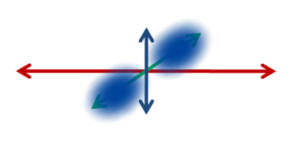
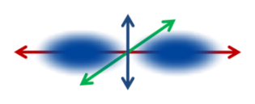
Triaxial deformation
If ²⁴Mg is triaxially deformed nuclei
p-states split into 3 different state
Triaxial deformation
Prolate deformation
²⁵_{Λ}Mg
Large overlap leads deep binding
Excitation Energy
Split into 3 states?
Middle
²⁴Mg⊗Λ(p-orbit)
G.S.
²⁴Mg⊗Λ(s-orbit)
Small overlap leads shallow binding
Observing such 3 different states is strong evidence for triaxial deformation of ²⁴Mg

Slide 11
Purpose
Purpose and problem
To reveal triaxial deformation of ²⁴Mg, we will predict the level structure of the p-states in ²⁵_{Λ}Mg
²⁵_{Λ}Mg
p-states will split into 3 different states, if ²⁴Mg is triaxially deformed
Method
HyperAMD
(Antisymmetrized Molecular Dynamics for hypernuclei)
No assumption on symmetry of nuclei
YNG-NF interaction

Slide 12
Theoretical framework: HyperAMD
We extended the AMD to hypernuclei
HyperAMD (Antisymmetrized Molecular Dynamics for hypernuclei)
Hamiltonian
NN：Gogny D1S
ΛN：YNG interaction (Central force) ^{[1]}
Wave function
Nucleon part：Slater determinant
Spatial part of single particle w.f. is
described as Gaussian packet
Single particle w.f. of Λ hyperon:
Superposition of Gaussian packets
Total w.f.：
[1] Y. Yamamoto, T. Motoba, H. Himeno, K. Ikeda and S. Nagata, Prog. Theor. Phys. Suppl. 117 (1994), 361.

Slide 13
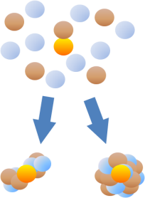
Theoretical framework: HyperAMD
Procedure of the calculation
Variational Calculation
Imaginary time development method
Variational parameters:
Λ hyperon
Initial w.f.
nucleons
(Described by
Gaussian wave packets)
Energy variation
Cluster
Shell

Slide 14
Theoretical framework: HyperAMD
Procedure of the calculation
Variational Calculation
Imaginary time development method
Variational parameters:
Angular Momentum Projection
Generator Coordinate Method(GCM)
Superposition of the w.f. with different configuration
Diagonalization of and

Slide 15
Results and Discussions
Λ single particle energy of the different p-orbit directions
Excitation spectra of the p-states

Slide 16
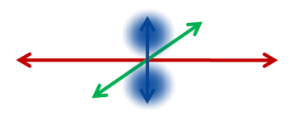
Results： Single particle energy of Λ hyperon
Λ single particle energy on (β, γ) plane
Single particle energy of Λ hyperon is different from each p state
This is due to the difference of overlap between Λ and nucleons
²⁵Mg (AMD, Λ in p orbit)
3 p-states with different spatial distributions of Λ
Λ
Lowest p state
2nd lowest p state
3rd lowest p state

Slide 17
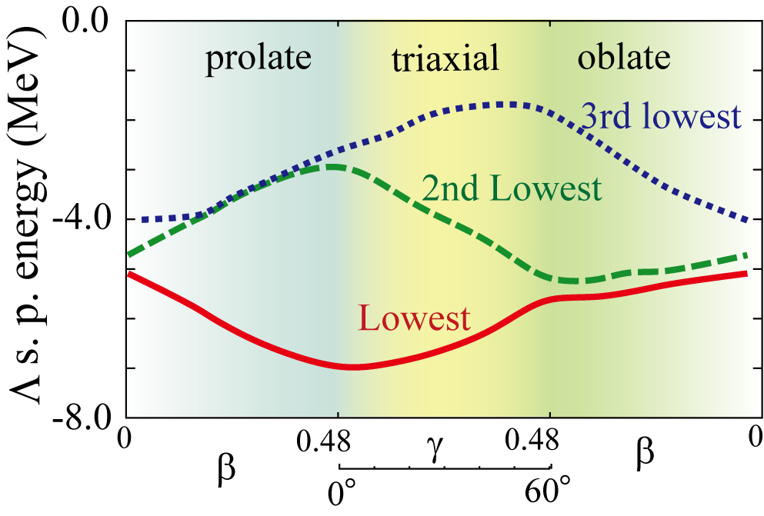
Results： Single particle energy of Λ hyperon
Λ single particle energy in axial/triaxial deformed nucleus
²⁵Mg (AMD)
Λ
III
II
III
II
III
II
I
I
I
3rd lowest p state
(Parallel to short axis)
2nd lowest p state
(Parallel to middle axis)
I
II
III
Lowest p state
(Parallel to long axis)
Λ s. p. energy is different from each other with triaxial deformation
split into 3 p-orbit states

Slide 18
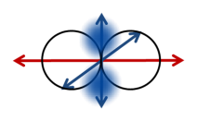
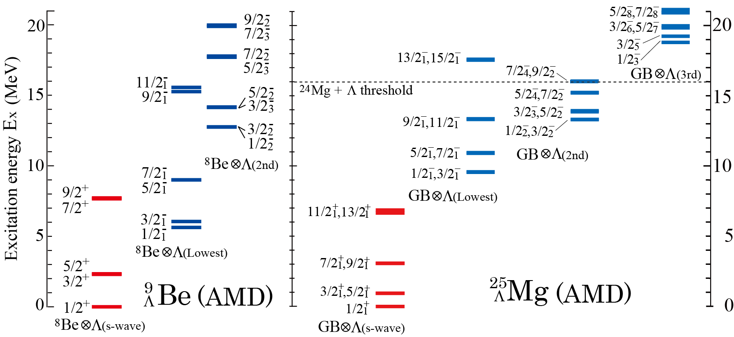
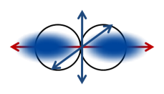
Results: Excitation spectra
3 bands are obtained by Λ hyperon in p-orbit
²⁴Mg⊗Λp(lowest), ²⁴Mg⊗Λp(2nd lowest), ²⁴Mg⊗Λp(3rd lowest)
Splitting of the p states
21
Λ
Ne +
Lowest threshold : in between 8.3 and 12.5 MeV
Λ

Slide 19
Summary
Summary
Knowledge of YN interaction will allow us to reveal structure of hypernuclei
Structure change and modification of nuclear properties by adding a hyperon
Bounding unbound systems by using hyperons as a glue
Probing nuclear structure (deformation) by using hyperon
Combination of the modern YN interaction with nuclear models
Antisymmetrized molecular dynamics + effective YN interaction
Probing nuclear deformation by using Λ
By looking at the orbit of Λ in hypernuclei, it is possible to use a Λ as a probe
Example: Splitting of the p orbits in ²⁵_{Λ}Mg due to triaxial deformation
Future plans (Mg hypernucleus)
To reveal how to observe the splitting of the p-state in hypernuclei

Slide 21
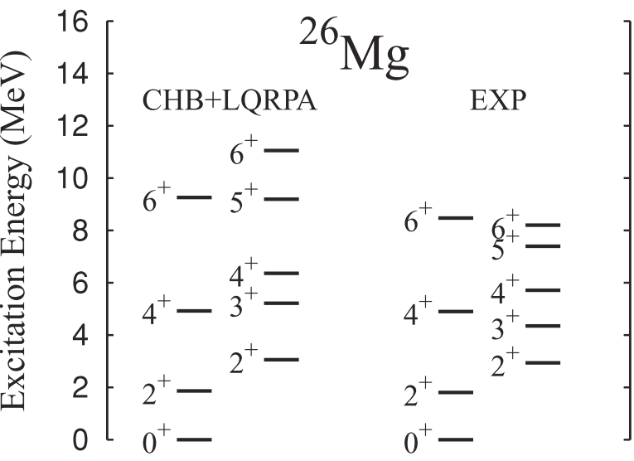
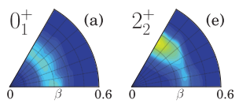
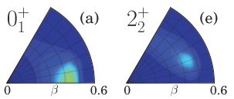
Triaxial deformation of ²⁶Mg
Constraint Hartree-Fock-Bogoliubov + Local QRPA (CHFB + LQRPA) approach
They solve the collective Schroedinger eq. and obtain the excitation spectra,
and they calculate the vibrational w.f. squared to analyze each state
N. Hinohara and Y. Kanada-En'yo, Phys. Rev.C 83, 014312 (2011)
²⁶Mg
²⁴Mg
The ²⁶Mg ground state has a γ-soft character
The p states of ²⁷_{Λ}Mg should split into three, if ²⁶Mg is triaxially deformed

Slide 22
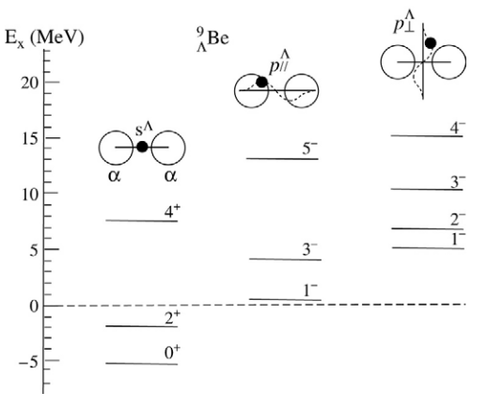
Genuine hypernuclear (super symmetric) state
⁹_{Λ}Be: α + α + Λ structure
Genuine hypernuclear states cannot be formed in ordinary ⁹Be
Example: _{Λ}Be
R.H. Dalitz, A. Gal, Phys. Rev. Lett. 36 (1976) 362
H. Bando, Nuclear Phys. A 450 (1986) 217c
⁹
In case of ⁹Be (α + α + n)
n
n
Forbidden by Pauli principle
allowed
⁹Be analog states
Genuine hypernuclear states
H. Bando, Nuclear Phys. A 450 (1986) 217c

Slide 23
Backup: ²⁵_{Λ}Mg with Λ in p orbit

Slide 24
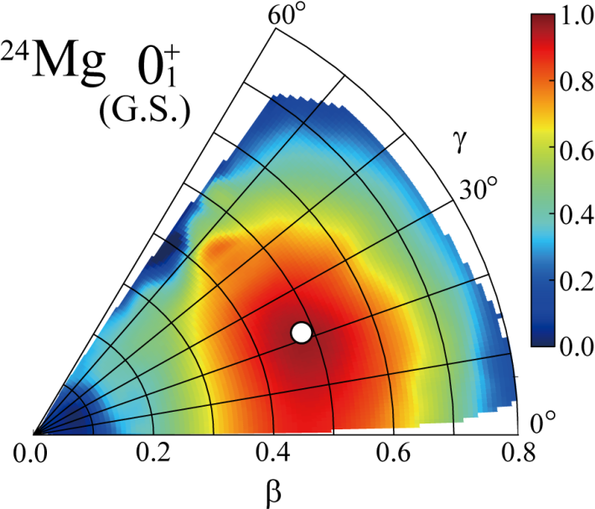
Backup：Deformation change due to Λ in p-orbit
2nd 2⁺ state of ²⁴Mg
Deformation changes are different
depending on the direction of each p-orbit
Peak positions of the GCM overlap
Lowest p: unchanged
2nd lowest:
3rd lowest:
GCM overlap:
(β=0.48, γ=21∘) (β=0.43, γ=15∘)
(β=0.48, γ=21∘) (β=0.53, γ=27∘)

Slide 25
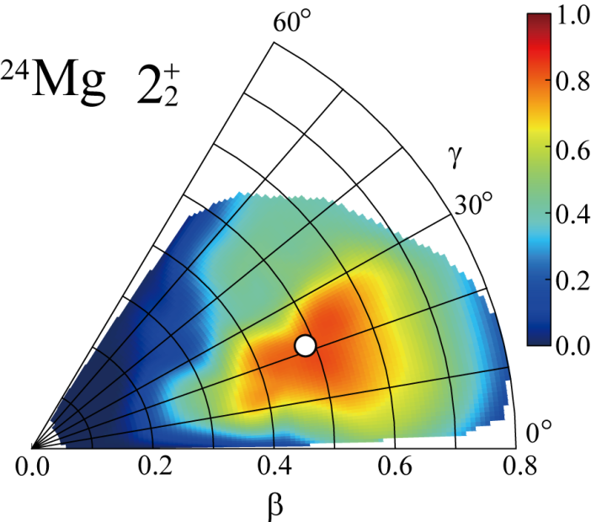
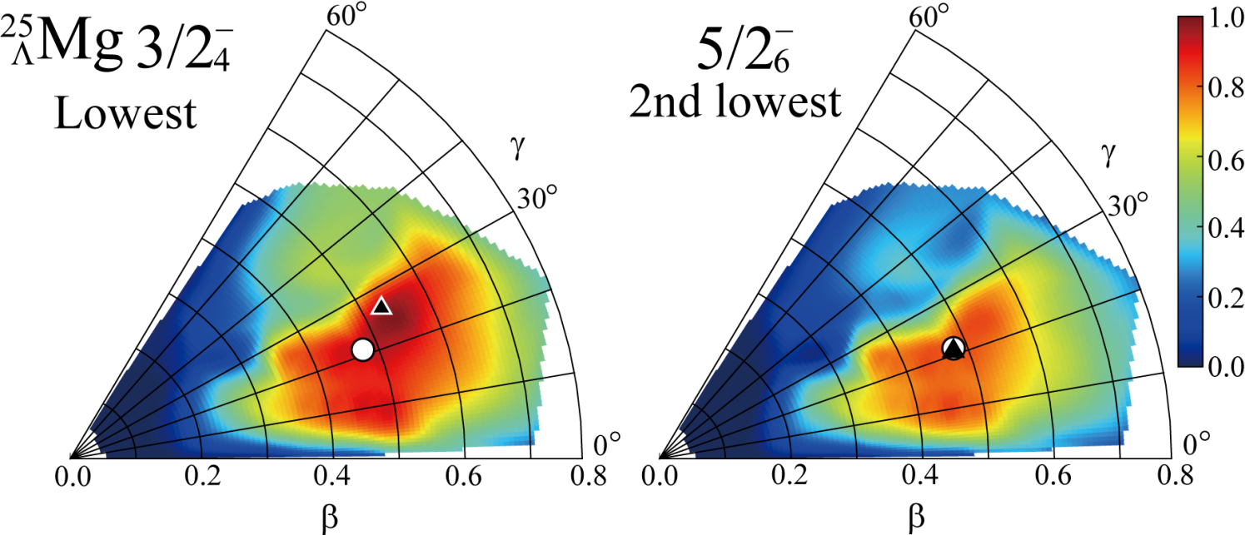
Backup：Deformation change due to Λ in p-orbit
2nd 2⁺ state of ²⁴Mg
Deformation changes are different
depending on the direction of each p-orbit
Peak positions of the GCM overlap
Lowest p:
2nd lowest: unchanged
GCM overlap:
(β=0.48, γ=21∘) (β=0.53, γ=27∘)

Slide 26
Backup：Density distributions of ²⁵_{Λ}Mg
Intrinsic wave functions corresponding to the peak of GCM overlap
−
1/2
1
Lowest p state (β=0.48, γ=21∘)
−
1/2
2
2nd lowest p state (β=0.43, γ=15∘)
−
1/2
3
3rd lowest p state (β=0.53, γ=27∘)

Slide 27
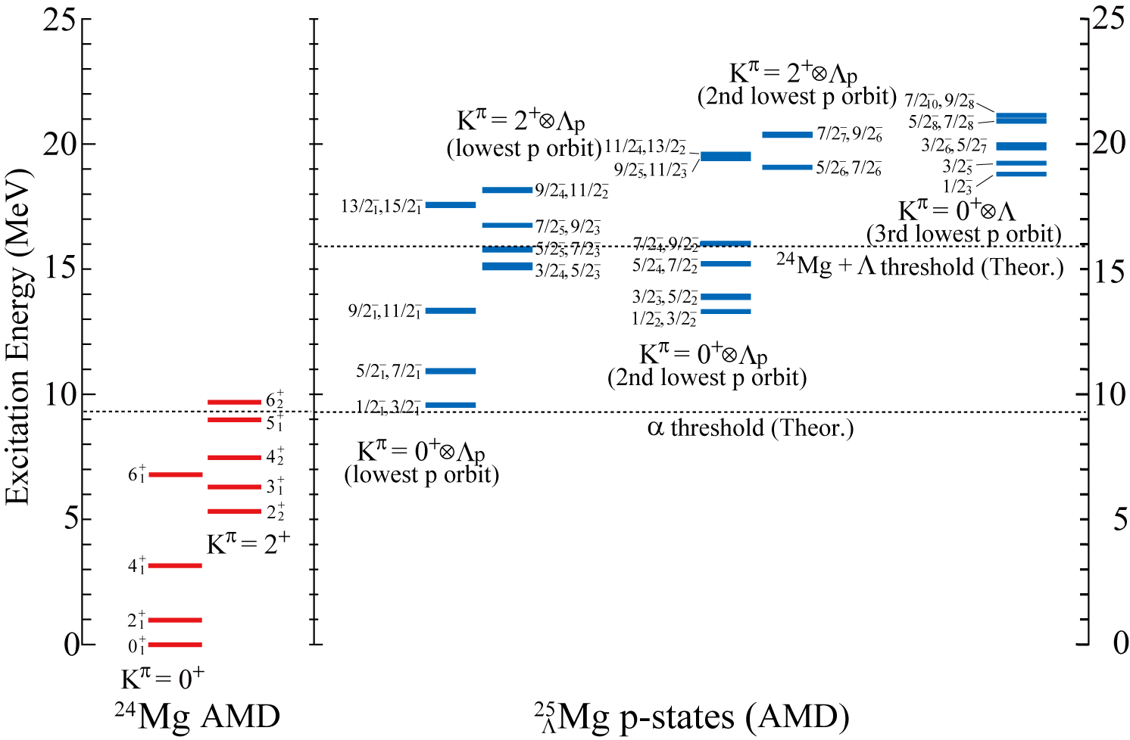
Results: Excitation spectra

Slide 28
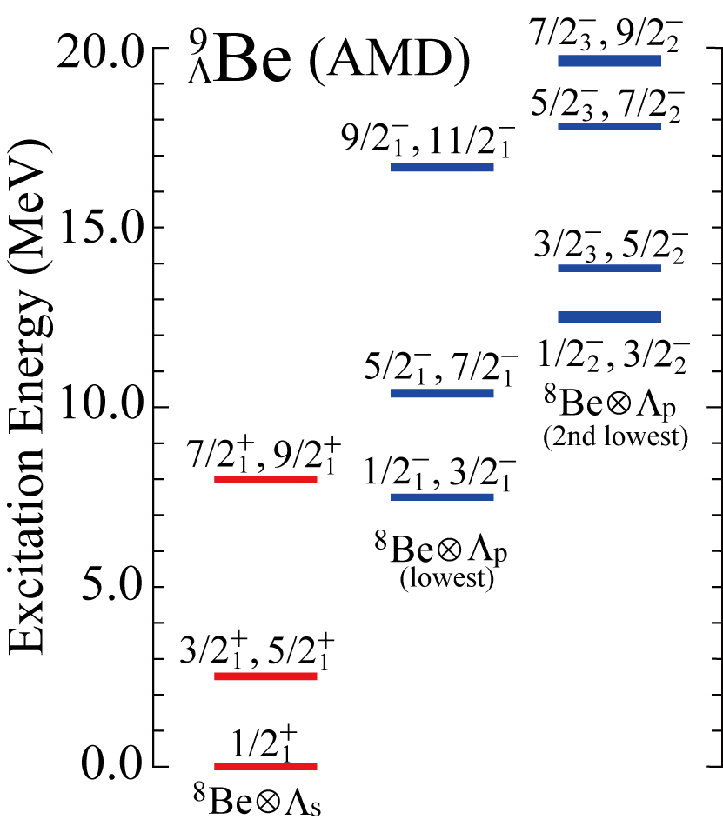
Back up: p-states in ⁹_{Λ}Be
K^{π} = 1⁻ band
K^{π} = 0⁻ band
[1] H. Bando, et al., PTP 66 (1981) 2118.
[2] H. Bando, et al., IJMP 21 (1990) 4021.

Slide 29
Backup: Constraint on the Λ single particle w.f.
The constraint potential on the Λ single particle w.f.
In actual calculation,
Total w.f.
Λ single particle w.f.

Slide 30
Backup: ²⁵_{Λ}Mg with Λ in s orbit
How does Λ modify the nuclear properties
of triaxial deformed (hyper)nuclei ?
Examples: ²⁵_{Λ}Mg
Positive parity bands associated with the triaxial deformation
M. Isaka, M. Kimura, A. Dote and A. Ohnishi, PRC 85 (2012), 034303.

Slide 31
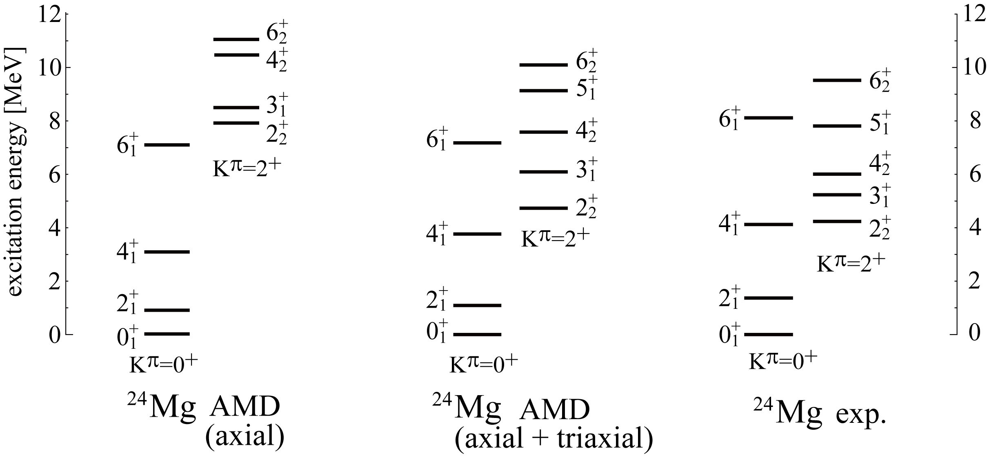
Structure of ²⁴Mg
Large deformation ・・・ Candidate of triaxial deformed nuclei
Excitation energy of K^{π}=2⁺ band depends on the triaxial deformation ^{[1,2]}
[1] M. Bender and P-H. Heenen, Phys. Rev. C78, 024309 (2008).
[2] M. Kimura, R. Yoshida and M.Isaka, Prog. Theor. Phys. 127 , 287(2011).

Slide 32
Structure of ²⁴Mg
Large deformation ・・・ Candidate of triaxial deformed nuclei
Excitation energy of K^{π}=2⁺ band depends on the triaxial deformation ^{[1,2]}
Ex
Ex
Ex
K^{π} = 2⁺ band is rigid against the exclusion of the triaxial deformation
How does Λ modify triaxial deformation of ²⁴Mg ?
[1] M. Bender and P-H. Heenen, Phys. Rev. C78, 024309 (2008).
[2] M. Kimura, R. Yoshida and M.Isaka, Prog. Theor. Phys. 127 , 287(2011).

Slide 33
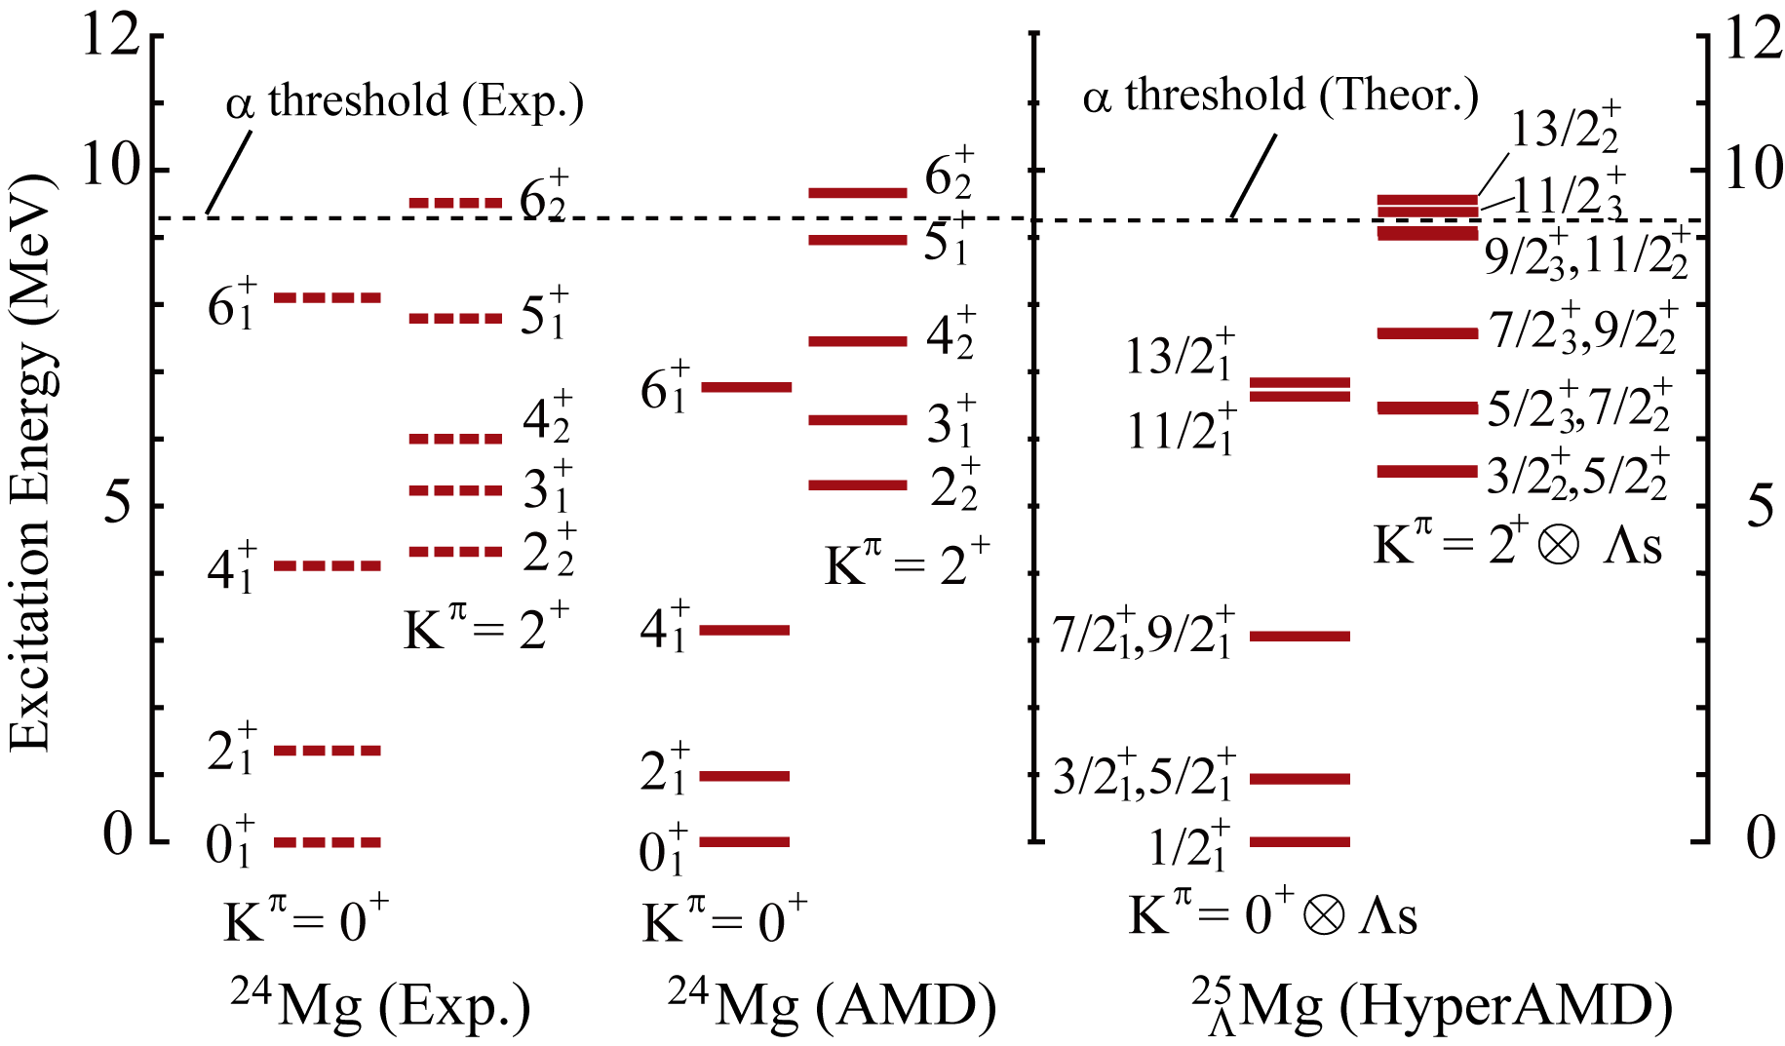
Results: Excitation spectra of ²⁵_{Λ}Mg
200keV
Excitation energy of K^{π}=2⁺⊗Λ_{s} band is shifted up by about 200 keV

Slide 34
Results: Reasons for the shift up
Difference of the Λ binding energy B_{Λ}
B_{Λ} for the K^{π}=0⁺⊗Λ_{s} band is larger than that for the K^{π}=2⁺⊗Λ_{s} band
Energy shift of the K^{π}=2⁺⊗Λ_{s} band
²⁴Mg
+
2
2
5.31 MeV
(K^{π}=2⁺)
B_{Λ} = 15.80 MeV
+
0
1
(K^{π}=0⁺)
+
3/2
2
(K^{π}=2⁺⊗Λ_{s})
B_{Λ} = 15.98 MeV
5.53 MeV
+
1/2
1
(K^{π}=0⁺⊗Λ_{s})
25
Mg
Λ

Slide 35
Results: Deformation change by Λ hyperon
Color plots: GCM overlap Contour lines: energy surface
K^{π}=0⁺ band: Energy surface is soft (flat) against the (β, γ) reduction
K^{π}=2⁺ band: rigid against the deformation change
Changes of GCM overlap
(β=0.48, γ=21∘) (β=0.43, γ=15∘)
By adding Λ to K^{π} = 0⁺
Unchanged:
(β=0.48, γ=21∘)
By adding Λ to K^{π} = 2⁺

Slide 36
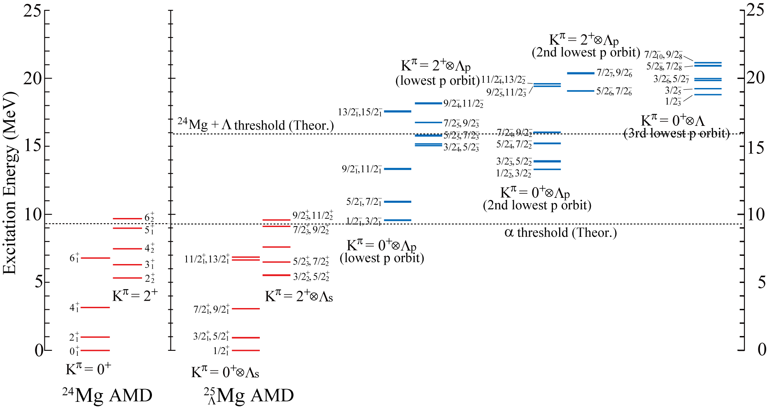
Backup: Excitation spectra of ²⁵_{Λ}Mg

Slide 37
Backup: application of HyperAMD to light hypernuclei

Slide 38
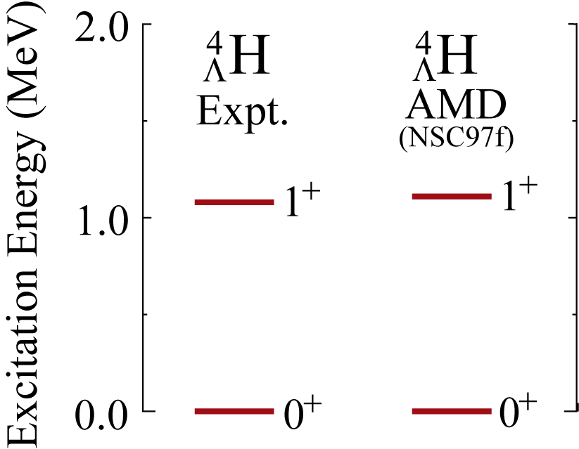
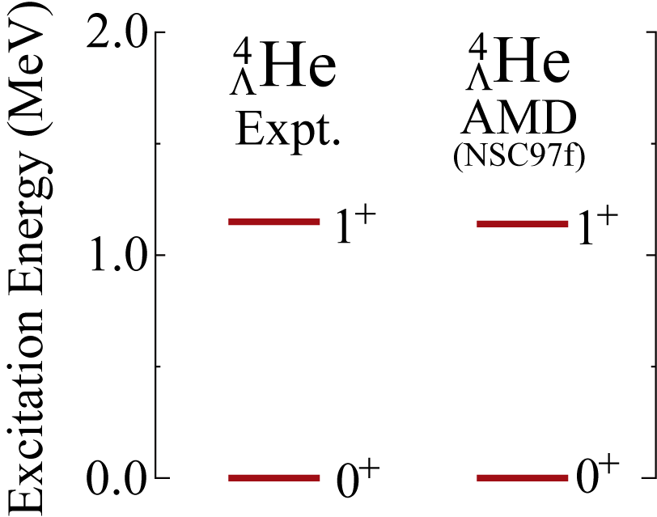
Backup

Slide 39
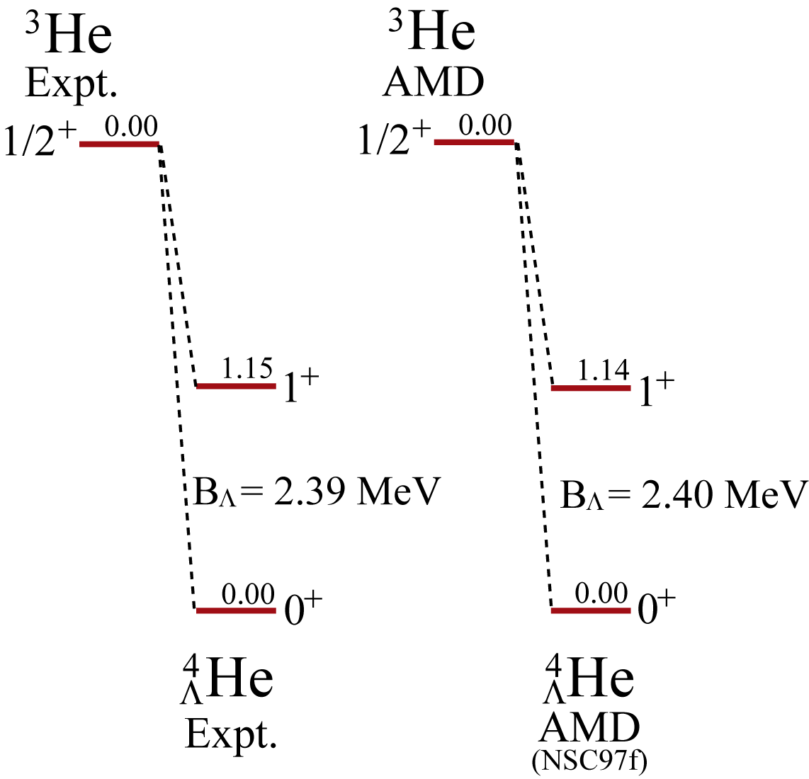
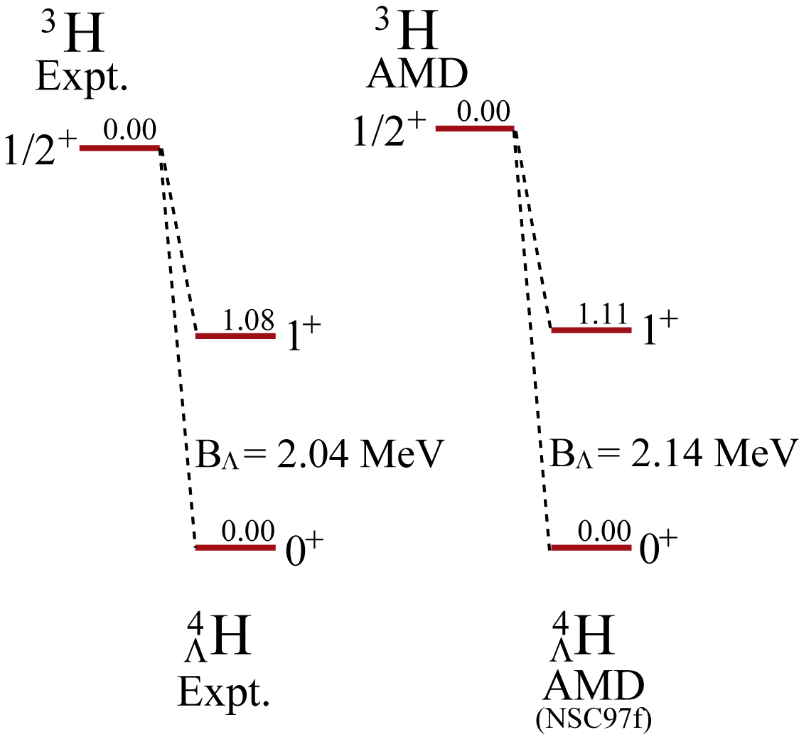
Backup

Slide 40
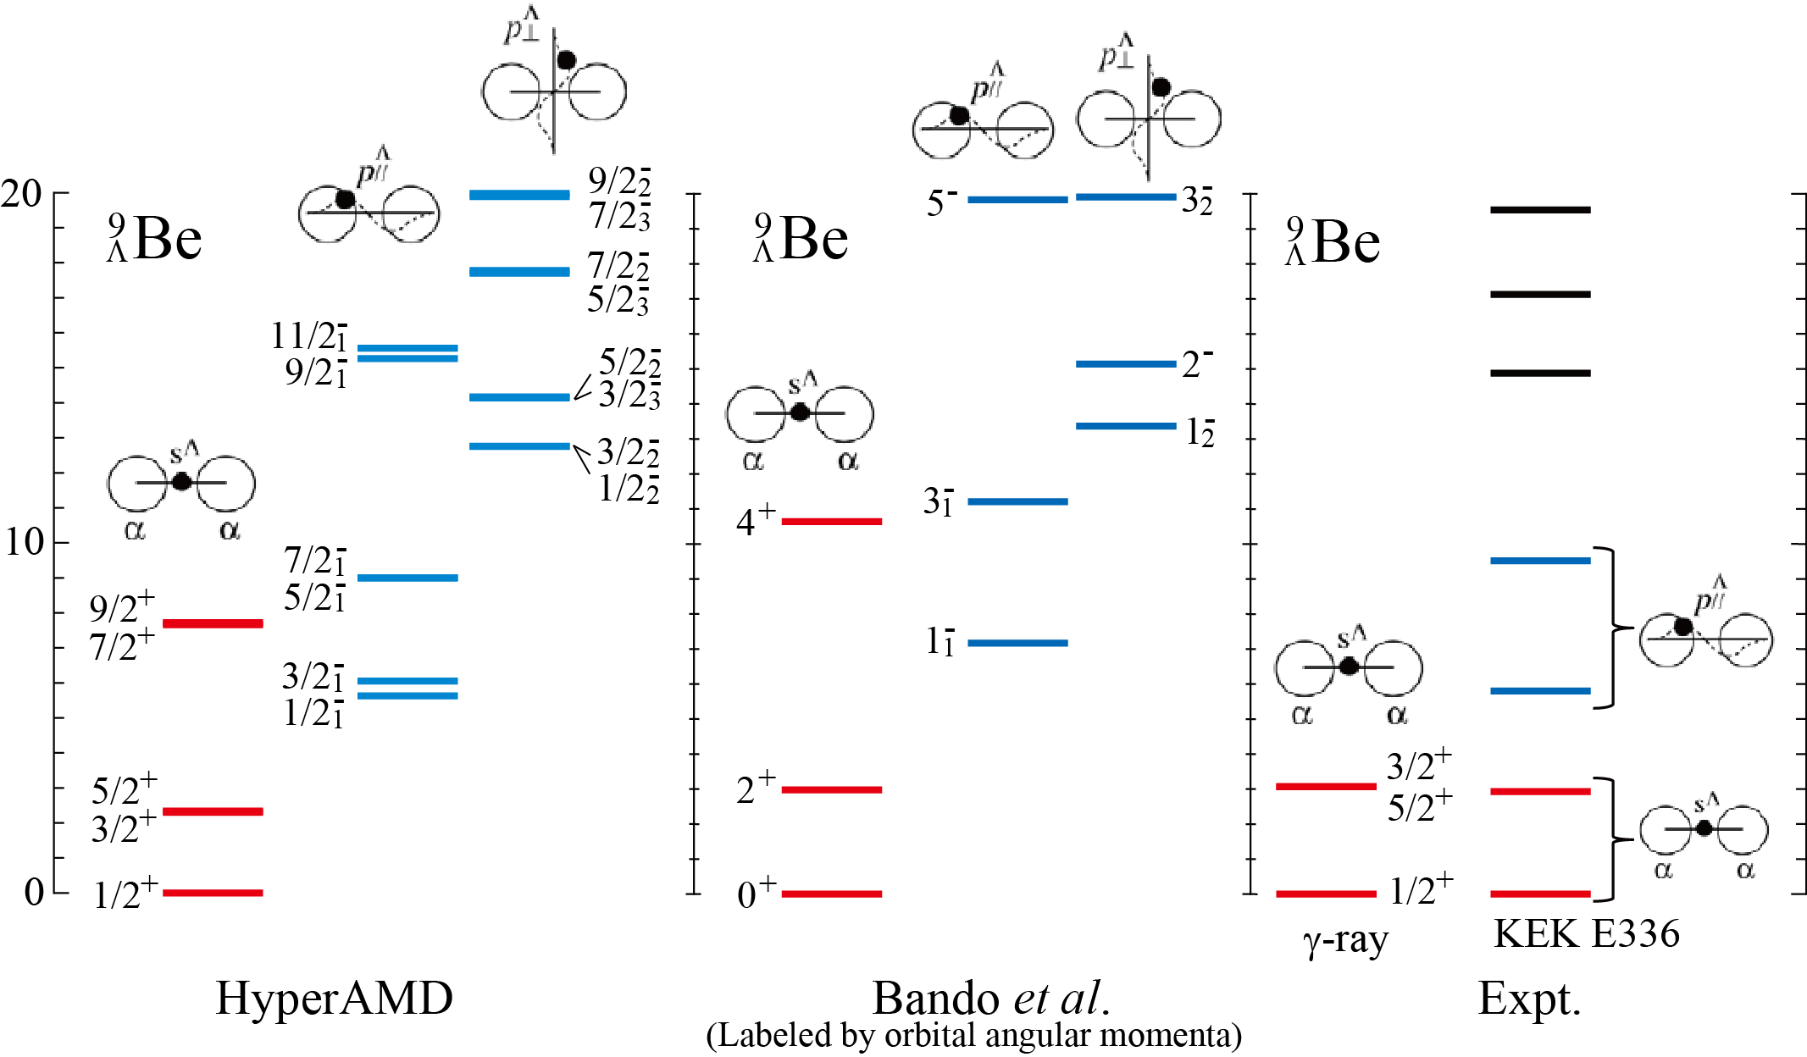
Application to ⁹_{Λ}Be hypernucleus
[2]
[3]
[1]
[1] Bando et al., PTP 66 (1981) 2118.
[2] M. May et al., PRL 51 (1983) 2085; H. Akikawa et al., PRL 88 (2002) 082501.
[3] O. Hashimoto et al., NPA 639 (1998) 93c

Slide 41
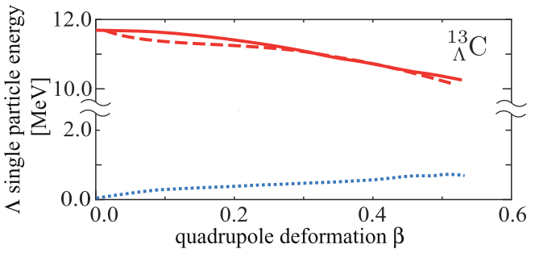
Λ binding energy
Reasons for the variation of the Λ binding energies
Overlap between Λ and nucleons
Λ in s-orbit: large overlap with small deformation
Λ in p-orbit: large overlap with large deformation
Large distribution of Λ reduces the kinetic energy
β = 0.00
¹²C(Pos.)⊗Λ(s)
¹²C(Neg)⊗Λ(s)
Λ binding energy [MeV]
β = 0.30
¹²C(Pos)⊗Λ(p)

Slide 42
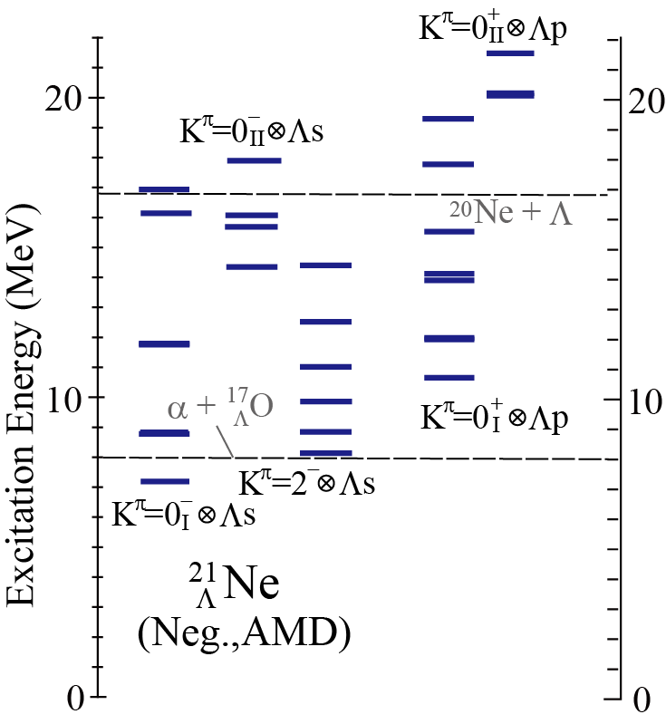
Backup: Structure study of sd shell Λ nuclei
A typical example: ²¹_{Λ}Ne
Coexistence of structures in a hypernucleus
Their modifications by Λ
α + ¹⁶O + Λ model calc.
T. Yamada, et al., PTP71 (1984), 985.
Various α + ¹⁶O + Λ states
B(E2) reduction in cluster band
AMD calc.
M. I., et al., PRC83 (2011), 054304.
(Deformed) mean-field states appear as well as cluster states
B(E2) reduction is different between the structures
²¹Ne
²¹Ne
(Neg., AMD)
(Neg., α + ¹⁶O + Λ)
M. I, et al.,
PRC83 (2011), 054304.
T. Yamada, et al.,
PTP71 (1984), 985.

