Slide 1

The Seventh International Symposium
on Chiral Symmetry in Hadrons and Nuclei
Recent theoretical developments in chirality in atomic nuclei
ShuangQuan Zhang (张双全)
(sqzhang@pku.edu.cn)
School of Physics, Peking University
Beihang University Beijing·2013-10-28

Slide 2
Content
Introduction
Theoretical tools for studying nuclear chirality
Particle Core Coupling --- working in laboratory frame
Tilted axis cranking --- working in intrinsic frame
Prediction and observation of multiple chiral doublets
Summary

Slide 3
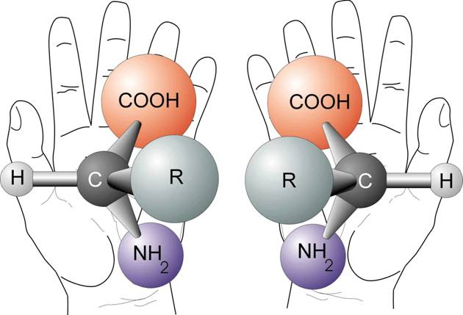
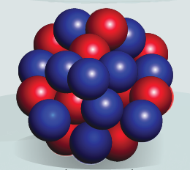
Chirality in Matter Hierarchy
Chirality exists commonly in nature.
p
p
S
S
Elementary Particles
Molecules & Human body
How can a finite nucleus present Chirality?
Microscopic quantal many-body system
with identical nucleons
Notes:
如果自旋的对称轴方向和电子的运动方向平行，这就是右手性电子；反过来，就是左手性电子。左旋中微子和右旋反中微子。
最常见的轴矢量，是角速度和角动量。极矢量（矢量）、轴矢量（赝矢量）。正常的矢量在宇称变换（空间反演）下，大小不变，方向相反。轴矢量在宇称变换下大小方向不改变。

Slide 4
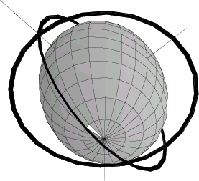
Chiral geometry in triaxial nucleus
Due to symmetry, a nucleus can not rotate around its symmetrical axis.
For a triaxial nucleus, an aplanar rotation are allowed.
The aplanar rotation of a triaxial nucleus can present chiral geometry.
j_{π}
Considering a nuclear system:
Odd-Odd nucleus in A~130
Configuration πh_{11/2}νh_{11/2}⁻¹
Triaxial collective core (R)
Particle-like valence proton (j_{π})，
Hole-like valence neutron (j_{ν})
R
int.
short
There are three nearly perpendicular AM:
Particle-like j_{π} mainly along short axis,
Hole-like j_{ν} mainly along long axis,
Collective rotation R mainly along int. axis,
⇒ the total angular momentum J is aplanar.
j_{ν}
long
Notes:
R 转动惯量最大（中间轴）；
Particle like －－－ short 粒子分布与原子核有最大的交叠，即与原子核的分布趋于一致。
Hole like －－－－ long

Slide 5
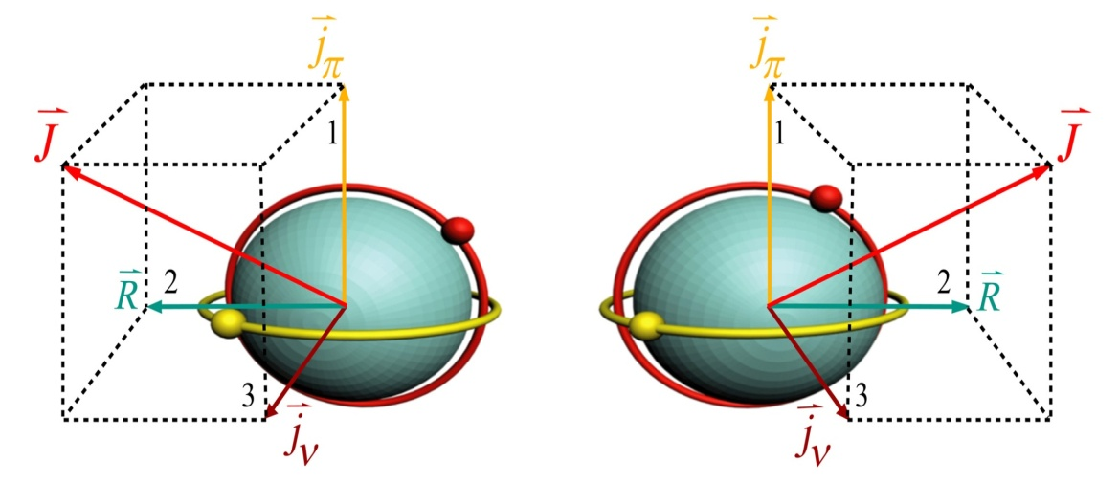
Chirality in Finite Nucleus
The aplanar rotation of a triaxial nucleus can present chiral geometry.
χ =TR_{y}(π);
χ = P Ry(π)
Left-handed
Right-handed
“chiral rotation”
The chirality here is caused by angular momentum geometry; one may call it “spin-chirality”.
Expected exp. signal：Two near degenerate ΔI =1 bands, called chiral doublet bands
S.Frauendorf and J.Meng, Nucl. Phys. A617, 131(1997)
Notes:
空间反射不改变轴矢量（角动量）方向，必须替换成时间反演。

Slide 6

Intrinsic frame VS. Laboratory frame
Intrinsic frame:
chiral symmetry breaking in intrinsic frame
χ = TRy(π)
χ |L⟩ = |R⟩; χ |R⟩ = |L⟩
Lab. frame:
the restoration of broken chiral symmetry
in lab. frame leads to
I+2
I+1
I
S.Frauendorf and J.Meng, Nucl. Phys. A617, 131(1997)
Notes:
1. Only in the intrinsic frame, we can talk left handed states or right handed states.

Slide 7
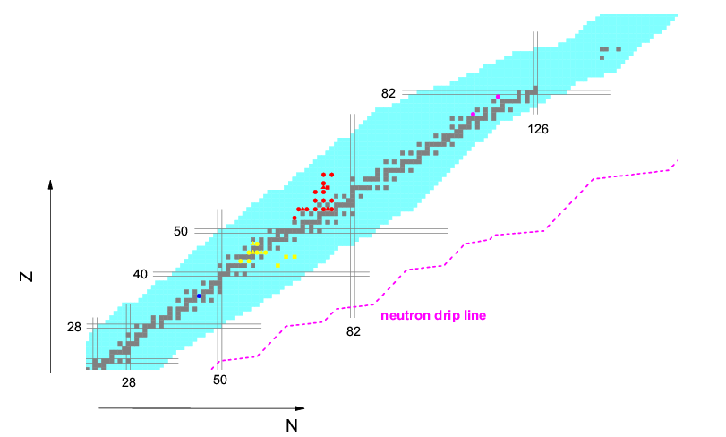
Observed chiral nuclei
Up till now, more than 30 candidate chiral nuclei have been reported in the A∼80, 100, 130, and 190 mass regions [Starosta_Koike_Chiara et al PRL2001].
Multi-chirality or multiple chiral doublets (MχD) were predicted in 2006 [Meng_Peng_Zhang_Zhou PRC2006] and experimentally observed in 2013 [Ayangeakaa_Garg_Anthony et al PRL2013].

Slide 8
Theoretical tools for nuclear chirality
Particle Core Coupling --- working in laboratory frame
− Triaxial Particle Rotor Model (PRM)
Frauendorf_Meng NPA1997; Peng_Meng_Zhang PRC2003; Koike_Starosta_Hamamoto PRL2004, Zhang_Qi_Wang_Meng PRC2007; Qi_Zhang_Meng_Wang_Frauendorf PLB2009; Lawrie_Shirinda PLB2010
Core-quasiparticle coupling model, which follows the KKDF method Starosta_Chiara_Fossan et al PRC2002; Koike_Starosta_Chiara_Fossan_LaFosse PRC2003; Droste_Rohozinski_Starosta_Prochniak_Grodner EPJA2009
Interacting Boson Fermion Fermion Model (IBFFM)
Brant_Vretenar_Ventura PRC2004; Brant_Tonev_De Angelis_VenturaPRC2008;
Tonev_De Angelis_Petkov et al PRL2006
Pair Truncated Shell Model
Higashiyama_Yoshinaga_Tanabe PRC2005; Higashiyama_Yoshinaga PRC2013
a quantum-mechanical model where total AM is a good quantum number.
describe the system in the lab. reference frame and yields directly the energy splitting and tunneling between doublet bands.
Normally, phenomelogical parameters, such as β and γ, has to be assumed at the very beginning.

Slide 9
Development and applications of PRM
Theoretical tools for nuclear chirality
One-particle-one-hole PRM
Frauendorf_Meng NPA1997 (pioneer work); Koike PRL2004 (selection rule); Peng PRC2003 (A=130 region); Qi PRC2009 (B(M1) staggering), CPL2010 (band interaction); Chen PRC2010 (variable MOI);
Two quasiparticles PRM
Zhang PRC2007 (model); Wang PRC2007 (¹²⁶Cs), PRC2008 (¹⁰⁶Rh), PRC2010 (¹²⁴Cs); Qi CPL2011 (neutron conf.); Lawrie PRC2008 (¹⁹⁸Tl), PLB2010 (level degeneracy);
Starosta PRC2002 (¹³²La); Koike PRC2003 (¹²⁸Cs);
n-particle-n-hole PRM
Qi PLB2009(¹³⁵Nd), PRC2011(^{103,105}Rh), CPL2012(transition in ¹³⁵Nd);
To investigate fingerprints of ideal/real chiral bands
Koike_Starosta_Hamamoto PRL2004 (selection rule); Qi_Zhang_Meng_Wang PRC2009(R) (B(M1) staggering); Shirinda_Lawrie EPJA2012 (more realistic case)
Higher excited chiral bands with the same intrinsic configuration
Droste_Rohozinski_Starosta_Prochniak_Grodner EPJA2009; Chen_Yao_Zhang_Qi PRC2010, Hamamoto PRC2013

Slide 10
Theoretical tools for nuclear chirality
Tilted axis cranking --- working in intrinsic frame
Single-j model Frauendorf_Meng NPA1997;
Hybird Woods-Saxon and Nilsson model Dimitrov_Frauendorf_Donau PRL2000
Skyrme Hartree-Fock model Olbratorwski_Dobaczewski_Dudek_Plociennik PRL2004
Covariant density function theory (CDFT) Madokoro_Meng_Ma_Yamaji PRC2000;
Meng_Peng_Zhang_Zhao Front.Phys.2013
can be easily extended to the multi-quasiparticle case.
the deformation parameters can be self-consistently obtained.
a semi-classical model, where the total AM is not a good quantum number and the electromagnetic transitions are calculated in semiclassical approximation.
the description of quantum tunneling of chiral partners is beyond the mean field approximation.

Slide 11
Development and applications of TAC
TAC based on Covariant Density Functional Theory
Meson exchange version:
3-D Cranking Madokoro_Meng_Ma_Yamaji, PRC62,061301(2000)
2-D Cranking Peng_Meng_Ring_Zhang, PRC78,024313(2008)
Point-coupling version: Simple and more suitable for systematic investigations
2-D Cranking Zhao_Zhang_Peng_Liang_Meng PLB699,181(2011)
Zhao_Peng_Liang_P. Ring_Meng PRL107, 122501 (2011)
(see also: parallel talk 28B207 by Peng-Wei Zhao)
Meng_Peng_Zhang_Zhao Front.Phys.2013
To describe the chiral partner based on the framework of TAC, one must go beyond mean field approximation.
TAC+RPA describes chiral vibration
Mukhopadhyay_Almehed_Garg PRL 2007. (¹³⁵Nd)
Almehed_Donau_Frauendorf PRC2011.
A chiral collective Hamiltonian based on the TAC solutions is developed and used to describe both chiral rotation and chiral vibration.
Chen_Zhang_Zhao_Jolos_Meng, PRC2013.
(see also: parallel talk 28B208 by Qi-Bo Chen)

Slide 12

Multi-Chirality
Multi-Chirality on a human body
Left and right eyes
Left and right hands
Left and right feet
… …
Multi-chirality on triaxial nucleus？
Suitable triaxial deformation
Suitable particle-hole configurations
Coexistence of above conditions

Slide 13
Do multiple chiral doublets(MχD) exist ?
Covariant density functional theory (CDFT)
CDFT has received wide attention due to its attractive features and its success in describing the properties of nuclei and many nuclear phenomena.
Ring PPNP1996, Vretenar et al., Phys. Rep2005, Meng et.al., PPNP2006.
  Triaxial deformation and configurations can be obtained self-consistently in RMF theory.
  It is easy to extend for nuclei with multiparticle and multihole suitable for chirality in RMF theory.
Not only adiabatic but also configuration-fixed constraint calculations are necessary to obtain PES for certain configurations.
Triaxial relativistic mean field theory
Constraint calculations

Slide 14
Adiabatic constraint
Adiabatic constraint
β
: Φ_{i}(β)
β+δβ
: Φ_{j}(β +δβ)
Always Occupy the lowest N levels

Slide 15
PES from adiabatic constraint calculation

Slide 16

Configuration-fixed constraint
Occupy the same energy levels for defifferent β
Lu Guo et al NPA 740, 59(2004)

Slide 17
2)．其他的计算结果
PESs from configuration-fixed constraint calculation
¹⁰⁶Rh
HO shells： n_{f} = 12, n_{b}=10
Effective interactions: PK1, NL1, NL3, NLSH, TM1
PESs for various fixed configurations are obtained !

Slide 18
Triaxial constraint RMF results for ¹⁰⁶Rh
MχD !

Slide 19
Prediction of MχD or multi-chirality
The investigation followed by:
Prediction for other odd-odd Rh isotopes: Peng_Sagawa_Zhang_Yao_Zhang_Meng, PRC77, 024309 (2008)
Confirmed with time-odd fields included: Yao_Qi_Zhang_Peng_Wang_Meng, PRC79, 067302 (2009)
Possible multiple chiral doublet bands in ¹⁰⁵Rh : Li_Zhang_Meng, PRC83, 037301 (2011)

Slide 20
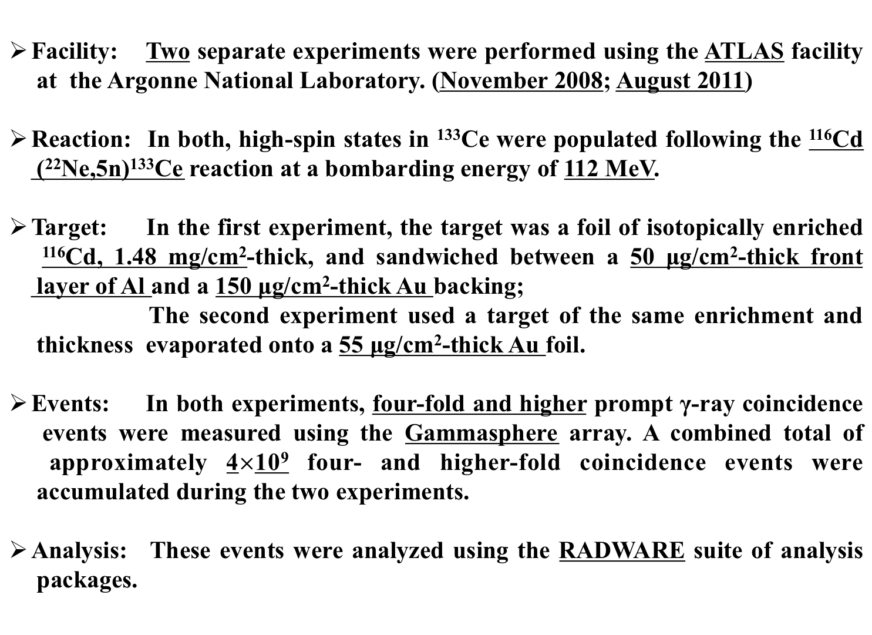
Search for M𝝌D in ¹³³Ce

Slide 21
Level scheme
Performed @ Argonne National Laboratory
Chiral doublet bands?
Chiral doublet bands?

Slide 22
Theoretical interpretations
On the theoretical side, the particle rotor model based on covariant density functional theory is developed in order to describe the M𝝌D candidates.
  Relativistic mean field theory
  Particle rotor model
  Numerical details
  Results and discussion

Slide 23
Numerical details
In RMF calculations
In PRM calculations

Slide 28
PRM results
Theoretical results reproduce the data well;
Staggering parameter S(I) vary smoothly with spin;
Similar behavior of B(M1)/B(E2) ratios is clearly evident;
Coriolis attenuation factor 0.7 is considered for Bands 2 and 3.
Ayangeakaa_Garg_Anthony et al PRL2013

Slide 29
Search for M𝝌D in ¹³³Ce
MχD observed in ¹³³Ce
Ayangeakaa_Garg_Anthony et al PRL2013
Two distinct sets of chiral partner bands based on the three quasi particle configurations have been identified in ¹³³Ce.
They are interpreted in the context of the M𝝌D phenomenon.
Calculations based on RMF and PRM reproduce the experimental results well.
The manifestation of triaxial shape coexistence are confirmed.
More candidates for multi-chirality?
¹⁰⁶Ag: R. Lieder et.al., Nov. 2011 @ iThemba
¹⁰³Rh: J. Timar et.al., @ Gammasphere

Slide 30
Summary
A brief review on theoretical development in chirality in atomic nucleus is given.
Numerous efforts have been devoted to the development of both the TAC methods and PRM models. Both PRM and TAC have their own advantages and disadvantages.
Multiple chiral doublets were predicted in 2006 with covariant density functional theory and have been observed in ¹³³Ce.
Many experimental and theoretical efforts are being devoted to explore nuclear chirality and multi-chirality.
YOU are welcome !!!

Slide 31
Acknowledgement
Q.B. Chen;
S.G. Frauendorf;
R.V. Jolos;
J. Li;
J. Meng;
J. Peng;
B. Qi;
P. Ring;
S.Y. Wang;
J.M. Yao;
L.F. Yu;
P.W. Zhao
Thank you !
Notes:
SA-China collabration

