Slide 1


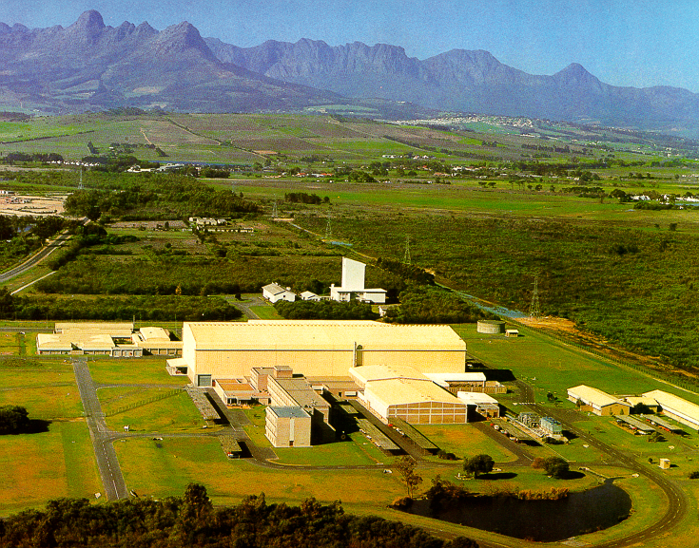
Studies of chirality
in the mass 80,100 & 190 regions
Rob Bark
iThemba LABS
Chiral Symmetry in Hadrons & Nuclei

Slide 2
A large collaboration
South Africa R.A. Bark P. Datta T. Dinoko J. Easton K. Guthikonda T.T. Ibrahim P. Jones E. Khaleel N. Kheswa N Khumalo E.A. Lawrie J.J. Lawrie E.O. Lieder R.M. Lieder R. Lindsay G.K. Mabala S.N.T. Majola S.M. Maliage P.L. Masiteng H. Mohammed S.M. Mullins S.H.T. Murray | J. Ndayishimiye S.S. Ntshangase D. Negi N. Orce P. Papka T.M. Ramashidza J.F. Sharpey-Schafer O. Shirinda P.A. Vymers M. Wiedeking S.M. Wyngaardt | China Q.B. Chen Y.Y. Chen R. Han C. He H. Hua X.Q. Li Y.J. Li Z.H. Li Z.P. Li C. Liu L. Liu J. Meng J. Peng B. Qi Z. Shi J.J Sun S.Y. Wang Z.G. Xiao C. Xu S.Q. Zhang Z.H. Zhang P.W. Zhao L.H. Zhu | Hungary J.Gal G. Kalinka B.M. Nyako J. Timar K. Juhasz France Ch. Vieu C Schück Germany R. Schwengner Poland Ch. Droste Sweden I. Ragnarsson

Slide 3
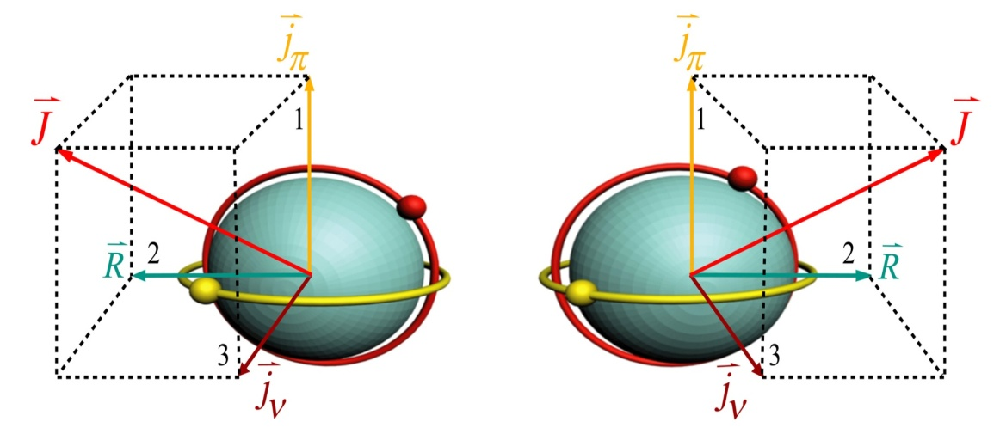
Chiral symmetry in atomic nuclei
forms in the angular momentum space,
by the angular momenta of the odd proton, odd neutron
and the rotation of the nucleus
The right-handed and left-handed systems have
the same excitation energy,
the same moments of inertia,
the same transition probabilities, …
therefore a chiral system can be identified by the observation
of a pair of degenerate rotational bands
S. Frauendorf, J. Meng, Nucl. Phys. A 617 (1997) 131

Slide 4
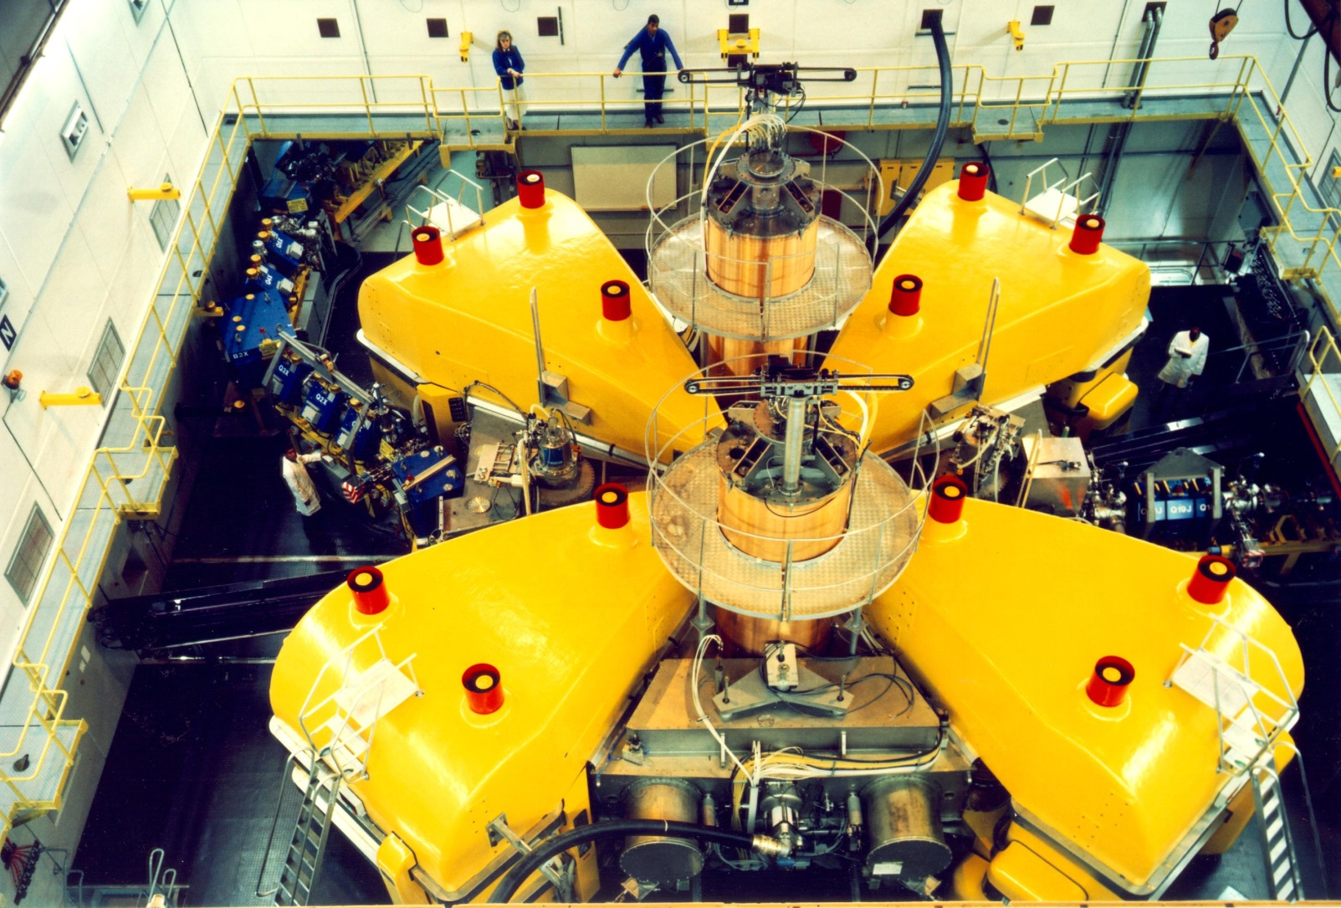
Separated-Sector Cyclotron k=200
Rf-system
High Energy Out
Low Energy In
Rf-system
Sector Magnet
Most Powerful cyclotron in Southern Hemisphere
Protons to heavy-ions
Notes:
This shows the separated-sector cyclotron. It has four separate magnet sectors with a diameter of 13 m. The RF-system consists of two lambda-half resonators that can operate in the frequency range 7 to 26 MHz. The dee voltage is 220 kV at a power level of 80 kW per resonator. Although it has been designed for a maximum proton energy of 200 MeV but has delivered proton beams of 227 MeV. The beam is inflected with two bending magnets and a magnetic channel and extracted with two septum magnets. Typically the cyclotron delivers a 85 µA beam of 66 MeV protons for radioisotope production with 100% transmission through the machine. Higher beam currents are available but better production target cooling is required for reliable operation at higher intensities.

Slide 5
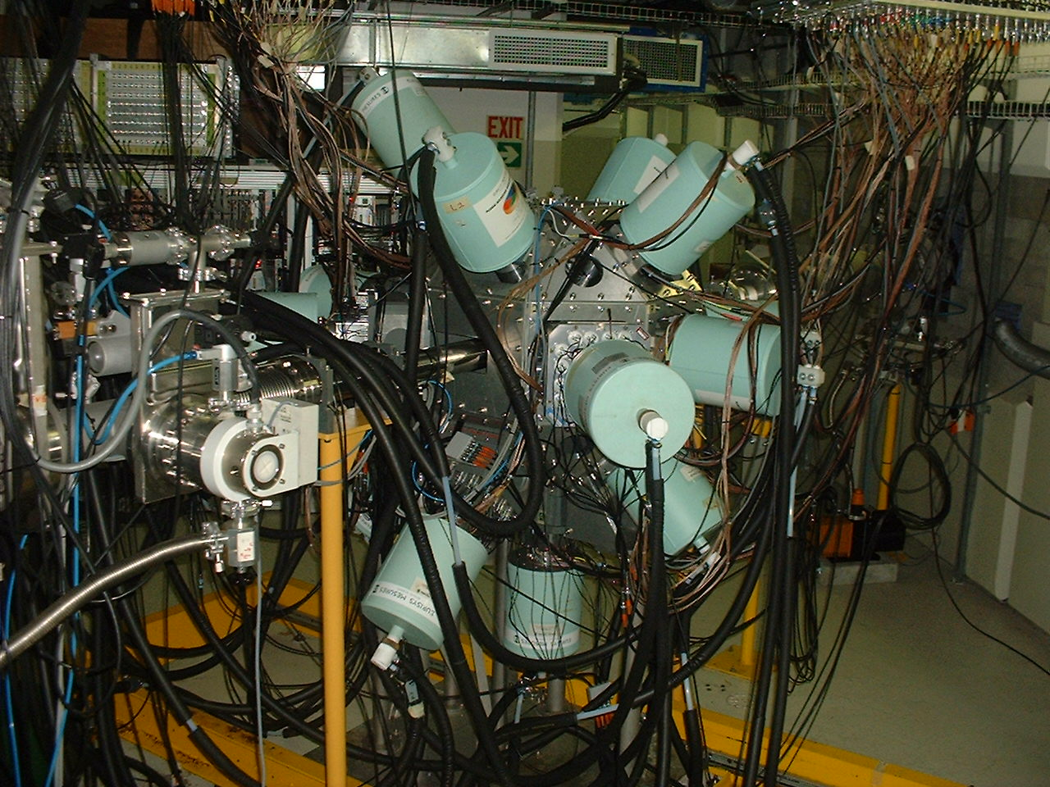
AFRODITE
Nuclei typically populated using heavy-ion, fusion-evaporation reactions
The main tool for observing γ-ray transitions from chiral bands is the AFRODITE array of up to 9 Compton-suppressed HpGE detectors
9 clover detectors
8 LEPS detectors
at iThemba LABS with the AFRODITE gamma-ray array:
→A=80 a new mass region, studies on ^{78,80}Br, by J. Meng et al. → A=130 ¹³⁶Pm, studies by P. Datta
→ A=100 ¹⁰⁶Ag, studies by E. Lieder, R. Lieder
→A=190 a new mass region, studies on ¹⁹²⁻¹⁹⁸Tl, by E.A. Lawrie
AFRODITE array

Slide 6
Questions
To what extent is nuclear chirality universal ?
  New regions
    A=80, 190 ? ^{78,80}Br, ^{194,198}Tl
  New configurations
    e.g. πg_{9/2} x νg_{9/2} ^{78,80}Br
    quasiparticle multiplicity ¹⁰⁶Ag, ¹⁹⁴Tl
    What degree of degeneracy can actually be reached in atomic nuclei? ¹⁹⁴Tl
  Effect of residual p-n interactions ¹⁹⁸Tl
  Complete Spectroscopy
    Measurement of all energies & transition rates ¹⁰⁶Ag

Slide 7
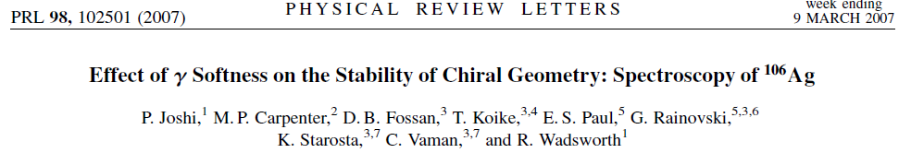
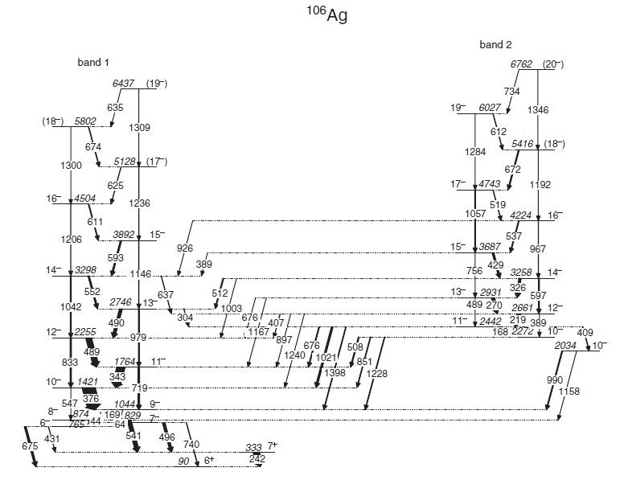
Complete Spectroscopy:
The case of ¹⁰⁶Ag
πg_{9/2} x νh_{11/2}

Slide 8
Fingerprints of chiral partner bands
A pair of chiral partner bands should have:
1. Energetically degenerate identical spin and parity states
a. Implies identical aligned angular momenta
b. Implies identical moments of inertia
2. Smooth staggering function S(I) = (E(I) – E(I-1))/2I
3. A staggering of the B(M1)/B(E2) ratios of the in-band transitions
4. B(M1, I→I-1) values of the in-band transitions show a staggering
B(M1, I→I-1) values stagger with opposite phase
Smoothly increasing B(E2, I→I-2) values for the in-band transitions
The reduced transition probabilities of the chiral partner bands behave similarly

Slide 9
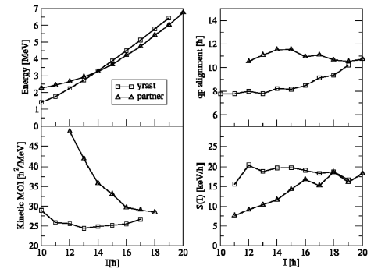
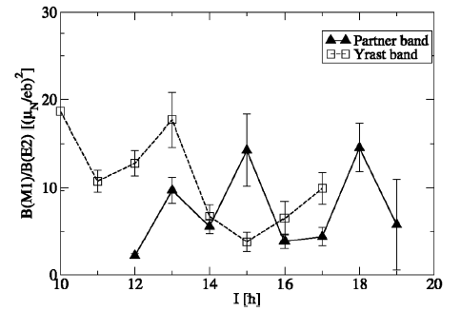
¹⁰⁶Ag
Staggering absent/ phase change
Persistent difference in
aligned angular momentum
Dissimilar staggering
Joshi et al. proposed a
shape transformation by chiral vibration due to γ-softness.
Ground (yrast) band is triaxial,
while partner bands is axially deformed (prolate)

Slide 10
Experimental details of experiment to search for multiple chiral bands (R.Lieder)
November 2011
Speaker: R.M. Lieder
Reaction: ⁹⁶Zr(¹⁴N,4n)¹⁰⁶Ag
Beam energy: 62 MeV
⁹⁶Zr targets: Stack of two self-supporting 0.7 mg/cm² foils
(1.3·10⁹ γγγ events)
AFRODITE array: 8 CLOVER detectors - four at 90º
four at 135º

Slide 11
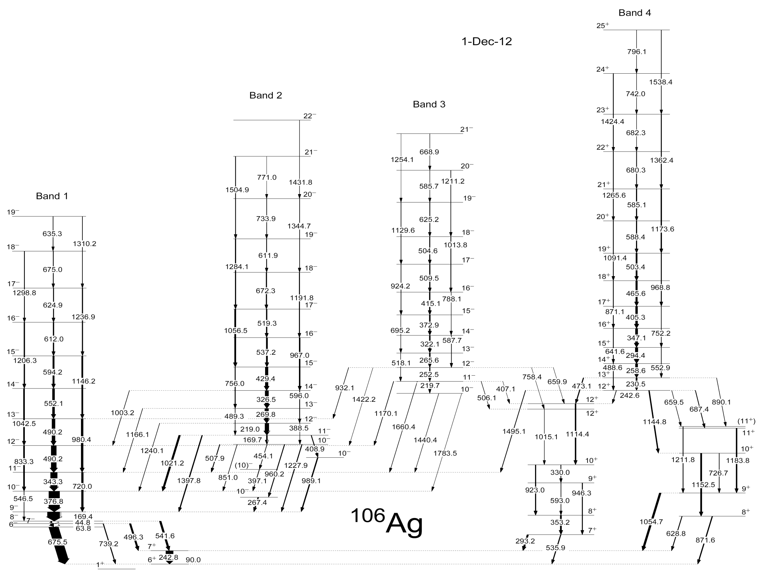
Jerrestam et al., NPA 577, 786 (1994) NORDBALL
Joshi et al., PRL 98, 102501 (2007) GAMMASPHERE
Levon et al. ZP 33, 131 (1992)
Low-spin
transitions
re-ordered
RDM
0.4
0.3
0.6
0.4
4.1
226

Slide 12
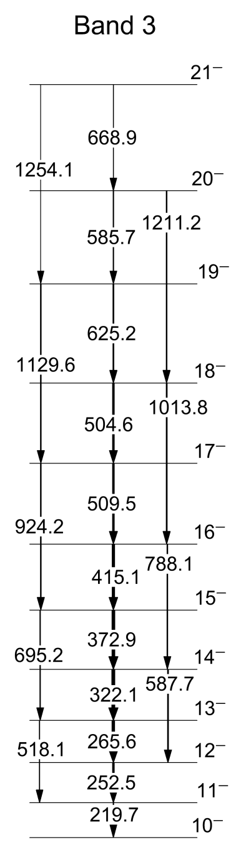
Summed γγ coincidence spectrum of band 3

Slide 13
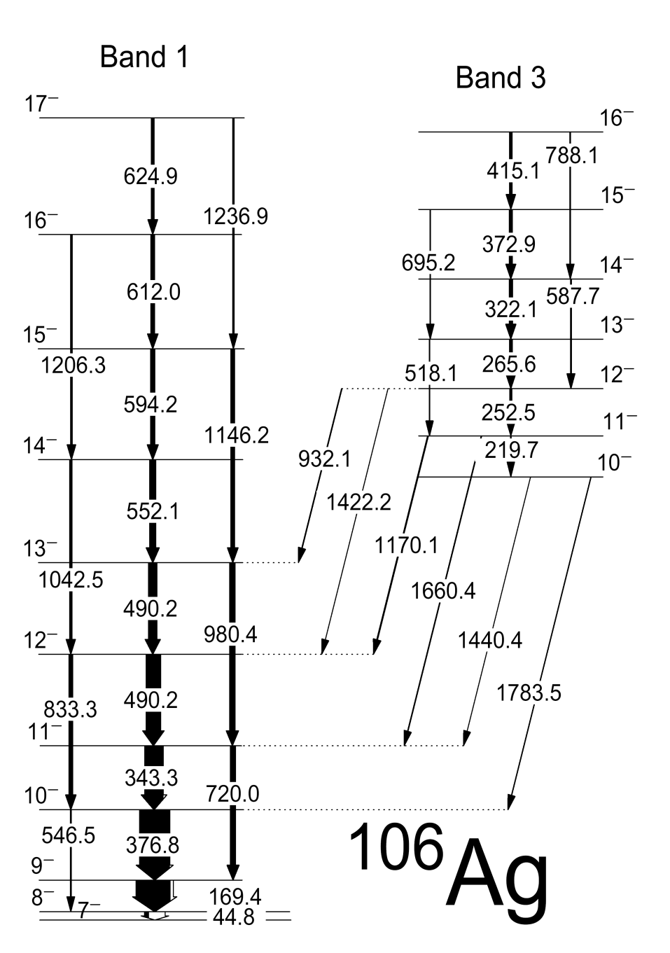
De-excitation of band 3 into band 1
Thin target
Thick target

Slide 14
Angular Distribution
Angular distribution sort: two matrices with 90º and 135º detectors against all.
Angular distribution of γ-rays emitted from aligned nuclei:
W(Θ) = A₂ P₂(cosΘ) + A₄ P₄(cosΘ)
Associated Legendre polynomials:
P₂(cosΘ) = 0.5 (3cos²Θ -1)
P₄(cosΘ) = 0.125 (35 cos⁴Θ - 30cos²Θ +3)
In AFRODITE the detectors were placed at 90º and 135º
The anisotropy can be calculated as
if A₄ = 0
Since all dipole transitions in ¹⁰⁶Ag have only a small quadrupole admixture, A₄ is very small.
W(135º) – W(90º)
W(90º)
A = 2

Slide 15
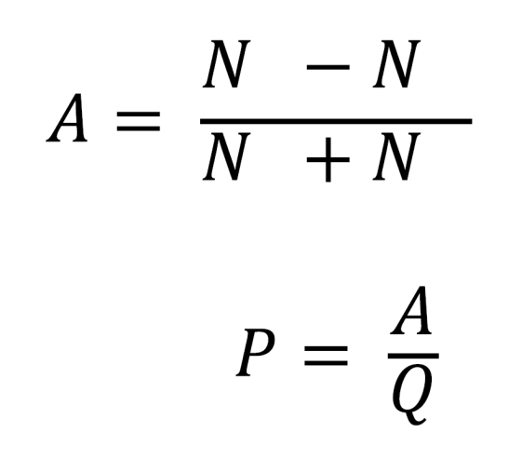
Linear polarization analysis
Polarization sort: Two matrices with parallel and perpendicular
scatter events in the 90º CLOVER detectors against all
┴
║
Beam
Anisotropy A_{p}:
┴
║
p
┴
║
Polarisation Sensitivity Q: Starosta et al., Nucl. Instr. Methods A378, 518 (1996)

Slide 16
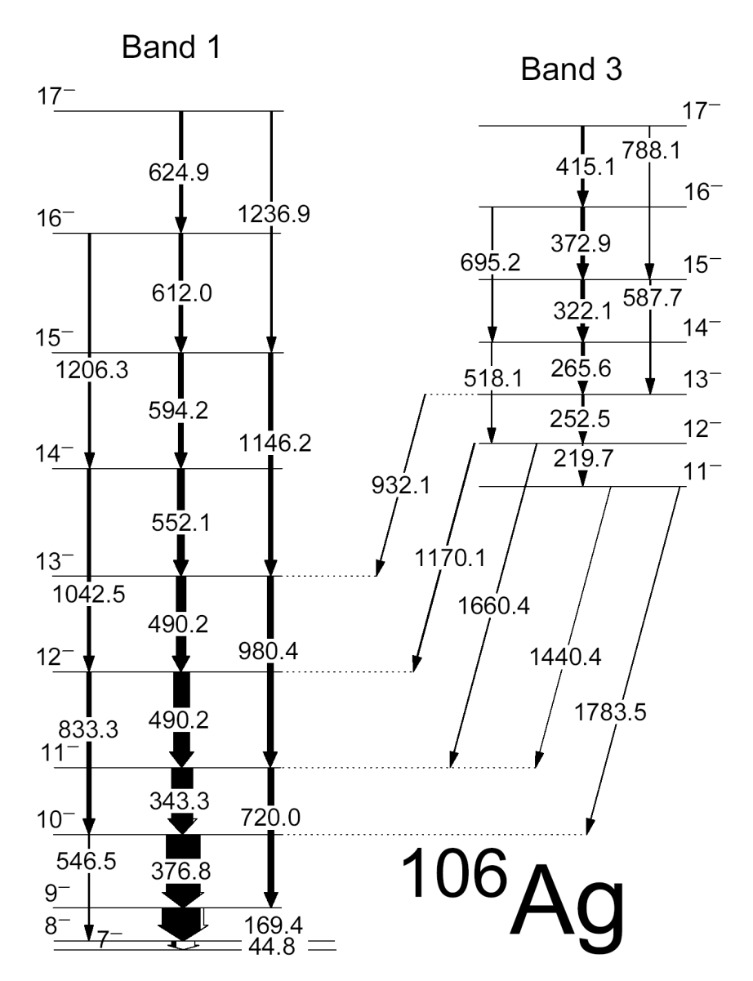
Ang. dis. & polarization analysis
16⁻⁻
15⁻⁻
14⁻⁻
13⁻⁻
12⁻⁻
11⁻⁻
505.8
10⁻⁻
12⁺

Slide 17
Experimental details of
DSAM LIFETIME experiment (E. Lieder)
October 2008
Speaker: E. Lieder
Reaction: ⁹⁶Zr(¹⁴N,4n)¹⁰⁶Ag
Beam energy: 71 MeV
⁹⁶Zr targets: 17 mg/cm² - DSAM (3·10⁹ γγ events)
2 mg/cm² - Stopping power (0.4·10⁹ γγ events)
0.7 mg/cm² - Level scheme study (0.3·10⁹ γγ events)
Recoil velocity: v/c = 1.3%
AFRODITE array: 9 CLOVER detectors - four at 45º
four at 135º
one at 90º
8 LEPS detectors

Slide 18
Lifetime analysis
Basis of DSAM: the energy of a γ-ray is changed when it is emitted from a moving nucleus.
The lifetime must be of the same order as the stopping time of the recoils in the target.
detector
N
γ
Θ)
E
γ
Recoils
Thick target
Beam ions
E_{γ} = E_{o}(1 + v/c cosΘ)
The lineshape resulting from Doppler shifts, attenuated during the stopping process in the target, is analysed.

Slide 19
Lifetime analysis
DSAM: Dependence of lineshape on
detector position
Ge
Ge
Ge
Θ
beam
target

Slide 20
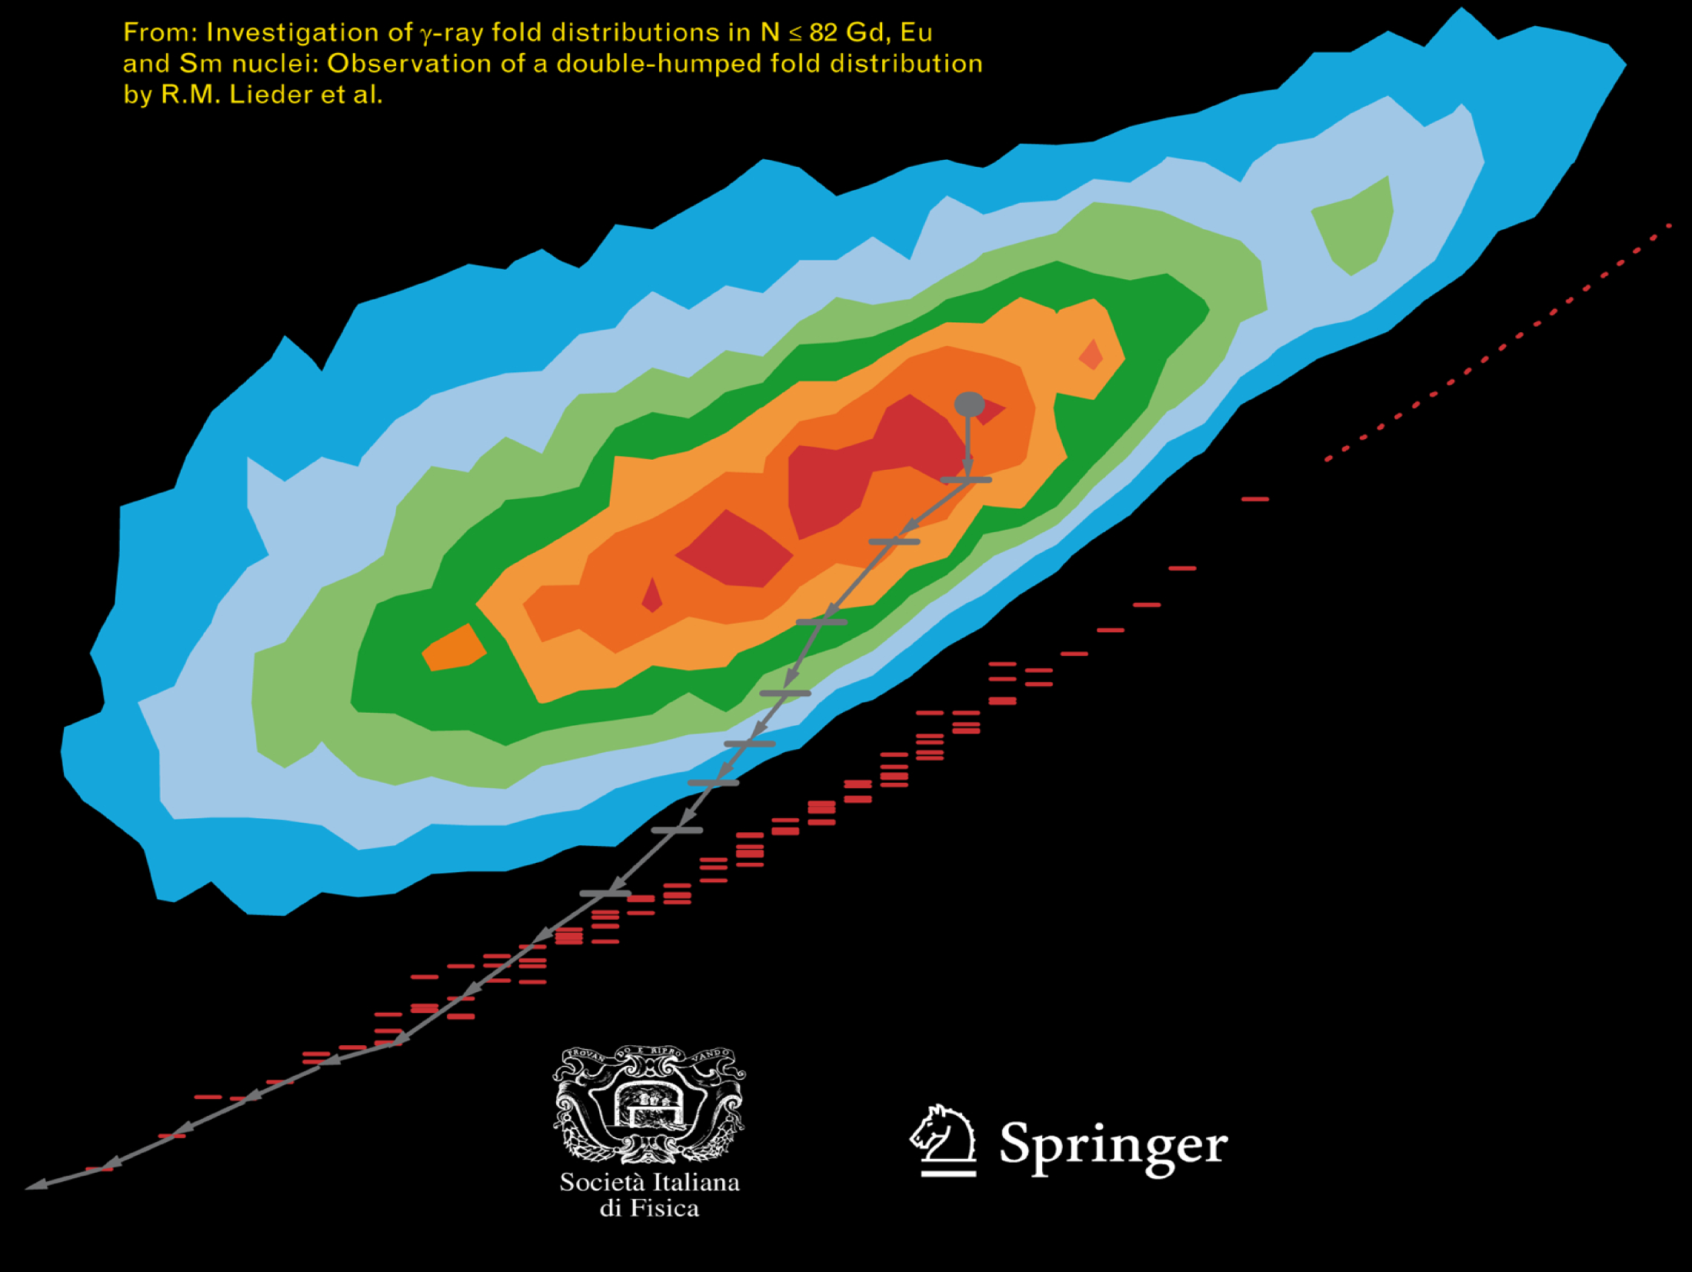
Depopulation of entry states

Slide 21
Monte-Carlo simulation calculations
of side feeding time distributions
Side
feeding
26+
a1=0.02 t1=0.006
a2=0.98 t2=0.06
Cascade
feeding
20+
a1=0.08 t1=0.014
a2=0.92 t2=0.10
I_{tot}=I₁+I₂
I₁
14+
a1=0.11 t1=0.019
a2=0.89 t2=0.22
I₂
I_{SF} = I_{tot} - I_{CF}
EUROBALL data; E.O. Lieder et al., Eur. Phys. J. A35, 135 (2008)

Slide 22
Decay modes taken into account in the simulation of the deexcitation of entry states:
Statistical E1, M1 and E2 transitions
Stretched E2 bands including rotational damping
Superdeformed bands in the continuum
Particle-hole excitations generating cascades of
stretched M1 transitions
The simulation is carried out with the code GAMMA

Slide 23
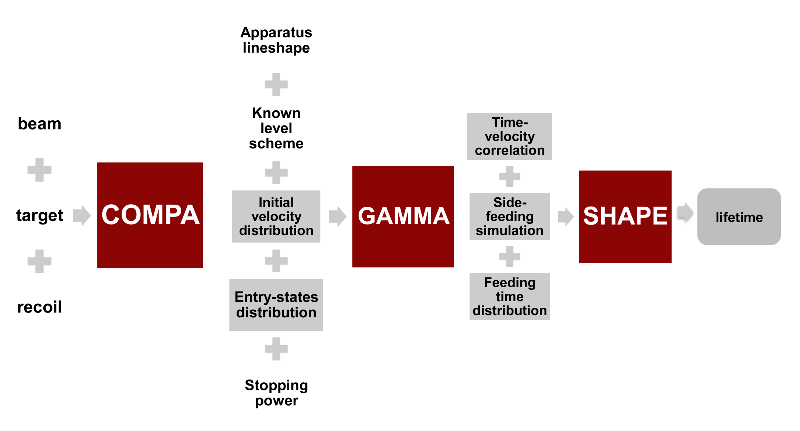
Lifetime analysis
DSAM: analysis programs developed
by A.A. Pasternak, Ioffe PTI,
St. Petersburg, Russia
Instrumental
lineshape
DSAM
Line shapes
Entry-state
population distribution
+
+
beam
energy
Entry-state
population distribution
+
Strength functions
of sidefeeding γ-rays

Slide 24
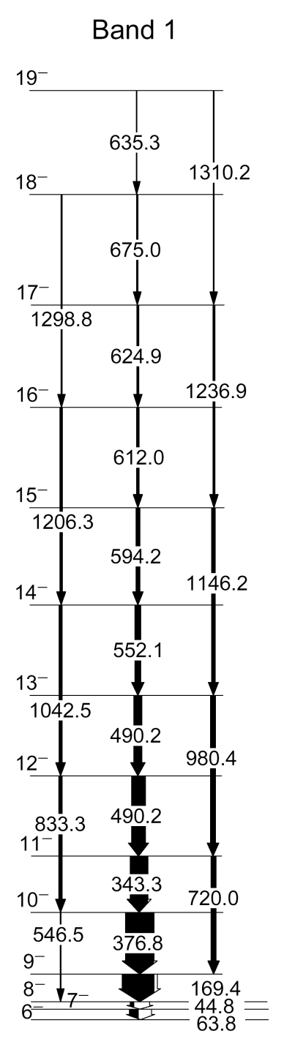
Lifetime analysis of band 1 in ¹⁰⁶Ag
0.28
0.28
0.27
0.24
0.35
0.27
0.41

Slide 25
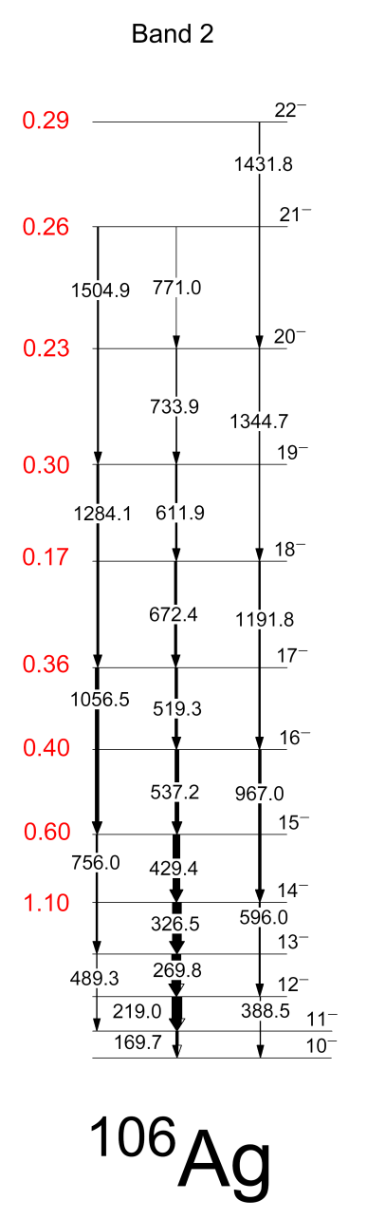
Lifetime analysis of band 2 in ¹⁰⁶Ag
τ = 0.26 ± 0.06 ps
τ = 0.30 ± 0.03 ps

Slide 26
Lifetime analysis of
band 1 in ¹⁰⁶Ag
0.28
0.28
0.27
0.24
0.35
0.27
0.41

Slide 27
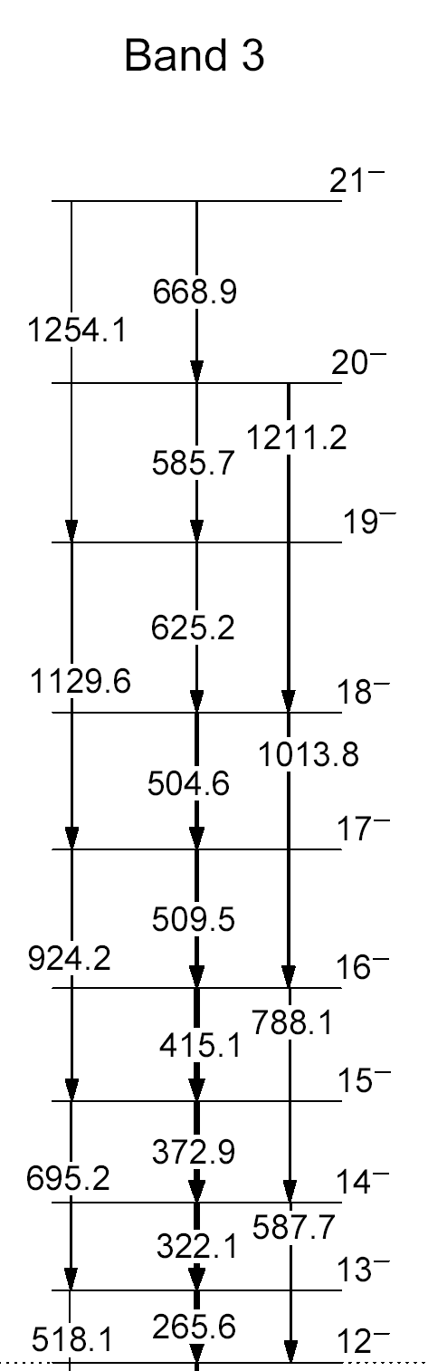
Lifetime analysis of band 3 in ¹⁰⁶Ag
18¯ τ = 0.18 ± 0.02 ps
17 ¯ τ = 0.27 ± 0.03 ps

Slide 28

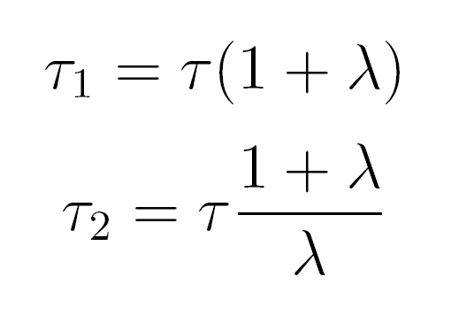
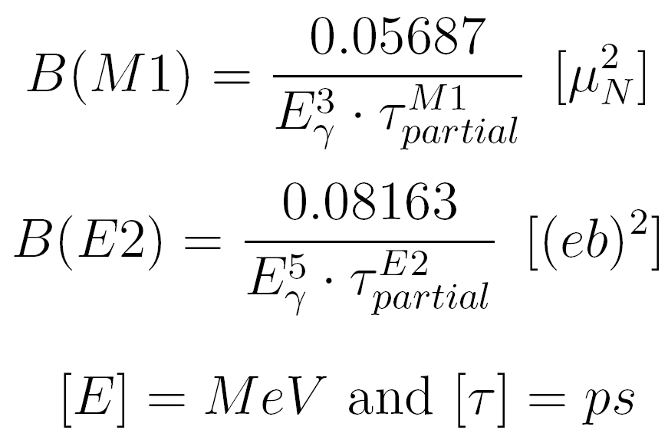
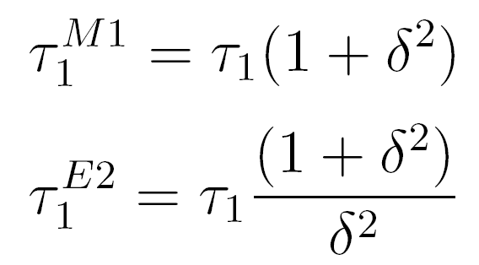
Reduced transition probabilities
From experimental values of τ, Е_{γ}, I _{γ}:
τ, I^{π}
Branching ratio:
E2
I₂
M1,E2,δ
I₁
Pure ΔI=1 M1 and ΔI=2 E2 transitions:
I^{π}-1
I^{π}-2
Mixed M1/E2 ΔI=1 transitions:

Slide 29
¹⁰⁶Ag – Our results:
B(E2, I I-2) and B(M1, I I-1) values,
B(M1)/B(E2) ratios and staggering parameters S(I)

Slide 30
Interpretation of Results:
Bands 4 & 6 are at high excitation energy
Could they be 4 or 6 quasiparticle?

Slide 31
Interpretation of results:
Comparison of ¹⁰⁶Ag and ¹⁰⁴Rh
Supports that bands 2 and 3 in ¹⁰⁶Ag have 4 quasiparticle configurations

Slide 32
Quasiparticle analysis:
¹⁰⁷Cd
The quasiparticle energies and aligned angular momenta represent the contributions solely from the valence quasiparticles.
These quantities are additive so that the configurations of bands in ¹⁰⁶Ag can be compared with those of the neighbouring nuclei.
¹⁰⁵Ag
¹⁰⁶Ag
¹⁰⁷Ag
¹⁰⁵Pd
Rotational frequency: ω(I) = I_{x}(I) = (I+0.5)² – K²
If K~ 0 , ω = Eγ/2 & I_{x} = (I+0.5)
Experimental Routhian: E'(I) = 0.5[E(I+1) + E(I-1)] - ω(I) I_{x}(I)
Quasiparticle energy: e'(I) = E'(I) - E'_{g}(I)
Aligned angular momentum: i = I_{x}(I) - I_{xg}(I)
E'_{g}(I) and I_{xg}(I) are the Routhians and spin components of the reference config.
The reference energy and angular momentum is deduced from the variable moment of inertia (VMI): J_{ref} = J₀ + J₁ ω² (J₀ and J₁ are the Harris parameters)
E(I+1) – E(I-1)
I_{x}(I+1) – I_{x}(I-1)

Slide 33
Quasiparticle analysis of bands in ¹⁰⁵Pd

Slide 34
Quasiparticle analysis of bands in ¹⁰⁵Ag
J_{o} = 8.9 ħ²/MeV, J₁ = 15.7 ħ⁴/MeV³
Obtained by fitting the ground-state band in ¹⁰⁴Pd,
considered as reference band (quasiparticle vacuum)

Slide 35
Band 1 in ¹⁰⁶Ag

Slide 36
Bands 2 and 3 in ¹⁰⁶Ag

Slide 37
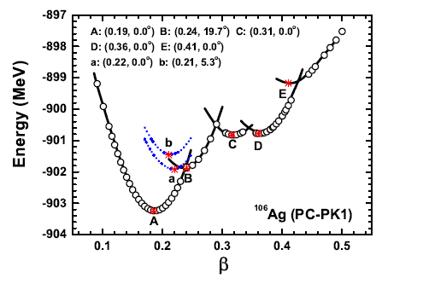


RMF configuration constrained calculations
potential energy surface

Slide 38
¹⁰⁶Ag – new interpretation excitation energy and spin
Joshi’s proposal: Bands1,2 : πg_{9/2}⁻¹ x νh_{11/2}
Our proposal: Bands 1: πg_{9/2} x νh_{11/2}
Bands 2,3: πg_{9/2} x νh_{11/2} x {νd_{5/2} νg_{7/2} }²

Slide 39
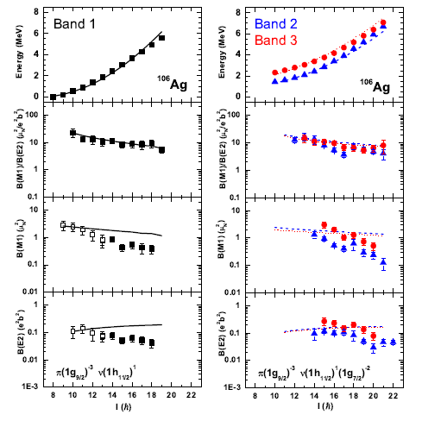
Good comparison with PRM
See talks of Qi-Bo Chen & Bin Qi
Band 1 – prolate rotor; Bands 2 & 3 Chiral vibrations (γ ~ 5°)

Slide 40
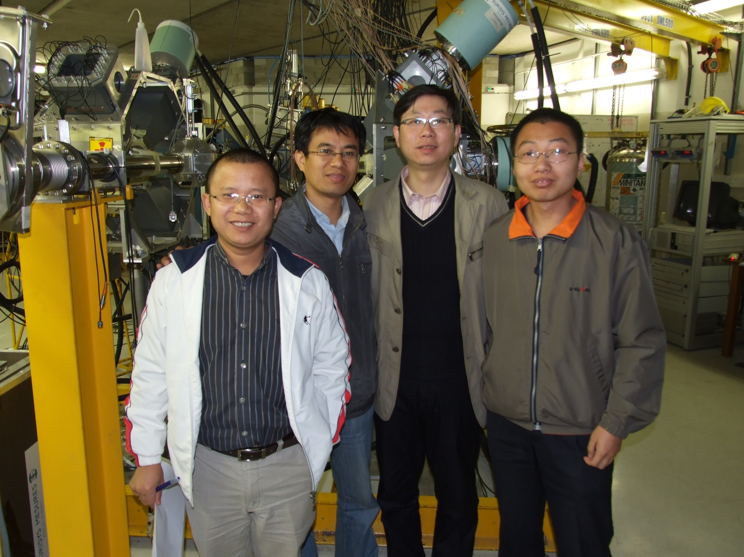
New Regions: A=80

Slide 41
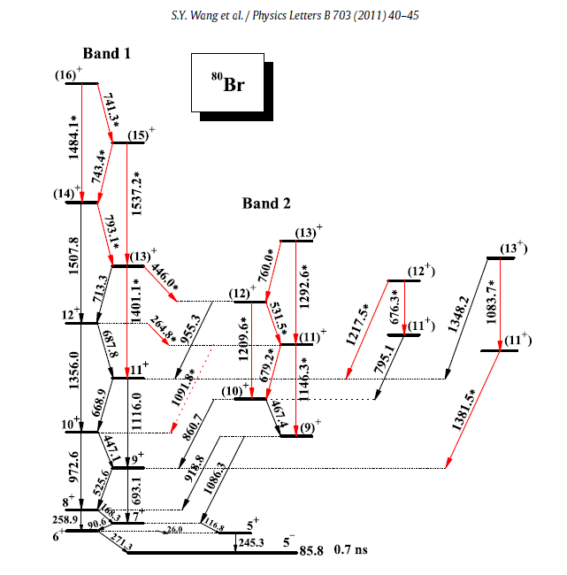
The case of ⁸⁰Br
⁷⁶Ge(¹¹B,α3n)⁸⁰Br
⁷⁶Ge(⁷Li,3n)⁸⁰Br
(data from Rossendorf)
πg_{9/2} x νg_{9/2}

Slide 42
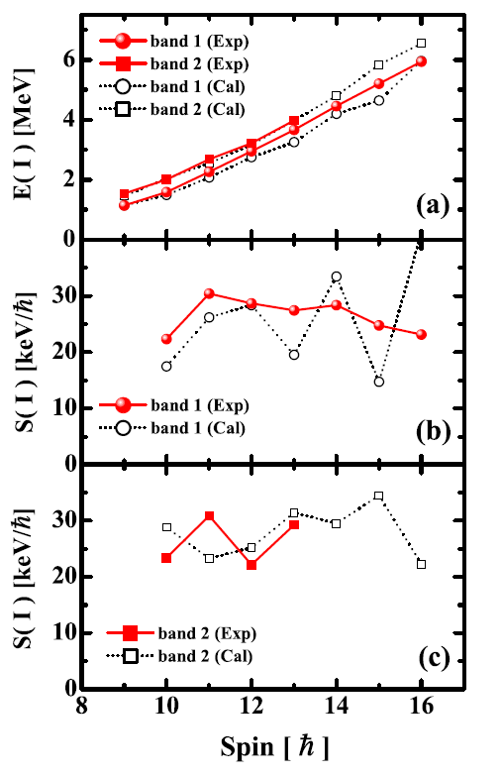
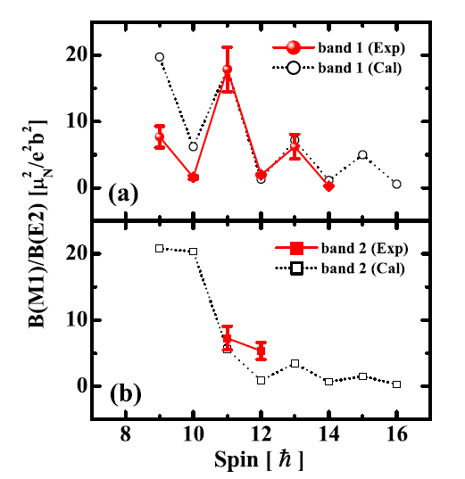
Properties of ⁸⁰Br
Good comparison with PRM

Slide 43
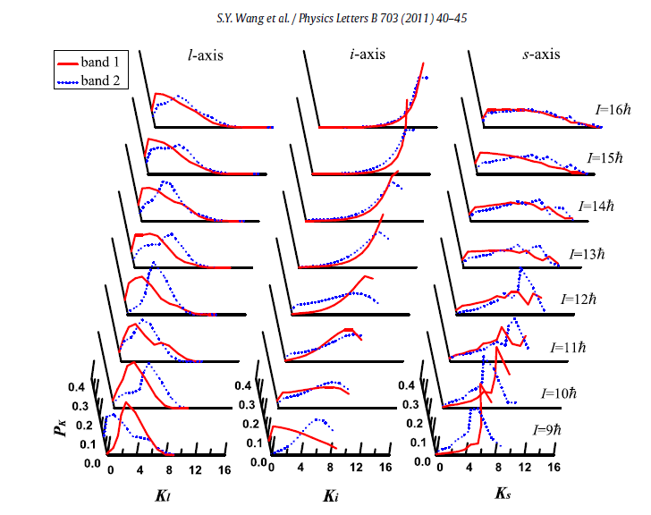
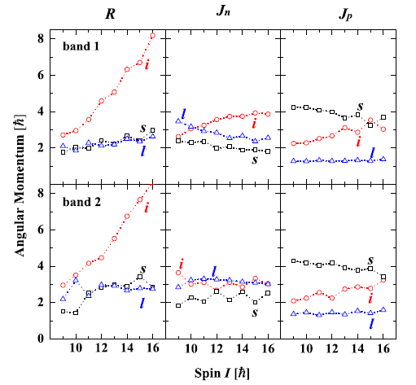
A case of Chiral Vibration
Static chirality demands equal
K- distributions
Band 1 – K=0; 0 phonon
Band 2 – K=6; 1 phonon
R oscillates through l-s plane
νg_{9/2} never fully aligns with
l-axis; Ω=7/2 orbital occupied

Slide 44
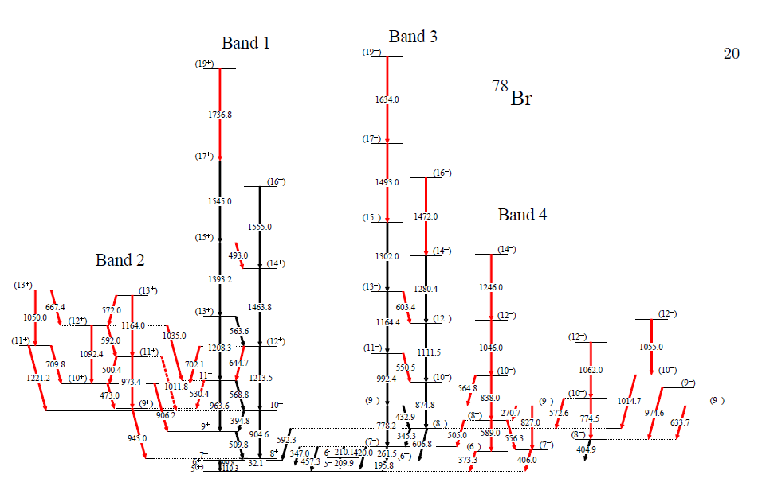
⁷⁸Br : see talk by Chen Liu
⁷⁰Zn(¹²C,p3n)⁷⁸Br

Slide 45

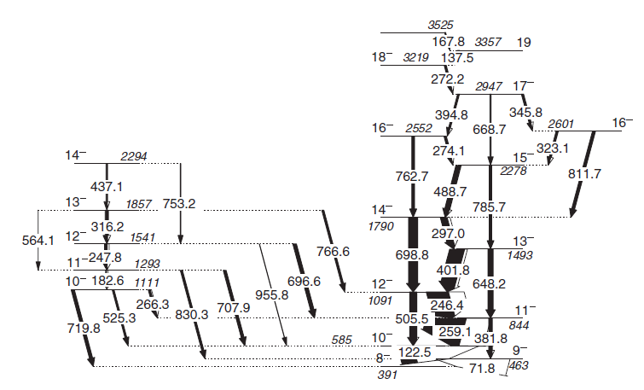
The effect of residual
p-n interactions: ¹⁹⁸Tl
πh_{9/2} x νi_{13/2}

Slide 46
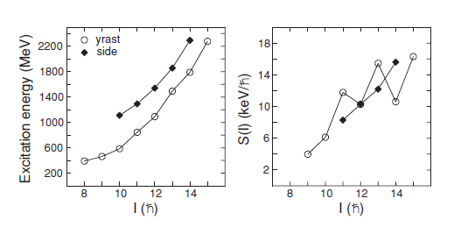
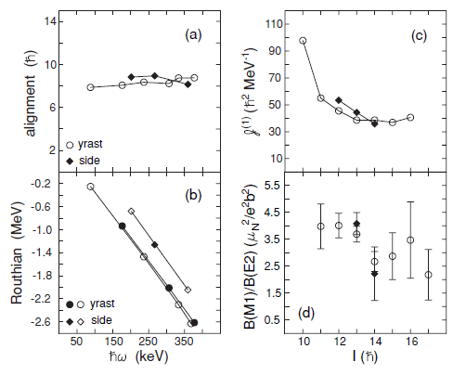
Properties of ¹⁹⁸Tl

Slide 47
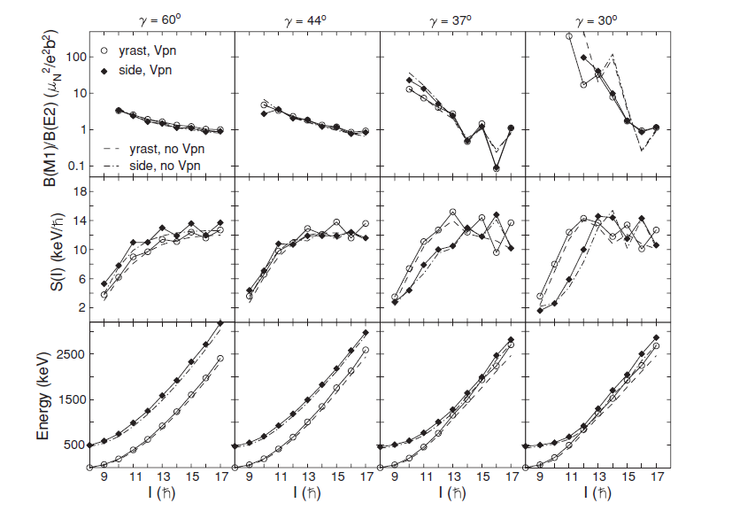
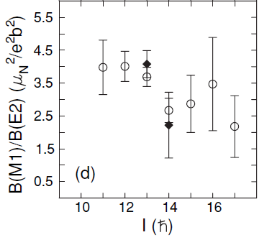
The effect of residual
p-n interactions and triaxiallity
PRM code of Ragnarsson & Semmes

Slide 48
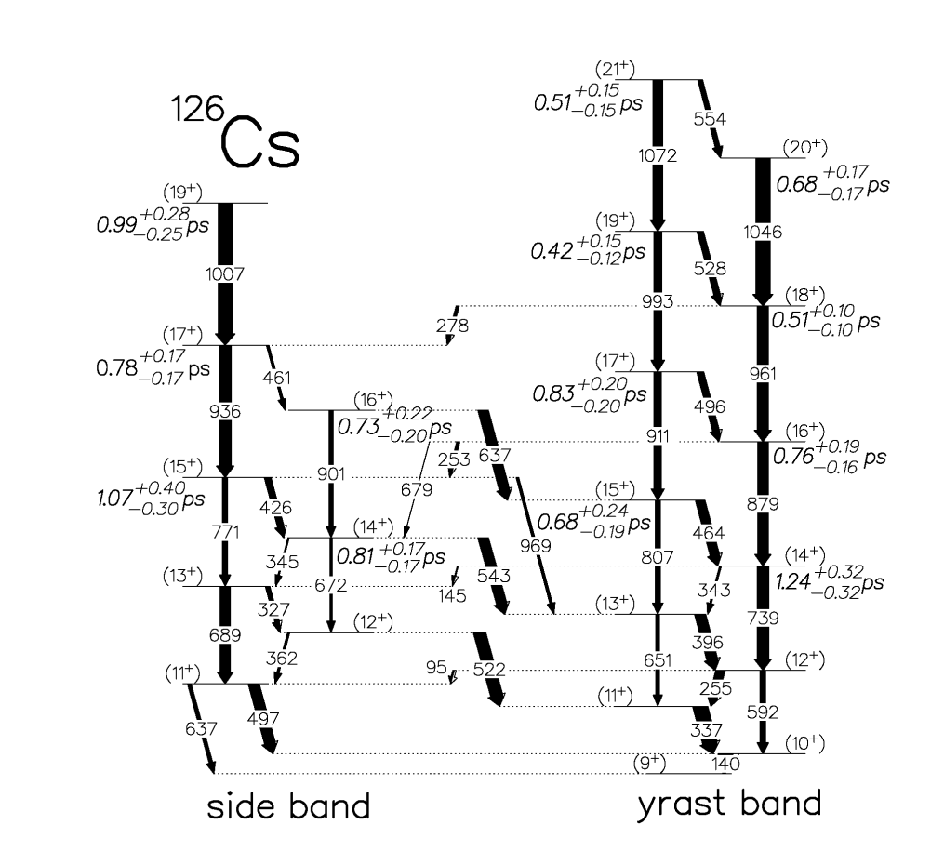
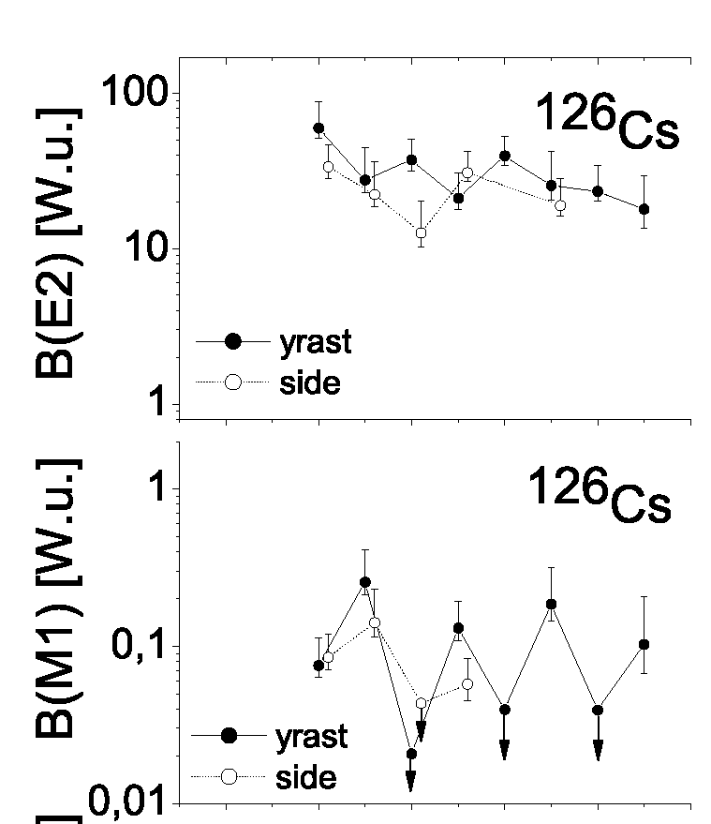
Best example of chiral partner bands:
¹²⁶Cs
13-Nov-2010
E. Grodner et al., EPJA 42, 79 (2009)

Slide 49
Degeneracy in ¹⁹⁴Tl
chiral partner bands
¹⁸¹Ta(¹⁸O,5n)¹⁹⁴Tl
more than 120
new transitions
previously known
PhD, PL Masiteng
Physics Letters B (2013)

Slide 50
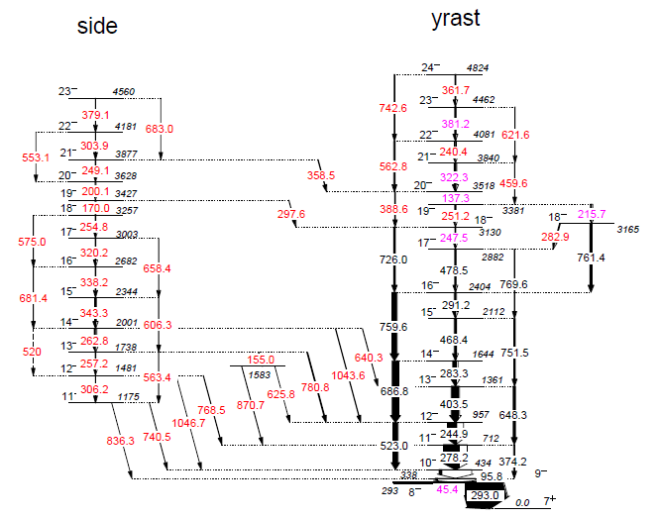
πh_{9/2} x (νi_{13/2} )³
πh_{9/2} x νi_{13/2}

Slide 51
2-qp, πh_{9/2} ⊗ νi_{13/2}⁻¹
4-qp, πh_{9/2} ⊗ νi_{13/2}⁻³
The candidate chiral pair in ¹⁹⁴Tl
is rather unique
This is the only pair of chiral candidate bands
observed through band crossing,
i.e. through a change in configuration from
πh_{9/2} ⊗ νi_{13/2}⁻¹ at low spins
to πh_{9/2} ⊗ νi_{13/2}⁻³ at high spins.
ΔE ≤ 110 keV
ΔE_{min} = 37 keV
This is the only known 4-quasiparticle
chiral pair, others are 2- or 3-qp bands
The 4-qp chiral pair shows exceptionally good
near-degeneracy, perhaps the best found
so far in any chiral system,
with relative excitation energy between the partner bands of ΔE ≤ 110 keV, the same alignments i_{x}, and very similar B(M1)/B(E2) transition probability ratios.
PhD, PL Masiteng

Slide 52
The candidate chiral pair in ¹⁹⁴Tl
is rather unique
The near-degeneracy in the excitation energies ΔE, the alignments Δi, and the transition probability ratios ΔB(M1)/B(E2) in the 4-qp pair in ¹⁹⁴Tl, is better than the near-degeneracy for the best previously known chiral candidate pairs, i.e. the 2-qp pair in ¹²⁸Cs and the 3-qp pair in ¹³⁵Nd.
This indicates that ¹⁹⁴Tl is perhaps the best candidate showing chiral symmetry in angular momentum space.
PhD, PL Masiteng
P.L. Masiteng, E.A. Lawrie, et al.,
Phys. Lett. B 719 (2013) 83

Slide 53
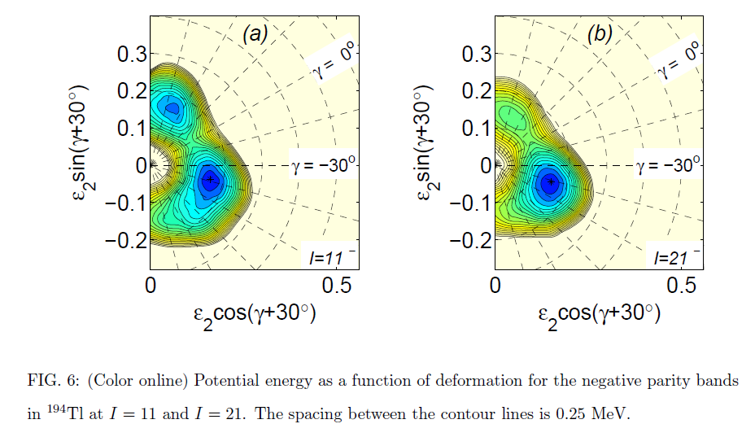

Slide 54
Thank You

