Slide 1
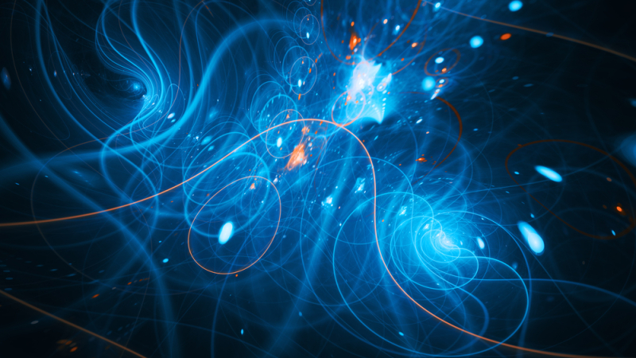


Prospects for Dark Matter in Pseudoscalar-Extended Two-Higgs-Doublet Model at
Future e⁺e⁻ Colliders
Alisa Drazdova, Yuri Kulchitsky, Alexander Sadousky
IP NASB, Minsk, Belarus ; JINR, Dubna
Notes:
1

Slide 2

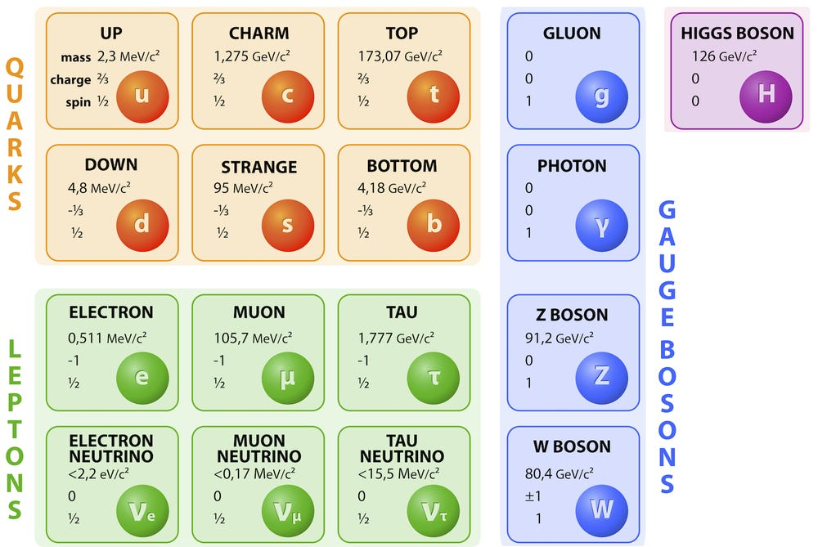

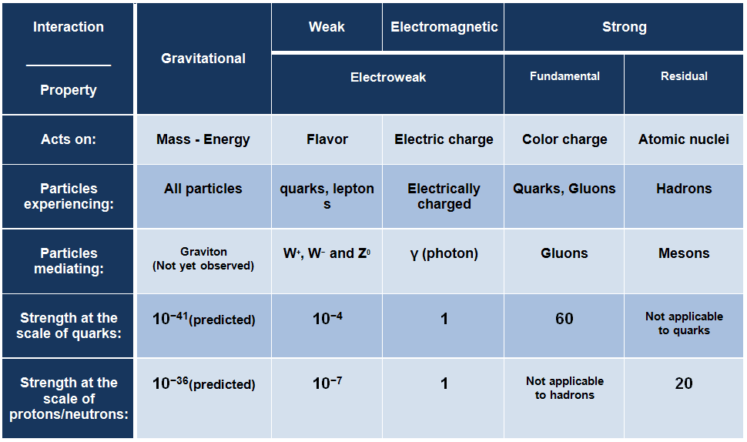
Standard Model
The SM describes the fundamental constituents of matter and their interactions
Notes:
The starting point of our talk is the Standard Model. It works very well. It describes all known elementary particles and three of the four fundamental forces: electromagnetism, the weak force, and the strong force. In 2012, scientists at the Large Hadron Collider discovered the Higgs boson. This was the last missing particle of the Standard Model. You can see its Lagrangian on the slide. It is a compact way to write down almost everything we know about the physics of the microworld.
The Standard Model has been tested many times in experiments and has always been confirmed. However, it also has some big limitations. The most obvious one is that it does not include gravity. We still do not know how to describe gravity at the quantum level.
But gravity is not the only problem. There are several phenomena that the Standard Model cannot explain at all, or can explain only partly. We will list them on the next slide.

Slide 3
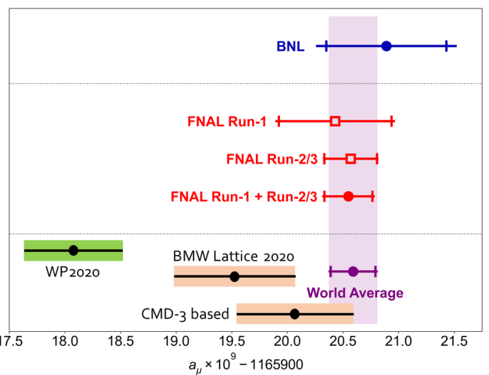

Standard Model Problems: an incomplete theory
Unknown nature of Dark Matter
Very small cosmological constant and very weak gravity interaction
Particle–antiparticle asymmetry in the Universe
Problem of neutrino masses, mixing, oscillations
Muon (g-2) μ anomaly (3.5σ→4.2σ BNL):
CMD-3 σ(𝑒⁺𝑒 ⁻→𝜋⁺𝜋 ⁻) → new theoretical calculation!
B-anomalies (4.5σ): semi-leptonic B-decays
CDF W-mass anomaly (7σ): new ATLAS & CMS at 13 TeV result!
4.2 σ
Notes:
When experiments at the LHC were being planned, scientists hoped not only to discover the Higgs boson but also to find physics beyond the Standard Model — such as supersymmetry, extra dimensions, or exotic particles. However, no convincing evidence of new physics has been found so far. This does not mean it does not exist. It is possible that new particles are simply too heavy to be produced at the LHC, or that their interactions with ordinary matter are too weak.
Here are the main problems that the Standard Model does not solve and that push us to search for new physics:
— Dark matter. Cosmological observations — such as galaxy rotation curves, gravitational lensing, and the anisotropy of the cosmic microwave background — show that about 85% of the matter in the Universe is non-baryonic. But the Standard Model does not contain a suitable dark matter candidate. In this talk, we will consider one of the many aspects of this question.
— The cosmological constant and gravity. The observed value of the cosmological constant is extremely small compared to theoretical estimates. This is the so-called cosmological constant problem. In addition, gravity remains outside the quantum description, and attempts to build a quantum theory of gravity have not yet succeeded.
— The baryon asymmetry of the Universe, i.e. the fact that there is much more matter than antimatter in the Universe.
— Neutrino masses. In the Standard Model, neutrinos are considered massless. However, neutrino oscillation experiments have clearly shown that neutrinos do have mass, albeit a very small one. This is a direct indication of new physics beyond the Standard Model.
— The muon magnetic moment anomaly. The discrepancy between the theoretical prediction of the Standard Model and the experimental value of the muon magnetic moment is 3.5–4.2 standard deviations. This hints at a possible contribution from new particles.
— B-anomalies. In semi-leptonic B-meson decays, deviations from the predictions of the Standard Model are observed at the level of 4.5σ. These deviations may indicate the existence of new charged bosons or leptoquarks.
— The W-boson mass anomaly. The CDF experiment at the Tevatron recorded a deviation of the W-boson mass from the predicted value of 7σ — a very serious discrepancy. However, subsequent results from ATLAS and CMS at 13 TeV did not confirm this deviation. Thus, the question remains open and requires further study.
All these anomalies point to the same conclusion: the Standard Model is not the final theory. It needs to be extended.

Slide 4
Dark Matter Candidates
Axions (ALPs)
Sterile Neutrinos
WIMPs
Mass: μeV – meV
Mass: keV – MeV
Mass: GeV – TeV
Interaction:
Interaction:
Interaction:
very weak (∝ 1/fₐ)
mixing with
electroweak
active neutrinos
Search methods:
Search methods:
Search methods:
• Helioscopes (IAXO)
• Colliders (LHC, CEPC)
• Cavities (ADMX)
• X-ray telescopes
• Tritium (KATRIN)
mono-X
• Direct searches
(LZ, XENONnT)
★ WIMP — Main candidate for CEPC research
Notes:
Before moving on to specific models, let us briefly consider the main dark matter candidates. They can be divided into three classes depending on their mass and the nature of their interactions.
The first class is axions and axion-like particles (ALPs). They were originally proposed to solve the strong CP problem in quantum chromodynamics, but they also turned out to be natural dark matter candidates. Axions are pseudoscalar particles. They are very light, with masses in the range from microelectronvolts to millielectronvolts, and they interact very weakly with ordinary matter. They are not detected at colliders but in special experiments such as helioscopes, where scientists look for axions coming from the Sun.
The second class is sterile neutrinos. These are hypothetical particles that do not participate in the weak interaction but mix with ordinary active neutrinos. Their mass may range from kilo-electronvolts to mega-electronvolts. Sterile neutrinos are interesting because they could explain both dark matter and the observed neutrino oscillations. However, searching for them is mostly a task for astrophysical observations.
The third class is WIMPs (Weakly Interacting Massive Particles). These are massive particles with masses from a few GeV to a TeV. They interact with ordinary matter with a strength of the order of the electroweak interaction. For a long time, WIMPs were considered the main candidates, and they were actively searched for at the LHC using mono-X signatures — events where a dark matter particle is produced in association with jets, a photon, or a gauge boson. However, despite intensive searches, no convincing evidence for the existence of WIMPs has been found so far.

Slide 5


2HDM (Two Higgs Doublet Model)
The Two Higgs Doublet Model (2HDM) is one of the simplest extension of the SM. Only one
scalar multiplet with the same transformation under the SM gauge symmetries as the Higgs field is added to the field content of the SM. Consequently, the 2HDM Lagrangian can be written as:
where
Ref. "Automatic evaluation of UV and R2 terms for beyond the Standard Model Lagrangians: a proof-of-principle", Celine Degrande, Comput. Phys.Commun. 197 (2015) 239-262.
Notes:
If a deviation from the Standard Model is found, what theoretical model should be used to interpret it? To plan searches and to analyse the data afterwards, we need a specific theoretical framework.
In this work, the Two-Higgs-Doublet Model (2HDM) has been chosen as such a framework. The two-Higgs-doublet model and its extension with a pseudoscalar singlet naturally allow us to add a dark matter candidate.
The 2HDM is a standard model recommended by the LHC Dark Matter Working Group for the interpretation of dark matter searches at colliders. The results from ATLAS and CMS are published within this model, which makes the results of this work comparable with existing constraints.

Slide 6




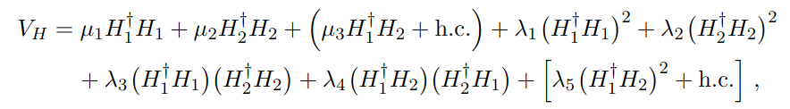




2HDM+a Model
Parameters:
2HDM+a
arxiv.1701.07427
light neutral pseudoscalar singlet
The interaction of a pseudoscalar with dark matter is given by the Lagrangian:
Parameter | Meaning
Determines how SM-like the light Higgs is.
Doublet potential
Ratio of the two Higgs doublet vacuum expectation values: tan⁡β=v2/v1.Controls the coupling of Higgs bosons to fermions.
Mixing angle between the two CP-odd states: the doublet pseudoscalar A and the singlet pseudoscalar a. This parameter controls the coupling of the SM-like Higgs h to the mediator a.
Singlet -doublet potential
Yukawa coupling of the pseudoscalar mediator a to the Dark Matter χ.
Quartic coupling between the two Higgs doublets in the scalar potential.
Singlet potential
Quartic portal couplings between the singlet P and the two Higgs doublets.
Notes:
Now let us move on to a detailed description of the 2HDM+ a model. This is an extension of the Standard Model in which a pseudoscalar singlet field is added to the two Higgs doublets.
The main parameters of the model are shown on the slide. They are divided into three groups: masses, mixing angles, and coupling constants.
Let us start with the masses. v is the vacuum expectation value of the electroweak theory. It is equal to 246 GeV and sets the scale of electroweak symmetry breaking. M_h is the mass of the light scalar, which is identified with the observed Higgs boson of mass 125 GeV. M_A, M_H, and M_H± are the masses of the heavy pseudoscalar, the heavy scalar, and the charged scalars, respectively. In my scan, these masses are fixed to large values so that they do not affect the kinematics. M_a is the mass of the pseudoscalar singlet — this is the mediator particle. Finally, m_χ is the mass of the dark matter particle.
The mixing angles determine how the original fields combine into physical states. cos(β-α) together with sin(β-α) determines how similar the light scalar h is to the Higgs boson of the Standard Model. For example, if sin(β-α) = 1, then h behaves exactly like the Standard Model Higgs boson. tanβ is the ratio of the vacuum expectation values of the two doublets. It controls how the Higgs particles interact with fermions. The most important angle for my study is sinθ. This is the mixing angle between the two pseudoscalar states: the doublet A and the singlet a. It determines the probability that the light scalar h decays into two mediators a.
The coupling constants complete the list. y_χ is the Yukawa coupling that describes the interaction of the pseudoscalar a with the dark matter fermion χ. In the Lagrangian, this looks like -i y_χ a χ̄ γ₅ χ. λ₃, λ_{P1} and λ_{P2} are the quartic couplings in the scalar potential. They affect the decay width h → a a and the shape of the potential.
The scalar potential of the model is shown at the bottom of the slide. It consists of three parts. V_H is the standard potential of the two doublets, including quadratic and quartic terms. V_HP contains the terms that couple the singlet P to the doublets. There is a trilinear term with the constant b_P as well as quadratic terms with λ_{P1} and λ_{P2}. Finally, V_P is a simple quadratic potential of the singlet itself.

Slide 7
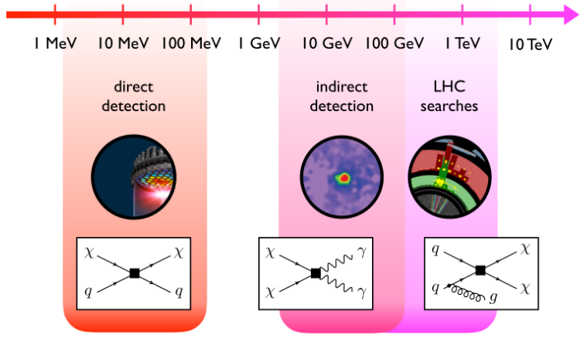
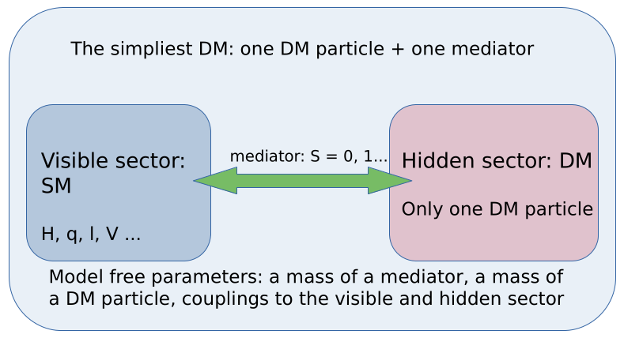
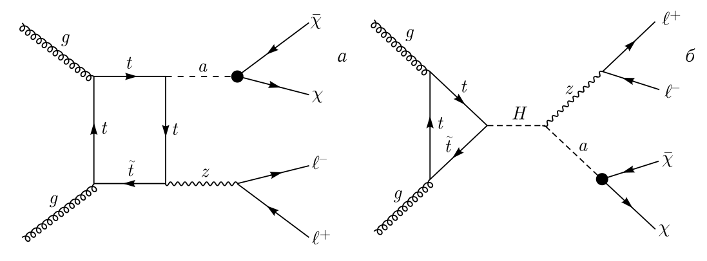
Results of CMS observations
More variety in leading MET signatures:
➢ mono-tt
➢ mono-jet
➢ mono-Higgs
➢ mono-Z
➢ mono-top
Notes:
The 2HDM+a model is not just a theoretical construct — it is actively tested experimentally, primarily at the Large Hadron Collider. We will not be able to use the same search methods for CEPC, but this study shows that this model clearly has promise.
The general logic of searching for dark matter at colliders is as follows. Since dark matter particles are not detected by the detector, their presence appears as an imbalance in transverse energy — the so-called missing energy. However, an imbalance alone is not enough. We also need to detect some visible particle produced in the same event. This could be a photon, a jet of hadrons, a W or Z gauge boson, or the Higgs boson. This signature is called "mono-X".
In the 2HDM+a model, the mediator — the particle that connects the visible and dark sectors — is the pseudoscalar a. It can be produced at the collider in various ways. In particular, the CMS collaboration studied the process of associated production of the pseudoscalar a and the Z boson, followed by the decays Z → mu+ mu- and a → χ χ̄, where χ is the dark matter particle. The final signature is two muons of opposite signs plus missing energy.

Slide 8
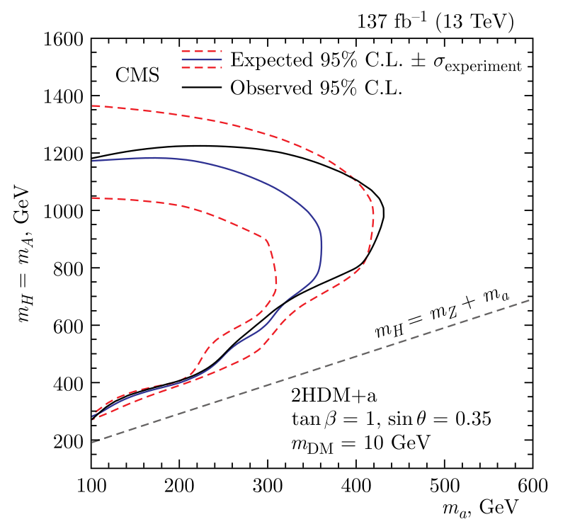

Results of CMS observations
Sirunyan A. M. et al. (CMS Collab.). Search for Dark Matter Produced in Association with a Leptonically Decaying Z Boson in Proton–Proton Collisions at s = 13 TeV // Eur. Phys. J. C. 2021. V. 81. P. 13; Erratum: Eur. Phys. J.
C. 2021. V. 81. P. 333
Notes:
This slide shows the experimental limits on the 2HDM+a model obtained by the CMS collaboration during the second run of the LHC (Run 2). The data were collected at an energy of 13 TeV, and the integrated luminosity was 137 inverse femtobarns.
The analysed process was the associated production of a Z boson and a pseudoscalar mediator a, followed by the decays Z → mu+ mu- and a → χ χ̄, where χ is the dark matter particle. No signal was found. Based on this, upper limits on the cross sections were obtained at the 95% confidence level. These limits were then reinterpreted as constraints on the masses of new particles.
The figure shows the exclusion region in the mass plane of the heavy scalar m_H versus the pseudoscalar m_a. The model parameters are fixed: tanβ = 1, sinθ = 0.35, and the dark matter particle mass m_χ = 10 GeV. It is important to read the plot correctly: the excluded region is in the lower left — that is, the region of small m_H and m_a. The region in the upper right, on the contrary, is allowed.
For small m_a (around 100 GeV), the mass of the heavy scalar m_H cannot go below about 200–300 GeV — this region is excluded. As m_a increases, the constraints become weaker. The best sensitivity is reached when m_H is about 1000 GeV, where the pseudoscalar mass m_a is limited from below to about 440 GeV.
Thus, the LHC has already placed certain limits, but they do not close the 2HDM+a model completely. A wide region of the parameter space remains open, which can be studied with CEPC. However, for the energies of CEPC, we cannot study heavy scalars. Therefore, the two experiments will be complementary.

Slide 9
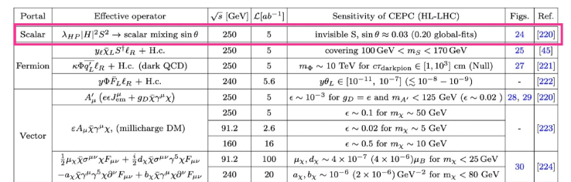
Dark matter observations at CEPC
Simplified Dark matter models:
- Scalar/Fermion/Vector portals
Ref. New Physics Search at the CEPC: a General Perspective, 67-88, arXiv:2505.24810v2
TABLE : Recent results from the CEPC study on dark sector signals. The first column lists the signal signatures, the second column presents the corresponding relevant operators, the third and fourth columns provide the center-of-mass energy and the integrated luminosity. The fifth column presents the sensitivity to the coupling,suppression scale, or branching ratios at the CEPC. Where relevant HL-LHC sensitivities are available, they are shown in parentheses or with Null meaning HL-LHC constraints do not apply.
Notes:
Besides the 2HDM+a model, there are also other ways to connect the visible and dark sectors. The general idea is that new particles — interaction carriers — act as a "portal" between ordinary matter and dark matter. Depending on the spin and nature of such a carrier, several types of portals can be distinguished.
The scalar portal, which is realised in the 2HDM+a and 2HDM+s models, assumes that the carrier is a pseudoscalar particle. The coupling to the Standard Model occurs through mixing with the Higgs boson, and the coupling to dark matter occurs through a direct decay into a DM pair. This is the type of portal studied in this work.
The fermion portal assumes that the carrier is a fermion that mixes with leptons or quarks of the Standard Model. Such a mechanism naturally appears in some supersymmetry models.
The vector portal introduces a new gauge field — the so-called dark photon. It can mix with the ordinary photon or the Z boson through kinetic mixing. Such a carrier can have a mass from MeV to TeV and can decay into both visible and dark particles.
The table shown, taken from the review article "New Physics Search at the CEPC: a General Perspective" (2025), summarises the results of studies of various portals at CEPC. For each type, the effective operator, energy, luminosity, and achieved sensitivity are indicated. For comparison, the expectations from the HL-LHC are shown in parentheses.
It can be seen that CEPC can cover a wide range of parameters: from weak coupling (sinθ ~ 0.03) in the scalar portal to very small constants (ε ~ 1e-3 to 1e-7) in vector models. This highlights the unique role of electron-positron colliders in processes of new physics.

Slide 10
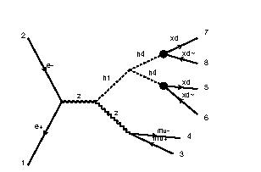
Model Parameters and Signal Simulation
Generator: MadGraph5MC@NLO.2.9.2
▪
▪
▪
▪
▪
Free parameters:
mh1 = [80:160] GeV
ma = [20:80] GeV General settings: Energy 250 GeV Mass of Dark matter particle mχ = 5, 10 GeV
Vacuum expectation values of the two Higgs doublets, tan(β) = 1 Coupling of mediator to DM gPXd = 1
Model: 2HDM+a + NNPDF 3.1 NNLO
Process: e+ e- > z h1, (h1 > h4 h4, h4 > χ χ~), z > mu+ mu-
2HDM+a
sinθ = 0.03.
sinθ = 0.05. sinθ = 0.1.
https://github.com/LHC-DMWG/model-repository/tree/master/models/Pseudoscalar_2HDM
Notes:
Event generation was performed using the MadGraph5 program, version 2.9.2. This is one of the standard tools in modern high-energy physics. It allows automatic calculation of cross sections and event generation for arbitrary models of new physics, including the ones we consider. MadGraph can work at tree level and with loop corrections. It supports interfaces to parton shower and hadronisation programs such as Pythia, and it is widely used in the ATLAS and CMS experiments as well as in theoretical studies. MadGraph5 allows us to study the Standard Model and also freely use models from the FeynRules Model Database. If necessary, one can define a custom model by working with parameter files and model Lagrangians. In this case, the 2HDM+a model is considered, using the NNPDF 3.1 PDF set. The process itself is: e+ e- → Z h1, followed by the decays h1 → h4 h4, then each mediator decays into a pair of dark matter particles, and the Z boson — for detection — decays into two muons.
The free parameters are the masses of the light scalar h1 and the mediator particle. The mass of h1 is scanned from 80 to 160 GeV, and the mass of the mediator is scanned from 20 to 80 GeV, both with a step of 5 GeV. The remaining parameters are fixed. The collision energy is 250 GeV, the dark matter particle mass is 10 GeV, the ratio of the vacuum expectation values is tanβ = 1, and the coupling of the mediator to dark matter is maximal, gPXd = 1.
The key parameter that controls the coupling of the Higgs boson to the mediator is the mixing angle sinθ, which I set to 0.03 — this is a weak coupling.
Thus, for each point in the mass space m_h1 and m_h4, I generate events, calculate the cross section, and build 2D and 3D scans. The results are presented on the next slide.

Slide 11
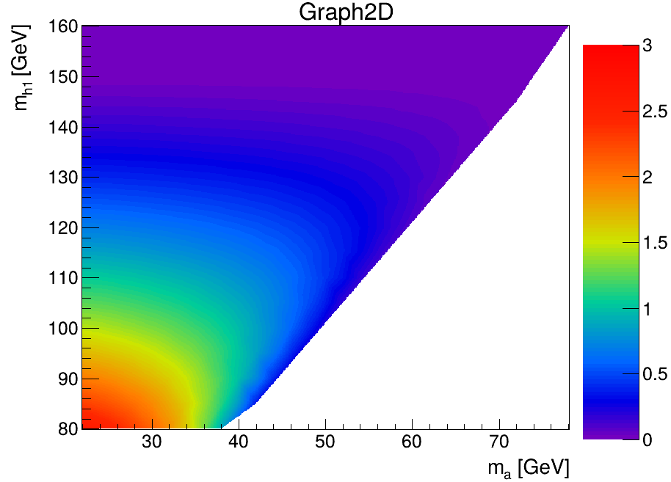
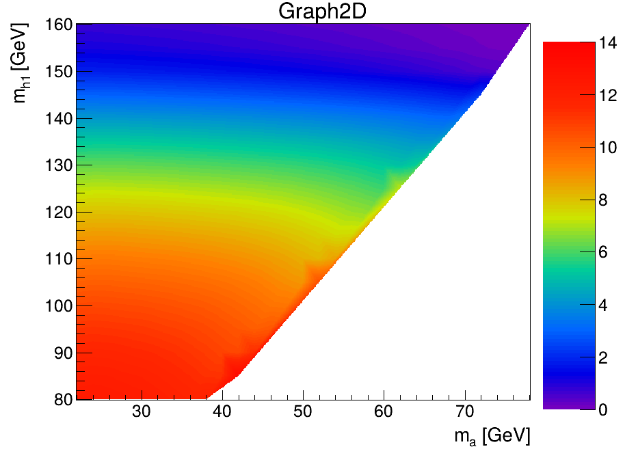
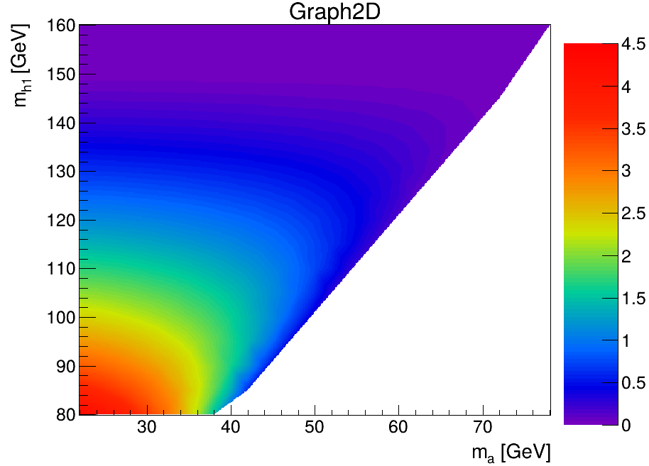
Results of the calculation of the total cross section for the processes
sinθ = 0.03
sinθ = 0.05
sinθ = 0.1
Cross section for m_χ = 10 GeV: sinθ = 0.03 → very small; sinθ = 0.05 → moderate; sinθ = 0.1 → larger.

Slide 12
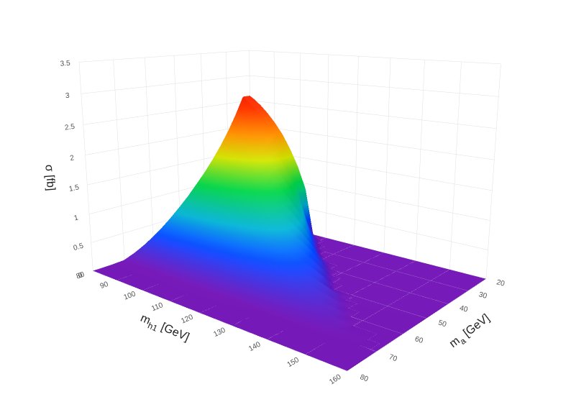
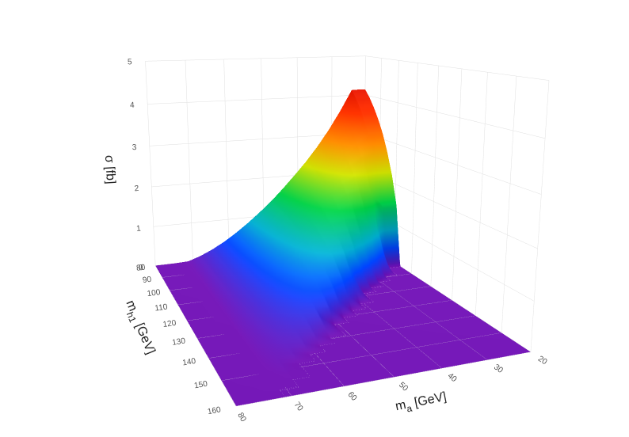
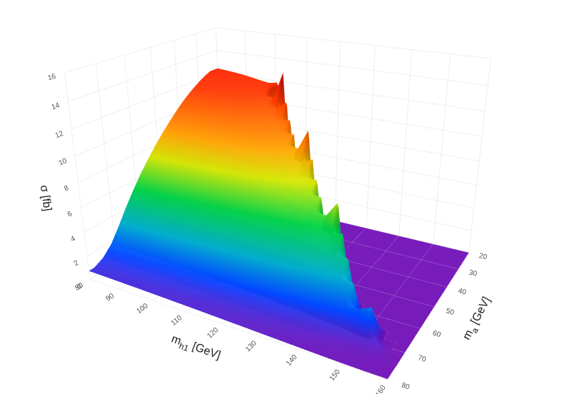
Results of the calculation of the total cross section for the processes
sinθ = 0.03
sinθ = 0.05
sinθ = 0.1
Cross section for m_χ = 10 GeV: sinθ = 0.03 → very small; sinθ = 0.05 → moderate; sinθ = 0.1 → larger.

Slide 13
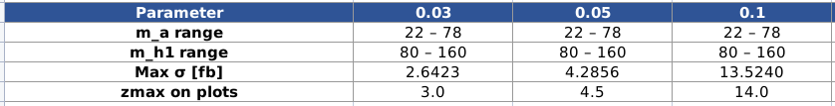
Summary
1. All three datasets share the same (m_h1, m_a) grid (80–160, step 5; 22–78, step 2; 329 points). Only cross-section values differ, reflecting different sinθ in 2HDM+a.
2. sinθ = 0.05 dataset has cross-sections ~50–80% larger than sinθ = 0.03 dataset across the whole space, with a uniform scaling factor.
3. sinθ = 0.1 dataset shows dramatic enhancement — up to higher values at specific resonances (e.g., (85,42): 0.353 → 11.377 fb). These narrow spikes suggest resonant enhancement near a threshold or a second Higgs resonance.
4. Away from resonant peaks, sinθ = 0.1 follows a similar shape but scaled up by ~50–80% relative to sinθ = 0.03, similar to sinθ = 0.05.
Notes:
All three datasets share the identical (m_h1, m_a) grid: m_h1 ∈ [80, 160] step 5, m_a ∈ [22, 78] step 2, 329 points each. The only difference is the cross-section values, reflecting different coupling parameters in the 2HDM+a model.
The dataset for sinθ = 0.05 (weak coupling) has cross-sections ~50–80% larger than the dataset for sinθ = 0.03 across the whole parameter space, with a relatively uniform scaling factor.
The dataset for sinθ = 0.1 (stronger coupling) shows dramatic enhancement — up to 500–600% at specific resonance points (e.g., (m_h1=85, m_a=42): 0.353 → 11.377 fb, a 32× increase). These narrow spikes suggest resonant enhancement, likely near a threshold or a second Higgs resonance.
Away from the resonant peaks, the sinθ = 0.1 dataset follows a similar shape to the other two datasets but scaled up by a roughly constant ~50–80% factor relative to the sinθ = 0.03 dataset, similar to the sinθ = 0.05 dataset.

Slide 14
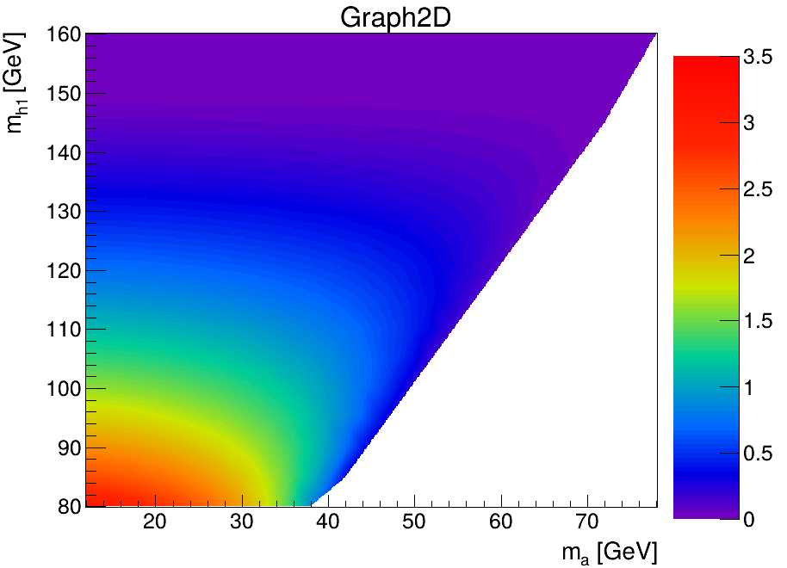
Results of the calculation of the total cross section for the processes
m_xd = 10 Gev
m_xd = 5 GeV
Cross section for m_χ = 10 GeV and m_χ = 5 GeV with sinθ = 0.03

Slide 15
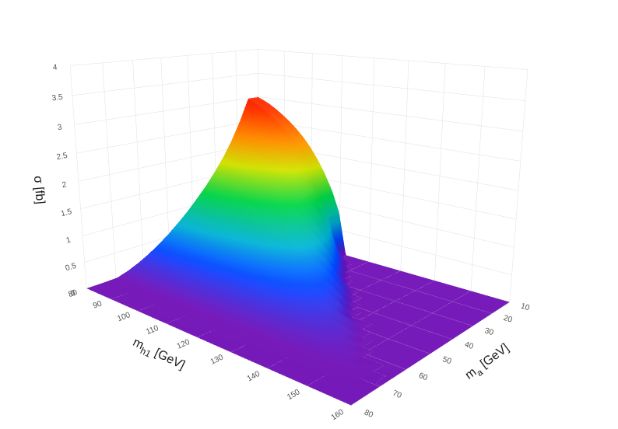
Results of the calculation of the total cross section for the processes
m_xd = 10 Gev
m_xd = 5 GeV
Cross section for m_χ = 10 GeV and m_χ = 5 GeV with sinθ = 0.03

Slide 16
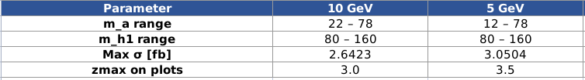
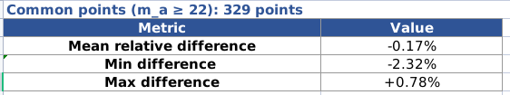
Summary
1. Scans have m_a step 2 GeV and extends down to m_a = 12 GeV (vs 22 GeV).
2. Low m_a points (12–20 GeV) in m_χ = 5 GeV give higher cross-sections, up to 3.05 fb at (80,12), vs 2.64 fb in m_χ = 10 GeV at (80,22).
3. At m_a ≥ 22 GeV, both datasets agree within ~2%. m_χ = 10 GeV is 1–2% lower at low masses and nearly identical at high masses.
Notes:
The m_χ = 5 GeV dataset provides a finer scan: m_a step 2 GeV (vs 4 GeV in the m_χ = 10 GeV dataset) and extends the range down to m_a = 12 GeV (vs 22 GeV).
The additional low m_a points (12–20 GeV) in the m_χ = 5 GeV dataset show significantly higher cross-sections, reaching up to 3.05 fb at (80,12), compared to the 2.64 fb maximum in the m_χ = 10 GeV dataset at (80,22).
At common points (m_a ≥ 22 GeV), the two datasets agree within ~2%. The m_χ = 10 GeV dataset is systematically ~1–2% lower at low (m_h1, m_a), and essentially identical (|diff| < 0.3%) at m_h1 ≥ 130 GeV.
The small discrepancy at low masses may arise from the different m_a grid spacing affecting interpolation accuracy, or from minor differences in the underlying calculation setup.

Slide 17
Sumarry
• Motivation: why we search for Dark Matter at CEPC
The Standard Model does not explain the nature of Dark Matter. CEPC, with its clean e⁺e⁻ environment, provides a unique sensitivity to invisible Higgs decays — BR(H→inv) < 0.26%, an order of magnitude better than LHC. This opens a window for discovering Higgs-portal Dark Matter.
• What has already been done at LHC (CMS Run 2)
CMS data (13 TeV, 137 fb⁻¹) showed no signal in the pp → Z + MET process. The low-mass region is excluded, but the high-mass region remains open. My analysis complements these searches in a clean e⁺e⁻ environment with model-independent measurements.

Slide 18
Sumarry
• This Work: 2D Scan in 2HDM+a
A detailed 2D scan of the e+e- → Z h1 → mu+ mu- + 4χ process was performed (√s = 250 GeV, m_h1 = 80–160 GeV, m_a = 20–80 GeV). The cross-section depends strongly on the coupling sinθ and the DM mass m_χ.
• Dependence on sinθ (for m_χ = 10 GeV)
sinθ = 0.03 (weak coupling) → very small cross-section.
sinθ = 0.05 → cross-section is ~50–80% larger than for sinθ = 0.03.
sinθ = 0.1 → dramatic enhancement (at specific resonances, e.g., at (m_h1=85, m_a=42): from 0.353 fb to 11.377 fb).
• Dependence on m_χ (for sinθ = 0.03)
Lower DM mass (m_χ = 5 GeV) gives a larger kinematic phase space.
Cross-section is higher for m_χ = 5 GeV (e.g., up to 3.05 fb at (80,12)) compared to m_χ = 10 GeV (2.64 fb at (80,22)).

Slide 19
Sumarry
• Conclusion & Novelty
This work provides a direct comparative analysis of the 2HDM+a model at CEPC. For the first time, the cross-section behaviour is mapped as a 2D function of m_h1 and m_a, clearly showing its dependence on sinθ and m_χ. The results help define optimal search strategies for the IDEA detector.
• Future Plans
- Extend the study to a direct comparison with the 2HDM+s (scalar portal) model.
- Perform scans for other benchmark values of sinθ (e.g., 0.3) and higher collider energies (√s = 360 GeV).
- Include Standard Model backgrounds to estimate the realistic signal significance at CEPC with 5.6 ab-1.

Slide 20
Akcnowledgements
I would like to express my sincere gratitude to:
• My colleagues from the Laboratory of Information Technologies at JINR, and especially to Kirill Slizhevskiy, for providing essential information, for discussions, and for invaluable help with the MadGraph event generator setup and simulations.

Slide 21
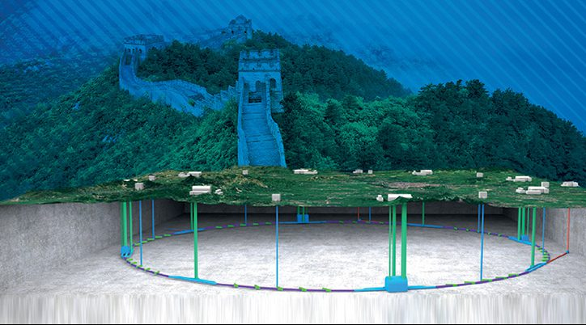
BACKUP SLIDES

Slide 22
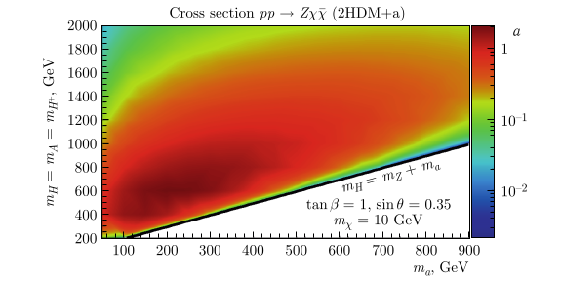
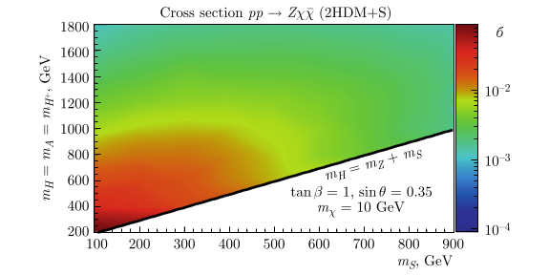
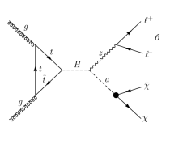
Results of the calculation of the total cross section for the process pp→Zχχˉfor the 2HDM+a (left) and 2HDM+S (right) models depending on the masses of the heavy Higgses (MH) and the mediator particle (ma or ms)
Savina et al. PEPAN 56 ⁿ2 (2025) 547-558.

