Slide 1

Retrofitting CSNS Utility Controls: Transition from Commercial SCADA to EPICS
Shaoxing Liang
China Spallation Neutron Source, Institute of High Energy Physics, CAS
2026/10/28

Slide 2
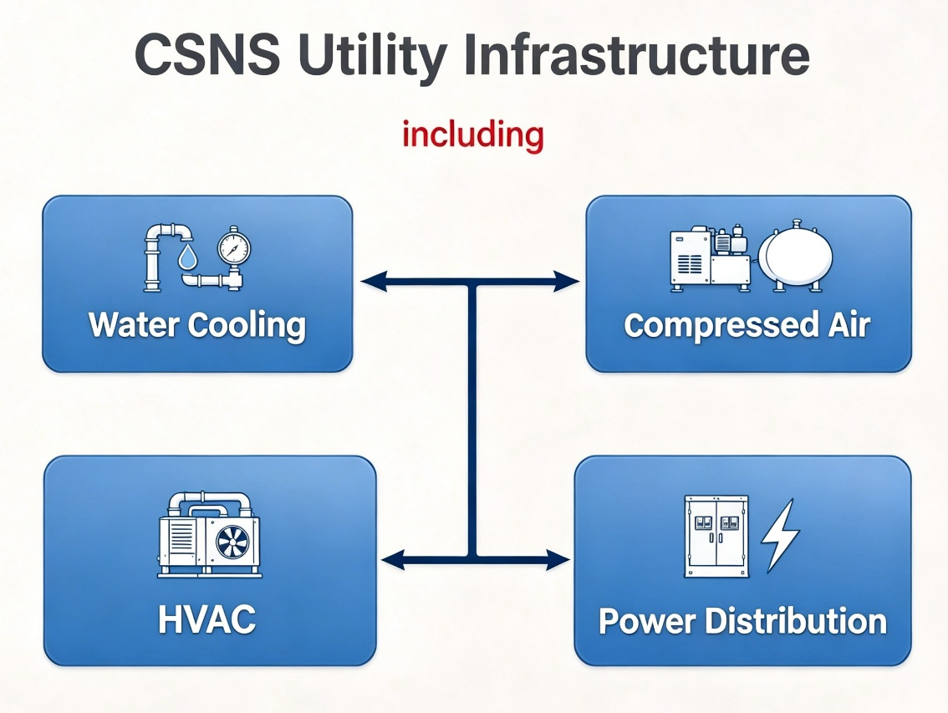


This lightning talk presents the utility control system migration project at the China Spallation Neutron Source (CSNS)
Originally monitored and controlled by commercial SCADA platforms

Slide 3
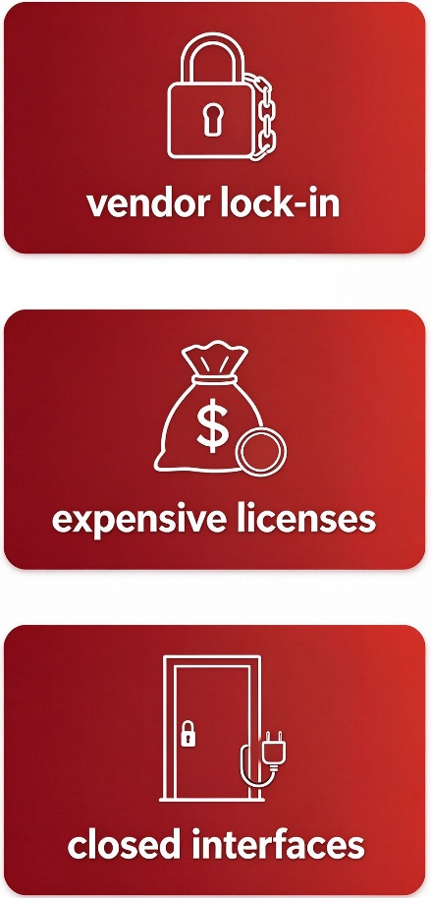

This lightning talk presents the utility control system migration project at the China Spallation Neutron Source (CSNS)
Although commercial SCADA
it brings

Slide 4


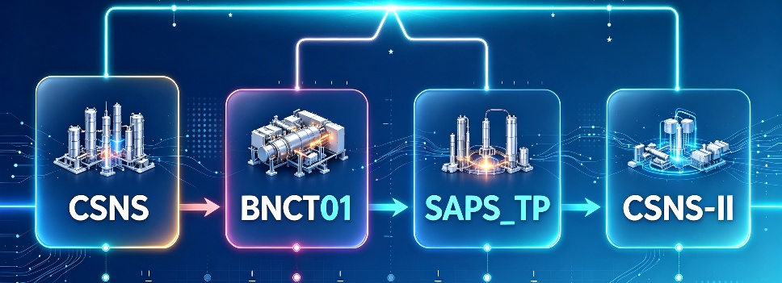
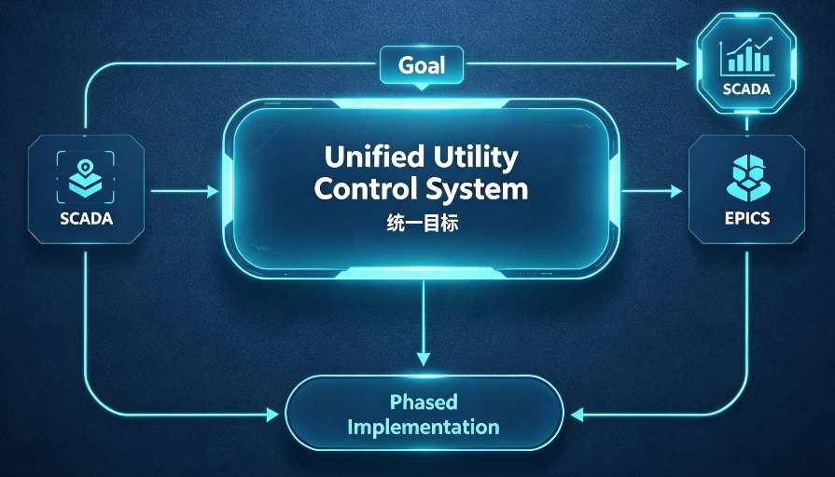
This lightning talk presents the utility control system migration project at the China Spallation Neutron Source (CSNS)
The growing number of subsystems and projects makes unified management challenging
To achieve a unified utility control system, we will implement the EPICS distributed control system in phases
BNCT01：Boron Neutron Capture Therapy Facility 01
SAPS_TP：Southern Advanced Photon Source Test Platform

Slide 5
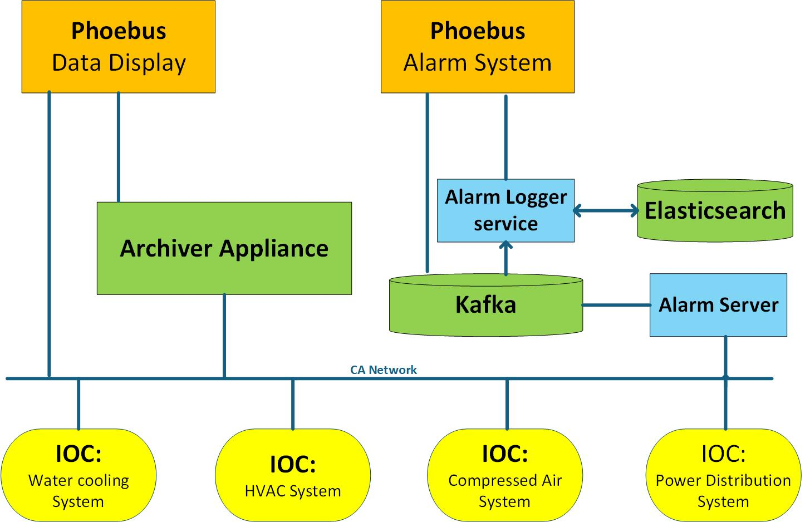
This lightning talk presents the utility control system migration project at the China Spallation Neutron Source (CSNS)
The EPICS system upgrade comprises four modules:
1.PLC-EPICS IOC Integration,
2.Data Archiving,
3.Phoebus-based HMI Reconstruction,
4.and Alarm Management System
EPICS Architecture Diagram

Slide 6
This lightning talk presents the utility control system migration project at the China Spallation Neutron Source (CSNS)
PLC-EPICS IOC Integration
1
Common Device Support Modules :
Name | Version | Purpose | Status
EPICS Base | 7.0.8.1 | EPICS Core | Deployed
ASYN | 4-38 | Asynchronous communication driver support | Deployed
modbus | R2-11 | Modbus protocol, such as Inovance PLC | Deployed
s7nodave | 3.0.2 | Siemens PLC | Deployed
Current Operation Status: Good, no errors
Additional extended functions will be further deployed and refined in the future

Slide 7
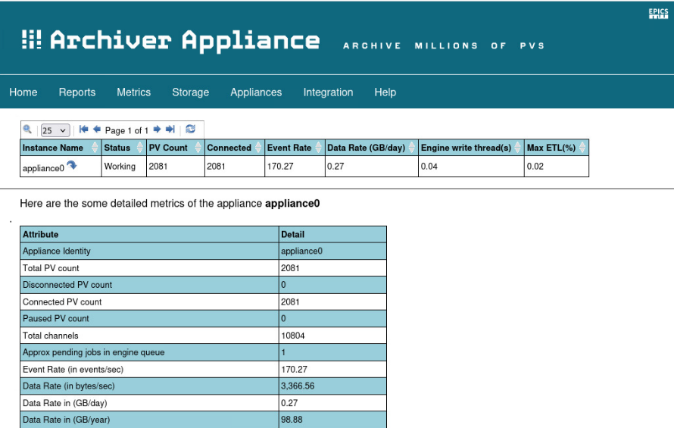
This lightning talk presents the utility control system migration project at the China Spallation Neutron Source (CSNS)
Data Archiving
2
Implemented based on EPICS Archiver Appliance:
Name | Version | Status
Apache-tomcat | 9.0.120 | Deployed
Archappl | V2.0.10 | Deployed
Archiver Appliance Management Interface in Use
Current Operation Status: Good, no errors
Additional extended functions will be further deployed and refined in the future

Slide 8
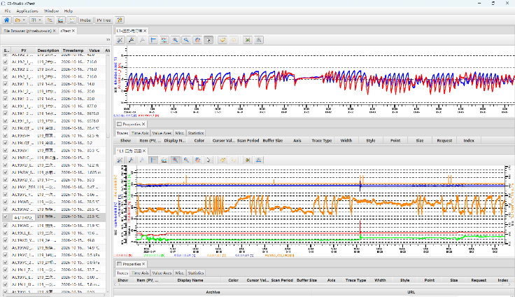
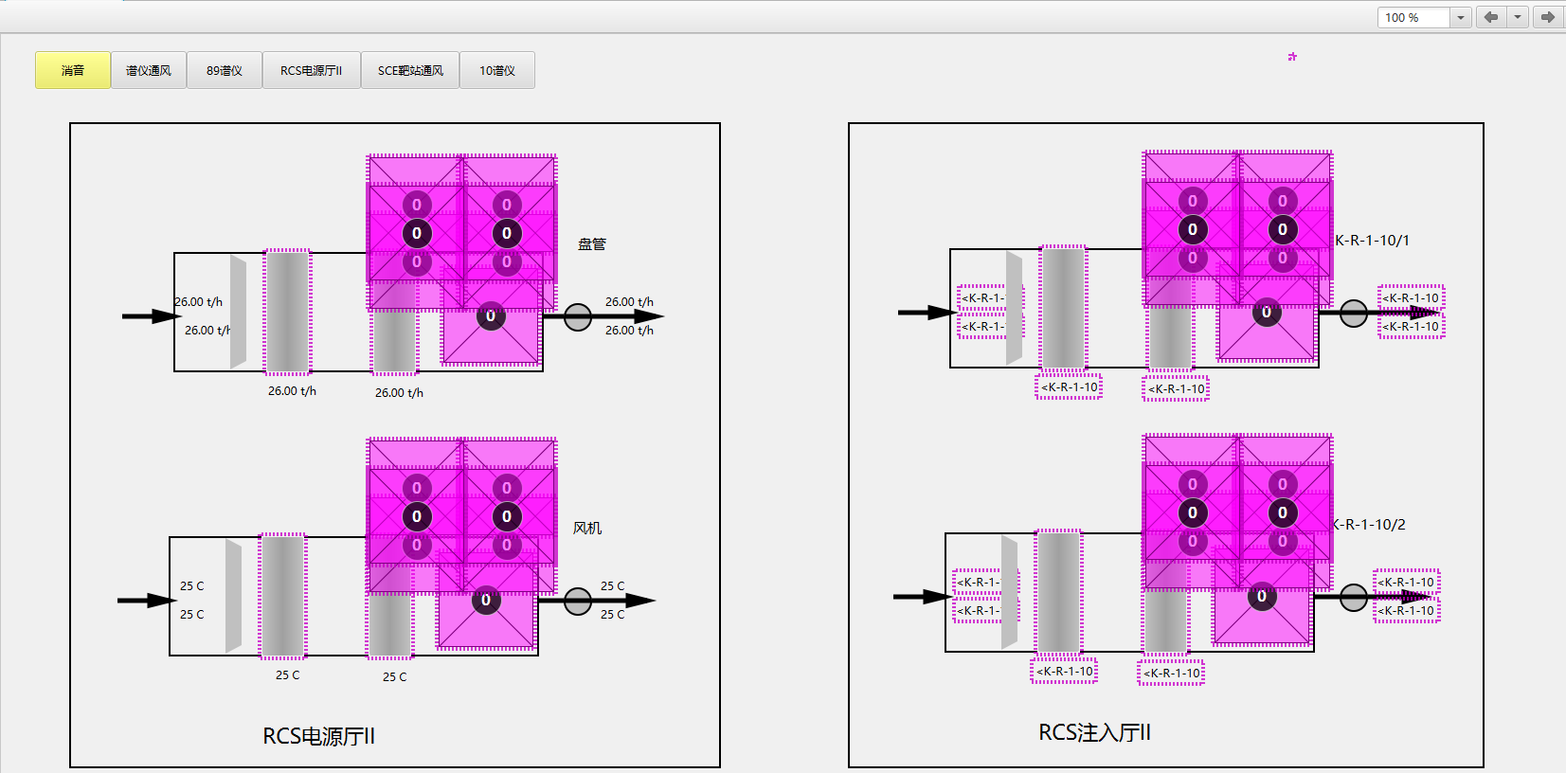
This lightning talk presents the utility control system migration project at the China Spallation Neutron Source (CSNS)
Phoebus-based HMI Reconstruction
3
Proposed Version of CS-Studio Phoebus :
Name | Version | Status
Phoebus | 4.7.4-SNAPSHOT | Deploying
Historical Trend Interface in Use
Progress: Basic features under ongoing development
Process Flow Interface in Use

Slide 9
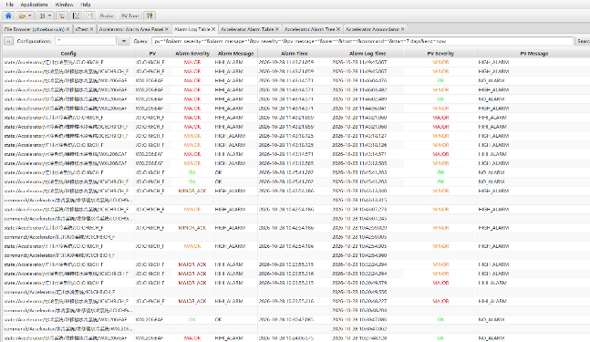
This lightning talk presents the utility control system migration project at the China Spallation Neutron Source (CSNS)
Alarm Management System
4
Name | Version | Purpose | Status
Zookeeper | 3.8.4 | Cluster coordination & service discovery | Deployed
Apache Kafka | 2.13-3.5.1 | Alarm message streaming & buffering | Deployed
Elasticsearch | 8.11.0 | Store & query historical alarm records | Deployed
Alarm Server | 5.0.5 | Monitor EPICS PVs, manage active alarms & ack | Deployed
Alarm Logger | 5.0.5 | Consume alarm stream and persist logs | Deployed
Progress: Basic features under ongoing development
Historical Alarm Test Screen in Use

Slide 10


This lightning talk presents the utility control system migration project at the China Spallation Neutron Source (CSNS)
The basic functions of data acquisition, data archiving, data query and operational alarm have been initially implemented. Extended features and further improvements will be developed on this basis.
The migration is carried out without interruption to equipment operation. Commercial SCADA and EPICS run in parallel, while O&M staff get familiar with the new workflow.

Slide 11
This lightning talk presents the utility control system migration project at the China Spallation Neutron Source (CSNS)
That’s all for my introduction.
Thank you!

