Slide 1


Luminosity Measurement Requirements at BEPCII
Jiaqi Fan & Jiuqing Wang
14/05/2026
Notes:
Good morning, everyone my name is fanjiaqi ,Today, I will give a brief introduction to Luminosity Measurement Requirements at BEPCII

Slide 2
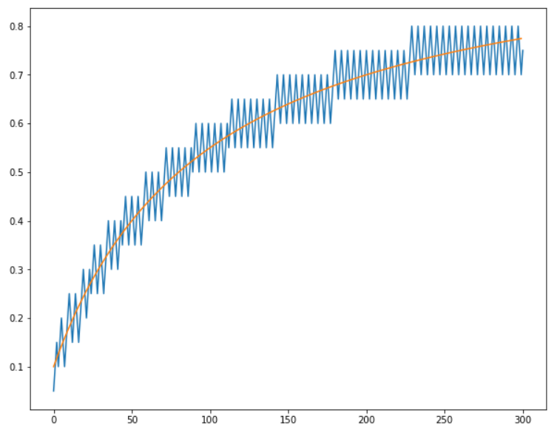
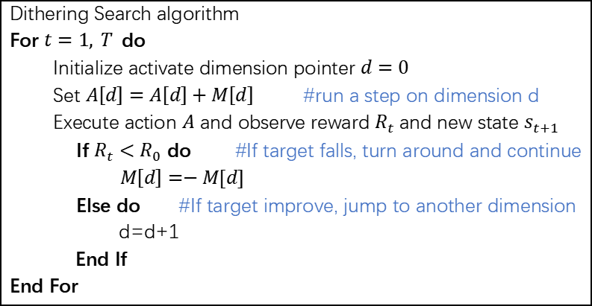
Introduction
BEPCII slow luminosity feedback
slow dither search method (Dither optimization): Adjust control knobs one by one with fixed step sizes).
knobs : offset knobs(control IP orbit）、tune knobs、coulping knobs……
target : small-angle luminosity(SAL)
It is essentially a luminosity-based numerical optimization algorithm. Although its optimization efficiency is relatively low, it causes little luminosity loss during the optimization process, making it well-suited for the continuous optimization requirements of BEPCII (operate in ‘decay’ model).
Dithering Search algorithm
For $t=1, T$do
Initialize activate dimension pointer $d=0$
Set $A\left[d\right]=A\left[d\right]+M\left[d\right]$ #run a step on dimension d
Execute action $A$ and observe reward $R_{t}$and new state $s_{t+1}$
If $R_{t}<R_{0}$ do #If target falls, turn around and continue
$M\left[d\right]=−M[d]$
Else do #If target improve, jump to another dimension
d=d+1
End If
End For
Schematic of dither method in the one-dimensional case. The orange line denotes the optimal knob setting, which varies over time; the blue line represents the optimal setting found by dither algorithm.
Notes:
First, let’s start with the BEPCII slow luminosity feedback system.The core method we use is slow dither search method,.It works by adjusting multiple control knobs one by one with fixed step sizes.
The figure shows how the dither method works in the one-dimensional case.The orange line is the optimal knob setting, which varies over time.The blue line is the optimal value found by the dither algorithm.
The control knobs could be:Offset knobs, which control the IP orbit;Tune knobs;Coupling knobs;and any other adjustable parameters that affect luminosity.
And our target is to optimize luminosity, which is measured by small-angle detectors, called small-angle luminosity.
Dither search is essentially a luminosity-based numerical optimization algorithm.Although its optimization efficiency is relatively low, it causes very little luminosity loss during the optimization process.
Therefore, it is well-suited for the continuous optimization requirements of BEPCII, which operates in decay mode.
And in this mode many parameters will gradually drift from their optimal positions as the beam current decays.

Slide 3
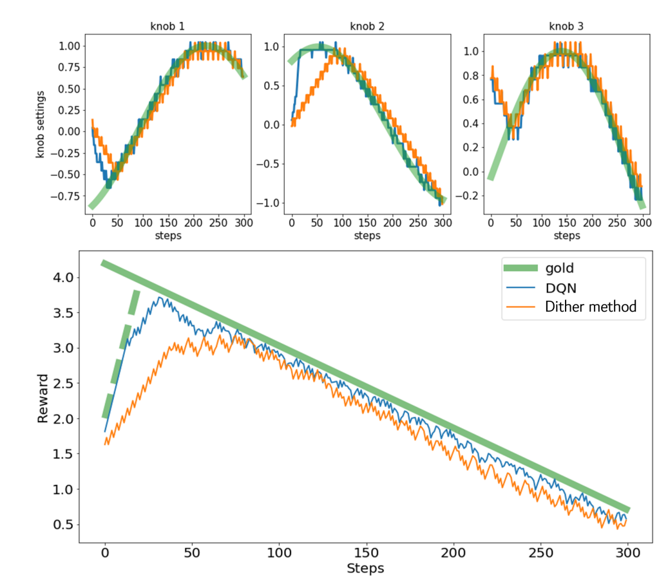
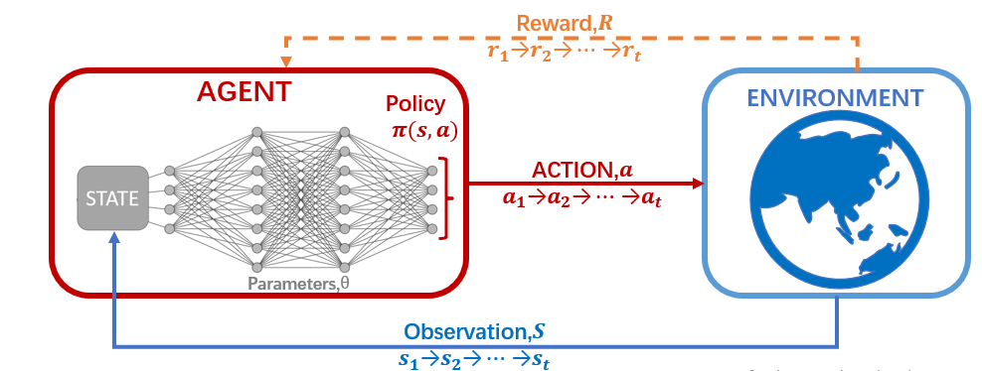
Introduction
BEPCII slow luminosity feedback
slow dither search method (Adjust multiple control knobs one by one with fixed step sizes).
Reinforcement Learning method: Train a RL agent based on dither search to achieve intelligent adjustment. (aim to improve optimization efficiency)
The training of reinforcement learning also relies on history
data from dither search method.
How to improving the performance of dither optimization.
Reinforcement learning scheme
Notes:
To further improve optimization performance, we propose a reinforcement learning method.We train a reinforcement learning agent based on the dither search method to achieve intelligent adjustment, aiming to improve optimization efficiency.
This picture shows the reinforcement learning scheme.The agent interacts with the environment, takes actions based on the observed state, and learns the optimal policy through rewards.
After training, the RL agent can achieve more efficient optimization than the dither search method.
Notably, the training of reinforcement learning also relies on historical data from the dither search method.So, how to improve the performance of dither optimization is the key question we focus on today.

Slide 4
Limitations
Main limitations of the slow luminosity feedback for BEPCII
responce speed (operation frequency)
luminosity precision
Notes:
Now let’s discuss the main limitations of the current slow luminosity feedback for BEPCII.
There are two key issues:
**Response speed**, or knob adjustment frequency;
and **luminosity measurement precision**.

Slide 5
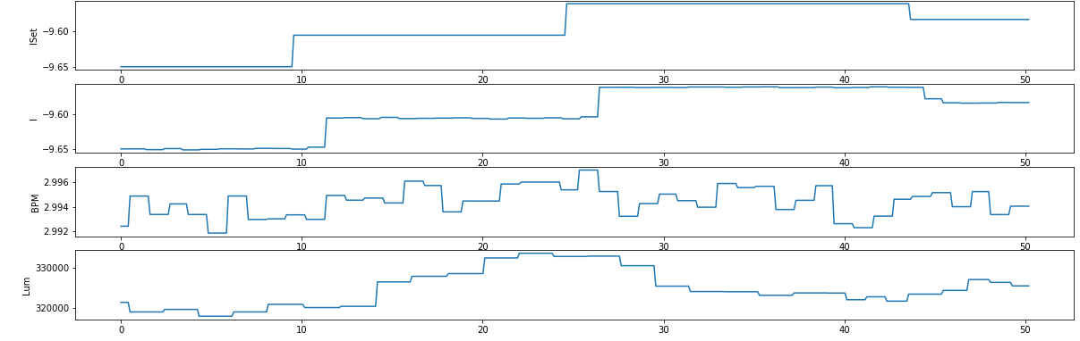
Limitations
Main limitations of the slow luminosity feedback for BEPCII
responce speed (Knob adjustment frequency)
luminosity precision
responce speed:
The time required from knob adjustment to obtaining the luminosity signal feedback.
Two parts: the magnet power supply settling time and the luminosity signal update time.
The fastest achievable rate under current settings is 4 seconds per step.
2.5S
1.5S
lum signal updated
SAL updata frequency: 1.5S
set knob
set knob
lum signal updated
magnet settled
magnet settled
Notes:
First, response speed.Response speed refers to the time from knob adjustment to receiving luminosity signal feedback.It includes two main time-consuming parts:the magnet power supply settling time and the luminosity signal update time.
Under current settings, the magnet power supply settling time costs about 1.5 seconds.This setting is mainly adopted for safety considerations and can be further reduced.
The SAL updates approximately every 1.5 seconds.Under this condition, the measured luminosity response time costs about 2.5 seconds.The fastest achievable rate now is 4 seconds per step.

Slide 6
Limitations
Main limitations of the slow luminosity feedback for BEPCII
responce speed (Knob adjustment frequency)
luminosity precision
Notes:
The Second is luminosity precision.

Slide 7
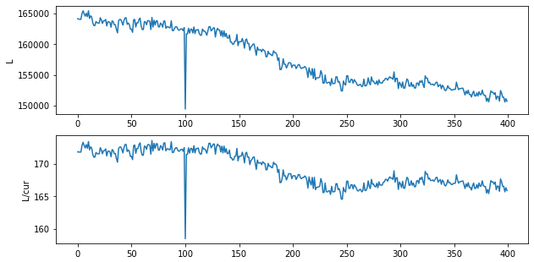
Limitations
Main limitations of the slow luminosity feedback(SLF) for BEPCII
responce speed (operation frequency)
luminosity precision
luminosity precision
Accuracy and stability of the luminosity measurement signal (SAL)
Noise level ~ >3%
Measured values of small-angle luminosity and those normalized by beam current
Notes:
The second is luminosity precision.
It depends on the accuracy and stability of the SAL measurement signal.
This plot shows the measured SAL values.
The current meaurement noise level of SAL is greater than 3%.

Slide 8
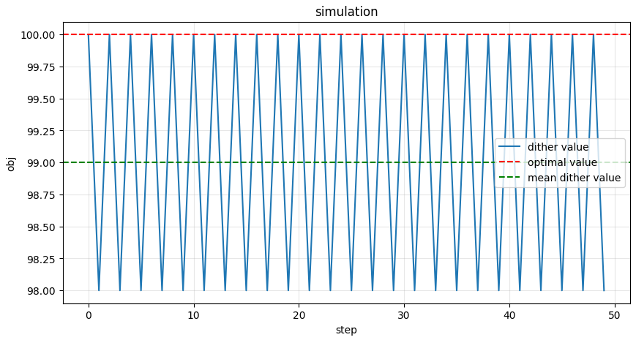
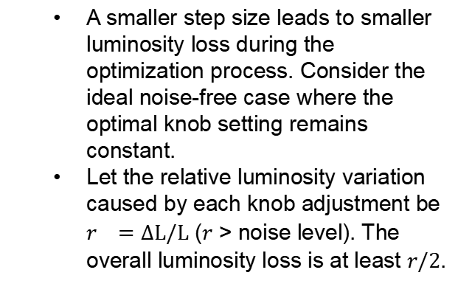
Limitations
How it affects the efficiency of dither optimization
The efficiency of luminosity feedback is mainly determined by two parameters: the adjustment step size and the adjustment frequency of the knobs.
luminosity noise determine the minimum step size for knob adjustment: the adjustment must produce a sufficiently large impact on luminosity to avoid being overwhelmed by measurement noise.
A smaller step size leads to smaller luminosity loss during the optimization process. Consider the ideal noise-free case where the optimal knob setting remains constant.
Let the relative luminosity variation caused by each knob adjustment be $r^{}=∆L/L$ ($r$ > noise level). The overall luminosity loss is at least $r/2$.
Notes:
These limitations directly affect the efficiency of dither optimization.
The optimization efficiency also depends on two parameters:*knob adjustment step size**and**knob adjustment frequency**
Luminosity maurement noise determines the minimum usable step size.
Because the luminosity change caused by adjustment must be large enough to avoid being overwhelmed by measurement noise.
A smaller step size leads to smaller luminosity loss during optimization.
In an ideal noise‑free case, when the relative luminosity change ratio is denoted as **r=ΔL/L**, which must be higher than the noise level.
The total luminosity loss is at least half of this ratio

Slide 9
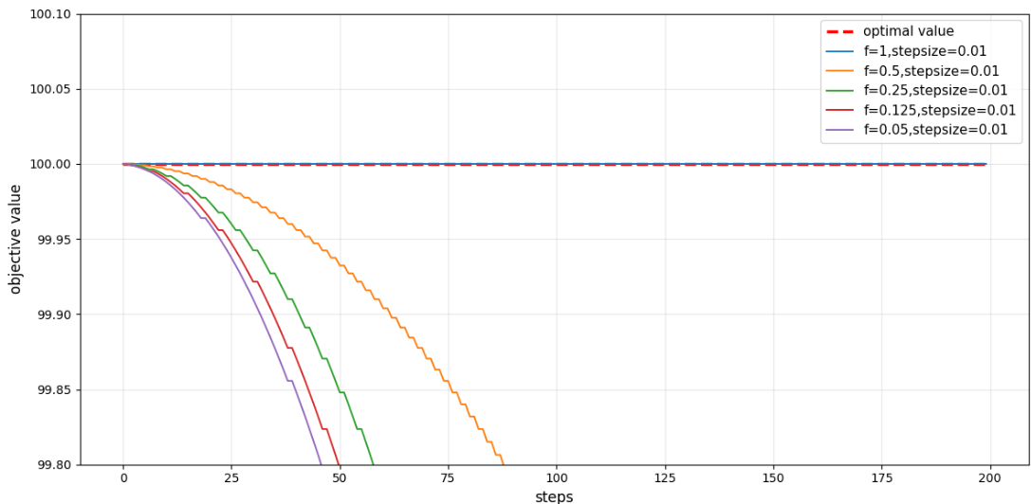
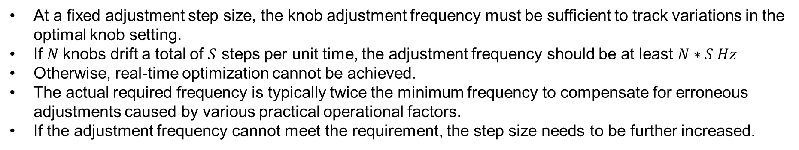
Limitations
At a fixed adjustment step size, the knob adjustment frequency must be sufficient to track variations in the optimal knob setting.
If $N$knobs drift a total of $S$ steps per unit time, the adjustment frequency should be at least $N∗S Hz$
Otherwise, real-time optimization cannot be achieved.
The actual required frequency is typically twice the minimum frequency to compensate for erroneous adjustments caused by various practical operational factors.
If the adjustment frequency cannot meet the requirement, the step size needs to be further increased.
Optimization performance at different frequencies under the same step size =0.01
Notes:
When the adjustment step size is fixed, the knob adjustment frequency must be high enough to track changes in the optimal knob settings.
We can understand this with a clear rule:If N knobs drift a total of S steps per unit time, the adjustment frequency must be at least N times S hertz to follow the drift in real time.If the frequency is lower than this threshold, real-time optimization is simply not possible.
In practice, we also face wrong adjustments caused by various real-world factors.So the actually required frequency is usually at least twice the theoretical minimum frequency.
If this required frequency cannot be achieved, we have no choice but to further increase the step size to compensate.
This picture shows the optimization performance at different frequencies with a fixed step size of 0.01. we can see:
Only when the frequency equals 1 Hz can we fully achieve stable and ideal optimization.Lower frequencies clearly lag behind and cannot keep up.

Slide 10
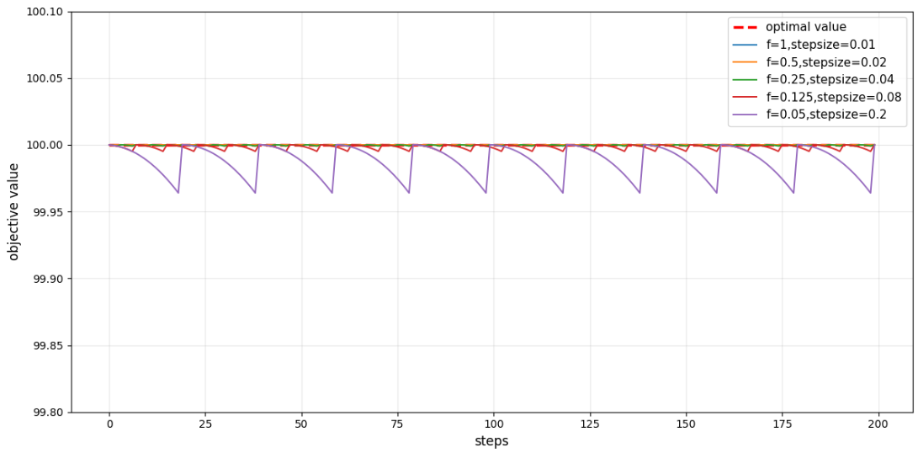
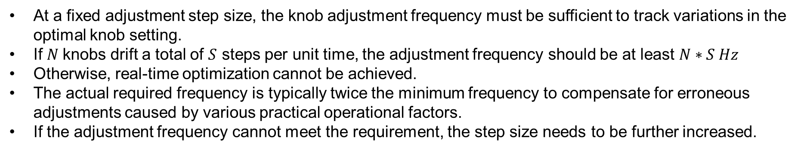
Limitations
At a fixed adjustment step size, the knob adjustment frequency must be sufficient to track variations in the optimal knob setting.
If $N$knobs drift a total of $S$ steps per unit time, the adjustment frequency should be at least $N∗S Hz$
Otherwise, real-time optimization cannot be achieved.
The actual required frequency is typically twice the minimum frequency to compensate for erroneous adjustments caused by various practical operational factors.
If the adjustment frequency cannot meet the requirement, the step size needs to be further increased.
Optimization performance at different frequencies with matched step size
Notes:
To enable optimization at lower frequencies, we can increase the step size, just as shown in this plot.
However, a larger step size obviously leads to **more luminosity loss**.

Slide 11
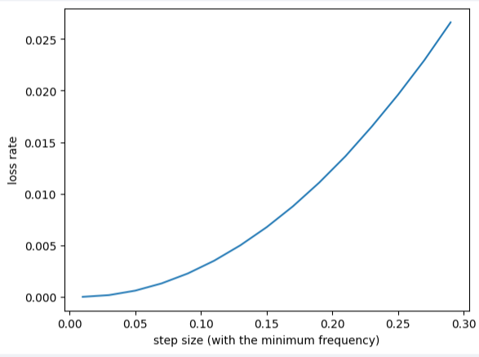
Limitations
Overall workflow:
Determine the minimum step size according to the luminosity noise
Determine the minimum adjustment frequency based on the number of knobs and their drift amplitude.
If the minimum frequency is achievable, will be OK to perform luminosity feedback
If not, then increase the step size to reduce the required frequency. (A larger step size leads to greater luminosity loss, proportional to the square of the step size.)
Notes:
The overall workflow of luminosity feedback is as follows:
First, we determine the minimum step size according to the luminosity measurement noise.
Next, we calculate the required adjustment frequency based on the number of knobs and their typical drift amplitude.
If the minimum frequency is achievable under the current system, the luminosity feedback can run properly.
But if the required frequency cannot be reached, we have to increase the step size to reduce the demand on adjustment frequency.
However, a larger step size leads to greater luminosity loss, and this loss is **proportional to the square of the step size**.

Slide 12
Summary
BEPCII slow luminosity feedback current state:
The SAL suffers from relatively high noise, resulting in a large step size
The adjustment frequency still has sufficient margin. This allows more knobs to be adjusted simultaneously. (Currently, it is estimated that a maximum of seven knobs can be adjusted simultaneously.)
In actual operation, luminosity is sampled multiple times and averaged to suppress noise. (while reducing the adjustment frequency)
Requiremnets:
3%--->1%
1/3 step size ---> 1/9 loss rate ---> 1.5% luminosity imporvement
Stable Luminosity
Smaller action step
Higher luminosity
Faster response
More control knobs
Lum : 5~10Hz <------- 1 Hz <--------
9 dims (offset、tune、coupling）
Notes:
Here is a summary of the current state of BEPCII slow luminosity feedback.
The SAL suffers from relatively high noise, resulting in a large adjustment step size.
With large step sizes, The adjustment frequency still has sufficient margin, allowing more knobs to be adjusted simultaneously. Currently, we estimate that up to seven knobs can be adjusted at the same time.
And In actual operation, luminosity is sampled multiple times and averaged to suppress measurement noise, although this will reduces the adjustment frequency.
To achieve better performance, we need:Faster response and More stable luminosity measurement.
to enable smaller action steps and more control knobs.All these will lead to higher luminosity.
If we reduce lunimosity noise to 1%, the step size can be reduce to 1/3 of the current value, the loss rate becomes 1/9, finally leading to at least 1.5% luminosity improvement.
Adjusting more knobs can also bring considerable luminosity gain.
To simultaneously tune the offset, tune, and coupling knobs, we need a total of 9 knobs.
With the precision of 1%, the required adjustment frequency is expected to be below 1 Hz. Considering the magnet power supply settling time, the luminosity signal update frequency may need to reach 5–10 Hz to meet the luminosity measurement needs.

Slide 13
Thank you!
Notes:
That’s all for my presentation.Thanks for your attention!

Slide 14
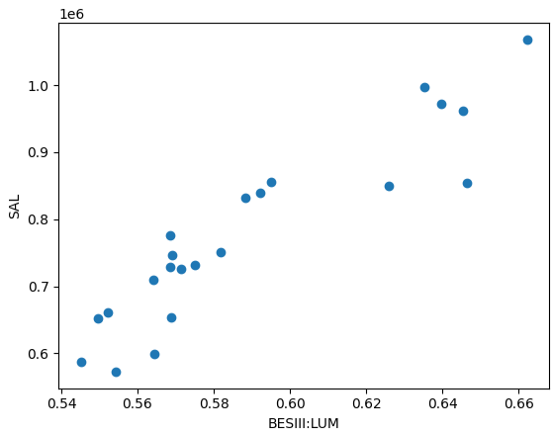
Limitations
Main limitations of the slow luminosity feedback for BEPCII
responce speed (operation frequency)
luminosity precision
luminosity precision
Another point worthy of attention: the consistency between SAL and end-cap luminosity.
The horizontal axis represents integrated luminosity of BESIII, and the vertical axis denotes integrated small-angle luminosity.
These points should lie on a straight line.
Whether the fast luminosity detector can be consistent with the slow luminosity detector may be a noteworthy issue, yet it is not critical for luminosity optimization within a single run.
Scatter plot of integrated luminosity and small-angle integrated luminosity for multiple runs.

