Slide 1
Luminosity Monitor for BEPC2 beam tunning
Xiao CAI
2026.5.14

Slide 2
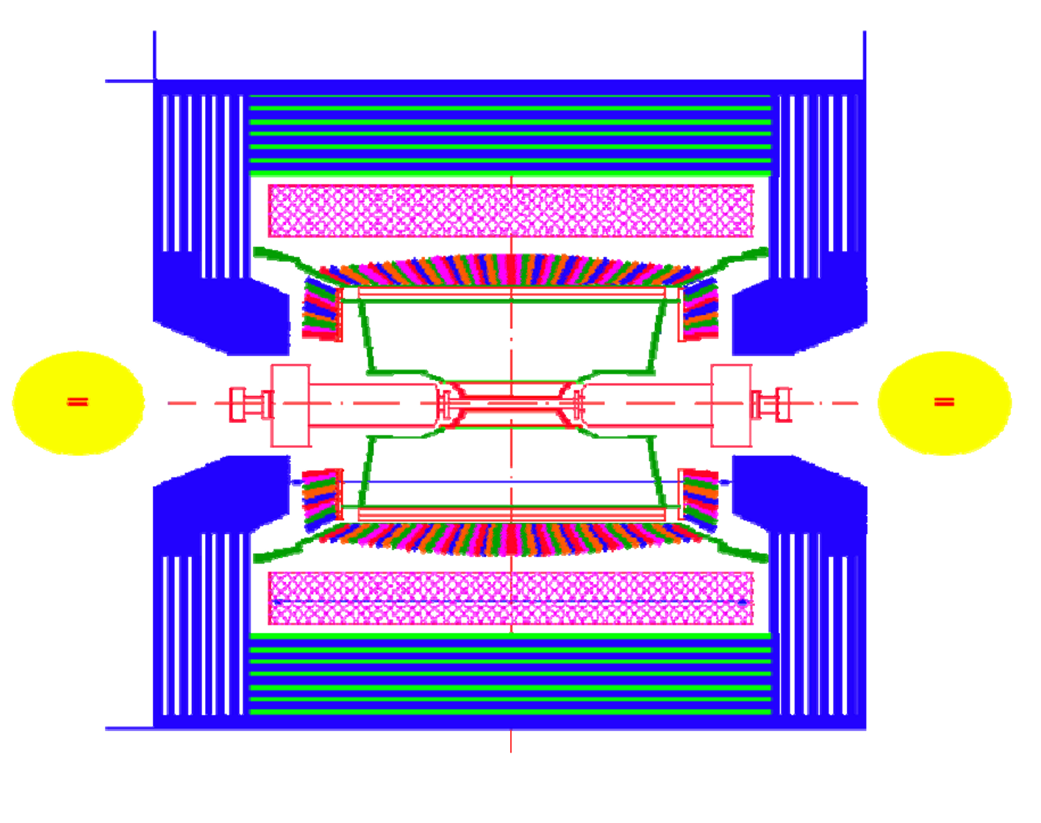
BES3
West side
East side
2009
BLM
BLM
2009
2026?
fBLM
ZDD
2011
2027?
cZDD
cZDD
2025
fBLM
2026?
BLM: BEPC2 Luminosity Monitor, USTC
(also called small angel luminosity detector)
ZDD: Zero Degree Detector, INFN
cZDD: crystal ZDD, Mainz University
fBLM: fast BLM, IHEP & Nanjing University
(also called ZDC, zero degree calorimeter)

Slide 3
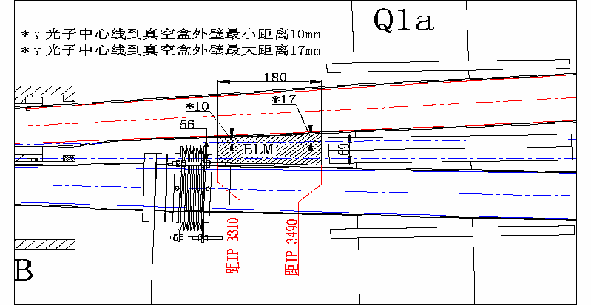
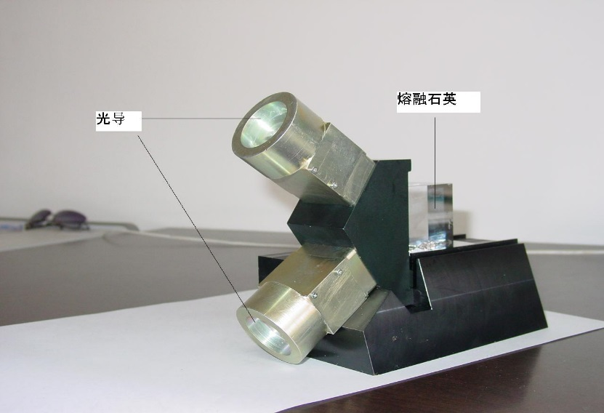
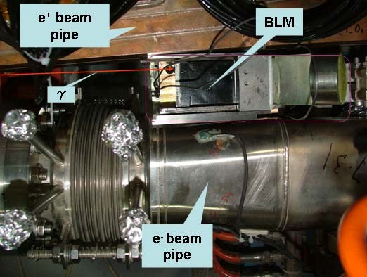


BLM (Provided by USTC, 2009)
$$e^{+}e^{−}→e^{+}e^{−}γ$$
PMT
Tungsten
converter
Light Guide
$$γ$$
Fused Silica
Fused Silica
Light Guide

Slide 4
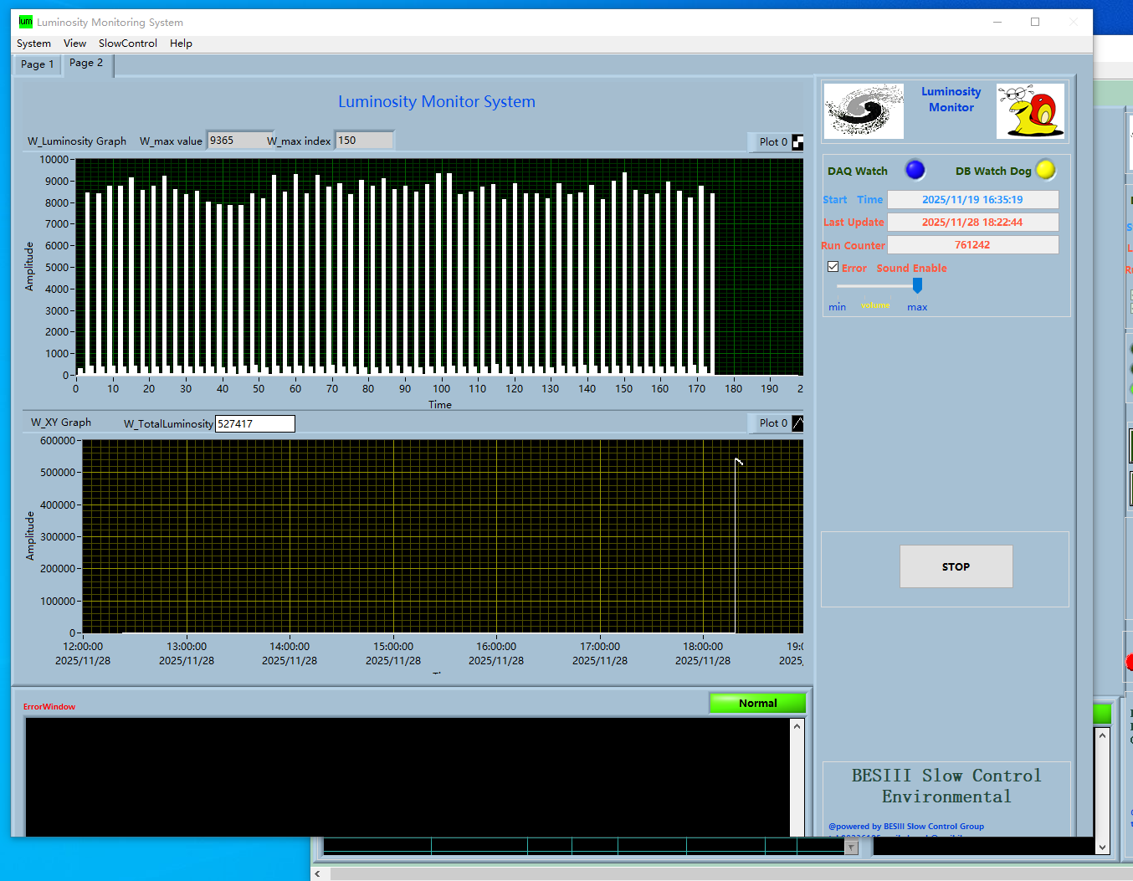
Slow control Online relative luminosity (BLM)

Slide 5
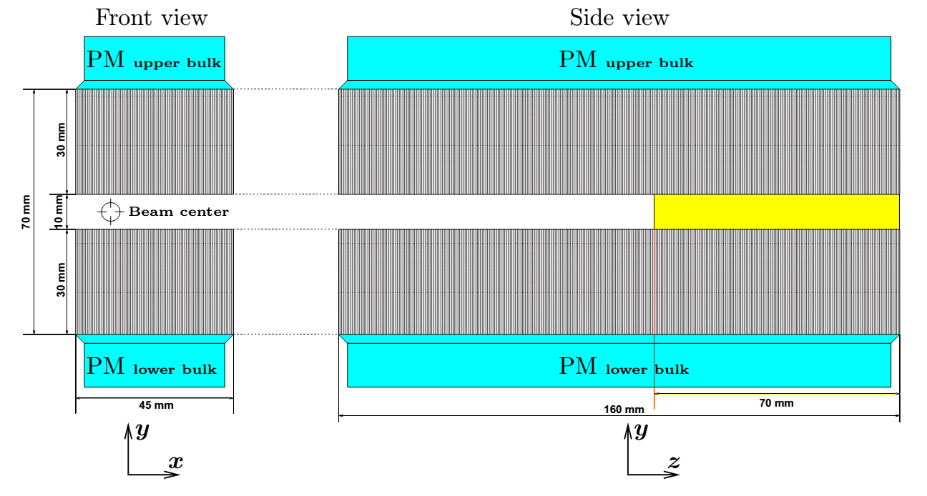
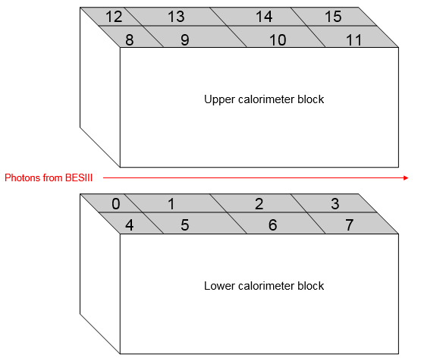
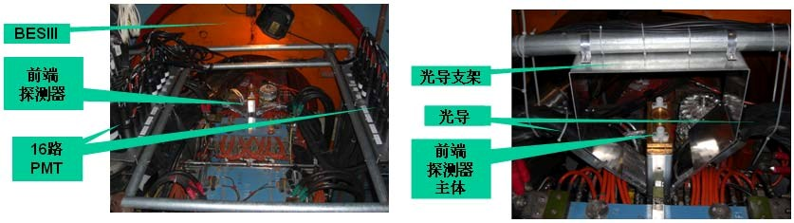


ZDD (provided by INFN-LNF, 2011)
$$e^{+}e^{−}→Hγ$$
$$γ$$
lead-scintillating fibers
lead-scintillating fibers
Fiber bundle

Slide 6
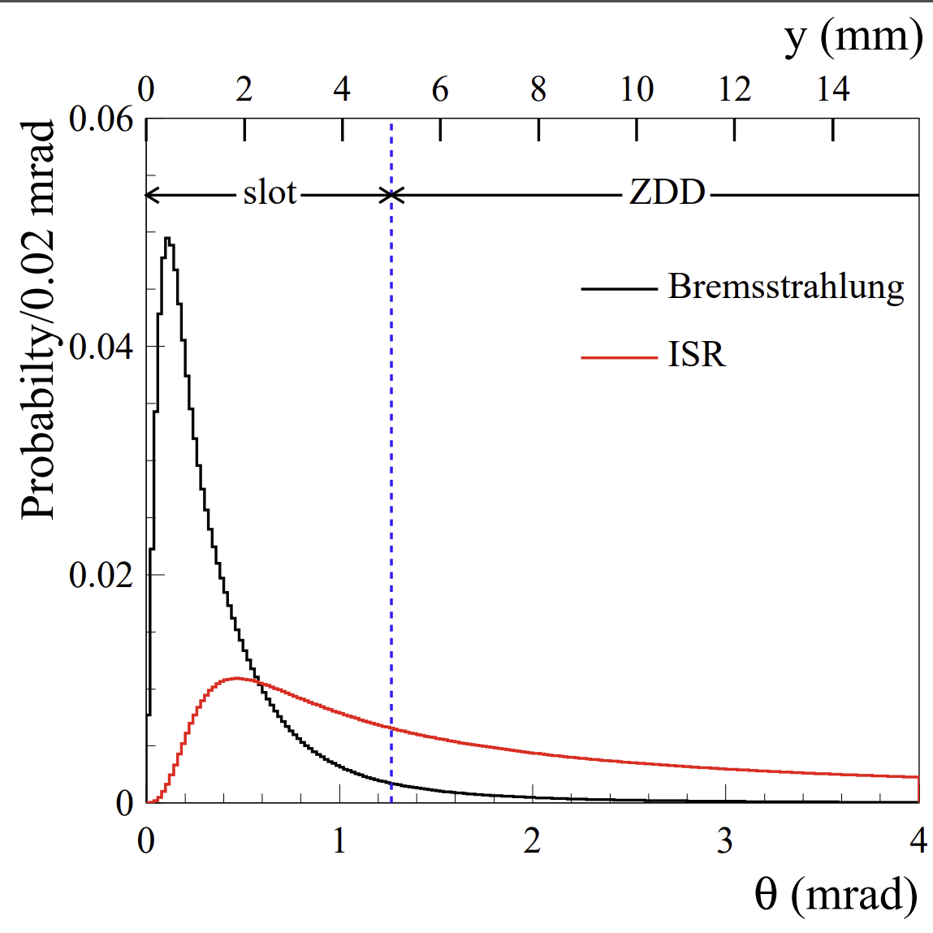
Angular distributions for emitted photons in Bremsstrahlung (black histogram) and ISR (red histogram) processes

Slide 7
BLM/ZDD electronics
BLM (west side)
Write threshold
PMT signal
×10 Fast amplifier
Discriminator
DAQ
~30m cable
DAQ input signal:
TTL, height >2.5V
Fast signal, width 2~3ns
Preamplifier box
Slow control PC
ZDD (east side)
Write threshold
ZDD signal
×10 Fast amplifier
Discriminator
DAQ
~30m cable
Preamplifier box
Flash ADC
BES3 DAQ
ZDD VME crate
BES experimental hall
BES electronics room (next to BES control room)
PMT signal & ZDD signal: front edge ~2ns, FWHM ~3.2ns, Pulse height ~100mV
ZDD 16 PMT signals send to ZDD VME system (flash ADC), as a part of BES3 physics data acquirement.
A sum signal for 4 PMTs (block 1/5/9/13) of ZDD send to preamplifier box for BEPC2 beam tunning.
Preamplifier box located at BES Electronics Platform first floor.

Slide 8
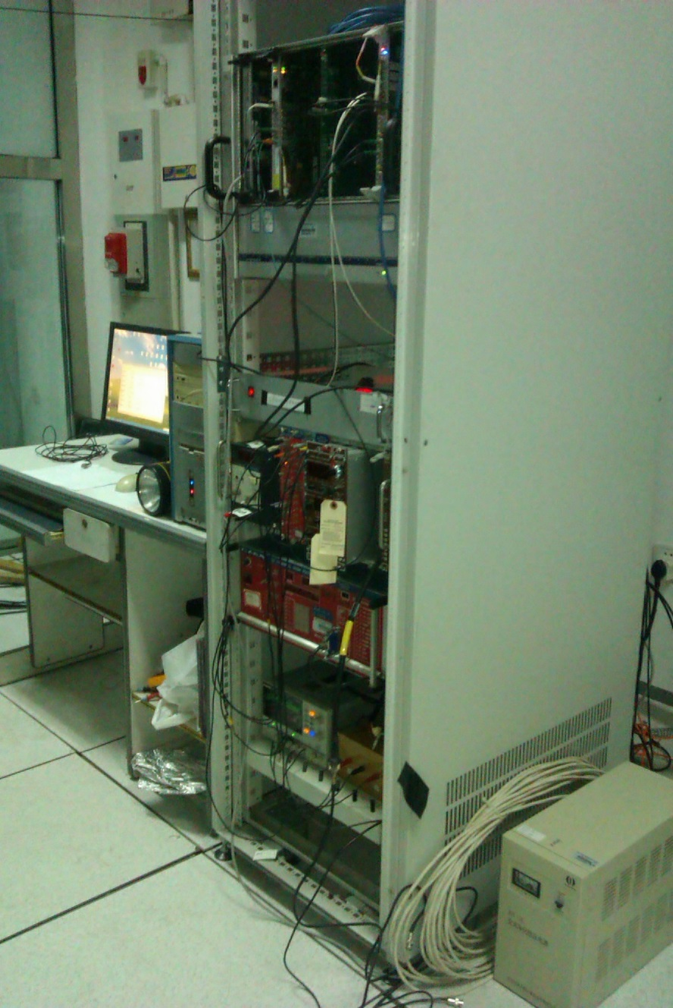
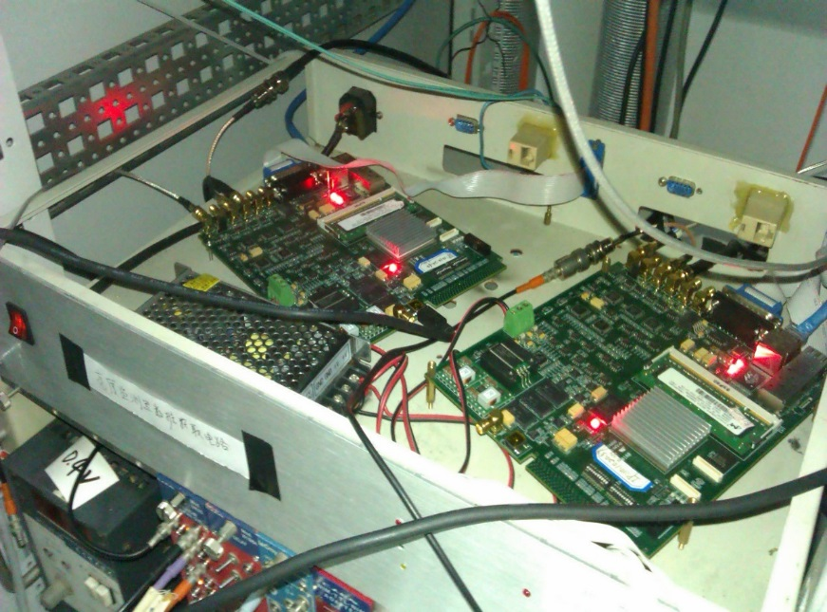
Electronics in BES electronics room
VME Crate
(Provide Time Signal)
Lum Crate
(Lum DAQ board)
DC Power Supply
(for Pre-Amplifier)

Slide 9
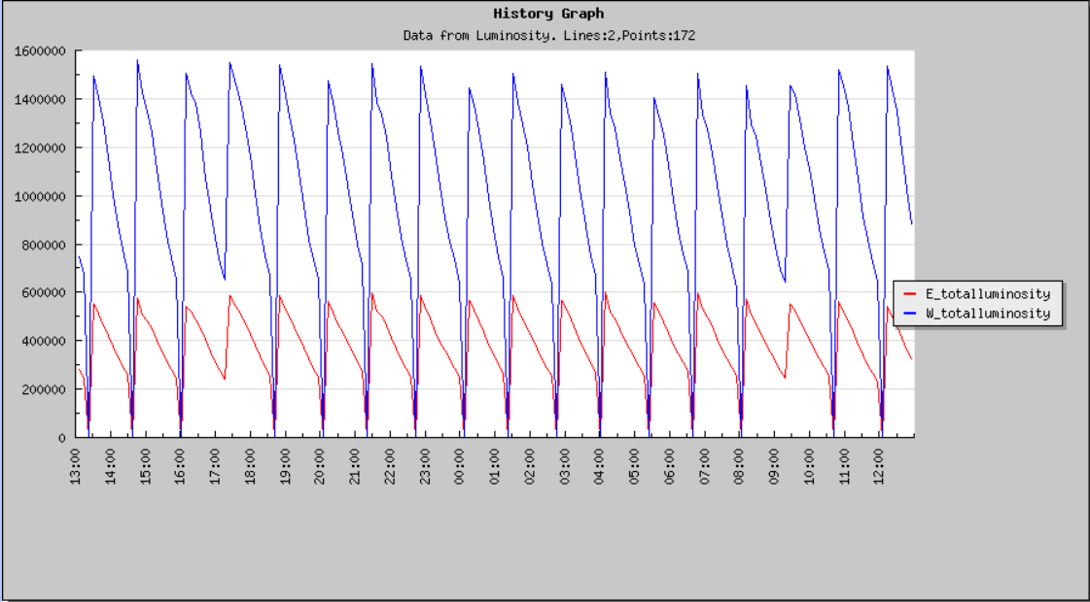
Slow control Online relative integrate luminosity (BLM&ZDD)
E: ZDD
W: BLM

Slide 10
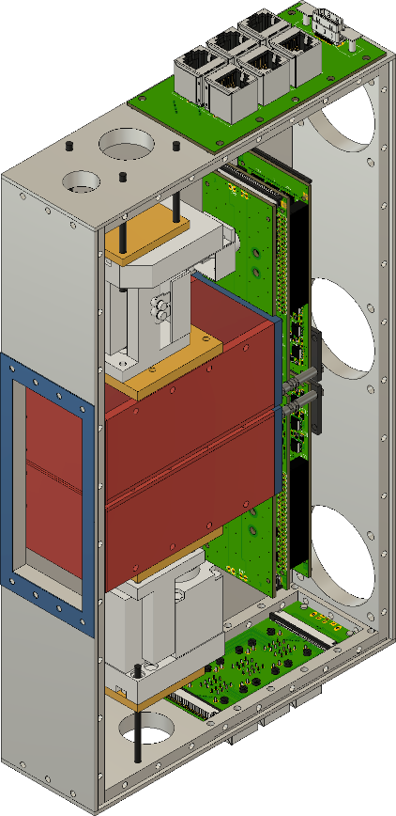
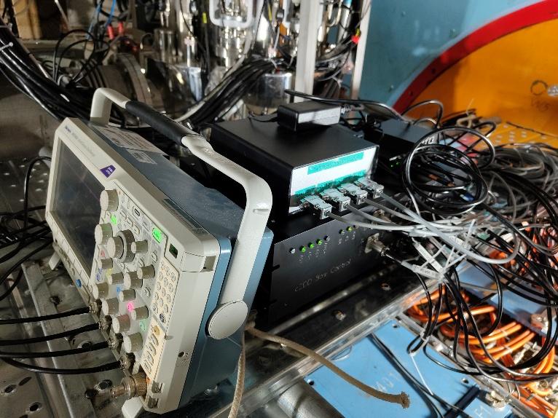
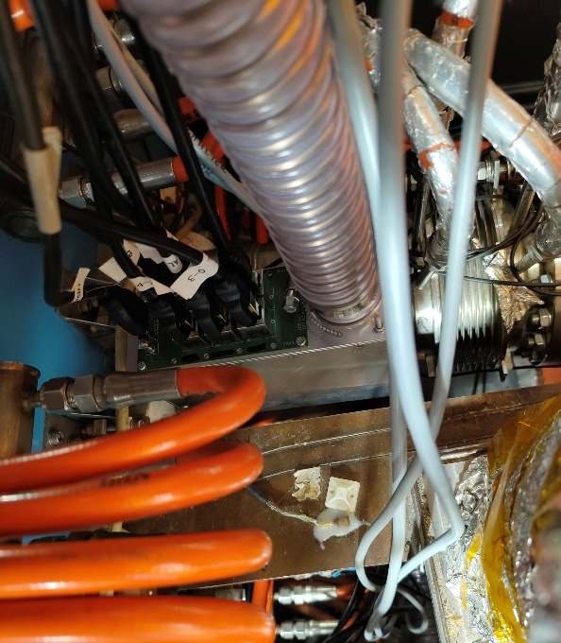
cZDD (provided by Mainz, 2025)
Motor Control of vertical stages
Oscilloscope
Router
Slow Control
Pipe for cooling air flow
Analog and Digital SiPM Signals
cZDD

Slide 11
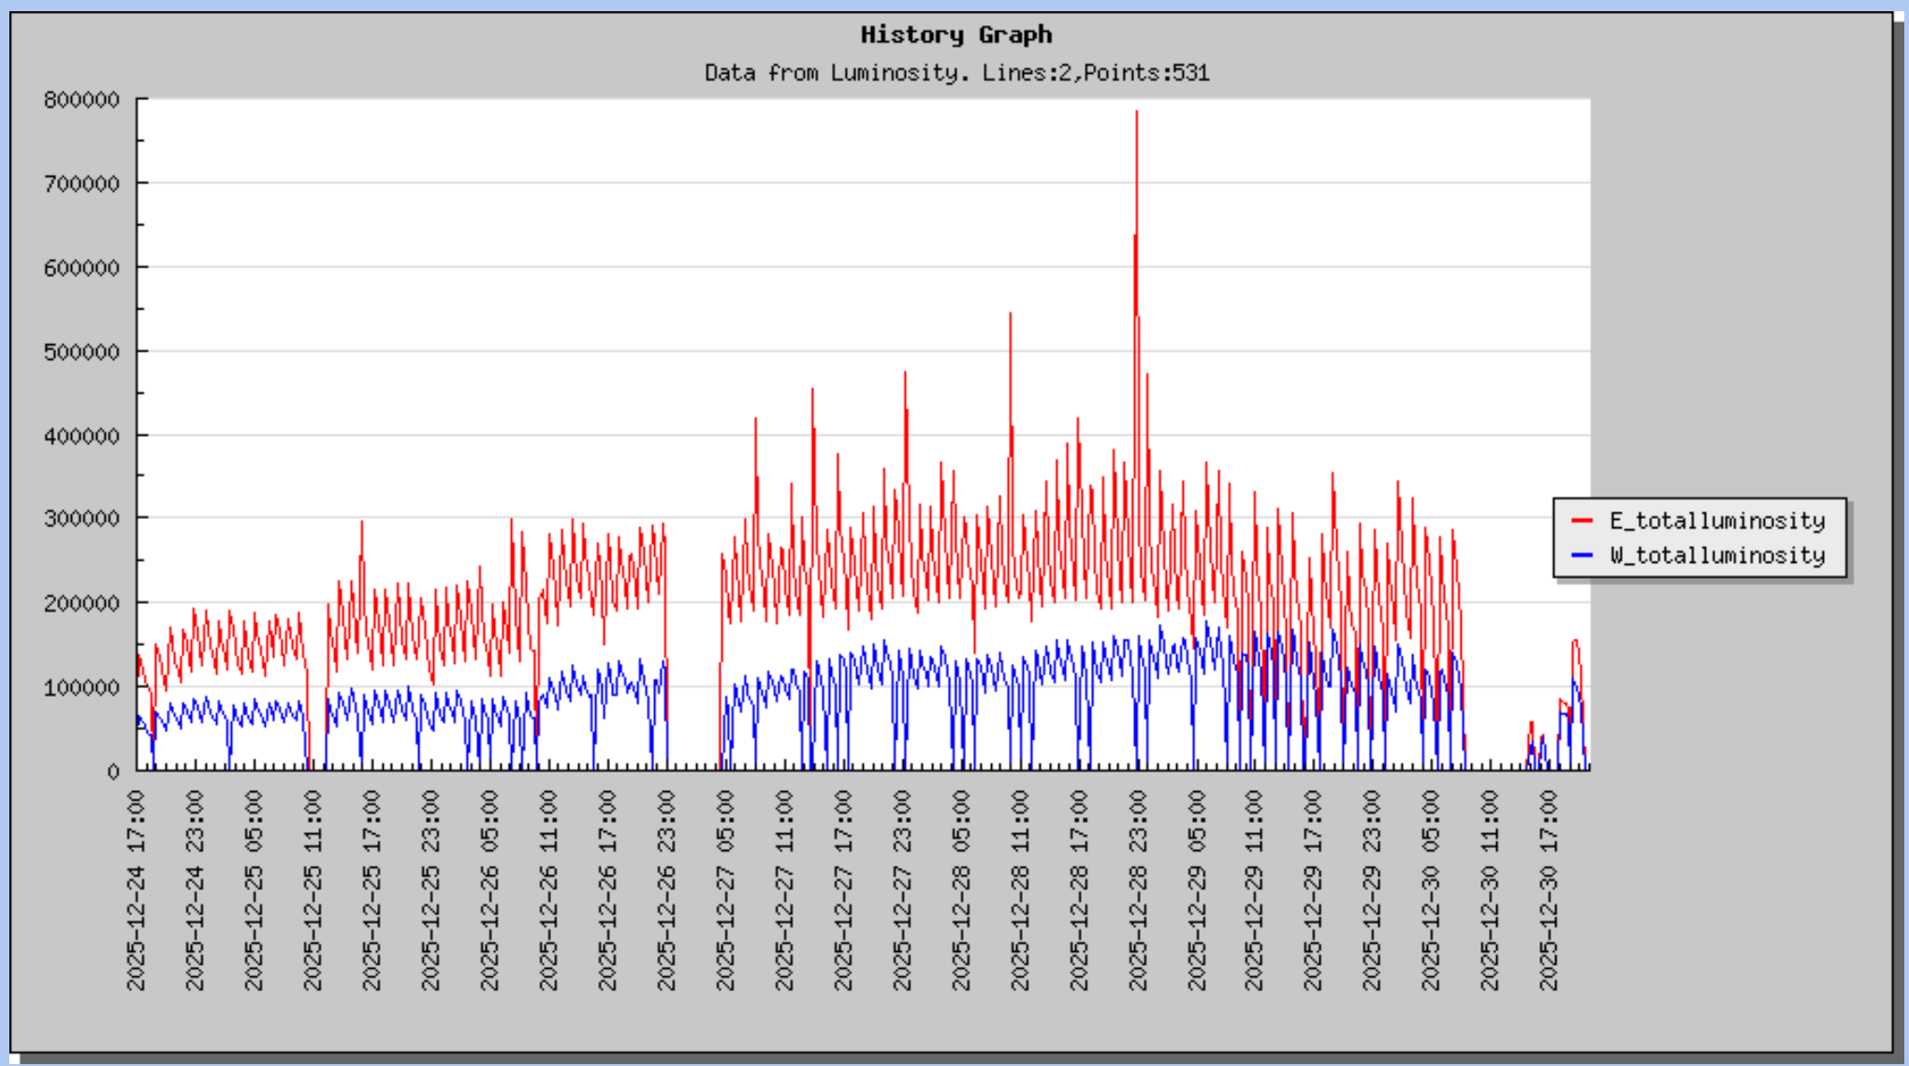
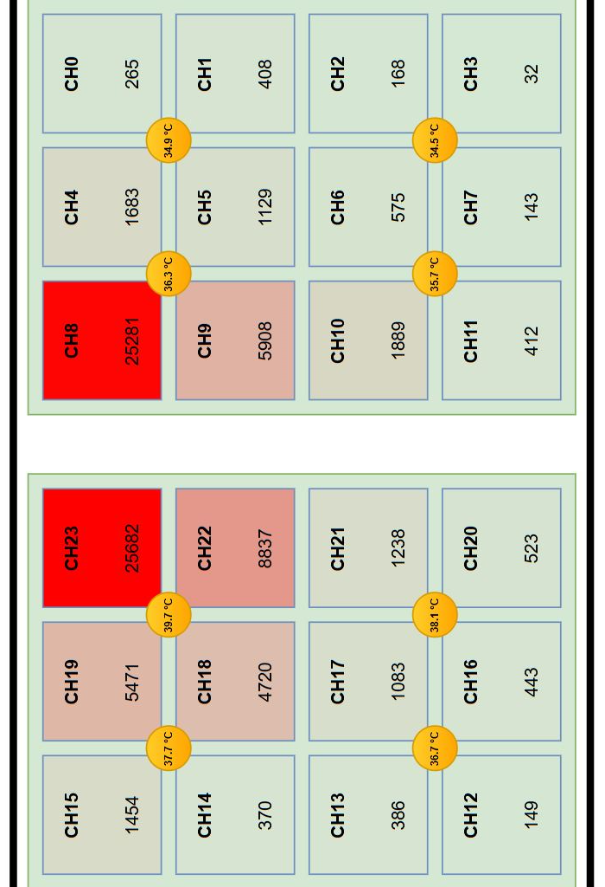
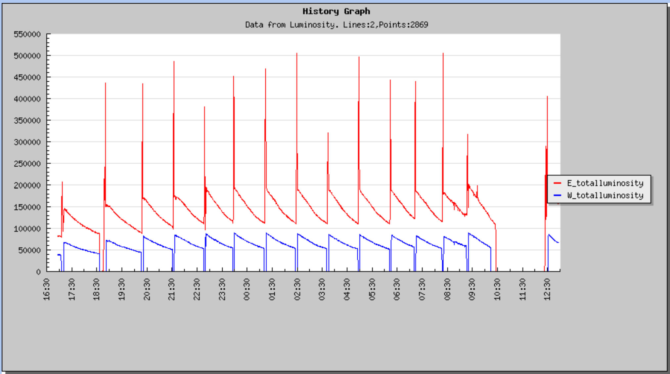
cZDD running status @2025
E: cZDD
W: BLM
E: cZDD
W: BLM

Slide 12
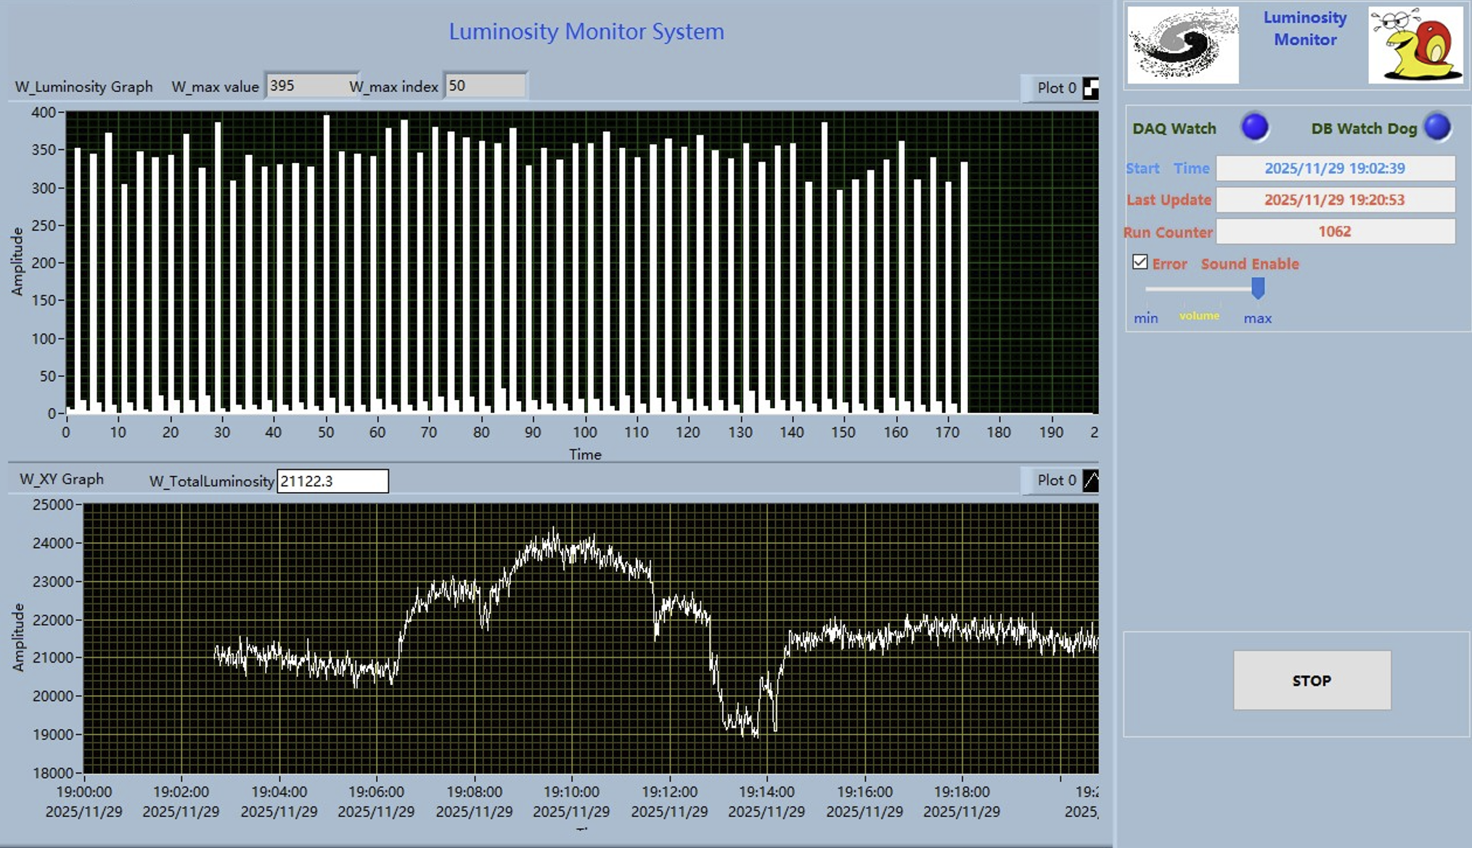
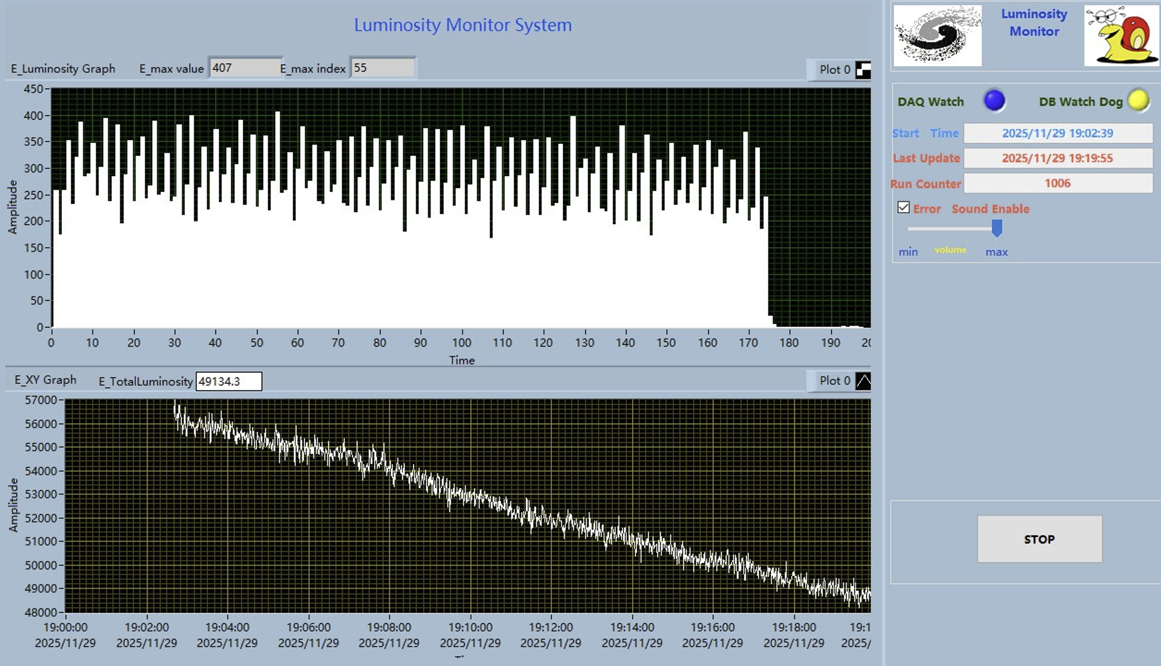
Slow control for BLM & cZDD
W: BLM
E: cZDD

Slide 13
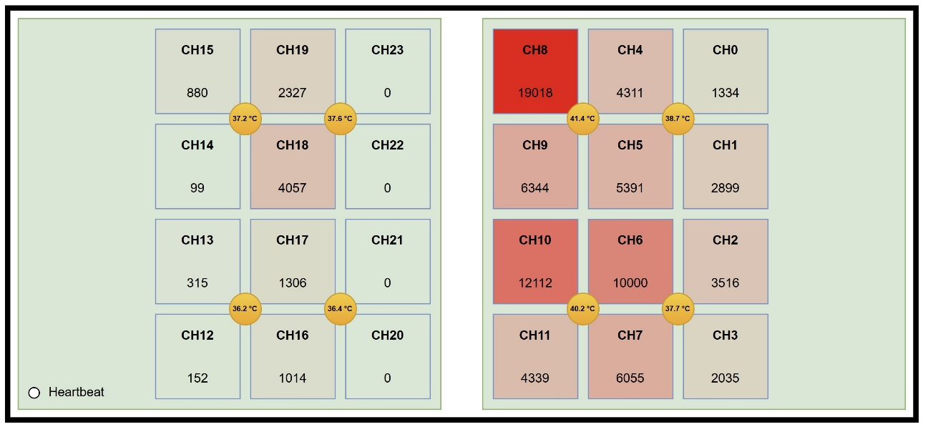
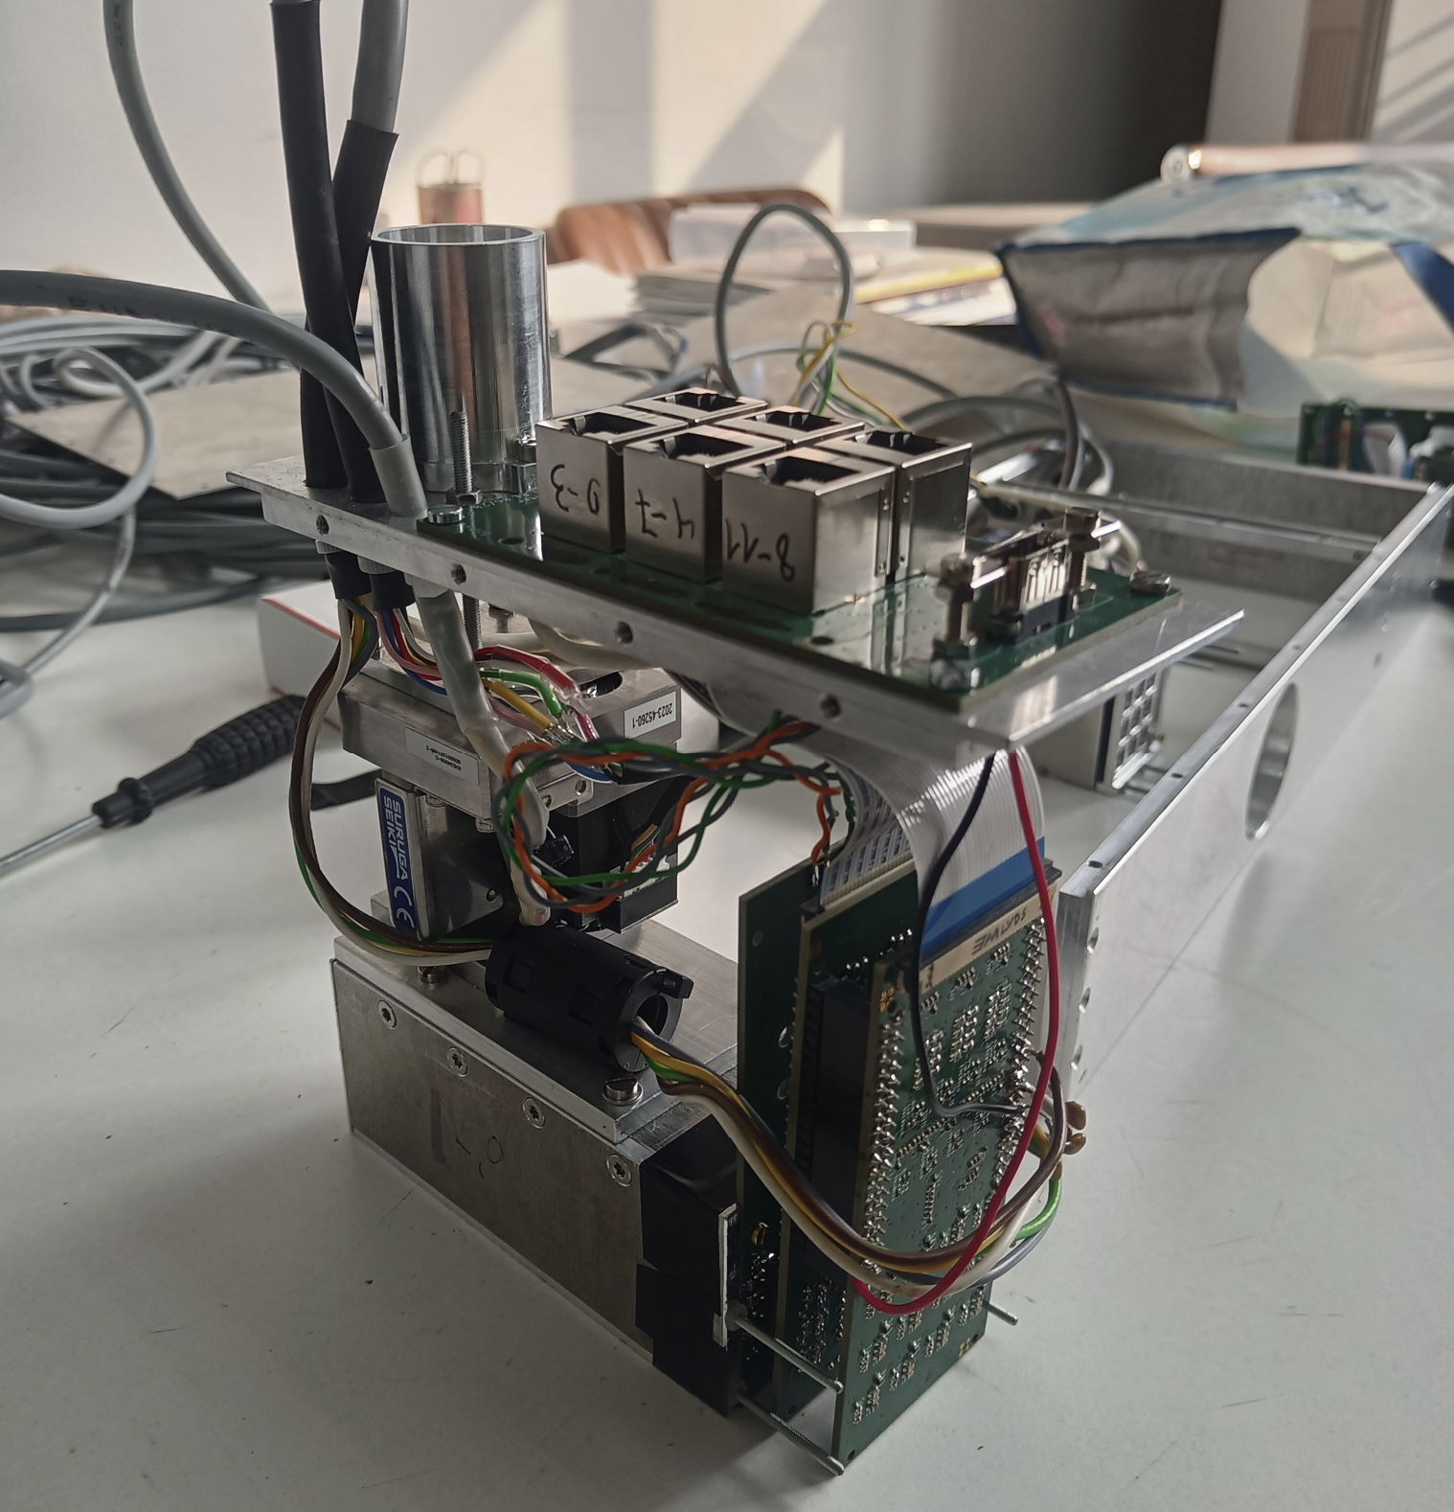
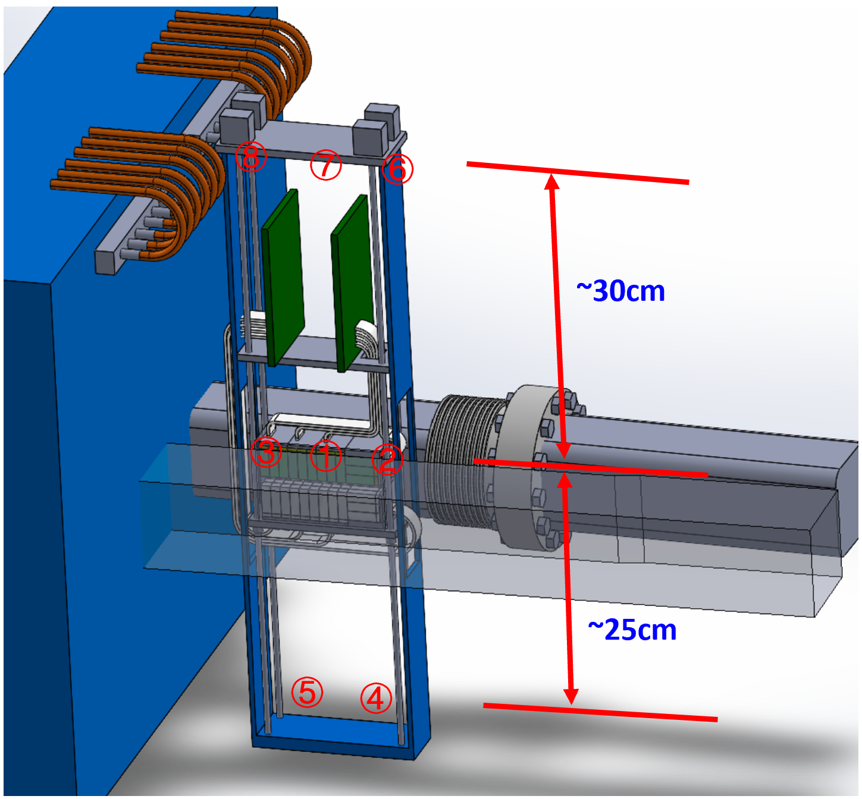
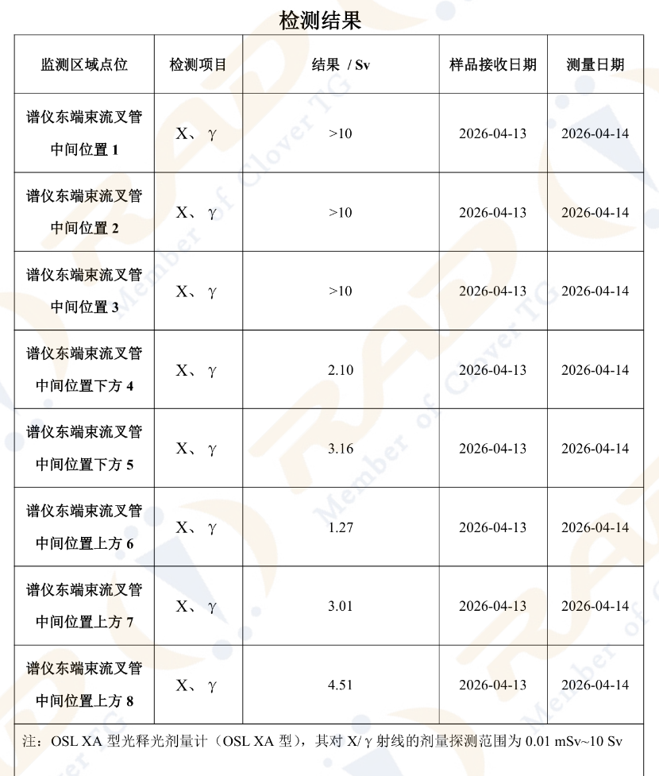
1 week doserate

Slide 14
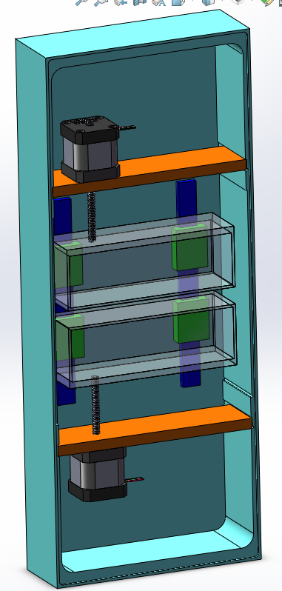
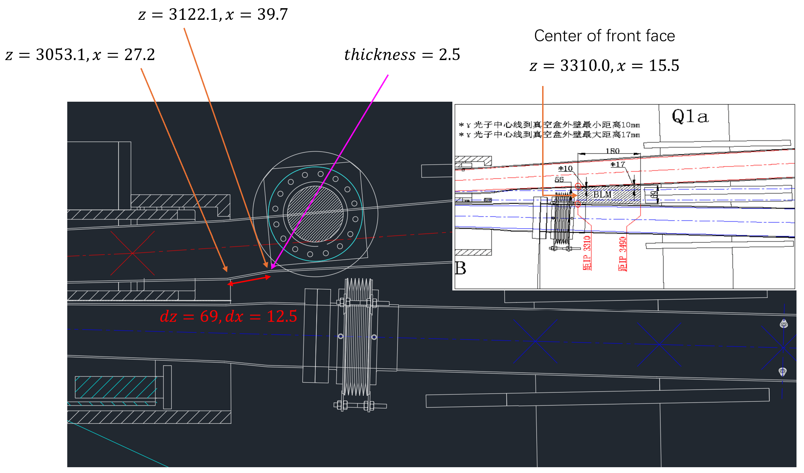
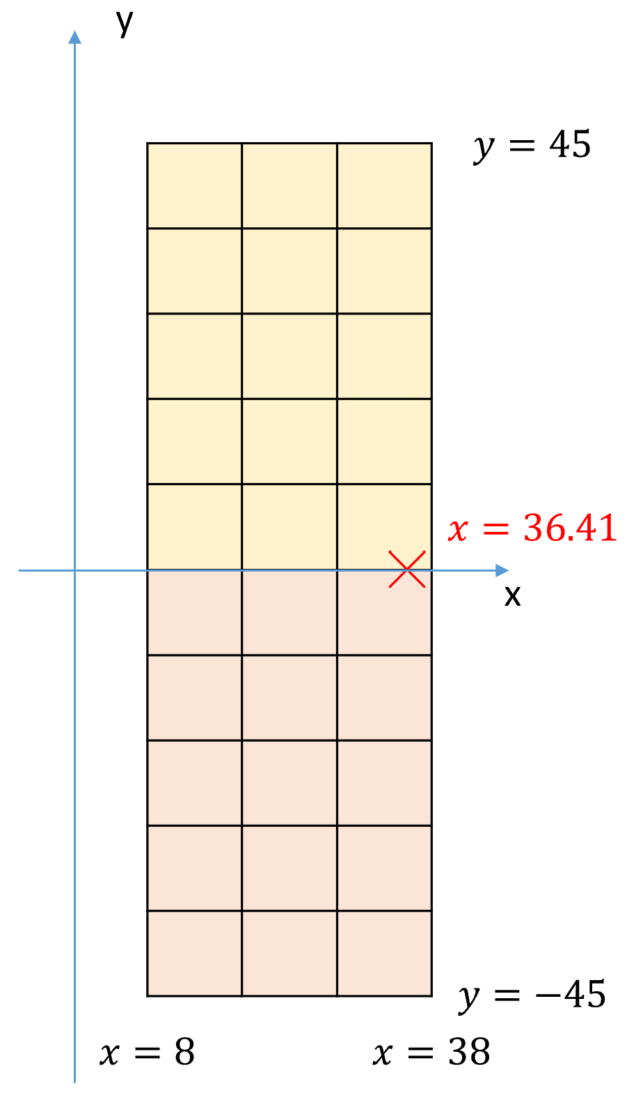
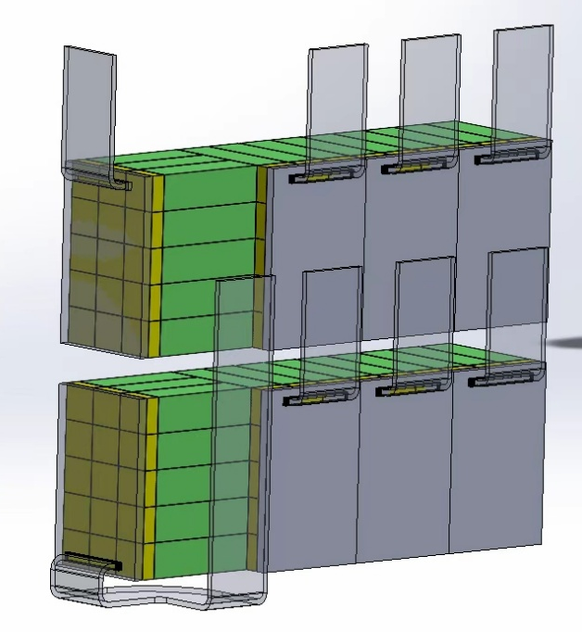
fBLM (provided by IHEP & NU, 2026?)

Slide 15
fBLM electronics
TCPIP
Detector
FPGA Card
1#
FPGA Card
2#
FPGA Card
3#
FPGA Card
4#
Upper
KELUSL00
KELUSL00
KELUSL00
KELUSL00
Trigger board
3*5 SiPM
3*5 SiPM
3*5 SiPM
3*5 SiPM
FMC
80pin
FMC
FMC
FMC
30ch ADC-1
30ch ADC-2
30ch ADC-3
30ch ADC-4
FMC
FMC
FMC
FMC
board1
80PIN
80PIN
80PIN
80PIN
board2
For Physics Analysis
board3
FEE1
board4
FEE2
BEE
FEE3
KELUSL00
KELUSL00
KELUSL00
KELUSL00
FEE4
3*5 SiPM
3*5 SiPM
3*5 SiPM
3*5 SiPM
~30m Fiber
HV
distribution
HV crate/module
SY4527/A2554
SC-PC
lower
For Beam Tunning

Slide 16
Thanks!

Slide 17
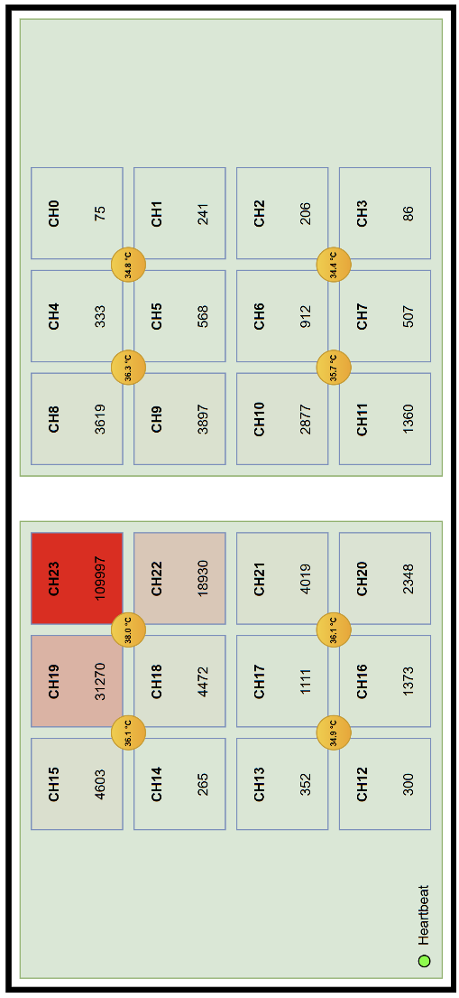
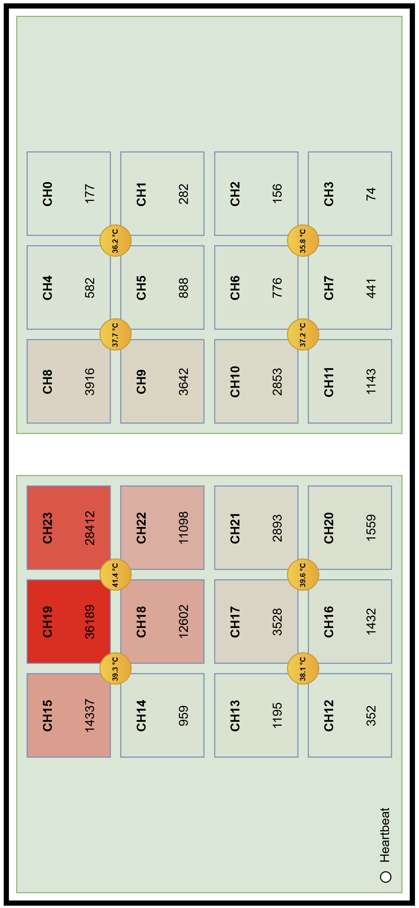
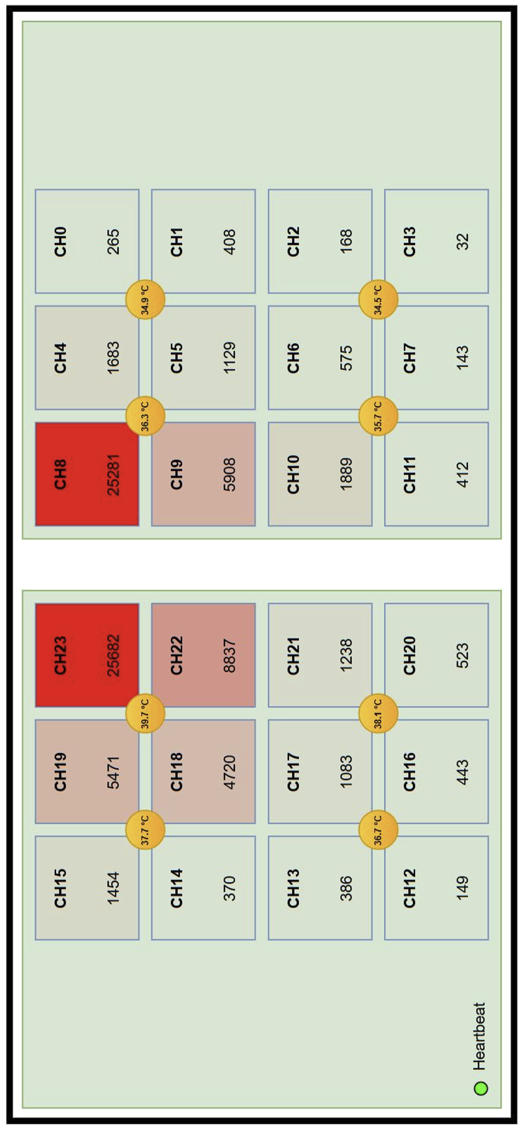
cZDD的各单元计数率
束流中心位置范围：
加速器磁场漂移，束流垂直方向变化较大。
探测器上下部分分别的位置条件范围从0.5-1cm调整成0.5-3cm（初定）
E+束的ISR光偏向E+束流管（东端铜方管），也就是左图中靠左一侧
2025.12月初
2025.12月底
2026.1.8

Slide 18
PC
EPICS HV IOC
EPICS GUI
HV
SY4527
TCP/IP
TCP/IP
HV & GND
BEE
ZYNQ EPICS IOC
FEE
Signal/HV
Concentrator
Fiber
Signal
Signal & HV
Detector
& GND
& GND?

Slide 19
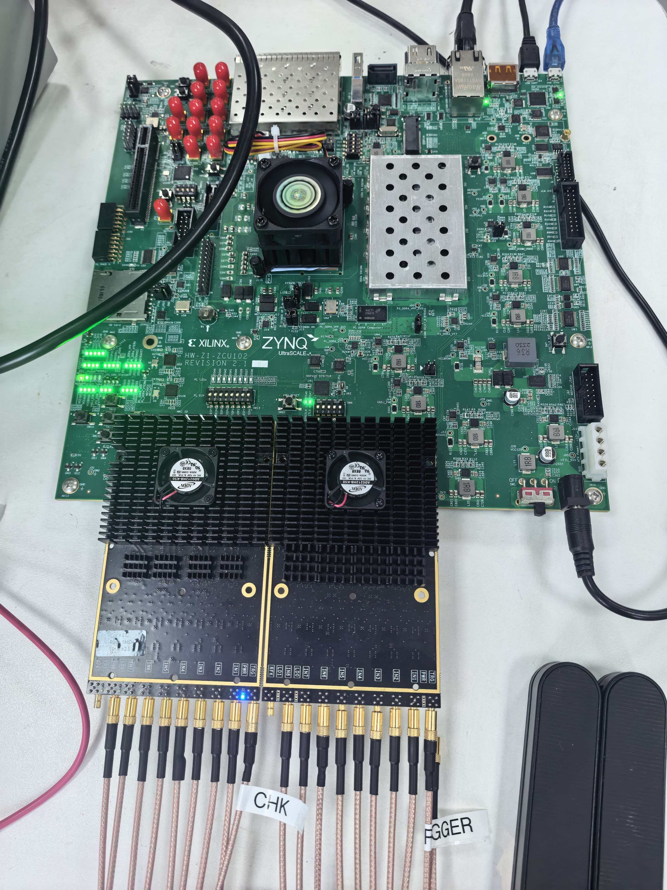
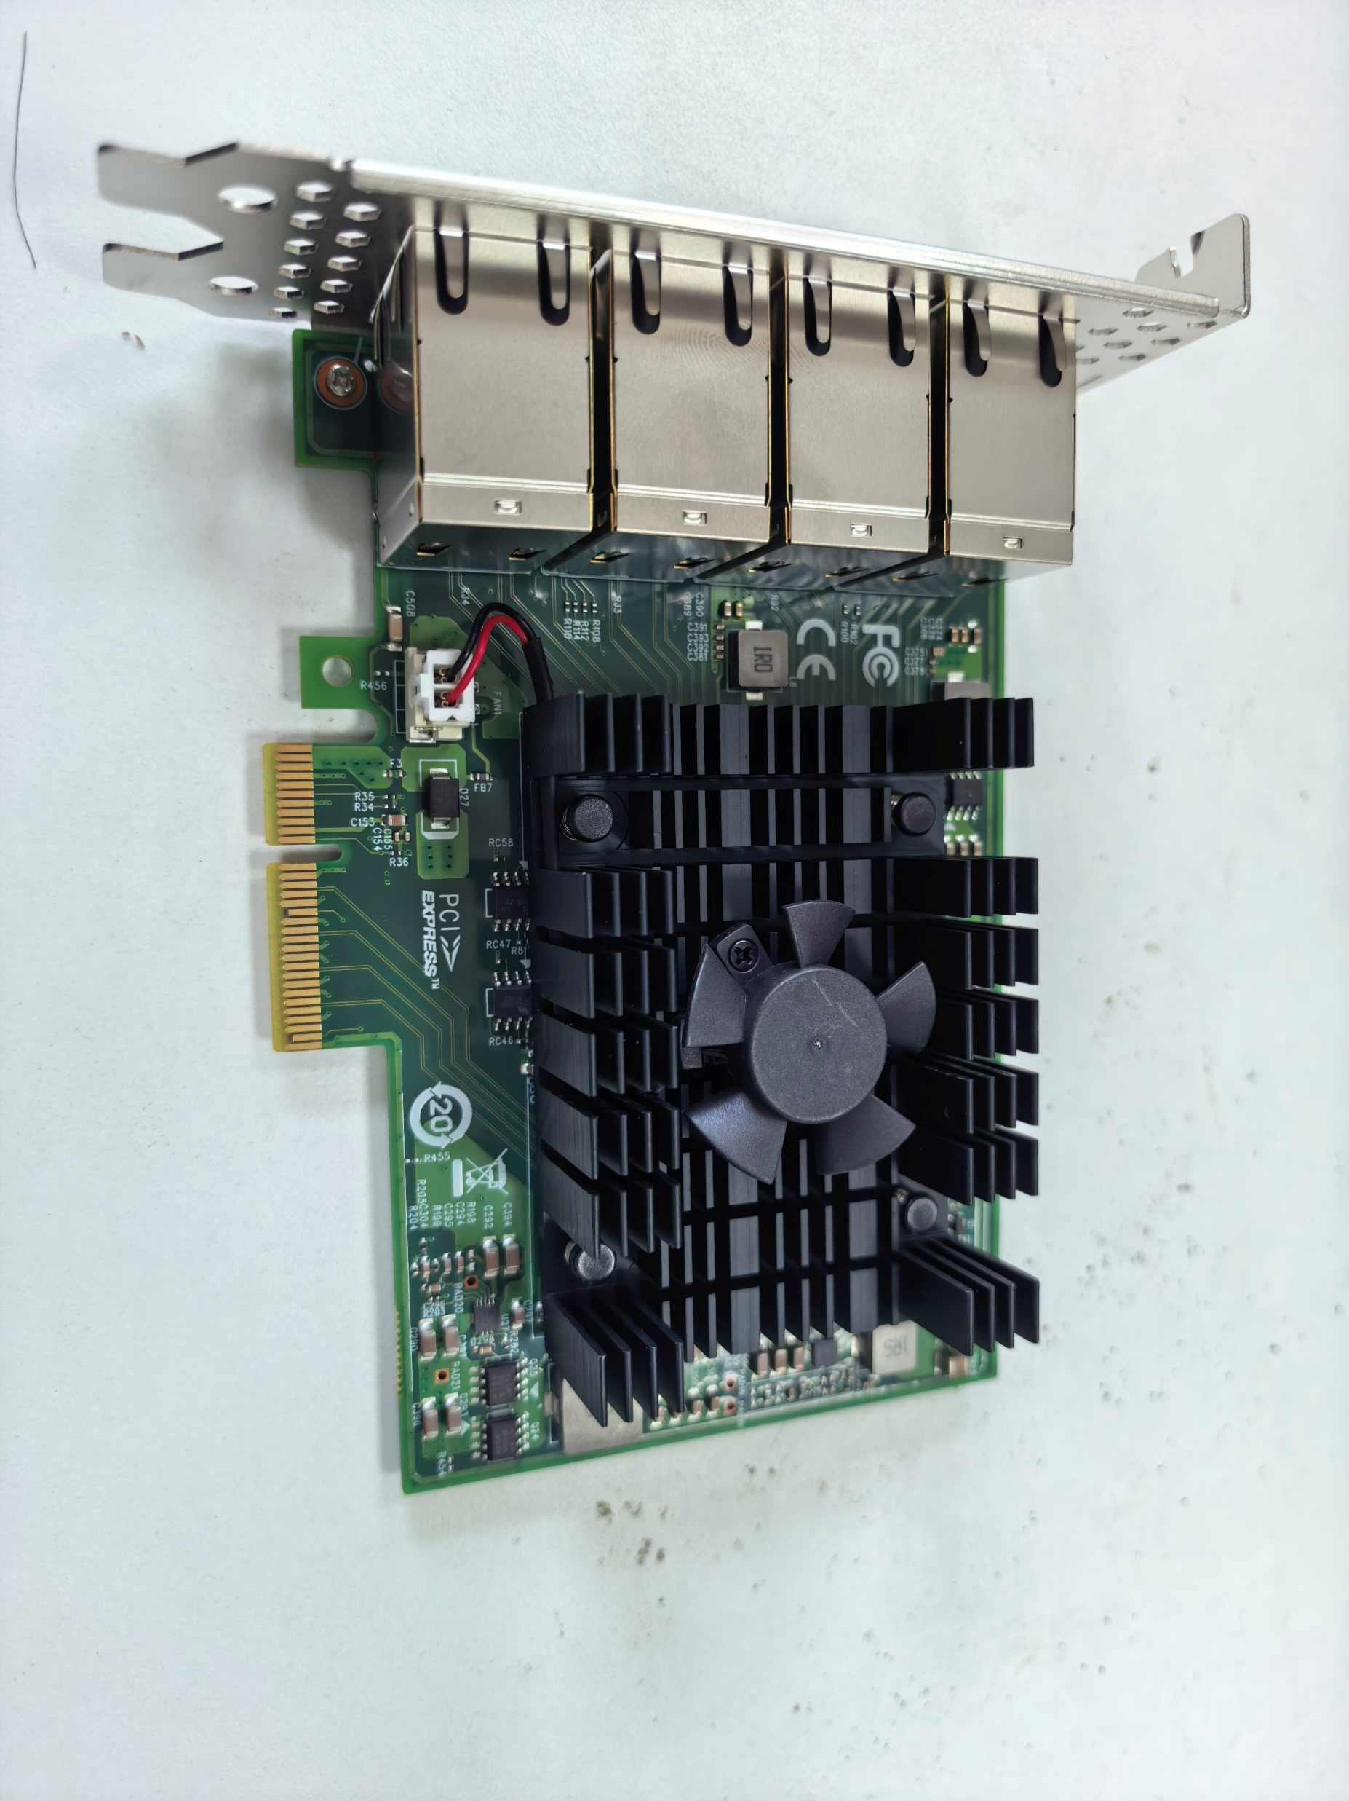
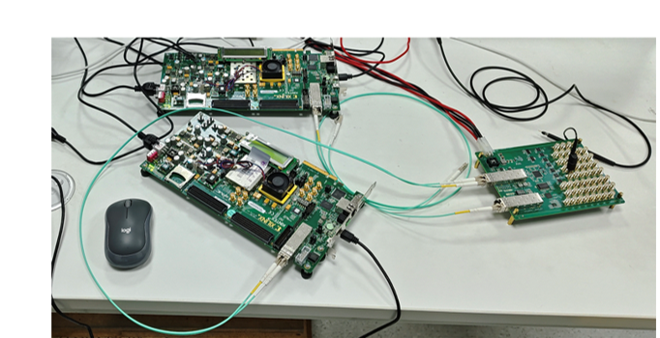

硬件架构
ZCU102
L1, CHK, CLK
ADC板卡
TCPIP
8 口网卡转 PCIe
触发转接板
触发转接板 (光纤输入)
目前使用开发板提供光纤信号；后续需要使用BESIII触发系统的时钟板和快控制主板提供光纤信号
ADC+FPGA (16 CH 输入)
UART
TCPIP
两块 FMC ADC 板卡接入ZCU102 FMC0 / FMC1，实现完整 16 通道输入
ZCU102 完成时钟/ADC 配置、JESD 接收、DDR 缓存和网络传输
PC 侧可通过多口网卡接收并重建事件波形
5
Notes:
这一页按硬件链路讲：触发板进入，ZCU102负责采样和打包，PC端接收。保留原来照片和箭头风格。

