Slide 1
BEPCII-U IP Luminosity Feedback Control System
Reporter: *Guodong Gao, Shujun Wei.
2026/05/14

Slide 2
CONTENTS
Development and Commissioning of the HEPS FOFB System.
Requirements for the BEPCII Luminosity Feedback Control System
Design of BEPCII Interaction Point(IP) Local Luminosity Feedback Control System
Summary

Slide 3
1. Development and Commissioning of the HEPS FOFB System
Notes:
In the second part, I will introduce our FOFB system commissioning and the orbit stability achievement

Slide 4
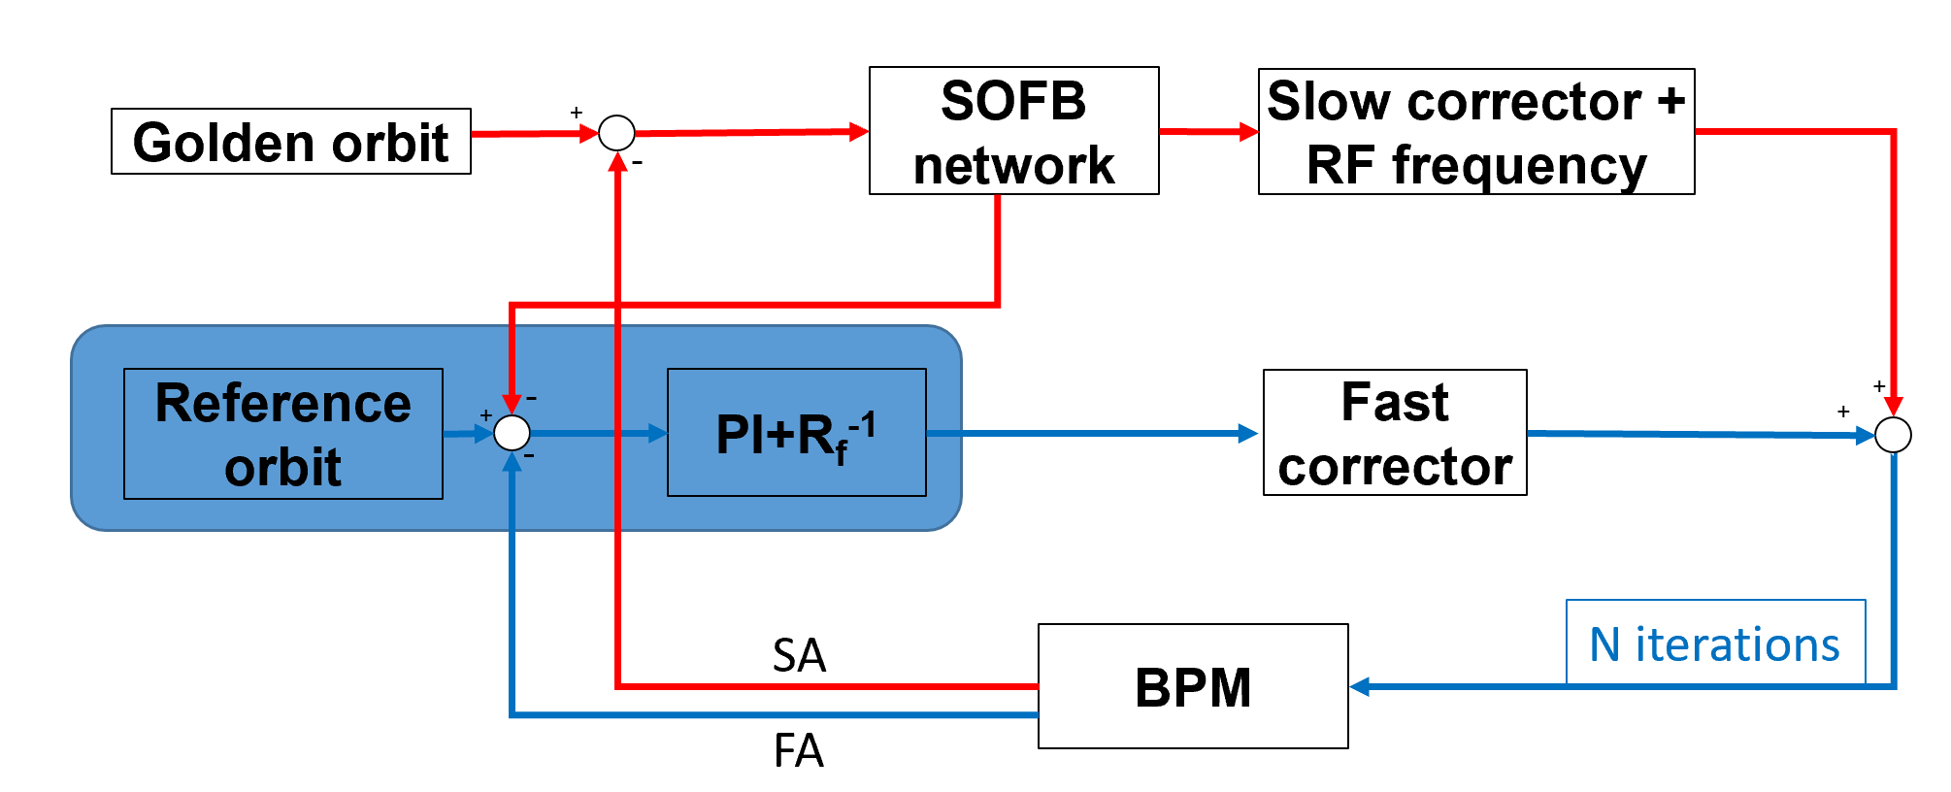
Global feedback strategy
In previous design, global orbit feedback included both SOFB and FOFB. However, we found that the FC strength does not unidirectional growth even when only FOFB is activated. Therefore, we currently adopt the feedback strategy of RF frequency FB + FOFB.
Parameter | Feedback design
Algorithm implementation | Fast + SOFB
BPM sampling rate | 22 kHz (FA)
FC sampling rate | 22 kHz
Signal processors (16 stations) | FPGA (Virtex-7)
Num. BPMs /plane | 576 (12 per cell)
FC /plane | 192 (4 per cell)
SC /plane | 288 (6 per cell)
FC PS bandwidth | 10 kHz
FC latency | < 25 μs
FOFB closed-loop bandwidth | >500 Hz
Global Feedback Strategy: RFFB + FOFB
Notes:
In our previous design, global orbit feedback included both SOFB and FOFB. However, we found that the FC strength does not unidirectional growth even when only FOFB is activated. Therefore, we currently adopt the feedback strategy of RF frequency FB + FOFB.
The FOFB sampling rate is 22kHz and our the designed closed-loop bandwidth is 500Hz.

Slide 5
FOFB system framework
“Ring-Star-Ring” structure
  12 BPMs are connected to a BPM ring;
  Connecting adjacent 3 BPM rings to 1 FOFB station.
  Link all 16 FOFB station to 1 large FOFB ring.
  Connecting 1 FOFB station to 3 FC PSC stations.
Notes:
In our design, 576 BPMs, 16 FOFB stations and 384 PSCs are connected through optical fiber and we adopted a ring-star-ring data transmission network structure. 12 BPMs are connected to a BPM ring; 3 adjacent BPM rings connected to the FOFB station and we have totally 16 FOFB stations.

Slide 6
FOFB station
One ATCA architecture FOC
Four BPM data transceivers
One clock distribution box
Several fiber optic patch panels
One data acquisition server
Directly connected to 36 DBPMs
Directly connected to several XBPMs
Directly connected to 24 PSCs
Notes:
One FOFB station includes one ATCA architecture FOC, 4 BPM data transceivers, 1 clock distribution box, one data acquisition server.

Slide 7
Hardware design of FOFB controller (FOC)
The overall hardware of the crate adopts a custom ATCA architecture. The front plug-in board includes 1 main control board, 1 auxiliary function board and 3 power interface boards.
MAIN board：Complete all core operations of FOFB, receive BPM data, communicate with the upper computer, etc.（X7VX690T FPGA）
AUX board： Receive timing signals, store and read FOFB data, update firmware programs online, monitor the crate status, etc.（XCKU060 FPGA）
PSC board： With 8-channel optical fiber interface to communicate with the fast corrector power supply controller.

Slide 8
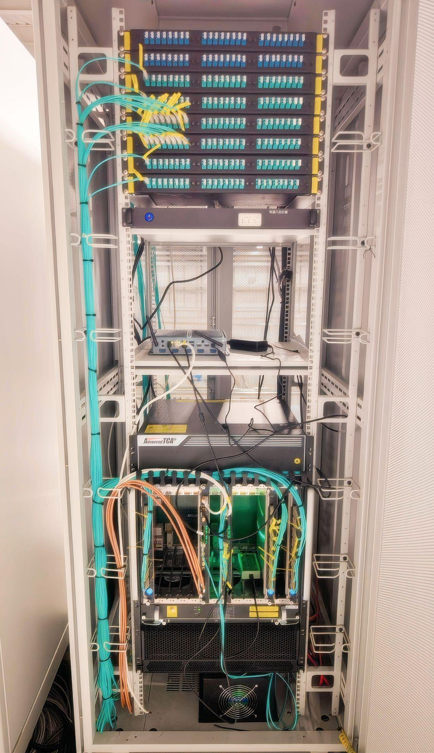
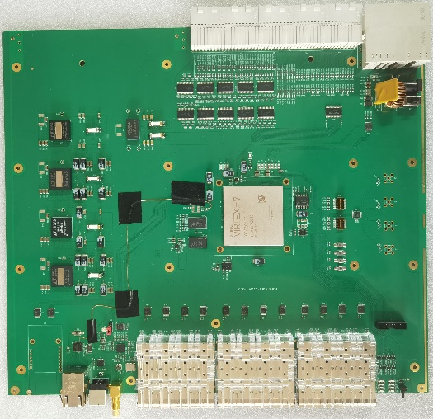
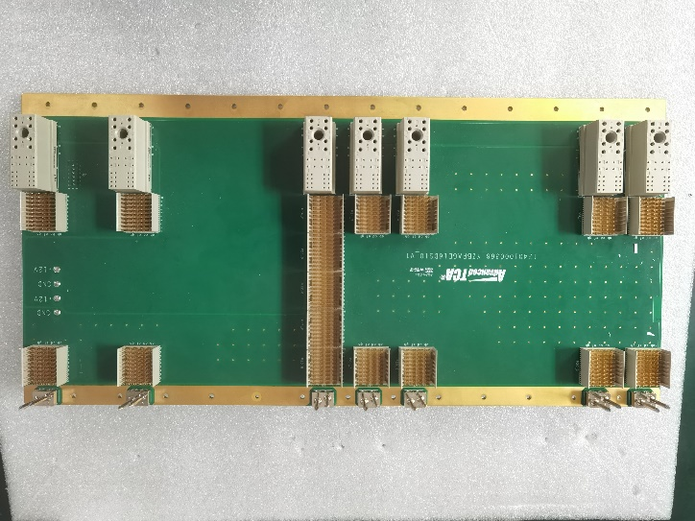
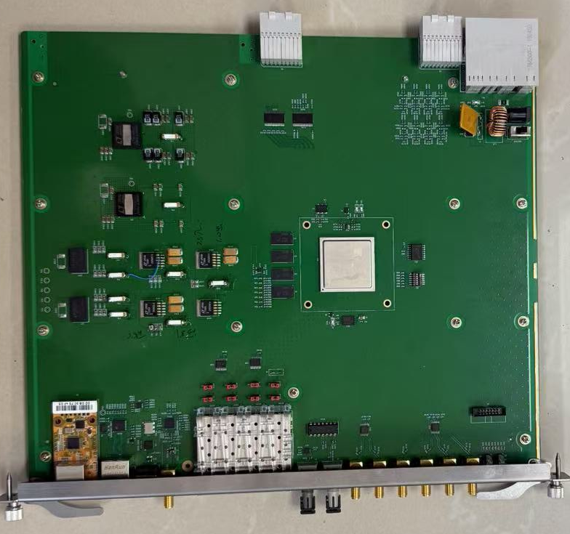
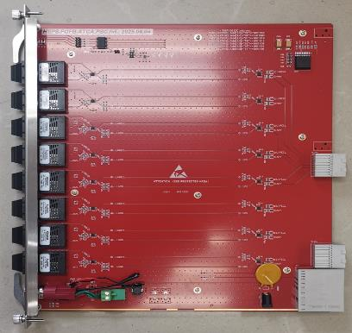
Hardware implementation
MAIN board
Backboard
AUX board
PSC board
FOFB Station
Notes:
The backboard is mainly used for routing and power supply.

Slide 9
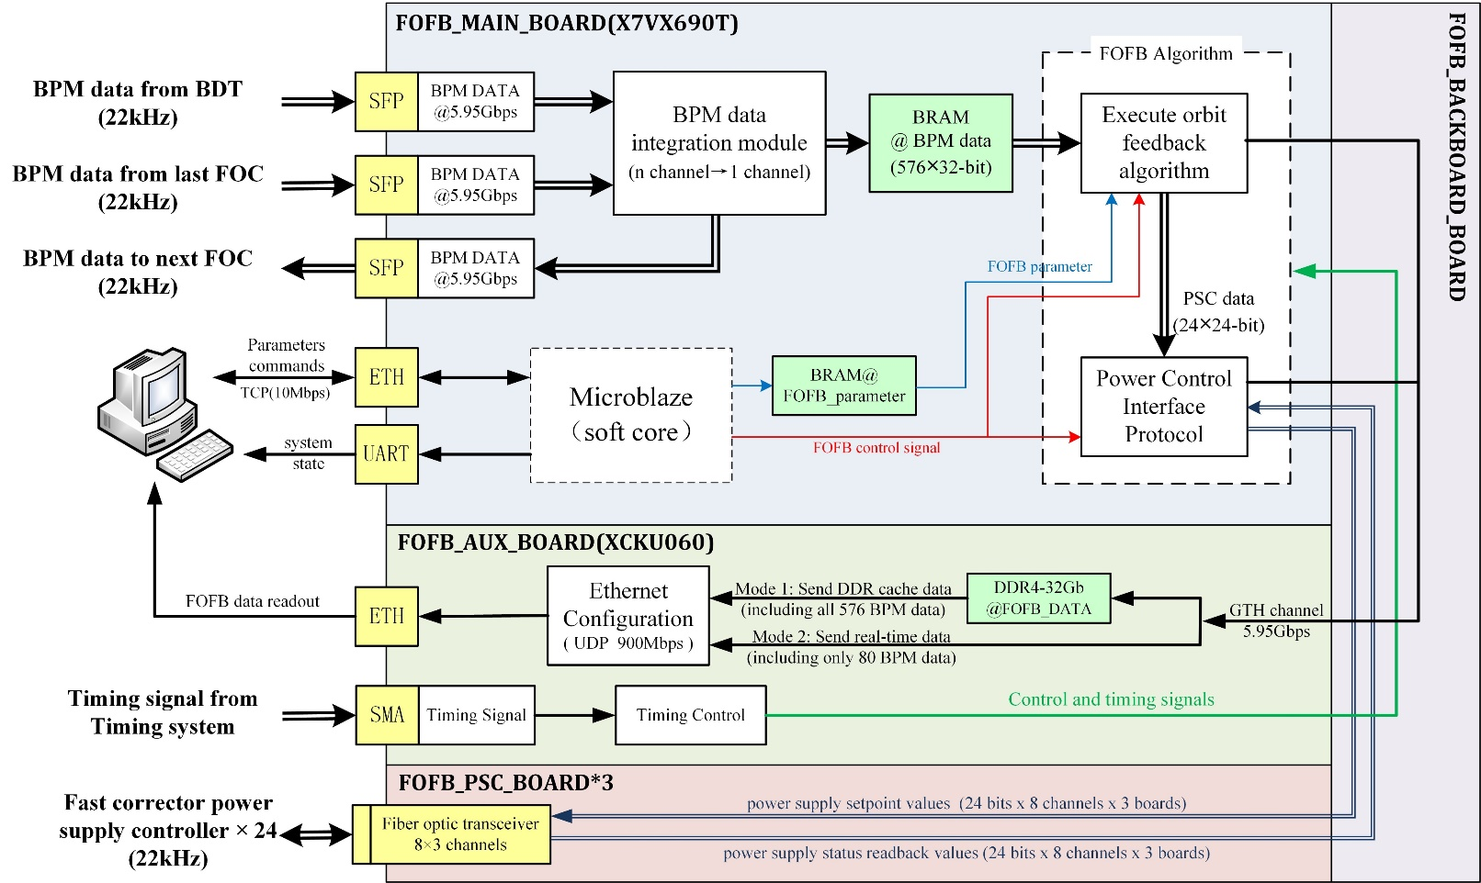
FOFB processor dataflow
The main control board adopts a pipeline structure to accomplish the functions of BPM data reception, FOFB calculation, and correction value transmission.
It is controlled by a MicroBlaze soft core, and finally sends the data that needs to be uploaded and saved to the auxiliary function board.
The auxiliary function board then performs DDR4 caching and transmits the data out.
A server will be connected to the FOC via a network to complete functions such as system control, parameter setting, data readout, and data storage.
Notes:
This is a schematic diagram of FOFB processor dataflow.

Slide 10
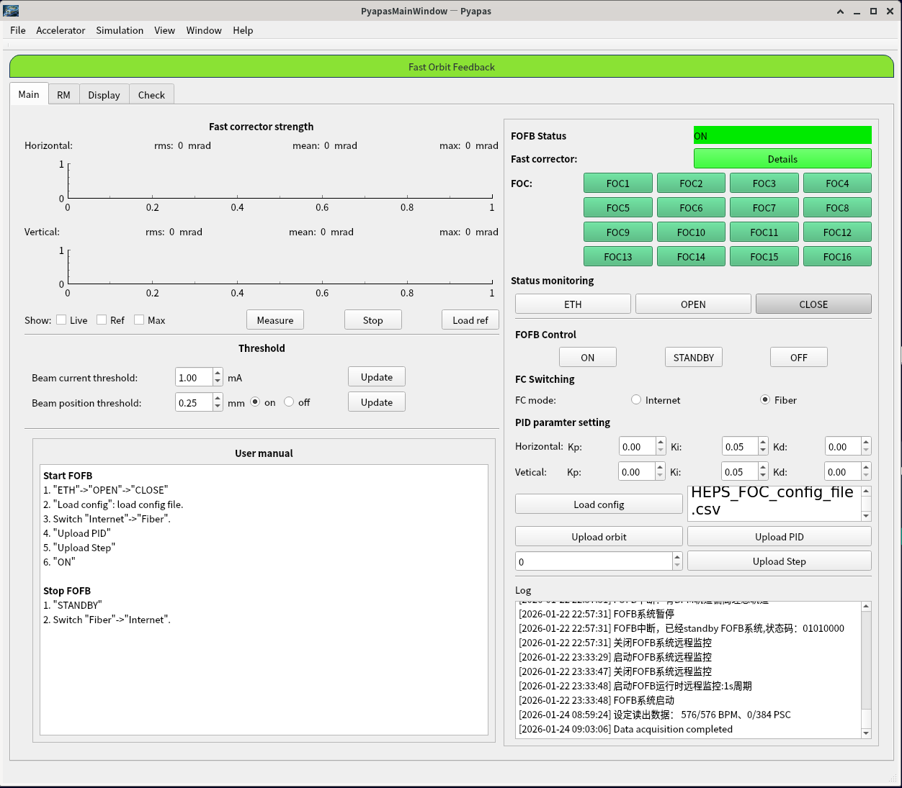
Upper-layer control software
Develop the Upper-Layer Control Software for the FOFB base on Pyapas.
The implemented functions include: calculation of inverse response matrix, BPM and FC selection and automatic configuration, synchronous state control of 16 FOCs, synchronous parameter input function, real-time monitoring of FOFB related equipment status, acquisition of 22kHz FOFB data, FC control interface selection, etc.
The read data is stored in binary file format, and after format conversion, the data can be saved in large quantities on the server.

Slide 11
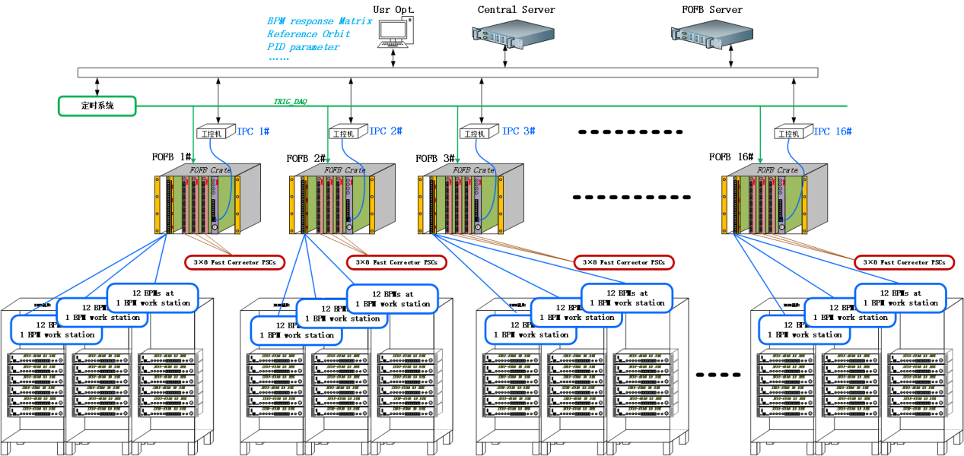
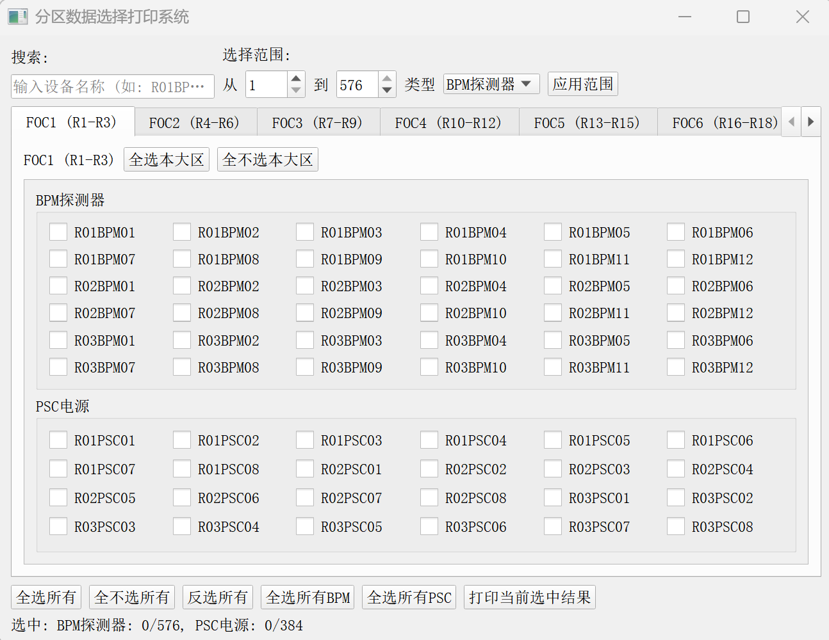
FOFB data acquisition system
  FA position data from 576 BPMs
  Status, setpoints, and readback values for 384 FCs
  Operational status of BPMs and FCs
  Hardware and software status of the FOFB system
  Settings of key parameters
  …
Real-time readout of synchronized data from FOFB-related equipment：Over 3,000 data acquisition points; Data throughput: 350 MB/s.
Notes:
This is the structure of FOFB data acquisition system, it can readout of synchronized data from FOFB-related equipment, including BPM datas, FCPS status, setpoints and readback values, also the status of hardware and software.

Slide 12
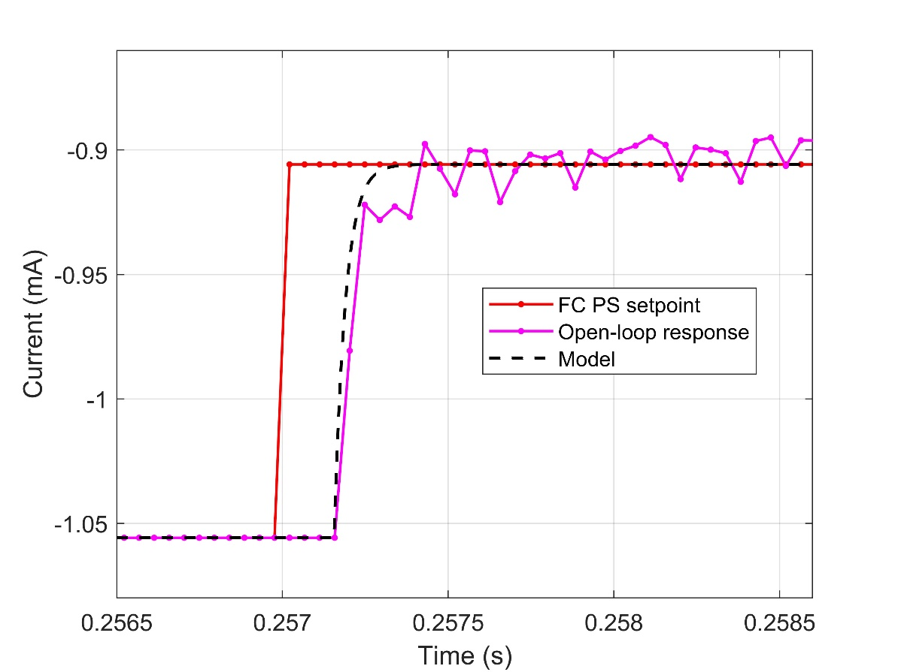
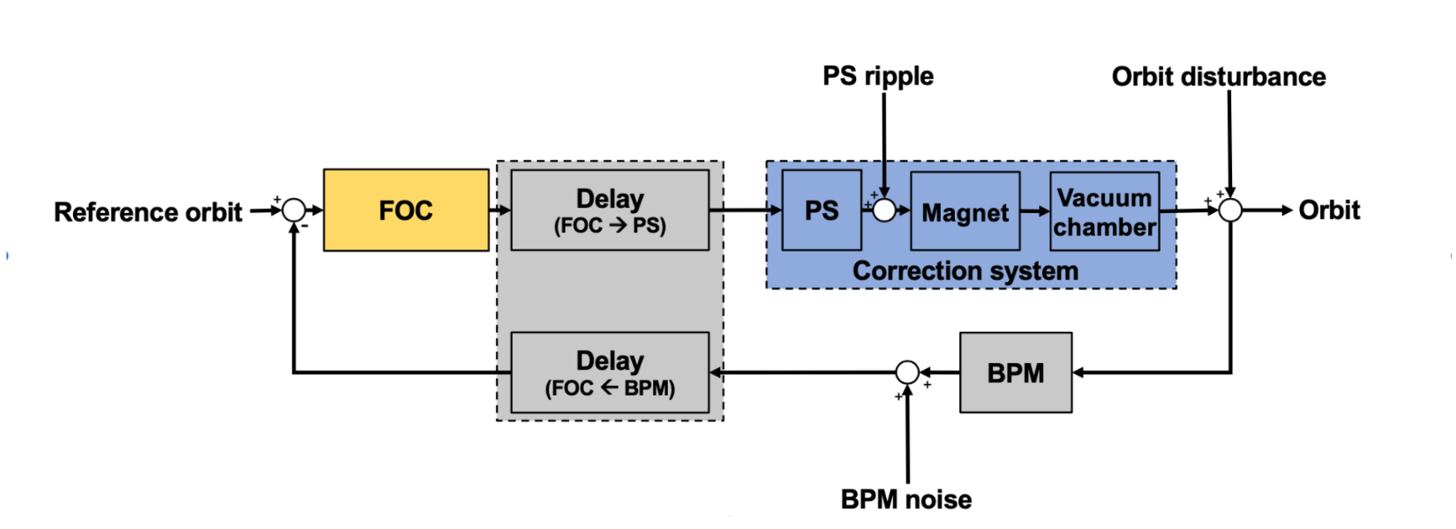
Open-loop response
x_{output}
i_{set}
0.15A
90%
180us
Open loop step response was conducted by providing 0.15A step on FC and using inverse response matrix on all bpm data.
It measures the total latency in the system. The plot shows 180 µs latency where no output from the fast corrector is observed. After this initial latency, the risetime from 0 to 90 % full value is 90 µs.
Notes:
Next, I will introduce the detailed commissioning process.
First, we measured the open-loop response of the system.
Open loop step response was conducted by providing 0.15A step on FC and using inverse response matrix on all bpm data to reconstructed the open-loop response.
It measures the total latency in the system. The plot shows 180 µs latency where no output from the fast corrector is observed. After this initial latency, the risetime from 0 to 90 % full value is 90 µs.

Slide 13
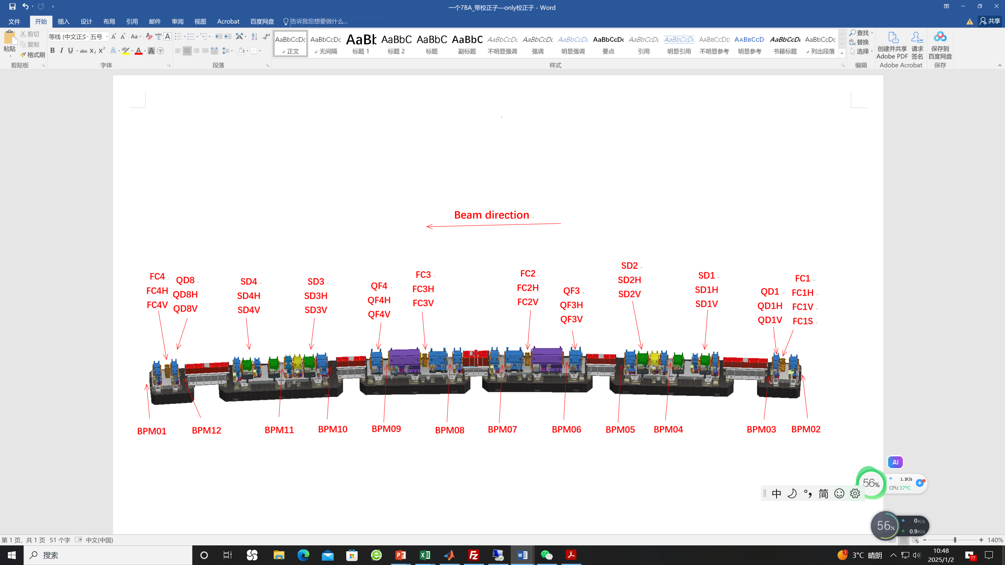
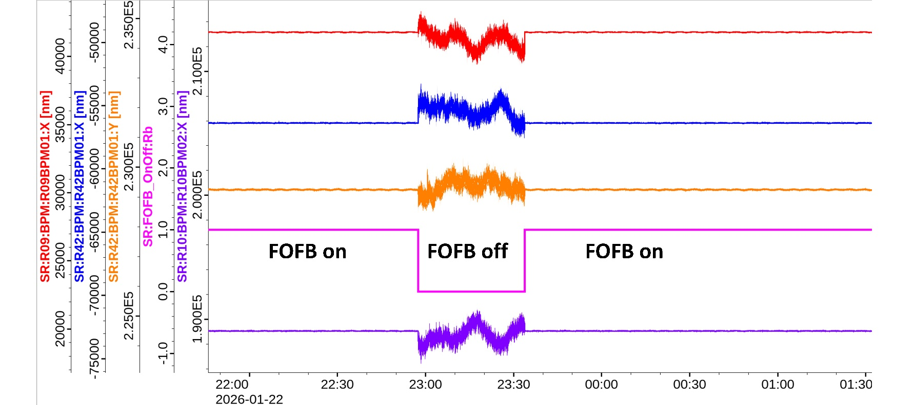
FOFB commissioning
FOFB loop（4*4）
Notes:
Now our FOFB system includes 4 FCs and 4 adjacent BPMs per cell, among which two are ID BPMs and two are Arc BPMs.
When we tried using the PI parameters designed during simulation, we quickly closed the loop of the FOFB system.
The bottom figure shows the orbit with and without FOFB.

Slide 14
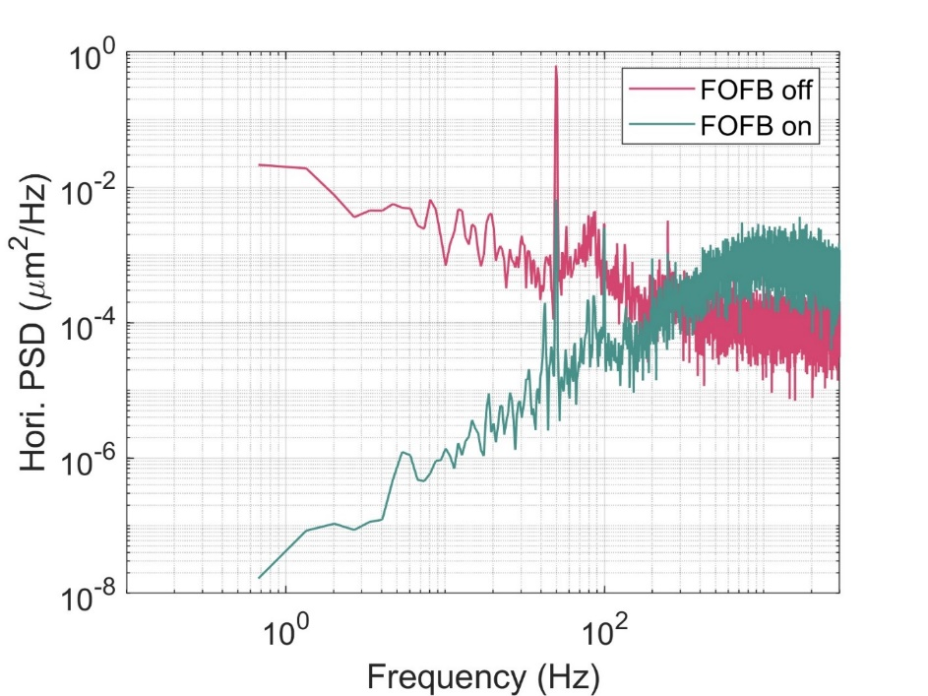
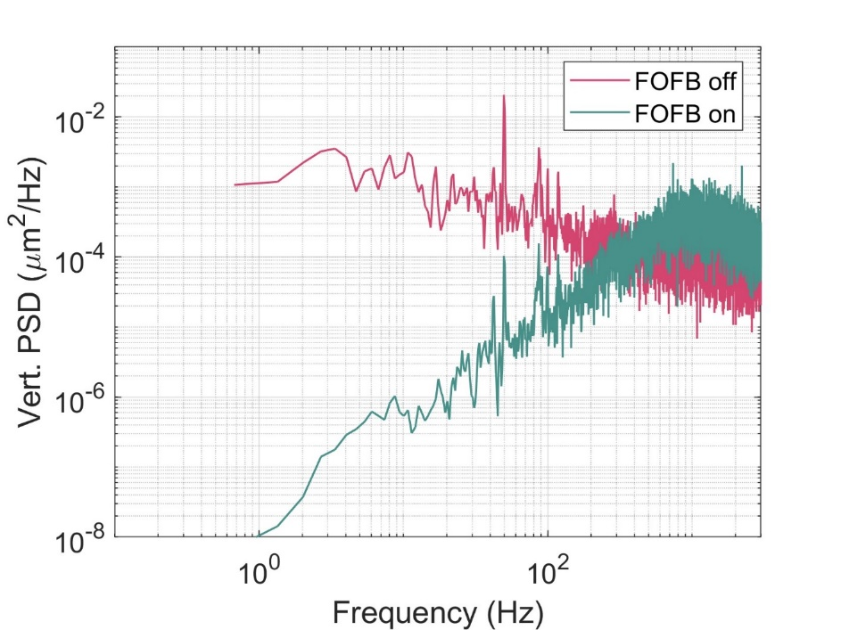
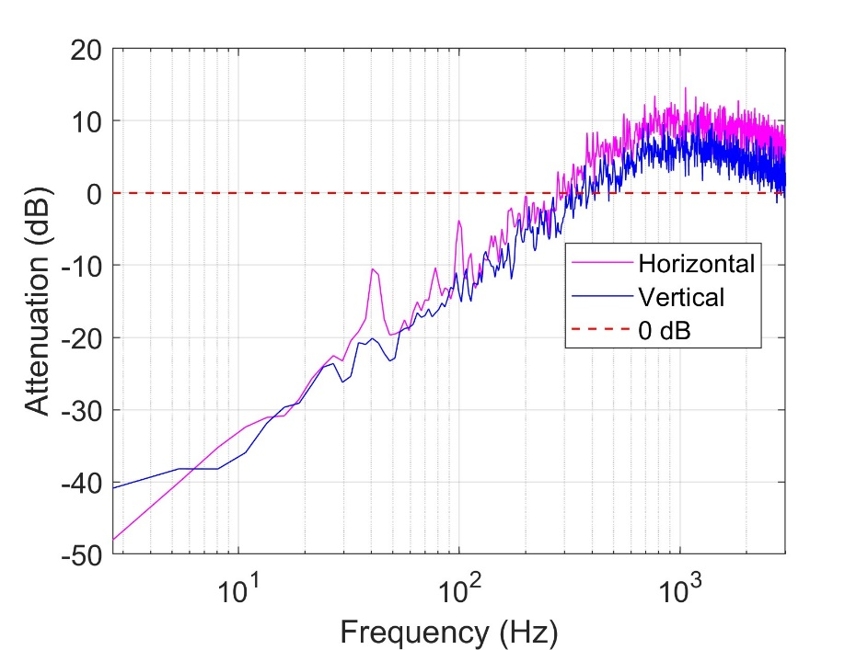
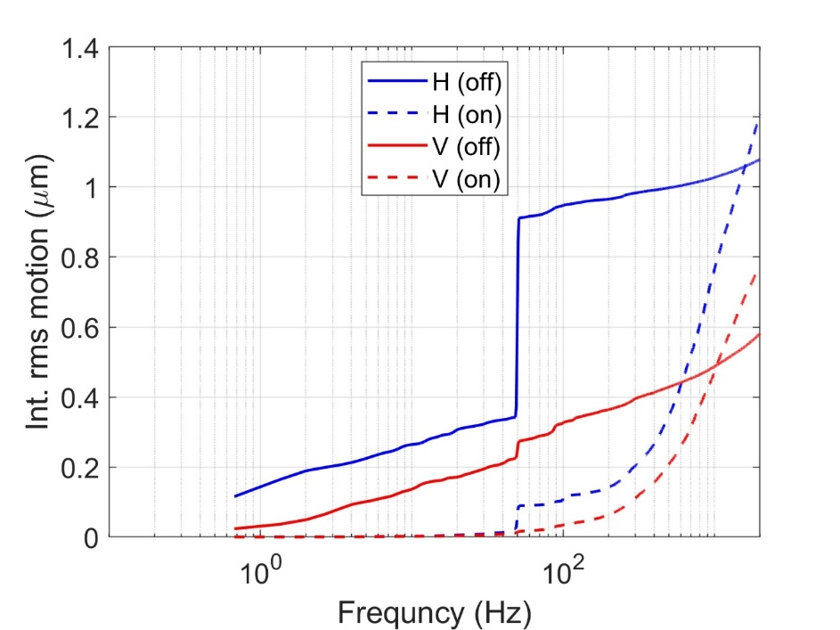
Close-loop bandwidth (80mA top-up)
R01BPM01 Hori.
R01BPM01 Vert.
300Hz in Hori.
400Hz in Vert.
Notes:
With FOFB data acquisition system, we analyzed the closed-loop bandwidth using FA data. The results show that at a beam current of 80 mA, the horizontal bandwidth can reach 300 Hz, and the vertical bandwidth can reach 400 Hz.

Slide 15
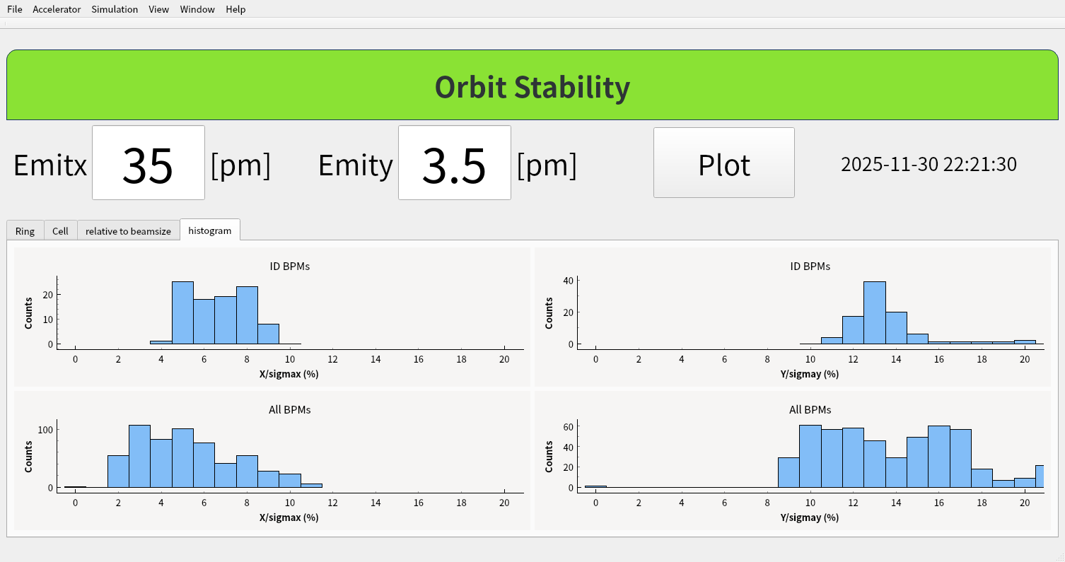
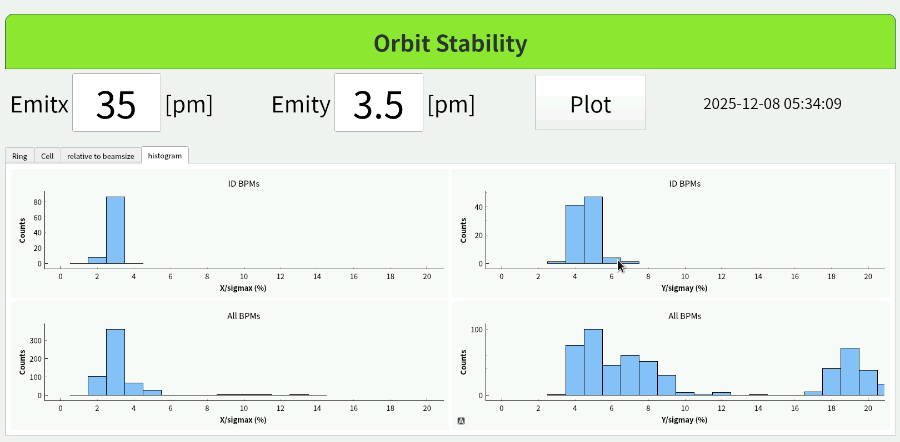
Orbit stability achievement （80mA top-up)
FOFB off
<10%σx
<20%σy
stability>40%
Optimize SCPS
stability<20%
FOFB
FOFB on
stability <10%
<5%σx
<8%σy
Notes:
As a result, the integrated rms orbit motion can be reduce to under 5% and 8% beam size in both planes from DC to 500Hz at the light source point, which satisfying the short-term orbit stability requirement.

Slide 16
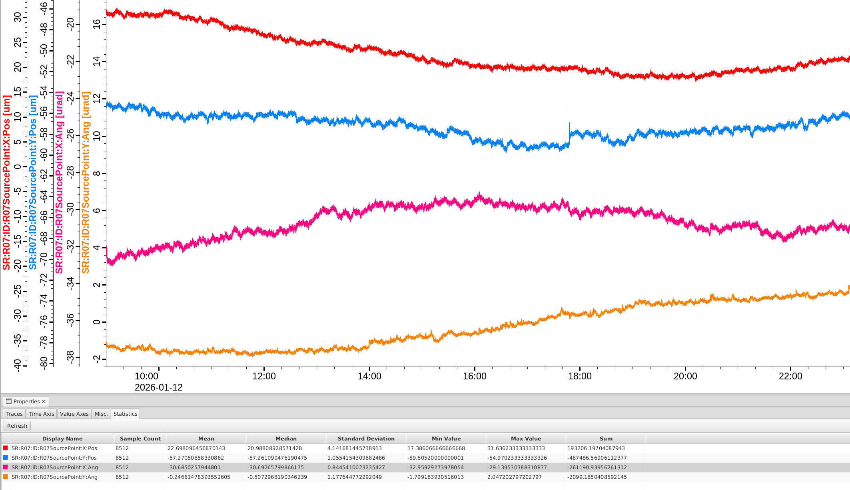
Orbit stability achievement (@100mA >10h）
FOFB off：source point position rms ~ 1-10um，source point angle rms~0.5-2urad (10h)
Notes:
The long-term stability can be compared with FOFB on and off. When FOFB off, the source point position fluctuation is about 1 to 10 um

Slide 17
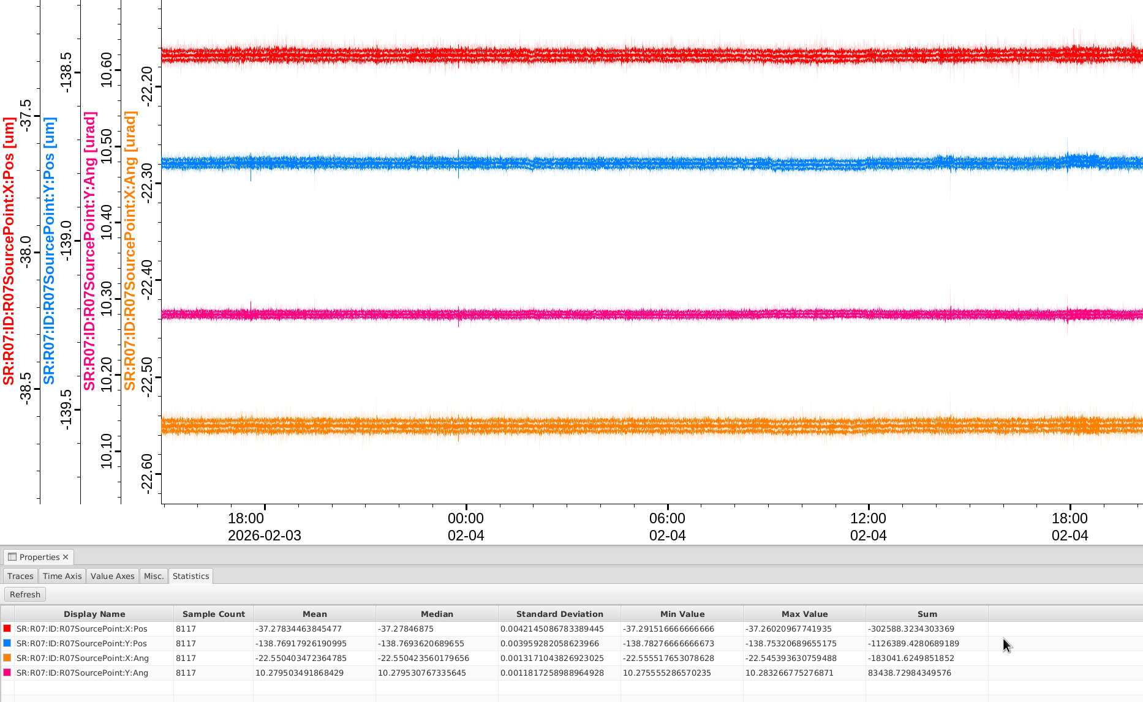
Orbit stability achievement (Long-term stability>10h @100mA）
FOFB off：source point position rms ~ 1-10um，source point angle rms~0.5-2urad (10h)
FOFB on: source point position rms < 10 nm, source point angle rms <3 nrad (>24h)
Notes:
And if FOFB on , the source point position rms is less than 10nm in 24 hours. At present, the FOFB system has been operating continuously for more than 3 days, and the orbit was very stable. During this time, the FC strengths did not accumulated. The above results illustrate the performance of FOFB in orbit stabilization.

Slide 18
2. Requirements for the BEPCII Luminosity Feedback Control System

Slide 19
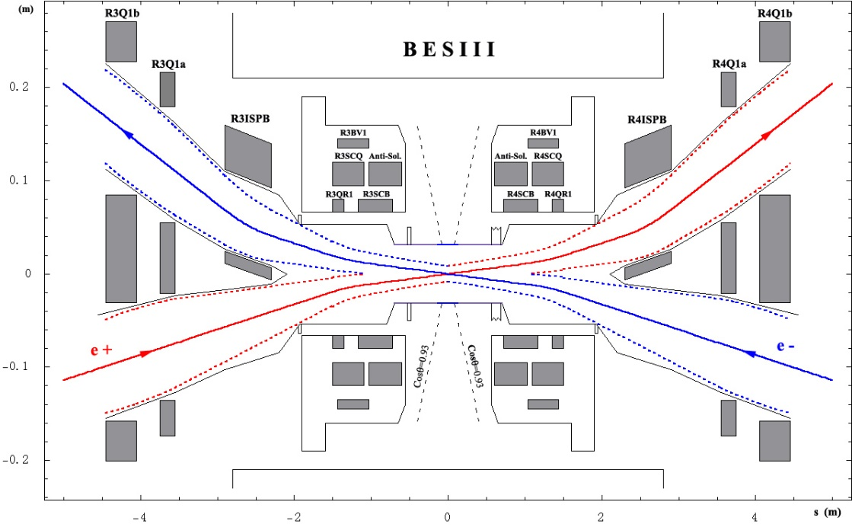
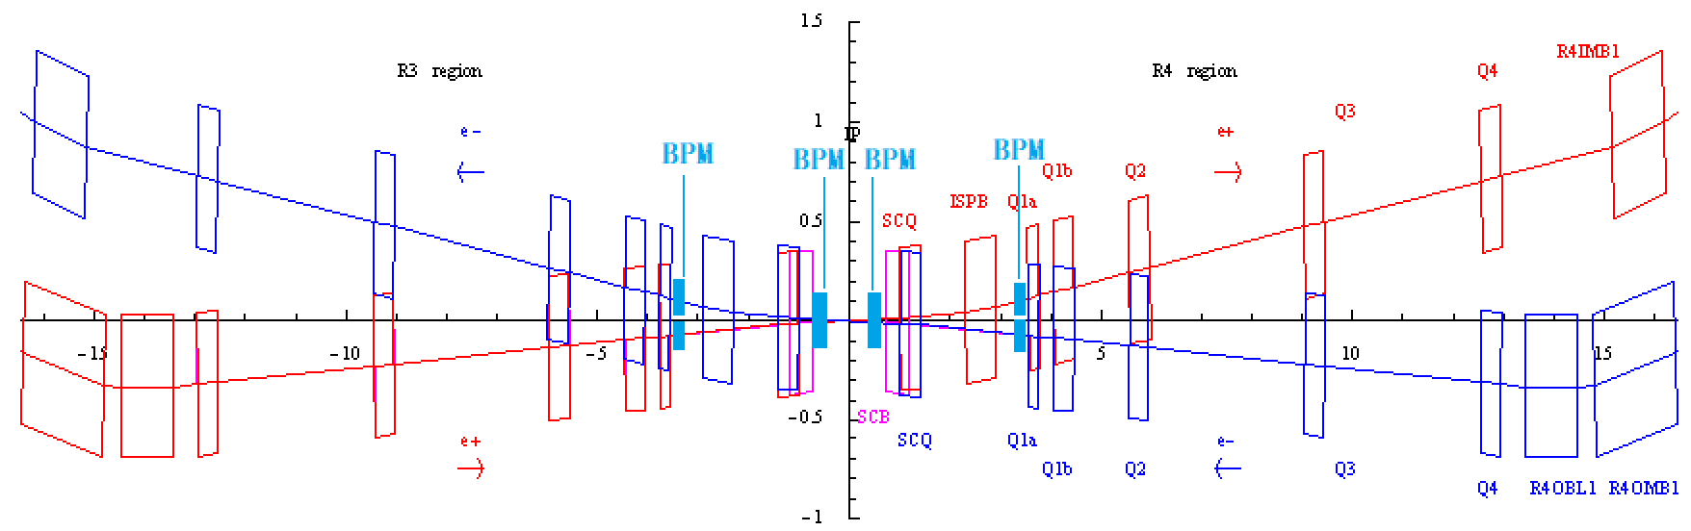
Current Status of BEPCII IP Region and BESIII
4 BPMs are equipped on both positron e⁺ and electron e⁻ beam lines near the IP.

Slide 20
Overall Structure of BESIII Detector
MDC, Main Drifter Chamber
TOF, Time Of Flight
EMC, Electro-Magnetic Calorimeter (CsI)
Muon Identifier

Slide 21
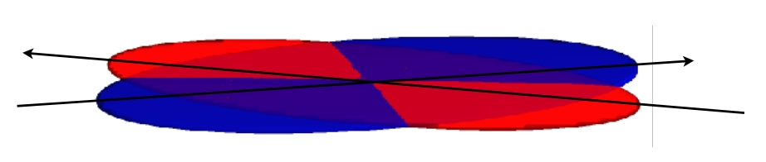
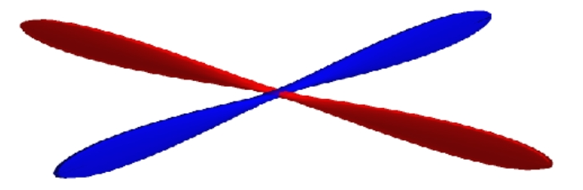
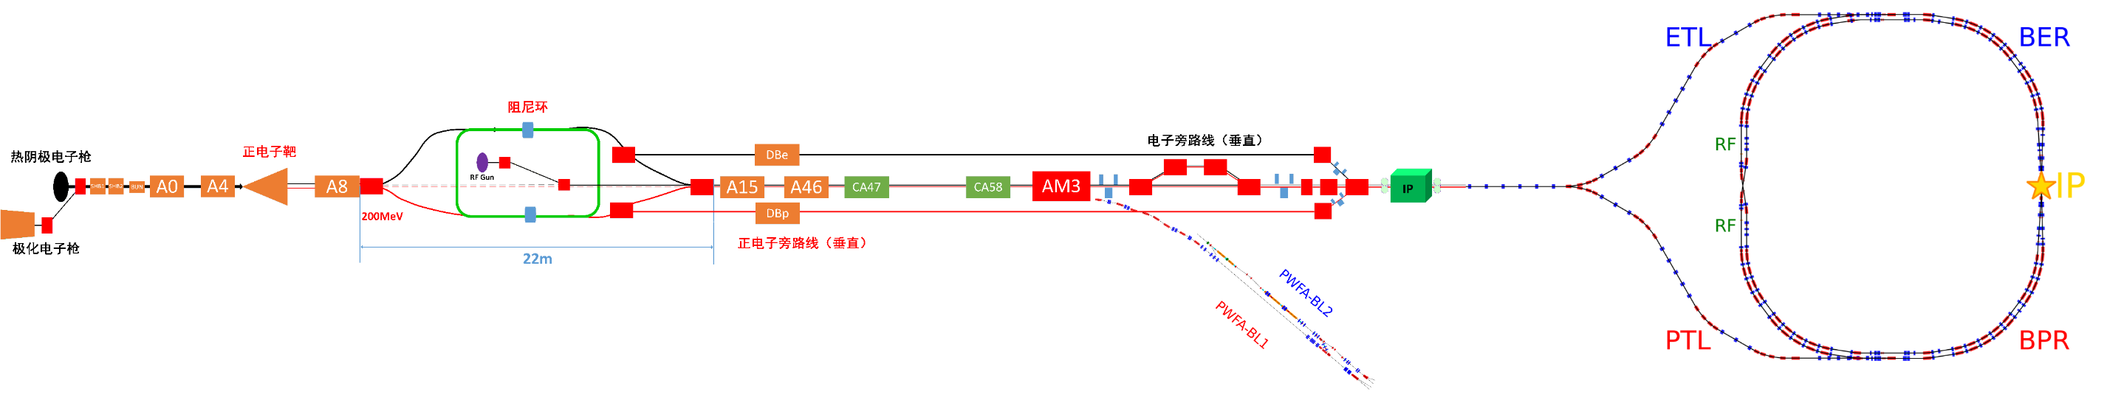
Scheme of Luminosity Upgrade with CW Strategy at BEPCII-U
Jiuqing Wang
BEPCII/U
1. IP: crab waist collision
2. Inner ring Inj. region: insert wigglers
BEPCII crab waist
3. Linac: Compact damping ring

Slide 22
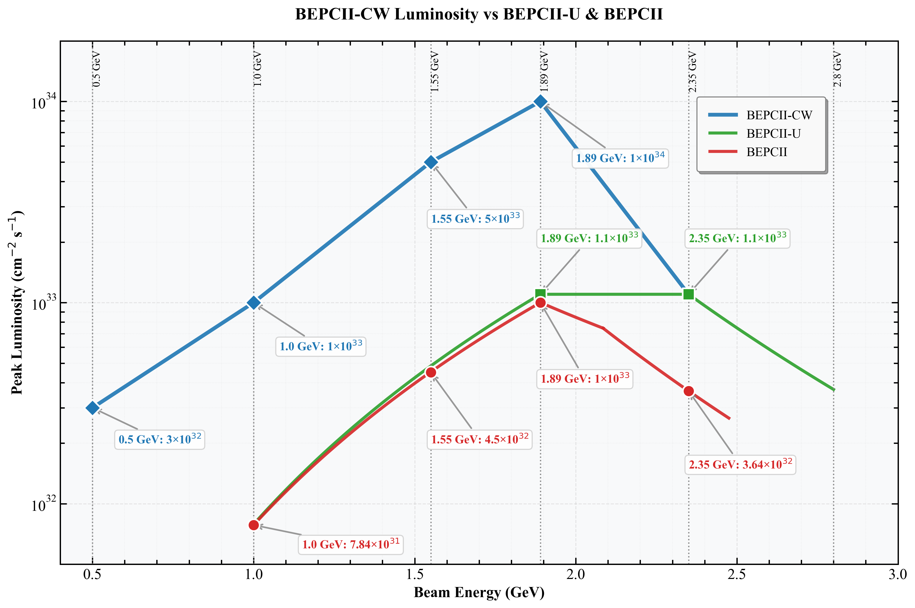
BEPCII Crab Waist performance outlook
Jiuqing Wang
The specifications at each energy are very preliminary.
Parameters and lattice design need to be carefully optimized for each energy.
Accelerator design is focusing on 1.89 GeV firstly.
Luminosity may increase by ×10 below 1.89GeV,.
Operation below 1GeV is enabled

Slide 23
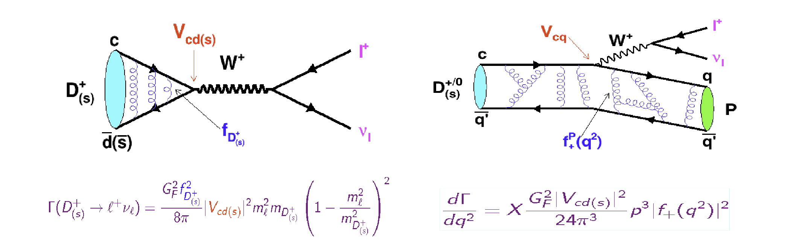
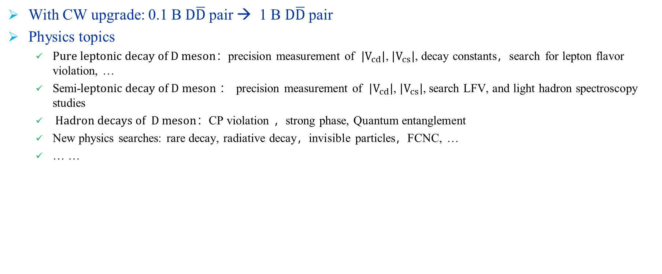
Benefits to BESIII Physics with CW
Charm physics with x10 data at 3.77 GeV
Haibo Li, Gang Li
With CW upgrade: 0.1 B $D\overline{D}$ pair → 1 B $D\overline{D}$ pair
Physics topics
  $Pure leptonic decay of D meson$：precision measurement of $|V_{cd}|$, $|V_{cs}|$, decay constants，search for lepton flavor violation, …
  Semi-$leptonic decay of D meson$： precision measurement of $|V_{cd}|$, $|V_{cs}|$, search LFV, and light hadron spectroscopy studies
  $Hadron decays of D meson$：CP violation ，strong phase, Quantum entanglement
  New physics searches: rare decay, radiative decay，invisible particles，FCNC, …
  … …

Slide 24
Benefits to BESIII Physics with CW
Physics potential at low energy region
Possible physical experiments
Haibo Li, Gang Li
Nucleon Form Factors near Threshold
Strange Hadron Physics
Energy Range: 1.7 - 2.0 GeV
Energy Range: 1.5 - 3.0 GeV
Measurement of e+e- → ppbar/nnbar cross sections and extraction of nucleon form factors.
Precision study of hadrons containing strange quarks (e.g., Λ, Σ, Ξ).
High-Precision R-Scan
phi Vector Meson Line Shape
Energy Range: 1.0 - 2.0 GeV (Precision < 5%)
Energy Range: 0.9 - 1.3 GeV
Precision measurement of the R value (σ_had/σ_mumu) in the center-of-mass energy region.
Detailed line shape scan of the phi(1020) meson in the specified region.
Exclusive Hadronic Cross Sections
rho-omega Scan
Energy Range: 1.0 - 2.0 GeV
Energy Range: 0.4 - 1.0 GeV
Measurement of exclusive channels (e.g., pipi, KK, LambdabarLambda) and their form factors.
Precision scan focusing on the e+e- → pi+pi- cross section measurement.
低能区（束流能量<=1.0GeV)

Slide 25
Requirements for the BEPCII Luminosity Feedback Control System
To achieve the above research objectives, it is necessary to establish a luminosity feedback control system at the BEPCII Interaction Point.

Slide 26
3. The Design of BEPCII Interaction Point(IP) Local Luminosity Feedback Control System

Slide 27
Framework of Local Orbit Control and Luminosity feedback System at BEPCII-U IP
Local Orbit Control and Luminosity Feedback System（based on FOFB）
The core equipment includes
  BPMs
  Luminosity Monitor
  TDC logic
  Interface to PSC
  ……

Slide 28
Main electronics function block of Orbit feedback system for BEPCII-U IP
BPM sub-system
  BPM detector
  PT module
  Digital BPM electronics
Luminosity monitor
sub-system
  Luminosity detector
  Front-end electronics
  DAS electronics
Interaction Point fast orbit feedback
control system of BEPCII
  FOC, Fast Orbit Controller
  BPM interface logic
  Luminosity monitor interface logic
  TDC logic
  Power Supply Controller Interface
  ……

Slide 29
System Construction Conception
Based on the hardware of the HEPS FOFB system, construct the local orbit feedback control as well as collision luminosity monitoring and feedback control system for BEPCII-U IP.

Slide 30
Some Considerations in the Design
The measurement accuracy of BPM data must be ensured.
The data from luminosity detectors and BPMs must maintain the same time delay.
Arriving time of electron and positron should be measured and monitored.
In the system implementation, referring to the work of SuperKEKB, beam orbit feedback control is adopted in the Y direction, and Fast luminosity dithering is applied in the X direction.

Slide 31
Summary
We have completed the design, installation, commissioning and running of the HEPS FOFB system.
BEPCII-U has demands for collider luminosity upgrade, and relevant work is currently under planning. Meanwhile, it is essential to develop an IP luminosity feedback control system based on luminosity monitoring.
We will develop this system based on the HEPS FOFB system.

Slide 32
Thank you for your attention

