Slide 1
Study on SiC Sensor Application in Fast Luminosity Detectors
Xiyuan Zhang¹ , Yanpeng Li^{1,2}, Meng Li^{1,3} , Jiaqi Zhou^{1,2} , Haoyu Shi¹, Dou Wang¹, Philip Bambade³, Weimin Song² and Xin Shi¹
¹Institute of High Energy Physics, CAS
²Jilin University
³Laboratoire de l'Accélérateur Linéaire (LAL),Centre Scientifique d’Orsay

Slide 2
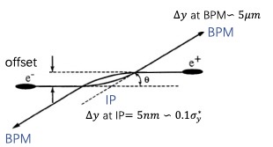
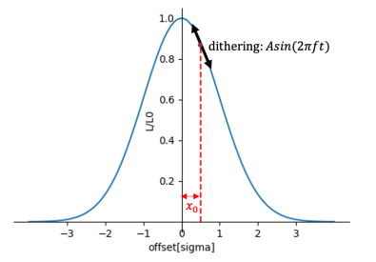
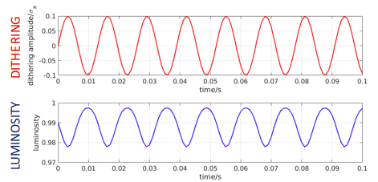
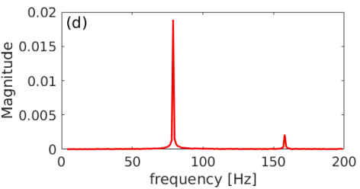

Necessity of the Fast Luminosity Monitor for CEPC
Meng Li from accelerator
Crab waist scheme for CEPC to achieve a very high luminosity (5×10³⁴ cm⁻²s⁻¹)
IP beam size very small
Luminosity sensitive to the stability of beam jitter (like ground motion)
Orbit feedback system at the IP to maintain an optimum collision and maximize the luminosity
Two possible methods for the IP orbit feedback system
Insufficient BPM resolution in the horizontal plane, a luminosity-driven dithering feedback system required
Vertical IP orbit feedback——Beam-beam deflection driven method
Horizontal IP orbit feedback——Luminosity driven method
Based on the measurement of the offset with BPMs upstream and downstream of the IP
Based on the measurements of the luminosity with a certain frequency dithering

Slide 3
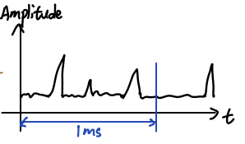
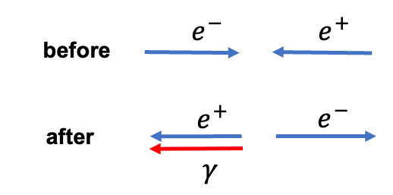
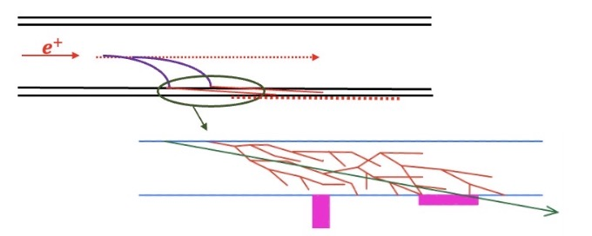
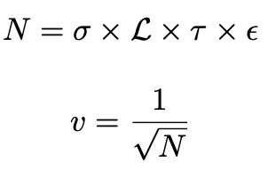
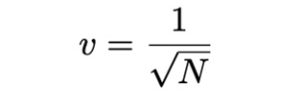
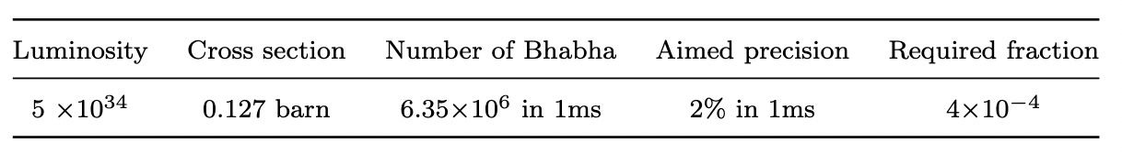

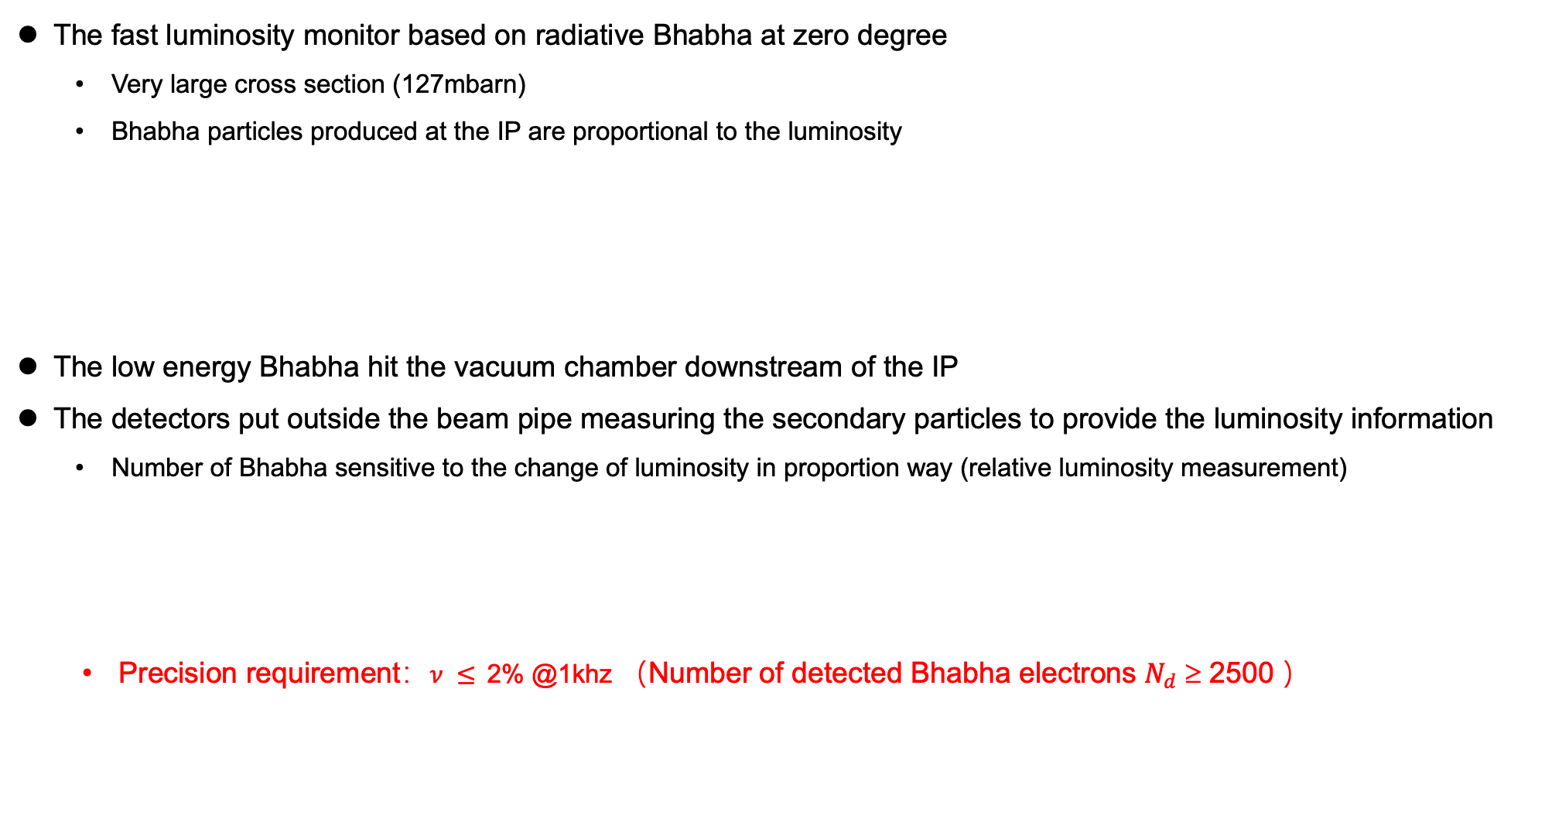
Fast Luminosity Monitor working principle
Meng Li from accelerator
The fast luminosity monitor based on radiative Bhabha at zero degree
Very large cross section (127mbarn)
Bhabha particles produced at the IP are proportional to the luminosity
The low energy Bhabha hit the vacuum chamber downstream of the IP
The detectors put outside the beam pipe measuring the secondary particles to provide the luminosity information
Number of Bhabha sensitive to the change of luminosity in proportion way (relative luminosity measurement)
Precision requirement：$ν ≤$2% @1khz （Number of detected Bhabha electrons $N_{d}$ ≥ 2500 ）

Slide 4
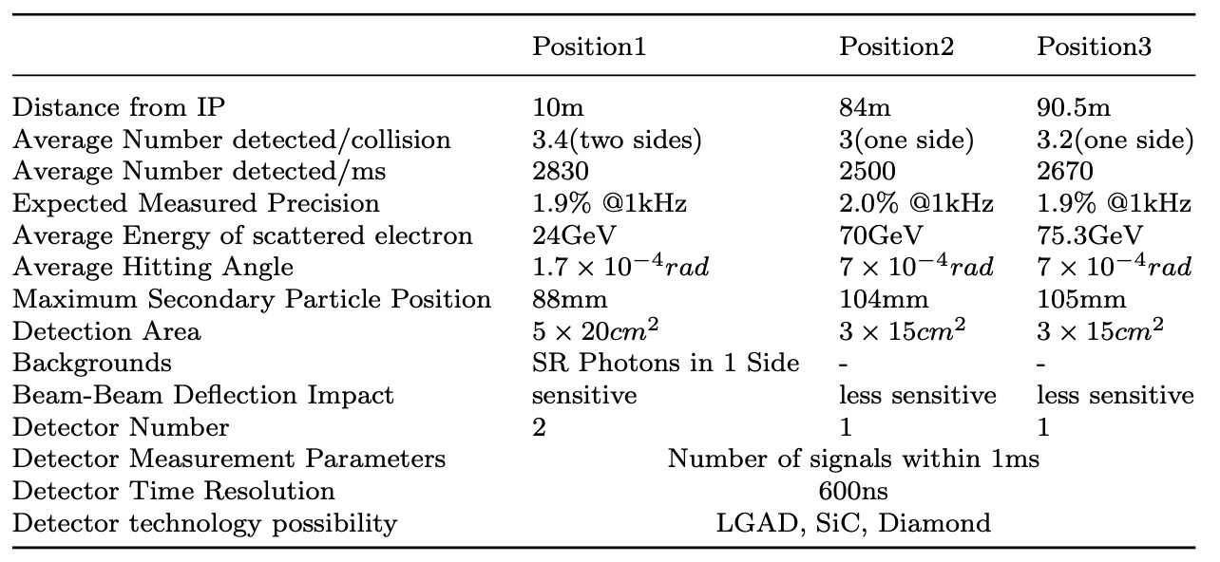
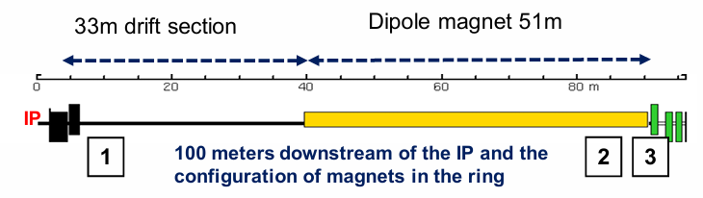
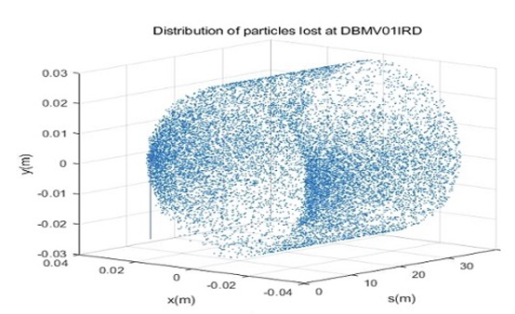
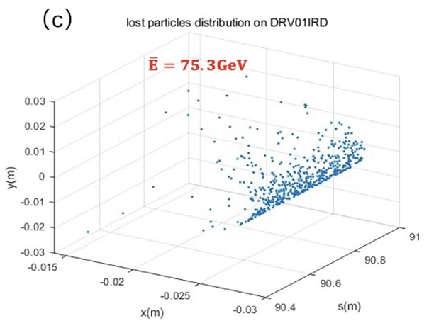
The position of Fast Luminosity Monitor
Meng Li from accelerator
Low-energy scattered electrons are mainly lost at Position 1、2 and 3
Positions 1 and 3 ：suitable for detector installation
Position 2 excluded：not feasible for detector installation（ inside the dipole magnet ）
355ns

Slide 5
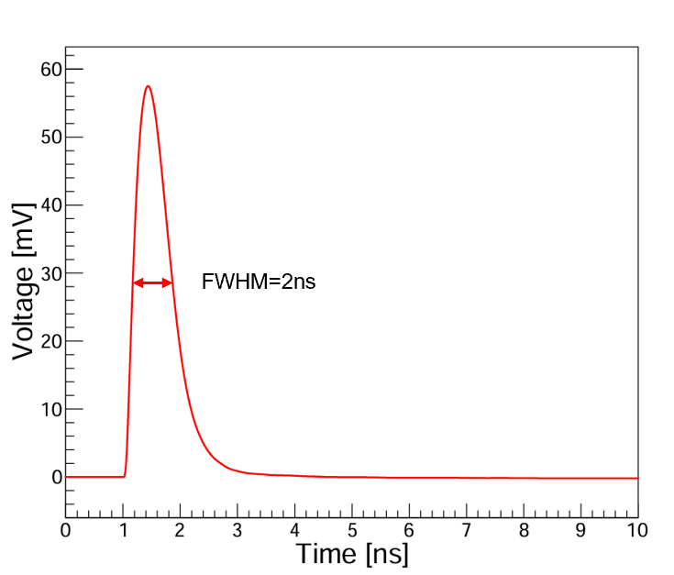



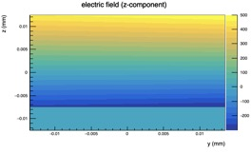


Simulation workflow in RASER (RAdiation SEmiconductoR)
Simulate the waveform generated by a single particle in a detector
Energy deposition
Simulation of the energy deposition of Bhabha electron events from GEANT4
Simulation of the electrical field & weighting field from DEVSIM
Simulation of the current signal from Calcurrent in RASER (RAdiation SEmiconductoR)
Simulation of the voltage signal from NGSPICE
Carrier Drift & Diffusion
Shockley–Ramo theorem
Independent development
Electrical field & weighting field
Advantages
Open Source;
Strong expandability;
Easily interact with other software
https://raser.team

Slide 6
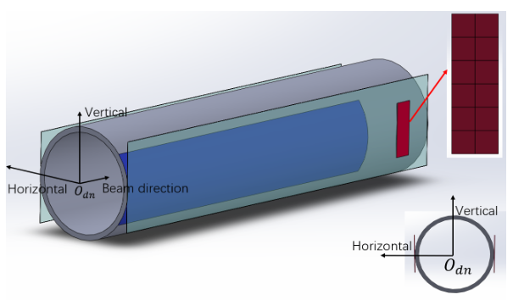
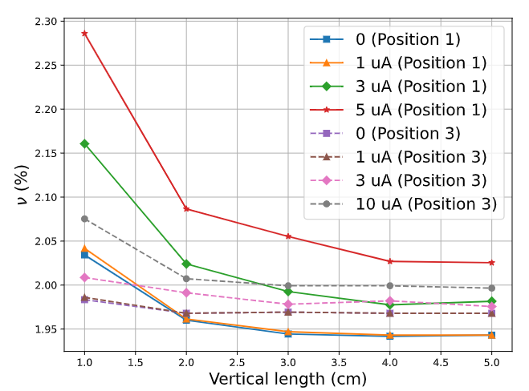
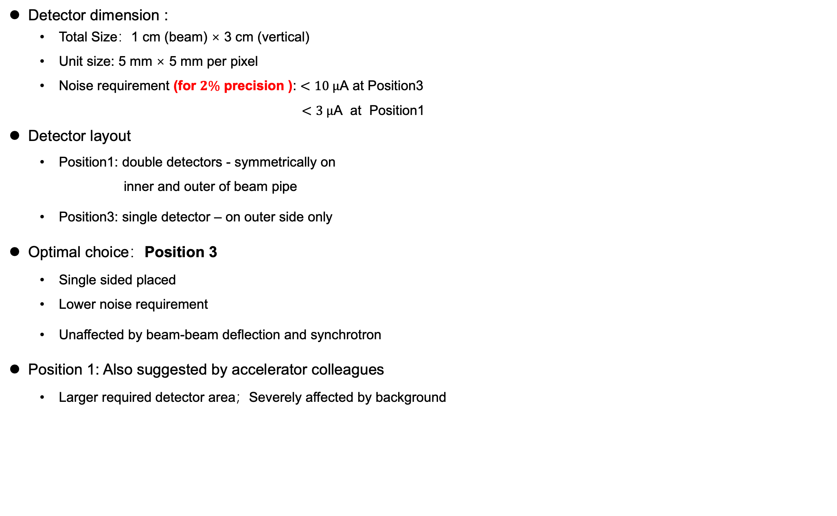
Detector Geometry & Layout Optimization
Detector dimension :
Total Size：1 cm (beam) × 3 cm (vertical)
Unit size: 5 mm × 5 mm per pixel
Noise requirement (for $2\%$ precision ): $<10 μ\text{A}$ at Position3
$<3 μ\text{A}$ at Position1
Detector layout
Position1: double detectors - symmetrically on
inner and outer of beam pipe
Position3: single detector – on outer side only
Optimal choice：Position 3
Single sided placed
Lower noise requirement
Unaffected by beam-beam deflection and synchrotron
Position 1: Also suggested by accelerator colleagues
Larger required detector area；Severely affected by background
3cm
1cm

Slide 7
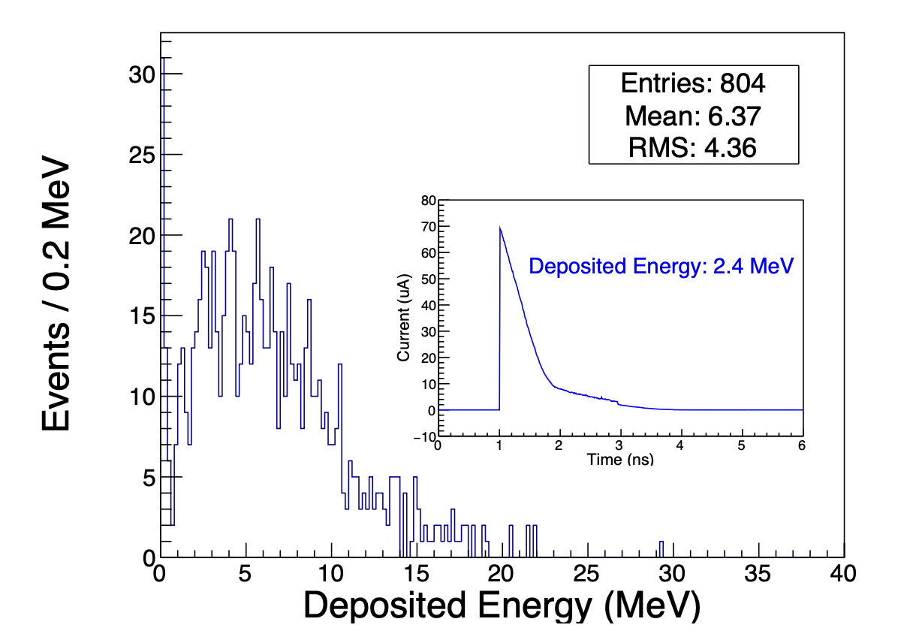
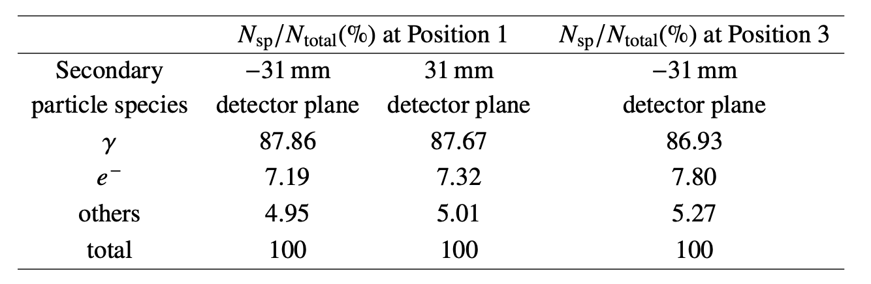
The Simulation to Estimate the Signal in the Detector
Types of secondary particles detected
Photon-dominated （ ~87% of detected secondary particles ）
Electrons ~ 8%
Others ~ 5%
Detector performance at nominal luminosity （Position3）
Total Energy deposition：~6 MeV per bunch crossing
Single-pixel current pulse: ~70 μA, ~3 ns full width

Slide 8
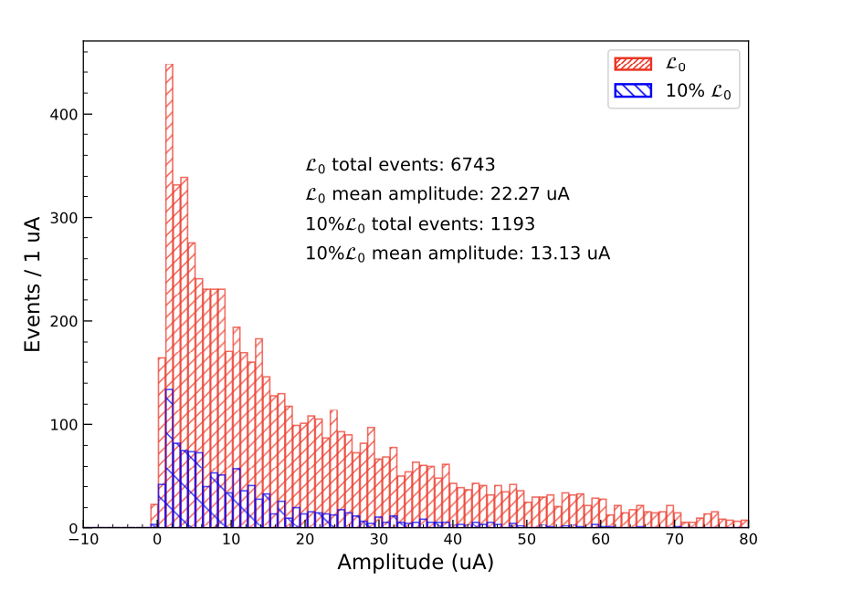
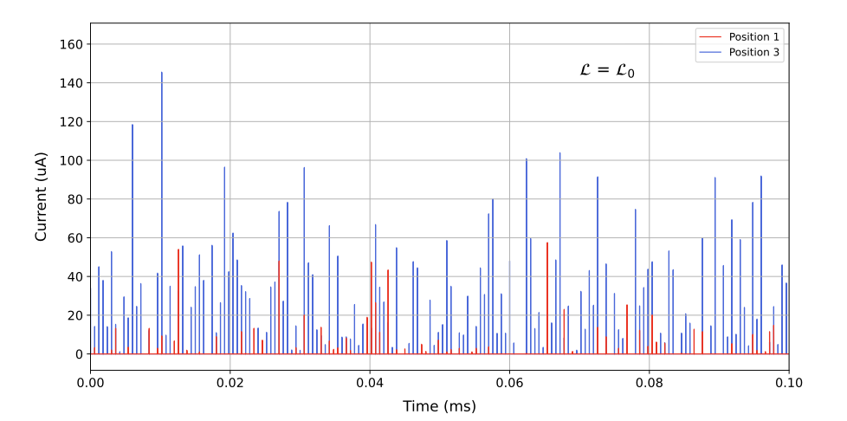
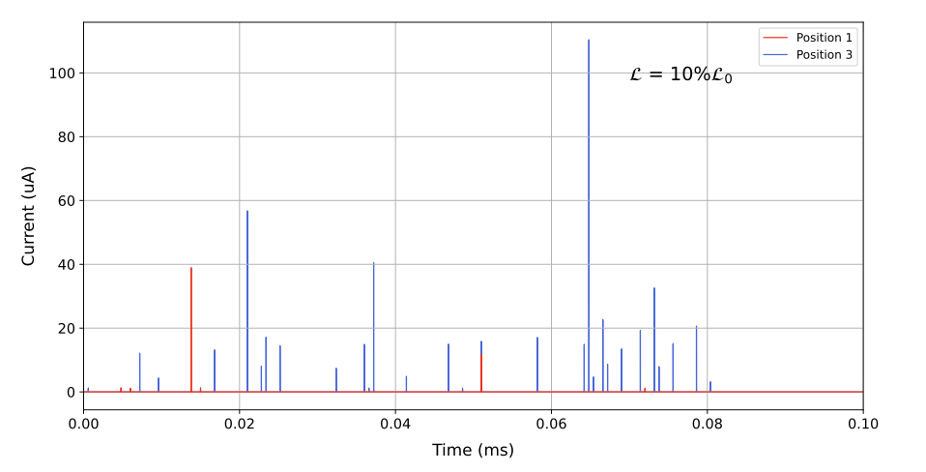

The Simulation to Estimate the Signal in the Detector
Detector response to luminosity reduction
Simulation conditions: $ℒ_{0}$ (nominal) vs. $10\% ℒ_{0}$
Observed effects at reduced luminosity
Fewer signal peaks (events decrease)
Lower amplitude per peak (weaker individual signals)
Position3

Slide 9
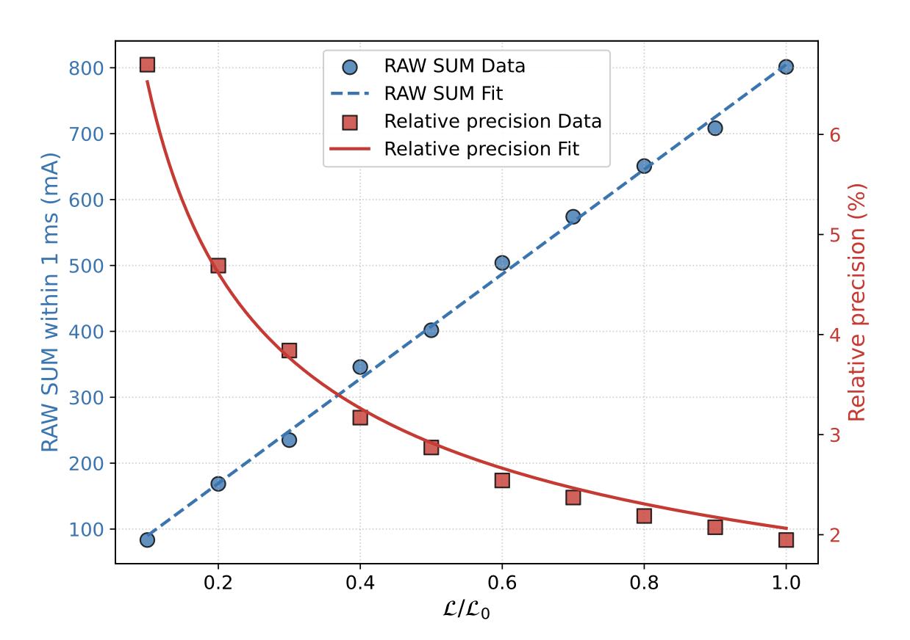


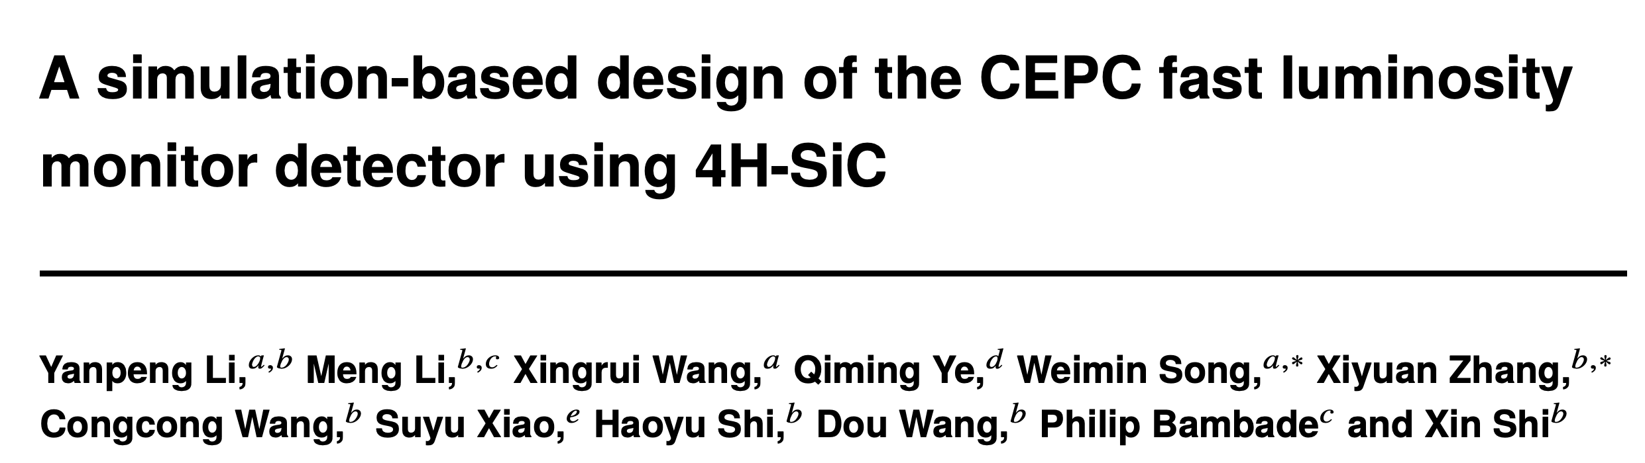

The Simulation to Estimate the Signal in the Detector
Quantifying Detector Response vs. Luminosity
RAW SUM：Sum of sampling points exceeding threshold within 1 ms
Key findings
Liner relationship: RAW SUM proportional to luminosity
Precision: $ν∝1/\sqrt{L}$
Nominal L₀： 2%
10% L₀：～7%
SuperKEKB experience:
Even 7% precision feedback reduces beam offsets
p: pixel number ；s: sampling point （10GHz，1ms）
DOI 10.1088/1748-0221/21/02/T02009

Slide 10
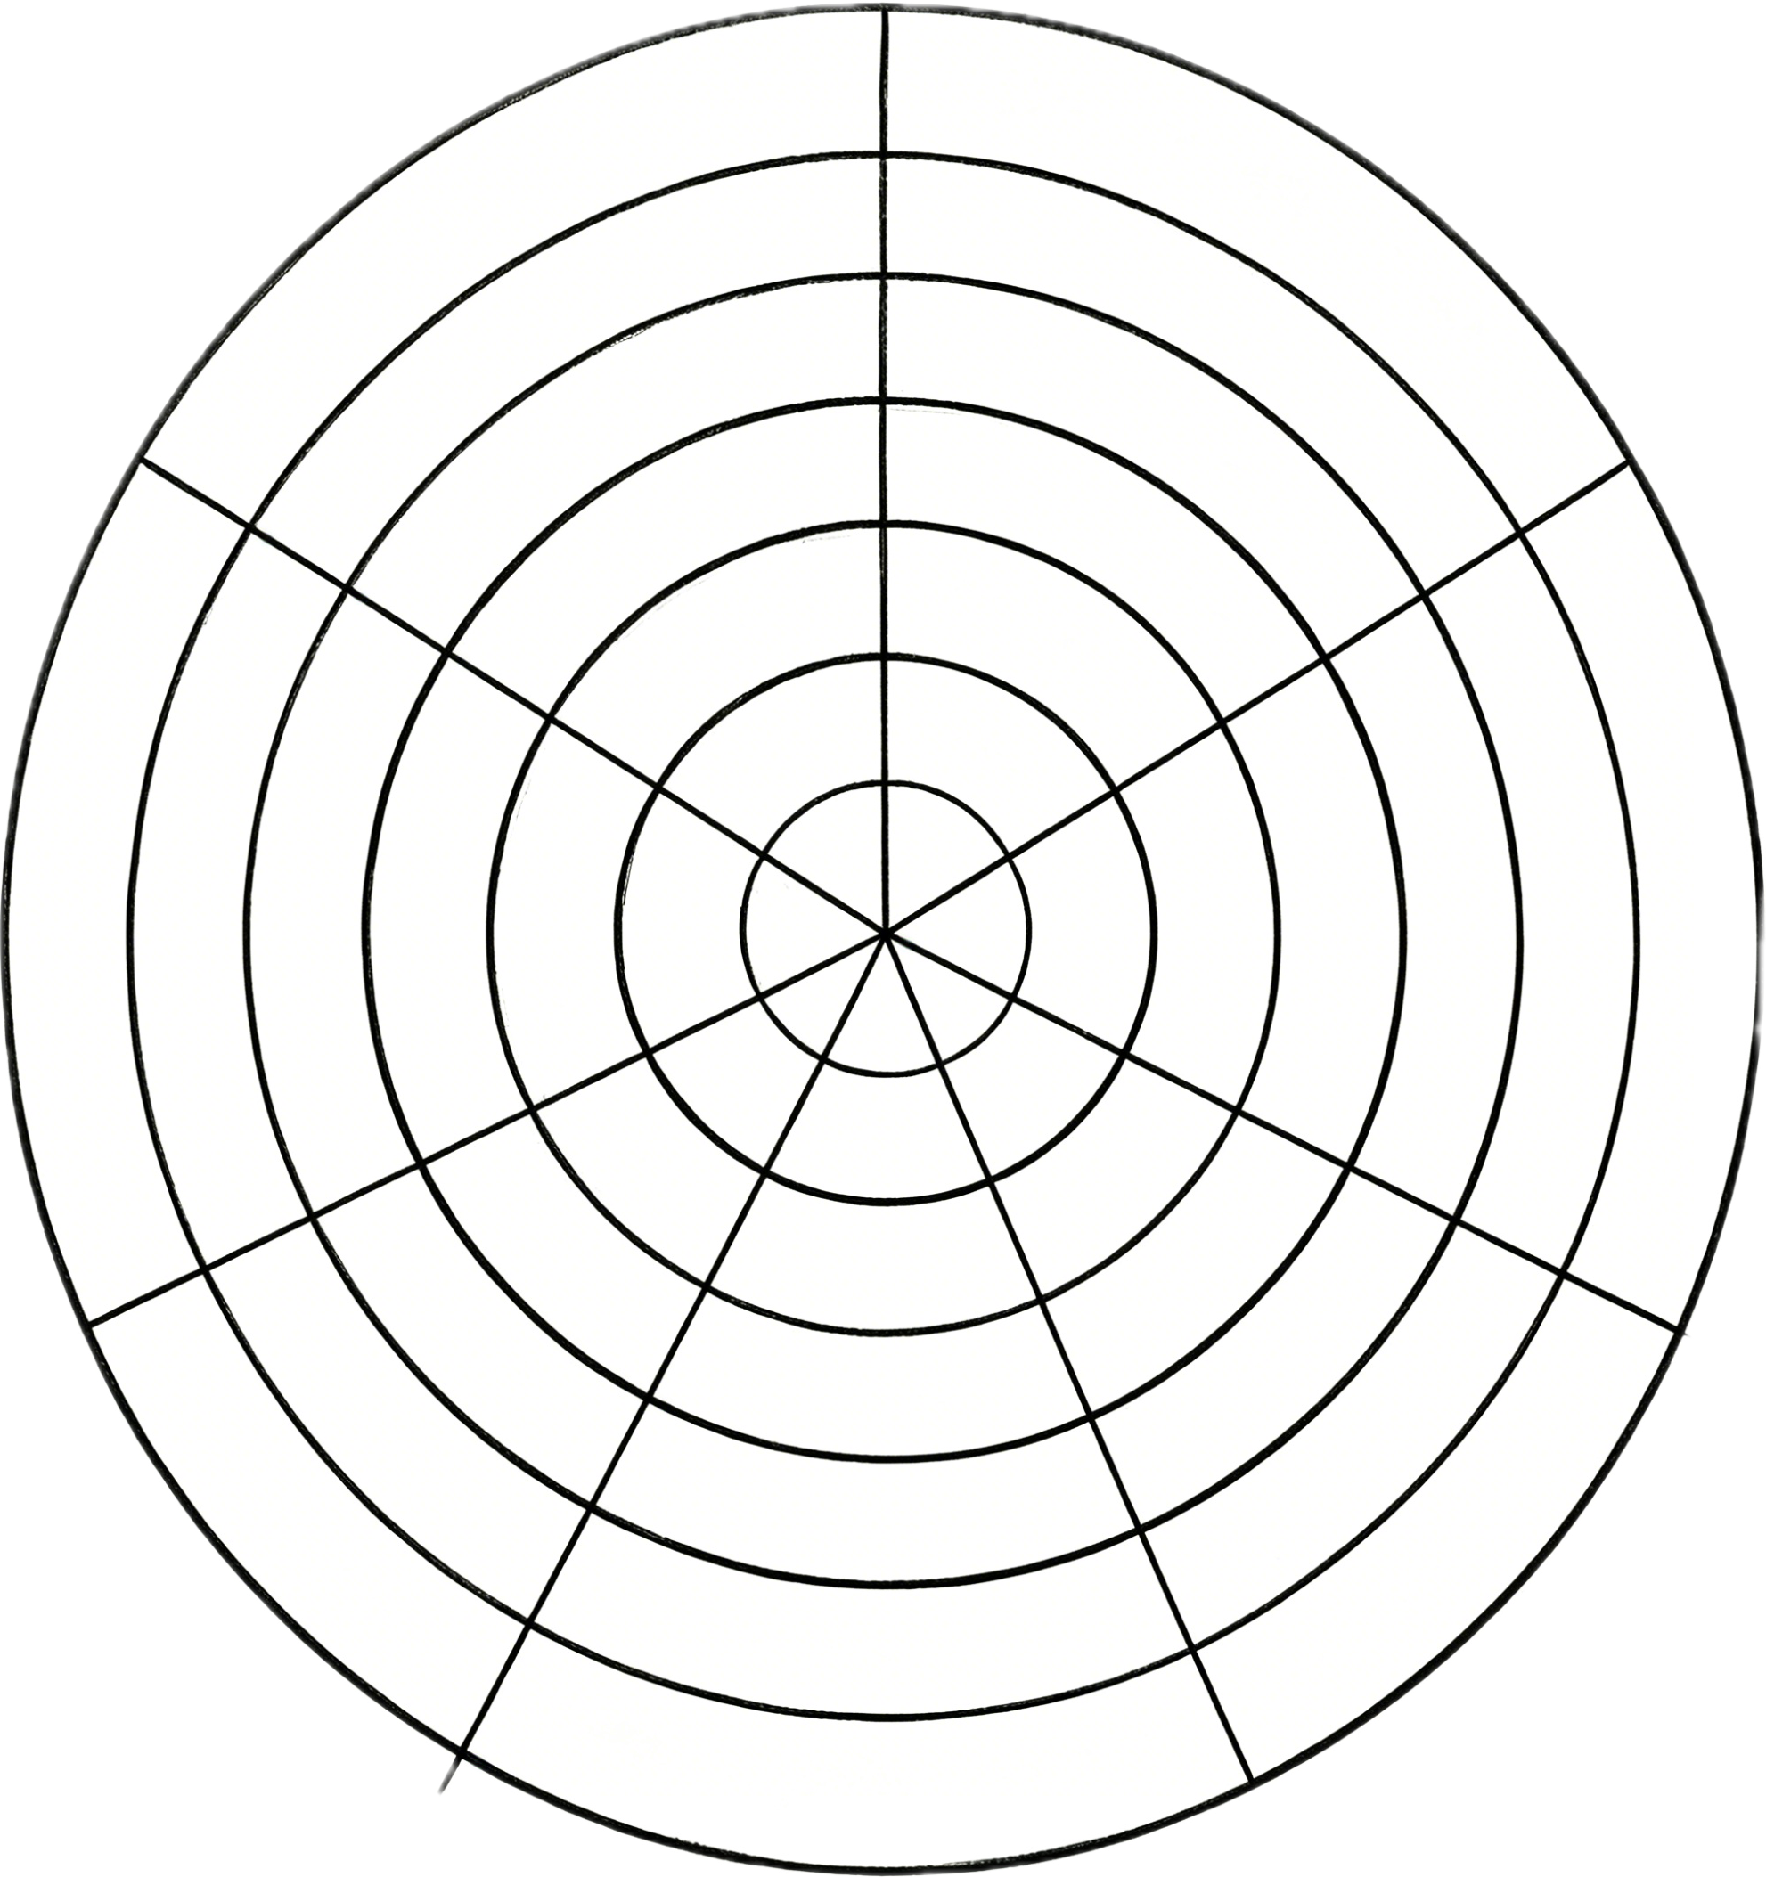
Silicon carbide
Wide band material Silicon Carbide(SiC) as particle detector material:
Pros:
Bandgap between silicon and diamond
Higher saturation velocity and breakdown field
Larger atomic displacement threshold
→ Potentially good radiation hardness
No dark current increase after irradiation
High thermal conductivity
→ No cooling needs
No sensitivity to visible light
Cons:
Different polytypes(3C, 4H, 6H)
Higher ionization energy
→ Smaller signals → LGAD
Epitaxial-grown limited to ~150μm thickness
Ionization Energy [eV]
13
Displacement Energy [eV]
7.6
Large-area Process
43
Mature
30-40
Highly mature
3.6
Immature
13-15
3· 10⁵
low-cost
10⁷
4· 10⁶
1.12
Mid-range
0.8· 10⁷
High-cost
3.23
Price
Breakdown Electric
Voltage [V/cm]
2· 10⁷
2.2· 10⁷
5.5
Bandgap[eV]
Electron Saturation Velocity [cm/s]
Diamond
SiC
Si

Slide 11
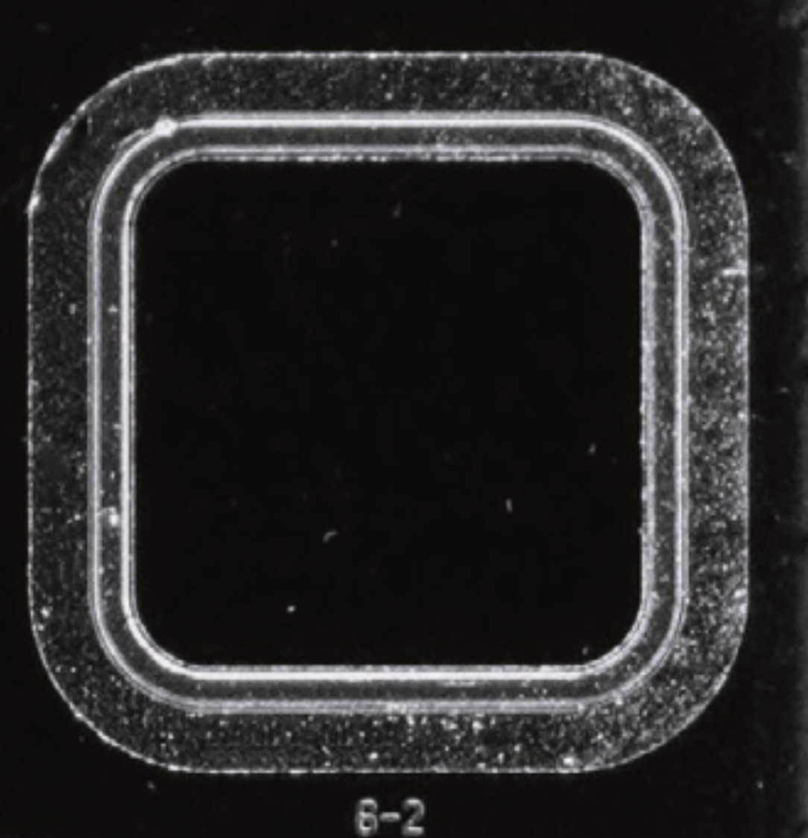
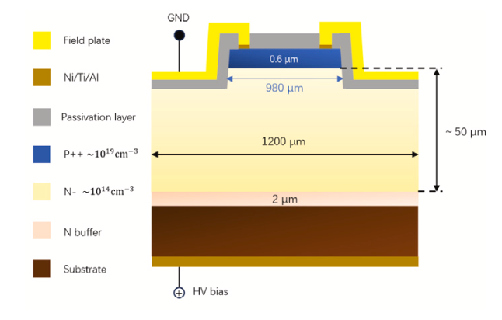
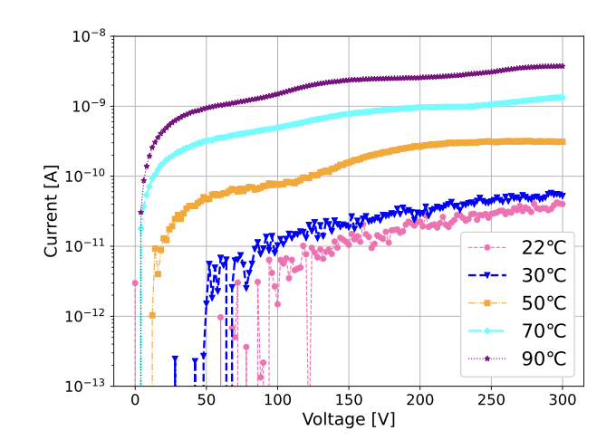
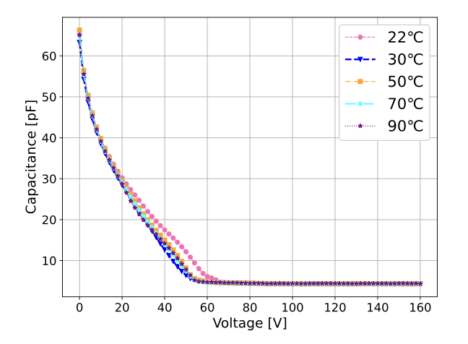
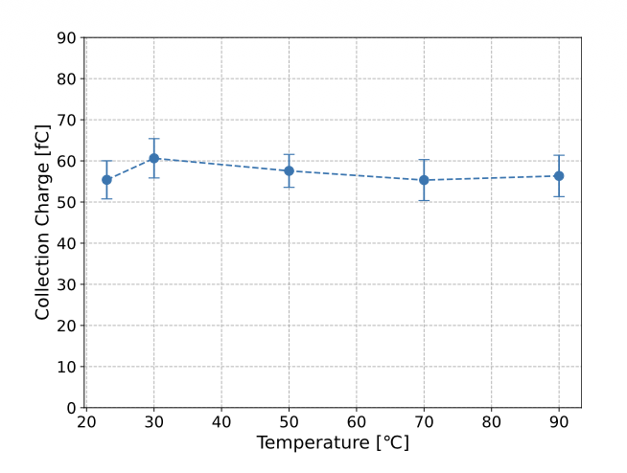
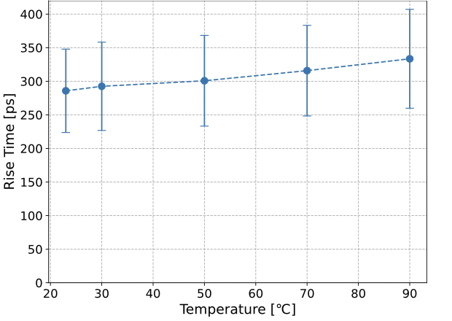
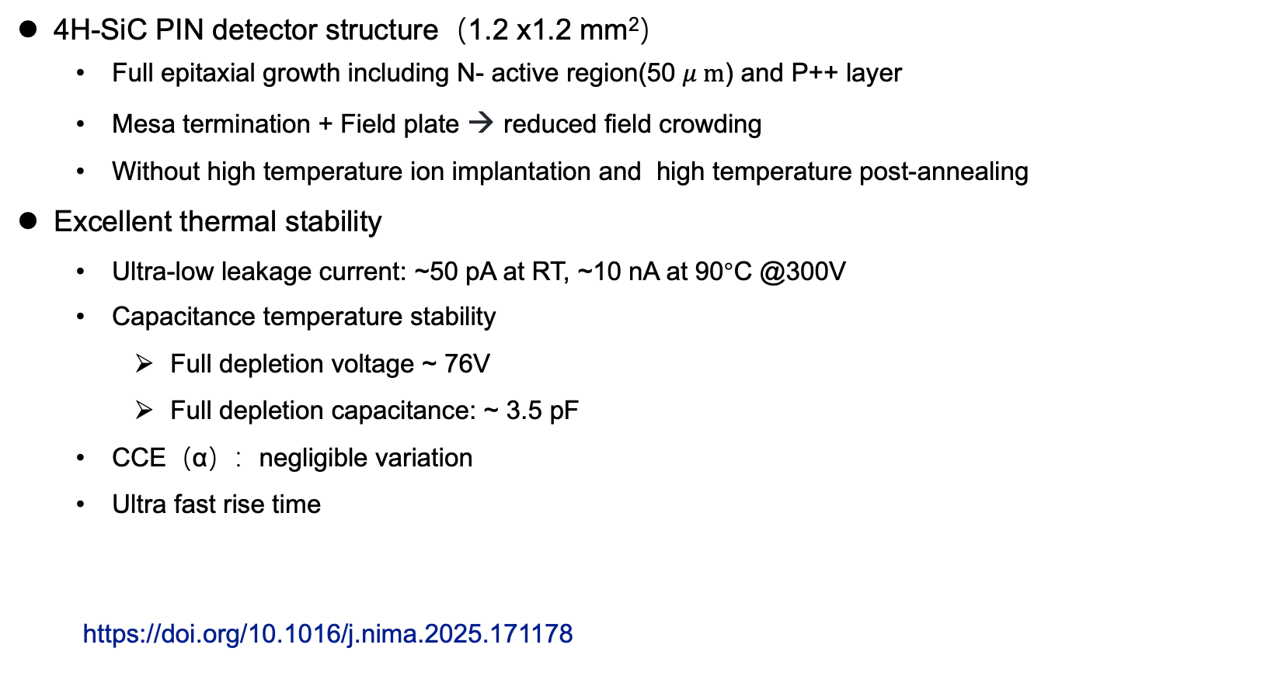
4H-SiC detector development @ IHEP —— SICAR1_PIN detector
4H-SiC PIN detector structure（1.2 x1.2 mm²）
Full epitaxial growth including N- active region(50 $μ m$) and P++ layer
Mesa termination + Field plate → reduced field crowding
Without high temperature ion implantation and high temperature post-annealing
Excellent thermal stability
Ultra-low leakage current: ~50 pA at RT, ~10 nA at 90°C @300V
Capacitance temperature stability
Full depletion voltage ~ 76V
Full depletion capacitance: ~ 3.5 pF
CCE（α）：negligible variation
Ultra fast rise time
https://doi.org/10.1016/j.nima.2025.171178

Slide 12
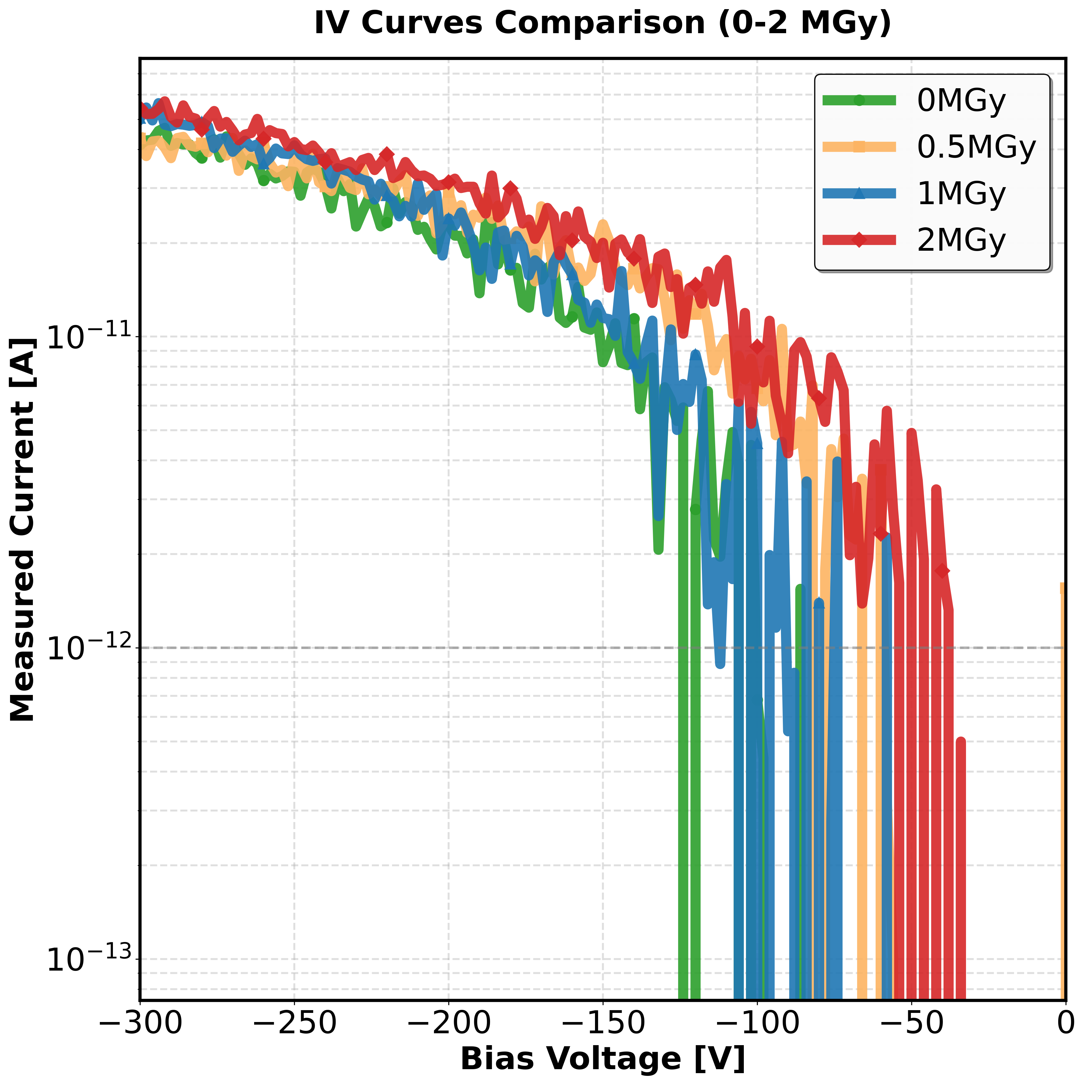
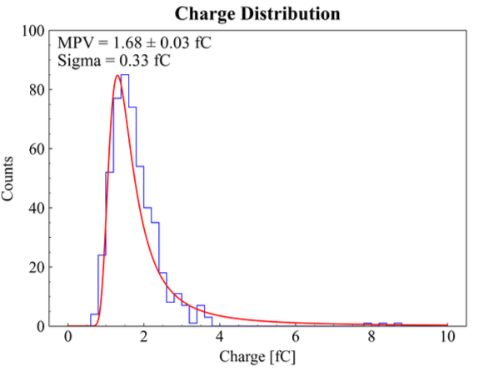
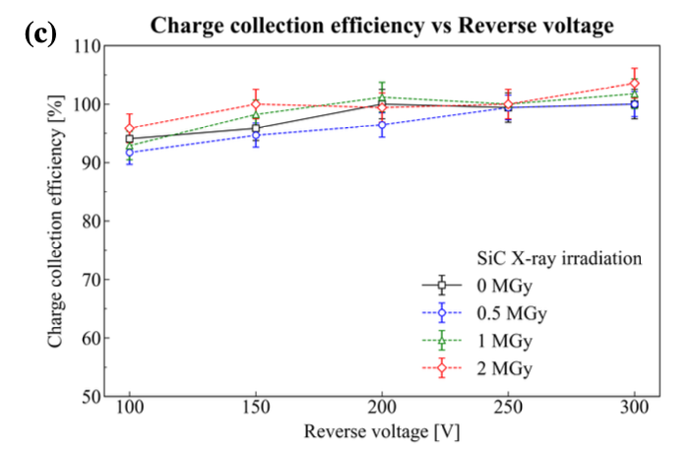
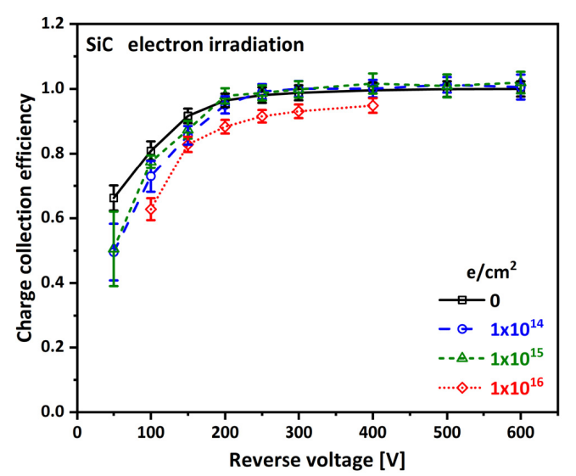
4H-SiC detector development @ IHEP —— SICAR1_PIN
FLM for CEPC—Secondary particle fraction
γ ：87% ； e- ：8%
X-ray radiation hardness up to 2MGy
Leakage current remains stable
CCE（β particle）— no degradation
Electron radiation hardness up to 1x10¹⁶ e/cm²
CCE reduction in the range of 10% at 1x10¹⁶ e/cm²
[1] https://doi.org/10.48550/arXiv.2603.18547
[2] DOI: 10.1109/TNS.2020.3029730

Slide 13
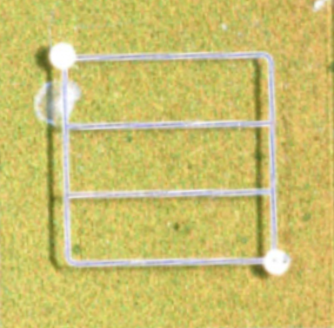
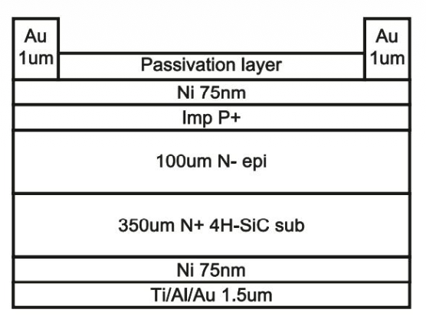
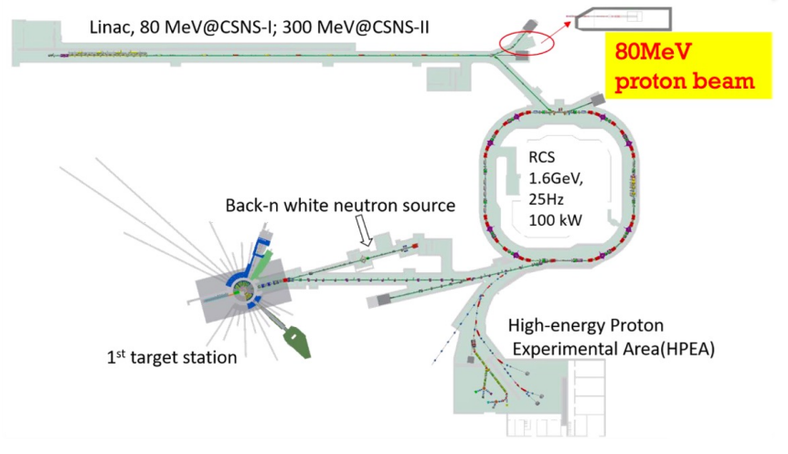
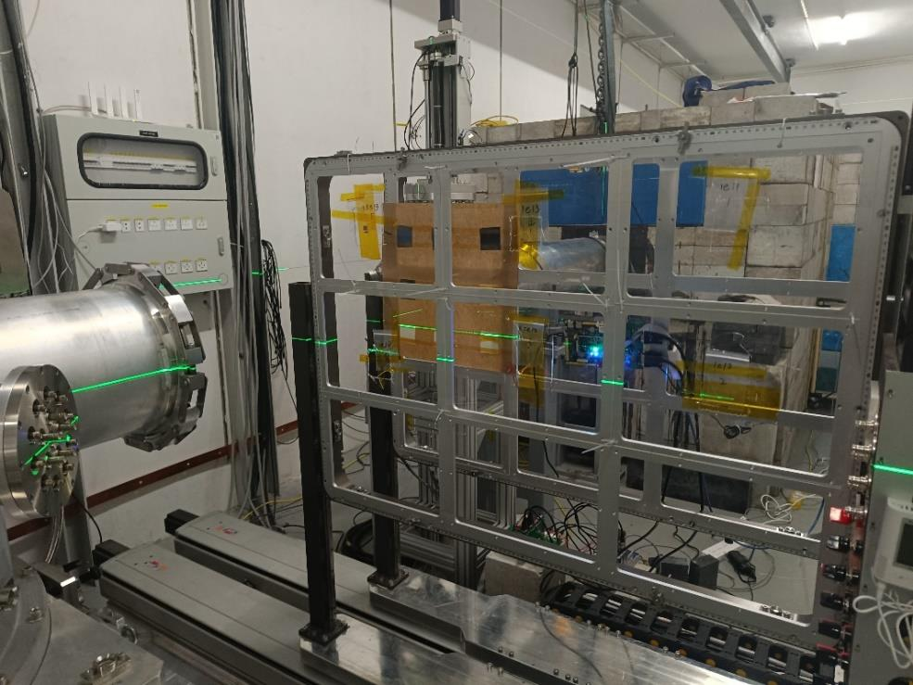
Proton irradiation assessment of 4H-SiC PIN from NJU
4H-SiC PIN-NJU（ 1.5 x1.5 mm² ）
Irradiation source— China Spallation Neutron Source （CSNS）
Beam energy: 80 MeV protons
Beam spot size: 20 mm × 20 mm
Fluence: 1.4e11 p/cm², 2.5e12 p/cm², 7.0e12 p/cm², 7.0e13 p/cm²
NJU

Slide 14
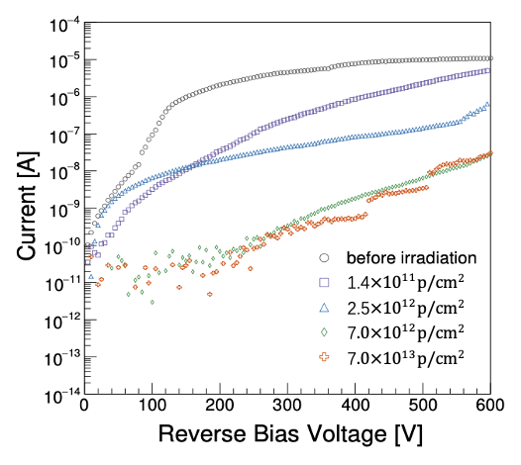
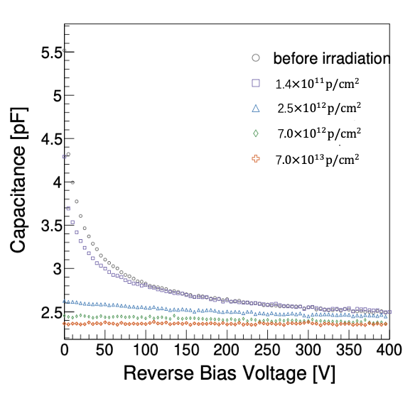
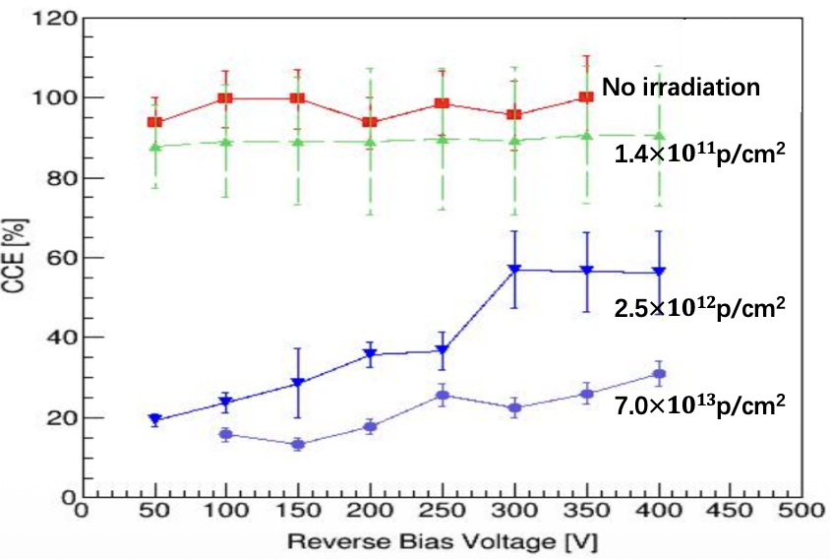
Proton irradiation assessment of 4H-SiC PIN from NJU
Leakage current decreases with increasing irradiation fluence（Opposite to Si）
C-V curve gradually flattens
Acceptor defects cause compensation effect on n-type doping
Alpha particle charge collection efficiency (CCE) degrades
CCE Drops to 30% of 7.0×10¹³ p/cm²

Slide 15
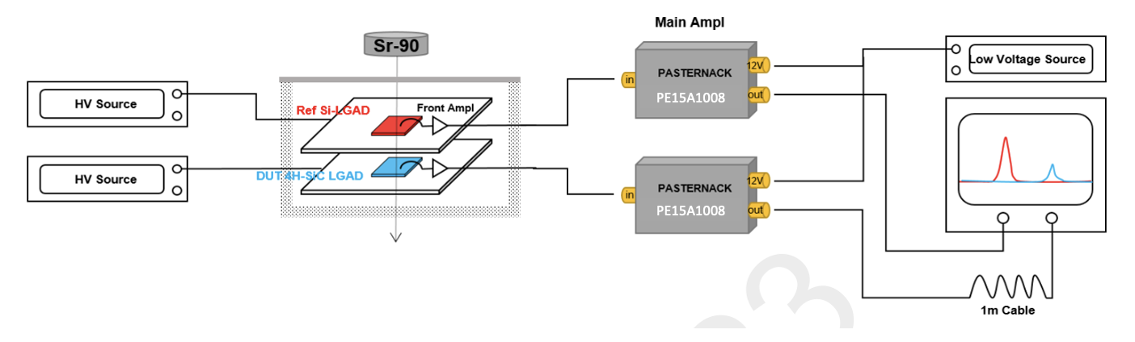
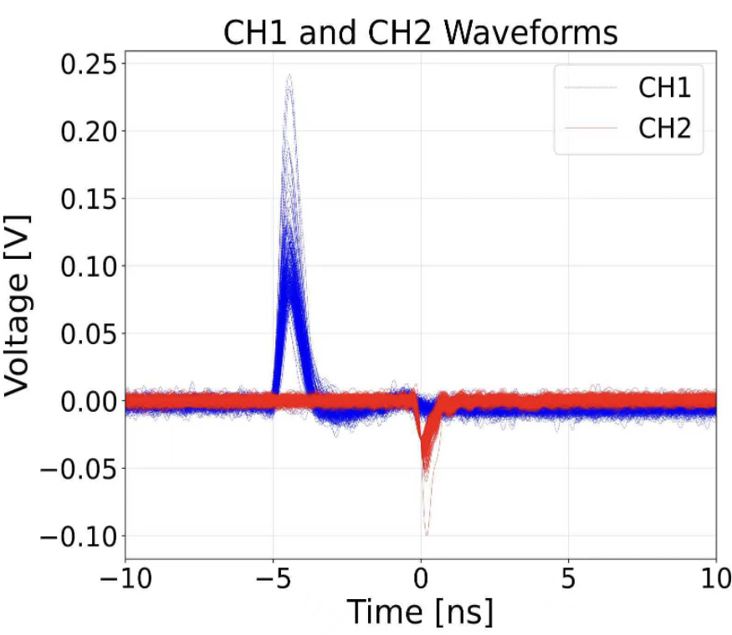

4H-SiC detector development @ IHEP —— SICAR1_PIN
Time resolution
⁹⁰Sr source
TIA amplifier (UCSC) + 2nd amplifier （PE 15A1008）
Reference（CH1）：Si-LGAD NDL （35ps）
Time resolution of 4H-SiC PIN ～21ps

Slide 16





Beam monitor at BSRF- 4W1A
Simulate CEPC beam at BSRF- 4W1A
Photon flux：7.5 x10¹² Phs/sec/0.1% BW
X-ray + electron response
External trigger: 1 Hz, sampling length: 100ns
Detector output signal closely follows beam current（e-） trend
X ray signal
Electron signal

Slide 17





4H-SiC detector development @ IHEP —— SICAR1_LGAD
4H-SiC LGAD detector structure（1 x1 mm²）
Full epitaxial growth including N- active region(50 $μ m$)
N+ gain layer and P++ layer
Mesa termination
Without high temperature ion implantation and
high temperature post-annealing
Gain factor calibration with α source
Gain factor: 2-3 @ 300V
50
[DOI: 10.1109/TNS.2024.3471863]

Slide 18


4H-SiC detector development @ IHEP —— SICAR1_LGAD
4H-SiC LGAD proton irradiation hardness
Beam energy: 80 MeV protons;
Fluence: 1.4e11p/cm² , 2.5e13p /cm² , 7.0e13 p/cm²
CV
Parallel-plate capacitor-like (2.5e13 p/cm² ~7e13 p/cm² )
IV
> 1$μ$A @300V (No irradiation);
5 orders of magnitude higher than PIN
Decreases with increasing fluence; reaches nA level at highest fluence

Slide 19

4H-SiC detector development @ IHEP —— SICAR1_LGAD
Charge collection vs. irradiation fluence
CCE degrades with irradiation fluence increasing
7e13p/cm² → CCE drops to 57% → Superior to PIN devices（CCE drop to 30%）
[DOI: 10.1109/TNS.2025.3635073]

Slide 20



4H-SiC detector development @ IHEP —— SICAR3_LGAD
4H-SiC LGAD optimization_SICAR3
High-temperature (500°C)； high-energy implantation > 1 MV
High-temperature annealing (1700°C) → Activate carriers and repair defects
High fabrication complexity and high cost → MPW
SICAR3

Slide 21


4H-SiC detector development @ IHEP —— SICAR3_LGAD
Leakage current
PIN：~1 nA at 1000 V without breakdown
LGAD ：Wafer1～100nA ； Wafer2～200nA； Wafer3～1$μA；$ Wafer4～4$μA；\text{at}\text{ 1000 }\text{V} \text{without} \text{breakdown}$
C-V
Gain layer fully depleted at 120V ～150V
Active layer fully depleted at 600V

Slide 22



4H-SiC detector development @ IHEP —— SICAR3_LGAD
Charge collection of beta @700V ： ~3 fC（PIN）；～40fC （LGAD）
Gain ～ 13 @ 700V

Slide 23
Summary
Simulation determines the optimal position and geometry of the SiC-based Fast Luminosity Monitor for CEPC， meeting the 2% precision requirement.
Simulated detector response vs. luminosity variation demonstrates its capability for real-time luminosity feedback.
SiC is radiation-hard, for photons and electrons
SiC LGAD achieves 13× gain factor at 700 V
.
Thanks！

Slide 24

Backup：Beam monitor for CSNS
High Energy Proton Experimental Station (HPES)
China's first 1.6 GeV proton source
a beam monitoring system to detect the flux of the proton beam
Macro pulse period: 40 ms
1 ms
…
Pulse interval 39 ms
…
410ns
Time
Micro pulse period：410ns
410ns
80ns

Slide 25



Beam monitor for CSNS
Signal acquisition using a 375 nm laser system
a signal generator to simulate the pulse period（40ms）
The charge collection decreases linearly with the laser intensity

Slide 26


Beam monitor for CSNS
ADC-FPGA co-debugging

