Slide 1
CO2 Cooling Technology
for LHC Experiments
A Comprehensive Literature Review of Evaporative CO2 (R744)
Thermal Management for High-Energy Physics Detectors
Based on 14 publications (2008–2024)
CERN · Nikhef · NTNU · RWTH Aachen · EPFL
Report Date: 25 May 2026

Slide 2
Outline
Structure of this review
1. Introduction — Why CO2 for HEP detectors?
2. The 2PACL Concept — Core innovation for passive temperature control
3. Operational Experience — LHCb VELO, ATLAS IBL, CMS Pixel
4. HL-LHC Era — Scaling to 300–500 kW cooling power
5. Control Systems — PLC redundancy, SCADA, UNICOS framework
6. Modelling & Simulation — Two-phase flow in mini-channels
7. Future Directions — Krypton, micro-channel cooling, DRD8
8. Key Parameters & Timeline
9. Design Principles & Conclusions
CO2 Cooling Technology for LHC Experiments — Literature Review
2

Slide 3
Why CO2? — Fundamental Advantages
Motivation for choosing CO2 as detector coolant
Key Thermo-Physical Properties
Material Budget Reduction
▪ High latent heat → less mass flow, smaller tubes
▪ High saturation pressure → pressure drop less significant
▪ Low viscosity → reduced pumping power
▪ Excellent heat transfer coefficient → efficient cooling
▪ Radiation hard → no polymerization, non-corrosive
▪ Non-conductive → safe for electronics contact
▪ Environmentally friendly → GWP = 1, zero ODP
▪ Operation from +15°C down to -45°C
▪ CMS Tracker study (Feld et al. 2011):
→ 45% reduction in cooling system material vs. C6F14
→ 7% reduction in total tracker endcap material
▪ Typical CO2 cooling tube: Ø1.6–2.0 mm ID
→ Titanium, 0.1 mm wall thickness
▪ Effect on particle detection physics:
→ Every gram of material degrades measurement precision
→ Minimizing radiation length (X0) is critical
CO2 Cooling Technology for LHC Experiments — Literature Review
3

Slide 4
Coolant Comparison
Properties of candidate cooling fluids for HEP detectors
Coolant | Pressure @ -25°C | Type | Key Advantage | Key Disadvantage
CO2 (R744) | ~14 bar | Two-phase evaporative | Best heat transfer, smallest tubes | High pressure containment
C3F8 | ~1.7 bar | Two-phase | Low operating pressure | Large pipe diameter, high GWP
C6F14 | ~6–9 bar | Single-phase liquid | Simple system design | Large flow rates, high GWP
C4F10 | ~1.9 bar | Two-phase | Proven in ALICE SPD | Limited pressure margin
Krypton | Very high | Two-phase (concept) | Reaches -60 to -80°C | Gaseous at room temp, experimental
Key Insight: CO2's high pressure is actually an ADVANTAGE — it reduces sensitivity to pressure drop, enabling smaller tube diameters.
Saturation Pressure vs. Temperature:
CO2 @ -30°C = 14 bar | C2F6 @ -30°C ≈ 3 bar | C3F8 @ -30°C ≈ 1.2 bar
Higher saturation pressure → less volume expansion on evaporation → smaller tubes
Higher absolute pressure → same dP is smaller fraction → can use smaller diameters
CO2 Cooling Technology for LHC Experiments — Literature Review
4

Slide 5
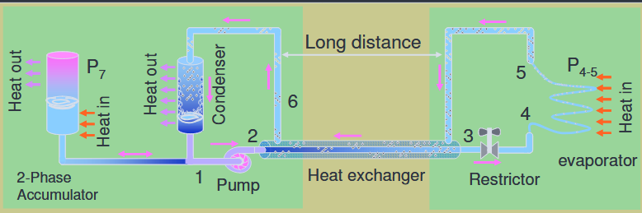
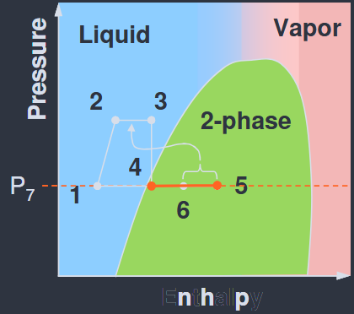
The 2PACL Concept — Core Innovation
2-Phase Accumulator Controlled Loop (Nikhef/CERN)
Thermodynamic Cycle States:
1. Accumulator liquid → pump inlet (saturated liquid)
2. Pump outlet → subcooled liquid at higher pressure
3. Heat exchanger → brings to saturation boundary
4. Expansion valve → two-phase mixture at evaporator P
5. Evaporator (detector) → isothermal boiling, heat in
6. Return to accumulator → mixture to condenser
Key Design Feature:
The accumulator is the ONLY temperature control point.
Set accumulator pressure = set evaporator temperature.
Distance from accumulator to detector: up to 100m.
Temperature stability achieved: < 0.1°C fluctuation.
Developed at Nikhef by B. Verlaat et al. (~2000)
Key Principle:
▪ Accumulator vessel with saturated liquid+vapor CO2
sets system pressure at a remote location
▪ Low hydraulic resistance between accumulator and
evaporator → evaporator pressure ≈ accumulator pressure
▪ Saturation pressure directly determines temperature
▪ Temperature controlled WITHOUT active components
(valves, heaters, sensors) inside the detector
Result: Completely passive detector cooling hardware
→ Maximum reliability in inaccessible radiation zones
CO2 Cooling Technology for LHC Experiments — Literature Review
5

Slide 6
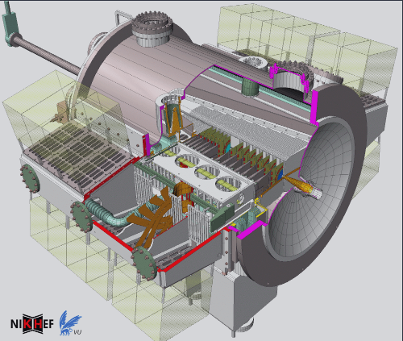
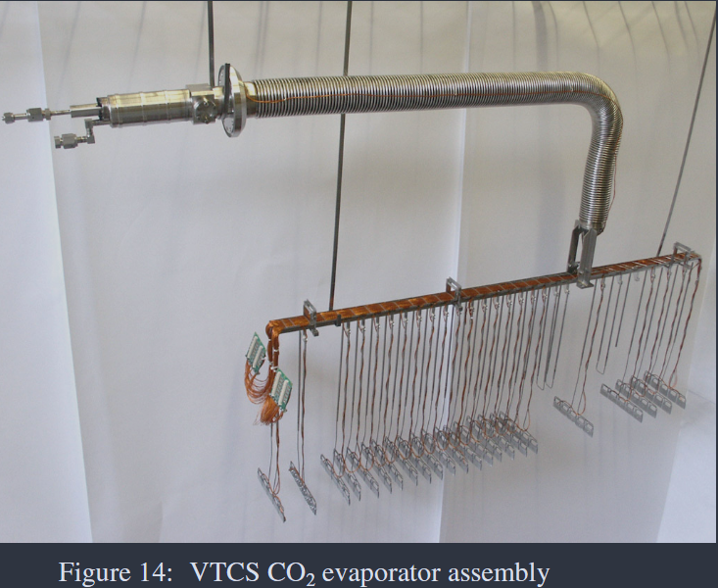
LHCb VELO — First CO2 Cooling at LHC (2008)
Van Lysebetten et al., 2008 — Pioneer implementation of 2PACL
DETECTOR: Vertex Locator — 23 silicon modules per half, 8 mm from LHC beam
KEY PARAMETERS:
▪ Cooling capacity: 800 W per detector half (1600 W total)
▪ Operating temperature: -25°C (sensors maintained below 0°C in vacuum)
▪ Environment: Ultra-high vacuum (~10⁻⁴ mbar) — no connectors allowed inside
CASCADE DESIGN (3 hydraulic systems):
▪ Primary: Chilled water (standard industrial)
▪ Secondary: R404a chiller (freon-based refrigeration)
▪ Tertiary: CO2 2PACL (mechanically pumped, accumulator-controlled)
RELIABILITY:
▪ Failsafe orbital welds + vacuum brazing (no connectors in vacuum)
▪ Fully passive detector-side hardware — no electronics in radiation zone
▪ Demonstrated long-term stable operation with minimal maintenance
CO2 Cooling Technology for LHC Experiments — Literature Review
6

Slide 7
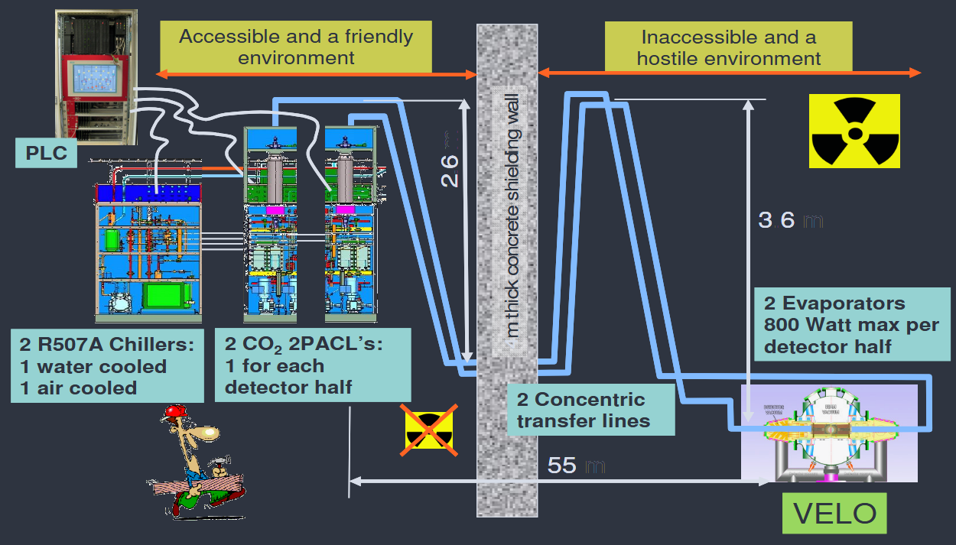

Slide 8
ATLAS IBL — Pushing to Lower Temperatures (2014)
Verlaat et al., 2017 — First CO2 system in ATLAS, lessons for Phase-II upgrades
Design Parameters & Innovations
Parameter | Value | Innovation | Benefit
Total heat load | 955 W (14 staves × 68 W) | 14 parallel cooling channels | Uniform temperature distribution
Temperature range | -35°C to +15°C | Wide dynamic range | Run-away prevention post-irradiation
Cooling tube | Ti Ø1.7mm × 0.1mm wall | Embedded in carbon foam | Minimal material budget
Supply line | Ø1.6mm capillary, 11m long | Concentric inside return tube | Return flow keeps supply cold
Loop length | 31 m total | Manifold in muon detector area | Accessible for maintenance
Stave structure | Carbon fiber (K13C2/RS3) | K9 carbon foam core (28 W/mK) | High thermal conductivity path
IRRADIATION ENVIRONMENT: 3×10¹⁵ neq/cm² at 550 fb⁻¹ integrated luminosity
→ Cold temperatures (< -35°C) prevent thermal runaway after radiation damage
→ Lessons learned directly feed into ATLAS ITk and CMS Phase-II designs
CO2 Cooling Technology for LHC Experiments — Literature Review
7

Slide 9
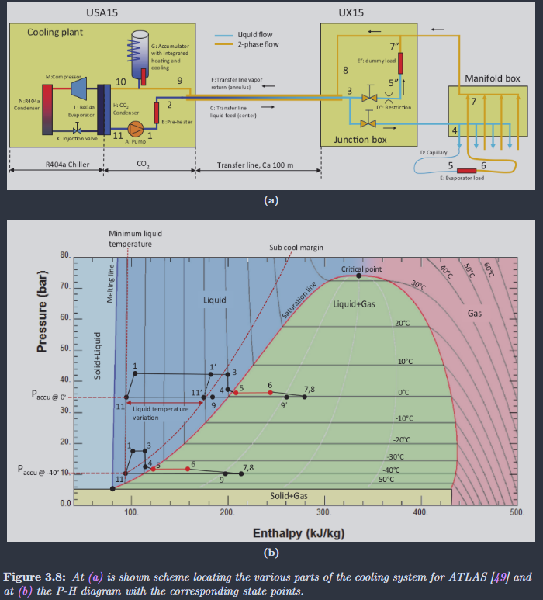
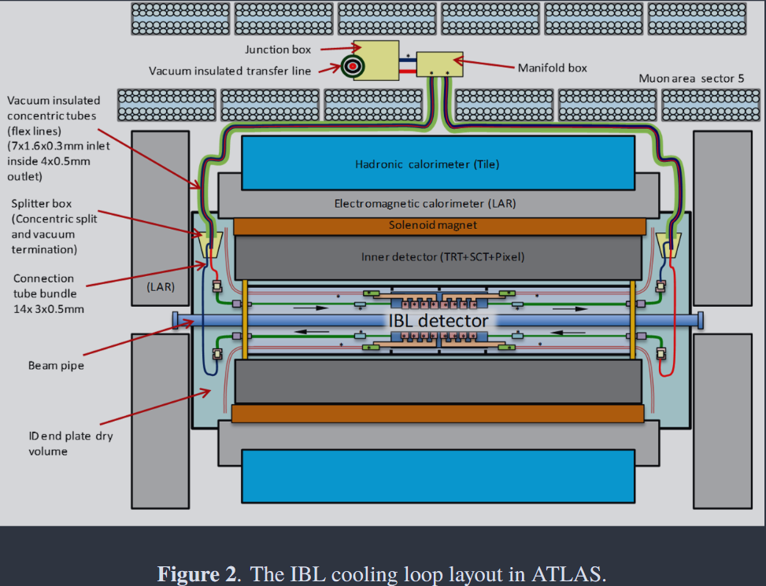
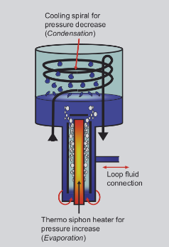
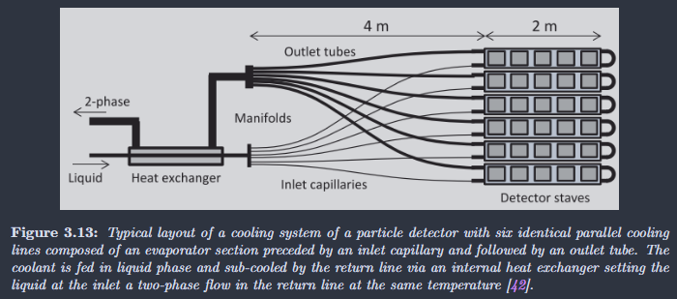

Slide 10
CMS Pixel Phase I — 15 kW Full-Scale Prototype (2015)
Tropea et al., 2015 — Scaling CO2 cooling to multi-kilowatt range
MILESTONE: Most powerful CO2 cooling system for HEP built at that time
DEVELOPMENT APPROACH:
▪ Full-scale prototype designed, constructed, and commissioned in 2013
▪ Based on experience from LHCb VELO and AMS Tracker systems
▪ Validated industrial component adaptation for HEP requirements
PERFORMANCE RESULTS:
▪ Excellent temperature stability demonstrated
▪ Robust behavior during power cycling (simulating detector on/off transitions)
▪ Design optimization path identified for final system construction
KEY LESSONS FOR SCALING UP:
▪ 2PACL concept scales successfully from ~1 kW to >15 kW
▪ Pump selection and accumulator sizing are critical
▪ Need for dedicated CO2 primary chiller at larger scales
▪ N+1 redundancy architecture validated
CO2 Cooling Technology for LHC Experiments — Literature Review
8

Slide 11
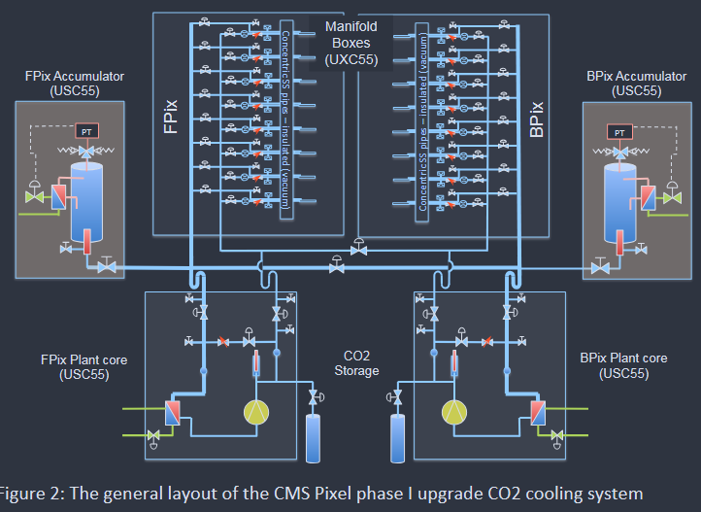
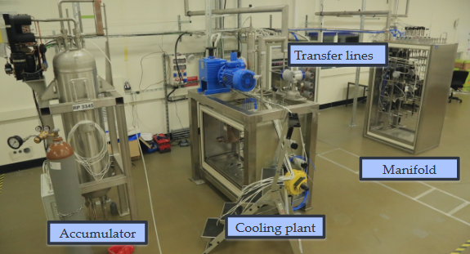

Slide 12
HL-LHC Era — Scaling to Unprecedented Levels (2026+)
Barroca et al., 2021; Zwalinski et al., 2023 — 300–500 kW cooling systems
Parameter | ATLAS ITk | CMS Phase-II | Notes
Nominal power | ~300 kW | ~500 kW | 10x increase over Phase-I
Detector temp. | Down to -43°C | Down to -43°C | Near CO2 freezing point (-56°C)
2PACL plants | 6 + 1 redundant | 8 + 1 redundant | N+1 redundancy architecture
R744 primary | 6 + 1 slices | 12 + 1 slices | Two-stage transcritical cycle
Location | 100 m underground | 100 m underground | Tri-axial vacuum insulated lines
R744 supply temp. | -53°C | -53°C | Only ~3°C above CO2 freezing point
Power backup | UPS + Diesel | UPS + Diesel | No interruption acceptable
DEMO program | 100 kW system | Built 2020–2023 | Pre-production validation
INNOVATION: First fully CO2-based detector cooling system — R744 primary + R744 (CO2) secondary 2PACL loop.
Surface CO2 storage tanks solve accumulator size constraints in underground caverns.
CO2 Cooling Technology for LHC Experiments — Literature Review
9

Slide 13
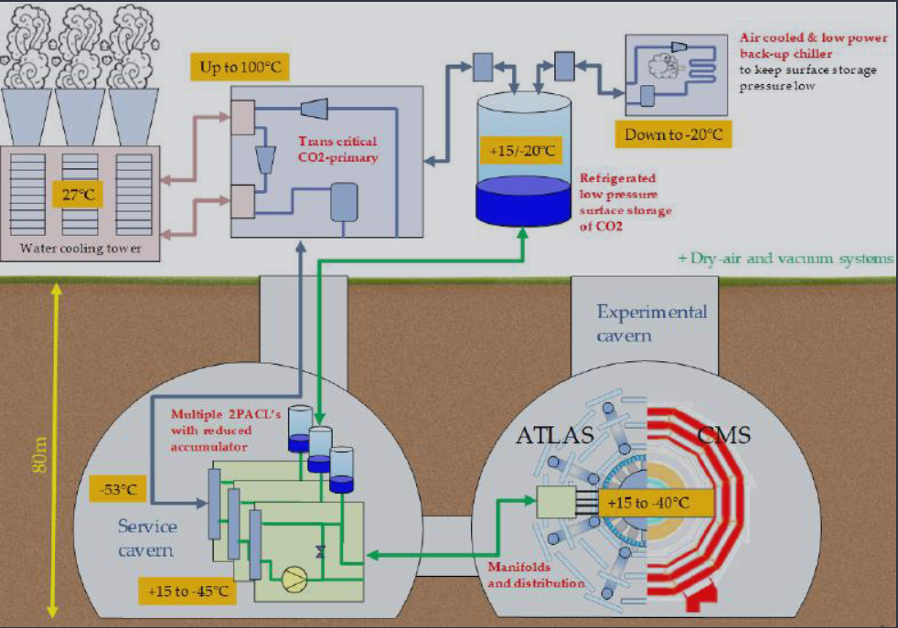
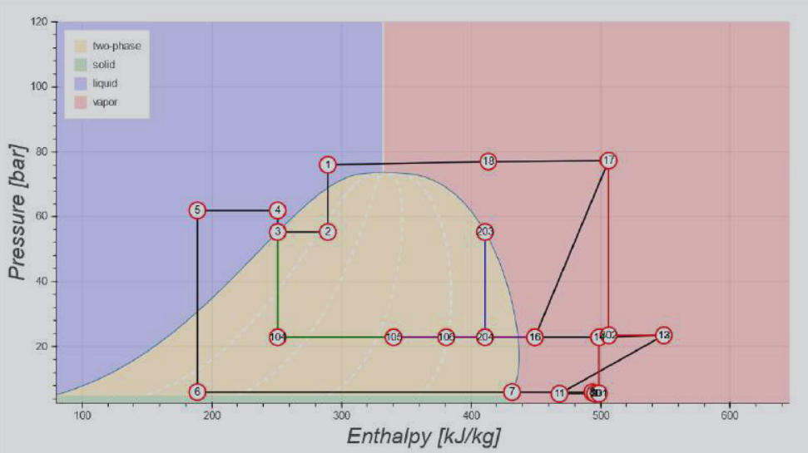
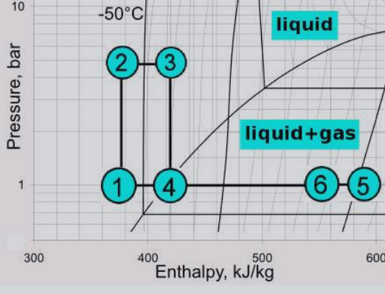
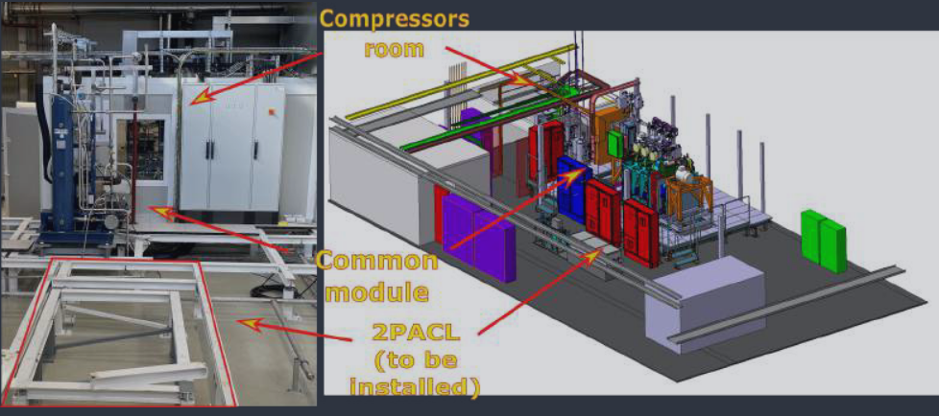
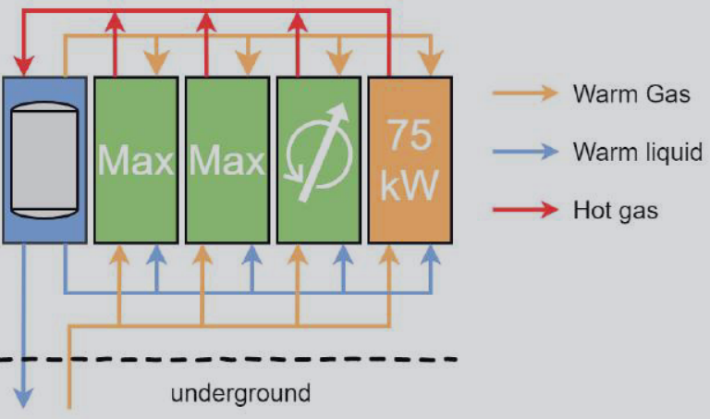

Slide 14
Control Systems Architecture
Zwalinski et al., 2014; Teixeira et al., 2022 — Industrial PLCs meet HEP requirements
HARDWARE LAYER:
▪ Schneider M580 HSBY redundant PLCs
▪ ~330 I/O points per cooling unit
▪ Distributed over 100m via ETHERNET IP
▪ WAGO + FESTO remote I/O couplers
▪ Redundant 24VDC power supplies with
redundancy modules
▪ Local Siemens touch panels for backup
SAFETY & INTERLOCKS:
▪ ~360 alarms and interlocks per unit
▪ Multi-level interlocking hierarchy
▪ UPS + diesel backup ensures CO2 flow
even during full power loss
SOFTWARE LAYER:
▪ UNICOS CPC6 framework (CERN standard)
▪ ~16 PID control loops per unit
▪ Split-range controllers with dynamic limiters
▪ SCADA: Siemens WinCC OA
▪ MODBUS TCP/IP to CERN Control Centre
▪ Online CO2 p-H diagram visualization
▪ Ring topology RIO for communication
redundancy
REDUNDANCY STRATEGY:
▪ Hot Standby (HSBY) PLC failover
▪ Ring topology survives single cable break
▪ Local touch panels for network failure
▪ Evaluated in R744 System A (2022)
CO2 Cooling Technology for LHC Experiments — Literature Review
10

Slide 15
Modelling & Simulation of Two-Phase CO2 Cooling
Barroca, 2019 — PhD Thesis on ATLAS ITk CO2 cooling modelling
CHALLENGE: Two-phase flow in mini-channels (Dh < 3 mm) is difficult to predict accurately.
▪ Limited experimental data for CO2 boiling in small channels
▪ Large uncertainties → conservative safety factors → suboptimal designs
CONTRIBUTIONS OF BARROCA PhD (2019):
▪ Python-based simulation toolkit for CO2 cooling design and optimization:
- Heat Transfer Coefficient (HTC) prediction along evaporators
- Frictional pressure drop modelling
- Flow distribution analysis in manifolds
- Thermal requirement calculations for detector subsystems
▪ Novel fit method to extract in-situ material properties from thermal measurements
- Thermal conductivity of ITk structural materials
- Manufacturing variability quantification
- HTC extraction from experimental data
KEY RESULT: New CO2 model parameters improved HTC prediction precision by FACTOR OF 2
for ITk working conditions, enabling more aggressive (lower mass) designs.
DRY-OUT MANAGEMENT: Systems designed to keep vapor quality < 35–40% to avoid dry-out.
Above this threshold, liquid film breaks → HTC drops sharply → wall temperature spikes.
CO2 Cooling Technology for LHC Experiments — Literature Review
11

Slide 16
Future Directions — Beyond CO2
Contiero et al., 2024; Mapelli et al., 2012; Gargiulo et al., 2024
KRYPTON COOLING
(-60 to -80°C)
▪ Beyond CO2 triple point (-56°C)
▪ Noble gas — zero GWP, zero ODP
▪ Low critical temp maximizes
thermal performance
▪ Gaseous at room temp → need
completely new cycle architecture
▪ Ejector-supported cycle proposed
▪ Conceptual stage (Contiero 2024)
MICRO-CHANNEL COOLING
(Silicon substrates)
▪ Si micro-channels etched into
110 μm thick wafers
▪ Channels: 200 × 70 μm
▪ Direct contact with sensors →
eliminates CTE mismatch
▪ NA62 GTK: baseline for thermal
management (C6F14 single-phase)
▪ Compatible with two-phase CO2
▪ Challenge: flow distribution in
large-area arrays
DRD8 COLLABORATION
(2024 proposal)
▪ WP1: Global system design &
integration (incl. robotics)
▪ WP2: Low-mass mechanics &
thermal management
▪ WP3: Detector cooling
– Project 3.1: New evaporative
cooling fluids & systems
– Project 3.2: Microchannel
cooling substrates
▪ WP4: Design & qualification
tools (XR, physics sim. link)
▪ 37+ participating institutes
CO2 Cooling Technology for LHC Experiments — Literature Review
12

Slide 17
Development Timeline
15+ years of CO2 cooling evolution at CERN
Year | Milestone | Significance
~2000 | 2PACL concept developed at Nikhef | Foundation of all subsequent systems
2008 | LHCb VELO operational — 1st CO2 system at LHC | Proof of concept: 2PACL works in real experiment
2011 | CMS tracker CO2 feasibility study (RWTH Aachen) | 45% material budget reduction demonstrated
2012 | Micro-channel cooling R&D begins (CERN/EPFL) | Alternative silicon substrate cooling
2014 | ATLAS IBL CO2 system operational | Lower temperatures (< -35°C), first in ATLAS
2015 | 15 kW CMS Pixel prototype commissioned | Scalability to multi-kW range validated
2016 | CMS Pixel Phase I operational | Largest CO2 system then operating at LHC
2019 | ATLAS ITk CO2 modelling (Barroca PhD) | 2× improvement in HTC prediction precision
2020 | DEMO 100 kW program launched | Pre-production validation at HL-LHC scale
2021 | Ultra-low temp R744 transcritical prototype | -53°C primary for underground 2PACL
2023 | HL-LHC system construction begins | ATLAS 300 kW + CMS 500 kW systems
2024 | Krypton concept + DRD8 proposal | Post-CO2 era planning begins
2026 | HL-LHC operation starts (LS3 complete) | Full-scale CO2 systems in production
CO2 Cooling Technology for LHC Experiments — Literature Review
13

Slide 18
Key Technical Parameters — Across All Systems
Comparison of operational and planned CO2 cooling systems
Parameter | LHCb VELO | ATLAS IBL | CMS Pixel Ph-I | ATLAS ITk (HL) | CMS Ph-II (HL)
Year operational | 2008 | 2014 | 2016 | 2026+ | 2026+
Cooling power | 1.6 kW | ~3 kW | ~15 kW | ~300 kW | ~500 kW
Detector temp. | -25°C | -35 to +15°C | -20°C | Down to -43°C | Down to -43°C
Tube diameter | ~2 mm | Ø1.7 mm ID | ~2 mm | ~2 mm | ~2 mm
Primary chiller | R404a | R404a | R507a | R744 transcritical | R744 transcritical
2PACL plants | 1 | 2 (redundant) | 2+ | 6 + 1 | 8 + 1
PLC type | Schneider | Schneider Premium | Schneider | Schneider M580 HSBY | Schneider M580 HSBY
SCADA | — | WinCC OA | WinCC OA | WinCC OA (UNICOS) | WinCC OA (UNICOS)
Backup power | UPS | UPS | UPS | UPS + Diesel | UPS + Diesel
Note: The 300× increase from LHCb VELO (1.6 kW) to CMS Phase-II (500 kW) represents the largest scaling of CO2 cooling technology in any application worldwide.
CO2 Cooling Technology for LHC Experiments — Literature Review
14

Slide 19
Key Design Principles & Lessons Learned
What 15+ years of CO2 cooling in HEP have taught us
1. MINIMIZE ACTIVE COMPONENTS in radiation zones
→ 2PACL accumulator enables passive, remote temperature control up to 100m away
2. KEEP VAPOR QUALITY BELOW 35–40%
→ Prevents dry-out, ensures reliable heat transfer, protects detector integrity
3. REDUNDANCY AT ALL LEVELS
→ N+1 cooling plants, redundant PLCs (HSBY), redundant power supplies, UPS + diesel
4. USE INDUSTRIAL COMPONENTS with HEP-specific adaptation
→ Oil-free pumps, radiation-hard sensors, UNICOS framework integration
5. CONCENTRIC REVERSE FLOW for supply lines
→ Uses return fluid cooling capacity to maintain supply line in liquid state
6. VACUUM INSULATION for long transfer lines
→ Critical for 100m vertical runs between surface R744 and underground 2PACL
7. SURFACE STORAGE for large CO2 volumes
→ Underground accumulator size limited by cavern space constraints
8. RIGOROUS PROTOTYPING before final installation
→ DEMO and pre-production systems de-risk final underground installations
CO2 Cooling Technology for LHC Experiments — Literature Review
15

Slide 20
Conclusions
CO2 evaporative cooling has transformed from a Nikhef innovation into the STANDARD technology for all major LHC tracking detector upgrades.
The 2PACL concept, with its elegant passive temperature control, has proven reliable across 15+ years of operation in LHCb VELO, ATLAS IBL, and CMS Pixel detectors.
HL-LHC pushes the technology to UNPRECEDENTED SCALE — from kilowatts to hundreds of kilowatts — with the innovative two-stage transcritical R744 primary system.
CO2 cooling advantages: 45% material budget reduction vs. fluorocarbon alternatives, environmentally friendly (GWP=1), radiation hard, excellent thermal performance.
FUTURE CHALLENGES: Krypton for -60 to -80°C (beyond CO2 triple point), micro-channel silicon cooling plates for even lower mass, and the DRD8 framework for coordinated global R&D.
The 15-year journey of CO2 cooling at the LHC demonstrates how a well-chosen working fluid, combined with innovative system design, can transform experimental physics instrumentation.
Based on 14 publications (2008–2024) | CERN · Nikhef · NTNU · RWTH Aachen · EPFL · Université Grenoble Alpes

Slide 21
References
14 publications reviewed in this literature survey
[1] Verlaat, B., et al. — CO2 cooling for HEP experiments. Nikhef.
[2] Verlaat, B., et al. (2017). The ATLAS IBL CO2 cooling system. JINST 12 C02064.
[3] Van Lysebetten, A., et al. (2008). CO2 cooling experience (LHCb). PoS(Vertex 2007)009.
[4] Feld, L., et al. (2011). CO2 cooling for the CMS tracker at SLHC. JINST 6 C01091.
[5] Tropea, P., et al. (2015). Design, construction and commissioning of a 15 kW CO2 evaporative cooling system. PoS(TIPP2014)223.
[6] Barroca, P., et al. (2021). An Ultra-Low Temperature Transcritical R744 Refrigeration System for Future Detectors at CERN LHC. Applied Sciences, 11, 7399.
[7] Barroca, P. (2019). Modelling of CO2 cooling of the ATLAS ITk Pixel Detector. PhD Thesis, Université Grenoble Alpes.
[8] Zwalinski, L., et al. (2023). Progress in new environmental friendly low temperature detector cooling systems. NIM A, 1047, 167688.
[9] Postema, H., & Verlaat, B. (2012). Cooling in HEP Vertex and Tracking Detectors. PoS(Vertex 2011)003.
[10] Zwalinski, L., et al. (2014). The Control System for the CO2 Cooling Plants for Physics Experiments. ICALEPCS2013.
[11] Mapelli, A., et al. (2012). Micro-Channel Cooling for HEP Particle Detectors and Electronics. IEEE ITHERM Conference.
[12] Gargiulo, C., et al. (2024). Proposal for DRD8: Mechanics & Cooling of Future Vertex and Tracking Systems.
[13] Contiero, L., et al. (2024). Applying krypton as refrigerant for cooling of future particle detector trackers at CERN. GL2024.
[14] Teixeira, D., et al. (2022). An Evaluation of Schneider M580 HSBY PLC Redundancy in the R744 System. ICALEPCS2021.
CO2 Cooling Technology for LHC Experiments — Literature Review
16

