Slide 1
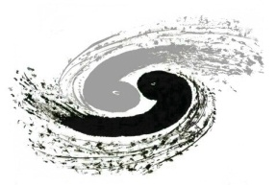
A symplectic machine learning model for fast space-charge simulation
中国科学院高能物理研究所
INSTITUTE OF HIGH ENERGY PHYSICS
Jinyu Wan (IHEP)
Ji Qiang (LBNL)
Yue Hao (MSU/FRIB)

Slide 2
Outline
Background
Symplectic space charge effect simulation
Machine learning model for symplectic SC simulation
Summary

Slide 3
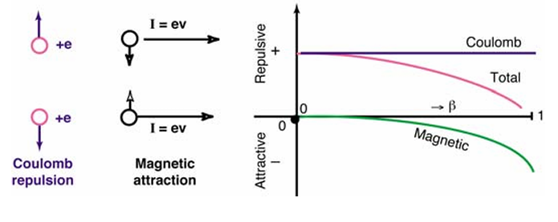
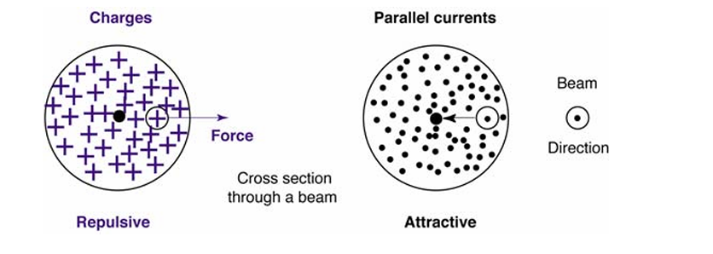
Background: Why SC effects matter
Interactions between charged particles in accelerators:
Space-charge effects are a type of Self-Fields generated by the distribution of charged particles.
The study of space-charge effects is important in high-intensity accelerators, as it causes beam emittance growth, halo formation, and even particle losses along the accelerator
space-charge effects
Wake field effects
Coherent synchrotron radiation
Figures from Schindl, Karlheinz. "Space charge." (2006).

Slide 4
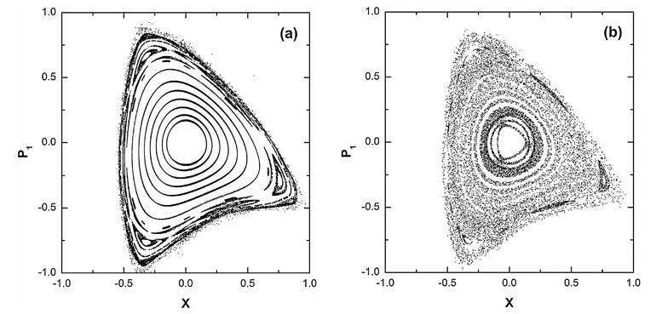
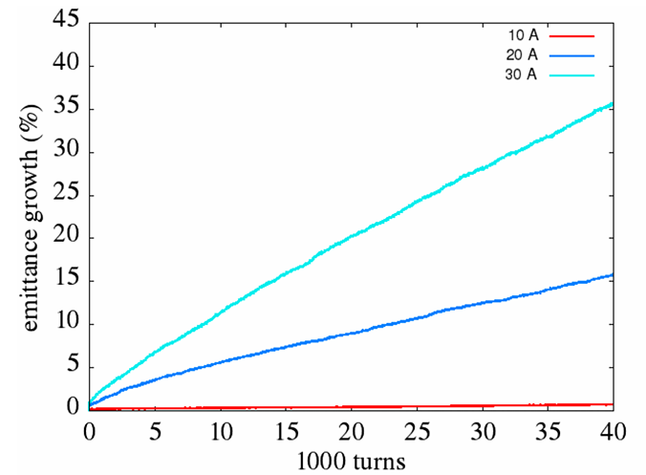
Background: Why SC effects matter
Invariant tori in phase space disappear [1]
Space charge-induced emittance growth[2]
W/O SC
W/ SC
Trajectories with large amplitudes become unstable and even chaotic.
Leads to particle loss and decreasing the beam lifetime.
Emittance: measurement of the beam’s spread in position-momentum space.
Emittance growth represent beam quality degrades
[1] Figure from Bountis, Tassos, and Charalampos Skokos. Physics Letters A 358.2 (2006)
[2] Figure from Qiang, Ji. Physical Review Accelerators and Beams 21.5 (2018).

Slide 5
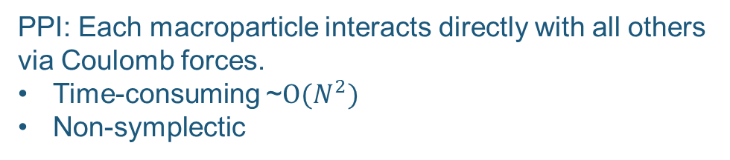

Simulation methods
Particle-particle interaction (PPI) methods and particles-in-cells (PIC) methods are widely used for numerical simulation of space-charge effects.
PIC methods are generally non-symplectic and long-term conservation can degrade.
Non-symplectic simulation will introduce artificial noise in long-term tracking, resulting in unphysical emittance growth, beam loss and resonance behaviors.
For ring accelerators, beam dynamics simulation requires particle tracking from ${10}^{3}−{10}^{6}$ of turns, where small numerical errors accumulate if the algorithm is not symplectic.
PPI: Each macroparticle interacts directly with all others via Coulomb forces.
Time-consuming ~$O(N^{2})$
Non-symplectic
PIC: Beam is deposited on a spatial mesh. Forces interpolated back to macroparticles.
Faster than PPI. Widely used in simulation codes such as IMPACT and TRACK.
Non-symplectic
Linacs
Single pass; Non-symplectic is acceptable
Ring accelerator
Multiple-turn pass; Simpleticity is important

Slide 6
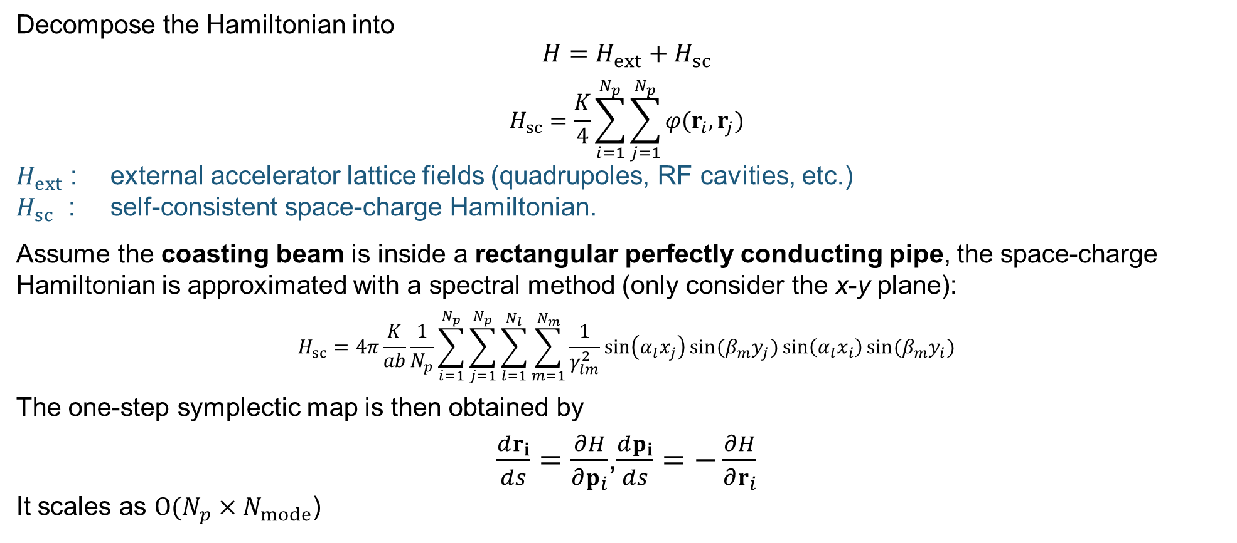
A symplectic method for SC effect calculation
Decompose the Hamiltonian into
$$H=H_{ext}+H_{sc}$$
$$H_{sc}=\frac{K}{4}\sum_{i=1}^{N_{p}}{\sum_{j=1}^{N_{p}}{φ(r_{i},r_{j})}}$$
$H_{ext}$ ​: external accelerator lattice fields (quadrupoles, RF cavities, etc.)
$H_{sc}$​ : self-consistent space-charge Hamiltonian.
Assume the coasting beam is inside a rectangular perfectly conducting pipe, the space-charge Hamiltonian is approximated with a spectral method (only consider the x-y plane):
$$H_{sc}=4π\frac{K}{ab}\frac{1}{N_{p}}\sum_{i=1}^{N_{p}}{\sum_{j=1}^{N_{p}}{\sum_{l=1}^{N_{l}}{\sum_{m=1}^{N_{m}}{\frac{1}{γ_{lm}^{2}}\sin\left(α_{l}x_{j}\right)sin⁡(β_{m}y_{j})}}}}\sin\left(α_{l}x_{i}\right)\sin{(β_{m}y_{i})}$$
The one-step symplectic map is then obtained by
$\frac{dr_{i}}{ds}=\frac{∂H}{∂p_{i}}$,$\frac{dp_{i}}{ds}=−\frac{∂H}{∂r_{i}}$
It scales as $O(N_{p}×N_{mode}$)
[3] Qiang, Ji. Physical Review Accelerators and Beams 26.2 (2023): 024601.

Slide 7
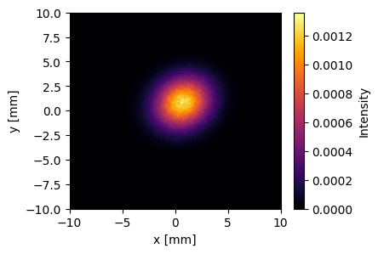
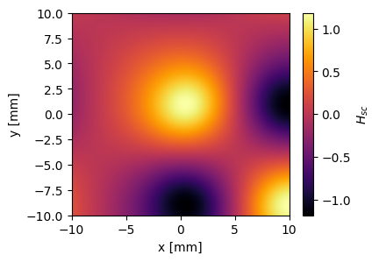
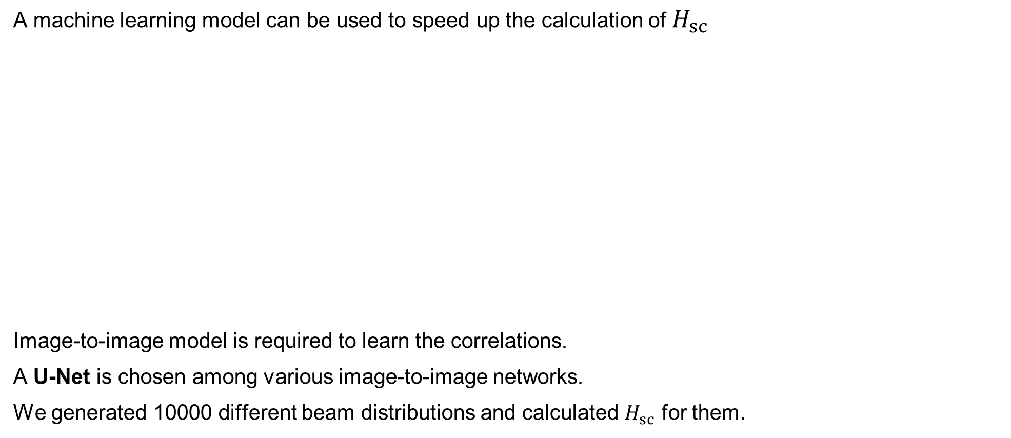

Motivation of using machine learning
A machine learning model can be used to speed up the calculation of $H_{sc}$
Image-to-image model is required to learn the correlations.
A U-Net is chosen among various image-to-image networks.
We generated 10000 different beam distributions and calculated $H_{sc}$ for them.
Beam distribution in x-y space
Values of $H_{sc}$
Calculate with
physical model or
ML model

Slide 8
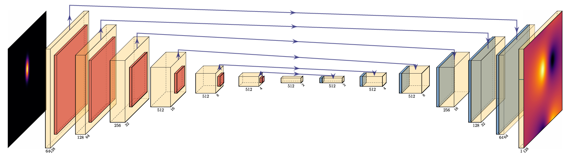
U-Net
U-Net is developed in 2015 for biomedical image segmentation [4]. It is Designed to take an image as input and output another image of the same size, but transformed.
In the space-charge problem, the input is the 2-D histogram of beam distribution and the output is the space-charge Hamiltonian.
Skip Connections to restore spatial details
Encoding
Decoding
Encoder-decoder structure of a U-Net
[4] Ronneberger et al., MICCAI 2015.

Slide 9
Generative Adversarial Net
U-Net and other supervised model’s outputs can be too smooth/blurry.
We want outputs that are not just close in average, but also as realistic as possible.
A Generative Adversarial Net framework will help to push the U-Net to create more realistic data.
Beam distribution
input
Generator
output
x
In this work, U-Net is used as the generator.
An additional discriminator is used to judge the output of the generator.
train
output
Discriminator
input train
D(x|y)
Generative Adversarial Net (GAN):

Slide 10
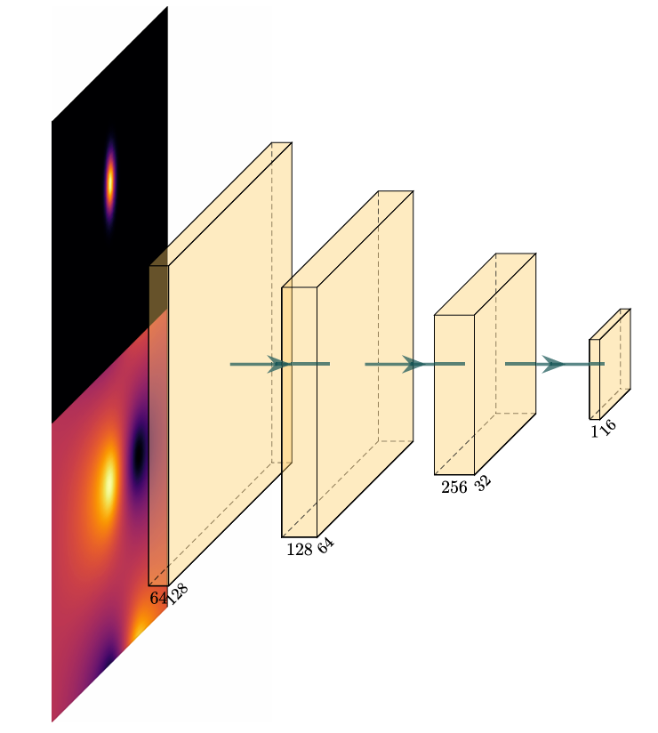
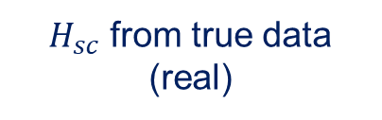
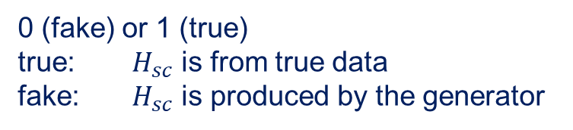
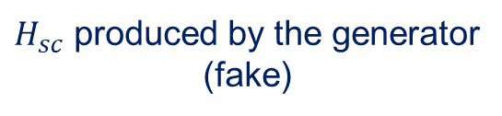
Generative Adversarial Net
U-Net and other supervised model’s outputs can be too smooth/blurry.
We want outputs that are not just close in average, but also as realistic as possible.
A Generative Adversarial Net framework will help to push the U-Net to create more realistic data.
Beam distribution
0 (fake) or 1 (true)
true: $H_{sc}$ is from true data
fake: $H_{sc}$ is produced by the generator
$H_{sc}$ from true data
(real)
or
$H_{sc}$ produced by the generator
(fake)
A batched discriminator

Slide 11
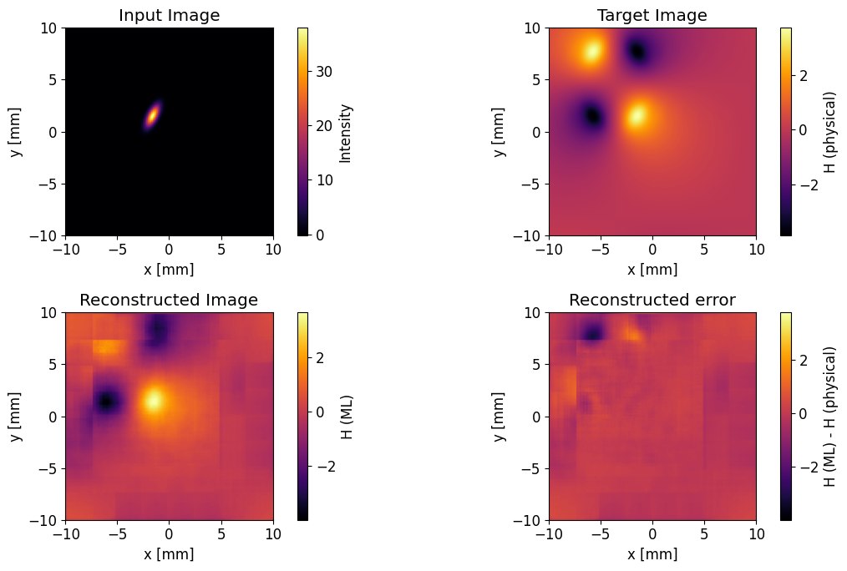
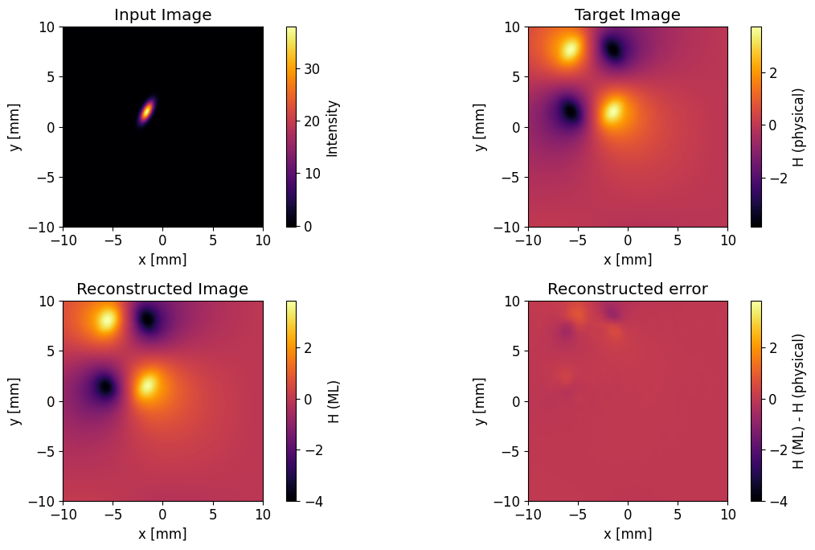

Contribution of GAN
Use the same data to train a pure U-Net auto-encoder and a GAN. Evaluate the models with the same test data.
GAN successfully sharpen the data to draw a more realistic $H_{sc}$ map.
Output of a pure U-Net
Output of a U-Net based GAN

Slide 12
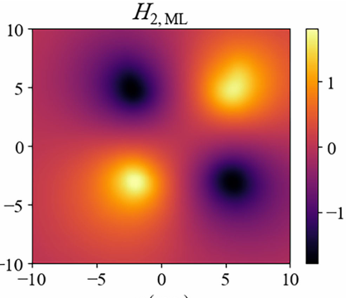
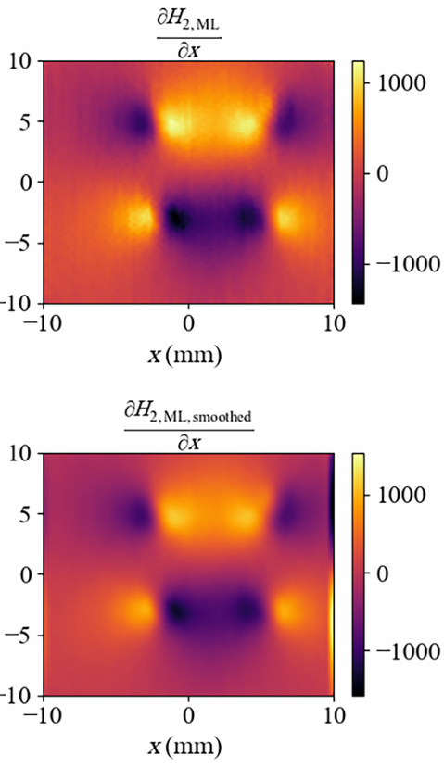
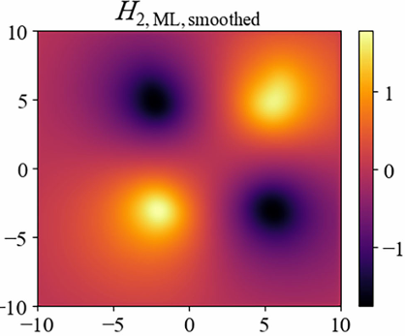


ML-based space-charge simulation
The ML model outputs a picture, with $N_{x}×N_{y}$ pixels. The fluctuations of the pixels are smoothed with a Gaussian smoothing kernel.
The smoothing averages small fluctuations between pixels.
It avoids unphysical spikes in the calculated space-charge kicks.
A 2-D function $H_{sc}$ is fitted with the $N_{x}×N_{y}$ grids.
Gaussian smoothing

Slide 13
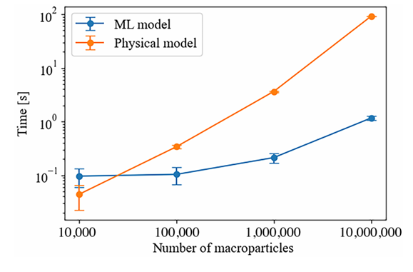
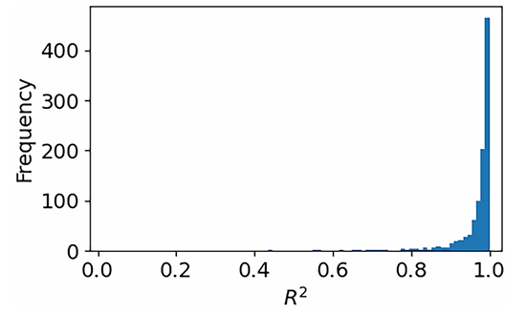

Model evaluation
The ML model achieve a $R^{2}$ over 0.9 for most test cases.
The efficiency is improved by an order of magnitude compared to using the physical model.
Coefficient of determination $R^{2}$ for 1000 test samples.
Computing time for a single space-charge kick

Slide 14
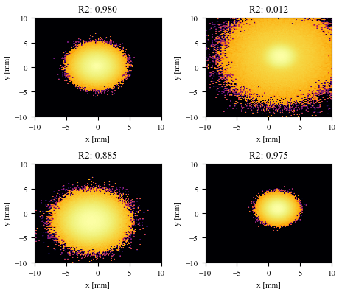
Worst-performance predictions
By examining the low-accuracy predictions in the test data, we found the low accuracy is caused by beam clipping of some core-halo beam with very large halo, which is unlikely.
Four core-halo beams. The x-y range is limited within ±10 mm
Particles with x and y coordinates larger than ±10 mm are clipped

Slide 15
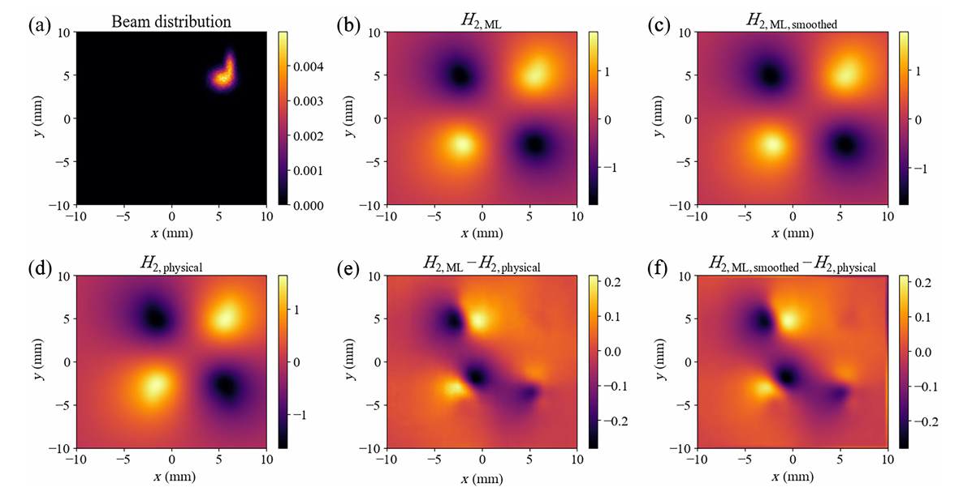
An irregular test case
An irregular beam is taken as an example: two combined Gaussian beams.
The the two Gaussian beams are centered at ~[5 mm, 5mm] in the x-y space.

Slide 16
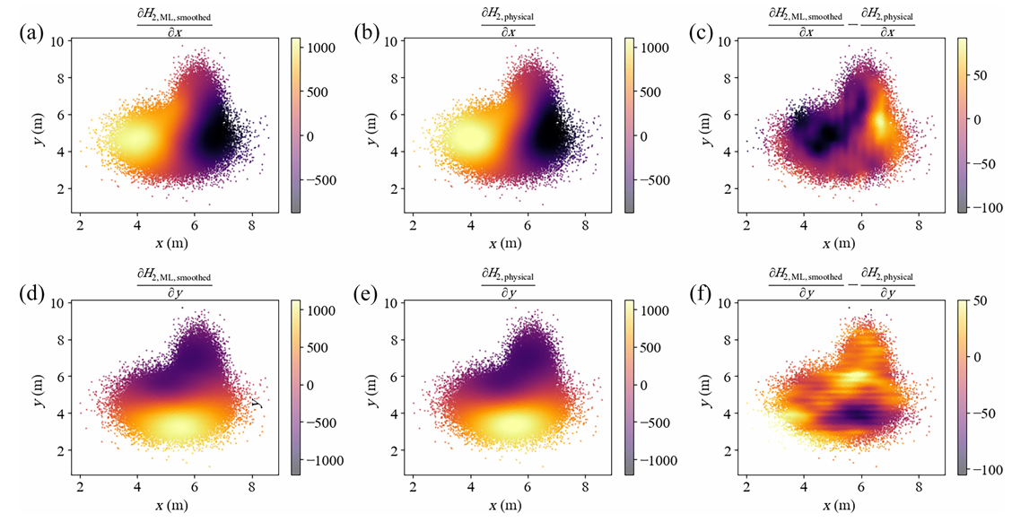
An irregular test case
An irregular beam is taken as an example: two combined Gaussian beams.
An average error of ~1% is observed in the mode

Slide 17
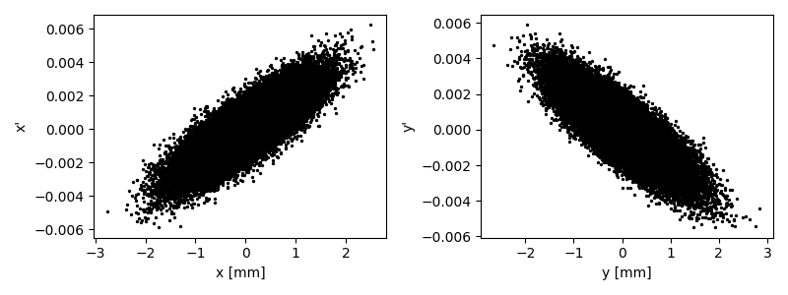
Long-term behavior
We simulate 1 GeV proton beam through periodic FODO cells.
Normalized emittance: 1 mm∙mrad
Beam current: 100 A
Initial distribution
Structure of a FODO cell
Quadrupole 1
0.1 m
0.2 m
0.2 m
0.1 m
0.4 m
Quadrupole 2
Coasting beam
Gaussian distribution
in x-y plane
Without space charge, particles in a FODO cell exhibit periodic transverse motion, repeating from cell to cell.
FODO
…
FODO
20,000 cells

Slide 18
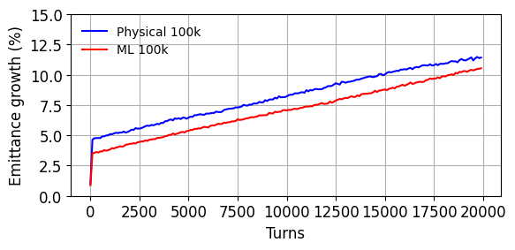
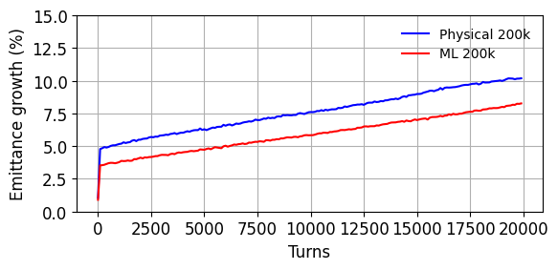
Long-term behavior
We simulate 1 GeV proton beam through periodic FODO cells.
Normalized emittance: 1 mm∙mrad
Beam current: 100 A
Emittance growth (100,000 particles)
Emittance growth (200,000 particles)
Both physical model and ML model show similar growth rate.
More macro-particles → lower emittance growth
It is numerical noise caused by insufficient particles, which applies for both methods.

Slide 19
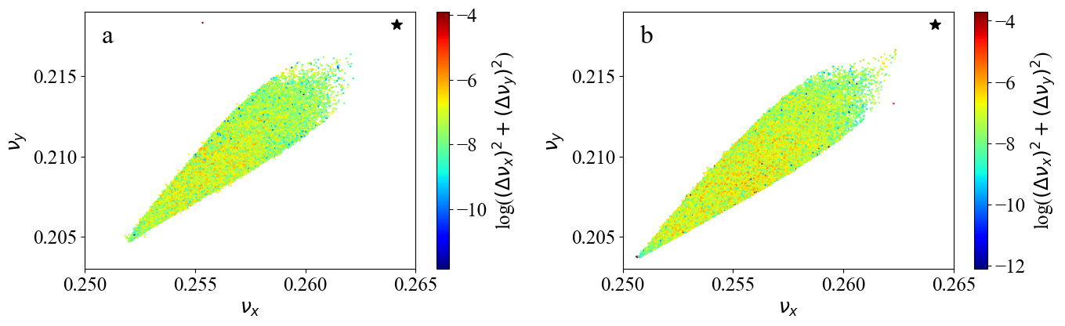
Long-term behavior
We simulate 1 GeV proton beam through periodic FODO cells.
Normalized emittance: 1 mm∙mrad
Beam current: 100 A
Tune spread of the particle trajectories
Physical model
ML model
The tune spread is correctly described with the ML model
The maximal difference between the two models is ~ 1%.

Slide 20
Integration into simulation code
The machine learning model is built and trained with Pytorch.
The model’s parameters are saved in ONNX format, an open format built to represent machine learning models, and can be used by various languages such as Python, C++, and Julia.
The model is integrated into JuTrack, an open source auto-differentiation enabled accelerator modeling and particle tracking code.
Example of creating space-charge enable elements in JuTrack:
D1 = DRIFT_SC_ML(len=D1L, a=a, b=b, Nl=nl, Nm=nm, Nsteps=4)
Q1 = KQUAD_SC_ML(len=Q1L, k1=Q1k, NumIntSteps=20, a=a, b=b, Nl=nl, Nm=nm, Nsteps=4)

Slide 21
Summary
A machine learning surrogate model is developed for fast space-charge effect simulation.
By deriving forces directly from the learned Hamiltonian, the method is symplectic by construction, ensuring long-term physical fidelity.
The ML model shows close results compared to the physical model with error level of ~1% in long-term tracking simulation.
The surrogate model delivers up to an order-of-magnitude speedup compared to traditional physical model.
The model is open source and has been integrated into simulation code such as JuTrack.
Thank you!

