Slide 1


Quantum Computing and Machine Learning Workshop 2026.8.19
Sun Yat-Sen University
Shenzhen, China
AI for High Energy Phenomenology
— What’s next?
Presented by Tianji Cai 蔡恬吉
School of Physical Science & Engineering
Tongji University, Shanghai, China

Slide 2
We’ve come a long way in the past decade.

Slide 3
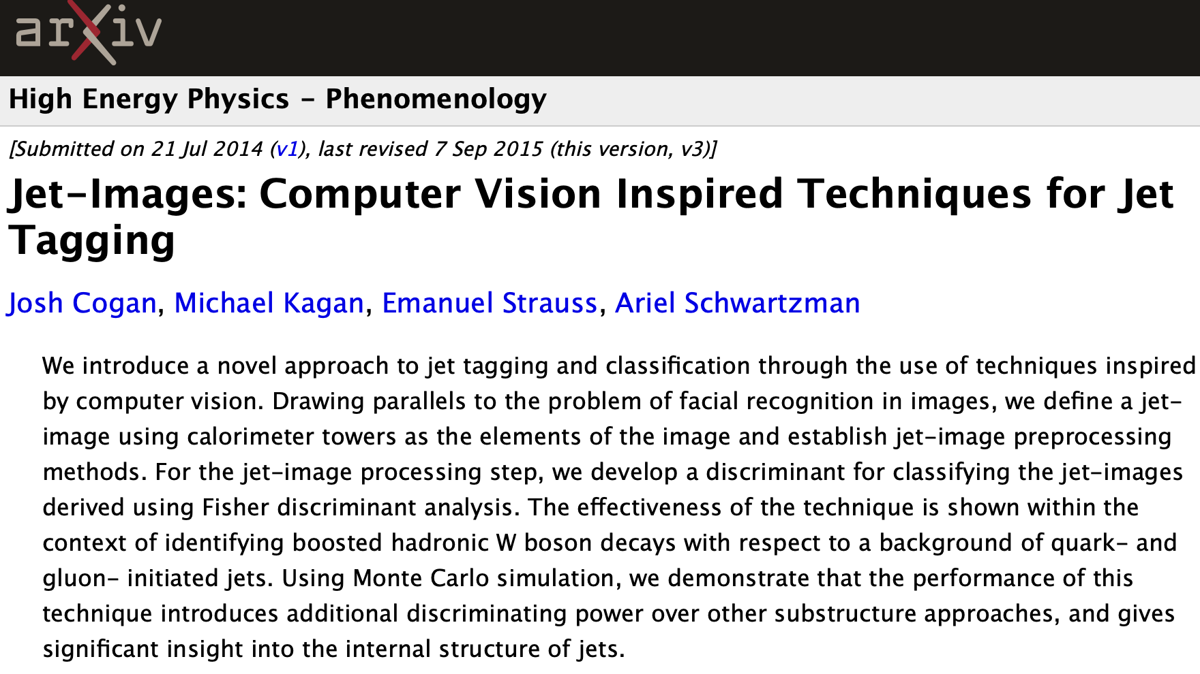

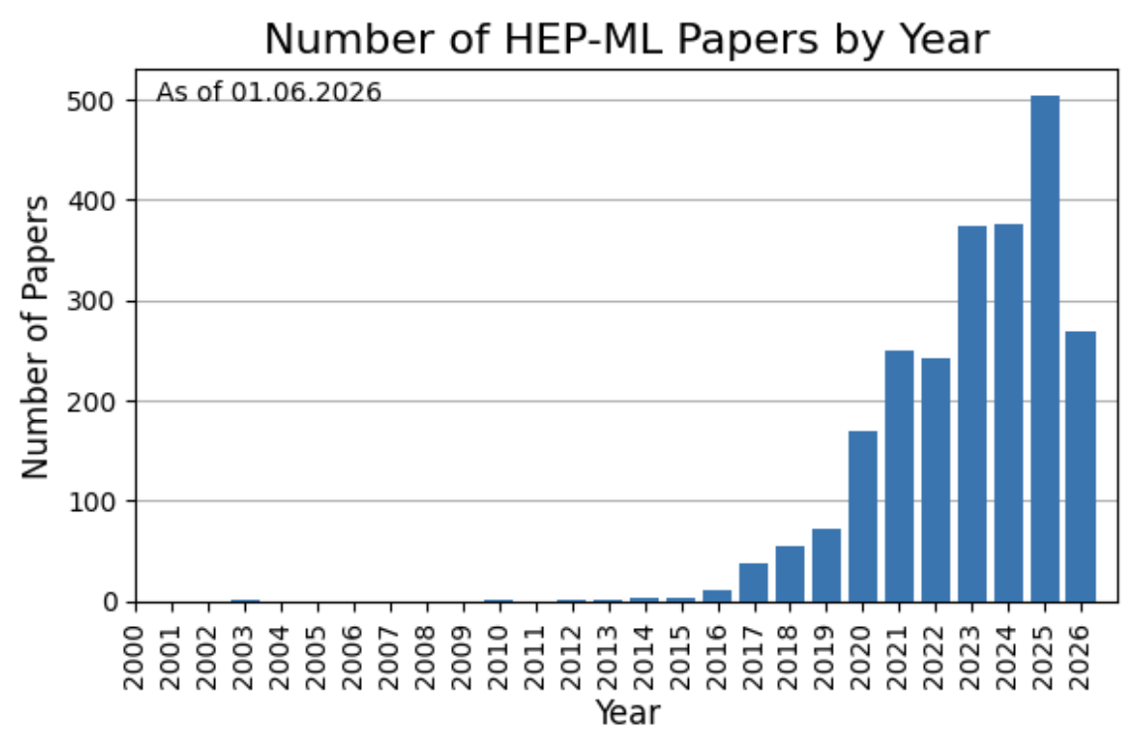
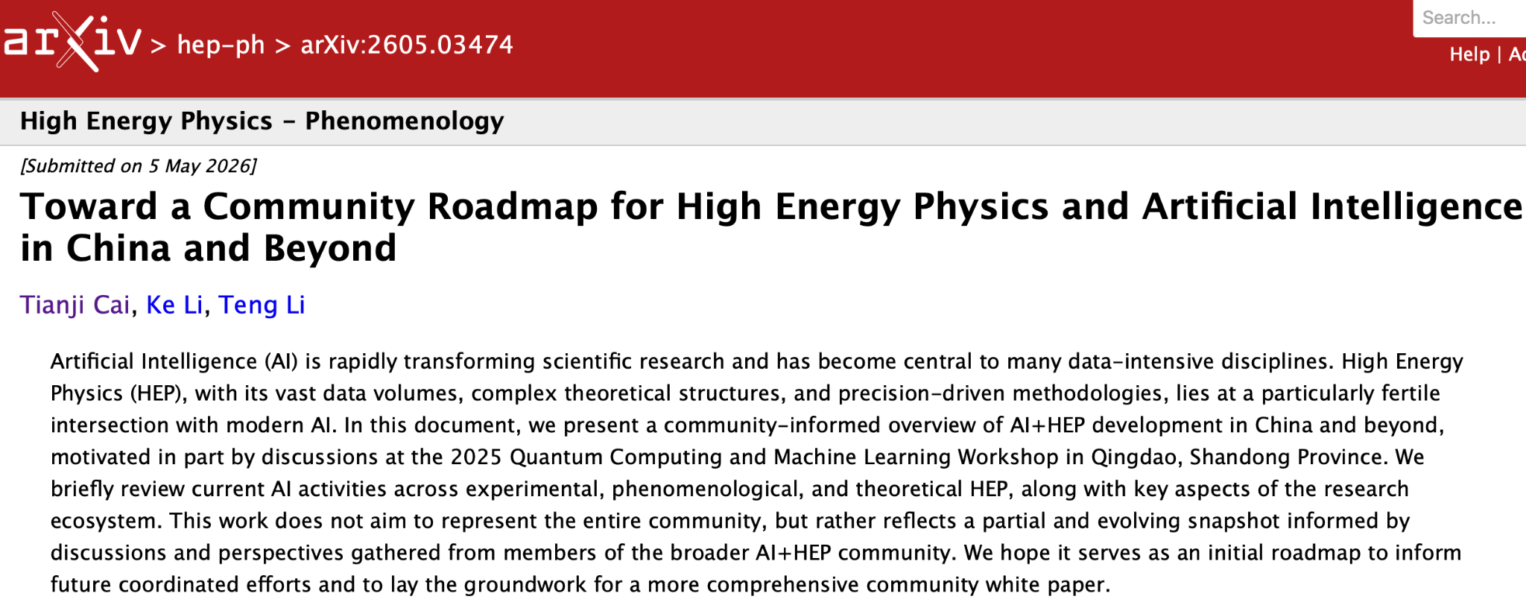
From the “humble” beginnings of images…
2014!!!
Subfields: hep-ex, hep-ph, hep-th, hep-lat,nucl-th, astro-ph.CO…
2026!!!
Special thanks to my co-authors Ke Li & Teng Li! 🥳
China

Slide 4
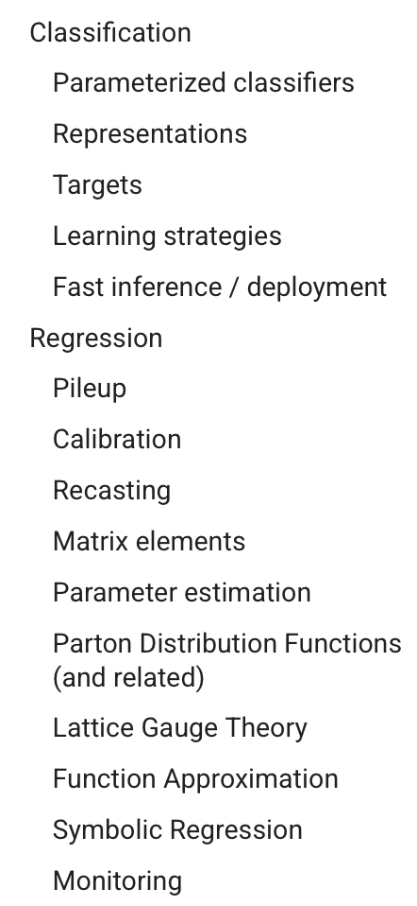
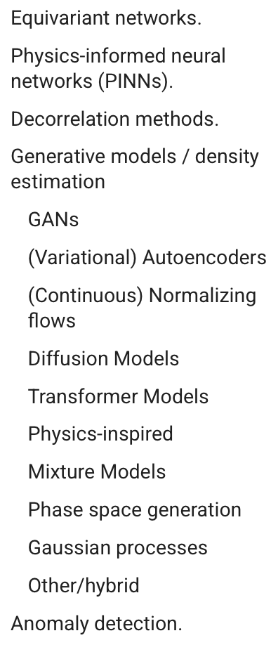
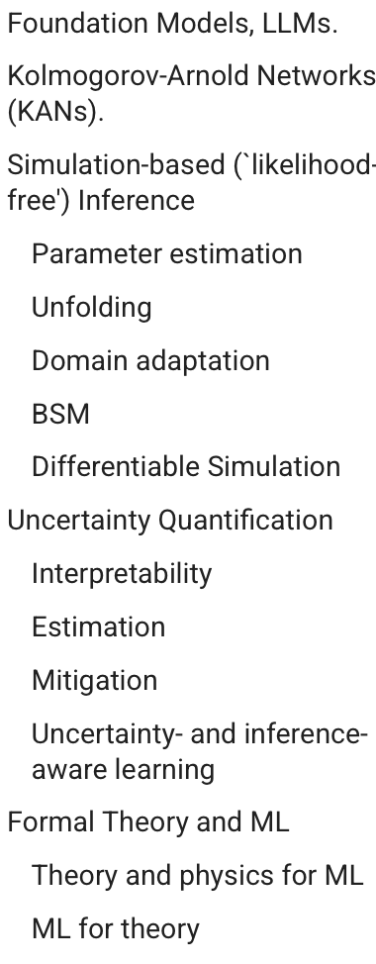
What have we achieved in Phase I Exploration?
AI has proven itself to be a powerful technical tool for many individual tasks. 💪💪💪
Now it’s time to enter Phase II:
Defining unifying themes that can shape and sharpen our field.
From HEP ML Living Review.

Slide 5
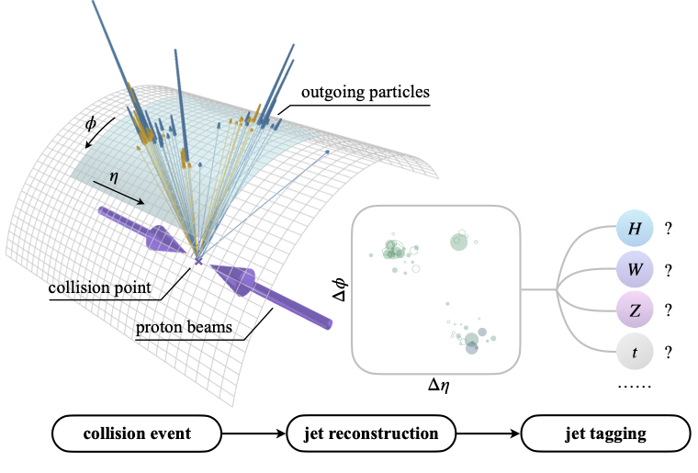
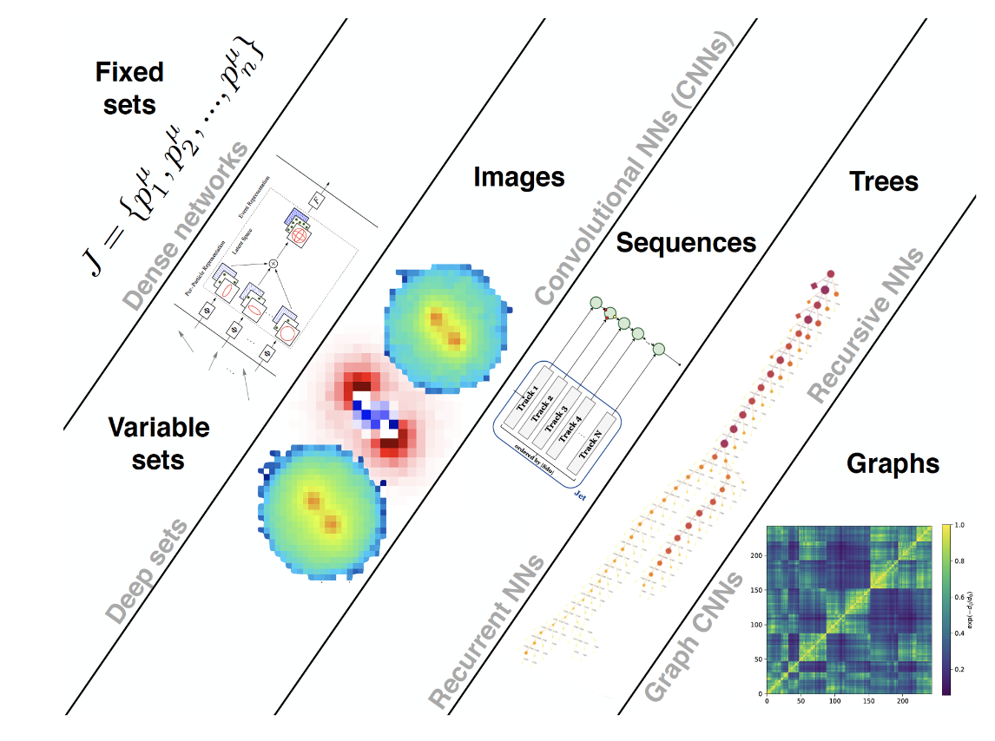
Collider jets remain the quintessential objects of study.
We also have developed a zoo of ML models to analyze jets & events.
Focus of this talk
Luckily, our community has many open datasets for (simulated) collider jets.

Slide 6
Now we are building larger and larger models…
(Mostly) from 2606.14870, 2510.24066.

Slide 7

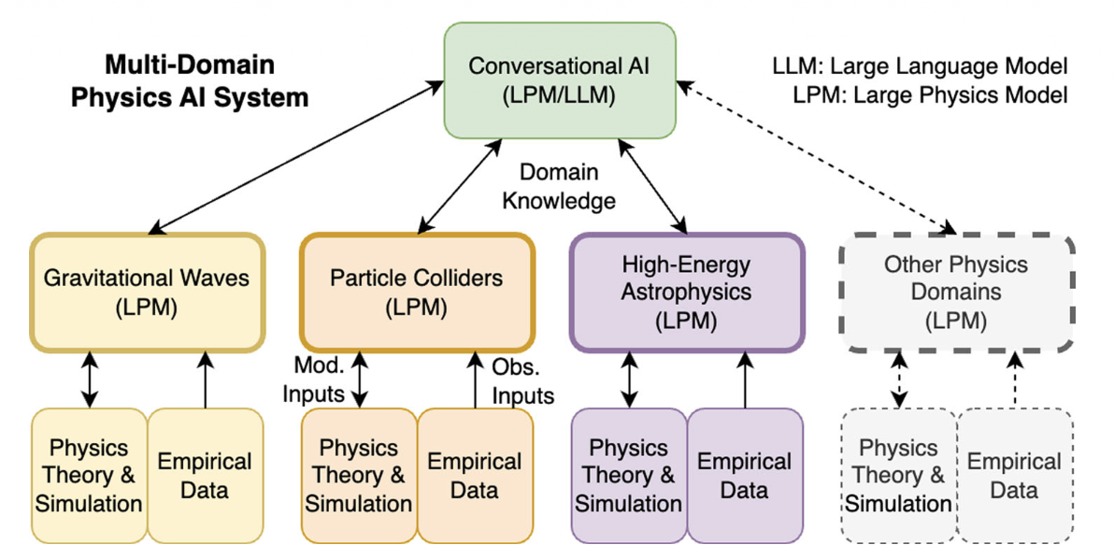
We physicists always dream big!
The dream of an automated system with collaborating LLMs and LPMs.
But what is a LPM?
→ Essentially a (domain-specific) foundation model.

Slide 8
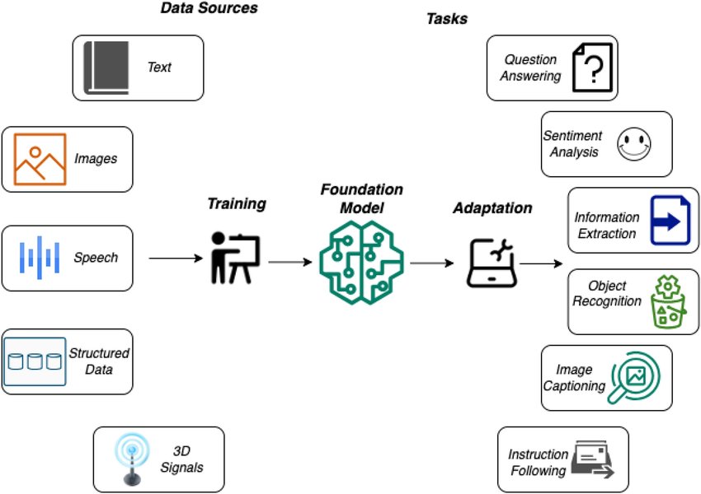
So what are foundation models (FMs)?
One model to rule them all.
FMs for Collider Jet Physics:
OmniJet-ɑ
OmniLearned
J-JEPA
HEP-JEPA
…
Pre-training paradigms include supervised learning, generative self-supervised learning, joint-embedding predictive learning…
Multi-dataset
& Multi-task

Slide 9
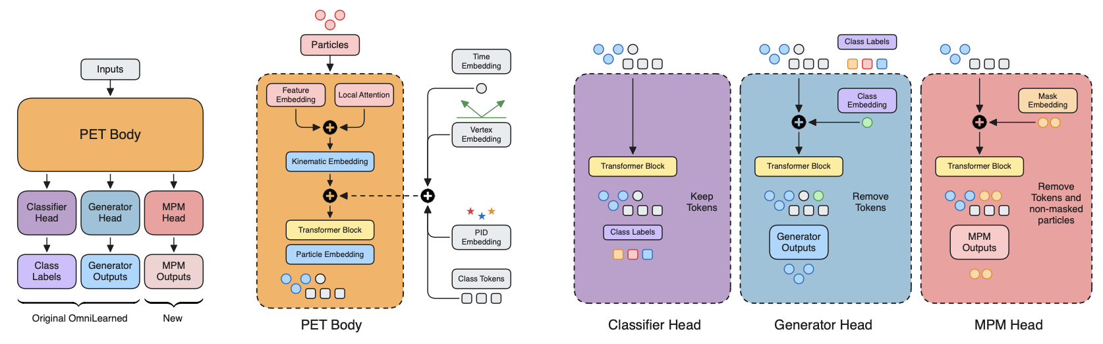
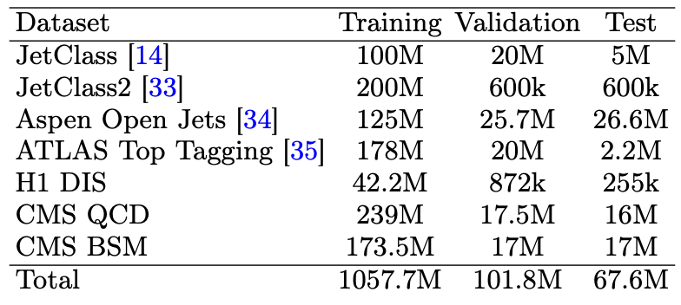
Since we’re all most familiar with supervised learning, let’s use OmniLearned as an example here.
Flow-matching
A total of ~1 billion jets used in making OmniLearned!!! 🙀

Slide 10
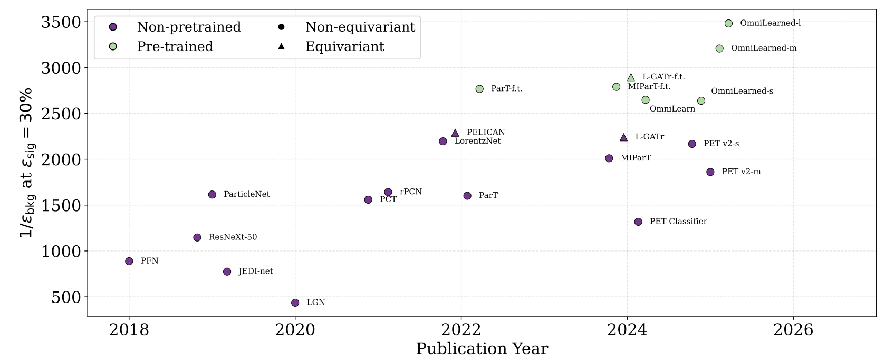
So what’s the magic?
Can also do b-tagging & anomaly detection very well.
With the (new) Generator head, it can also do jet generation relatively well.
Task: Top Tagging
Seems to also show some advantages for predictive tasks in cosmology, neutrino physics, and molecular dynamics…
Magic comes at a cost…
OmniLearned models were trained using up to 512 A100 GPUs on NERSC. 😵

Slide 11
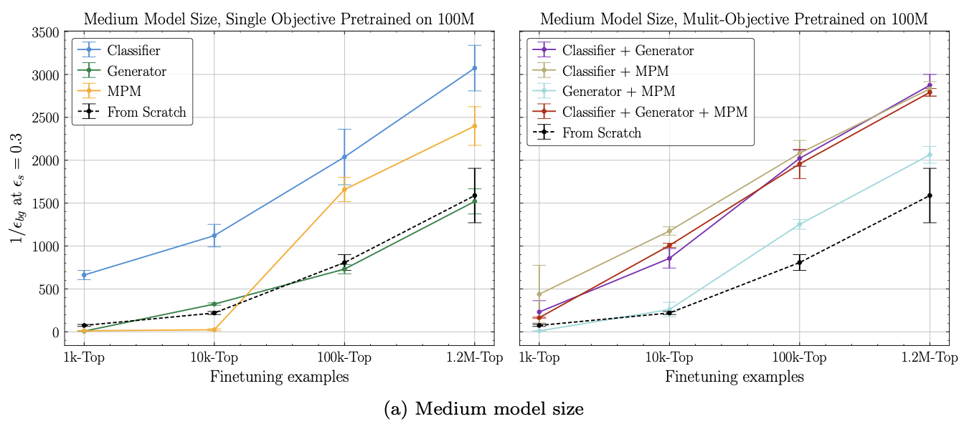
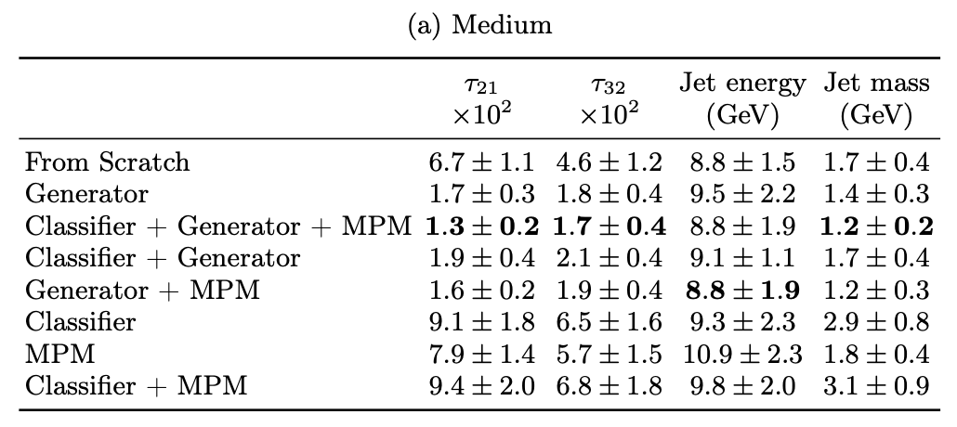
Of course, reality is much messier…
👈 Pure classifier pre-training is optimal when data & model are both big.
Generator has to be in the pre-training objective for downstream jet generation.👇
This is a bit awkward. 😿
FMs are very expensive. If they don’t show clear advantages, why do we need FMs in the first place? 🤔

Slide 12
Now is the perfect time to understand what we have —
so that we build what we want.
Caution:
Preliminary results ahead! May contain errors. For the full story, please wait for 26XX.XXXX. 😉
Ongoing work with Anna Hallin, ShivaSankar K.A., Michael Krämer.

Slide 13
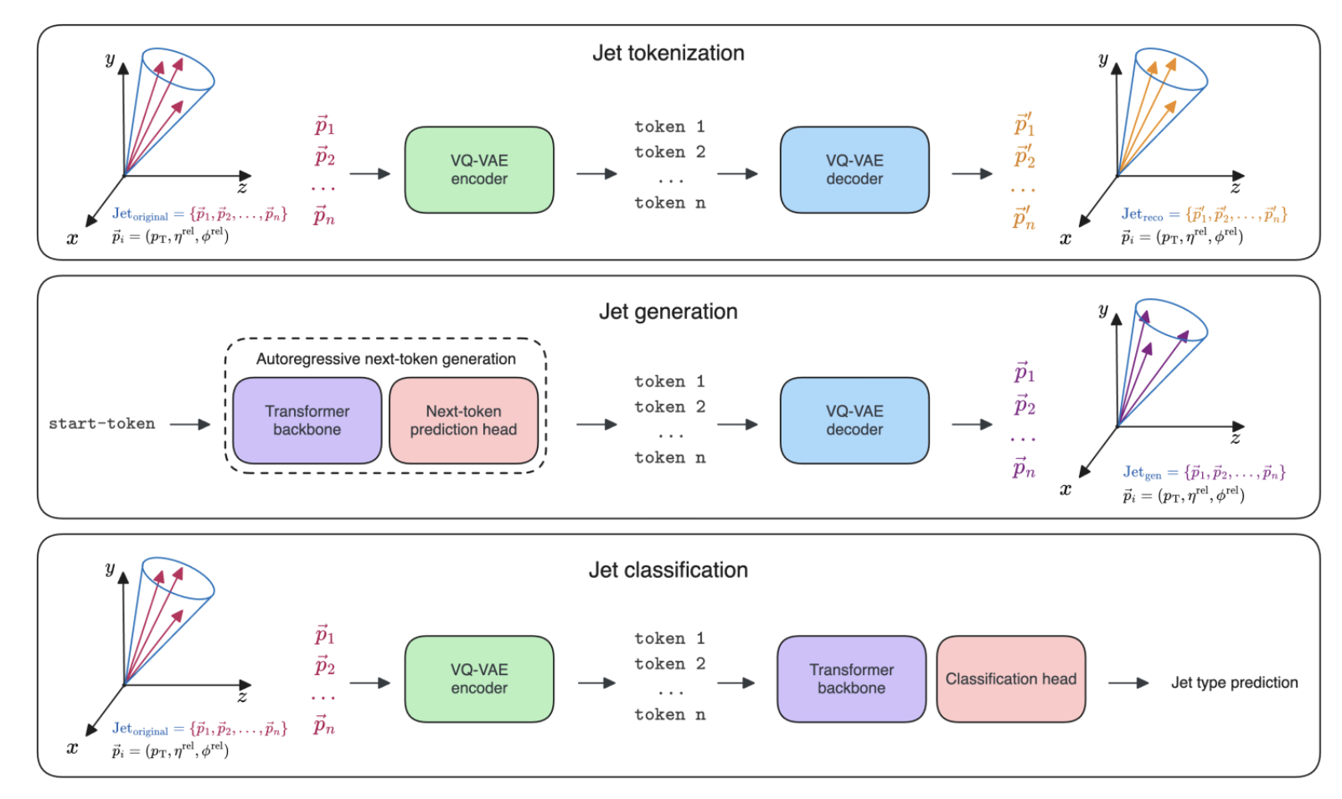
We instead chose the OmniJet-ɑ models (for obvious reasons).
Given a jet, order the constituents based on their p_{T}.
→ Predict tokens auto-regressively.
From 2403.05618.

Slide 14
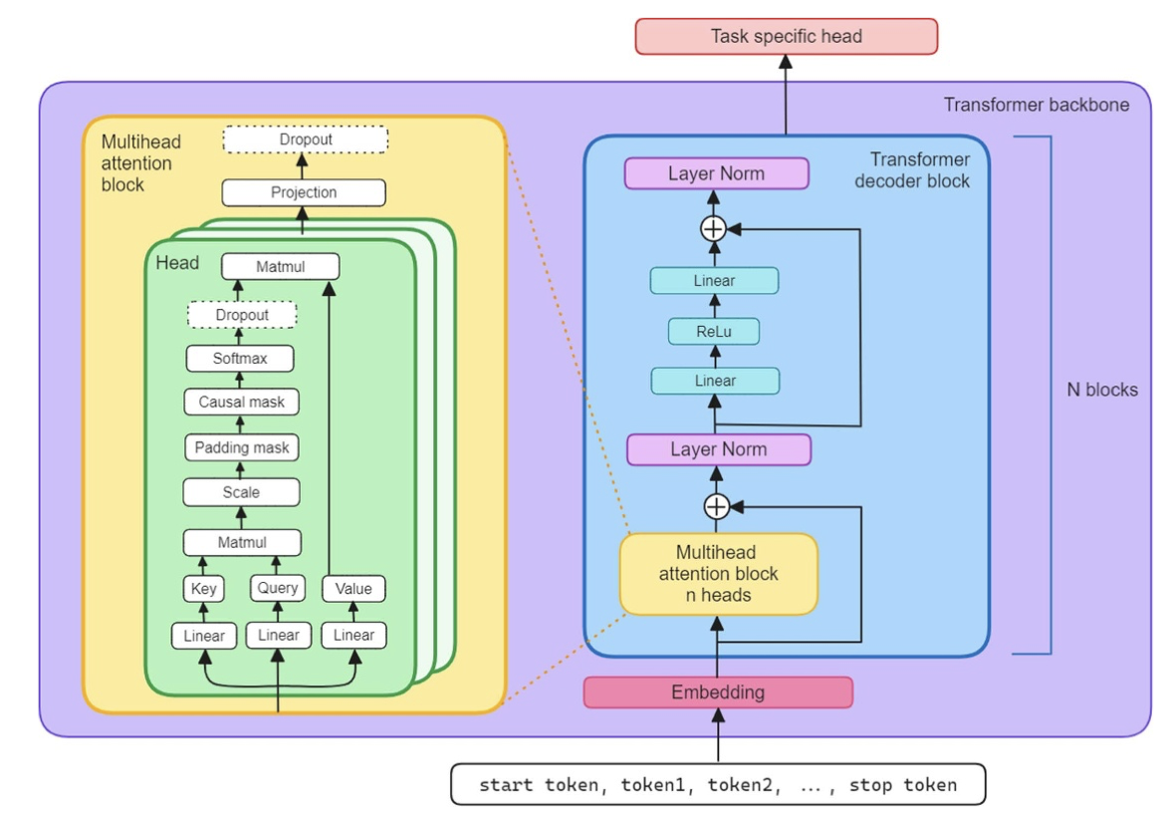
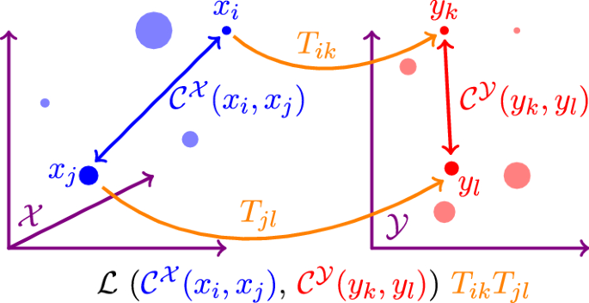
Here’s the model architecture, and how we dissect it.
1 Linear Layer
OR
2 Transformer Layers + 1 Linear Layer
The Gromov-Wasserstein Distance (GW) to compare the intrinsic geometric structure of different models.
8
Backbone Blocks
From 2403.05618.
minimize over all (i, k)(j, l) combinations

Slide 15
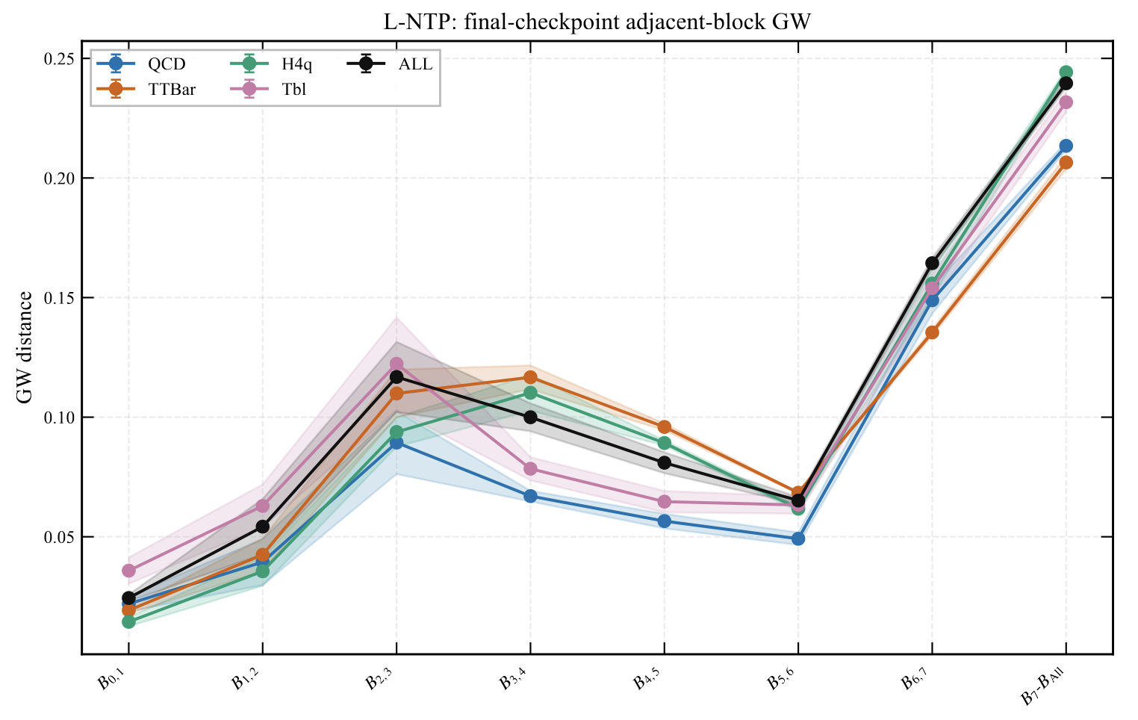
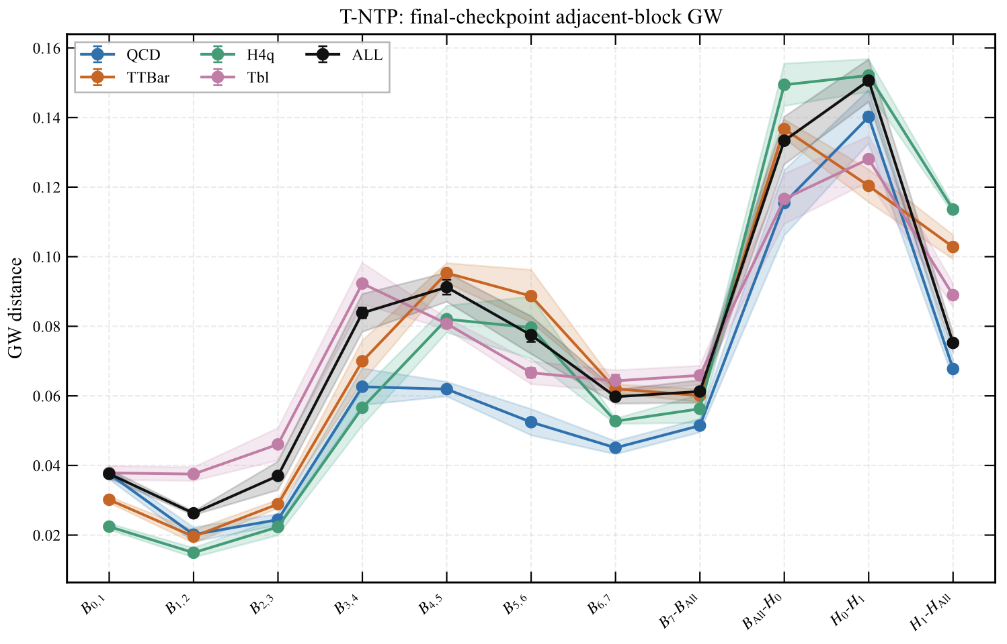
Q1. How does the model interior change?
👈 If the head is just a simple linear layer.
Now if the head is more complicated (2 transformer + 1 linear).👇
So does the model somehow become “lazy” and “procrastinate”? 🤔

Slide 16
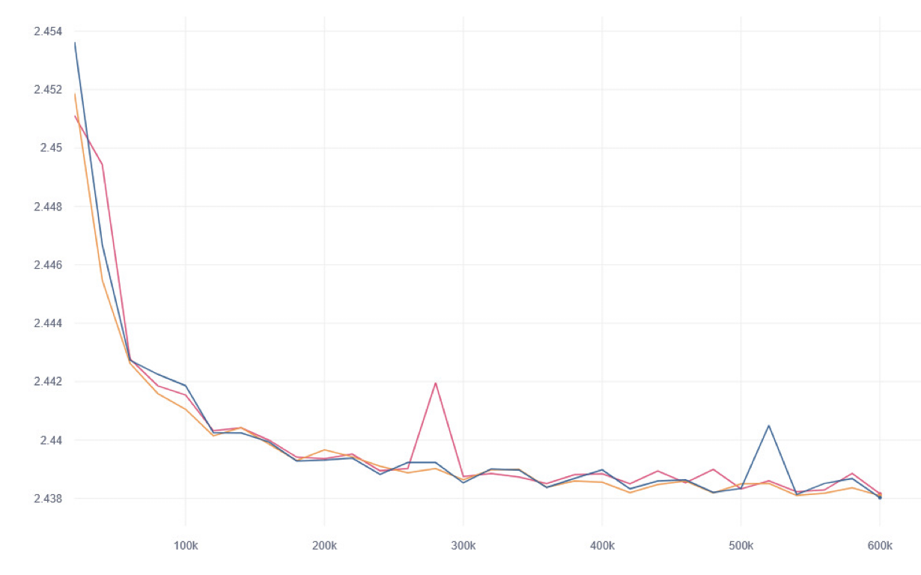
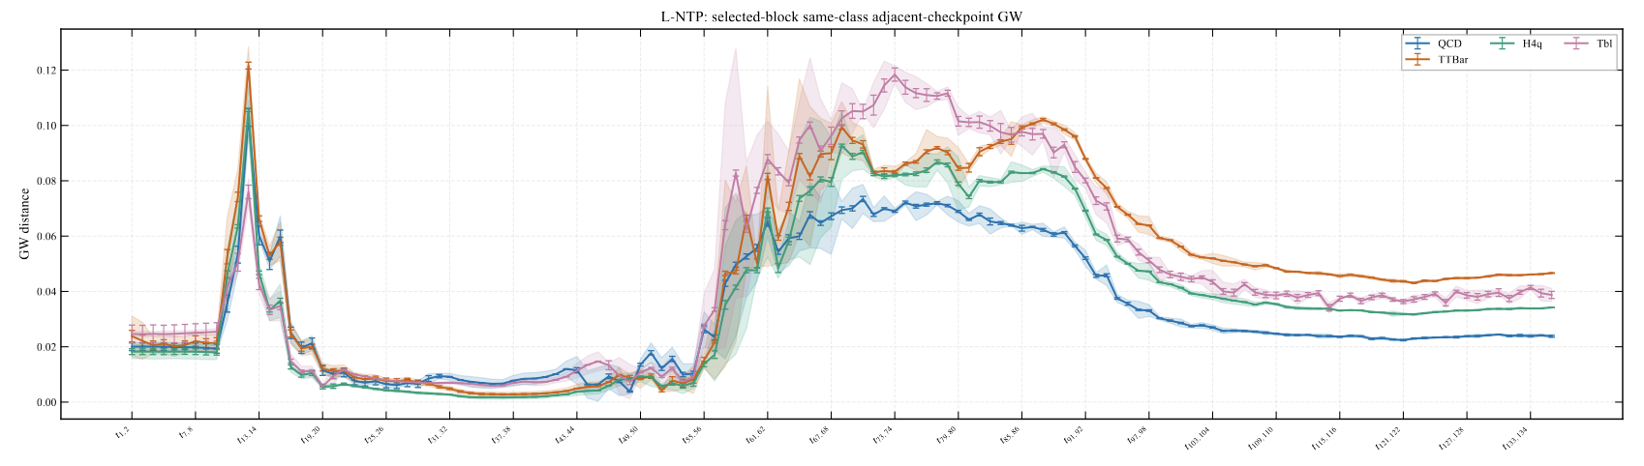
Q2. How does the model change during training?
Nothing special here really 🥲
If we only look at the validation loss curve 👉
If instead we manage to open the black-box 👇
Wow, three regimes? Why’s that? 🤩

Slide 17
Q3. Do different models converge after being well-trained?
Well, truth is, we’re still waiting for the final analysis results as we speak. Sorry about that! 😝
From what we have so far, different models do not seem to be converging—a bit disappointing… 😿
Or does this mean we need better (and larger) models? 💁

Slide 18
AI as Our New Microscope 🔬
In my view, this is a new form of experimental physics—one in which data and AI models become the experimental system.
Even AI agents will need to design and perform such experiments to explore, test hypotheses, and make discoveries (and, inevitably, lots of GPUs).

Slide 19
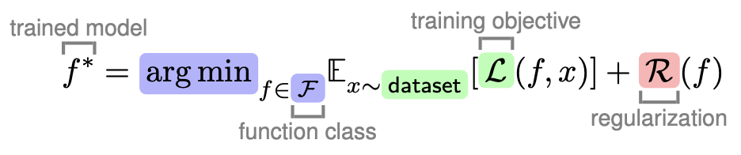
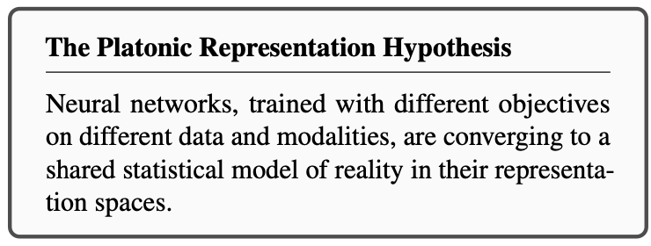
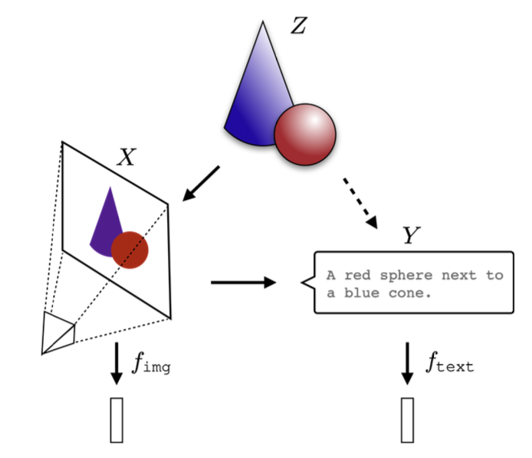
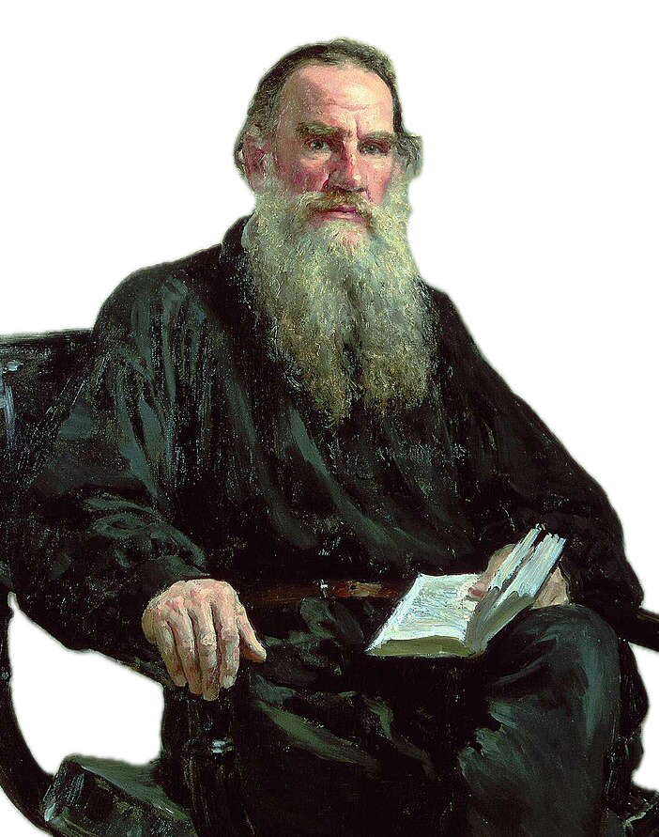
Future is in the model representation space?
Inspiration from our CS colleagues: 2405.07987
Bigger models more likely to find the min
Simplicity bias stronger for bigger models
Anna Karenina Principle:
All good models are alike; each failed model fails in its own way.

Slide 20

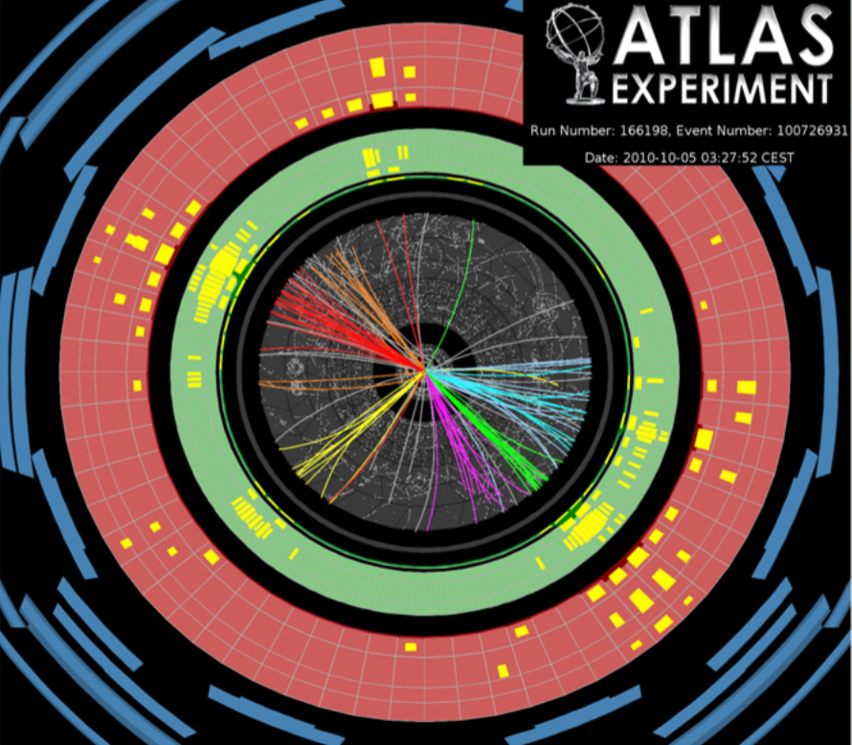
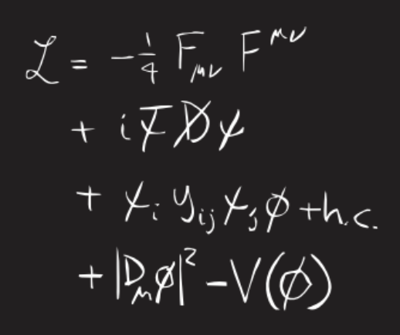
My Vision of Scientific(𝚿) AI in particle physics
Good Models for Collider Data Analysis
Now performance is a prerequisite, not the focus.
Models themselves become our discovery tool.
Or perhaps something
completely alien?

Slide 21
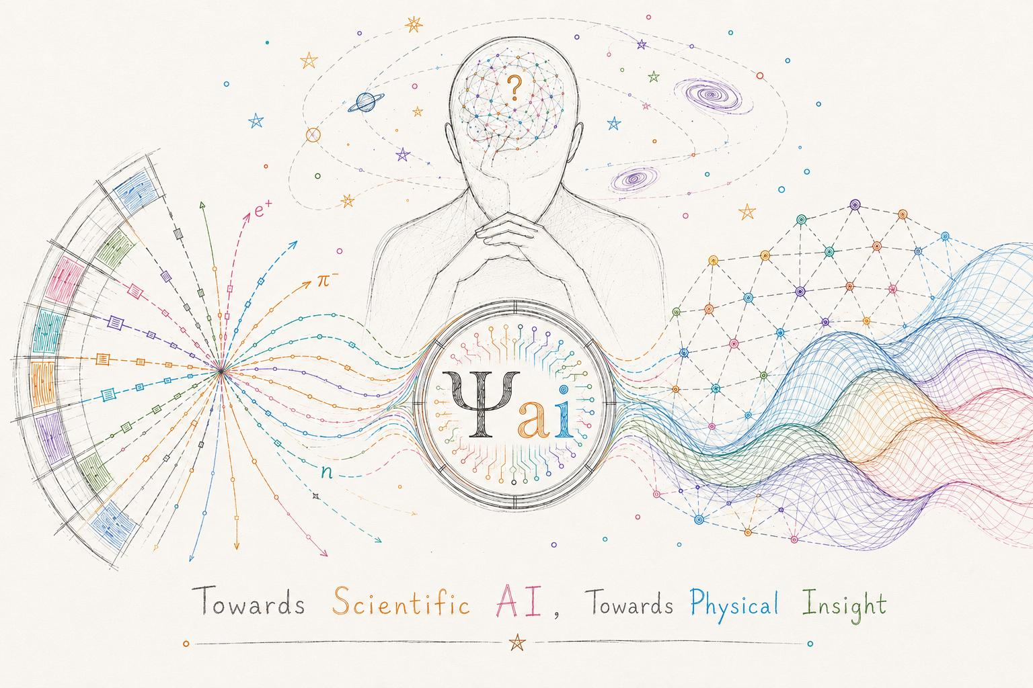
Thanks for your attention!
Contact Emails: tianji_cai@tongji.edu.cn / tianjiresearch@gmail.com.
Q&A?

Slide 22
Backup Slides

Slide 23
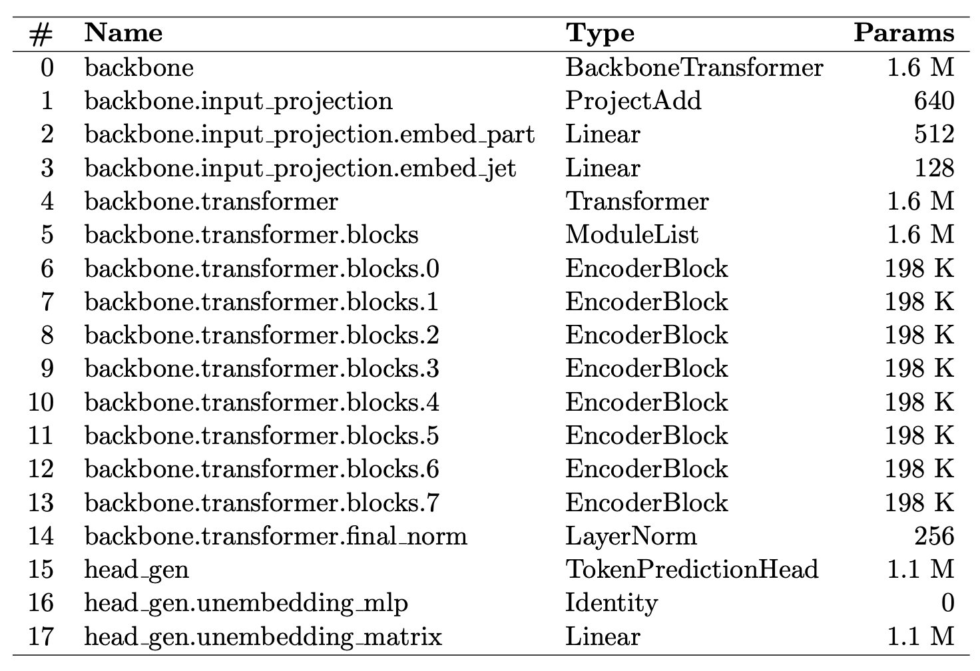
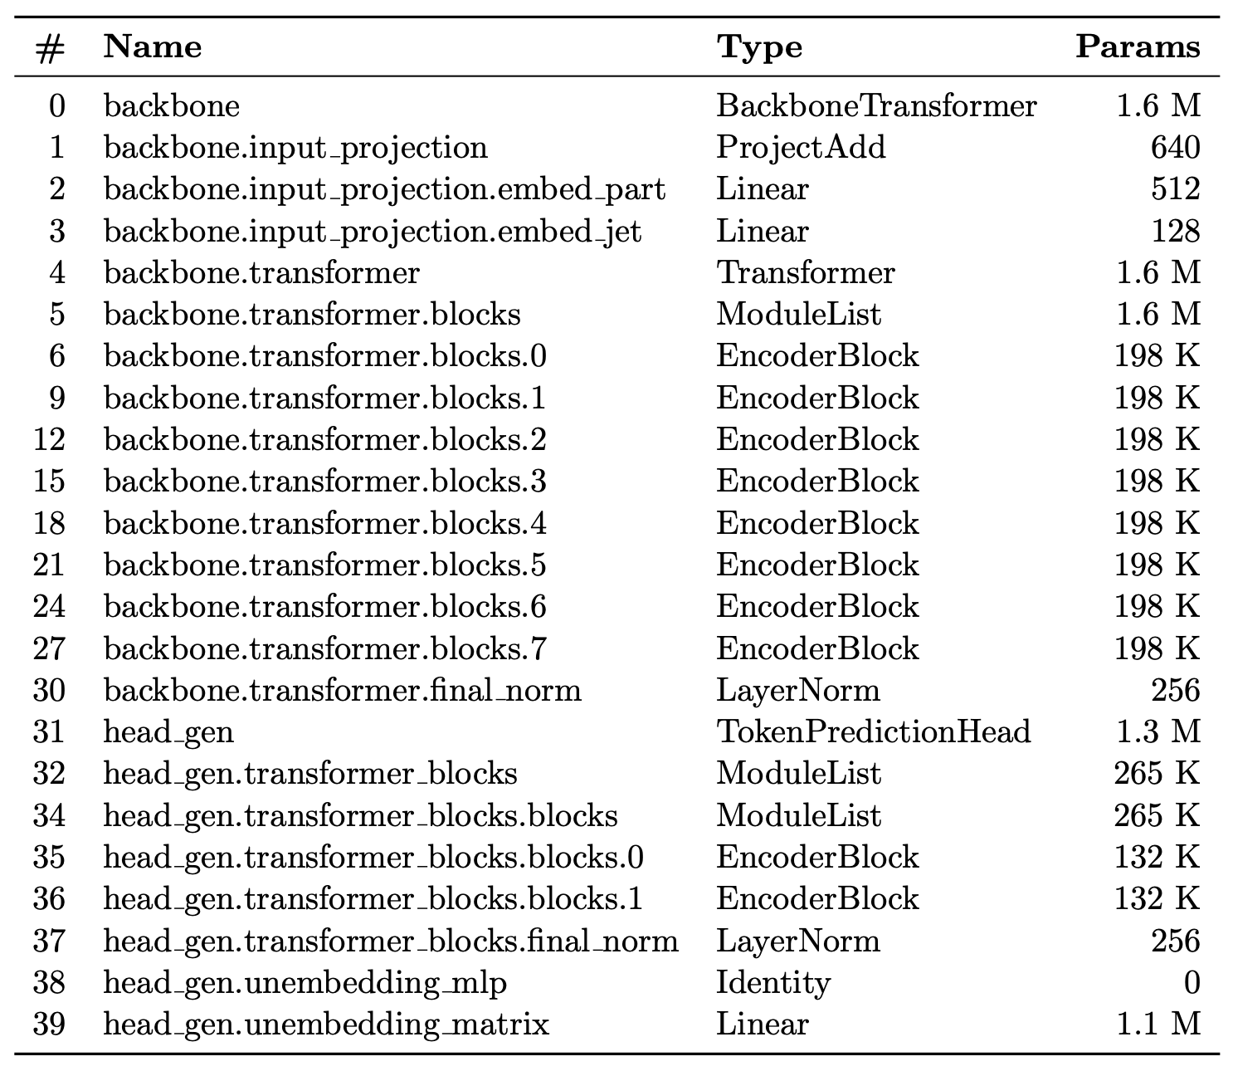
Model Architecture
L-NTP
T-NTP

