Slide 1
8层PSS测试结果
邹世明
2026/05/14

Slide 2
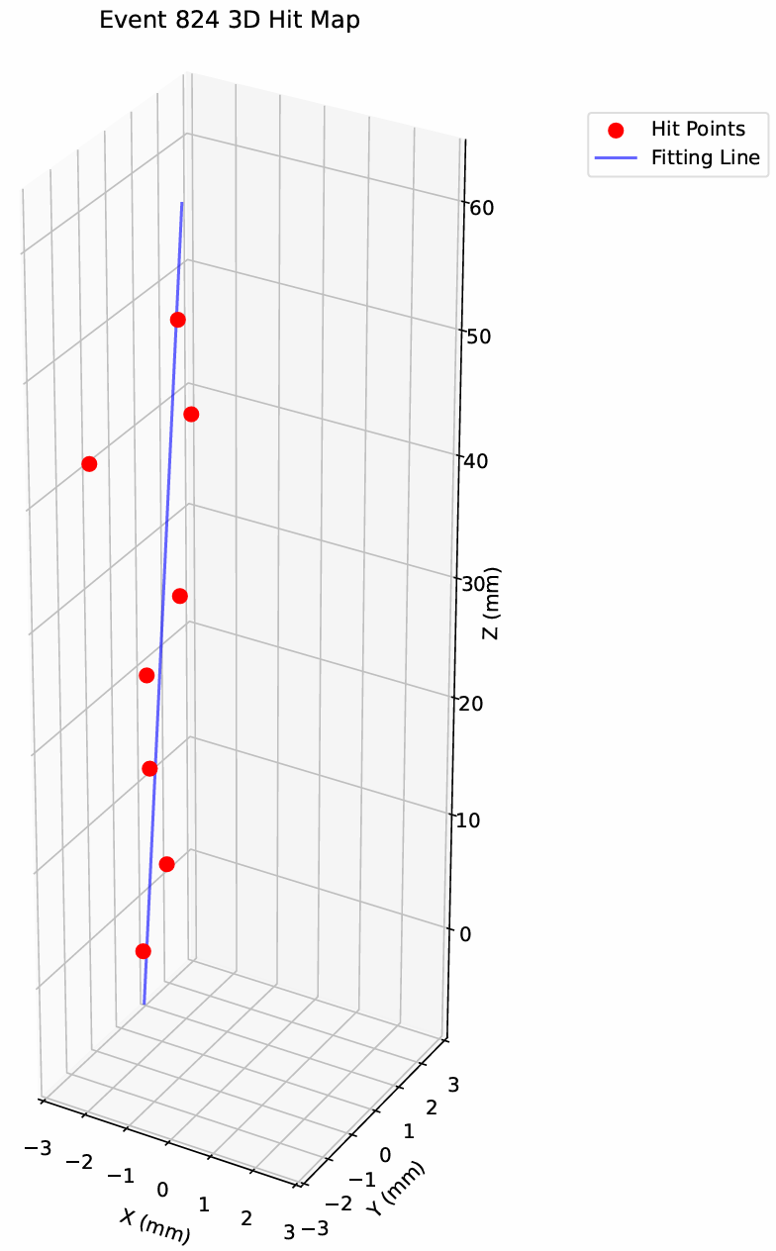
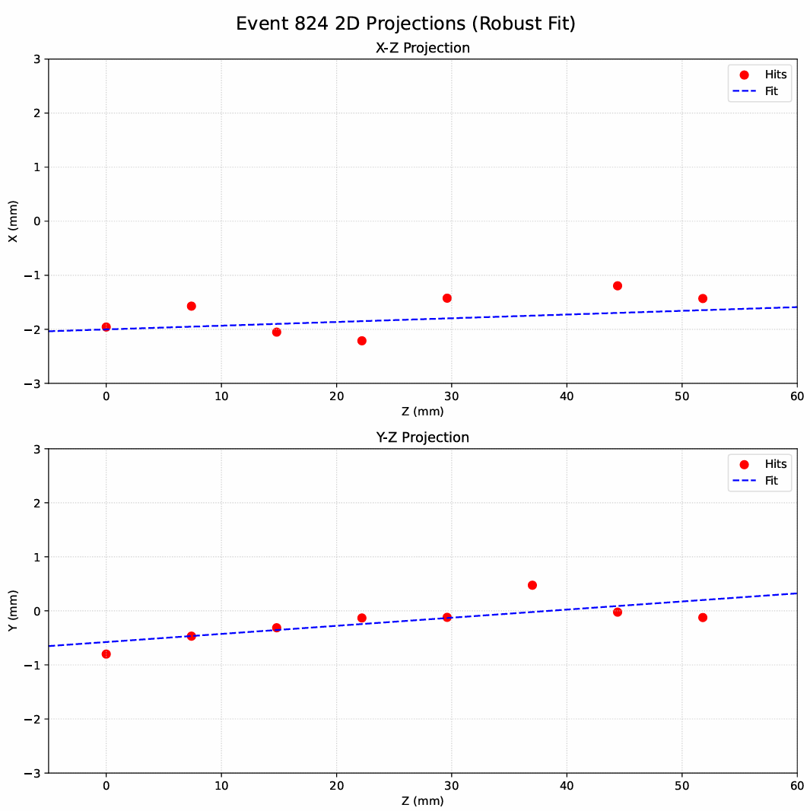
Hit map from cosmic ray test
missing point

Slide 3
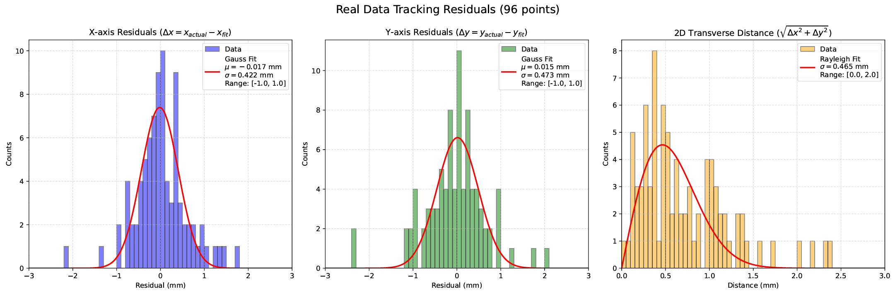
Position distribution
Real data from cosmic ray test

Slide 4
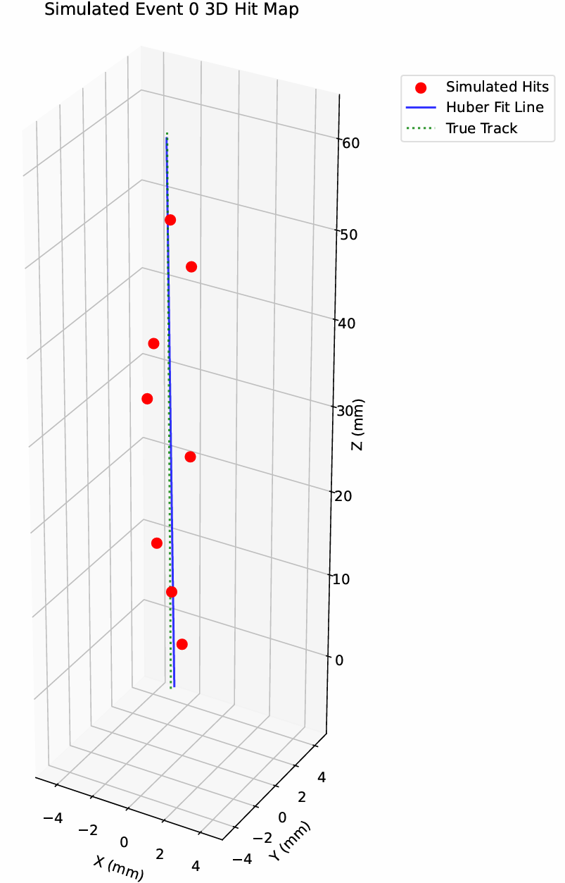
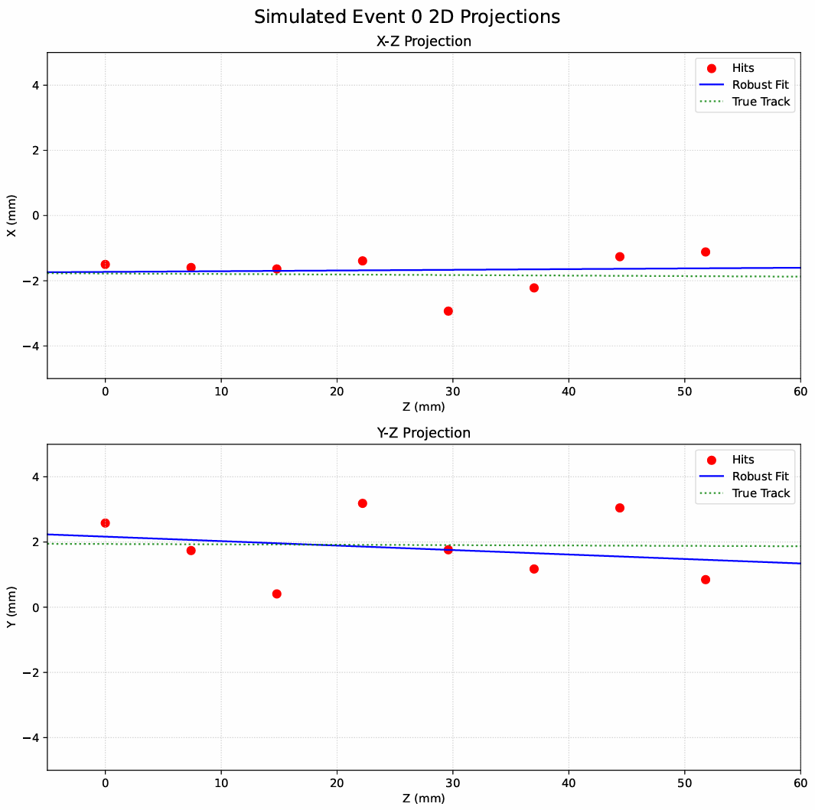
Hit map from simulation
通过随机数产生一条z=a*x+b或者z=c*y+d的随机直线.
对直线上的点加上sigma = 0.7mm的高斯弥散

Slide 5
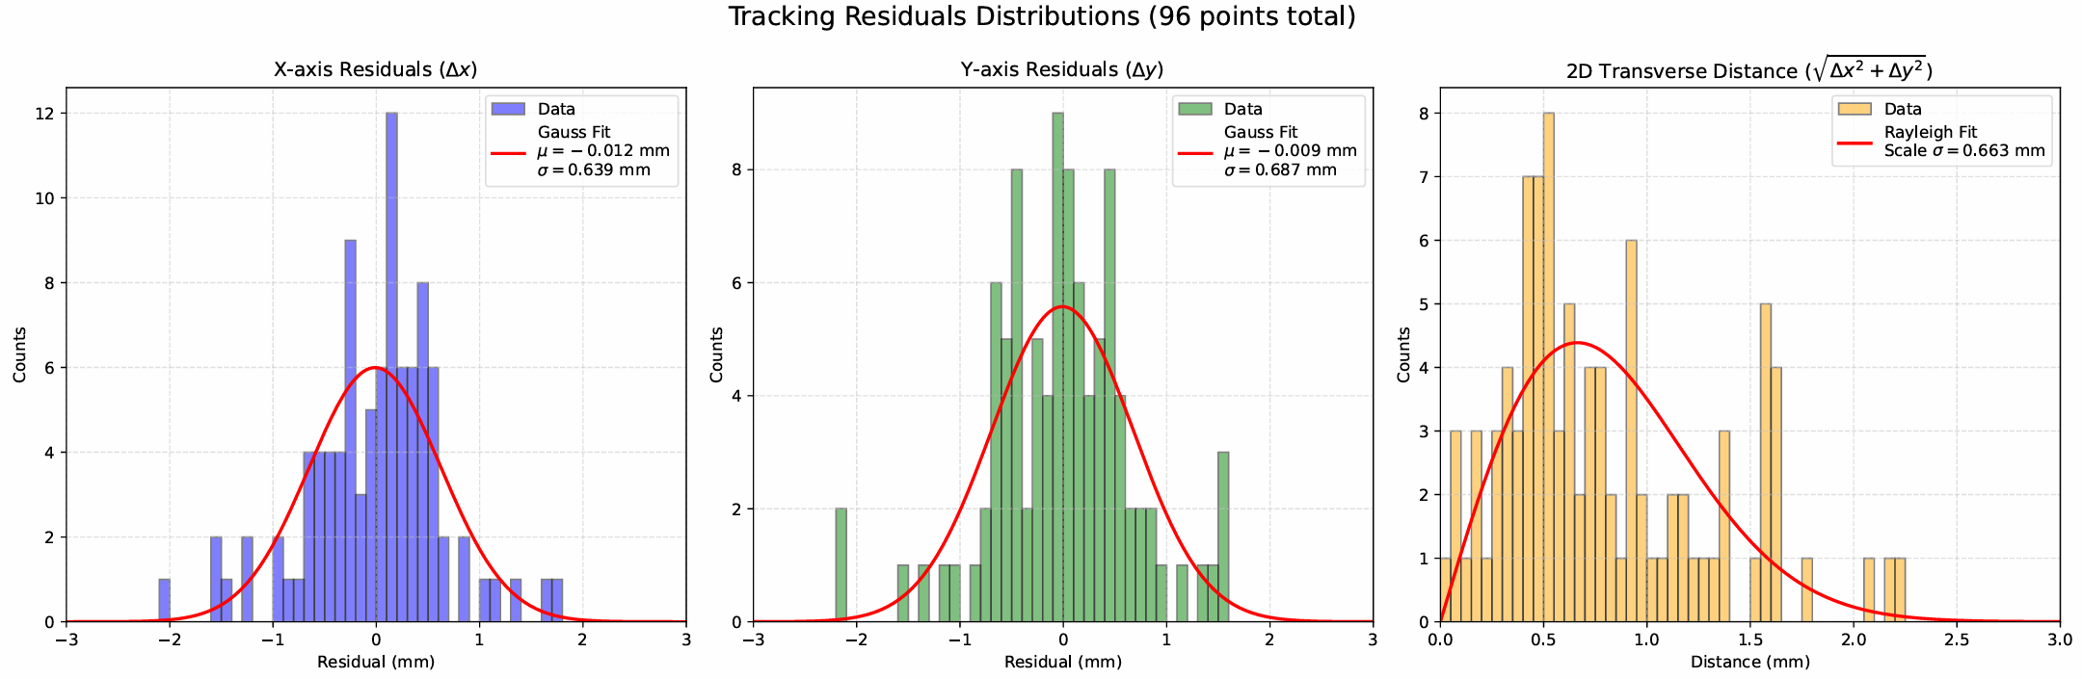
Position distribution
From simulation

Slide 6
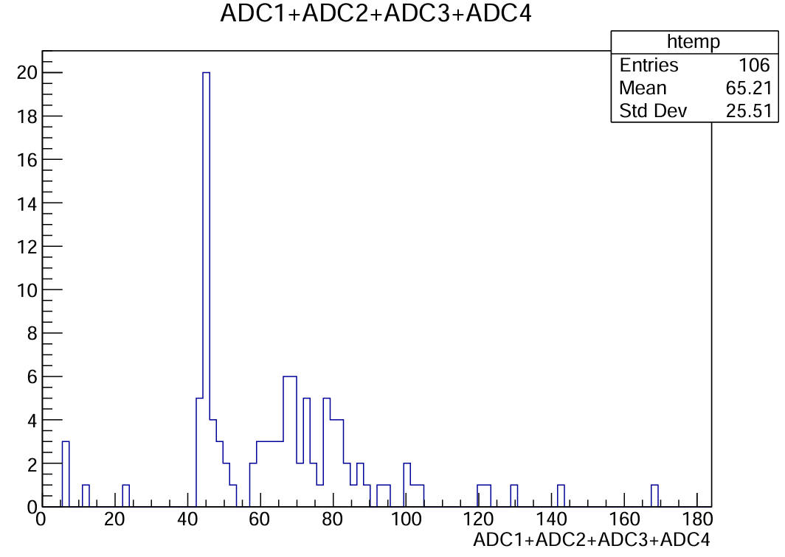
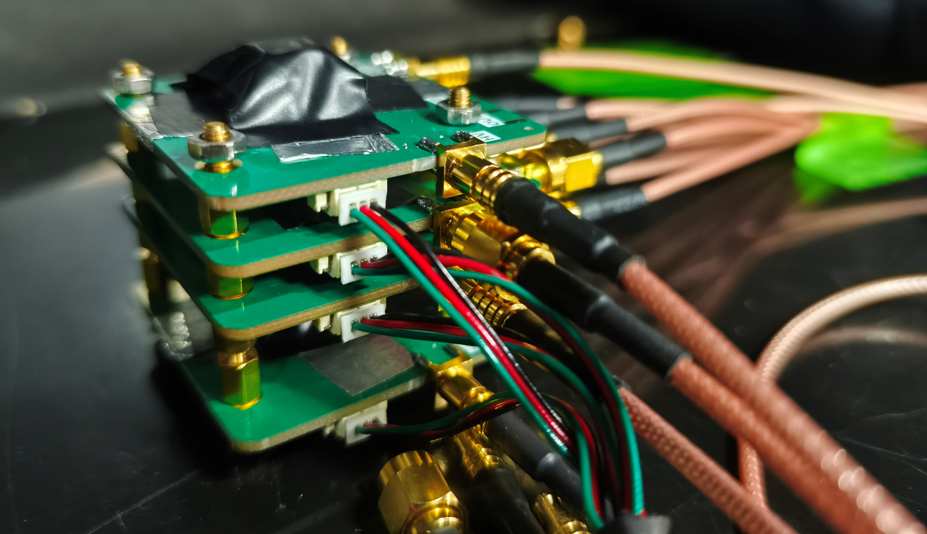
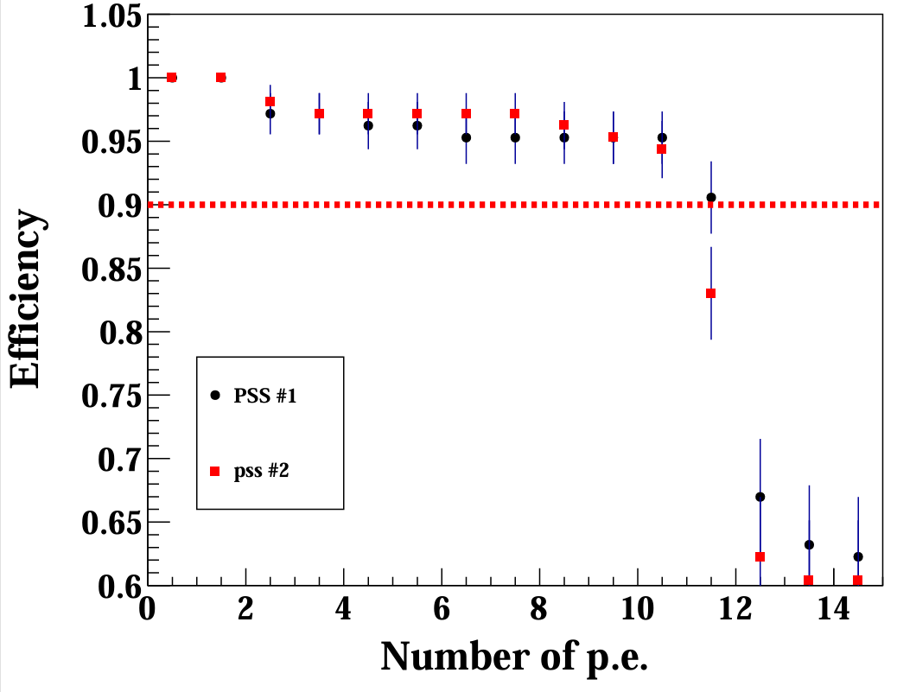
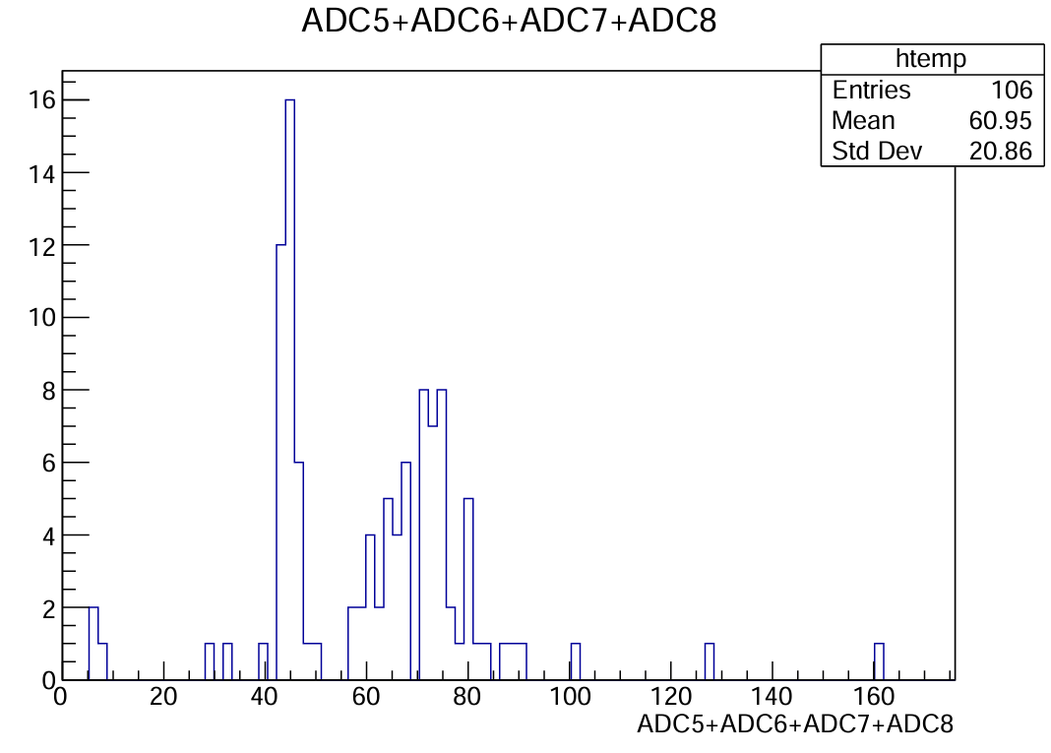
Efficiency

