Slide 1
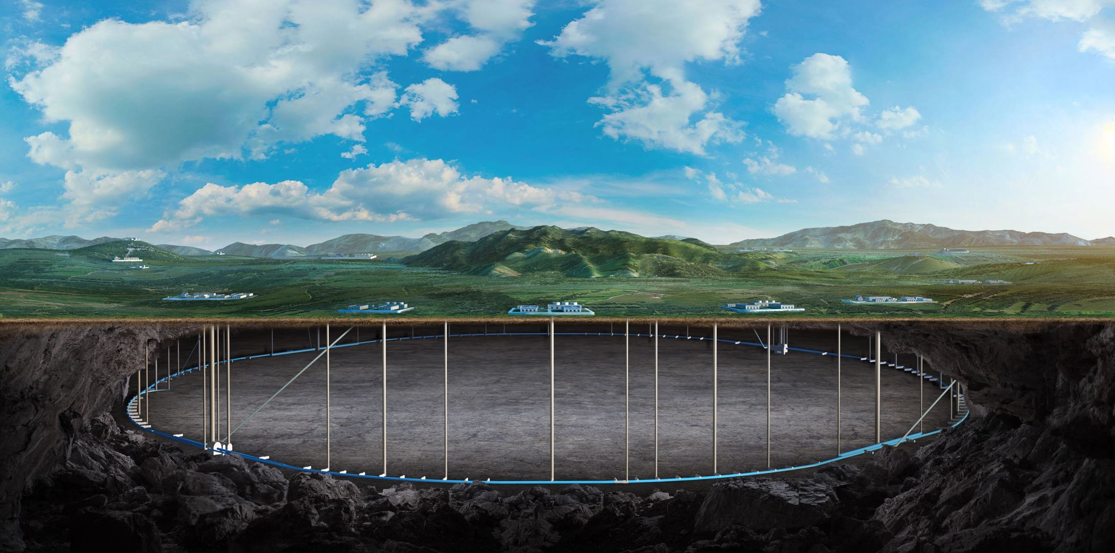


CEPC vertex Detector publication plan
Zhijun Liang
CEPC Workshop, April 8, 2026, Lisbon, Portugal

Slide 2
Vertex detector publication plan
Paper title | Main editors | Journal | timeline
Beam Test of a Baseline Vertex Detector Prototype for CEPC | Zhijun Liang, Wei wei, Ying Zhang, Joao et al | IEEE Trans. Nucl. Sci. 71(6), 1319–1323 (2024) | published
Characterization of the JadePix-3 CMOS pixel sensor for the CEPC vertex detector | Yunpeng Lu et al | NIMA | published
Beam test result and digitization of TaichuPix‑3: A Monolithic Active Pixel Sensors for CEPC vertex detector | Hancen Lu , Zhijun Liang et al | NIM or JINST | to be ready in 3 months
Design and Performance Evaluation of the CEPC Vertex Detector Based on Stitching MAPS Technology | Chengdong Fu, Tianyuan Zhang et al | NIM or JINST or EPJC | to be ready in 3 months
Advanced performance evaluation and Layout optimization of the CEPC Vertex Detector | Chengdong Fu, Tianyuan Zhang et al | NIM or JINST or EPJC | to be ready in 12 months
domestic CIS technology for CEPC vertex detector | Ying Zhang, Yunping et al | IEEE TNS | to be done in late 2027

Slide 3
Vertex+physics
Paper title | Main editors | Journal | timeline
Optimisation of the vertex detector and measurement of Higgs decays to second-generation quarks at the CEPC | Jialin Li, Hao Liang ,Kaili Zhang ,Yifan Zhu, Jun Guo ,Haijun Yang , Manqi Ruan | JHEP 03 (2026) 141 | published

